Slide 1





NSF 1443054: CIF21 DIBBs: Middleware and High Performance Analytics Libraries for Scalable Data Science
Software: MIDAS
HPC-ABDS
Image & Model Fitting Abstractions
February 2017

Slide 2
Imaging applications
Many scientific domains now collect large scale image data, e.g.
  Astronomy: wide-area telescope data
  Ecology, meteorology: Satellite imagery
  Biology, neuroscience: Live-cell imaging, MRIs, …
  Medicine: X-ray, MRI, CT, …
  Physics, chemistry: electron microscopy, …
  Earth science: Sonar, satellite, radar, …
Challenge has moved from collecting data to analyzing it
  Large scale (number of images or size of images) overwhelming for human analysis
  Recent progress in computer vision makes reliable automated image analysis feasible

Slide 3
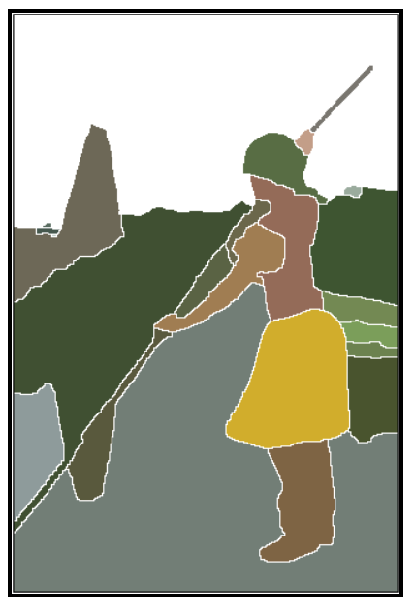
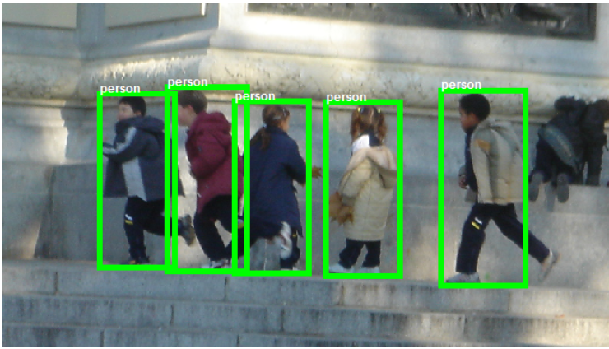
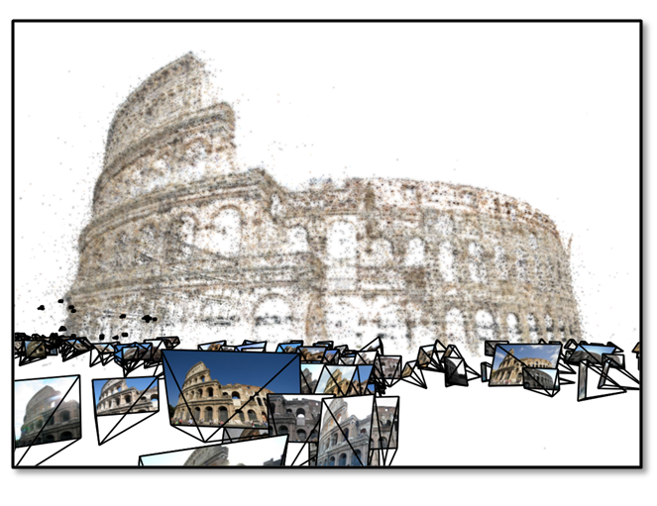
Key image analysis problems
Many names for similar problems; most fall into:
  Segmentation: Dividing image into homogeneous regions
  Detection, recognition: Finding and identifying important structures and their properties
  Reconstruction: Inferring properties of a data source from noisy, incomplete observations (e.g. removing noise from an image, estimating 3d structure of scene from multiple images)
  Matching and alignment: Finding correspondences between images
Most of these problems can be thought of as image pre-processing followed by model fitting
Arbelaez 2011
Dollar 2012
Crandall 2013

Slide 4
SPIDAL image abstractions
SPIDAL has or will have support for imaging at several levels of abstractions:
  Low-level: image processing (e.g. filtering, denoising), local/global feature extraction
  Mid-level: object detection, image segmentation, object matching, 3D feature extraction, image registration
  Application level: radar informatics, polar image analysis, spatial image analysis, pathology image analysis

Slide 5
SPIDAL model-fitting abstractions
Most image analysis relies on some form of model fitting:
  Segmentation: fitting parameterized regions (e.g. contiguous regions) to an image
  Object detection: fitting object model to an image
  Registration and alignment: fitting model of image transformation (e.g. warping) between multiple images
  Reconstruction: fitting prior information about the visual world to observed data
Usually high degree of noise and outliers, so not a simple matter of e.g. linear regression or constraint satisfaction!
Instead involves defining an energy function or error function, and finding minima of that error function

Slide 6
SPIDAL model-fitting abstractions
SPIDAL has or will have support for model fitting at several levels of abstractions:
  Low-level: grid search, Viterbi, Forward-Backward, Markov Chain Monte Carlo (MCMC) algorithms, deterministic simulated annealing, gradient descent
  Mid-level: Support Vector Machine learning, Random Forest learning, K-means, vector clustering, Latent Dirichlet Allocation
  Application level: Spatial clustering, image clustering

Slide 7
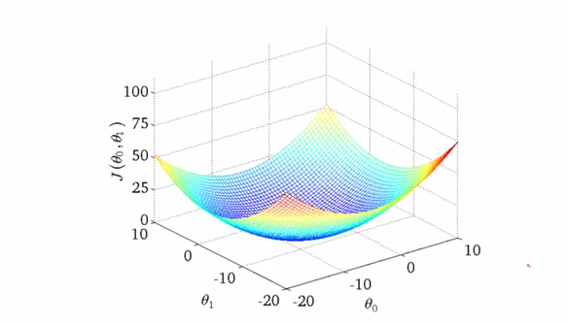
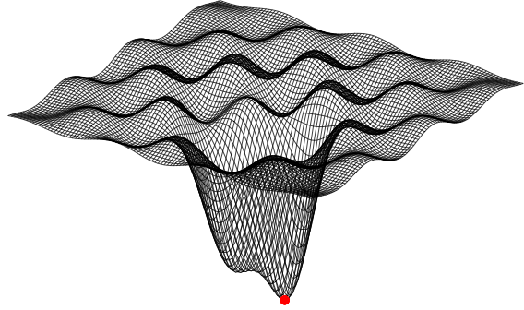
Energy minimization (optimization)
Very general idea: find parameters of a model that minimize an energy (or cost function), given a set of data
  Global minima easy to find if energy function is simple (e.g. convex)
  Energy function usually has unknown number & distribution of local minima; global minimum very difficult to find
  Many algorithms tailored to cost functions for specific applications, usually some heuristics to encourage finding “good” solutions, rarely theoretical guarantees. High computation cost.
  Remember deterministic annealing
- Arman Bahl

Slide 8
Common energy minimization cases
Parameter space: Continuous vs. Discrete
Energy functions with particular forms, e.g.:
  Hidden Markov Model: chain of observable and unobservable variables. Each unknown variable is a (nondeterministic) function of its observable variable, and the two unobservables before and after.
  Markov Random Field: generalization of
  HMM, each unobservable variable is
  function of a small number of neighboring
  unobservables.

Slide 9
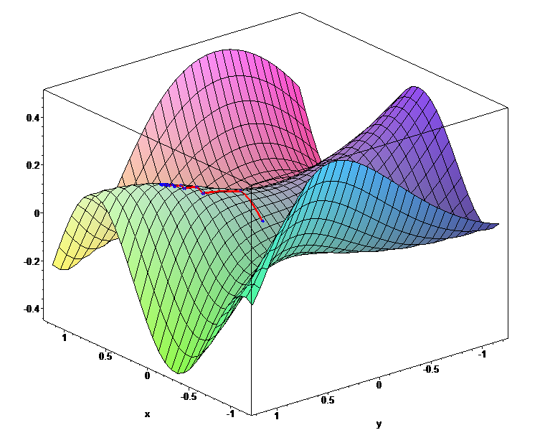
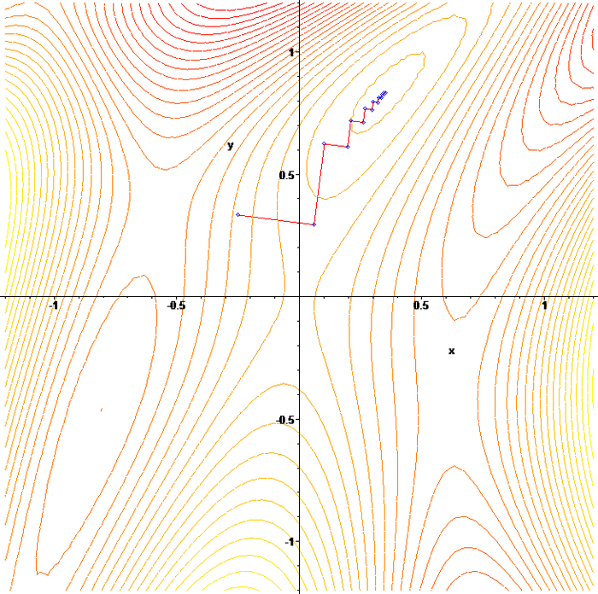
Continuous optimization
Most techniques rely on gradient descent, “hill-climbing”
  E.g. Newton’s method with various heuristics to escape local minima
Support in SPIDAL
  Levenberg-Marquardt
  Deterministic annealing
  Custom methods as in neural networks or SMACOF for MDS

Slide 10
Discrete optimization support in SPIDAL
Grid search: trivially parallelizable but inefficient
Viterbi and Forward-Backward: efficient exact algorithms for Maximum A Posteriori (MAP) and marginal inference using dynamic programming, but restricted to Hidden Markov Models.
Loopy Belief Propagation: approximate algorithm for MAP inference on Markov Random Field models. No optimality or even convergence guarantees, but applicable to a general class of models.
Tree ReWeighted Message Passing (TRW): approximate algorithm for MAP inference on some MRFs. Computes bounds that often give meaningful measure of quality of solution (with respect to unknown global minimum).
Markov Chain Monte Carlo: approximate algorithms for graphical models including HMMs, MRFs, and Bayes Nets in general.

Slide 11
SPIDAL Algorithms – Optimization I
Manxcat: Levenberg Marquardt Algorithm for non-linear χ² optimization with sophisticated version of Newton’s method calculating value and derivatives of objective function. Parallelism in calculation of objective function and in parameters to be determined. Complete – needs SPIDAL Java optimization
Viterbi algorithm, for finding the maximum a posteriori (MAP) solution for a Hidden Markov Model (HMM). The running time is O(n*s^2) where n is the number of variables and s is the number of possible states each variable can take. We will provide an "embarrassingly parallel" version that processes multiple problems (e.g. many images) independently; parallelizing within the same problem not needed in our application space. Needs Packaging in SPIDAL
Forward-backward algorithm, for computing marginal distributions over HMM variables. Similar characteristics as Viterbi above. Needs Packaging in SPIDAL

Slide 12
SPIDAL Algorithms – Optimization II
Loopy belief propagation (LBP) for approximately finding the maximum a posteriori (MAP) solution for a Markov Random Field (MRF). Here the running time is O(n^2*s^2*i) in the worst case where n is number of variables, s is number of states per variable, and i is number of iterations required (which is usually a function of n, e.g. log(n) or sqrt(n)). Here there are various parallelization strategies depending on values of s and n for any given problem.
  We will provide two parallel versions: embarrassingly parallel version for when s and n are relatively modest, and parallelizing each iteration of the same problem for common situation when s and n are quite large so that each iteration takes a long time relative to number of iterations required.
  Needs Packaging in SPIDAL
Markov Chain Monte Carlo (MCMC) for approximately computing distributions and sampling over MRF variables. Similar to LBP with the same two parallelization strategies. Needs Packaging in SPIDAL

Slide 13
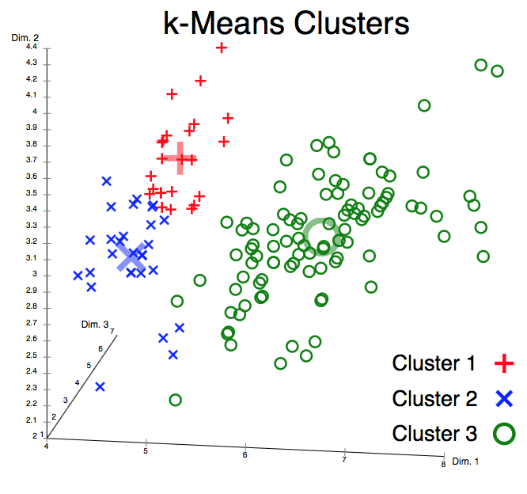
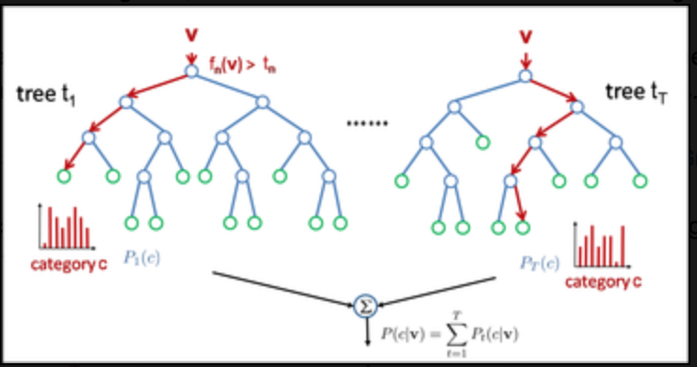
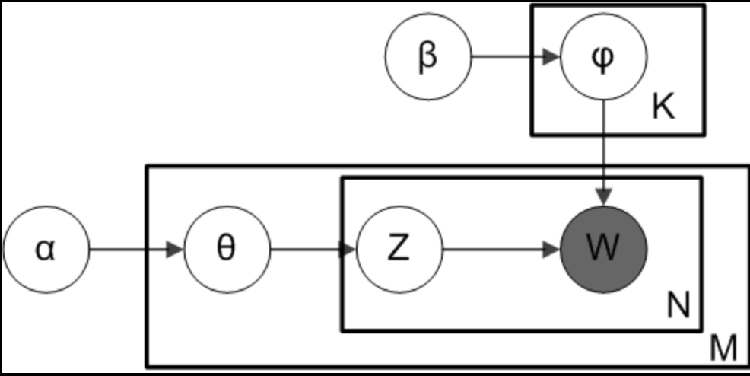
Higher-level model fitting
Clustering: K-means, vector clustering
Topic modeling: Latent Dirichlet Allocation
Machine learning: Random Forests, Support Vector Machines
Applications: spatial clustering, image clustering
Plate notation for smoothed LDA
Random Forest

Slide 14
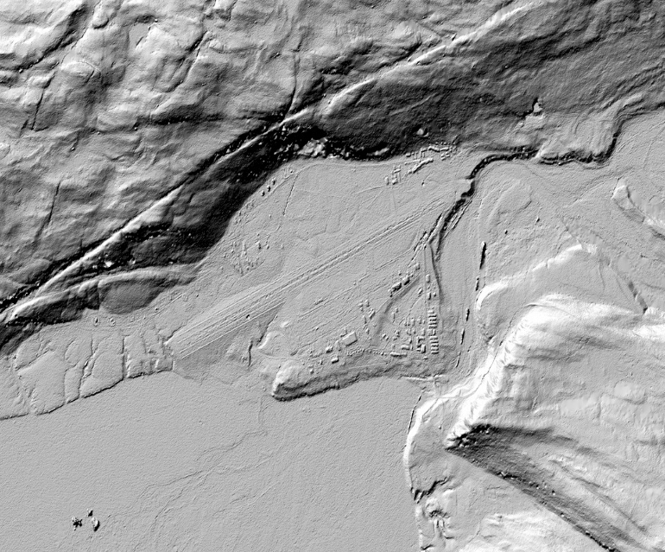
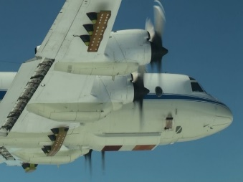
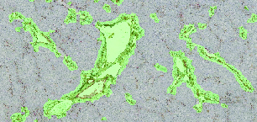
Two exemplar applications: Polar science and Pathology imaging
Despite very different applications, data, and approaches, same key abstractions apply!
  Segmentation: divide radar imagery into ice vs rock, or pathology images into parts of cells, etc.
  Recognition: subsurface features of ice, organism components in biology
  Reconstruction: estimate 3d structure of ice, or 3d structure of organisms

