Slide 1





NSF 1443054: CIF21 DIBBs: Middleware and High Performance Analytics Libraries for Scalable Data Science
Software: MIDAS
HPC-ABDS
SPIDAL Java
Optimized
February 2017

Slide 2
SPIDAL Java
From Saliya Ekanayake, Virginia Tech
Learn more at
  SPIDAL Java paper
  Java Thread and Process Performance paper
  SPIDAL Examples Github
  Machine Learning with SPIDAL cookbook
  SPIDAL Java cookbook
Slide 3: Factors that affect parallel Java performance
Slide 4: Performance chart
Slides 5: Overview of thread models and affinity
Slides 6 – 7: Threads in detail
Slides 8 – 9: Affinity in detail
Slides 10 –13: Performance charts
Slide 14 – 15: Improving Inter-Process Communication (IPC)
Slide 16 – 17: Other factors – Serialization, GC, Cache, I/O

Slide 3
Performance Factors
Threads
  Can threads “magically” speedup your application?
Affinity
  How to place threads/processes across cores?
  Why should we care?
Communication
  Why Inter-Process Communication (IPC) is expensive?
  How to improve?
Other factors
  Garbage collection
  Serialization/Deserialization
  Memory references and cache
  Data read/write

Slide 4
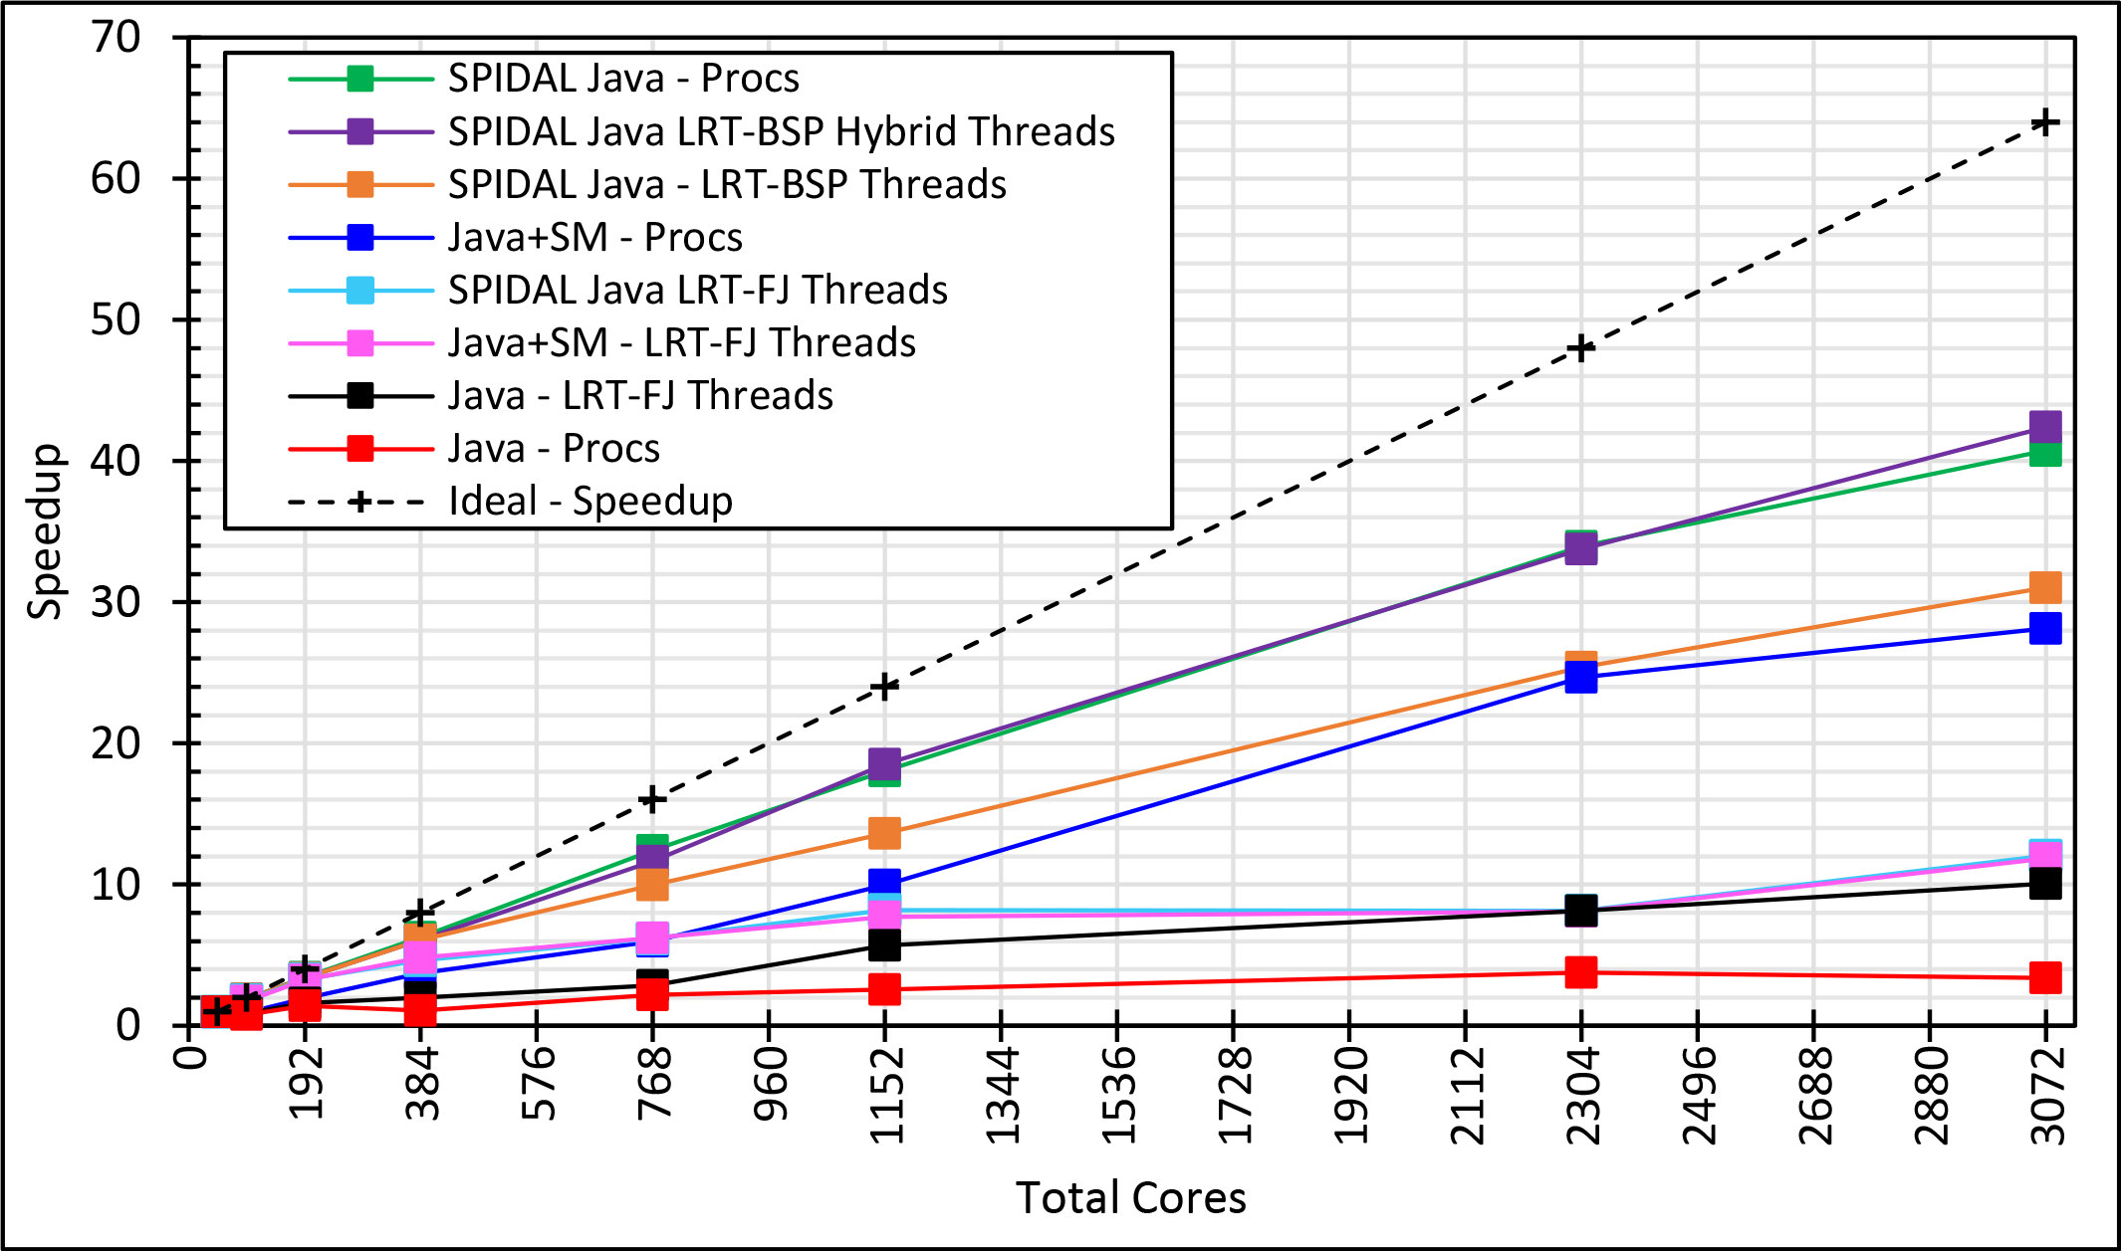
Java MPI performs better than FJ Threads
128 24 core Haswell nodes on SPIDAL 200K DA-MDS Code
Speedup compared to 1 process per node on 48 nodes
Best MPI; inter and intra node
BSP Threads are better than FJ and at best match Java MPI
MPI; inter/intra node; Java not optimized
Best FJ Threads intra node; MPI inter node

Slide 5
Investigating Process and Thread Models
Fork Join (FJ) Threads lower performance than Bulk Synchronous Parallel (BSP)
LRT is Long Running Threads
Results
  Large effects for Java
  Best affinity is process and thread binding to cores - CE
  At best LRT mimics performance of “all processes”
6 Thread/Process Affinity Models
LRT-FJ
LRT-BSP
Serial work
Non-trivial parallel work
Busy thread synchronization
Threads Affinity | Processes Affinity
 | Cores | Socket | None (All)
Inherit | CI | SI | NI
Explicit per core | CE | SE | NE

Slide 6
Threads in Detail
The usual approach is to use thread pools to execute parallel tasks.
  Works well for multi-tasking such as serving network requests.
  Pooled threads sleep while no tasks are assigned to them.
  But, this sleep, awake and get scheduled cycle is expensive for compute intensive parallel algorithms.
  E.g. Implementation of the classic Fork-Join construct.
The as-is implementation is to use a long running thread pool for the forked tasks and join them when they are completed.
  We call this the LRT-FJ implementation.
Serial work
Non-trivial parallel work

Slide 7
Threads in Detail
Serial work
Non-trivial parallel work
LRT-FJ
LRT-FJ is expensive for complex algorithms, especially for those with iterations over parallel loops.
Alternatively, this structure can be implemented using Long Running Threads – Bulk Synchronous Parallel (LRT-BSP).
  Resembles the classic BSP model of processes.
  A long running thread pool similar to LRT-FJ.
  Threads occupy CPUs always – “hot” threads.
LRT-FJ vs. LRT-BSP.
  High context switch overhead in FJ.
  BSP replicates serial work but reduced overhead.
  Implicit synchronization in FJ.
  BSP use explicit busy synchronizations.
LRT-BSP
Serial work
Non-trivial parallel work
Busy thread synchronization

Slide 8
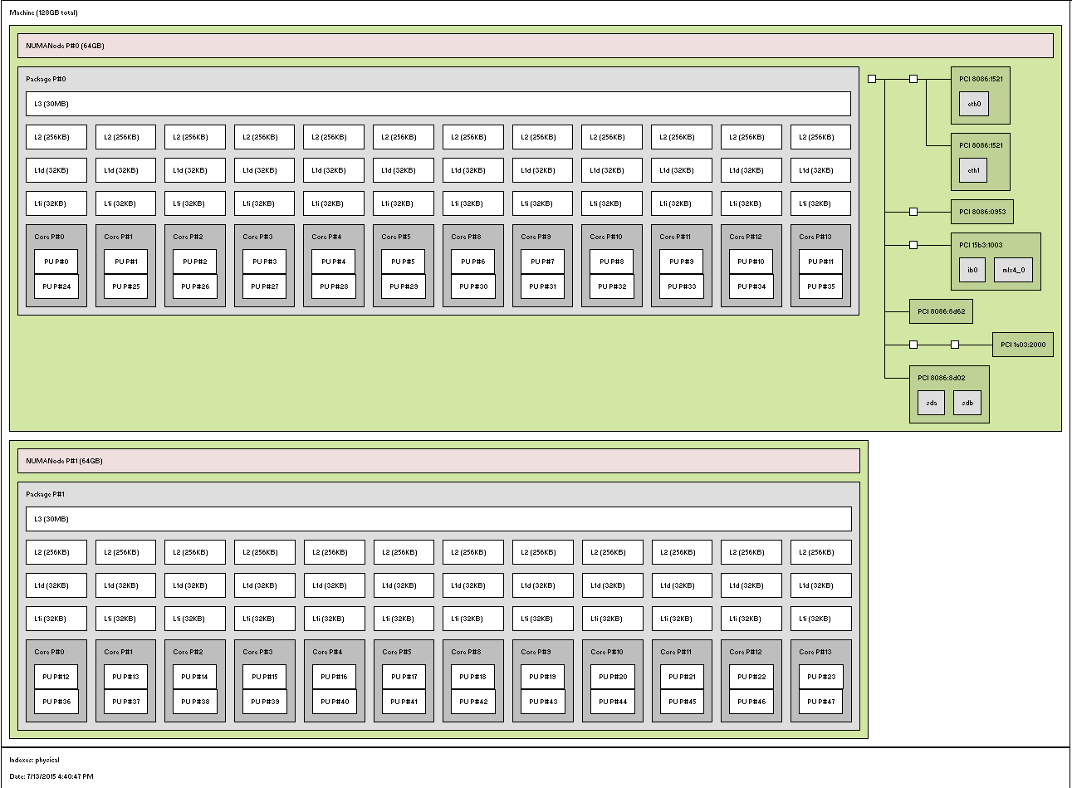
Affinity in Detail
Non-Uniform Memory Access (NUMA) and threads
E.g. 1 node in Juliet HPC cluster
  2 Intel Haswell sockets, 12 (or 18) cores each
  2 hyper-threads (HT) per core
  Separate L1,L2 and shared L3
Which approach is better?
  All-processes
  All-threads
  12 T x 2 P
  Other combinations
Where to place threads?
  Node, socket, core
12 cores
1 Core – 2 HTs
Socket 0
Intel QPI
2 sockets
Socket 1

Slide 9
Affinity in Detail
P0
P1
P3
P4
C0
C1
C2
C3
C4
C5
C6
C7
2x4 CI
Socket 0
Socket 1
Six affinity patterns
E.g. 2x4
  Two threads per process
  Four processes per node
  Two 4 core sockets
P0,P1
P2,P3
Threads Affinity | Processes Affinity
 | Cores | Socket | None (All)
Inherit | CI | SI | NI
Explicit per core | CE | SE | NE
C0
C1
C2
C3
C4
C5
C6
C7
2x4 SI
Socket 0
Socket 1
P0,P1,P2,P3
C0
C1
C2
C3
C4
C5
C6
C7
2x4 NI
Socket 0
Socket 1
Worker threads are free to “roam” over cores/sockets
P0
P1
P3
P4
C0
C1
C2
C3
C4
C5
C6
C7
2x4 CE
Socket 0
Socket 1
P0,P1
P2,P3
Worker thread
C0
C1
C2
C3
C4
C5
C6
C7
2x4 SE
Background thread (GC and other JVM threads)
Socket 0
Socket 1
Process
P0,P1,P2,P3
C0
C1
C2
C3
C4
C5
C6
C7
2x4 NE
Socket 0
Socket 1
Worker threads are pinned to a core on each socket

Slide 10
A Quick Peek into Performance
No thread pinning and FJ
Threads pinned to cores and FJ
No thread pinning and BSP
Threads pinned to cores and BSP
K-Means 10K performance on 16 nodes

Slide 11
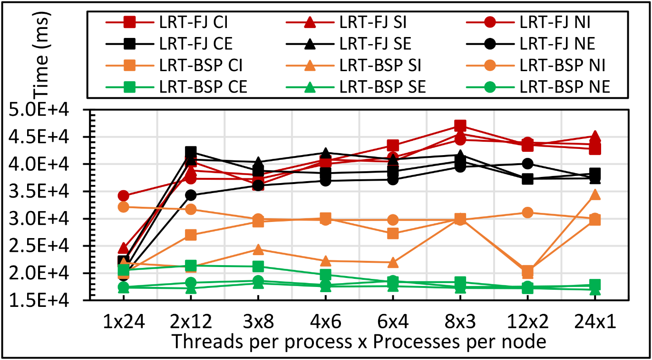
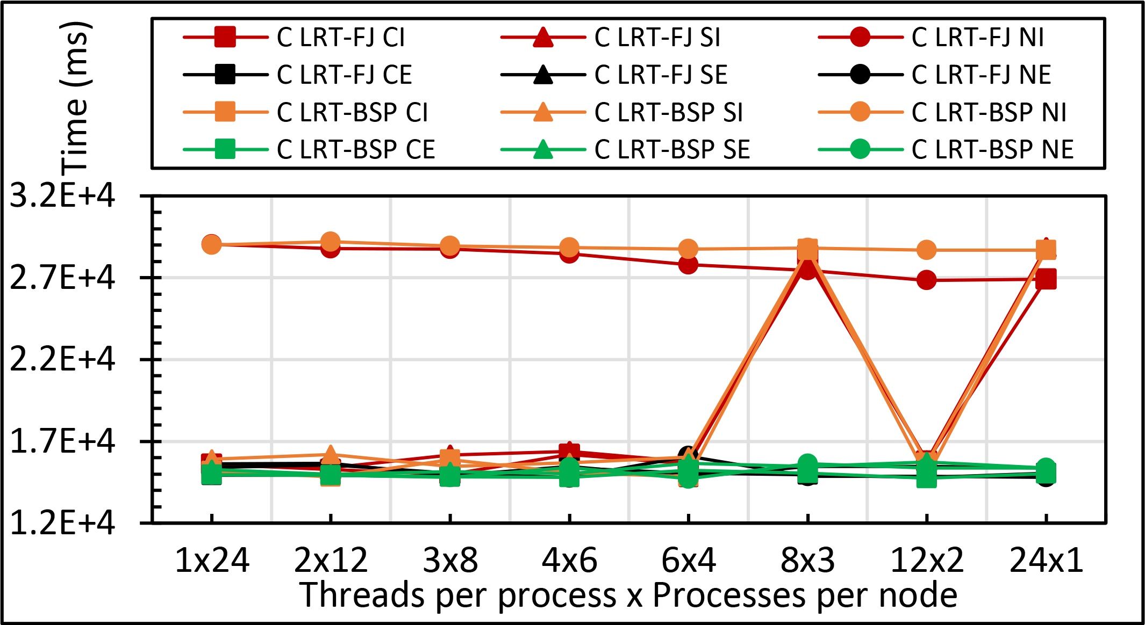
Performance
Sensitivity
Kmeans: 1 million points and 1000 centers performance on 16 24 core nodes for LRT-FJ and LRT-BSP with varying affinity patterns (6 choices) over varying threads and processes
C less sensitive than Java
All processes less sensitive than all threads
Java
C

Slide 12
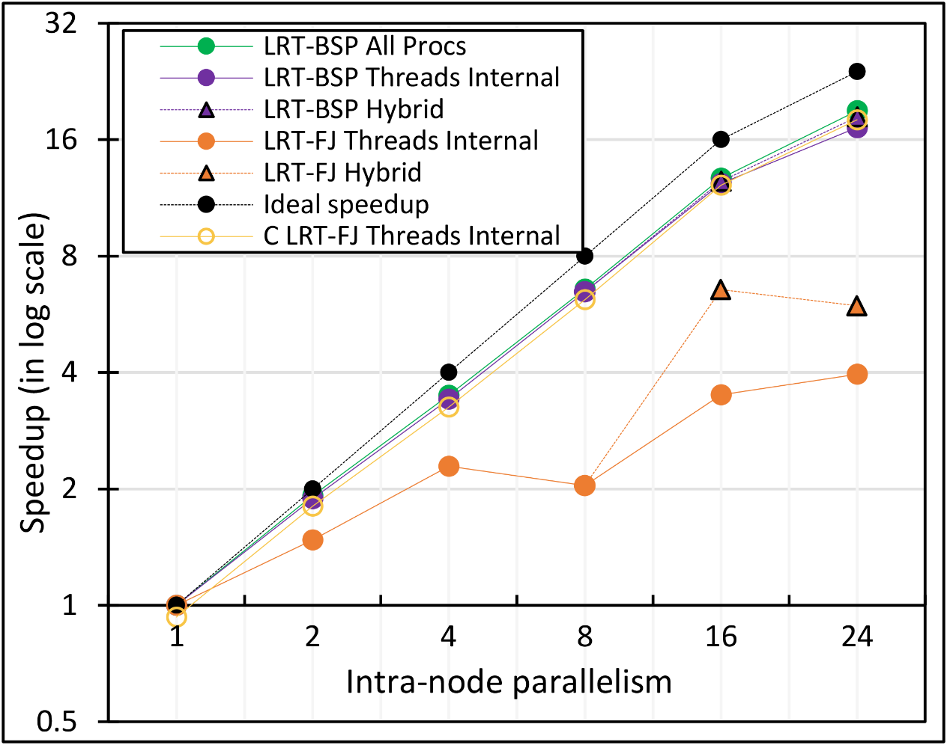
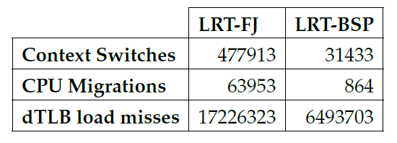
Performance Dependence on Number of Cores inside 24-core node (16 nodes total)
All MPI internode
  All Processes
LRT BSP Java
  All Threads internal to node
  Hybrid – Use one process per chip
LRT Fork Join Java
  All Threads
  Hybrid – Use one process per chip
Fork Join C
All Threads
15x
74x
2.6x

Slide 13
Java versus C Performance
C and Java Comparable with Java doing better on larger problem sizes
All data from one million point dataset with varying number of centers on 16 nodes 24 core Haswell

Slide 14
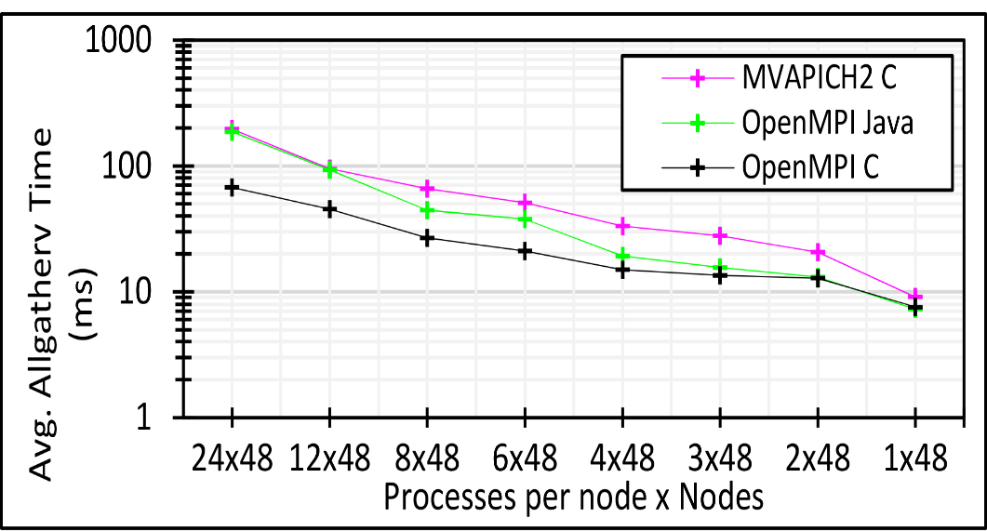
Communication Mechanisms
Collective communications are expensive.
  Allgather, allreduce, broadcast.
  Frequently used in parallel machine learning
  E.g.
    Identical message size per node, yet 24 MPI is ~10 times slower than 1 MPI
    Suggests #ranks per node should be 1 for the best performance
    How to reduce this cost?
3 million double values distributed uniformly over 48 nodes

Slide 15
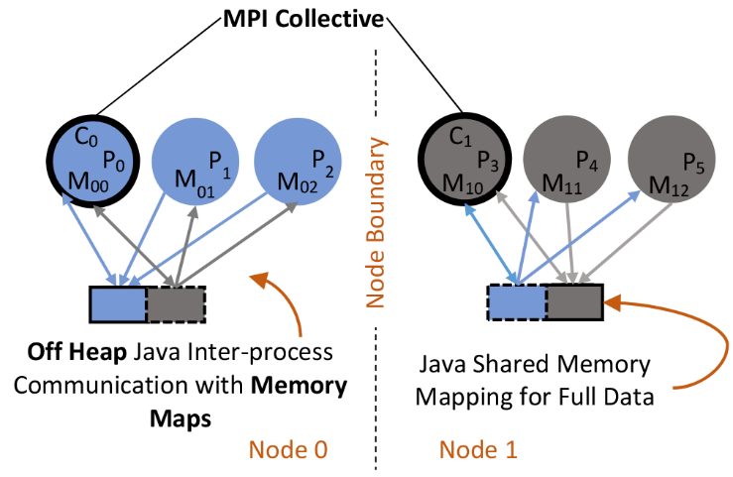
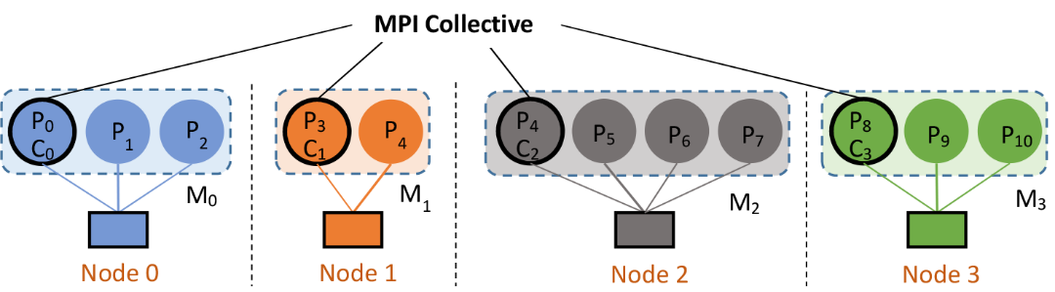
Communication Mechanisms
Shared Memory (SM) for intra-node communication.
  Custom Java implementation in SPIDAL.
    Uses OpenHFT’s Bytes API.
  Reduce network communications to the number of nodes.
    Heterogeneity support, i.e. machines with multiple core/socket counts can run that many MPI processes.
    Java SM architecture

Slide 16
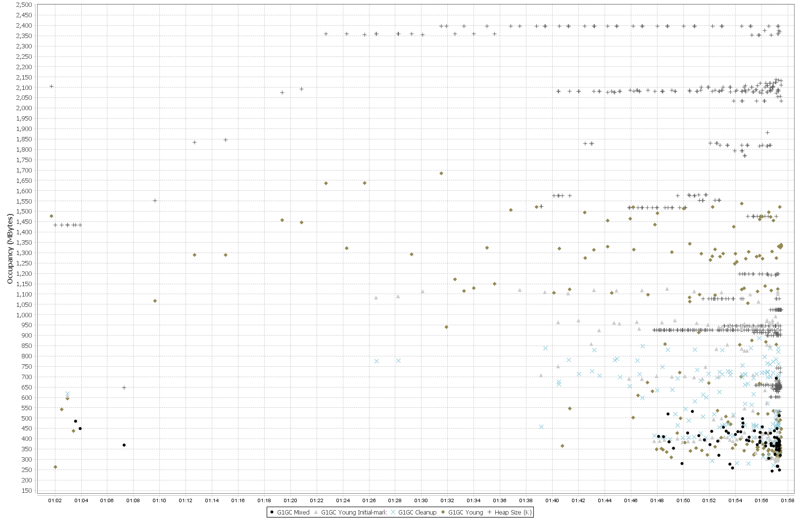

Other Factors: Garbage Collection (GC)
“Stop the world” events are expensive.
  Especially, for parallel machine learning.
  Typical OOP → allocate – use – forget.
  Original SPIDAL code produced frequent garbage of small arrays.
Unavoidable, but can be reduced by:
  Static allocation.
  Object reuse.
Advantage.
  Less GC – obvious.
  Scale to larger problem sizes.
    E.g. Original SPIDAL code required 5GB (x 24 = 120 GB per node) heap per process to handle 200K DA-MDS. Optimized code use < 1GB heap to finish within the same timing.
Heap size per process reaches –Xmx (2.5GB) early in the computation
Frequent GC
Heap size per process is well below (~1.1GB) of –Xmx (2.5GB)
Virtually no GC activity after optimizing

Slide 17
Other Factors
Serialization/Deserialization.
  Default implementations are verbose, especially in Java.
  Kryo is by far the best in compactness.
  Off-heap buffers are another option.
Memory references and cache.
  Nested structures are expensive.
  Even 1D arrays are preferred over 2D when possible.
  Adopt HPC techniques – loop ordering, blocked arrays.
Data read/write.
  Stream I/O is expensive for large data
  Memory mapping is much faster and JNI friendly in Java
    Native calls require extra copies as objects move during GC.
    Memory maps are in off-GC space, so no extra copying is necessary

