Slide 1

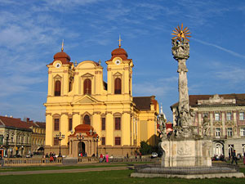
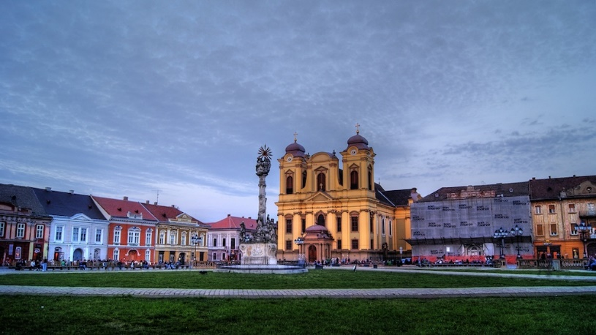

SPIDAL Library and WebPlotViz web Visualization system
4th International Winter School on Big Data
Timişoara, Romania, January 22-26, 2018
http://grammars.grlmc.com/BigDat2018/
January 25, 2018
Geoffrey Fox gcf@indiana.edu
http://www.dsc.soic.indiana.edu/, http://spidal.org/ http://hpc-abds.org/kaleidoscope/
Department of Intelligent Systems Engineering
School of Informatics and Computing, Digital Science Center
Indiana University Bloomington

Slide 2
SPIDAL Tutorial ready to go!
The tutorial material can be found at
  Video: https://youtu.be/ZpYFKGYQ1Uk
  https://dsc-spidal.github.io/tutorials/
The tutorial consist of
  Installation of SPIDAL software including openmpi and two applications
    Fungi sequence clustering
    Pathology data
This goes through use of SPIDAL Clustering and Dimension Reduction as well as WebPlotViz online visualization system

Slide 3
Qiu/Fox Core SPIDAL Parallel HPC Library with Collective Used
DA-MDS Rotate, AllReduce, Broadcast
Directed Force Dimension Reduction AllGather, Allreduce
Irregular DAVS Clustering Partial Rotate, AllReduce, Broadcast
DA Semimetric Clustering (Deterministic Annealing) Rotate, AllReduce, Broadcast
K-means AllReduce, Broadcast, AllGather DAAL
SVM AllReduce, AllGather
SubGraph Mining AllGather, AllReduce
Latent Dirichlet Allocation Rotate, AllReduce
Matrix Factorization (SGD) Rotate DAAL
Recommender System (ALS) Rotate DAAL
Singular Value Decomposition (SVD) AllGather DAAL
QR Decomposition (QR) Reduce, Broadcast DAAL
Neural Network AllReduce DAAL
Covariance AllReduce DAAL
Low Order Moments Reduce DAAL
Naive Bayes Reduce DAAL
Linear Regression Reduce DAAL
Ridge Regression Reduce DAAL
Multi-class Logistic Regression Regroup, Rotate, AllGather
Random Forest AllReduce
Principal Component Analysis (PCA) AllReduce DAAL
DAAL implies integrated on node with Intel DAAL Optimized Data Analytics Library (Runs on KNL!)

Slide 4
Examples of HPC Analytics Using SPIDAL Clustering and Dimension Reduction

Slide 5
Clustering and Visualization
The SPIDAL Library includes several clustering algorithms with sophisticated features
  Deterministic Annealing
  Radius cutoff in cluster membership
  Elkans algorithm using triangle inequality
They also cover two important cases
  Points are vectors – algorithm O(N) for N points
  Points not vectors – all we know is distance δ(i, j) between each pair of points i and j. algorithm O(N²) for N points
We find visualization important to judge quality of clustering
As data typically not 2D or 3D, we use dimension reduction to project data so we can then view it
Have a browser viewer WebPlotViz that replaces an older Windows system
Clustering and Dimension Reduction are modest (for #sequences < 1 million) HPC applications
Calculating distance δ(i, j) is similar compute load but pleasingly parallel
All examples require HPC but largest size used ~600 cores

Slide 6
Fungal Sequences
Input data
  ~7 million gene sequences in FASTA format.
Pre-processing
  Input data filtered to locate unique sequences that appear multiple occasions in the input data, resulting in 170K gene sequences.
  Smith–Waterman algorithm is applied to generate distance matrix for 170K gene sequences.
Clustering data with DAPWC
  Run DAPWC iteratively to produce clean clustering for the data. Initial step of DAPWC is done with 8 clusters. Resulting clusters are visualized and further clustered using DAPWC with appropriate number of clusters that are determined through visualizing in WebPlotViz.
  Resulting clusters are gathered and merged to produce the final clustering result.

Slide 7



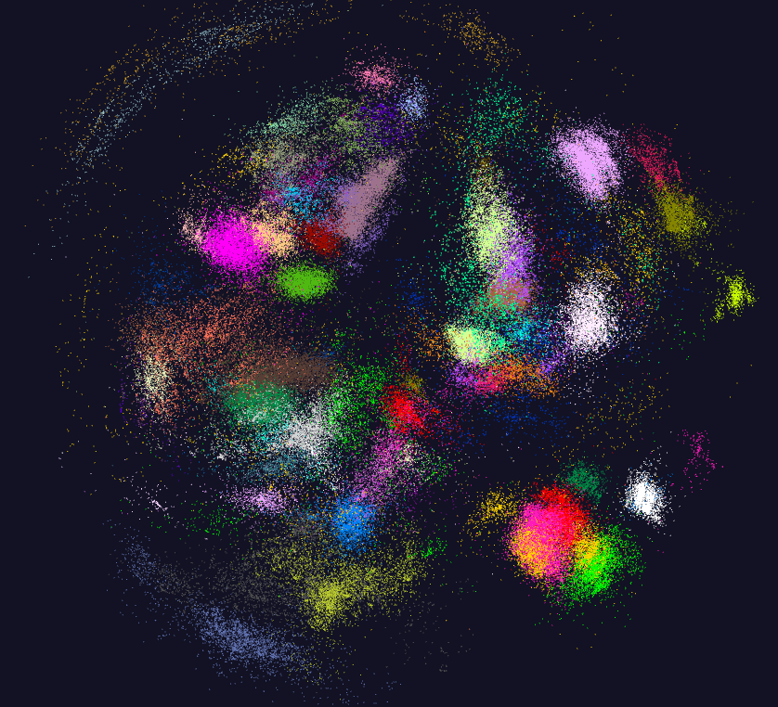
170K Fungi sequences

Slide 8
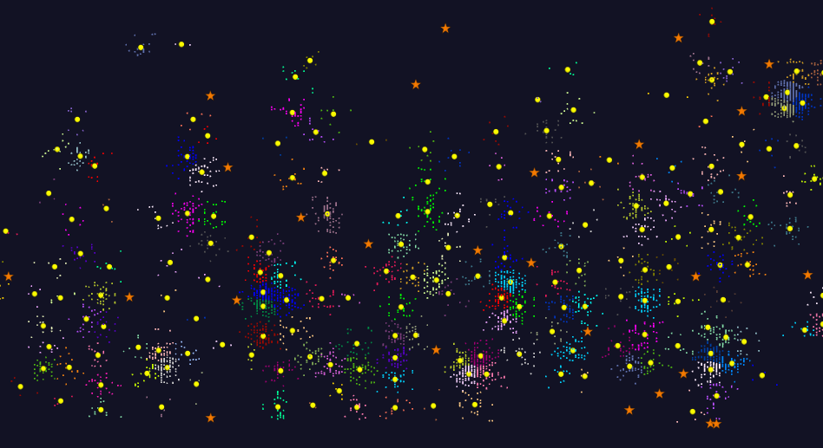
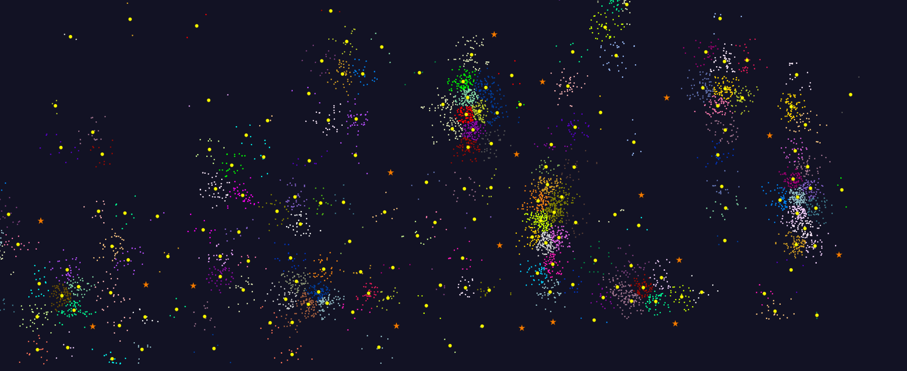
2D Vector Clustering with cutoff at 3 σ
Orange Star – outside all clusters; yellow circle cluster centers
LCMS Mass Spectrometer Peak Clustering. Charge 2 Sample with 10.9 million points and 420,000 clusters visualized in WebPlotViz

Slide 9

Protein Universe Browser for COG Sequences with a few illustrative biologically identified clusters
Note Clusters NOT distinct

Slide 10
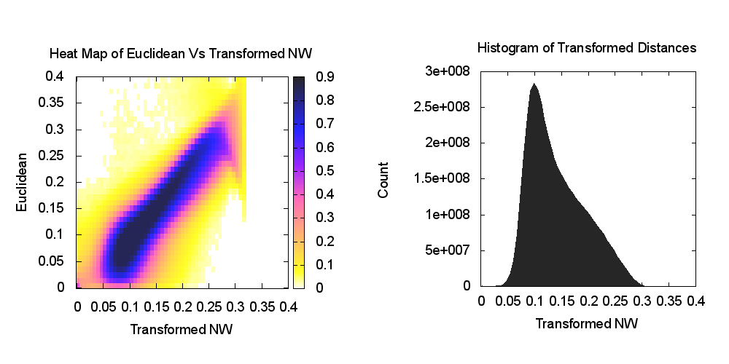
Heatmap of biology distance (Needleman-Wunsch) vs 3D Euclidean Distances – mapping pretty good
If d a distance, so is f(d) for any monotonic f. Optimize choice of f

Slide 11
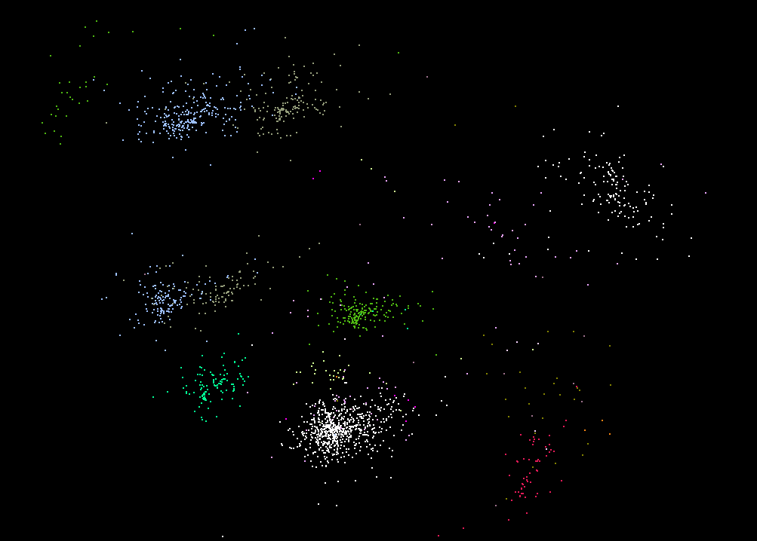
Visualization can identify problems e.g. what were thought to be the same Species are in different locations

Slide 12
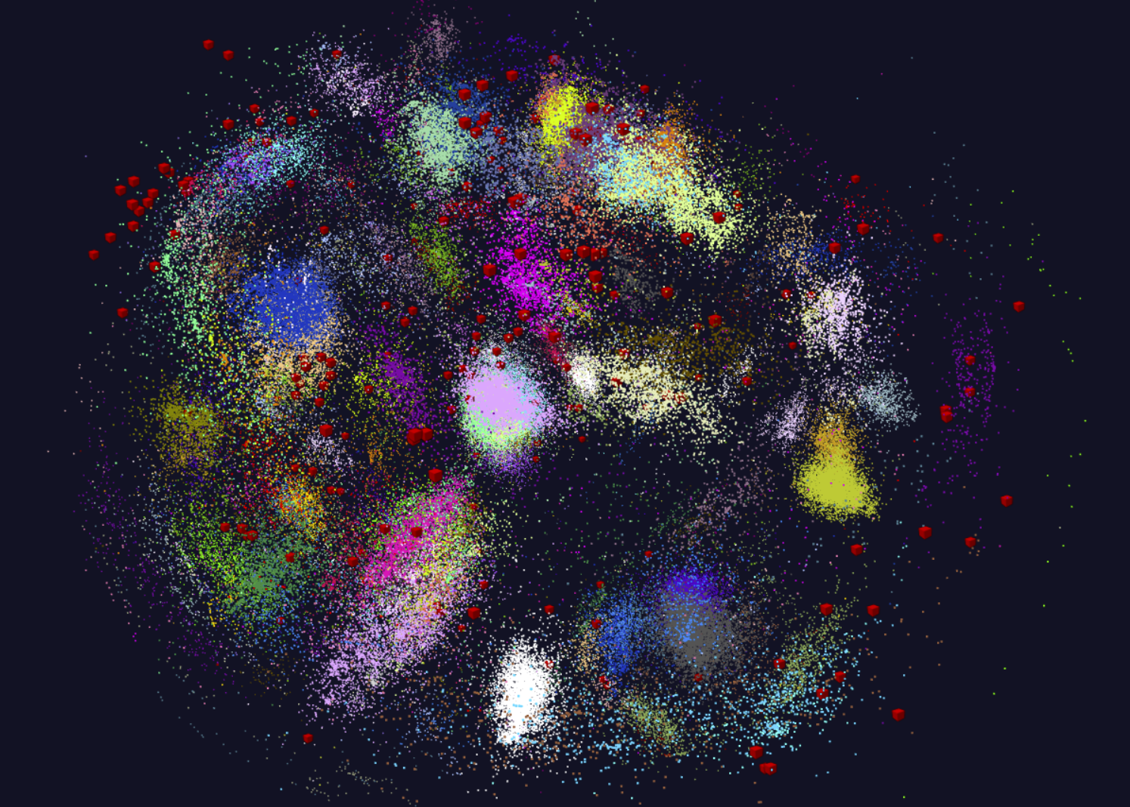
This compares the 170K clustered Fungi sequences with 286 related Fungi. There is clearly little correspondence explained perhaps by location of 170K – namely Scotland.

Slide 13
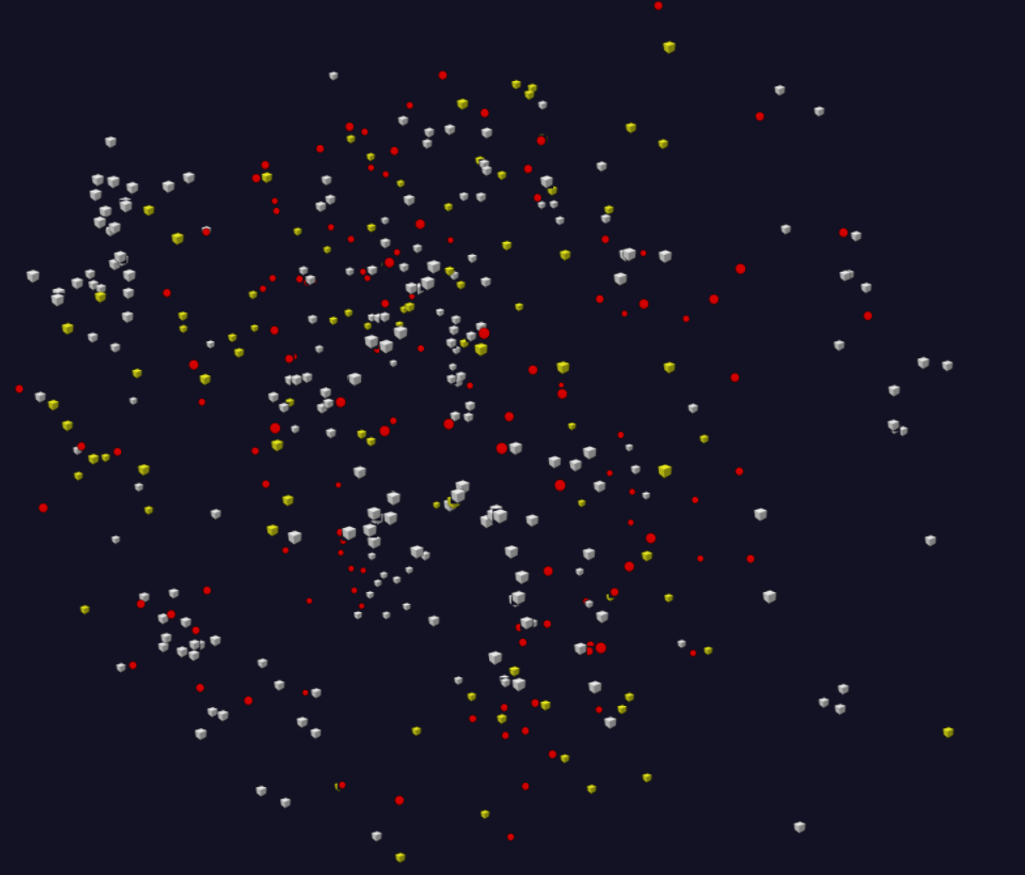
This compares the 170K clustered Fungi sequences with 286 related Fungi, with the 170K replaced by centers of the 211 clusters discovered.
The 286 previous Fungi
The 124 large clusters with >200 members
The 87 small clusters with < 200 members
There is again little correspondence. This is clearest when image rotated to look for correlations.

Slide 14
Spherical Phylogram
Take a set of sequences mapped to nD with MDS (WDA-SMACOF) (n=3 or ~20)
  N=20 captures ~all features of dataset?
Consider a phylogenetic tree and use neighbor joining formulae (valid for Euclidean spaces) to calculate distances of nodes to sequences (or later other nodes) starting at bottom of tree
Do a new MDS fixing mapping of sequences noting that sequences + nodes have defined distances
Use RAxML or Neighbor Joining (N=20?) to find tree
Random note: do not need Multiple Sequence Alignment; pairwise tools are easier to use and give reliably good results

Slide 15
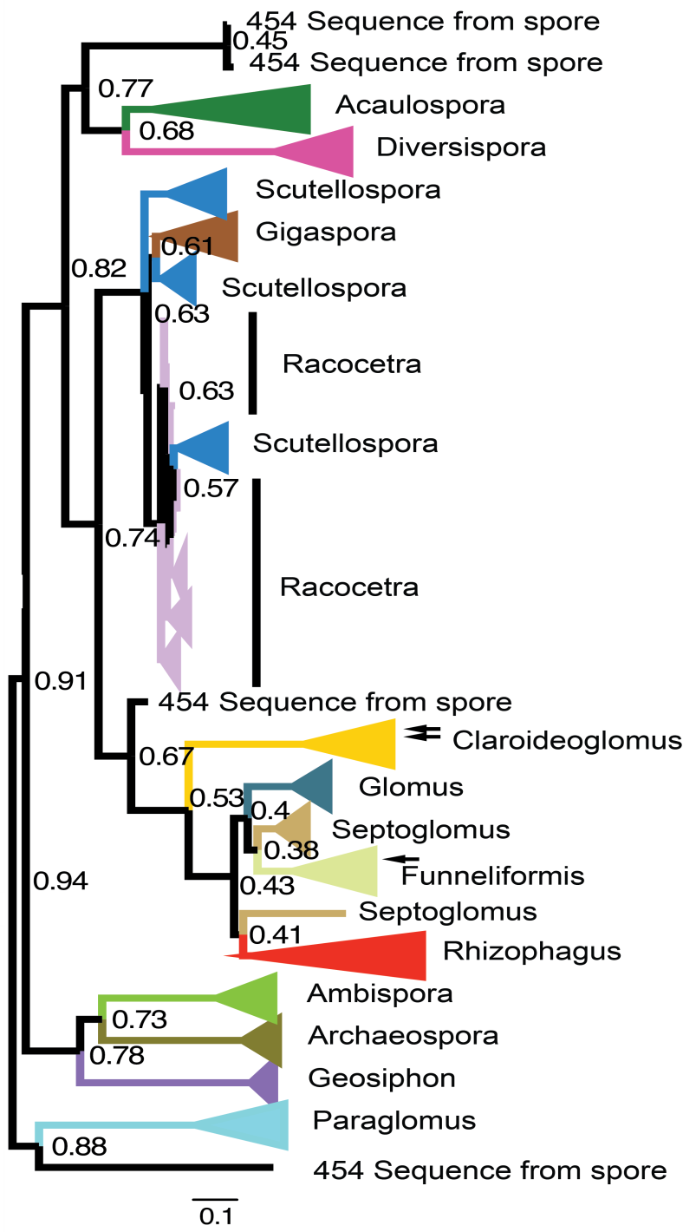
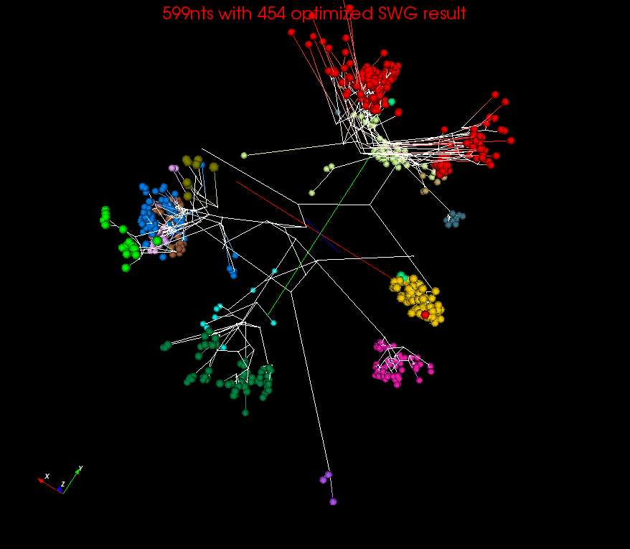
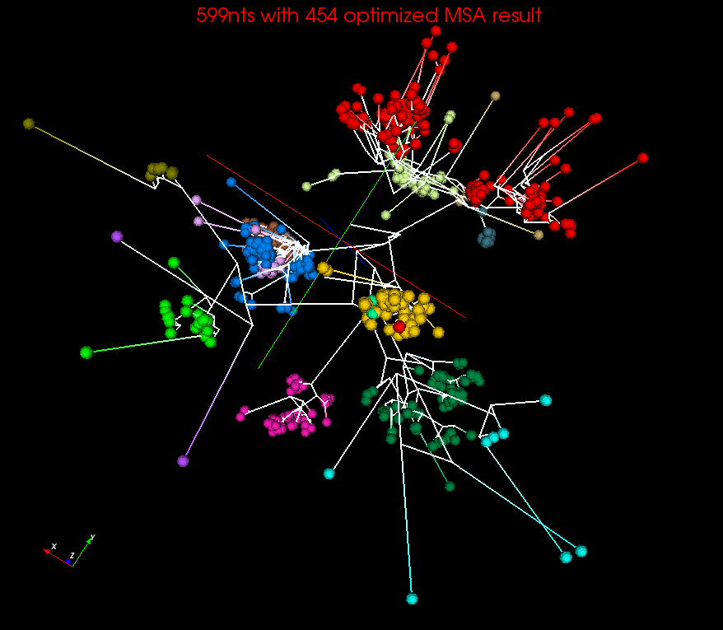
Spherical Phylograms visualized for MSA or SWG distances
Get a 3D not 2D representation of the tree with rigorous view of distances between sequences
MSA
(Multiple Sequence Alignment)
SWG (Smith Waterman)
RAxML result.
visualized in FigTree

Slide 16
Math of Deterministic Annealing
H(χ) is objective function to be minimized as a function of parameters χ (as in Stress formula given earlier for MDS)
Gibbs Distribution at Temperature T
P(χ) = exp( - H(χ)/T) / ∫ dχ exp( - H(χ)/T)
Or P(χ) = exp( - H(χ)/T + F/T )
Use the Free Energy combining Objective Function and Entropy
F = < H - T S(P) > = ∫ dχ {P(χ)H + T P(χ) lnP(χ)}
Simulated annealing performs these integrals by Monte Carlo
Deterministic annealing corresponds to doing integrals analytically (by mean field approximation) and is much much faster
Need to introduce a modified Hamiltonian for some cases so that integrals are tractable. Introduce extra parameters to be varied so that modified Hamiltonian matches original
In each case temperature is lowered slowly – say by a factor 0.99 at each iteration

Slide 17
General Features of Deterministic Annealing
In many problems, decreasing temperature is classic multiscale – finer resolution (√T is “just” distance scale)
In clustering √T is distance in space of points (and centroids), for MDS scale in mapped Euclidean space
Start with T = ∞, all points are in same place – the center of universe
  For MDS all Euclidean points are at center and distances are zero. For clustering, there is one cluster
As Temperature lowered there are phase transitions in clustering cases where clusters split
  Algorithm determines whether split needed as second derivative matrix singular
Note DA has similar features to hierarchical methods and you do not have to specify a number of clusters; you need to specify a final distance scale

Slide 18
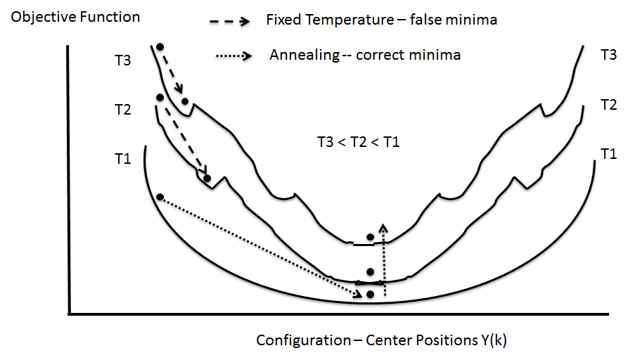
(Deterministic) Annealing
Find minimum at high temperature when trivial
Small change avoiding local minima as lower temperature
Typically gets better answers than standard libraries
And can be parallelized and put on GPU’s etc.

Slide 19
Tutorials on using SPIDAL
DAMDS, Clustering, WebPlotviz https://dsc-spidal.github.io/tutorials/
Active WebPlotViz for clustering plus DAMDS on fungi
  https://spidal-gw.dsc.soic.indiana.edu/public/resultsets/1273112137
  https://spidal-gw.dsc.soic.indiana.edu/public/resultsets/1167269857
  https://spidal-gw.dsc.soic.indiana.edu/public/groupdashboard/Anna_GeneSeq
Active WebPlotViz for 2D Proteomics https://spidal-gw.dsc.soic.indiana.edu/public/resultsets/1657429765
Active WebPlotViz for Pathology Images https://spidal-gw.dsc.soic.indiana.edu/public/resultsets/1678860580
Harp https://github.com/DSC-SPIDAL/Harp
Bigdat 2018 link (see README) https://drive.google.com/open?id=126NLJPTYnjzmzm_iHmv0HrE9v2NKVm--
SPIDAL video: https://youtu.be/ZpYFKGYQ1Uk
Harp-DAAL Video https://www.youtube.com/watch?v=prfPewgMrRQ

Slide 20
WebPlotViz

Slide 21
WebPlotViz Basics
Many data analytics problems can be formulated as study of points that are often in some abstract non-Euclidean space (bags of genes, documents ..) that typically have pairwise distances defined but sometimes not scalar products.
Helpful to visualize set of points to understand better structure
Principal Component Analysis (linear mapping) and Multidimensional Scaling MDS (nonlinear and applicable to non-Euclidean spaces) are methods to map abstract spaces to three dimensions for visualization
  Both run well in parallel and give great results
In past used custom client visualization but recently switch to commodity HTML5 web viewer WebPlotViz

Slide 22
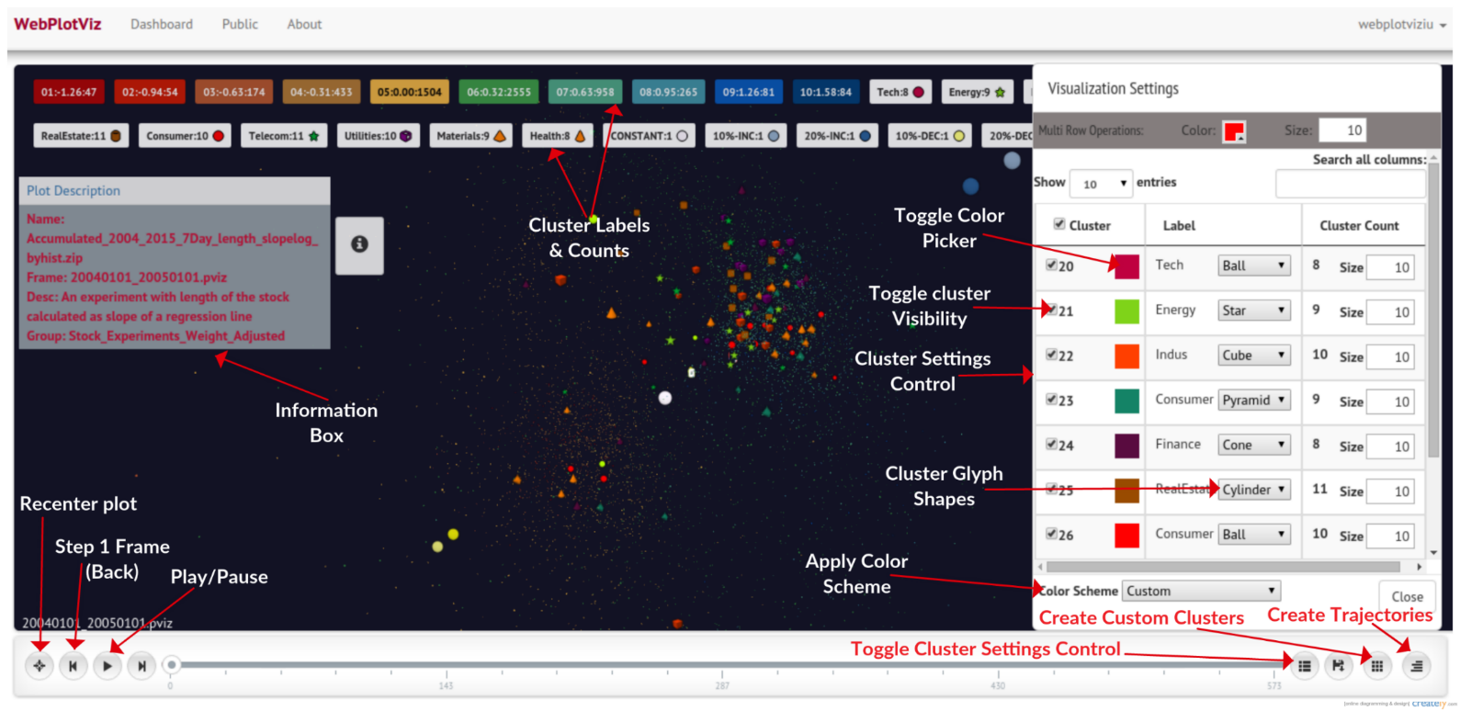
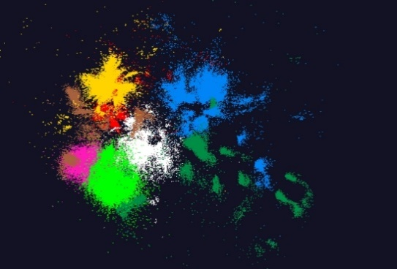
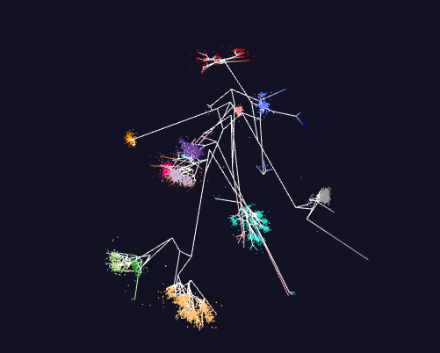
WebPlotViz
100k points
Trees

Slide 23
WebPlotViz Basics II
Supports visualization of 3D point sets (typically derived by mapping from abstract spaces) for streaming and non-streaming case
  Simple data management layer
  3D web visualizer with various capabilities such as defining color schemes, point sizes, glyphs, labels
Core Technologies
  MongoDB management
  Play Server side framework
  Three.js
  WebGL
  JSON data objects
  Bootstrap Javascript web pages
Open Source
http://spidal-gw.dsc.soic.indiana.edu/
~10,000 lines of extra code
Front end view (Browser)
Plot visualization & time series animation (Three.js)
Upload
Request Plots
JSON Format Plots
Web Request Controllers (Play Framework)
Server
Upload format to JSON Converter
Data Layer
(MongoDB)
MongoDB

Slide 24
Stock Daily Data Streaming Example
Typical streaming case considered. Sequence of “collections of abstract points”; cluster, classify etc.; map to 3D; visualize
Example is collection of around 7000 distinct stocks with daily values available at ~2750 distinct times
  Clustering as provided by Wall Street – Dow Jones set of 30 stocks, S&P 500, various ETF’s etc.
The Center for Research in Security Prices (CSRP) database through the Wharton Research Data Services (wrds) web interface
Available for free to the Indiana University students for research
2004 Jan 01 to 2015 Dec 31 have daily Stock prices in the form of a CSV file
We use the information
  ID, Date, Symbol, Factor to Adjust Volume, Factor to Adjust Price, Price, Outstanding Stocks

Slide 25
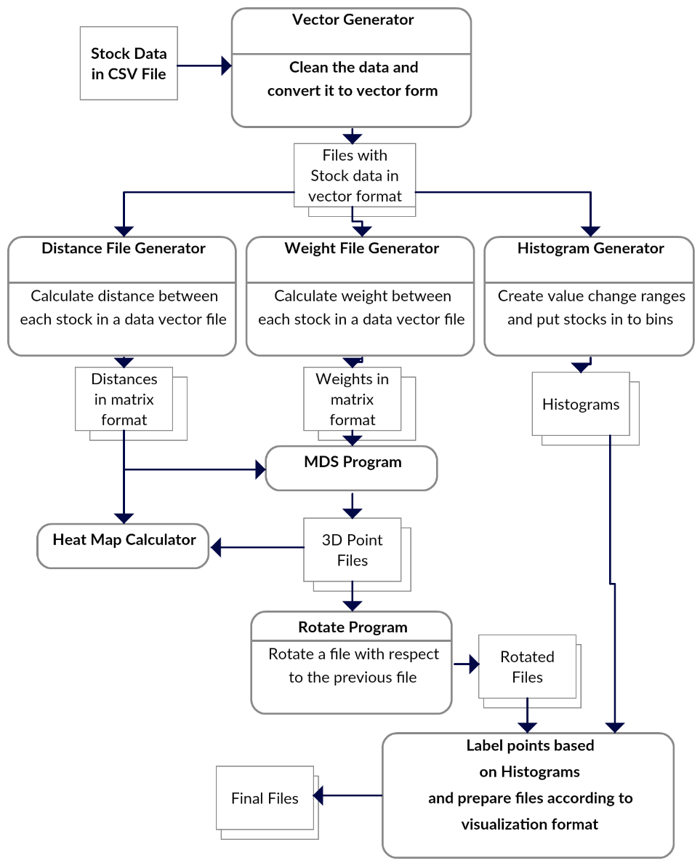
Stock Problem Workflow
Clean data
Calculate distance between stocks
Calculate distance between stocks (Pearson Correlation as missing data)
Map 250-2800 dimensional stock values to 3D for each time
Align each time
Visualize
Will move to Apache Beam to support custom runs

Slide 26

Relative Changes in Stock Values using one day values measured from January 2004 and starting after one year January 2005
Filled circles are final values
Finance
Origin
0% change
Energy
Dow Jones
S&P
Mid Cap
+10%
Apple
+20%

Slide 27
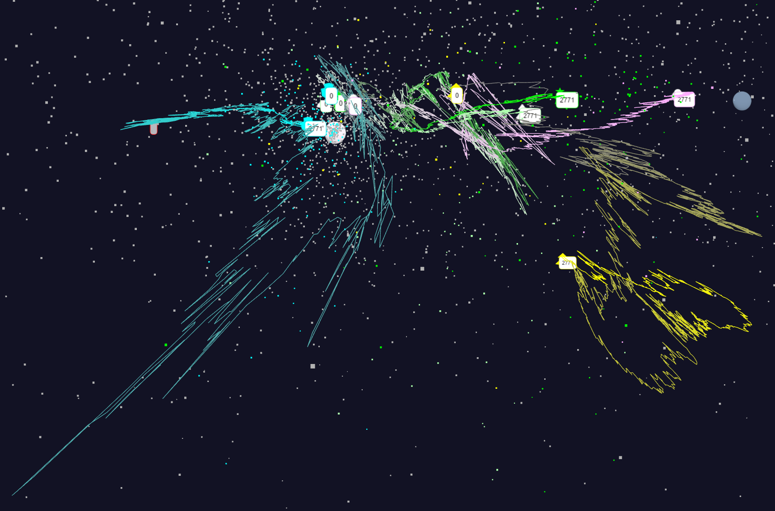
Relative Changes in Stock Values using one day values
S&P
Mid Cap
Dow Jones
+10%
Finance
Origin
0% change
Energy

Slide 28
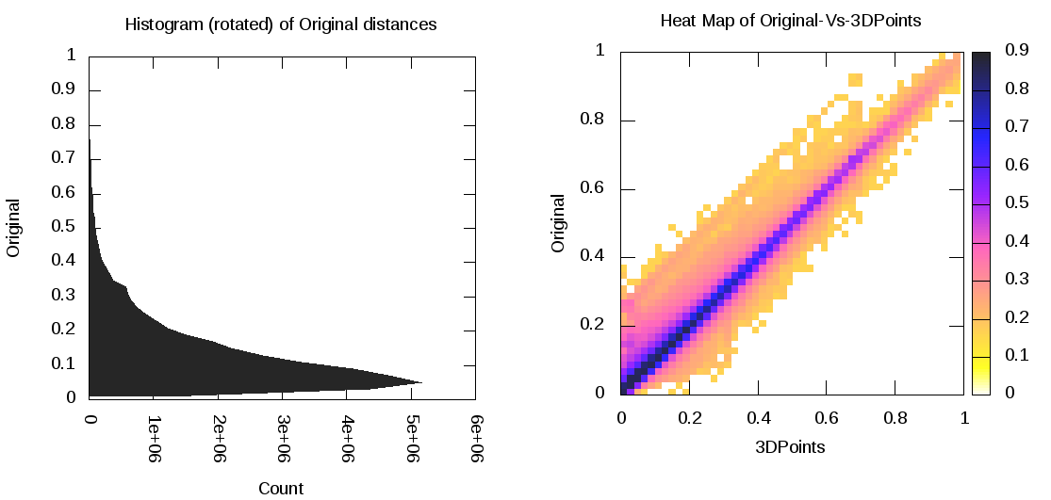
Notes on Mapping to 3D
MDS performed separately at each day – quality judged by match between abstract space distance and mapped space distance
  Pretty good agreement as seen in heat map averaged over all stocks and all days
Each day is mapped independently and is ambiguous up to global rotations and translations
  Align each day to minimize day to day change averaged over all stocks

Slide 29
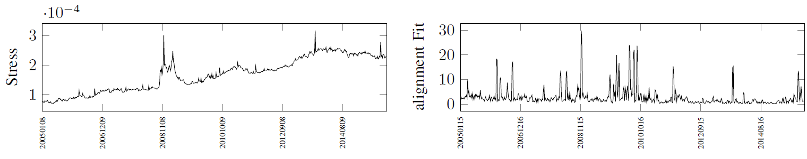
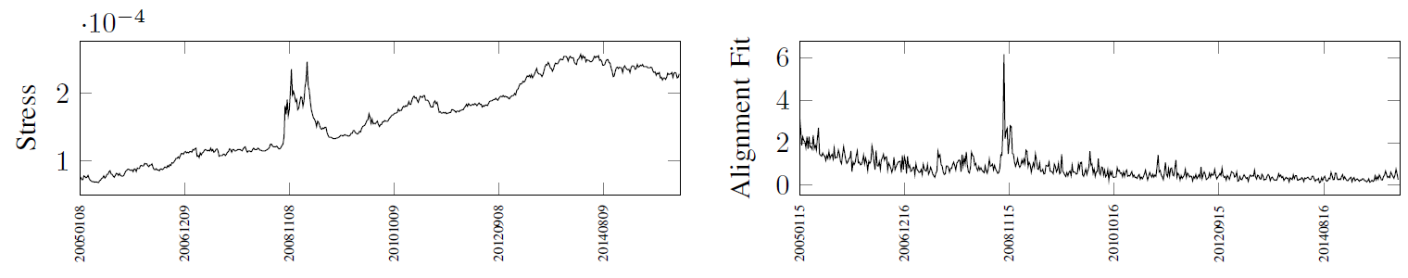
Aligning consecutive plots
Independent MDS
Initialize MDS with previous solution

Slide 30
Links to data sets
Fungi
  All the plots
    https://spidal-gw.dsc.soic.indiana.edu/public/groupdashboard/Anna_GeneSeq
    https://spidal-gw.dsc.soic.indiana.edu/public/resultsets/668018718 Latest with 211 clusters
    https://spidal-gw.dsc.soic.indiana.edu/public/resultsets/1167269857
Pathology
  All the plots
    https://spidal-gw.dsc.soic.indiana.edu/public/groupdashboard/FushengWang
  https://spidal-gw.dsc.soic.indiana.edu/public/resultsets/1678860580
2D Proteomics
  All the plots
    https://spidal-gw.dsc.soic.indiana.edu/public/groupdashboard/Sponge
  https://spidal-gw.dsc.soic.indiana.edu/public/resultsets/1657429765
Time series stock data
  All the plots
    https://spidal-gw.dsc.soic.indiana.edu/public/groupdashboard/Stocks
  https://spidal-gw.dsc.soic.indiana.edu/public/timeseriesview/1494305167

Slide 31
Java Performance

Slide 32
Performance Factors
Threads
  Can threads “magically” speedup your application?
Affinity
  How to place threads/processes across cores?
    FJ=Fork Join (normal); BSP = Continuously running
  Why should we care?
Communication
  Why Inter-Process Communication (IPC) is expensive?
  How to improve?
Other factors
  Garbage collection
  Serialization/Deserialization
  Memory references and cache
  Data read/write

Slide 33
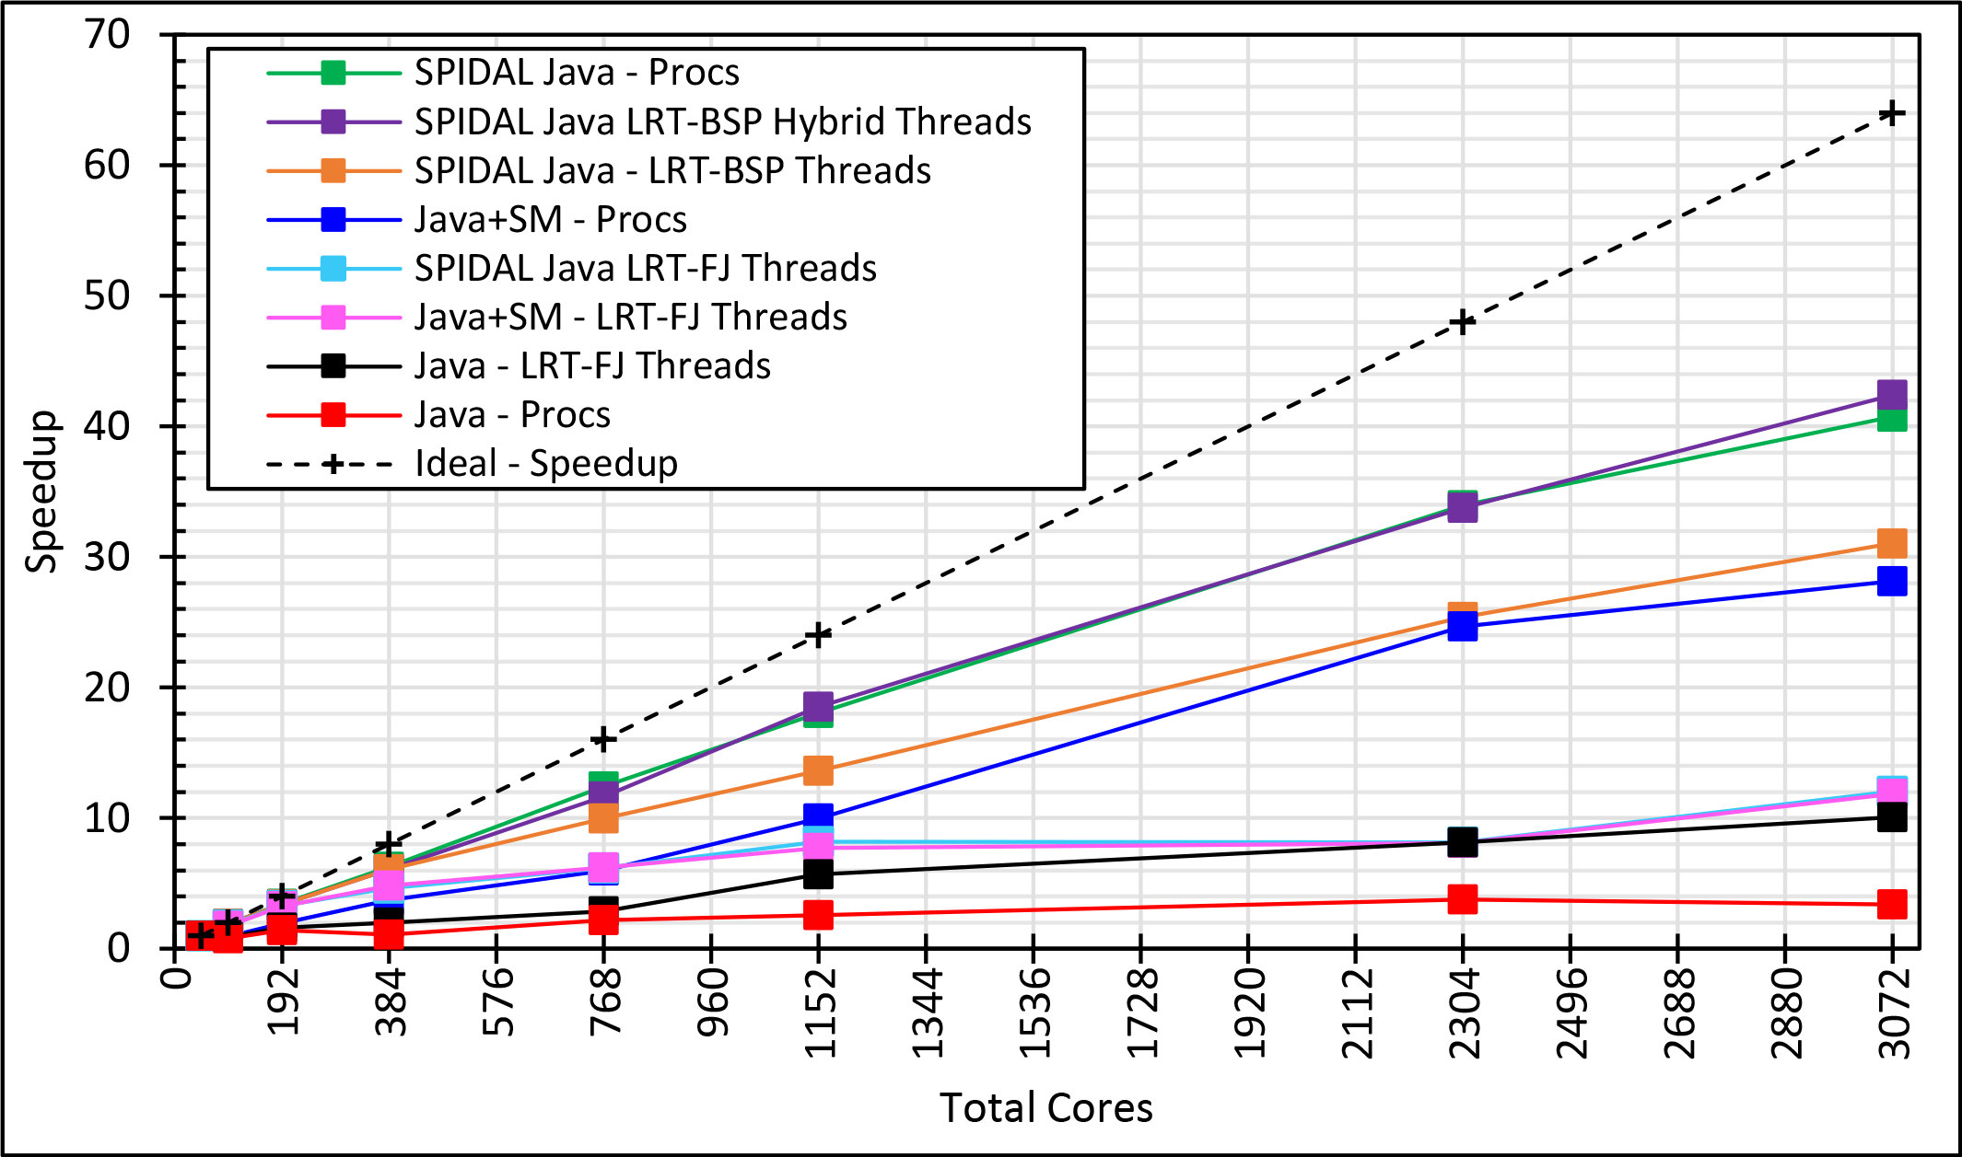
DAMDS on 128 Haswell 24 core Node. Speedup compared to 1 process per node on 48 nodes
Best MPI; inter and intra node
BSP Threads are better than FJ and at best match Java MPI
MPI; inter/intra node; Java not optimized
Best FJ Threads intra node; MPI inter node

Slide 34
Investigating Process and Thread Models
Fork Join (FJ) Threads lower performance than Bulk Synchronous Parallel (BSP)
LRT is Long Running Threads
Results
  Large effects for Java
  Best affinity is process and thread binding to cores - CE
  At best LRT mimics performance of “all processes”
6 Thread/Process Affinity Models
LRT-FJ
LRT-BSP
Threads Affinity | Processes Affinity
 | Cores | Socket | None (All)
Inherit | CI | SI | NI
Explicit per core | CE | SE | NE
Serial work
Non-trivial parallel work
Busy thread synchronization

Slide 35
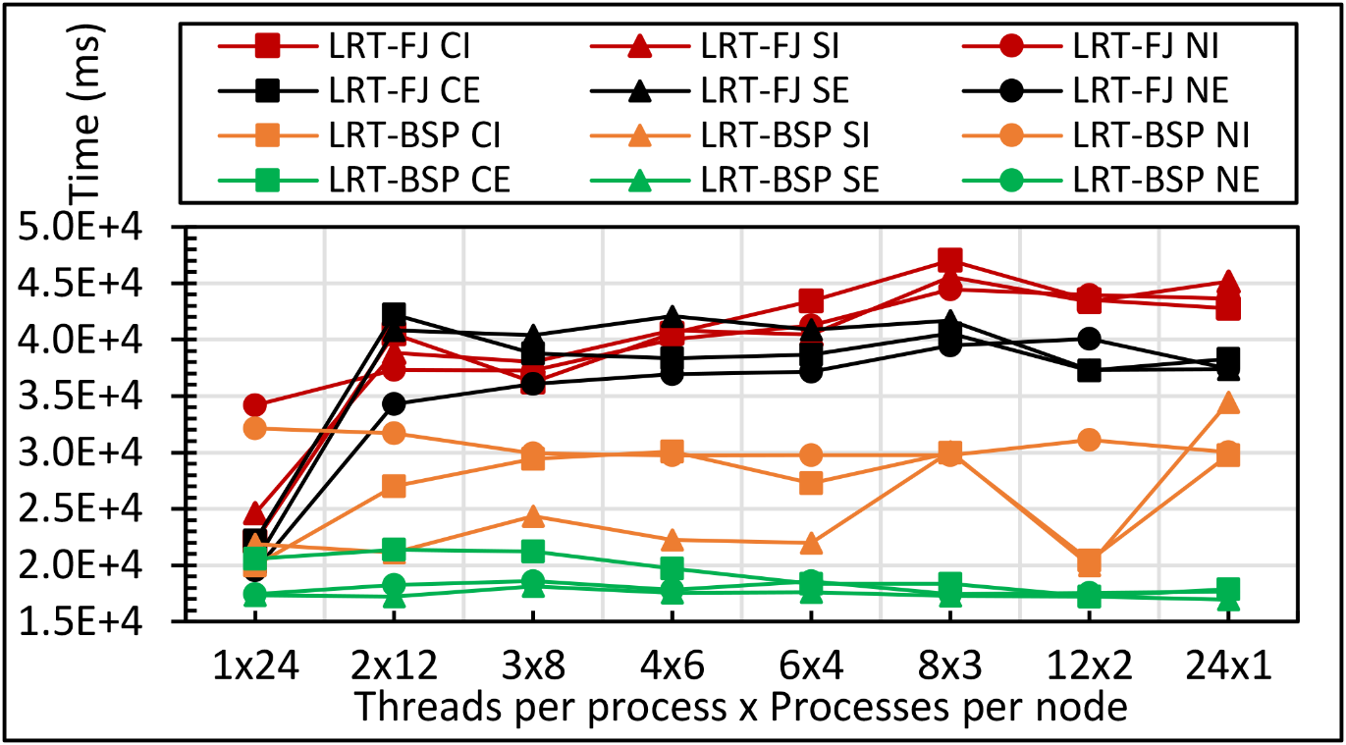
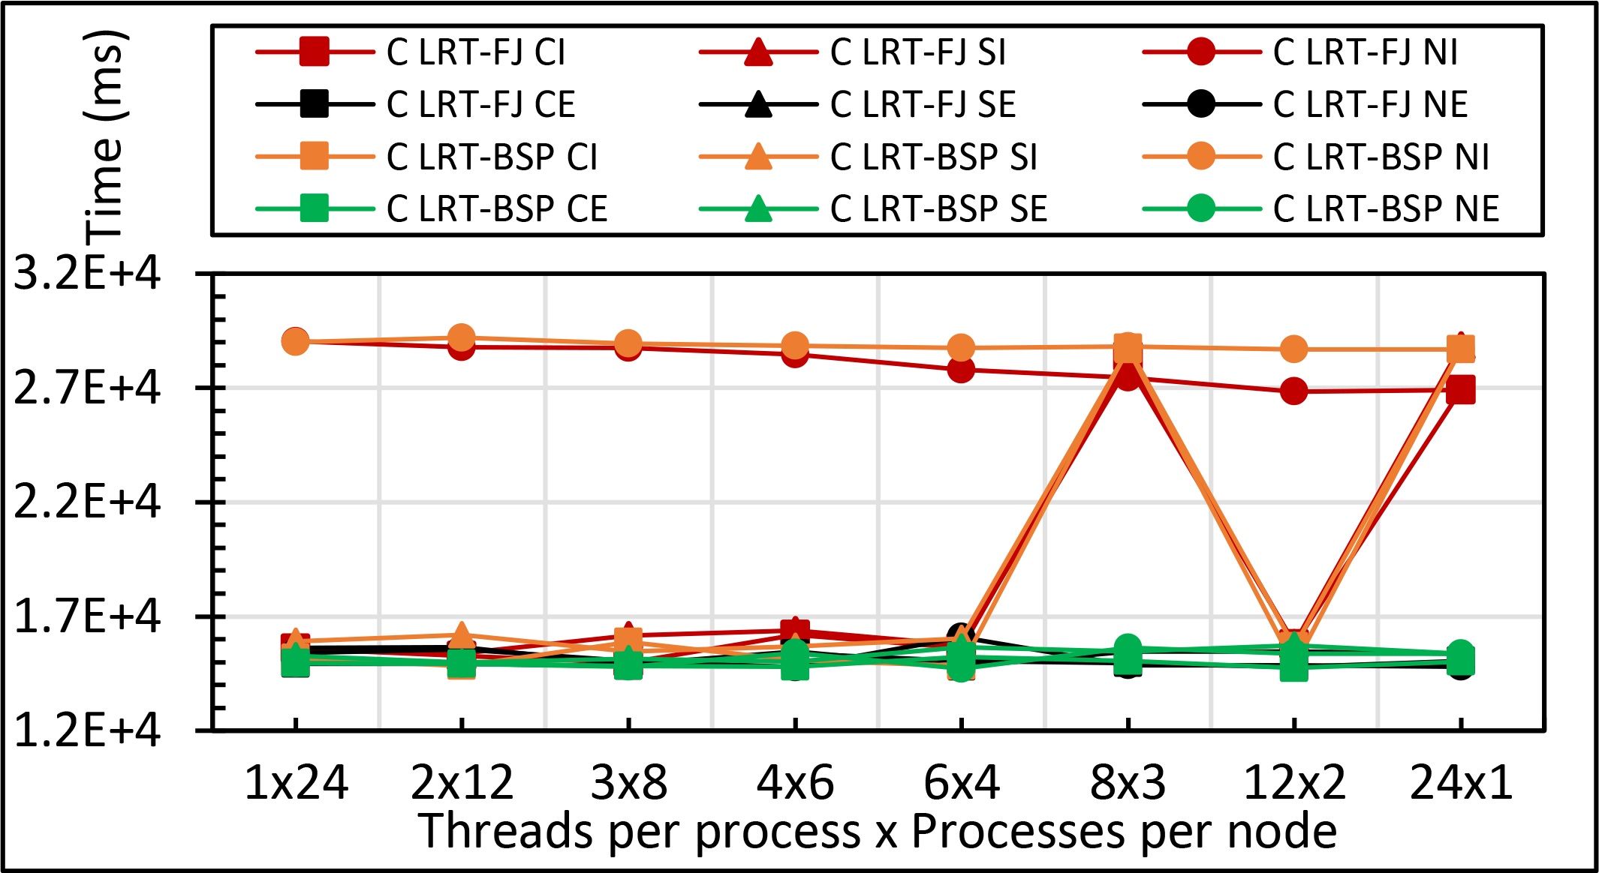
Performance Sensitivity
Languages
Process v. Thread
Thread Model
Java
Kmeans: 1 million points and 1000 centers performance on 16 24 core nodes for LRT-FJ and LRT-BSP with varying affinity patterns (6 choices) over varying threads and processes
C less sensitive than Java
All processes less sensitive than all threads
C

Slide 36
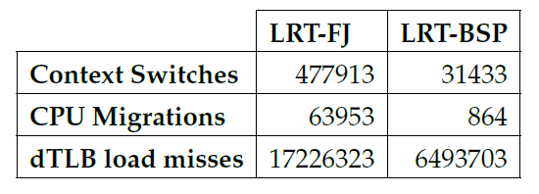
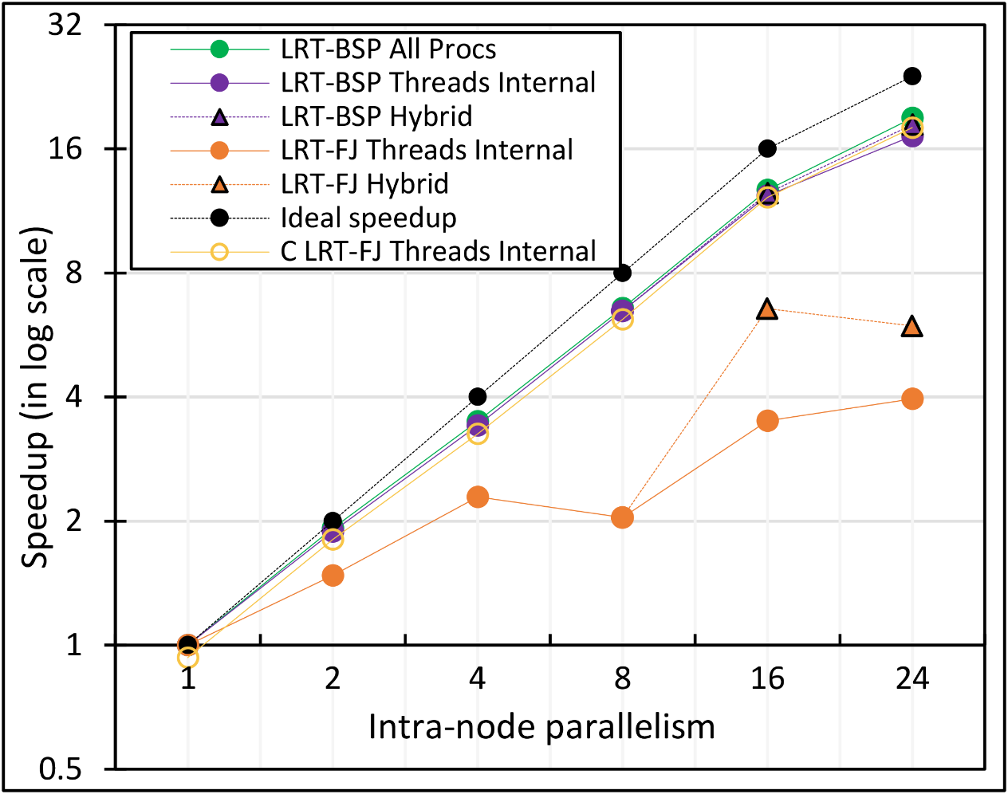
Performance Dependence on Number of Cores inside 24-core node (16 nodes total)
15x
74x
2.6x
All MPI internode
  All Processes
LRT BSP Java
  All Threads internal to node
  Hybrid – Use one process per chip
LRT Fork Join Java
  All Threads
  Hybrid – Use one process per chip
Fork Join C
All Threads

Slide 37
Java versus C Performance
C and Java Comparable with Java doing better on larger problem sizes
All data from one million point dataset with varying number of centers on 16 nodes 24 core Haswell

Slide 38
Performance of HPC Analytics

Slide 39
Performance Evaluation
K-Means Clustering (results given already)
  MPI Java and C – LRT-FJ and LRT-BSP
  Flink K-Means
  Spark K-Means
DA-MDS
  MPI Java – LRT-FJ and LRT-BSP
DA-PWC
  MPI Java – LRT-FJ
MDSasChisq
  MPI Java – LRT-FJ
HPC Cluster
  128 Intel Haswell nodes with 2.3GHz nominal frequency
    96 nodes with 24 cores on 2 sockets (12 cores each)
    32 nodes with 36 cores on 2 sockets (18 cores each)
  128GB memory per node
  40Gbps Infiniband
Software
  RHEL 6.8
  Java 1.8
  OpenHFT JavaLang 6.7.2
  Habanero Java 0.1.4
  OpenMPI 1.10.1

Slide 40
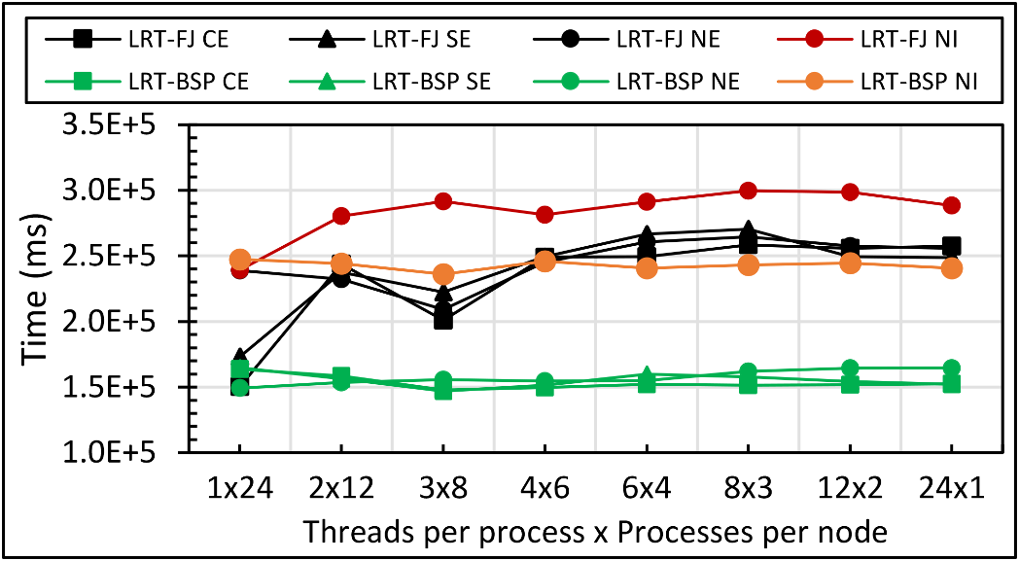
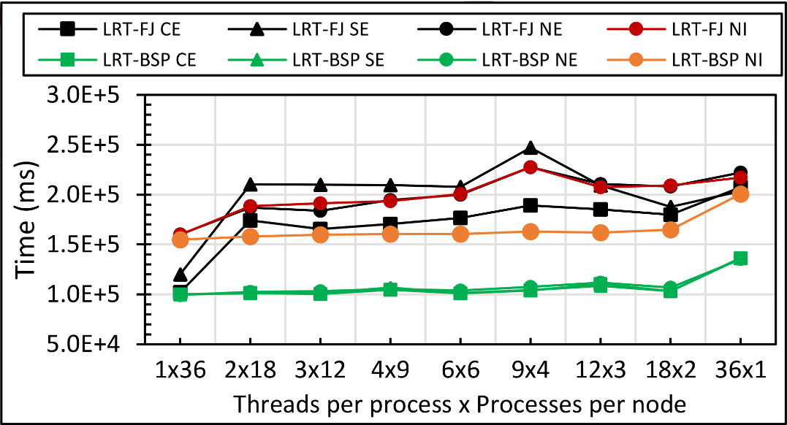
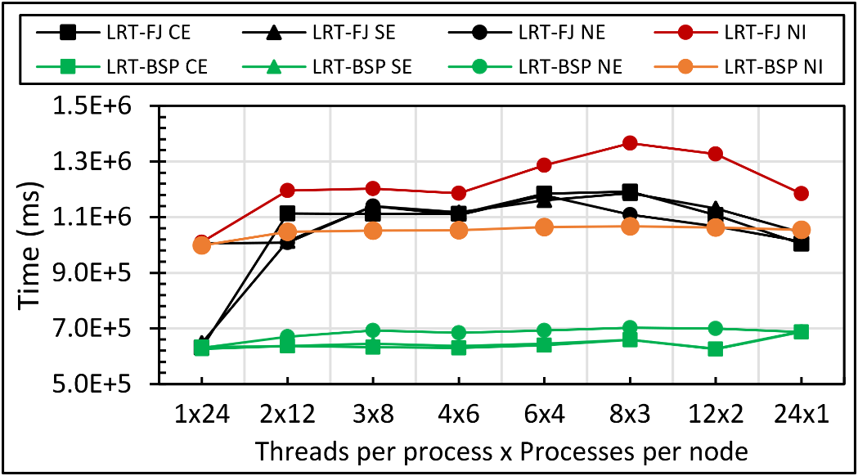
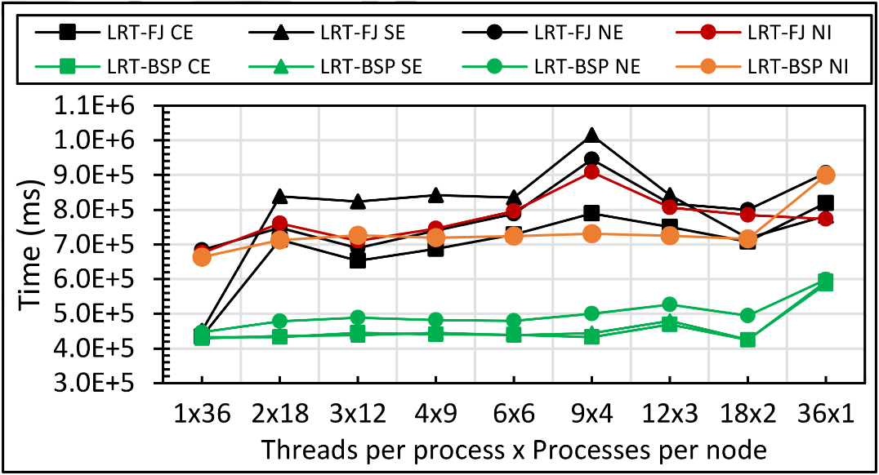
DA-MDS
Java DA-MDS 50k on 16 of 24-core nodes
Java DA-MDS 50k on 16 of 36-core nodes
Java DA-MDS 100k on 16 of 24-core nodes
Java DA-MDS 100k on 16 of 36-core nodes

Slide 41
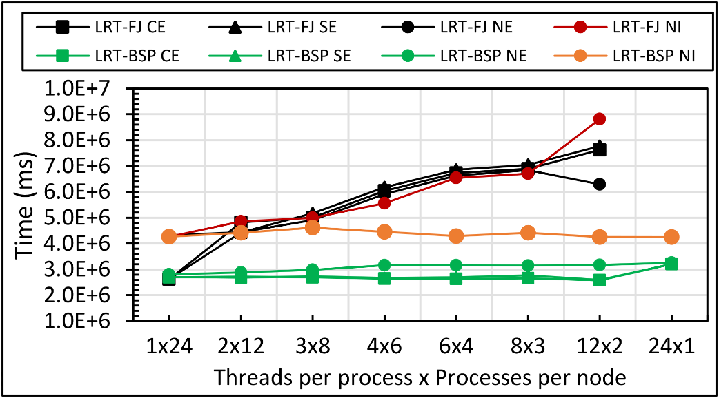
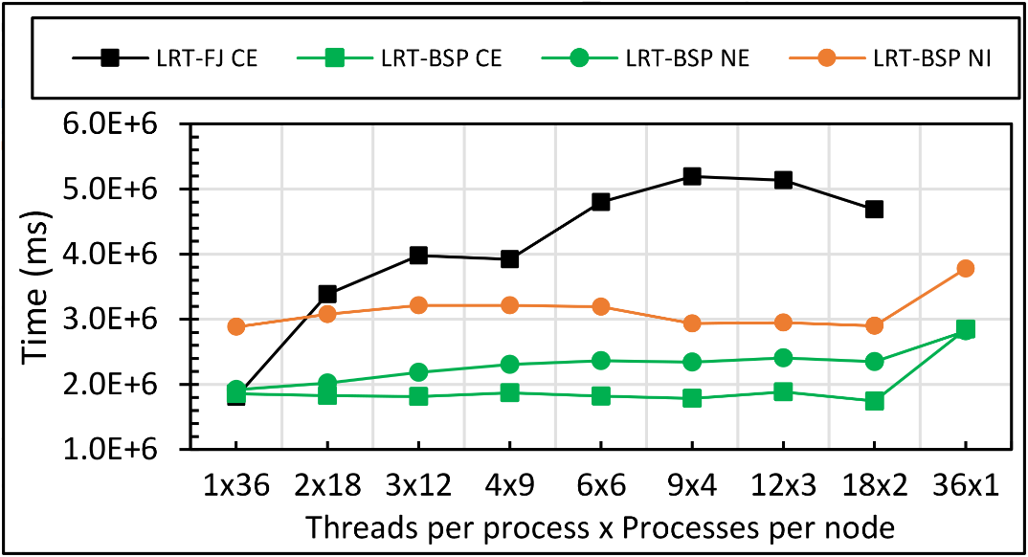
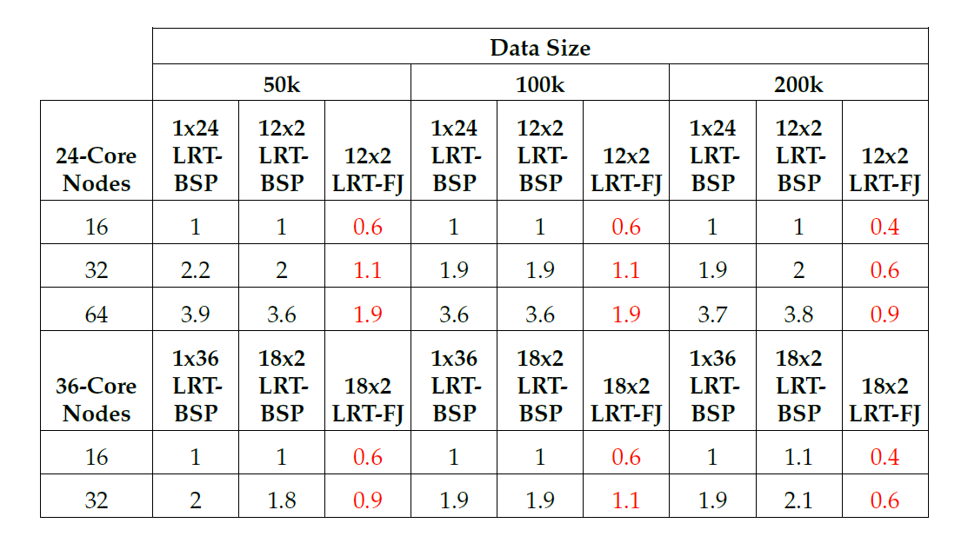
Java DA-MDS 200k on 16 of 24-core nodes
Java DA-MDS 200k on 16 of 36-core nodes
15x
74x
2.6x
Linux perf statistics for DA-MDS run of 18x2 on 32 nodes. Affinity pattern is CE.
DA-MDS
Java DA-MDS speedup comparison for LRT-FJ and LRT-BSP

Slide 42
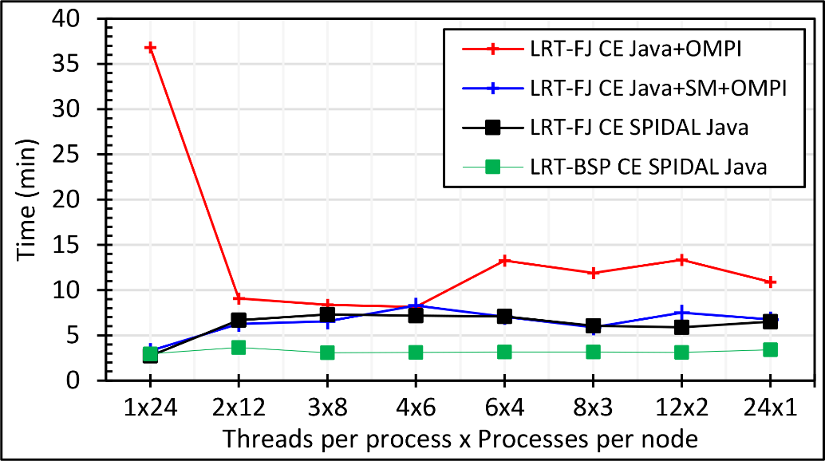
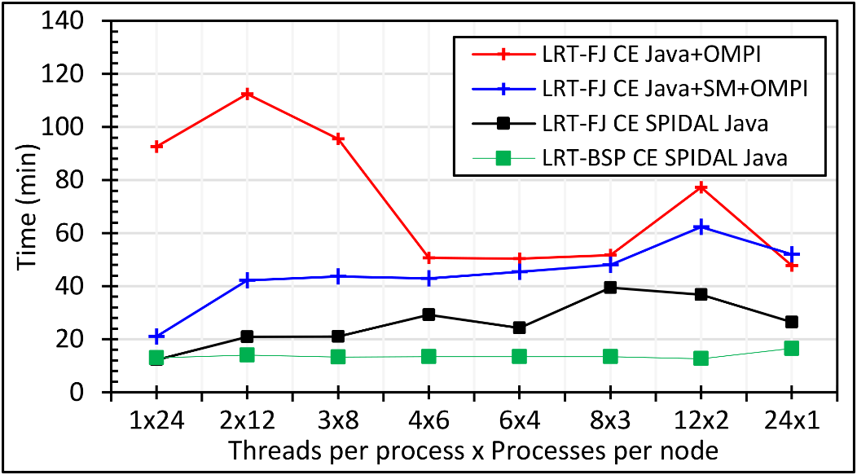
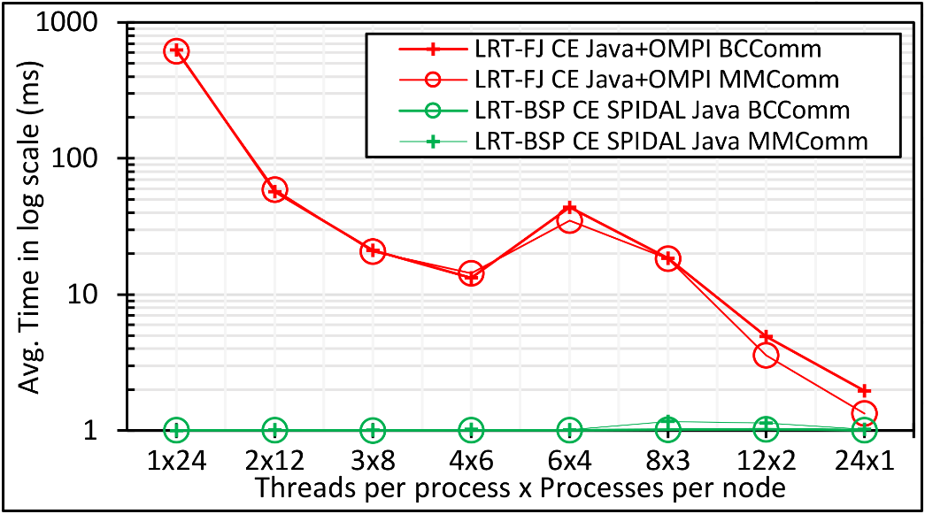
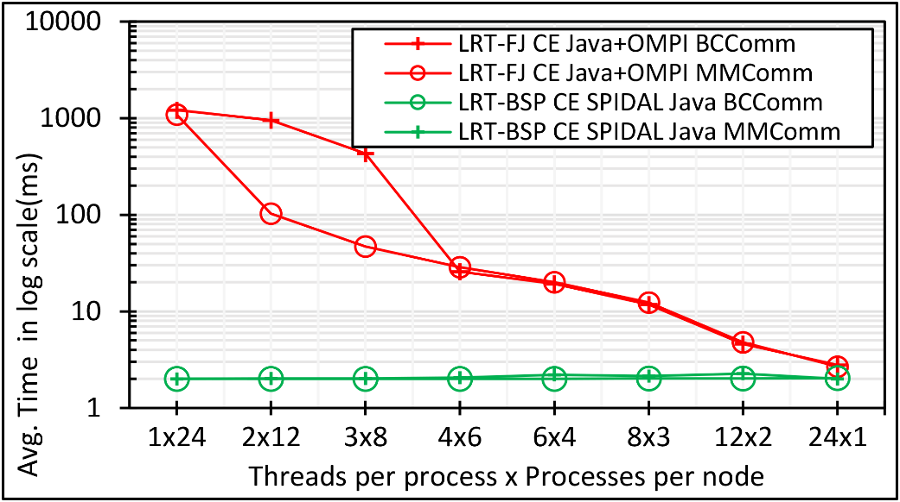
Performance with and without optimizations.
The bottom 2 figures are communication performance
DA-MDS
Java DA-MDS 100k on 48 of 24-core nodes
Java DA-MDS 200k on 48 of 24-core nodes
Java DA-MDS 100k communication on 48 of 24-core nodes
Java DA-MDS 200k communication on 48 of 24-core nodes
Notes:
Note. Linear increase in communication time when going from 100k to 200k with shared memory communication.

Slide 43
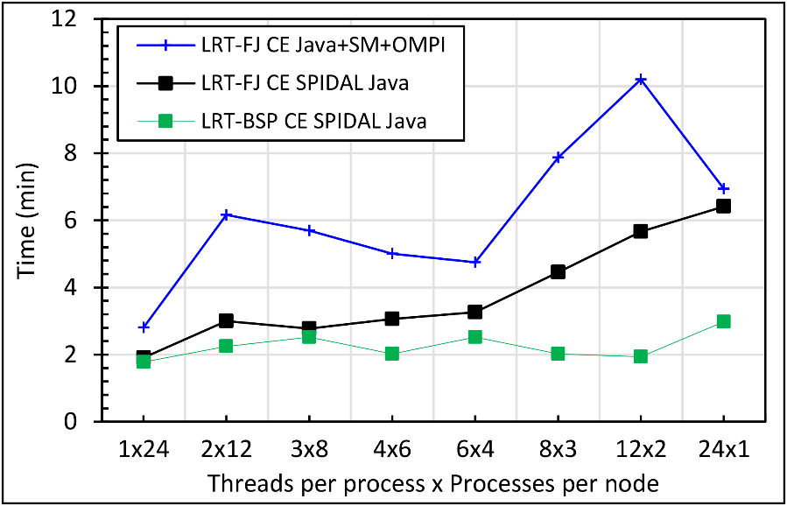
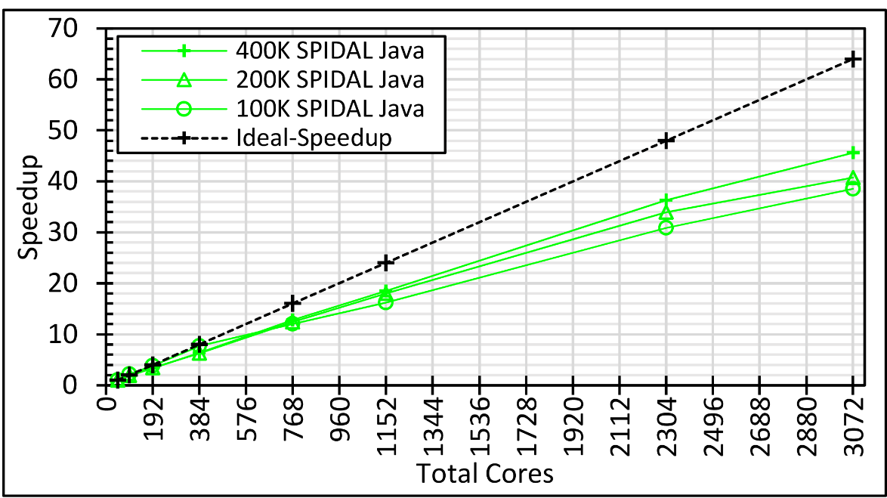
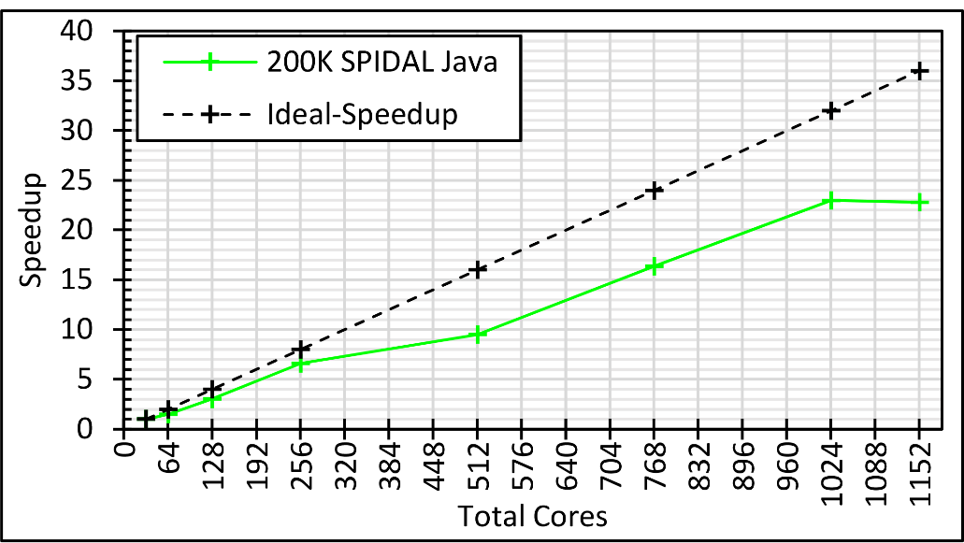
DA-MDS
Performance with and without optimizations
The best speedup with varying problem size and cores on 24-core and 36-core nodes
Java DA-MDS 400k on 48 of 24-core nodes
Java DA-MDS speedup with varying data sizes
Java DA-MDS speedup on 36-core nodes
Notes:
Note. 400K LRT-FJ CE could NOT be done due to reaching memory limits

Slide 44
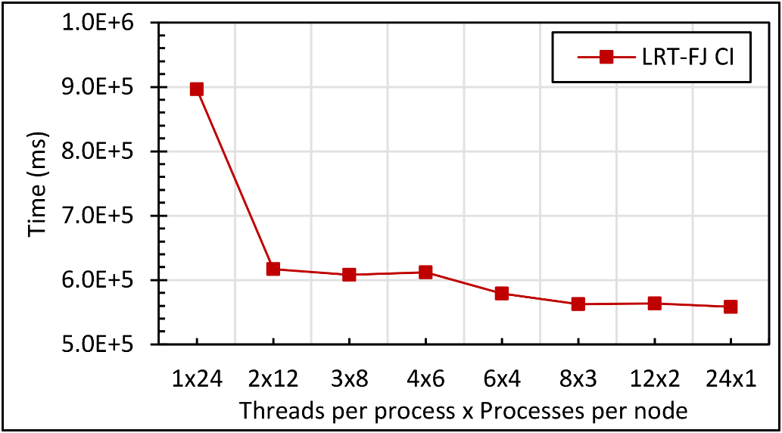
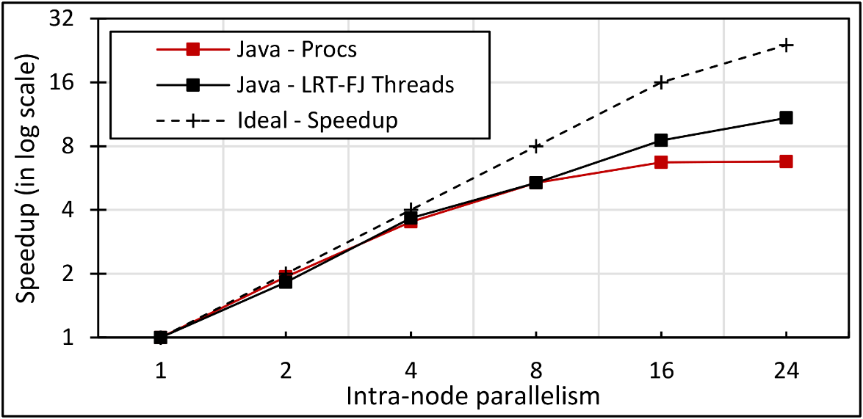
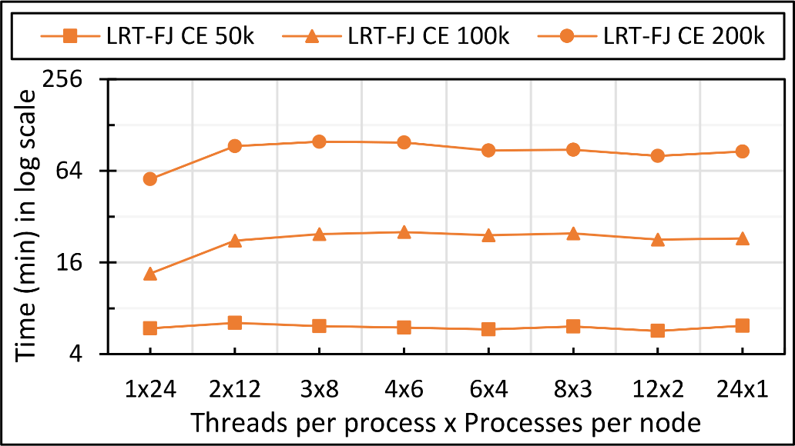
Unoptimized MDSasChisq and DA-PWC
Java MDSasChisq performance on 32 of 24-core nodes
Java MDSasChisq speedup on 32 of 24-core nodes
Java MPI Optimizations for Shared Memory not included
Java DA-PWC performance on 32 of 24-core nodes
Notes:
Note. 400K LRT-FJ CE could NOT be done due to reaching memory limits

Slide 45
Graph Analytics
Finding and Counting Subgraphs

Slide 46
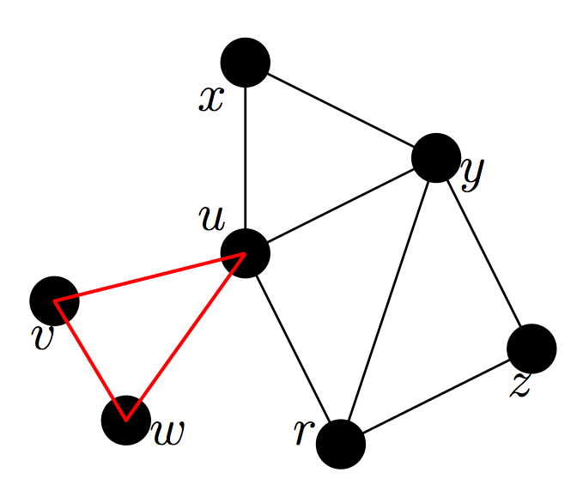
Counting Triangles in Massive Networks
Basic problem: count the number of triangles in a network
Many applications in data mining, network analysis, social science, and database systems
  Analysis of complex network: clustering coefficients, transitivity [Watts 1998]
  Spam detection, content quality estimation of network [Becchetti KDD’08].
  Modeling evolution of social network [Leskovec KDD’08]
  Motif detection, community detection [Berry’09], outlier detection [Tsourakakis ’08]

Slide 47
Our Results²
A space-efficient algorithm based on non-overlapping partitioning
A novel approach to reduce communication cost drastically.
Adaptation of a parallel partitioning scheme with a novel weight function
Up to 25-fold space saving on networks with experimented on. Up to 90% reduction of communication cost.
Comparable to the fastest available algorithm, significantly faster than the rest
²S. Arifuzzaman, M. Khan and M. Marathe. A Space-efficient Parallel Algorithm for Counting Exact Triangles in Massive Networks. In Proceedings of the 17th IEEE International Conference on High Performance Computing and Communications, 2015

Slide 48
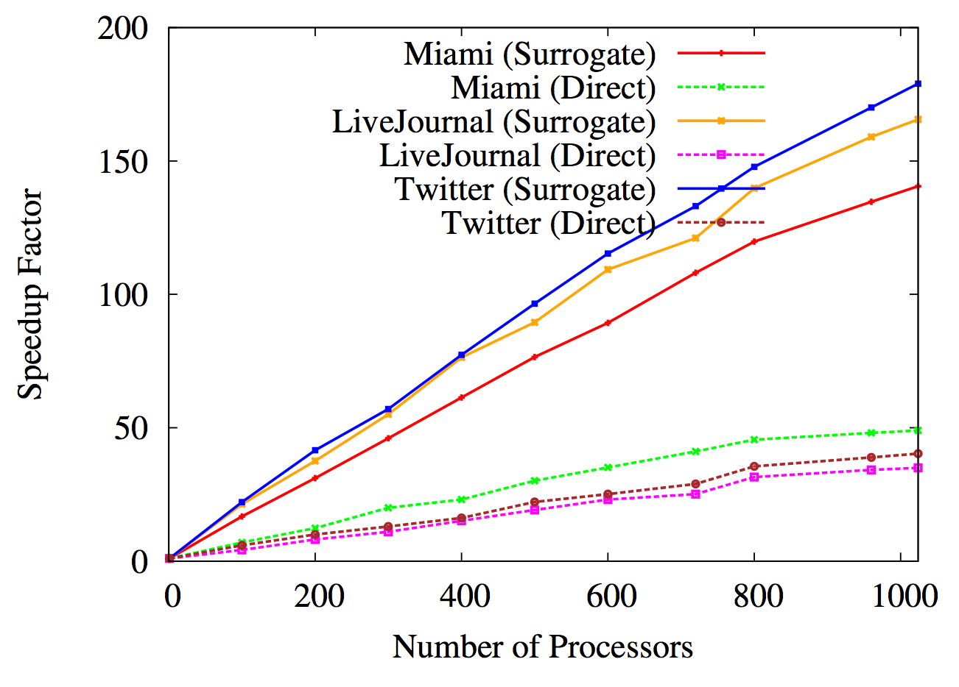
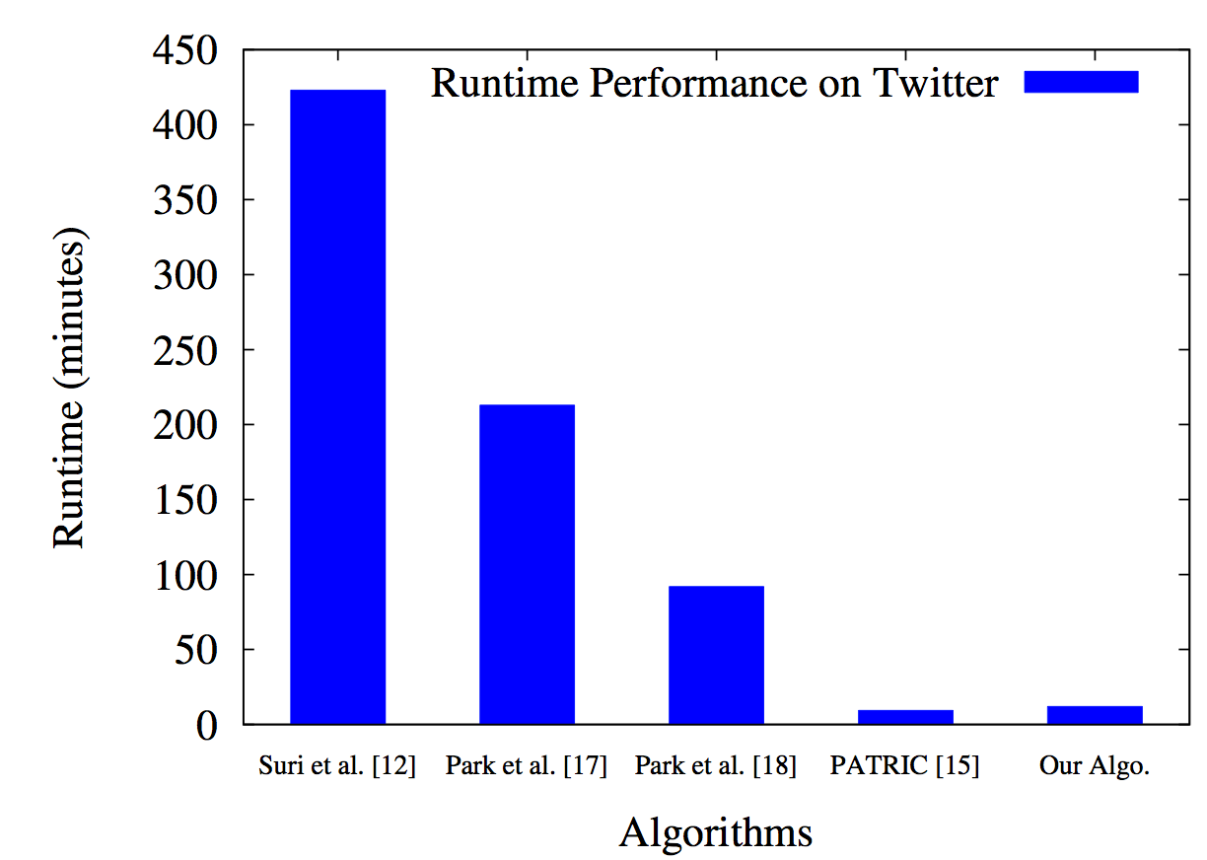
Our results
Speedup factor
Achieves a speedup factor of ≈ 150 with 1024 processors.
Almost linear speedup up to a large number of processors
Running time comparison with state-of-the-art algorithms

Slide 49
Finding subgraphs in labeled graphs
K
S
K
Public health question: How long are typical chains of infections involving only kids
K
S
A
K: kid
A: adult
S: senior

Slide 50
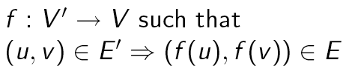
Finding subgraphs in labeled graphs
H=(V’,E’): small template/subgraph
Non-induced embedding:
Embedding of H in G
Goal: find one or more non-induced embeddings of labeled subgraph H in G
G=(V,E): very large graph

Slide 51
Summary of results (I)
Parallel algorithms for approximating #trees (non-induced) and tree-like subgraphs
  For given ε, δ: produces (1±ε) approximation with probability ≥ 1-δ
  Distributed implementation using MPI for certain kinds of subgraphs
  Hadoop based implementation with worst case work complexity bound of O(2^{2k}m f(ε,δ))
  Scales to graphs with over 500 million edges and templates of size up to 12
  Labeled queries, functions on embeddings
Zhao Zhao, Maleq Khan, V. S. Anil Kumar, Madhav Marathe, ICPP 2011
Zhao Zhao, Guanying Wang, Ali Butt, Maleq Khan, V. S. Anil Kumar, Madhav Marathe, IPDPS 2012
Zhao Zhao, Meng Li, Guanying Wang, Ali Butt, Maleq Khan, Madhav Marathe, Judy Qiu, Anil Vullikanti. Finding and counting subgraphs using MapReduce, Submitted (2017)

Slide 52
Summary of results (II)
Improved performance using Harp
  Model partition with pipelined communication and data compression technique to reduce memory footprint.
  Adaptive-group communication with regroup operation developed to accelerate communication.
  Partitioning neighbor list for fine-grained task granularity and load balance in concurrent threading of a single node
  Can run large treelets (up to 15 vertices) and massive graphs (up to 5 billion edges and 0.66 billion vertices) for subgraph counting problems
Zhao Zhao, Meng Li, Guanying Wang, Ali Butt, Maleq Khan, Madhav Marathe, Judy Qiu, Anil Vullikanti. Finding and counting subgraphs using MapReduce. IEEE Transactions on Multi-Scale Computing Systems, 2018
Langshi Chen, Bo Peng, Zhao Zhao, Saliya Ekanayake, Anil Vullikanti, Madhav Marathe, Lei Jiang and Judy Qiu. High-Performance Massive Subgraph Counting using Pipelined Adaptive Group Communication. In preparation

Slide 53
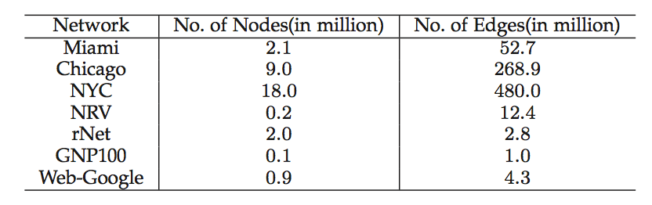
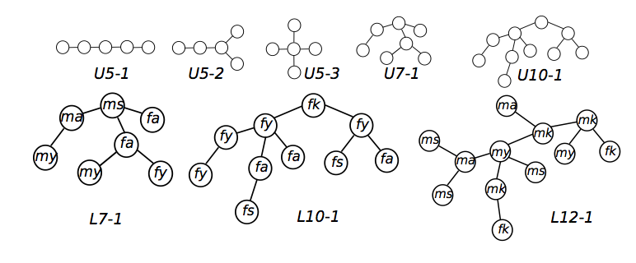
Performance (I)
Graphs considered
Template subgraphs
Unlabeled
Labeled

Slide 54
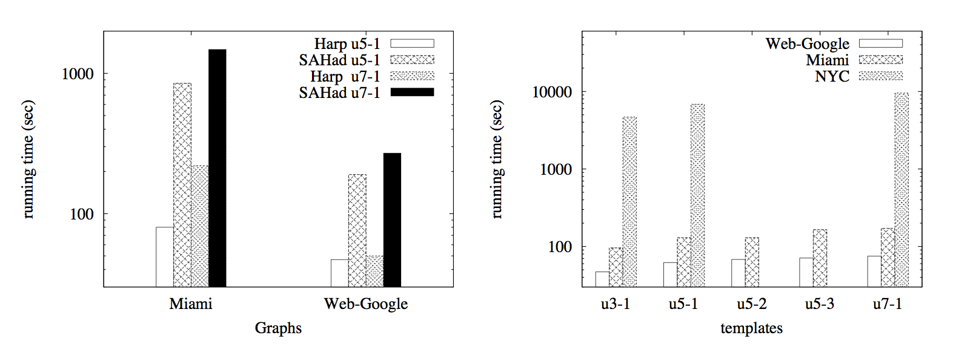
Performance (II) of original results

Slide 55

Optimized Harp DAAL Framework I
Triangles have a small nearest or next to nearest neighbor halo
Large subgraphs can have large halos leading to communication size and complexity
Point in process #1
2 Halo Points in process #2
Optimized Harp DAAL Framework
Processor Boundary

Slide 56
What’s Hard?
Small graph easy
Fully connected, “giant graph” even easier
Medium graph very hard
u12-2
A graph can be divided into several partitions

Slide 57


“Force Diagrams” for macromolecules and Facebook

Slide 58
Adaptive-Group Communication
MPI collective operation (e.g., AlltoAll)
Harp Adaptive-Group Communication
Data driven communication
Routing rules defined at runtime with data partition ID
On-demand decoupled steps and each step
Execution flow driven
Static communication type defined in codes (Sender ID, Send Size, DataType)
(Receiver ID, Send Size, DataType)
P1
P2
P3
P4
P5
P1
P2
P3
P4
P5

Slide 59

Datasets: Twitter with 44 million vertices, 2 billion edges, subgraph template size of 10 to 12 vertices
25 nodes of Intel® Xeon E5 2670
Large templates have longer sub-template chain causing communication variation
Harp-DAAL has 2x to 5x speedups over state-of-the-art MPI-Fascia solution
Performance of adaptive communication approach

Slide 60

Optimized Harp DAAL Framework

Slide 61
Most recent Virginia Tech Results
Have improved algorithm using novel algebraic techniques
Express subgraph detection as finding multilinear terms in polynomials (Koutis and Williams 2009)
Our results
  New MPI based algorithm for parallel multilinear detection
  Significantly lower overheads than color coding, in terms of both time and space
  Space complexity grows linearly in template size
Saliya Ekanayake, Jose Cadena, Udayanga Wickramasinghe and Anil Vullikanti.
PARMUD: High Performance Parallel Multilinear Detection, IPDPS 2018 (to appear)

