Slide 1
Distinguishing Parallel and Distributed Computing Performance
SPIDAL Presentation
Geoffrey Fox, Saliya Ekanayake, Supun Kamburugamuve October 28, 2016
gcf@indiana.edu
http://www.dsc.soic.indiana.edu/, http://spidal.org/ http://hpc-abds.org/kaleidoscope/
Department of Intelligent Systems Engineering
School of Informatics and Computing, Digital Science Center
Indiana University Bloomington

Slide 2
HPC-ABDS
High Performance Computing Enhanced Big Data Apache Stack
DataFlow and In-place Runtime

Slide 3
Big Data and Parallel/Distributed Computing
In one beginning, MapReduce enables easy parallel database like operations and Hadoop provided wonderful open source implementation
Andrew Ng introduced “summation form” and showed much Machine Learning could be implemented in MapReduce (Mahout in Apache)
Then noted that iteration ran badly in Hadoop as used disks for communication; Hadoop choice gives great fault tolerance
This led to a slew of MapReduce improvements using either BSP SPMD (Twister, Giraph) or
Dataflow: Apache Storm, Spark, Flink, Heron …. and Dryad
Recently Google open sources Google Cloud Dataflow as Apache Beam using Spark and Flink as runtime or proprietary Google Dataflow
  Support Batch and Streaming

Slide 4
HPC-ABDS Parallel Computing
Both simulations and data analytics use similar parallel computing ideas
Both do decomposition of both model and data
Both tend use SPMD and often use BSP Bulk Synchronous Processing
One has computing (called maps in big data terminology) and communication/reduction (more generally collective) phases
Big data thinks of problems as multiple linked queries even when queries are small and uses dataflow model
Simulation uses dataflow for multiple linked applications but small steps such as iterations are done in place
Reduction in HPC (MPIReduce) done as optimized tree or pipelined communication between same processes that did computing
Reduction in Hadoop or Flink done as separate map and reduce processes using dataflow
  This leads to 2 forms (In-Place and Flow) of runtime discussed later
Interesting Fault Tolerance issues highlighted by Hadoop-MPI comparisons – not discussed here!

Slide 5

Java MPI performance is good if you work hard
128 24 core Haswell nodes on SPIDAL 200K DA-MDS Code
Communication dominated by MPI Collective performance
Speedup compared to 1 process per node on 48 nodes
Best MPI; inter and intra node
MPI; inter/intra node; Java not optimized
Best FJ Threads intra node; MPI inter node

Slide 6
Java versus C Performance
C and Java Comparable with Java doing better on larger problem sizes
LRT-BSP affinity CE; one million point dataset 1k,10k,50k,100k, and 500k centers on 16 24 core Haswell nodes over varying threads and processes.

Slide 7
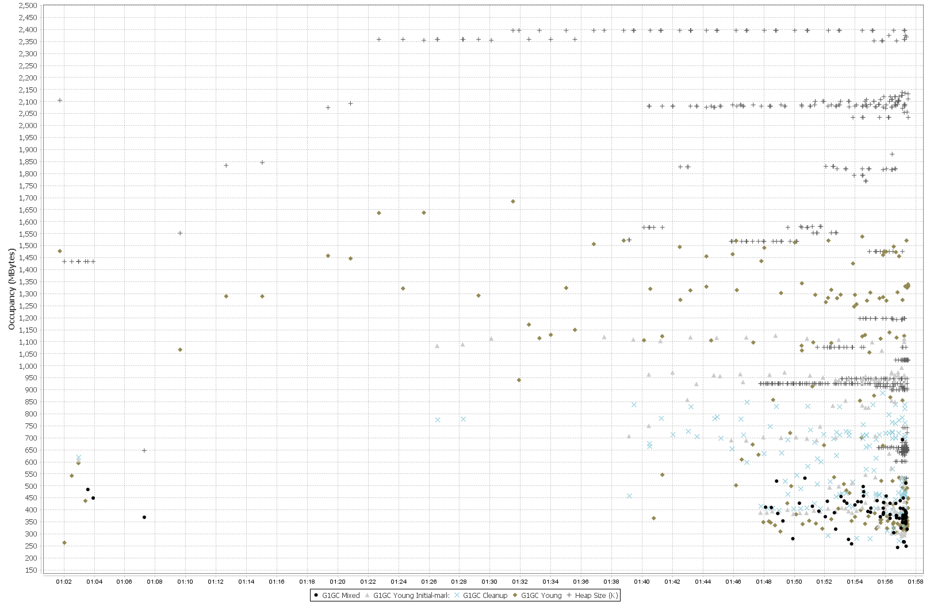
Heap Size
Each point is a Garbage Collection Activity
Time

Slide 8
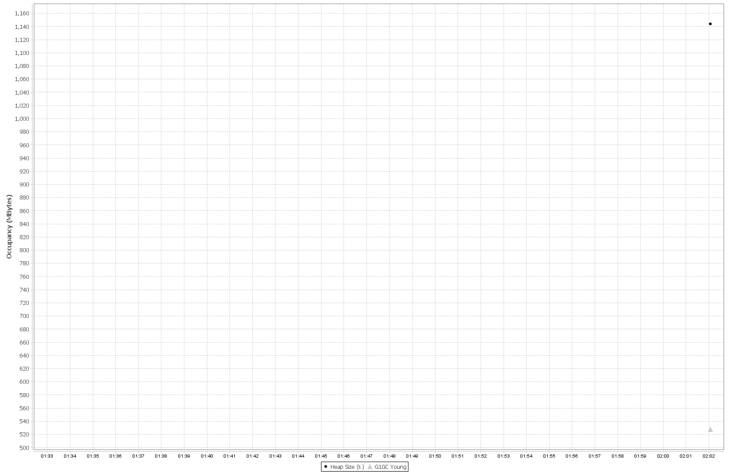
Heap Size
After Java Optimization
Time

Slide 9
Apache Flink and Spark Dataflow Centric Computation
Both express a computation as a data-flow graph
Graph Nodes → User defined operators
Graph Edges → Data
Data source nodes and Data sink nodes (i.e. File read, File write, Message Queue read)
Automatic placement of partitioned data in the parallel tasks

Slide 10
Dataflow Operation
The operators in API define the computation as well how nodes are connected
  For example lets take map and reduce operators and our initial data set is A
  Map function produces a distributed dataset B by applying the user defined operator on each partition of A. If A had N partitions, B can contain N elements.
  The Reduce function is applied on B, producing a data set with a single partition.
A
Map
B
Reduce
C
B = A.map() {
User defined code to execute on a partition of A
};
C = B.reduce() {
User defined code to reduce two elements in B
}
Logical graph
a_1
Map 1
b_1
Reduce
C
a_n
Map
n
b_n
Execution graph

Slide 11
Dataflow operators
Map: Parallel execution
Filter: Filter out data
Project: Select part of the data unit
Group: Group data according to some criteria like keys
Reduce: Reduce the data into a small data set.
Aggregate: Works on the whole data set to compute a value, SUM, MIN
Join: Join two data sets based on Keys.
Cross: Join two data sets as in the cross product
Union: Union of two data sets

Slide 12

Apache Spark
Dataflow is executed by a driver program
The graph is created on the fly by the driver program
The data is represented as Resilient Distributed Data Sets (RDD)
The data is on the worker nodes and operators applied on this data
These operators produce other RDDs and so on
Using lineage graph of RDDs for fault tolerance

Slide 13

Apache Flink
The data is represented as a DataSet
User creates the dataflow graph and submits to cluster
Flink optimizes this graph and creates an execution graph
This graph is executed by the cluster
Support Streaming natively
Check-pointing based fault tolerance

Slide 14


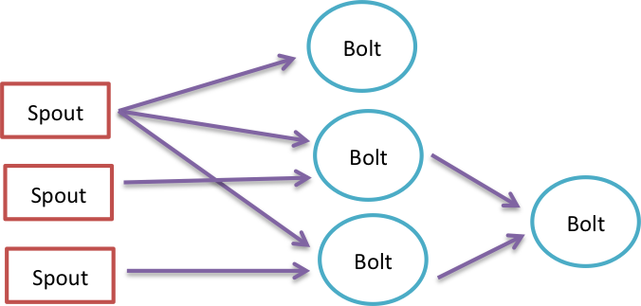
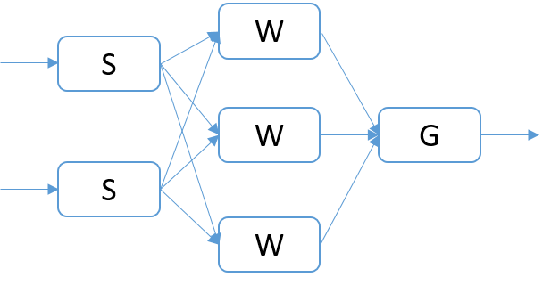
Twitter (Apache) Heron
Extends Storm
Pure data streaming
Data flow graph is called a topology
User Graph
Topology

Slide 15
Data abstractions
(Spark RDD & Flink DataSet)
In memory representation of the partitions of a distributed data set
Has a high level language type (Integer, Double, custom Class)
Immutable
Lazy loading
Partitions are loaded in the tasks
Parallelism is controlled by the no of partitions (parallel tasks on a data set <= no of partitions)
Partition 0
Partition i
Partition n
RDD/DataSet
Input Format to Read Data as partitions
HDFS/Lustre/Local File system

Slide 16

Breaking Programs into Parts
Fine Grain Parallel Computing Data/model parameter decomposition
Coarse Grain Dataflow
HPC or ABDS

Slide 17
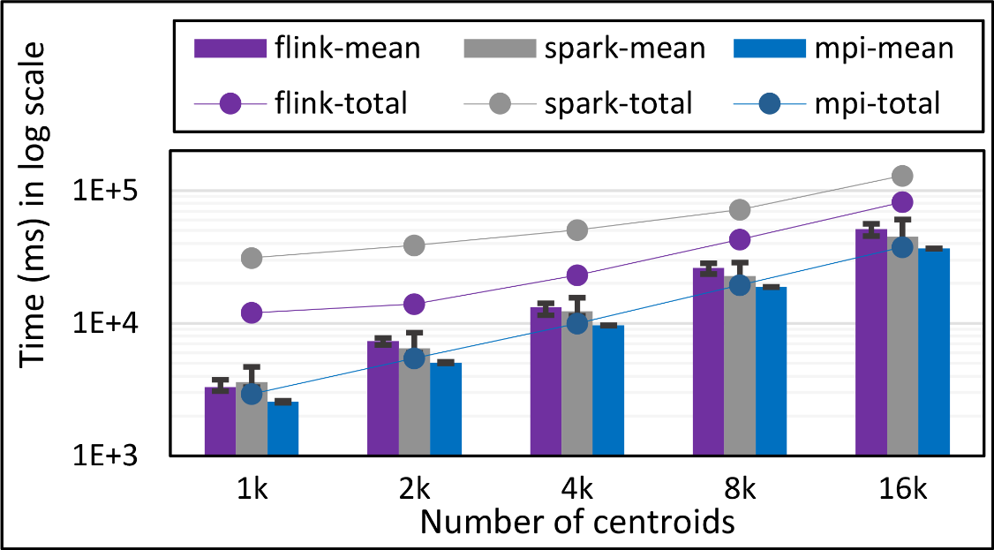
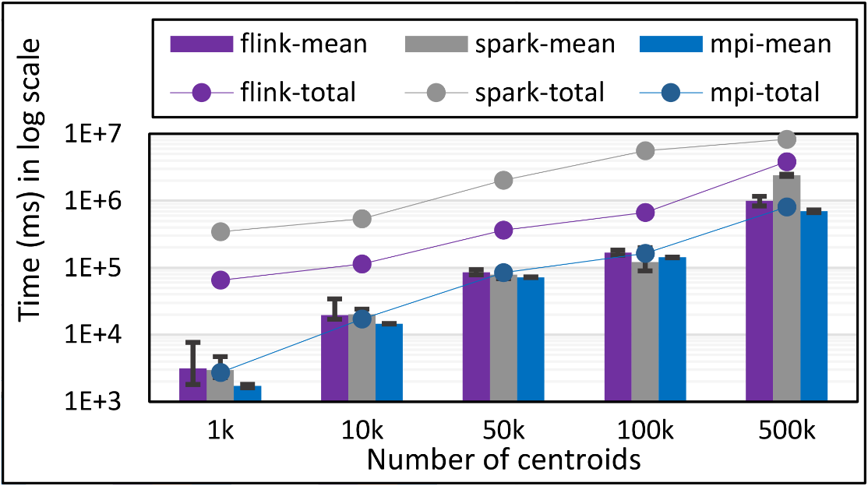
K-Means Clustering in Spark, Flink, MPI
Data Set <Points>
Flink Kmeans
Map (nearest centroid calculation)
Reduce (update centroids)
Data Set <Initial Centroids>
Data Set <Updated Centroids>
Broadcast
K-Means total and compute times for 1 million 2D points and 1k,10,50k,100k, and 500k centroids for Spark, Flink, and MPI Java LRT-BSP CE. Run on 16 nodes as 24x1.
K-Means total and compute times for 1 million 2D points and 1k,10,50k,100k, and 500k centroids for Spark, Flink, and MPI Java LRT-BSP CE. Run on 16 nodes as 24x1.
K-Means total and compute times for 100k 2D points and1k,2k,4k,8k, and 16k centroids for Spark, Flink, and MPI Java LRT-BSP CE. Run on 1 node as 24x1.
Notes:
Note the differences in communication architectures
Note times are in log scale
Bars indicate compute only times, which is similar across these frameworks
Overhead is dominated by communications in Flink and Spark

Slide 18
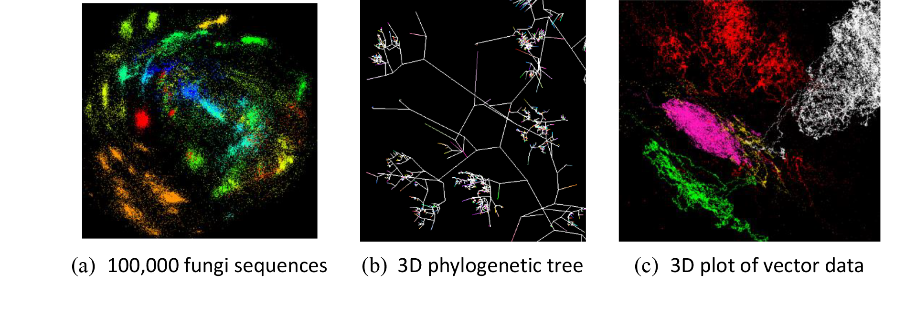
Flink Multi Dimensional Scaling (MDS)
Projects NxN distance matrix to NxD matrix where N is the number of points and D is the target dimension.
The input is two NxN matrices (Distance and Weight) and one NxD initial point file.
The NxN matrices are partitioned row wise
3 NxD matrices are used in the computations which are not partitioned.
For each operation on NxN matrices, one or more of NxD matrices are required.
All three iterations have dynamic stopping criteria. So loop unrolling is not possible.
Our algorithm uses deterministic annealing and has three nested loops called Temperature, Stress and CG (Conjugate Gradient) in that order.

Slide 19
Flink vs MPI DA-MDS Performance
Total time of MPI Java and Flink MDS implementations for 96 and 192 parallel tasks with no of points ranging from 1000 to 32000. The graph also show the computation time. The total time includes computation time, communication overhead, data loading and framework overhead. In case of MPI there is no framework overhead. This test has 5 Temperature Loops, 2 Stress Loops and 16 CG Loops.
Total time of MPI Java and Flink MDS implementations for 96 and 192 parallel tasks with no of points ranging from 1000 to 32000. The graph also show the computation time. The total time includes computation time, communication overhead, data loading and framework overhead. In case of MPI there is no framework overhead. This test has 1 Temperature Loop, 1 Stress Loop and 32 CG Loops.

Slide 20

Flink MDS Dataflow Graph for MDS inner loop

Slide 21
HPC-ABDS Parallel Computing
MPI designed for fine grain case and typical of parallel computing used in large scale simulations
  Only change in model parameters are transmitted
  In-place implementation
  Synchronization important as parallel computing
Dataflow typical of distributed or Grid computing workflow paradigms
  Data sometimes and model parameters certainly transmitted
  If used in workflow, large amount of computing and no synchronization constraints
  Caching in iterative MapReduce avoids data communication and in fact systems like TensorFlow, Spark or Flink are called dataflow but often implement “model-parameter” flow
Inefficient to use same runtime mechanism independent of characteristics
  Use In-Place implementations for parallel computing with high overhead and Flow for flexible low overhead cases
HPC-ABDS plan is to keep current user interfaces (say to Spark Flink Hadoop Storm Heron) and transparently use HPC to improve performance

Slide 22
Harp (Hadoop Plugin) brings HPC to ABDS
Basic Harp: Iterative HPC communication; scientific data abstractions
Careful support of distributed data AND distributed model
Avoids parameter server approach but distributes model over worker nodes and supports collective communication to bring global model to each node
Applied first to Latent Dirichlet Allocation LDA with large model and data
MapReduce Model
MapCollective Model
MapReduce Applications
MapCollective Applications
M
M
M
M
M
M
M
M
MapReduce V2
Harp
Shuffle
Collective Communication
R
R
YARN

Slide 23
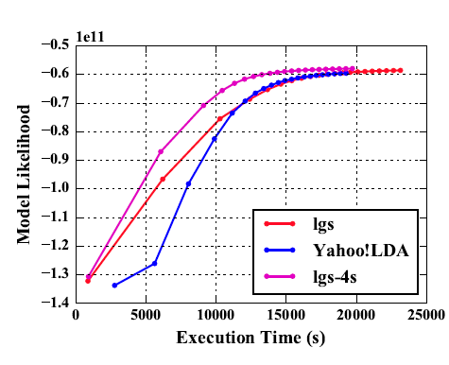
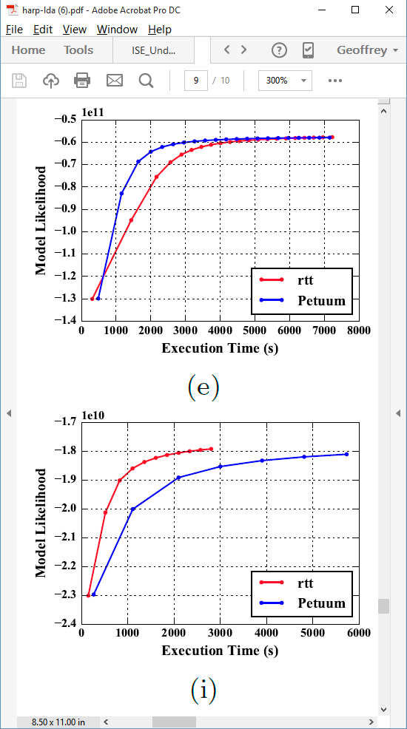
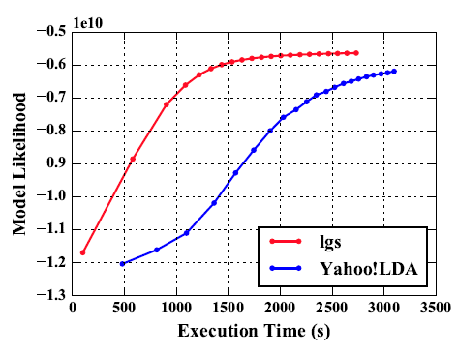
Latent Dirichlet Allocation on 100 Haswell nodes: red is Harp (lgs and rtt)
Clueweb
Clueweb
enwiki
Bi-gram

Slide 24
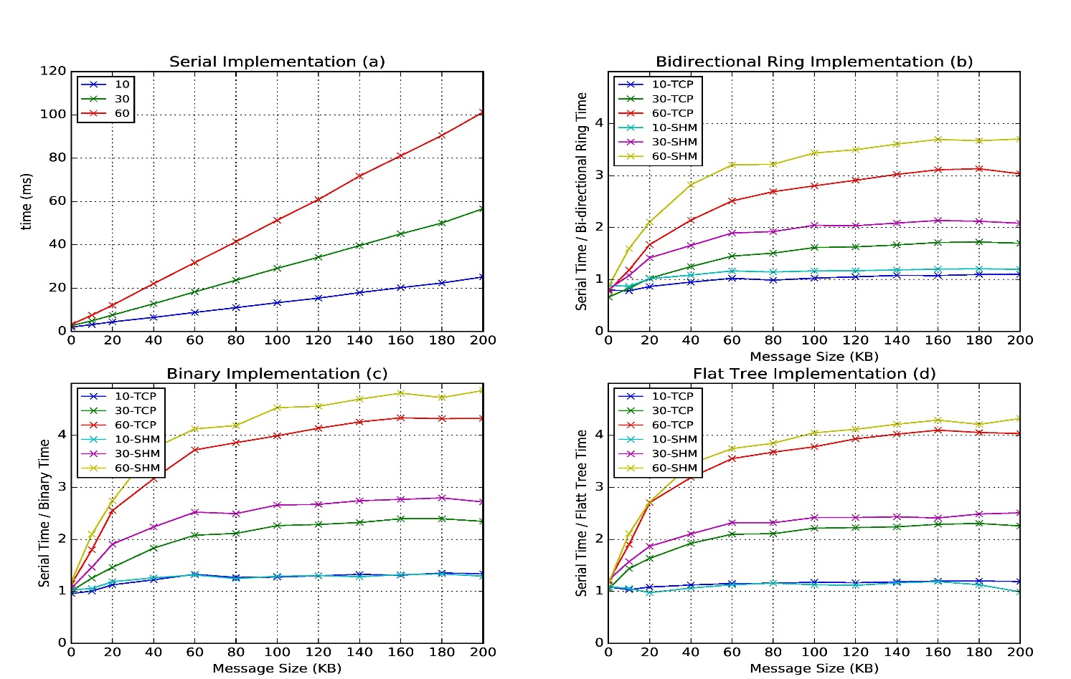
Improvement of Storm (Heron) using HPC communication algorithms
Latency of binary tree, flat tree and bi-directional ring implementations compared to serial implementation. Different lines show varying # of parallel tasks with either TCP communications and shared memory communications(SHM).
Original Time
Speedup Ring
Speedup Binary
Speedup Tree

Slide 25
Next Steps in HPC-ABDS
Currently we are circumventing the dataflow and adding HPC runtime to Apache systems (Storm, Hadoop, Flink, Heron)
We can aim exploit better Apache capabilities and additionally
  Allow more careful data specification such as separating "model parameters" (variable) from "data“ (fixed)
  Allowing richer (less automatic) dataflow and data placement operations. In particular allow equivalent of HPF DECOMPOSITION directive to align decompositions
  Implement HPC dataflow runtime "in-place" to implement "classic parallel computing" and higher performance dataflow
This is all as modifications to Apache source
We should be certain to be less ambitious than HPF and not spend 5 years making an inadequate compiler
Resultant system will support parallel computing and orchestration (workflow), batch and streaming.

Slide 26
Application Requirements
It would be good to understand which applications fit
  MapReduce
  Current Spark/Flink/Heron but not MapReduce
  HPC-ABDS (MPI) but not current Spark/Flink/Heron
a) could be Database (Hive etc.), Data-lake and
b) is certainly Streaming and Spark etc. outperform Hadoop on many big data applications
c) is Global Machine Learning (large scale and iterative like Deep learning, clustering, hidden factors, topic models) and graph problems

