Slide 1
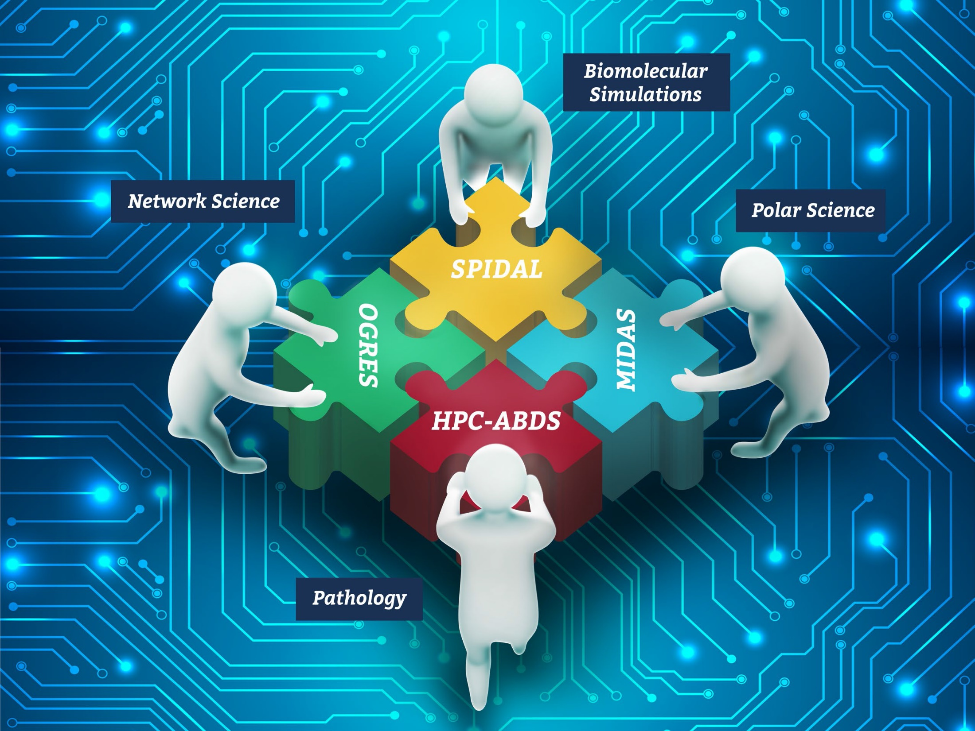
NSF 1443054: CIF21 DIBBs: Middleware and High Performance Analytics Libraries for Scalable Data Science
Software: MIDAS HPC-ABDS
Geoffrey Fox Panel Talk: February 15 2017

Slide 2
Current challenges and opportunities for big data research and development

Slide 3
Some Questions?
Discover what data analytics is being used or could be used in different research areas.
e.g. How important is deep learning in a general science field?
e.g. what data analytics is needed for Precision Medicine, SKA, explosion of light source image data
This is non-trivial as need training as not so many experts in both application fields and modern big data approaches
Get a better consensus as to requirements of infrastructure
What fraction of data analysis can use modern cloud technology
What fraction require high performance computing
How important is streaming data
How important is interactive use
Integrate the many distributed instruments (microscopes, sequencers)
Implications of exascale technologies and “End of Moore’s Law”
Research replacement of O(N²) algorithms systematically to O(NlogN)

Slide 4
Status of NSF 1443054 Project
Big Data Application Analysis identifies features of data intensive applications that need to be supported in software and represented in benchmarks. This analysis was started for proposal and has been extended to support HPC-Simulations-Big Data convergence.
The project is a collaboration between computer and domain scientists in application areas in Biomolecular Simulations, Network Science, Epidemiology, Computer Vision, Spatial Geographical Information Systems, Remote Sensing for Polar Science and Pathology Informatics.
HPC-ABDS as Cloud-HPC interoperable software with performance of HPC (High Performance Computing) and the rich functionality of the commodity Apache Big Data Stack was an idea developed for proposal. We have successfully delivered and extended this approach, which is one of ideas described in Exascale Big Data report.

Slide 5
Status of NSF 1443054 Project
MIDAS integrating middleware that links HPC and ABDS now has several components including an architecture for Big Data analytics, an integration of HPC in communication and scheduling on ABDS; it also has rules to get high performance Java scientific code.
SPIDAL (Scalable Parallel Interoperable Data Analytics Library) now has 20 members with domain specific (general) and core algorithms.
Benchmarks. Need to develop benchmarks covering these issues as most big data benchmarks have a commercial focus
Language: SPIDAL Java runs as fast as C++
Designed and Proposed HPCCloud as hardware-software infrastructure supporting
Big Data Big Simulation Convergence
Big Data Management via Apache Stack ABDS
Big Data Analytics using SPIDAL and other libraries

