Slide 1





NSF 1443054: CIF21 DIBBs: Middleware and High Performance Analytics Libraries for Scalable Data Science
Software: MIDAS
HPC-ABDS
Pathology
Spatial Analysis
February 2017

Slide 2
Algorithms – Nuclei Segmentation for Pathology Images
Segment boundaries of nuclei from pathology
images and extract features for each nucleus
Consist of tiling, segmentation,
vectorization, boundary object aggregation
Could be executed on MapReduce
(MIDAS Harp)
Execution pipeline on MapReduce (MIDAS Harp)
Nuclear segmentation algorithm

Slide 3
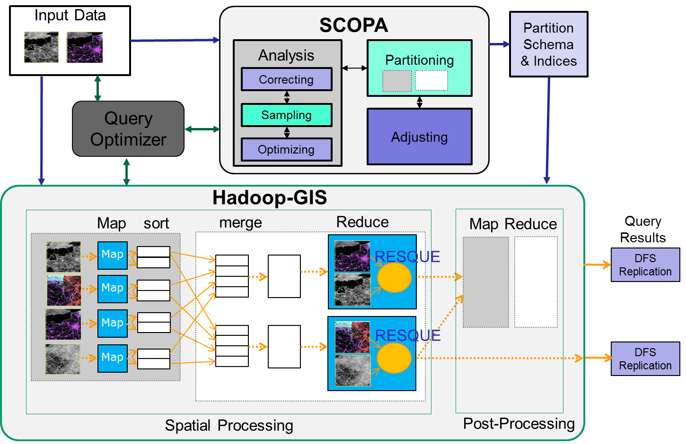
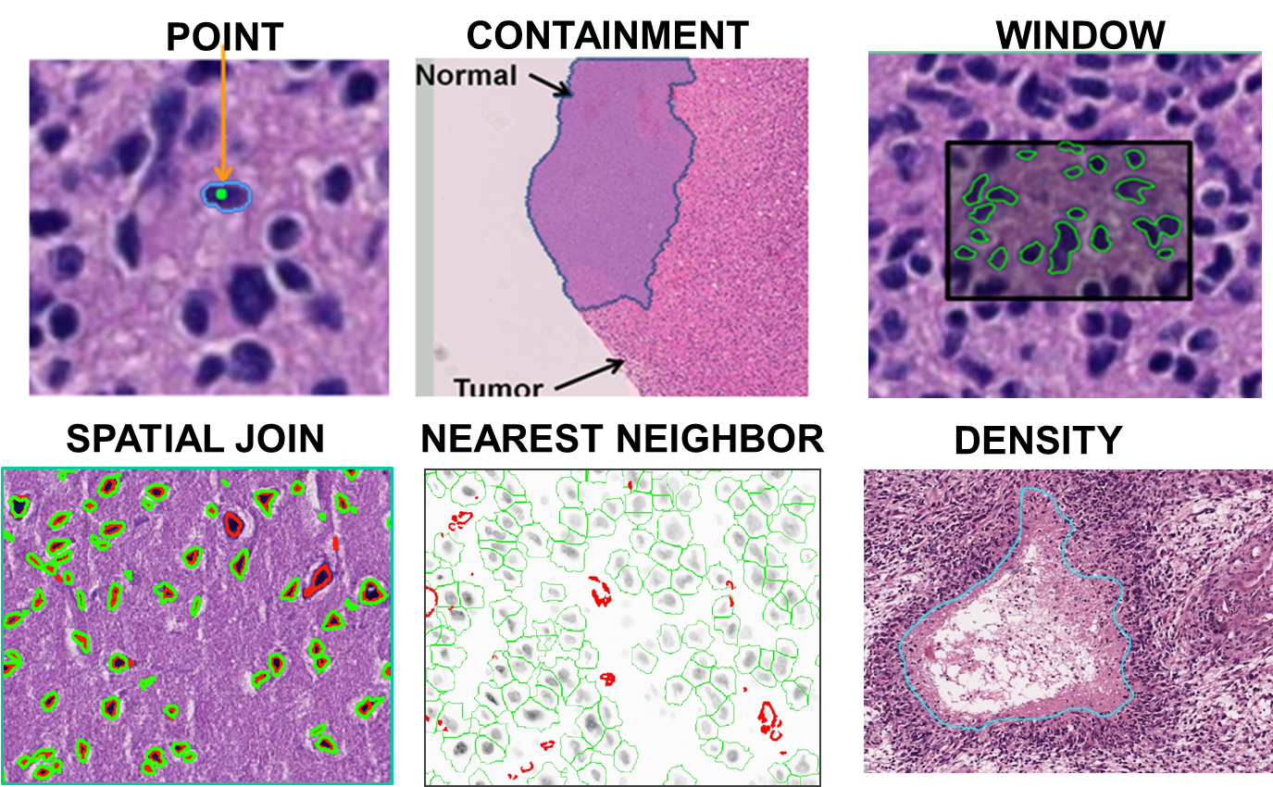
Algorithms – Spatial Querying Methods
Hadoop-GIS is a general framework to support high performance spatial queries and analytics for spatial big data on MapReduce.
It supports multiple types of spatial queries on MapReduce through spatial partitioning, customizable spatial query engine and on-demand indexing.
SparkGIS is a variation of Hadoop-GIS which runs on Spark to take advantage of in-memory processing.
Will extend Hadoop/Spark to Harp MIDAS runtime.
2D complete; 3D in progress
Spatial Queries
Architecture of Spatial Query Engine

Slide 4

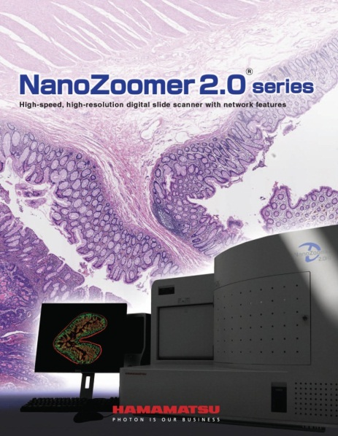
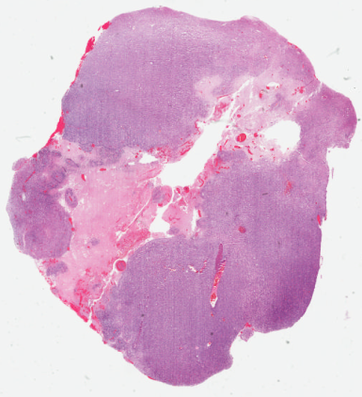
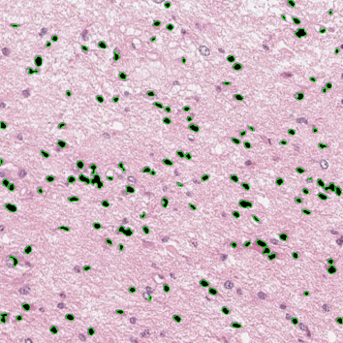
Enabled Applications – Digital Pathology
Glass Slides
Scanning
Whole Slide Images
Image Analysis
Digital pathology images scanned from human tissue specimens provide rich information about morphological and functional characteristics of biological systems.
Pathology image analysis has high potential to provide diagnostic assistance, identify therapeutic targets, and predict patient outcomes and therapeutic responses.
It relies on both pathology image analysis algorithms and spatial querying methods.
Extremely large image scale.

Slide 5
2D/3D Pathology Image and Spatial Analysis
          2D Cell Segmentation
          Scalable Pathology Image Processing
          Scalable 2D Spatial Queries
          3D Vessel Segmentation
          Scalable 3D spatial queries
Jun Kong, Emory University
Fusheng Wang, Stony Brook University

Slide 6
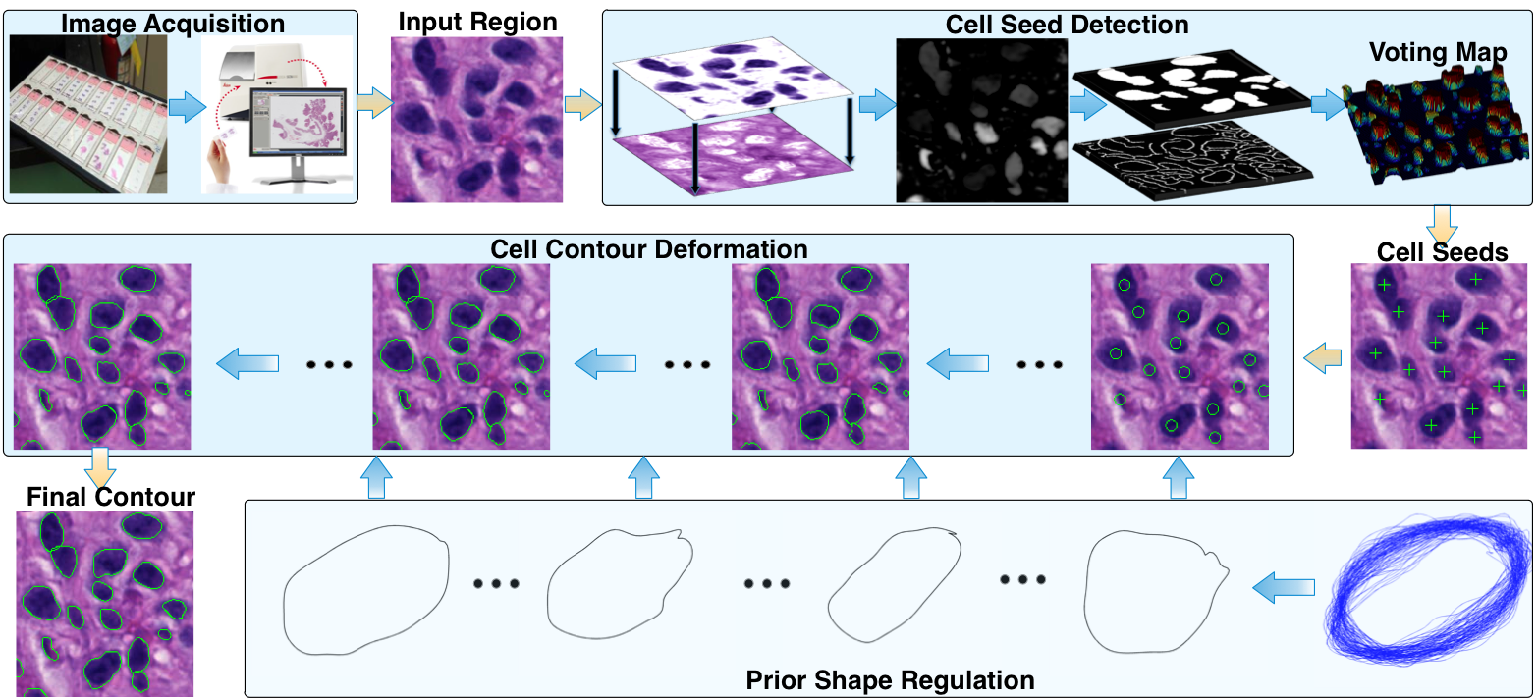
2D Cell Segmentation Overview
Seed Detection
(determine the number of cells and contour initialization)
Active Contour Model (deform contours)
Pengyue Zhang, Fusheng Wang, et al: Automated Level Set Segmentation of
Histopathologic Cells with Sparse Shape Prior Support and Dynamic Occlusion
Constraint. To Appear in ISBI 2017.

Slide 7
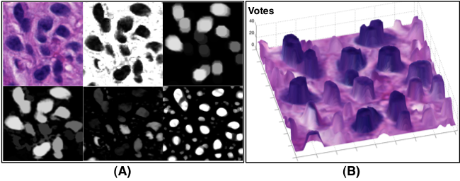
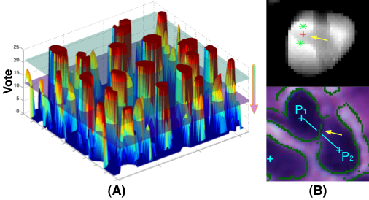
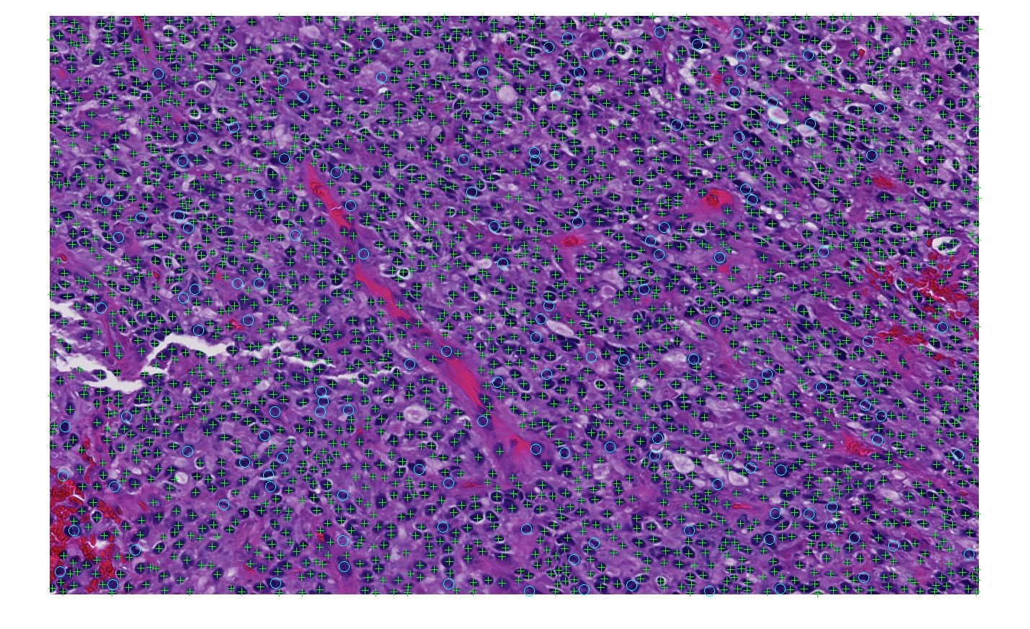
Cell Detection and Seed Detection
(C)
(D)
Cell Detection
Seed Detection
Notes:
The total number of human annotated cells for seed detection is 5396.
Note that we evaluate our approach with non-touching and occluded cells in each image separately.
Four metrics are computed from each image to show seed detection performance: (1)Cell Number Error; (2)Miss Detection (M); (3)False Recognition (F); (4)Over- (O); (5)Under- Segmentation (U)

Slide 8
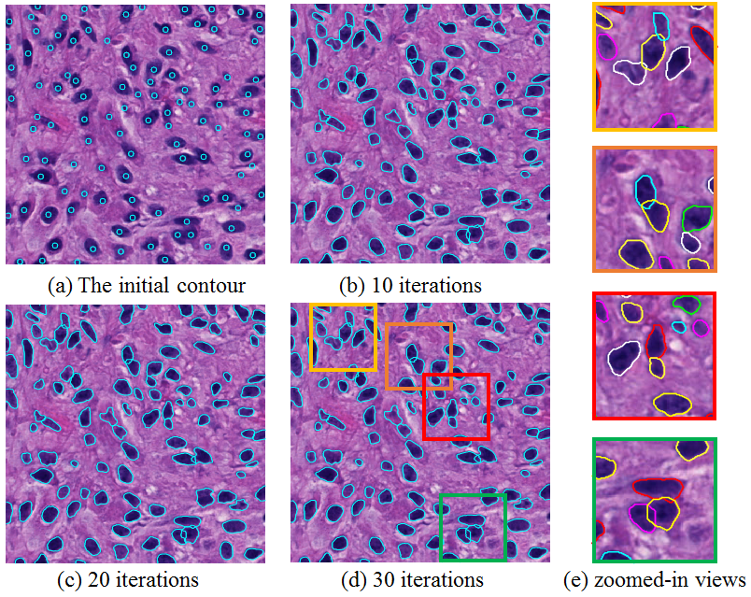
Cell Segmentation

Slide 9
Scalable 2D Pathology Image Analysis
Overlapping partitioning of large images
MapReduce processing of each tiles - mapping
Normalization of boundary objects – mapping
Aggregation of segmented objects -reducing

Slide 10
Scalable 2D Spatial Queries: Hadoop-GIS
A general framework to support high performance spatial queries and analytics for spatial big data on MapReduce
Data skew aware spatial data partitioning
Multi-level spatial indexing
Hybrid query engine combining MapReduce and database engine
http://bmidb.cs.stonybrook.edu/hadoopgis/

Slide 11
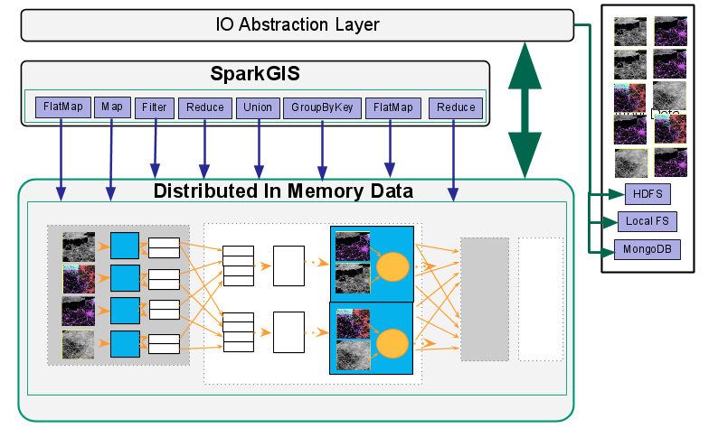
SparkGIS: Hadoop-GIS on Spark
SparkGIS: an in-memory variation of Hadoop-GIS
  Implement spatial querying pipelines in Spark – reusing spatial querying methods in Hadoop-GIS
  Removes HDFS dependency: MongoDB, HDFS, local FS, Cassndra, HBase, Hive etc.
  Reduce I/O cost: multiple iterative jobs can be scheduled on same data with little IO overhead
  Streamed processing: processing data without waiting for all data ready

Slide 12
3D Pathology Image Analysis
Whole slide images
High resolution and large file size: 100,000 x 100,000 pixels per image
Large file size: 300 - 500MB/image, serval hundreds of slices per 3D volume
Numerous micro-anatomical object types with complex 3D structures
Objectives
Quantitative image analysis of whole slide image volume to derive 3D spatial structures and features with a complete framework of 3D blood vessel reconstruction
Scalable spatial analytics to explore 3D spatial relationships and discover spatial patterns of large scale 3D micro-anatomical objects with high performance systems

Slide 13
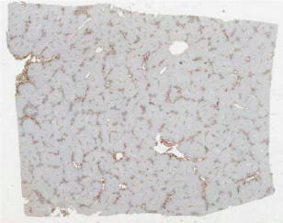
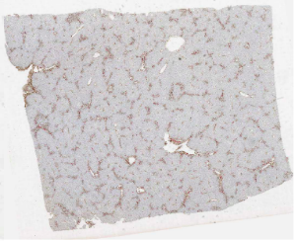
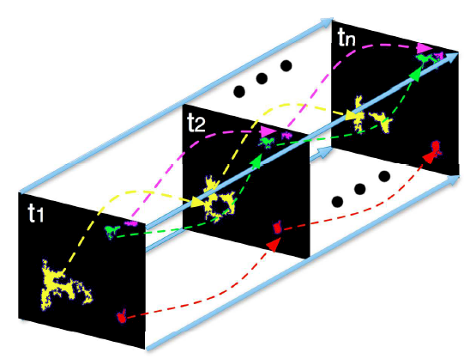
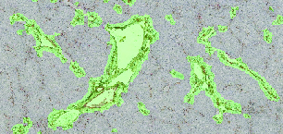
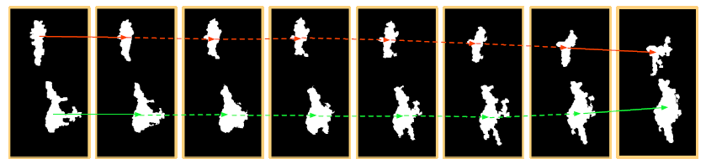
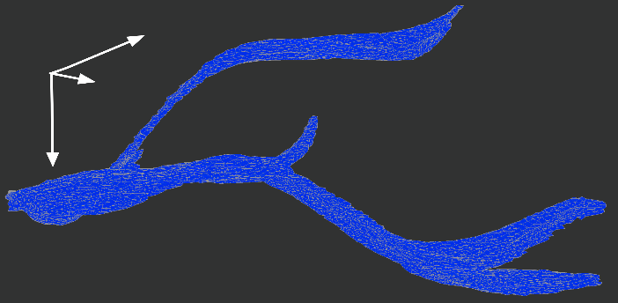
3D Primary Vessel Reconstruction
3D WSI Volume
Image Registration
Vessel Association
Image Segmentation
Vessel Interpolation
3D Vessel Rendering

Slide 14
Scalable 3-D Spatial Queries and Analytics
Large scale 3D dataset
  Millions of 3D objects such as nuclei can be extracted from a 3D pathology image volume with tens of slides
Characteristics of 3D spatial data
  Complex structures, e.g., Blood vessels have tree structures with branches
  Multiple representations: different Levels of Detail (LOD)
High computation complexity
  3D geometry computation is pretty expensive

Slide 15
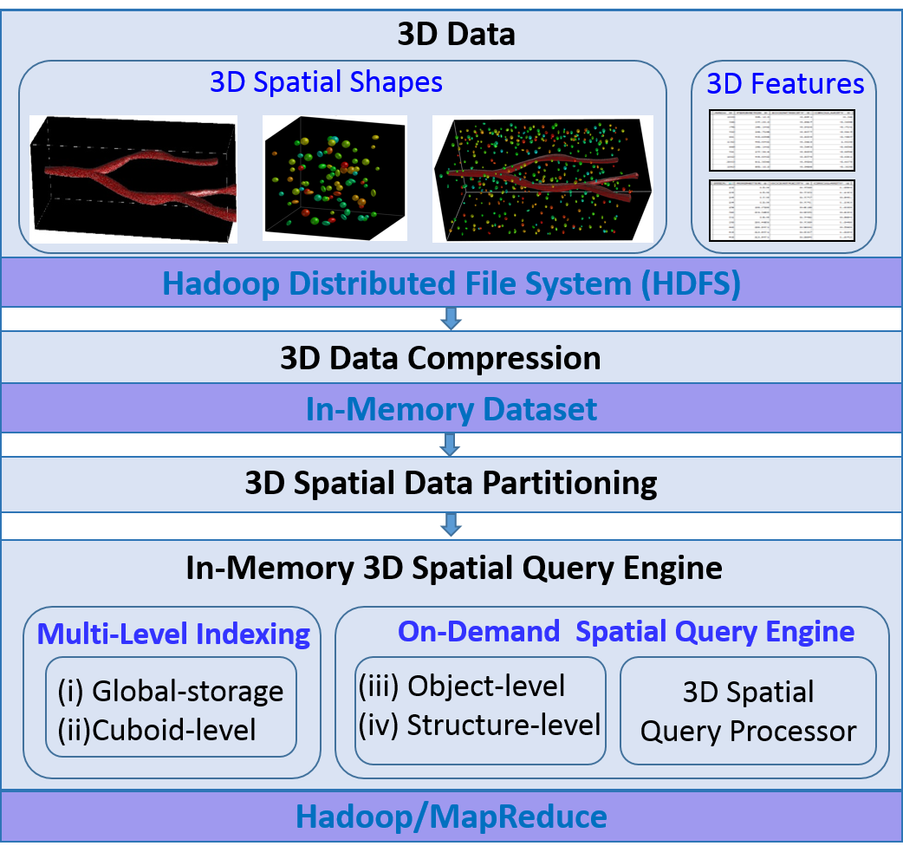
Scalable 3-D Spatial Queries and Analytics: Hadoop-GIS 3D
The derived 3D data from pathology image analysis is stored on HDFS
3D data compression
  Fit data into memory
  Store multiple levels of details by an progressive compression approach
3D data partitioning
  Generate each cuboid as a processing unit for parallel computation in MapReduce
Multi-level indexing
  Accelerate spatial data access
On-demand Spatial Query Engine
  Provide multiple types of spatial query, such as spatial join and nearest neighbor query

