Slide 1





NSF 1443054: CIF21 DIBBs: Middleware and High Performance Analytics Libraries for Scalable Data Science
Software: MIDAS
HPC-ABDS
Public Health
February 2017

Slide 2
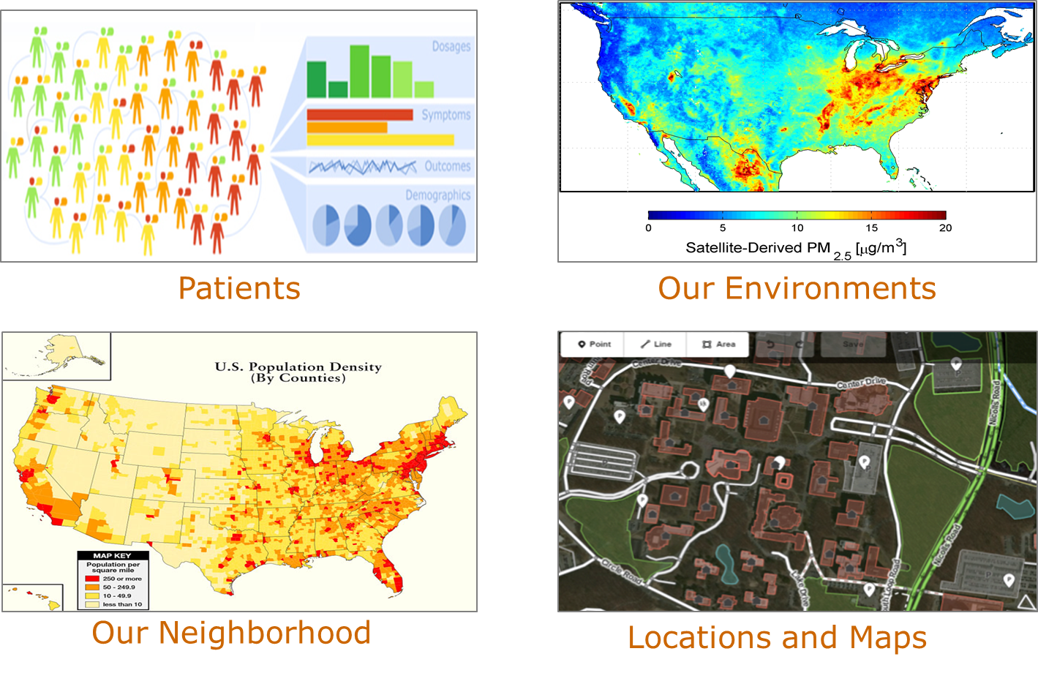
Applications – Public Health
GIS-oriented public health research has a strong focus on the locations of patients and the agents of disease, and studies the spatial patterns and variations.
Integrating multiple spatial big data sources at fine spatial resolutions allow public health researchers and health officials to adequately identify, analyze, and monitor health problems at the community level.
This will rely on high performance spatial querying methods on data integration.
Note synergy between GIS and Large image processing as in pathology.

Slide 3
Integrative Big Spatial Data Analytics for Public Health Studies
Fusheng Wang
Department of Biomedical Informatics
Department of Computer Science
Stony Brook University

Slide 4
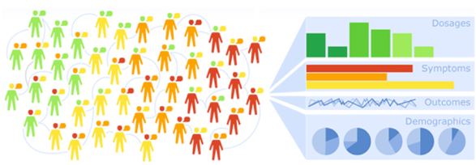
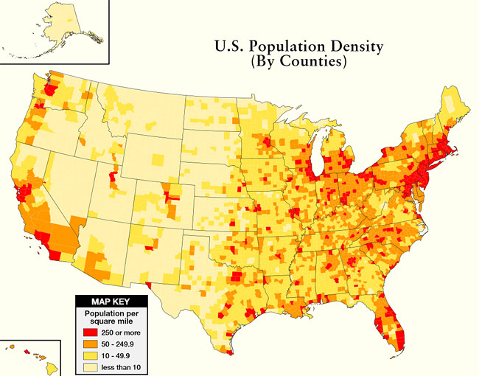
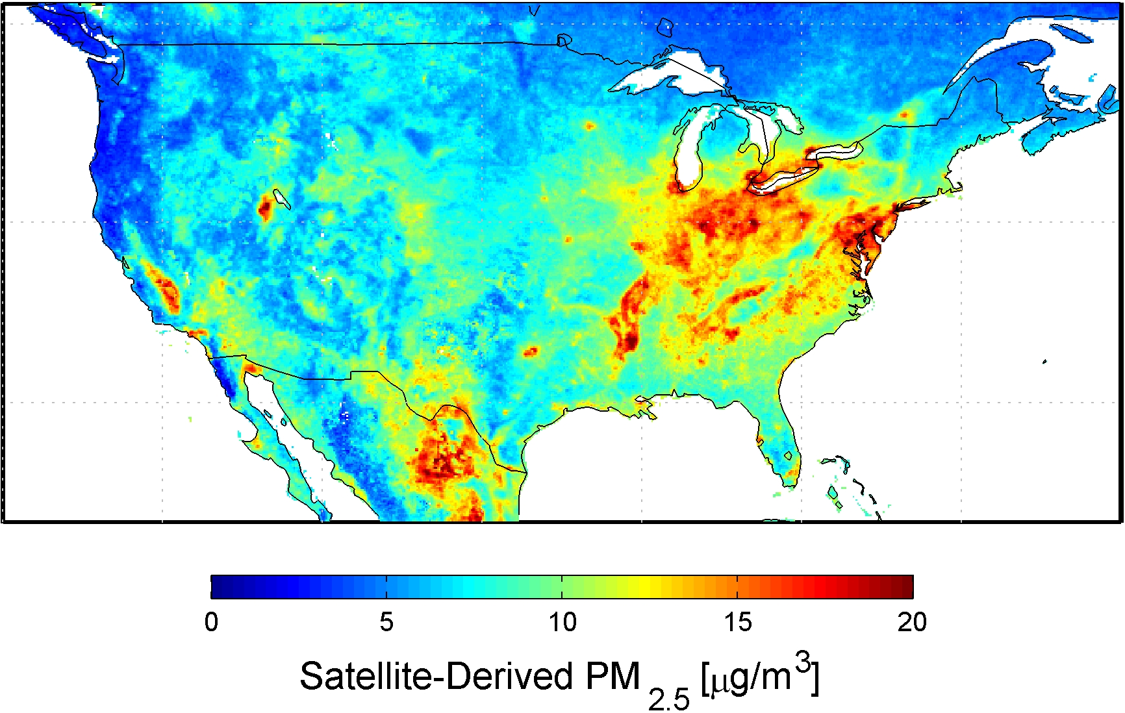

Big Spatial Data for Public Health
Patients
Our Neighborhood
Our Environments
Web and Social Media
Notes:
Public health research with spatial analytics
~~~~~~~~~~~
1) In our research, we focus on spatial data analytics
And we have special interests in
integrating all sorts of spatial data sources
for public health studies or applications
2) Our research is established on
the increasing accessibility of spatial data source
that, recent years, have been made available by governments, private companies, or even the contents generated by online users.
3) For example, you can have
large scale patient claim data or Electronic health records
All these data can provide patients' home addresses,
after geocoding, can be then used for spatial analysis.
4) Our Neighborhood
Traditionally, Census data, TIGER data
and many other community survey data, for example,
provide many valuable demographic and socio-economic characteristics about our neighborhood.
5) For our environments,
Many data sets are also available
And continuously monitor
the air quality, weather or climate condition
for any particular region or locations
6) More recently,
As people have been relying more and more on
online web services and social media
The online users’ digit footprints
which also often come with geolocation
can be used for analyzing users'
interest on health related topic or
their needs for healthcare services
for any particular region or neighborhood.

Slide 5
Open Patient Data: NY State SPARCS Health Outcomes
Open NY is Governor Cuomo’s initiative to make state government information more accessible to the public
NY Department of Health, Statewide Planning and Research (SPARCS) collects patient level detail on patient characteristics, diagnoses and treatments, services, and charges for each hospital inpatient stay and outpatient
  In patients (2M+ per year), outpatients (11M+ per year), ER (7M+), ambulatory surgery (2.5M+)
  Patients addresses included
Vital records (death and birth)

Slide 6
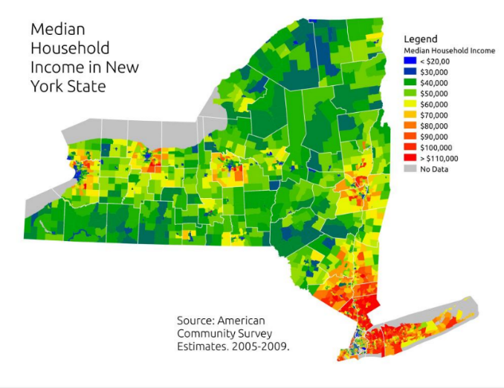
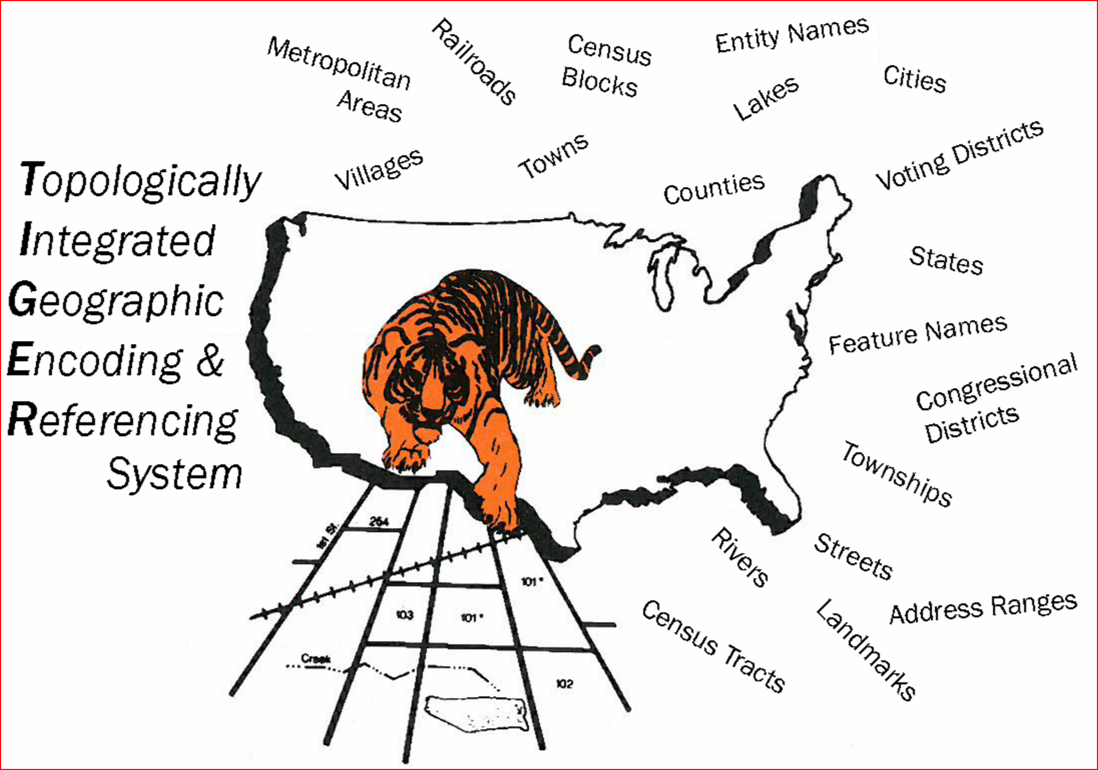
Population Characteristics: Census and TIGER
Census and TIGER (Topologically Integrated Geographic Encoding and Referencing)
  Census data contain detailed demographic and economic data
  TIGER contains legal and statistical geographic boundaries with varying granularities, and can be linked with census data
  Census blocks ⊆ Block groups ⊆ Census tracts ⊆ ZIP code areas ⊆ Counties ⊆ State

Slide 7
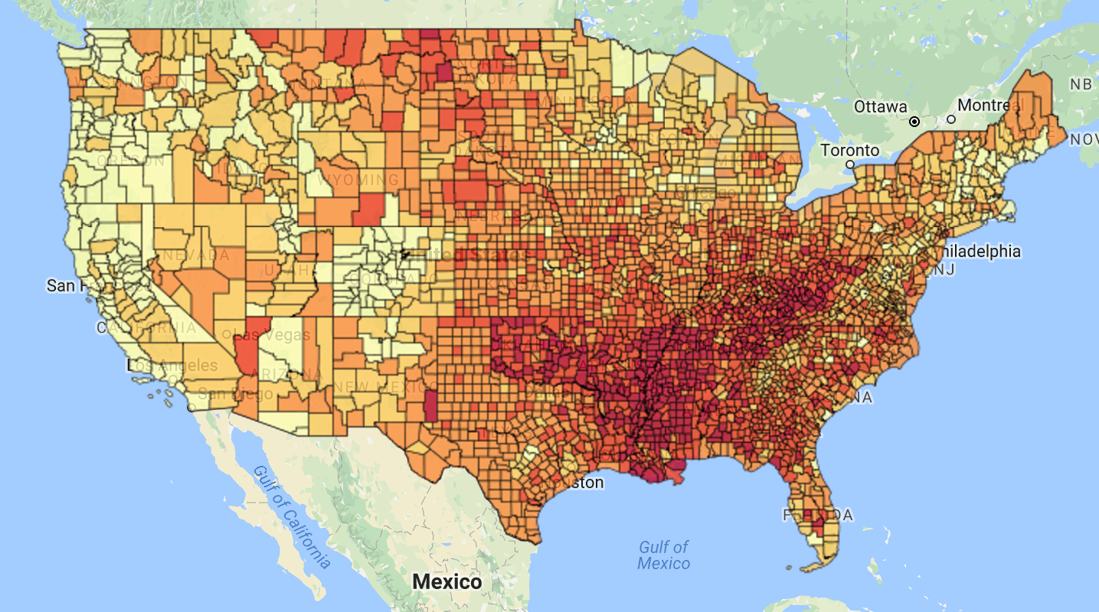
Social Media Data
We are collecting tweets related to drugs (opioid and marijuana) and health (e.g., breast cancer) national wide
Tweets come with locations (city) or are geotagged
Tweets about physical inactivity [Nguyen: JPH16]

Slide 8
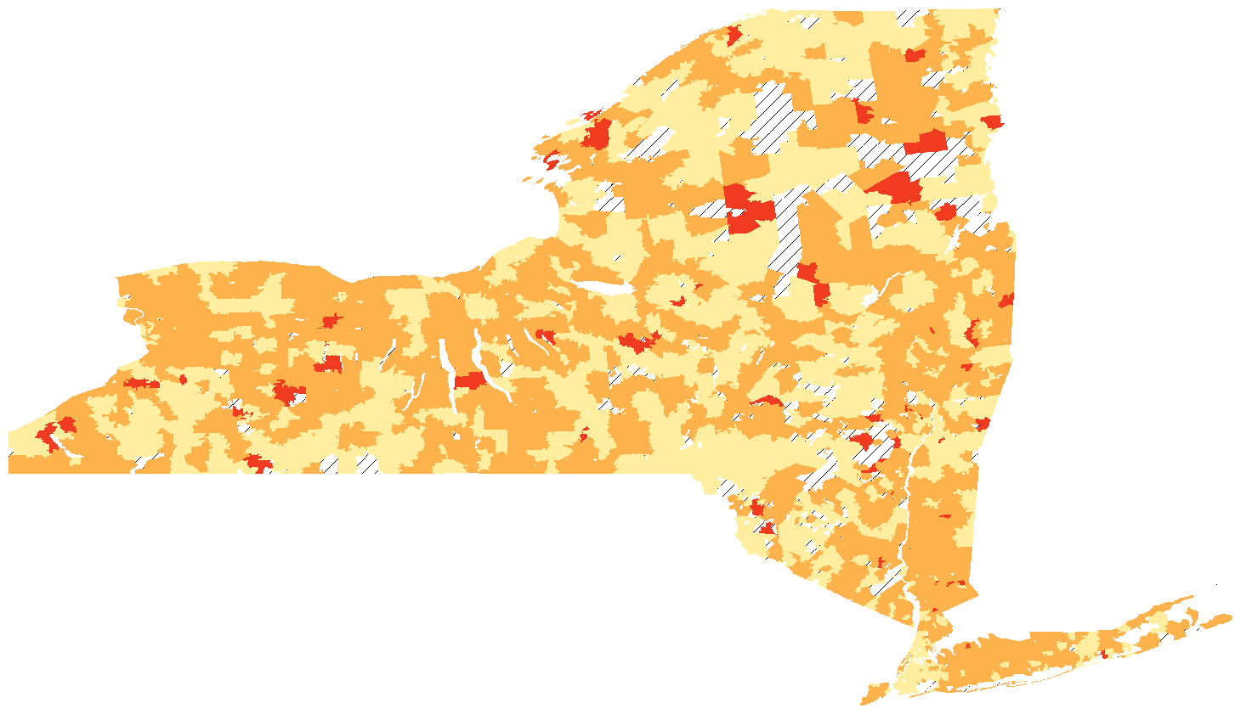
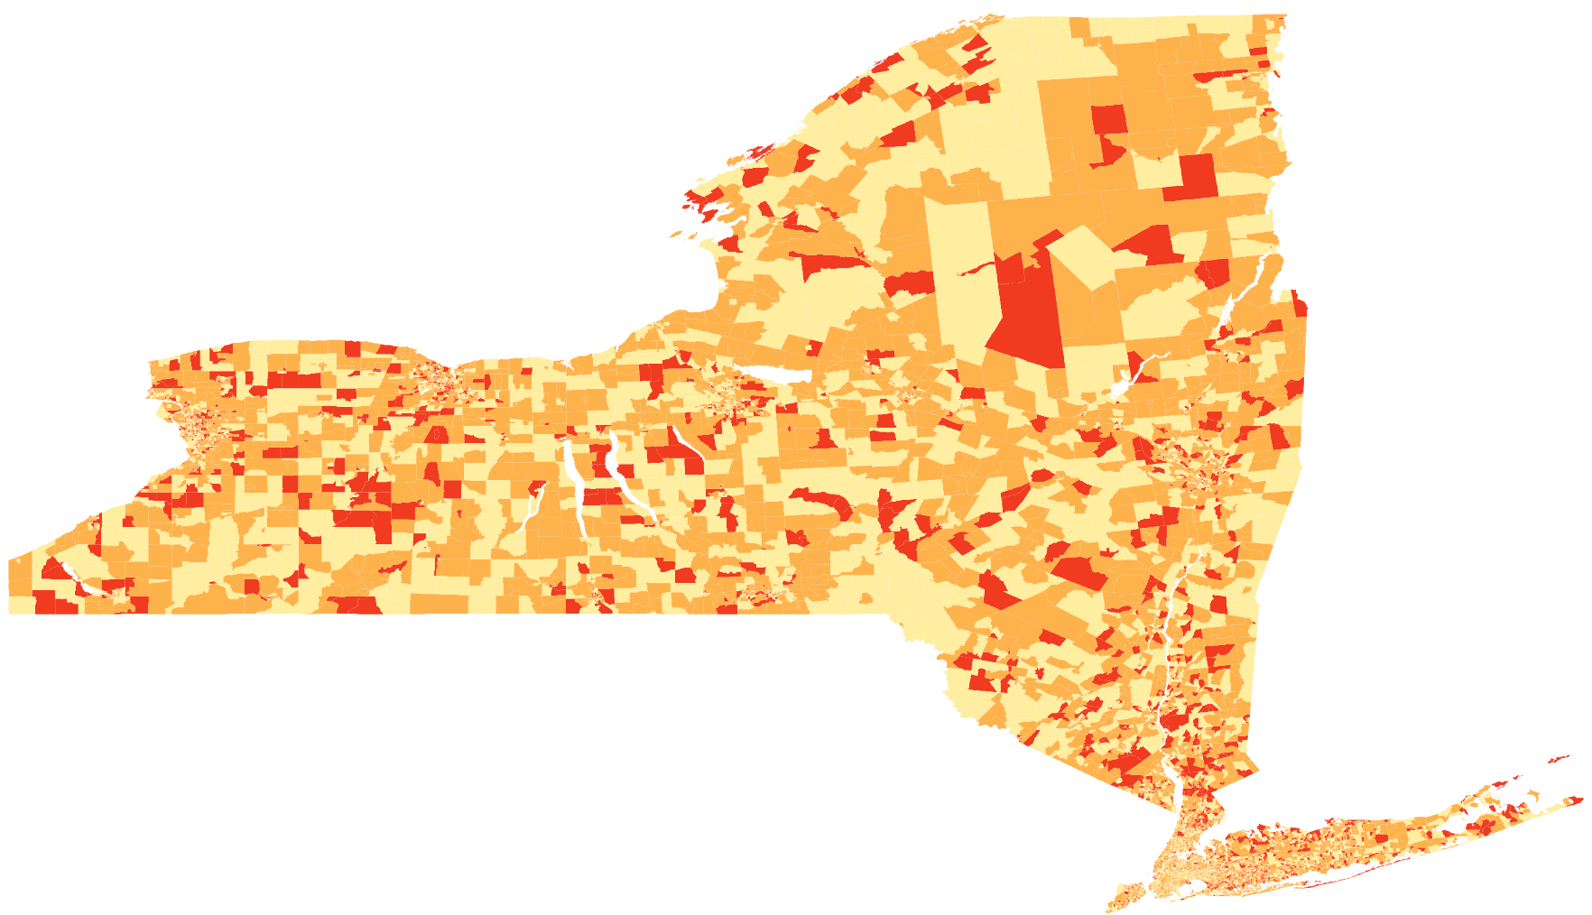
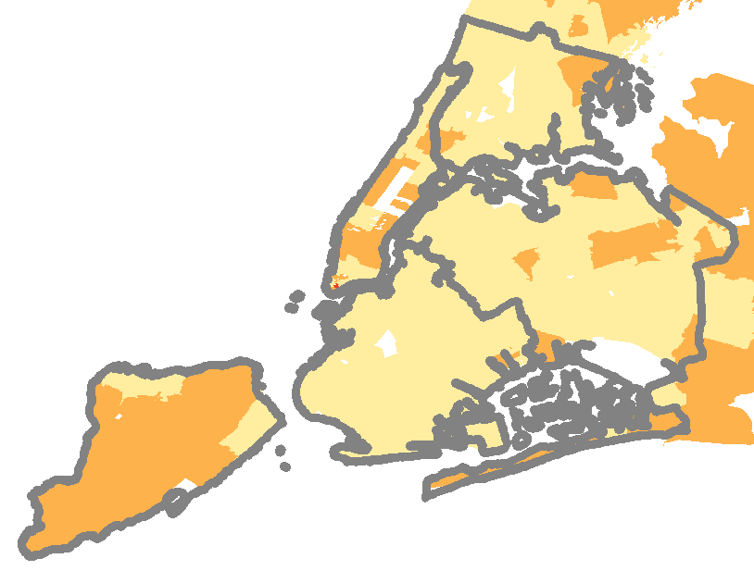
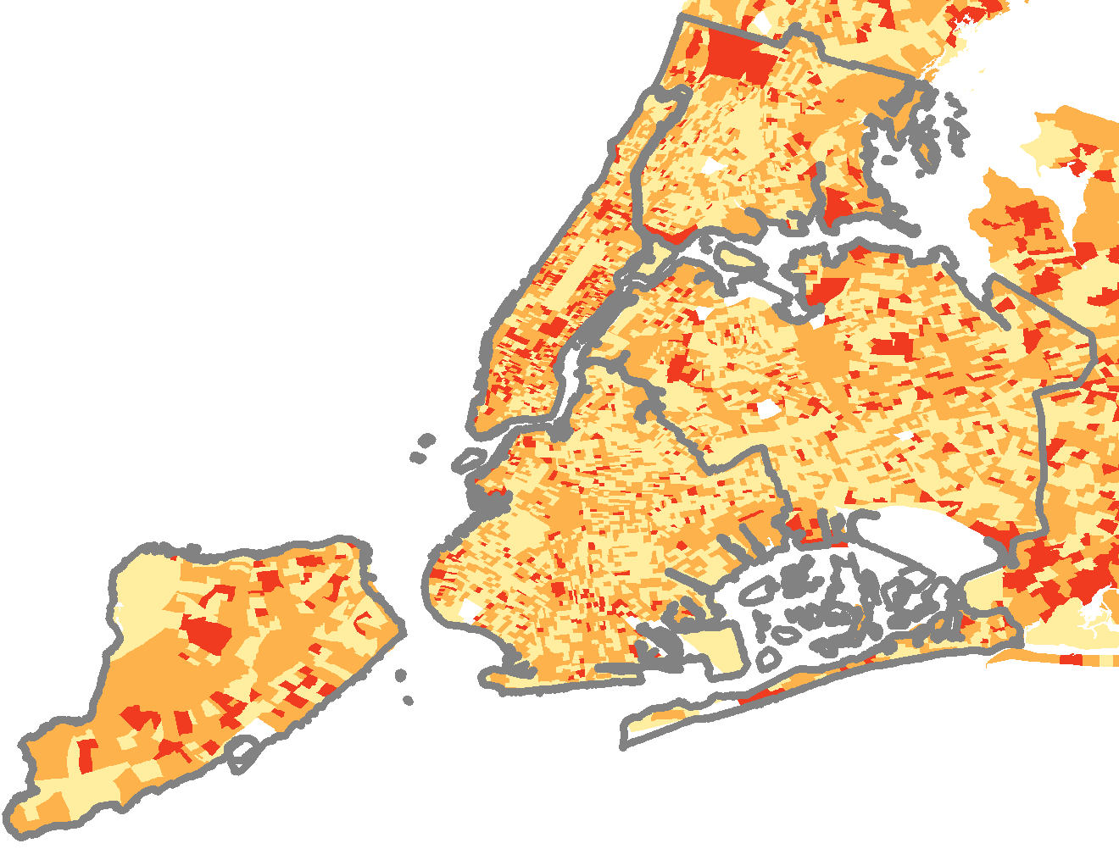
Example: Spatial Resolutions for Breast Cancer Distributions
by county
by ZIP code
by census blocks
The reality:
  High resolution health outcome data was not available
  Lack of tools to support large scale spatial data integration and analytics

Slide 9
Integrated Spatial Big Data Analytics for Public Health
Can we have better understanding of public health through access to large scale data with fine grained geographical resolutions?
Can we get alerts on potential risks for our health, by linking population health and external risks to individual health?
    For example, the fatality rate for admitted pneumonia patients in NYC is twice that of NY State. Why?
Our goal: integrated spatial big data analytics for public health

Slide 10
Integrated spatial big data analytics for public health
Consolidate multiple spatial data sources through spatial queries
Develop high performance infrastructure to support data integration and analysis
  Hadoop-GIS
Support high resolution multi-scale spatial analysis for public health at community level
  Analyze spatial patterns and variations
  Identify spatial hot spots or outliers for diseases
  Model spatial relationships between diseases and external spatial impact factors

Slide 11
Ongoing Projects
Spatial pattern analysis of New York State cancer incidence at Census track level
  e.g.: 4 air toxics (PAHPOM, Chromium VI, Acetaldehyde, Arsenic) will affect lung cancer
Spatial analysis of 30-day readmission of congestive heart failure
Spatial analysis of opioid caused death in NY
Social media based spatial analysis of drug use in US
Sequence patterns and association rules learning mining based on diagnosis and procedures in NY
Comparative spatial analytics methods for large scale healthcare data analytics: region vs point

