Slide 1





NSF 1443054: CIF21 DIBBs: Middleware and High Performance Analytics Libraries for Scalable Data Science
Software: MIDAS
HPC-ABDS
Polar Science Applications
February 2017

Slide 2
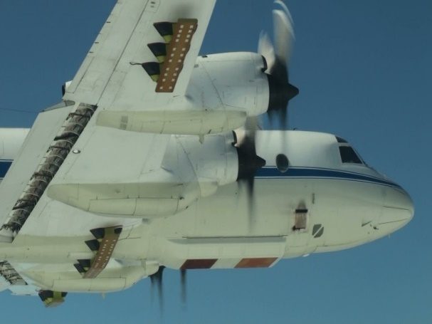
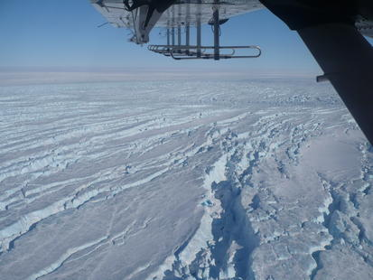
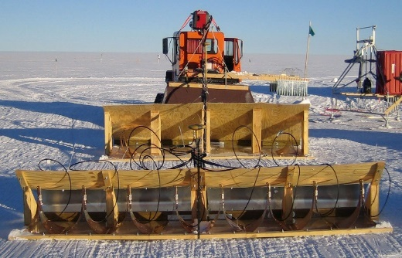
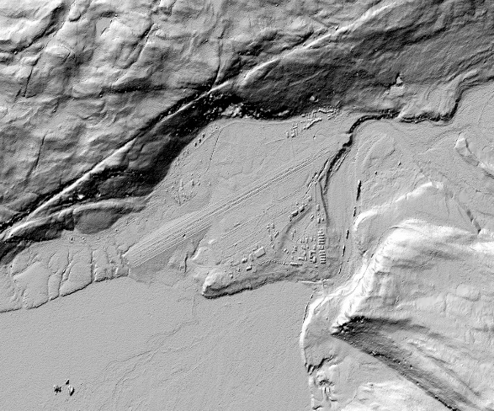
Polar Applications
Aerial radar collects large-scale data about polar ice sheets, but extracting useful observations for input into glaciology models is labor-intensive.
Quantity and velocity of data is overwhelming for human analysis, especially when different sources of weak evidence must be integrated together (e.g. from multiple flight paths, ice cores, radar types, etc).

Slide 3
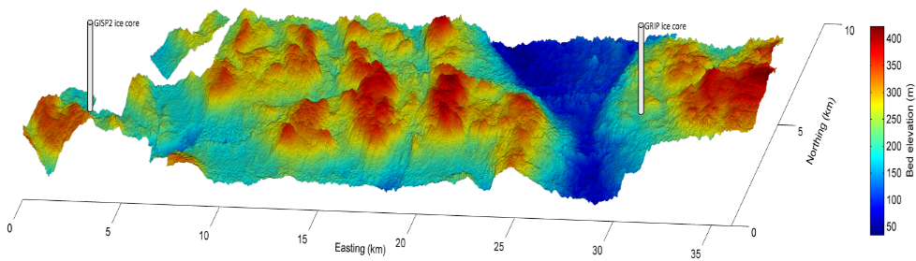
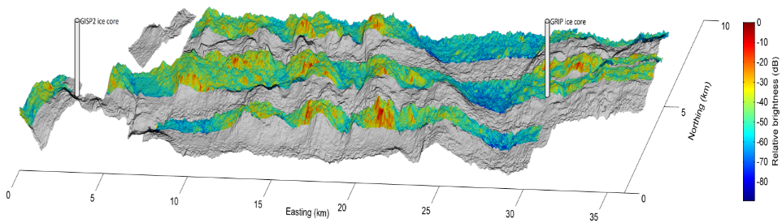
Polar Applications
Opportunities for automatic analysis:
  Ice layer detection and tracking
  3D imaging of ice surface & base
  Feature identification, tracking
  Photogrammmetry

Slide 4
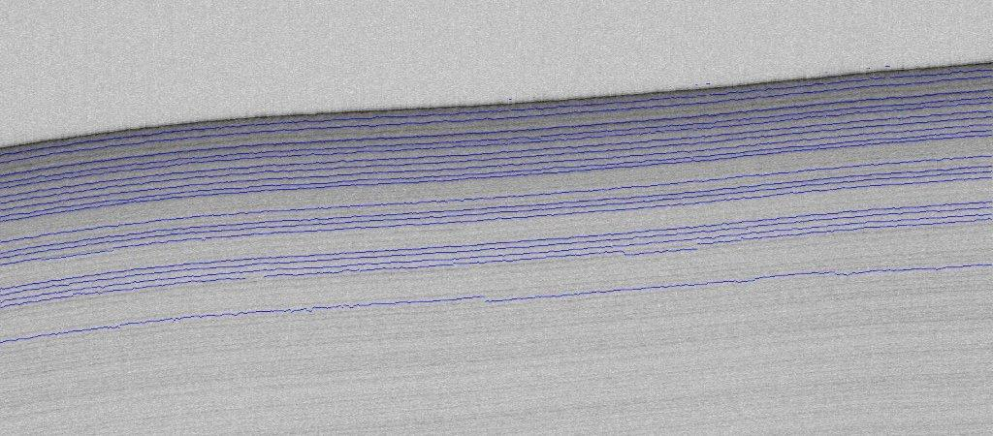
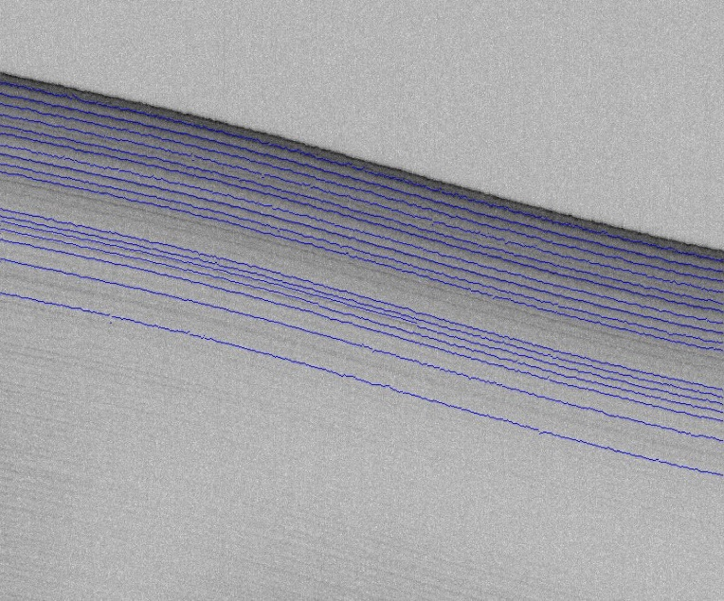
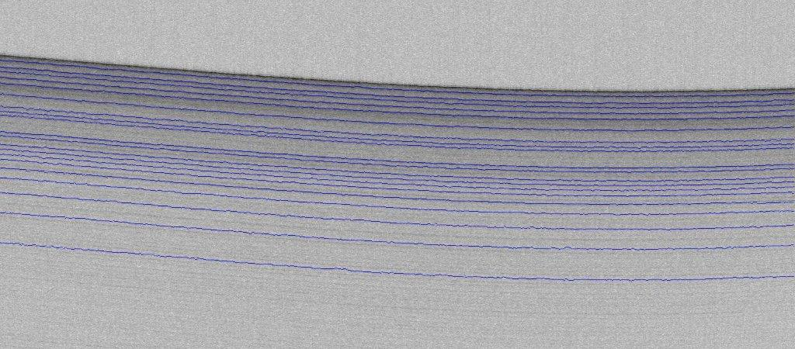
Layer Tracking: Fine Resolution Land Ice
J. Mitchell, D. Crandall, G. Fox, and J. Paden, “A semiautomatic approach for estimating near surface internal layers from snow radar imagery,” in IEEE International Geoscience and Remote Sensing Symposium, 2013

Slide 5
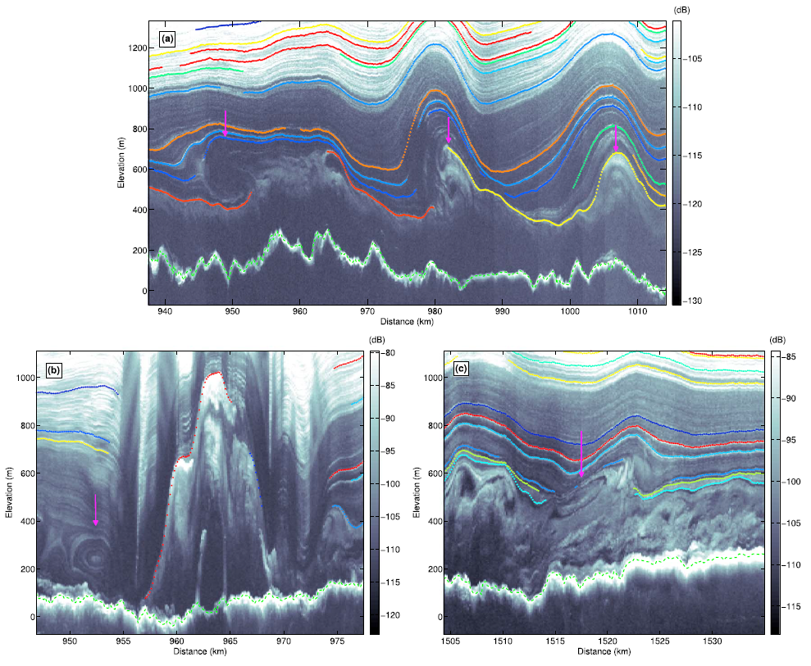
Layer Tracking: Coarse Resolution Land Ice
Layers represent volcanic events, ice crystalline fabric changes, etc.
MacGregor, J.A., M.A. Fahnestock, G.A. Catania, J.D. Paden, S. Gogineni, S.C. Rybarski, S.K. Young, A.N. Mabrey, B.M. Wagman and M. Morlighem, Radiostratigraphy and age structure of the Greenland Ice Sheet, Journal of Geophysical Research Earth Surface, Jan 2015, 2014JF003215.

Slide 6
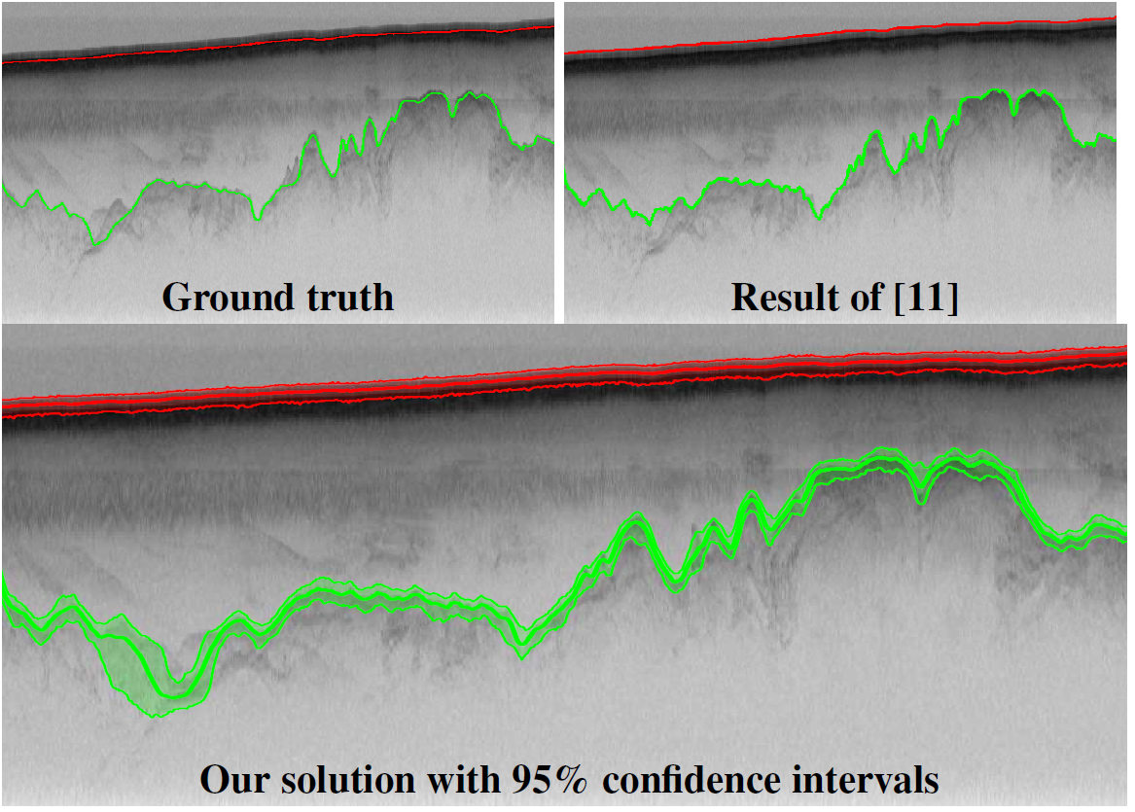
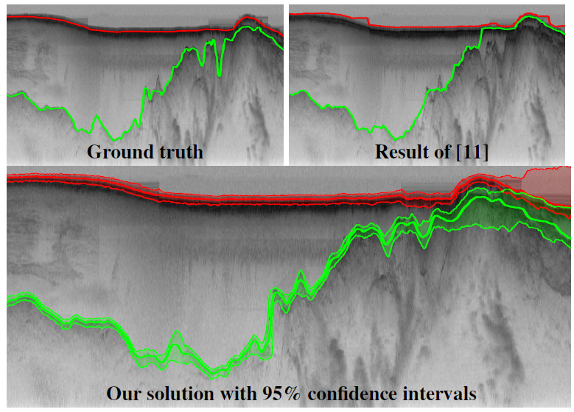
Layer Tracking: Ice Surface and Ice Bottom
Stefan Lee Jerome Mitchell David J. Crandall Geoffrey C. Fox, ESTIMATING BEDROCK AND SURFACE LAYER BOUNDARIES AND CONFIDENCE
INTERVALS IN ICE SHEET RADAR IMAGERY USING MCMC, ICIP 2014.

Slide 7
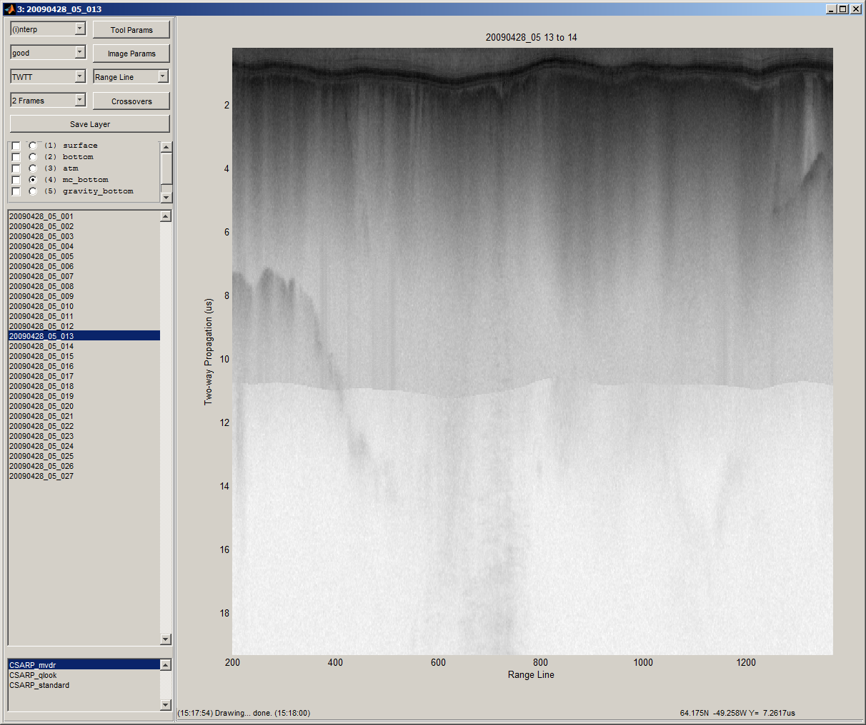
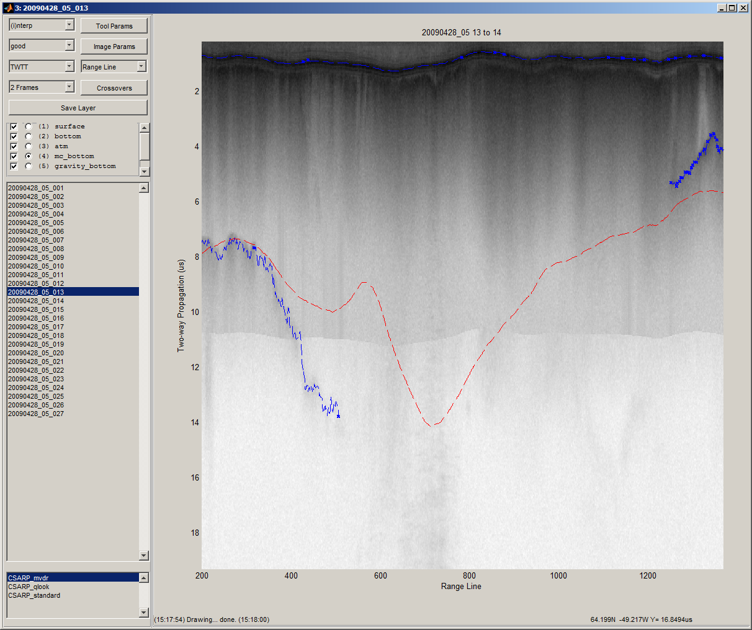
Layer Tracking: Ice Surface and Ice Bottom
Some regions are very hard to track, but auxiliary data sources and human input may be available.
Semi-automatic, human-in-loop analysis requires fast, scalable algorithms.

Slide 8
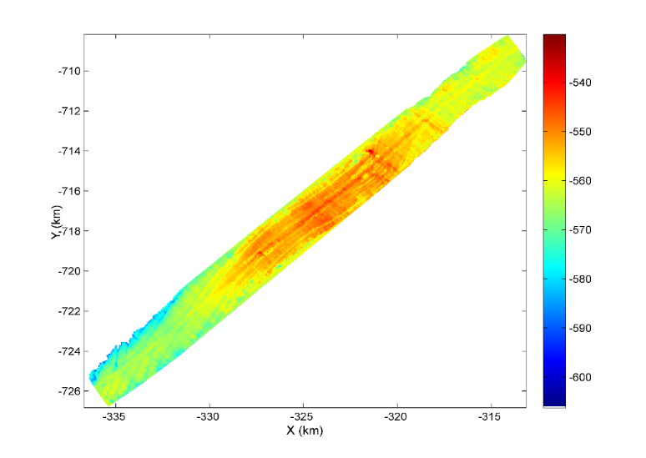
3-D Imaging
Primary goal: extract surface from 3-D radar images
Parametric model used is computationally expensive (N-D numerical search).
Best solution is dependent on neighboring solutions → Non exhaustive global optimization.
100’s of TB of data collected per mission
Bed Elevation (m) relative to WGS-84 Ellipsoid

Slide 9
3-D Imaging
Global optimizer (GO) starts with an ice surface and bottom as shown by bold black line/
Each range shell contributes an N-dimensional local optimization function where N is the number of targets that intersect that shell. The inputs to the local optimization function are the locations of the N targets in the range shell usually provided as the angle to each target.
Each range shell can be interrogated for its optimal number of targets and target locations.
GO perturbs surface location to maximize a cost function made up of local optimization results, surface shape constraints, and auxiliary data.
Auxiliary data include surface DEM from other measurements.

Slide 10
3-D Imaging

Slide 11
3-D Imaging
Global optimizer can make local optimizer more productive and efficient.
FIRST: Often the maximum of the local optimization is off by a long way, but a peak still exists at the true solution that GO could find.
SECOND: Restrict the N-dimensional search space to a small region of interest.

Slide 12
Perturb solution and data to test algorithm

Slide 13
Perturb solution and data to test algorithm

Slide 14
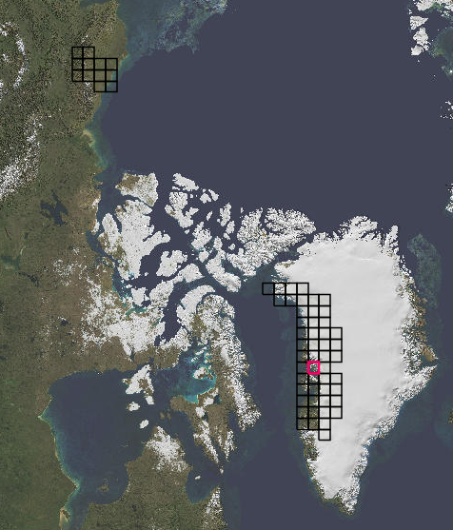
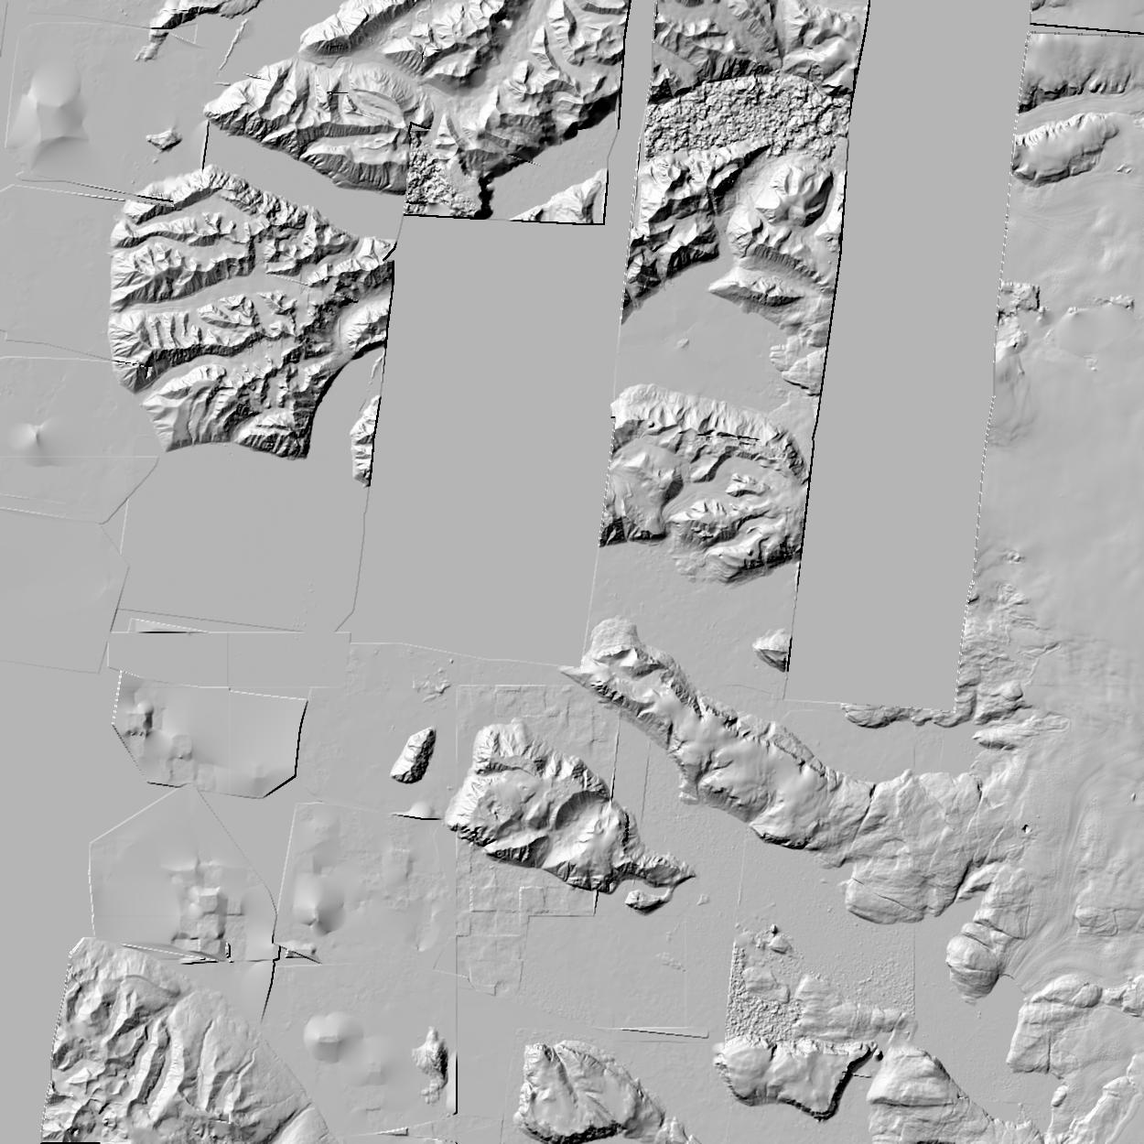
Photogrammetry: feature detection, image bundling, feature tracking
0.5 meter resolution → huge amounts of data (many PB)
Primary goal: digital elevation model using photogrammetry.
Eventually want to support repeat measurements for elevation change and surface velocity.
Small pipelines setup that are effective for small amounts of data

Slide 15
NSF 1443054: CIF21 DIBBs: Middleware and High Performance Analytics Libraries for Scalable Data Science
Software: MIDAS
HPC-ABDS
Pathology
Spatial Analysis
February 2017

Slide 16
Algorithms – Nuclei Segmentation for Pathology Images
Segment boundaries of nuclei from pathology
images and extract features for each nucleus
Consist of tiling, segmentation,
vectorization, boundary object aggregation
Could be executed on MapReduce
(MIDAS Harp)
Execution pipeline on MapReduce (MIDAS Harp)
Nuclear segmentation algorithm

Slide 17
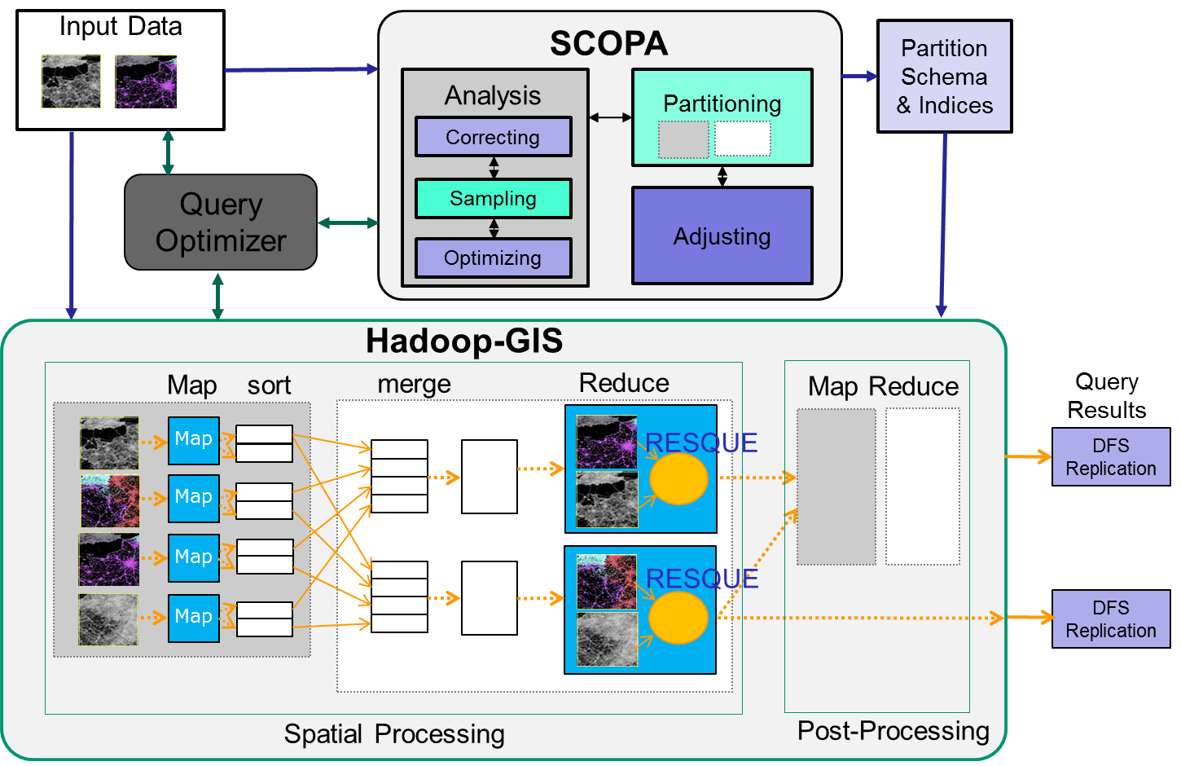
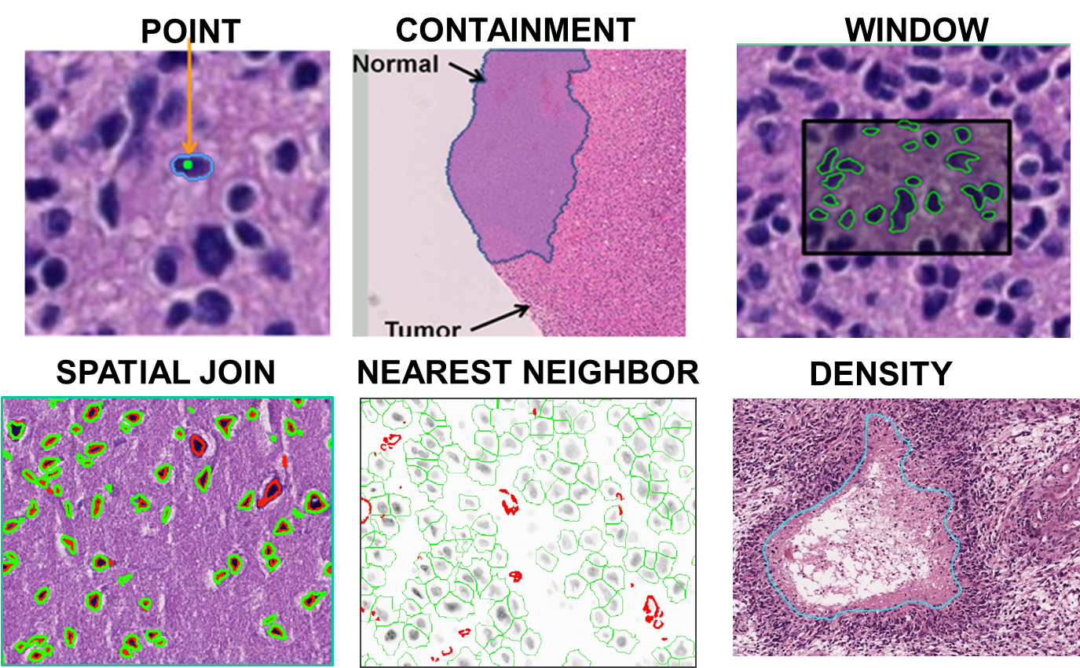
Algorithms – Spatial Querying Methods
Hadoop-GIS is a general framework to support high performance spatial queries and analytics for spatial big data on MapReduce.
It supports multiple types of spatial queries on MapReduce through spatial partitioning, customizable spatial query engine and on-demand indexing.
SparkGIS is a variation of Hadoop-GIS which runs on Spark to take advantage of in-memory processing.
Will extend Hadoop/Spark to Harp MIDAS runtime.
2D complete; 3D in progress
Spatial Queries
Architecture of Spatial Query Engine

Slide 18
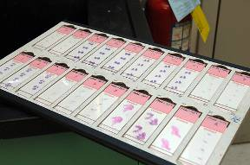
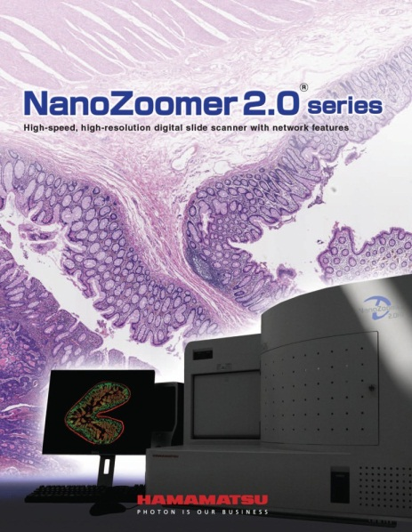
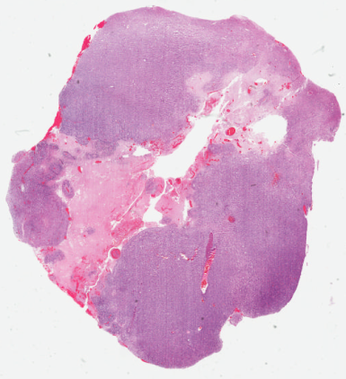
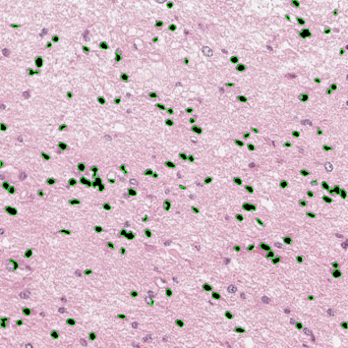
Enabled Applications – Digital Pathology
Glass Slides
Scanning
Whole Slide Images
Image Analysis
Digital pathology images scanned from human tissue specimens provide rich information about morphological and functional characteristics of biological systems.
Pathology image analysis has high potential to provide diagnostic assistance, identify therapeutic targets, and predict patient outcomes and therapeutic responses.
It relies on both pathology image analysis algorithms and spatial querying methods.
Extremely large image scale.

Slide 19
2D/3D Pathology Image and Spatial Analysis
          2D Cell Segmentation
          Scalable Pathology Image Processing
          Scalable 2D Spatial Queries
          3D Vessel Segmentation
          Scalable 3D spatial queries
Jun Kong, Emory University
Fusheng Wang, Stony Brook University

Slide 20
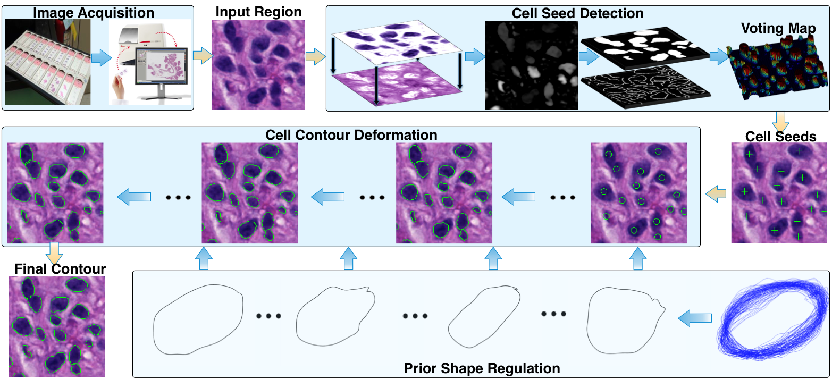
2D Cell Segmentation Overview
Seed Detection
(determine the number of cells and contour initialization)
Active Contour Model (deform contours)
Pengyue Zhang, Fusheng Wang, et al: Automated Level Set Segmentation of
Histopathologic Cells with Sparse Shape Prior Support and Dynamic Occlusion
Constraint. To Appear in ISBI 2017.

Slide 21
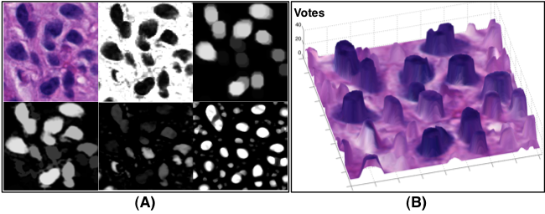
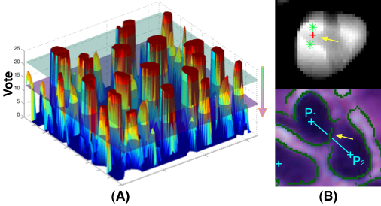
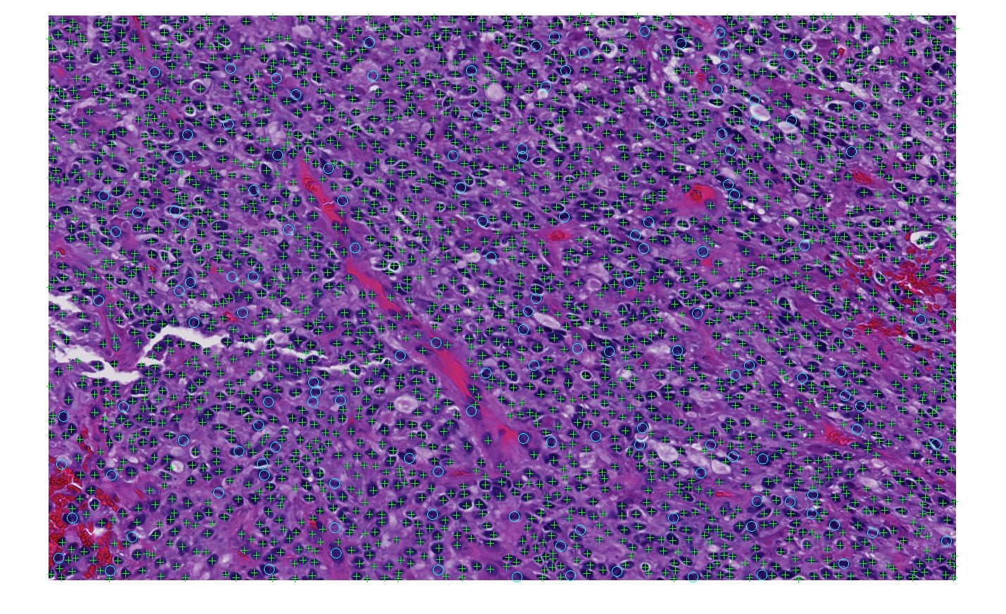
Cell Detection and Seed Detection
(C)
(D)
Cell Detection
Seed Detection
Notes:
The total number of human annotated cells for seed detection is 5396.
Note that we evaluate our approach with non-touching and occluded cells in each image separately.
Four metrics are computed from each image to show seed detection performance: (1)Cell Number Error; (2)Miss Detection (M); (3)False Recognition (F); (4)Over- (O); (5)Under- Segmentation (U)

Slide 22
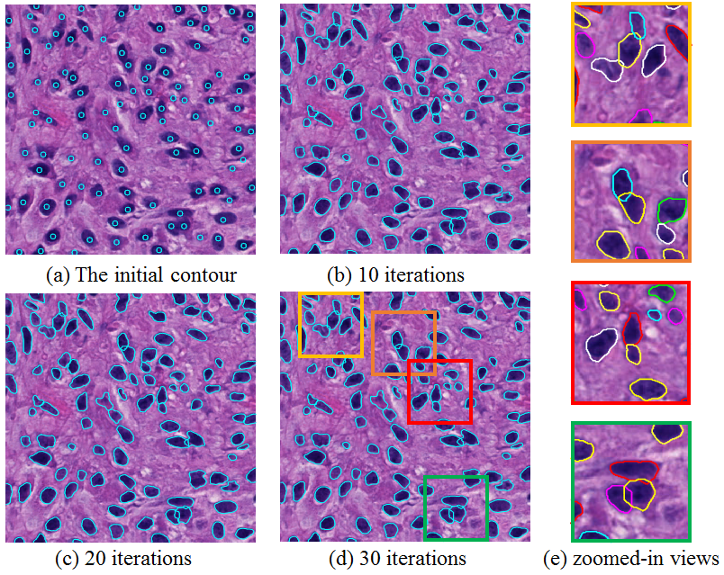
Cell Segmentation

Slide 23
Scalable 2D Pathology Image Analysis
Overlapping partitioning of large images
MapReduce processing of each tiles - mapping
Normalization of boundary objects – mapping
Aggregation of segmented objects -reducing

Slide 24
Scalable 2D Spatial Queries: Hadoop-GIS
A general framework to support high performance spatial queries and analytics for spatial big data on MapReduce
Data skew aware spatial data partitioning
Multi-level spatial indexing
Hybrid query engine combining MapReduce and database engine
http://bmidb.cs.stonybrook.edu/hadoopgis/

Slide 25
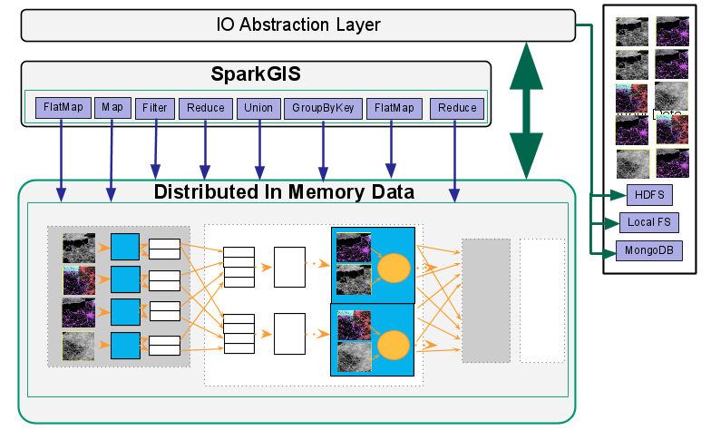
SparkGIS: Hadoop-GIS on Spark
SparkGIS: an in-memory variation of Hadoop-GIS
  Implement spatial querying pipelines in Spark – reusing spatial querying methods in Hadoop-GIS
  Removes HDFS dependency: MongoDB, HDFS, local FS, Cassndra, HBase, Hive etc.
  Reduce I/O cost: multiple iterative jobs can be scheduled on same data with little IO overhead
  Streamed processing: processing data without waiting for all data ready

Slide 26
3D Pathology Image Analysis
Whole slide images
High resolution and large file size: 100,000 x 100,000 pixels per image
Large file size: 300 - 500MB/image, serval hundreds of slices per 3D volume
Numerous micro-anatomical object types with complex 3D structures
Objectives
Quantitative image analysis of whole slide image volume to derive 3D spatial structures and features with a complete framework of 3D blood vessel reconstruction
Scalable spatial analytics to explore 3D spatial relationships and discover spatial patterns of large scale 3D micro-anatomical objects with high performance systems

Slide 27
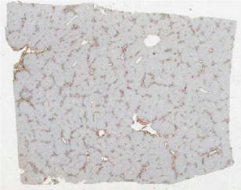
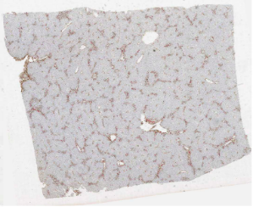
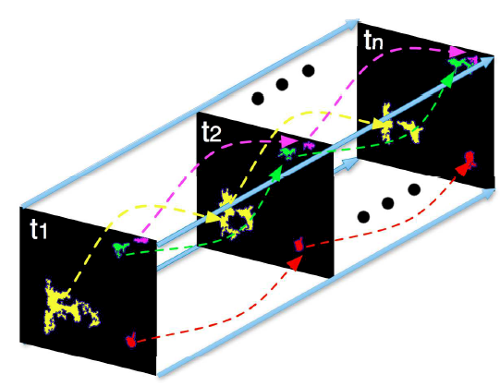
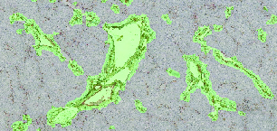
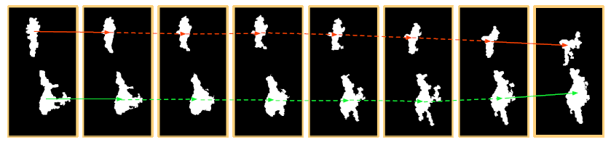
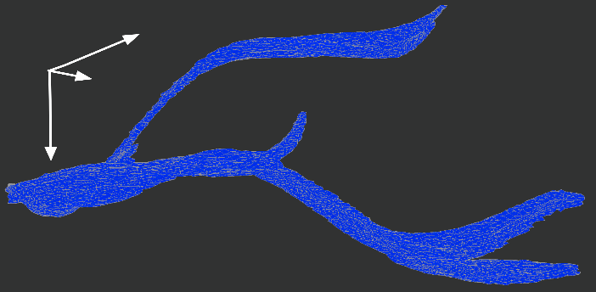
3D Primary Vessel Reconstruction
3D WSI Volume
Image Registration
Vessel Association
Image Segmentation
Vessel Interpolation
3D Vessel Rendering

Slide 28
Scalable 3-D Spatial Queries and Analytics
Large scale 3D dataset
  Millions of 3D objects such as nuclei can be extracted from a 3D pathology image volume with tens of slides
Characteristics of 3D spatial data
  Complex structures, e.g., Blood vessels have tree structures with branches
  Multiple representations: different Levels of Detail (LOD)
High computation complexity
  3D geometry computation is pretty expensive

Slide 29
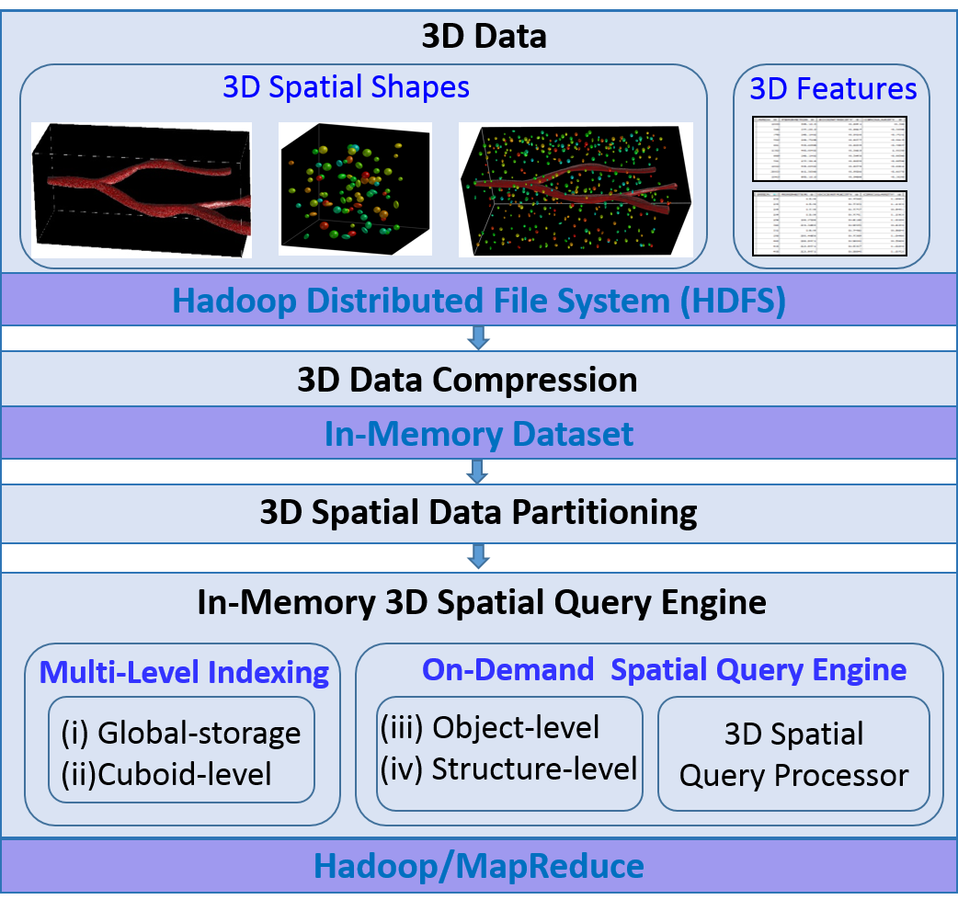
Scalable 3-D Spatial Queries and Analytics: Hadoop-GIS 3D
The derived 3D data from pathology image analysis is stored on HDFS
3D data compression
  Fit data into memory
  Store multiple levels of details by an progressive compression approach
3D data partitioning
  Generate each cuboid as a processing unit for parallel computation in MapReduce
Multi-level indexing
  Accelerate spatial data access
On-demand Spatial Query Engine
  Provide multiple types of spatial query, such as spatial join and nearest neighbor query

