Slide 1
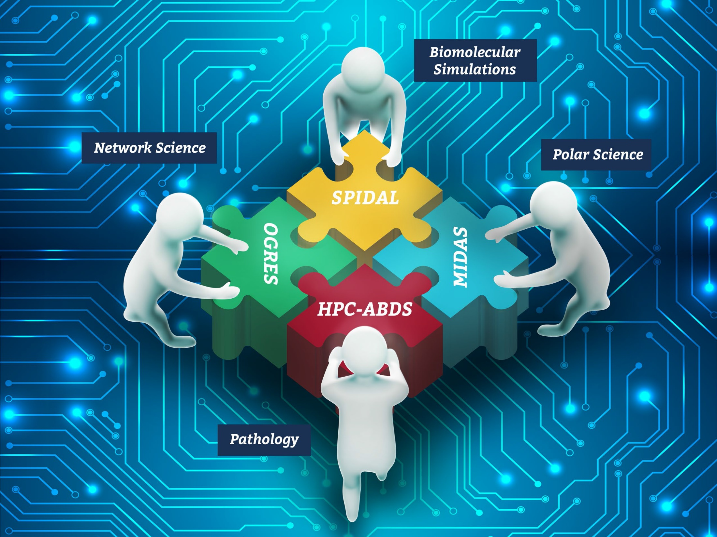
NSF 1443054: CIF21 DIBBs: Middleware and High Performance Analytics Libraries for Scalable Data Science
Software: MIDAS HPC-ABDS
Tutorial Overview
February 2017
http://dsc.soic.indiana.edu/publications/SPIDALTutorialProgram-Feb2017.pdf

Slide 2
SPIDAL Project Datanet: CIF21 DIBBs: Middleware and High Performance Analytics Libraries for Scalable Data Science
NSF14-43054 started October 1, 2014
Indiana University (Fox, Qiu, Crandall, von Laszewski)
Rutgers (Jha)
Virginia Tech (Marathe)
Kansas (Paden)
Stony Brook (Wang)
Arizona State (Beckstein)
Utah (Cheatham)
A co-design project: Software, algorithms, applications

Slide 3
Status of NSF 1443054 Project
Big Data Application Analysis identifies features of data intensive applications that need to be supported in software and represented in benchmarks. This analysis was started for proposal and has been extended to support HPC-Simulations-Big Data convergence.
The project is a collaboration between computer and domain scientists in application areas in Biomolecular Simulations, Network Science, Epidemiology, Computer Vision, Spatial Geographical Information Systems, Remote Sensing for Polar Science and Pathology Informatics.
HPC-ABDS as Cloud-HPC interoperable software with performance of HPC (High Performance Computing) and the rich functionality of the commodity Apache Big Data Stack was a bold idea developed for proposal. We have successfully delivered and extended this approach, which is one of ideas described in Exascale Big Data report.

Slide 4
Status of NSF 1443054 Project
MIDAS integrating middleware that links HPC and ABDS now has several components including an architecture for Big Data analytics, an integration of HPC in communication and scheduling on ABDS; it also has rules to get high performance Java scientific code.
SPIDAL (Scalable Parallel Interoperable Data Analytics Library) now has 20 members with domain specific (general) and core algorithms.
Benchmarks. We reached out to database community with keynote and paper at WBDB2015 Benchmarking Workshop.
Language: SPIDAL Java runs as fast as C++
Designed and Proposed HPCCloud as hardware-software infrastructure supporting
Big Data Big Simulation Convergence
Big Data Management via Apache Stack ABDS
Big Data Analytics using SPIDAL and other libraries

Slide 5
HPC and/or Cloud 1.0 2.0 3.0
Cloud 1.0: IaaS PaaS
Cloud 2.0: DevOps
Cloud 3.0: Insight (Solution) as a Service from IBM; server-less computing; event driven function as a service
HPC 1.0 and Cloud 1.0 separate ecosystems
HPCCloud or HPC-ABDS: Take performance of HPC and functionality of Cloud (Big Data) systems
HPCCloud 2.0 Use DevOps to invoke HPC or Cloud software on VM, Docker, HPC infrastructure
HPCCloud 3.0 Automate Solution as a Service using HPC-ABDS on varied infrastructure suitable for HPC and Big Data Management and Analytics

Slide 6
Contents of Tutorial I
Introduction HPC Cloud and Big Data, Big Simulation, HPC Convergence
Big Data Use Cases: Ogres and Diamonds. Examples available
Examples of HPC Analytics and applications: Clustering, dimension reduction, visualization
Deterministic Annealing Algorithms for Big Data Analytics
WebPlotViz browser 3D viewer
Tutorial to use these SPIDAL tools
General HPC-ABDS High Performance Computing Enhanced Apache Big Data Stack
SPIDAL Java making Java run fast
Parallel Performance of core SPIDAL Data Analytics
Comparison of Parallel and Distributed Computing in MPI, Spark, Flink

Slide 7
Contents of Tutorial II
HPC ABDS MIDAS Components
RADICAL-Pilot, Pilot-YARN, Pilot-Spark
Technology and Application to Biomolecular Simulations
Harp Plugin for Hadoop and several algorithms (LDA)
Streaming Applications in HPC-ABDS
SPIDAL Algorithms
General discussion
Graph Algorithms
SPIDAL Image & Model Fitting Abstractions

Slide 8
Contents of Tutorial III
Polar Science Applications
Pathology Applications
Public Health Geospatial applications
MDAnalysis Biomolecular Simulations
HPC Cloud Convergence
HPCCloud and Software Defined Systems
SPIDAL Status and Challenges

