Slide 1





NSF 1443054: CIF21 DIBBs: Middleware and High Performance Analytics Libraries for Scalable Data Science
Software: MIDAS
HPC-ABDS
Big Data
Use Cases February 2017

Slide 2
Application Nexus of HPC, Big Data, Simulation Convergence
Use-case Data and Model
NIST Collection
Big Data Ogres
Convergence Diamonds

Slide 3
Data and Model in Big Data and Simulations I
Need to discuss Data and Model as problems have both intermingled, but we can get insight by separating which allows better understanding of Big Data - Big Simulation “convergence” (or differences!)
The Model is a user construction and it has a “concept”, parameters and gives results determined by the computation. We use term “model” in a general fashion to cover all of these.
Big Data problems can be broken up into Data and Model
  For clustering, the model parameters are cluster centers while the data is set of points to be clustered
  For queries, the model is structure of database and results of this query while the data is whole database queried and SQL query
  For deep learning with ImageNet, the model is chosen network with model parameters as the network link weights. The data is set of images used for training or classification

Slide 4
Data and Model in Big Data and Simulations II
Simulations can also be considered as Data plus Model
  Model can be formulation with particle dynamics or partial differential equations defined by parameters such as particle positions and discretized velocity, pressure, density values
  Data could be small when just boundary conditions
  Data large with data assimilation (weather forecasting) or when data visualizations are produced by simulation
Big Data implies Data is large but Model varies in size
  e.g. LDA with many topics or deep learning has a large model
  Clustering or Dimension reduction can be quite small in model size
Data often static between iterations (unless streaming); Model parameters vary between iterations
Data and Model Parameters are often confused in papers as term data used to describe the parameters of models.

Slide 5

Use Case Template
26 fields completed for 51 areas
Government Operation: 4
Commercial: 8
Defense: 3
Healthcare and Life Sciences: 10
Deep Learning and Social Media: 6
The Ecosystem for Research: 4
Astronomy and Physics: 5
Earth, Environmental and Polar Science: 10
Energy: 1

Slide 6
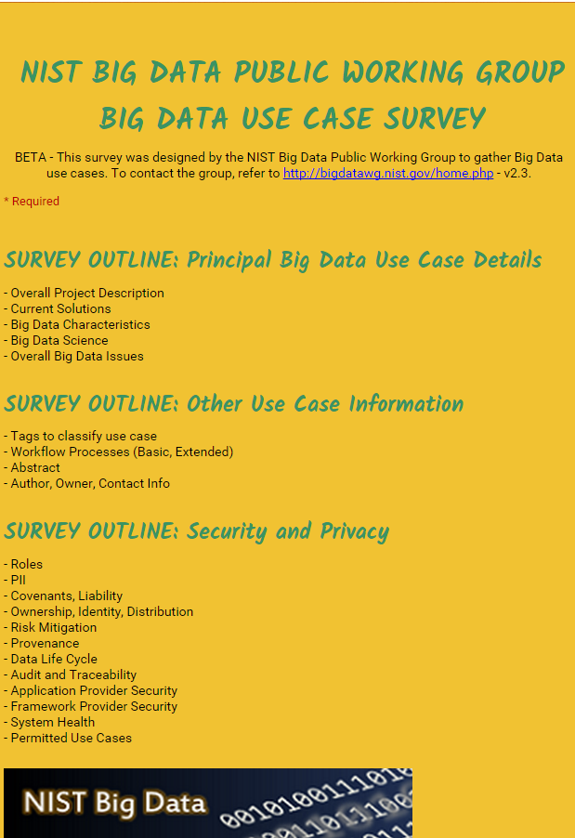
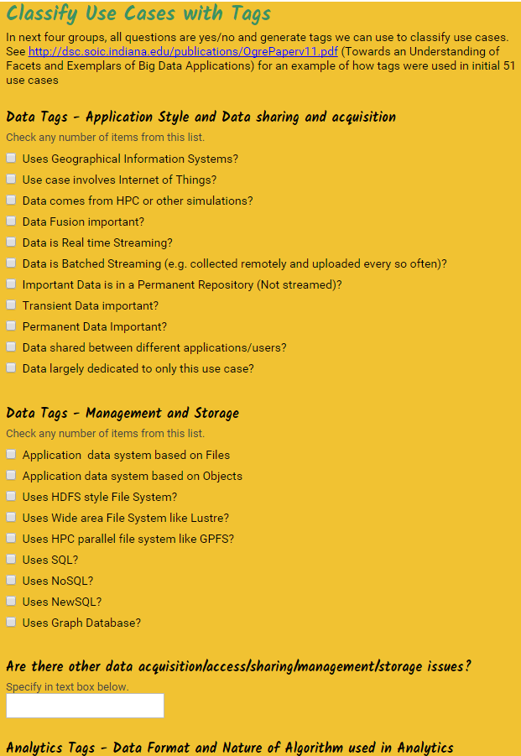
http://hpc-abds.org/kaleidoscope/survey/
Online Use Case Form

Slide 7
51 Detailed Use Cases: Contributed July-September 2013
Covers goals, data features such as 3 V’s, software, hardware
Government Operation(4): National Archives and Records Administration, Census Bureau
Commercial(8): Finance in Cloud, Cloud Backup, Mendeley (Citations), Netflix, Web Search, Digital Materials, Cargo shipping (as in UPS)
Defense(3): Sensors, Image surveillance, Situation Assessment
Healthcare and Life Sciences(10): Medical records, Graph and Probabilistic analysis, Pathology, Bioimaging, Genomics, Epidemiology, People Activity models, Biodiversity
Deep Learning and Social Media(6): Driving Car, Geolocate images/cameras, Twitter, Crowd Sourcing, Network Science, NIST benchmark datasets
The Ecosystem for Research(4): Metadata, Collaboration, Language Translation, Light source experiments
Astronomy and Physics(5): Sky Surveys including comparison to simulation, Large Hadron Collider at CERN, Belle Accelerator II in Japan
Earth, Environmental and Polar Science(10): Radar Scattering in Atmosphere, Earthquake, Ocean, Earth Observation, Ice sheet Radar scattering, Earth radar mapping, Climate simulation datasets, Atmospheric turbulence identification, Subsurface Biogeochemistry (microbes to watersheds), AmeriFlux and FLUXNET gas sensors
Energy(1): Smart grid
Published by NIST as http://nvlpubs.nist.gov/nistpubs/SpecialPublications/NIST.SP.1500-3.pdf with common set of 26 features recorded for each use-case; “Version 2” being prepared
26 Features for each use case Biased to science

Slide 8

Part of Property Summary Table

Slide 9
51 Use Cases: What is Parallelism Over?
People: either the users (but see below) or subjects of application and often both
Decision makers like researchers or doctors (users of application)
Items such as Images, EMR, Sequences below; observations or contents of online store
  Images or “Electronic Information nuggets”
  EMR: Electronic Medical Records (often similar to people parallelism)
  Protein or Gene Sequences;
  Material properties, Manufactured Object specifications, etc., in custom dataset
  Modelled entities like vehicles and people
Sensors – Internet of Things
Events such as detected anomalies in telescope or credit card data or atmosphere
(Complex) Nodes in RDF Graph
Simple nodes as in a learning network
Tweets, Blogs, Documents, Web Pages, etc.
  And characters/words in them
Files or data to be backed up, moved or assigned metadata
Particles/cells/mesh points as in parallel simulations

Slide 10
Sample Features of 51 Use Cases I
PP (26) “All” Pleasingly Parallel or Map Only
MR (18) Classic MapReduce MR (add MRStat below for full count)
MRStat (7) Simple version of MR where key computations are simple reduction as found in statistical averages such as histograms and averages
MRIter (23) Iterative MapReduce or MPI (Flink, Spark, Twister)
Graph (9) Complex graph data structure needed in analysis
Fusion (11) Integrate diverse data to aid discovery/decision making; could involve sophisticated algorithms or could just be a portal
Streaming (41) Some data comes in incrementally and is processed this way
Classify (30) Classification: divide data into categories
S/Q (12) Index, Search and Query

Slide 11
Sample Features of 51 Use Cases II
CF (4) Collaborative Filtering for recommender engines
LML (36) Local Machine Learning (Independent for each parallel entity) – application could have GML as well
GML (23) Global Machine Learning: Deep Learning, Clustering, LDA, PLSI, MDS,
  Large Scale Optimizations as in Variational Bayes, MCMC, Lifted Belief Propagation, Stochastic Gradient Descent, L-BFGS, Levenberg-Marquardt . Can call EGO or Exascale Global Optimization with scalable parallel algorithm
Workflow (51) Universal
GIS (16) Geotagged data and often displayed in ESRI, Microsoft Virtual Earth, Google Earth, GeoServer etc.
HPC (5) Classic large-scale simulation of cosmos, materials, etc. generating (visualization) data
Agent (2) Simulations of models of data-defined macroscopic entities represented as agents

Slide 12
Other Benchmark Sets

Slide 13
7 Computational Giants of
NRC Massive Data Analysis Report
http://www.nap.edu/catalog.php?record_id=18374 Big Data Models?
G1: Basic Statistics e.g. MRStat
G2: Generalized N-Body Problems
G3: Graph-Theoretic Computations
G4: Linear Algebraic Computations
G5: Optimizations e.g. Linear Programming
G6: Integration e.g. LDA and other GML
G7: Alignment Problems e.g. BLAST

Slide 14
HPC (Simulation) Benchmark Classics
Linpack or HPL: Parallel LU factorization
for solution of linear equations; HPCG
NPB version 1: Mainly classic HPC solver kernels
  MG: Multigrid
  CG: Conjugate Gradient
  FT: Fast Fourier Transform
  IS: Integer sort
  EP: Embarrassingly Parallel
  BT: Block Tridiagonal
  SP: Scalar Pentadiagonal
  LU: Lower-Upper symmetric Gauss Seidel
Simulation Models

Slide 15
13 Berkeley Dwarfs
Largely Models for Data or Simulation
Dense Linear Algebra
Sparse Linear Algebra
Spectral Methods
N-Body Methods
Structured Grids
Unstructured Grids
MapReduce
Combinational Logic
Graph Traversal
Dynamic Programming
Backtrack and
Branch-and-Bound
Graphical Models
Finite State Machines
First 6 of these correspond to Colella’s original. (Classic simulations)
Monte Carlo dropped.
N-body methods are a subset of Particle in Colella.
Note a little inconsistent in that MapReduce is a programming model and spectral method is a numerical method.
Need multiple facets to classify use cases!

Slide 16
Classifying Use cases

Slide 17
Classifying Use Cases
The Big Data Ogres built on a collection of 51 big data uses gathered by the NIST Public Working Group where 26 properties were gathered for each application.
This information was combined with other studies including the Berkeley dwarfs, the NAS parallel benchmarks and the Computational Giants of the NRC Massive Data Analysis Report.
The Ogre analysis led to a set of 50 features divided into four views that could be used to categorize and distinguish between applications.
The four views are Problem Architecture (Macro pattern); Execution Features (Micro patterns); Data Source and Style; and finally the Processing View or runtime features.
We generalized this approach to integrate Big Data and Simulation applications into a single classification looking separately at Data and Model with the total facets growing to 64 in number, called convergence diamonds, and split between the same 4 views.
A mapping of facets into work of the SPIDAL project has been given.

Slide 19
64 Features in 4 views for Unified Classification of Big Data and Simulation Applications
Both
Simulations
Analytics
(Model for Big Data)
(Nearly all Data)
(All Model)
(Mix of Data and Model)
(Nearly all Data+Model)

Slide 20
Convergence Diamonds and their 4 Views I
One view is the overall problem architecture or macropatterns which is naturally related to the machine architecture needed to support application.
  Unchanged from Ogres and describes properties of problem such as “Pleasing Parallel” or “Uses Collective Communication”
The execution (computational) features or micropatterns view, describes issues such as I/O versus compute rates, iterative nature and regularity of computation and the classic V’s of Big Data: defining problem size, rate of change, etc.
  Significant changes from ogres to separate Data and Model and add characteristics of Simulation models. e.g. both model and data have “V’s”; Data Volume, Model Size
  e.g. O(N²) Algorithm relevant to big data or big simulation model

Slide 21
Convergence Diamonds and their 4 Views II
The data source & style view includes facets specifying how the data is collected, stored and accessed. Has classic database characteristics
  Simulations can have facets here to describe input or output data
  Examples: Streaming, files versus objects, HDFS v. Lustre
Processing view has model (not data) facets which describe types of processing steps including nature of algorithms and kernels by model e.g. Linear Programming, Learning, Maximum Likelihood, Spectral methods, Mesh type,
  mix of Big Data Processing View and Big Simulation Processing View and includes some facets like “uses linear algebra” needed in both: has specifics of key simulation kernels and in particular includes facets seen in NAS Parallel Benchmarks and Berkeley Dwarfs
Instances of Diamonds are particular problems and a set of Diamond instances that cover enough of the facets could form a comprehensive benchmark/mini-app set
Diamonds and their instances can be atomic or composite

Slide 22
Problem Architecture View

Slide 23
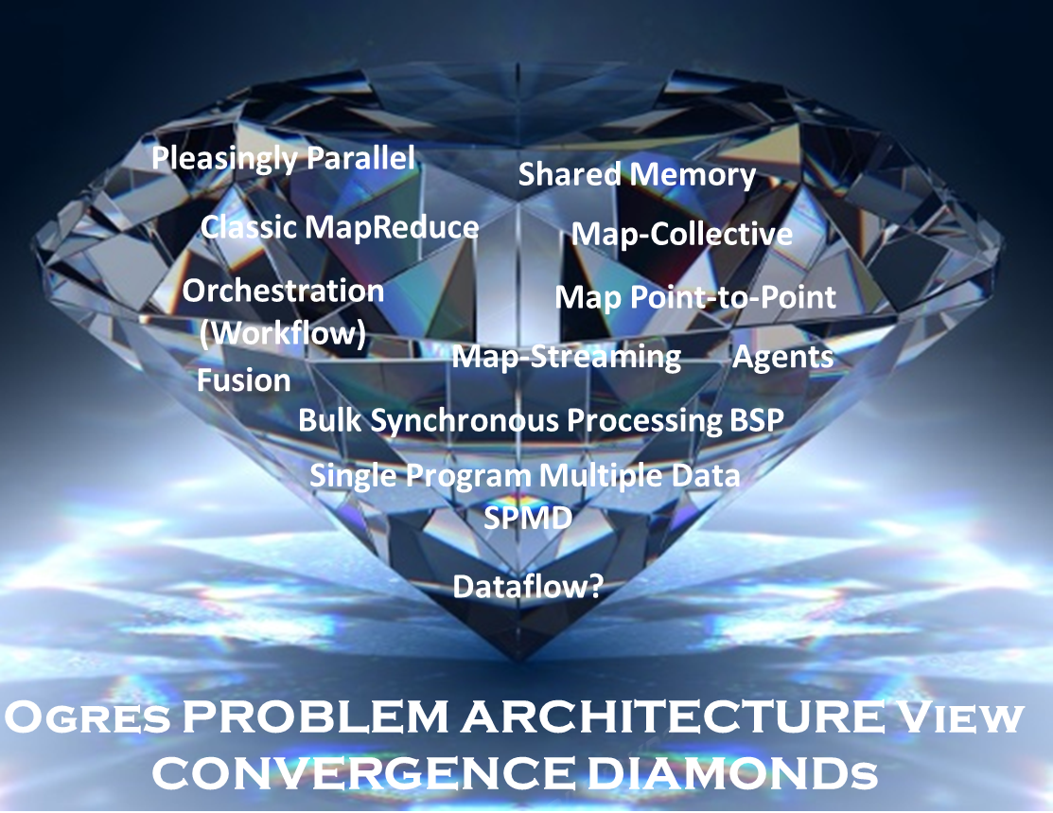

Slide 24
Problem Architecture View (Meta or MacroPatterns)
Pleasingly Parallel – as in BLAST, Protein docking, some (bio-)imagery including Local Analytics or Machine Learning – ML or filtering pleasingly parallel, as in bio-imagery, radar images (pleasingly parallel but sophisticated local analytics)
Classic MapReduce: Search, Index and Query and Classification algorithms like collaborative filtering (G1 for MRStat in Features, G7)
Map-Collective: Iterative maps + communication dominated by “collective” operations as in reduction, broadcast, gather, scatter. Common datamining pattern
Map-Point to Point: Iterative maps + communication dominated by many small point to point messages as in graph algorithms
Map-Streaming: Describes streaming, steering and assimilation problems
Shared Memory: Some problems are asynchronous and are easier to parallelize on shared rather than distributed memory – see some graph algorithms
SPMD: Single Program Multiple Data, common parallel programming feature
BSP or Bulk Synchronous Processing: well-defined compute-communication phases
Fusion: Knowledge discovery often involves fusion of multiple methods.
Dataflow: Important application features often occurring in composite Ogres
Use Agents: as in epidemiology (swarm approaches) This is Model only
Workflow: All applications often involve orchestration (workflow) of multiple components
Most (11 of total 12) are properties of Data+Model
Notes:
Big dwarfs are Ogres
Implement Ogres in ABDS+

Slide 25
Structure of Applications
Real-time (streaming) data is increasingly common in scientific and engineering research, and it is ubiquitous in commercial Big Data (e.g., social network analysis, recommender systems and consumer behavior classification)
  So far little use of commercial and Apache technology in analysis of scientific streaming data
Pleasingly parallel applications important in science (long tail) and data communities
Commercial-Science application differences: Search and recommender engines have different structure to deep learning, clustering, topic models, graph analyses such as subgraph mining
  Latter very sensitive to communication and can be hard to parallelize
  Search typically not as important in Science as in commercial use as search volume scales by number of users
Should discuss data and model separately
  Term data often used rather sloppily and often refers to model

Slide 26
Local and Global Machine Learning
Many applications use LML or Local machine Learning where machine learning (often from R or Python or Matlab) is run separately on every data item such as on every image
But others are GML Global Machine Learning where machine learning is a basic algorithm run over all data items (over all nodes in computer)
  maximum likelihood or χ² with a sum over the N data items – documents, sequences, items to be sold, images etc. and often links (point-pairs).
  GML includes Graph analytics, clustering/community detection, mixture models, topic determination, Multidimensional scaling, (Deep) Learning Networks
Note Facebook may need lots of small graphs (one per person and ~LML) rather than one giant graph of connected people (GML)

Slide 27
6 Forms of MapReduce
Describes Architecture of
- Problem (Model reflecting data)
- Machine
- Software
2 important variants (software) of Iterative MapReduce and Map-Streaming a) “In-place” HPC b) Flow for model and data

Slide 28
Examples in Problem Architecture View PA
The facets in the Problem architecture view include 5 very common ones describing synchronization structure of a parallel job:
  MapOnly or Pleasingly Parallel (PA1): the processing of a collection of independent events;
  MapReduce (PA2): independent calculations (maps) followed by a final consolidation via MapReduce;
  MapCollective (PA3): parallel machine learning dominated by scatter, gather, reduce and broadcast;
  MapPoint-to-Point (PA4): simulations or graph processing with many local linkages in points (nodes) of studied system.
  MapStreaming (PA5): The fifth important problem architecture is seen in recent approaches to processing real-time data.
  We do not focus on pure shared memory architectures PA6 but look at hybrid architectures with clusters of multicore nodes and find important performances issues dependent on the node programming model.
Most of our codes are SPMD (PA-7) and BSP (PA-8).

Slide 29
Relation of Problem and Machine Architecture
Problem is Model plus Data
In my old papers (especially book Parallel Computing Works!), I discussed computing as multiple complex systems mapped into each other
Problem → Numerical formulation → Software → Hardware
Each of these 4 systems has an architecture that can be described in similar language
One gets an easy programming model if architecture of problem matches that of Software
One gets good performance if architecture of hardware matches that of software and problem
So “MapReduce” can be used as architecture of software (programming model) or “Numerical formulation of problem”

Slide 30
Processing View

Slide 31
Diamond Facets in Processing (runtime) View I used in Big Data and Big Simulation
Pr-1M Micro-benchmarks ogres that exercise simple features of hardware such as communication, disk I/O, CPU, memory performance
Pr-2M Local Analytics executed on a single core or perhaps node
Pr-3M Global Analytics requiring iterative programming models (G5,G6) across multiple nodes of a parallel system
Pr-12M Uses Linear Algebra common in Big Data and simulations
  Subclasses like Full Matrix
  Conjugate Gradient, Krylov, Arnoldi iterative subspace methods
  Structured and unstructured sparse matrix methods
Pr-13M Graph Algorithms (G3) Clear important class of algorithms -- as opposed to vector, grid, bag of words etc. – often hard especially in parallel
Pr-14M Visualization is key application capability for big data and simulations
Pr-15M Core Libraries Functions of general value such as Sorting, Math functions, Hashing
Notes:
Big dwarfs are Ogres
Implement Ogres in ABDS+

Slide 32
Diamond Facets in Processing (runtime) View II used in Big Data
Pr-4M Basic Statistics (G1): MRStat in NIST problem features
Pr-5M Recommender Engine: core to many e-commerce, media businesses; collaborative filtering key technology
Pr-6M Search/Query/Index: Classic database which is well studied (Baru, Rabl tutorial)
Pr-7M Data Classification: assigning items to categories based on many methods
  MapReduce good in Alignment, Basic statistics, S/Q/I, Recommender, Classification
Pr-8M Learning of growing importance due to Deep Learning success in speech recognition etc..
Pr-9M Optimization Methodology: overlapping categories including
  Machine Learning, Nonlinear Optimization (G6), Maximum Likelihood or χ² least squares minimizations, Expectation Maximization (often Steepest descent), Combinatorial Optimization, Linear/Quadratic Programming (G5), Dynamic Programming
Pr-10M Streaming Data or online Algorithms. Related to DDDAS (Dynamic Data-Driven Application Systems)
Pr-11M Data Alignment (G7) as in BLAST compares samples with repository
Notes:
Big dwarfs are Ogres
Implement Ogres in ABDS+

Slide 33
Diamond Facets in Processing (runtime) View III used in Big Simulation
Pr-16M Iterative PDE Solvers: Jacobi, Gauss Seidel etc.
Pr-17M Multiscale Method? Multigrid and other variable resolution approaches
Pr-18M Spectral Methods as in Fast Fourier Transform
Pr-19M N-body Methods as in Fast multipole, Barnes-Hut
Pr-20M Both Particles and Fields as in Particle in Cell method
Pr-21M Evolution of Discrete Systems as in simulation of Electrical Grids, Chips, Biological Systems, Epidemiology. Needs Ordinary Differential Equation solvers
Pr-22M Nature of Mesh if used: Structured, Unstructured, Adaptive
Covers NAS Parallel Benchmarks and Berkeley Dwarfs
Notes:
Big dwarfs are Ogres
Implement Ogres in ABDS+

Slide 34
Execution View

Slide 35
Examples in Execution View EV
The Execution view is a mix of facets describing either data or model; PA was largely the overall Data+Model
EV-M14 is Complexity of model (O(N²) for N points) seen in the non-metric space models EV-M13 such as one gets with DNA sequences.
EV-M11 describes iterative structure distinguishing Spark, Flink, and Harp from the original Hadoop.
The facet EV-M8 describes the communication structure which is a focus of our research as much data analytics relies on collective communication which is in principle understood but we find that significant new work is needed compared to basic HPC releases which tend to address point to point communication.
The model size EV-M4 and data volume EV-D4 are important in describing the algorithm performance as just like in simulation problems, the grain size (the number of model parameters held in the unit – thread or process – of parallel computing) is a critical measure of performance.

Slide 36
View for Micropatterns or Execution Features
Performance Metrics; property found by benchmarking Diamond
Flops per byte; memory or I/O
Execution Environment; Core libraries needed: matrix-matrix/vector algebra, conjugate gradient, reduction, broadcast; Cloud, HPC etc.
Volume: property of a Diamond instance: a) Data Volume and b) Model Size
Velocity: qualitative property of Diamond with value associated with instance. Only Data
Variety: important property especially of composite Diamonds; Data and Model separately
Veracity: important property of applications but not kernels;
Model Communication Structure; Interconnect requirements; Is communication BSP, Asynchronous, Pub-Sub, Collective, Point to Point?
Is Data and/or Model (graph) static or dynamic?
Much Data and/or Models consist of a set of interconnected entities; is this regular as a set of pixels or is it a complicated irregular graph?
Are Models Iterative or not?
Data Abstraction: key-value, pixel, graph(G3), vector, bags of words or items; Model can have same or different abstractions e.g. mesh points, finite element, Convolutional Network
Are data points in metric or non-metric spaces? Data and Model separately?
Is Model algorithm O(N²) or O(N) (up to logs) for N points per iteration (G2)

Slide 37
Data Source and Style View

Slide 38
Examples in Data View DV
We can highlight DV-5 streaming where there is a lot of recent progress;
DV-9 categorizes our Biomolecular simulation application with data produced by an HPC simulation
DV-10 is Geospatial Information Systems covered by our spatial algorithms.
DV-7 provenance, is an example of an important feature that we are not covering.
The data storage and access DV-3 and D-4 is covered in our pilot data work.
The Internet of Things DV-8 is not a focus of our project although our recent streaming work relates to this and our addition of HPC to Apache Heron and Storm is an example of the value of HPC-ABDS to IoT.

Slide 39
Data Source and Style Diamond View I
SQL NewSQL or NoSQL: NoSQL includes Document,
Column, Key-value, Graph, Triple store; NewSQL is SQL redone to exploit NoSQL performance
Other Enterprise data systems: 10 examples from NIST integrate SQL/NoSQL
Set of Files or Objects: as managed in iRODS and extremely common in scientific research
File systems, Object, Blob and Data-parallel (HDFS) raw storage: Separated from computing or colocated? HDFS v Lustre v. Openstack Swift v. GPFS
Archive/Batched/Streaming: Streaming is incremental update of datasets with new algorithms to achieve real-time response (G7); Before data gets to compute system, there is often an initial data gathering phase which is characterized by a block size and timing. Block size varies from month (Remote Sensing, Seismic) to day (genomic) to seconds or lower (Real time control, streaming)
  Streaming divided into categories overleaf
Notes:
Big dwarfs are Ogres
Implement Ogres in ABDS+

Slide 40
Data Source and Style Diamond View II
Streaming divided into 5 categories depending on event size and synchronization and integration
  Set of independent events where precise time sequencing unimportant.
  Time series of connected small events where time ordering important.
  Set of independent large events where each event needs parallel processing with time sequencing not critical
  Set of connected large events where each event needs parallel processing with time sequencing critical.
  Stream of connected small or large events to be integrated in a complex way.
Shared/Dedicated/Transient/Permanent: qualitative property of data; Other characteristics are needed for permanent auxiliary/comparison datasets and these could be interdisciplinary, implying nontrivial data movement/replication
Metadata/Provenance: Clear qualitative property but not for kernels as important aspect of data collection process
Internet of Things: 24 to 50 Billion devices on Internet by 2020
HPC simulations: generate major (visualization) output that often needs to be mined
Using GIS: Geographical Information Systems provide attractive access to geospatial data
Notes:
Big dwarfs are Ogres
Implement Ogres in ABDS+

Slide 41
Data Source and Style View
10 Bob Marcus Data Processing Use Cases

Slide 42
10 Bob Marcus Data Processing Use Cases
Multiple users performing interactive queries and updates on a database with basic availability and eventual consistency (BASE = (Basically Available, Soft state, Eventual consistency) as opposed to ACID = (Atomicity, Consistency, Isolation, Durability) )
Perform real time analytics on data source streams and notify users when specified events occur
Move data from external data sources into a highly horizontally scalable data store, transform it using highly horizontally scalable processing (e.g. Map-Reduce), and return it to the horizontally scalable data store (ELT Extract Load Transform)
Perform batch analytics on the data in a highly horizontally scalable data store using highly horizontally scalable processing (e.g MapReduce) with a user-friendly interface (e.g. SQL like)
Perform interactive analytics on data in analytics-optimized database
Visualize data extracted from horizontally scalable Big Data store
Move data from a highly horizontally scalable data store into a traditional Enterprise Data Warehouse (EDW)
Extract, process, and move data from data stores to archives
Combine data from Cloud databases and on premise data stores for analytics, data mining, and/or machine learning
Orchestrate multiple sequential and parallel data transformations and/or analytic processing using a workflow manager

Slide 43



1. Multiple users performing interactive queries and updates on a database with basic availability and eventual consistency
Generate a SQL Query
Process SQL Query (RDBMS Engine, Hive, Hadoop, Drill)
Data Storage: RDBMS, HDFS, Hbase
Includes access to traditional ACID database
Data, Streaming, Batch ...

Slide 44
Typical Big Data Pattern 2. Perform real time analytics on data source streams and notify users when specified events occur
Specify filter
Filter Identifying Events
Fetch streamed Data
Post Selected Events
Streaming Data
Posted Data
Identified Events
Streaming Data
Streaming Data
Archive
Repository
Storm (Heron), Kafka, Hbase, Zookeeper

Slide 45
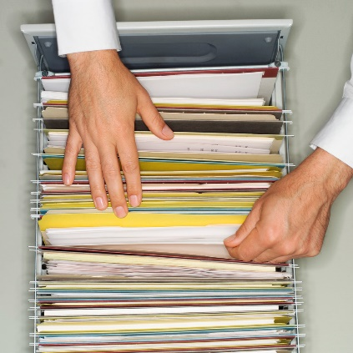
3. Move data from external data sources into a highly horizontally scalable data store, transform it using highly horizontally scalable processing (e.g. Map-Reduce), and return it to the horizontally scalable data store (ELT)
Transform with Hadoop, Spark, Giraph…
Enterprise
Data
Warehouse
Data Storage: HDFS, Hbase
OLTP Database
Streaming Data
Web Services
ETL is Extract Load Transform
http://www.dzone.com/articles/hadoop-t-etl

Slide 46
4. Perform batch analytics on the data in a highly horizontally scalable data store using highly horizontally scalable processing (e.g MapReduce) with a user-friendly interface (e.g. SQL like)
SQL Query General Analytics
HCatalog
Hive
Mahout, R
Hadoop, Spark, Giraph, Pig …
Data Storage: HDFS, Hbase
Data, Streaming, Batch …..

Slide 47
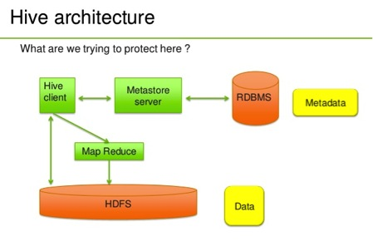
Hive Example
http://venublog.com/2013/07/16/hadoop-summit-2013-hive-authorization/

Slide 48
5. Perform interactive analytics on data in analytics-optimized database
Mahout, R SPIDAL
Hadoop, Spark, Flink, Giraph, Pig …
Data Storage: HDFS, Hbase, MongoDB
Data, Streaming, Batch …..

Slide 49
Typical Big Data Pattern 5A. Perform interactive analytics on observational scientific data
Science Analysis Code, Mahout, R, SPIDAL
Grid or Many Task Software, Hadoop, Spark, Giraph, Pig …
Data Storage: HDFS, Hbase, File Collection
Direct Transfer
Transport batch of data to primary analysis data system
Streaming Twitter data for Social Networking
Local Accumulate and initial computing
NIST examples include LHC, Remote Sensing, Astronomy and Bioinformatics
Record Scientific Data in “field”

Slide 50
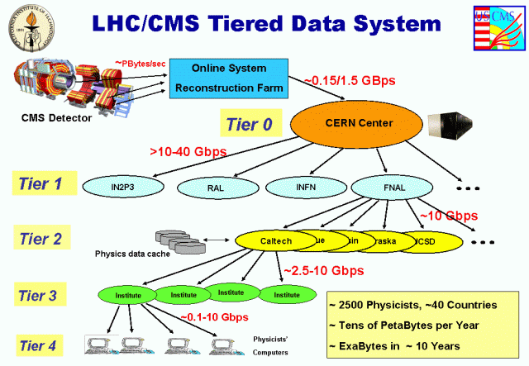
Particle Physics (LHC)
LHC Data analyzes ~30 petabytes of data per year produced at CERN using ~300,000 cores around the world
Data reduced in size, replicated and looked at by physicists

Slide 51
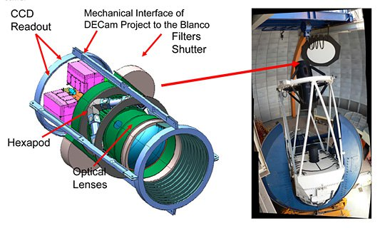
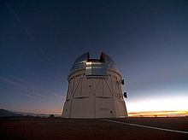
Astronomy – Dark Energy Survey I
Victor M. Blanco Telescope Chile where new wide angle 520 mega pixel camera DECam installed
https://indico.cern.ch/event/214784/session/5/contribution/410
Ends up as part of International Virtual observatory (IVOA), which is a collection of interoperating data archives and software tools which utilize the internet to form a scientific research environment in which astronomical research programs can be conducted.

Slide 52
Astronomy – Dark Energy Survey II
For DES (Dark Energy Survey) the data are sent from the mountaintop via a microwave link to La Serena, Chile. From there, an optical link forwards them to the NCSA (UIUC) as well as NERSC (LBNL) for storage and "reduction”. Here galaxies and stars in both the individual and stacked images are identified, catalogued, and finally their properties measured and stored in a database.
DES Machine room at NCSA

Slide 53
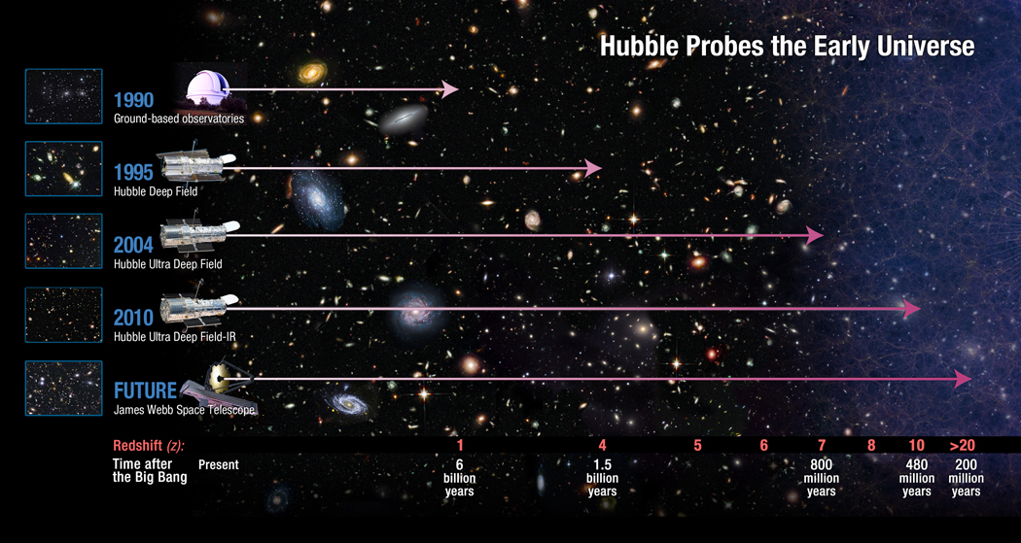
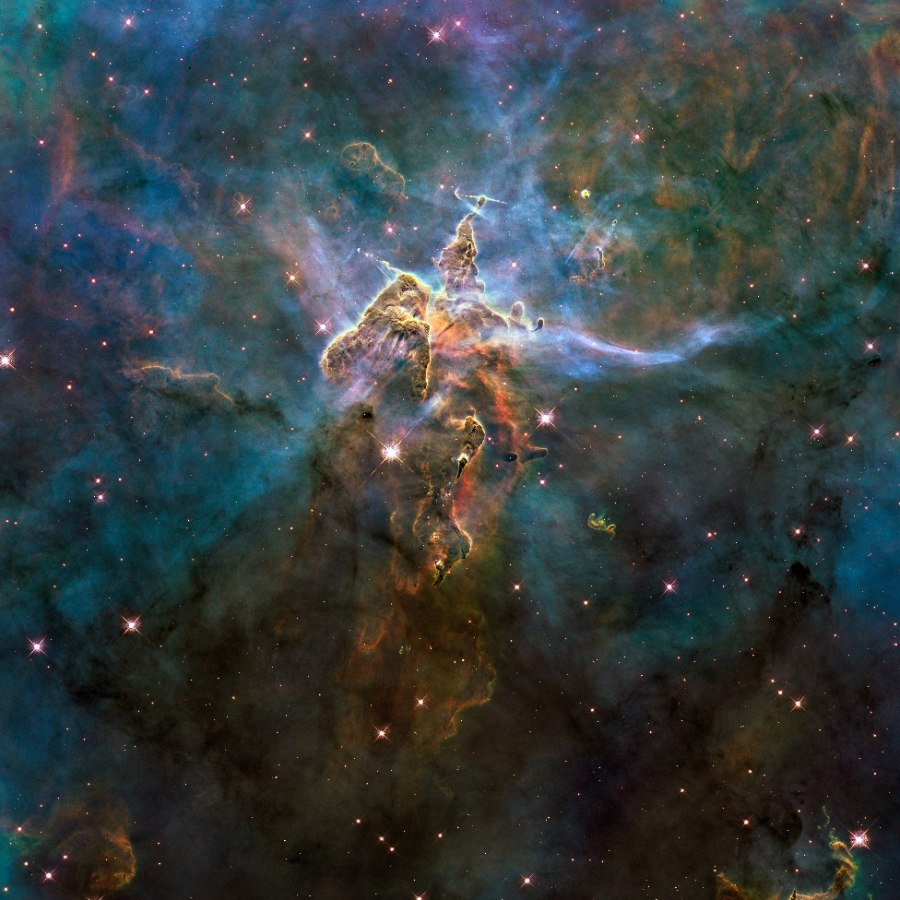
Astronomy
Hubble
Space Telescope
HST Processing in Baltimore Md
http://asd.gsfc.nasa.gov/archive/hubble/a_pdf/news/facts/FS14.pdf

Slide 54
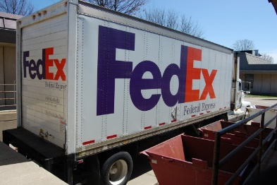
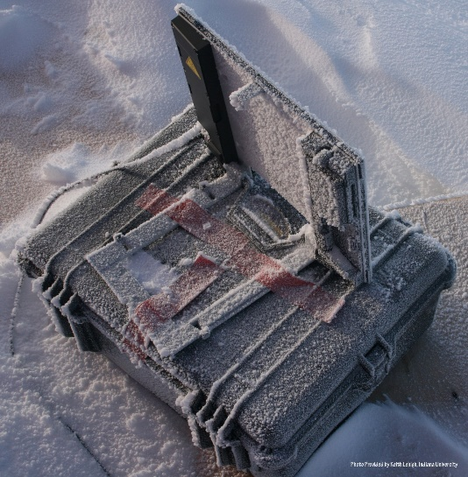

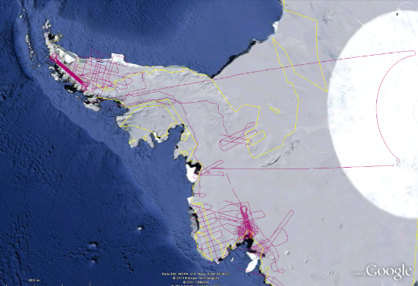
CReSIS Remote Sensing: Radar Surveys
Expeditions last 1-2 months and gather up to 100 TB data. Most is saved on removable disks and flown back to continental US at end. A sample is analyzed in field to check instrument

Slide 55
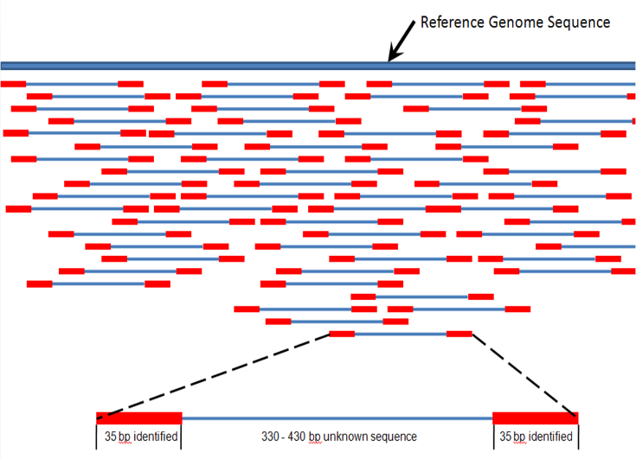
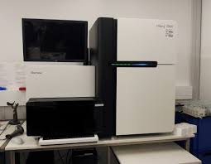

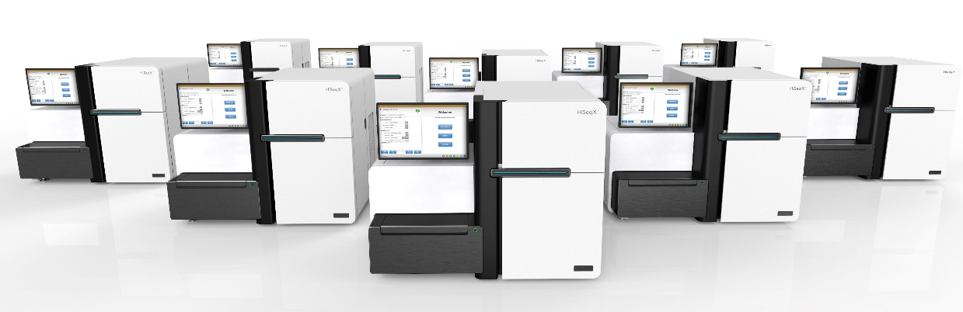
Gene Sequencing
Distributed (Illumina) devices distributed across world in many laboratories take data in form of “reads” that are aligned into a full sequence
This processing often local but data needs to be compared with world’s other gene so uploaded to central repository
Illumina HiSeq X 10 can sequence 18,000 genomes per year at $1000 each. Produces 0.6Terabases per day

Slide 56
6. Visualize data extracted from horizontally scalable Big Data store
Interactive Visualization
Specify Analytics
Orchestration Layer
Prepare Interactive Visualization
Mahout, R
Hadoop, Spark, Giraph, Pig …
Data Storage: HDFS, Hbase

Slide 57
7. Move data from a highly horizontally scalable data store into a traditional Enterprise Data Warehouse
Data Warehouse Query
Enterprise
Data
Warehouse
Transform with Hadoop, Spark, Giraph …
Data Storage: HDFS, Hbase, (RDBMS)
OLTP Database
Streaming Data
Web Services

Slide 58
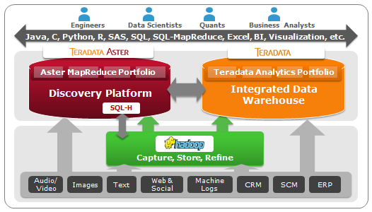
Moving to EDW Example from Teradata
Moving data from HDFS to Teradata Data Warehouse and Aster Discovery Platform
http://blogs.teradata.com/data-points/announcing-teradata-aster-big-analytics-appliance/

Slide 59
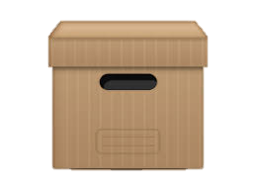
8. Extract, process, and move data from data stores to archives
Transform as needed
Transform with Hive, Drill, Hadoop, Spark, Giraph, Pig …
Data Storage: HDFS, Hbase, RDBMS
Archive
OLTP Database
Streaming Data
Web Services
http://www.dzone.com/articles/hadoop-t-etl
ETL is Extract Load Transform

Slide 60
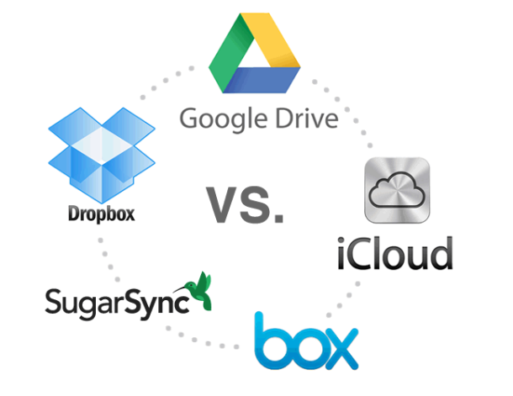
9. Combine data from Cloud databases and on premise data stores for analytics, data mining, and/or machine learning
Mahout, R
Similar to 4 and 5
Hadoop, Spark, Giraph, Pig …
Data Storage: HDFS, Hbase
On premise Data
Streaming Data

Slide 61
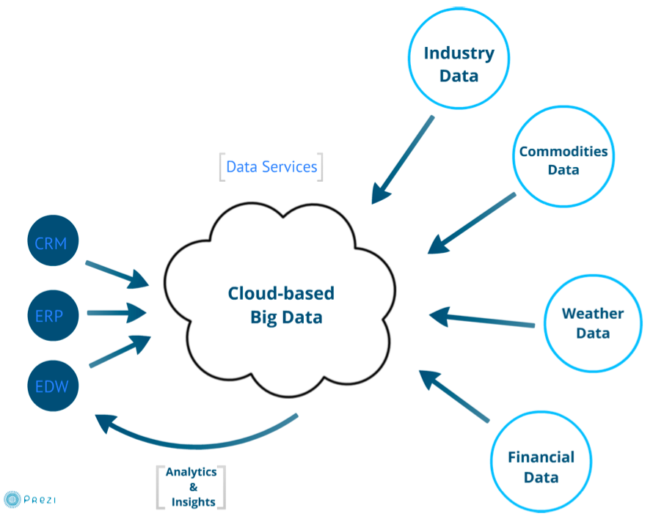
Example: Integrate Cloud and local data
http://wikibon.org/w/images/2/20/Cloud-BigData.png

Slide 62
10. Orchestrate multiple sequential and parallel data transformations and/or analytic processing using a workflow manager
This can be used for science by adding data staging phases as in case 5A
Specify Analytics Pipeline
Orchestration Layer (Workflow)
Analytic-3
(Visualize)
Analytic-2
Analytic-1
Hadoop, Spark, Giraph, Pig …
Data Storage: HDFS, Hbase

Slide 63
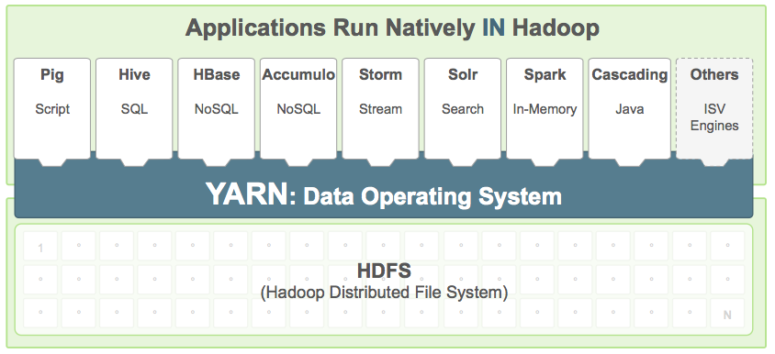
Example from Hortonworks
http://hortonworks.com/hadoop/yarn/

