Slide 1
Tools in SPIDAL: Scalable Parallel Interoperable Data Analytics Library
Large Scale Data Analytics Workshop
August 9 2013
Geoffrey Fox
gcf@indiana.edu
http://www.infomall.org/
School of Informatics and Computing
Indiana University Bloomington

Slide 2
Overview
Higher level (but still low level tools) Capabilities
Biology Distance Calculations
Clustering
Dimension Reduction
Plotting – Point and Heat maps
Mode
Batch versus Online (Interpolative)
Even Lower Level Capabilities
Eigenvalue Solvers
Conjugate Gradient Equation solvers
Robust χ² Solver (Levenberg-Marquardt)
Implementations http://beaver.ads.iu.edu:9000/
MPI and/or Iterative MapReduce run up to 1000 cores with MPI/Threading mix
Parallel Threading
Not much GPU
~75,000 lines of Java or C#
Techniques
Expectation Maximization (Steepest Descent)
Deterministic Annealing to avoid local minima
Second Order Newton solvers
PS I have always worked on Optimization problems – first paper 1966

Slide 3
Multi-Dimensional Scaling
Map general set of n points to d (typically 3) dimensions
Map genomic/proteomic sequences to ~20D as alternative to Multiple Sequence Alignment
Original Data is vectors: Generative Topographic Map GTM and Deterministic Annealing + GTM
No vectors – only a distance metric d(X_{i} , X_{j}) : Classic MDS with SMACOF and χ² versions: Minimize Stress
σ(X) = Σ_{i<j=1}^{n} weight(i, j) [δ(i, j) - d(X_{i} , X_{j})]²
δ(i, j) are input dissimilarities
SMACOF has deterministic annealing version
Recently added SMACOF for weight(i, j) ≠ 1; until this needed slower χ² method for general problem
Note O(n²) Objective function makes Newton’s method effective because conjugate gradient makes O(n³) linear equation solvers act as constant . O(n²) solver
Interpolative (online) versions

Slide 4
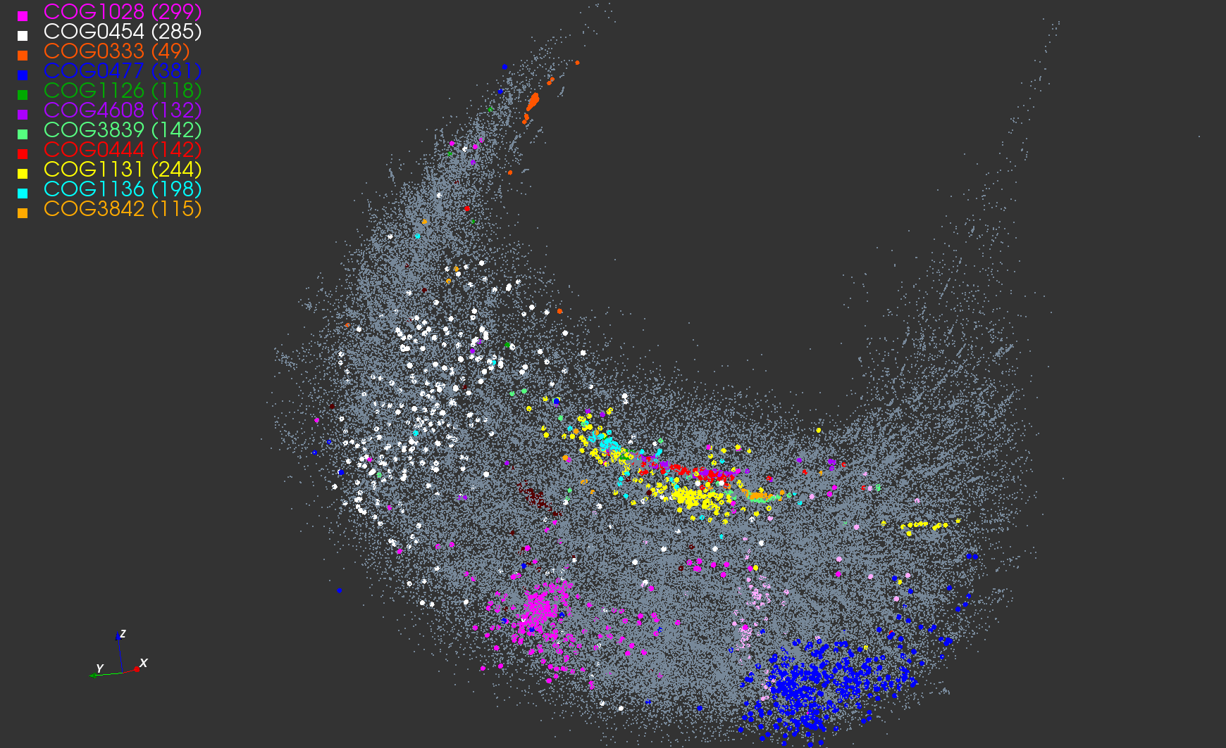
Protein Universe Browser for COG Sequences with a few illustrative biologically identified clusters

Slide 5
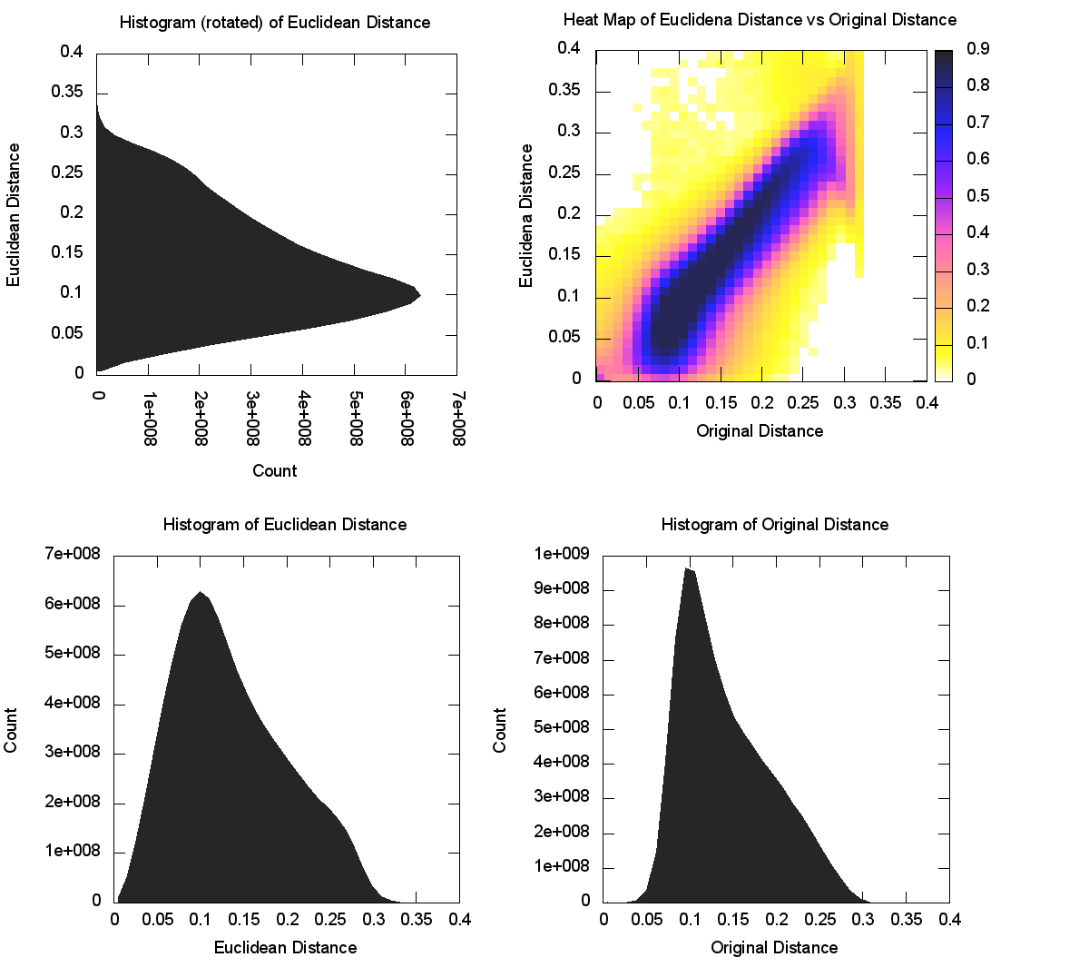
CoG NW Sqrt (4D)

Slide 6
Clustering
Vector Datasets O(N): Kmeans plus deterministic annealing
Improved Elkans algorithm (Qiu)
Continuous Clustering (solve for cluster density at a center)
Trimmed (finite size) clusters
Non-metric Spaces with only dissimilarities defined O(N²) with deterministic annealing
Deterministic Annealing (vector or non-vector) always improves results but not always needed note
DA does not need specification of # clusters
Comes from early neural networks days (Hopfield, Durbin)
Hierarchical algorithms (roughly built in with DA)
Related algorithms Gaussian Mixture Models, PLSI (probabilistic latent semantic indexing), LDA (Latent Dirichlet Allocation) also with Deterministic annealing

Slide 7
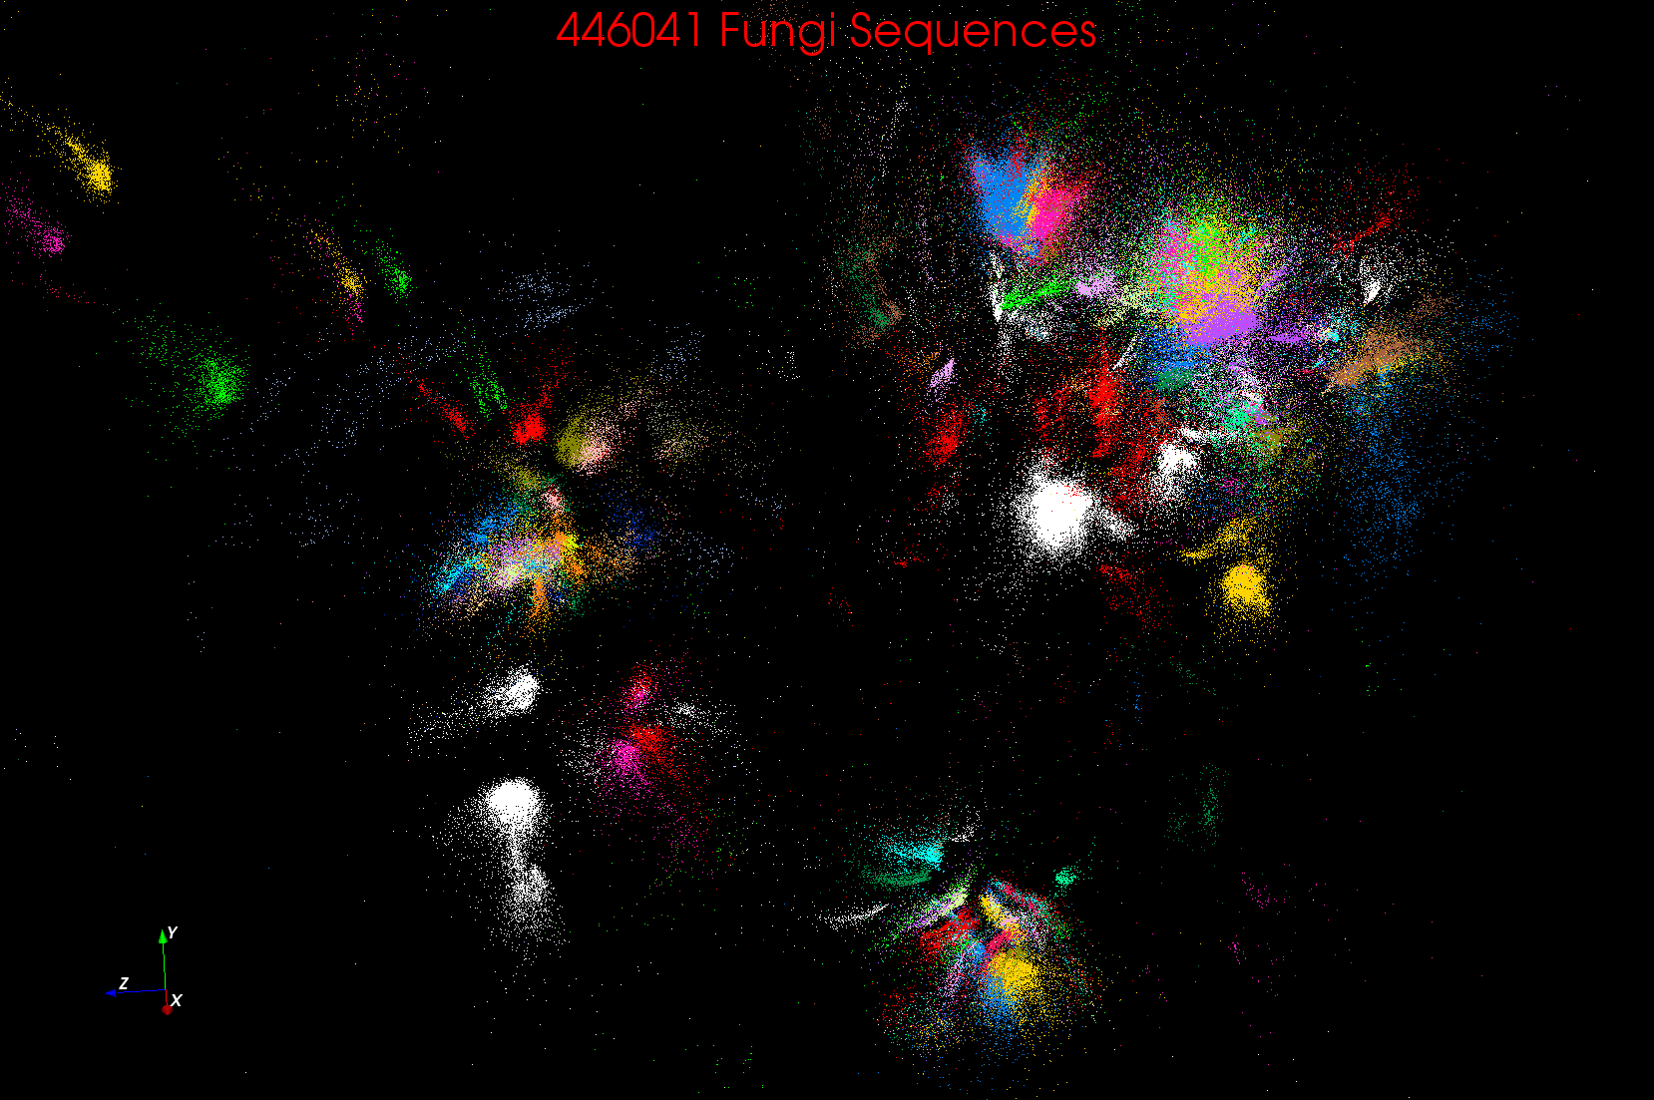
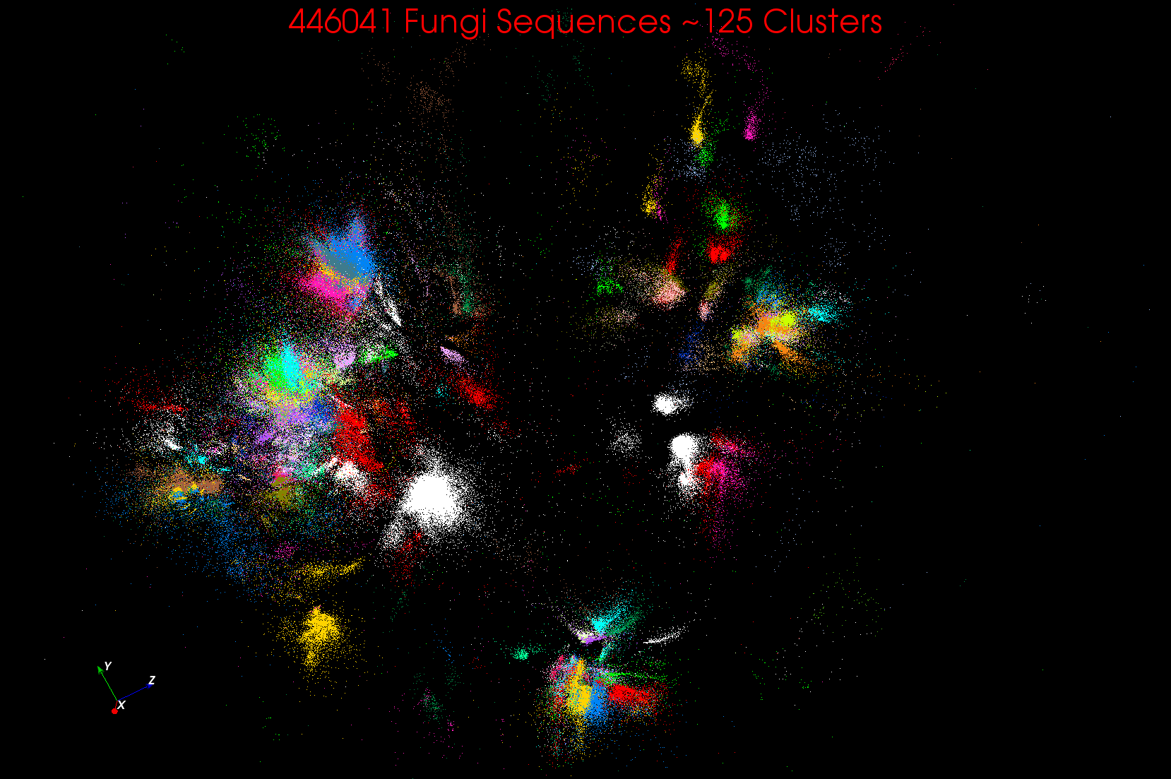
~125 Clusters from Fungi sequence set
Non metric space Sequences Length ~500 Smith Waterman
A month on 768 cores

Slide 8
Deterministic Annealing
F({y}, T)
Solve Linear Equations for each temperature
Nonlinear effects mitigated by initializing with solution at previous higher temperature
Configuration {y}
Minimum evolving as temperature decreases
Movement at fixed temperature going to false minima if not initialized “correctly

Slide 9
Basic Deterministic Annealing
H is objective function to be minimized as a function of parameters χ
Gibbs Distribution at Temperature T P(χ) = exp( - H(χ)/T) / ∫ dχ exp( - H(χ)/T)
Or P(χ) = exp( - H(χ)/T + F/T )
Minimize Free Energy combining Objective Function and Entropy F = < H - T S(P) > = ∫ dχ {P(χ)H + T P(χ) lnP(χ)}
Simulated annealing corresponds to doing these integrals by Monte Carlo
Deterministic annealing corresponds to doing integrals analytically (by mean field approximation) and is much faster
In each case temperature is lowered slowly – say by a factor 0.95 to 0.9999 at each iteration
Start with one cluster, others emerge automatically as T decreases

Slide 10
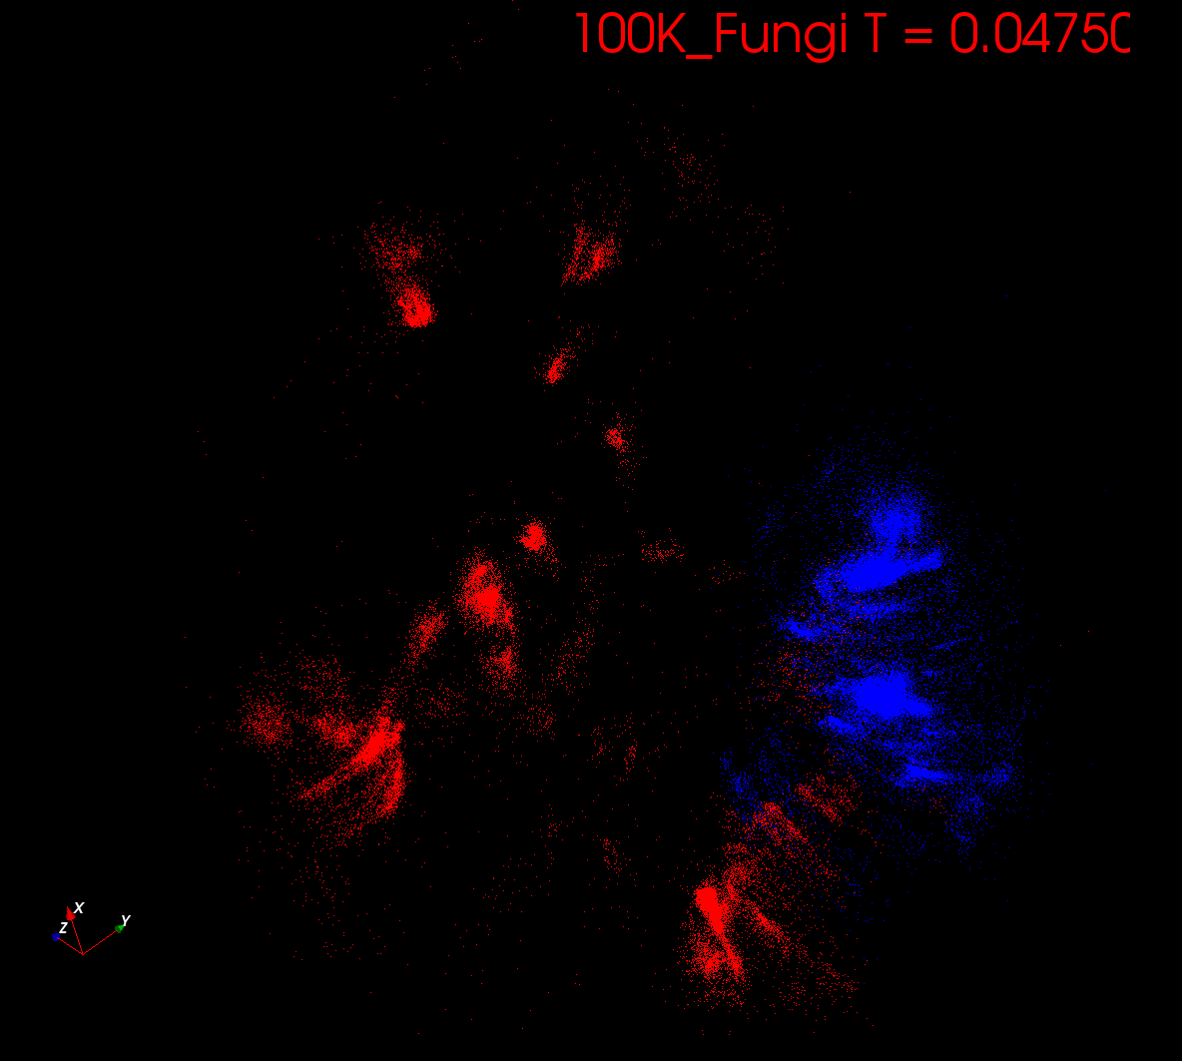
Start at T= “∞” with 1 Cluster
Decrease T, Clusters emerge at instabilities

Slide 11
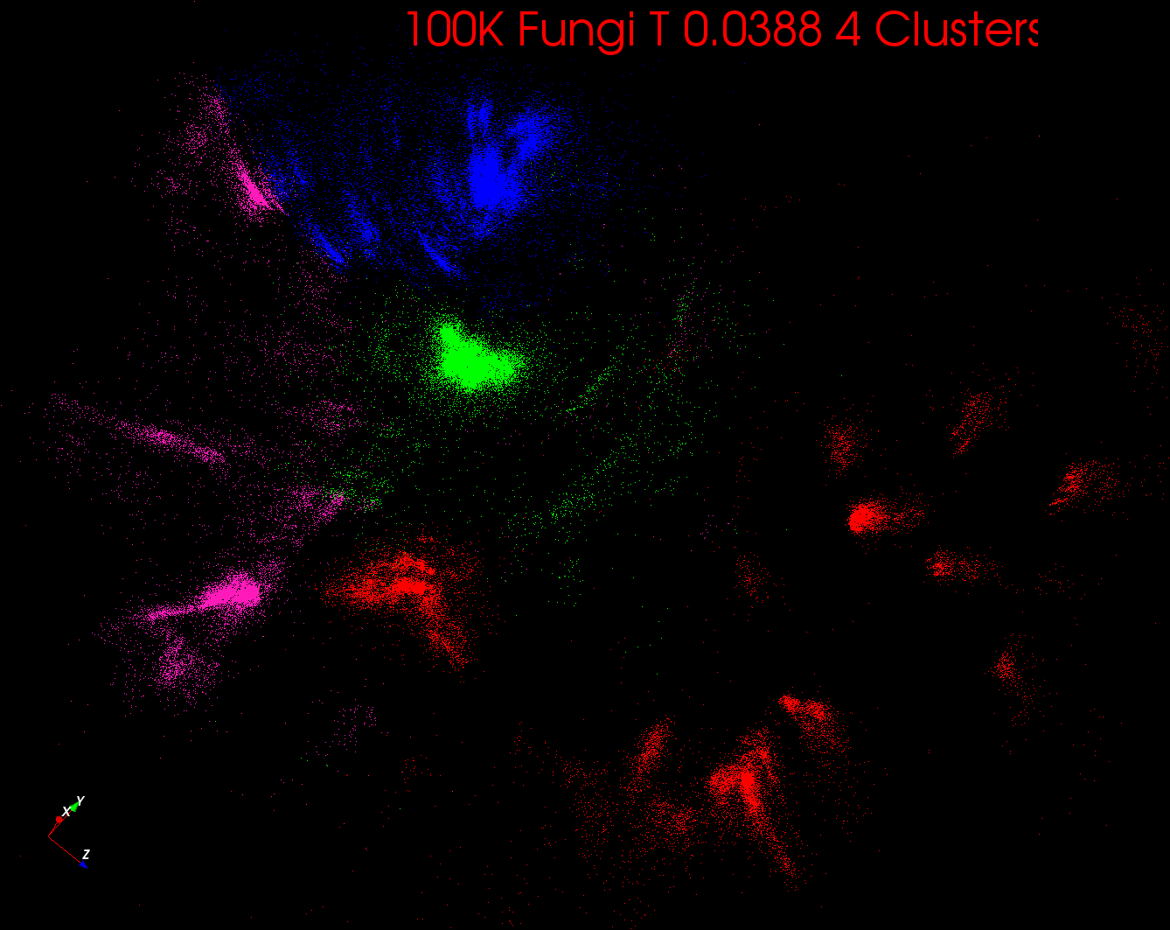

Slide 12
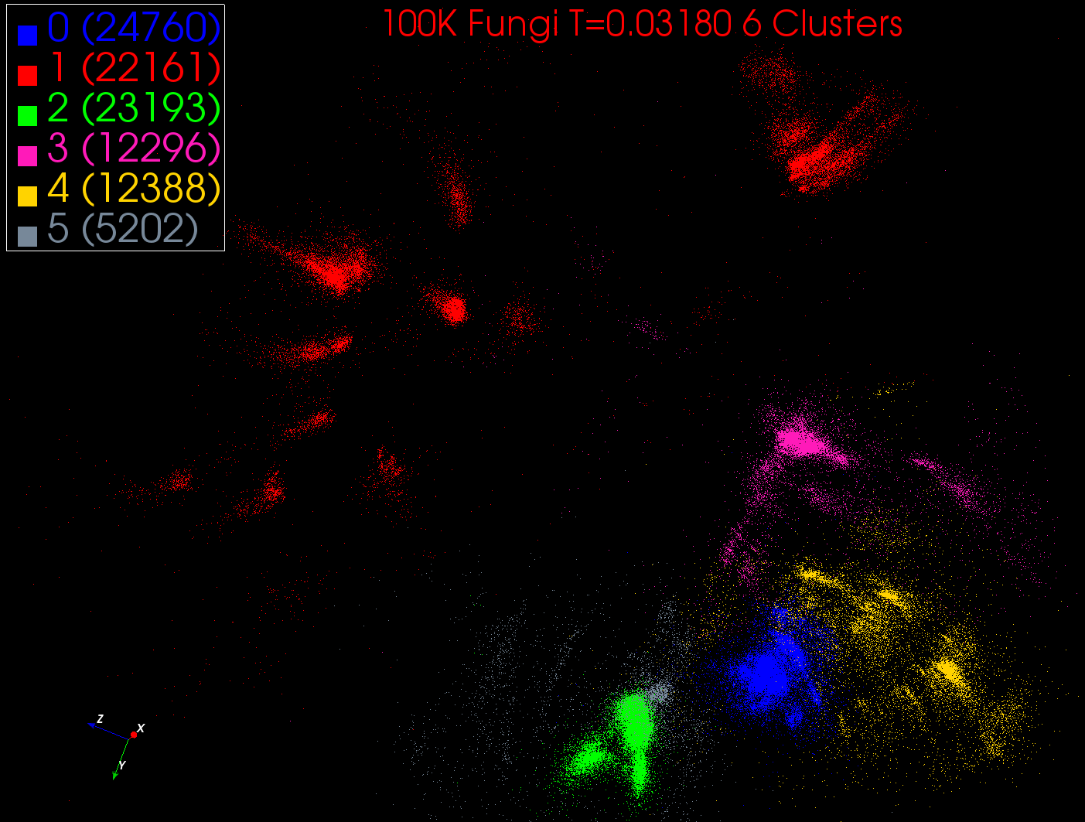

Slide 13
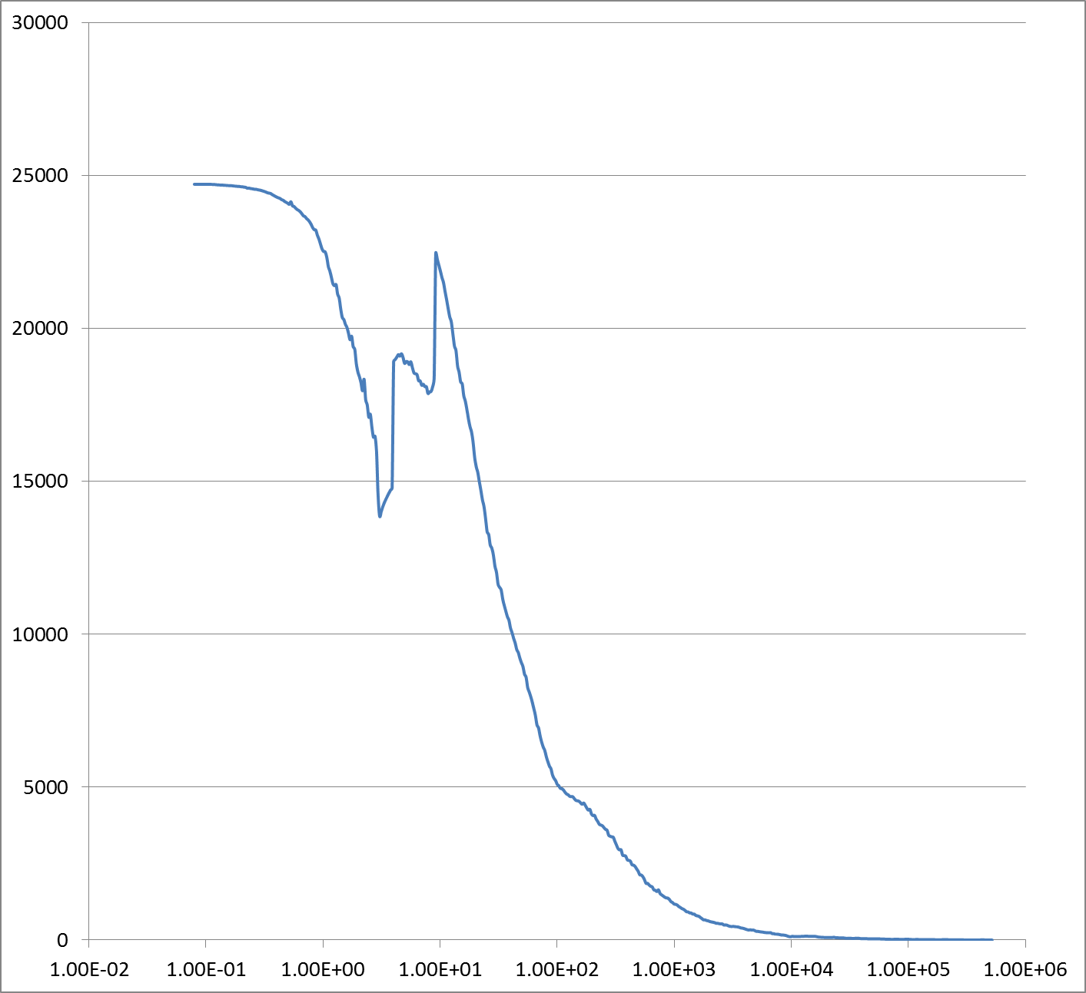
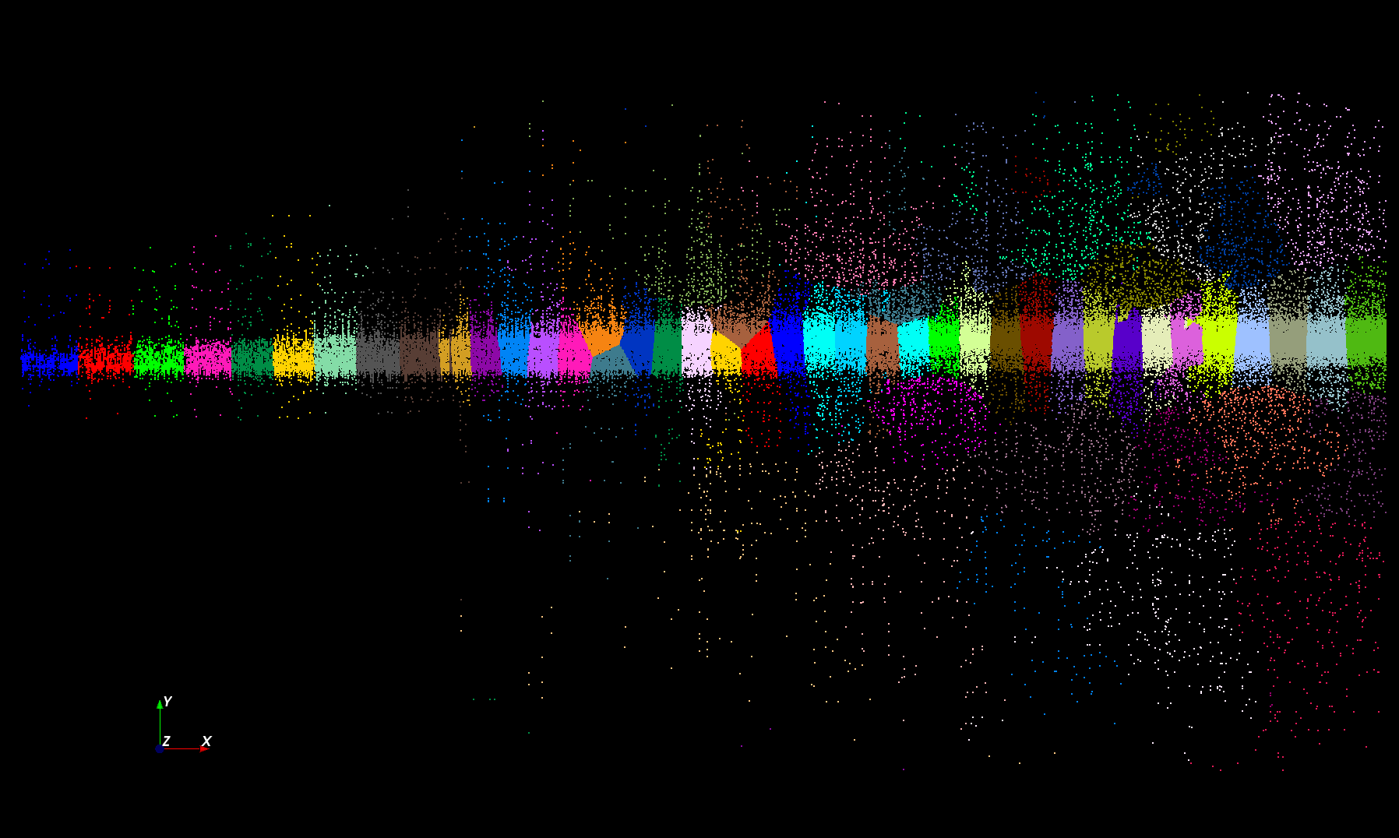
Proteomics LC-MS 2D DA Clustering T= 25000 60 Clusters
Number of Clusters
End
Start
Temperature

Slide 14
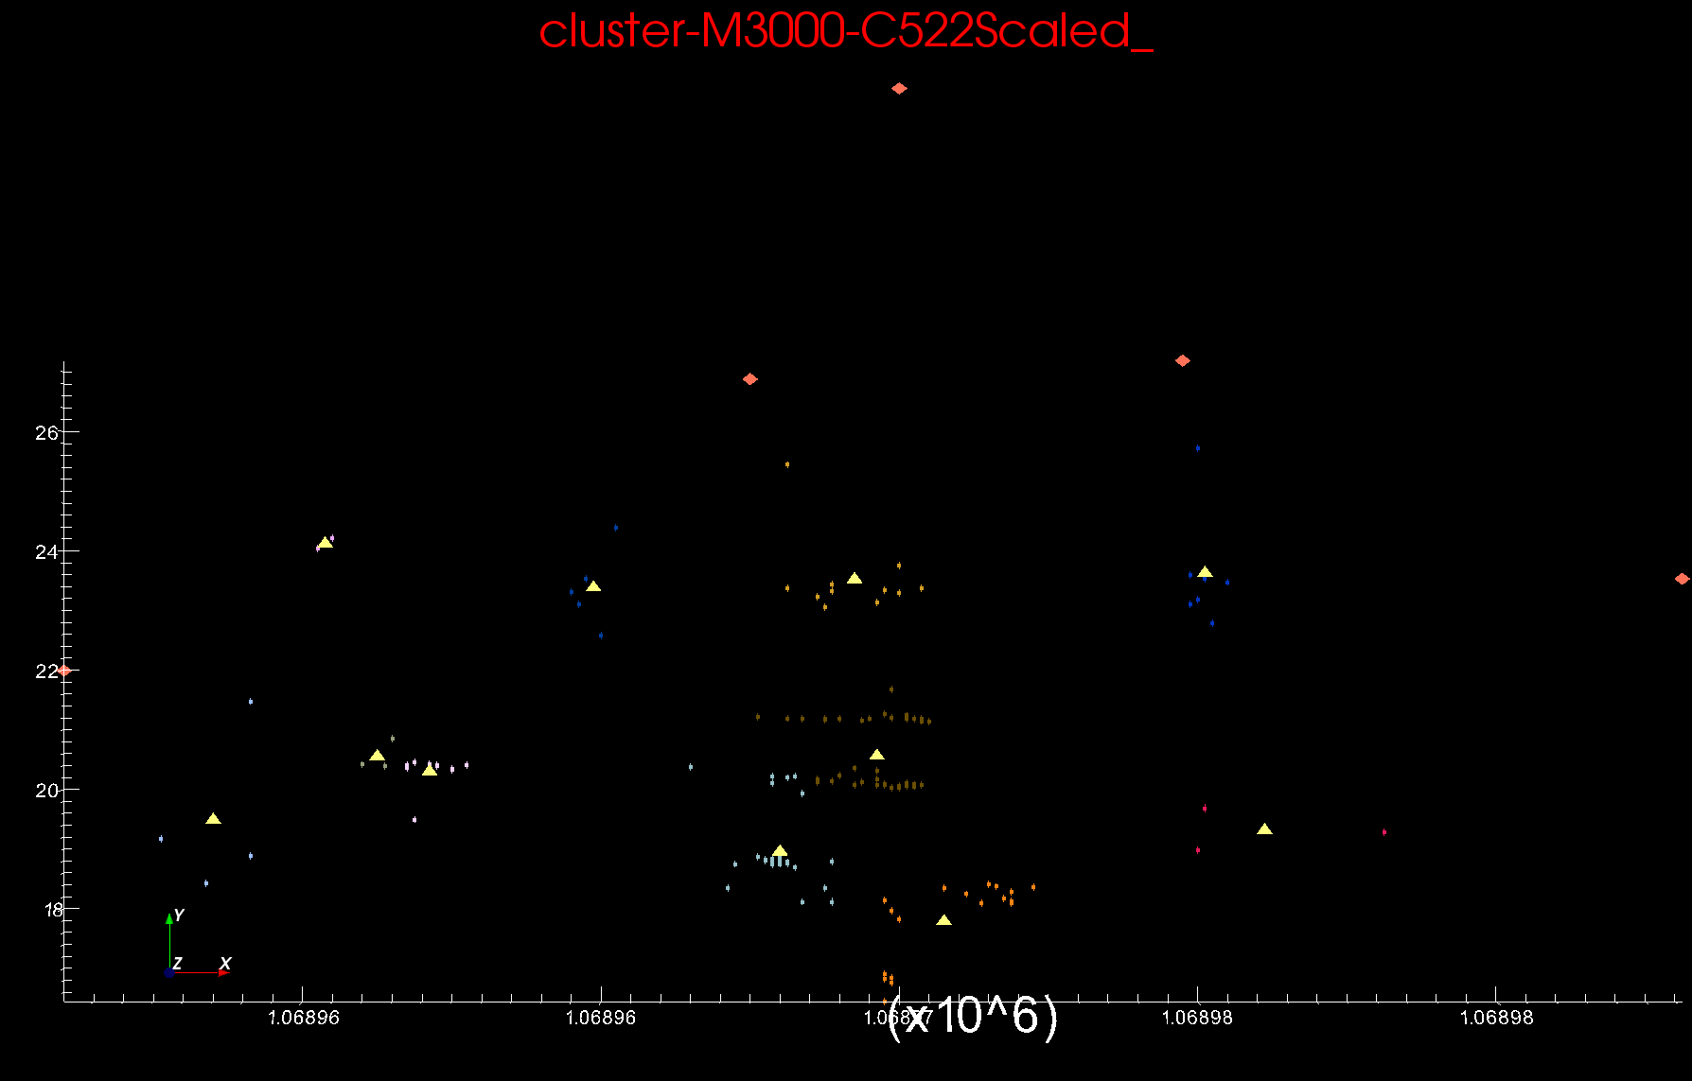
Proteomics 2D DA Clustering T=0.1 small sample of ~30,000 Clusters Count >=2
Orange sponge points
Outliers not in cluster
Yellow triangles Centers

Slide 15
Clusters v. Regions
Lymphocytes 4D
Pathology 54D
In Lymphocytes clusters are distinct
In Pathology, clusters divide space into regions and sophisticated methods like deterministic annealing are probably unnecessary

Slide 16
Generalizing large Scale χ²
χ² = Σ_{i=1}^{N} [t(i, x(k)) – e(i)]²
“Just” an objective function to be minimized as a function of x(k)
Parallelism over i and k
If you can calculate ∂t(i)/∂x(k) (automatic compilers available), then can either do
“Steepest descent” x(k) = x₀(k) – Σ_{i=1}^{N} const ∂t(i)/∂x(k) guaranteed to decrease χ² but likely to get local minima
“Newton’s method” solving second order Taylor expansion always fails unless “regularize” but always succeeds with good solver (maybe too slow though)
Levenberg Marquardt regularizes Σ_{i=1}^{N} ∂t(i)/∂x(k) ∂t(i)/∂x(l) by adding multiple Q of unit matrix
Solve equations by conjugate gradient ~ N (# parameters)²
“Manxcat” (based on 1976 physics expt code) choses Q etc.

Slide 17
Overview
Higher level (but still low level tools) Capabilities
Biology Distance Calculations
Clustering
Dimension Reduction
Plotting – Point and Heat maps
Mode
Batch versus Online (Interpolative)
Even Lower Level Capabilities
Eigenvalue Solvers
Conjugate Gradient Equation solvers
Robust χ² Solver (Levenberg-Marquardt)
Implementations http://beaver.ads.iu.edu:9000/
MPI and/or Iterative MapReduce run up to 1000 cores with MPI/Threading mix
Parallel Threading
Not much GPU
~75,000 lines of Java or C#
Techniques
Expectation Maximization (Steepest Descent)
Deterministic Annealing to avoid local minima
Second Order Newton solvers
PS I have always solved Optimization problems – first paper 1966

Slide 18
Future
Scale to lots more cores and larger problems (HPC, Azure …)
Add GPU’s or MIC chip
Lets look at other problems
Bundle as easy to use services
Choose best batch set for large batch + online run
O(N²) → O(N)
Exploit cluster as well as point parallelism (similar to better hierarchical method)

