Slide 1
SPIDAL Java High Performance Data Analytics with Java on Large Multicore HPC Clusters
24th High Performance Computing Symposium (HPC 2016)
April 3-6, 2016, Pasadena, CA, USA
as part of the SCS Spring Simulation Multi-Conference (SpringSim'16)
Saliya Ekanayake | Supun Kamburugamuve | Geoffrey Fox
sekanaya@indiana.edu
https://github.com/DSC-SPIDAL | http://saliya.org

Slide 2
High Performance?
64x Ideal (if life was so fair!)
40x Speedup with SPIDAL Java
We’ll discuss today
Typical Java with Threads and MPI
Typical Java with All MPI
48 Nodes
Intel Haswell HPC Clusterwith 40Gbps Infiniband
128 Nodes

Slide 3
Introduction
Big Data and HPC
Big data + cloud is the norm, but not always
Some applications demand significant computation and communication
HPC clusters are ideal
However, it’s not easy
Java
Unprecedented big data ecosystem
Apache has over 300 big data systems, mostly written in Java
Performance and APIs have improved greatly with 1.7x
Not much used in HPC, but can give comparative performance (e.g. SPIDAL Java)
Comparative performance to C (more on this later)
Google query https://www.google.com/webhp?sourceid=chrome-instant&ion=1&espv=2&ie=UTF-8#q=java%20faster%20than%20c will point to interesting discussions on why.
Interoperable and productive

Slide 4
SPIDAL Java
Scalable Parallel Interoperable Data Analytics Library (SPIDAL)
Available at https://github.com/DSC-SPIDAL
Includes Multidimensional Scaling (MDS) and Clustering Applications
DA-MDS
Y. Ruan and G. Fox, "A Robust and Scalable Solution for Interpolative Multidimensional Scaling with Weighting," eScience (eScience), 2013 IEEE 9th International Conference on, Beijing, 2013, pp. 61-69. doi: 10.1109/eScience.2013.30
DA-PWC
Fox, G. C. Deterministic annealing and robust scalable data mining for the data deluge. In Proceedings of the 2nd International Workshop on Petascal Data Analytics: Challenges and Opportunities, PDAC ’11, ACM (New York, NY, USA, 2011), 39–40.
DA-VS
Fox, G., Mani, D., and Pyne, S. Parallel deterministic annealing clustering and its application to lc-ms data analysis. In Big Data, 2013 IEEE International Conference on (Oct 2013), 665–673.
MDSasChisq
General MDS implementation using LevenbergMarquardt algorithm
Levenberg, K. A method for the solution of certain non-linear problems in least squares. Quarterly Journal of Applied Mathmatics II, 2 (1944), 164–168.)

Slide 5
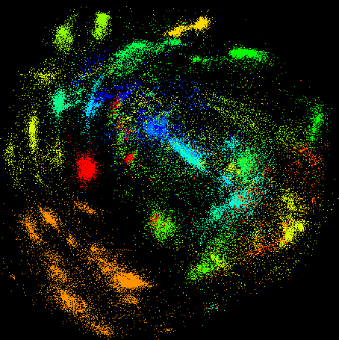
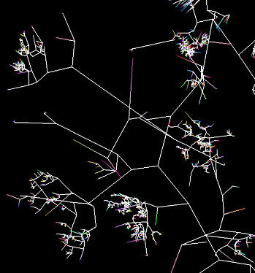
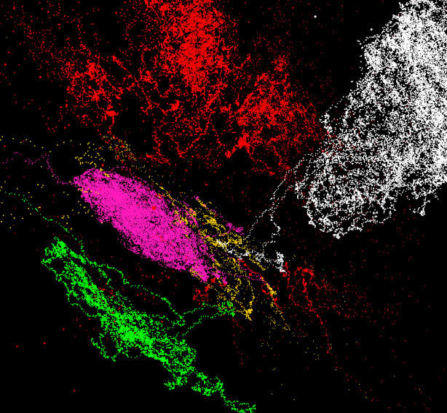
SPIDAL Java Applications
DA-MDS
Gene Sequence Clustering and Visualization
Results at WebPlotViz
https://spidal-gw.dsc.soic.indiana.edu/resultsets/991946447
https://spidal-gw.dsc.soic.indiana.edu/resultsets/795366853
A few snapshots
Sequence File
Pairwise Alignment
3D Plot
DA-PWC
100,000 fungi sequences
3D phylogenetic tree
3D plot of vector data

Slide 6
SPIDAL Java Applications
Stocks Data Analysis
Time series view of stocks
E.g. with 1 year moving window https://spidal-gw.dsc.soic.indiana.edu/public/timeseriesview/825496517

Slide 7
Performance Challenges
Intra-node Communication
Exploiting Fat Nodes
Overhead of Garbage Collection
Cost of Heap Allocated Objects
Cache and Memory Access

Slide 8
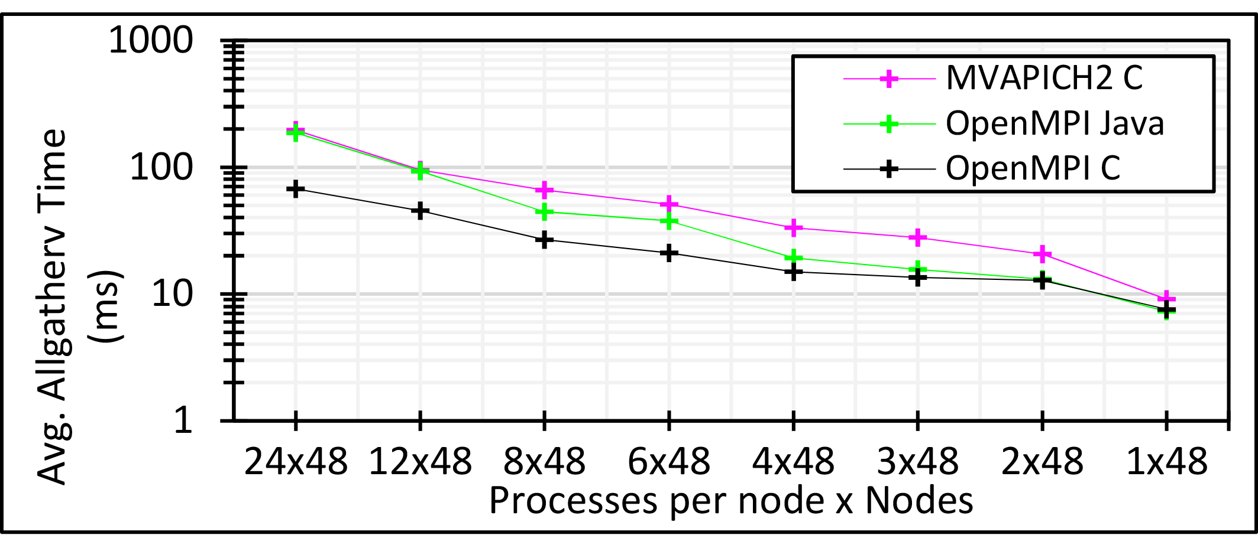
Performance Challenges
Intra-node Communication [1/3]
Large core counts per node – 24 to 36
Data analytics use global collective communication – Allreduce, Allgather, Broadcast, etc.
HPC simulations, in contrast, typically, uses local communications for tasks like halo exchanges.
Identical message size per node, yet 24 MPI is ~10 times slower than 1 MPI
Suggests #ranks per node should be 1 for the best performance
But how to exploit all available cores?
3 million double values distributed uniformly over 48 nodes

Slide 9
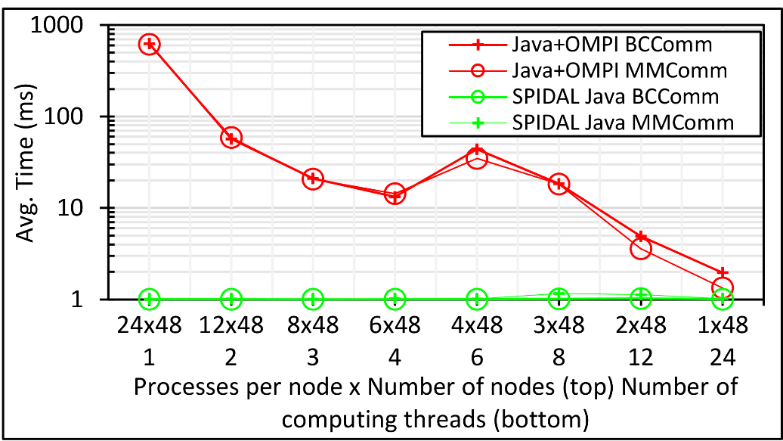
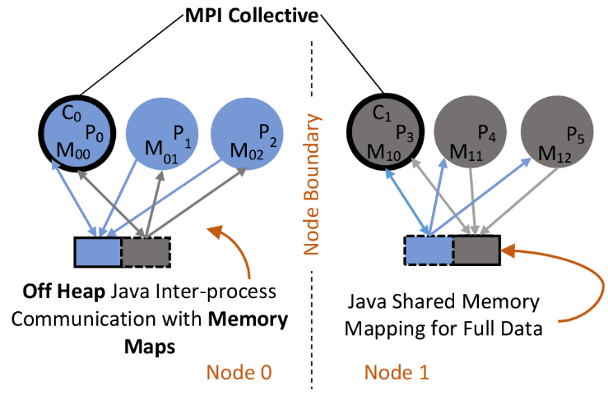
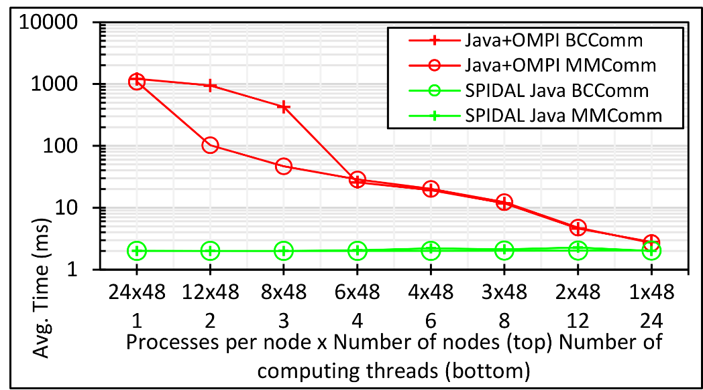
Performance Challenges
Intra-node Communication [2/3]
Solution: Shared memory
Use threads? → didn’t work well (explained shortly)
Processes with shared memory communication
Custom implementation in SPIDAL Java outside of MPI framework
100K DA-MDS Run Communication
Only 1 rank per node participates in the MPI collective call
Others exchange data using shared memory maps
200K DA-MDS Run Communication

Slide 10
Performance Challenges
Intra-node Communication [3/3]
Heterogeneity support
Nodes with 24 and 36 cores
Automatically detects configuration and allocates memory maps
Implementation
Custom shared memory implementation using OpenHFT’s Bytes API
Supports collective calls necessary within SPIDAL Java

Slide 11
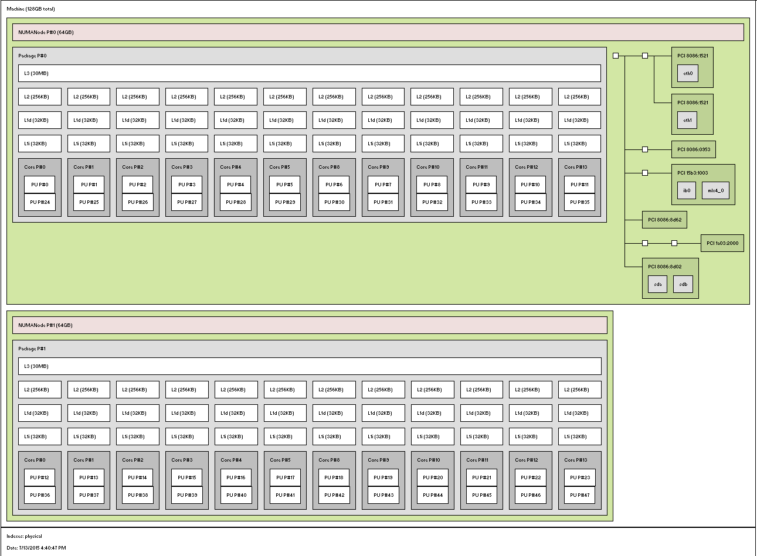
Performance Challenges
Exploiting Fat Nodes [1/2]
Large #Cores per Node
E.g. 1 Node in Juliet HPC cluster
2 Sockets
12 Cores each
2 Hardware threads per core
L1 and L2 per core
L3 shared per socket
Two approaches
All processes → 1 proc per core
1 Process multiple threads
Which is better?
1 Core – 2 HTs
Socket 0
Socket 1

Slide 12
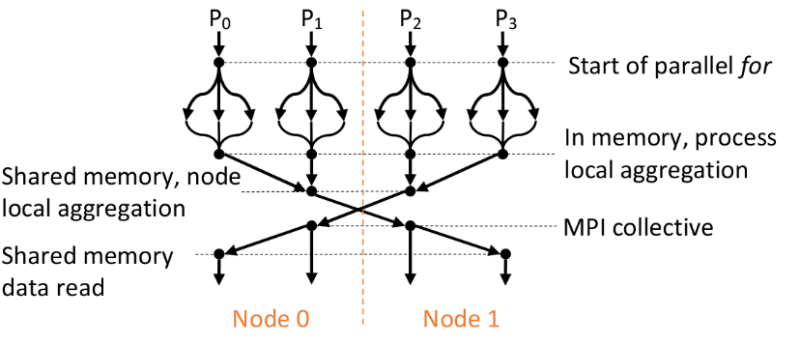
Performance Challenges
Exploiting Fat Nodes [2/2]
Suggested thread model in literature → fork-join regions within a process
Thread creation and scheduling overhead accumulates over iterations and significant (~5%)
True for Java threads as well as OpenMP in C/C++ (see https://github.com/esaliya/JavaThreads and https://github.com/esaliya/CppStack/tree/master/omp2/letomppar)
Long running threads do better than this model, still have non-negligible overhead
Solution is to use processes with shared memory communications as in SPIDAL Java
process
Iterations
Prev. Optimization

Slide 13
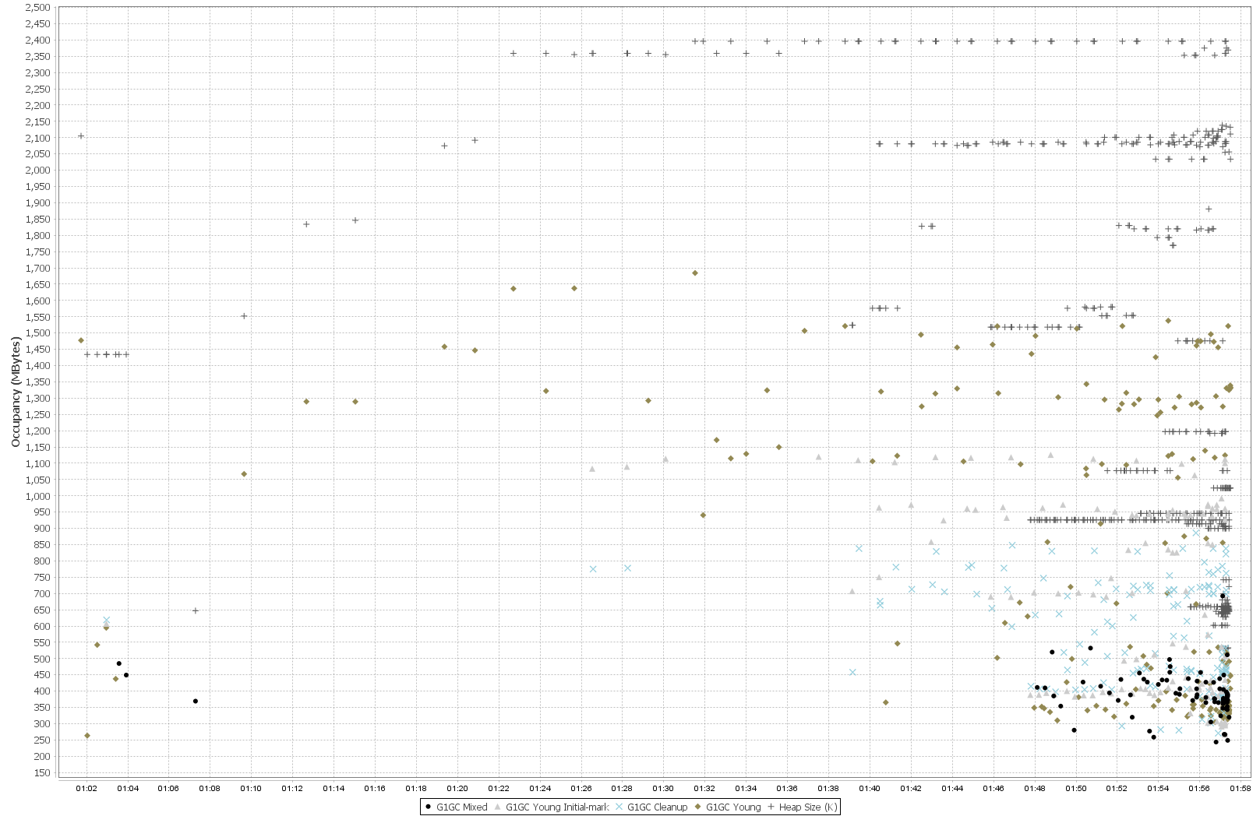
Performance Challenges
Heap size per process reaches –Xmx (2.5GB) early in the computation
Garbage Collection
“Stop the world” events are expensive
Especially, for parallel processes with collective communications
Typical OOP → allocate – use – forget
Original SPIDAL code produced frequent garbage of small arrays
Solution: Zero-GC using
Static allocation and reuse
Off-heap static buffers (more on next slide)
Advantage
No GC – obvious
Scale to larger problem sizes
E.g. Original SPIDAL code required 5GB (x 24 = 120 GB per node) heap per process to handle 200K MDS. Optimized code use < 1GB heap to finish within the same timing.
Note. Physical memory is 128GB, so with optimized SPIDAL can now do 1 million point MDS within hardware limits.
Frequent GC
Heap size per process is well below (~1.1GB) of –Xmx (2.5GB)
Virtually no GC activity after optimizing

Slide 14
Performance Challenges
I/O with Heap Allocated Objects
Java-to-native I/O creates copies of objects in heap
Otherwise can’t guarantee object’s memory location due to GC
Too expensive
Solution: Off-heap buffers (memory maps)
Initial data loading → significantly faster than Java stream API calls
Intra-node messaging → gives the best performance
MPI inter-node communications
Cache and Memory Access
Nested data structures are neat, but expensive
Solution: Contiguous memory with 1D arrays over 2D structures
Indirect memory references are costly
Also, adopted from HPC
Blocked loops and loop ordering

Slide 15
Evaluation
HPC Cluster
128 Intel Haswell nodes with 2.3GHz nominal frequency
96 nodes with 24 cores on 2 sockets (12 cores each)
32 nodes with 36 cores on 2 sockets (18 cores each)
128GB memory per node
40Gbps Infiniband
Software
Java 1.8
OpenHFT JavaLang 6.7.2
Habanero Java 0.1.4
OpenMPI 1.10.1
Application: DA-MDS
Computations grow $O\left(N^{2}\right)$
Communication global and is $O(N)$

Slide 16
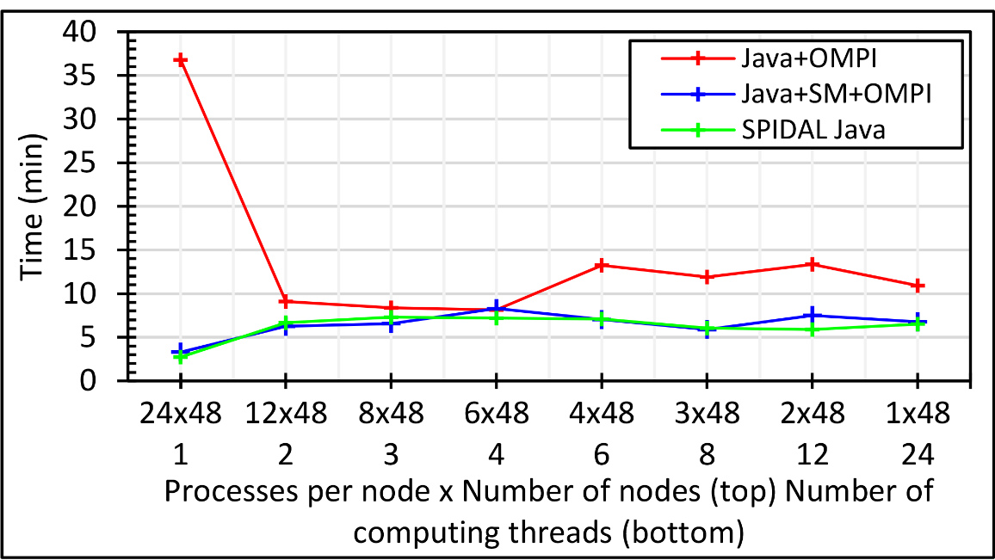
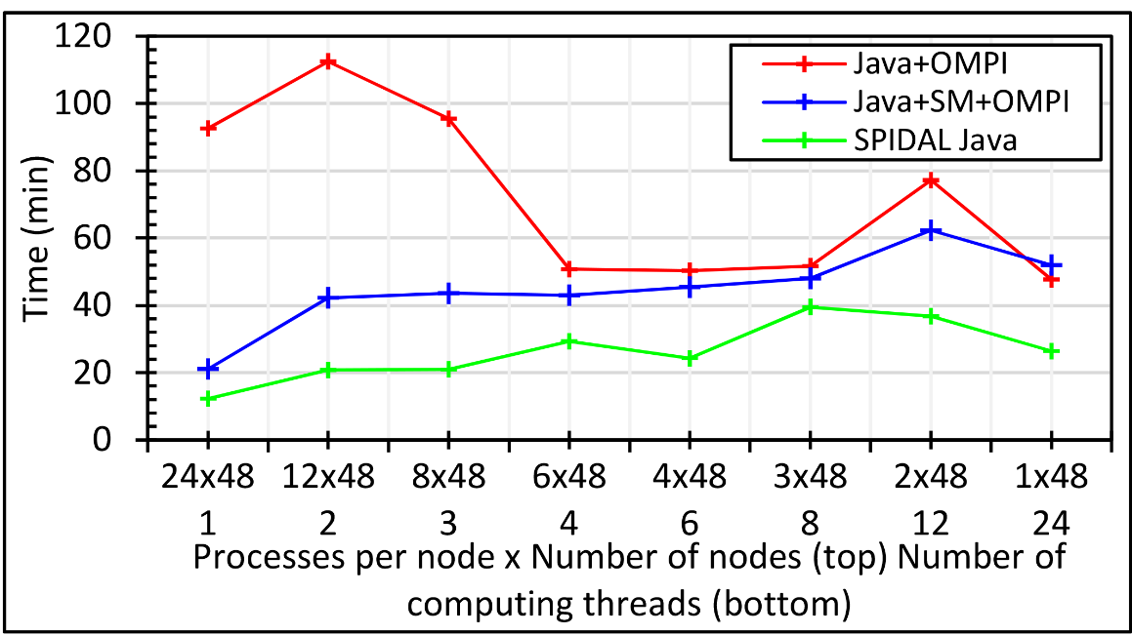
1152 Total Parallelism across 48 nodes
All combinations of 24 way parallelism per node
LHS is all processes
RHS is all internal threads and MPI across nodes
100K
DA-MDS
With SM communications in SPIDAL, processes outperform threads (blue line)
Other optimizations further improves performance (green line)
200K
DA-MDS
400K
DA-MDS

Slide 17
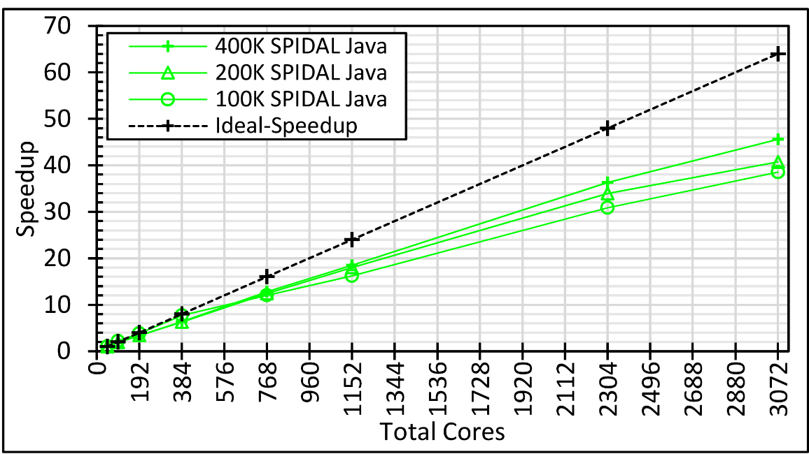
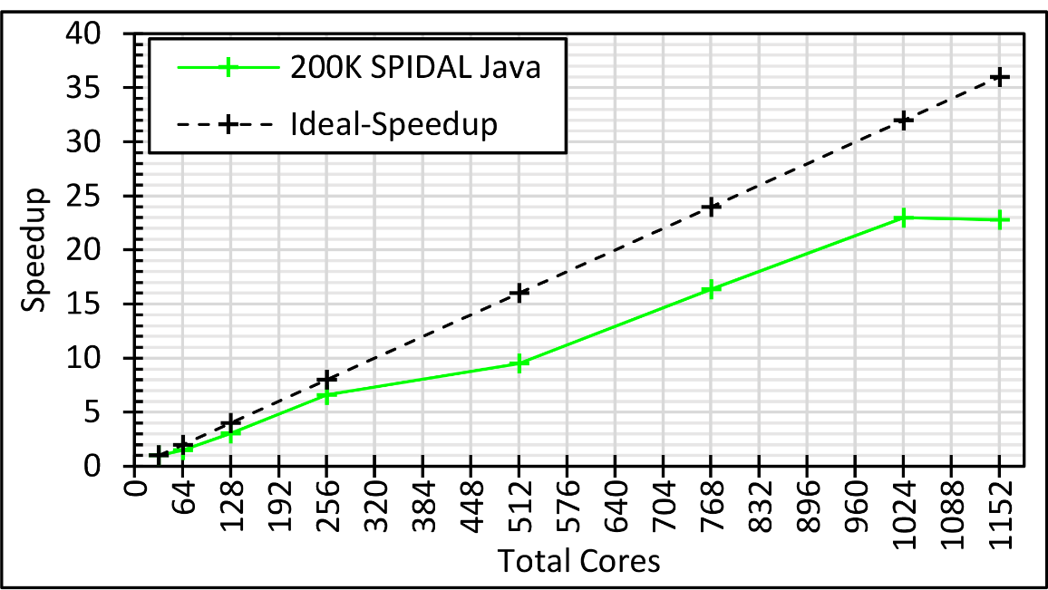
Speedup for varying data sizes
All processes
LHS is 1 proc per node across 48 nodes
RHS is 24 procs per node across 128 nodes (ideal 64x speedup)
Larger data sizes show better speedup
(400K – 45x, 200K – 40x, 100K – 38x)
Speedup on 36 core nodes
All processes
LHS is 1 proc per node across 32 nodes
RHS is 36 procs per node across 32 nodes (ideal 36x speedup)
Speedup plateaus around 23x after 24 way parallelism per node

Slide 18
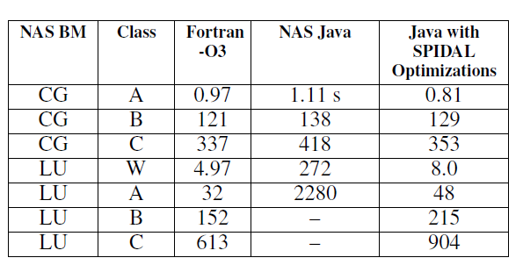
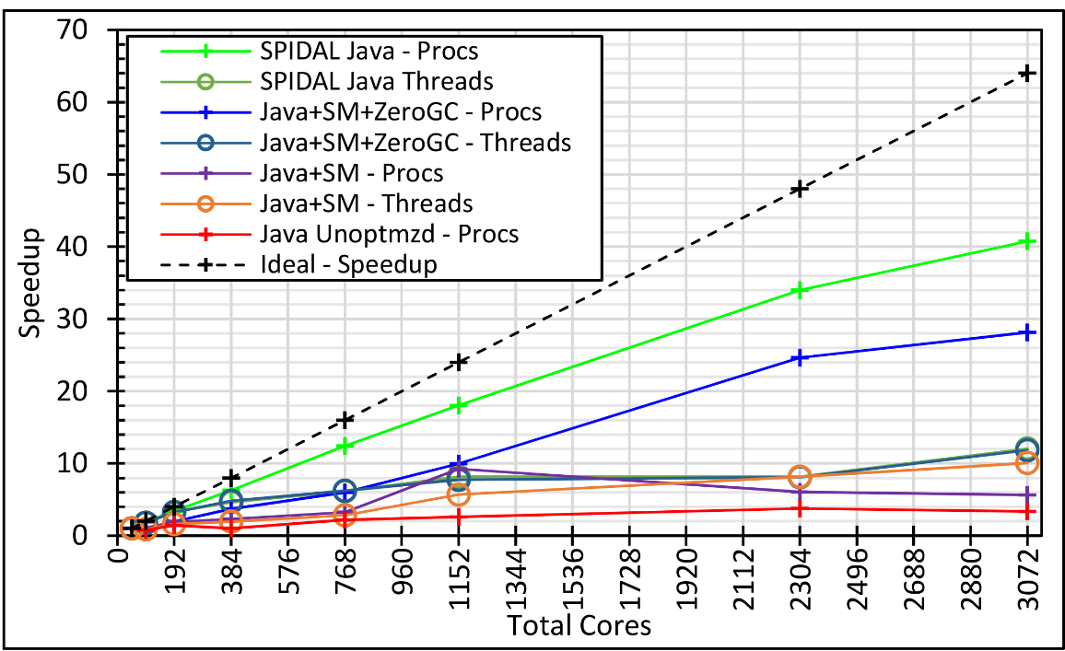
Java, is it worth it? – YES!
Also, with JIT some cases in MDS are better than C
The effect of different optimizations on speedup

