Slide 1
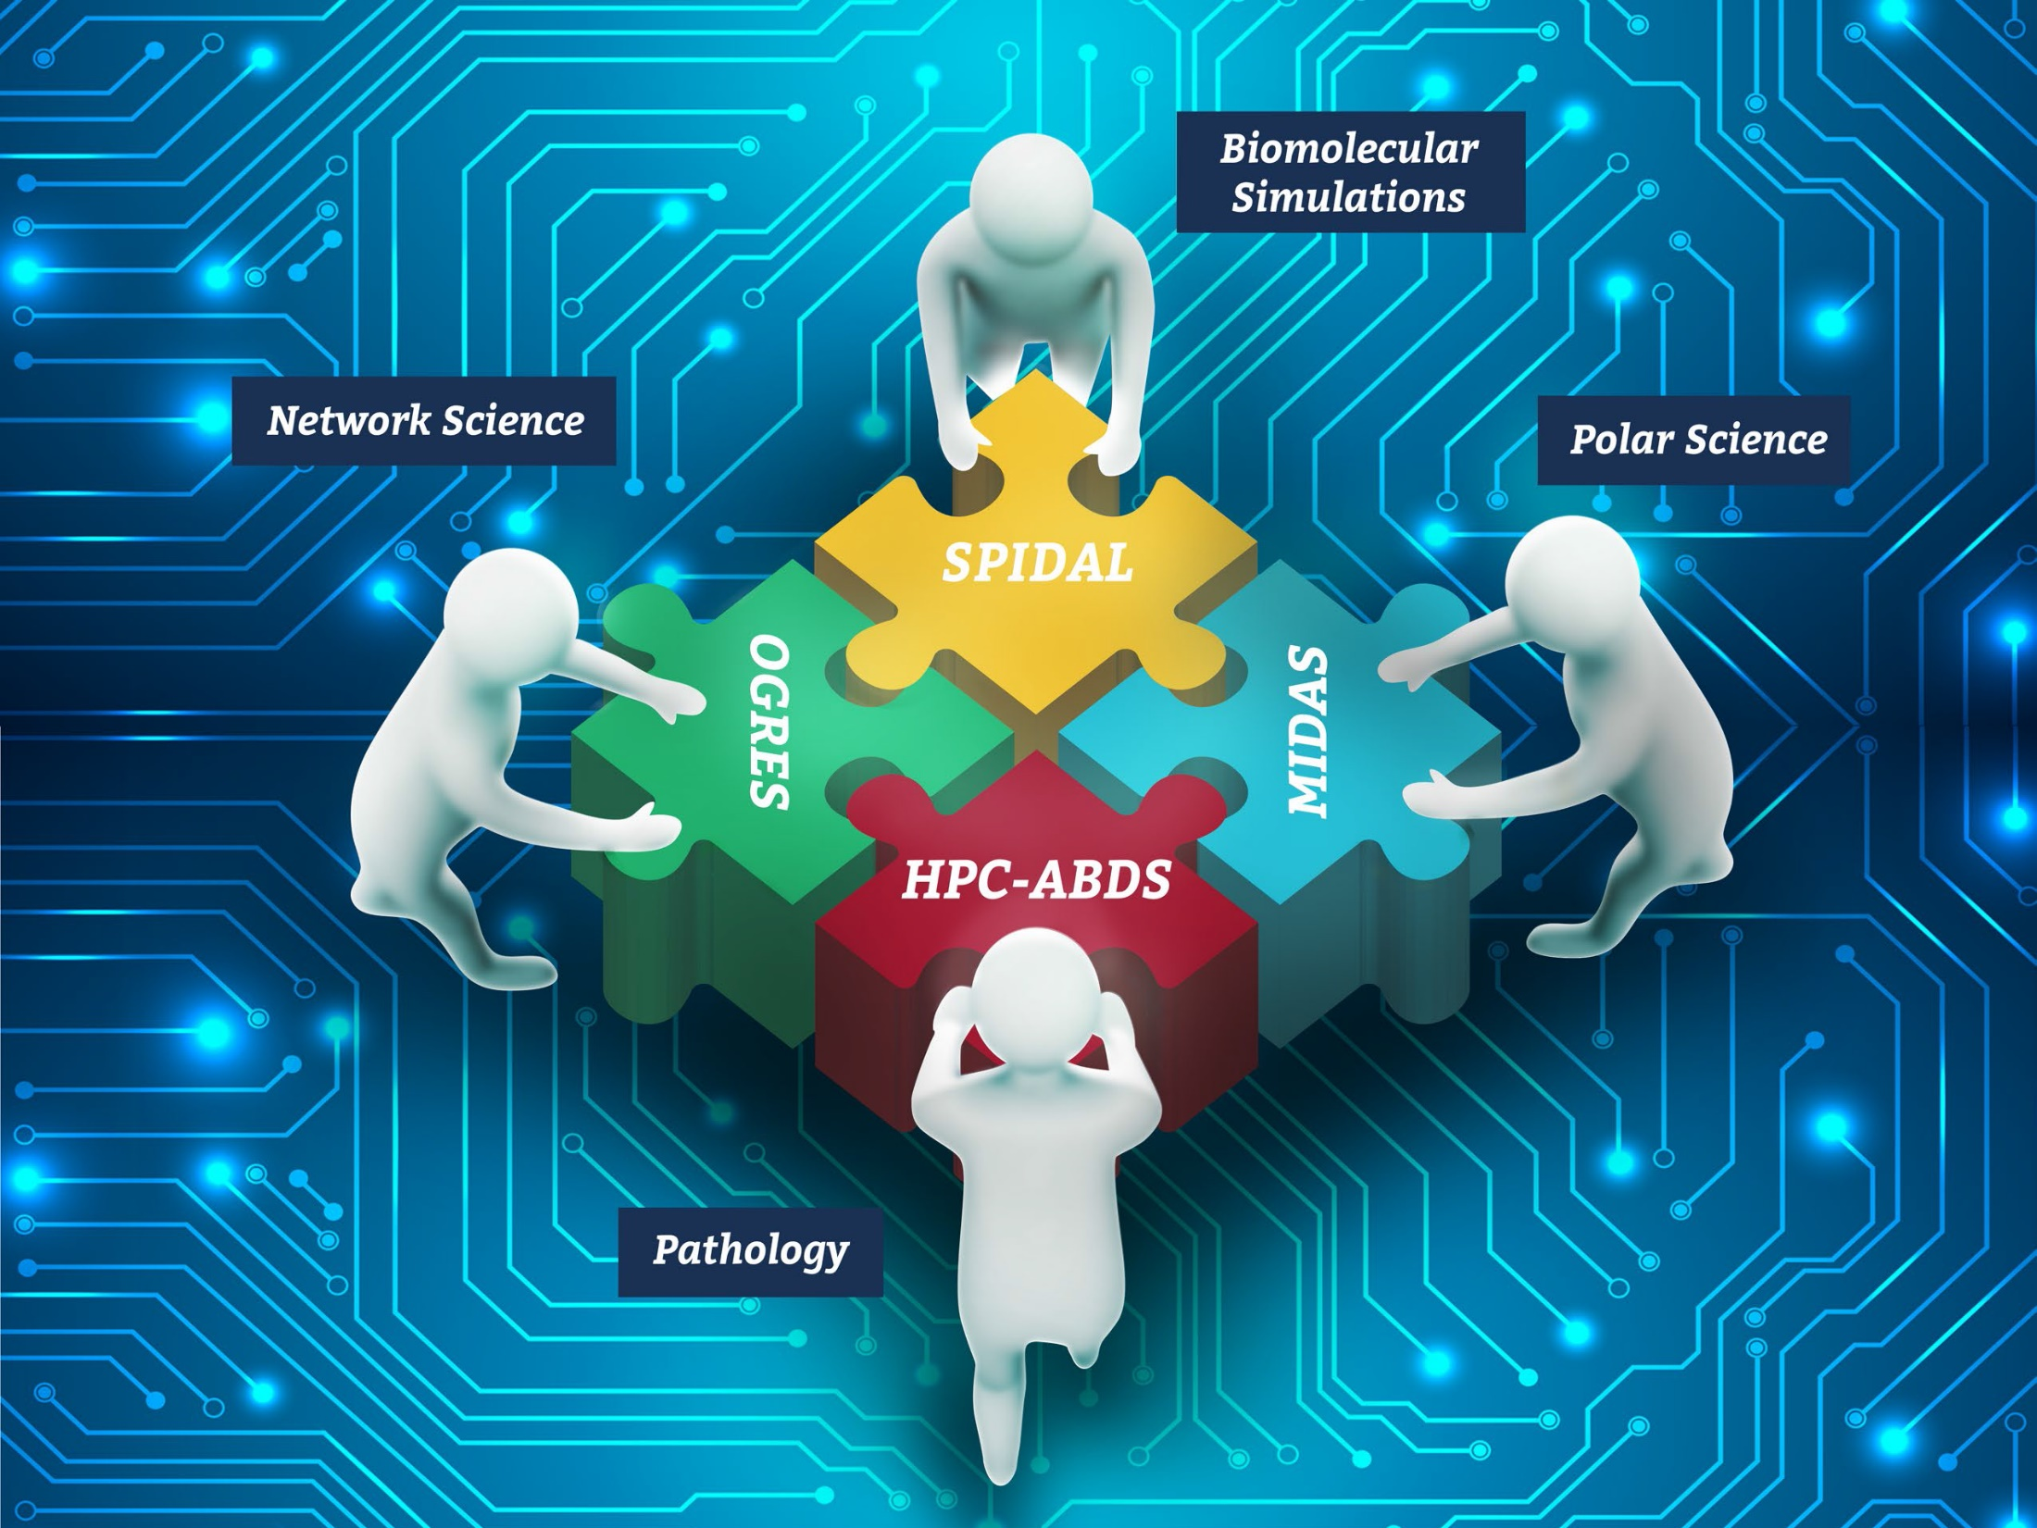
NSF 1443054: CIF21 DIBBs: Middleware and High Performance Analytics Libraries for Scalable Data Science
Software: MIDAS HPC-ABDS
MDAnalysis
Biomolecular Simulations February 2017

Slide 2
Contents
Slides 3 to 8 describe MDAnalysis software package (to which we are adding high performance in SPIDAL)
Slides 9 to 16 describe application area and accompany tutorial

Slide 3
MDAnalysis http://mdanalysis.org
Open source Python Library that abstracts access to all common trajectory data formats used in the biomolecular simulation field.
International developer (7 core developers, 36 contributors, 2 GSoC students, 2 REU students) and user community (~1k downloads per release, >250 citations) https://github.org/MDAnalysis
Python/Cython/C
object oriented
~45k LOC
~24k lines comments
> 4000 tests with CI
licence GPL v2
extensive documentation http://mdanalysis.org

Slide 4
“Topology” + “Trajectory” = “Universe”
Universe binds topology (atom descriptions, static) and trajectory (coordinates, dynamic) data together
import MDAnalysis as mda
u = mda.Universe(‘topol.tpr’, ‘traj.xtc’)
print(u)
<Universe with 12421 atoms and 8993 bonds>
Particles are stored as AtomGroups
print(u.atoms)
<AtomGroup with 12421 atoms>
Iterate over time steps in trajectory and process atoms
for ts in u.trajectory:
analyze_func(u.atoms)

Slide 5
Accessing atoms: selections & AtomGroup
Create new groups with atom selections (full query language):
protein =
u.atoms.select_atoms(
“protein and backbone”)
print(protein)
<AtomGroup with 2113 atoms>
AtomGroups behave like Python lists
print(list(protein[:5]))
[<Atom 1: N of type NH3 of resname ALA, resid 1 and segid IFAB>,
<Atom 2: HT1 of type HC of resname ALA, resid 1 and segid IFAB>,
<Atom 3: HT2 of type HC of resname ALA, resid 1 and segid IFAB>,
<Atom 4: HT3 of type HC of resname ALA, resid 1 and segid IFAB>,
<Atom 5: CA of type CT1 of resname ALA, resid 1 and segid IFAB>]]

Slide 6
Fundamental abstraction: AtomGroup
Selections allow fine control over which part of the system to analyze.
solvshell =
u.atoms.select_atoms(
“resname SOL and
around 5.0 protein”)
print(solvshell)
<AtomGroup with 2792 atoms>
AtomGroups can be combined and written to files in any format.
ag = protein + solvshell
ag.write(“prot_shell.pdb”)
print(ag)
<AtomGroup with 4905 atoms>

Slide 7
Atom data as NumPy arrays
AtomGroups contain particles (“atoms”).
Properties of all particles are NumPy arrays (common data structure in all scientific Python code: interoperability)
ag.names
array(['N', 'HT1', 'HT2', ..., 'OH2', 'H1', 'H2'],
dtype='|S4')
ag.charges
array([-0.3 , 0.33 , 0.33 ,
...,
-0.834, 0.417, 0.417])
ag.positions
array([[-12.57699966, 10.42199993, -5.22900009],
[-13.59200001, 10.19900036, -5.19299984],
[-12.31599998, 10.22900009, -6.21700001],
...,
[ -5.02600002, -12.31200027, 13.30200005],
[ -5.45100021, -11.82499981, 12.59500027],
[ -4.14099979, -12.47900009, 12.97900009]],
dtype=float32)
ag.velocities
ag.forces

Slide 8
Basic analysis pattern: Iterate over frames
trajectories contain frames: one snapshot of all particles at a specific time (positions[, velocities[, forces]])
Universe.trajectory is a Python iterable
Python iterator syntax (e.g., slicing every 10th frame)
for ts in u.trajectory[::10]:
analyze(ag.positions)
AtomGroup.positions updates every step
iteration reads data from disk for each frame (out of core processing, no limitations to trajectory and system sizes)
alternatively: load a subset of all coordinates into a NumPy array and hold it all in memory for fast processing:
positions_protein = u.trajectory.timeseries(protein)

Slide 9
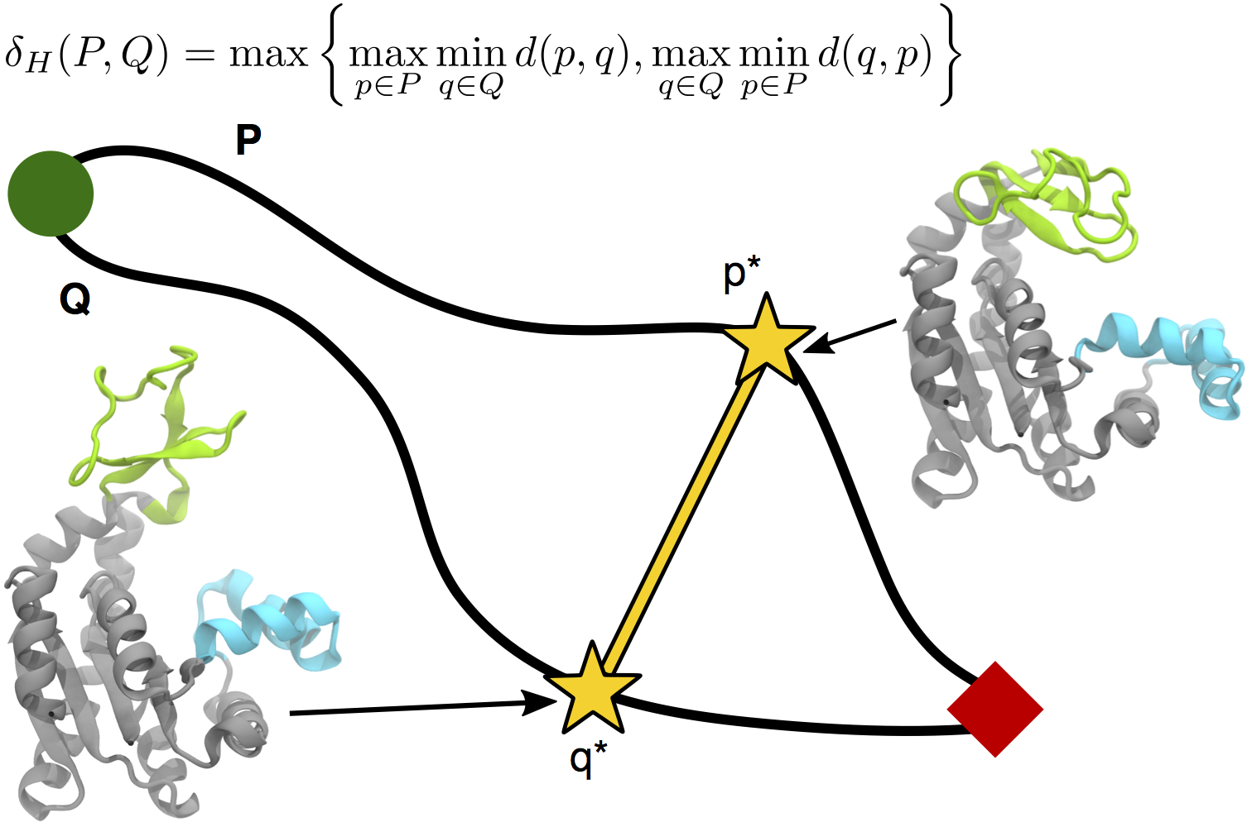
Biomolecular Simulation Data Analysis
Utah (CPPTraj), Arizona State (MDAnalysis), Rutgers
Parallelize key algorithms including O(N²) distance computations between trajectories
Integrate SPIDAL O(N²) distance and clustering libraries
Path Similarity Analysis (PSA) with Hausdorff distance

Slide 10
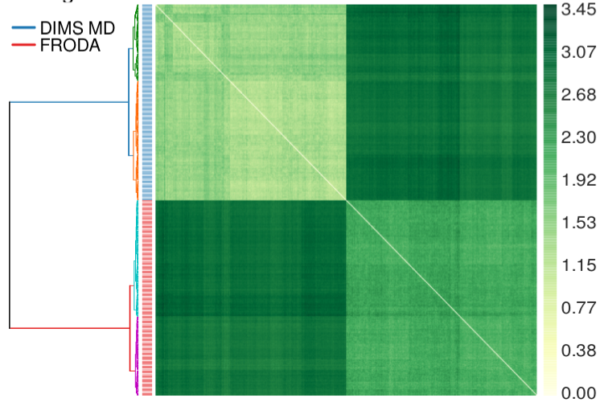
Parallelizing analysis of biomolecular simulations: MDAnalysis with MIDAS radical.pilot
analysis of ensembles of molecular dynamics (MD) trajectories: MDAnalysis Python library http://mdanalysis.org
MAP-REDUCE with MIDAS radical.pilot http://radical-cybertools.github.io/radical-pilot/
}
MDAnalysis python script 1
MAP
REDUCE
MDAnalysis python script 2
MDAnalysis python script
MDAnalysis python script 3
MDAnalysis python script 4
radical.pilot
MDAnalysis python script 5

Slide 11
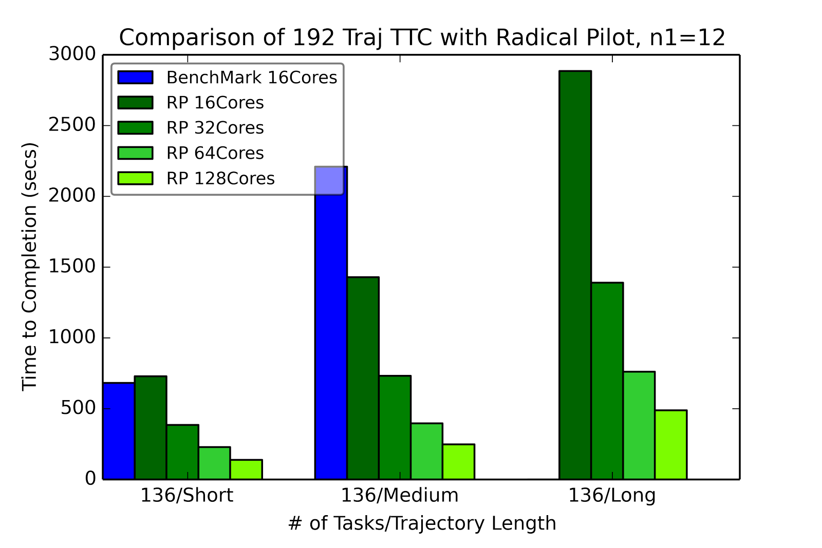
RADICAL-Pilot Hausdorff distance: all-pairs problem
Clustered distances for two methods for sampling macromolecular transitions (200 trajectories each) showing that both methods produce distinctly different pathways.
RADICAL Pilot benchmark run for three different test sets of trajectories, using 12x12 “blocks” per task.

Slide 12
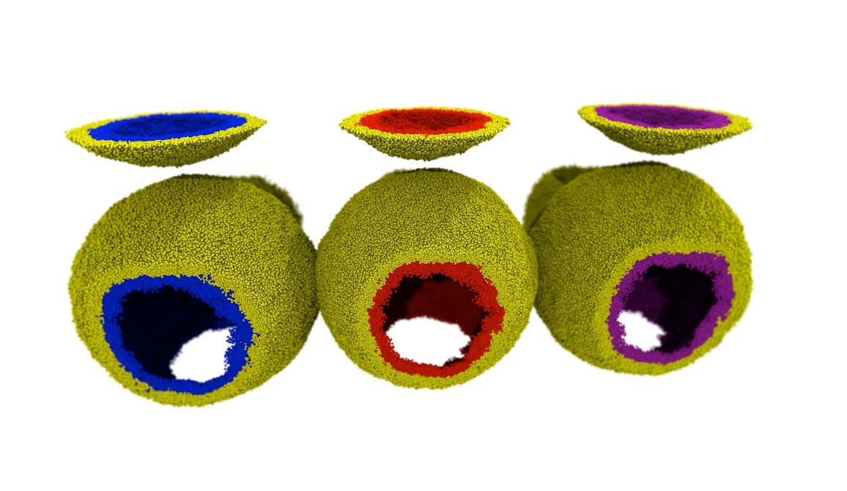
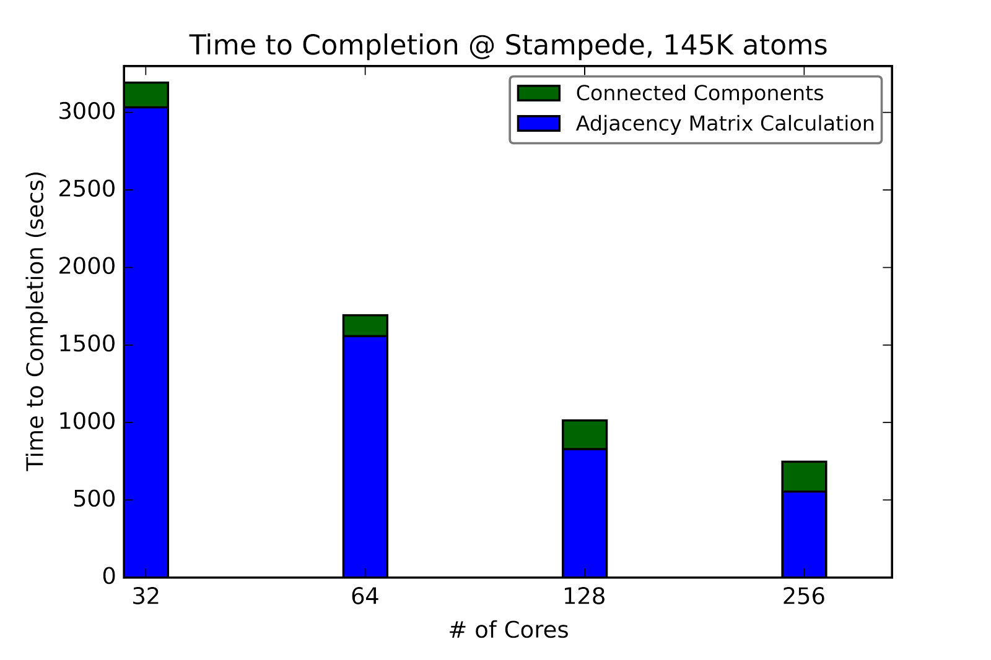
Classification of lipids in membranes
Biological membranes are lipid bilayers with distinct inner and outer surfaces that are formed by lipid mono layers (leaflets). Movement of lipids between leaflets or change of topology (merging of leaflets during fusion events) is difficult to detect in simulations.
Lipids colored by leaflet
Same color: continuous leaflet.

Slide 13
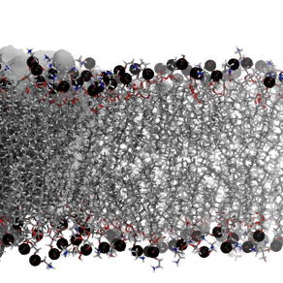
LeafletFinder
LeafletFinder is a graph-based algorithm to detect continuous lipid membrane leaflets in a MD simulation*. The current implementation is slow and does not work well for large systems (>100,000 lipids).
Phosphate atom coordinates
Build nearest-neighbors adjacency matrix
Find largest connected subgraphs
* N. Michaud-Agrawal, E. J. Denning, T. B. Woolf, and O. Beckstein. MDAnalysis: A toolkit for the analysis of molecular dynamics simulations. J Comp Chem, 32:2319–2327, 2011.

Slide 14
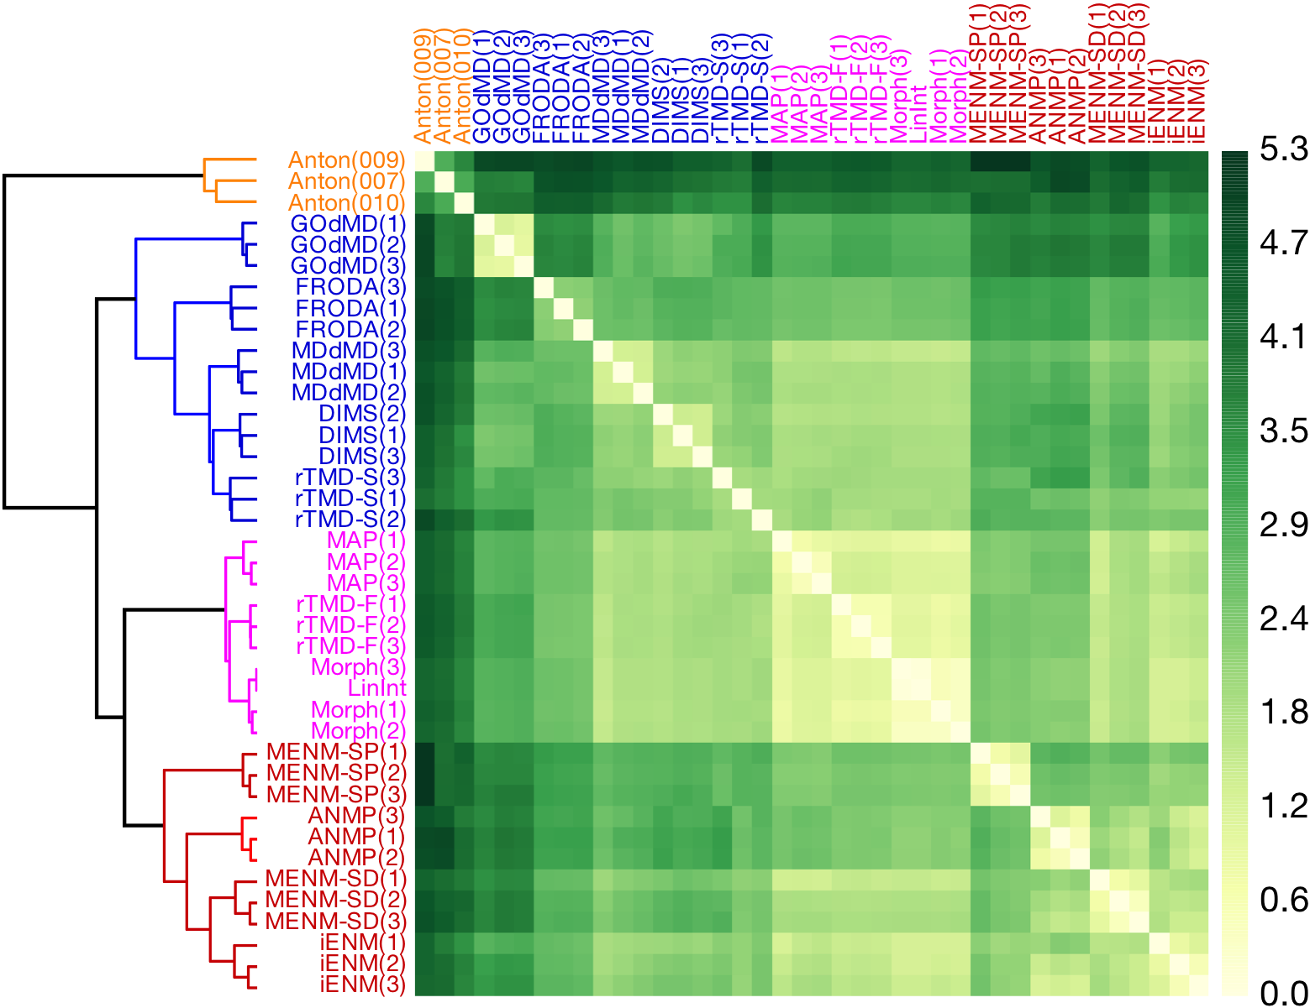
Path Similarity Analysis*
quantify difference between trajectories (paths P, Q in 3N dimensional configuration space) – without low-dimensional projections!
use metric on paths δ(P, Q) (from computational geometry)
Fréchet metric
Hausdorff metric
for N trajectories
compute the (symmetric) N x N distance matrix D_{ij} = δ(P_{i}, P_{j})
cluster D
Applications
evaluation of path sampling algorithms
extraction of molecular-scale determinants for path differences
selection of pathways for enhanced sampling approaches
computation of order parameters for macromolecular transitions
*S. L. Seyler, A. Kumar, M. F. Thorpe, and O. Beckstein. Path similarity analysis: A method for quantifying macromolecular pathways. PLoS Comput Biol, 11(10):e1004568, 10 2015. doi: 10.1371/journal.pcbi. 1004568.

Slide 15
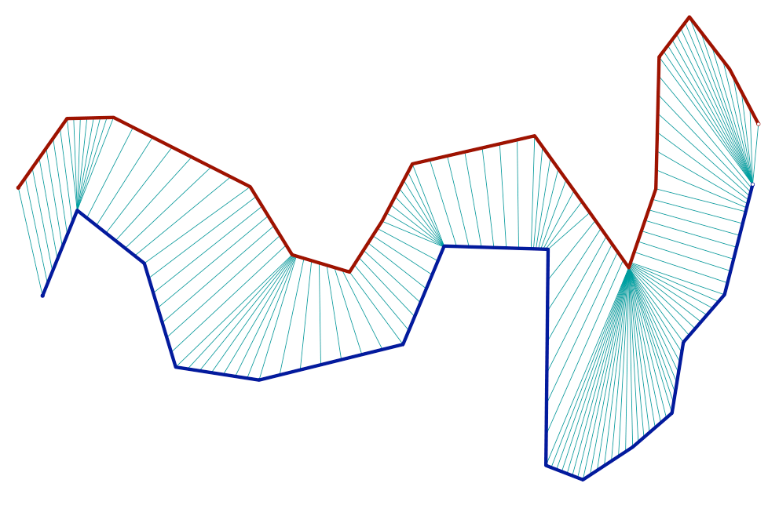
Computational cost
p
P
Trajectories with ~M frames
point-wise distance d(p,q) between frames p and q: e.g.
Hausdorff distance: O(M²) (naïve)
q
Q
discrete Fréchet distance: O(M²) (dynamic programming)
for N trajectories: distance matrix D_{ij} = δ(P_{i}, P_{j})
symmetric; D_{ii} = δ(P_{i}, P_{i}) = 0
N(N–1)/2 distance computations

Slide 16
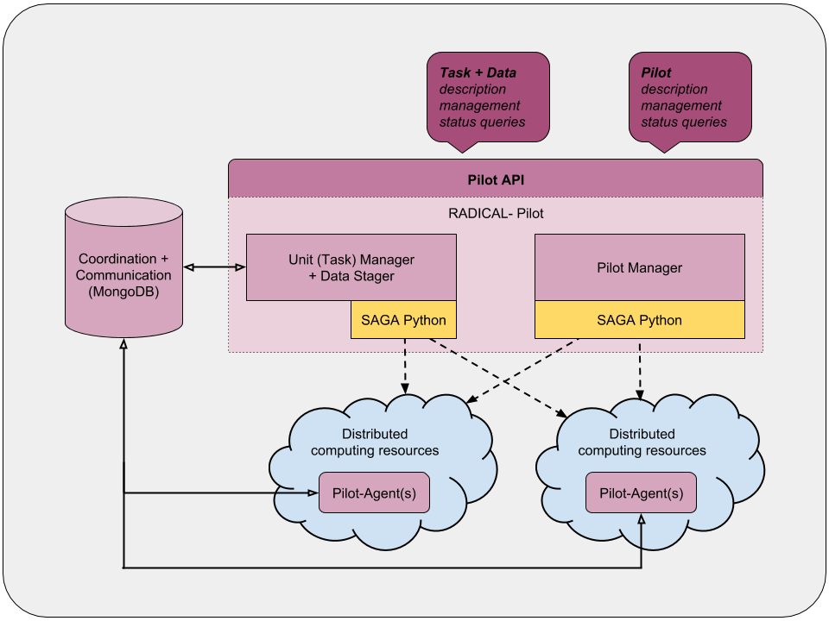
Map-reduce distance matrix calculation with MIDAS radical.pilot
Large number of calculations for a moderate ensemble of trajectories: e.g. N=400 (tutorial): 400 • 399 / 2 = 79,800
BUT: N(N–1) independent calculations (each fairly expensive but of almost constant cost – number of frames in trajectories M is typically similar): pleasingly parallel
MAP – REDUCE
split D into blocks of size w
compute block matrices
recombine blocks into full matrix
radical.pilot
MIDAS radical.pilot to manage jobs for computing blocks: plug in serial MDAnalysis code without additional changes: easy!
Now do the tutorial
https://becksteinlab.github.io/SPIDAL-MDAnalysis-Midas-tutorial/

