Slide 1
MDS and Visualization
September 25 2018
Geoffrey Fox
gcf@indiana.edu
http://www.infomall.org
School of Informatics, Computing and Engineering
Digital Science Center
Indiana University Bloomington

Slide 2
Clustering and Visualization
The SPIDAL Library includes several clustering algorithms with sophisticated features
Deterministic Annealing
Radius cutoff in cluster membership
Elkans algorithm using triangle inequality
They also cover two important cases
Points are vectors – algorithm O(N) for N points
Points not vectors – all we know is distance δ(i, j) between each pair of points i and j. algorithm O(N²) for N points
We find visualization important to judge quality of clustering
As data typically not 2D or 3D, we use dimension reduction to project data so we can then view it
Have a browser viewer WebPlotViz that replaces an older Windows system
Clustering and Dimension Reduction are modest (for #sequences < 1 million) HPC applications
Calculating distance δ(i, j) is similar compute load but pleasingly parallel
All examples require HPC but largest size used ~600 cores

Slide 3
Motivation for Dimension Reduction
Large and high-dimensional data
Appears in everywhere; science, business, web, …
Complex to understand and hard to interpret
Dimension reduction is a way to summarize and visualize: PCA, MDS, GTM, SOM, etc
Hard to interpret high dimensional data analysis – exploit human eye!
Interactive 3D scatter plots
Help to understand the overall structure
Help to find cluster structures in data
Exploit human visual perception
Users can tag, use different colors, explore spaces, ...

Slide 4
Visualization by Dimension Reduction
Dimension Reduction
High Dimensional Data
Low Dimensional Representation
PCA, GTM, …
Non-metric Pairwise Data
MDS
Also known as low-dimensional embedding or non-linear mapping
Provide a method to simplify data
Preserve the raw data information as much as possible in a low dimensional space
We focus on finding 2- or 3-dimensional representation in order to visualize high-dimensional data in a virtual 2D/3D space
Some cases where mapping to d>3 dimensional space

Slide 5
Methods for Dimension Reduction
We need to find a way of visualizing data (roughly same as mapping to two or three dimensions) so that relationships preserved
Simplest relationship is distance
Map datapoints in high dimension to lower dimensions
Many such dimension reduction algorithms
PCA Principal component analysis best linear algorithm
MDS is best nonlinear: Minimize Stress σ(X) = Σ_{i<j=1}^{n} weight(i,j) (δ(i, j) - d(X_{i} , X_{j}))²
δ(i, j) are input distances and d(X_{i} , X_{j}) the Euclidean distance squared in target space
SMACOF or Scaling by minimizing a complicated function is clever steepest descent (expectation maximization EM) algorithm
Could just view as non linear χ² problem
Slower but more general
All parallelize with high efficiency

Slide 6
Fungal Sequences
Input data
~7 million gene sequences in FASTA format.
Pre-processing
Input data filtered to locate unique sequences that appear multiple occasions in the input data, resulting in 170K gene sequences.
Smith–Waterman algorithm is applied to generate distance matrix for 170K gene sequences.
Clustering data with DAPWC
Run DAPWC iteratively to produce clean clustering for the data. Initial step of DAPWC is done with 8 clusters. Resulting clusters are visualized and further clustered using DAPWC with appropriate number of clusters that are determined through visualizing in WebPlotViz.
Resulting clusters are gathered and merged to produce the final clustering result.

Slide 7
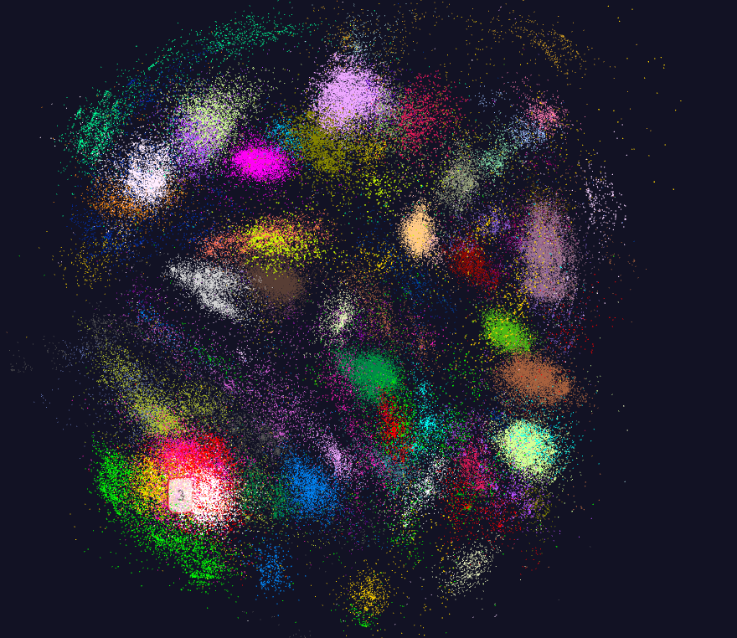
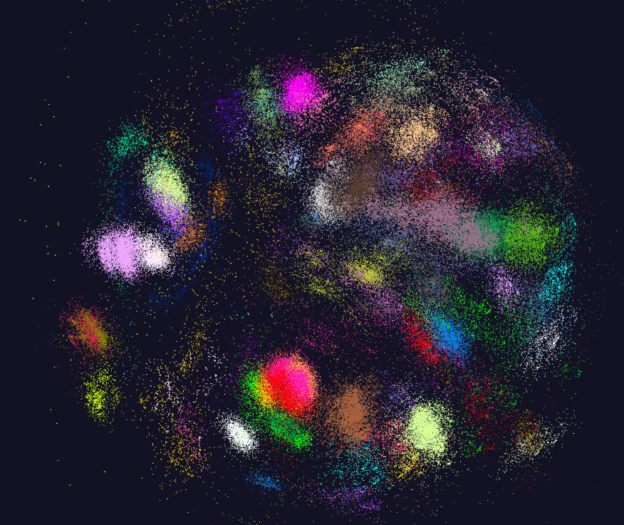
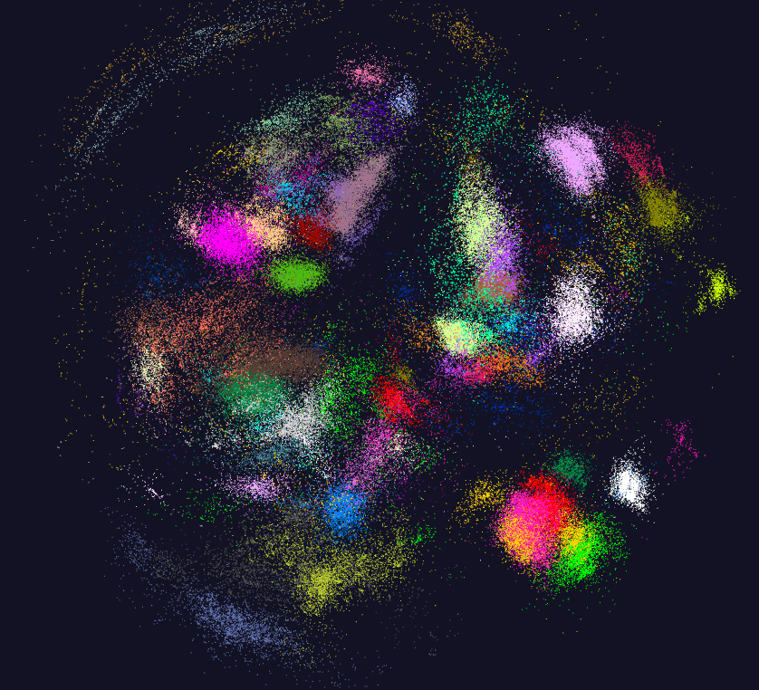
170K Fungi sequences

Slide 8
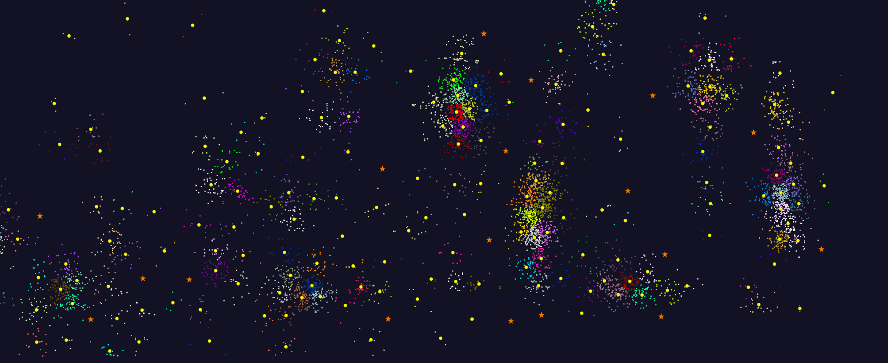
2D Vector Clustering with cutoff at 3 σ
Orange Star – outside all clusters; yellow circle cluster centers
LCMS Mass Spectrometer Peak Clustering. Charge 2 Sample with 10.9 million points and 420,000 clusters visualized in WebPlotViz

Slide 9
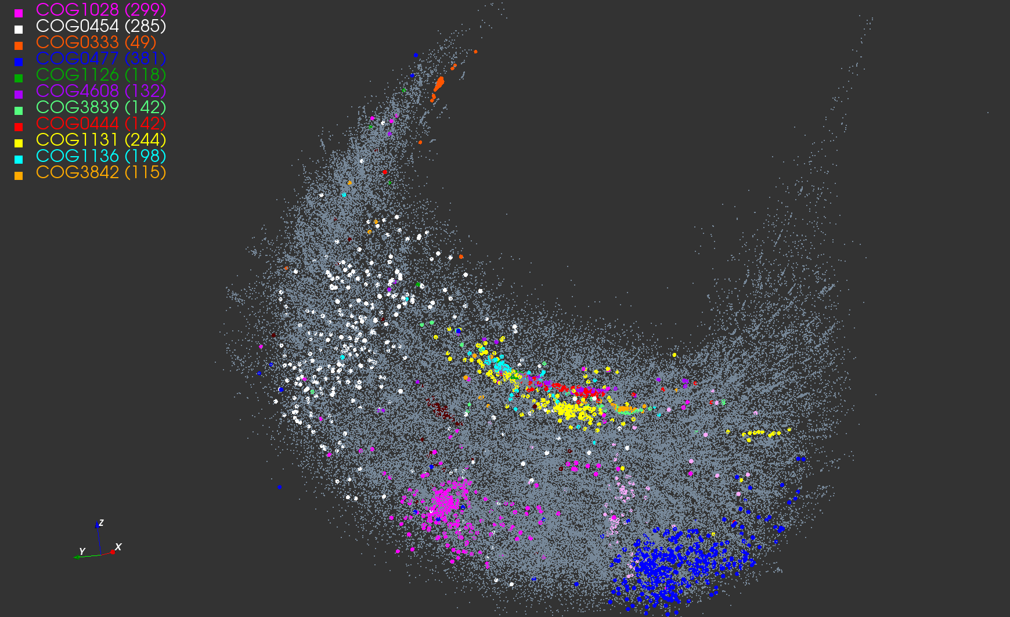
Protein Universe Browser for COG Sequences with a few illustrative biologically identified clusters Note Clusters NOT distinct

Slide 10
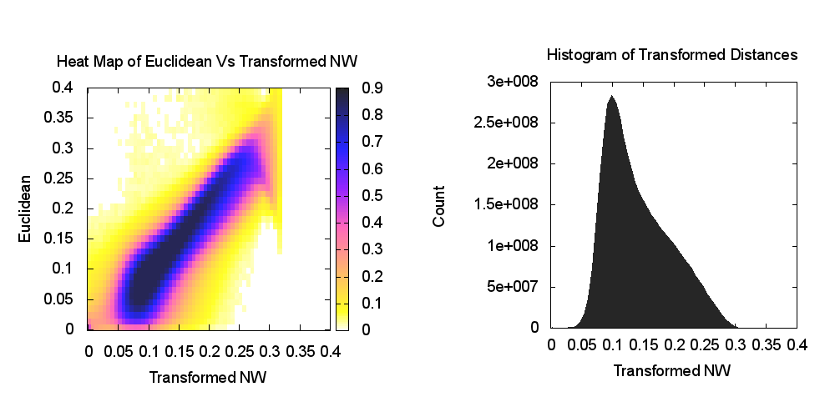
Heatmap of biology distance (Needleman-Wunsch) vs 3D Euclidean Distances – mapping pretty good
If d a distance, so is f(d) for any monotonic f. Optimize choice of f

Slide 11
Visualization can identify problems e.g. what were thought to be the same Species are in different locations

Slide 12
WebPlotViz
http://spidal-gw.dsc.soic.indiana.edu/

Slide 13
WebPlotViz Basics
Many data analytics problems can be formulated as study of points that are often in some abstract non-Euclidean space (bags of genes, documents ..) that typically have pairwise distances defined but sometimes not scalar products.
Helpful to visualize set of points to understand better structure
Principal Component Analysis (linear mapping) and Multidimensional Scaling MDS (nonlinear and applicable to non-Euclidean spaces) are methods to map abstract spaces to three dimensions for visualization
Both run well in parallel and give great results
In past used custom client visualization but recently switch to commodity HTML5 web viewer WebPlotViz

Slide 14
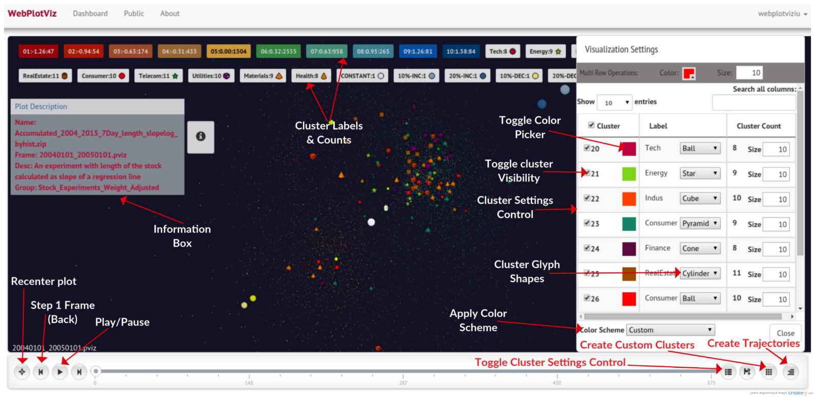
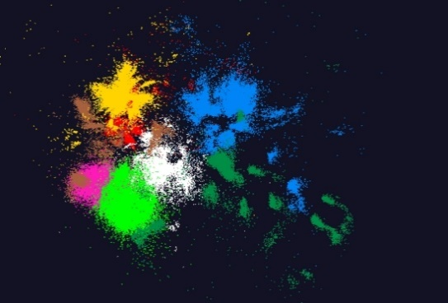
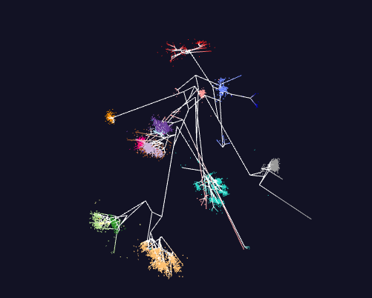
WebPlotViz
100k points
Trees

Slide 15
WebPlotViz Basics II
Supports visualization of 3D point sets (typically derived by mapping from abstract spaces) for streaming and non-streaming case
Simple data management layer
3D web visualizer with various capabilities such as defining color schemes, point sizes, glyphs, labels
Core Technologies
MongoDB management
Play Server side framework
Three.js
WebGL
JSON data objects
Bootstrap Javascript web pages
Open Source http://spidal-gw.dsc.soic.indiana.edu/
~10,000 lines of extra code
Front end view (Browser)
Plot visualization & time series animation (Three.js)
Upload
Request Plots
JSON Format Plots
Web Request Controllers (Play Framework)
Server
Upload format to JSON Converter
Data Layer (MongoDB)
MongoDB

Slide 16
Stock Daily Data Streaming Example
Typical streaming case considered. Sequence of “collections of abstract points”; cluster, classify etc.; map to 3D; visualize
Example is collection of around 7000 distinct stocks with daily values available at ~2750 distinct times
Clustering as provided by Wall Street – Dow Jones set of 30 stocks, S&P 500, various ETF’s etc.
The Center for Research in Security Prices (CSRP) database through the Wharton Research Data Services (wrds) web interface
Available for free to the Indiana University students for research
2004 Jan 01 to 2015 Dec 31 have daily Stock prices in the form of a CSV file
We use the information
ID, Date, Symbol, Factor to Adjust Volume, Factor to Adjust Price, Price, Outstanding Stocks

Slide 17
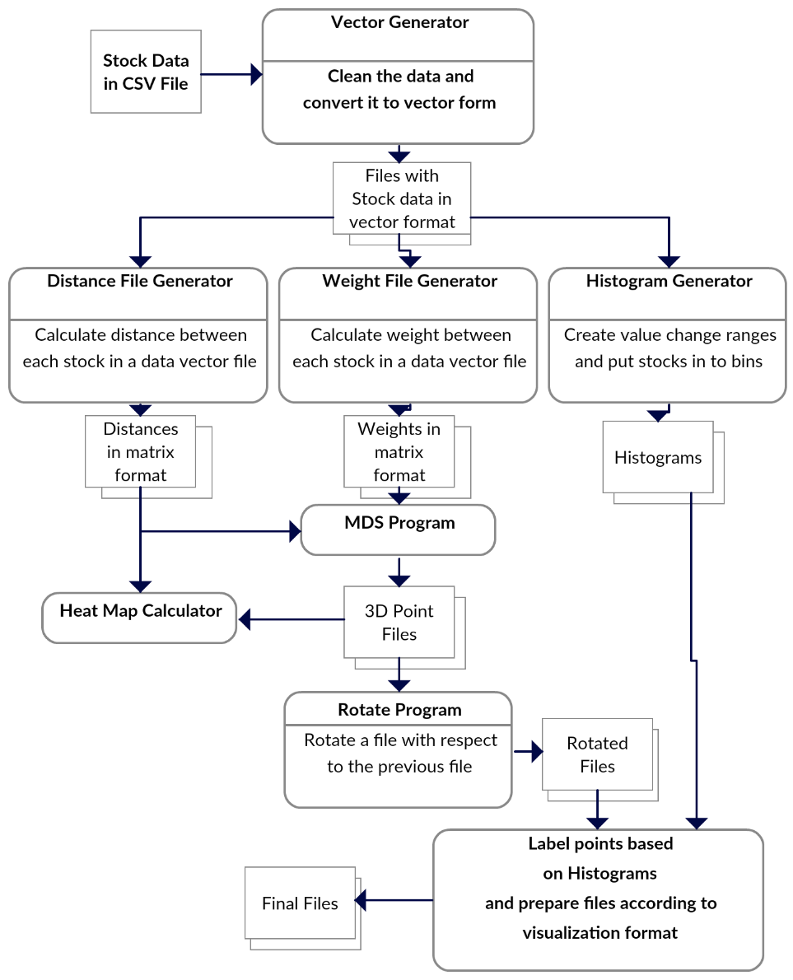
Stock Problem Workflow
Clean data
Calculate distance between stocks
Calculate distance between stocks (Pearson Correlation as missing data)
Map 250-2800 dimensional stock values to 3D for each time
Align each time
Visualize
Will move to Apache Beam to support custom runs

Slide 18
Relative Changes in Stock Values using one day values measured from January 2004 and starting after one year January 2005 Filled circles are final values
Finance
Origin
0% change
Energy
Dow Jones
S&P
Mid Cap
+10%
Apple
+20%

Slide 19
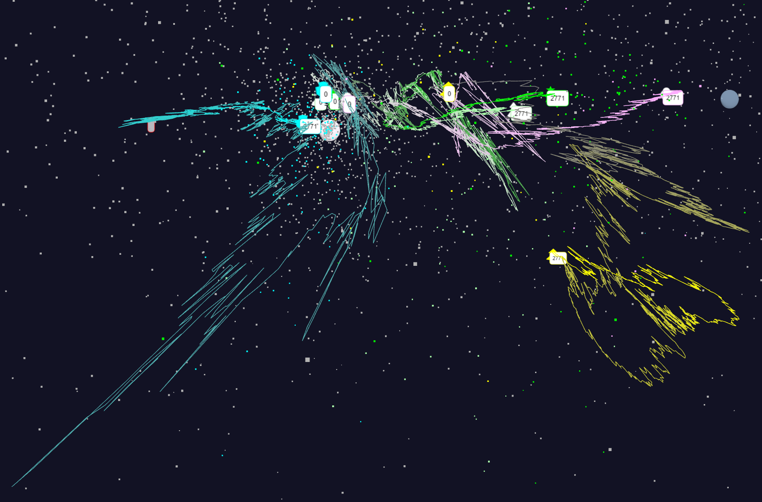
Relative Changes in Stock Values using one day values
S&P
Mid Cap
Dow Jones
+10%
Finance
Origin
0% change
Energy

Slide 20
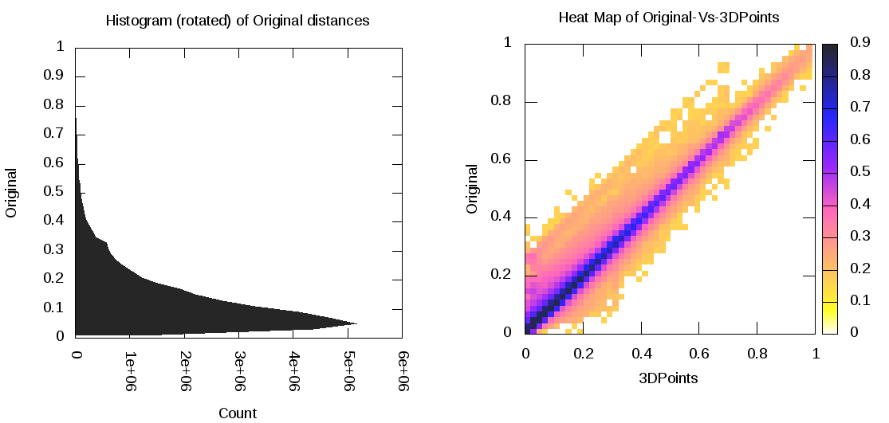
Notes on Mapping to 3D
MDS performed separately at each day – quality judged by match between abstract space distance and mapped space distance
Pretty good agreement as seen in heat map averaged over all stocks and all days
Each day is mapped independently and is ambiguous up to global rotations and translations
Align each day to minimize day to day change averaged over all stocks

Slide 21
Links to data sets
Fungi
All the plots
https://spidal-gw.dsc.soic.indiana.edu/public/groupdashboard/Anna_GeneSeq
https://spidal-gw.dsc.soic.indiana.edu/public/resultsets/668018718 Latest with 211 clusters
https://spidal-gw.dsc.soic.indiana.edu/public/resultsets/1167269857
Pathology
All the plots
https://spidal-gw.dsc.soic.indiana.edu/public/groupdashboard/FushengWang
https://spidal-gw.dsc.soic.indiana.edu/public/resultsets/1678860580
2D Proteomics
All the plots
https://spidal-gw.dsc.soic.indiana.edu/public/groupdashboard/Sponge
https://spidal-gw.dsc.soic.indiana.edu/public/resultsets/1657429765
Time series stock data
All the plots
https://spidal-gw.dsc.soic.indiana.edu/public/groupdashboard/Stocks
https://spidal-gw.dsc.soic.indiana.edu/public/timeseriesview/1494305167

