Slide 1
Study of Biological Sequence Structure: Clustering and Visualization
&
Survey on High Productivity Computing Systems (HPCS) Languages
Saliya ekanayake
School of Informatics and Computing
Indiana University

Slide 2
Study of Biological Sequence Structure: Clustering and Visualization
Identify similarities present in biological sequences and present them in a comprehensible manner to the biologists
How?
What?

Slide 3
Outline
Architecture
Data
Algorithms
Determination of Clusters
  Visualization
  Cluster Size
  Effect of Gap Penalties
  Global Vs. Local Sequence Alignment
  Distance Types
  Distance Transformation
Cluster Verification
Cluster Representation
Cluster Comparison
Spherical Phylogenetic Trees
Sequel
Summary

Slide 4
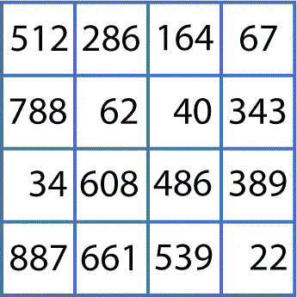
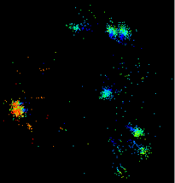
Simple Architecture
Capturing Similarity
Presenting Similarity
P2 Dimension Reduction
# | X | Y | Z
0 | 0.358 | 0.262 | 0. 295
1 | 0.252 | 0.422 | 0.372
D3
>G0H13NN01D34CL
GTCGTTTAAGCCATTACGTC …
>G0H13NN01DK2OZ
GTCGTTAAGCCATTACGTC …
P1
Distance Calculation
P4 Visualization
D1
D2
D5
P3 Clustering
D4
# | Cluster
0 | 1
1 | 3
Processes:
P1 – Pairwise distance calculation
P2 – Multi-dimensional scaling
P3 – Pairwise clustering
P4 – Visualization
Data:
D1 – Input sequences
D2 – Distance matrix
D3 – Three dimensional coordinates
D4 – Cluster mapping
D5 – Plot file

Slide 5
Data
16S rRNA Sequences
  Over Million (1160946) Sequences
    ~68K Unique Sequences
  Lengths Range from 150 to 600
Fungi Sequences
  Nearly Million (957387) Sequences
    ~48K Unique Sequences
  Lengths Range from 200 to 1000

Slide 6
Algorithms [1/3]
Pairwise Sequence Alignment
  Optimizations
    Avoid sequence validation when aligning
    Avoid alphabet guessing
    Avoid nested data structures
    Improve substitution matrix access time
Name | Algorithms | Alignment Type | Language | Library | Parallelization | Target Environment
SALSA-SWG | Smith-Waterman (Gotoh) | Local | C# | None | Message Passing with MPI.NET | Windows HPC cluster
SALSA-SWG-MBF | Smith-Waterman (Gotoh) | Local | C# | .NET Bio (formerly MBF) | Message Passing with MPI.NET | Windows HPC cluster
SALSA-NW-MBF | Needleman-Wunsch (Gotoh) | Global | C# | .NET Bio (formerly MBF) | Message Passing with MPI.NET | Windows HPC cluster
SALSA-SWG-MBF2Java | Smith-Waterman (Gotoh) | Local | Java | None | Map Reduce with Twister | Cloud / Linux cluster
SALSA-NW-BioJava | Needleman-Wunsch (Gotoh) | Global | Java | BioJava | Map Reduce with Twister | Cloud / Linux cluster

Slide 7
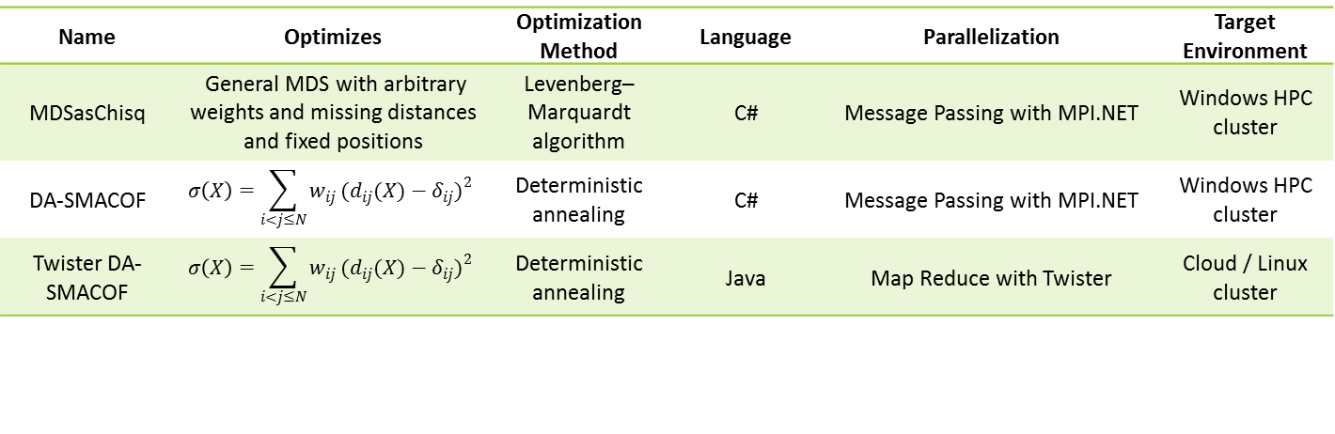

Algorithms [2/3]
Deterministic Annealing Pairwise Clustering (DA-PWC)
  Runs in $O(NlogN)$
  Accepts $NxN$ Distance Matrix
  Returns $N$ Points Mapped to $M$ Clusters
    Also finds cluster centers
  Implemented in C# with MPI.NET
Multi-Dimensional Scaling
Name | Optimizes | Optimization Method | Language | Parallelization | Target Environment
MDSasChisq | General MDS with arbitrary weights and missing distances and fixed positions | Levenberg–Marquardt algorithm | C# | Message Passing with MPI.NET | Windows HPC cluster
DA-SMACOF | $$σ\left(X\right)=\sum_{i<j≤N}{w_{ij}}{(d_{ij}(X)−δ_{ij})}^{2}$$ | Deterministic annealing | C# | Message Passing with MPI.NET | Windows HPC cluster
Twister DA-SMACOF | $$σ\left(X\right)=\sum_{i<j≤N}{w_{ij}}{(d_{ij}(X)−δ_{ij})}^{2}$$ | Deterministic annealing | Java | Map Reduce with Twister | Cloud / Linux cluster

Slide 8



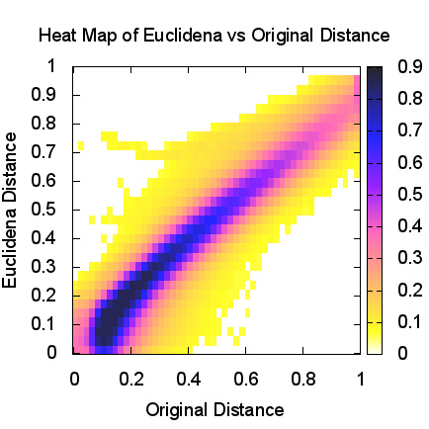
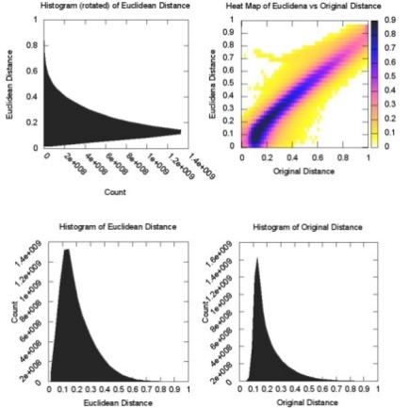
Algorithms [3/3]
  Options in MDSasChisq
    Fixed points
      Preserves an already known dimensional mapping for a subset of points and positions others around those
    Rotation
      Rotates and/or inverts a points set to “align” with a reference set of points enabling visual side-by-side comparison
    Distance transformation
      Reduces input distance dimensionality using monotonic functions
    Heatmap generation
      Provides a visual correlation of mapping into lower dimension
(a) Different Mapping of (b)
(b) Reference
(c) Rotation of (a) into (b)

Slide 9
Simple Architecture
Complex
Input Sequences
Sample Set
Out Sample Set
Split Data
=
+
Out Sample Set
Simple Architecture
Interpolate to Sample Regions
Region Refinement
Find Mega Regions
Sample Set
Sample Regions
Coarse Grained Regions
Refined Mega Regions
Simple Architecture
Subset Clustering
Analyze Each Mega Region
Mega Region
Initial Plot
Final Plot

Slide 10
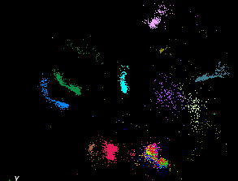
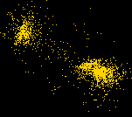
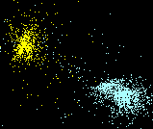
Determination of Clusters [1/5]
Visualization
Cluster Size
  Number of Points Per Cluster ← Not Known in Advance
    One point per cluster ← Perfect, but useless
  Solution → Hierarchical Clustering
    Guidance from biologists
    Depends on visualization
Sequence | Cluster
0 | 2
1 | 1
… | …
Vs.
Multiple groups identified as one cluster
Refined clusters to show proper split of groups

Slide 11
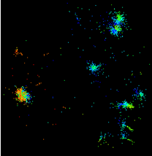
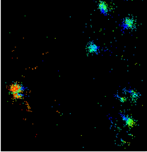
Determination of Clusters [2/5]
Effect of Gap Penalties ← Indistinguishable for the Test Data
Data Set | Sample of 16S rRNA
Number of Sequences | 6822
Alignment Type | Smith-Waterman
Scoring Matrix | EDNAFULL
 |  |  |  |  | Ref.
Gap Open | -4 | -4 | -8 | -10 | -16 | -16 | -16 | -20 | -20 | -20 | -24 | -24 | -24 | -24
Gap Extension | -2 | -4 | -4 | -4 | -4 | -8 | -16 | -4 | -8 | -16 | -4 | ­-8 | -16 | -20
-10/-4
Reference -16/-4
-4/-4

Slide 12
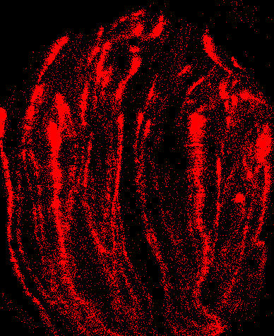
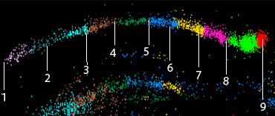
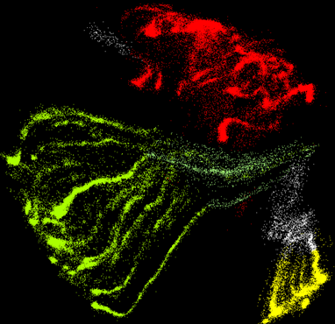
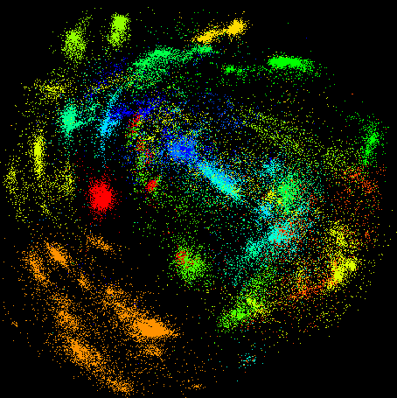
Determination of Clusters [3/5]
Global Vs. Local Sequence Alignment
Sequence 1 | TTGAGTTTTAACCTTGCGGCCGTA
Sequence 2 | AAGTTTCTTGCCGG
Global alignment | TTGAGTTTTAACCTTGCGGCCGTA |||||| ||| |||| ---AAGTTT---CTT---GCCG–G
Local alignment | ttgagttttaacCTTGCGGccgta ||||||| aagtttCTTGCGG
Global alignment has formed superficial alignments when sequence lengths differ greatly !
Long thin line formation with global alignment
Reasonable structure with local alignment

Slide 13
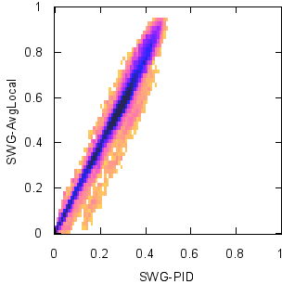
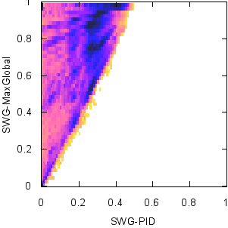
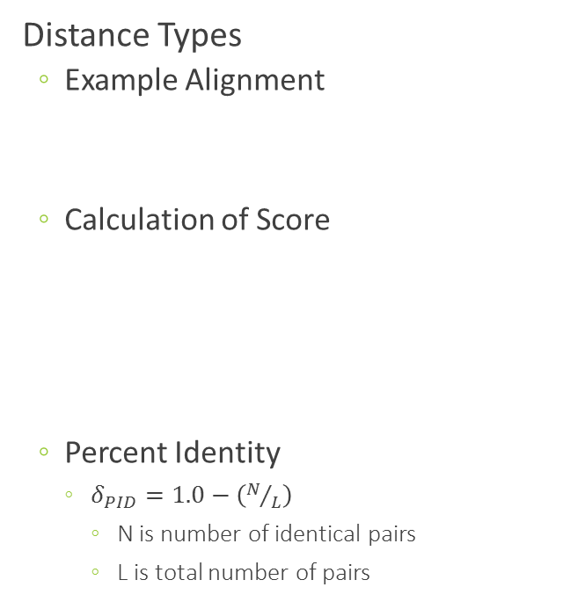
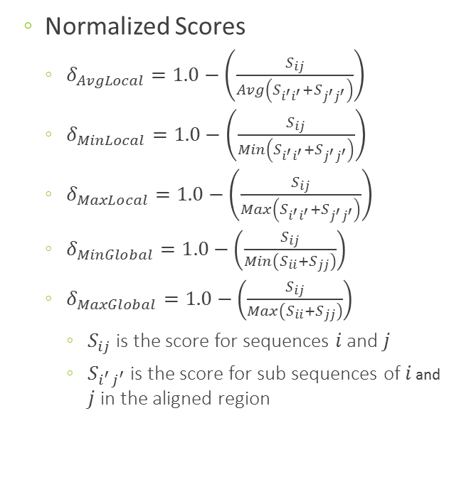
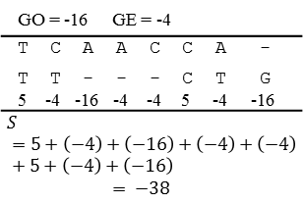
Determination of Clusters [4/5]
Distance Types
  Example Alignment
  Calculation of Score
  Percent Identity
    $δ_{PID}=1.0−\left(N/L\right)$
      N is number of identical pairs
      L is total number of pairs
  Normalized Scores
    $δ_{AvgLocal}=1.0−\left(\frac{S_{ij}}{Avg\left(S_{i^{′}i^{′}}+S_{j^{′}j^{′}}\right)}\right)$
    $δ_{MinLocal}=1.0−\left(\frac{S_{ij}}{Min\left(S_{i^{′}i^{′}}+S_{j^{′}j^{′}}\right)}\right)$
    $δ_{MaxLocal}=1.0−\left(\frac{S_{ij}}{Max\left(S_{i^{′}i^{′}}+S_{j^{′}j^{′}}\right)}\right)$
    $δ_{MinGlobal}=1.0−\left(\frac{S_{ij}}{Min\left(S_{ii}+S_{jj}\right)}\right)$
    $δ_{MaxGlobal}=1.0−\left(\frac{S_{ij}}{Max\left(S_{ii}+S_{jj}\right)}\right)$
      $S_{ij}$ is the score for sequences $i$ and $j$
      $S_{i^{′}j^{′}}$ is the score for sub sequences of $i$ and $j$ in the aligned region
Local normalized scores correlate with percent identity, but not global normalized scores !
Aligned region
 | A | T | C | G
A | 5 | -4 | -4 | -4
T | -4 | 5 | -4 | -4
C | -4 | -4 | 5 | -4
G | -4 | -4 | -4 | 5
GO = -16 GE = -4
T C A A C C A - T T - - - C T G 5 -4 -16 -4 -4 5 -4 -16
$$S=5+\left(−4\right)+\left(−16\right)+\left(−4\right)+\left(−4\right)+5+\left(−4\right)+\left(−16\right)$$ $$= −38$$

Slide 14
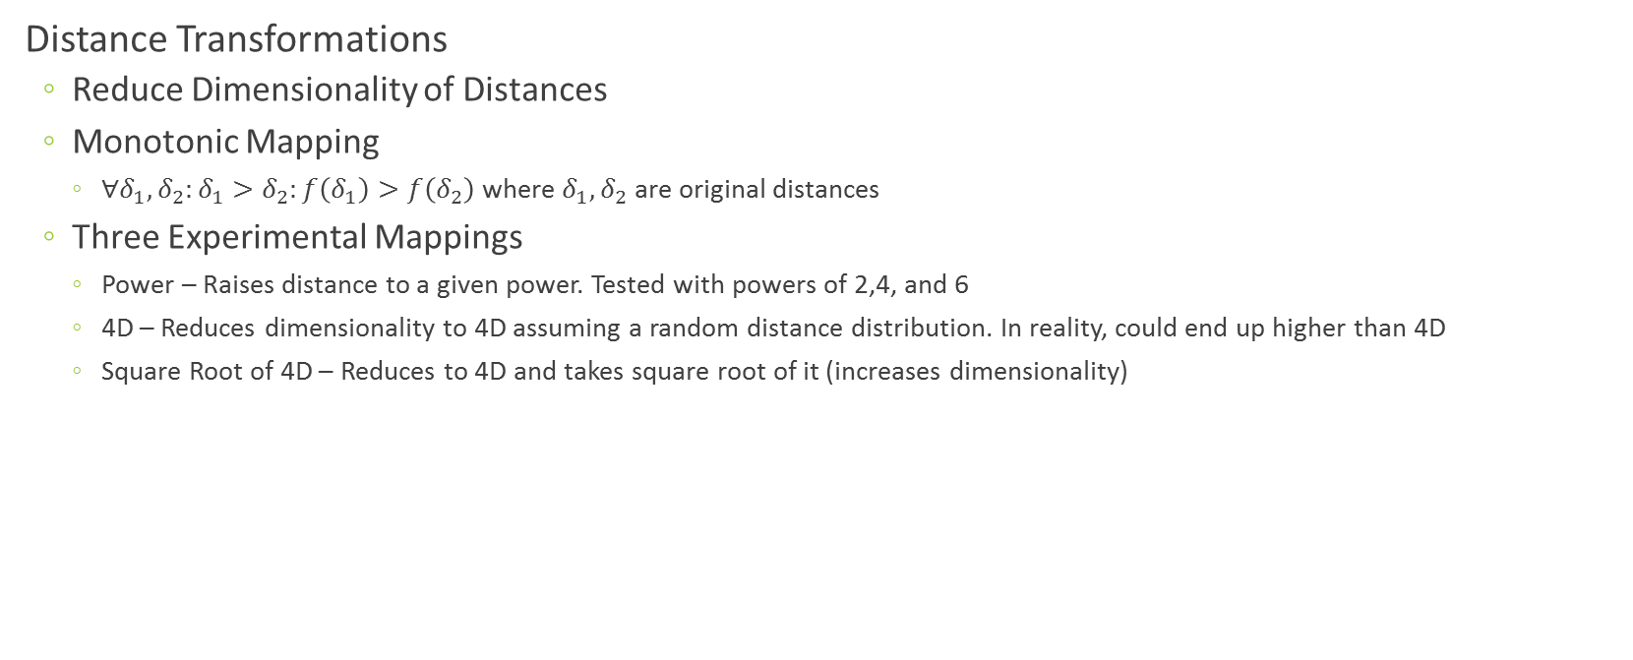
Determination of Clusters [5/5]
Distance Transformations
  Reduce Dimensionality of Distances
  Monotonic Mapping
    $∀δ_{1},δ_{2}:δ_{1}>δ_{2}:f\left(δ_{1}\right)>f\left(δ_{2}\right)$ where $δ_{1},δ_{2}$ are original distances
  Three Experimental Mappings
    Power – Raises distance to a given power. Tested with powers of 2,4, and 6
    4D – Reduces dimensionality to 4D assuming a random distance distribution. In reality, could end up higher than 4D
    Square Root of 4D – Reduces to 4D and takes square root of it (increases dimensionality)

Slide 15

Cluster Verification
Clustering with Consensus Sequences
  Goal
    Consensus sequences should appear near the mass of clusters

Slide 16
Cluster Representation
Sequence Mean
  Find the sequence that corresponds to the minimum mean distance to other sequences in a cluster
Euclidean Mean
  Find the sequence that corresponds to the minimum mean Euclidean distance to other points in a cluster
Centroid of Cluster
  Find the sequence nearest to the centroid point in the Euclidean space
Sequence/Euclidean Max
  Alternatives to first two definitions using maximum distances instead of mean

Slide 17
Cluster Comparison
Compare Clustering (DA-PWC) Results vs. CD-HIT and UCLUST
http://salsametagenomicsqiime.blogspot.com/2012/08/study-of-uclust-vs-da-pwc-for-divergent.html

Slide 18

Spherical Phylogenetic Trees
Traditional Methods – Rectangular, Circular, Slanted, etc.
  Preserves Parent-Child Distances, but Structure Present in Leaf Nodes are Lost
Spherical Phylogenetic Trees
  Overcomes this with Neighbor Joining in http://en.wikipedia.org/wiki/Neighbor_joining
  Distances are in,
    Original space
    10 Dimensional Space
    3 Dimensional Space
http://salsafungiphy.blogspot.com/2012/11/phylogenetic-tree-generation-for.html

Slide 19
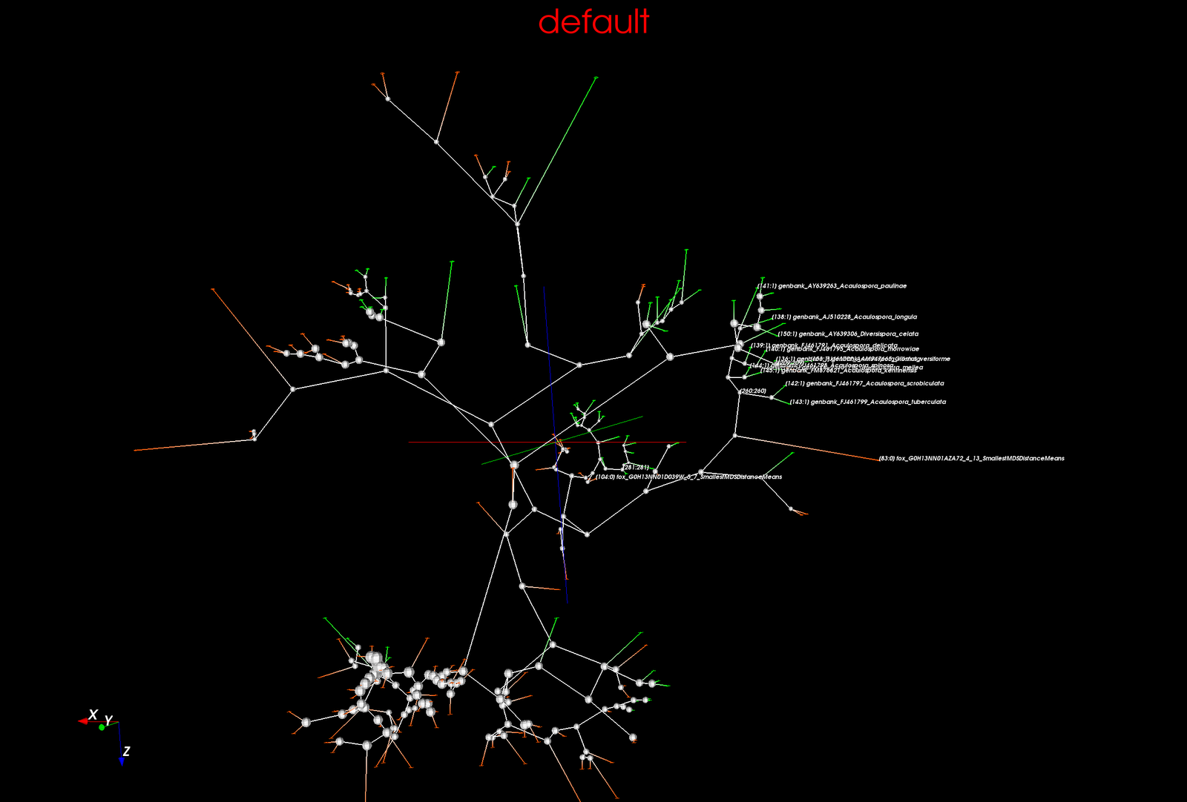

Slide 20
Sequel
More Insight on Score as a Distance Measure
Study of Statistical Significance

Slide 21
References
Million Sequence Project http://salsahpc.indiana.edu/millionseq/
The Fungi Phylogenetic Project http://salsafungiphy.blogspot.com/
The COG Project http://salsacog.blogspot.com/
SALSA HPC Group http://salsahpc.Indiana.edu

Slide 22
Survey on High Productivity Computing Systems (HPCS) Languages
Compare HPCS languages through five parallel programming idioms

Slide 23
Outline
Parallel Programs
Parallel Programming Memory Models
Idioms of Parallel Computing
  Data Parallel Computation
  Data Distribution
  Asynchronous Remote Tasks
  Nested Parallelism
  Remote Transactions

Slide 24
Parallel Programs
Steps in Creating a Parallel Program
Constructs to Create ACUs
  Explicit
    Java threads, Parallel.Foreach in TPL
  Implicit
    for loops, also do blocks in Fortress
  Compiler Directives
    #pragma omp parallel for in OpenMP
Sequential
Computation
Tasks
Abstract
Computing
Units (ACU)
e.g. processes
Parallel
Program
Physical
Computing
Units (PCU)
e.g. processor, core
………………
…
…
…
ACU 0
ACU 1
…
ACU 0
ACU 1
PCU 0
PCU 1
…
…
…
…
…
…
…
ACU 2
ACU 3
ACU 2
ACU 3
…
PCU 2
PCU 3
…
…
…
…
Decomposition
Assignment
Orchestration
Mapping

Slide 25
Parallel Programming Memory Models
Local Address Space
Local Address Space
...
Local Address Space
...
Task
Task
Task
...
Task
Task
Task
Task
Task
Shared
Distributed
Task
Task
Task
Shared Global Address Space
Local Address Space
Local Address Space
Local Address Space
Local Address Space
Partitioned Shared Address Space
Partitioned Global Address Space
Local Address Spaces
X Y
X
X
Hybrid
Task
...
Task
Task
...
Task
Task
...
Task
...
Shared Global Address Space
Shared Global Address Space
Shared Global Address Space
Task 1
Task 2
Task 3
Task
Task
Task
Z
Array [ ]
Local Address Space
Local Address Space
Local Address Space
Partitioned Shared Address Space
Each task has declared a private variable X
Task 1 has declared another private variable Y
Task 3 has declared a shared variable Z
An array is declared as shared across the shared address space
Processor
Network
CPU
CPU
Processor
...
Processor
Processor
Task
Task
Task
CPU
CPU
CPU
CPU
CPU
CPU
Processor
Processor
Shared Memory Implementation
Task
Task
...
Every task can access variable Z
Every task can access each element of the array
Only Task 1 can access variable Y
Each copy of X is local to the task declaring it and may not necessarily contain the same value
Access of elements local to a task in the array is faster than accessing other elements.
Task 3 may access Z faster than Task 1 and Task 2
Distributed Memory Implementation
Task
CPU
CPU
CPU
CPU
Network
Memory
Memory
Memory
Memory
Memory
Memory
Shared Global Address Space
Local Address Space
Notes:
Memory model → abstraction of address space → one classifier of parallel languages
Shared memory model → no explicit communication to share but require locks
Distributed memory model → explicit communication, but easy to map to physically distributed machines
PGAS → best of both worlds

Slide 26
Idioms of Parallel Computing
Common Task | Language
 | Chapel | X10 | Fortress
Data parallel computation | forall | finish … for … async | for
Data distribution | dmapped | DistArray | arrays, vectors, matrices
Asynchronous Remote Tasks | on … begin | at … async | spawn … at
Nested parallelism | cobegin … forall | for … async | for … spawn
Remote transactions | on … atomic (not implemented yet) | at … atomic | at … atomic

Slide 27
Data Parallel Computation
Chapel
X10
Fortress
forall (a,b,c) in zip (A,B,C) do
a = b + alpha * c;
for (p in A)
A(p) = 2 * A(p);
Array
for i <- 1:10 do
A[i] := i end
Number Range
Zipper
Sequential
for ([i] in 1 .. N)
sum += i;
Number Range
forall i in 1 … N do
a(i) = b(i);
A:ZZ32[3,3]=[1 2 3;4 5 6;7 8 9]
for (i,j) <- A.indices() do
A[i,j] := i end
Arithmetic domain
Array Indices
Statement Context
Parallel
A = B + alpha * C;
Parallel
finish for (p in A)
async A(p) = 2 * A(p);
for a <- A do
println(a) end
Array Elements
Short Forms
[i in 1 … N] a(i) = b(i);
for a <- {[\ZZ32\] 1,3,5,7,9} do
println(a) end
end
Set
Expression Context
writeln(+ reduce [i in 1 .. 10] i**2;)
for i <- sequential(1:10) do
A[i] := i end
Sequential
for a <- sequential({[\ZZ32\] 1,3,10,8,6}) do
println(a) end
end

Slide 28
Data Distribution
Chapel
X10
Fortress
Intended
  blocked
  blockCyclic
  columnMajor
  rowMajor
  Default
No Working Implementation
var D: domain(2) = [1 .. m, 1 .. n];
var A: [D] real;
val R = (0..5) * (1..3);
val arr = new Array[Int](R,10);
Domain and Array
Region and Array
const D = [1..n, 1..n];
const BD = D dmapped Block(boundingBox=D);
var BA: [BD] real;
val blk = Dist.makeBlock((1..9)*(1..9));
val data : DistArray[Int]= DistArray.make[Int](blk, ([i,j]:Point(2)) => i*j);
Box Distribution of Domain
Box Distribution of Array

Slide 29
Asynchronous Remote Tasks
Chapel
X10
Fortress
{ // activity T
async {S1;} // spawns T1
async {S2;} // spawns T2
}
spawn at a.region(i) do exp end
begin writeline(“Hello”);
writeline(“Hi”);
Remote and Asynchronous
Asynchronous
Asynchronous
at (p) async S
  migrates the computation to p and spawns a new activity in p to evaluate S and returns control
async at (p) S
  spawns a new activity in current place and returns control while the spawned activity migrates the computation to p and evaluates S there
async at (p) async S
  spawns a new activity in current place and returns control while the spawned activity migrates the computation to p and spawns another activity in p to evaluate S there
(v,w) := (exp1,
at a.region(i) do exp2 end)
on A[i] do begin
A[i] = 2 * A[i]
writeline(“Hello”);
writeline(“Hi”);
Implicit Multiple Threads and Region Shift
Remote and Asynchronous
do
v := exp1
at a.region(i) do
w := exp2
end
x := v+w
end
Implicit Thread Group and Region Shift
Remote and Asynchronous

Slide 30
Nested Parallelism
Chapel
X10
Fortress
cobegin {
forall (a,b,c) in (A,B,C) do
a = b + alpha * c;
forall (d,e,f) in (D,E,F) do
d = e + beta * f;
}
finish { async S1; async S2; }
T:Thread[\Any\] = spawn do exp end
T.wait()
Explicit Thread
Data Parallelism Inside Task Parallelism
do exp1 also do exp2 end
Structural Construct
Data Parallelism Inside Task Parallelism
Data Parallelism Inside Task Parallelism
Given a data parallel code in X10 it is possible to spawn new activities inside the body that gets evaluated in parallel. However, in the absence of a built-in data parallel construct, a scenario that requires such nesting may be custom implemented with constructs like finish, for, and async instead of first having to make data parallel code and embedding task parallelism
sync forall (a) in (A) do
if (a % 5 ==0) then
begin f(a);
else
a = g(a);
arr:Array[\ZZ32,ZZ32\]=array[\ZZ32\](4).fill(id)
for i <- arr.indices() do
t = spawn do arr[i]:= factorial(i) end
t.wait()
end
Task Parallelism Inside Data Parallelism
Note on Task Parallelism Inside Data Parallelism
Note on Task Parallelism Inside Data Parallelism

Slide 31
Remote Transactions
X10
Fortress
var n : Int = 0;
finish {
async atomic n = n + 1; //(a)
async atomic n = n + 2; //(b)
}
val blk = Dist.makeBlock((1..1)*(1..1),0);
val data = DistArray.make[Int](blk, ([i,j]:Point(2)) => 0);
val pt : Point = [1,1];
finish for (pl in Place.places()) {
async{
val dataloc = blk(pt);
if (dataloc != pl){
Console.OUT.println("Point " + pt + " is in place " + dataloc);
at (dataloc) atomic {
data(pt) = data(pt) + 1;
}
}
else {
Console.OUT.println("Point " + pt + " is in place " + pl);
atomic data(pt) = data(pt) + 2;
}
}
}
Console.OUT.println("Final value of point " + pt + " is " + data(pt));
do
x:Z32 := 0
y:Z32 := 0
z:Z32 := 0
atomic do
x += 1
y += 1
also atomic do
z := x + y
end
z
end
var n : Int = 0;
finish {
async n = n + 1; //(a) -- BAD
async atomic n = n + 2; //(b)
}
Unconditional Local
Local
f(y:ZZ32):ZZ32=y y
D:Array[\ZZ32,ZZ32\]=array[\ZZ32\](4).fill(f)
q:ZZ32=0
at D.region(2) atomic do
println("at D.region(2)")
q:=D[2]
println("q in first atomic: " q)
also at D.region(1) atomic do
println("at D.region(1)")
q+=1
println("q in second atomic: " q)
end
println("Final q: " q)
def pop() : T {
var ret : T;
when(size>0) {
ret = list.removeAt(0);
size --;
}
return ret;
}
Unconditional Remote
The atomicity is weak in the sense that an atomic block appears atomic only to other atomic blocks running at the same place. Atomic code running at remote places or non-atomic code running at local or remote places may interfere with local atomic code, if care is not taken
Conditional Local
Remote (true if distributions were implemented)

Slide 32
K-Means Implementation
Why K-Means?
  Simple to Comprehend
  Broad Enough to Exploit Most of the Idioms
Distributed Parallel Implementations
  Chapel and X10
Parallel Non Distributed Implementation
  Fortress
Complete Working Code in Appendix of Paper

Slide 33
Thank you!
Questions ?

