Slide 1
Cloud Technologies and
Their Applications
March 26, 2010 Indiana University Bloomington
Judy Qiu
xqiu@indiana.edu
http://salsahpc.indiana.edu
Pervasive Technology Institute
Indiana University
Notes:
SALSA is
Service Aggregated Linked Sequential Activities

Slide 2
Important Trends
  In all fields of science and throughout life (e.g. web!)
  Impacts preservation, access/use, programming model
    new commercially supported data center model replacing compute grids
Data Deluge
Cloud Technologies
Multicore/
Parallel Computing
eSciences
  Implies parallel computing important again
    Performance from extra cores – not extra clock speed
  A spectrum of eScience applications (biology, chemistry, physics …)
  Data Analysis
  Machine learning
Notes:
Within past 5 year, Data -> Hardware -> Software -> Application
Data coming from everywhere 24/7.
Science faces a data deluge.
How to manage and analyze information?
Data are too large to fit into memory and take impractical time to run and get results
e.g. 50K all pairs SWG (O(N2)) takes ~5 hours on 768 cores. A sequential run takes 160 days.
MPI OpenMP RPC RMI

Slide 3
Challenges for CS Research
Science faces a data deluge. How to manage and analyze information?
Recommend CSTB foster tools for data capture, data curation, data analysis
―Jim Gray’s
Talk to Computer Science and Telecommunication Board (CSTB), Jan 11, 2007
There’re several challenges to realizing the vision on data intensive systems and building generic tools (Workflow, Databases, Algorithms, Visualization ).
Cluster-management software
Distributed-execution engine
Language constructs
Parallel compilers
Program Development tools
. . .
Notes:
Jim Gray’s talk to the Computer Science and Telecommunications Board in 2007
His vision of the fourth paradigm of scientific research. Focus on Data-intensive Systems and Scientific communications
New scientific research is highlighted by “data science”

Slide 4
Cloud as a Service and MapReduce
Data Deluge
Cloud Technologies
Multicore
eScience
Notes:
Within past 5 year
Data -> Hardware -> Software -> Application
Data coming from everywhere 24/7.
Data are too large to fit into memory and take impractical time to run and get results
e.g. 50K all pairs SWG (O(N2)) takes ~5 hours on 768 cores. A sequential run takes 160 days.
MPI OpenMP RPC RMI

Slide 5


Clouds as Cost Effective Data Centers
Builds giant data centers with 100,000’s of computers; ~ 200
-1000 to a shipping container with Internet access
“Microsoft will cram between 150 and 220 shipping containers filled with data center gear into a new 500,000 square foot Chicago facility. This move marks the most significant, public use of the shipping container systems popularized by the likes of Sun Microsystems and Rackable Systems to date.”

Slide 6

Clouds hide Complexity
SaaS: Software as a Service
IaaS: Infrastructure as a Service or HaaS: Hardware as a Service – get your computer time with a credit card and with a Web interaface
PaaS: Platform as a Service is IaaS plus core software capabilities on which you build SaaS
Cyberinfrastructure is “Research as a Service”
SensaaS is Sensors as a Service
2 Google warehouses of computers on the banks of the Columbia River, in The Dalles, Oregon
Such centers use 20MW-200MW
(Future) each
150 watts per core
Save money from large size, positioning with cheap power and access with Internet

Slide 7

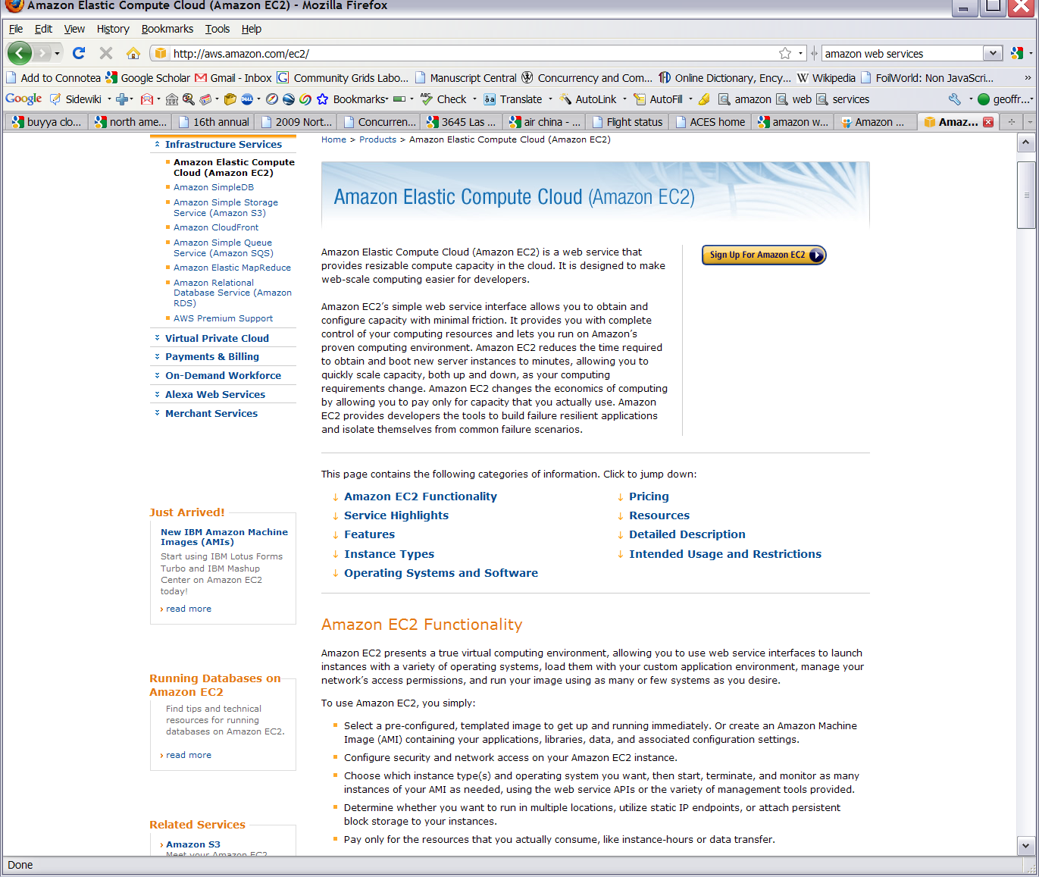






Commercial Cloud

Slide 8
Map Reduce
The Story of Sam …

Slide 9


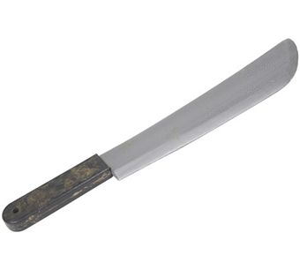
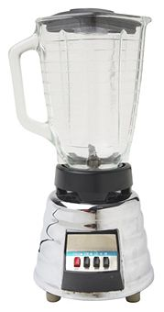


Sam’s Problem
Sam thought of “drinking” the apple
He used a to cut the and a to make juice.

Slide 10
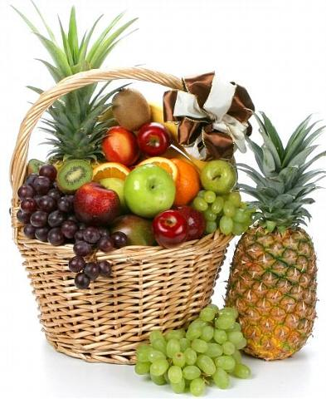

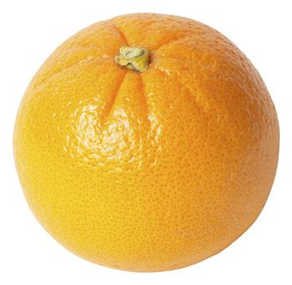

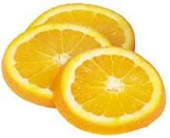
MapReduce
Sam applied his invention to all the fruits he could find in the fruit basket
(map ‘( ))
A list of values mapped into another list of values, which gets reduced into a single value
( )
(reduce ‘( ))
Classical Notion of Map Reduce in Functional Programming
Notes:
MapReduce is a high level technology from Information Retrieval
It is the model of Google MapReduce ➔ “Map => Reduce”?

Slide 11
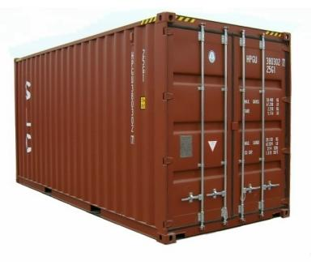
Creative Sam
Implemented a parallel version of his innovation
Fruits
Each input to a map is a list of <key, value> pairs
(<a, > , <o, > , <p, > , …)
A list of <key, value> pairs mapped into another list of <key, value> pairs which gets grouped by the key and reduced into a list of values
Each output of a map is a list of <key, value> pairs
(<a’, > , <o’, > , <p’, > , …)
Grouped by key
The idea of Map Reduce in Data Intensive Computing
Each input to a reduce is a <key, value-list> (possibly a list of these, depending on the grouping/hashing mechanism)
e.g. <a’, ( …)>
Reduced into a list of values
Notes:
To create his favorite mix fruit juice he can use a combiner after the reducers
If several <key, value-list> fall into the same group (based on the grouping/hashing algorithm) then use the blender (reducer) separately on each of them
The knife (mapper) and blender (reducer) should not contain residue after use – Side Effect Free
In general reducer should be associative and commutative

Slide 12
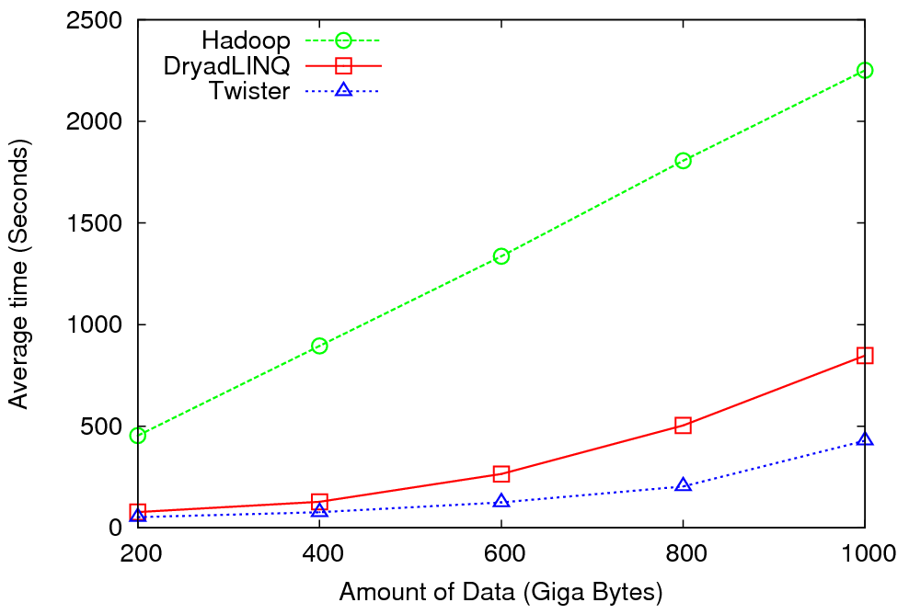

High Energy Physics Data Analysis
Data analysis requires ROOT framework (ROOT Interpreted Scripts)
The Data set is a large (up to 1TB)
Performance depends on disk access speeds
Hadoop implementation uses a shared parallel file system (Lustre)
  ROOT scripts cannot access data from HDFS
  On demand data movement has significant overhead
Dryad stores data in local disks
  Better performance

Slide 13

Reduce Phase of Particle Physics
“Find the Higgs” using MapReduce
Higgs in Monte Carlo
Combine Histograms produced by separate Root “Maps” (of event data to partial histograms) into a single Histogram delivered to Client

Slide 14
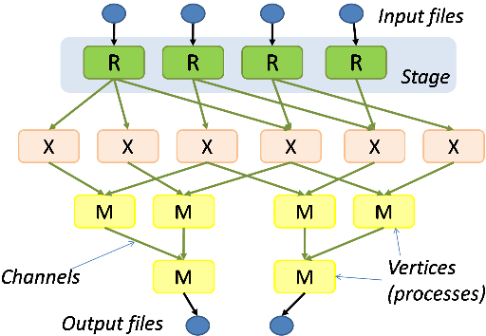
Hadoop & Dryad
Apache Hadoop
Microsoft Dryad
Master Node
Data/Compute Nodes
Job
Tracker
M
M
M
M
R
R
R
R
Name
Node
Data blocks
1
2
2
4
3
3
HDFS
Apache Implementation of Google’s MapReduce
Uses Hadoop Distributed File System (HDFS) to manage data
Map/Reduce tasks are scheduled based on data locality in HDFS
Hadoop handles:
  Job Creation
  Resource management
  Fault tolerance & re-execution of failed map/reduce tasks
The computation is structured as a directed acyclic graph (DAG)
  Superset of MapReduce
Vertices – computation tasks
Edges – Communication channels
Dryad process the DAG executing vertices on compute clusters
Dryad handles:
  Job creation, Resource management
  Fault tolerance & re-execution of vertices

Slide 15
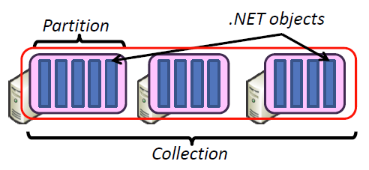
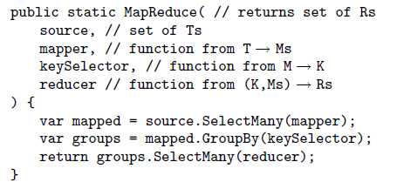
DryadLINQ
Implementation supports:
  Execution of DAG on Dryad
  Managing data across vertices
  Quality of services
Standard LINQ operations
DryadLINQ operations
DryadLINQ Compiler
Vertex :
execution task
Directed Acyclic Graph (DAG) based execution flows
Edge :
communication path
Dryad Execution Engine

Slide 16


Applications using Dryad & DryadLINQ
CAP3 [1] - Expressed Sequence Tag assembly to re-construct full-length mRNA
Input files (FASTA)
DryadLINQ
CAP3
CAP3
CAP3
Output files
Perform using DryadLINQ and Apache Hadoop implementations
Single “Select” operation in DryadLINQ
“Map only” operation in Hadoop
[4] X. Huang, A. Madan, “CAP3: A DNA Sequence Assembly Program,” Genome Research, vol. 9, no. 9, pp. 868-877, 1999.

Slide 17
MapReduce
Data Partitions
Map(Key, Value)
A hash function maps the results of the map tasks to r reduce tasks
Reduce(Key, List<Value>)
Reduce Outputs
Implementations support:
  Splitting of data
  Passing the output of map functions to reduce functions
  Sorting the inputs to the reduce function based on the intermediate keys
  Quality of services

Slide 18
MapReduce
3
Data is split into m parts
A hash function maps the results of the map tasks to r reduce tasks
1
D1
map
reduce
O1
5
D2
A combine task may be necessary to combine all the outputs of the reduce functions together
Data
map
reduce
O2
Dm
map
2
data split
map
reduce
map function is performed on each of these data parts concurrently
4
Once all the results for a particular reduce task is available, the framework executes the reduce task
The framework supports:
  Splitting of data
  Passing the output of map functions to reduce functions
  Sorting the inputs to the reduce function based on the intermediate keys
  Quality of services

Slide 19
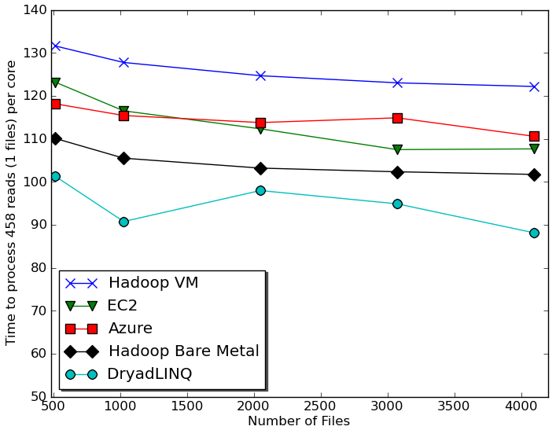

Usability and Performance of Different Cloud Approaches
Cap3 Performance
Cap3 Efficiency
Lines of code including file copy
Azure : ~300
EC2 : ~700
Hadoop: ~400
Dryad: ~450

Slide 20
Data Intensive Applications
Data Deluge
Cloud Technologies
Multicore
eScience
Notes:
Within past 5 year
Data -> Hardware -> Software -> Application
Data coming from everywhere 24/7.
Data are too large to fit into memory and take impractical time to run and get results
e.g. 50K all pairs SWG (O(N2)) takes ~5 hours on 768 cores. A sequential run takes 160 days.
MPI OpenMP RPC RMI

Slide 21






MapReduce “File/Data Repository” Parallelism
Instruments
Map = (data parallel) computation reading and writing data
Reduce = Collective/Consolidation phase e.g. forming multiple global sums as in histogram
Communication via Messages/Files
Portals
/Users
Disks
Map₁
Map₂
Map₃
Reduce
Computers/Disks

Slide 22
Some Life Sciences Applications
EST (Expressed Sequence Tag) sequence assembly program using DNA sequence assembly program software CAP3.
Metagenomics and Alu repetition alignment using Smith Waterman dissimilarity computations followed by MPI applications for Clustering and MDS (Multi Dimensional Scaling) for dimension reduction before visualization
Mapping the 60 million entries in PubChem into two or three dimensions to aid selection of related chemicals with convenient Google Earth like Browser. This uses either hierarchical MDS (which cannot be applied directly as O(N²)) or GTM (Generative Topographic Mapping).
Correlating Childhood obesity with environmental factors by combining medical records with Geographical Information data with over 100 attributes using correlation computation, MDS and genetic algorithms for choosing optimal environmental factors.

Slide 23

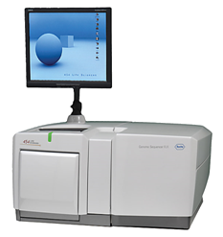
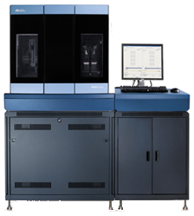

DNA Sequencing Pipeline
Illumina/Solexa Roche/454 Life Sciences Applied Biosystems/SOLiD
Internet
Modern Commerical Gene Sequences
Read Alignment
Pairwise
clustering
Form block
Pairings
Sequence
alignment
Dissimilarity
Matrix
N(N-1)/2 values
Visualization
Plotviz
FASTA File
N Sequences
Blocking
MPI
MDS
MapReduce

Slide 24
Alu and Metagenomics Workflow
Data is a collection of N sequences – 100’s of characters long
  These cannot be thought of as vectors because there are missing characters
  “Multiple Sequence Alignment” (creating vectors of characters) doesn’t seem to work if N larger than O(100)
Can calculate N² dissimilarities (distances) between sequences (all pairs)
Find families by clustering (using much better methods than Kmeans). As no vectors, use vector free O(N²) methods
Map to 3D for visualization using Multidimensional Scaling MDS – also O(N²)
N = 50,000 runs in 10 hours (all above) on 768 cores
Need to address millions of sequences …..
Currently using a mix of MapReduce and MPI
Twister will do all steps as MDS, Clustering just need MPI Broadcast/Reduce

Slide 25


Biology MDS and Clustering Results
Alu Families
This visualizes results of Alu repeats from Chimpanzee and Human Genomes. Young families (green, yellow) are seen as tight clusters. This is projection of MDS dimension reduction to 3D of 35399 repeats – each with about 400 base pairs
Metagenomics
This visualizes results of dimension reduction to 3D of 30000 gene sequences from an environmental sample. The many different genes are classified by clustering algorithm and visualized by MDS dimension reduction

Slide 26
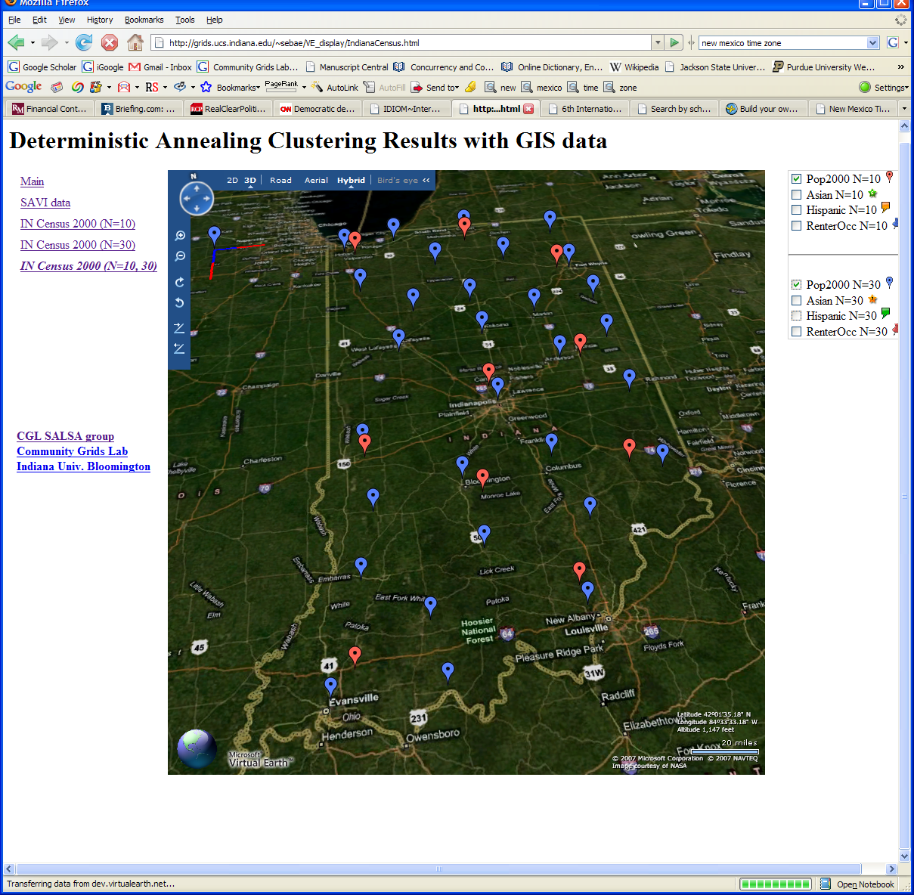
Deterministic Annealing Clustering of Indiana Census Data
Decrease temperature (distance scale) to discover more clusters
Notes:
Blue and Red baloon shows different resolutions.
Notice that the Coarse resolution (in red) doesn’t show Purdue.

Slide 27

All-Pairs Using DryadLINQ
125 million distances
4 hours & 46 minutes
Calculate Pairwise Distances (Smith Waterman Gotoh)
Calculate pairwise distances for a collection of genes (used for clustering, MDS)
Fine grained tasks in MPI
Coarse grained tasks in DryadLINQ
Performed on 768 cores (Tempest Cluster)
[5] Moretti, C., Bui, H., Hollingsworth, K., Rich, B., Flynn, P., & Thain, D. (2009). All-Pairs: An Abstraction for Data Intensive Computing on Campus Grids. IEEE Transactions on Parallel and Distributed Systems , 21, 21-36.

Slide 28
Hadoop/Dryad Comparison
Inhomogeneous Data I
Inhomogeneity of data does not have a significant effect when the sequence lengths are randomly distributed
Dryad with Windows HPCS compared to Hadoop with Linux RHEL on Idataplex (32 nodes)
Notes:
10k data size

Slide 29
Hadoop/Dryad Comparison
Inhomogeneous Data II
This shows the natural load balancing of Hadoop MR dynamic task assignment using a global pipe line in contrast to the DryadLinq static assignment
Dryad with Windows HPCS compared to Hadoop with Linux RHEL on Idataplex (32 nodes)
Notes:
10k data size

Slide 30
Hadoop VM Performance Degradation
Perf. Degradation = (T_{vm} – T_{baremetal})/T_{baremetal}
15.3% Degradation at largest data set size

Slide 31
Dryad & DryadLINQ Evaluation
Higher Jumpstart cost
  User needs to be familiar with LINQ constructs
Higher continuing development efficiency
  Minimal parallel thinking
  Easy querying on structured data (e.g. Select, Join etc..)
Many scientific applications using DryadLINQ including a High Energy Physics data analysis
Comparable performance with Apache Hadoop
  Smith Waterman Gotoh 250 million sequence alignments, performed comparatively or better than Hadoop & MPI
Applications with complex communication topologies are harder to implement

Slide 32

Application Classes
Old classification of Parallel software/hardware use in terms of 5 “Application architecture” Structures now has one more!
1 | Synchronous | Lockstep Operation as in SIMD architectures | SIMD
2 | Loosely Synchronous | Iterative Compute-Communication stages with independent compute (map) operations for each CPU. Heart of most MPI jobs | MPP
3 | Asynchronous | Compute Chess; Combinatorial Search often supported by dynamic threads | MPP
4 | Pleasingly Parallel | Each component independent | Grids
5 | Metaproblems | Coarse grain (asynchronous) combinations of classes 1)-4). The preserve of workflow. | Grids
6 | MapReduce++ | It describes file(database) to file(database) operations which has subcategories including. Pleasingly Parallel Map Only Map followed by reductions Iterative “Map followed by reductions” – Extension of Current Technologies that supports much linear algebra and datamining | Clouds Hadoop/ Dryad Twister
Notes:
Twister is an example of MapReduce++ -- supports MapReduce model with iteration (data stays in memory and communication via streams not files)
Synchronous and loosely Synchronous classes are classic simulations – Particle dynamics and solve Partial Differential Equations
Asynchronous class is uncommon in Science
Pleasingly Parallel Metaproblems and MapReduce++ important classes for data analysis

Slide 33

Twister(MapReduce++)
Pub/Sub Broker Network
Map Worker
M
Streaming based communication
Intermediate results are directly transferred from the map tasks to the reduce tasks – eliminates local files
Cacheable map/reduce tasks
  Static data remains in memory
Combine phase to combine reductions
User Program is the composer of MapReduce computations
Extends the MapReduce model to iterative computations
Worker Nodes
R
Reduce Worker
D
D
MR
Driver
User
Program
M
M
M
M
D
MRDeamon
R
R
R
R
Data Read/Write
Communication
Data Split
File System
Iterate
Static
data
Configure()
User Program
Map(Key, Value)
δ flow
Reduce (Key, List<Value>)
Combine (Key, List<Value>)
Different synchronization and intercommunication mechanisms used by the parallel runtimes
Close()
Notes:
MapReduce did some things very well but we needed MPI for MDS and Clustering.
BUT we realize not all MPI – just map and reduce iterate
Thus we designed Twister
Add new release

Slide 34


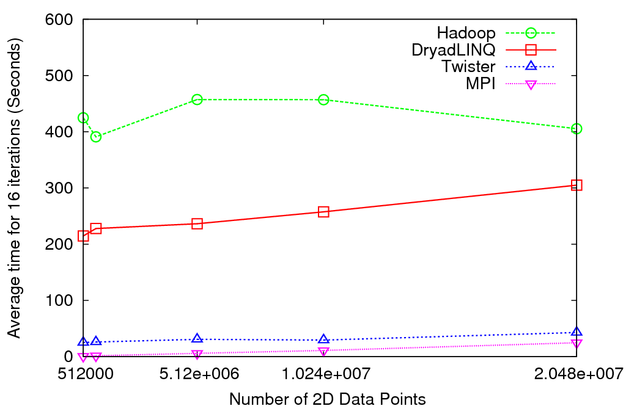
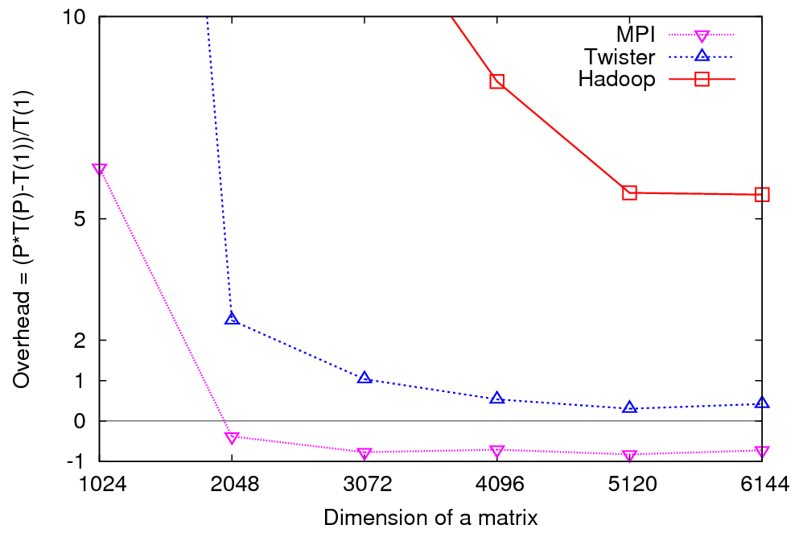
Iterative Computations
K-means
Matrix Multiplication
Performance of K-Means
Parallel Overhead Matrix Multiplication
Notes:
replace

Slide 35
Parallel Computing and Algorithms
Data Deluge
Cloud Technologies
Parallel Computing
eScience
Notes:
Within past 5 year
Data -> Hardware -> Software -> Application
Data coming from everywhere 24/7.
Data are too large to fit into memory and take impractical time to run and get results
e.g. 50K all pairs SWG (O(N2)) takes ~5 hours on 768 cores. A sequential run takes 160 days.
MPI OpenMP RPC RMI

Slide 36
Parallel Data Analysis Algorithms on Multicore
Developing a suite of parallel data-analysis capabilities
  Clustering with deterministic annealing (DA)
  Dimension Reduction for visualization and analysis (MDS, GTM)
  Matrix algebra as needed
    Matrix Multiplication
    Equation Solving
    Eigenvector/value Calculation
Notes:
Results
Microsoft CCR supports MPI, dynamic threading
Detailed performance measurements with Speedups of 7.5 or above on 8-core systems for “large problems” using deterministic annealed (avoid local minima) algorithms for clustering, Gaussian Mixtures, GTM (dimensional reduction) etc.

Slide 37
General Formula DAC GM GTM DAGTM DAGM
N data points E(x) in D dimensions space and minimize F by EM
  Deterministic Annealing Clustering (DAC)
F is Free Energy
EM is well known expectation maximization method
p(x) with Σ p(x) =1
T is annealing temperature (distance resolution) varied down from ∞ with final value of 1
Determine cluster center Y(k) by EM method
K (number of clusters) starts at 1 and is incremented by algorithm
Vector and Pairwise distance versions of DAC
DA also applied to dimension reduce (MDS and GTM)

Slide 38
Browsing PubChem Database
60 million PubChem compounds with 166 features
  Drug discovery
  Bioassay
3D visualization for data exploration/mining
  Mapping by MDS(Multi-dimensional Scaling) and
  GTM(Generative Topographic Mapping)
  Interactive visualization tool PlotViz
  Discover hidden structures
Notes:
With David Wild

Slide 39
High Performance
Dimension Reduction and Visualization
Need is pervasive
  Large and high dimensional data are everywhere: biology, physics, Internet, …
  Visualization can help data analysis
Visualization with high performance
  Map high-dimensional data into low dimensions.
  Need high performance for processing large data
  Developing high performance visualization algorithms: MDS(Multi-dimensional Scaling), GTM(Generative Topographic Mapping), DA-MDS(Deterministic Annealing MDS), DA-GTM(Deterministic Annealing GTM), …
Notes:
MDS (Multi-dimensional Scaling)
GTM (Generative Topographic Mapping)
DA-MDS(Deterministic Annealing MDS)
DA-GTM(Deterministic Annealing GTM)

Slide 40
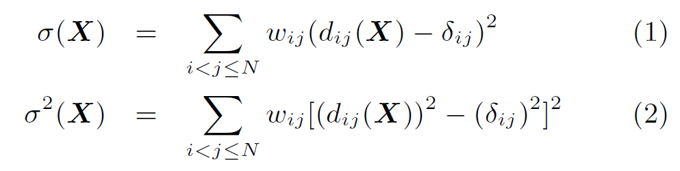

Dimension Reduction Algorithms
Multidimensional Scaling (MDS) [1]
  Given the proximity information among points.
  Optimization problem to find mapping in target dimension of the given data based on pairwise proximity information while minimize the objective function.
  Objective functions: STRESS (1) or SSTRESS (2)
  Only needs pairwise distances δ_{ij} between original points (typically not Euclidean)
  d_{ij}(X) is Euclidean distance between mapped (3D) points
Generative Topographic Mapping
(GTM) [2]
  Find optimal K-representations for the given data (in 3D), known as
  K-cluster problem (NP-hard)
  Original algorithm use EM method for optimization
  Deterministic Annealing algorithm can be used for finding a global solution
  Objective functions is to maximize log-likelihood:
[1] I. Borg and P. J. Groenen. Modern Multidimensional Scaling: Theory and Applications. Springer, New York, NY, U.S.A., 2005.
[2] C. Bishop, M. Svens´en, and C. Williams. GTM: The generative topographic mapping. Neural computation, 10(1):215–234, 1998.

Slide 41
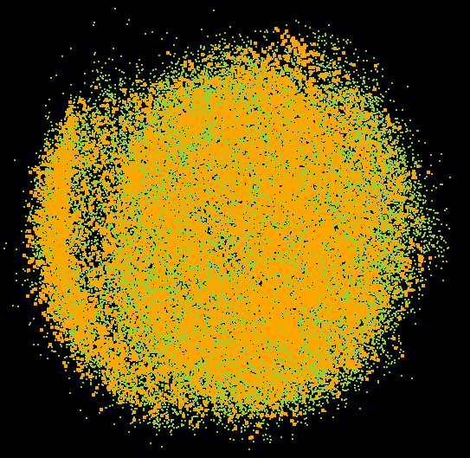
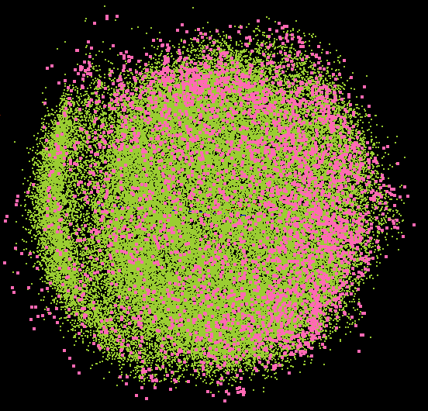
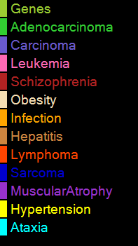
PlotViz Screenshot (I) - MDS

Slide 42
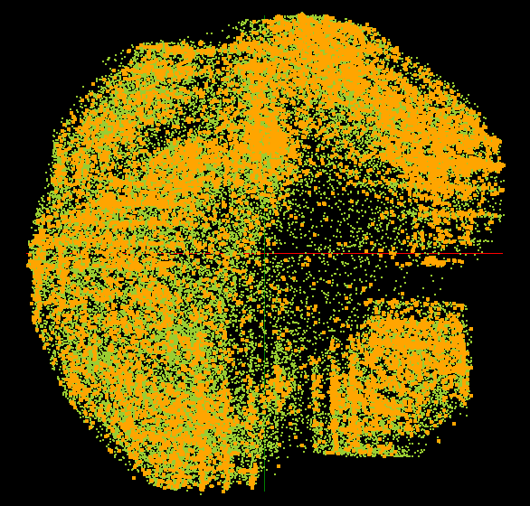
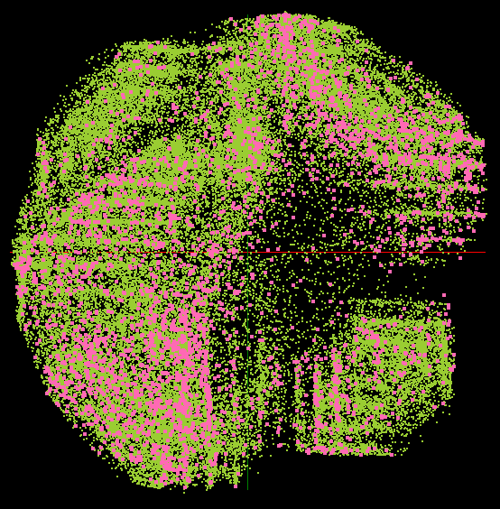
PlotViz Screenshot (II) - GTM

Slide 43
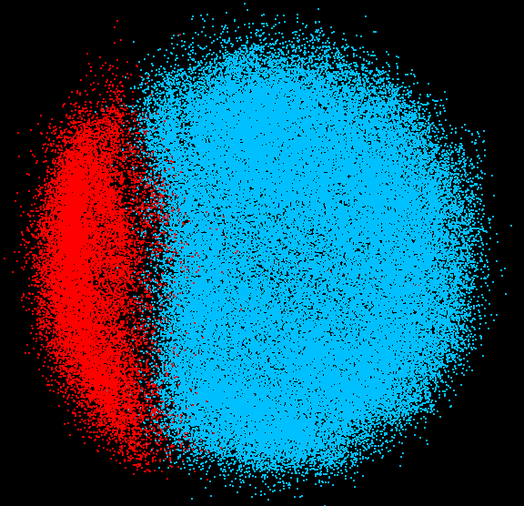
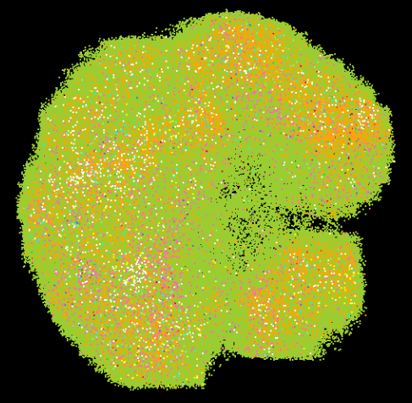
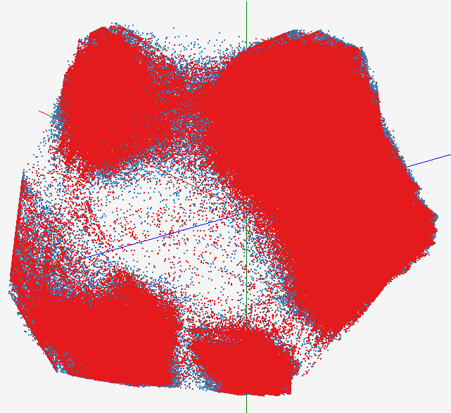
High Performance Data Visualization..
Developed parallel MDS and GTM algorithm to visualize large and high-dimensional data
Processed 0.1 million PubChem data having 166 dimensions
Parallel interpolation can process up to 2M PubChem points
GTM with interpolation for
2M PubChem data
2M PubChem data is plotted in 3D with GTM interpolation approach. Red points are 100k sampled data and blue points are 4M interpolated points.
MDS for 100k PubChem data
100k PubChem data having 166 dimensions are visualized in 3D space. Colors represent 2 clusters separated by their structural proximity.
GTM for 930k genes and diseases
Genes (green color) and diseases (others) are plotted in 3D space, aiming at finding cause-and-effect relationships.
[3] PubChem project, http://pubchem.ncbi.nlm.nih.gov/

Slide 44
Interpolation Method
MDS and GTM are highly memory and time consuming process for large dataset such as millions of data points
MDS requires O(N²) and GTM does O(KN) (N is the number of data points and K is the number of latent variables)
Training only for sampled data and interpolating for out-of-sample set can improve performance
Interpolation is a pleasingly parallel application
n
in-sample
Training
Trained data
N-n
out-of-sample
Interpolated
MDS/GTM map
Interpolation
Total N data

Slide 45
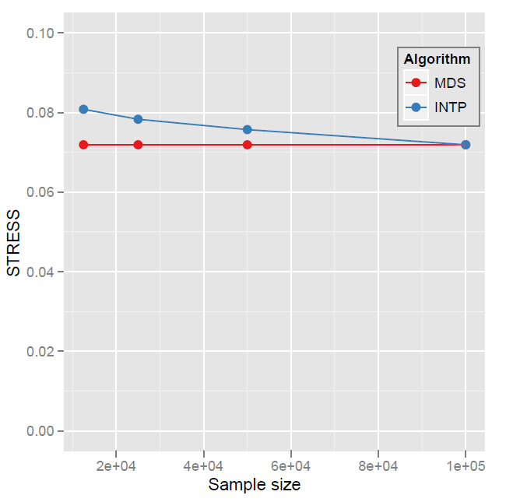
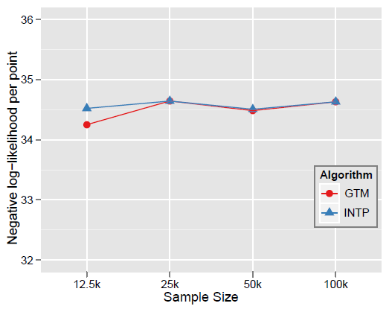

Quality Comparison
(Original vs. Interpolation)
MDS
GTM
Quality comparison between Interpolated result upto 100k based on the sample data (12.5k, 25k, and 50k) and original MDS result w/ 100k.
STRESS:
w_{ij} = 1 / ∑δ_{ij}²
Interpolation result (blue) is getting close to the original (read) result as sample size is increasing.

Slide 46
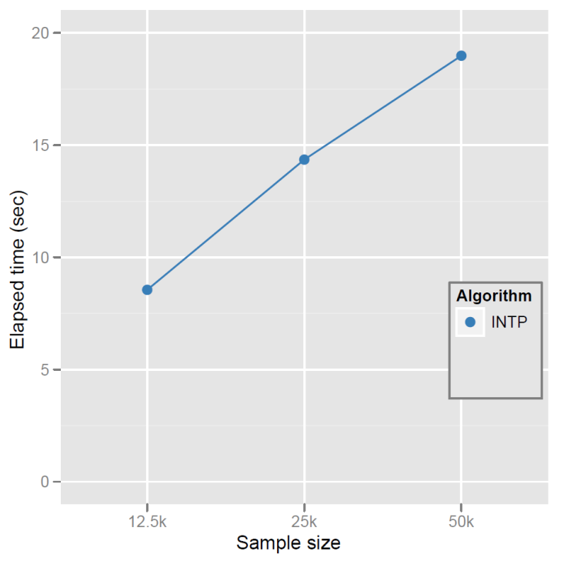
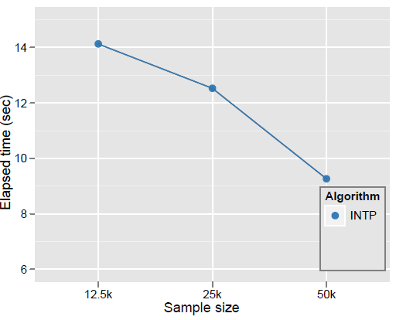
Elapsed Time of Interpolation
MDS
GTM
Elapsed time of parallel MI-MDS running time upto 100k data with respect to the sample size using 16 nodes of the Tempest. Note that the computational time complexity of MI-MDS is O(Mn) where n is the sample size and M = N − n.
Note that original MDS for only 25k data takes 2881(sec
Elapsed time for GTM interpolation is O(M) where M=N-n (n is the samples size), which is decreasing as the sample size increased

Slide 47
Important Trends
Data Deluge
Cloud Technologies
Multicore
eScience
Notes:
Within past 5 year
Data -> Hardware -> Software -> Application
Data coming from everywhere 24/7.
Data are too large to fit into memory and take impractical time to run and get results
e.g. 50K all pairs SWG (O(N2)) takes ~5 hours on 768 cores. A sequential run takes 160 days.
MPI OpenMP RPC RMI

Slide 48
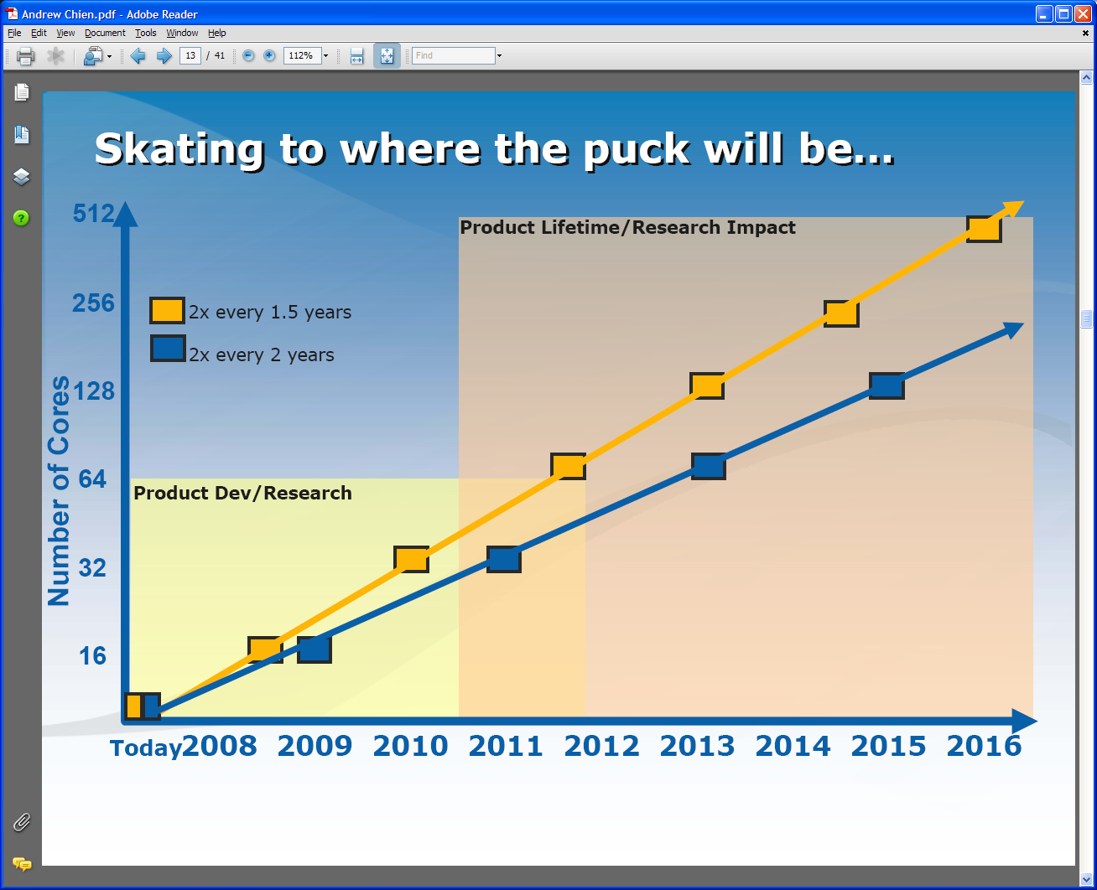
Intel’s Projection

Slide 49
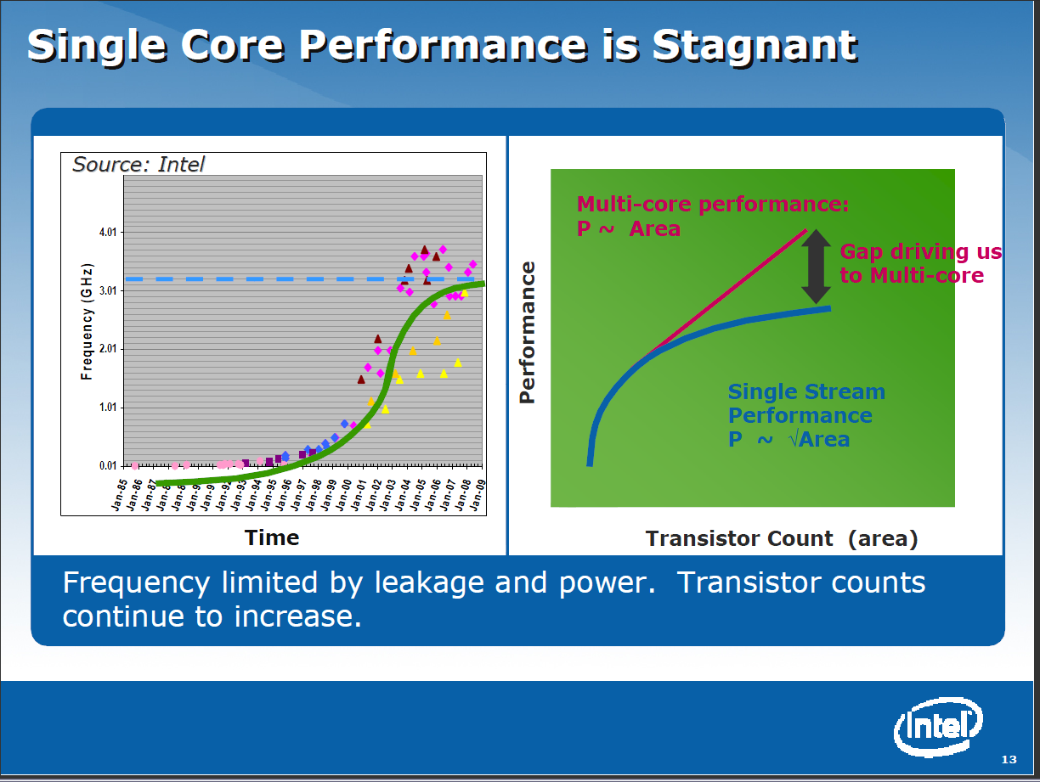

Slide 50
Intel’s Multicore Application Stack

Slide 51
Runtime System Used
We implement micro-parallelism using Microsoft CCR
(Concurrency and Coordination Runtime) as it supports both MPI rendezvous and dynamic (spawned) threading style of parallelism http://msdn.microsoft.com/robotics/
CCR Supports exchange of messages between threads using named ports and has primitives like:
  FromHandler: Spawn threads without reading ports
  Receive: Each handler reads one item from a single port
  MultipleItemReceive: Each handler reads a prescribed number of items of a given type from a given port. Note items in a port can be general structures but all must have same type.
  MultiplePortReceive: Each handler reads a one item of a given type from multiple ports.
CCR has fewer primitives than MPI but can implement MPI collectives efficiently
Use DSS (Decentralized System Services) built in terms of CCR for service model
DSS has ~35 µs and CCR a few µs overhead (latency, details later)

Slide 52
Typical CCR Performance Measurement
Performance of CCR vs MPI for MPI Exchange Communication
Machine | OS | Runtime | Grains | Parallelism | MPI Latency
Intel8 (8 core, Intel Xeon CPU, E5345, 2.33 Ghz, 8MB cache, 8GB memory) (in 2 chips) | Redhat | MPJE(Java) | Process | 8 | 181
 |  | MPICH2 (C) | Process | 8 | 40.0
 |  | MPICH2:Fast | Process | 8 | 39.3
 |  | Nemesis | Process | 8 | 4.21
Intel8 (8 core, Intel Xeon CPU, E5345, 2.33 Ghz, 8MB cache, 8GB memory) | Fedora | MPJE | Process | 8 | 157
 |  | mpiJava | Process | 8 | 111
 |  | MPICH2 | Process | 8 | 64.2
Intel8 (8 core, Intel Xeon CPU, x5355, 2.66 Ghz, 8 MB cache, 4GB memory) | Vista | MPJE | Process | 8 | 170
 | Fedora | MPJE | Process | 8 | 142
 | Fedora | mpiJava | Process | 8 | 100
 | Vista | CCR (C#) | Thread | 8 | 20.2
AMD4 (4 core, AMD Opteron CPU, 2.19 Ghz, processor 275, 4MB cache, 4GB memory) | XP | MPJE | Process | 4 | 185
 | Redhat | MPJE | Process | 4 | 152
 |  | mpiJava | Process | 4 | 99.4
 |  | MPICH2 | Process | 4 | 39.3
 | XP | CCR | Thread | 4 | 16.3
Intel4 (4 core, Intel Xeon CPU, 2.80GHz, 4MB cache, 4GB memory) | XP | CCR | Thread | 4 | 25.8
MPI Exchange Latency in µs (20-30 µs computation between messaging)
CCR outperforms Java always and even standard C except for optimized Nemesis

Slide 53
Notes on Performance
Speed up = T(1)/T(P) = ε (efficiency ) P
  with P processors
Overhead f = (PT(P)/T(1)-1) = (1/ε -1)
is linear in overheads and usually best way to record results if overhead small
For communication f ∝ ratio of data communicated to calculation complexity = n^{-0.5} for matrix multiplication where n (grain size) matrix elements per node
Overheads decrease in size as problem sizes n increase (edge over area rule)
Scaled Speed up: keep grain size n fixed as P increases
Conventional Speed up: keep Problem size fixed n ∝ 1/P

Slide 54
Threading versus MPI on node
Always MPI between nodes
Clustering by Deterministic Annealing
(Parallel Overhead = [PT(P) – T(1)]/T(1), where T time and P number of parallel units)
MPI
MPI
Parallel Overhead
MPI
Thread
Thread
Thread
Thread
Thread
MPI
MPI
MPI
MPI
Thread
Thread
Parallel Patterns (ThreadsxProcessesxNodes)
Note MPI best at low levels of parallelism
Threading best at Highest levels of parallelism (64 way breakeven)
Uses MPI.Net as an interface to MS-MPI

Slide 55
Typical CCR Comparison with TPL
Efficiency = 1 / (1 + Overhead)
Hybrid internal threading/MPI as intra-node model works well on Windows HPC cluster
Within a single node TPL or CCR outperforms MPI for computation intensive applications like clustering of Alu sequences (“all pairs” problem)
TPL outperforms CCR in major applications

Slide 56
Convergence is Happening
Multicore
Clouds
Data intensive application with basic activities:
capture, curation, preservation, and analysis (visualization)
Data Intensive
Paradigms
Cloud infrastructure and runtime
Parallel threading and processes
Notes:
Jim Gray’s talk to the Computer Science and Telecommunications Board in 2007
His vision of the fourth paradigm of scientific research. Focus on Data-intensive Systems and Scientific communications
New scientific research is highlighted by “data science”

Slide 57
Science Cloud (Dynamic Virtual Cluster) Architecture
Smith Waterman Dissimilarities, CAP-3 Gene Assembly, PhyloD Using DryadLINQ, High Energy Physics, Clustering, Multidimensional Scaling, Generative Topological Mapping
Applications
Services and Workflow
Runtimes
Apache Hadoop / MapReduce++ / MPI
Microsoft DryadLINQ / MPI
Linux Bare-system
Linux Virtual Machines
Windows Server 2008 HPC
Bare-system
Windows Server 2008 HPC
Infrastructure software
Xen Virtualization
Xen Virtualization
XCAT Infrastructure
Hardware
iDataplex Bare-metal Nodes
Dynamic Virtual Cluster provisioning via XCAT
Supports both stateful and stateless OS images

Slide 58
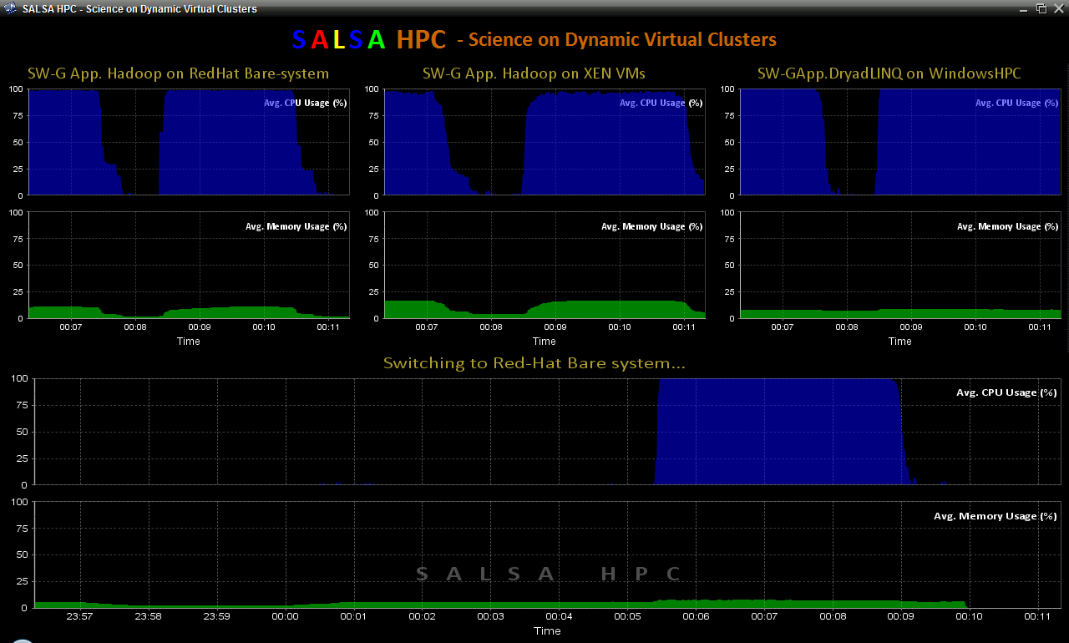
Dynamic Virtual Clusters
Dynamic Cluster Architecture
Monitoring & Control Infrastructure
Monitoring Infrastructure
Monitoring Interface
Pub/Sub Broker Network
SW-G Using Hadoop
SW-G Using Hadoop
SW-G Using DryadLINQ
Linux
Bare-system
Linux on Xen
Windows Server 2008 Bare-system
Virtual/Physical Clusters
Summarizer
XCAT Infrastructure
XCAT Infrastructure
Switcher
iDataplex Bare-metal Nodes
(32 nodes)
iDataplex Bare-metal Nodes
Switchable clusters on the same hardware (~5 minutes between different OS such as Linux+Xen to Windows+HPCS)
Support for virtual clusters
SW-G : Smith Waterman Gotoh Dissimilarity Computation as an pleasingly parallel problem suitable for MapReduce style applications

Slide 59
SALSA HPC Dynamic Virtual Clusters Demo
At top, these 3 clusters are switching applications on fixed environment. Takes ~30 Seconds.
At bottom, this cluster is switching between Environments – Linux; Linux +Xen; Windows + HPCS. Takes about ~7 minutes.
It demonstrates the concept of Science on Clouds using a FutureGrid cluster.

Slide 60
Summary of Plans
Intend to implement range of biology applications with Dryad/Hadoop
FutureGrid allows easy Windows v Linux with and without VM comparison
Initially we will make key capabilities available as services that we eventually implement on virtual clusters (clouds) to address very large problems
  Basic Pairwise dissimilarity calculations
  Capabilities already in R (done already by us and others)
  MDS in various forms
  GTM Generative Topographic Mapping
  Vector and Pairwise Deterministic annealing clustering
Point viewer (Plotviz) either as download (to Windows!) or as a Web service gives Browsing
Should enable much larger problems than existing systems
Note much of our code written in C# (high performance managed code) and runs on Microsoft HPCS 2008 (with Dryad extensions)
  Hadoop code written in Java
  Will look at Twister as a “universal” solution

Slide 61
Summary of Initial Results
Dryad/Hadoop/Azure/EC2 promising for Biology computations
Dynamic Virtual Clusters allow one to switch between different modes
Overhead of VM’s on Hadoop (15%) acceptable
Inhomogeneous problems currently favors Hadoop over Dryad
MapReduce++ allows iterative problems (classic linear algebra/datamining) to use MapReduce model efficiently
  Prototype Twister released

Slide 62
Future Work
The support for handling large data sets, the concept of moving computation to data, and the better quality of services provided by cloud technologies, make data analysis feasible on an unprecedented scale for assisting new scientific discovery.
Combine "computational thinking“ with the “fourth paradigm” (Jim Gray on data intensive computing)
Research from advance in Computer Science and Applications (scientific discovery)
Notes:
A glimpse of the future

Slide 63
SALSA Group
http://salsahpc.indiana.edu
Group Leader: Judy Qiu
Staff: Scott Beason
CS PhD: Jaliya Ekanayake, Thilina Gunarathne, Jong Youl Choi,
Seung-Hee Bae, Yang Ruan, Hui Li, Bingjing Zhang, Saliya Ekanayake,
CS Masters: Stephen Wu

Slide 64
Thank you!

