Slide 1

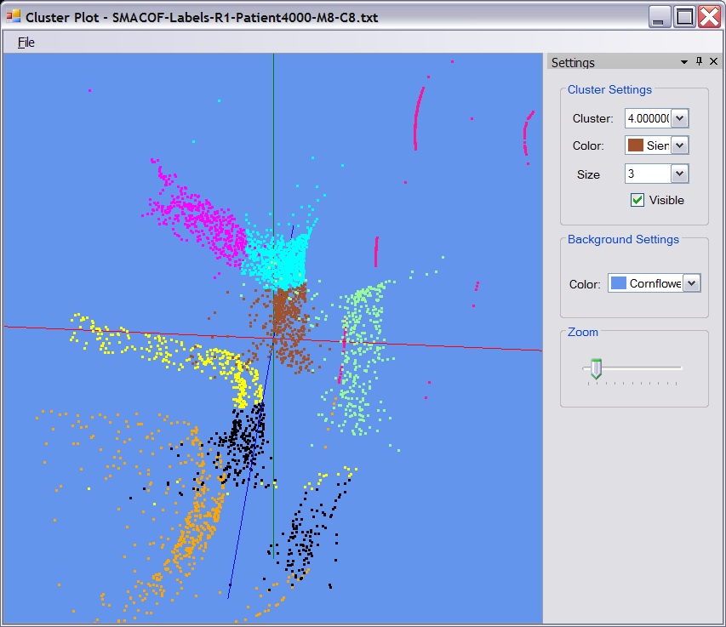




Parallel Data Analysis from Multicore to Cloudy Grids
http://www.infomall.org/salsa
Indiana University
Geoffrey Fox, Xiaohong Qiu, Scott Beason, Seung-Hee Bae, Jaliya Ekanayake,
Jong Youl Choi, Yang Ruan
Commercial and Scientific data Intensive applications require scalable high Cyberinfrastructure that exploits cloud and grid style technologies for the extensive pleasing parallel filtering from distributed repositories combined with parallel multicore clusters for detailed data mining. SALSA is exploring examples from several fields including bioinformatics, medical informatics, GIS and particle physics.
Technologies used are Dryad (distributive data intensive management), Microsoft HPC Server (Clusters and MPI) and CCR (threading).
We have new parallel algorithms for clustering using deterministic annealing and MDS (Multidimensional Scaling) with latter used to drive 3D visualization of dimension reduced systems. Performance analysis shows good performance of on clusters of 8-24 core nodes. We have separate clustering algorithms that either use vectors or solely the pairwise distances between points.
High Energy Physics Data Analysis
High Energy Physics data analysis is both data (many Petabytes) and computation intensive. We have developed a data analysis tool using DraydLINQ and its MapReduce support to analyze LHC particle physics experiment data from the Center for Advanced Computing Research at Caltech. The tool uses DryadLINQ to distribute the data files across available computing nodes and then execute a set of analysis scripts written in CINT (an interpreted language of the physics analysis package ROOT) on all these files in parallel. After processing each data file, the analysis scripts produce histograms of identified features, which are merged (the “Reduce” of MapReduce) to dynamically produce a final result of overall data analysis.
HEP Data
(binary data )
ROOT interpreted
script executed using Dryad
map
map
map
Histogram (binary data)
ROOT interpreted
script
reduce
C# Client
visualize
High Energy Physics Data Analysis using DryadLINQ
Medical Informatics and Bioinformatics
Obesity epidemic is a well-documented public health problem in the United States and environmental conditions have been identified as intervening factors through their impact on physical activity and eating habits. We are working with IU medical school to relate patient records to environmental factors and the figure shows clusters in the patient records visualized after MDS dimension reduction. This involves clustering of 20 dimensional vectors.
In bioinformatics we have instead used the pairwise clustering to study collections of gene sequences. The clustering can again be visualized with MDS as this algorithm also only requires distances and not original vectors. We are using this to identify gene families and study multiple sequence alignment algorithms that do not perform well on large size gene collections.
Medical Data Analysis using MS-MPI
on Windows HPC Cluster
Performance Benchmarking
We’ve conducted extensive performance measurements to validate a variety of different programming models for data intensive problems on Windows Clusters of up to 128 cores (a 768 core cluster is on order). Our results show both MPI and CCR perform well with MPI outperforming CCR on large problems. We have compared long running threads with rendezvous to case where threads generated dynamically for each parallel section. The results shown on a 24 core workstation show speed up of 28 on the largest problem size that exploits extra cache available with multiple cores.
Comparison of MPI.Net and CCR Threads on parallel Pairwise Clustering
Parallel
Overhead f
Speedup = 24/(1+f)
16-way
24-way
1-way
2-way
4-way
8-way
Speedup 28
MPI 1 2 1 4 2 1 8 4 2 1 16 8 4 2 1 24 12 8 6 4 3 2 1 Processes
CCR 1 1 2 1 2 4 1 2 4 8 1 2 4 8 16 1 2 3 4 6 8 12 24 Threads
4 Intel Six Core Xeon E7450 2.4GHz 48GB Memory 12M L2 Cache
3 Dataset sizes
SALSA Parallel Computing Initiative

