Slide 1
Cloud Technologies and Bioinformatics Applications
Indiana University Mini-Workshop SC09
Portland Oregon November 16 2009
Geoffrey Fox
gcf@indiana.edu www.infomall.org/salsa
Community Grids Laboratory
Pervasive Technology Institute
Indiana University
Notes:
SALSA is
Service Aggregated Linked Sequential Activities

Slide 2
Collaborators in SALSA Project
Microsoft Research
Technology Collaboration
Azure (Clouds)
Dennis Gannon
Roger Barga
Dryad (Parallel Runtime)
Christophe Poulain
CCR (Threading)
George Chrysanthakopoulos
DSS (Services)
Henrik Frystyk Nielsen
Indiana University
SALSA Technology Team
Geoffrey Fox
Judy Qiu
Scott Beason
Jaliya Ekanayake
Thilina Gunarathne
Thilina Gunarathne
Jong Youl Choi
Yang Ruan
Seung-Hee Bae
Hui Li
Saliya Ekanayake
Applications
Bioinformatics, CGB
Haixu Tang, Mina Rho,
Peter Cherbas, Qunfeng Dong
IU Medical School
Gilbert Liu
Demographics (Polis Center)
Neil Devadasan
Cheminformatics
David Wild, Qian Zhu
Physics
CMS group at Caltech (Julian Bunn)
Community Grids Lab
and UITS RT – PTI

Slide 3
Cluster Configurations
Feature | GCB-K18 @ MSR | iDataplex @ IU | Tempest @ IU
CPU | Intel Xeon CPU L5420 2.50GHz | Intel Xeon CPU L5420 2.50GHz | Intel Xeon CPU E7450 2.40GHz
# CPU /# Cores per node | 2 / 8 | 2 / 8 | 4 / 24
Memory | 16 GB | 32GB | 48GB
# Disks | 2 | 1 | 2
Network | Giga bit Ethernet | Giga bit Ethernet | Giga bit Ethernet / 20 Gbps Infiniband
Operating System | Windows Server Enterprise - 64 bit | Red Hat Enterprise Linux Server -64 bit | Windows Server Enterprise - 64 bit
# Nodes Used | 32 | 32 | 32
Total CPU Cores Used | 256 | 256 | 768
DryadLINQ
Hadoop/ Dryad / MPI
DryadLINQ / MPI

Slide 4
Convergence is Happening
Multicore
Clouds
Data intensive application (three basic activities):
capture, curation, and analysis (visualization)
Data Intensive
Paradigms
Cloud infrastructure and runtime
Parallel threading and processes
Notes:
Jim Gray’s talk to the Computer Science and Telecommunications Board in 2007
His vision of the fourth paradigm of scientific research. Focus on Data-intensive Systems and Scientific communications

Slide 5
Science Cloud (Dynamic Virtual Cluster) Architecture
Smith Waterman Dissimilarities, CAP-3 Gene Assembly, PhyloD Using DryadLINQ, High Energy Physics, Clustering, Multidimensional Scaling, Generative Topological Mapping
Applications
Runtimes
Apache Hadoop / MapReduce++ / MPI
Microsoft DryadLINQ / MPI
Linux Bare-system
Linux Virtual Machines
Windows Server 2008 HPC
Bare-system
Windows Server 2008 HPC
Infrastructure software
Xen Virtualization
Xen Virtualization
XCAT Infrastructure
Hardware
iDataplex Bare-metal Nodes
Dynamic Virtual Cluster provisioning via XCAT
Supports both stateful and stateless OS images

Slide 6
Data Intensive Architecture
Instruments
User Data
Files
Files
Files
Visualization
User Portal
Knowledge
Discovery
Users
Files
Files
Files
Initial
Processing
Higher Level
Processing
Such as R
PCA, Clustering
Correlations …
Maybe MPI
Prepare for
Viz
MDS
Notes:
From 1980-2000?, we largely looked at HPC for simulation; now we have data deluge
1) Data starts on some disk/sensor/instrument
It needs to be decomposed/partitioned; often partitioning natural from source of data
2) One runs a filter of some sort extracting data of interest and (re)formatting it
Pleasingly parallel with often “millions” of jobs
Communication latencies can be many milliseconds and can involve disks
3) Using same (or map to a new) decomposition, one runs a possibly parallel application that could require iterative steps between communicating processes or could be pleasing parallel
Communication latencies may be at most some microseconds and involves shared memory or high speed networks
Workflow links 1) 2) 3) with multiple instances of 2) 3)
Pipeline or more complex graphs
Filters are “Maps” or “Reductions” in MapReduce language

Slide 7






MapReduce “File/Data Repository” Parallelism
Instruments
Map = (data parallel) computation reading and writing data
Reduce = Collective/Consolidation phase e.g. forming multiple global sums as in histogram
Communication via Messages/Files
Portals
/Users
Disks
Map₁
Map₂
Map₃
Reduce
Computers/Disks

Slide 8
Cloud Computing: Infrastructure and Runtimes
Cloud infrastructure: outsourcing of servers, computing, data, file space, etc.
  Handled through Web services that control virtual machine lifecycles.
Cloud runtimes: tools (for using clouds) to do data-parallel computations.
  Apache Hadoop, Google MapReduce, Microsoft Dryad, and others
  Designed for information retrieval but are excellent for a wide range of science data analysis applications
  Can also do much traditional parallel computing for data-mining if extended to support iterative operations
  Not usually on Virtual Machines

Slide 9
Application Classes
(Parallel software/hardware in terms of 5 “Application architecture” Structures)
1 | Synchronous | Lockstep Operation as in SIMD architectures
2 | Loosely Synchronous | Iterative Compute-Communication stages with independent compute (map) operations for each CPU. Heart of most MPI jobs
3 | Asynchronous | Compute Chess; Combinatorial Search often supported by dynamic threads
4 | Pleasingly Parallel | Each component independent – in 1988, Fox estimated at 20% of total number of applications | Grids
5 | Metaproblems | Coarse grain (asynchronous) combinations of classes 1)-4). The preserve of workflow. | Grids
6 | MapReduce++ | It describes file(database) to file(database) operations which has three subcategories. Pleasingly Parallel Map Only Map followed by reductions Iterative “Map followed by reductions” – Extension of Current Technologies that supports much linear algebra and datamining | Clouds
Notes:
CGL-MapReduce is an example of MapReduce++ -- supports MapReduce model with iteration (data stays in memory and communication via streams not files)

Slide 10
Applications & Different Interconnection Patterns
Map Only | Classic MapReduce | Ite rative Reductions MapReduce++ | Loosely Synchronous
CAP3 Analysis Document conversion (PDF -> HTML) Brute force searches in cryptography Parametric sweeps | High Energy Physics (HEP) Histograms SWG gene alignment Distributed search Distributed sorting Information retrieval | Expectation maximization algorithms Clustering Linear Algebra | Many MPI scientific applications utilizing wide variety of communication constructs including local interactions
- CAP3 Gene Assembly - PolarGrid Matlab data analysis | - Information Retrieval - HEP Data Analysis - Calculation of Pairwise Distances for ALU Sequences | Kmeans Deterministic Annealing Clustering - Multidimensional Scaling MDS | - Solving Differential Equations and - particle dynamics with short range forces
Input
iterations
Input
Input
map
map
map
Pij
reduce
Output
reduce
Domain of MapReduce and Iterative Extensions
MPI

Slide 11
Some Life Sciences Applications
EST (Expressed Sequence Tag) sequence assembly program using DNA sequence assembly program software CAP3.
Metagenomics and Alu repetition alignment using Smith Waterman dissimilarity computations followed by MPI applications for Clustering and MDS (Multi Dimensional Scaling) for dimension reduction before visualization
Correlating Childhood obesity with environmental factors by combining medical records with Geographical Information data with over 100 attributes using correlation computation, MDS and genetic algorithms for choosing optimal environmental factors.
Mapping the 26 million entries in PubChem into two or three dimensions to aid selection of related chemicals with convenient Google Earth like Browser. This uses either hierarchical MDS (which cannot be applied directly as O(N²)) or GTM (Generative Topographic Mapping).

Slide 12
Cloud Related Technology Research
MapReduce
  Hadoop
  Hadoop on Virtual Machines (private cloud)
  Dryad (Microsoft) on Windows HPCS
MapReduce++ generalization to efficiently support iterative “maps” as in clustering, MDS …
Azure Microsoft cloud
FutureGrid dynamic virtual clusters switching between VM, “Baremetal”, Windows/Linux …

Slide 13
Alu and Sequencing Workflow
Data is a collection of N sequences – 100’s of characters long
  These cannot be thought of as vectors because there are missing characters
  “Multiple Sequence Alignment” (creating vectors of characters) doesn’t seem to work if N larger than O(100)
Can calculate N² dissimilarities (distances) between sequences (all pairs)
Find families by clustering (much better methods than Kmeans). As no vectors, use vector free O(N²) methods
Map to 3D for visualization using Multidimensional Scaling MDS – also O(N²)
N = 50,000 runs in 10 hours (all above) on 768 cores
Our collaborators just gave us 170,000 sequences and want to look at 1.5 million – will develop new algorithms!
MapReduce++ will do all steps as MDS, Clustering just need MPI Broadcast/Reduce

Slide 14
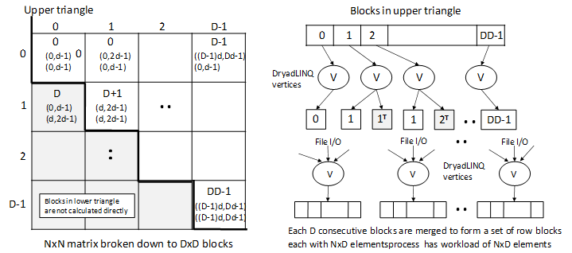
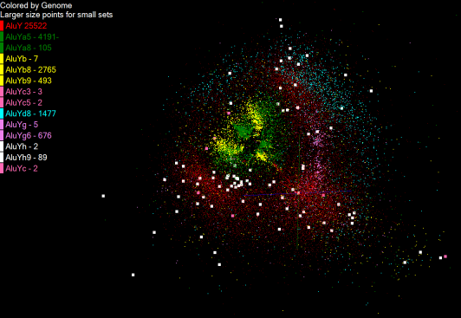
Pairwise Distances – ALU Sequences
125 million distances
4 hours & 46 minutes
Calculate pairwise distances for a collection of genes (used for clustering, MDS)
O(N^2) problem
“Doubly Data Parallel” at Dryad Stage
Performance close to MPI
Performed on 768 cores (Tempest Cluster)
Processes work better than threads when used inside vertices
100% utilization vs. 70%
Notes:
1~180 lines without threading in DryadLINQ, with threading, it is about 400 lines
MPI ~500 lines
The Alu clustering problem [27] is one of the most challenging problems for sequencing clustering because Alus represent the largest repeat families in human genome. There are about 1 million copies of Alu sequences in human genome, in which most insertions can be found in other primates and only a small fraction (~ 7000) are human-specific. This indicates that the classification of Alu repeats can be deduced solely from the 1 million human Alu elements. Notable, Alu clustering can be viewed as a classical case study for the capacity of computational infrastructures because it is not only of great intrinsic biological interests, but also a problem of a scale that will remain as the upper limit of many other clustering problem in bioinformatics for the next few years, e.g. the automated protein family classification for a few millions of proteins predicted from large metagenomics projects. In our work here we examine Alu samples of 35339 and 50,000 sequences.

Slide 15
Hadoop/Dryad Model
Block Arrangement in Dryad
and Hadoop
Execution Model in Dryad
and Hadoop
Need to generate a single file with full NxN distance matrix

Slide 16


Slide 17


Slide 18
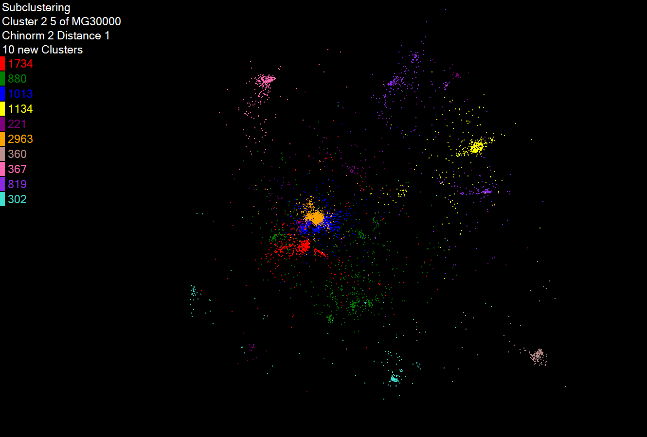
Hierarchical Subclustering

Slide 19
Pairwise Clustering
30,000 Points on Tempest
Clustering by Deterministic Annealing
MPI
Parallel Overhead
Thread
Thread
Thread
Thread
MPI
Thread
Thread
Thread
MPI
Parallelism
MPI

Slide 20
Dryad versus MPI for Smith Waterman
Flat is perfect scaling

Slide 21
Dryad Scaling on Smith Waterman
Flat is perfect scaling

Slide 22
Dryad for Inhomogeneous Data
Calculation Time per Pair [A,B] α Length A * Length B
Total
Mean Length 400
Computation
Time (ms)
Sequence Length Standard Deviation
Flat is perfect scaling – measured on Tempest
Notes:
Sensitive to small data set; load balance; 10k data size; ??? Labels computation, total

Slide 23
Hadoop/Dryad Comparison
“Homogeneous” Data
Dryad
Hadoop
Time per Alignment (ms)
Dryad with Windows HPCS compared to Hadoop with Linux RHEL on Idataplex
Using real data with standard deviation/length = 0.1
Notes:
Real data; mean length of sequence is 300.

Slide 24
Hadoop/Dryad Comparison
Inhomogeneous Data I
Inhomogeneity of data does not have a significant effect when the sequence lengths are randomly distributed
Dryad with Windows HPCS compared to Hadoop with Linux RHEL on Idataplex (32 nodes)
Notes:
10k data size

Slide 25
Hadoop/Dryad Comparison
Inhomogeneous Data II
This shows the natural load balancing of Hadoop MR dynamic task assignment using a global pipe line in contrast to the DryadLinq static assignment
Dryad with Windows HPCS compared to Hadoop with Linux RHEL on Idataplex (32 nodes)
Notes:
10k data size

Slide 26
Hadoop VM Performance Degradation
Perf. Degradation = (T_{vm} – T_{baremetal})/T_{baremetal}
15.3% Degradation at largest data set size

Slide 27
Block Dependence of Dryad SW-G
Processing on 32 node IDataplex
Dryad Block Size D | 128x128 | 64x64 | 32x32
Time to partition data | 1.839 | 2.224 | 2.224
Time to process data | 30820.0 | 32035.0 | 39458.0
Time to merge files | 60.0 | 60.0 | 60.0
Total Time | 30882.0 | 32097.0 | 39520.0
Smaller number of blocks D increases data size per block and makes cache use less efficient
Other plots have 64 by 64 blocking

Slide 28
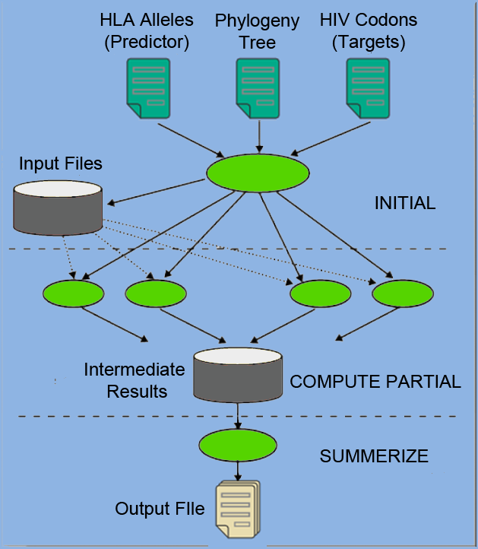
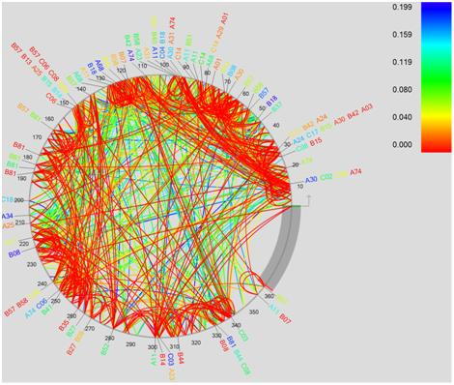
PhyloD using Azure and DryadLINQ
Derive associations between HLA alleles and HIV codons and between codons themselves

Slide 29
Mapping of PhyloD to Azure

Slide 30
PhyloD Azure Performance
Number of active Azure workers during a run of PhyloD application
Efficiency vs. number of worker roles in PhyloD prototype run on Azure March CTP

Slide 31
MapReduce++ (CGL-MapReduce)
Pub/Sub Broker Network
Map Worker
M
Worker Nodes
R
Reduce Worker
D
D
MR
Driver
User
Program
D
MRDeamon
M
M
M
M
R
R
R
R
Communication
Data Split
File System
Streaming based communication
Intermediate results are directly transferred from the map tasks to the reduce tasks – eliminates local files
Cacheable map/reduce tasks - Static data remains in memory
Combine phase to combine reductions
User Program is the composer of MapReduce computations
Extends the MapReduce model to iterative computations

Slide 32


CAP3 - DNA Sequence Assembly Program
EST (Expressed Sequence Tag) corresponds to messenger RNAs (mRNAs) transcribed from the genes residing on chromosomes. Each individual EST sequence represents a fragment of mRNA, and the EST assembly aims to re-construct full-length mRNA sequences for each expressed gene.
Input files (FASTA)
GCB-K18-N01
\DryadData\cap3\cap3data
10
0,344,CGB-K18-N01
1,344,CGB-K18-N01
…
9,344,CGB-K18-N01
Cap3data.pf
V
V
Cap3data.00000000
\\GCB-K18-N01\DryadData\cap3\cluster34442.fsa
\\GCB-K18-N01\DryadData\cap3\cluster34443.fsa
...
\\GCB-K18-N01\DryadData\cap3\cluster34467.fsa
Output files
Input files
(FASTA)
IQueryable<LineRecord> inputFiles=PartitionedTable.Get <LineRecord>(uri);
IQueryable<OutputInfo> = inputFiles.Select(x=>ExecuteCAP3(x.line));
[1] X. Huang, A. Madan, “CAP3: A DNA Sequence Assembly Program,” Genome Research, vol. 9, no. 9, pp. 868-877, 1999.

Slide 33
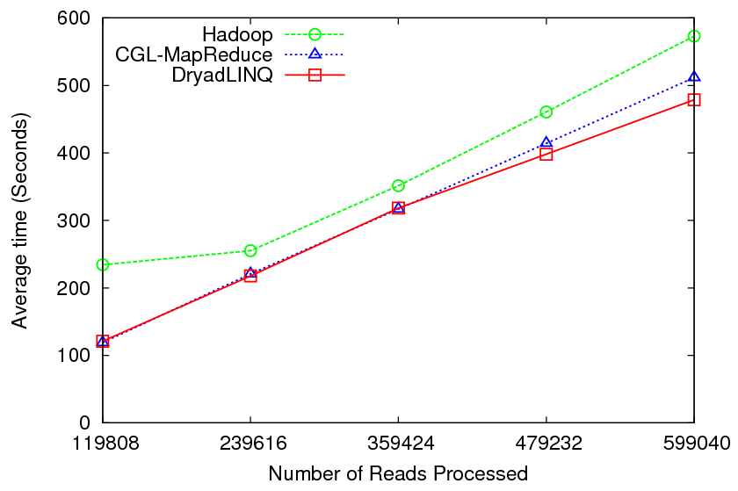
CAP3 - Performance

Slide 34


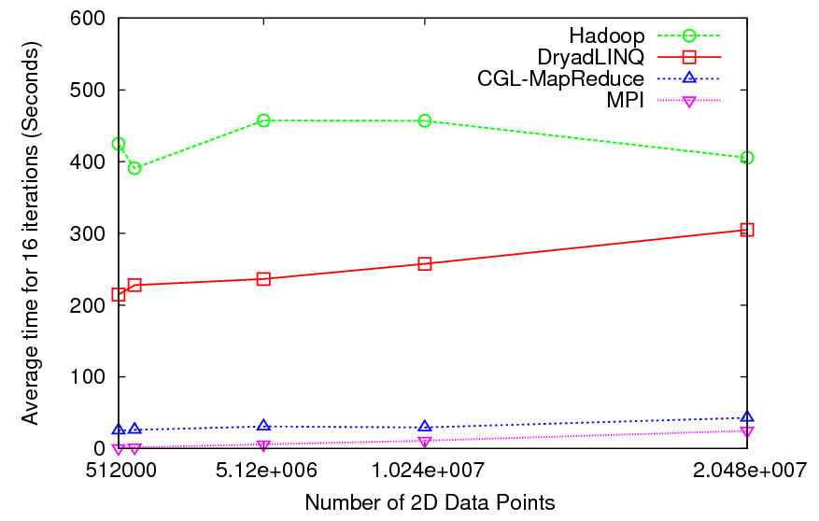
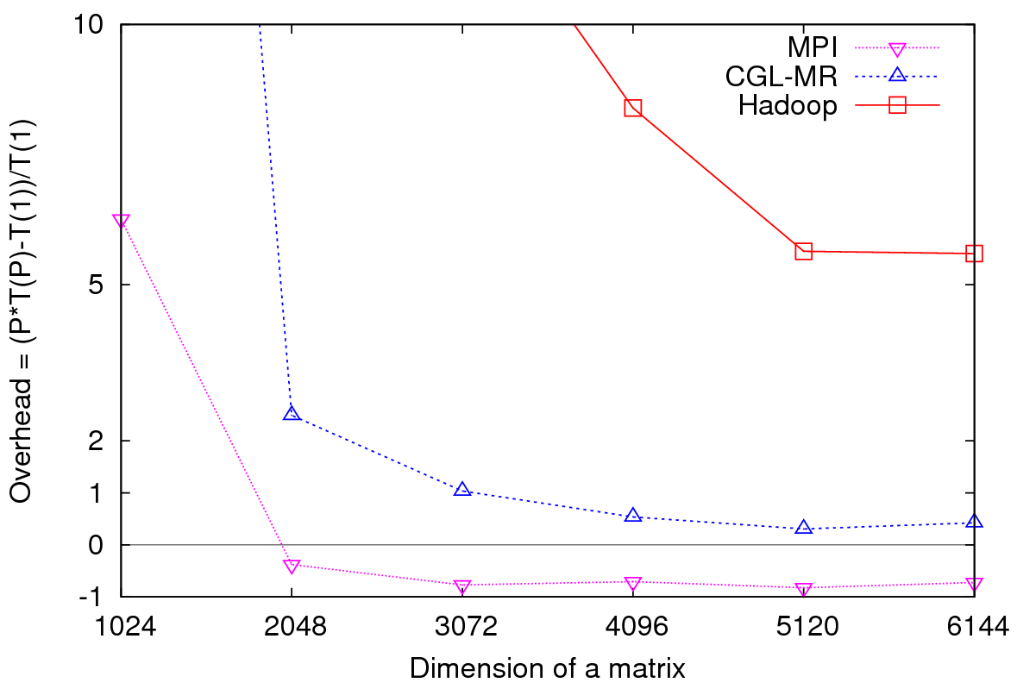
Iterative Computations
K-means
Matrix Multiplication
Performance of K-Means
Parallel Overhead Matrix Multiplication

Slide 35
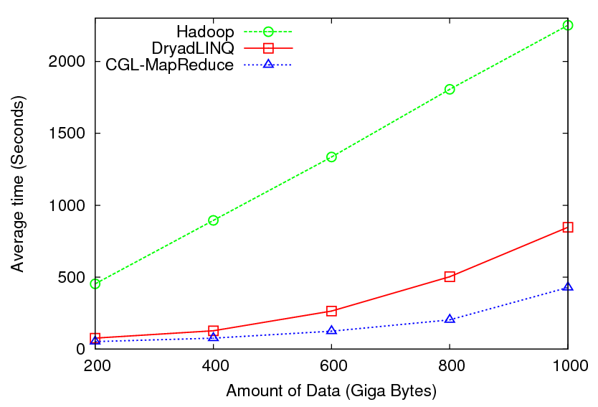

High Energy Physics Data Analysis
Histogramming of events from a large (up to 1TB) data set
Data analysis requires ROOT framework (ROOT Interpreted Scripts)
Performance depends on disk access speeds
Hadoop implementation uses a shared parallel file system (Lustre)
  ROOT scripts cannot access data from HDFS
  On demand data movement has significant overhead
Dryad stores data in local disks
  Better performance

Slide 36

Reduce Phase of Particle Physics
“Find the Higgs” using Dryad
Higgs in Monte Carlo
Combine Histograms produced by separate Root “Maps” (of event data to partial histograms) into a single Histogram delivered to Client

Slide 37
Kmeans Clustering
Time for 20 iterations
Iteratively refining operation
New maps/reducers/vertices in every iteration
File system based communication
Loop unrolling in DryadLINQ provide better performance
The overheads are extremely large compared to MPI
CGL-MapReduce is an example of MapReduce++ -- supports MapReduce model with iteration (data stays in memory and communication via streams not files)
Large
Overheads

Slide 38
Different Hardware/VM configurations
Ref | Description | Number of CPU cores per virtual or bare-metal node | Amount of memory (GB) per virtual or bare-metal node | Number of virtual or bare-metal nodes
BM | Bare-metal node | 8 | 32 | 16
1-VM-8-core (High-CPU Extra Large Instance) | 1 VM instance per bare-metal node | 8 | 30 (2GB is reserved for Dom0) | 16
2-VM-4- core | 2 VM instances per bare-metal node | 4 | 15 | 32
4-VM-2-core | 4 VM instances per bare-metal node | 2 | 7.5 | 64
8-VM-1-core | 8 VM instances per bare-metal node | 1 | 3.75 | 128
Invariant used in selecting the number of MPI processes
Number of MPI processes = Number of CPU cores used

Slide 39

MPI Applications
Feature | Matrix multiplication | K-means clustering | Concurrent Wave Equation
Description | Cannon’s Algorithm square process grid | K-means Clustering Fixed number of iterations | A vibrating string is (split) into points Each MPI process updates the amplitude over time
Grain Size
Computation Complexity | O (n^3) | O(n) | O(n)
Message Size
Communication Complexity | O(n^2) | O(1) | O(1)
Communication/Computation
n
n
1
n
n
d
n
C
1
d
1
n

Slide 40
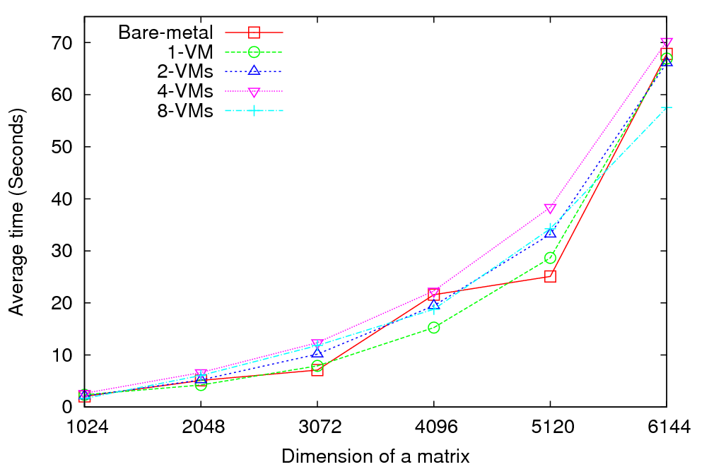
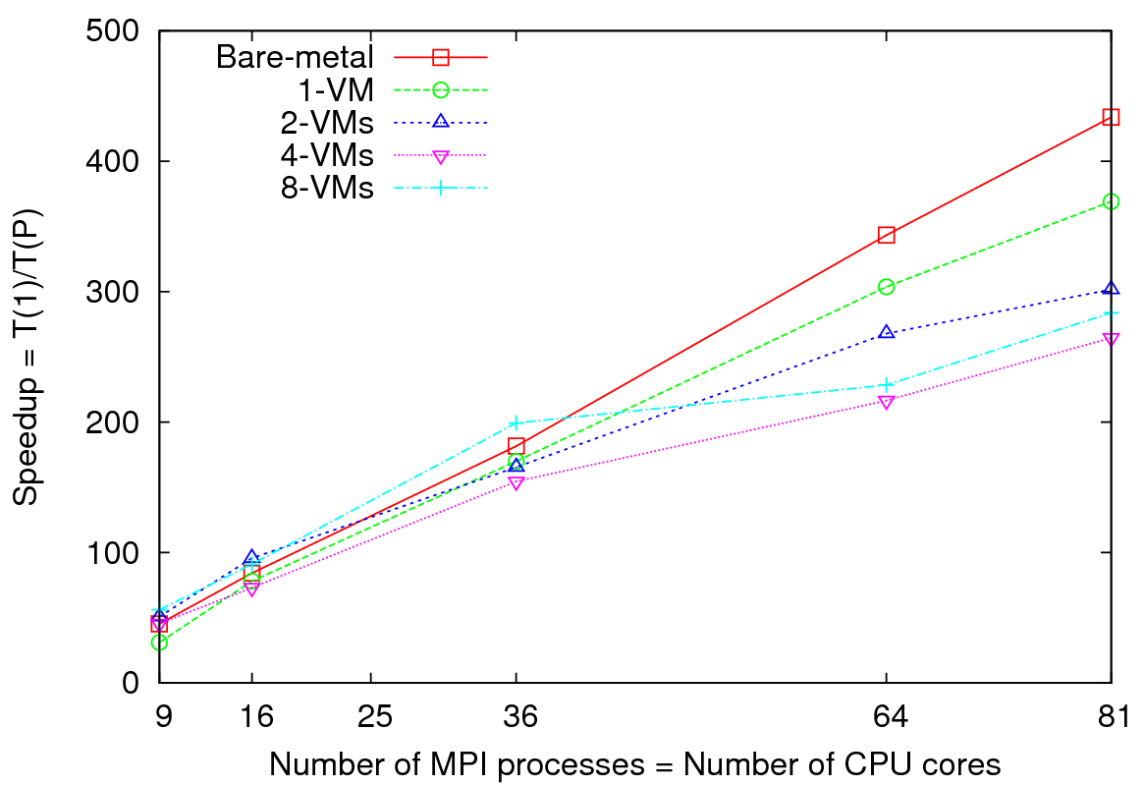
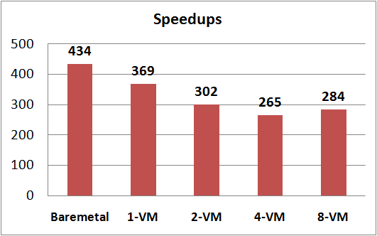
MPI on Clouds: Matrix Multiplication
Performance - 64 CPU cores
Speedup – Fixed matrix size (5184x5184)
Implements Cannon’s Algorithm
Exchange large messages
More susceptible to bandwidth than latency
At 81 MPI processes, 14% reduction in speedup is seen for 1 VM per node

Slide 41
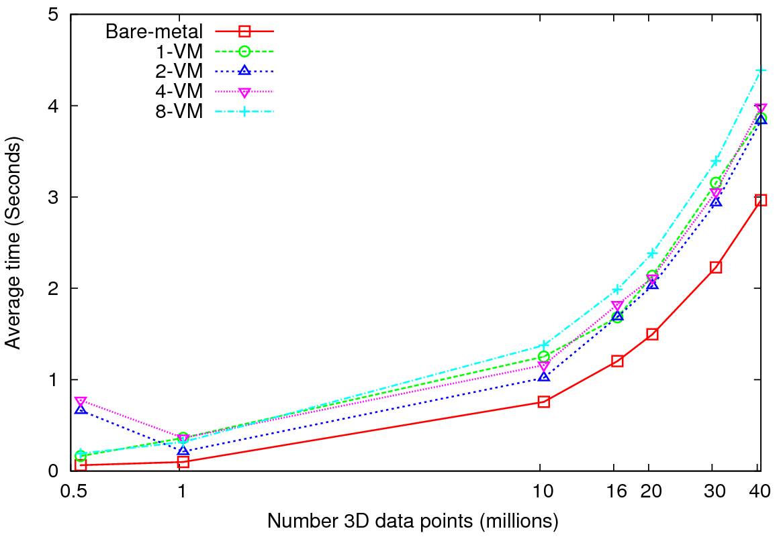
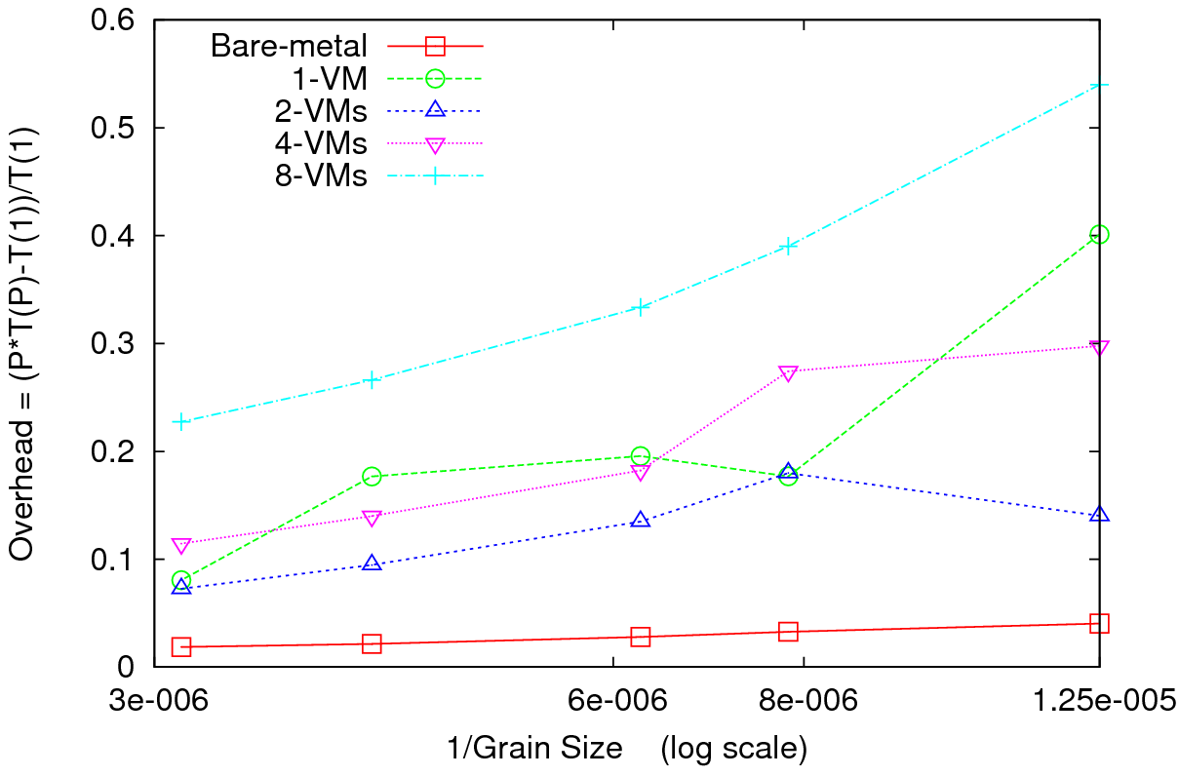
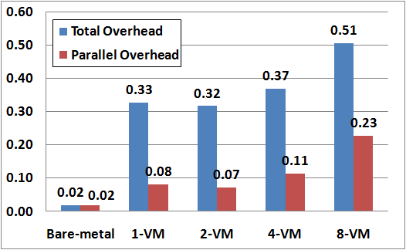
MPI on Clouds Kmeans Clustering
Performance – 128 CPU cores
Overhead
Perform Kmeans clustering for up to 40 million 3D data points
Amount of communication depends only on the number of cluster centers
Amount of communication << Computation and the amount of data processed
At the highest granularity VMs show at least 33% overhead compared to bare-metal
Extremely large overheads for smaller grain sizes
Overhead = (P * T(P) –T(1))/T(1)

Slide 42
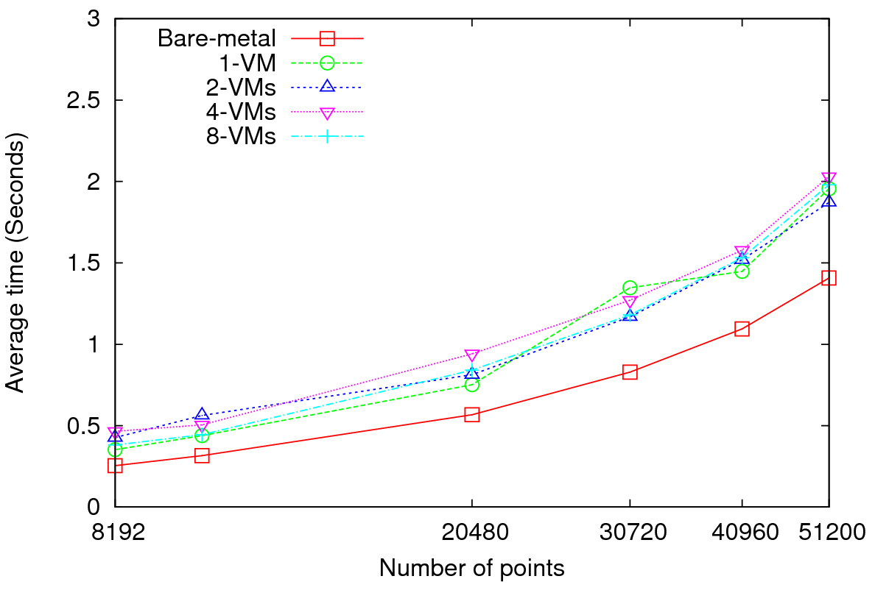
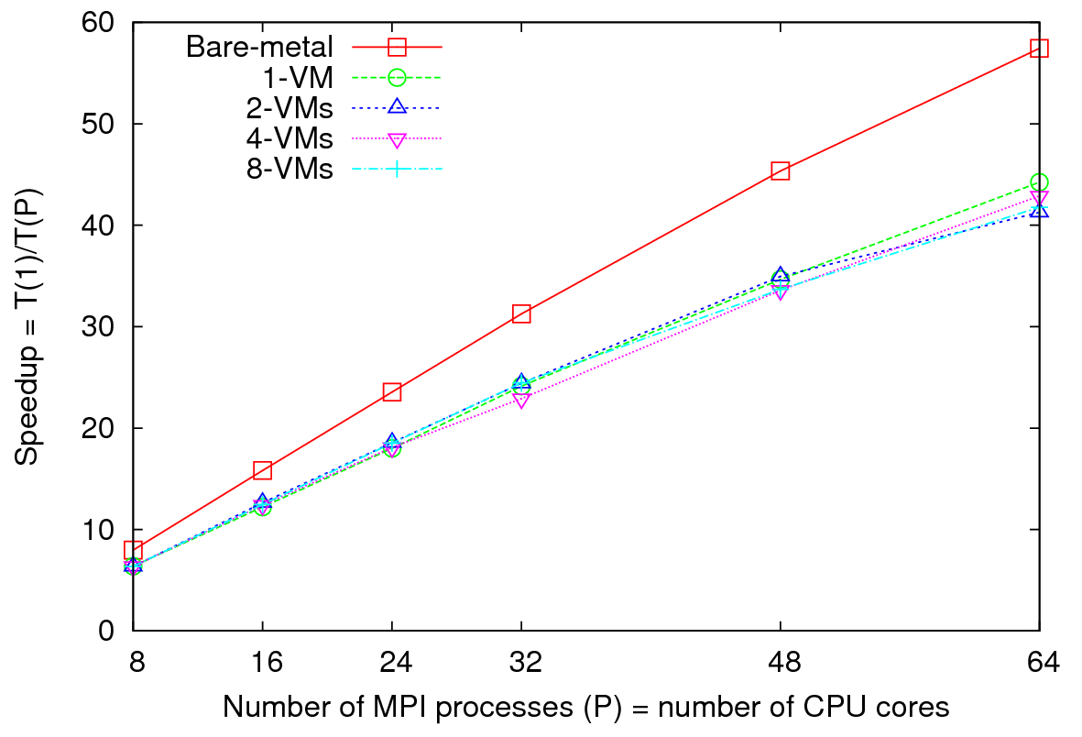
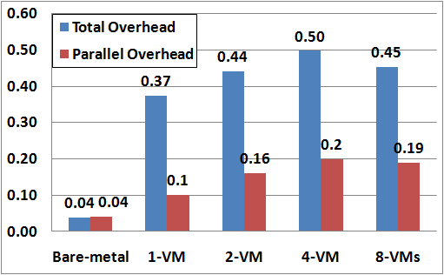
MPI on Clouds
Parallel Wave Equation Solver
Performance - 64 CPU cores
Total Speedup – 30720 data points
Clear difference in performance and speedups between VMs and bare-metal
Very small messages (the message size in each MPI_Sendrecv() call is only 8 bytes)
More susceptible to latency
At 51200 data points, at least 40% decrease in performance is observed in VMs

Slide 43
High Performance
Dimension Reduction and Visualization
Need is pervasive
  Large and high dimensional data are everywhere: biology, physics, Internet, …
  Visualization can help data analysis
Visualization with high performance
  Map high-dimensional data into low dimensions.
  Need high performance for processing large data
  Developing high performance visualization algorithms: MDS(Multi-dimensional Scaling), GTM(Generative Topographic Mapping), DA-MDS(Deterministic Annealing MDS), DA-GTM(Deterministic Annealing GTM), …
Notes:
MDS (Multi-dimensional Scaling)
GTM (Generative Topographic Mapping)
DA-MDS(Deterministic Annealing MDS)
DA-GTM(Deterministic Annealing GTM)

Slide 44
Analysis of 26 Million PubChem Entries
26 million PubChem compounds with 166 features
  Drug discovery
  Bioassay
3D visualization for data exploration/mining
  Mapping by MDS(Multi-dimensional Scaling) and
  GTM(Generative Topographic Mapping)
  Interactive visualization tool PlotViz
  Discover hidden structures

Slide 45
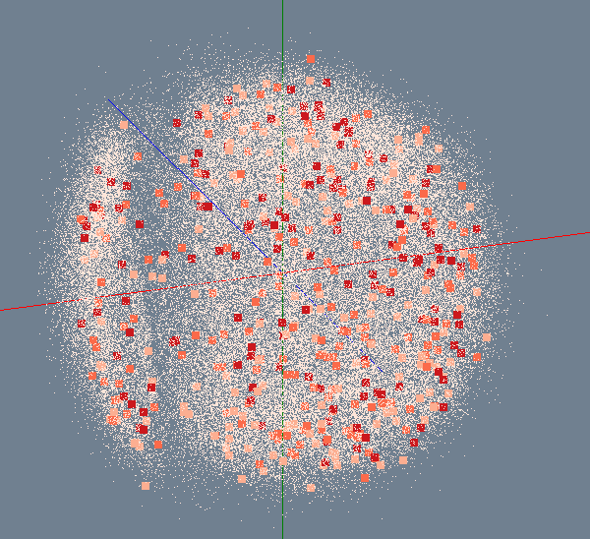
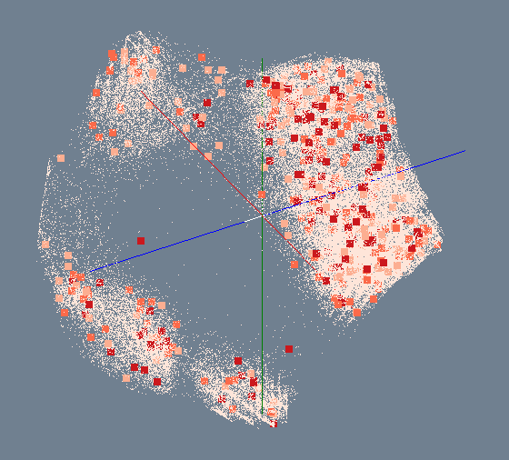
MDS/GTM for 100K PubChem
Number of Activity Results
> 300
200 ~ 300
100 ~ 200
< 100
MDS
GTM

Slide 46
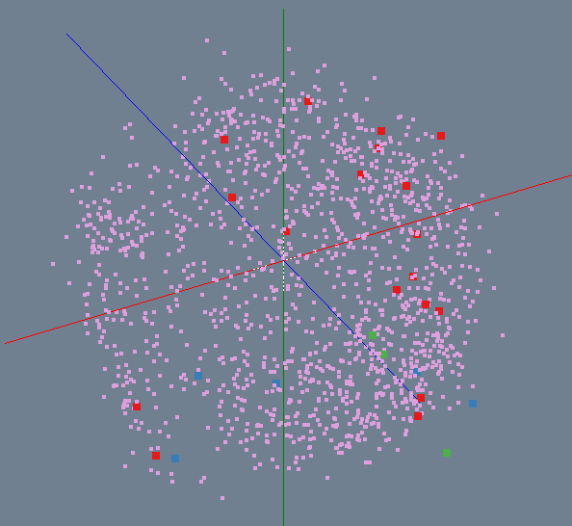
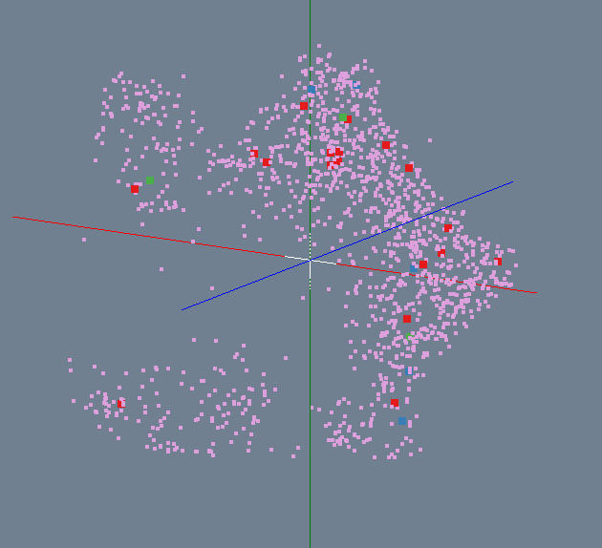
Bioassay activity in PubChem
Highly Active
Active
Inactive
Highly Inactive
MDS
GTM

Slide 47
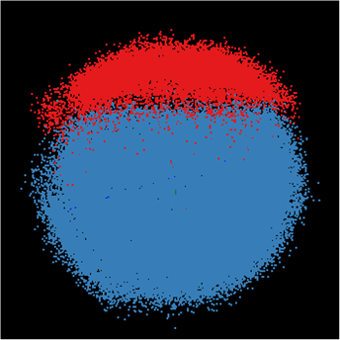
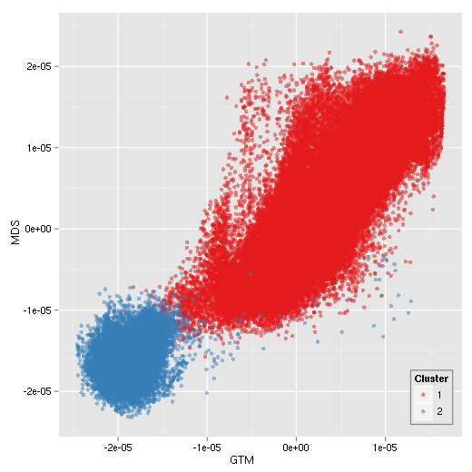
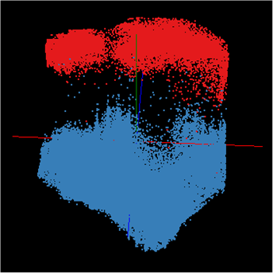
Correlation between MDS/GTM
MDS
GTM
Canonical Correlation between MDS & GTM
Notes:
Colors represent k-mean (k=2) results. Correlation is measured between MDS and GTM by using Canonical Correlation Analysis (CCA) and it shows high-correlation between them.

Slide 48
Child Obesity Study
Discover environmental factors related with child obesity
About 137,000 Patient records with 8 health-related and 97 environmental factors has been analyzed
Health data
Environment data
Genetic Algorithm
BMI
Blood Pressure
Weight
Height
…
Greenness
Neighborhood
Population
Income
…
Canonical Correlation Analysis
Visualization

Slide 49
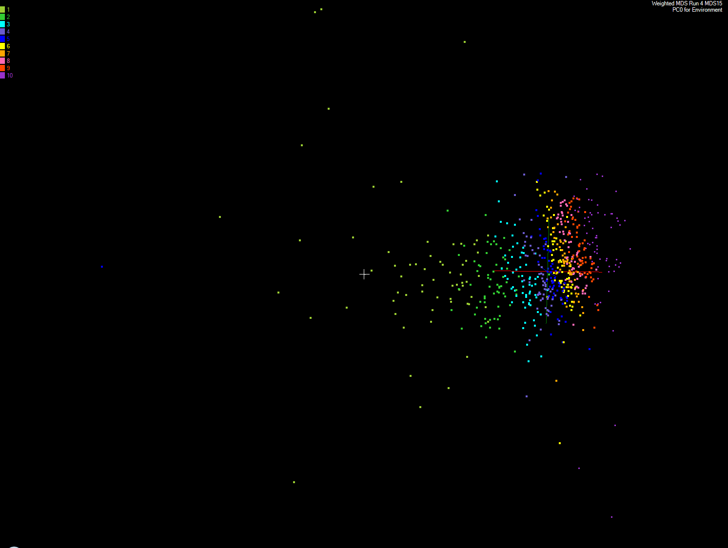
Apply MDS to Patient Record Data
and correlation to GIS properties
MDS and Primary PCA Vector
MDS of 635 Census Blocks with 97 Environmental Properties
Shows expected Correlation with Principal Component – color varies from greenish to reddish as projection of leading eigenvector changes value
Ten color bins used

Slide 50
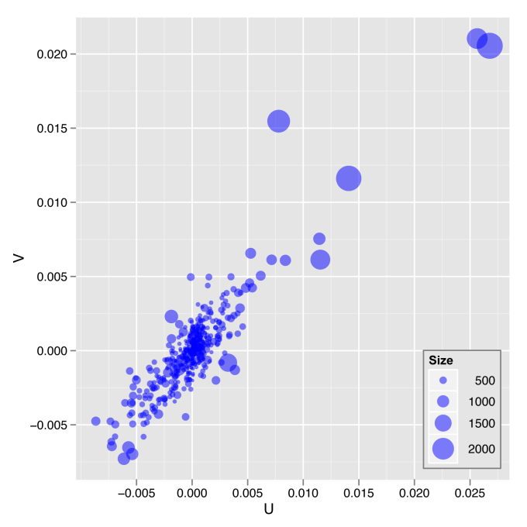
Canonical Correlation Analysis
and Multidimensional Scaling
The plot of the first pair of canonical variables for 635 Census Blocks compared to patient records

Slide 51
SALSA
Dynamic Virtual Cluster Hosting
Monitoring Infrastructure
SW-G Using Hadoop
SW-G Using Hadoop
SW-G Using DryadLINQ
SW-G Using Hadoop
SW-G Using Hadoop
SW-G Using DryadLINQ
Linux
Bare-system
Linux on Xen
Windows Server 2008 Bare-system
Cluster Switching from Linux Bare-system to Xen VMs to Windows 2008 HPC
XCAT Infrastructure
iDataplex Bare-metal Nodes (32 nodes)
SW-G : Smith Waterman Gotoh Dissimilarity Computation
– A typical MapReduce style application

Slide 52
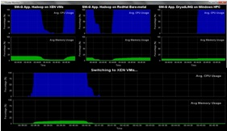
Monitoring Infrastructure
Monitoring Interface
Pub/Sub Broker Network
Virtual/Physical Clusters
Summarizer
XCAT Infrastructure
Switcher
iDataplex Bare-metal Nodes
(32 nodes)

Slide 53
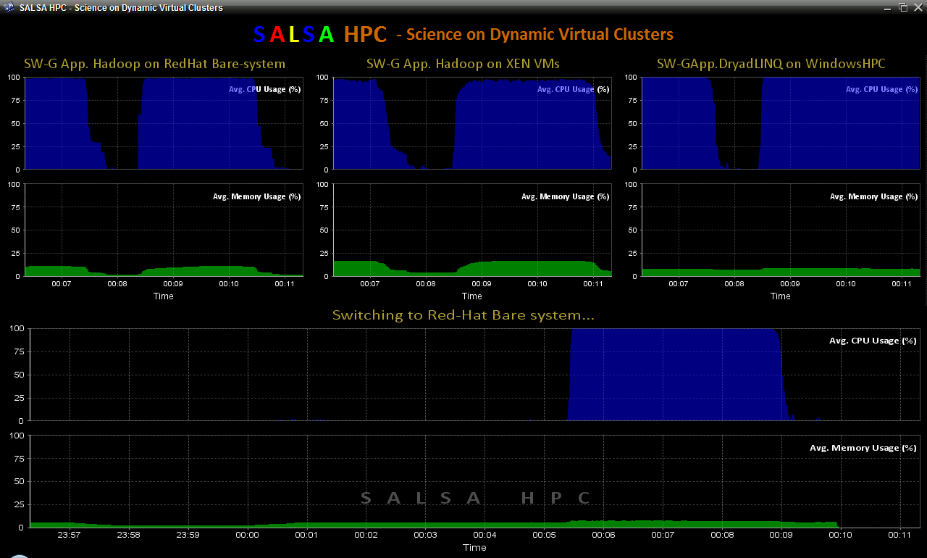
SALSA HPC Dynamic Virtual Clusters

Slide 54
Summary: Key Features of our Approach I
Intend to implement range of biology applications with Dryad/Hadoop
FutureGrid allows easy Windows v Linux with and without VM comparison
Initially we will make key capabilities available as services that we eventually implement on virtual clusters (clouds) to address very large problems
  Basic Pairwise dissimilarity calculations
  R (done already by us and others)
  MDS in various forms
  Vector and Pairwise Deterministic annealing clustering
Point viewer (Plotviz) either as download (to Windows!) or as a Web service
Note much of our code written in C# (high performance managed code) and runs on Microsoft HPCS 2008 (with Dryad extensions)
  Hadoop code written in Java

Slide 55
Summary: Key Features of our Approach II
Dryad/Hadoop/Azure promising for Biology computations
Dynamic Virtual Clusters allow one to switch between different modes
Overhead of VM’s on Hadoop (15%) acceptable
Inhomogeneous problems currently favors Hadoop over Dryad
MapReduce++ allows iterative problems (classic linear algebra/datamining) to use MapReduce model efficiently

