Slide 1
Science Clouds and FutureGrid’s Perspective
June 18 2012
Science Clouds Workshop
HPDC 2012 Delft
Geoffrey Fox
gcf@indiana.edu
Director, Digital Science Center, Pervasive Technology Institute
Associate Dean for Research and Graduate Studies, School of Informatics and Computing
Indiana University Bloomington

Slide 2
Panel Questions
Brief description of the project – goal, testbed infrastructure, target users/application.
Unique science cloud characteristics - how is/are your science application(s) distinct from traditional commercial cloud applications?
Discuss some of the challenges and findings from the project
Discuss any practical findings that are useful for cloud admins, developers and/or users.
Discuss future research, development and challenges for wider adoptability of cloud environments for use of science based on your project experience.

Slide 3
What is FutureGrid?
FutureGrid modeled on Grid5000
FutureGrid mission is to enable experimental work that advances:
  Innovation and scientific understanding of distributed computing and parallel computing paradigms,
  The engineering science of middleware that enables these paradigms,
  The use and drivers of these paradigms by important applications, and,
  The education of a new generation of
  students and workforce on the use of
  these paradigms and their applications.
The implementation of mission includes
  Distributed flexible hardware
  with supported use
  Identified IaaS and PaaS “core” software
  with supported use
  Outreach
~4500 cores in 5 sites
FutureGrid Usage

Slide 4
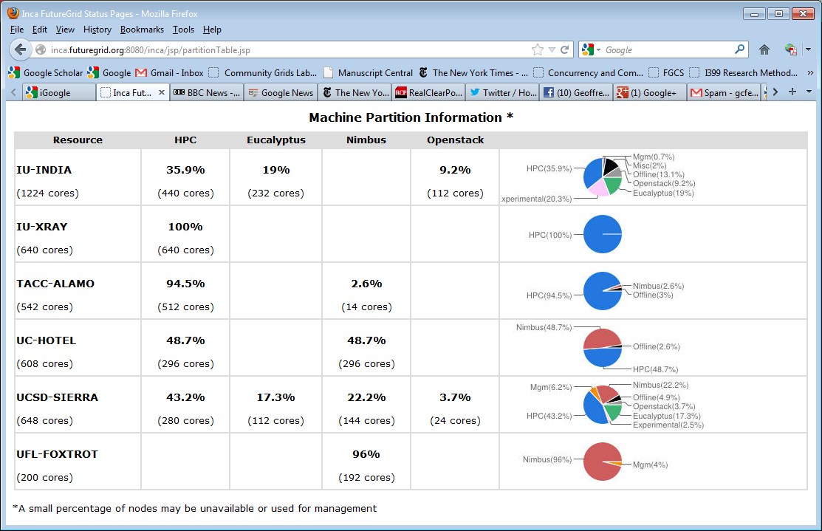
FutureGrid: Inca Monitoring

Slide 5
5 Use Types for FutureGrid
220 approved projects June 17 2012
  https://portal.futuregrid.org/projects
Training Education and Outreach (8%)
  Semester and short events; promising for small universities
Interoperability test-beds (3%)
  Grids and Clouds; Standards; from Open Grid Forum OGF
Domain Science applications (31%)
  Life science highlighted (18%), Non Life Science (13%)
Computer science (47%)
  Largest current category
Computer Systems Evaluation (27%)
  XSEDE (TIS, TAS), OSG, EGI
Clouds are meant to need less support than other models; FutureGrid needs more user support …….

Slide 6
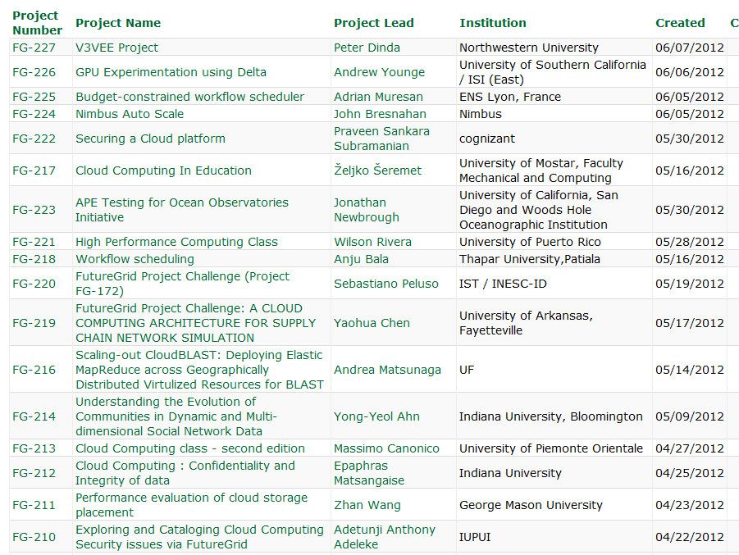
  https://portal.futuregrid.org/projects

Slide 7
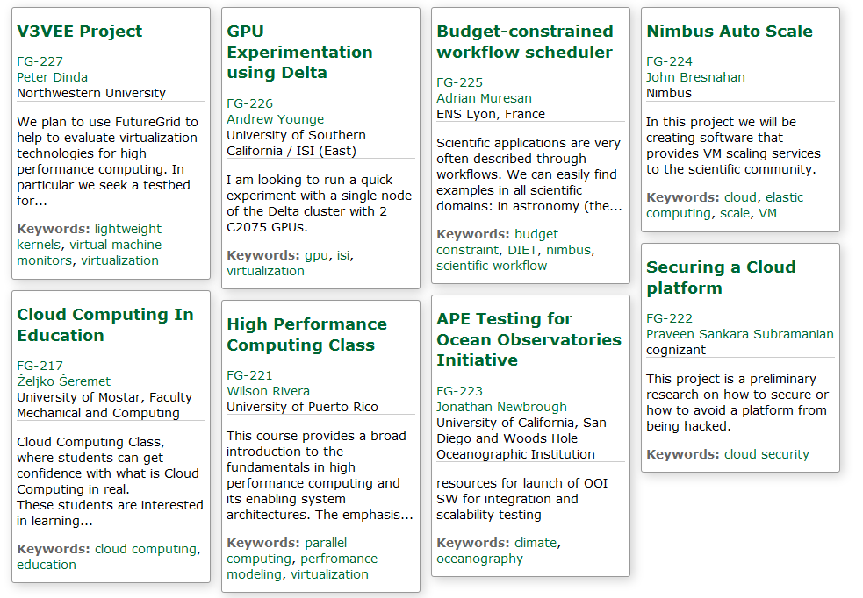
Recent Projects

Slide 8
Distribution of FutureGrid Technologies and Areas
220 Projects
Hard to support multiple IaaS on same cluster
Dynamically provision

Slide 9
Using Science Clouds in a Nutshell
High Throughput Computing; pleasingly parallel; grid applications
Multiple users (long tail of science) and usages (parameter searches)
Internet of Things (Sensor nets) as in cloud support of smart phones
(Iterative) MapReduce including “most” data analysis
Exploiting elasticity and platforms (HDFS, Object Stores, Queues ..)
Use worker roles, services, portals (gateways) and workflow
Good Strategies:
  Build the application as a service;
  Build on existing cloud deployments such as Hadoop;
  Use PaaS if possible;
  Design for failure;
  Use as a Service (e.g. SQLaaS) where possible;
  Address Challenge of Moving Data

Slide 10
Cosmic Comments
Are clouds different from Grids: in principle or in practice?
Does a “modest-size private science cloud” make sense
  Too small to be elastic
Should governments fund use of commercial clouds (or build their own)
  Most science doesn’t have privacy issues motivating some private clouds
Does Cloud + MPI Engine cover the future?
Most interest in clouds from “new” applications such as life sciences
Recent cloud infrastructure (Eucalyptus 3, OpenStack Essex) much improved
More employment opportunities in clouds than HPC and Grids; so cloud related activities popular with students
Science Cloud Summer School July 30-August 3
  Part of virtual summer school in computational science and engineering and expect over 200 participants spread over 9 sites
Science Cloud and MapReduce XSEDE Community groups

