Slide 1
Scientific Image Restoration Anywhere
Vibhatha Abeykoon*, Zhengchun Liu**,
Rajkumar Kettimuthu**, Geoffrey Fox*
and
Ian Foster**
** Argonne National Laboratory
* Indiana University Bloomington

Slide 2
Image Restoration with High Efficiency
Deep Learning Models are used in most of the scientific experimental facilities. The intensity of the usage has highly increased in the recent years.
Low Latency inference is one of the highly demanding requests by scientists.
Once the deep learning models are trained they must be portable such that it can be used anywhere with less installation and configuration overheads.

Slide 3
Objectives
Faster Inference
Low Cost Medium for Inference
Availability for Scientific Applications

Slide 4
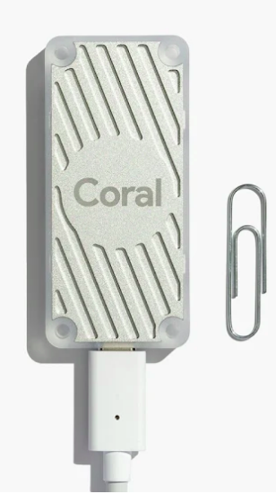
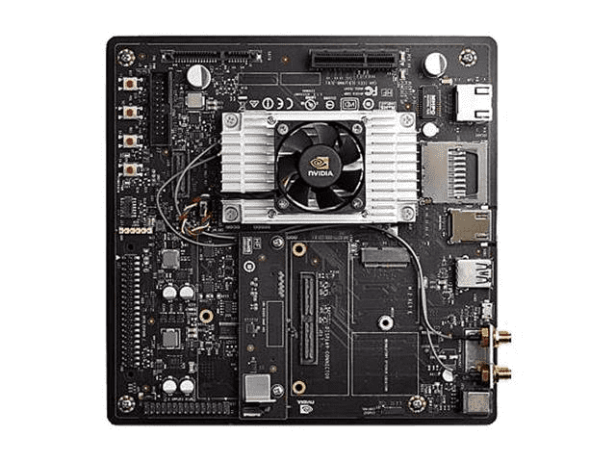
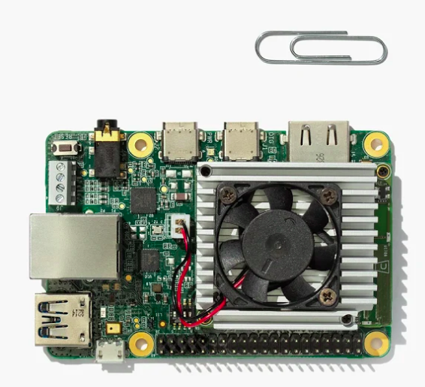
Technology Usage and Data Source
Tensorflow 1.14
TensorflowLite (Edge Compatible Models)
TPU Accelerator
TPU Dev Board
GPU Accelerator: NVIDIA Jetson
Low-Dose X-ray images from APS (Argonne Photon Source)
TPU Accelerator
Jetson Tx2
TPU Dev Board

Slide 5
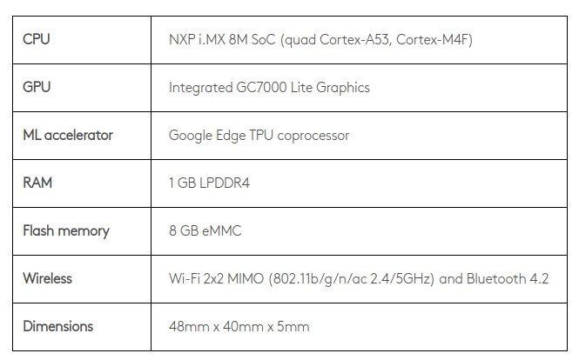
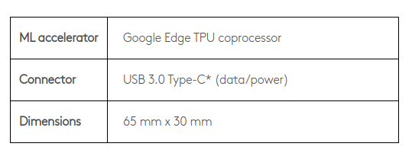
Edge TPU Specs
(5V USB Type-C)
Edge TPU Dev Board
Edge TPU Accelerator

Slide 6
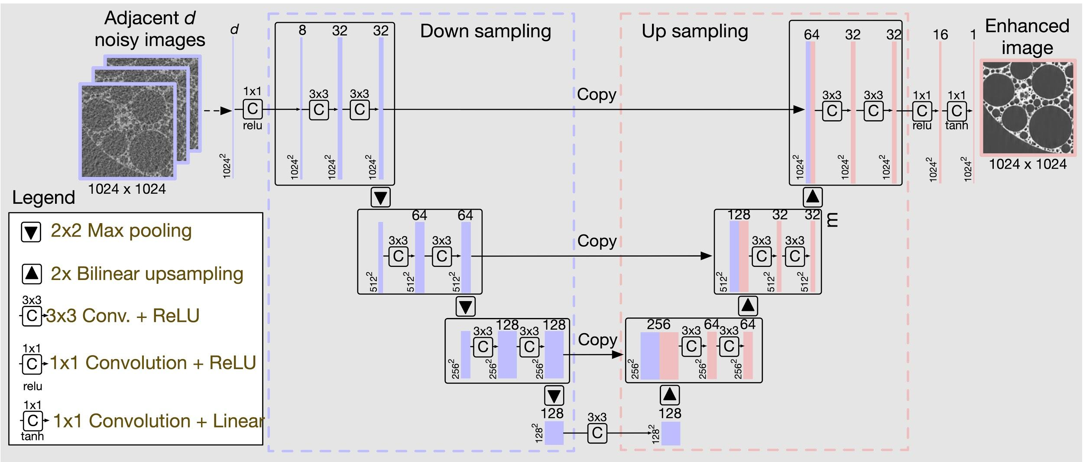
TomoGAN Generator Architecture
Operations | Layers
1x1 conv2D + Relu | 3
3x3 Conv2D + Relu | 13
Bilinear upsampling | 3
Max Pooling | 3
Concatenation (Channel Axis) | 3
For inference, TomoGAN needs 301 Billion floating-point operation to denoise an image with 1024x1024 pixels.
Ref.: Z. Liu et al. TomoGAN. arXiv:1902.07582

Slide 7
Post Quantization of Training Model
Fast
Model is modified after training (for quantization purpose)
Works well with smaller and large models

Slide 8
Quantization-Aware Training Model
Very slow
Model configured with fake quantization layers
Good for small models (observation with current experiments on GPU training)

Slide 9
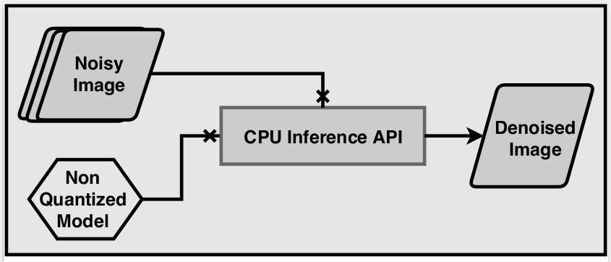
Workflow 1: Inference with CPU
Use Non-quantized model and do inference on CPU
Records timing and quality stats

Slide 10
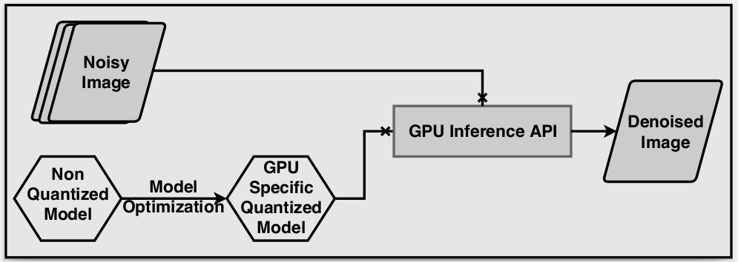
Workflow 2: Inference with GPU
Non-quantized model converted to GPU compatible quantization model
Records timing and quality stats

Slide 11
Workflow 3: Inference with TPU
Model Quantization to TPU Compatibility requires a sample dataset.
The sample dataset governs the quantization range
Wrote custom wrapper (Specially for image to image translation) for BasicEngine (Tensoflow API modification)(currently not supported as an API in Tensorflow)
Use Interpreter API (Extended API was designed for Image Restoration)

Slide 12
Fine Tune Layer
Improves the Image Quality
Shallow CNN Used
Quantized for Edge-TPU Compatibility

Slide 13
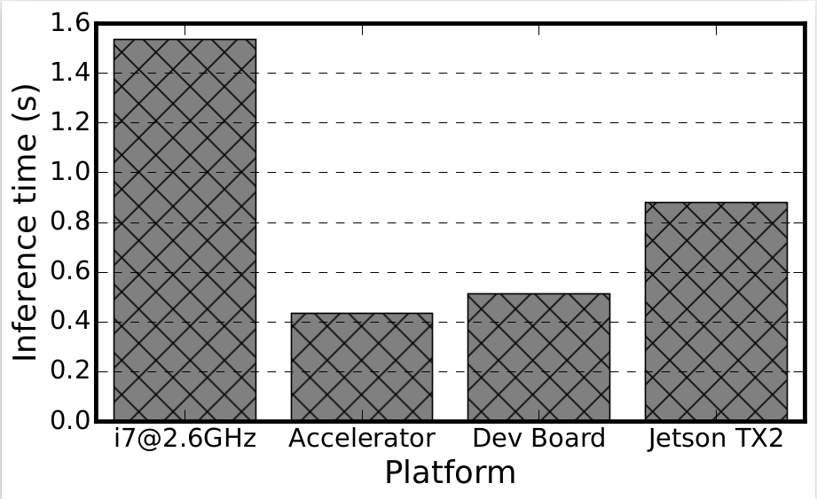
Performance Evaluation on Inference
TPU Accelerator is much faster than CPU
TPU Accelerator performs well on GPU but slower than TPU.

Slide 14
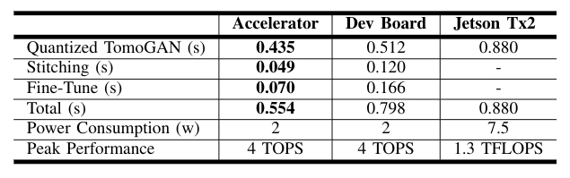
Performance Time Breakdown

Slide 15
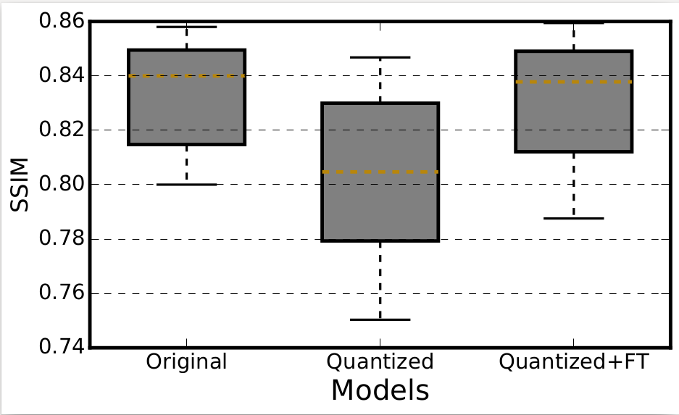
Image Quality Evaluation with SSIM
Structural Similarity Index is used.
Fine Tune Layer improves the Quantized model up to the image quality of a non-quantized model.
Original model doesn’t use edge an device. It is a non-quantized model.

Slide 16
Conclusion
We design a faster inference workflow to restore scientific images (Edge TPU and Edge GPU).
Enabled the inference workflow to generate high quality images even after quantization.
Low cost solution with higher efficiency.
High accessibility to scientific application developers.
Designed a portable system which can run anywhere.

Slide 17
Thank You

