Slide 1



Analysis Tools for
Data Enabled Science
SALSA HPC Group
http://salsahpc.indiana.edu
School of Informatics and Computing
Indiana University

Slide 2




Presenter Introduction
Twister Bingjing Zhang Funded by Microsoft Foundation Grant, Indiana University's Faculty Research Support Program and NSF OCI-1032677 Grant
 | Twister4Azure Thilina Gunarathne Funded by Microsoft Azure Grant
High-Performance Visualization Algorithms For Data-Intensive Analysis Seung-Hee Bae and Jong Youl Choi Funded by NIH Grant 1RC2HG005806-01

Slide 3






Presenter Introduction
 | DryadLINQ CTP Evaluation Hui Li, Yang Ruan, and Yuduo Zhou Funded by Microsoft Foundation Grant
Million Sequence Challenge Saliya Ekanayake, Adam Hughs, Yang Ruan Funded by NIH Grant 1RC2HG005806-01
 | Cyberinfrastructure for Remote Sensing of Ice Sheets Jerome Mitchell Funded by NSF Grant OCI-0636361

Slide 4
Twister Architecture
Kernels, Genomics, Proteomics, Information Retrieval, Polar Science
Scientific Simulation Data Analysis and Management
Dissimilarity Computation, Clustering, Multidimentional Scaling, Generative Topological Mapping
Applications
Security, Provenance, Portal
Programming Model
Services and Workflow
High Level Language
Runtime
Cross Platform Iterative MapReduce (Collectives, Fault Tolerance, Scheduling)
Storage
Distributed File Systems
Object Store
Data Parallel File System
Linux HPC
Bare-system
Amazon Cloud
Windows Server HPC
Bare-system
Azure Cloud
Grid Appliance
Infrastructure
Virtualization
Virtualization
Hardware
CPU Nodes
GPU Nodes

Slide 5
Status of Iterative MapReduce
(a) Map Only
(b) Classic MapReduce
(c) Iterative MapReduce
(d) Loosely Synchronous
Input
Input
Iterations
Input
map
map
map
P_{ij}
reduce
reduce
Output
CAP3 Analysis
Smith-Waterman Distances
Parametric sweeps
PolarGrid Matlab data analysis
High Energy Physics (HEP) Histograms
Distributed search
Distributed sorting
Information retrieval
Expectation maximization clustering e.g. Kmeans
Linear Algebra
Multimensional Scaling
Page Rank
Many MPI scientific applications such as solving differential equations and particle dynamics
Domain of MapReduce and Iterative Extensions
MPI

Slide 6
GTM vs. MDS
GTM
MDS (SMACOF)
Purpose
Non-linear dimension reduction
Find an optimal configuration in a lower-dimension
Iterative optimization method
Input
Vector-based data
Non-vector (Pairwise similarity matrix)
Objective
Function
Maximize Log-Likelihood
Minimize STRESS or SSTRESS
Complexity
O(KN) (K << N)
O(N²)
Optimization
Method
EM
Iterative Majorization (EM-like)

Slide 7


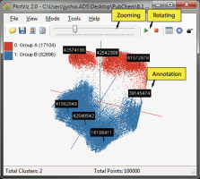
PlotViz, Visualization System
Parallel Visualization Algorithms
PlotViz
Parallel visualization algorithms (GTM, MDS, …)
Improved quality by using DA optimization
Interpolation
Twister Integration (Twister-MDS, Twister-LDA)
Provide Virtual 3D space
Cross-platform
Visualization Toolkit (VTK)
Qt framework

Slide 8
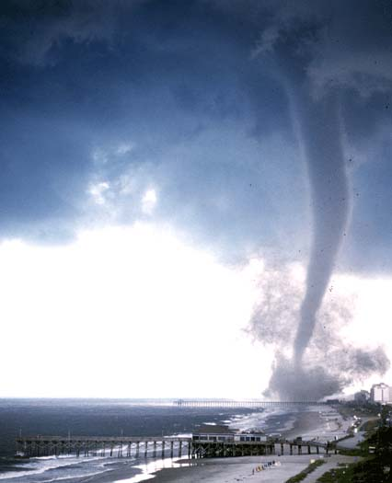

Twister v0.9
  New Infrastructure for Iterative MapReduce Programming
  Distinction on static and variable data
  Configurable long running (cacheable) map/reduce tasks
  Pub/sub messaging based communication/data transfers
  Broker Network for facilitating communication

Slide 9
Main program’s process space
Worker Nodes
configureMaps(..)
Local Disk
configureReduce(..)
Cacheable map/reduce tasks
while(condition){
runMapReduce(..)
May send <Key,Value> pairs directly
Map()
Iterations
Reduce()
Combine() operation
Communications/data transfers via the pub-sub broker network & direct TCP
updateCondition()
Main program may contain many MapReduce invocations or iterative MapReduce invocations
} //end while
close()

Slide 10
Master Node
B
Pub/sub
Broker Network
Twister
Driver
B
B
B
Main Program
One broker serves several Twister daemons
Twister Daemon
Twister Daemon
map
reduce
Cacheable tasks
Worker Pool
Worker Pool
Scripts perform:
Data distribution, data collection, and partition file creation
Local Disk
Local Disk
Worker Node
Worker Node

Slide 11
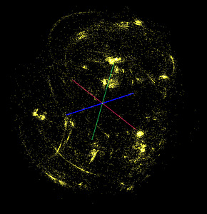
Twister-MDS Demo
II. Send intermediate results
Master Node
ActiveMQ
Broker
Twister
Driver
MDS Monitor
Twister-MDS
PlotViz
I. Send message to start the job
Client Node

Slide 12
Broadcasting Mechanism
  Method A
    Hierarchical Sending
  Method B
    Improved Hierarchical Sending
  Method C
    All-to-All Sending

Slide 13
Method A
Twister Daemon Node
ActiveMQ Broker Node
8 Brokers and 32 Daemon Nodes in total
Twister Driver Node
Broker-Daemon Connection
Broker-Broker Connection
Broker-Driver Connection

Slide 14
Hierarchical Sending
Twister Daemon Node
8 Brokers and 32 Daemon Nodes in total
ActiveMQ Broker Node
Twister Driver Node
Broker-Daemon Connection
Broker-Broker Connection
Broker-Driver Connection

Slide 15
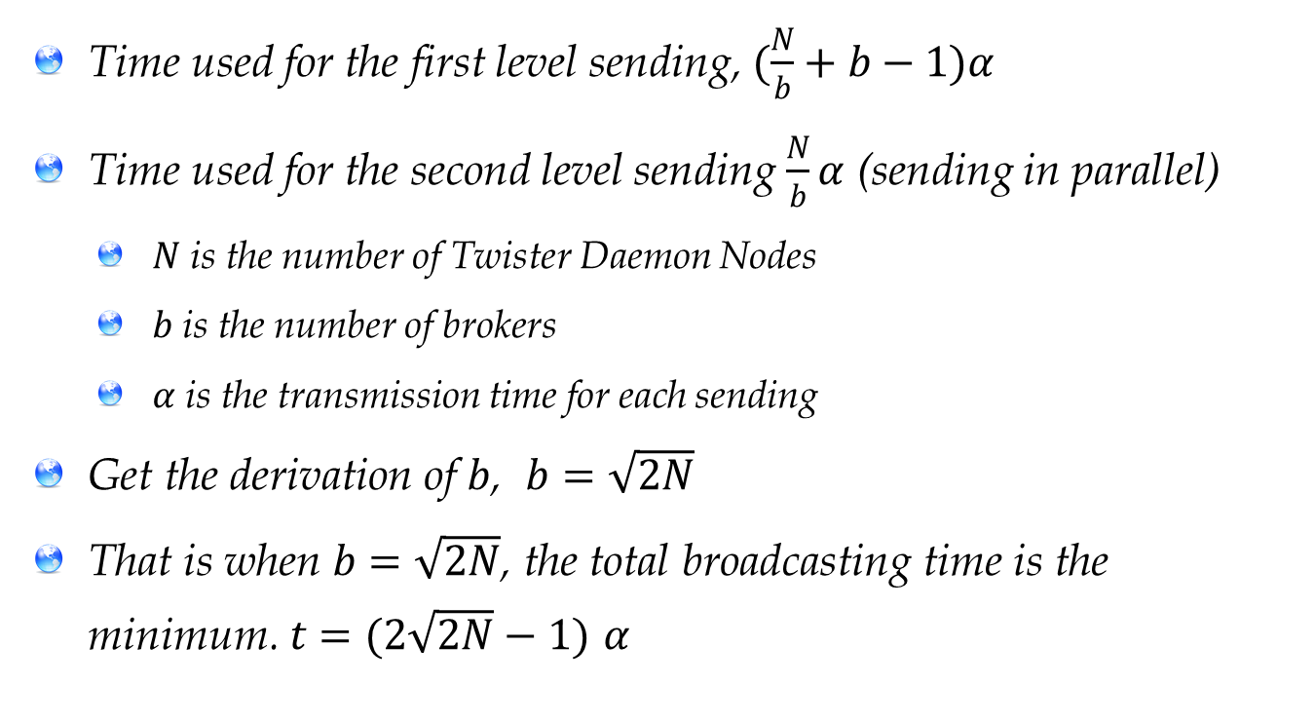
The Estimation of Broadcasting Time
  Time used for the first level sending, $(\frac{N}{b}+b−1)α$
  Time used for the second level sending $\frac{N}{b}α$ (sending in parallel)
    $N$ is the number of Twister Daemon Nodes
    $b$ is the number of brokers
    $α$ is the transmission time for each sending
  Get the derivation of $b$, $b=\sqrt{2N}$
  That is when $b=\sqrt{2N}$, the total broadcasting time is the minimum. $t=(2\sqrt{2N}−1)$ $α$

Slide 16
Method B
Twister Daemon Node
7 Brokers and 32 Daemon Nodes in total
ActiveMQ Broker Node
Twister Driver Node
Broker-Daemon Connection
Broker-Broker Connection
Broker-Driver Connection

Slide 17
Hierarchical Sending
Twister Daemon Node
7 Brokers and 32 Computing Nodes in total
ActiveMQ Broker Node
Twister Driver Node
Broker-Daemon Connection
Broker-Broker Connection
Broker-Driver Connection

Slide 18
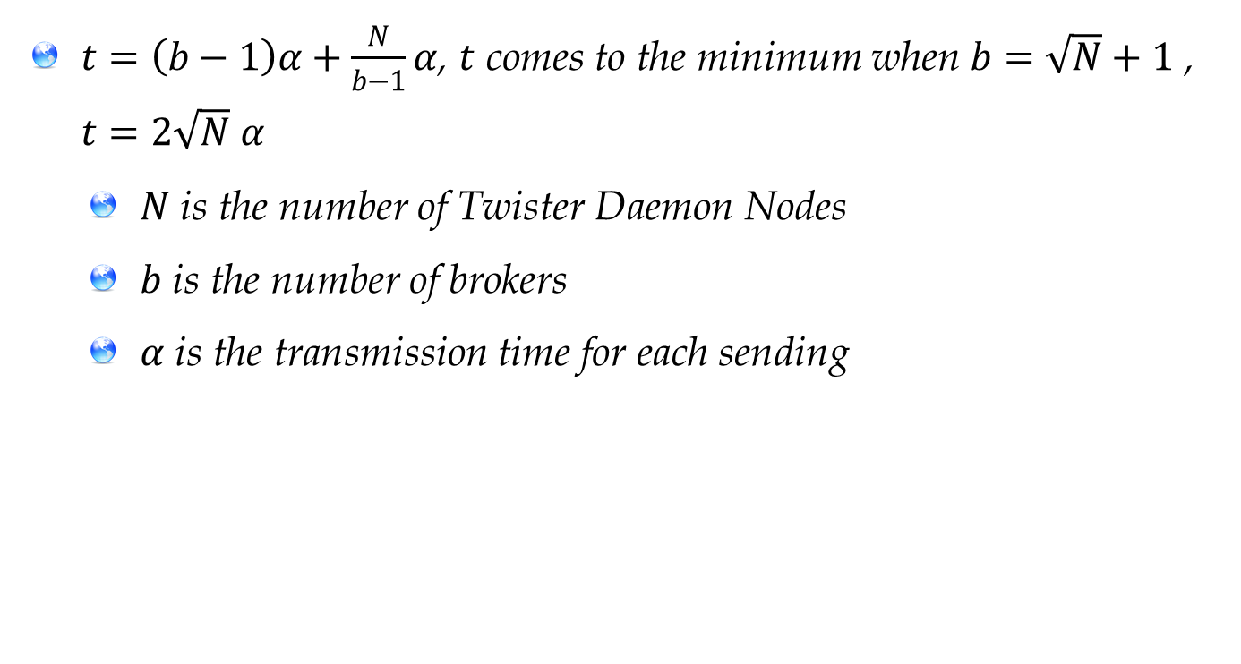
The Estimation of Broadcasting Time
  $t=\left(b−1\right)α+\frac{N}{b−1}α$, $t$ comes to the minimum when $b=\sqrt{N}+1$ , $t=2\sqrt{N}$ $α$
  $N$ is the number of Twister Daemon Nodes
  $b$ is the number of brokers
  $α$ is the transmission time for each sending

Slide 19
Comparison of Twister-MDS Execution Time between Method B and Method A
(100 iterations, 200 broadcastings, 40 nodes, 51200 data points)

Slide 20
Method C
Twister Daemon Node
5 Brokers and 4 Computing Nodes in total
ActiveMQ Broker Node
Twister Driver Node
Broker-Daemon Connection
Broker-Driver Connection

Slide 21
Twister-Kmeans: Centroids Splitting
Centroid 1
Centroids
Centroid 2
Centroid 3
Centroid N

Slide 22
Twister-Kmeans: Centroids Broadcasting
Twister Driver Node
ActiveMQ Broker Node
Twister Daemon Node
Centroid 1
Centroid 2
Centroid 3
Centroid 4
Centroid 1
Centroid 1
Centroid 1
Centroid 1
Centroid 2
Centroid 2
Centroid 2
Centroid 2
Centroid 3
Centroid 3
Centroid 3
Centroid 3
Centroid 4
Centroid 4
Centroid 4
Centroid 4

Slide 23
Map to Reduce
Twister Map Task
ActiveMQ Broker Node
Centroid 1
Centroid 1
Centroid 1
Centroid 1
Twister Reduce Task
Centroid 2
Centroid 2
Centroid 2
Centroid 2
Centroid 3
Centroid 3
Centroid 3
Centroid 3
Centroid 4
Centroid 4
Centroid 4
Centroid 4
Centroid 1
Centroid 2
Centroid 3
Centroid 4
Centroid 1
Centroid 2
Centroid 3
Centroid 4
Centroid 1
Centroid 2
Centroid 3
Centroid 4
Centroid 1
Centroid 2
Centroid 3
Centroid 4

Slide 24
Broadcasting on 40 Nodes
(In Method C, centroids are split to 160 blocks, sent through 40 brokers in 4 rounds)

Slide 25
MRRoles4Azure
Distributed, highly scalable and highly available cloud services as the building blocks.
Utilize eventually-consistent , high-latency cloud services effectively to deliver performance comparable to traditional MapReduce runtimes.
Decentralized architecture with global queue based dynamic task scheduling
Minimal management and maintenance overhead
Supports dynamically scaling up and down of the compute resources.
MapReduce fault tolerance

Slide 26
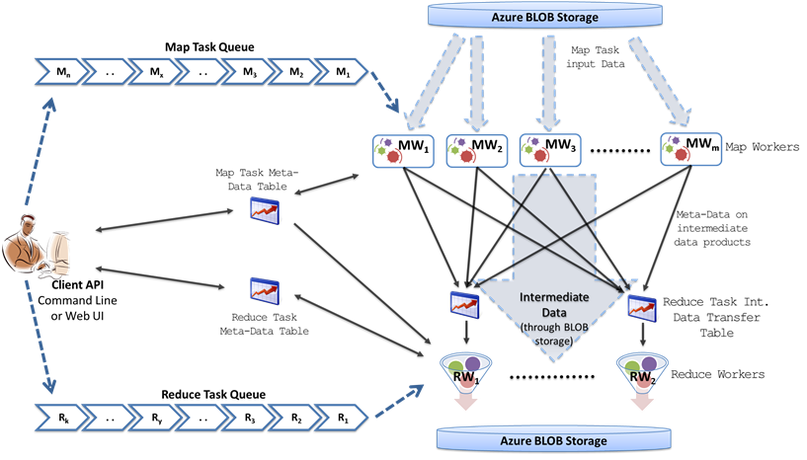
MRRoles4Azure
Azure Queues for scheduling, Tables to store meta-data and monitoring data, Blobs for input/output/intermediate data storage.

Slide 27
Iterative MapReduce for Azure
Programming model extensions to support broadcast data
Merge Step
In-Memory Caching of static data
Cache aware hybrid scheduling using Queues, bulletin board (special table) and execution histories
Hybrid intermediate data transfer

Slide 28

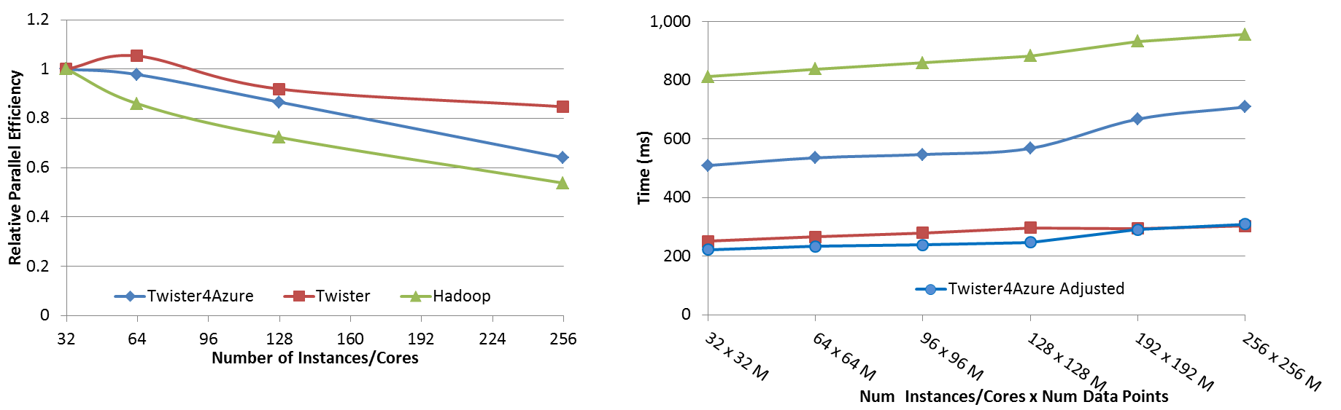




Performance – Kmeans Clustering
Task Execution Time Histogram
Number of Executing Map Task Histogram
Strong Scaling with 128M Data Points
Weak Scaling
Performance with/without
data caching
Speedup gained using data cache
Scaling speedup
Increasing number of iterations
Notes:
Right(c): Twister4Azure executing Map Task histogram for 128 million data points in 128 Azure small instances
Figure 5. KMeansClustering Scalability. Left(a): Relative parallel efficiency of strong scaling using 128 million data points.
Center(b): Weak scaling. Workload per core is kept constant (ideal is a straight horizontal line).

Slide 29
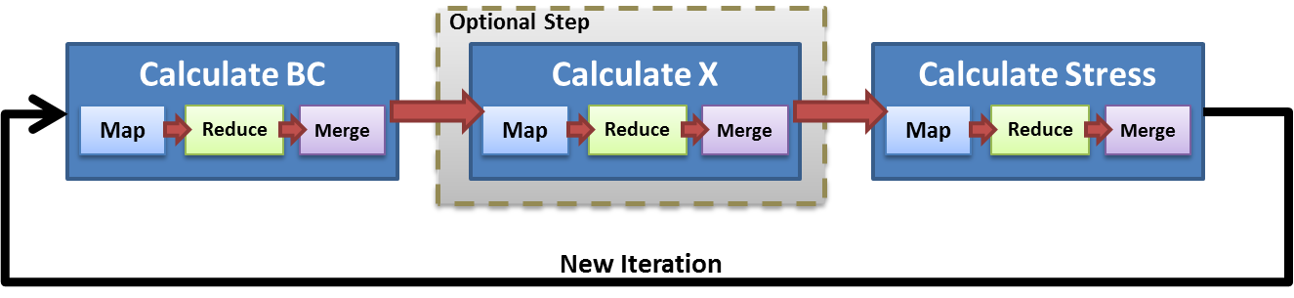
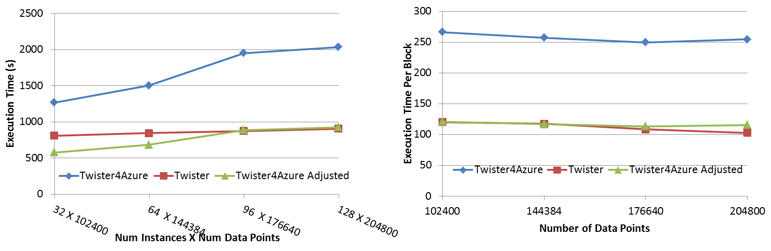
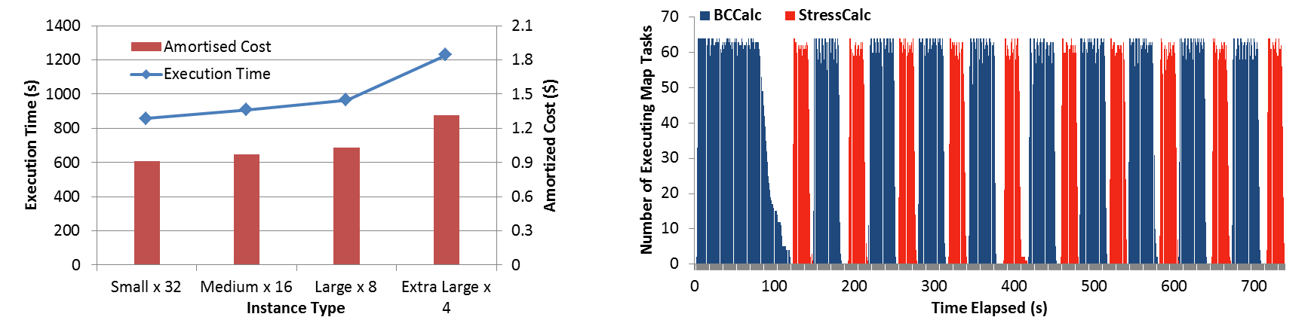
Performance – Multi Dimensional Scaling
Weak Scaling
Data Size Scaling
Task Execution Time Histogram
Azure Instance Type Study
Number of Executing Map Task Histogram
Performance with/without
data caching
Speedup gained using data cache
Scaling speedup
Increasing number of iterations
Notes:
Weak scaling where workload per core is ~constant. Ideal is a straight horizontal line. Center : Data size scaling with 128 Azure small instances/cores, 20 iterations.
Instance type study using 76800 data points, 32 instances, 20 iterations. Right: Twister4Azure executing Map Task histogram for 144384 x144384 distance matrix in 64 Azure small instances, 10 iterations

Slide 30
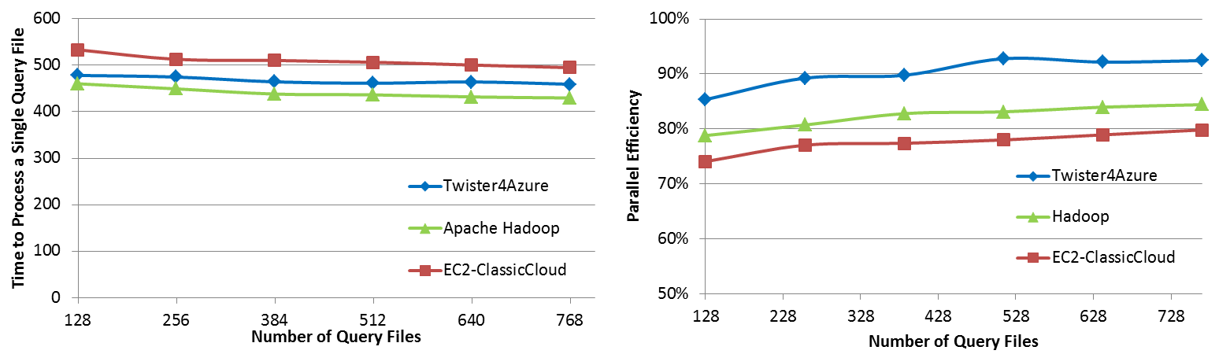

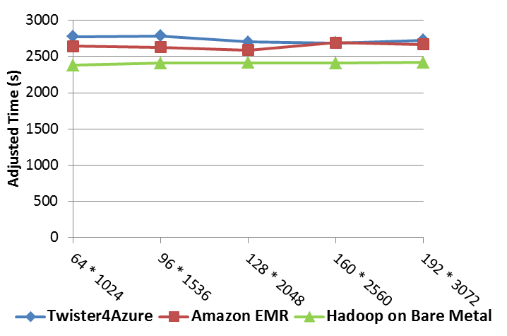
Performance Comparisons
BLAST Sequence Search
Smith Waterman Sequence Alignment
Cap3 Sequence Assembly

Slide 31

Integrate Twister with
ISGA Analysis Web Server
ISGA
<<XML>>
Ergatis
<<XML>>
TIGR Workflow
Cloud,
Other DCEs
SGE
Condor
clusters
clusters
Chris Hemmerich, Adam Hughes, Yang Ruan, Aaron Buechlein, Judy Qiu, and Geoffrey Fox. Map-Reduce Expansion of the ISGA Genomic Analysis Web Server (2010) The 2nd IEEE International Conference on Cloud Computing Technology and Science

Slide 32
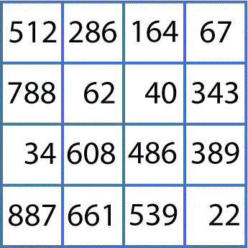
Simple Bioinformatics Pipeline
O(NxN)
Pairwise Clustering
O(NxN)
Cluster Indices
Pairwise Alignment & Distance Calculation
Gene Sequences
Visualization
3D Plot
O(NxN)
Coordinates
Distance Matrix
Multi-Dimensional Scaling

Slide 33
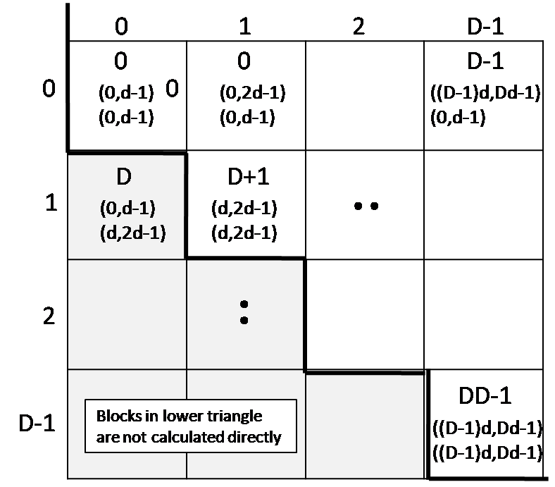
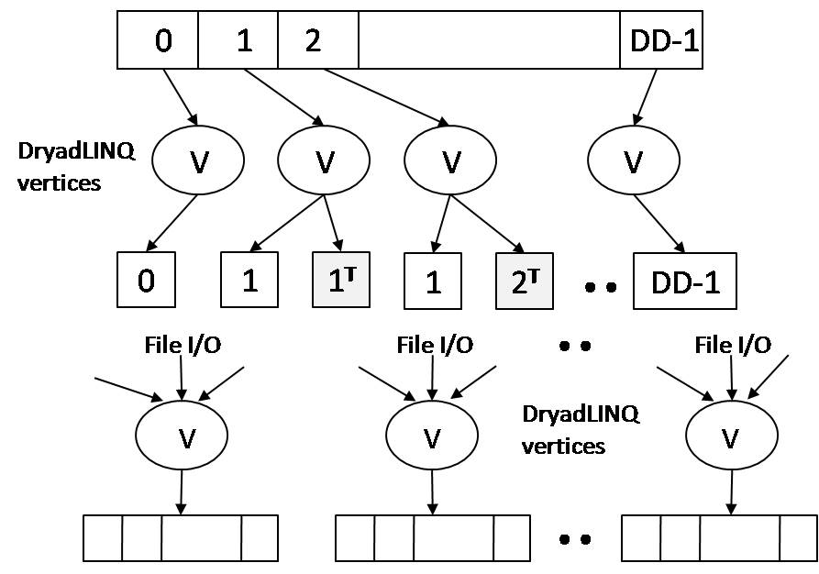
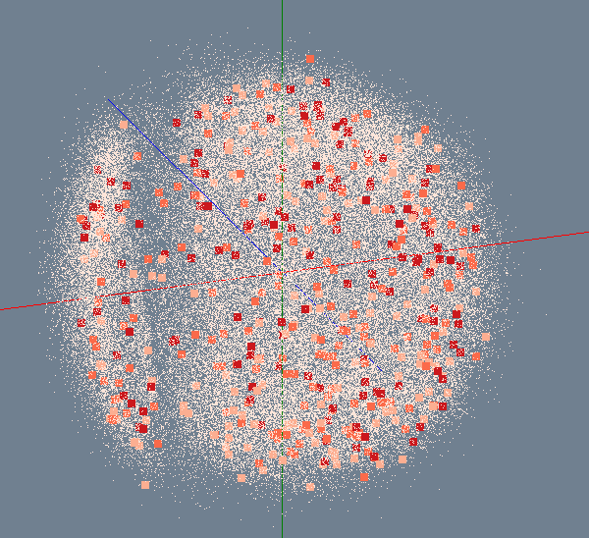

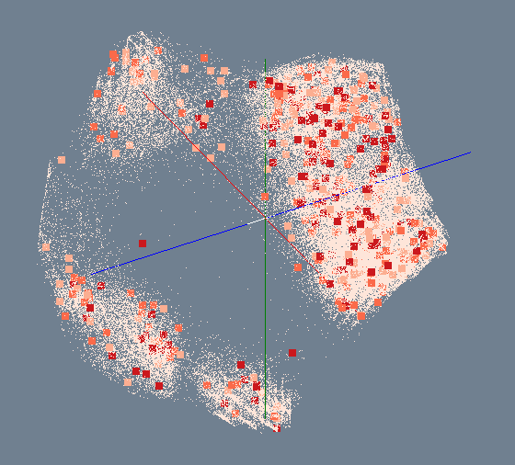
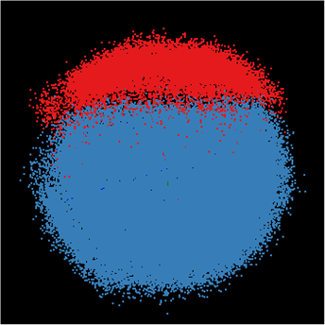
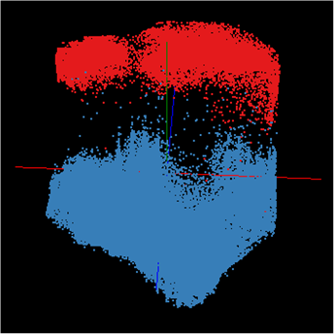
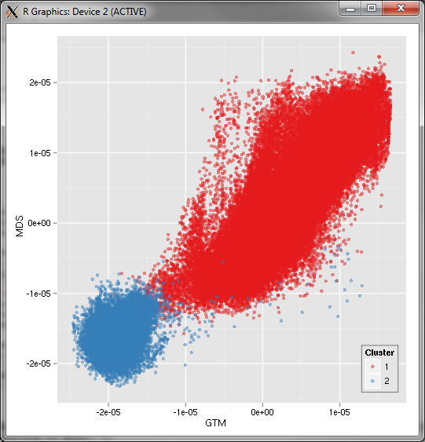
Bioinformatics Pipeline
Gene Sequences (N = 1 Million)
Pairwise Alignment & Distance Calculation
Distance Matrix
Select Reference
Reference Sequence Set (M = 100K)
Reference Coordinates
N - M Sequence Set (900K)
Interpolative MDS with Pairwise Distance Calculation
x, y, z
Multi-Dimensional Scaling (MDS)
O(N²)
N - M Coordinates
x, y, z
Visualization
3D Plot

Slide 34
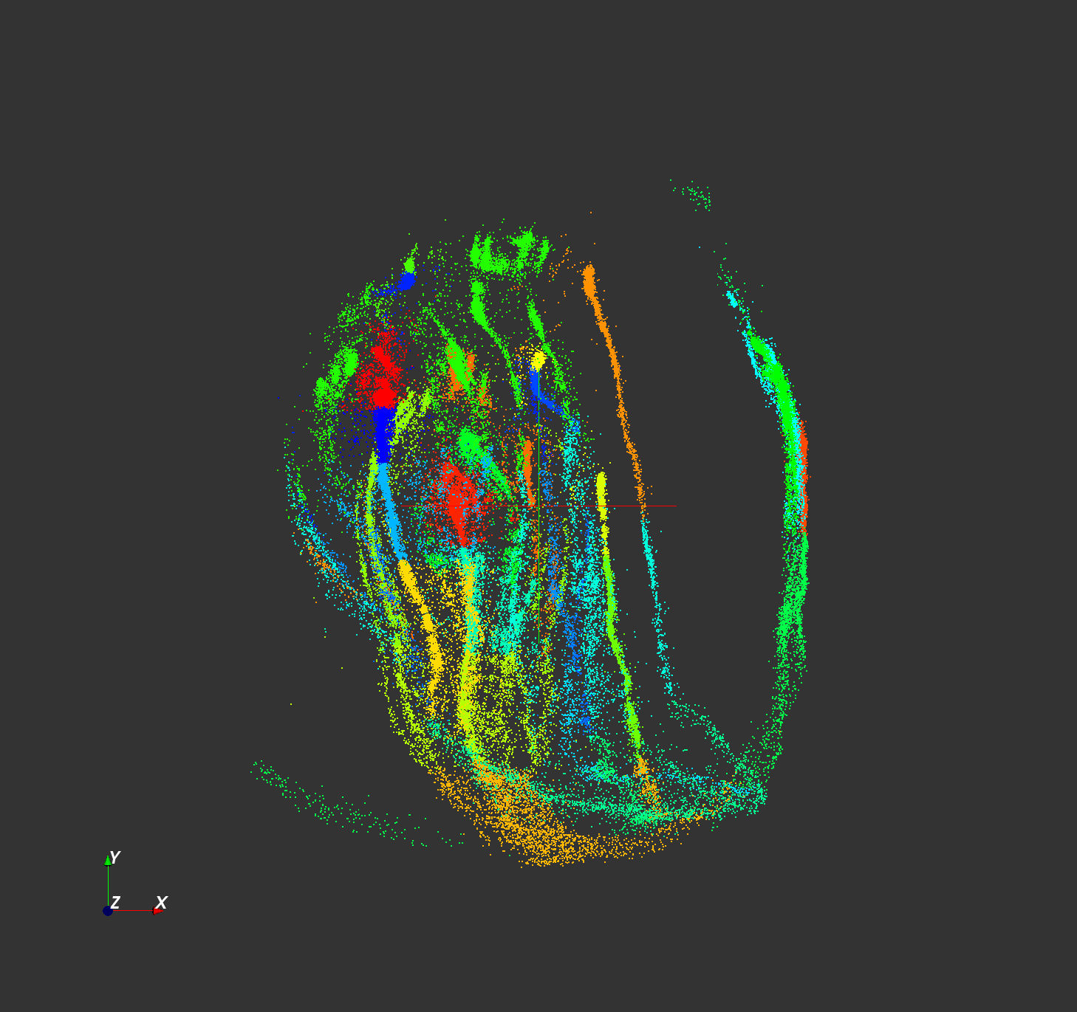
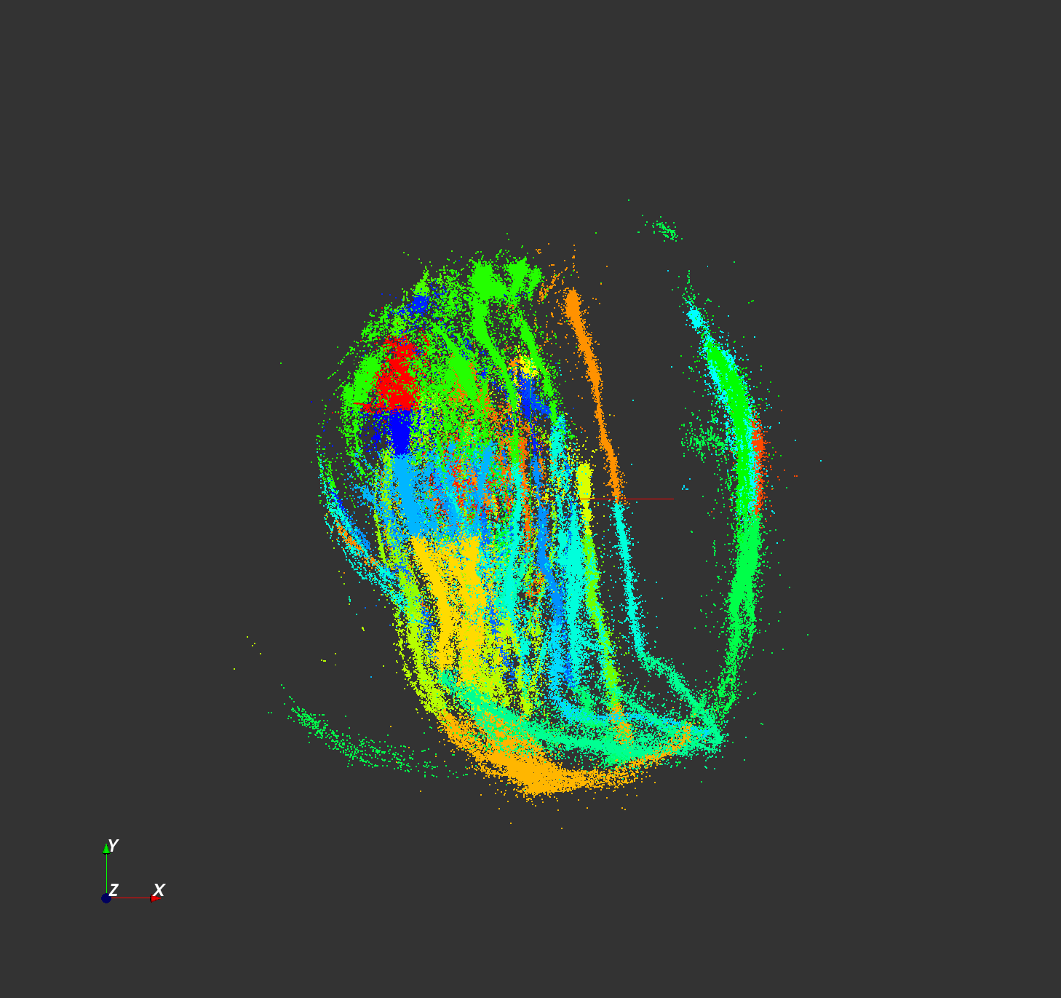

Million Sequence Challenge
  Input DataSize: 680k
  Sample Data Size: 100k
  Out-Sample Data Size: 580k
  Test Environment: PolarGrid with 100 nodes, 800 workers.
100k sample data
680k data

Slide 35
High-Performance
Visualization Algorithms
For Data-Intensive Analysis

Slide 36

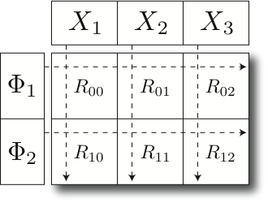
Parallel GTM
GTM / GTM-Interpolation
A
1
A
B
C
Parallel HDF5
ScaLAPACK
B
2
1
MPI / MPI-IO
C
Parallel File System
K latent
points
N data
points
2
Cray / Linux / Windows Cluster
Finding K clusters for N data points
    Relationship is a bipartite graph (bi-graph)
    Represented by K-by-N matrix (K << N)
Decomposition for P-by-Q compute grid
    Reduce memory requirement by 1/PQ
GTM Software Stack

Slide 37
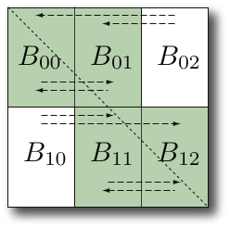
Scalable MDS
Parallel MDS
MDS Interpolation
O(N²) memory and computation required.
  100k data → 480GB memory
Balanced decomposition of NxN matrices by P-by-Q grid.
  Reduce memory and computing requirement by 1/PQ
Communicate via MPI primitives
Finding approximate mapping position w.r.t. k-NN’s prior mapping.
Per point it requires:
  O(M) memory
  O(k) computation
Pleasingly parallel
Mapping 2M in 1450 sec.
  vs. 100k in 27000 sec.
  7500 times faster than estimation of the full MDS.
c1
c2
c3
r1
r2

Slide 38
Interpolation extension to GTM/MDS
MPI, Twister
n
In-sample
Training
Trained data
1
N-n
Out-of-sample
Interpolated map
2
Interpolation
......
P-1
p
Total N data
MapReduce
Full data processing by GTM or MDS is computing- and memory-intensive
Two step procedure
  Training : training by M samples out of N data
  Interpolation : remaining (N-M) out-of-samples are approximated without training

Slide 39
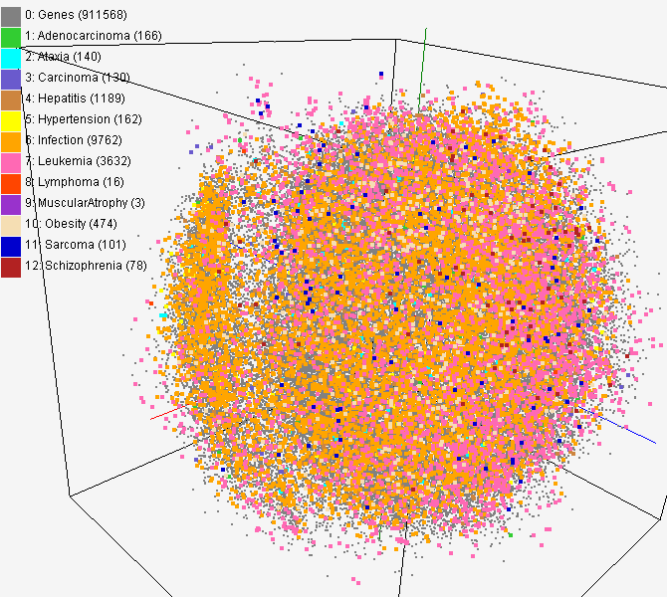
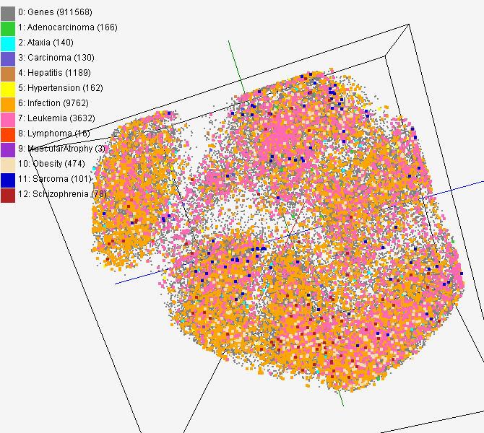
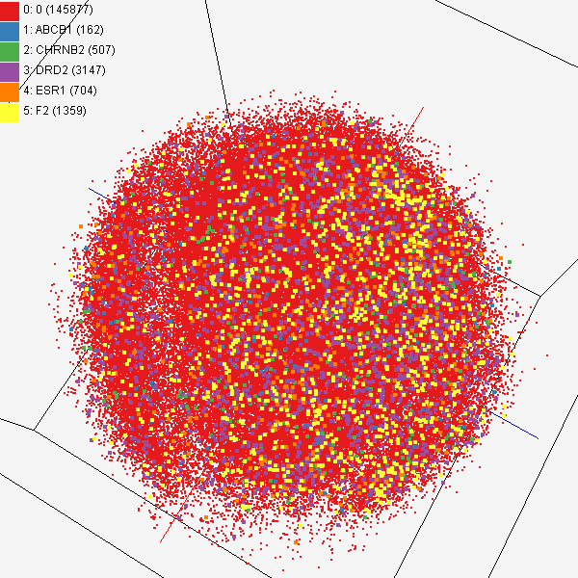
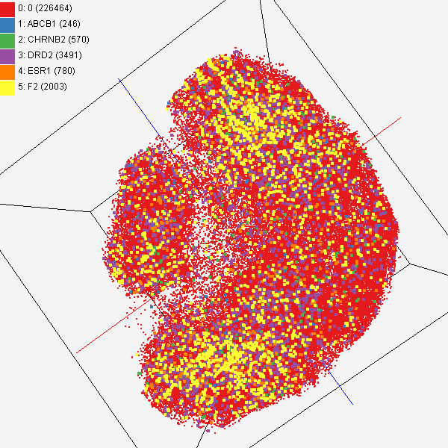
GTM/MDS Applications
PubChem data with CTD visualization by using MDS (left) and GTM (right)
About 930,000 chemical compounds are visualized as a point in 3D space, annotated by the related genes in Comparative Toxicogenomics Database (CTD)
Chemical compounds shown in literatures, visualized by MDS (left) and GTM (right)
Visualized 234,000 chemical compounds which may be related with a set of 5 genes of interest (ABCB1, CHRNB2, DRD2, ESR1, and F2) based on the dataset collected from major journal literatures which is also stored in Chem2Bio2RDF system.

Slide 40
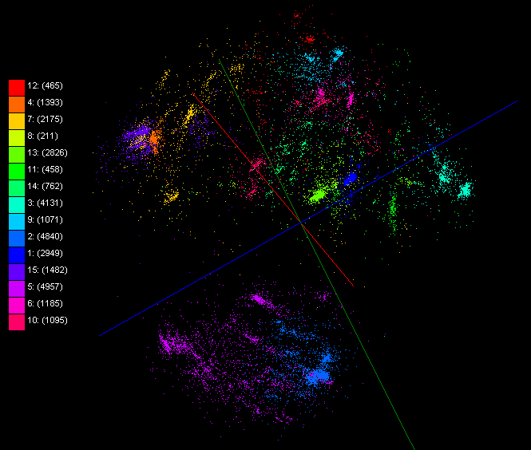
Mapping by Dissimilarity
ALU 35339
Metagenomics 30000

Slide 41
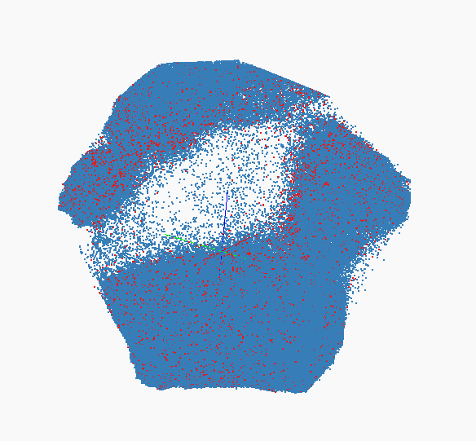
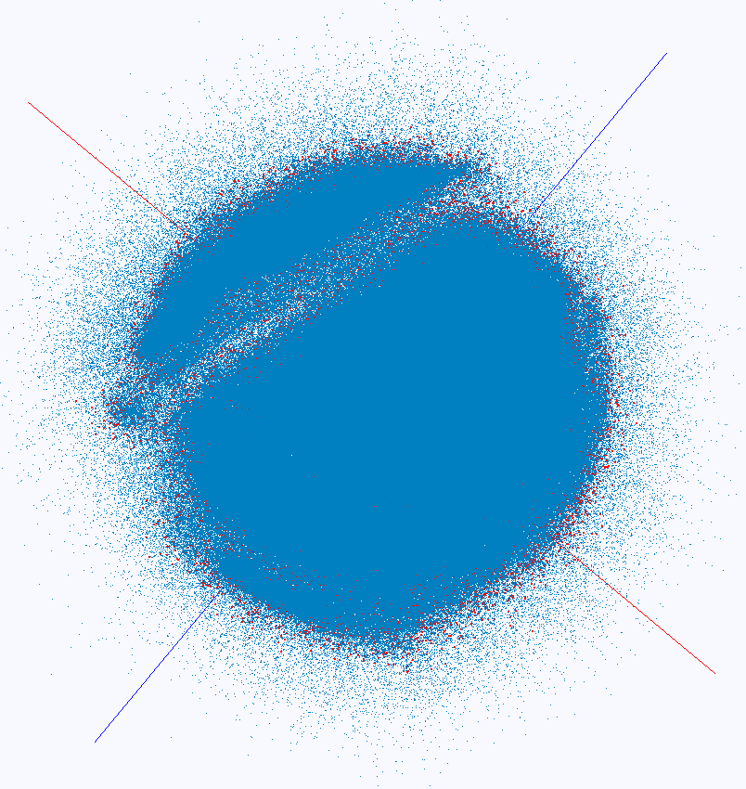
Interpolation
100K training and 2M interpolation of PubChem Interpolation MDS (left) and GTM (right)

Slide 42
Science with PolarGrid

Slide 43
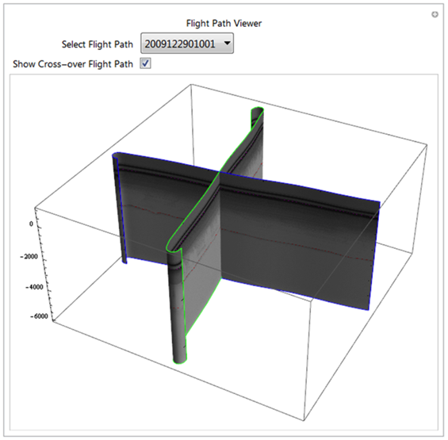
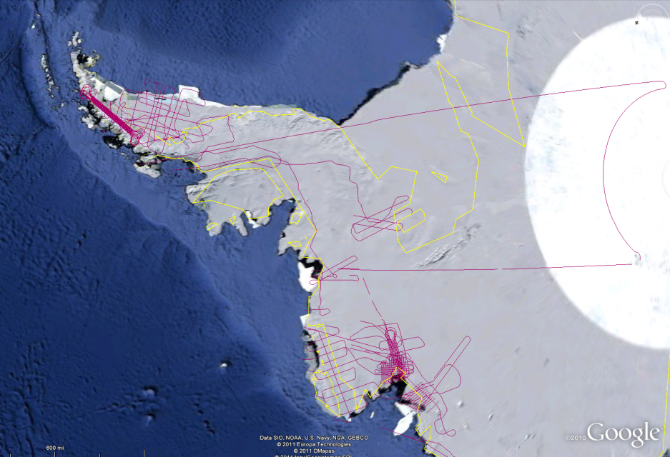
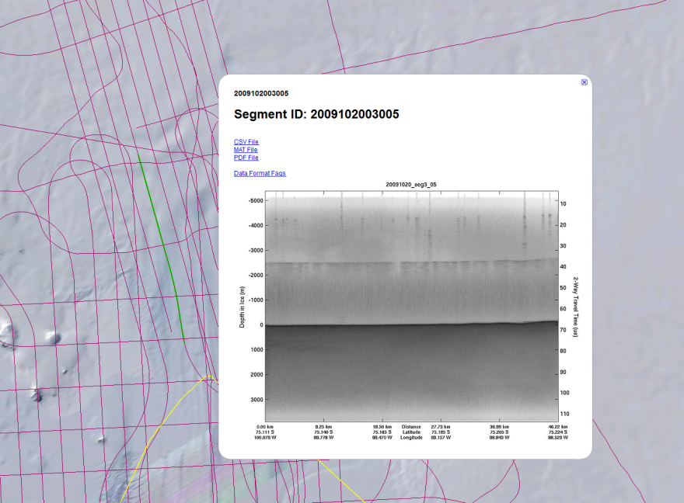
2009 Antarctica Season
  Top: 3D visualization of crossover flight paths
  Bottom Left and Right:
  The Web Map Service (WMS) protocol enables users to access the original data set from MATLAB and GIS software in order to display a single frame for a particular flight path

Slide 44
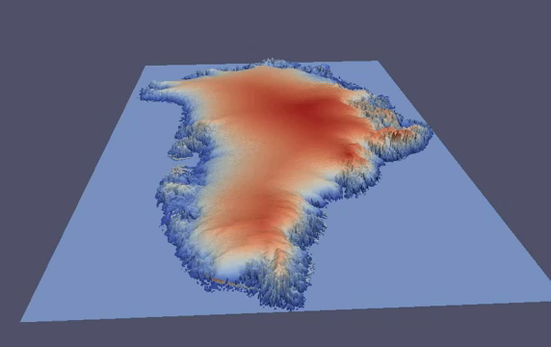
3D Visualization of Greenland

Slide 45
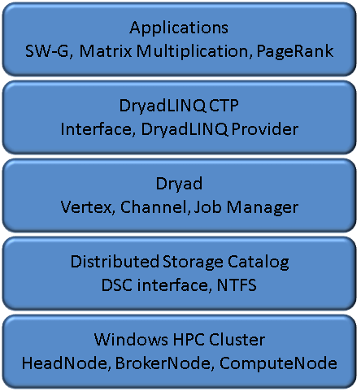
DryadLINQ CTP Evaluation
Investigate in applicability and performance of DryadLINQ CTP to develop scientific applications.
Goals:
  Evaluate key features and interfaces
  Probe parallel programming models
Three applications:
  SW-G bioinformatics application
  Matrix Multiplication
  PageRank

Slide 46
Matrix-Matrix Multiplication
Parallel algorithms for matrix multiplication
    Row partition
    Row column partition
    2 dimensional block decomposition in Fox algorithm
Multi core technologies
    PLINQ, TPL, and Thread Pool
Hybrid parallel model
    Port multi-core to Dryad task to improve Performance
Timing model for MM

Slide 47
SW-G bioinformatics application
  Workload of SW-G, a pleasingly parallel application, is heterogeneous due to the difference in input gene sequences. Hence workload balancing becomes an issue.
Two approach to alleviate it:
    Randomized distributed input data
    Partition job into finer granularity tasks

Slide 48





Acknowledgement
SALSA HPC Group
Indiana University
http://salsahpc.indiana.edu

