Slide 1
Clouds and
Application to Sensor Nets
Ball Aerospace Dayton OH
November 4 2010
Geoffrey Fox
gcf@indiana.edu
http://www.infomall.org http://www.futuregrid.org
Director, Digital Science Center, Pervasive Technology Institute
Associate Dean for Research and Graduate Studies, School of Informatics and Computing
Indiana University Bloomington

Slide 2
Important Trends
Data Deluge in all fields of science
Multicore implies parallel computing important again
  Performance from extra cores – not extra clock speed
  GPU enhanced systems can give big power boost
Clouds – new commercially supported data center model replacing compute grids (and your general purpose computer center)
Light weight clients: Sensors, Smartphones and tablets accessing and supported by backend services in cloud
Commercial efforts moving much faster than academia in both innovation and deployment

Slide 3
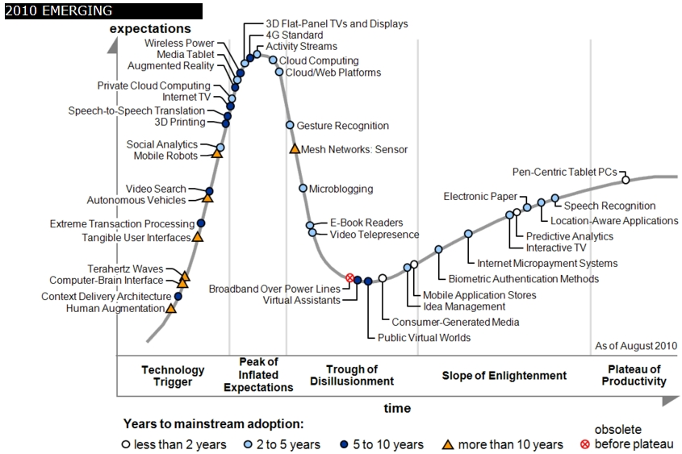
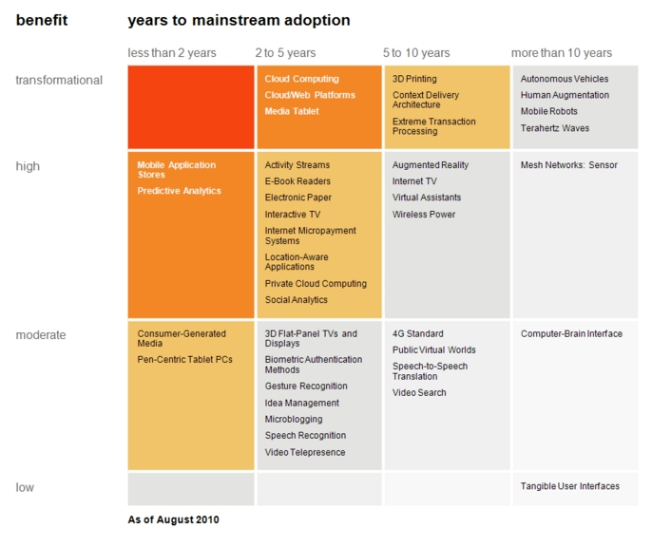

Transformational
High
Moderate
Low
Gartner 2009 Hype Curve
Clouds, Web2.0
Service Oriented Architectures
Cloud Computing
Cloud Web Platforms
Media Tablet

Slide 4



Data Centers Clouds &
Economies of Scale I
Range in size from “edge” facilities to megascale.
Economies of scale
  Approximate costs for a small size center (1K servers) and a larger, 50K server center.
2 Google warehouses of computers on the banks of the Columbia River, in The Dalles, Oregon
Such centers use 20MW-200MW
(Future) each with 150 watts per CPU
Save money from large size, positioning with cheap power and access with Internet
Technology | Cost in small-sized Data Center | Cost in Large Data Center | Ratio
Network | $95 per Mbps/ month | $13 per Mbps/ month | 7.1
Storage | $2.20 per GB/ month | $0.40 per GB/ month | 5.7
Administration | ~140 servers/ Administrator | >1000 Servers/ Administrator | 7.1
Each data center is
11.5 times
the size of a football field

Slide 5


Data Centers, Clouds
& Economies of Scale II
Builds giant data centers with 100,000’s of computers;
~ 200-1000 to a shipping container with Internet access
“Microsoft will cram between 150 and 220 shipping containers filled with data center gear into a new 500,000 square foot Chicago facility. This move marks the most significant, public use of the shipping container systems popularized by the likes of Sun Microsystems and Rackable Systems to date.”

Slide 6
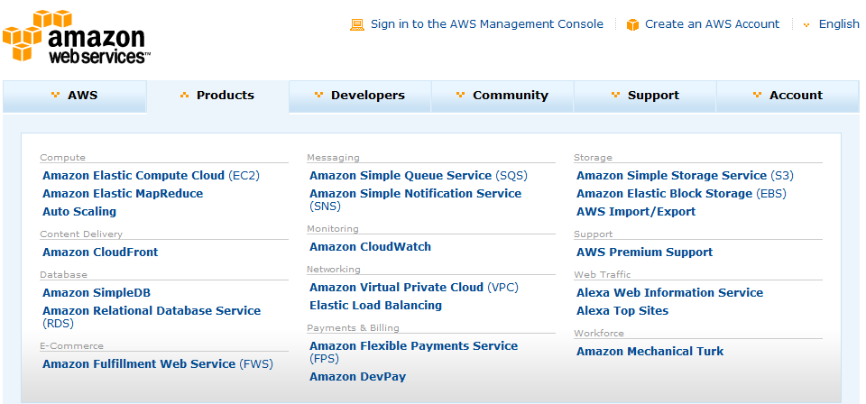








Commercial Cloud Systems
Software
Google App Engine

Slide 7
















X as a Service
IaaS: Infrastructure as a Service or HaaS: Hardware as a Service – get your computer time with a credit card and with a Web interface
PaaS: Platform as a Service is IaaS plus core software capabilities on which you build SaaS
SaaS: Software as a Service imply software capabilities
(programs) have a service (messaging) interface
  Applying systematically reduces system complexity to being linear in number of components
  Access via messaging rather than by installing in /usr/bin
Net Centric Grids are “Military IT as a Service”
Other Services
Clients

Slide 8





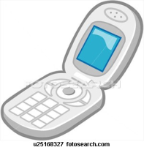
Sensors as a Service
Cell phones are important sensor/Collaborative device
Sensors as a Service
Sensor Processing as a Service (MapReduce)

Slide 10
Grids MPI and Clouds
Grids are useful for managing distributed systems
  Pioneered service model for Science
  Developed importance of Workflow
  Performance issues – communication latency – intrinsic to distributed systems
  Can never run large differential equation based simulations or datamining
Clouds can execute any job class that was good for Grids plus
  More attractive due to platform plus elastic on-demand model
  MapReduce easier to use than MPI for appropriate parallel jobs
  Currently have performance limitations due to poor affinity (locality) for compute-compute (MPI) and Compute-data
  These limitations are not “inevitable” and should gradually improve as in July 13 Amazon Cluster announcement
  Will probably never be best for most sophisticated parallel differential equation based simulations
Classic Supercomputers (MPI Engines) run communication demanding differential equation based simulations
  MapReduce and Clouds replaces MPI for other problems
  Much more data processed today by MapReduce than MPI (Industry Informational Retrieval manipulates ~50 Petabytes per day)

Slide 11
Key Cloud Concepts I
Clouds are (by definition) commercially supported approach to large scale computing
  So we should expect Clouds to replace Compute Grids
  Current Grid technology involves “non-commercial” software solutions which are hard to evolve/sustain
  Maybe Clouds ~4% IT expenditure 2008 growing to 14% in 2012 (IDC Estimate)
Public Clouds are broadly accessible resources like Amazon and Microsoft Azure – powerful but not easy to customize and perhaps data trust/privacy issues
  DoD could set up large military clouds that act equivalently to public clouds
Private Clouds run similar software and mechanisms but on “your own computers” (not clear if still elastic)
  Allows hierarchical architectures with small systems near sensors backed up by larger on demand systems; hybrid clouds with multiple levels
Services still are correct architecture with either REST (Web 2.0) or Web Services
Clusters are still critical concept for Parallel or Cloud software

Slide 12
Key Cloud Concepts II:
Infrastructure and Runtimes
Cloud infrastructure: outsourcing of servers, computing, data, file space, utility computing, etc.
  Handled through Web services that control virtual machine lifecycles.
Cloud runtimes or Platform: tools (for using clouds) to do data-parallel (and other) computations.
  New runtime: Apache Hadoop, Google MapReduce, Microsoft Dryad, Bigtable, Chubby and others
  MapReduce designed for information retrieval but is excellent for a wide range of data analysis applications
  Can also do much traditional parallel computing for data-mining if extended to support iterative operations (see Twister)
  Important new languages – Sawzall, Pig Latin (both open source) aimed at scripting data analysis applications – I think this an area where major new progress to be expected

Slide 13
Collaboration as a Service
(described in detail at CTS conference)
Describes use of clouds to host the various services needed for collaboration, crisis management, command and control etc.
  Manage exchange of information between collaborating people and sensors
  Support the shared databases and information processing defining common knowledge
  Support filtering of information from sensors and databases
  Simulations might be managed from clouds but run on “MPI engines” outside Clouds if needed parallel implementation
Data sources, users and simulations outside cloud
Good for clouds as many loosely coupled individual computers;

Slide 14
MapReduce
Data Partitions
Map(Key, Value)
A hash function maps the results of the map tasks to reduce tasks
Reduce(Key, List<Value>)
Reduce Outputs
Implementations (Hadoop – Java; Dryad – Windows) support:
  Splitting of data
  Passing the output of map functions to reduce functions
  Sorting the inputs to the reduce function based on the intermediate keys
  Quality of service

Slide 15






MapReduce “File/Data Repository” Parallelism
Map = (data parallel) computation reading and writing data
Reduce = Collective/Consolidation phase e.g. forming multiple global sums as in histogram
Instruments
Iterative MapReduce
Map Map Map Map
Reduce Reduce Reduce
Communication
Reduce
Portals
/Users
Disks
Map₁
Map₂
Map₃

Slide 16

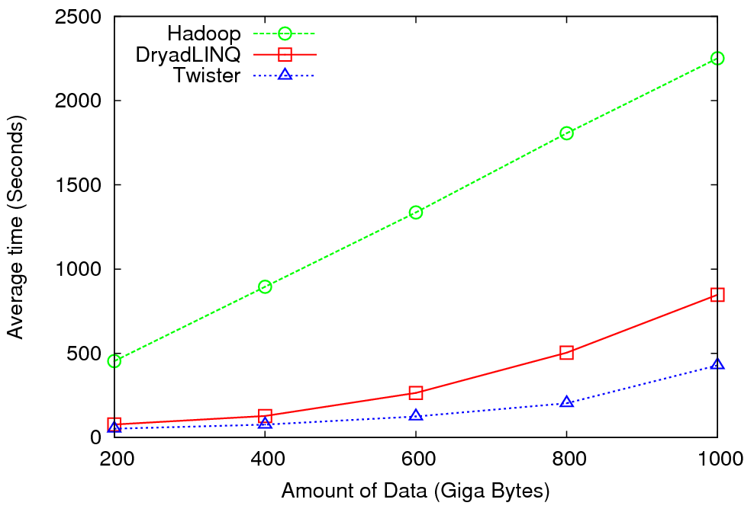
High Energy Physics Data Analysis
An application analyzing data from Large Hadron Collider
(1TB but 100 Petabytes eventually)
Input to a map task: <key, value>
key = Some Id value = HEP file Name
Output of a map task: <key, value>
key = random # (0<= num<= max reduce tasks)
value = Histogram as binary data
Input to a reduce task: <key, List<value>>
key = random # (0<= num<= max reduce tasks)
value = List of histogram as binary data
Output from a reduce task: value
value = Histogram file
Combine outputs from reduce tasks to form the final histogram

Slide 17
Hadoop/Dryad Comparison
Inhomogeneous Data I
Inhomogeneity of data does not have a significant effect when the sequence lengths are randomly distributed
Dryad with Windows HPCS compared to Hadoop with Linux RHEL on Idataplex (32 nodes)

Slide 18
Hadoop/Dryad Comparison
Inhomogeneous Data II
This shows the natural load balancing of Hadoop MR dynamic task assignment using a global pipe line in contrast to the DryadLinq static assignment
Dryad with Windows HPCS compared to Hadoop with Linux RHEL on Idataplex (32 nodes)

Slide 19
Hadoop VM Performance Degradation
Perf. Degradation = (T_{vm} – T_{baremetal})/T_{baremetal}
15.3% Degradation at largest data set size

Slide 20
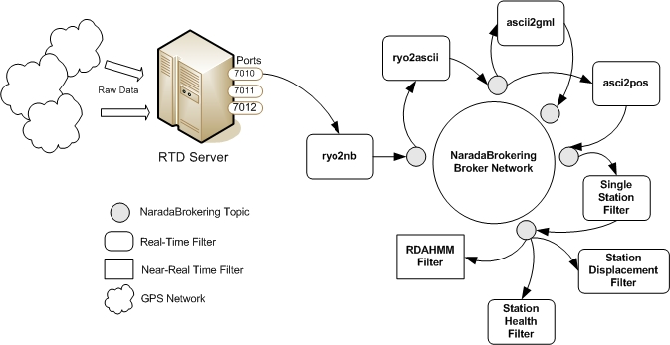
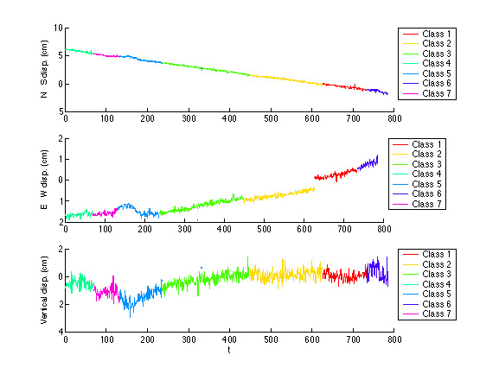
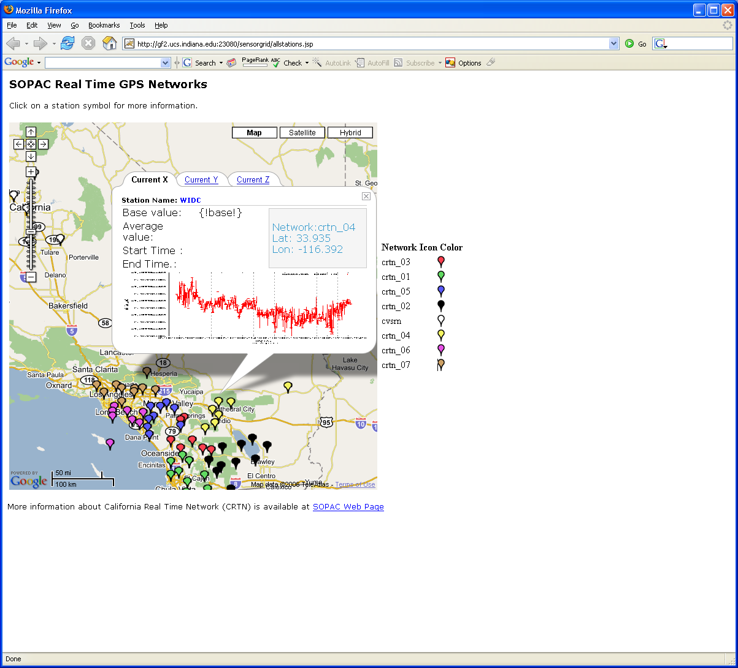
Real-Time GPS Sensor Data-Mining
Services process real time data from ~70 GPS Sensors in Southern California
Brokers and Services on Clouds – no major performance issues
CRTN GPS
Earthquake
Streaming Data
Support
Transformations
Data Checking
Archival
Hidden Markov
Datamining (JPL)
Display (GIS)
Real Time
20
Notes:
20

Slide 21
Processing Real-Time GPS Streams
ascii2gml
ryo2ascii
RYO
Ports
ascii2pos
7010
NB Server
Raw Data
Scripps
RTD
Server
ryo2nb
Single Station
7011
7012
GPS Networks
Displacement Filter
RDAHMM Filter
Station Health
Filter
/SOPAC/GPS/CRTN01/RYO
Raw Data
ryo2nb
ryo2ascii
/SOPAC/GPS/CRTN01/ASCII
ascii2pos
Single Station
RDAHMM Filter
/SOPAC/GPS/CRTN01/POS
Broker and
services in
the cloud
/SOPAC/GPS/CRTN01/DSME
A Complete Sensor Message Processing Path, including a data analysis application.

Slide 22
Lightweight Cyberinfrastructure to support mobile Data gathering expeditions plus classic central resources (as a cloud)

Slide 23
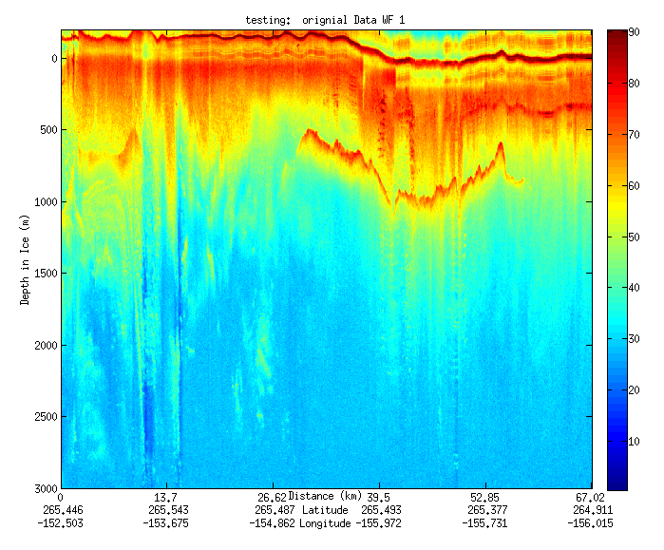
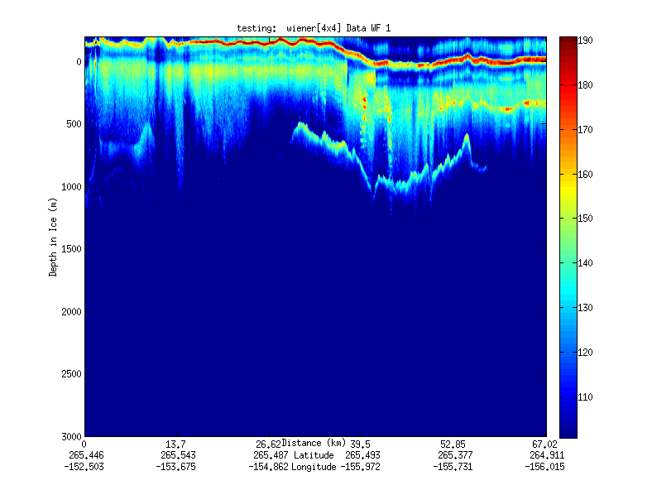
Geospatial Examples on Cloud Infrastructure
Image processing and mining
  SAR Images from Polar Grid (Matlab)
  Apply to 20 TB of data
  Could use MapReduce
Flood modeling
  Chaining flood models over a geographic area.
  Parameter fits and inversion problems.
  Deploy Services on Clouds – current models do not need parallelism
Real time GPS processing (QuakeSim)
  Services and Brokers (publish subscribe Sensor Aggregators) on clouds
  Performance issues not critical
Filter

Slide 24
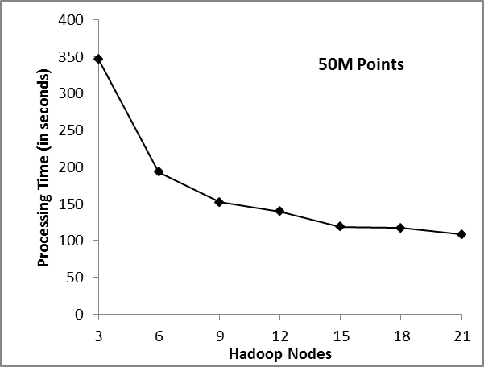
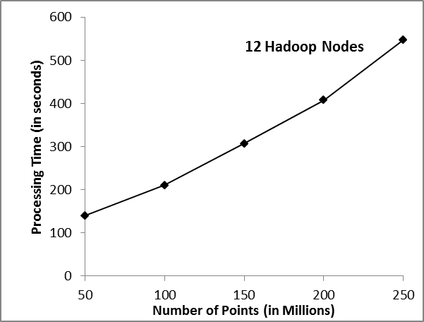
Matlab and Hadoop: Test Case
Application: Analyze PolarGrid flight line with specially tailored Douglas-Peucker algorithm
Process from 50M to 250M points
Two experiments: left is fixed data size with variable nodes, right is fixed nodes with variable data sizes

Slide 25


Twister
Pub/Sub Broker Network
Map Worker
M
Worker Nodes
R
Reduce Worker
Streaming based communication
Intermediate results are directly transferred from the map tasks to the reduce tasks – eliminates local files
Cacheable map/reduce tasks
  Static data remains in memory
Combine phase to combine reductions
User Program is the composer of MapReduce computations
Extends the MapReduce model to iterative computations
D
D
MR
Driver
User
Program
M
M
M
M
D
MRDeamon
R
R
R
R
Data Read/Write
Communication
Data Split
File System
Iterate
Static
data
Configure()
User Program
Map(Key, Value)
δ flow
Reduce (Key, List<Value>)
Combine (Key, List<Value>)
Different synchronization and intercommunication mechanisms used by the parallel runtimes
Close()

Slide 26
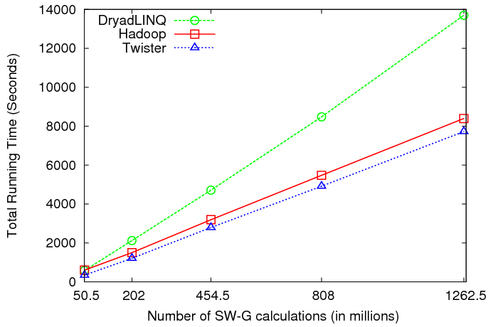

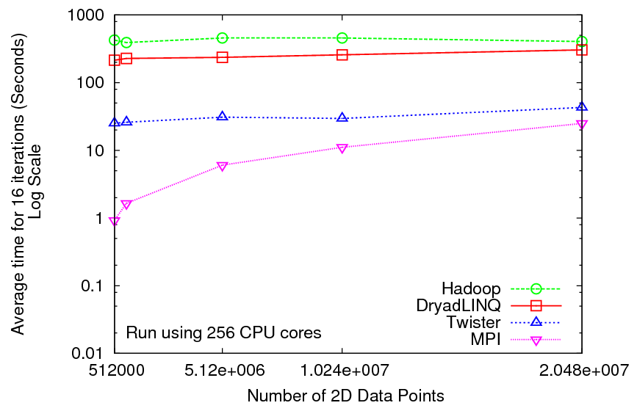
Iterative and non-Iterative
Computations
K-means
Smith Waterman is a non iterative case and of course runs fine in Twister
K-means in Twister
Performance of K-Means

Slide 27
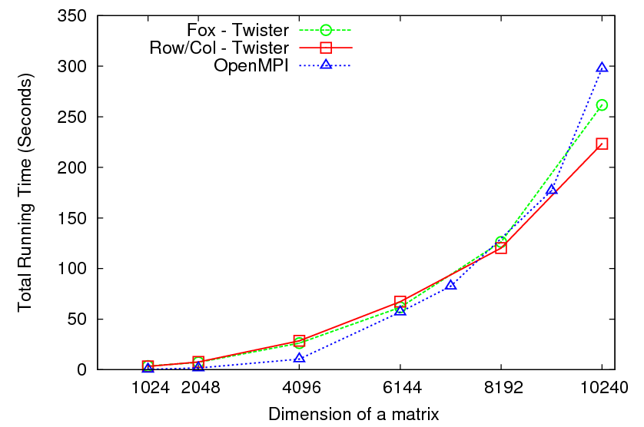

Matrix Multiplication
64 cores
Square blocks Twister
Row/Col decomp Twister
Square blocks OpenMPI

Slide 28

Performance of Pagerank using
ClueWeb Data (Time for 20 iterations)
using 32 nodes (256 CPU cores) of Crevasse

Slide 29


Sequence Assembly in the Clouds
Cap3 Parallel Efficiency
Cap3 – Time Per core per file (458 reads in each file) to process sequences

Slide 30
Azure/Amazon MapReduce

Slide 31
Fault Tolerance and MapReduce
MPI does “maps” followed by “communication” including “reduce” but does this iteratively
There must (for most communication patterns of interest) be a strict synchronization at end of each communication phase
  Thus if a process fails then everything grinds to a halt
In MapReduce, all Map processes and all reduce processes are independent and stateless and read and write to disks
Thus failures can easily be recovered by rerunning process without other jobs hanging around waiting
Note Google uses fault tolerance to enable preemption of resources by higher priority jobs. This could be important in Sensor clouds

Slide 32
Conclusions
Grids manage distributed software (workflow) and systems/data (standard protocols)
Clouds augment Grids in elastic utility computing, data analysis languages and runtime
Sensors suitable for elastic clouds (sensors can be managed by individual cloud cores)
Need to harness languages (Sawzall, Pig Latin) and runtimes (Twister, MapReduce) for sensor analysis
Need hybrid cloud systems to go from sensor constellations to back end systems

