Slide 1
Next Generation Grid: Integrating Parallel and Distributed Computing Runtimes for an HPC Enhanced Cloud and Fog Spanning IoT Big Data and Big Simulations
Geoffrey Fox, Supun Kamburugamuve, Judy Qiu, Shantenu Jha
June 28, 2017
IEEE Cloud 2017 Honolulu Hawaii
gcf@indiana.edu
http://www.dsc.soic.indiana.edu/, http://spidal.org/
Department of Intelligent Systems Engineering
School of Informatics and Computing, Digital Science Center
Indiana University Bloomington
`

Slide 2
“Next Generation Grid – HPC Cloud” Problem Statement
Design a dataflow event-driven FaaS (microservice) framework running across application and geographic domains.
Build on Cloud best practice but use HPC wherever possible and useful to get high performance
Smoothly support current paradigms Hadoop, Spark, Flink, Heron, MPI, DARMA …
Use interoperable common abstractions but multiple polymorphic implementations.
  i.e. do not require a single runtime
Focus on Runtime but this implicitly suggests programming and execution model
This next generation Grid based on data and edge devices – not computing as in old Grid

Slide 3
Important Trends I
Data gaining in importance compared to simulations
  Data analysis techniques changing with old and new applications
All forms of IT increasing in importance; both data and simulations increasing
Internet of Things and Edge Computing growing in importance
Exascale initiative driving large supercomputers
Use of public clouds increasing rapidly
  Clouds becoming diverse with subsystems containing GPU’s, FPGA’s, high performance networks, storage, memory …
  They have economies of scale; hard to compete with
Serverless computing attractive to user:
“No server is easier to manage than no server”

Slide 4
Important Trends II
Rich software stacks:
  HPC for Parallel Computing
  Apache for Big Data including some edge computing (streaming data)
On general principles parallel and distributed computing has different requirements even if sometimes similar functionalities
  Apache stack typically uses distributed computing concepts
  For example, Reduce operation is different in MPI (Harp) and Spark
Important to put grain size into analysis
  Its easier to make dataflow efficient if grain size large
Streaming Data ubiquitous including data from edge
Edge computing has some time-sensitive applications
  Choosing a good restaurant can wait seconds
  Avoiding collisions must be finished in milliseconds

Slide 5
Predictions/Assumptions
Classic Supercomputers will continue for large simulations and may run other applications but these codes will be developed on
Next-Generation Commodity Systems which are dominant force
  Merge Cloud HPC and Edge computing
  Clouds running in multiple giant datacenters offering all types of computing
  Distributed data sources associated with device and Fog processing resources
  Server-hidden computing for user pleasure
  Support a distributed event driven dataflow computing model covering batch and streaming data
  Needing parallel and distributed (Grid) computing ideas

Slide 6
Motivation Summary
Explosion of Internet of Things and Cloud Computing
  Clouds will continue to grow and will include more use cases
Edge Computing is adding an additional dimension to Cloud Computing
  Device --- Fog ---Cloud
Event driven computing is becoming dominant
  Signal generated by a Sensor is an edge event
  Accessing a HPC linear algebra function could be event driven and replace traditional libraries by FaaS (as NetSolve GridSolve Neos did in old Grid)
Services will be packaged as a powerful Function as a Service FaaS
Serverless must be important: users not interested in low level details of IaaS or even PaaS?
Applications will span from Edge to Multiple Clouds

Slide 7

Implementing these ideas at a high level

Slide 8
Proposed Approach I
Unit of Processing is an Event driven Function
  Can have state that may need to be preserved in place (Iterative MapReduce)
  Can be hierarchical as in invoking a parallel job
  Functions can be single or 1 of 100,000 maps in large parallel code
Processing units run in clouds, fogs or devices but these all have similar architecture
  Fog (e.g. car) looks like a cloud to a device (radar sensor) while public cloud looks like a cloud to the fog (car)
Use polymorphic runtime that uses different implementations depending on environment e.g. on fault-tolerance – latency (performance) tradeoffs
Data locality (minimize explicit dataflow) properly supported as in HPF alignment commands (specify which data and computing needs to be kept together)

Slide 9
Proposed Approach II
Analyze the runtime of existing systems
  Hadoop, Spark, Flink, Naiad Big Data Processing
  Storm, Heron Streaming Dataflow
  Kepler, Pegasus, NiFi workflow
  Harp Map-Collective, MPI and HPC AMT runtime like DARMA
  And approaches such as GridFTP and CORBA/HLA (!) for wide area data links
Propose polymorphic unification (given function can have different implementations)
Choose powerful scheduler (Mesos?)
Support processing locality/alignment including MPI’s never move model with grain size consideration
One should integrate HPC and Clouds

Slide 10
Implementing these ideas in detail

Slide 11
Components of Big Data Stack
Google likes to show a timeline; we can build on (Apache version of) this
2002 Google File System GFS ~HDFS
2004 MapReduce Apache Hadoop
2006 Big Table Apache Hbase
2008 Dremel Apache Drill
2009 Pregel Apache Giraph
2010 FlumeJava Apache Crunch
2010 Colossus better GFS
2012 Spanner horizontally scalable NewSQL database ~CockroachDB
2013 F1 horizontally scalable SQL database
2013 MillWheel ~Apache Storm, Twitter Heron (Google not first!)
2015 Cloud Dataflow Apache Beam with Spark or Flink (dataflow) engine
Functionalities not identified: Security, Data Transfer, Scheduling, DevOps, serverless computing (assume OpenWhisk will improve to handle robustly lots of large functions)

Slide 12
HPC-ABDS
Integrated wide range of HPC and Big Data technologies.
I gave up updating!

Slide 13
What do we need in runtime for distributed HPC FaaS
Finish examination of all the current tools
Handle Events
Handle State
Handle Scheduling and Invocation of Function
Define data-flow graph that needs to be analyzed
Handle data flow execution graph with internal event-driven model
Handle geographic distribution of Functions and Events
Design dataflow collective and P2P communication model
Decide which streaming approach to adopt and integrate
Design in-memory dataset model for backup and exchange of data in data flow (fault tolerance)
Support DevOps and server-hidden cloud models
Support elasticity for FaaS (connected to server-hidden)

Slide 14
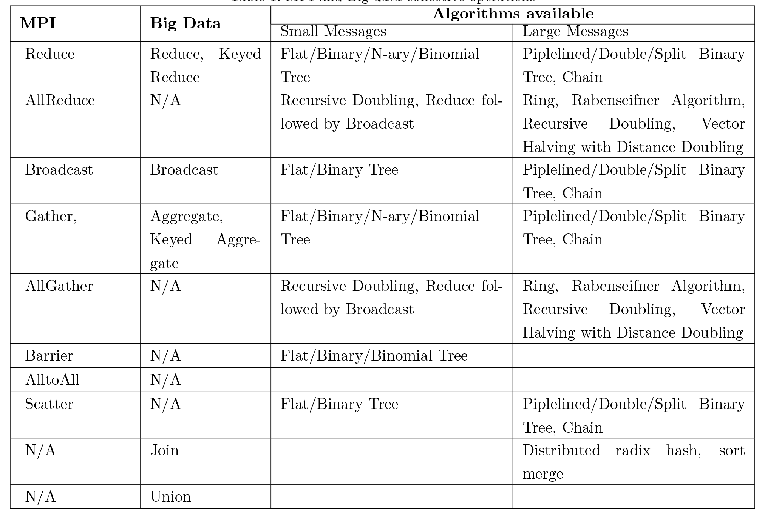
Communication Primitives
Big data systems do not implement optimized communications
It is interesting to see no AllReduce implementations
  AllReduce has to be done with Reduce + Broadcast
No consideration of RDMA except as add-on

Slide 15
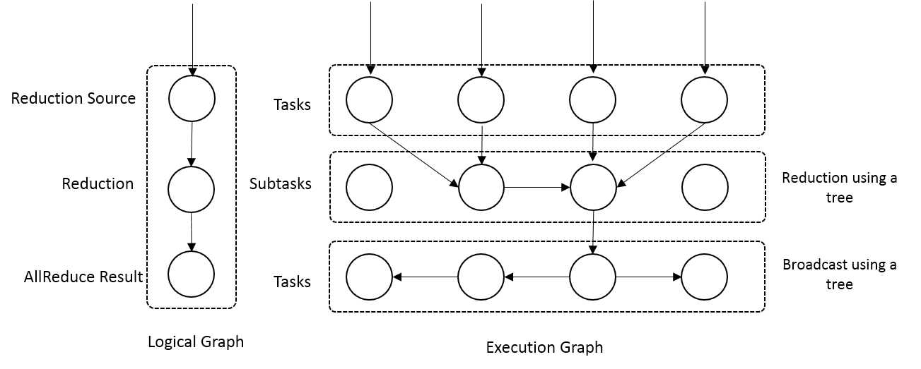
Optimized Dataflow Communications
Novel feature of our approach
Optimize the dataflow graph to facilitate different algorithms
Example - Reduce
  Add subtasks and arrange them according to an optimized algorithm
  Trees, Pipelines
Preserves the asynchronous nature of dataflow computation
Reduce communication as a dataflow graph modification

Slide 16
Dataflow Graph State and Scheduling
State is a key issue and handled differently in systems
  CORBA, AMT, MPI and Storm/Heron have long running tasks that preserve state
  Spark and Flink preserve datasets across dataflow node
  All systems agree on coarse grain dataflow; only keep state in exchanged data.
Scheduling is one key area where dataflow systems differ
  Dynamic Scheduling
    Fine grain control of dataflow graph
    Graph cannot be optimized
  Static Scheduling
    Less control of the dataflow graph
    Graph can be optimized

Slide 17
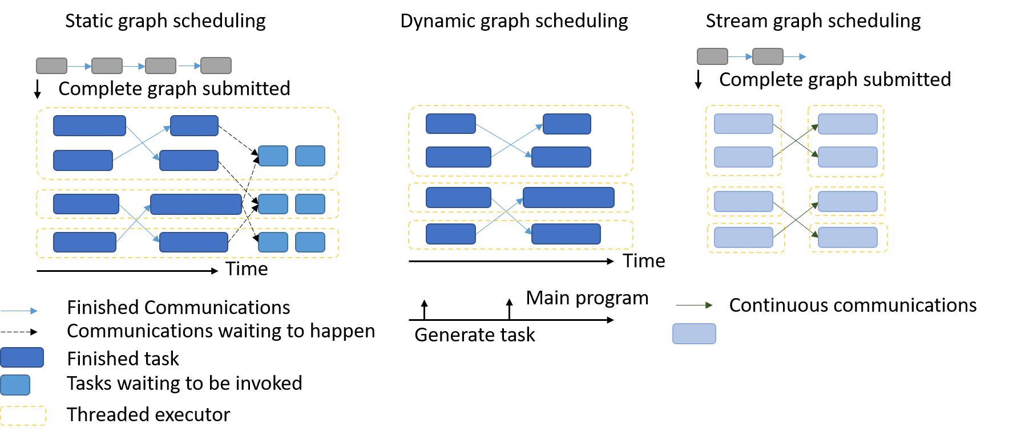
Dataflow Graph Task Scheduling

Slide 18
Fault Tolerance
Similar form of check-pointing mechanism is used in HPC and Big Data
  MPI, Flink, Spark
  Flink and Spark do better than MPI due to use of database technologies; MPI is a bit harder due to richer state
Checkpoint after each stage of the dataflow graph
  Natural synchronization point
  Generally allows user to choose when to checkpoint (not every stage)
Executors (processes) don’t have external state, so can be considered as coarse grained operations

Slide 19
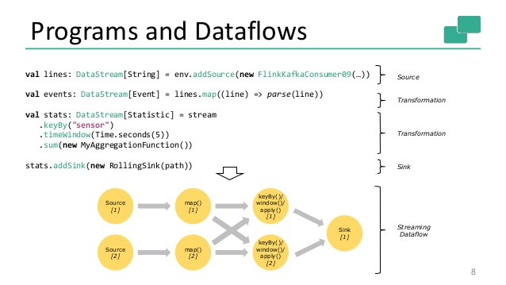
Spark Kmeans Flink Streaming Dataflow
P = loadPoints()
C = loadInitCenters()
for (int i = 0; i < 10; i++) {
T = P.map().withBroadcast(C)
C = T.reduce() }

Slide 20

Flink MDS Dataflow Graph

Slide 21
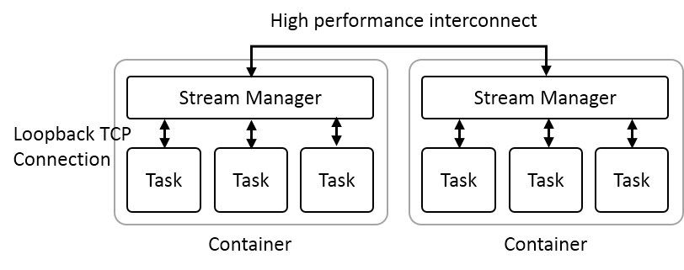
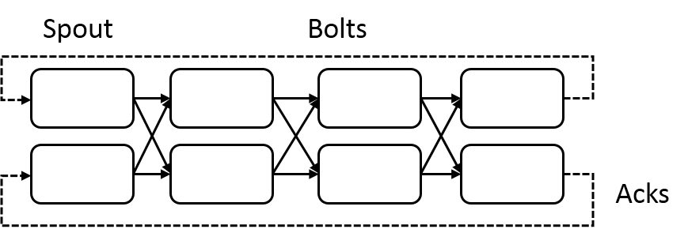
Heron Streaming Architecture
System Management
Add HPC
Infiniband
Omnipath
Inter node
Intranode
Typical Dataflow Processing Topology
User Specified Dataflow
All Tasks Long running
No context shared apart from dataflow
Parallelism 2; 4 stages

Slide 22
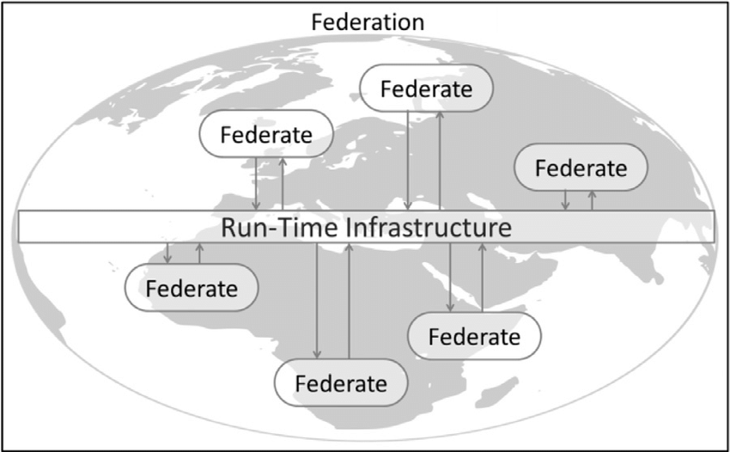
Naiad Timely Dataflow HLA Distributed Simulation

Slide 23
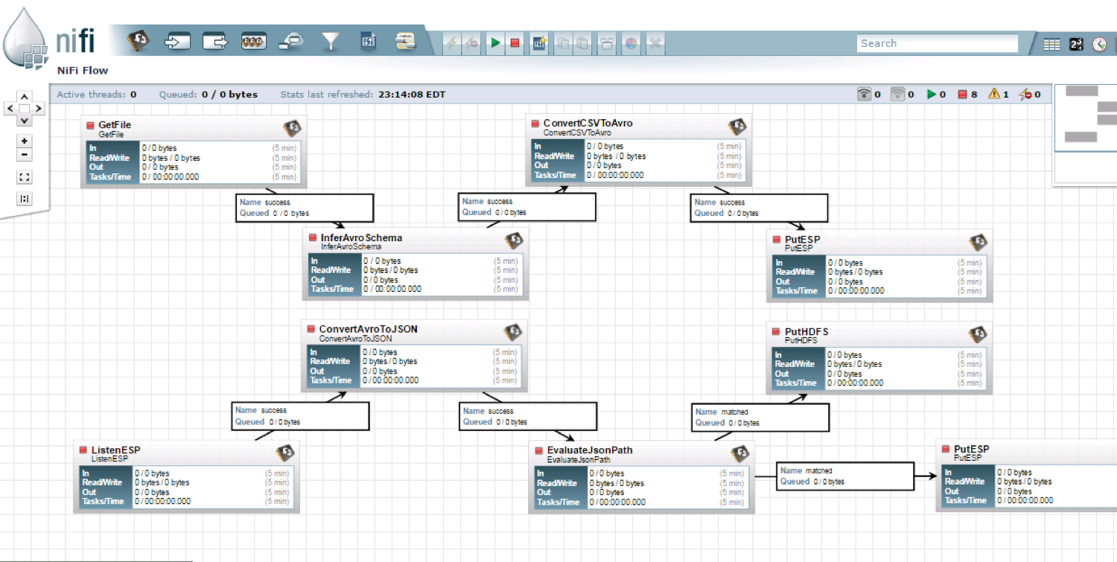
NiFi Workflow

Slide 24
Dataflow for a linear algebra kernel
Typical target of HPC AMT System
Danalis 2016

Slide 25
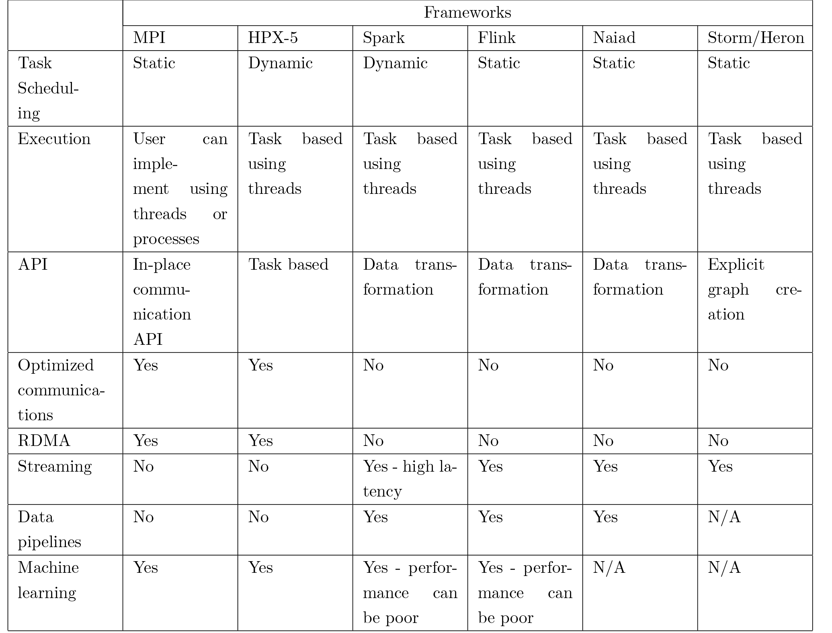
Dataflow Frameworks
Every major big data framework is designed according to dataflow model
Batch Systems
  Hadoop, Spark, Flink, Apex
Streaming Systems
  Storm, Heron, Samza, Flink, Apex
HPC AMT Systems
  Legion, Charm++, HPX-5, Dague, COMPs
Design choices in dataflow
  Efficient in different application areas

Slide 26

HPC Runtime versus ABDS distributed Computing Model on Data Analytics
Hadoop writes to disk and is slowest; Spark and Flink spawn many processes and do not support AllReduce directly;
MPI does in-place combined reduce/broadcast and is fastest
Need Polymorphic Reduction capability choosing best implementation
Use HPC architecture with
  Mutable model
  Immutable data

Slide 27
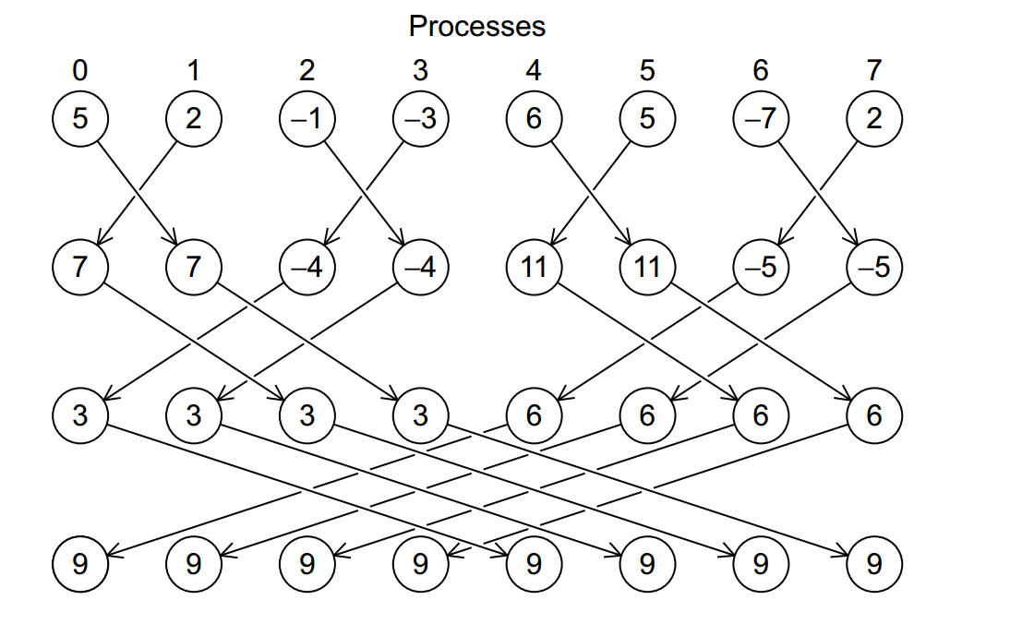
Illustration of In-Place AllReduce in MPI

Slide 28



Multidimensional Scaling
MDS execution time on 16 nodes with 20 processes in each node with varying number of points
MDS execution time with 32000 points on varying number of nodes. Each node runs 20 parallel tasks

Slide 29
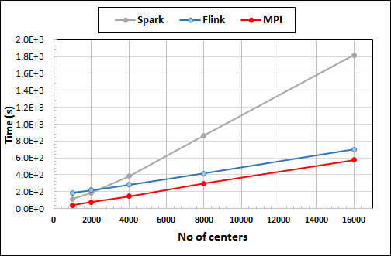
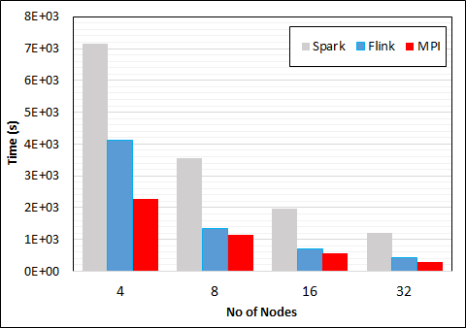
K-Means Clustering in Spark, Flink, MPI
Data Set <Points>
Dataflow for K-means
Data Set <Initial Centroids>
Map (nearest centroid calculation)
Reduce (update centroids)
Data Set <Updated Centroids>
Broadcast
K-Means execution time on 16 nodes with 20 parallel tasks in each node with 10 million points and varying number of centroids. Each point has 100 attributes.
K-Means execution time on varying number of nodes with 20 processes in each node with 10 million points and 16000 centroids. Each point has 100 attributes.
Notes:
Note the differences in communication architectures
Note times are in log scale
Bars indicate compute only times, which is similar across these frameworks
Overhead is dominated by communications in Flink and Spark

Slide 30
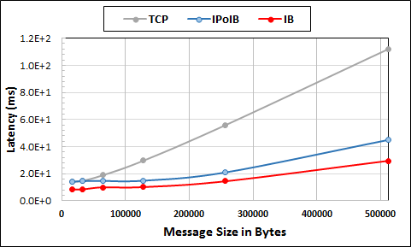
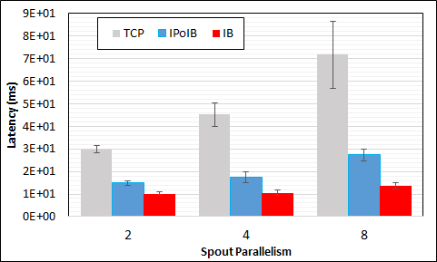
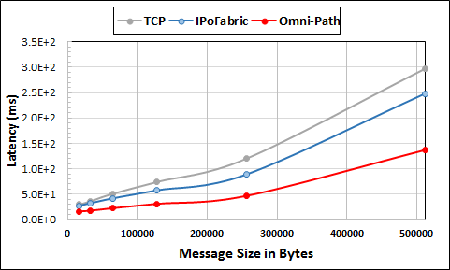
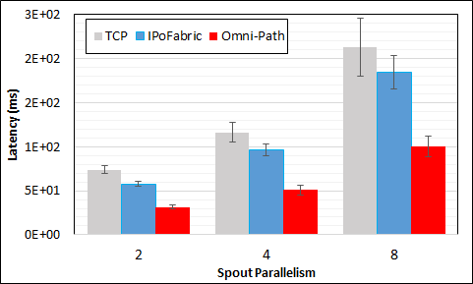
Heron High Performance Interconnects
Infiniband & Intel Omni-Path integrations
Using Libfabric as a library
Natively integrated to Heron through Stream Manager without needing to go through JNI

Slide 31
Summary of HPC Cloud – Next Generation Grid
We suggest an event driven computing model built around Cloud and HPC and spanning batch, streaming, batch and edge applications
Expand current technology of FaaS (Function as a Service) and server-hidden computing
We have integrated HPC into many Apache systems with HPC-ABDS
We have analyzed the different runtimes of Hadoop, Spark, Flink, Storm, Heron, Naiad, DARMA (HPC Asynchronous Many Task)
  There are different technologies for different circumstances but can be unified by high level abstractions such as communication collectives
  Need to be careful about treatment of state – more research needed

