Slide 1
Apache Spark
Vibhatha Abeykoon
Tyler Balson
Gregor von Laszewski
Geoffrey Fox
March 18 2018

Slide 2
A: Introduction to Spark

Slide 3
Introduction
Spark is a fast general purpose clustered computing system
Although much slower than custom parallel computing solutions
Open Source
One feature of Spark is its in-memory cluster computation capability
Uses middleware to allow more data to be stored in RAM
Can run up to 100 times faster than Hadoop MapReduce in memory and 10 times faster on disk
Spark is easy to use based on Hadoop (MapReduce model)
Applications can be written in a Java, Python, R and Scala (naturally we will focus on Python)
Includes over 80 high-level operators that can be interacted with from Java, Python, R and Scala shells
Only works for certain problems but these are dominant
The generality of Spark allows for the combination of available Spark libraries for use in the same application
Included libraries are SQL, MLlib, GraphX and Spark Streaming

Slide 4
Motivation and History of Spark
Created in 2009 at UC Berkley’s AMPLab by Matei Zaharia to address the Hadoop MapReduce cluster computing paradigm. Hadoop had 3 problems:
Uses disk based processing (slow compared to in-memory based)
Applications only written in Java (security concerns)
No stream processing support only batch processing
Original UC Berkeley user group used Spark to monitor and predict Bay Area traffic patterns
In 2010 Spark became open source under the BSD license
2013 Spark turned into an Apache Software project
Currently one of the largest projects of the Apache foundation
2014 Spark 1.0.0 released the largest release to this date and started the 1.x line
2016 Spark 2.0.0 released
Current Spark release 2.2.1 (12/2017)

Slide 5
Key Features
Spark decreases the number of reads and writes to disc which significantly increasing the processing speed
The 80 high-level operators help Spark overcome the limitation of Hadoop MapReduce restriction to java
Possible to develop parallel applications with Scala, Python and R
Other systems could be used in same way with more work from community
In-memory processing reduces disc reads and writes
Data size continues to increase reading and writing TBs and PBs isn’t viable
Storing data in servers’ RAM makes access significantly faster
DAG (directed acyclic graph) execution engine
Fault tolerant
The Spark RDD abstraction handles failures of any worker nodes within the cluster so data loss is negligible
Spark Streaming allows for the processing of real-time data streams
Not as powerful as Apache Storm/Heron/Flink
Single workflow to sophisticated analytics by integrating streaming data, machine learning, map and reduces and queries
Spark is compatible with all other forms of Hadoop data
But Hadoop not aimed at many important applications!
Lazy Evaluation: “Execution will not start until an action is triggered", ex: Data is not loaded before execution
Active community around the globe working with Spark, is very important feature

Slide 6
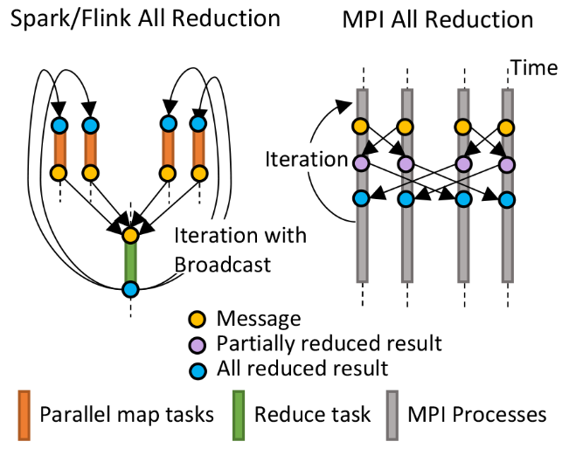
HPC Runtime versus Spark distributed Computing Model on Data Analytics
Hadoop writes to disk and is slowest; Spark and Flink spawn many processes and do not support AllReduce directly; MPI does in-place combined reduce/broadcast and is fastest
Need Polymorphic Reduction capability choosing best implementation
Use HPC architecture with
Mutable model
Immutable data

Slide 7
Resilient Distributed Dataset (RDD)
This is a cacheable database technology
Fundamental data structure of Spark and naturally supports in-memory processing
The state of the memory is stored as an object and the object is shared among jobs
Sharing data as objects in memory is 1-2 orders of magnitude faster than network and Disk sharing
Iterative and interactive processes become more efficient because of efficient data reuse
Iterative examples include PageRank, K-means clusters and logistic regression
An interactive example is interactive datamining where several queries are run on the same dataset
Makes better use of database technologies than previous technologies
Previous frameworks required that data be written to a stable file storage system (distributed file system)
This process creates overhead that could dominate execution times
Data replication
Disk I/O
Serialization
Notes:
https://cs.stanford.edu/~matei/papers/2012/nsdi_spark.pdf

Slide 8
Features of Spark
For completeness we will include in-memory computations, which is a core of Apache Spark
Lazy Evaluation
In Spark lazy evaluation means that results are not computed immediately, instead execution starts when an action is triggered
In Spark evaluation happens when a transformation occurs
Spark maintains a record of the operation
Fault Tolerance
RDDs track data lineage and rebuild data upon failures
RDDs do this by remembering how they were created from other datasets
RDDs are created by transformations (map, join …)
Immutability
Safely share data across processes
Create and retrieve data anytime
Ensures easy caching, sharing and replication
Allows computations to be consistent
Partitioning
Fundamental unit of parallelism within Spark RDD
Each partition is a mutable logical division of data
Partitions are created by performing a transformation of existing partitions
Persistence
Coarse-grained Operations

Slide 9
B: Spark RDD

Slide 10
Supported RDD Operations -- Transformations
Transformations – function to create a new RDD from an existing RDD
Takes an RDD as input and outputs one or more RDDs
Anytime a transformation is performed a new RDD is created
Transformations of RDDs create an RDD lineage of all the parent RDDs (previous and current RDD inputs and transformations)
The RDD lineage may also be referred to as RDD operator graph or an RDD dependency graph
Graph of transformations that need to be executed after an action is called
The RDD lineage creates a "logical execution plan" of all the parent RDDs to the current new RDD
Directed Acyclic Map ==> logical execution plan
The logical execution plan starts with the earliest RDDs with no dependencies to other RDDs and ends with the RDD that generates the result from the execution of the "current" action
In Spark generating the lineage graph is straight forward
Spark.logLineage property can be set to true (defaults to false) this will then provide a RDD lineage graph using RDD.toDebugString after the execution of an action (running a Spark job)
Two types of transformations in Spark
Narrow transformation
Wide transformation

Slide 11
Supported RDD Operations – Transformations
Narrow Transformations
Wide Transformations
Notes:
Figure was inspired by https://data-flair.training/blogs/spark-rdd-operations-transformations-actions/

Slide 12
Supported RDD Operations Transformations examples (later for details)
Many are classic database operations
Map() - map function defined is applied to each element in the RDD
Flatmap() - similar to map, but it can return a multiple new RDDs
Filter() - creates a new RDD after filtering out specifics from original RDD
MapPartitions() - Works on RDD partitions, useful when distributed computation is done.
Union(dataset) - Performs union operation (putting them together in a single RDD) on RDDs
Intersect() - Finds the intersecting elements in RDDs and creating a new RDD
Distinct() - Finds out the distinct elements in RDDs and creating a new RDD
Join() - Performs inner or outer join on a dataset.

Slide 13
Supported RDD Operations Actions
When you need to work with the actual dataset an action must be performed as transformations simply create new RDDs from other RDDs where actions actually produce values
Values are produced by actions by executing the RDD lineage graph
An action in Spark is an RDD operator that will produce a non-RDD value
These values are stored either in drivers or to an external storage system
Actions are what bring "laziness" of RDD to the spot light
Results are only computed when an action is called
Importance of synchronization key
Action are one way of sending data from the Executor to the driver and the other is accumulators

Slide 14
Supported RDD Operations Actions Examples
Count()
Collect()
Take()
Top()
CountByValue()
Reduce()
Fold()
Aggregate()
Foreach()

Slide 15
Transformations vs. Actions
Transformations generate a new modified RDD based off the parent RDD
Actions return values from the computation performed on the RDD

Slide 16
RDD Operations
1. Transformations: define new RDDs based on the current one.
e.g., filter, map, flatMap, reduce, etc.
2. Actions: return values.
e.g., count, sum, collect, etc.
RDD
New RDD
RDD
Value

Slide 17
Transformations: map, flatMap and reduceByKey
map(func) | Return a new distributed dataset formed by passing each element of the source through a function func.
flatMap(func) | Similar to map, but each input item can be mapped to 0 or more output items (so func should return a Seq rather than a single item).
reduceByKey(func, [numTasks]) | When called on a dataset of (K, V) pairs, returns a dataset of (K, V) pairs where the values for each key are aggregated using the given reduce function func, which must be of type (V,V) => V. Like in groupByKey, the number of reduce tasks is configurable through an optional second argument.

Slide 18
Transformations: filter, mapPartitions, and mapPartitionsWithIndex
filter(func) | Return a new dataset formed by selecting those elements of the source on which func returns true.
mapPartitions(func) | Similar to map, but runs separately on each partition (block) of the RDD, so func must be of type Iterator<T> => Iterator<U> when running on an RDD of type T.
mapPartitionsWithIndex(func) | Similar to mapPartitions, but also provides func with an integer value representing the index of the partition, so func must be of type (Int, Iterator<T>) => Iterator<U> when running on an RDD of type T.

Slide 19
Actions: reduce, collect, and count
reduce(func) | Aggregate the elements of the dataset using a function func (which takes two arguments and returns one). The function should be commutative and associative so that it can be computed correctly in parallel.
collect() | Return all the elements of the dataset as an array at the driver program. This is usually useful after a filter or other operation that returns a sufficiently small subset of the data.
count() | Return the number of elements in the dataset.

Slide 20
RDD Persistence
RDD to be persisted using the persist() or cache() methods on it. The first time it is computed in an action, it will be kept in memory on the nodes.
Fault-tolerant – if any partition of an RDD is lost, it will automatically be recomputed using the transformations that originally created it.
Remove RDD, use the RDD.unpersist() method
Storage Level | Meaning
MEMORY_ONLY | Store RDD as deserialized Java objects in the JVM. If the RDD does not fit in memory, some partitions will not be cached and will be recomputed on the fly each time they're needed. This is the default level.
MEMORY_AND_DISK | Store RDD as deserialized Java objects in the JVM. If the RDD does not fit in memory, store the partitions that don't fit on disk, and read them from there when they're needed.

Slide 21
C: Spark Directed Acyclic Graph (DAG) and Libraries

Slide 22
Directed Acyclic Graph (DAG) Execution Engine
DAG is a programming style for distributed systems.
Basically Spark uses vertices and edges to represent RDDs and operation to be applied on RDD respectively.
DAG is modelled in Spark using a DAG scheduler which further splits the graph into stages of the tasks.
DAG scheduler splits up the original task into smaller subtasks and use transformations in RDD to perform sub task operations.
In Spark the DAG can have any number of stages
This prevents having to split a single job up into several jobs if more than two stages are required
Allows simple jobs to complete after one stage
In MapReduce DAG has two predefined stages
Map
Reduce
https://databricks.com/blog/2015/06/22/understanding-your-spark-application-through-visualization.html
Directed Acyclic Graph (DAG)
Edges have direction, represented by the arrows
Links of DAG are transformations, actions, maps
Nodes of graph are result or RDD instances
3
1
2
4
5
7
6
Notes:
https://github.com/apache/spark/blob/master/core/src/main/scala/org/apache/spark/scheduler/DAGScheduler.scala

Slide 23
DAG In Action
For DAG to work, it uses Scala layer (Java, Python are other interpreters) as the first interpreter to get the information on the task that has to be performed.
Once a job or a set of tasks is submitted to Spark, it creates an Operator Graph.
In process, at the time an Action is called on Spark RDD, spark submits a task to the DAG scheduler with the information on what to do when to do.
DAG Scheduler has stages being defined depending on the operation submitted to it. A certain stage data partitioning can take place and in a certain stage data gathering can take place after a computation in being performed on separate partitions.
The small stages are passed to Task Scheduler and task scheduler manages all the sub tasks generated for a particular job.
A cluster manager is the tool which launch the tasks and Task schedulers submit those requests on the cluster manager.
Cluster manager will submit these tasks to different machines or workers.
Each of the workers are executing these tasks. (Master-worker parallel computing paradigm)
Notes:
https://github.com/apache/spark/blob/master/core/src/main/scala/org/apache/spark/scheduler/DAGScheduler.scala

Slide 24
DAG In Action
Image From : https://d2h0cx97tjks2p.cloudfront.net/blogs/wp-content/uploads/internals-of-job-execution-in-apache-spark.jpg

Slide 25
Spark Libraries
GraphX
Processing graphs
MLlib
Machine learning (ML) Algorithms
Spark Streaming
Process live data streams
Spark SQL
Process SQL and unstructured data
SparkR
Integrates usability of R with scalability of Spark
Spark Stack
GraphX
(graph)
MLlib
(ML)
Spark
Stream
Spark
SQL
Apache Spark

Slide 26
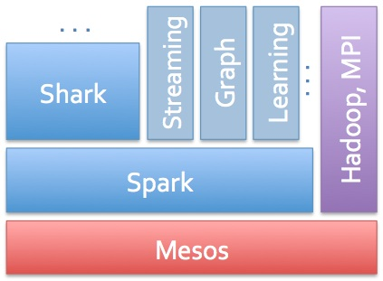
Shark
Spark SQL was originally called as Shark. "Shark was a component of Spark, an open source, distributed and fault-tolerant, in-memory analytics system, that can be installed on the same cluster as Hadoop. In particular, Shark was fully compatible with Hive and supports HiveQL, Hive data formats, and user-defined functions. In addition Shark can be used to query data4 in HDFS, HBase, and Amazon S3.".
Hadoop SQL is Hive
Spark SQL was Shark
SQL database on top of MapReduce
Spark Stack (2012)
Image Source : http://s.radar.oreilly.com/files/2012/11/spark-stack.jpg

Slide 27
MLlib
MLlib is another library developed on top of Spark for Machine Learning based computations on distributed systems.
The library is being supported with Java, Scala, Python and R.
Spark has significant performance over MapReduce concept as they have modified the MapReduce concept in Spark.
ML Library has most of the day to day used libraries in the machine learning community.

Slide 28
MLlib : Algorithms
Classification
Logistic regression
Naïve Bayes
Regression
Linear regression
Survival regression
Decision Trees
Random Forest
Gradient Boosted Trees
Recommendation
Alternating Least Squares
Clustering
K-Means
GMM
Topic Modeling
Latent Dirichlet Allocation
Feature Transformation
Normalization
Hashing
Decomposition
PCA
SVD

Slide 29
D: Machine Learning in Spark and other Approaches

Slide 30
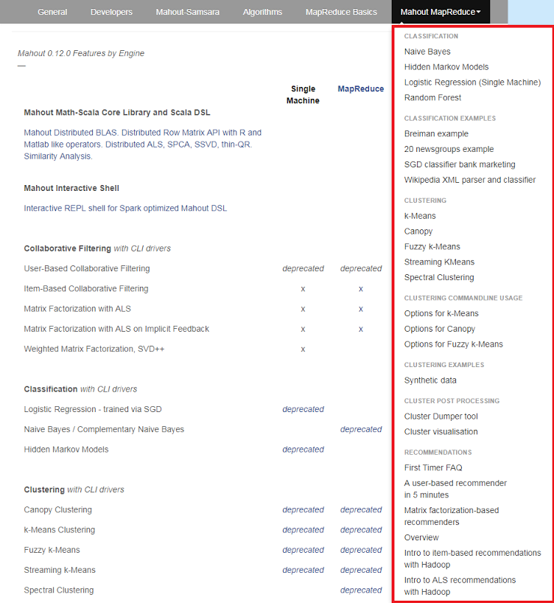
Mahout and SPIDAL
Mahout was Hadoop machine learning library but largely abandoned as Spark outperformed Hadoop
SPIDAL outperforms Spark Mllib and Flink due to better communication and in-place dataflow.
Has Harp-(DAAL) optimized machine learning interface
SPIDAL also has community algorithms
Biomolecular Simulation
Graphs for Network Science
Image processing for pathology and polar science

Slide 31
Qiu/Fox Core SPIDAL Parallel HPC Library with Collective Used
DA-MDS Rotate, AllReduce, Broadcast
Directed Force Dimension Reduction AllGather, Allreduce
Irregular DAVS Clustering Partial Rotate, AllReduce, Broadcast
DA Semimetric Clustering (Deterministic Annealing) Rotate, AllReduce, Broadcast
K-means AllReduce, Broadcast, AllGather DAAL
SVM AllReduce, AllGather
SubGraph Mining AllGather, AllReduce
Latent Dirichlet Allocation Rotate, AllReduce
Matrix Factorization (SGD) Rotate DAAL
Recommender System (ALS) Rotate DAAL
Singular Value Decomposition (SVD) AllGather DAAL
QR Decomposition (QR) Reduce, Broadcast DAAL
Neural Network AllReduce DAAL
Covariance AllReduce DAAL
Low Order Moments Reduce DAAL
Naive Bayes Reduce DAAL
Linear Regression Reduce DAAL
Ridge Regression Reduce DAAL
Multi-class Logistic Regression Regroup, Rotate, AllGather
Random Forest AllReduce
Principal Component Analysis (PCA) AllReduce DAAL
DAAL implies integrated on node with Intel DAAL Optimized Data Analytics Library (Runs on KNL!)

Slide 32
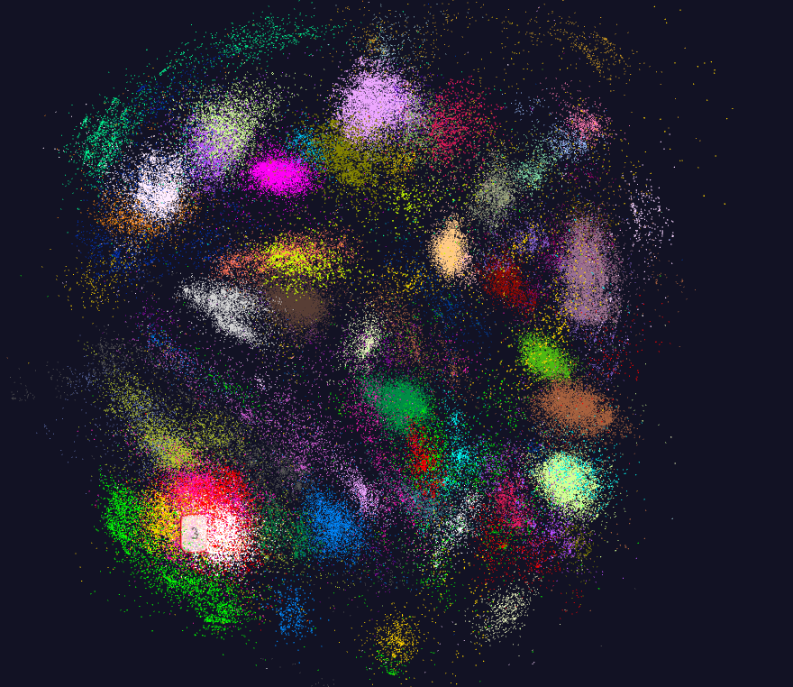
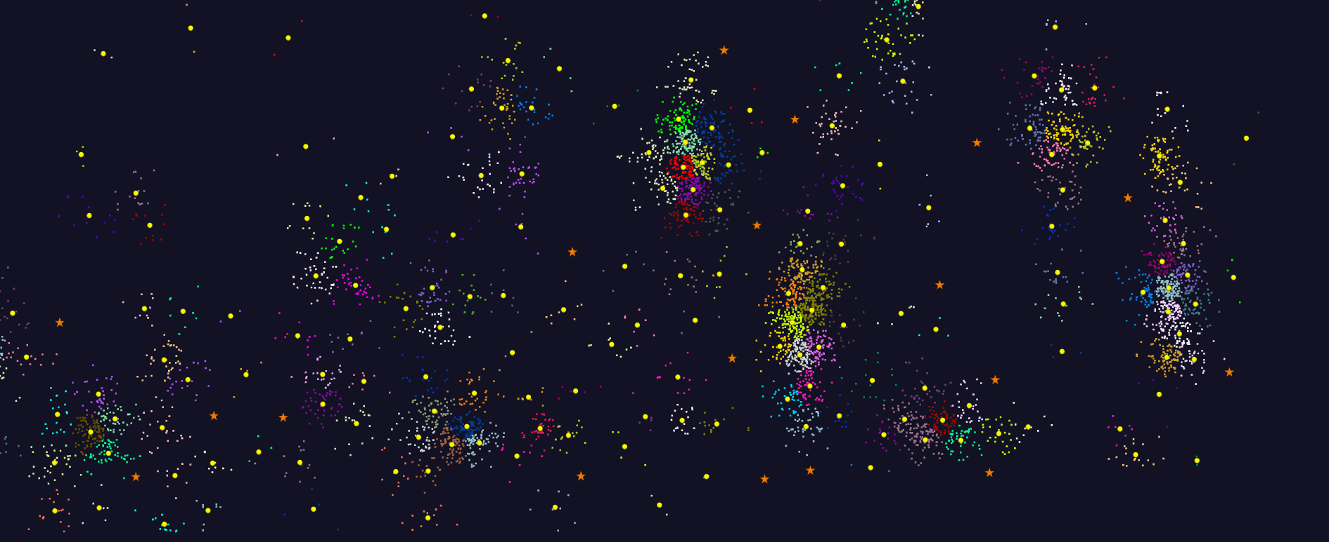
K-means Clustering
Sets of points in some abstract space with a distance defined
Group together nearby points

Slide 33
K-means in Detail
Basic K-means is;
Choose a number of centers N
Randomly or thoughtfully assign cluster numbers to points Iterate
Assign each point to cluster that is nearest to it (or use initial choice)
Calculate center of each cluster as mean of assigned points
Calculate change from previous iteration – stop if small enough
Lots of variants
e.g. a vector space and “just a distance” version

Slide 34
KMeans Example Using Spark

Slide 35
Dataflow at Different Grain sizes
Coarse Grain Dataflows links jobs in such a pipeline
Visualization
Dimension
Reduction
Data preparation
Clustering
But internally to each job you can also elegantly express algorithm as dataflow but with more stringent performance constraints
Corresponding to classic Spark K-means Dataflow
P = loadPoints()
C = loadInitCenters()
for (int i = 0; i < 10; i++) {
T = P.map().withBroadcast(C)
C = T.reduce() }
Internal Execution Dataflow Nodes
Reduce
Iterate
HPC Communication
Maps
Iterate

Slide 36
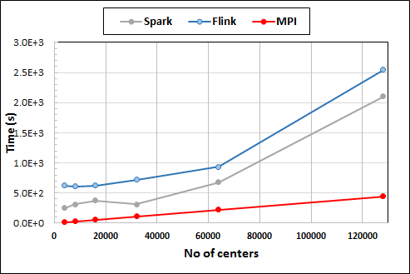
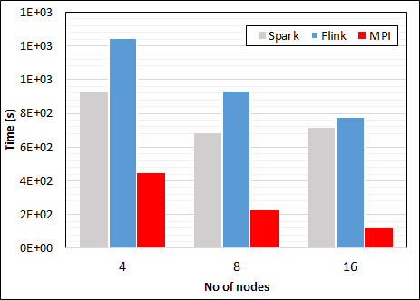
K-Means Clustering in Spark, Flink, MPI
K-Means execution time on 8 nodes with 20 processes in each node with 1 million points and varying number of centroids. Each point has 2 attributes.
K-Means execution time on varying number of nodes with 20 processes in each node with 1 million points and 64000 centroids. Each point has 2 attributes.
K-Means performed well on all three platforms when the computation time is high and communication time is low as illustrated in 10 million points. After lowering the computation and increasing the communication by setting the points to 1 million, the performance gap between MPI and the other two platforms increased.
Notes:
Note the differences in communication architectures
Note times are in log scale
Bars indicate compute only times, which is similar across these frameworks
Overhead is dominated by communications in Flink and Spark

Slide 37
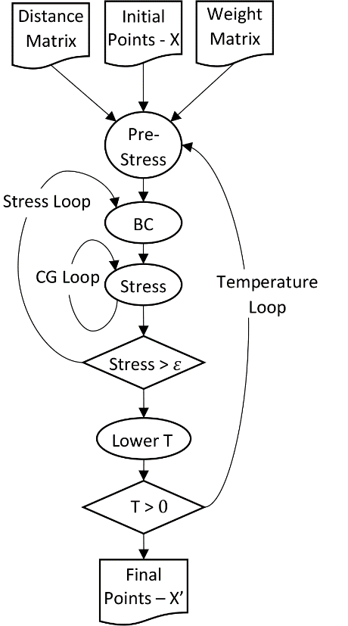
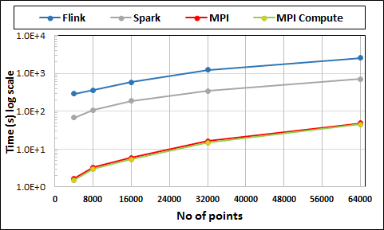
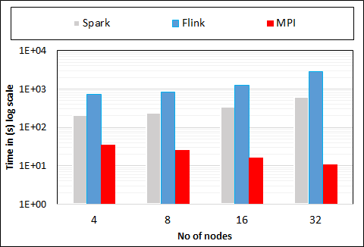
Multidimensional Scaling: 3 Nested Parallel Sections
Flink
Spark
MPI
MPI Factor of 20-200 Faster than Spark/Flink
MDS execution time on 16 nodes with 20 processes in each node with varying number of points
MDS execution time with 32000 points on varying number of nodes. Each node runs 20 parallel tasks

Slide 38
Data Access and Deployment of Spark Cluster
Spark can run in a variety of environments including in the cloud while having the ability to access multiple data sources
HDFS
Cassandra
Hbase
S3
Any Hadoop data source
Running Environments
Apache Mesos
Hadoop YARN
Standalone cluster mode (simplest)
Amazon EC2, Azure, HPC Cluster etc.

Slide 39
Limitations
Spark needs to be integrated with a cloud-based platform like HDFS as it does not have a file management system
The memory consumption Is very high
The in-memory capability may be a bottleneck for economical processing of big data (memory is expensive)
Large amount of data are required for efficiency
MLlib has insufficient number of available algorithms
Spark Streaming limited

Slide 40
Difficulty in Parallelism Size of Synchronization constraints
Loosely Coupled
HPC Clouds/Supercomputers
Memory access also critical
HPC Clouds
High Performance Interconnect
MapReduce as in scalable databases
Disk I/O
Unstructured Adaptive Sparsity
Medium size Jobs
Global Machine Learning
e.g. parallel clustering
Deep Learning
Pleasingly Parallel
Often independent events
LDA
Graph Analytics e.g. subgraph mining
Linear Algebra at core (typically not sparse)
Large scale simulations
Current major Big Data category
Structured Adaptive Sparsity
Huge Jobs
Commodity Clouds
Spectrum of Applications and Algorithms
Exascale Supercomputers
Spark/Hadoop

Slide 41
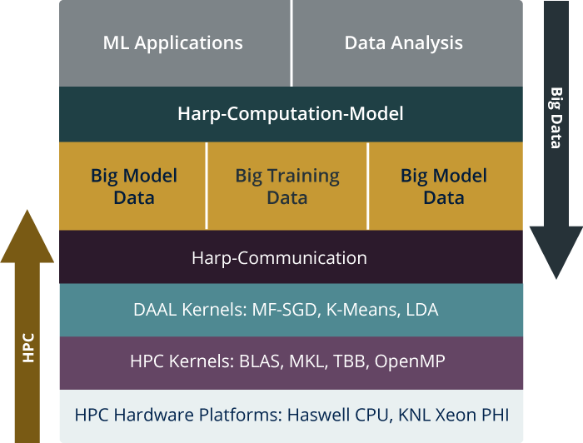
HPC-ABDS is Cloud-HPC interoperable software with the performance of HPC (High Performance Computing) and the rich functionality of the commodity Apache Big Data Stack. This concept is illustrated by Harp-DAAL.
Big Model Parameters
Big Model Parameters
High Level Usability: Python Interface, well documented and packaged modules
Middle Level Data-Centric Abstractions: Computation Model and optimized communication patterns
Low Level optimized for Performance: HPC kernels Intel® DAAL and advanced hardware platforms such as Xeon and Xeon Phi
Harp-DAAL

Slide 42
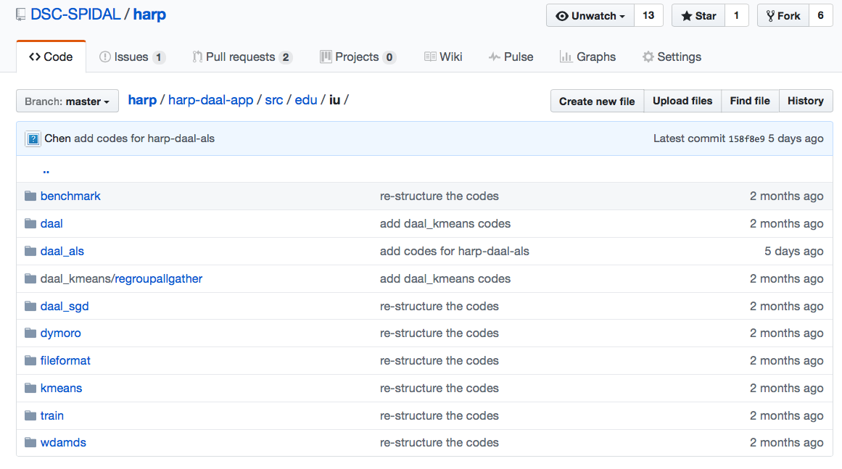
Harp-DAAL: Prototype and Production Code
Available at https://dsc-spidal.github.io/harp
Source codes became available on Github in February, 2017.
Harp-DAAL follows the same standard of DAAL’s original codes
Twelve Applications
Harp-DAAL Kmeans
Harp-DAAL MF-SGD
Harp-DAAL MF-ALS
Harp-DAAL SVD
Harp-DAAL PCA
Harp-DAAL Neural Networks
Harp-DAAL Naïve Bayes
Harp-DAAL Linear Regression
Harp-DAAL Ridge Regression
Harp-DAAL QR Decomposition
Harp-DAAL Low Order Moments
Harp-DAAL Covariance

Slide 43
Harp v. Spark Harp v. Torch Harp v. MPI
Datasets: 5 million points, 10 thousand centroids, 10 feature dimensions
10 to 20 nodes of Intel KNL7250 processors
Harp-DAAL has 15x speedups over Spark MLlib
Datasets: 500K or 1 million data points of feature dimension 300
Running on single KNL 7250 (Harp-DAAL) vs. single K80 GPU (PyTorch)
Harp-DAAL achieves 3x to 6x speedups
Datasets: Twitter with 44 million vertices, 2 billion edges, subgraph templates of 10 to 12 vertices
25 nodes of Intel Xeon E5 2670
Harp-DAAL has 2x to 5x speedups over state-of-the-art MPI-Fascia solution

Slide 44
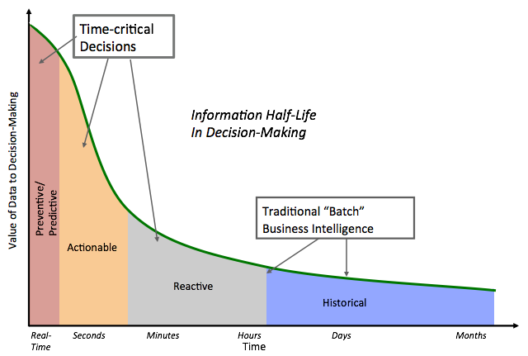
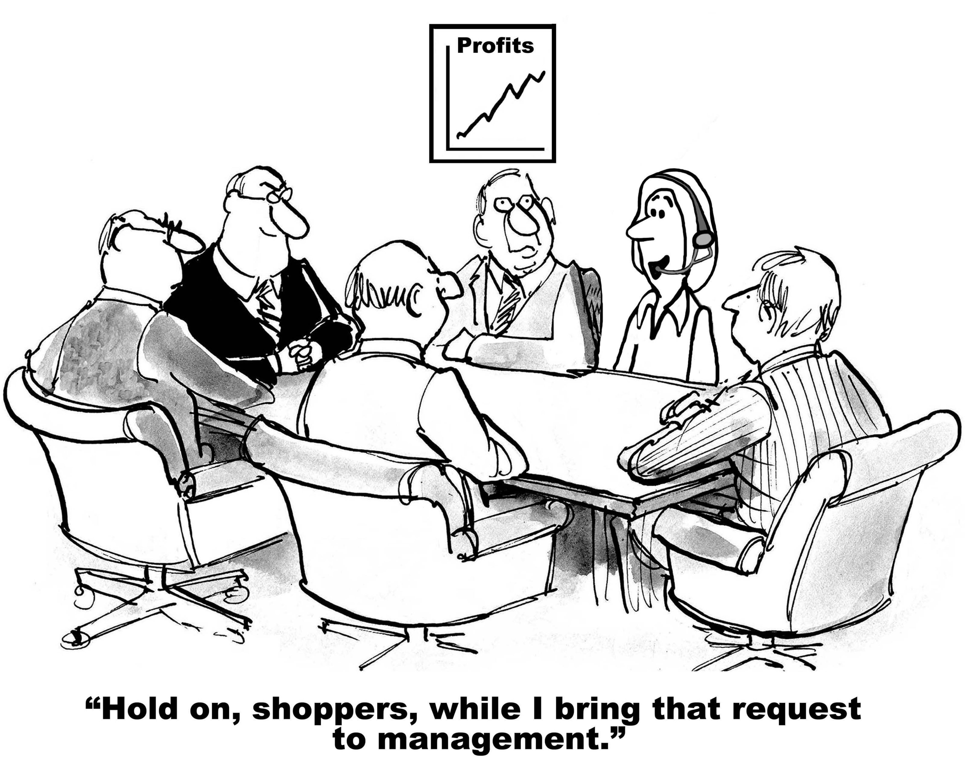
Value of Data
[1] Courtesy Michael Franklin, BIRTE, 2015.

Slide 45
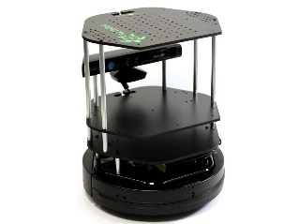
Data Pipeline for Apache Heron or Storm
Sending to
pub-sub
Sending to
Persisting
storage
Multiple
streaming
workflows
Streaming
workflow
A stream application with some tasks running in parallel
Gateway
Message Brokers
RabbitMQ, Kafka
Streaming Workflows
End to end delays without any processing is less than 10ms
Apache Heron and Storm queue Data and pass to permanently running “bolts” aka “maps”
Spark Streaming gathers a mini-batch set of events and executes a batch job
Indiana university version Hosted on HPC and OpenStack cloud

Slide 46
Apache Spark with Docker (1)
Pull Image from Docker Repository
We use a Docker image from Docker Hub: (https://hub.docker.com/r/sequenceiq/spark/)This repository contains a Docker file to build a Docker image with Apache Spark and Hadoop Yarn.
Running the Image
Running interactively
Running in the background
Run Spark
After a container is launched, we can run Spark in the following two modes: 1) yarn-client and 2) yarn-cluster. The differences between the two modes can be found here: https://spark.apache.org/docs/latest/running-on-yarn.html

Slide 47
Apache Spark with Docker (2)
Spark running modes:
Run Spark in Yarn-Client Mode
Run Spark in Yarn-Cluster Mode
Observe Task Execution from Running Logs of Spark Pi
We can observe the difference of Spark task execution by adjusting the parameter of SparkPi and the Pi result by tuning arguments.
Launch Spark Interactive Shell: Scala shell
Launch PySpark Interactive Shell: Python shell
In the lab, we will learn detailed steps of using coding Spark applications with Docker.

