Slide 1
Cloud Management in Cloudmesh & Twister2: A High-Performance Big Data Programming Environment
13th Cloud Control Workshop, June 13-15, 2018
Skåvsjöholm in the Stockholm Archipelago
Geoffrey Fox, Gregor von Laszewski, Judy Qiu June 13, 2018
Department of Intelligent Systems Engineering, Indiana University
gcf@indiana.edu, http://www.dsc.soic.indiana.edu/, http://spidal.org/
`,
Work with Supun Kamburugamuva, Shantenu Jha, Kannan Govindarajan, Pulasthi Wickramasinghe, Gurhan Gunduz, Ahmet Uyar

Slide 2
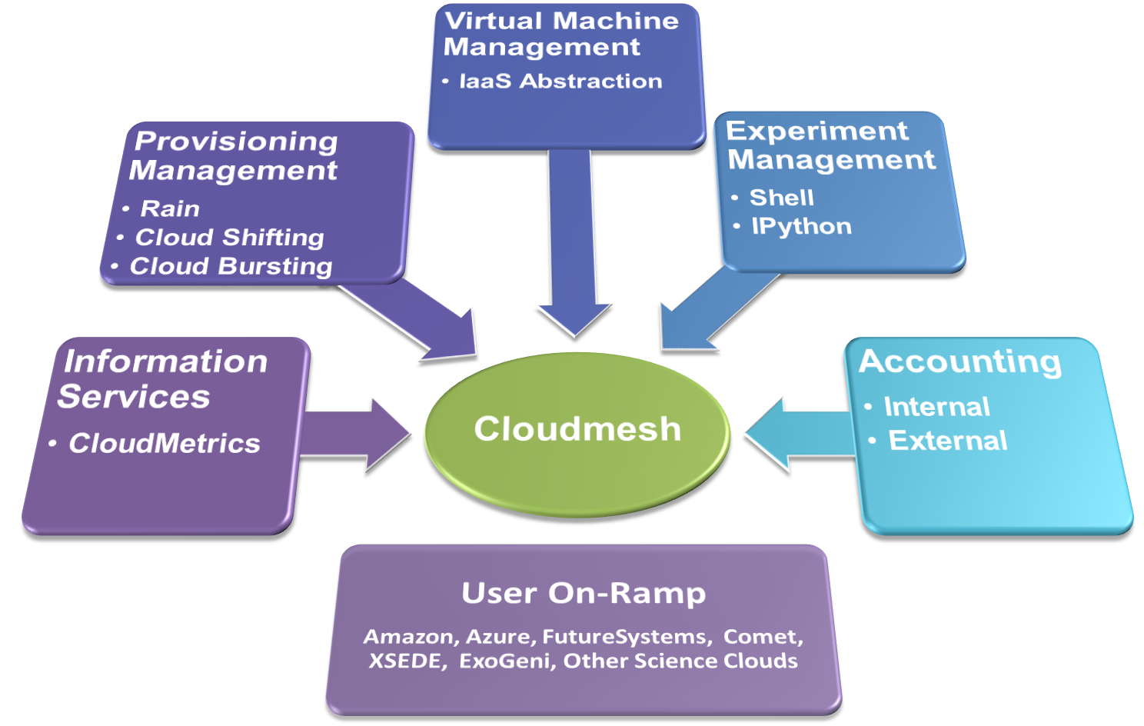
Management Requirements: Cloudmesh
Dynamic Bare-metal deployment
DevOps
Cross-platform workflow management of tasks
Cross-platform templated VM management
Cross platform experiment management
Supports NIST Big Data Reference Architecture
Big Data Programming Requirements: Harp, Twister2
Spans data management to complex parallel machine learning e.g. graphs
Scalable HPC quality parallel performance
Compatible with Heron, Hadoop and Spark in many cases
Deployable on Docker, Kubernetes and Mesos
Cloudmesh, Harp, Twister2 are tools built on other tools

Slide 3
Cloudmesh Capabilities
Cloudmesh Management
Infrastructure
Manage which infrastructure services are running on which resources
Hybrid Infrastructure
Abstract the IaaS framework with templated(software-defined) image management so we can say
cloud = “IU-cloud” // cloud = “aws”
myvm = start vm
login myvm
Platform Management
Provide one line commands to deploy templated platforms
deploy hadoop --hosts myvms
Experiment management
Simple collection of data for an “experiment” = job
Simple execution of repetitive tasks for benchmarking
Cloudmesh
https://github.com/cloudmesh/client
Orginated from FutureGrid project which needed to support multiple different infrastructures
Use to offer virtual clusters on XSEDE Comet
As University resources decline, moving away from OpenStack to bare metal Docker (we have taught all cloud classes at IU last 8 years)
Cloudmesh Deployment
Dynamic infrastructure deployment
of clouds such as OpenStack and HPC batch system on the same compute resources via bare metal provisioning
Dynamic deployment of platforms
based on user specific deployments for the duration of the application execution

Slide 4
Cloudmesh Layered Architecture View
Allows adding Components
Integrates Abstractions to make adding easier
Exposes functionality through client and portal
Uses REST services
Allows Jupyter invocation
https://github.com/cloudmesh/client

Slide 5
Cloudmesh Abstractions v3.0 What Abstract Services do We Need?
Services
Just a subset to address them most common and immediate needs we found across applications (NIST)

Slide 6
Tools used by Cloudmesh
Provisioning Tools to provide bare-metal or hypervisor-based systems:
Cobbler, Foreman, Razor, RackHD, XCAT, Juju
DevOps - Deploy & manage services & software stacks based on Devel./Users needs.
Supports bare metal and virtualized environments: Ansible, Puppet, Chef, Saltstack
Virtual Machines - emulation of a computer system
LibCloud plus Azure, AWS (Boto), OpenStack, EC2, Google,
Containers operating system virtualization running in resource-isolated processes
Docker, Swarm, Kubernetes
Orchestration - manage the interconnections and interactions among workloads
Heat, Saltstack, Azure Automation, IBM Cloud Orchestrator, , TOSCA
Service Specification – Design REST services with portable API documentation
OpenAPI (Swagger), RAML, BluePrint API, NIST BDRA
We are building/using Cloudmesh capabilities to launch Big Data technologies such as Mesos, SLURM, Hadoop, Spark, Heron, Twister2
We are using tools in red

Slide 7
Cloudmesh supports NIST Big Data Architecture
Cloudmesh for NIST
NIST NIST Big Data Reference Architecture publication Volume 8 : Reference Architecture Interface https://bigdatawg.nist.gov/_uploadfiles/M0641_v1_7213461555.docx
Build Cloudmesh services for each of NIST BDRA interfaces
Must be vendor neutral
Uses XSEDE Comet at SDSC bringing
HPC
Virtualization
Containers via Virtual Cluster VC
Microservices via VC

Slide 8
Big Data and Simulation Difficulty in Parallelism Size of Synchronization constraints
Loosely Coupled
Tightly Coupled
HPC Clouds: Accelerators
High Performance Interconnect
HPC Clouds/Supercomputers
Memory access also critical
Commodity Clouds
Size of Disk I/O
MapReduce as in scalable databases
Global Machine Learning
e.g. parallel clustering
Deep Learning
Graph Analytics e.g. subgraph mining
LDA
Pleasingly Parallel
Often independent events
Unstructured Adaptive Sparse
Current major Big Data category
Linear Algebra at core (often not sparse)
Structured Adaptive Sparse
Parameter sweep simulations
Largest scale simulations
Just two problem characteristics
There is also data/compute distribution seen in grid/edge computing
Exascale Supercomputers

Slide 9
Integrating HPC and Apache Programming Environments
Harp-DAAL with a kernel Machine Learning library exploiting the Intel node library DAAL and HPC style communication collectives within the Hadoop ecosystem. The broad applicability of Harp-DAAL is supporting many classes of data-intensive computation, from pleasingly parallel to machine learning and simulations.
Twister2 is a toolkit of components that can be packaged in different ways
Integrated batch or streaming data capabilities familiar from Apache Hadoop, Spark, Heron and Flink but with high performance.
Separate bulk synchronous and data flow communication;
Task management as in Mesos, Yarn and Kubernetes
Dataflow graph execution models
Launching of the Harp-DAAL library
Streaming and repository data access interfaces,
In-memory databases and fault tolerance at dataflow nodes. (use RDD to do classic checkpoint-restart)

Slide 10
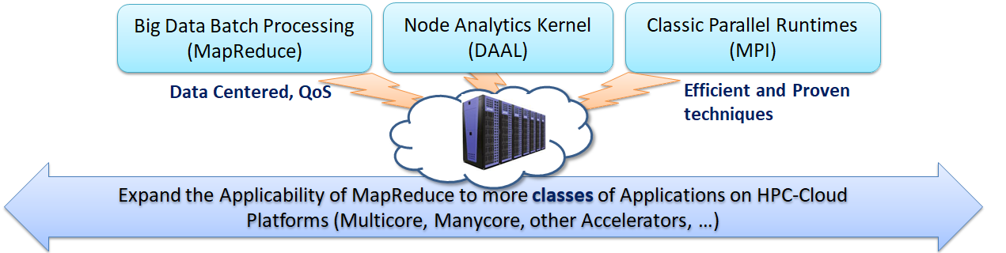
Harp-DAAL: A HPC-Cloud convergence framework for productivity and performance
Harp is an Hadoop plug-in offering highly optimized Map collective operations plus support of computation models covering much machine learning
Harp-DAAL seamlessly integrates Intel’s DAAL node Data Analytics Library
DAAL: SubGraph Mining, K-means, Matrix Factorization, Recommender System (ALS), Singular Value Decomposition (SVD), QR Decomposition, Neural Network, Covariance, Low Order Moments, Naive Bayes Reduce, Linear Regression, Ridge Regression, Principal Component Analysis (PCA)
No DAAL yet: DA-MDS Multi-dimensional Scaling (DA is Deterministic Annealing), Directed Force Dimension, Irregular DAVS Clustering, DA Semimetric Clustering, Multi-class Logistic Regression, SVM, Latent Dirichlet Allocation, Random Forest

Slide 11
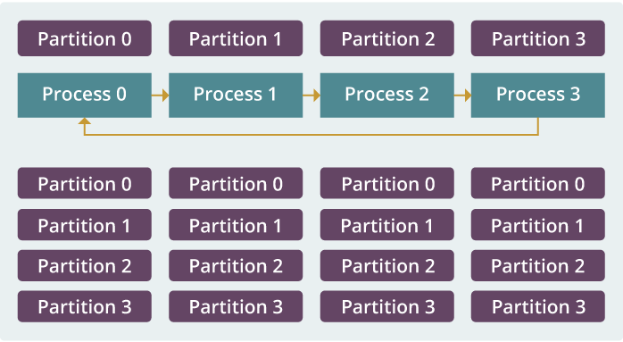
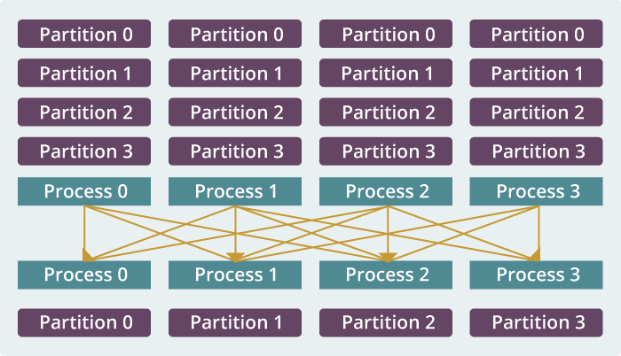
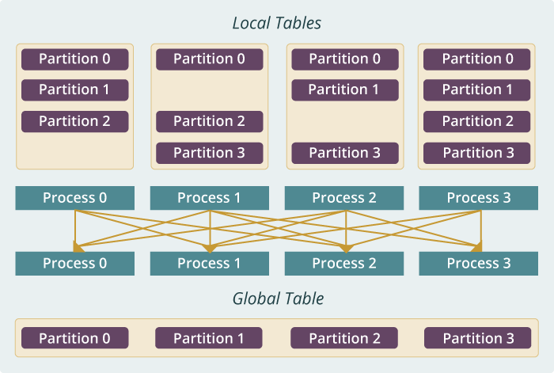
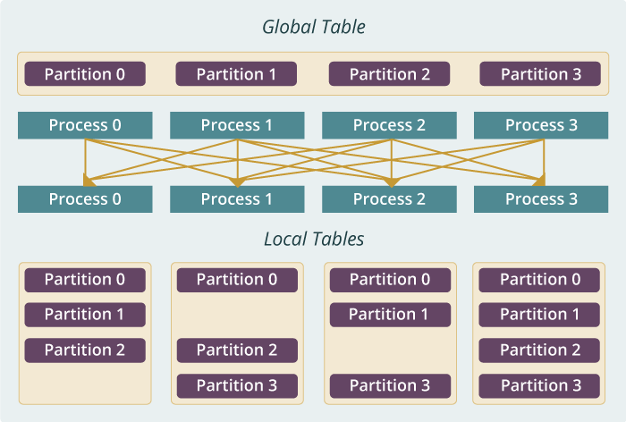
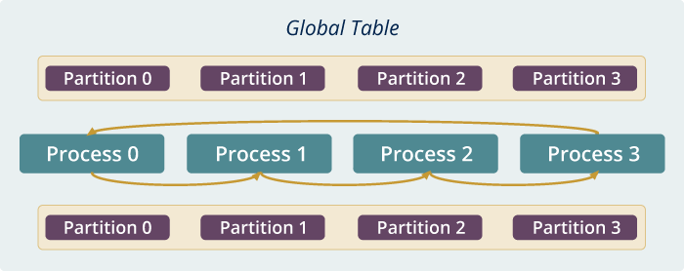
Run time software for Harp
broadcast
reduce
allreduce
allgather
regroup
push & pull
rotate
Map Collective Run time merges MapReduce and HPC

Slide 12
Harp v. Spark Harp v. Torch Harp v. MPI
Datasets: 5 million points, 10 thousand centroids, 10 feature dimensions
10 to 20 nodes of Intel KNL7250 processors
Harp-DAAL has 15x speedups over Spark MLlib
Datasets: 500K or 1 million data points of feature dimension 300
Running on single KNL 7250 (Harp-DAAL) vs. single K80 GPU (PyTorch)
Harp-DAAL achieves 3x to 6x speedups
Datasets: Twitter with 44 million vertices, 2 billion edges, subgraph templates of 10 to 12 vertices
25 nodes of Intel Xeon E5 2670
Harp-DAAL has 2x to 5x speedups over state-of-the-art MPI-Fascia solution

Slide 13
Twister2: “Next Generation Grid - Edge – HPC Cloud” Programming Environment
Analyze the runtime of existing systems
Hadoop, Spark, Flink, Pregel Big Data Processing
OpenWhisk and commercial FaaS
Storm, Heron, Apex Streaming Dataflow
Kepler, Pegasus, NiFi workflow systems
Harp Map-Collective, MPI and HPC AMT asynchronous many task runtime like DARMA
And approaches such as GridFTP and CORBA/HLA (!) for wide area data links
Most systems are monolithic and make choices that are sometimes non-optimal
Build a toolkit with components that can have multiple implementations such as
Static or dynamic scheduling
Dataflow or BSP communication
http://www.iterativemapreduce.org/

Slide 14
Twister2 Components I
Area | Component | Implementation | Comments: User API
Architecture Specification | Coordination Points | State and Configuration Management; Program, Data and Message Level | Change execution mode; save and reset state
 | Execution Semantics | Mapping of Resources to Bolts/Maps in Containers, Processes, Threads | Different systems make different choices - why?
 | Parallel Computing | Spark Flink Hadoop Pregel MPI modes | Owner Computes Rule
Job Submission | (Dynamic/Static) Resource Allocation | Plugins for Slurm, Yarn, Mesos, Marathon, Aurora | Client API (e.g. Python) for Job Management
Task System | Task migration | Monitoring of tasks and migrating tasks for better resource utilization | Task-based programming with Dynamic or Static Graph API; FaaS API; Support accelerators (CUDA,KNL)
 | Elasticity | OpenWhisk
 | Streaming and FaaS Events | Heron, OpenWhisk, Kafka/RabbitMQ
 | Task Execution | Process, Threads, Queues
 | Task Scheduling | Dynamic Scheduling, Static Scheduling, Pluggable Scheduling Algorithms
 | Task Graph | Static Graph, Dynamic Graph Generation

Slide 15
Twister2 Components II
Area | Component | Implementation | Comments
Communication API | Messages | Heron | This is user level and could map to multiple communication systems
 | Dataflow Communication | Fine-Grain Twister2 Dataflow communications: MPI,TCP and RMA Coarse grain Dataflow from NiFi, Kepler? | Streaming, ETL data pipelines; Define new Dataflow communication API and library
 | BSP Communication Map-Collective | Conventional MPI, Harp | MPI Point to Point and Collective API
Data Access | Static (Batch) Data | File Systems, NoSQL, SQL | Data API
 | Streaming Data | Message Brokers, Spouts
Data Management | Distributed Data Set | Relaxed Distributed Shared Memory(immutable data), Mutable Distributed Data | Data Transformation API; Spark RDD, Heron Streamlet
Fault Tolerance | Check Pointing | Upstream (streaming) backup; Lightweight; Coordination Points; Spark/Flink, MPI and Heron models | Streaming and batch cases distinct; Crosses all components
Security | Storage, Messaging, execution | Research needed | Crosses all Components

Slide 16
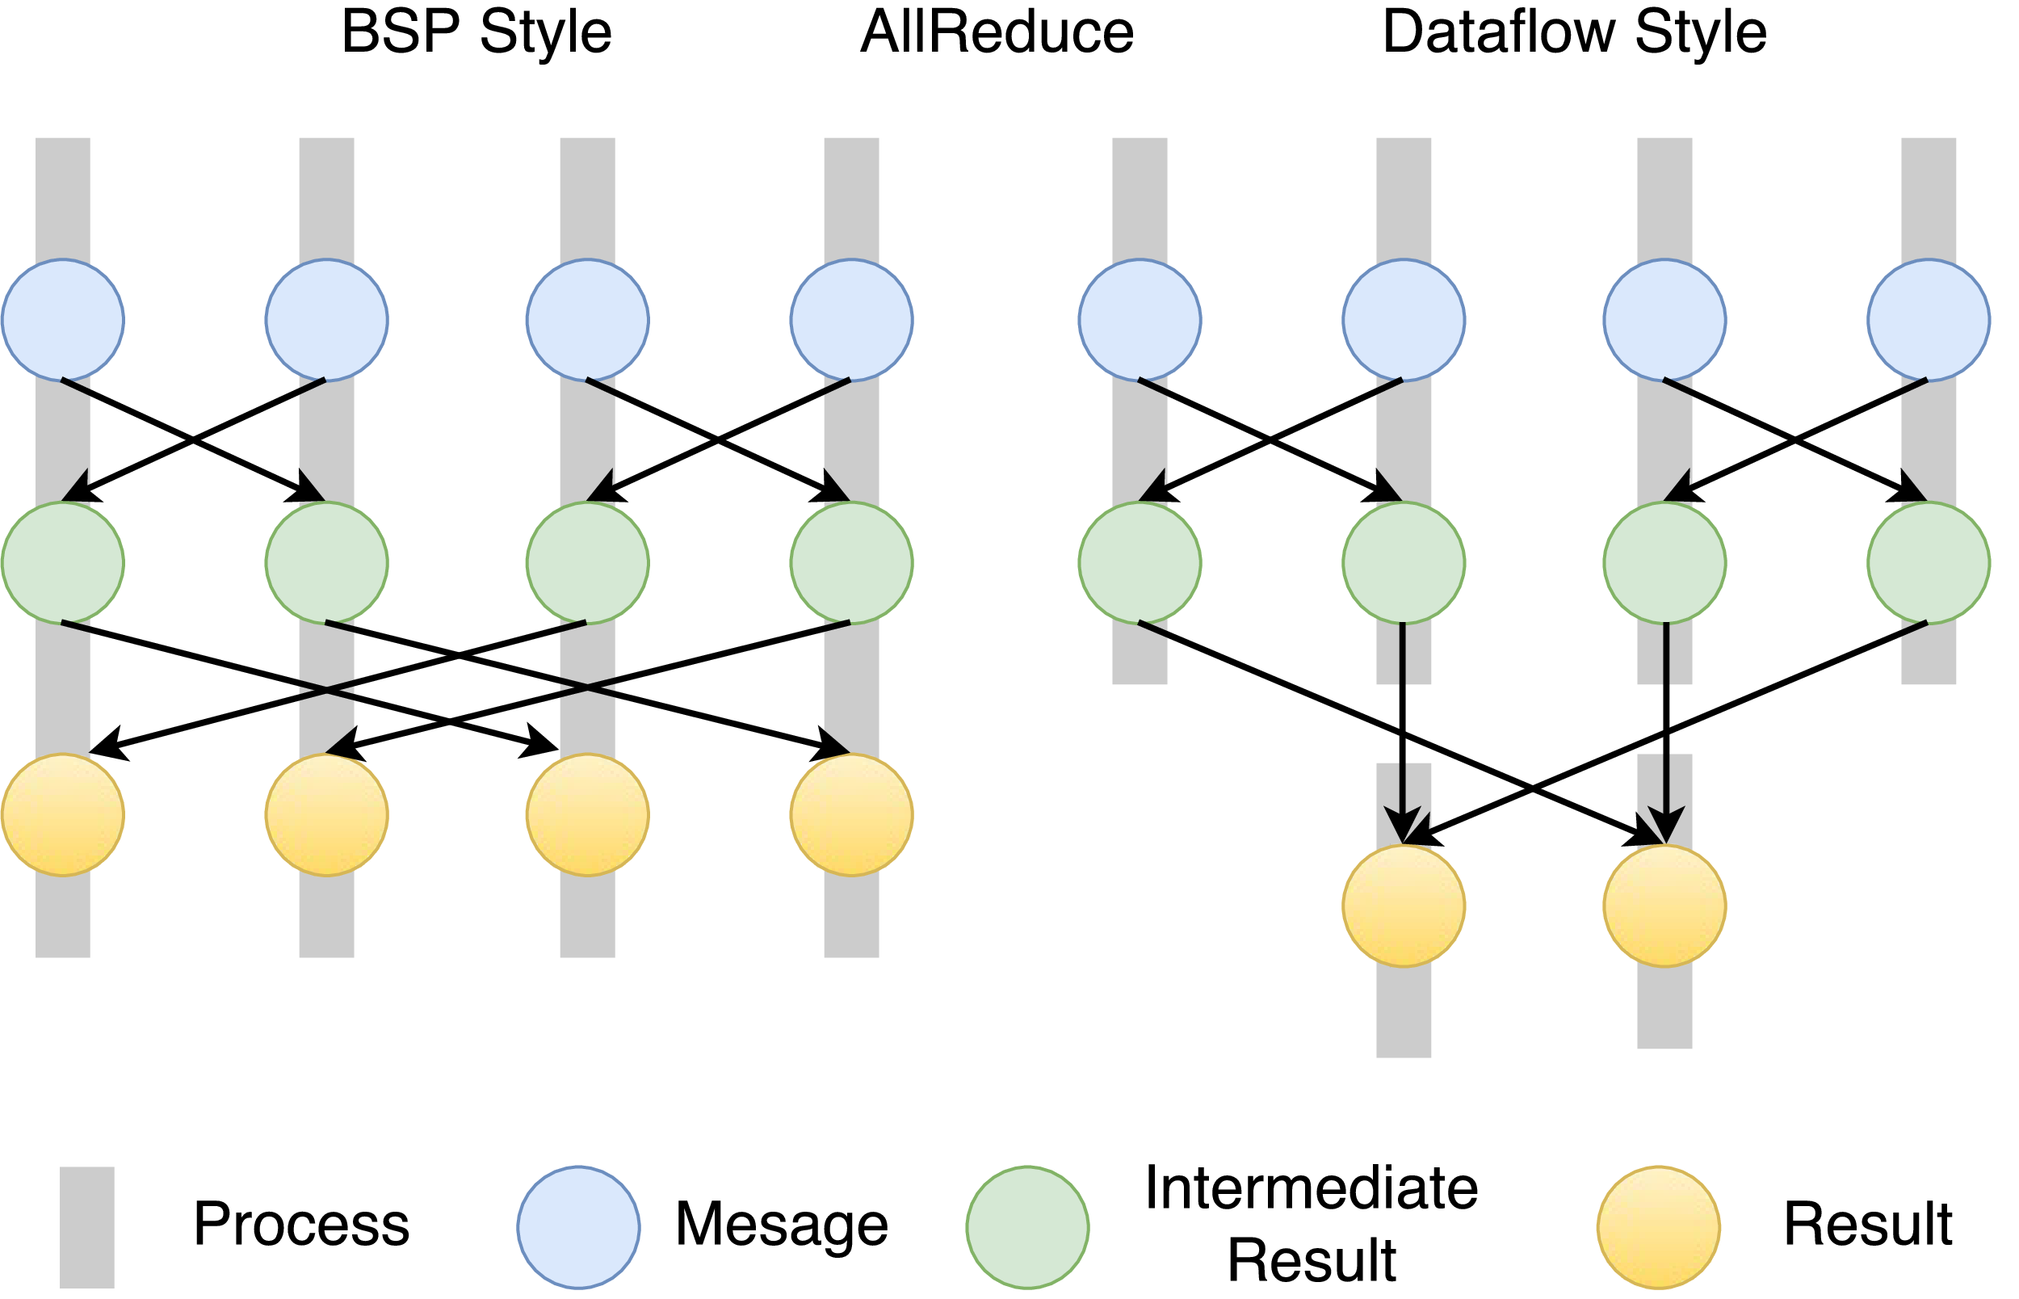
Twister2 Dataflow Communications
Twister:Net offers two communication models
BSP (Bulk Synchronous Processing) message-level communication using TCP or MPI separated from its task management plus extra Harp collectives
DFW a new Dataflow library built using MPI software but at data movement not message level
Non-blocking
Dynamic data sizes
Streaming model
Batch case is modeled as a finite stream
The communications are between a set of tasks in an arbitrary task graph
Key based communications
Data-level Communications spilling to disks
Target tasks can be different from source tasks

Slide 17
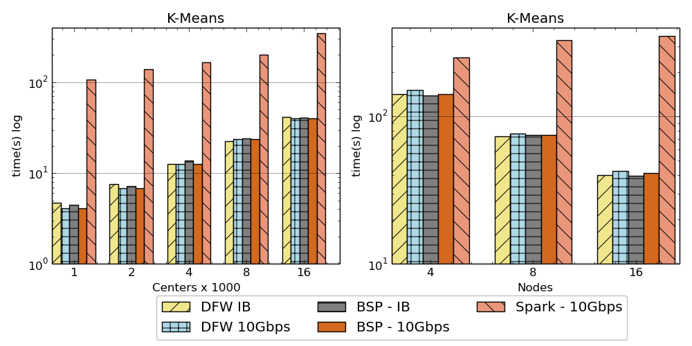
Twister:Net and Apache Heron and Spark
Left: K-means job execution time on 16 nodes with varying centers, 2 million points with 320-way parallelism. Right: K-Means wth 4,8 and 16 nodes where each node having 20 tasks. 2 million points with 16000 centers used.
Latency of Apache Heron and Twister:Net DFW (Dataflow) for Reduce, Broadcast and Partition operations in 16 nodes with 256-way parallelism

Slide 18
Twister2 Timeline: End of August 2018
Twister:Net Dataflow Communication API
Dataflow communications with MPI or TCP
Harp for Machine Learning (Custom BSP Communications)
Rich collectives
Around 30 ML algorithms
HDFS Integration
Task Graph
Streaming - Storm model
Batch analytics - Hadoop
Deployments on Docker, Kubernetes, Mesos (Aurora), Nomad, Slurm

Slide 19
Twister2 Timeline: End of December 2018
Native MPI integration to Mesos, Yarn
Naiad model based Task system for Machine Learning
Link to Pilot Jobs
Fault tolerance
Streaming
Batch
Hierarchical dataflows with Streaming, Machine Learning and Batch integrated seamlessly
Data abstractions for streaming and batch (Streamlets, RDD)
Workflow graphs (Kepler, Spark) with linkage defined by Data Abstractions (RDD)
End to end applications

Slide 20
Twister2 Timeline: After December 2018
Dynamic task migrations
RDMA and other communication enhancements
Integrate parts of Twister2 components as big data systems enhancements (i.e. run current Big Data software invoking Twister2 components)
Heron (easiest), Spark, Flink, Hadoop (like Harp today)
Support different APIs (i.e. run Twister2 looking like current Big Data Software)
Hadoop
Spark (Flink)
Storm
Refinements like Marathon with Mesos etc.
Function as a Service and Serverless
Support higher level abstractions
Twister:SQL

Slide 21
Summary of Cloudmesh Harp Twister2
Cloudmesh provides a client to manipulate “software defined” infrastructures, platforms and services.
We have built a high performance data analysis library SPIDAL supported by an Hadoop plug-in Harp with computation models
We have integrated HPC into many Apache systems with HPC-ABDS with rich set of communication collectives as in Harp
We have done a preliminary analysis of the different runtimes of Hadoop, Spark, Flink, Storm, Heron, Naiad, DARMA (HPC Asynchronous Many Task) and identified key components
There are different technologies for different circumstances but can be unified by high level abstractions such as communication/data/task/workflow API’s
Apache systems use dataflow communication which is natural for distributed systems but slower for classic parallel computing. We suggest Twister:Net
No standard dataflow library (why?). Add Dataflow primitives in MPI-4?
HPC could adopt some of tools of Big Data as in Coordination Points (dataflow nodes), State management (fault tolerance) with RDD (datasets)
Could integrate dataflow and workflow in a cleaner fashion

