Slide 1
XSEDE TAS
Scientific Impact Framework
Gregor von Laszewski
Fugang Wang
Steve Gallo
Tom Furlani

Slide 2
Requirements
Program manager
How can we measure the impact of projects, field of study and other categories?
Review Committee
How can we prioritize requests for resources?
User
How can I provide supporting information to those providing XSEDE resources and get resources for free?

Slide 3
Problem
XSEDE provides large scale resources to users to advance science.
What is the impact of providing such facilities like XSEDE?
How is the impact of scientific research of individual user, project, or field of study, and what if being related to the granted allocation in XD?
What is the criteria to judge whether the proposal is potentially leading to good research and broader impact, and how to get metrics to back up this?
Notes:
The three problems mentioned here: XD impact in general (how to justify the funding XD received?); individual impact within XD (how to compare individuals based on XD relevant impact); general achievement/reputation for prospective XD PIs/users

Slide 4
Background and Related Efforts
Measure a project’s impact in general
nanohub’s citation statistics - https://nanohub.org/citations
A ‘citation’ is a published work that cites/refers nanohub site or its related content
Secondary citation is the citation of the above defined ‘citation’
Statistical distributions of the ‘citation’ related data based on different criteria (author’s organization; topic area – research, education, and so on; continent; cited/referred tools/content; cited year; publication type)
Overall secondary citation and h-index computed
Measure an individual’s scientific achievement/impact
Faculty recruit/promotion: for the research perspective – number of publications; metrics like h-index, g-index; data based on recent pubs
USCIS immigration – First Preference EB-1: number of publications; citations; citation geographical distribution; articles reviewed; etc.
Notes:
What metrics are being used by others to measure researchers; funded projects, etc.

Slide 5
Approach
Using the publication and citation data to derive measurement for scientific output impact.
Publication and/or citation data are available via subscribed resources (such as ISI Web of Knowledge) or open access like Google Scholar, Microsoft Academic Search, however they usually don't provide unlimited access.
Another approach is to gather the data from users directly.
We will also need users’ input to identify if a publication is XD related (via the XD portal biblio module)
Notes:
Publication and citation data for each individual XD user are the raw data to be sued to derive various metrics.
Automated way vs user provided data. The former is to evaluate the researchers’ impact in general; the latter to get XD related publications, and then to get XD related impact metrics.

Slide 6
Data Aquisition
Publication data:
Automatic approach:
Mining the NSF award search data provided by NSF;
Utilizing services from Google Scholar, Microsoft Academic Search, etc.;
Meshup data from different sources;
Requiring user input
XD portal provides a means for users to upload their publication data. However currently the data gathered are very limited.
Users provide their public profile id in a 3rd party online biblio management system like Google Scholar, and we then do the automatic retrieval;
Citation data:
Should not be provided by users. Google Scholar is now being utilized and others such as ISI are on the list to explore.
Notes:
Automatic approach – to get the ‘in general’ metrics indicating individual researcher’s achievement.
User provided data – a) via XD portal, XD related publications to compute XD related metrics. The data is very limited since the biblio upload is an optional but not required, and users typically don’t feel motivated to do that. While getting more such data, the XD related metrics would be increasing significantly.
User provided data – b) Based on Google scholar profile id to retrieve the publication list has been done in the proof of concept work. So if the users are providing such information via the XD portal or via POPS as part of the allocation request process, we can try this approach to automatically get user vetted publications list.
Citation data via Google Scholar seems working fine, although quite slowly. In the future this process might be kept running to find citation for new publications; or updating the old data if all completed.

Slide 7
Metrics
Intuitive Metrics: # of publications, # of citations
H-index
Derived based on productivity (quantity of papers published) and impact (based on citation)
h as the number of papers with citation number higher or equal to h
G-index
Similar to h-index but it uses average citations so you got rewarded if you have a paper with very high citations
i10-index (number of publications with at least 10 citations)
Does a researcher keep up with the good research he/she usually does more recently – Metrics from only recent publications

Slide 8
Metrics
Intuitive Metrics: Number of publications, Number of citations
H-index (see also next slide)
Derived based on productivity (quantity of papers published) and impact (based on citation)
h as the number of papers with citation number higher or equal to h
G-index (see also next slide)
Similar to h-index but it uses average citations so you got rewarded if you have a paper with very high citations
Proposed by Leo Egghe on 2006
http://link.springer.com/article/10.1007%2Fs11192-006-0144-7
Other Metrics – i10-index (number of publications with at least 10 citations)
Does a researcher keep up with the good research he/she usually does more recently – Metrics from only recent publications
Notes:
The metrics currently defined; and the ‘recent’ versions for all of them.

Slide 9
Metrics h-index
H-index
.
A scientist has index h if h of his/her N papers have at least h citations each, and the other (N−h) papers have no more than h citations each
Proposed by J. E. Hirsch on 2005
http://www.pnas.org/content/102/46/16569
H-index(m) to compare veteran researchers with junior researchers
Ref: http://en.wikipedia.org/wiki/H-index
Notes:
Picture helps to understand what H-index and G-index stand for

Slide 10
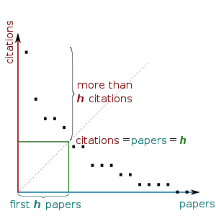
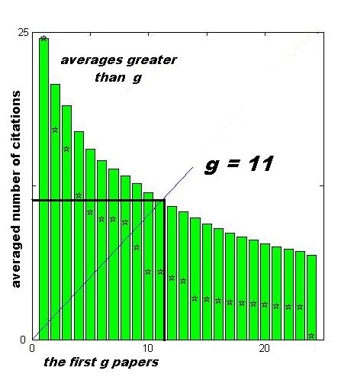
Metrics Cont’d
H-index: A scientist has index h if h of his/her Np papers have at least h citations each, and the other (Np − h) papers have no more than h citations each.
G-index: Given a set of articles ranked in decreasing order of the number of citations that they received, the g-index is the (unique) largest number such that the top g articles received (together) at least g2 citations.
Ref: http://en.wikipedia.org/wiki/G-index
Ref: http://en.wikipedia.org/wiki/H-index
Notes:
Picture helps to understand what H-index and G-index stand for

Slide 11
Metrics Cont’d
H-index: A scientist has index h if h of his/her Np papers have at least h citations each, and the other (Np − h) papers have no more than h citations each.
G-index: Given a set of articles ranked in decreasing order of the number of citations that they received, the g-index is the (unique) largest number such that the top g articles received (together) at least g2 citations.
Ref: http://en.wikipedia.org/wiki/G-index
Ref: http://en.wikipedia.org/wiki/H-index
Notes:
Picture helps to understand what H-index and G-index stand for

Slide 12
Design
Pluggable data sources via mining databases and/or accessing 3rd party service APIs
Mashup database providing common interface to collaborating systems like XDMOD
Service layer and web presentation
Notes:
The 3 highlighted points of the architecture view.
Currently the framework is implemented like this, while we haven’t tried all the items mentioned in the 3rd party layer yet.

Slide 13
Implementation
The core system code base is in python.
MySQL is the main database solution used but mongodb is a possible alternative.
Python library MySQLdb, SQLAlchemy, psycopg2 are used to interact with the various data sources.
Python library requests and BeautifulSoup are used in scraping citation data and properly parsing them.
Uses flask framework for the service interface and Web GUI (an early service prototype used cherrypy).
Various JavaScript libraries such as highcharts are utilized in the web tier.
Notes:
A bit more details on the implementation.

Slide 14
Progress and Status
Mined NSF award search data and retrieved publications for all XD users (Done)
Fetching publication data from XDcDB (Done)
A mashup database containing the consolidated data (Done)
Fetching citation data for all publications via Google Scholar (in progress)
Defined and calculated metrics (# of pubs; # of citations; h-index; and g-index) for a portion of users as a proof of concept
General – Completed for all PIs who had active usage in 2012
XD Related – Based on all currently available user uploaded publications (~500)
Data is now presented via the python flask service framework we have been prototyping and is planned to be integrated within XDMOD framework
http://fuwang.uits.indiana.edu:8080/tas/
http://fuwang.uits.indiana.edu:8080/xdportalpub/
Notes:
Clarify the two major achievement/goals: the ‘General’, based on the mashup data including automatically retrieved data from NSF award search and the user uploaded ones via XD portal; the ‘XD Related’ are based only on the user uploaded publications, and google shoclar citations data for those publications.
The ‘XD Related’ data are more like a snapshot since the current available data are most likely very incompleted.

Slide 15
Access: Rest Services – Db – Web Interface

Slide 16
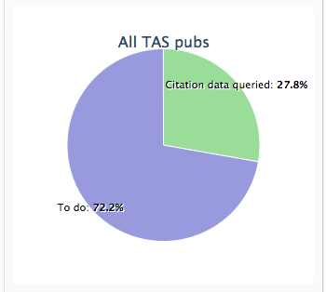
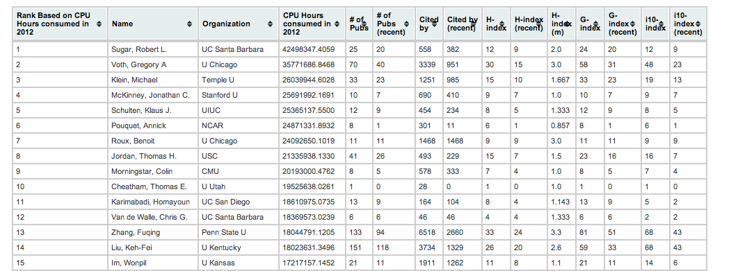
Status – in general
NOTE THE DATA PRESENTED HERE IS STILL INCOMPLETE AND MUST NOT BE USED WITHOUT UNDERSTANDING THE LIMITATIONS OF THE DATA
Citation data & metrics available for all XD Pis
1469 active in 2012 (based on XD resource usage)
This accounts for 27.8% of all publications collected, or ~34k out of ~122k
In progress to obtain the citation data for the rest of publications.
Data Source Disclaimer:
The NSF award search data through October 2012
The citation data were obtained from Google Scholar.
The user information were obtained from XDcDB.
The usage data were obtained from XDMOD
Notes:
This picture and data will be updated to the latest in the final version for NSF review since now the citation retrieval is still in progress. (Updated for XD 13)
Publication data are based on all the data we have – the mashup data including the NSF data and the XD portal data.
Since the major portion of the data are from NSF award search, an in that source most authors have incomplete author names (last name, first initial e.g.) so the metrics could appear higher than it should be for some users with common names.
Citation data are from google scholar.

Slide 17
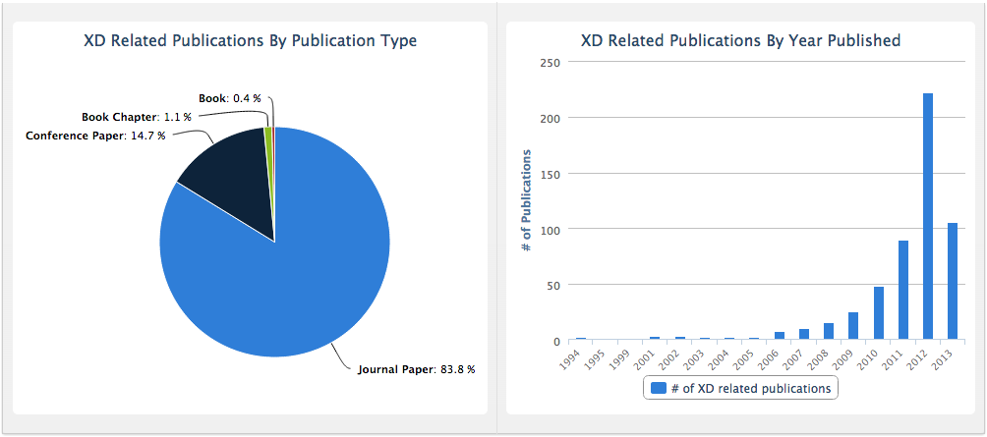
Status – XD related only
NOTE THE DATA PRESENTED HERE IS STILL INCOMPLETE AND MUST NOT BE USED WITHOUT UNDERSTANDING THE LIMITATIONS OF THE DATA
XD users: 627
Organizations: 180
XSEDE projects: 222
Number of publications: 536
Total citations received from these publications: 4946
(As of July 16, 2013)
Notes:
Based on all user uploaded publications. Citations are from Google Scholar.
There are some more publications uploaded since we obtained these data. We will sync the latest data before the review and update the statistics and metrics as well. (Done for XD 13)
How to motivate more users to upload their publications, and also uploa

Slide 18
Future Plans
Completing the citation data fetching from Google Scholar
Other databases: ISI, Microsoft research, ….
Formal study
Streamlined process to update the data continuously
Mining NSF award db for new XD users
Adding newly uploaded publications from XD portal db
Updating metrics for those impacted entities
Metrics in other levels like Field of Study (fos)
The impact metrics correlating with the input/cost (e.g. CPU Hours consumed in XD allocations; Supporting grant fund)
Investigating other sources for citation data
Estimating number of citations based on JIF if available (?)
Accurate publications list (Author info incomplete or ambiguous)
Collaborating with the XD portal to 1> Let the users verify and confirm the publications; 2> Identify XD related publications and association
Make latest data available to be integrated into XDMOD framework

Slide 19
Lessons learned
This effort impacts and interaction between the following efforts is recommended:
POPS 2.0 (review process)
TAS (integration into portal framework)
XSEDE portal (bibliography gathering)
ORCID
many different systems
users should register one or more of them
Resumes are quite an accurate set of data
can resumes be uploaded and be automatically mined?
limited funding
unique XSEDE personID how does it relate to other stuff

