Slide 1
FutureGrid
TeraGrid Science Advisory Board
San Diego CA
July 19 2010
Geoffrey Fox
gcf@indiana.edu
http://www.infomall.org http://www.futuregrid.org
Director, Digital Science Center, Pervasive Technology Institute
Associate Dean for Research and Graduate Studies, School of Informatics and Computing
Indiana University Bloomington

Slide 2
FutureGrid Concepts
Support development of new applications and new middleware using Cloud, Grid and Parallel computing (Nimbus, Eucalyptus, Hadoop, Globus, Unicore, MPI, OpenMP. Linux, Windows …) looking at functionality, interoperability, performance
Enable replicable experiments in computer science of grid and cloud computing
Open source software built around Moab/xCAT to support dynamic provisioning from Cloud to HPC environment, Linux to Windows ….. with monitoring, benchmarks and support of important existing middleware
June 2010 Initial users; September 2010 All hardware (except IU “shared memory system”) accepted and significant use starts; October 2011 FutureGrid allocatable via TeraGrid process

Slide 3
FutureGrid Partners
Indiana University (Architecture, core software, Support)
  Collaboration between research and infrastructure groups
Purdue University (HTC Hardware)
San Diego Supercomputer Center at University of California San Diego (INCA, Monitoring)
University of Chicago/Argonne National Labs (Nimbus)
University of Florida (ViNE, Education and Outreach)
University of Southern California Information Sciences (Pegasus to manage experiments)
University of Tennessee Knoxville (Benchmarking)
University of Texas at Austin/Texas Advanced Computing Center (Portal)
University of Virginia (OGF, Advisory Board and allocation)
Center for Information Services and GWT-TUD from Technische Universtität Dresden. (VAMPIR)
Red institutions have FutureGrid hardware

Slide 4
FutureGrid Hardware
Secondary
Default local
System type
# CPUs
# Cores
TFLOPS
RAM (GB)
s
torage (TB)
file system
Site
Dynamically configurable systems
IBM iDataPlex
256
1024
11
3072
335*
Lustre
IU
Dell PowerEdge
192
1152
12
1152
15
NFS
TACC
IBM iDataPlex
168
672
7
2016
120
GPFS
UC
IBM iDataPlex
168
672
7
2688
72
Lustre/PVFS
UC
SD
Subtotal
784
3520
37
8928
542
Systems not dynamically configurable
Cray XT5m
168
672
6
1344
335*
Lustre
IU
Shared memory system TBD
40**
480**
4**
640**
335*
Lustre
IU
GPU Cluster TBD
Cell BE Cluster
4
IBM iDataPlex
64
256
2
768
5
NFS
UF
High
Throughput Cluster
192
384
4
192
PU
Subtotal
552
2080
21
3328
10
Total
1336
5600
58
10560
552
FutureGrid has dedicated network (except to TACC) and a network fault and delay generator
Can isolate experiments on request; IU runs Network for NLR/Internet2
(Many) additional partner machines will run FutureGrid software and be supported (but allocated in specialized ways)
(*) IU machines share same storage; (**) Shared memory and GPU Cluster in year 2

Slide 5
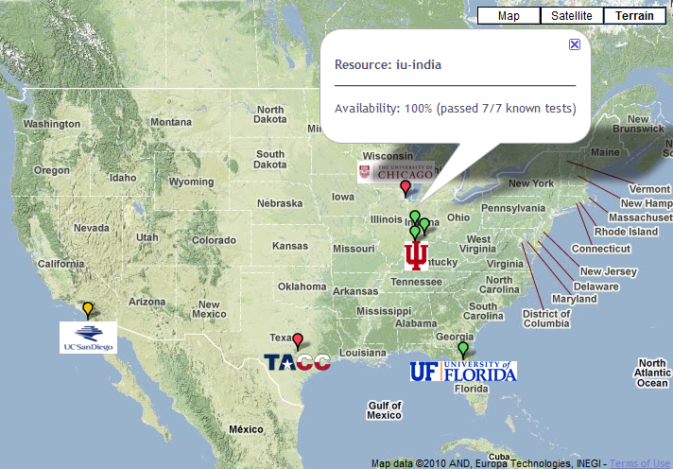

FutureGrid: a Grid/Cloud Testbed
IU Cray operational, IU IBM (iDataPlex) completed stability test May 6
UCSD IBM operational, UF IBM stability test completed June 12
Network, NID and PU HTC system operational
UC IBM stability test completed June 7; TACC Dell running acceptance tests
NID: Network Impairment Device
Private
Public
FG Network

Slide 6
Storage and Interconnect Hardware
System Type | Capacity (TB) | File System | Site | Status
DDN 9550 (Data Capacitor) | 339 | Lustre | IU | Existing System
DDN 6620 | 120 | GPFS | UC | New System
SunFire x4170 | 72 | Lustre/PVFS | SDSC | New System
Dell MD3000 | 30 | NFS | TACC | New System
Machine | Name | Internal Network
IU Cray | xray | Cray 2D Torus SeaStar
IU iDataPlex | india | DDR IB, QLogic switch with Mellanox ConnectX adapters Blade Network Technologies & Force10 Ethernet switches
SDSC iDataPlex | sierra | DDR IB, Cisco switch with Mellanox ConnectX adapters Juniper Ethernet switches
UC iDataPlex | hotel | DDR IB, QLogic switch with Mellanox ConnectX adapters Blade Network Technologies & Juniper switches
UF iDataPlex | foxtrot | Gigabit Ethernet only (Blade Network Technologies; Force10 switches)
TACC Dell | tango | QDR IB, Mellanox switches and adapters Dell Ethernet switches
Names from International Civil Aviation Organization (ICAO) alphabet

Slide 7
Network Impairment Device
Spirent XGEM Network Impairments Simulator for jitter, errors, delay, etc
Full Bidirectional 10G w/64 byte packets
up to 15 seconds introduced delay (in 16ns increments)
0-100% introduced packet loss in .0001% increments
Packet manipulation in first 2000 bytes
up to 16k frame size
TCL for scripting, HTML for manual configuration
Need exciting proposals to use!!

Slide 8
FutureGrid Usage Model
The goal of FutureGrid is to support the research on the future of distributed, grid, and cloud computing.
FutureGrid will build a robustly managed simulation environment and test-bed to support the development and early use in science of new technologies at all levels of the software stack: from networking to middleware to scientific applications.
The environment will mimic TeraGrid and/or general parallel and distributed systems – FutureGrid is part of TeraGrid and one of two experimental TeraGrid systems (other is GPU)
  It will also mimic commercial clouds (initially IaaS not PaaS)
FutureGrid is a (small ~5000 core) Science/Computer Science Cloud but it is more accurately a virtual machine or bare-metal based simulation environment
This test-bed will succeed if it enables major advances in science and engineering through collaborative development of science applications and related software.

Slide 9
Some Current FutureGrid usages
Investigate metascheduling approaches on Cray and iDataPlex
Deploy Genesis II and Unicore end points on Cray and iDataPlex clusters
Develop new Nimbus cloud capabilities
Prototype applications (BLAST) across multiple FutureGrid clusters and Grid’5000
Compare Amazon, Azure with FutureGrid hardware running Linux, Linux on Xen or Windows
Test ScaleMP software shared memory for genome assembly
Develop Genetic algorithms on Hadoop for optimization
Attach power monitoring equipment to iDataPlex nodes to study power use versus use characteristics
Industry (Columbus IN) running CFD codes to study combustion strategies to maximize energy efficiency
Support evaluation needed by XD TIS and TAS services
Investigate performance of Kepler workflow engine
Study scalability of SAGA in difference latency scenarios
Test and evaluate new algorithms for phylogenetics/systematics research in CIPRES portal
Investigate performance overheads of clouds in parallel and distributed environments
Support tutorials and classes in cloud, grid and parallel computing
~12 active/finished users out of ~32 early user applicants

Slide 10
Education on FutureGrid
Build up tutorials on supported software
Support development of curricula requiring privileges and systems destruction capabilities that are hard to grant on conventional TeraGrid
Offer suite of appliances supporting online laboratories
Will support 200 students in NCSA Virtual Summer School on “Big Data” July 26-30 with set of certified images – first offering of FutureGrid 101 Class; Teragrid ‘10 “Cloud technologies, data-intensive science and the TG”; CloudCom conference tutorials Nov 3-Dec 3
Experimental class use fall semester at Indiana and Florida

Slide 11
FutureGrid Software Architecture
Flexible Architecture allows one to configure resources based on images
Managed images allows to create similar experiment environments
Experiment management allows reproducible activities
Through our modular design we allow different clouds and images to be “rained” upon hardware.
Note will eventually be supported at “TeraGrid Production Quality”
Will support deployment of “important” middleware including TeraGrid stack, Condor, BOINC, gLite, Unicore, Genesis II, MapReduce, Bigtable …..
  Will accumulate more supported software as system used!
Will support links to external clouds, GPU clusters etc.
  Grid5000 initial highlight with OGF29 Hadoop deployment over Grid5000 and FutureGrid
  Interested in more external system collaborators!

Slide 12
Software Components
Portals including “Support” “use FutureGrid” “Outreach”
Monitoring – INCA, Power (GreenIT)
Experiment Manager: specify/workflow
Image Generation and Repository
Intercloud Networking ViNE
Performance library
Rain or Runtime Adaptable InsertioN Service: Schedule and Deploy images
Security (including use of isolated network), Authentication, Authorization,

Slide 13
Dynamic provisioning Examples
Give me a virtual cluster with 30 nodes based on Xen
Give me 15 KVM nodes each in Chicago and Texas linked to Azure and Grid5000
Give me a Eucalyptus environment with 10 nodes
Give 32 MPI nodes running on first Linux and then Windows
Give me a Hadoop environment with 160 nodes
Give me a 1000 BLAST instances linked to Grid5000
Run my application on Hadoop, Dryad, Amazon and Azure … and compare the performance

Slide 14
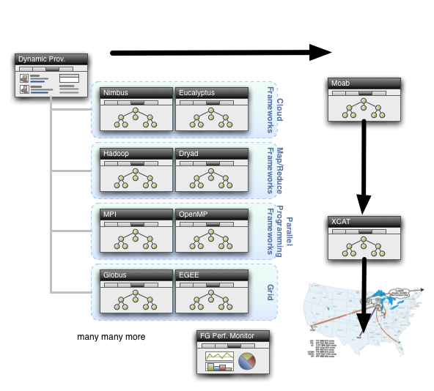
Dynamic Provisioning

Slide 15
Security Issues
Need to provide dynamic flexible usability and preserve system security
Still evolving process but initial approach involves
Encouraging use of “as a Service” approach e.g. “Database as a Software” not “Database in your image”; clearly possible for some cases as in “Hadoop as a Service”
  Commercial clouds use aaS for database, queues, tables, storage …..
  Makes complexity linear in #features rather than exponential if need to support all images with or without all features
Have a suite of vetted images that can be used by users with suitable roles
  Typically do not allow root access; can be VM or not VM based
  Can create images and requested that they be vetted
“Dangerous images” (e.g. allow root access) use VM’s and network isolation

Slide 16
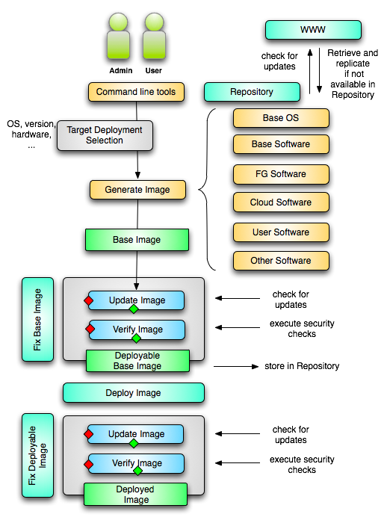
Image Creation Process
Creating deployable image
  User chooses one base mages
  User decides who can access the image; what additional software is on the image
  Image gets generated; updated; and verified
Image gets deployed
Deployed image gets continuously
  Updated; and verified
Note: Due to security requirement an image must be customized with authorization mechanism
  We are not creating NxN images as many users will only need the base image
  Administrators will use the same process to create the images that are vetted by them
  An image gets customized through integration via a CMS process

Slide 17
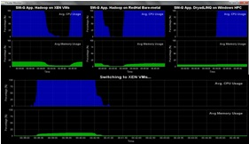
Dynamic Virtual Clusters
Dynamic Cluster Architecture
Monitoring & Control Infrastructure
Monitoring Infrastructure
Monitoring Interface
Pub/Sub Broker Network
SW-G Using Hadoop
SW-G Using Hadoop
SW-G Using DryadLINQ
Linux
Bare-system
Linux on Xen
Windows Server 2008 Bare-system
Virtual/Physical Clusters
Summarizer
XCAT Infrastructure
XCAT Infrastructure
Switcher
iDataplex Bare-metal Nodes
(32 nodes)
iDataplex Bare-metal Nodes
Switchable clusters on the same hardware (~5 minutes between different OS such as Linux+Xen to Windows+HPCS)
Support for virtual clusters
SW-G : Smith Waterman Gotoh Dissimilarity Computation as an pleasingly parallel problem suitable for MapReduce style application

Slide 19
FutureGrid Interaction with Commercial Clouds
We support experiments that link Commercial Clouds and FutureGrid experiments with one or more workflow environments and portal technology installed to link components across these platforms
We support environments on FutureGrid that are similar to Commercial Clouds and natural for performance and functionality comparisons.
  These can both be used to prepare for using Commercial Clouds and as the most likely starting point for porting to them (item c below).
  One example would be support of MapReduce-like environments on FutureGrid including Hadoop on Linux and Dryad on Windows HPCS which are already part of FutureGrid portfolio of supported software.
We develop expertise and support porting to Commercial Clouds from other Windows or Linux environments
We support comparisons between and integration of multiple commercial Cloud environments -- especially Amazon and Azure in the immediate future
We develop tutorials and expertise to help users move to Commercial Clouds from other environments.

Slide 20
RAIN: Dynamic Provisioning
Change underlying system to support current user demands at different levels
  Linux, Windows, Xen, KVM, Nimbus, Eucalyptus, Hadoop, Dryad
  Switching between Linux and Windows possible!
Stateless (means no “controversial” state) images: Defined as any node that that does not store permanent state, or configuration changes, software updates, etc.
  Shorter boot times
  Pre-certified; easier to maintain
Statefull installs: Defined as any node that has a mechanism to preserve its state, typically by means of a non-volatile disk drive.
  Windows
  Linux with custom features
Encourage use of services: e.g. MyCustomSQL as a service and not MyCustomSQL as part of installed image?
Runs OUTSIDE virtualization so cloud neutral
Use Moab to trigger changes and xCAT to manage installs

Slide 21
Basic FG Security Concerns
Elementary security concerns and requirements
  Single sign on (including services: Nimbus, Eucalyptus, …) ; Auditing; Image Management (creation, curation, storage) ; role based authorization
Authentication
  Single sign on with the help of CiLogon and/or Atlasian Crowd (TBD): leverage InCommon, Shiboleth, OpenID, and a local IdP based on LDAP
Authorization
  Group/role based authorization
    Support individual users, classes, communities while reusing base images
    Provide a local FG IdP to integrate role/group based authorization (based on LDAP)
More Secure Image Management
  Vetted images get generated while allowing augmentation with role based authorization (this is done in other systems by hand and often can lead to exploit as experience shows, we make it more secure while users must specify which FG users can have access to their system. Users must have an account on FG to access this kind of image)
  Authorization is done via verification of groups managed in an LDAP server
  Images are tested continuously for common exploit dangers (we run a service)
  Images are integrated in an automatic Configuration Management System (CMS) so updates are executed dynamically

Slide 22
More Secure Image Management
Vetted images are supported and are stateless.
  Users do not need root on their images. If components are to be added they must be added through a vetting process and verified. Users can create new images while adding vetted modules
  Stateless images are our default.
    However, users can snapshot images. Through integration with CMS they are automatically upgraded (see previous slide). E.g. if you save an image and load it, the first thing that takes place is an image update.
If a user needs root, the image will run on a VM, possibly with network access restrictions.
  However, we like to avoid the need for root as much as possible.
In all cases security checks will be conducted continuously.
  If a possible exploit can be found the image is quarantined

Slide 23
xCAT and Moab in detail
xCAT
  Uses Preboot eXecution Environment (PXE) to perform remote network installation from RAM or disk file systems
    Creates stateless Linux images (today)
  Changes the boot configuration of the nodes
  We are intending in future to use remote power control and console to switch on or of the servers (IPMI)
Moab
  Meta-schedules over resource managers
    Such as TORQUE(today) and Windows HPCS
  control nodes through xCAT
    Changing the OS
    Remote power control in future

Slide 24
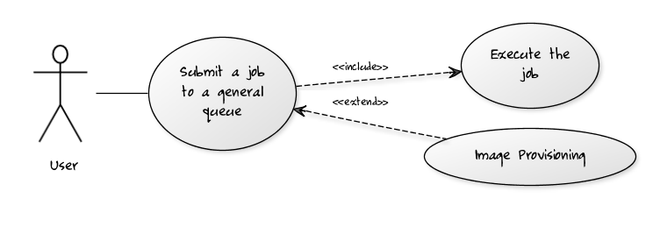
Per Job Reprovisioning
The user submits a job to a general queue. This job specifies a custom Image type attached to it.
The Image gets reprovisioned on the resources
The job gets executed within that image
After job is done the Image is no longer needed.
Use case: Many different users with many different images

Slide 25
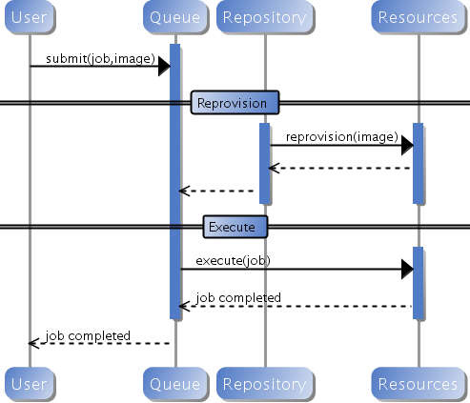
Custom Reprovisioning
Normal approach to job submission

Slide 26
Reprovisioning based on prior state
The user submits a job to a general queue. This job specifies an OS (re-used stateless image) type attached to it.
The queue evaluates the OS requirement.
  If an available node has OS already running, run the job there.
  If there are no OS types available, reprovision an available node and submit the job to the new node.
Repeat the provisioning steps if the job requires multiple processors (such as a large MPI job).
Use case: reusing the same stateless image between usages

Slide 27
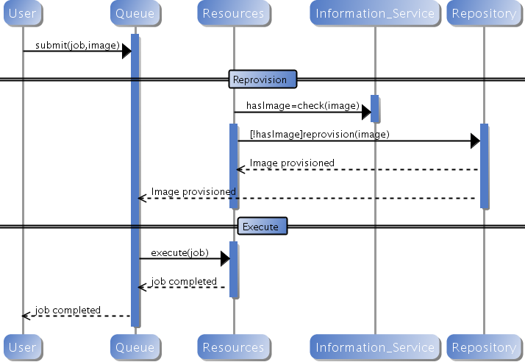
Generic Reprovisioning

Slide 28
Manage your own VO queue
This use case illustrates how a group of users or a Virtual Organization (VO) can handle their own queue to specifically tune their application environment to their specification.
A VO sets up a new queue, and provides an Operating System image that is associated to this image.
  Can aid in image creation through the use of advanced scripts and a configuration management tool.
A user within the VO submits a job to the VO queue.
The queue is evaluated, and determines if there are free resource nodes available.
  If there is an available node and the VO OS is running on it, then the Job is scheduled there.
  If an un-provisioned node is available, the VO OS is provisioned and the job is then submitted to that node.
  If there are other idle nodes without jobs running, a node can be re-provisioned to the VO OS and the job is then submitted to that node.
Repeat the provisioning steps if multiple processors are required (such as an MPI job).
Use case: Provide a service to the users of a VO. For example: submit a job that uses particular software. For example provide a queue called Genesis or Hadoop for the associated user community. Provisioning is hidden from the users.

Slide 29
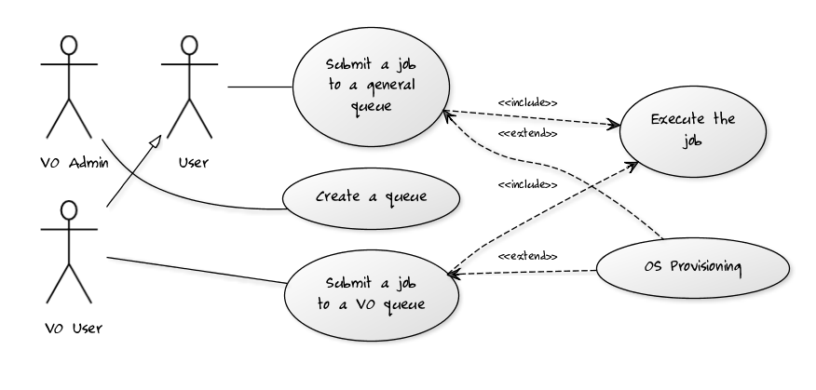
VO Queue

Slide 30
Current Status of Dynamic Provisioning @ FutureGrid
FutureGrid now supports the Dynamic Provisioning feature through MOAB.
  Submit a job with ‘os1’ requested, if there is a node running ‘os1’ and in idle status, the job will be scheduled.
  If there is no node running ‘os1’, a provisioning job will be started automatically and change an idle node’s OS to the requested one. And when it's done, the submitted job will be scheduled there.
  In our experiment we used 2 rhel5 OS and dynamically switched between, one stateless and one statefull.
  In our experiment the reprovisioning costs were
    Approximately 4-5 minutes for Statefull and Stateless
    Used sierra.futuregrid.org iDataPlex at SDSC

Slide 31
Difficult Issues
Performance of VM’s poor with Infiniband: FutureGrid does not have resources to address such core VM issues – we can identify issues and report
What about root access? Typically administrators involved in preparation of images requiring root access. This is part of certification process. We will offer certified tools to prepare images
What about attacks on Infiniband switch? We need to study this
How does one certify statefull images? All statefull images must have a certain default software included that auto-update the image which is tested against a security service prior to staging. In case an image is identified as having a security risk it is no longer allowed to be booted.

