Slide 1
Contributions to
Data Science and Clouds
April 18 2013
Geoffrey Fox
gcf@indiana.edu
http://www.infomall.org http://www.futuregrid.org
School of Informatics and Computing
Digital Science Center
Indiana University Bloomington

Slide 2
Big Data Ecosystem in One Sentence
Use Clouds running Data Analytics processing Big Data to solve problems in X-Informatics ( or e-X)
X = Astronomy, Biology, Biomedicine, Business, Chemistry, Crisis, Energy, Environment, Finance, Health, Intelligence, Lifestyle, Marketing, Medicine, Pathology, Policy, Radar, Security, Sensor, Social, Sustainability, Wealth and Wellness with more fields (physics) defined implicitly
Spans Industry and Science (research)
Education: Data Science see recent New York Times articles
http://datascience101.wordpress.com/2013/04/13/new-york-times-data-science-articles/

Slide 3
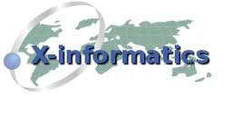



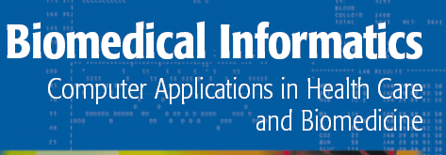


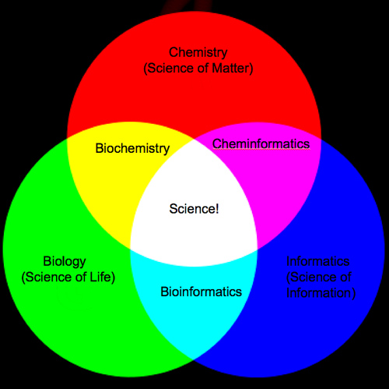

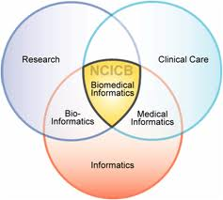
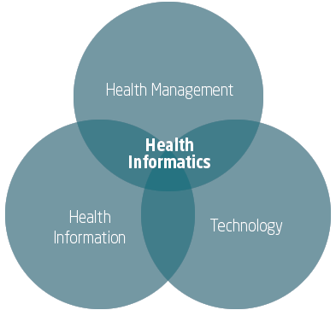
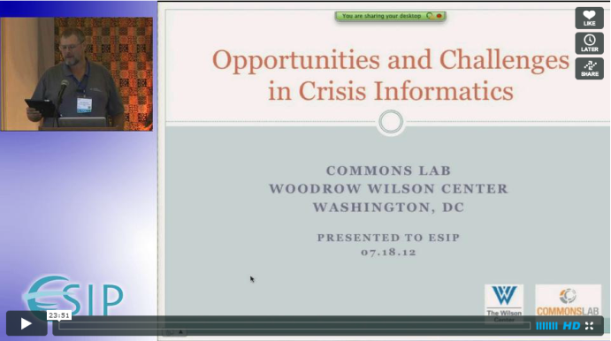

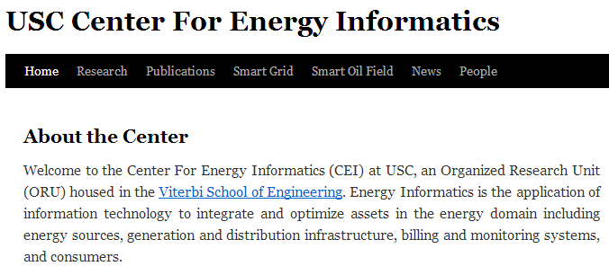
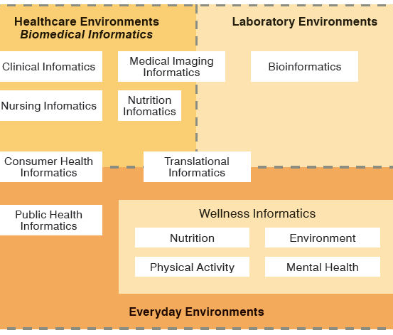
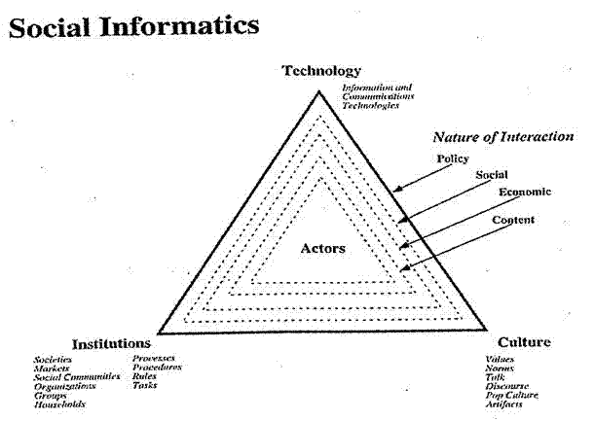

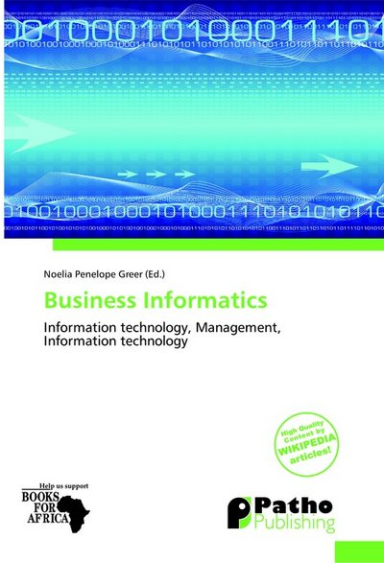
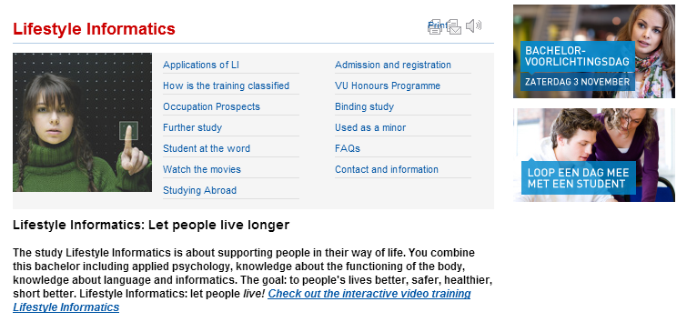
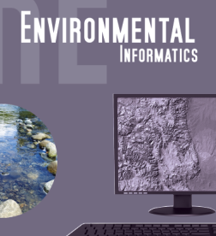

Social Informatics

Slide 4
Areas of Importance
Economic Imperative: There are a lot of data and a lot of jobs
Computing Model: Industry adopted clouds which are attractive for data analytics
Research Model: 4th Paradigm; From Theory to Data driven science?
Confusion in a new-old field: lack of consensus academically in several aspects from storage to algorithms, to processing and education
Progress in Data Intensive Programming Models
Progress in Academic (open source) clouds
Progress in scalable robust Algorithms: new data need better algorithms?
Progress in Data Science Education: opportunities at universities

Slide 5
Economic Imperative
There are a lot of data and a lot of jobs

Slide 6

Some Trends
  The Data Deluge is clear trend from Commercial (Amazon, e-commerce) , Community (Facebook, Search) and Scientific applications
  Light weight clients from smartphones, tablets to sensors
  Multicore reawakening parallel computing
  Exascale initiatives will continue drive to high end with a simulation orientation
  Clouds with cheaper, greener, easier to use IT for (some) applications
  New jobs associated with new curricula
    Clouds as a distributed system (classic CS courses)
    Data Analytics (Important theme in academia and industry)
    Network/Web Science

Slide 7
Some Data sizes
  ~40 10⁹ Web pages at ~300 kilobytes each = 10 Petabytes
  Youtube 48 hours video uploaded per minute;
    in 2 months in 2010, uploaded more than total NBC ABC CBS
    ~2.5 petabytes per year uploaded?
  LHC 15 petabytes per year
  Radiology 69 petabytes per year
  Square Kilometer Array Telescope will be 100 terabits/second
  Earth Observation becoming ~4 petabytes per year
  Earthquake Science – few terabytes total today
  PolarGrid – 100’s terabytes/year
  Exascale simulation data dumps – terabytes/second

Slide 8
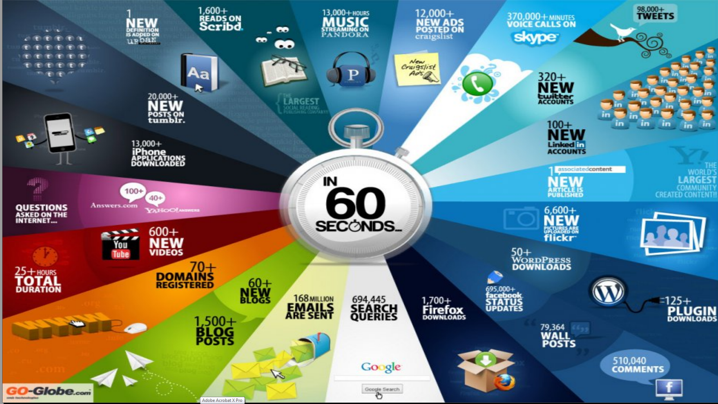
http://cs.metrostate.edu/~sbd/ Oracle

Slide 9
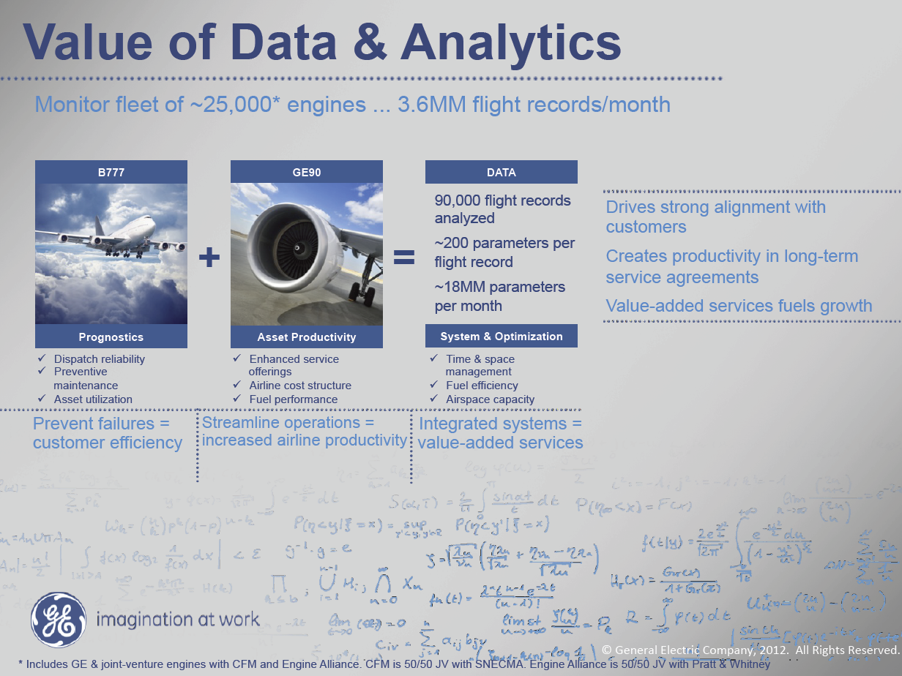
MM = Million
Ruh VP Software GE http://fisheritcenter.haas.berkeley.edu/Big_Data/index.html

Slide 10
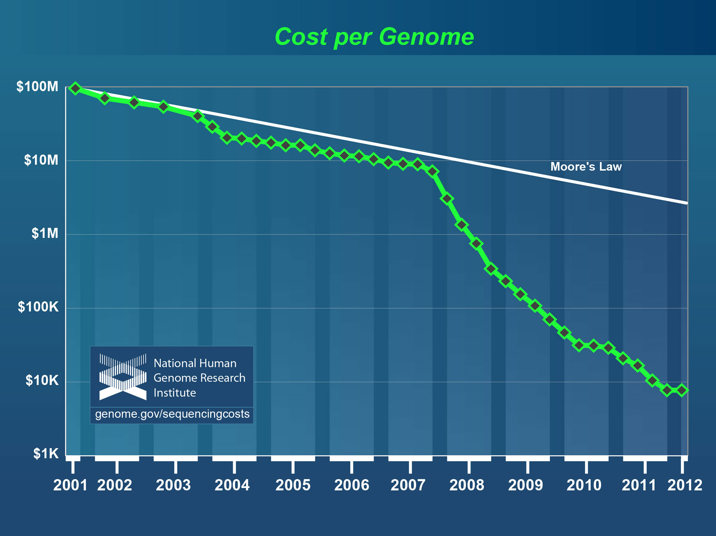
Why need cost effective
Computing!
Full Personal Genomics: 3 petabytes per day
http://www.genome.gov/sequencingcosts/

Slide 11
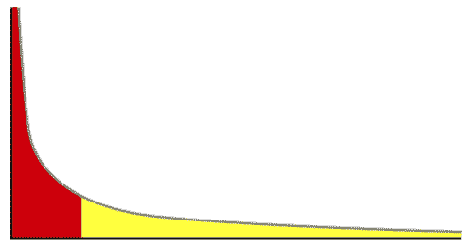
The Long Tail of Science
High energy physics, astronomy
genomics
The long tail: economics, social science, ….
Collectively “long tail” science is generating a lot of data
  Estimated at over 1PB per year and it is growing fast.
80-20 rule: 20% users generate 80% data but not necessarily 80% knowledge
Gannon Talk

Slide 12

Jobs v. Countries
http://www.microsoft.com/en-us/news/features/2012/mar12/03-05CloudComputingJobs.aspx

Slide 13

McKinsey Institute on Big Data Jobs
There will be a shortage of talent necessary for organizations to take advantage of big data. By 2018, the United States alone could face a shortage of 140,000 to 190,000 people with deep analytical skills as well as 1.5 million managers and analysts with the know-how to use the analysis of big data to make effective decisions.
Informatics aimed at 1.5 million jobs. Computer Science covers the 140,000 to 190,000
http://www.mckinsey.com/mgi/publications/big_data/index.asp.

Slide 14
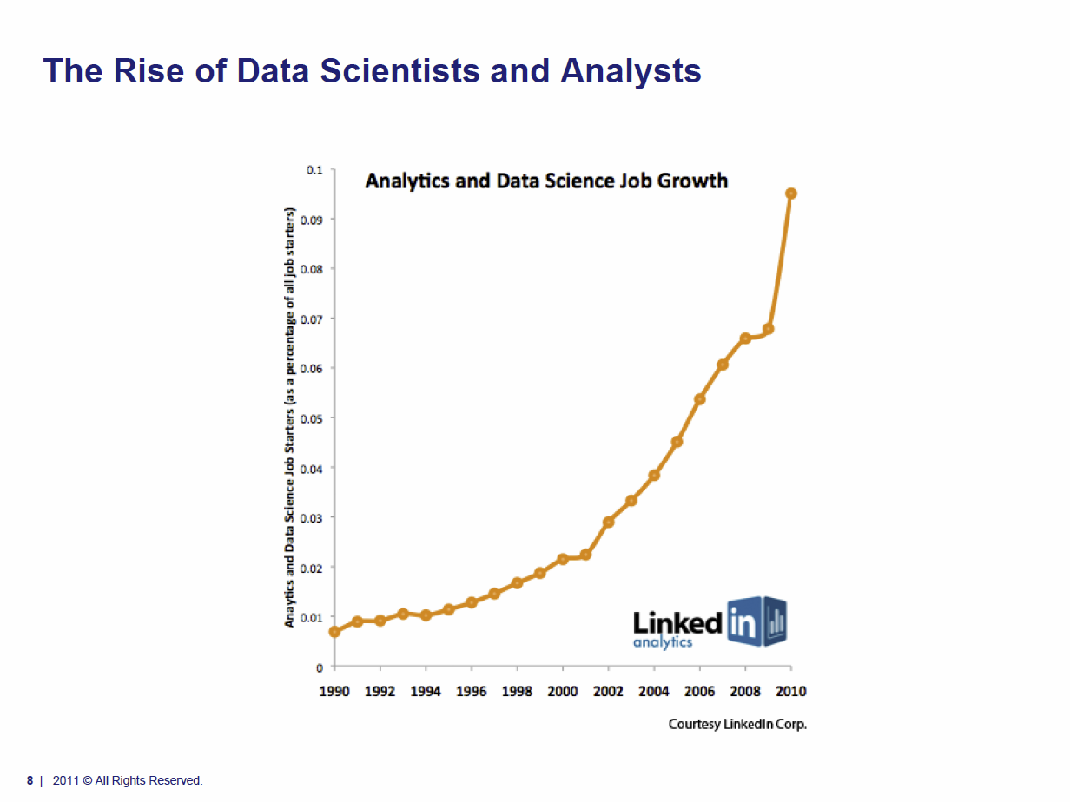
Tom Davenport Harvard Business School http://fisheritcenter.haas.berkeley.edu/Big_Data/index.html Nov 2012

Slide 15
Computing Model
Industry adopted clouds which are attractive for data analytics

Slide 16
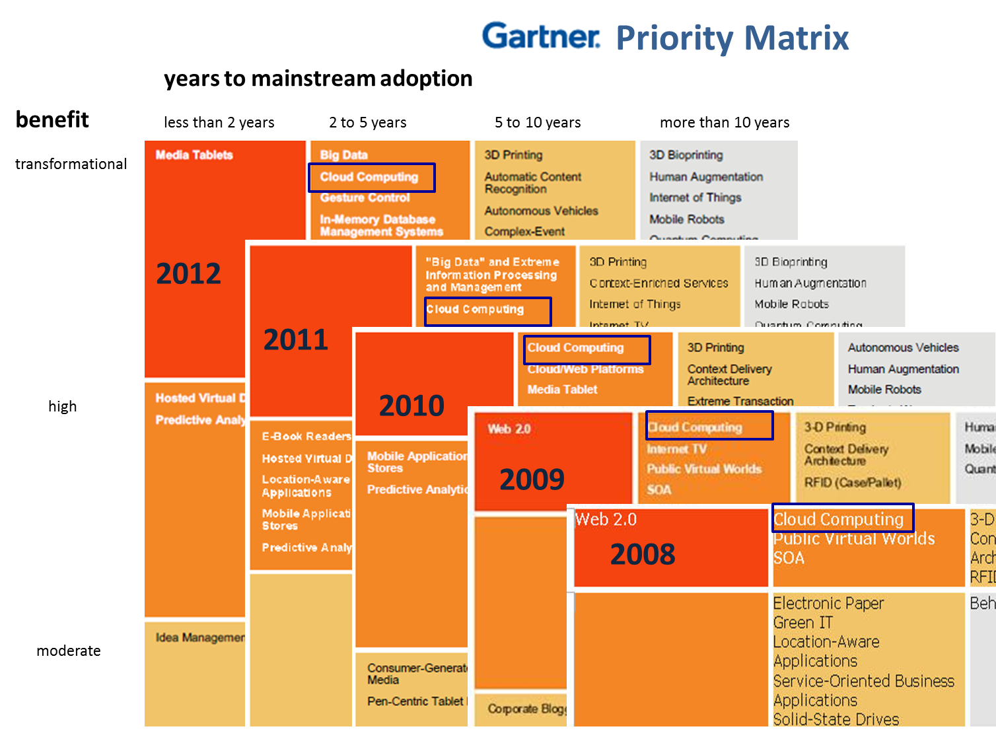
5 years Cloud Computing
2 years Big Data Transformational

Slide 17
Amazon making money
It took Amazon Web Services (AWS) eight years to hit $650 million in revenue, according to Citigroup in 2010.
Just three years later, Macquarie Capital analyst Ben Schachter estimates that AWS will top $3.8 billion in 2013 revenue, up from $2.1 billion in 2012 (estimated), valuing the AWS business at $19 billion.

Slide 18
Physically Clouds are Clear
A bunch of computers in an efficient data center with an excellent Internet connection
They were produced to meet need of public-facing Web 2.0 e-Commerce/Social Networking sites
They can be considered as “optimal giant data center” plus internet connection
Note enterprises use private clouds that are giant data centers but not optimized for Internet access

Slide 19
Virtualization made several things more convenient
Virtualization = abstraction; run a job – you know not where
Virtualization = use hypervisor to support “images”
  Allows you to define complete job as an “image” – OS + application
Efficient packing of multiple applications into one server as they don’t interfere (much) with each other if in different virtual machines;
They interfere if put as two jobs in same machine as for example must have same OS and same OS services
Also security model between VM’s more robust than between processes

Slide 20
Clouds Offer From different points of view
Features from NIST:
  On-demand service (elastic);
  Broad network access;
  Resource pooling;
  Flexible resource allocation;
  Measured service
Economies of scale in performance and electrical power (Green IT)
Powerful new software models
  Platform as a Service is not an alternative to Infrastructure as a Service – it is instead an incredible valued added
  Amazon is as much PaaS as Azure

Slide 21
Research Model
4th Paradigm; From Theory to Data driven science?

Slide 22
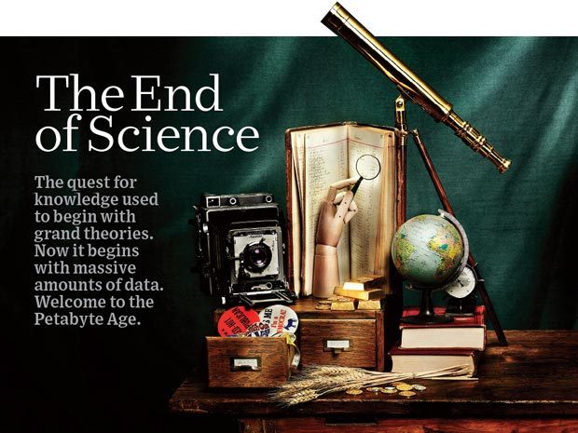
http://www.wired.com/wired/issue/16-07 September 2008

Slide 23
The 4 paradigms of Scientific Research
Theory
Experiment or Observation
  E.g. Newton observed apples falling to design his theory of mechanics
Simulation of theory or model
Data-driven (Big Data) or The Fourth Paradigm: Data-Intensive Scientific Discovery (aka Data Science)
  http://research.microsoft.com/en-us/collaboration/fourthparadigm/ A free book
  More data; less models

Slide 24
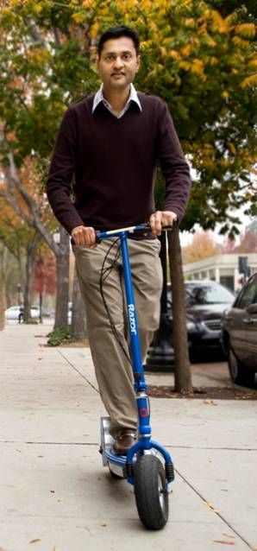
More data usually beats better algorithms
Here's how the competition works. Netflix has provided a large data set that tells you how nearly half a million people have rated about 18,000 movies. Based on these ratings, you are asked to predict the ratings of these users for movies in the set that they have not rated. The first team to beat the accuracy of Netflix's proprietary algorithm by a certain margin wins a prize of $1 million!
Different student teams in my class adopted different approaches to the problem, using both published algorithms and novel ideas. Of these, the results from two of the teams illustrate a broader point. Team A came up with a very sophisticated algorithm using the Netflix data. Team B used a very simple algorithm, but they added in additional data beyond the Netflix set: information about movie genres from the Internet Movie Database(IMDB). Guess which team did better?
Anand Rajaraman is Senior Vice President at Walmart Global eCommerce, where he heads up the newly created @WalmartLabs,
http://anand.typepad.com/datawocky/2008/03/more-data-usual.html
20120117berkeley1.pdf Jeff Hammerbacher

Slide 25
Confusion in the new-old data field
lack of consensus academically in several aspects from storage to algorithms, to processing and education

Slide 26
Data Communities Confused I?
Industry seems to know what it is doing although it’s secretive – Amazon’s last paper on their recommender system was 2003
  Industry runs the largest data analytics on clouds
  But industry algorithms are rather different from science
Academia confused on repository model: traditionally one stores data but one needs to support “running Data Analytics” and one is taught to bring computing to data as in Google/Hadoop file system
  Either store data in compute cloud OR enable high performance networking between distributed data repositories and “analytics engines”
Academia confused on data storage model: Files (traditional) v. Database (old industry) v. NOSQL (new cloud industry)
  Hbase MongoDB Riak Cassandra are typical NOSQL systems
Academia confused on curation of data: University Libraries, Projects, National repositories, Amazon/Google?

Slide 27
Data Communities Confused II?
Academia agrees on principles of Simulation Exascale Architecture: HPC Cluster with accelerator plus parallel wide area file system
  Industry doesn’t make extensive use of high end simulation
Academia confused on architecture for data analysis: Grid (as in LHC), Public Cloud, Private Cloud, re-use simulation architecture with database, object store, parallel file system, HDFS style data
Academia has not agreed on Programming/Execution model: “Data Grid Software”, MPI, MapReduce ..
Academia has not agreed on need for new algorithms: Use natural extension of old algorithms, R or Matlab. Simulation successes built on great algorithm libraries; what algorithms are important
Academia could attract more students: with data-oriented curricula that prepare for industry or research careers

Slide 28
Clouds in Research

Slide 29
Clouds have highlighted SaaS PaaS IaaS
But equally valid for classic clusters
Software
(Application
Or Usage) SaaS
Education
Applications
CS Research Use e.g. test new compiler or storage model
Software Services are building blocks of applications
The middleware or computing environment including HPC, Grids …
Nimbus, Eucalyptus, OpenStack, OpenNebula
CloudStack plus Bare-metal
OpenFlow – likely to grow in importance
Cloud e.g. MapReduce
HPC e.g. PETSc, SAGA
Computer Science e.g. Compiler tools, Sensor nets, Monitors
Platform
PaaS
Infra
structure
IaaS
Software Defined Computing (virtual Clusters)
Hypervisor, Bare Metal
Operating System
Network
NaaS
Software Defined Networks
OpenFlow GENI

Slide 30
Science Computing Environments
Large Scale Supercomputers – Multicore nodes linked by high performance low latency network
  Increasingly with GPU enhancement
  Suitable for highly parallel simulations
High Throughput Systems such as European Grid Initiative EGI or Open Science Grid OSG typically aimed at pleasingly parallel jobs
  Can use “cycle stealing”
  Classic example is LHC data analysis
Grids federate resources as in EGI/OSG or enable convenient access to multiple backend systems including supercomputers
Use Services (SaaS)
  Portals make access convenient and
  Workflow integrates multiple processes into a single job

Slide 31
Clouds HPC and Grids
Synchronization/communication Performance
Grids > Clouds > Classic HPC Systems
Clouds naturally execute effectively Grid workloads but are less clear for closely coupled HPC applications
Classic HPC machines as MPI engines offer highest possible performance on closely coupled problems
The 4 forms of MapReduce/MPI
  Map Only – pleasingly parallel
  Classic MapReduce as in Hadoop; single Map followed by reduction with fault tolerant use of disk
  Iterative MapReduce use for data mining such as Expectation Maximization in clustering etc.; Cache data in memory between iterations and support the large collective communication (Reduce, Scatter, Gather, Multicast) use in data mining
  Classic MPI! Support small point to point messaging efficiently as used in partial differential equation solvers

Slide 32
What Applications work in Clouds
Pleasingly (moving to modestly) parallel applications of all sorts (over users or usages) with roughly independent data or spawning independent simulations
  Long tail of science and integration of distributed sensors
Commercial and Science Data analytics that can use MapReduce (some of such apps) or its iterative variants (most other data analytics apps)
Which science applications are using clouds?
  Venus-C (Azure in Europe): 27 applications not using Scheduler, Workflow or MapReduce (except roll your own)
  50% of applications on FutureGrid are from Life Science
  Locally Lilly corporation is commercial cloud user (for drug discovery) but not IU Biology
But overall very little science use of clouds

Slide 33
Internet of Things and the Cloud
It is projected that there will be 24 billion devices on the Internet by 2020. Most will be small sensors that send streams of information into the cloud where it will be processed and integrated with other streams and turned into knowledge that will help our lives in a multitude of small and big ways.
The cloud will become increasing important as a controller of and resource provider for the Internet of Things.
As well as today’s use for smart phone and gaming console support, “Intelligent River” “smart homes and grid” and “ubiquitous cities” build on this vision and we could expect a growth in cloud supported/controlled robotics.
Some of these “things” will be supporting science
Natural parallelism over “things”
“Things” are distributed and so form a Grid

Slide 34
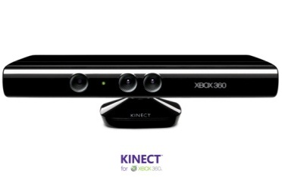








Sensors (Things) as a Service
Output Sensor
Sensors as a Service
Sensor Processing as a Service (could use
MapReduce)
A larger sensor ………
https://sites.google.com/site/opensourceiotcloud/ Open Source Sensor (IoT) Cloud

Slide 35
Data Intensive Programming Models

Slide 36
Map Collective Model (Judy Qiu)
Combine MPI and MapReduce ideas
Implement collectives optimally on Infiniband, Azure, Amazon ……
Iterate
Input
map
Initial Collective Step
Generalized Reduce
Final Collective Step

Slide 37
Twister Iterative MapReduce for Data Intensive Applications
Generalize to arbitrary Collective
Broadcast
Compute
Communication
Reduce/ barrier
New Iteration
Smaller Loop-Variant Data
Larger Loop-Invariant Data
(Iterative) MapReduce structure with Map-Collective is framework
Twister runs on Linux or Azure
Twister4Azure is built on top of Azure tables, queues, storage
Qiu, Gunarathne
Notes:
Most of these applications consists of iterative computation and communication steps where single iterations can easily be specified as MapReduce computations.
Large input data sizes which are loop-invariant and can be reused across iterations.
Loop-variant results.. Orders of magnitude smaller…
While these can be performed using traditional MapReduce frameworks, Traditional is not efficient for these types of computations. MR leaves lot of room for improvements in terms of iterative applications.

Slide 38
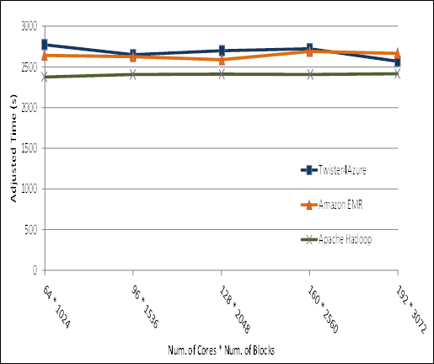

Pleasingly Parallel
Performance Comparisons
Smith Waterman
Sequence Alignment
BLAST Sequence Search
Cap3 Sequence Assembly

Slide 39
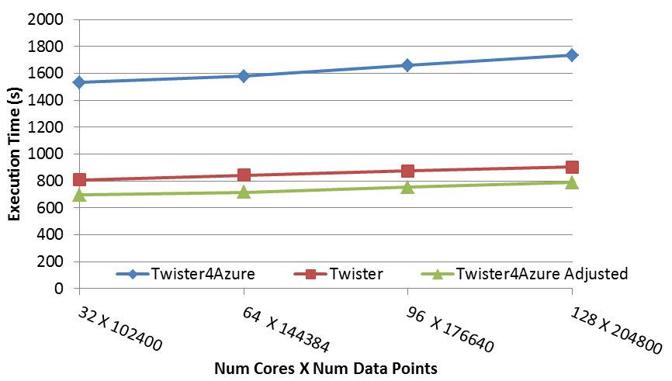
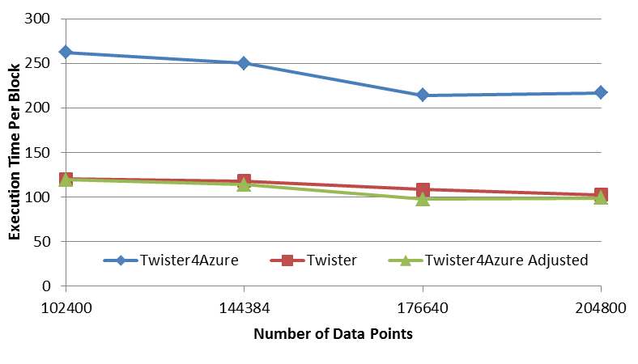
Multi Dimensional Scaling
BC: Calculate BX
X: Calculate invV (BX)
Calculate Stress
Map
Reduce
Merge
Map
Reduce
Merge
Map
Reduce
Merge
New Iteration
Performance adjusted for sequential performance difference
Weak Scaling
Data Size Scaling
Scalable Parallel Scientific Computing Using Twister4Azure. Thilina Gunarathne, BingJing Zang, Tak-Lon Wu and Judy Qiu. Submitted to Journal of Future Generation Computer Systems. (Invited as one of the best 6 papers of UCC 2011)
Notes:
The Java HPC Twister experiment was performed in a dedicated large-memory cluster of Intel(R) Xeon(R) CPU E5620 (2.4GHz) x 8 cores with 192GB memory per compute node and with Gigabit Ethernet on Linux. Java HPC Twister results do not include the initial data distribution time.
Azure large instances with 4 workers per instances is used. Memory mapped based caching and AllGather primitive are used.
Left: Weak scaling where workload per core is ~constant. Ideal is a straight horizontal line. X axis is
Right: Data size scaling with 128 Azure small instances/cores, 20 iterations.
The Twister4Azure adjusted (t_{a}) depicts the performance of Twister4Azure normalized according to the sequential MDS BC calculation and Stress calculation performance ratio between the Azure(t_{sa}) and Cluster(t_{sc}) environments used for Java HPC Twister. It is calculated using t_{a} x (t_{sc}/t_{sa}). This estimation however does not account for the overheads that remain constant irrespective of the computation time. Hence Twister4Azure seems to perform better, but in reality when the task execution times become smaller, twister4Azure overheads will become relatively larger and the performance would not be as good as shown in the adjusted curve.

Slide 40
Kmeans
Hadoop adjusted for Azure: Hadoop KMeans run time adjusted for the performance difference of iDataplex vs Azure

Slide 41
Kmeans Strong Scaling
(with Hadoop Adjusted)
128 Million data points. 500 Centroids (clusters). 20 Dimensions. 10 iterations
Parallel efficiency relative to the 32 core run time.
Note Hadoop slower by factor of 2

Slide 42
Kmeans Clustering
This shows that the communication and synchronization overheads between iterations are very small (less than one second, which is the lowest measured unit for this graph).
128 Million data points(19GB), 500 centroids (78KB), 20 dimensions
10 iterations, 256 cores, 256 map tasks per iteration

Slide 43
FutureGrid Technology

Slide 44
FutureGrid Testbed as a Service
FutureGrid is part of XSEDE set up as a testbed with cloud focus
Operational since Summer 2010 (i.e. now in third year of use)
The FutureGrid testbed provides to its users:
  Support of Computer Science and Computational Science research
  A flexible development and testing platform for middleware and application users looking at interoperability, functionality, performance or evaluation
  FutureGrid is user-customizable, accessed interactively and supports Grid, Cloud and HPC software with and without VM’s
  A rich education and teaching platform for classes
Offers OpenStack, Eucalyptus, Nimbus, OpenNebula, HPC (MPI) on same hardware moving to software defined systems; supports both classic HPC and Cloud storage

Slide 45
4 Use Types for FutureGrid TestbedaaS
292 approved projects (1734 users) April 6 2013
  USA(79%), Puerto Rico(3%- Students in class), India, China, lots of European countries (Italy at 2% as class)
  Industry, Government, Academia
Computer science and Middleware (55.6%)
  Core CS and Cyberinfrastructure; Interoperability (3.6%) for Grids and Clouds such as Open Grid Forum OGF Standards
New Domain Science applications (20.4%)
  Life science highlighted (10.5%), Non Life Science (9.9%)
Training Education and Outreach (14.9%)
  Semester and short events; focus on outreach to HBCU
Computer Systems Evaluation (9.1%)
  XSEDE (TIS, TAS), OSG, EGI; Campuses

Slide 46
Education and Training Use of FutureGrid
27 Semester long classes: 563+ students
  Cloud Computing, Distributed Systems, Scientific Computing and Data Analytics
3 one week summer schools: 390+ students
  Big Data, Cloudy View of Computing (for HBCU’s), Science Clouds
1 two day workshop: 28 students
5 one day tutorials: 173 students
From 19 Institutions
Developing 2 MOOC’s (Google Course Builder) on Cloud Computing and use of FutureGrid supported by either FutureGrid or downloadable appliances (custom images)
  See http://cgltestcloud1.appspot.com/preview
FutureGrid appliances support Condor/MPI/Hadoop/Iterative MapReduce virtual clusters

Slide 47
Performance of Dynamic Provisioning
4 Phases a) Design and create image (security vet) b) Store in repository as template with components c) Register Image to VM Manager (cached ahead of time) d) Instantiate (Provision) image

Slide 48
Performance 1
Notes:
See native performance for FLOPS metrics (great!) See a 4-5% overhead and slightly higher variance with PCI-Express bus speed benchmarks. Still not bad!

Slide 49
Performance 2
Notes:
Overall FFT and all Matrix multiplication is near native. As we can see with the PCIE benchmarks, there is some added overhead there, but only a few % of native.

Slide 50
Algorithms
Scalable Robust Algorithms: new data need better algorithms?

Slide 51
Algorithms for Data Analytics
In simulation area, it is observed that equal contributions to improved performance come from increased computer power and better algorithms
http://cra.org/ccc/docs/nitrdsymposium/pdfs/keyes.pdf
In data intensive area, we haven’t seen this effect so clearly
  Information retrieval revolutionized but
  Still using Blast in Bioinformatics (although Smith Waterman etc. better)
  Still using R library which has many non optimal algorithms
  Parallelism and use of GPU’s often ignored

Slide 52
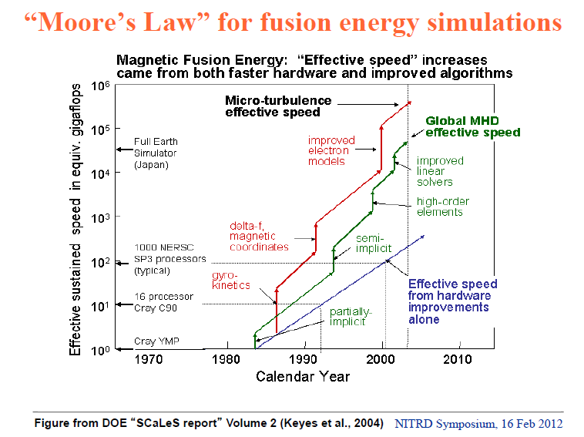

Slide 53
Data Analytics Futures?
PETSc and ScaLAPACK and similar libraries very important in supporting parallel simulations
Need equivalent Data Analytics libraries
Include datamining (Clustering, SVM, HMM, Bayesian Nets …), image processing, information retrieval including hidden factor analysis (LDA), global inference, dimension reduction
  Many libraries/toolkits (R, Matlab) and web sites (BLAST) but typically not aimed at scalable high performance algorithms
Should support clouds and HPC; MPI and MapReduce
  Iterative MapReduce an interesting runtime; Hadoop has many limitations
Need a coordinated Academic Business Government Collaboration to build robust algorithms that scale well
  Crosses Science, Business Network Science, Social Science
Propose to build community to define & implement
SPIDAL or Scalable Parallel Interoperable Data Analytics Library

Slide 54
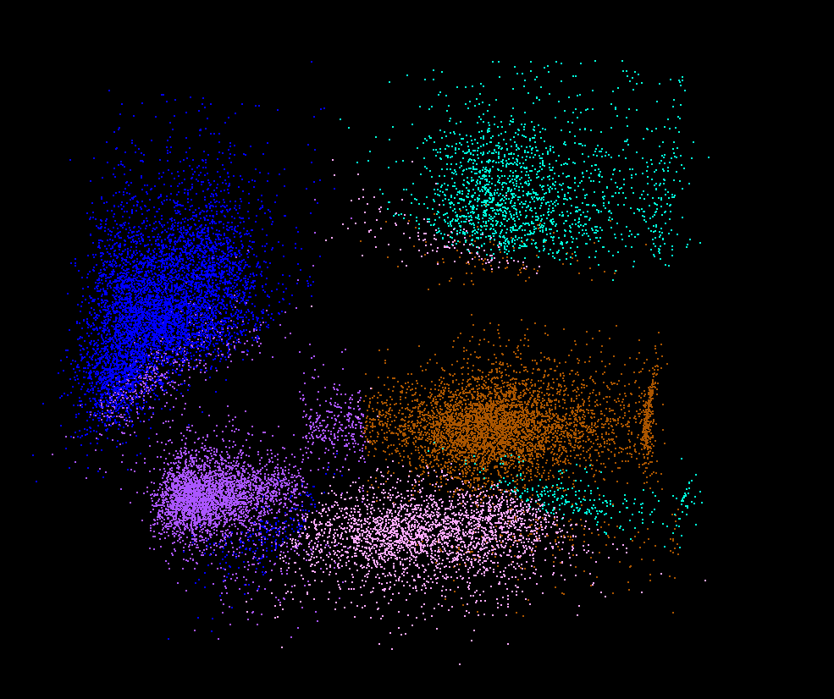
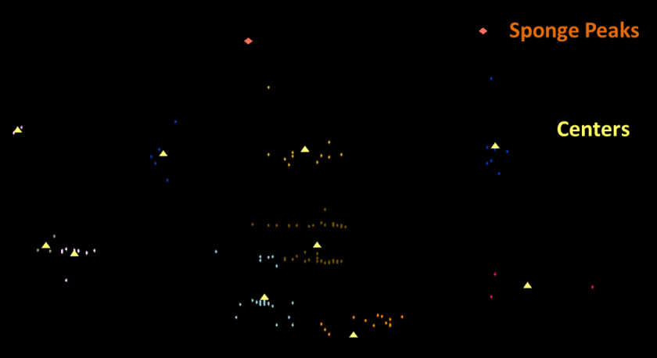
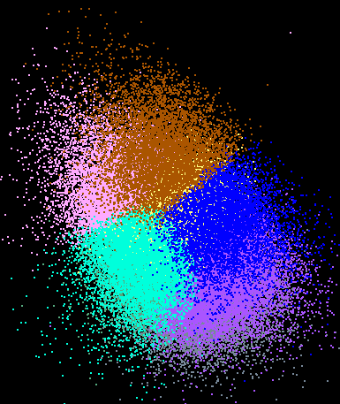
Dimension Reduction/MDS
You can get answers but do you believe them!
Need to visualize
H_{MDS} = Σ_{x<y=1}^{N} weight(x,y) (δ(x, y) – d_{3D}(x, y))²
Here x and y separately run over all points in the system, δ(x, y) is distance between x and y in original space while d_{3D}(x, y) is distance between them after mapping to 3 dimensions. One needs to minimize H_{MDS} for optimal choices of mapped positions X_{3D}(x).
LC-MS 2D
Pathology 54D
Lymphocytes 4D

Slide 55

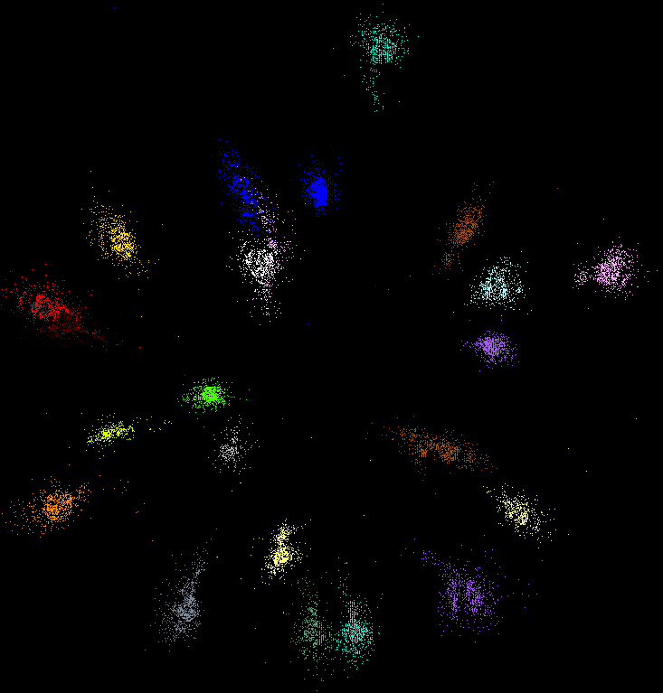
MDS and Clustering run well in parallel for Metric and non Metric Cases
Use deterministic annealing for robustness
Slower for non-metric case
~50,000 lines of C#; R routines do not exist
COG Database with a few biology clusters
Metagenomics with DA clusters

Slide 56
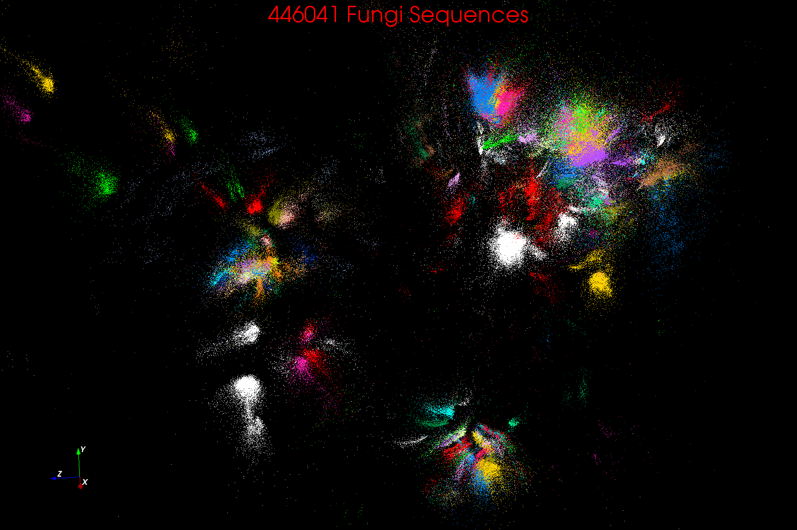
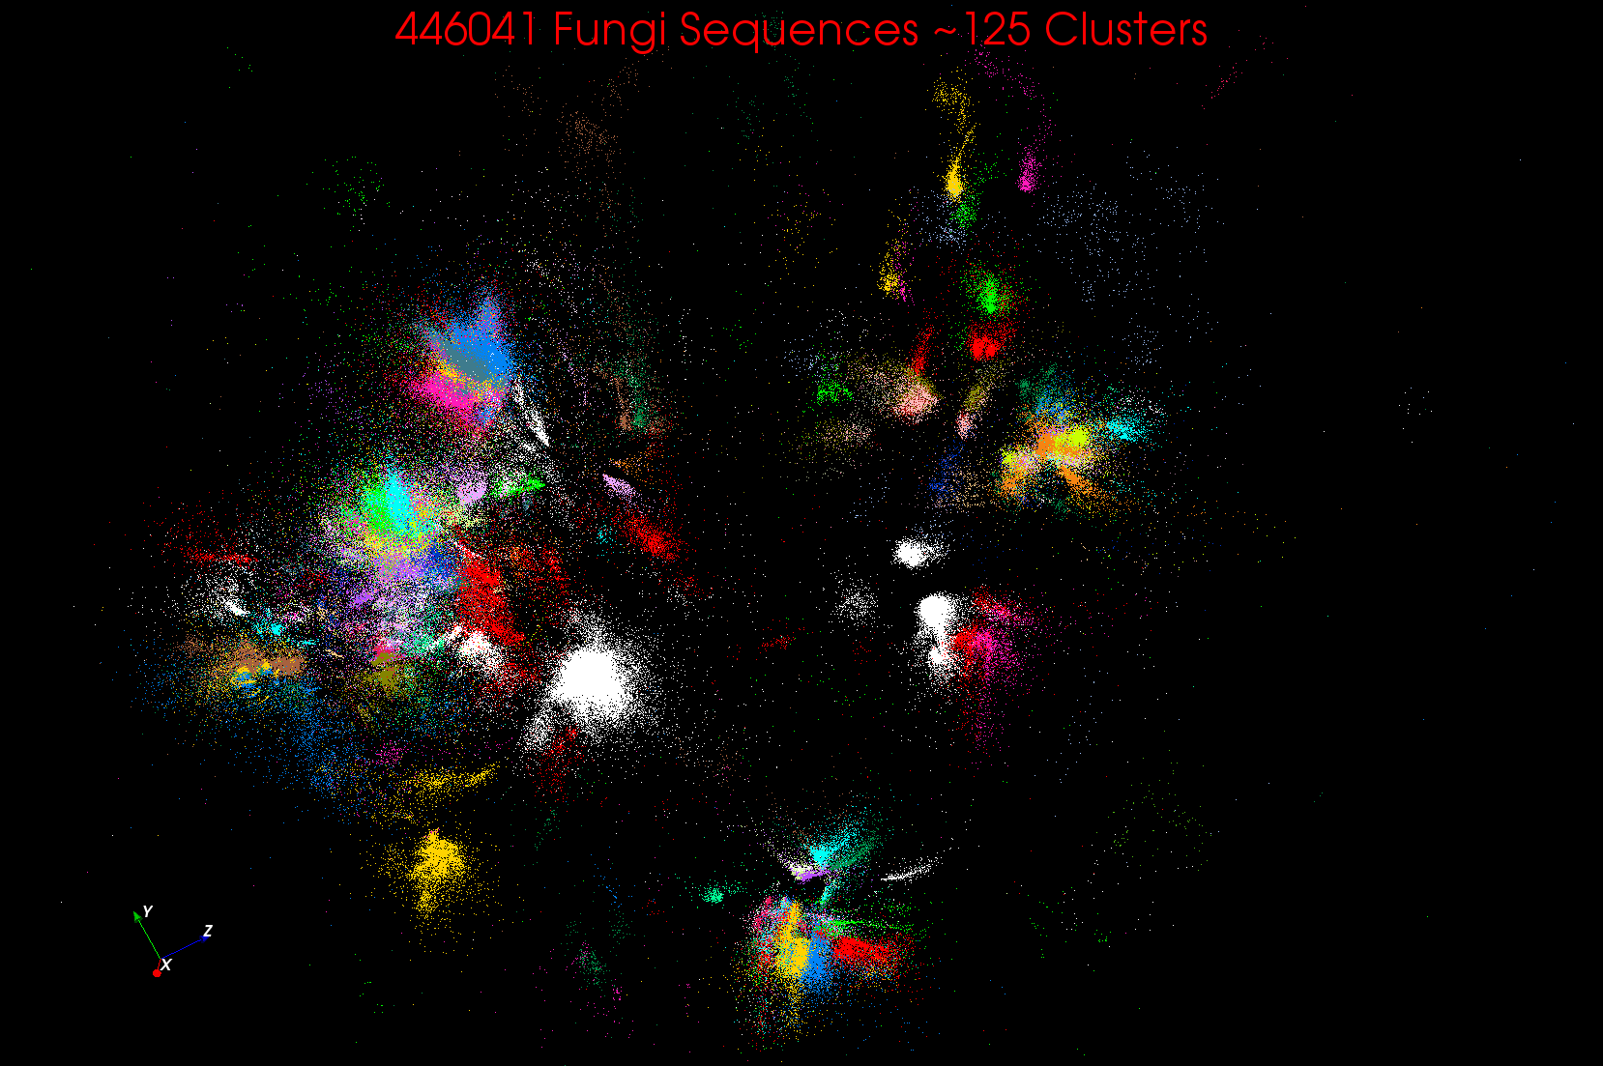
~125 Clusters from Fungi sequence set

Slide 57
Data Science Education
Opportunities at universities
see recent New York Times articles
http://datascience101.wordpress.com/2013/04/13/new-york-times-data-science-articles/

Slide 58
Data Science Education
Broad Range of Topics from Policy to curation to applications and algorithms, programming models, data systems, statistics, and broad range of CS subjects such as Clouds, Programming, HCI,
Plenty of Jobs and broader range of possibilities than computational science but similar cosmic issues
  What type of degree (Certificate, minor, track, “real” degree)
  What implementation (department, interdisciplinary group supporting education and research program)

Slide 59
Computational Science
Interdisciplinary field between computer science and applications with primary focus on simulation areas
Very successful as a research area
  XSEDE and Exascale systems enable
Several academic programs but these have been less successful than computational science research as
  No consensus as to curricula and jobs (don’t appoint faculty in computational science; do appoint to DoE labs)
  Field relatively small
Started around 1990

Slide 60
Massive Open Online Courses (MOOC)
MOOC’s are very “hot” these days with Udacity and Coursera as start-ups
Over 100,000 participants but concept valid at smaller sizes
Relevant to Data Science as this is a new field with few courses at most universities
Technology to make MOOC’s: Google Open Source Course Builder is lightweight LMS (learning management system)
Supports MOOC model as a collection of short prerecorded segments (talking head over PowerPoint) termed lessons – typically 15 minutes long
Compose playlists of lessons into sessions, modules, courses
  Session is an “Album” and lessons are “songs” in an iTunes analogy

Slide 61
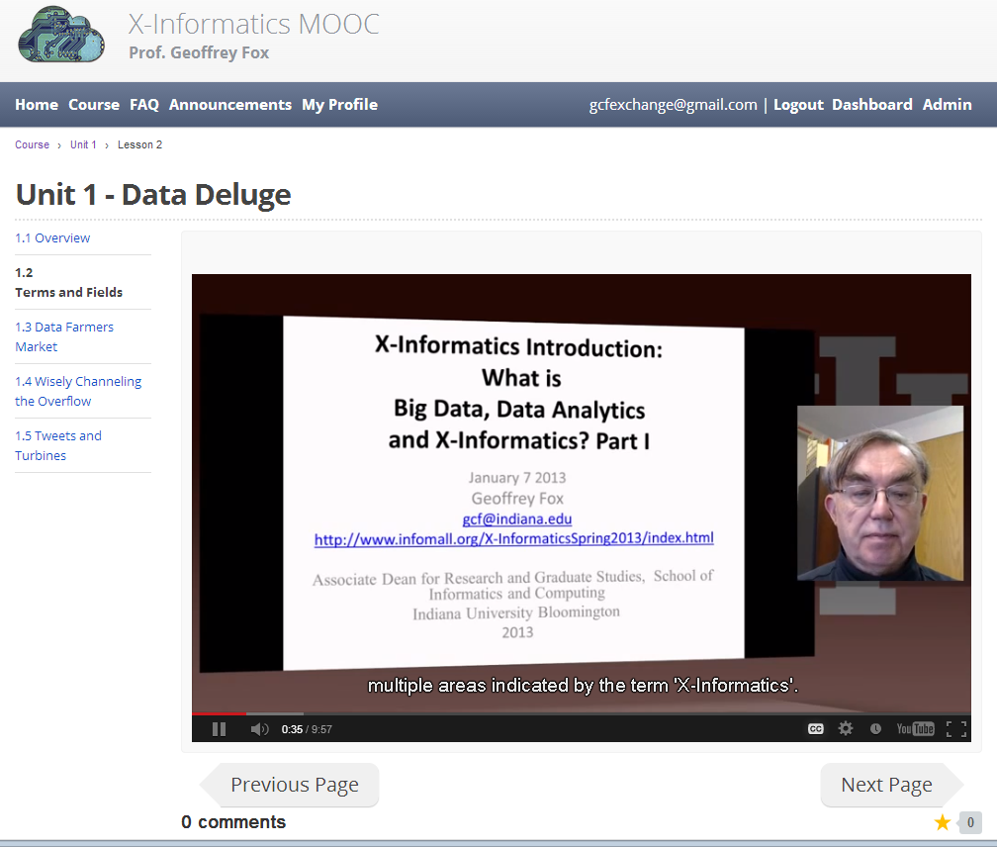
MOOC’s for Traditional Lectures
We can take MOOC lessons and view them as a “learning object” that we can share between different teachers
i.e. as a way of teaching typical sized classes but with less effort as shared material
Start with what’s in repository;
pick and choose;
Add custom material of individual teachers
The ~15 minute Video over PowerPoint of MOOC’s much easier to re-use than PowerPoint
Do not need special mentoring support
Defining how to support computing labs with FutureGrid or appliances + Virtual Box

Slide 62
Conclusions

Slide 63
Conclusions
Clouds and HPC are here to stay and one should plan on using both
Data Intensive programs are not like simulations as they have large “reductions” (“collectives”) and do not have many small messages
  Clouds suitable
Iterative MapReduce an interesting approach; need to optimize collectives for new applications (Data analytics) and resources (clouds, GPU’s …)
Need an initiative to build scalable high performance data analytics library on top of interoperable cloud-HPC platform
Many promising data analytics algorithms such as deterministic annealing not used as implementations not available in R/Matlab etc.
  More sophisticated software and runs longer but can be efficiently parallelized so runtime not a big issue

Slide 64
Conclusions II
Software defined computing systems linking NaaS, IaaS, PaaS, SaaS (Network, Infrastructure, Platform, Software) likely to be important
More employment opportunities in clouds than HPC and Grids and in data than simulation; so cloud and data related activities popular with students
International activity to discuss data science education
  Agree on curricula; is such a degree attractive?
Role of MOOC’s as either
  Disseminating new curricula
  Managing course fragments that can be assembled into custom courses for particular interdisciplinary students

