Slide 1
Building a Scalable Framework for the Collaborative Annotation of Real Time Data Streams
Thesis Defense 01/11/2013
Student: Tao Huang
Advisor: Prof. Geoffrey C. Fox
School of Informatics and Computing
Pervasive Technology Institute
Indiana University

Slide 2
Outline
Introduction
Motivation
Research Background
Collaborative Annotation Framework
Annotation in Mobile
Experiments
Contribution & Future work

Slide 3
Introduction
Concepts
  Distributed Collaboration
  General Annotation
  Collaborative Annotation
Research Context
  Annotation content
  Supported environment
  Flexible annotation forms

Slide 4
Introduction – Collaboration Systems
H.323: Tandberg, Polycom systems
Web based: WebEx, Google Doc, Office 365
Access Grid
GlobalMMCS

Slide 5
Introduction - Annotation
Annotation Definitions
  A commentary on an object that: (Cousins et al. 2000)
    the annotator intends to be separable from the object itself
    the reader interprets to be separable from the object itself
  A marked-up comment made to information in a book, document, online record, video, software code or other information (Wikipedia)
Annotation is to link related metadata to the content data

Slide 6
Introduction – Annotation Systems
Simple Annotation
  Annotations of bibliographic entries
  Reference management: Zotero
  Genome Annotation: BioDAS.org
  Video Annotation: IBM VideoAnnEx, Youtube annotation
Collaborative Annotation
  Text Annotation: Wiki, Google Docs, Office Live workspace
  Anchored Forums: Annotatiesysteem
  Multimedia Annotation: ELAN, Vannotea, eSports and etc.

Slide 7
Introduction – Mobile Annotation
Seamless Annotation
End User Place Annotation
Collaborative Image Annotation

Slide 8
Outline
Introduction
Motivation
Research Background
Collaborative Annotation Framework
Annotation in Mobile
Experiments
Contribution & Future work

Slide 9
Motivation
Questions about existing collaboration systems
Questions about existing annotation systems
Questions about mobile annotation

Slide 10
Motivation
High demands of collaborative annotation
Limited Annotation on Live Streams
Non interoperable collaboration platforms
Increasing trend of mobile access

Slide 11
Outline
Introduction
Motivation
Research Background
Collaborative Annotation Framework
Annotation in Mobile
Experiments
Contribution & Future work

Slide 12
Research Background
Traditional Collaboration Systems
Mobile annotation researches

Slide 13
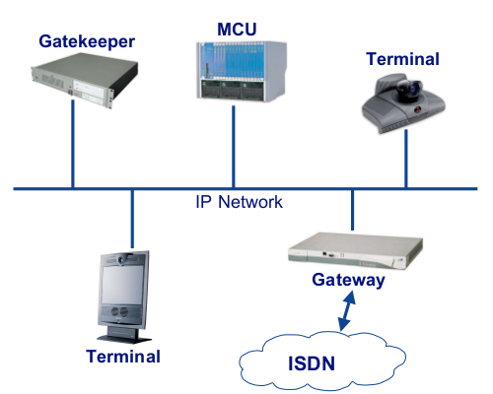
Research Background – Collaboration Systems
H.323

Slide 14
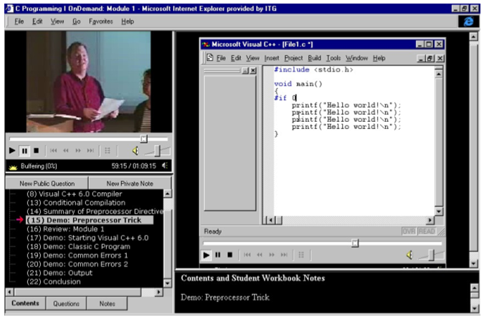
Research Background – Collaboration Systems
MRAS

Slide 15
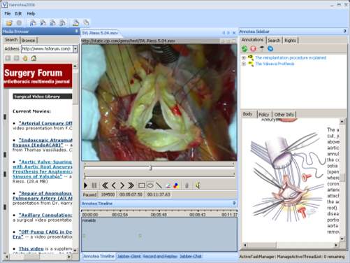
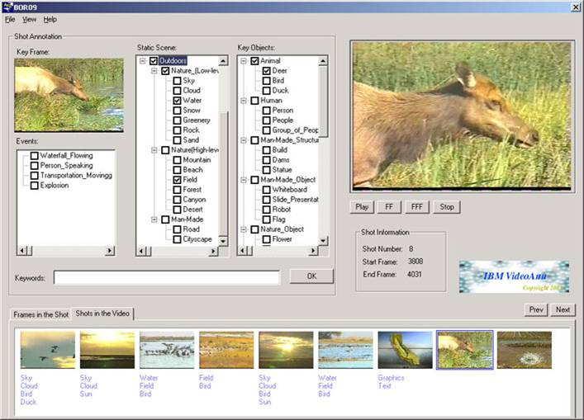
Research Background – Collaboration Systems
VideoAnnEx
Vannotea

Slide 16
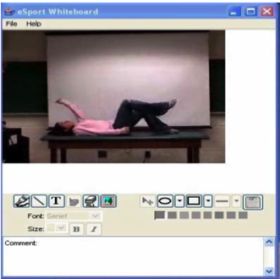
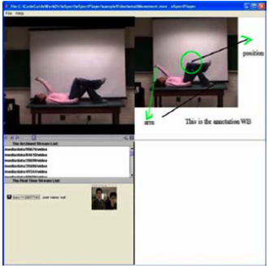
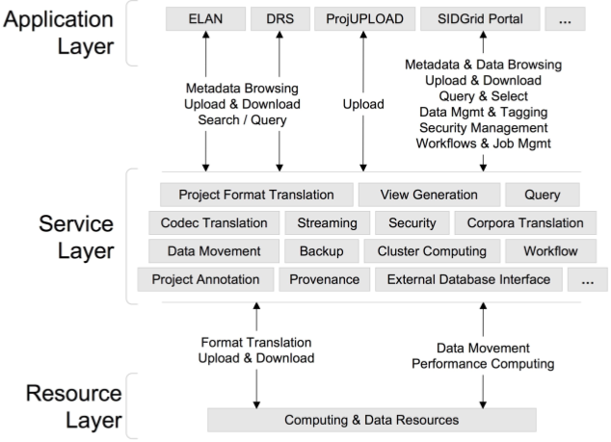
Research Background – Collaboration Systems
eSports
SIDGrid

Slide 17
Research Background – Mobile Annotation
Location recognition based on image and keywords 2004
Interactive place annotation using cell phones 2006
Layar: A mobile search system 2011
Android based image annotation system 2011

Slide 18
Research Background – Mobile Annotation
Popular topics
  Image/Text Based Location Recognition
  Digital Content/Place Annotation
  Tag/Scene Based Recommendation
Problems
  Thin client
  Limited Collaboration
  Limited Interaction on Content Data

Slide 19
Outline
Introduction
Motivation
Research Background
Collaborative Annotation Framework
Annotation in Mobile
Experiments
Contribution & Future work

Slide 20
Collaborative Framework
System Architecture
Session Management
Desktop User Interface

Slide 21
Collaborative Framework – Cont.
Annotation Interface
Stream Rendering & Archiving
Annotation Management
Annotation retrieval

Slide 22
Outline
Introduction
Motivation
Research Background
Collaborative Annotation Framework
Annotation in Mobile
Experiments
Contribution & Future work

Slide 23
Annotation in Mobile
Collaboration between Mobile and Desktop
Session control improvement
Multimedia proxy
Mobile Annotation Meta-data

Slide 24
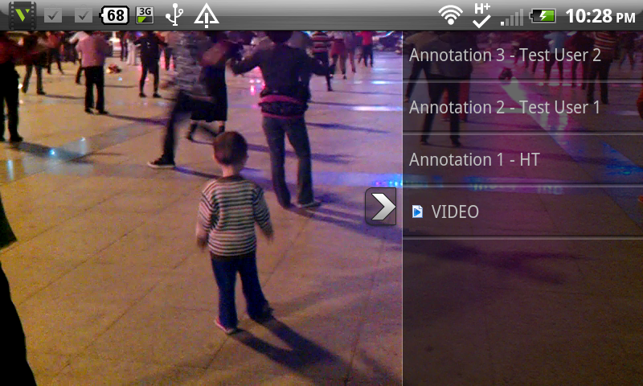
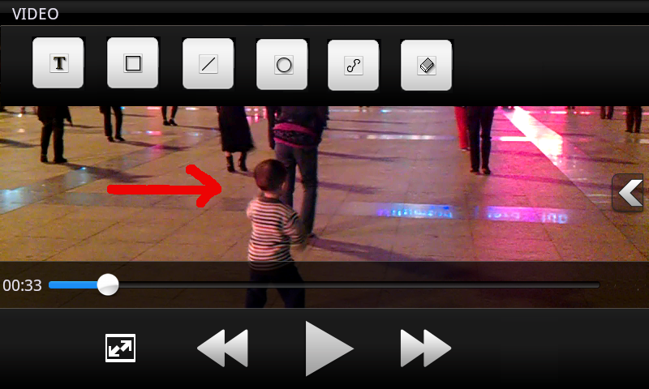
Annotation in Mobile - Design
Difference between Desktop and Mobile Clients
Extra layer of event translation: Stream Proxies

Slide 25
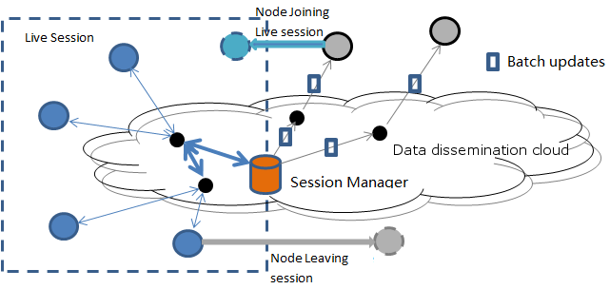
Annotation in Mobile – Session Management
Batch Session Updates
Ignore heartbeat events

Slide 26
Annotation in Mobile – Multimedia Proxy

Slide 27
Outline
Introduction
Motivation
Research Background
Collaborative Annotation Framework
Annotation in Mobile
Experiments
Contribution & Future work

Slide 28
Experiments & Analysis
Performance
Scalability

Slide 29
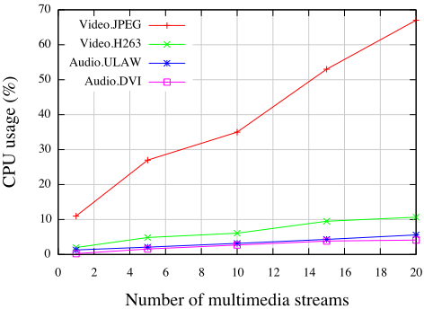
Experiments – Performance(Desktop)
Computing Resource Usage Test

Slide 30
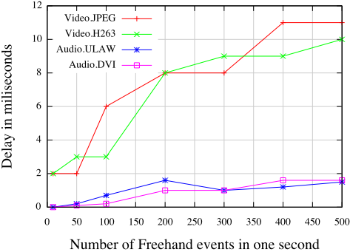
Experiments – Latency(Desktop)
Latency Tests with heavy annotation payloads

Slide 31
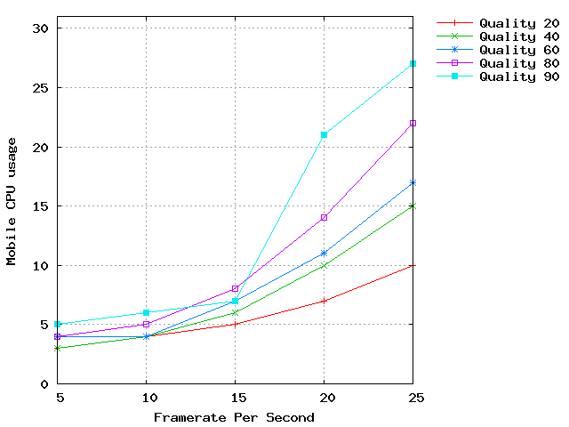
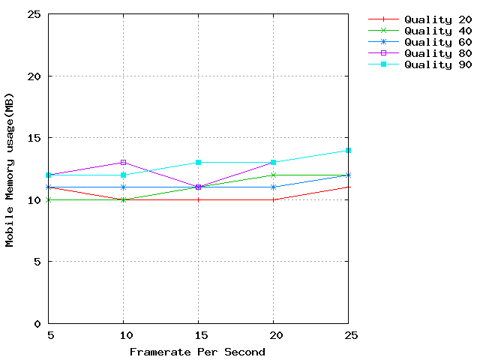
Experiments – Performance(Mobile)
Computing Resource Usage Test

Slide 32
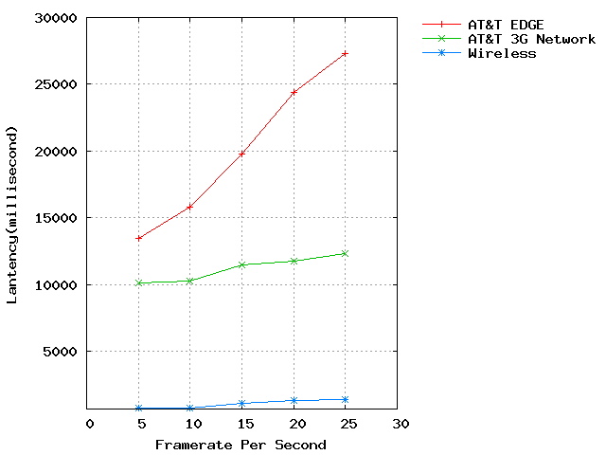
Experiments – Latency(Mobile)
Latency Tests in Different Networks

Slide 33
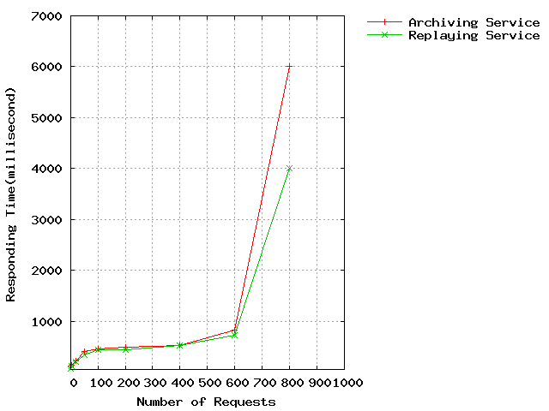
Experiments –Scalability
Responding time of Archiving & Replaying Service for different number of requests

Slide 34
Experiments –Scalability
Average time before session list changes under different system loads
Messages per Second | Average time(ms)
0 | 0
314 | 0.73
876 | 1.11
1219 | 1.79
1682 | 2.41
2013 | 2.99
2508 | 3.87

Slide 35
Outline
Introduction
Motivation
Research Background
Collaborative Annotation Framework
Annotation in Mobile
Experiments
Contribution & Future work

Slide 36
Conclusion & Future work
Reasonable performance
Good scalability
Inter-operation between desktop and mobile systems
Stability
Increase the number of supported streams
Introduce more mobile platforms: iOS and Windows Phone, Linux based mobile systems

Slide 37
References
Tao Huang, Geoffrey Fox Collaborative Annotation of Real Time Streams on Android-Enabled Devices Workshop 13-IoT Internet of Things, Machine to Machine and Smart Services Applications (IoT 2012) at The 2012 International Conference on Collaboration Technologies and Systems (CTS 2012) May 21-25, 2012 The Westin Westminster Hotel Denver, Colorado, USA, Technical Report February 14 2012
Tao Huang, Shrideep Pallickara, Geoffrey Fox A Distributed Framework for Collaborative Annotation of Streams Proceeedings of The 2009 International Symposium on Collaborative Technologies and Systems CTS 2009 May 18-22, 2009 The Westin Baltimore Washington International Airport Hotel Baltimore, Maryland, USA
Wenjun Wu, Tao Huang, Geoffrey Fox Building Scalable and High Efficient Java Multimedia Collaboration Proceedings of IEEE 2006 International Symposium on Collaborative Technologies and Systems CTS 2006 conference Las Vegas May 14-17 2006; IEEE Computer Society, Ed: Smari, Waleed & McQuay, William, pp18-25. ISBN 0-9785699-0-3 DOI
Wenjun Wu, Geoffrey Fox, Hasan Bulut, Ahmet Uyar, Tao Huang Service Oriented Architecture for VoIP conferencing. Special Issue on Voice over IP - Theory and Practice of the International Journal of Communication Systems Volume 19, Issue 4 , Pages 445 - 461 Edited by John Fox, P. GburzynskiDOI

Slide 38
Acknowledgement
My Advisor: Prof. Geoffrey C. Fox
Professors in my Research Committee
Prof. Shrideep Pallickara (Colorado State University)
Staff and Memebers of Pervasive Technology Institute

Slide 39

Thanks
Any Questions

