Slide 1
Data Intensive Cyberinfrastructure
University of Tennessee, Knoxsville
August 26 2010
Geoffrey Fox
gcf@indiana.edu
http://www.infomall.org http://www.futuregrid.org
Director, Digital Science Center, Pervasive Technology Institute
Associate Dean for Research and Graduate Studies, School of Informatics and Computing
Indiana University Bloomington

Slide 2
Data Intensive Cyberinfrastructure
Abstract
The technology landscape is changing rapidly with CPU and clouds growing in importance compared to Grids. On the application side, the data deluge is bringing new computational challenges and opportunities. We use bioinformatics and information retrieval to contrast the architecture differences between data analysis/mining and large scale simulation. We critique MapReduce and MPI and suggest that runtimes interpolating between these paradigms are appropriate. Performance results compare commercial clouds and traditional clusters and we highlight FutureGrid as a platform to explore these emerging ideas..

Slide 3
Layout of the Talk
Important Trends
Cloud Technologies
Data Intensive Science Applications
  Use of Clouds
  Algorithms
FutureGrid

Slide 4
Important Trends
Data Deluge in all fields of science
Multicore implies parallel computing important again
  Performance from extra cores – not extra clock speed
  GPU enhanced systems can give big power boost
Clouds – new commercially supported data center model replacing compute grids (and your general purpose computer center)
Light weight clients: Sensors, Smartphones and tablets accessing and supported by backend services in cloud
Commercial efforts moving much faster than academia in both innovation and deployment

Slide 5
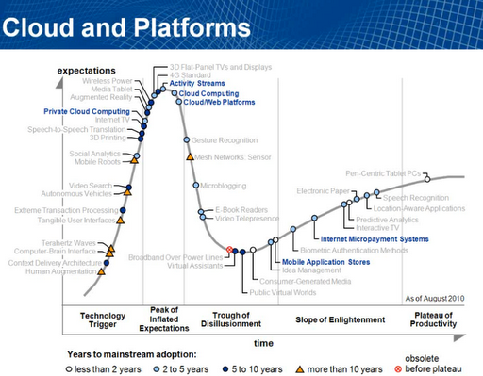

Gartner 2009 Hype Curve
Clouds, Web2.0
Service Oriented Architectures

Slide 6



Data Centers Clouds & economies of scale
Range in size from “edge” facilities to megascale.
Economies of scale
  Approximate costs for a small size center (1K servers) and a larger, 50K server center.
2 Google warehouses of computers on the banks of the Columbia River, in The Dalles, Oregon
Such centers use 20MW-200MW
(Future) each with 150 watts per CPU
Save money from large size, positioning with cheap power and access with Internet
Technology | Cost in small-sized Data Center | Cost in Large Data Center | Ratio
Network | $95 per Mbps/ month | $13 per Mbps/ month | 7.1
Storage | $2.20 per GB/ month | $0.40 per GB/ month | 5.7
Administration | ~140 servers/ Administrator | >1000 Servers/ Administrator | 7.1
Each data center is
11.5 times
the size of a football field

Slide 7


Data Centers, Clouds
& economies of scale II
Builds giant data centers with 100,000’s of computers;
~ 200-1000 to a shipping container with Internet access
“Microsoft will cram between 150 and 220 shipping containers filled with data center gear into a new 500,000 square foot Chicago facility. This move marks the most significant, public use of the shipping container systems popularized by the likes of Sun Microsystems and Rackable Systems to date.”

Slide 8
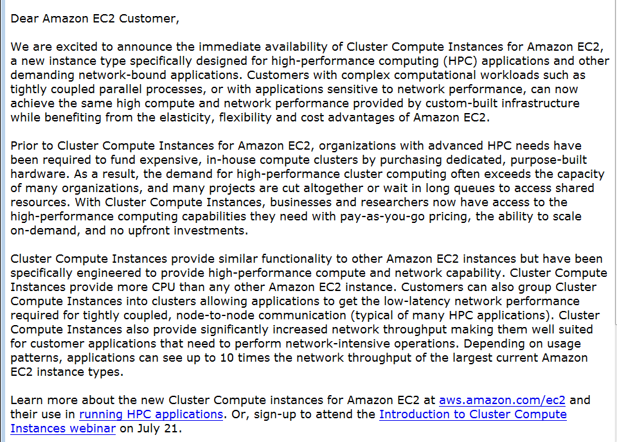


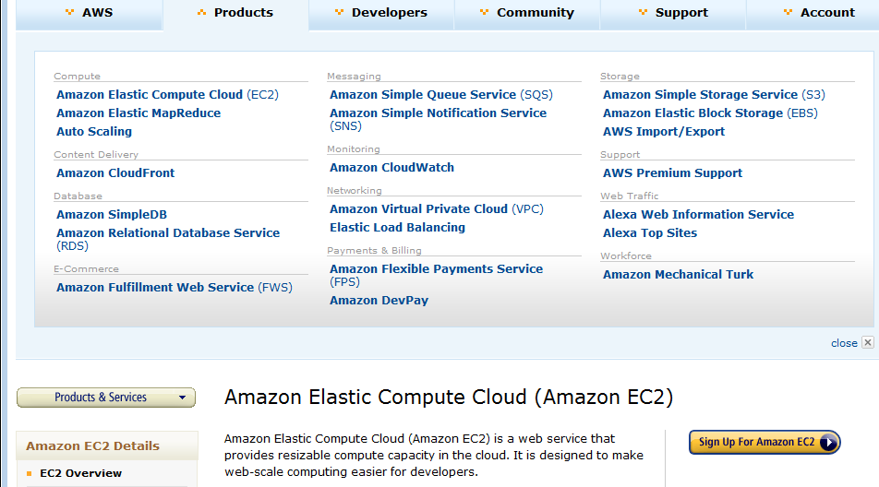





Amazon offers a lot!
The Cluster Compute Instances use hardware-assisted (HVM) virtualization instead of the paravirtualization used by the other instance types and requires booting from EBS, so you will need to create a new AMI in order to use them. We suggest that you use our Centos-based AMI as a base for your own AMIs for optimal performance. See the EC2 User Guide or the EC2 Developer Guide for more information.
The only way to know if this is a genuine HPC setup is to benchmark it, and we've just finished doing so. We ran the gold-standard High Performance Linpack benchmark on 880 Cluster Compute instances (7040 cores) and measured the overall performance at 41.82 TeraFLOPS using Intel's MPI (Message Passing Interface) and MKL (Math Kernel Library) libraries, along with their compiler suite. This result places us at position 146 on the Top500 list of supercomputers. The input file for the benchmark is here and the output file is here.

Slide 9
Philosophy of Clouds and Grids
Clouds are (by definition) commercially supported approach to large scale computing
  So we should expect Clouds to replace Compute Grids
  Current Grid technology involves “non-commercial” software solutions which are hard to evolve/sustain
  Maybe Clouds ~4% IT expenditure 2008 growing to 14% in 2012 (IDC Estimate)
Public Clouds are broadly accessible resources like Amazon and Microsoft Azure – powerful but not easy to customize and perhaps data trust/privacy issues
Private Clouds run similar software and mechanisms but on “your own computers” (not clear if still elastic)
  Platform features such as Queues, Tables, Databases limited
Services still are correct architecture with either REST (Web 2.0) or Web Services
Clusters still critical concept

Slide 10
















X as a Service
SaaS: Software as a Service imply software capabilities
(programs) have a service (messaging) interface
  Applying systematically reduces system complexity to being linear in number of components
  Access via messaging rather than by installing in /usr/bin
IaaS: Infrastructure as a Service or HaaS: Hardware as a Service – get your computer time with a credit card and with a Web interface
PaaS: Platform as a Service is IaaS plus core software capabilities on which you build SaaS
Cyberinfrastructure is “Research as a Service”
SensaaS is Sensors (Instruments) as a Service (cf. Data as a Service)
Other Services
Clients

Slide 11
Grids and Clouds + and -
Grids are useful for managing distributed systems
  Pioneered service model for Science
  Developed importance of Workflow
  Performance issues – communication latency – intrinsic to distributed systems
Clouds can execute any job class that was good for Grids plus
  More attractive due to platform plus elasticity
  Currently have performance limitations due to poor affinity (locality) for compute-compute (MPI) and Compute-data
  These limitations are not “inevitable” and should gradually improve

Slide 12
Cloud Computing:
Infrastructure and Runtimes
Cloud infrastructure: outsourcing of servers, computing, data, file space, utility computing, etc.
  Handled through Web services that control virtual machine lifecycles.
Cloud runtimes or Platform: tools (for using clouds) to do data-parallel (and other) computations.
  Apache Hadoop, Google MapReduce, Microsoft Dryad, Bigtable, Chubby and others
  MapReduce designed for information retrieval but is excellent for a wide range of science data analysis applications
  Can also do much traditional parallel computing for data-mining if extended to support iterative operations
  MapReduce not usually on Virtual Machines

Slide 13
Authentication and Authorization: Provide single sign in to both FutureGrid and Commercial Clouds linked by workflow
Workflow: Support workflows that link job components between FutureGrid and Commercial Clouds. Trident from Microsoft Research is initial candidate
Data Transport: Transport data between job components on FutureGrid and Commercial Clouds respecting custom storage patterns
Program Library: Store Images and other Program material (basic FutureGrid facility)
Blob: Basic storage concept similar to Azure Blob or Amazon S3
DPFS Data Parallel File System: Support of file systems like Google (MapReduce), HDFS (Hadoop) or Cosmos (dryad) with compute-data affinity optimized for data processing
Table: Support of Table Data structures modeled on Apache Hbase or Amazon SimpleDB/Azure Table
SQL: Relational Database
Queues: Publish Subscribe based queuing system
Worker Role: This concept is implicitly used in both Amazon and TeraGrid but was first introduced as a high level construct by Azure
MapReduce: Support MapReduce Programming model including Hadoop on Linux, Dryad on Windows HPCS and Twister on Windows and Linux
Software as a Service: This concept is shared between Clouds and Grids and can be supported without special attention
Web Role: This is used in Azure to describe important link to user and can be supported in FutureGrid with a Portal framework

Slide 14
MapReduce
Data Partitions
Map(Key, Value)
A hash function maps the results of the map tasks to reduce tasks
Reduce(Key, List<Value>)
Reduce Outputs
Implementations (Hadoop – Java; Dryad – Windows) support:
  Splitting of data
  Passing the output of map functions to reduce functions
  Sorting the inputs to the reduce function based on the intermediate keys
  Quality of service

Slide 15






MapReduce “File/Data Repository” Parallelism
Map = (data parallel) computation reading and writing data
Reduce = Collective/Consolidation phase e.g. forming multiple global sums as in histogram
Instruments
Iterative MapReduce
Map Map Map Map
Reduce Reduce Reduce
Communication
Reduce
Portals
/Users
Disks
Map₁
Map₂
Map₃

Slide 16

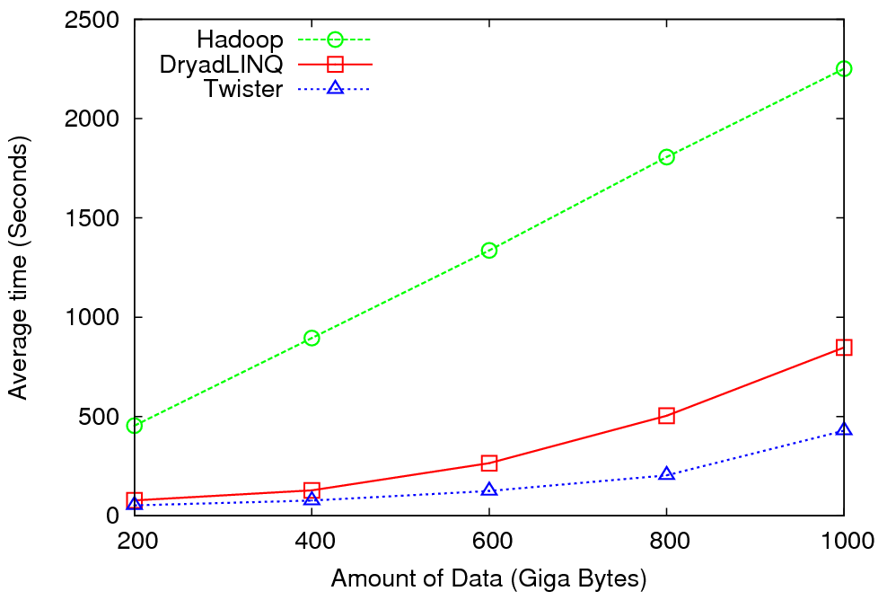
High Energy Physics Data Analysis
An application analyzing data from Large Hadron Collider
(1TB but 100 Petabytes eventually)
Input to a map task: <key, value>
key = Some Id value = HEP file Name
Output of a map task: <key, value>
key = random # (0<= num<= max reduce tasks)
value = Histogram as binary data
Input to a reduce task: <key, List<value>>
key = random # (0<= num<= max reduce tasks)
value = List of histogram as binary data
Output from a reduce task: value
value = Histogram file
Combine outputs from reduce tasks to form the final histogram

Slide 17

Reduce Phase of Particle Physics
“Find the Higgs” using Dryad
Higgs in Monte Carlo
Combine Histograms produced by separate Root “Maps” (of event data to partial histograms) into a single Histogram delivered to Client

Slide 18
Broad Architecture Components
Traditional Supercomputers (TeraGrid and DEISA) for large scale parallel computing – mainly simulations
  Likely to offer major GPU enhanced systems
Traditional Grids for handling distributed data – especially instruments and sensors
Clouds for “high throughput computing” including much data analysis and emerging areas such as Life Sciences using loosely coupled parallel computations
  May offer small clusters for MPI style jobs
  Certainly offer MapReduce
Integrating these needs new work on distributed file systems and high quality data transfer service
  Link Lustre WAN, Amazon/Google/Hadoop/Dryad File System
  Offer Bigtable (distributed scalable Excel)

Slide 19

Application Classes
Old classification of Parallel software/hardware in terms of
5 (becoming 6) “Application architecture” Structures)
1 | Synchronous | Lockstep Operation as in SIMD architectures | SIMD
2 | Loosely Synchronous | Iterative Compute-Communication stages with independent compute (map) operations for each CPU. Heart of most MPI jobs | MPP
3 | Asynchronous | Computer Chess; Combinatorial Search often supported by dynamic threads | MPP
4 | Pleasingly Parallel | Each component independent – in 1988, Fox estimated at 20% of total number of applications | Grids
5 | Metaproblems | Coarse grain (asynchronous) combinations of classes 1)-4). The preserve of workflow. | Grids
6 | MapReduce++ | It describes file(database) to file(database) operations which has subcategories including. Pleasingly Parallel Map Only Map followed by reductions Iterative “Map followed by reductions” – Extension of Current Technologies that supports much linear algebra and datamining | Clouds Hadoop/ Dryad Twister
Notes:
CGL-MapReduce is an example of MapReduce++ -- supports MapReduce model with iteration (data stays in memory and communication via streams not files)

Slide 20
Applications & Different Interconnection Patterns
Map Only | Classic MapReduce | Iterative Reductions MapReduce++ | Loosely Synchronous
CAP3 Analysis Document conversion (PDF -> HTML) Brute force searches in cryptography Parametric sweeps | High Energy Physics (HEP) Histograms SWG gene alignment Distributed search Distributed sorting Information retrieval | Expectation maximization algorithms Clustering Linear Algebra | Many MPI scientific applications utilizing wide variety of communication constructs including local interactions
- CAP3 Gene Assembly - PolarGrid Matlab data analysis | - Information Retrieval - HEP Data Analysis - Calculation of Pairwise Distances for ALU Sequences | Kmeans Deterministic Annealing Clustering - Multidimensional Scaling MDS | - Solving Differential Equations and - particle dynamics with short range forces
Input
iterations
Input
Input
map
map
map
Pij
reduce
Output
reduce
Domain of MapReduce and Iterative Extensions
MPI

Slide 21
Fault Tolerance and MapReduce
MPI does “maps” followed by “communication” including “reduce” but does this iteratively
There must (for most communication patterns of interest) be a strict synchronization at end of each communication phase
  Thus if a process fails then everything grinds to a halt
In MapReduce, all Map processes and all reduce processes are independent and stateless and read and write to disks
  As 1 or 2 (reduce+map) iterations, no difficult synchronization issues
Thus failures can easily be recovered by rerunning process without other jobs hanging around waiting
Re-examine MPI fault tolerance in light of MapReduce
  Twister will interpolate between MPI and MapReduce

Slide 22


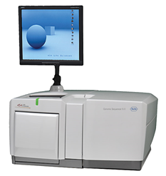
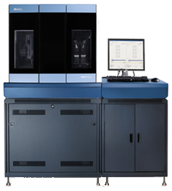
DNA Sequencing Pipeline
MapReduce
Pairwise
clustering
Sequence
alignment
Dissimilarity
Matrix
N(N-1)/2 values
Visualization
Plotviz
FASTA File
N Sequences
Blocking
block
Pairings
MPI
MDS
Read Alignment
Illumina/Solexa Roche/454 Life Sciences Applied Biosystems/SOLiD
Internet
Modern Commercial Gene Sequencers
This chart illustrate our research of a pipeline mode to provide services on demand (Software as a Service SaaS)
User submit their jobs to the pipeline. The components are services and so is the whole pipeline.

Slide 23
Alu and Metagenomics Workflow
“All pairs” problem
Data is a collection of N sequences. Need to calculate N² dissimilarities (distances) between sequnces (all pairs).
  These cannot be thought of as vectors because there are missing characters
  “Multiple Sequence Alignment” (creating vectors of characters) doesn’t seem to work if N larger than O(100), where 100’s of characters long.
Step 1: Can calculate N² dissimilarities (distances) between sequences
Step 2: Find families by clustering (using much better methods than Kmeans). As no vectors, use vector free O(N²) methods
Step 3: Map to 3D for visualization using Multidimensional Scaling (MDS) – also O(N²)
Results:
N = 50,000 runs in 10 hours (the complete pipeline above) on 768 cores
Discussions:
Need to address millions of sequences …..
Currently using a mix of MapReduce and MPI
Twister will do all steps as MDS, Clustering just need MPI Broadcast/Reduce

Slide 24

Alu Families
This visualizes results of Alu repeats from Chimpanzee and Human Genomes. Young families (green, yellow) are seen as tight clusters. This is projection of MDS dimension reduction to 3D of 35399 repeats – each with about 400 base pairs

Slide 25

Metagenomics
This visualizes results of dimension reduction to 3D of 30000 gene sequences from an environmental sample. The many different genes are classified by clustering algorithm and visualized by MDS dimension reduction

Slide 26

All-Pairs Using DryadLINQ
125 million distances
4 hours & 46 minutes
Calculate Pairwise Distances (Smith Waterman Gotoh)
Calculate pairwise distances for a collection of genes (used for clustering, MDS)
Fine grained tasks in MPI
Coarse grained tasks in DryadLINQ
Performed on 768 cores (Tempest Cluster)
Moretti, C., Bui, H., Hollingsworth, K., Rich, B., Flynn, P., & Thain, D. (2009). All-Pairs: An Abstraction for Data Intensive Computing on Campus Grids. IEEE Transactions on Parallel and Distributed Systems , 21, 21-36.

Slide 27
Hadoop/Dryad Comparison
Inhomogeneous Data I
Inhomogeneity of data does not have a significant effect when the sequence lengths are randomly distributed
Dryad with Windows HPCS compared to Hadoop with Linux RHEL on Idataplex (32 nodes)

Slide 28
Hadoop/Dryad Comparison
Inhomogeneous Data II
This shows the natural load balancing of Hadoop MR dynamic task assignment using a global pipe line in contrast to the DryadLinq static assignment
Dryad with Windows HPCS compared to Hadoop with Linux RHEL on Idataplex (32 nodes)

Slide 29
Hadoop VM Performance Degradation
Perf. Degradation = (T_{vm} – T_{baremetal})/T_{baremetal}
15.3% Degradation at largest data set size

Slide 30

Twister(MapReduce++)
Pub/Sub Broker Network
Map Worker
M
Worker Nodes
R
Reduce Worker
Streaming based communication
Intermediate results are directly transferred from the map tasks to the reduce tasks – eliminates local files
Cacheable map/reduce tasks
  Static data remains in memory
Combine phase to combine reductions
User Program is the composer of MapReduce computations
Extends the MapReduce model to iterative computations
D
D
MR
Driver
User
Program
M
M
M
M
D
MRDeamon
R
R
R
R
Data Read/Write
Communication
Data Split
File System
Iterate
Static
data
Configure()
User Program
Map(Key, Value)
δ flow
Reduce (Key, List<Value>)
Combine (Key, List<Value>)
Different synchronization and intercommunication mechanisms used by the parallel runtimes
Close()

Slide 31


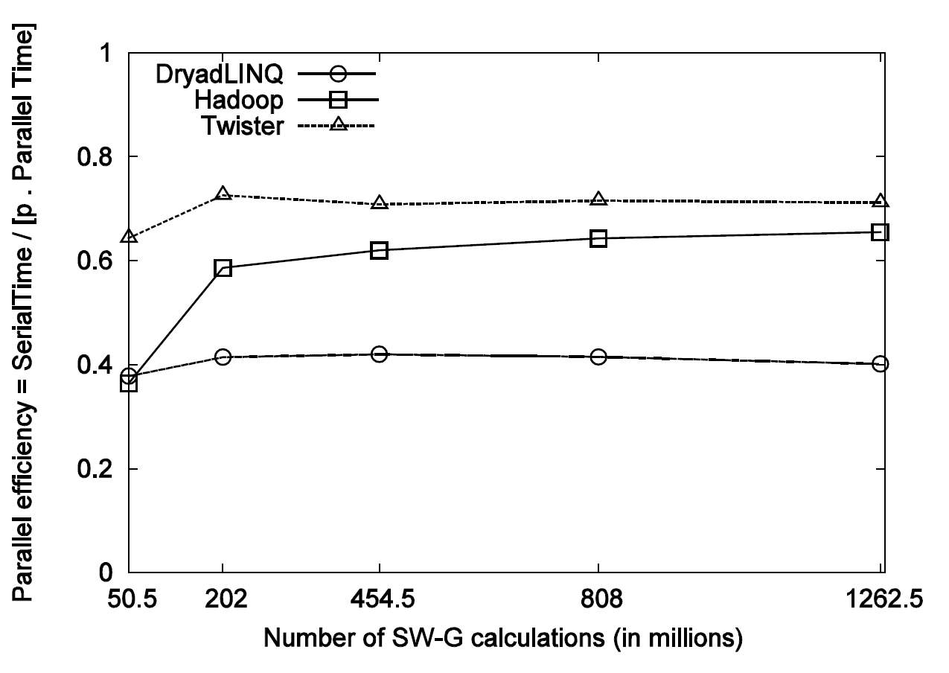
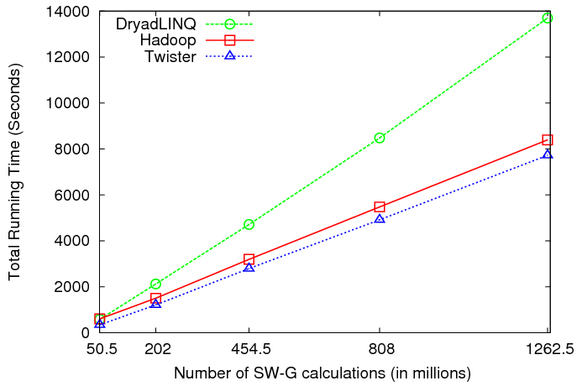
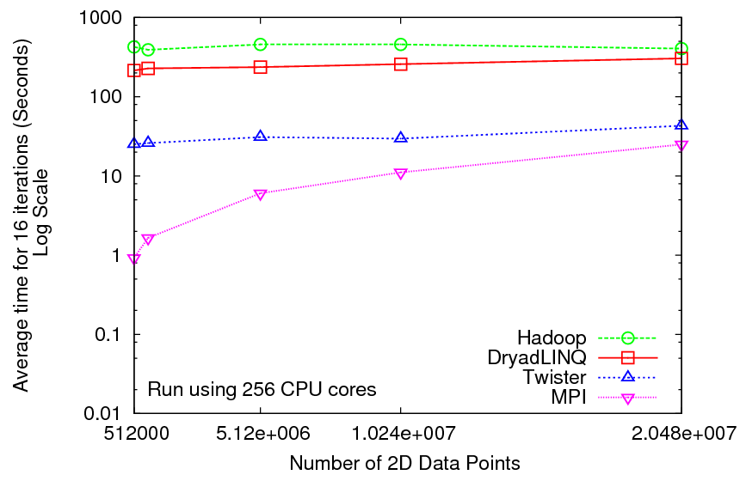
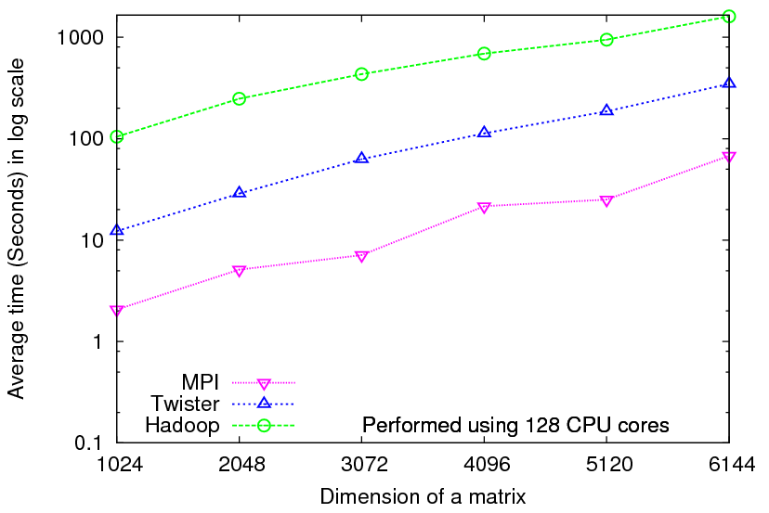
Iterative Computations
K-means
Matrix Multiplication
Smith Waterman
Performance of K-Means
Performance Matrix Multiplication

Slide 32

Performance of Pagerank using
ClueWeb Data (Time for 20 iterations)
using 32 nodes (256 CPU cores) of Crevasse

Slide 33
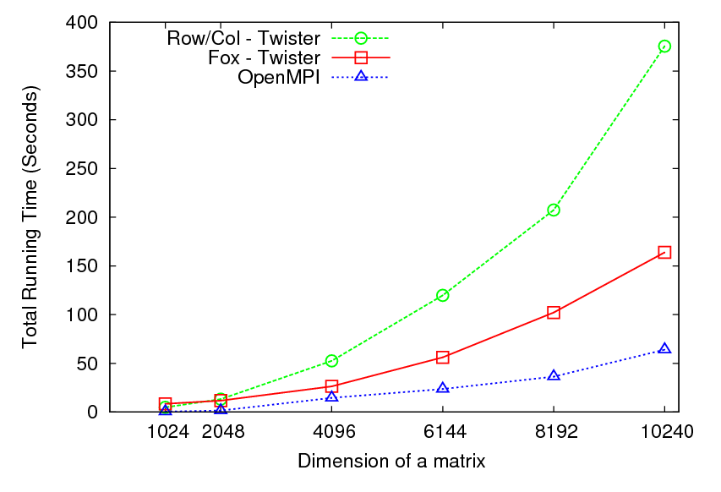
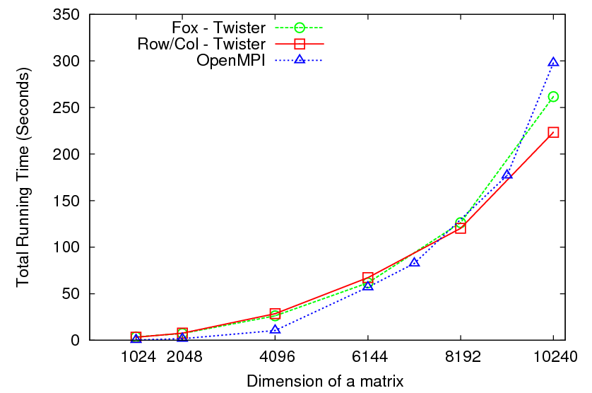
Matrix Multiplication
32 nodes
8 nodes

Slide 34
TwisterMPIReduce
PairwiseClustering
MPI
Multi Dimensional Scaling MPI
Generative Topographic Mapping MPI
Other …
TwisterMPIReduce
Azure Twister (C# C++)
Java Twister
Microsoft Azure
FutureGrid
Local Cluster
Amazon EC2
Runtime package supporting subset of MPI mapped to Twister
Set-up, Barrier, Broadcast, Reduce

Slide 35
2916 iterations
(384 CPUcores)
968 iterations
(384 CPUcores)
343 iterations
(768 CPU cores)

Slide 36


Sequence Assembly in the Clouds
Cap3 parallel efficiency
Cap3 – Per core per file (458 reads in each file) time to process sequences

Slide 37


Applications using Dryad & DryadLINQ
CAP3 - Expressed Sequence Tag assembly to re-construct full-length mRNA
Input files (FASTA)
DryadLINQ
CAP3
CAP3
CAP3
Output files
Perform using DryadLINQ and Apache Hadoop implementations
Single “Select” operation in DryadLINQ
“Map only” operation in Hadoop
X. Huang, A. Madan, “CAP3: A DNA Sequence Assembly Program,” Genome Research, vol. 9, no. 9, pp. 868-877, 1999.

Slide 38
Cap3 Performance with different EC2 Instance Types
Notes:
Instance Type CPU Cores Memory Local Disk Space Cost per hour
Small 1 1.7 GB 250 GB 0.12$
Medium 2 3.5 GB 500 GB 0.24$
Large 4 7 GB 1000 GB 0.48$
Extra Large 8 15 GB 2000 GB 0.96$

Slide 39
 | AWS/ Azure | Hadoop | DryadLINQ
Programming patterns | Independent job execution | MapReduce | DAG execution, MapReduce + Other patterns
Fault Tolerance | Task re-execution based on a time out | Re-execution of failed and slow tasks. | Re-execution of failed and slow tasks.
Data Storage | S3/Azure Storage. | HDFS parallel file system. | Local files
Environments | EC2/Azure, local compute resources | Linux cluster, Amazon Elastic MapReduce | Windows HPCS cluster
Ease of Programming | EC2 : ** Azure: *** | **** | ****
Ease of use | EC2 : *** Azure: ** | *** | ****
Scheduling & Load Balancing | Dynamic scheduling through a global queue, Good natural load balancing | Data locality, rack aware dynamic task scheduling through a global queue, Good natural load balancing | Data locality, network topology aware scheduling. Static task partitions at the node level, suboptimal load balancing

Slide 40
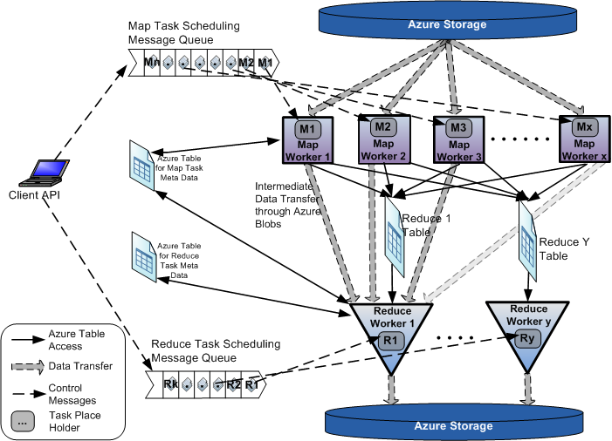
AzureMapReduce

Slide 41
Early Results with
AzureMapreduce
Compare
Hadoop - 4.44 ms Hadoop VM - 5.59 ms DryadLINQ - 5.45 ms Windows MPI - 5.55 ms

Slide 42
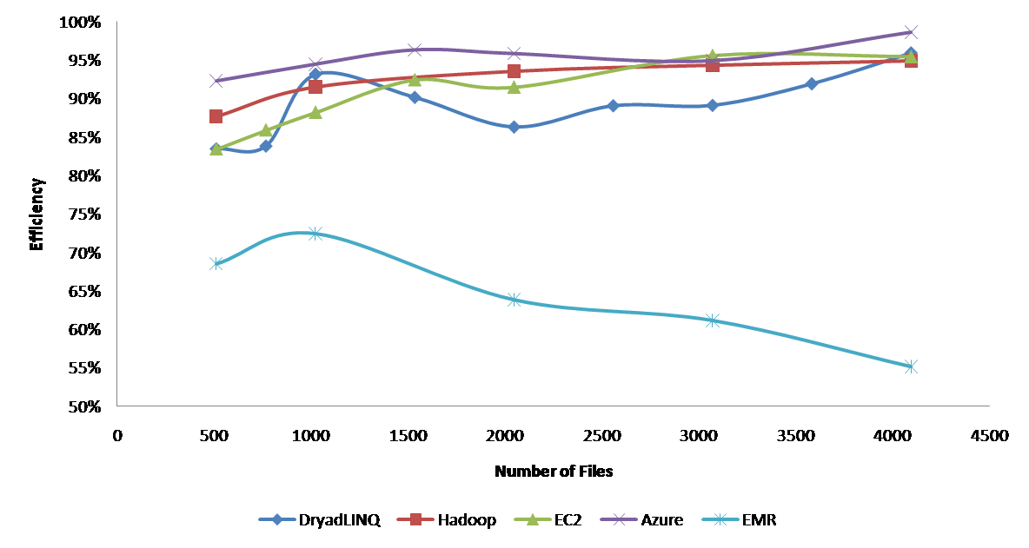
Currently we can’t make Amazon Elastic MapReduce run well
Hadoop runs well on Xen FutureGrid Virtual Machines

Slide 43
Some Issues with AzureTwister and AzureMapReduce
Transporting data to Azure: Blobs (HTTP), Drives (GridFTP etc.), Fedex disks
Intermediate data Transfer: Blobs (current choice) versus Drives (should be faster but don’t seem to be)
Azure Table v Azure SQL: Handle all metadata
Messaging Queues: Use real publish-subscribe system in place of Azure Queues
Azure Affinity Groups: Could allow better data-compute and compute-compute affinity

Slide 44
Parallel Data Analysis Algorithms on Multicore
Developing a suite of parallel data-analysis capabilities
  Clustering with deterministic annealing (DA)
  Dimension Reduction for visualization and analysis (MDS, GTM)
  Matrix algebra as needed
    Matrix Multiplication
    Equation Solving
    Eigenvector/value Calculation
Notes:
Results
Microsoft CCR supports MPI, dynamic threading
Detailed performance measurements with Speedups of 7.5 or above on 8-core systems for “large problems” using deterministic annealed (avoid local minima) algorithms for clustering, Gaussian Mixtures, GTM (dimensional reduction) etc.

Slide 45
General Deterministic Annealing Formula
N data points E(x) in D dimensions space and minimize F by EM
  Deterministic Annealing Clustering (DAC)
F is Free Energy
EM is well known expectation maximization method
p(x) with Σ p(x) =1
T is annealing temperature varied down from ∞ with final value of 1
Determine cluster center Y(k) by EM method
K (number of clusters) starts at 1 and is incremented by algorithm

Slide 46
Deterministic Annealing I
Gibbs Distribution at Temperature T
P(χ) = exp( - H(χ)/T) / ∫ dχ exp( - H(χ)/T)
Or P(χ) = exp( - H(χ)/T + F/T )
Minimize Free Energy
F = < H - T S(P) > = ∫ dχ {P(χ)H + T P(χ) lnP(χ)}
Where χ are (a subset of) parameters to be minimized
Simulated annealing corresponds to doing these integrals by Monte Carlo
Deterministic annealing corresponds to doing integrals analytically and is naturally much faster
In each case temperature is lowered slowly – say by a factor 0.99 at each iteration

Slide 47
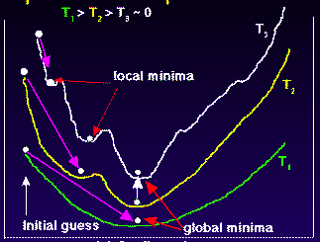
Deterministic
Annealing
F({y}, T)
Solve Linear Equations for each temperature
Nonlinearity effects mitigated by initializing with solution at previous higher temperature
Configuration {y}
Minimum evolving as temperature decreases
Movement at fixed temperature going to local minima if not initialized “correctly

Slide 48
Deterministic Annealing II
For some cases such as vector clustering and Gaussian Mixture Models one can do integrals by hand but usually will be impossible
So introduce Hamiltonian H₀(χ, ε) which by choice of ε can be made similar to H(χ) and which has tractable integrals
P₀(χ) = exp( - H₀(χ)/T + F₀/T ) approximate Gibbs
F_{R} (P₀) = < H_{R} - T S₀(P₀) >|₀ = < H_{R} – H₀> |₀ + F₀(P₀)
Where <…>|₀ denotes ∫ dχ P_{o}(χ)
Easy to show that real Free Energy
F_{A} (P_{A}) ≤ F_{R} (P₀)
In many problems, decreasing temperature is classic multiscale – finer resolution (T is “just” distance scale)
Related to variational inference

Slide 49
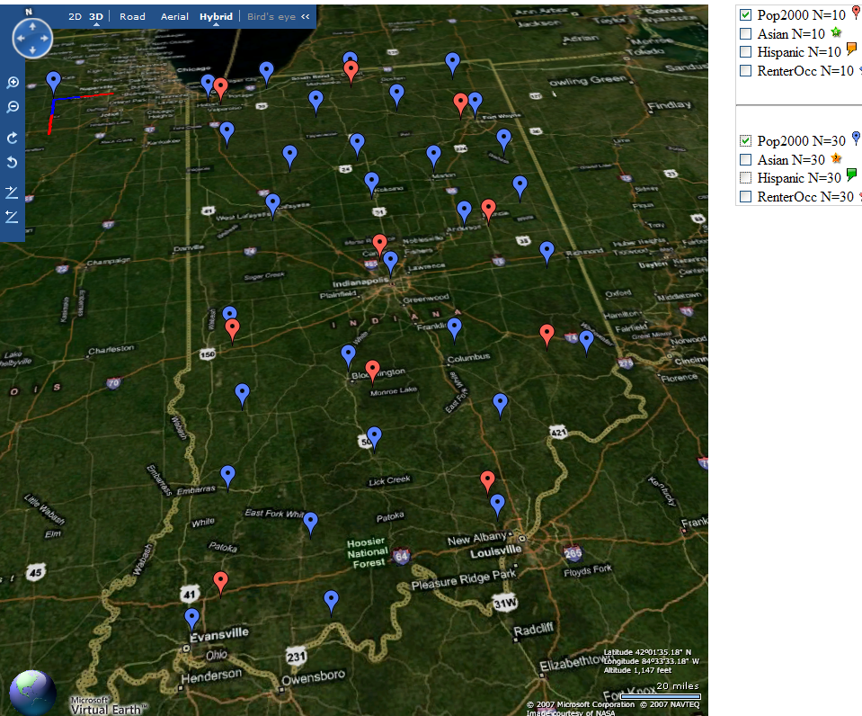
Deterministic Annealing Clustering of Indiana Census Data
Decrease temperature (distance scale) to discover more clusters
Distance Scale
Temperature^{0.5}
Red is coarse resolution with 10 clusters
Blue is finer resolution with 30 clusters
Clusters find cities in Indiana
Distance Scale is √Temperature

Slide 50
Implementation of DA I
Expectation step E is find ε minimizing F_{R} (P₀) and
Follow with M step setting χ = <χ> |₀ = ∫ dχ χ P_{o}(χ) and if one does not anneal over all parameters and one follows with a traditional minimization of remaining parameters
In clustering, one then looks at second derivative matrix of F_{R} (P₀) wrt ε and as temperature is lowered this develops negative eigenvalue corresponding to instability
This is a phase transition and one splits cluster into two and continues EM iteration
One starts with just one cluster

Slide 51
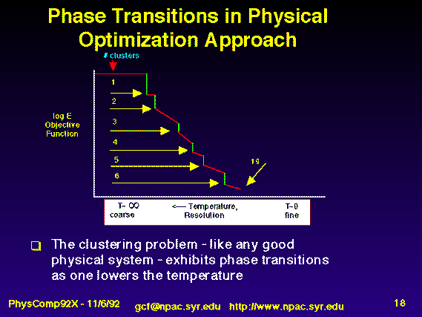
Rose, K., Gurewitz, E., and Fox, G. C. ``Statistical mechanics and phase transitions in clustering,'' Physical Review Letters, 65(8):945-948, August 1990.
My #5 my most cited article (311)

Slide 52
Implementation II
Clustering variables are M_{i}(k) where this is probability point i belongs to cluster k
In Clustering, take H₀ = ∑_{i=1}^{N} ∑_{k=1}^{K} M_{i}(k) ε_{i}(k)
<M_{i}(k)> = exp( -ε_{i}(k)/T ) / ∑_{k=1}^{K} exp( -ε_{i}(k)/T )
Central clustering has ε_{i}(k) = (X(i)- Y(k))² and ε_{i}(k) determined by Expectation step in pairwise clustering
  H_{Central} = ∑_{i=1}^{N} ∑_{k=1}^{K} M_{i}(k) (X(i)- Y(k))²
  H_{central} and H₀ are identical
  Centers Y(k) are determined in M step
Pairwise Clustering given by nonlinear form
H_{PC} = 0.5 ∑_{i=1}^{N} ∑_{j=1}^{N} δ(i, j) ∑_{k=1}^{K} M_{i}(k) M_{j}(k) / C(k)
with C(k) = ∑_{i=1}^{N} M_{i}(k) as number of points in Cluster k
And now H₀ and H_{PC} are different

Slide 53
Multidimensional Scaling MDS
Map points in high dimension to lower dimensions
Many such dimension reduction algorithm (PCA Principal component analysis easiest); simplest but perhaps best is MDS
Minimize Stress
σ(X) = Σ_{i<j=1}^{n} weight(i,j) (δ_{ij} - d(X_{i} , X_{j}))²
δ_{ij} are input dissimilarities and d(X_{i} , X_{j}) the Euclidean distance squared in embedding space (3D usually)
SMACOF or Scaling by minimizing a complicated function is clever steepest descent (expectation maximization EM) algorithm
Computational complexity goes like N². Reduced Dimension
There is Deterministic annealed version of it
Could just view as non linear χ² problem (Tapia et al. Rice)
All will/do parallelize with high efficiency

Slide 54
Implementation III
One tractable form was linear Hamiltonians
Another is Gaussian H₀ = Σ_{i=1}^{n} (X(i) - μ(i))² / 2
Where X(i) are vectors to be determined as in formula for Multidimensional scaling
H_{MDS} = Σ_{i< j=1}^{n} weight(i,j) (δ(i, j) - d(X(i) , X(j) ))²
Where δ(i, j) are observed dissimilarities and we want to represent as Euclidean distance between points X(i) and X(j) (H_{MDS} is quartic or involves square roots)
The E step is minimize
Σ_{i< j=1}^{n} weight(i,j) (δ(i, j) – constant.T - (μ(i) - μ(j))² )²
with solution μ(i) = 0 at large T
Points pop out from origin as Temperature lowered

Slide 55
High Performance Dimension Reduction and Visualization
Need is pervasive
  Large and high dimensional data are everywhere: biology, physics, Internet, …
  Visualization can help data analysis
Visualization of large datasets with high performance
  Map high-dimensional data into low dimensions (2D or 3D).
  Need Parallel programming for processing large data sets
  Developing high performance dimension reduction algorithms:
    MDS(Multi-dimensional Scaling), used earlier in DNA sequencing application
    GTM(Generative Topographic Mapping)
    DA-MDS(Deterministic Annealing MDS)
    DA-GTM(Deterministic Annealing GTM)
  Interactive visualization tool PlotViz
We are supporting drug discovery by browsing 60 million compounds in PubChem database with 166 features each
Notes:
With David Wild

Slide 56
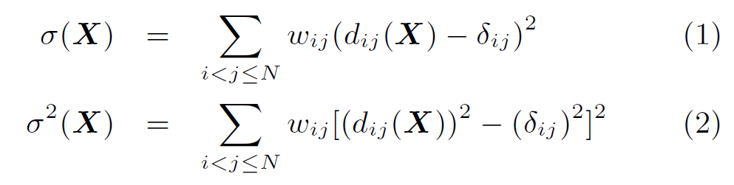

Dimension Reduction Algorithms
Multidimensional Scaling (MDS) [1]
  Given the proximity information among points.
  Optimization problem to find mapping in target dimension of the given data based on pairwise proximity information while minimize the objective function.
  Objective functions: STRESS (1) or SSTRESS (2)
  Only needs pairwise distances δ_{ij} between original points (typically not Euclidean)
  d_{ij}(X) is Euclidean distance between mapped (3D) points
Generative Topographic Mapping
(GTM) [2]
  Find optimal K-representations for the given data (in 3D), known as
  K-cluster problem (NP-hard)
  Original algorithm use EM method for optimization
  Deterministic Annealing algorithm can be used for finding a global solution
  Objective functions is to maximize log-likelihood:
[1] I. Borg and P. J. Groenen. Modern Multidimensional Scaling: Theory and Applications. Springer, New York, NY, U.S.A., 2005.
[2] C. Bishop, M. Svens´en, and C. Williams. GTM: The generative topographic mapping. Neural computation, 10(1):215–234, 1998.
Notes:
MDS implemented in C#; GTM in R and C/C++

Slide 57
GTM vs. MDS
GTM
MDS (SMACOF)
Purpose
Non-linear dimension reduction
Find an optimal configuration in a lower-dimension
Iterative optimization method
Objective
Function
Maximize Log-Likelihood
Minimize STRESS or SSTRESS
Complexity
O(KN) (K << N)
O(N²)
Optimization
Method
EM
Iterative Majorization (EM-like)
MDS also soluble by viewing as nonlinear χ² with iterative linear equation solver

Slide 58
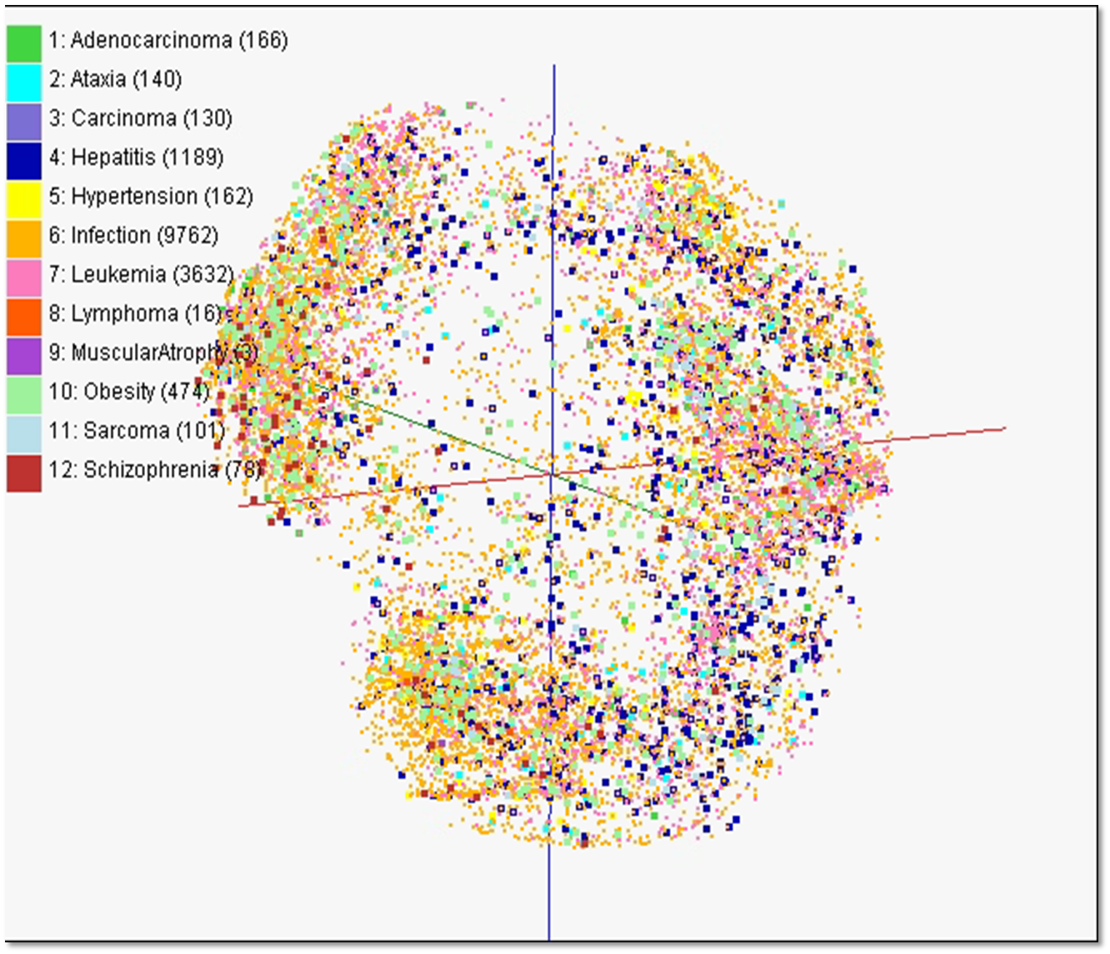
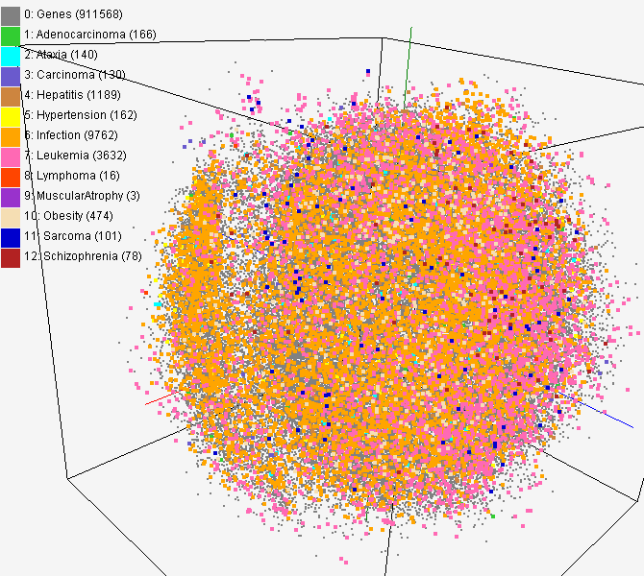
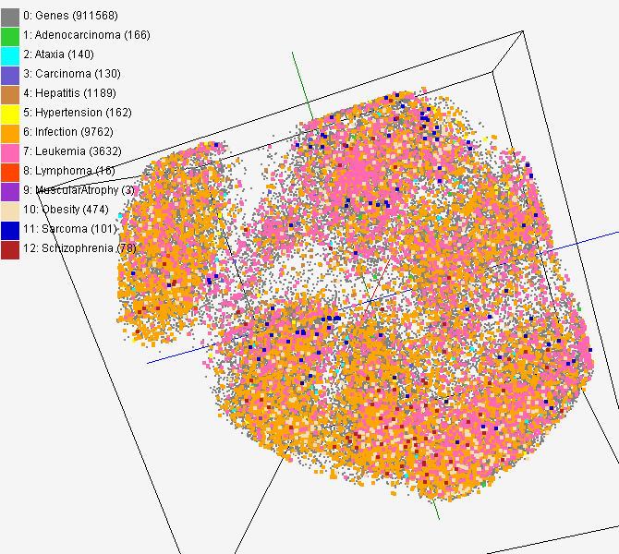
MDS and GTM Map (1)
PubChem data with CTD visualization by using MDS (left) and GTM (right)
About 930,000 chemical compounds are visualized as a point in 3D space, annotated by the related genes in Comparative Toxicogenomics Database (CTD)

Slide 59
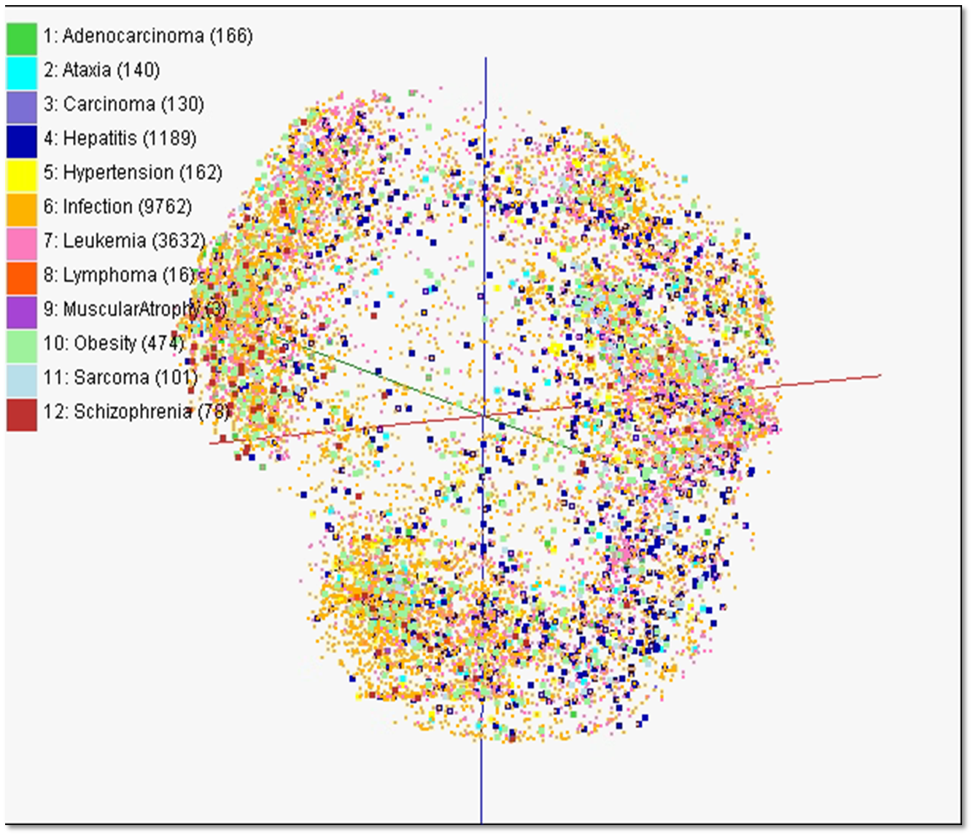

Slide 60
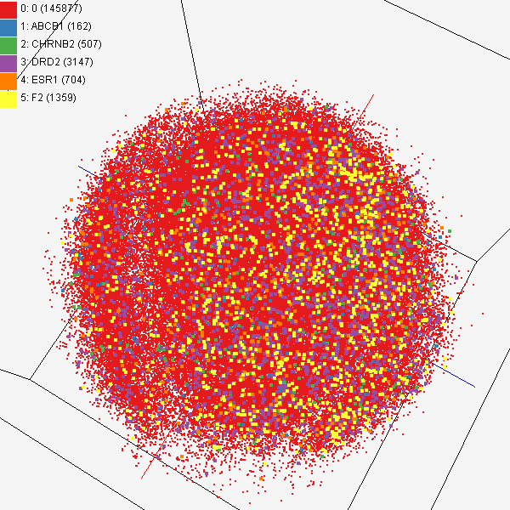
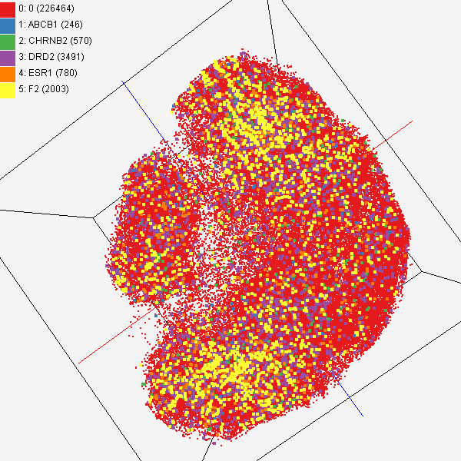
MDS and GTM Map (2)
Chemical compounds shown in literatures, visualized by MDS (left) and GTM (right)
Visualized 234,000 chemical compounds which may be related with a set of 5 genes of interest (ABCB1, CHRNB2, DRD2, ESR1, and F2) based on the dataset collected from major journal literatures which is also stored in Chem2Bio2RDF system.

Slide 61
Interpolation Method
MDS and GTM are highly memory and time consuming process for large dataset such as millions of data points
MDS requires O(N²) and GTM does O(KN) (N is the number of data points and K is the number of latent variables)
Training only for sampled data and interpolating for out-of-sample set can improve performance
Interpolation is a pleasingly parallel application suitable for MapReduce and Clouds
n
in-sample
Training
Trained data
N-n
out-of-sample
Interpolated
MDS/GTM map
Interpolation
Total N data

Slide 62
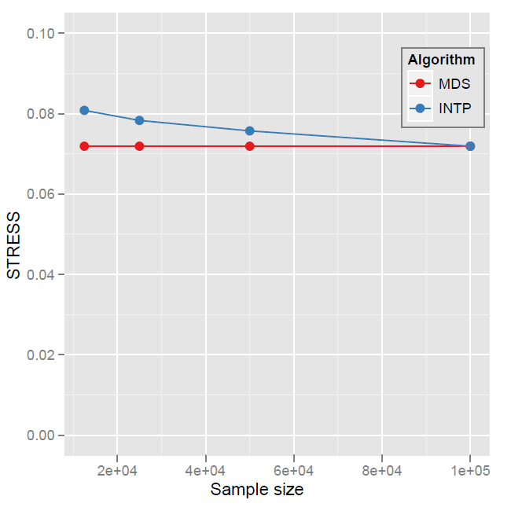
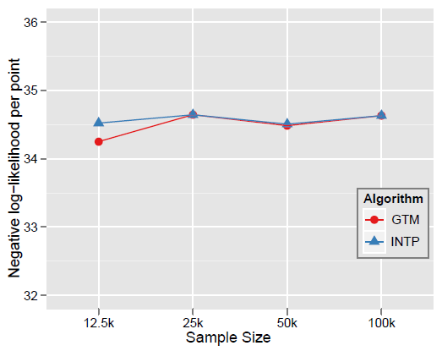

Quality Comparison
(O(N²) Full vs. Interpolation)
MDS
GTM
Quality comparison between Interpolated result upto 100k based on the sample data (12.5k, 25k, and 50k) and original MDS result w/ 100k.
STRESS:
w_{ij} = 1 / ∑δ_{ij}²
16 nodes
Interpolation result (blue) is getting close to the original (red) result as sample size is increasing.
Time = C(250 n² + nN_{I}) where sample size n and N_{I} points interpolated
Notes:
12.5K 25K 50K 100K Run on 16 nodes of Tempest
Note that we gain performance of over a factor of 100 for this data size. It would be more for larger data set.

Slide 63
Algorithms and Clouds I
Clouds are suitable for “Loosely coupled” data parallel applications
Quantify “loosely coupled” and define appropriate programming model
“Map Only” (really pleasingly parallel) certainly run well on clouds (subject to data affinity) with many programming paradigms
Parallel FFT and adaptive mesh PDE solver probably pretty bad on clouds but suitable for classic MPI engines
MapReduce and Twister are candidates for “appropriate programming model”
1 or 2 iterations (MapReduce) and Iterative with large messages (Twister) are “loosely coupled” applications
How important is compute-data affinity and concepts like HDFS

Slide 64
Algorithms and Clouds II
Platforms: exploit Tables as in SHARD (Scalable, High-Performance, Robust and Distributed) Triple Store based on Hadoop
  What are needed features of tables
Platforms: exploit MapReduce and its generalizations: are there other extensions that preserve its robust and dynamic structure
  How important is the loose coupling of MapReduce
  Are there other paradigms supporting important application classes
What are other platform features are useful
Are “academic” private clouds interesting as they (currently) only have a few of Platform features of commercial clouds?
Long history of search for latency tolerant algorithms for memory hierarchies
  Are there successes? Are they useful in clouds?
  In Twister, only support large complex messages
  What algorithms only need TwisterMPIReduce

Slide 65
Algorithms and Clouds III
Can cloud deployment algorithms be devised to support compute-compute and compute-data affinity
What platform primitives are needed by datamining?
  Clearer for partial differential equation solution?
Note clouds have greater impact on programming paradigms than Grids
Workflow came from Grids and will remain important
  Workflow is coupling coarse grain functionally distinct components together while MapReduce is data parallel scalable parallelism
Finding subsets of MPI and algorithms that can use them probably more important than making MPI more complicated
Note MapReduce can use multicore directly – don’t need hybrid MPI OpenMP Programming models

Slide 66
FutureGrid key Concepts I
FutureGrid provides a testbed with a wide variety of computing services to its users
  Supporting users developing new applications and new middleware using Cloud, Grid and Parallel computing (Hypervisors – Xen, KVM, ScaleMP, Linux, Windows, Nimbus, Eucalyptus, Hadoop, Globus, Unicore, MPI, OpenMP …)
  Software supported by FutureGrid or users
  ~5000 dedicated cores distributed across country
The FutureGrid testbed provides to its users:
  A rich development and testing platform for middleware and application users looking at interoperability, functionality and performance
  Each use of FutureGrid is an experiment that is reproducible
  A rich education and teaching platform for advanced cyberinfrastructure classes
  Ability to collaborate with the US industry on research projects

Slide 67
FutureGrid key Concepts II
Cloud infrastructure supports loading of general images on Hypervisors like Xen; FutureGrid dynamically provisions software as needed onto “bare-metal” using Moab/xCAT based environment
Key early user oriented milestones:
  June 2010 Initial users
  October 2010-January 2011 Increasing not so early users allocated by FutureGrid
  October 2011 FutureGrid allocatable via TeraGrid process
To apply for FutureGrid access or get help, go to homepage www.futuregrid.org. Alternatively for help send email to help@futuregrid.org. You should receive an automated reply to email within minutes, and contact clearly from a live human no later than next (U.S.) business day after sending an email message. Please send email to PI gcf@indiana.edu if problems

Slide 68
FutureGrid Partners
Indiana University (Architecture, core software, Support)
  Collaboration between research and infrastructure groups
Purdue University (HTC Hardware)
San Diego Supercomputer Center at University of California San Diego (INCA, Monitoring)
University of Chicago/Argonne National Labs (Nimbus)
University of Florida (ViNE, Education and Outreach)
University of Southern California Information Sciences (Pegasus to manage experiments)
University of Tennessee Knoxville (Benchmarking)
University of Texas at Austin/Texas Advanced Computing Center (Portal)
University of Virginia (OGF, Advisory Board and allocation)
Center for Information Services and GWT-TUD from Technische Universtität Dresden. (VAMPIR)
Red institutions have FutureGrid hardware

Slide 69
Compute Hardware
System type | # CPUs | # Cores | TFLOPS | Total RAM (GB) | Secondary Storage (TB) | Site | Status
Dynamically configurable systems
IBM iDataPlex | 256 | 1024 | 11 | 3072 | 339* | IU | Operational
Dell PowerEdge | 192 | 768 | 8 | 1152 | 30 | TACC | Being installed
IBM iDataPlex | 168 | 672 | 7 | 2016 | 120 | UC | Operational
IBM iDataPlex | 168 | 672 | 7 | 2688 | 96 | SDSC | Operational
Subtotal | 784 | 3136 | 33 | 8928 | 585
Systems not dynamically configurable
Cray XT5m | 168 | 672 | 6 | 1344 | 339* | IU | Operational
Shared memory system TBD | 40 | 480 | 4 | 640 | 339* | IU | New System TBD
IBM iDataPlex | 64 | 256 | 2 | 768 | 1 | UF | Operational
High Throughput Cluster | 192 | 384 | 4 | 192 |  | PU | Not yet integrated
Subtotal | 464 | 1792 | 16 | 2944 | 1
Total | 1248 | 4928 | 49 | 11872 | 586

Slide 70
Storage Hardware
System Type | Capacity (TB) | File System | Site | Status
DDN 9550 (Data Capacitor) | 339 | Lustre | IU | Existing System
DDN 6620 | 120 | GPFS | UC | New System
SunFire x4170 | 96 | ZFS | SDSC | New System
Dell MD3000 | 30 | NFS | TACC | New System

Slide 71
Network & Internal Interconnects
FutureGrid has dedicated network (except to TACC) and a network fault and delay generator
Can isolate experiments on request; IU runs Network for NLR/Internet2
(Many) additional partner machines will run FutureGrid software and be supported (but allocated in specialized ways)
Machine | Name | Internal Network
IU Cray | xray | Cray 2D Torus SeaStar
IU iDataPlex | india | DDR IB, QLogic switch with Mellanox ConnectX adapters Blade Network Technologies & Force10 Ethernet switches
SDSC iDataPlex | sierra | DDR IB, Cisco switch with Mellanox ConnectX adapters Juniper Ethernet switches
UC iDataPlex | hotel | DDR IB, QLogic switch with Mellanox ConnectX adapters Blade Network Technologies & Juniper switches
UF iDataPlex | foxtrot | Gigabit Ethernet only (Blade Network Technologies; Force10 switches)
TACC Dell | alamo | QDR IB, Mellanox switches and adapters Dell Ethernet switches

Slide 72
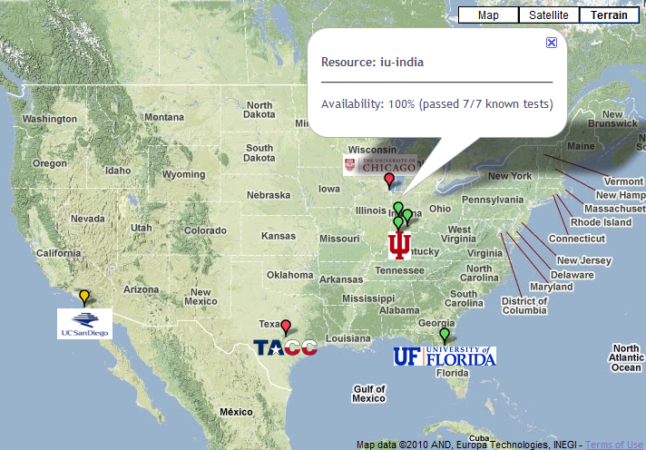

FutureGrid: a Grid/Cloud Testbed
Operational: IU Cray operational; IU , UCSD, UF & UC IBM iDataPlex operational
Network, NID operational
TACC Dell running acceptance tests – ready ~September 1
NID: Network Impairment Device
Private
Public
FG Network

Slide 73
Network Impairment Device
Spirent XGEM Network Impairments Simulator for jitter, errors, delay, etc
Full Bidirectional 10G w/64 byte packets
up to 15 seconds introduced delay (in 16ns increments)
0-100% introduced packet loss in .0001% increments
Packet manipulation in first 2000 bytes
up to 16k frame size
TCL for scripting, HTML for manual configuration
Need more proposals to use (have one from University of Delaware)

Slide 74
FutureGrid Usage Model
The goal of FutureGrid is to support the research on the future of distributed, grid, and cloud computing
FutureGrid will build a robustly managed simulation environment and test-bed to support the development and early use in science of new technologies at all levels of the software stack: from networking to middleware to scientific applications
The environment will mimic TeraGrid and/or general parallel and distributed systems – FutureGrid is part of TeraGrid (but not part of formal TeraGrid process for first two years)
  Supports Grids, Clouds, and classic HPC
  It will mimic commercial clouds (initially IaaS not PaaS)
  Expect FutureGrid PaaS to grow in importance
FutureGrid can be considered as a (small ~5000 core) Science/Computer Science Cloud but it is more accurately a virtual machine or bare-metal based simulation environment
This test-bed will succeed if it enables major advances in science and engineering through collaborative development of science applications and related software

Slide 75
Some Current FutureGrid early uses
Investigate metascheduling approaches on Cray and iDataPlex
Deploy Genesis II and Unicore end points on Cray and iDataPlex clusters
Develop new Nimbus cloud capabilities
Prototype applications (BLAST) across multiple FutureGrid clusters and Grid’5000
Compare Amazon, Azure with FutureGrid hardware running Linux, Linux on Xen or Windows for data intensive applications
Test ScaleMP software shared memory for genome assembly
Develop Genetic algorithms on Hadoop for optimization
Attach power monitoring equipment to iDataPlex nodes to study power use versus use characteristics
Industry (Columbus IN) running CFD codes to study combustion strategies to maximize energy efficiency
Support evaluation needed by XD TIS and TAS services
Investigate performance of Kepler workflow engine
Study scalability of SAGA in difference latency scenarios
Test and evaluate new algorithms for phylogenetics/systematics research in CIPRES portal
Investigate performance overheads of clouds in parallel and distributed environments
Support tutorials and classes in cloud, grid and parallel computing (IU, Florida, LSU)
~12 active/finished users out of ~32 early user applicants

Slide 76
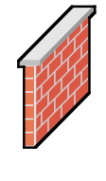
OGF’10 Demo
SDSC
Rennes
Grid’5000 firewall
UF
Lille
UC
Sophia
ViNe provided the necessary inter-cloud connectivity to deploy CloudBLAST across 5 Nimbus sites, with a mix of public and private subnets.

Slide 77
Education on FutureGrid
Build up tutorials on supported software
Support development of curricula requiring privileges and systems destruction capabilities that are hard to grant on conventional TeraGrid
Offer suite of appliances (customized VM based images) supporting online laboratories
Supporting ~200 students in Virtual Summer School on “Big Data” July 26-30 with set of certified images – first offering of FutureGrid 101 Class; TeraGrid ‘10 “Cloud technologies, data-intensive science and the TG”; CloudCom conference tutorials Nov 30-Dec 3 2010
Experimental class use fall semester at Indiana, Florida and LSU

Slide 78


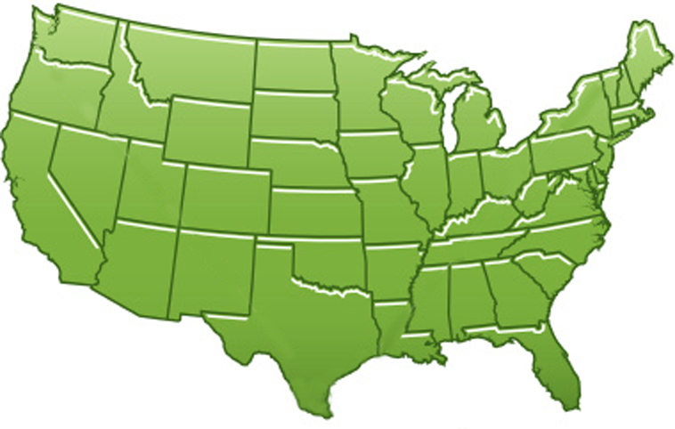















300+ Students learning about Twister & Hadoop
MapReduce technologies, supported by FutureGrid.
July 26-30, 2010 NCSA Summer School Workshop
http://salsahpc.indiana.edu/tutorial
Washington
University
University of
Minnesota
Michigan
State
Johns
Hopkins
Univ.Illinois
at Chicago
Iowa
State
Penn
State
IBM Almaden
Research Center
Notre
Dame
University of
California at
Los Angeles
Indiana
University
San Diego
Supercomputer
Center
University of
Texas at El Paso
University of
Arkansas
University
of Florida

Slide 79
Software Components
Portals including “Support” “use FutureGrid” “Outreach”
Monitoring – INCA, Power (GreenIT)
Experiment Manager: specify/workflow
Image Generation and Repository
Intercloud Networking ViNE
Virtual Clusters built with virtual networks
Performance library
Rain or Runtime Adaptable InsertioN Service: Schedule and Deploy images
Security (including use of isolated network), Authentication, Authorization,

Slide 80
FutureGrid Software
Architecture
Flexible Architecture allows one to configure resources based on images
Managed images allows to create similar experiment environments
Experiment management allows reproducible activities
Through our modular design we allow different clouds and images to be “rained” upon hardware.
Note will eventually be supported at “TeraGrid Production Quality”
Will support deployment of “important” middleware including TeraGrid stack, Condor, BOINC, gLite, Unicore, Genesis II, MapReduce, Bigtable …..
  Will accumulate more supported software as system used!
Will support links to external clouds, GPU clusters etc.
  Grid5000 initial highlight with OGF29 Hadoop deployment over Grid5000 and FutureGrid
  Interested in more external system collaborators!

Slide 81
Dynamic provisioning Examples
Need to provision
  Linux or Windows O/S
  Linux or (Windows O/S) on Hypervisors (KVM, Xen, ScaleMP)
  Appliances – O/S plus application/middleware on bare-metal or hypervisors
Give me a virtual cluster with 30 nodes based on Xen
Give me 15 KVM nodes each in Chicago and Texas linked to Azure and Grid5000
Give me a Eucalyptus environment with 10 nodes
Give 32 MPI nodes running on first Linux and then Windows with Cray iDataPlex Dell comparisons
Give me a Hadoop or Dryad environment with 160 nodes
  Compare with Amazon and Azure
Give me a 1000 BLAST instances linked to Grid5000
Give me two 8 node (64 core) ScaleMP instances on Alamo and India

Slide 82
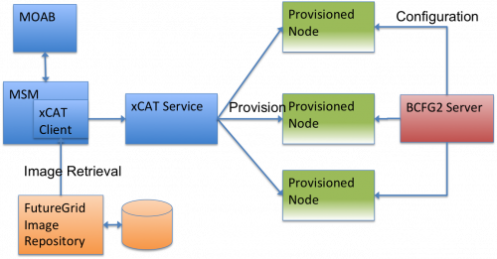
Dynamic Provisioning Experiment
Logical View

Slide 83
Dynamic Provisioning Results
Time minutes
Number of nodes
Time elapsed between requesting a job and the jobs reported start time on the provisioned node. The numbers here are an average of 2 sets of experiments.

Slide 84
Provisioning times for nodes in a 32 node request
Time minutes
The nodes took an average of 3 minutes and 45 seconds to switch from the stateful to stateless image with a standard deviation of 14 seconds.

Slide 85
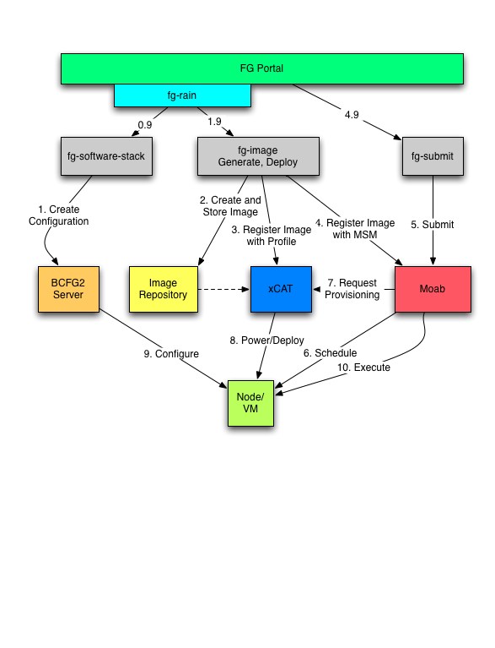
Phase III Process View

Slide 86
Security Issues
Need to provide dynamic flexible usability and preserve system security
Still evolving process but initial approach involves
Encouraging use of “as a Service” approach e.g. “Database as a Software” not “Database in your image”; clearly possible for some cases as in “Hadoop as a Service”
  Commercial clouds use aaS for database, queues, tables, storage …..
  Makes complexity linear in #features rather than exponential if need to support all images with or without all features
Have a suite of vetted images (here images includes customized appliances) that can be used by users with suitable roles
  Typically do not allow root access; can be VM or not VM based
  Can create images and requested that they be vetted
“Privileged images” (e.g. allow root access) use VM’s and network isolation

Slide 87
FutureGrid Interaction with Commercial Clouds
We support experiments that link Commercial Clouds and FutureGrid with one or more workflow environments and portal technology installed to link components across these platforms
We support environments on FutureGrid that are similar to Commercial Clouds and natural for performance and functionality comparisons
  These can both be used to prepare for using Commercial Clouds and as the most likely starting point for porting to them
  One example would be support of MapReduce-like environments on FutureGrid including Hadoop on Linux and Dryad on Windows HPCS which are already part of FutureGrid portfolio of supported software
We develop expertise and support porting to Commercial Clouds from other Windows or Linux environments
We support comparisons between and integration of multiple commercial Cloud environments – especially Amazon and Azure in the immediate future
We develop tutorials and expertise to help users move to Commercial Clouds from other environments

