Slide 1
Particle Physics Phenomenology: The Beginning of Data Science diverted by Parallel Computing
Geoffrey Fox
Dept. Intelligent Systems Engineering
Informatics and Computing, Physics
Indiana University Bloomington
September 16 2016

Slide 2
OUR First PAPER
Fox, G. C. and Hey, A. J. G., “Non-diffractive Production of Meson Resonances,'' Nuclear Physics, B56, 386 (1973).
Abstract: We study the peripheral cross sections of resonances that cannot be produced by π exchange In particular, we concentrate on the four meson nonets expected as L = 1 quark-antiquark states (i e., the J^{P} = O⁺ π_{N}(980); J^{P} = 1⁺ A₁, B; J^{P} = 2⁺ A₂) We use SU(3), Regge poles, factorization, exchange degeneracy, pole extrapolation, and the vector meson-photon analogy
Built on Fox, G.C., “Veni, Vidi, Vici Regge theory”, Comments Nucl. Part. Phys. 3 (1969) 190-197 and many other papers by lots of people
  Note my PhD supervisor’s main advice was “Geoffrey, nobody looks at data. That’s a promising area”. He then switched to economics
Study culminated in A.C. Irving, R.P. Worden, “Regge Phenomenology”, Phys. Rept. 34 (1977) 117-231
  Robert Worden, Cambridge PhD 1972 (finished at Caltech) but Robert went to software industry (Logica) and Tony and I went to parallel computing

Slide 3
Regge and S-Matrix Theories
Our whole field forgotten in 1977 as all of particle physics correctly moved to high transverse momentum (smaller distance interactions) and stopped studying the basic particle physics interactions
Suffers as nothing on web and many papers, data, codes etc. lost
Today changed as nuclear physics studying the larger distances has moved into regime we studied in 1960-1977
Reggeon

Slide 4
Our Past is Revisited!
Distance scales
  Nuclear Physics 1-15 fermi (Fermi = 10⁻¹⁵ meters)
  Pion 0.6 fermi, Proton 0.85 fermi
  1970 Particle Physics 0.05 Fermi
  LHC 10⁻⁴ Fermi
Particle Physics 0.05 Fermi to 10⁻³ to 10⁻⁴ Fermi 1977-now
Nuclear Physics moved from 1-10 Fermi to 0.1 Fermi around 2002
Neutral Pion Photoproduction in a Regge Model V. Mathieu, G. Fox, A. P. Szczepaniak Phys. Rev. D 92, 074013 (2015) revisits
Robert Worden, Regge models of forward pion and eta photoproduction, Cambridge 1972
Fraction of total Cross-Section
  LHC trigger on 10⁻⁷ of collisions
  Jefferson lab more like 10⁻³
We had a summer School in 2015 and collected S-Matrix and Regge theory references http://www.indiana.edu/~jpac/Resources.html

Slide 5
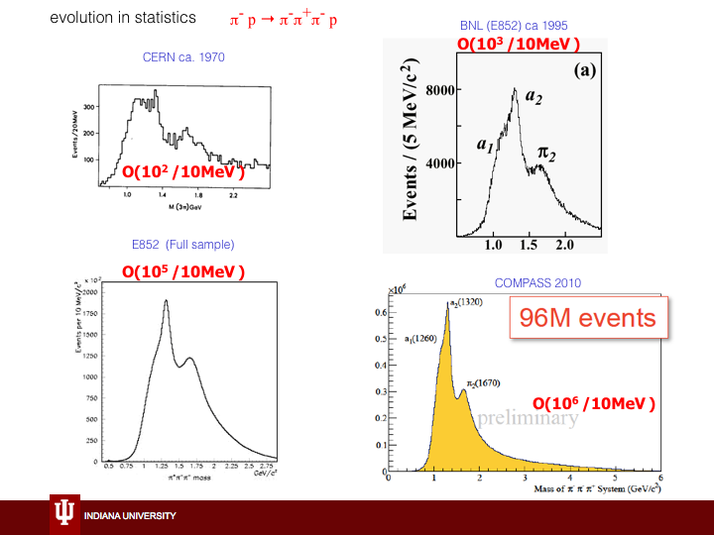
MUCH More Data is Possible
Interestingly Fox and Hey explain why this reaction hard to understand (Deck Effect) but only very recently confirmed
Wonderful statistics only for a few reactions
Should use a different trigger!

Slide 6
Scattering Processes
The original 1975 Picture book was third part of a series produced by Caltech particle physics group
  I don’t have others
Tony and I studied the ~400 quasi two-body reactions (quasi as involve decaying resonances)
Today we have 7176 data points on 55 reactions to repeat “Fox-Hey, Irving-Worden”
http://www.indiana.edu/~jpac/Resources.html#fox

Slide 7
Phenomenology I
Phenomenology in Particle Physics, 1971, (C. B. Chiu, G. Fox and A. J. G. Hey) http://authors.library.caltech.edu/910/1/PHYS1971.pdf
What is phenomenology? Reach not for your dictionary; make no vain efforts to pronounce it; we will come clean and explain all.
Science is noted for a competitive and helpful interaction between theorists and experimentalists. Unfortunately in almost all developing sciences, the moving hand of time drives a widening wedge between theory and experiment. Thus theorists are fully occupied in the mathematical and philosophical intricacies of their latest ideas. Again, experimentalists must concentrate on the design of their apparatus to insure they will get the best possible results current technology will allow. Phenomenology seeks to close the between those once close friends, theory and experiment, and so restore the interaction which is both vital to and characteristic of science. Although a classical concept, phenomenology is best known in its second-quantized form.

Slide 8
Phenomenology II
Note this branch of physics – like some but not all fields – produces data which is essentially impossible to calculate but there are many underlying ideas that need to be respected in interpretation.
Characteristic of much of today’s big data
The basic tool of the phenomenologist is, first, the construction of simple models that embody important theoretical ideas, and then, the critical comparison of these models with all relevant experimental data. It follows that a phenomenologist must combine a broad understanding of theory with a complete knowledge of current and future feasible experiments in order to allow him to interact meaningfully with both major branches of a science. The impact of phenomenology is felt in both theory and experiment. Thus it can pinpoint unexpected experimental observations and so delineate areas where new theoretical ideas are needed. Further, it can suggest the most useful experiments to be done to test the latest theories. This is especially important in these barren days where funds are limited, experiments take many "physicist-years" to complete, and theories are multitudinous and complicated.

Slide 9
What did we do I?
Phenomenology (aka data science) was often considered “second class” and something you did if you failed as a theoretician.
Study of strong interactions hard as
  Many theoretical facts and probably true conjectures
  No known way of estimating any cross-section (scattering probability) in a way that could be improved systematically as in a perturbation theory or series expansion.
There is today sophisticated Quantum Chromo Dynamics QCD calculations using lots of computer time but currently they can only find very simple observables – certainly not a 2 to 2 or more complicated reaction cross-section
Cross-sections are squares of amplitudes that depend on a lot of unobserved quantum numbers. The theory is for specific amplitudes which are obscured in cross section.
At Caltech Feynman was very supportive of phenomenology and taught us to change models discretely and not update them continuously.

Slide 10
What did we do II?
We constructed formulae for scattering amplitudes as sums over several terms with many unknown coefficients and fitted them to data.
  As model involved parameters that were shared across many reactions, we chose to look at many reactions simultaneously
  We looked at total cross-sections, differential cross-sections and observables sensitive to spin dependence of amplitudes
  We learnt a lot about nonlinear χ² (least squares) fits
  We had lots of punched cards for program and data – 100,000 lines of Fortran
  We plotted out results on Calcomp pen plotters and printed lots of paper.
Lots of wrong results by distinguished people as they didn’t compare with data.
Regge Concepts
  Wrong Signature Nonsense Zeros
  Exchange Degeneracy
  Two-component duality
  FESR Finite Energy Sum rules
  Daughters, Conspirators, Evasion
  SCRAM Strong-Cut Reggeized Absorption Model
  GORE Good Old Regge Theory
  WIZKID, Weak Cuts generated through the absorption prescription
  HIPPIE Hide Parity Partners In the Error function; ad-hoc backward scattering cut model; NAIVE HIPPIE; SUPER HIPPIE

Slide 11
How Did Parallel Computing derail this?
Our second paper based on hypercube at Caltech and transputers in UK
Fox, G. C., Hey, A. and Otto, S., “Matrix Algorithms on the Hypercube I: Matrix Multiplication,'' Parallel Computing, 4, 17 (1987)
We didn’t fully understand need to publish and left Matrix Algorithms II … unpublished
We correctly switched from phenomenology as field was moribund as no new data but we joined an HPCC initiative 1990-2000 that largely ignored data and focused on simulations
  Note it was High Performance Computing HPC originally but they added
  C for communications but not
  D for data
Partly as Moore’s law for computers preceded Moore’s law for experimental devices and partly a mistake.
Now we are back in data science!

Slide 12
A personal misdirection
Around 1973 I decided that division between phenomenologist and experimentalist made little sense as experiments needed a model to even to begin to process data
If only because no experiment is perfect and you need to estimate effects of apparatus inefficiency; typically done by running model generated events through apparatus
Further theory suggests what observables (particular moments of data) to measure
So I joined 3 Fermilab experiments
E110 was aimed squarely at Regge theory but never got enough data and superseded by E260 in 1977 that studied successfully but ephemerally small distance physics
E350 – “Triple Regge theory” was a spectacular success but everybody had forgotten this physics in 1978
But phenomenology needs to span lots of experiments and so this is an interesting useful experience but probably not the right approach.
So I went back to parallel computing after a diversion with Wolfram and SMP (to become Mathematica) and Unix on VAX11/780

Slide 13
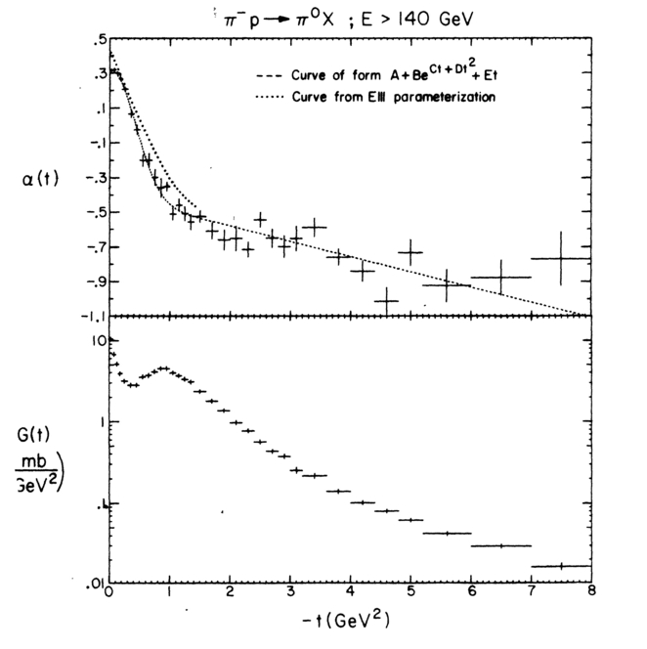
E350: Triple Regge Data
Note get good agreement with ρ trajectory from E111 π⁻ p → π⁰ n
WSNZ very clear
Extend trajectory measurement to t = - 8 (GeV/c)²
Agreement between π⁰ and η inclusive
Full and all neutral final states

Slide 14
S Matrix Theory
At this time QCD calculations were only just starting and we had no realistic expectation of calculating amplitudes from first principles
We could hope to derive some features (constraints) from first principles
S-matrix theory hoped that constraints would be enough to define a “unique” answer
Constraints VERY helpful for data science

Slide 15
Quasi Two Body Reactions
Produce unstable particles like Δ++ and ρ
I claimed there are 400 such reactions in 1975 and they allow unique studies of dynamics as have neat features like spin dependence and richer quantum numbers
Only way to study some resonances: L=1 quark states for Fox-Hey; Glueballs today
Resonances as bumps (remember Higgs) in mass spectra inspired me to do PhD in this area

Slide 16
Regge Theory
Observed particles lie on Regge trajectories and these control scattering in “crossed channels”
Tullio Regge 1931-2014 was at Turin and Institute for Advanced Study from 1965 to 1979
In 1959, Regge discovered a mathematical property of potential scattering in the Schrödinger equation—that the scattering amplitude can be thought of as an analytic function of the angular momentum

Slide 17
For every World, there are two more twisted ones
π⁺ p → π⁺ p has two reactions related by “crossing”
A key feature of relativistic field theories not present in potential theories
t channel
π⁺ π⁻ → p p
u channel
π⁻ p → π⁻ p
Next slide will show in s, t, u plane with
s + t + u = 2m² + 2μ²
-

Slide 18
Regge Theory for π⁻p → π⁰n
Picture 12
Regge Theory has (at least) three distinctive predictions
Shrinkage – power of s in s^{2α(t)-2} decreases as –t decreases so peaks get sharper as energy increases
WSNZ Wrong Signature Nonsense zeroes. Trajectory and amplitude vanishes at α = 0.
Factorization. Total coupling constant product of those at “top” and “bottom” vertex
Corrections due to “cuts”

Slide 19
E111 π⁻ p → π⁰ n
Best data and best success of Regge Theory?

Slide 20
Details from Fox and hey
From Fox and Hey 54 pages 80 equations 21 figures 17 Tables
  We wrote longer papers in those days

Slide 21
Details from Fox and hey II
From Fox and Hey 54 pages 80 equations 21 figures 17 Tables

Slide 22
Irving & Worden fig. 2.7
Pomeron etc.
ρ
π⁻p →π⁰n
K*
np →pn
(23-63 GeV/c
π Exchange + ρ, A₂
B
Triple Regge, proton

Slide 23
2010 ReggE Fits
π⁺ p backward scattering
Nucleon Exchange with WSNZ
π⁻ p backward scattering
Δ⁺⁺ Exchange without WSNZ
√s

Slide 24
E110
Natural parity
Total
Excluding special alignment and calibration runs, the first run recorded 1.058 million events from all triggers at 100 GeV/c with 280 000 events in the ππn_{T} trigger.
The second run had 1.680 million events at 175 GeV/c of which 481000 were from ππn_{T}. Final samples used for decay distributions are 10577 events at 100 GeV/c and 9895 events at 175 GeV/c
Unnatural
Parity
s Helicity 0
Unnatural
Parity
t Helicity 0
Unnatural
Parity
t Helicity 1
Unnatural
Parity
s Helicity 1

Slide 25
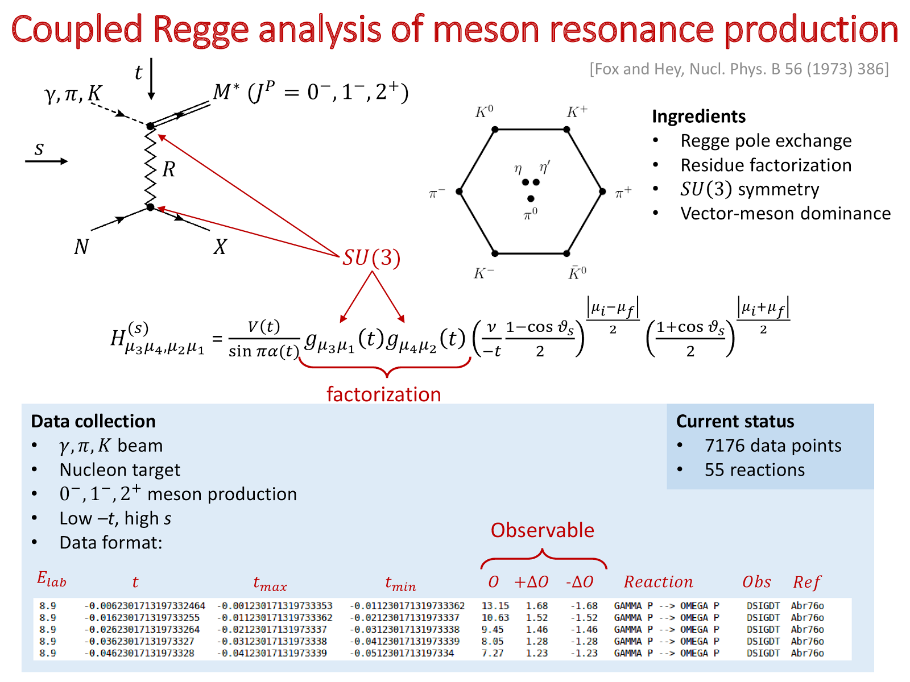
Revisit Fox and Hey
Indiana University, Jefferson laboratory

Slide 26
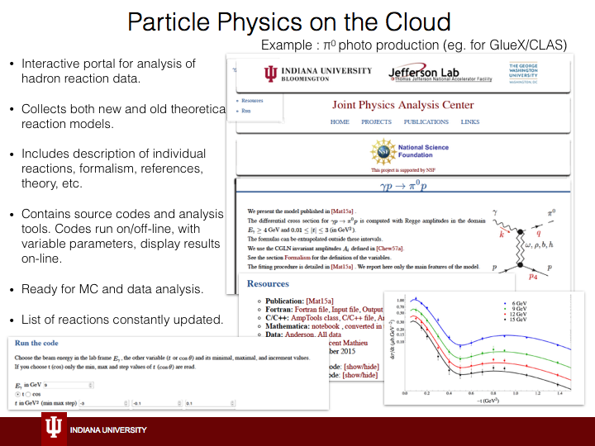
Interactive Visualization now much better!
http://cgl.soic.indiana.edu/jpac/Pi0Phot.php
But rest of software NOT as good as that in 1970

Slide 27
Neutron Proton Charge exchange
2016 Analysis
π (red) and ρ A₂ Regge exchange destructive interference in total (black)
Note changes in behavior at highest energies p_{lab}≥ 20 GeV/c

