Slide 1
Challenges in Big Data,
Big Simulations, Clouds and HPC
IEEE Cloud and Big Data Computing
Toulouse France July 18-21
http://cbdcom2016.sciencesconf.org/
Geoffrey Fox
July 19, 2016
gcf@indiana.edu
http://www.dsc.soic.indiana.edu/, http://spidal.org/ http://hpc-abds.org/kaleidoscope/
Department of Intelligent Systems Engineering
School of Informatics and Computing, Digital Science Center
Indiana University Bloomington

Slide 2
Abstract
We review several questions at the intersection of Big Data, Big Simulations, Clouds and HPC. We consider broad topics:
  What are the application and user requirements? e.g. is the data streaming, how similar are commercial and scientific requirements?
  What is execution structure of problems? e.g. is it dataflow or more like MPI? Should we use threads or processes? Is execution pleasingly parallel?
  What about the many choices for infrastructure and middleware? Should we use classic HPC cluster, Docker or OpenStack (OpenNebula)? Where are Big Data (Apache) approaches superior/inferior to those familiar from Grid and HPC work?
  The choice of language for Big Data and Big Simulation-- C++, Java, Scala, Python, R highlights performance v. productivity trade-offs. What is actual performance of Big Data implementations and what are good benchmarks?
  Is software sustainability important and is the Apache model a good approach to this? How useful is DevOps to specify software systems?
We consider these in context of a Big Data - Big Simulation convergence and propose a simple approach but there is no consensus yet

Slide 3
What are the application and user requirements?
e.g. is the data streaming, how similar are commercial and scientific requirements?
NIST Big Data Initiative
Use Cases and Properties

Slide 4
51 Detailed Use Cases: Contributed July-September 2013
Covers goals, data features such as 3 V’s, software, hardware
Government Operation(4): National Archives and Records Administration, Census Bureau
Commercial(8): Finance in Cloud, Cloud Backup, Mendeley (Citations), Netflix, Web Search, Digital Materials, Cargo shipping (as in UPS)
Defense(3): Sensors, Image surveillance, Situation Assessment
Healthcare and Life Sciences(10): Medical records, Graph and Probabilistic analysis, Pathology, Bioimaging, Genomics, Epidemiology, People Activity models, Biodiversity
Deep Learning and Social Media(6): Driving Car, Geolocate images/cameras, Twitter, Crowd Sourcing, Network Science, NIST benchmark datasets
The Ecosystem for Research(4): Metadata, Collaboration, Language Translation, Light source experiments
Astronomy and Physics(5): Sky Surveys including comparison to simulation, Large Hadron Collider at CERN, Belle Accelerator II in Japan
Earth, Environmental and Polar Science(10): Radar Scattering in Atmosphere, Earthquake, Ocean, Earth Observation, Ice sheet Radar scattering, Earth radar mapping, Climate simulation datasets, Atmospheric turbulence identification, Subsurface Biogeochemistry (microbes to watersheds), AmeriFlux and FLUXNET gas sensors
Energy(1): Smart grid
Published by NIST as http://nvlpubs.nist.gov/nistpubs/SpecialPublications/NIST.SP.1500-3.pdf
“Version 2” being prepared
26 Features for each use case Biased to science

Slide 5
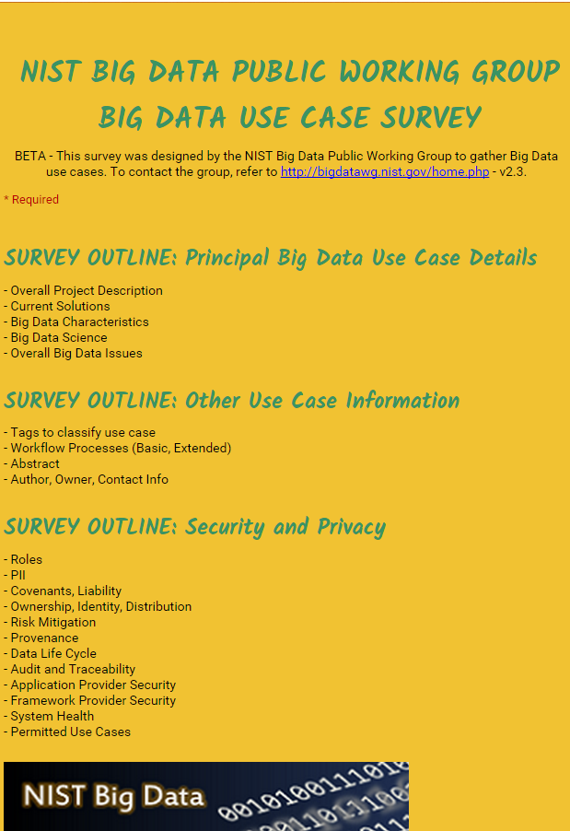
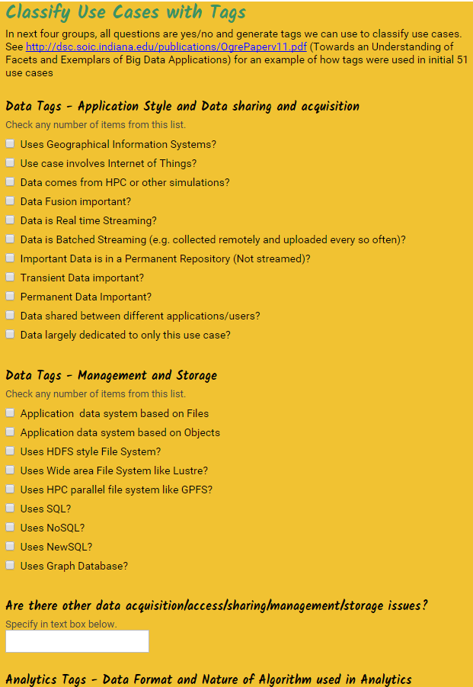
http://hpc-abds.org/kaleidoscope/survey/
Online Use Case Form

Slide 6
Sample Features of 51 Use Cases I
PP (26) “All” Pleasingly Parallel or Map Only
MR (18) Classic MapReduce MR (add MRStat below for full count)
MRStat (7) Simple version of MR where key computations are simple reduction as found in statistical averages such as histograms and averages
MRIter (23) Iterative MapReduce or MPI (Flink, Spark, Twister)
Graph (9) Complex graph data structure needed in analysis
Fusion (11) Integrate diverse data to aid discovery/decision making; could involve sophisticated algorithms or could just be a portal
Streaming (41) Some data comes in incrementally and is processed this way
Classify (30) Classification: divide data into categories
S/Q (12) Index, Search and Query

Slide 7
Sample Features of 51 Use Cases II
CF (4) Collaborative Filtering for recommender engines
LML (36) Local Machine Learning (Independent for each parallel entity) – application could have GML as well
GML (23) Global Machine Learning: Deep Learning, Clustering, LDA, PLSI, MDS,
  Large Scale Optimizations as in Variational Bayes, MCMC, Lifted Belief Propagation, Stochastic Gradient Descent, L-BFGS, Levenberg-Marquardt . Can call EGO or Exascale Global Optimization with scalable parallel algorithm
Workflow (51) Universal
GIS (16) Geotagged data and often displayed in ESRI, Microsoft Virtual Earth, Google Earth, GeoServer etc.
HPC (5) Classic large-scale simulation of cosmos, materials, etc. generating (visualization) data
Agent (2) Simulations of models of data-defined macroscopic entities represented as agents

Slide 8
Data and Model in Big Data and Simulations
Need to discuss Data and Model as problems combine them, but we can get insight by separating which allows better understanding of Big Data - Big Simulation “convergence” (or differences!)
Big Data implies Data is large but Model varies
  e.g. LDA with many topics or deep learning has large model
  Clustering or Dimension reduction can be quite small in model size
Simulations can also be considered as Data and Model
  Model is solving particle dynamics or partial differential equations
  Data could be small when just boundary conditions
  Data large with data assimilation (weather forecasting) or when data visualizations are produced by simulation
Data often static between iterations (unless streaming); Model varies between iterations

Slide 9
7 Computational Giants of
NRC Massive Data Analysis Report
http://www.nap.edu/catalog.php?record_id=18374 Big Data Models?
G1: Basic Statistics e.g. MRStat
G2: Generalized N-Body Problems
G3: Graph-Theoretic Computations
G4: Linear Algebraic Computations
G5: Optimizations e.g. Linear Programming
G6: Integration e.g. LDA and other GML
G7: Alignment Problems e.g. BLAST

Slide 10
HPC (Simulation) Benchmark Classics
Linpack or HPL: Parallel LU factorization
for solution of linear equations; HPCG
NPB version 1: Mainly classic HPC solver kernels
  MG: Multigrid
  CG: Conjugate Gradient
  FT: Fast Fourier Transform
  IS: Integer sort
  EP: Embarrassingly Parallel
  BT: Block Tridiagonal
  SP: Scalar Pentadiagonal
  LU: Lower-Upper symmetric Gauss Seidel
Simulation Models

Slide 11
13 Berkeley Dwarfs
Dense Linear Algebra
Sparse Linear Algebra
Spectral Methods
N-Body Methods
Structured Grids
Unstructured Grids
MapReduce
Combinational Logic
Graph Traversal
Dynamic Programming
Backtrack and
Branch-and-Bound
Graphical Models
Finite State Machines
Largely Models for Data or Simulation
First 6 of these correspond to Colella’s original. (Classic simulations)
Monte Carlo dropped.
N-body methods are a subset of Particle in Colella.
Note a little inconsistent in that MapReduce is a programming model and spectral method is a numerical method.
Need multiple facets to classify use cases!

Slide 12
Classifying Use cases

Slide 13
Classifying Use Cases
Take 51 NIST and other use cases → derive multiple specific features
Generalize and systematize with features termed “facets”
50 Facets (Big Data) termed Ogres divided into 4 sets or views where each view has “similar” facets
Add simulations and look separately at Data and Model gives 64 Facets describing Big Simulation and Data termed Convergence Diamonds looking at either data or model or their combination
Allows one to study coverage of benchmark sets and architectures

Slide 15
64 Features in 4 views for Unified Classification of Big Data and Simulation Applications
Both
Simulations
Analytics
(Model for Big Data)
(Nearly all Data)
(All Model)
(Mix of Data and Model)
(Nearly all Data+Model)

Slide 16
Convergence Diamonds and their 4 Views I
One view is the overall problem architecture or macropatterns which is naturally related to the machine architecture needed to support application.
  Unchanged from Ogres and describes properties of problem such as “Pleasing Parallel” or “Uses Collective Communication”
The execution (computational) features or micropatterns view, describes issues such as I/O versus compute rates, iterative nature and regularity of computation and the classic V’s of Big Data: defining problem size, rate of change, etc.
  Significant changes from ogres to separate Data and Model and add characteristics of Simulation models. e.g. both model and data have “V’s”; Data Volume, Model Size
  e.g. O(N²) Algorithm relevant to big data or big simulation model

Slide 17
Convergence Diamonds and their 4 Views II
The data source & style view includes facets specifying how the data is collected, stored and accessed. Has classic database characteristics
  Simulations can have facets here to describe input or output data
  Examples: Streaming, files versus objects, HDFS v. Lustre
Processing view has model (not data) facets which describe types of processing steps including nature of algorithms and kernels by model e.g. Linear Programming, Learning, Maximum Likelihood, Spectral methods, Mesh type,
  mix of Big Data Processing View and Big Simulation Processing View and includes some facets like “uses linear algebra” needed in both: has specifics of key simulation kernels and in particular includes facets seen in NAS Parallel Benchmarks and Berkeley Dwarfs
Instances of Diamonds are particular problems and a set of Diamond instances that cover enough of the facets could form a comprehensive benchmark/mini-app set
Diamonds and their instances can be atomic or composite

Slide 18
DISCUSSION
What are the application and user requirements?
e.g. is the data streaming, how similar are commercial and scientific requirements?
NIST Big Data Initiative
Use Cases and Properties

Slide 19
Structure of Applications
Real-time (streaming) data is increasingly common in scientific and engineering research, and it is ubiquitous in commercial Big Data (e.g., social network analysis, recommender systems and consumer behavior classification)
  So far little use of commercial and Apache technology in analysis of scientific streaming data
Pleasingly parallel applications important in science (long tail) and data communities
Commercial-Science application differences: Search and recommender engines have different structure to deep learning, clustering, topic models, graph analyses such as subgraph mining
  Latter very sensitive to communication and can be hard to parallelize
  Search typically not as important in Science as in commercial use as search volume scales by number of users
Should discuss data and model separately
  Term data often used rather sloppily and often refers to model

Slide 20
What is structure of problems and what does this imply?
  e.g. do big data requirements imply clouds or HPC machines or both
  e.g. difference between big data and big simulation problem structure
  The Big Data Ogres and Convergence Diamonds
  6 Forms of MapReduce
  2 Forms of Communication/Flow

Slide 21
Problem Architecture View (Meta or MacroPatterns)
Pleasingly Parallel – as in BLAST, Protein docking, some (bio-)imagery including Local Analytics or Machine Learning – ML or filtering pleasingly parallel, as in bio-imagery, radar images (pleasingly parallel but sophisticated local analytics)
Classic MapReduce: Search, Index and Query and Classification algorithms like collaborative filtering (G1 for MRStat in Features, G7)
Map-Collective: Iterative maps + communication dominated by “collective” operations as in reduction, broadcast, gather, scatter. Common datamining pattern
Map-Point to Point: Iterative maps + communication dominated by many small point to point messages as in graph algorithms
Map-Streaming: Describes streaming, steering and assimilation problems
Shared Memory: Some problems are asynchronous and are easier to parallelize on shared rather than distributed memory – see some graph algorithms
SPMD: Single Program Multiple Data, common parallel programming feature
BSP or Bulk Synchronous Processing: well-defined compute-communication phases
Fusion: Knowledge discovery often involves fusion of multiple methods.
Dataflow: Important application features often occurring in composite Ogres
Use Agents: as in epidemiology (swarm approaches) This is Model only
Workflow: All applications often involve orchestration (workflow) of multiple components
Most (11 of total 12) are properties of Data+Model
Notes:
Big dwarfs are Ogres
Implement Ogres in ABDS+

Slide 22
Local and Global Machine Learning
Many applications use LML or Local machine Learning where machine learning (often from R or Python or Matlab) is run separately on every data item such as on every image
But others are GML Global Machine Learning where machine learning is a basic algorithm run over all data items (over all nodes in computer)
  maximum likelihood or χ² with a sum over the N data items – documents, sequences, items to be sold, images etc. and often links (point-pairs).
  GML includes Graph analytics, clustering/community detection, mixture models, topic determination, Multidimensional scaling, (Deep) Learning Networks
Note Facebook may need lots of small graphs (one per person and ~LML) rather than one giant graph of connected people (GML)

Slide 23
6 Forms of MapReduce
Describes Architecture of
- Problem (Model reflecting data)
- Machine
- Software
2 important variants (software) of Iterative MapReduce and Map-Streaming a) “In-place” HPC b) Flow for model and data

Slide 24
Relation of Problem and Machine Architecture
Problem is Model plus Data
In my old papers (especially book Parallel Computing Works!), I discussed computing as multiple complex systems mapped into each other
Problem → Numerical formulation → Software → Hardware
Each of these 4 systems has an architecture that can be described in similar language
One gets an easy programming model if architecture of problem matches that of Software
One gets good performance if architecture of hardware matches that of software and problem
So “MapReduce” can be used as architecture of software (programming model) or “Numerical formulation of problem”

Slide 25
Diamond Facets in Processing (runtime) View I used in Big Data and Big Simulation
Pr-1M Micro-benchmarks ogres that exercise simple features of hardware such as communication, disk I/O, CPU, memory performance
Pr-2M Local Analytics executed on a single core or perhaps node
Pr-3M Global Analytics requiring iterative programming models (G5,G6) across multiple nodes of a parallel system
Pr-12M Uses Linear Algebra common in Big Data and simulations
  Subclasses like Full Matrix
  Conjugate Gradient, Krylov, Arnoldi iterative subspace methods
  Structured and unstructured sparse matrix methods
Pr-13M Graph Algorithms (G3) Clear important class of algorithms -- as opposed to vector, grid, bag of words etc. – often hard especially in parallel
Pr-14M Visualization is key application capability for big data and simulations
Pr-15M Core Libraries Functions of general value such as Sorting, Math functions, Hashing
Notes:
Big dwarfs are Ogres
Implement Ogres in ABDS+

Slide 26
Diamond Facets in Processing (runtime) View II used in Big Data
Pr-4M Basic Statistics (G1): MRStat in NIST problem features
Pr-5M Recommender Engine: core to many e-commerce, media businesses; collaborative filtering key technology
Pr-6M Search/Query/Index: Classic database which is well studied (Baru, Rabl tutorial)
Pr-7M Data Classification: assigning items to categories based on many methods
  MapReduce good in Alignment, Basic statistics, S/Q/I, Recommender, Classification
Pr-8M Learning of growing importance due to Deep Learning success in speech recognition etc..
Pr-9M Optimization Methodology: overlapping categories including
  Machine Learning, Nonlinear Optimization (G6), Maximum Likelihood or χ² least squares minimizations, Expectation Maximization (often Steepest descent), Combinatorial Optimization, Linear/Quadratic Programming (G5), Dynamic Programming
Pr-10M Streaming Data or online Algorithms. Related to DDDAS (Dynamic Data-Driven Application Systems)
Pr-11M Data Alignment (G7) as in BLAST compares samples with repository
Notes:
Big dwarfs are Ogres
Implement Ogres in ABDS+

Slide 27
Diamond Facets in Processing (runtime) View III used in Big Simulation
Pr-16M Iterative PDE Solvers: Jacobi, Gauss Seidel etc.
Pr-17M Multiscale Method? Multigrid and other variable resolution approaches
Pr-18M Spectral Methods as in Fast Fourier Transform
Pr-19M N-body Methods as in Fast multipole, Barnes-Hut
Pr-20M Both Particles and Fields as in Particle in Cell method
Pr-21M Evolution of Discrete Systems as in simulation of Electrical Grids, Chips, Biological Systems, Epidemiology. Needs Ordinary Differential Equation solvers
Pr-22M Nature of Mesh if used: Structured, Unstructured, Adaptive
Covers NAS Parallel Benchmarks and Berkeley Dwarfs
Notes:
Big dwarfs are Ogres
Implement Ogres in ABDS+

Slide 28
View for Micropatterns or Execution Features
Performance Metrics; property found by benchmarking Diamond
Flops per byte; memory or I/O
Execution Environment; Core libraries needed: matrix-matrix/vector algebra, conjugate gradient, reduction, broadcast; Cloud, HPC etc.
Volume: property of a Diamond instance: a) Data Volume and b) Model Size
Velocity: qualitative property of Diamond with value associated with instance. Only Data
Variety: important property especially of composite Diamonds; Data and Model separately
Veracity: important property of applications but not kernels;
Model Communication Structure; Interconnect requirements; Is communication BSP, Asynchronous, Pub-Sub, Collective, Point to Point?
Is Data and/or Model (graph) static or dynamic?
Much Data and/or Models consist of a set of interconnected entities; is this regular as a set of pixels or is it a complicated irregular graph?
Are Models Iterative or not?
Data Abstraction: key-value, pixel, graph(G3), vector, bags of words or items; Model can have same or different abstractions e.g. mesh points, finite element, Convolutional Network
Are data points in metric or non-metric spaces? Data and Model separately?
Is Model algorithm O(N²) or O(N) (up to logs) for N points per iteration (G2)

Slide 29
Comparison of Data Analytics with Simulation I
Simulations (models) produce big data as visualization of results – they are data source
  Or consume often smallish data to define a simulation problem
  HPC simulation in (weather) data assimilation is data + model
Pleasingly parallel often important in both
Both are often SPMD and BSP
  Non-iterative MapReduce is major big data paradigm
  not a common simulation paradigm except where “Reduce” summarizes pleasingly parallel execution as in some Monte Carlos
Big Data often has large collective communication
  Classic simulation has a lot of smallish point-to-point messages
  Motivates Map-Collective model
Simulations characterized often by difference or differential operators leading to nearest neighbor sparsity
Some important data analytics can be sparse as in PageRank and “Bag of words” algorithms but many involve full matrix algorithm

Slide 30


“Force Diagrams” for macromolecules and Facebook

Slide 31
Comparison of Data Analytics with Simulation II
There are similarities between some graph problems and particle simulations with a strange cutoff force.
  Both Map-Communication
Note many big data problems are “long range force” (as in gravitational simulations) as all points are linked.
  Easiest to parallelize. Often full matrix algorithms
  e.g. in DNA sequence studies, distance δ(i, j) defined by BLAST, Smith-Waterman, etc., between all sequences i, j.
  Opportunity for “fast multipole” ideas in big data. See NRC report
Current Ogres/Diamonds do not have facets to designate underlying hardware: GPU v. Many-core (Xeon Phi) v. Multi-core as these define how maps processed; they keep map-X structure fixed; maybe should change as ability to exploit vector or SIMD parallelism could be a model facet.
In image-based deep learning, neural network weights are block sparse (corresponding to links to pixel blocks) but can be formulated as full matrix operations on GPUs and MPI in blocks.
In HPC benchmarking, Linpack being challenged by a new sparse conjugate gradient benchmark HPCG, while I am diligently using non- sparse conjugate gradient solvers in clustering and Multi-dimensional scaling.

Slide 32
Data Source and Style Diamond View I
SQL NewSQL or NoSQL: NoSQL includes Document,
Column, Key-value, Graph, Triple store; NewSQL is SQL redone to exploit NoSQL performance
Other Enterprise data systems: 10 examples from NIST integrate SQL/NoSQL
Set of Files or Objects: as managed in iRODS and extremely common in scientific research
File systems, Object, Blob and Data-parallel (HDFS) raw storage: Separated from computing or colocated? HDFS v Lustre v. Openstack Swift v. GPFS
Archive/Batched/Streaming: Streaming is incremental update of datasets with new algorithms to achieve real-time response (G7); Before data gets to compute system, there is often an initial data gathering phase which is characterized by a block size and timing. Block size varies from month (Remote Sensing, Seismic) to day (genomic) to seconds or lower (Real time control, streaming)
  Streaming divided into categories overleaf
Notes:
Big dwarfs are Ogres
Implement Ogres in ABDS+

Slide 33
Data Source and Style Diamond View II
  Streaming divided into 5 categories depending on event size and synchronization and integration
  Set of independent events where precise time sequencing unimportant.
  Time series of connected small events where time ordering important.
  Set of independent large events where each event needs parallel processing with time sequencing not critical
  Set of connected large events where each event needs parallel processing with time sequencing critical.
  Stream of connected small or large events to be integrated in a complex way.
Shared/Dedicated/Transient/Permanent: qualitative property of data; Other characteristics are needed for permanent auxiliary/comparison datasets and these could be interdisciplinary, implying nontrivial data movement/replication
Metadata/Provenance: Clear qualitative property but not for kernels as important aspect of data collection process
Internet of Things: 24 to 50 Billion devices on Internet by 2020
HPC simulations: generate major (visualization) output that often needs to be mined
Using GIS: Geographical Information Systems provide attractive access to geospatial data
Notes:
Big dwarfs are Ogres
Implement Ogres in ABDS+

Slide 34
DISCUSSION
What is structure of problems and what does this imply?
  e.g. do big data requirements imply clouds or HPC machines or both
  e.g. difference between big data and big simulation problem structure
  The Big Data Ogres and Convergence Diamonds
  6 Forms of MapReduce

Slide 35
Implications of Big Data Requirements
“Atomic” Job Size: Very large jobs are critical aspects of leading edge simulation, whereas much data analysis is pleasing parallel and involves many quite small jobs. The latter follows from event structure of much observational science.
  Accelerators produce a stream of particle collisions; telescopes, light sources or remote sensing a stream of images. The many events produced by modern instruments implies data analysis is a computationally intense problem but can be broken up into many quite small jobs.
  Similarly the long tail of science produces streams of events from a multitude of small instruments
Why use HPC machines to analyze data and how large are they? Some scientific data has been analyzed on HPC machines because the responsible organizations had such machines often purchased to satisfy simulation requirements. Whereas high end simulation requires HPC style machines, that is typically not true for data analysis; that is done on HPC machines because they are available

Slide 36
What about the many choices for infrastructure and middleware?
  Should we use classic HPC cluster, Docker or OpenStack (OpenNebula)?
  Do we need dataflow or more like MPI and SPMD, Bulk Synchronous Processing?
  Should we use threads or processes?
  Where are Big Data (Apache) approaches superior/inferior to those familiar from Grid and HPC work?
  Software Functionality and Performance
  HPC-ABDS
  High performance Computing Enhanced Apache Big Data Stack
  Clouds v. HPC clusters
  Flink, Spark, HPC(MPI) Tradeoffs

Slide 37
HPC-ABDS

Slide 38
Functionality of 21 HPC-ABDS Layers
Message Protocols:
Distributed Coordination:
Security & Privacy:
Monitoring:
IaaS Management from HPC to hypervisors:
DevOps:
Interoperability:
File systems:
Cluster Resource Management:
Data Transport:
A) File management
B) NoSQL
C) SQL
In-memory databases & caches / Object-relational mapping / Extraction Tools
Inter process communication Collectives, point-to-point, publish-subscribe, MPI:
A) Basic Programming model and runtime, SPMD, MapReduce:
B) Streaming:
A) High level Programming:
B) Frameworks
Application and Analytics:
Workflow-Orchestration:

Slide 39
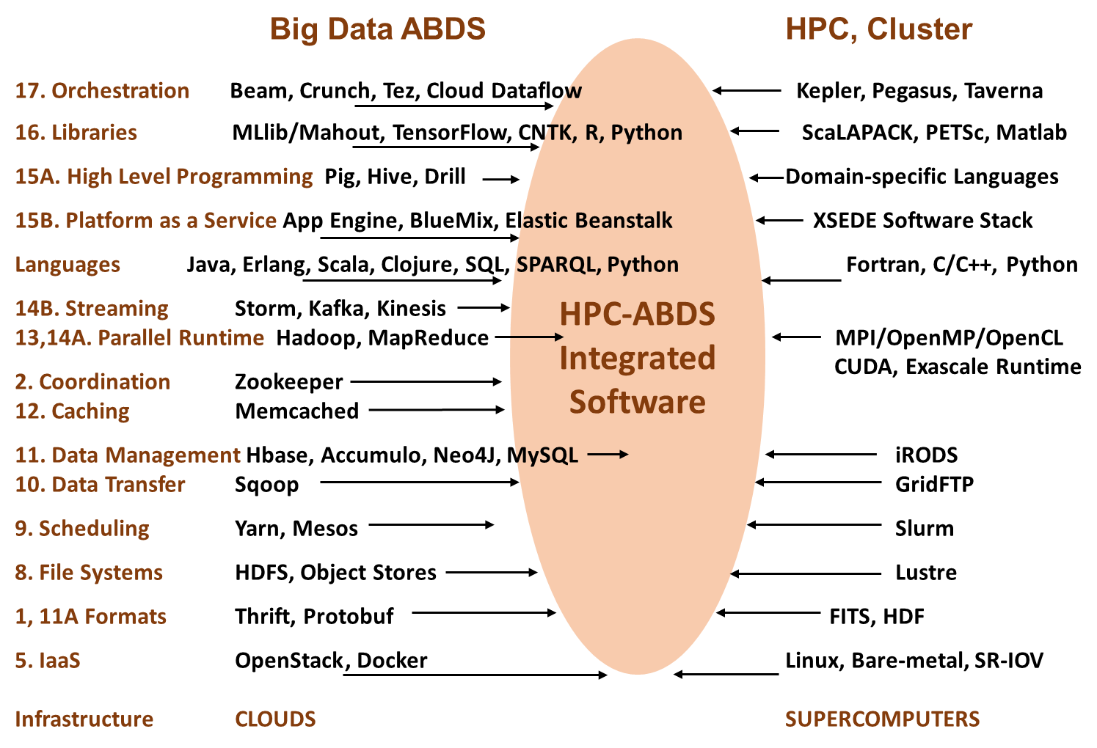

Slide 40
Typical Big Data Pattern 2. Perform real time analytics on data source streams and notify users when specified events occur
Specify filter
Filter Identifying Events
Fetch streamed Data
Post Selected Events
Streaming Data
Posted Data
Identified Events
Streaming Data
Streaming Data
Archive
Repository
Storm (Heron), Kafka, Hbase, Zookeeper

Slide 41
Typical Big Data Pattern 5A. Perform interactive analytics on observational scientific data
Science Analysis Code, Mahout, R, SPIDAL
Grid or Many Task Software, Hadoop, Spark, Giraph, Pig …
Data Storage: HDFS, Hbase, File Collection
Direct Transfer
Transport batch of data to primary analysis data system
Streaming Twitter data for Social Networking
Local Accumulate and initial computing
NIST examples include LHC, Remote Sensing, Astronomy and Bioinformatics
Record Scientific Data in “field”

Slide 42
Research activities illustrate key HPC-ABDS levels
Level 17: Orchestration: Apache Beam (Google Cloud Dataflow)
Level 16: Applications: Datamining for molecular dynamics, Image processing for remote sensing and pathology, graphs, streaming, bioinformatics, social media, financial informatics, text mining
Level 16: Algorithms: Generic and application specific; SPIDAL Library
Level 14: Programming: Storm, Heron (Twitter replaces Storm), Hadoop, Spark, Flink. Improve Inter- and Intra-node performance; science data structures
Level 13: Runtime Communication: Enhanced Storm and Hadoop (Spark, Flink, Giraph) using HPC runtime technologies, Harp
Level 12: In-memory Database: Redis used in “Pilot Data memory”
Level 11: Data management: Hbase and MongoDB integrated via use of Beam and other Apache tools; enhance Hbase
Level 9: Cluster Management: Integrate Pilot Jobs with Yarn, Mesos, Spark, Hadoop; integrate Storm and Heron with Slurm
Level 6: DevOps: Python Cloudmesh virtual Cluster Interoperability

Slide 43
Parallel Computing Approaches
Both simulations and data analytics use similar parallel computing ideas
Both do decomposition of both model and data
Both tend use SPMD and often use BSP Bulk Synchronous Processing
One has computing (called maps in big data terminology) and communication/reduction (more generally collective) phases
Big data thinks of problems as multiple linked queries even when queries are small and uses dataflow model
Simulation uses dataflow for multiple linked applications but small steps just as iterations are done in place
Reduction in HPC (MPIReduce) done as optimized tree or pipelined communication between same processes that did computing
Reduction in Hadoop or Flink done as separate processes using dataflow
  This leads to 2 forms (In-Place and Flow) of Map-X described earlier
Interesting Fault Tolerance issues highlighted by Hadoop-MPI comparisons – not discussed here!

Slide 44
General Reduction in Hadoop, Spark, Flink
Map Tasks
Separate Map and Reduce Tasks
MPI only has one sets of tasks for map and reduce
MPI gets efficiency by using shared memory intra-node (of 24 cores)
MPI achieves AllReduce by interleaving multiple binary trees
Switching tasks is expensive! (see later)
Reduce Tasks
Follow by Broadcast for AllReduce which is what most iterative algorithms use
Output partitioned with Key

Slide 45
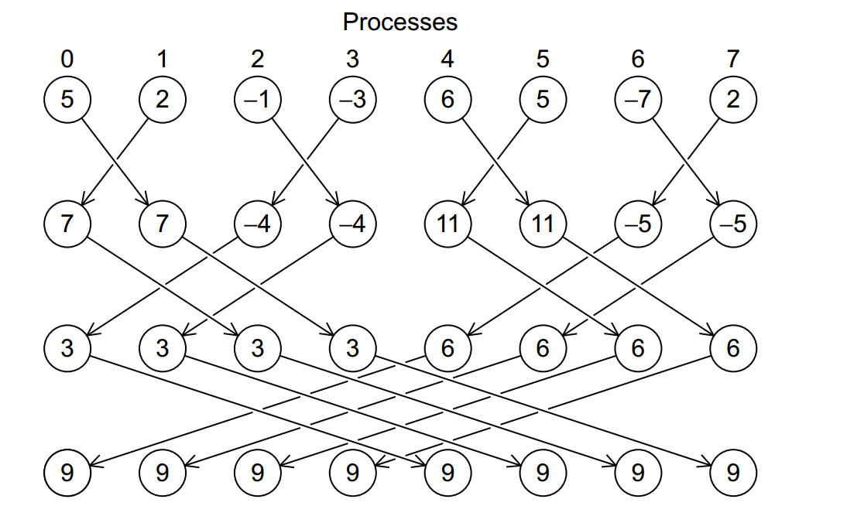
Illustration of In-Place AllReduce in MPI

Slide 46
Programming Model I
Programs are broken up into parts
  Functionally (coarse grain)
  Data/model parameter decomposition (fine grain)
Fine grain needs low latency or minimal data copying
Coarse grain has lower communication /
compute cost
MPI
Dataflow
Possible Iteration

Slide 47
Programming Model II
MPI designed for fine grain case and typical of parallel computing used in large scale simulations
  Only change in model parameters are transmitted
Dataflow typical of distributed or Grid computing paradigms
  Data sometimes and model parameters certainly transmitted
  Caching in iterative MapReduce avoids data communication and in fact systems like TensorFlow, Spark or Flink are called dataflow but usually implement “model-parameter” flow
Different Communication/Compute ratios seen in different cases with ratio (measuring overhead) larger when grain size smaller. Compare
  Intra-job reduction such as Kmeans clustering accumulation of center changes at end of each iteration and
  Inter-Job Reduction as at end of a query or word count operation

Slide 48
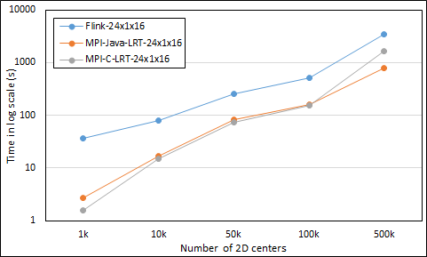
Kmeans Clustering Flink and MPI one million points fixed; various # centers
24 cores on 16 nodes
Flink
Java
C
MPI

Slide 49
Programming Model III
Need to distinguish
  Grain size and Communication/Compute ratio (characteristic of problem or component (iteration) of problem)
  DataFlow versus “Model-parameter” Flow (characteristic of algorithm)
  In-Place versus Flow Software implementations
Inefficient to use same mechanism independent of characteristics
Classic Dataflow is approach of Spark and Flink so need to add parallel in-place computing as done by Harp for Hadoop
  TensorFlow uses In-Place technology
Note parallel machine learning (GML not LML) can benefit from HPC style interconnects and architectures as seen in GPU-based deep learning
  So commodity clouds not necessarily best

Slide 50
Harp (Hadoop Plugin) brings HPC to ABDS
Basic Harp: Iterative HPC communication; scientific data abstractions
Careful support of distributed data AND distributed model
Avoids parameter server approach but distributes model over worker nodes and supports collective communication to bring global model to each node
Applied first to Latent Dirichlet Allocation LDA with large model and data
MapReduce Model
MapCollective Model
MapReduce Applications
MapCollective Applications
M
M
M
M
M
M
M
M
MapReduce V2
Harp
Shuffle
Collective Communication
R
R
YARN

Slide 51
Automatic parallelization
Database community looks at big data job as a dataflow of (SQL) queries and filters
Apache projects like Pig, MRQL and Flink aim at automatic query optimization by dynamic integration of queries and filters including iteration and different data analytics functions
Going back to ~1993, High Performance Fortran HPF compilers optimized set of array and loop operations for large scale parallel execution of optimized vector and matrix operations
HPF worked fine for initial simple regular applications but ran into trouble for cases where parallelism hard (irregular, dynamic)
Will same happen in Big Data world?
Straightforward to parallelize k-means clustering but sophisticated algorithms like Elkans method (use triangle inequality) and fuzzy clustering are much harder (but not used much NOW)
Will Big Data technology run into HPF-style trouble with growing use of sophisticated data analytics?

Slide 52
DISCUSSION
What about the many choices for infrastructure and middleware?
  Should we use classic HPC cluster, Docker or OpenStack (OpenNebula)?
  Where are Big Data (Apache) approaches superior/inferior to those familiar from Grid and HPC work?
  Software Functionality and Performance
  HPC-ABDS
  High performance Computing Enhanced Apache Big Data Stack
  Clouds v. HPC clusters
  Flink, Spark, HPC(MPI) Tradeoffs

Slide 53
Who uses What Software
HPC/Science use of Big Data Technology now: Some aspects of the Big Data stack are being adopted by the HPC community: Docker and Deep Learning are two examples.
Big Data use of HPC: The Big Data community has used (small) HPC clusters for deep learning, and it uses GPUs and FPGAs for training deep learning systems
Docker v. OpenStack(hypervisor): Docker (or equivalent) is quite likely to be the virtualization approach of choice (compared to say OpenStack) for both data and simulation applications. OpenStack is more complex than Docker and only clearly needed if you share at core level whereas large scale simulations and data analysis seem to just need node level sharing.
  Parallel computing almost implies sharing at node not core level
Science use of Big Data: Some fraction of the scientific community uses Big Data style analysis tools (Hadoop, Spark, Cassandra, Hbase ….)

Slide 54
The choice of language for Big Data and Big Simulation?
  C++, Java, Scala, Python, R highlights performance v. productivity trade-offs.
  What is actual performance of Big Data implementations and what are good benchmarks?
  Need more Performance evaluation

Slide 55
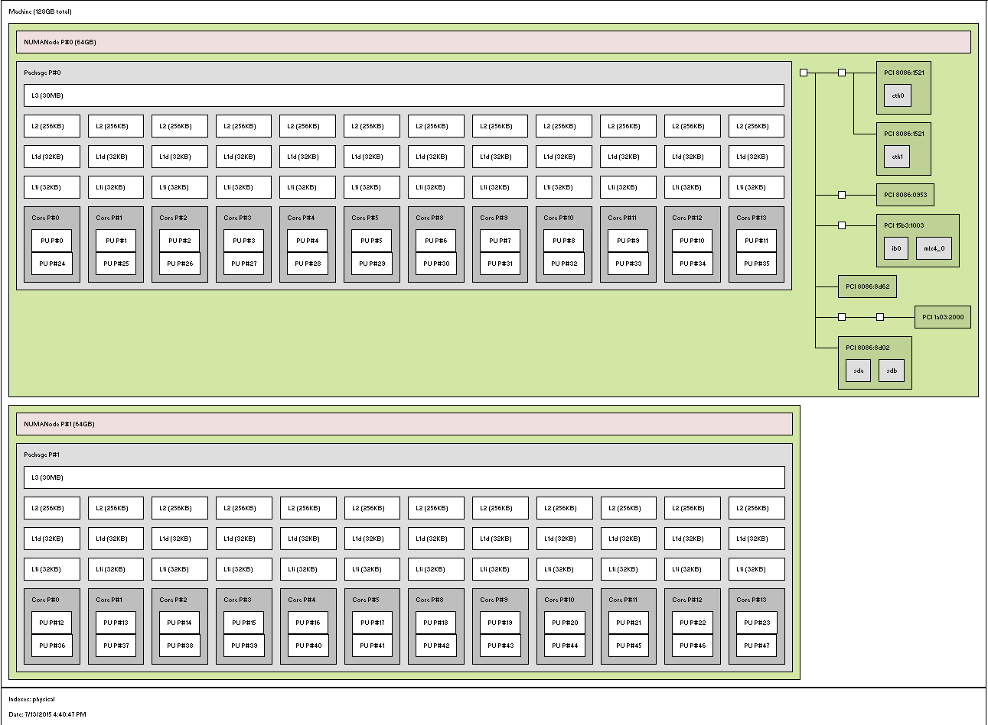
MPI, Fork-Join and Long Running Threads
Quite large number of cores per node in simple main stream clusters
  E.g. 1 Node in Juliet 128 node HPC cluster
    2 Sockets, 12 or 18 Cores each, 2 Hardware threads per core
    L1 and L2 per core, L3 shared per socket
Denote Configurations TxPxN for N nodes each with P processes and T threads per process
  Many choices in T and P
  Choices in Binding of processes and threads
  Choices in MPI where best seems to be SM “shared memory” with all messages for node combined in node shared memory
Socket 0
1 Core – 2 HTs
Socket 1

Slide 56
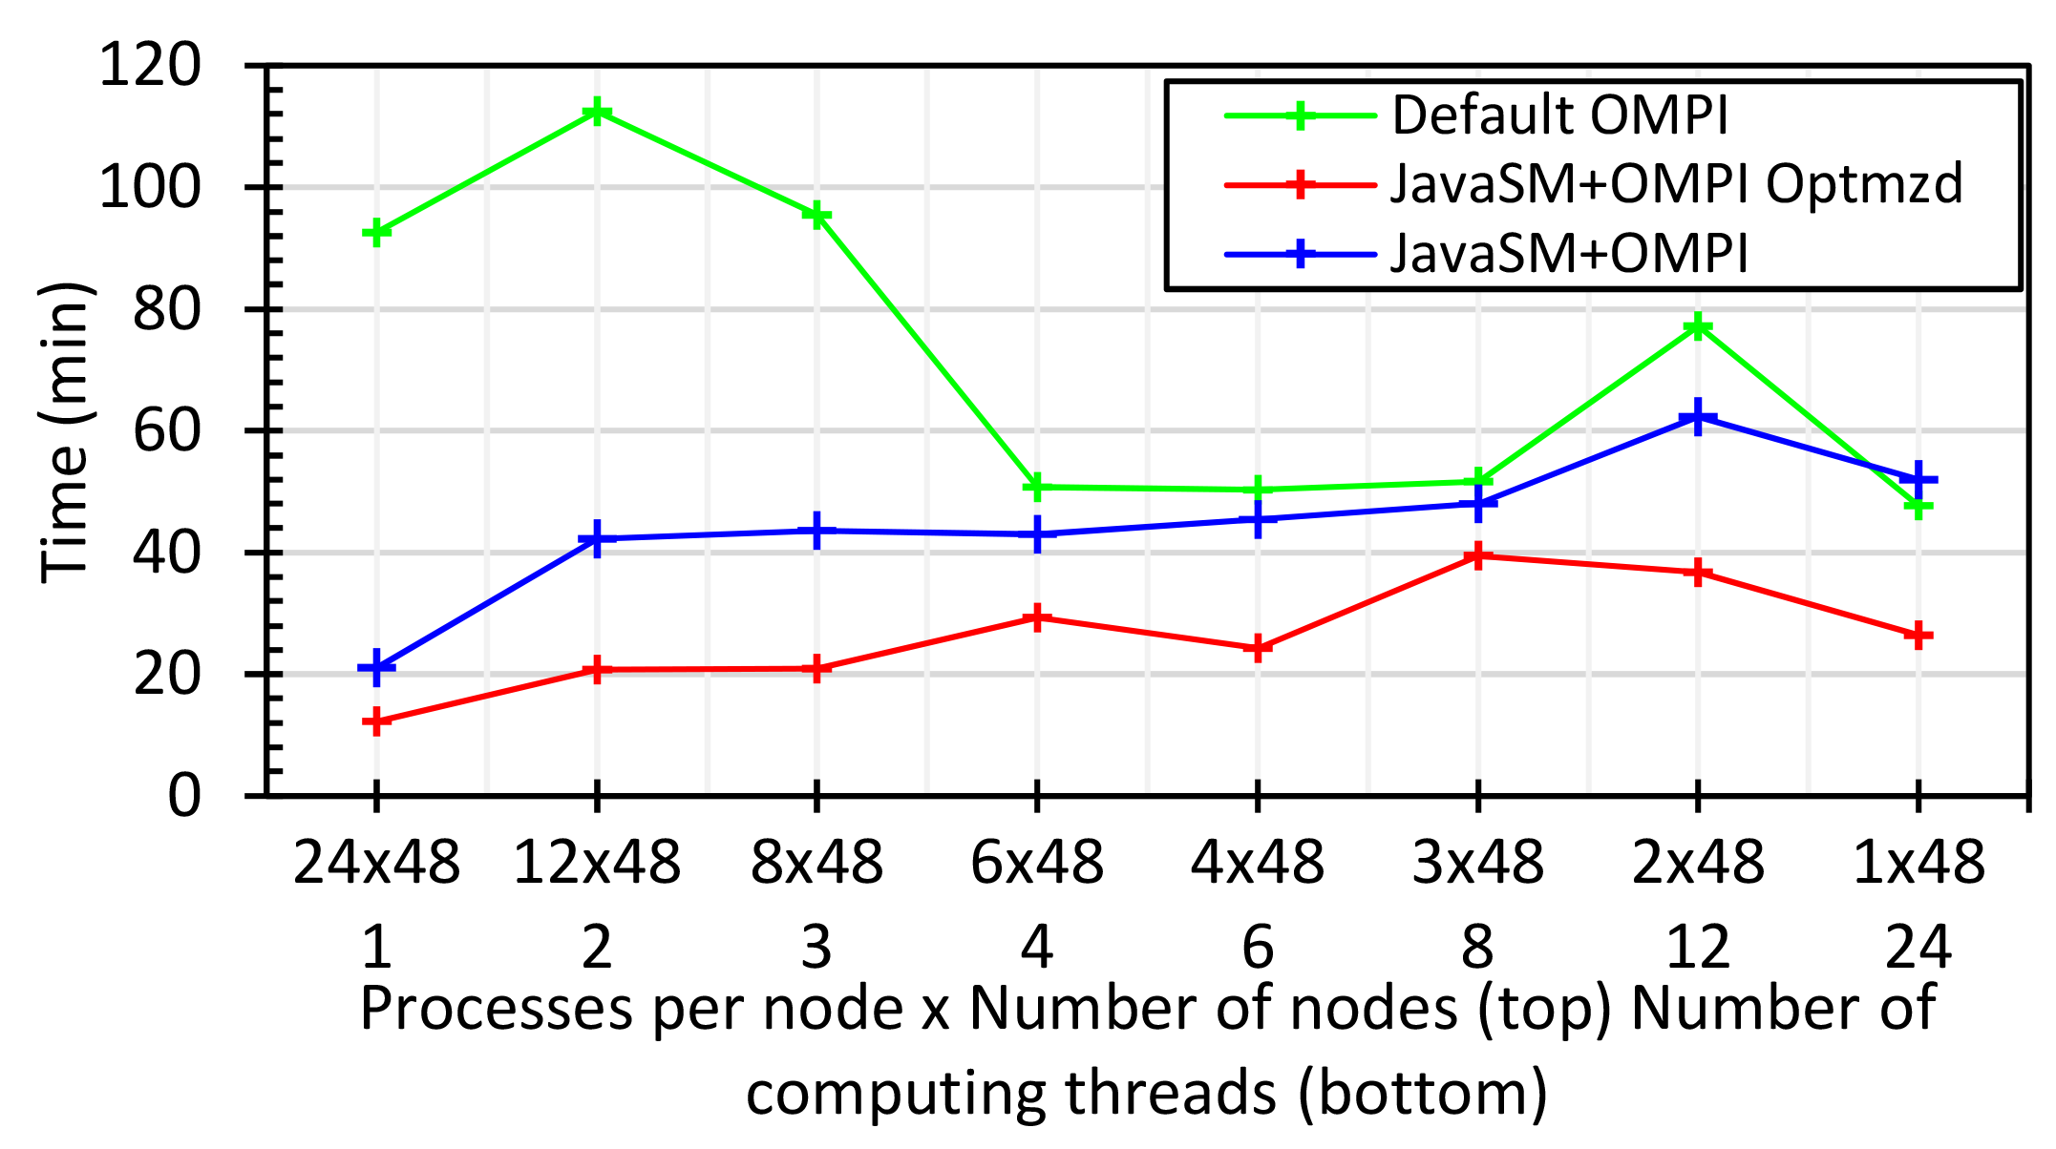
Java MPI performs better than FJ Threads I
48 24 core Haswell nodes 200K DA-MDS Dataset size
Default MPI much worse than threads
Optimized MPI using shared memory node-based messaging is much better than threads (default OMPI does not support SM for needed collectives)
All MPI
All Threads

Slide 57
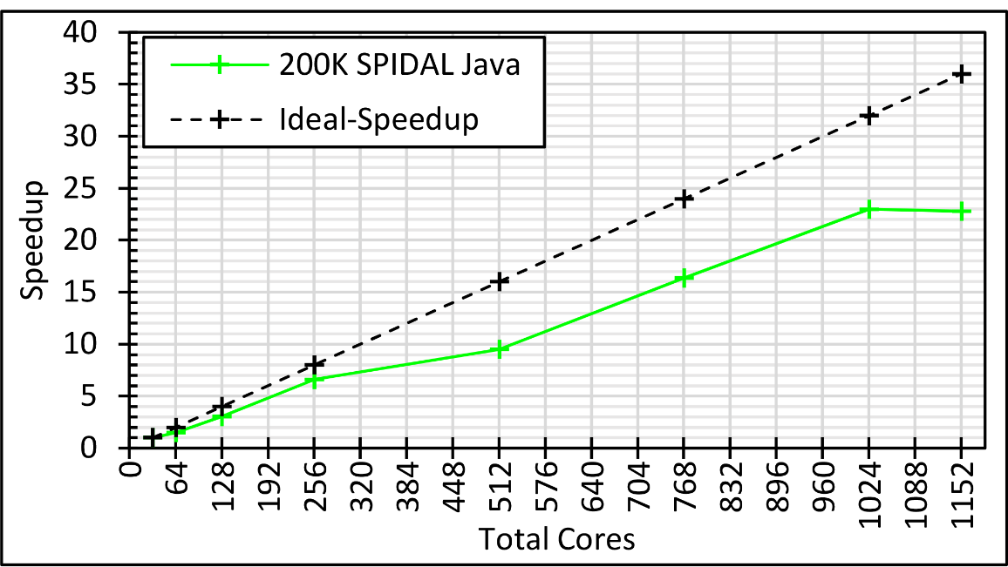
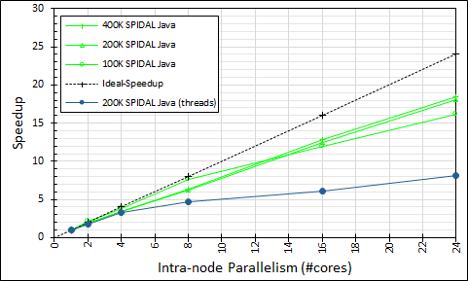
Intra-node Parallelism
All Processes: 32 nodes with 1-36 cores each; speedup compared to 32 nodes with 1 process; optimized Java
Processes (Green) and FJ Threads (Blue) on 48 nodes with 1-24 cores; speedup compared to 48 nodes with 1 process; optimized Java

Slide 58

Java MPI performs better than FJ Threads II
128 24 core Haswell nodes on SPIDAL DA-MDS Code
Speedup compared to 1 process per node on 48 nodes
Best MPI; inter and intra node
MPI; inter/intra node; Java not optimized
Best FJ Threads intra node; MPI inter node

Slide 59
MPI, Fork-Join and Long Running Threads
K-Means 1 million 2D points and 1k centers
Case 0: FJ threads
  Proc bound to T cores using MPI
  Threads inherit the same binding
Case 1: LRT threads
  Procs and threads are both unbound
Case 2: LRT threads
  Similar to Case 0 with LRT threads
Case 3: LRT threads
  Proc bound to all cores (= non bound)
  Each worker thread is bound to a core
P0,P1..,P7
C0
C1
C2
C3
C4
C5
C6
C7
Socket 0
Socket 1
All Threads
All MPI
Fork Join
LRT
Differ in helper threads

Slide 60
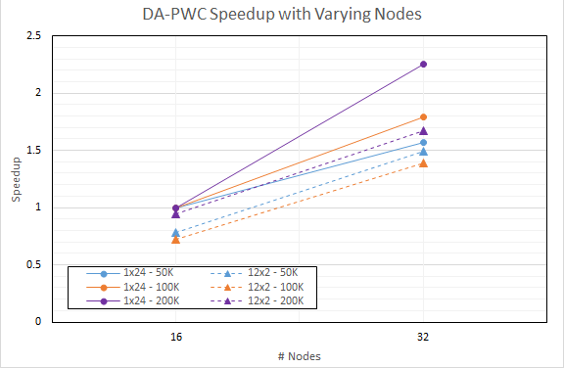
DA-PWC Non Vector Clustering
Speedup referenced to 1 Thread, 24 processes, 16 nodes
Increasing problem size
Circles 24 processes
Triangles: 12 threads, 2 processes on each node

Slide 61
DISCUSSION
The choice of language for Big Data and Big Simulation?
  C++, Java, Scala, Python, R highlights performance v. productivity trade-offs.
  What is actual performance of Big Data implementations and what are good benchmarks?
  Need more Performance evaluation

Slide 62
Choosing Languages
Language choice C++, Fortran, Java, Scala, Python, R, Matlab needs thought. This is a mixture of technical and social issues.
Java Grande was a 1997-2000 activity to make Java run fast and web site still there! http://www.javagrande.org/
Basic Java now much better but object structure, dynamic memory allocation and Garbage collection have their overheads
Java virtual machine JVM dominant Big Data environment?
One can mix languages quite efficiently
  Java MPI as binding to C++ version excellent
Scripting languages Python, R, Matlab address different requirements than Java, C++ ….

Slide 63
Is software sustainability important?
  Is the Apache model a good approach to this?
  How useful is DevOps to specify software systems?
  Some but not dramatic pressure on HPC community
  DevOps promising but not mature

Slide 64
Constructing HPC-ABDS Exemplars
This is one of next steps in NIST Big Data Working Group
Jobs are defined hierarchically as a combination of Ansible (preferred over Chef or Puppet as Python) scripts
Scripts are invoked on Infrastructure (Cloudmesh Tool)
INFO 524 “Big Data Open Source Software Projects” IU Data Science class required final project to be defined in Ansible and decent grade required that script worked (On NSF Chameleon and FutureSystems)
  80 students gave 37 projects with ~15 pretty good such as
  “Machine Learning benchmarks on Hadoop with HiBench”, Hadoop/YARN, Spark, Mahout, Hbase
  “Human and Face Detection from Video”, Hadoop, Spark, OpenCV, Mahout, MLLib
Build up curated collection of Ansible scripts defining use cases for benchmarking, standards, education https://docs.google.com/document/d/1OCPO2uqOkADvoxynRyZwh5IyFQ2_m1fkpBVMo3UBblg
Fall 2015 class INFO 523 introductory data science class was less constrained; students just had to run a data science application
  140 students: 45 Projects (NOT required) with 91 technologies, 39 datasets

Slide 65
Cloudmesh Interoperability DevOps Tool
Model: Define software configuration with tools like Ansible (Chef, Puppet); instantiate on a virtual cluster
Save scripts not virtual machines and let script build applications
Cloudmesh is an easy-to-use command line program/shell and portal to interface with heterogeneous infrastructures taking script as input
  It first defines virtual cluster and then instantiates script on it
Supports OpenStack, AWS, Azure, SDSC Comet, virtualbox, libcloud supported clouds as well as classic HPC and Docker infrastructures
  Has an abstraction layer that makes it possible to integrate other IaaS frameworks
Managing VMs across different IaaS providers is easier
Demonstrated interaction with various cloud providers:
  FutureSystems, Chameleon Cloud, Jetstream, CloudLab, Cybera, AWS, Azure, virtualbox
Status: AWS, and Azure, VirtualBox, Docker need improvements; we focus currently on SDSC Comet and NSF resources that use OpenStack
HPC Cloud Interoperability Layer

Slide 66
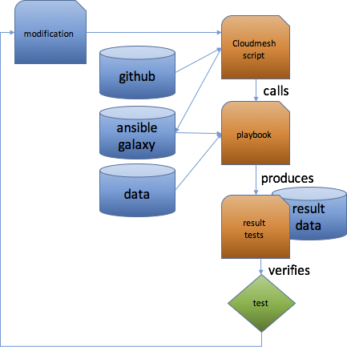
Structure of “Software Defined”
Big Data Exemplars
Github (Ansible Galaxy) collects basic Ansible roles
Exemplar (student project) may add specialized roles and defines a project Ansible playbook executed by a Cloudmesh cm script such as
  cm launcher hibench —parameterA=40 —parameterB=xyz ….
  —cloud=chameleon
Typical Playbook is short
  include role python
  include role hadoop
  include role pig
  include role fetch data
  include role execute benchmark
Figure illustrates testing a new
infrastructure or code change

Slide 67
DISCUSSION
Is software sustainability important?
  Is the Apache model a good approach to this?
  How useful is DevOps to specify software systems?
  Some but not dramatic pressure on HPC community
  DevOps promising but not mature

Slide 68
“Software Engineering”
Fixed Stacks or a “sea of components”? There are ongoing trade-offs between “integrated” systems and those involving collections of components. Funding availability important here
  Commercial big data tends to use the latter with the component of choice changing rapidly (e.g., as seen in Hadoop replaced by Spark and now Spark being challenged by Flink).
  Conversely, the HPC community remains committed to much of the 1990s tool base.
  Performance focus suggest fixed stacks to HPC
Implications of HPC Isolation: The fraction of students learning traditional HPC languages and tools is declining rapidly. If the HPC developer base is to be sustained, HPC must embrace more widely used tools

Slide 69
Performance, Productivity, Sustainability
Performance-Productivity: The Big Data community emphasizes rapid development and human productivity, even at the expense of execution efficiency. The HPC community has long discussed productivity but has not yet embraced it as a metric of success.
Performance Focus of HPC: The earlier “Grid computing” emphasis of HPC computing did not have same performance emphasis seen in big simulation work today (i.e. it was nearer Big Data in philosophy).
Sustainability: The economic sustainability model for Big Data software seems more robust than that for big simulation, given the relative sizes of the communities and the rapid growth of data analytics.

Slide 70
Big Data - Big Simulation
Convergence?
HPC-Clouds convergence?
Where are differences in approach, opinion?
Convergence Diamonds
HPC-ABDS Software on differently optimized hardware infrastructure

Slide 71
Components in Big Data HPC Convergence
Applications, Benchmarks and Libraries
  51 NIST Big Data Use Cases, 7 Computational Giants of the NRC Massive Data Analysis, 13 Berkeley dwarfs, 7 NAS parallel benchmarks
  Unified discussion by separately discussing data & model for each application;
  64 facets– Convergence Diamonds -- characterize applications
  Characterization identifies hardware and software features for each application across big data, simulation; “complete” set of benchmarks (NIST)
Software Architecture and its implementation
  HPC-ABDS: Cloud-HPC interoperable software: performance of HPC (High Performance Computing) and the rich functionality of the Apache Big Data Stack.
  Added HPC to Hadoop, Storm, Heron, Spark; will add to Beam and Flink
  Work in Apache model contributing code
Run same HPC-ABDS across all platforms but “data management” nodes have different balance in I/O, Network and Compute from “model” nodes
  Optimize to data and model functions as specified by convergence diamonds
  Do not optimize for simulation and big data
Convergence Language: Make C++, Java, Scala, Python … perform well

Slide 72
Typical Convergence Architecture
Running same HPC-ABDS software across all platforms but data management machine has different balance in I/O, Network and Compute from “model” machine
Model has similar issues whether from Big Data or Big Simulation.
Data Management Model for Big Data
and Big Simulation

Slide 73
DISCUSSION
Big Data - Big Simulation
Convergence?
HPC-Clouds convergence?
Where are differences in approach, opinion?
Convergence Diamonds
HPC-ABDS Software on differently optimized hardware infrastructure

Slide 74
What do we mean by convergence?
Commercial v. Science Data: Big Data reasonably clearly defined but covers the major commercial activities as well as scientific data analysis; the commercial activity is much the largest and we typically refer to that in discussing convergence. However analyzing scientific big data is very important and must be considered
Super large v Typical HPC Clusters: HPC spans both "leadership class supercomputers" and general HPC clusters from departmental size and above. Most deep learning for Big Data operates (today) on medium scale hardware. Hence, the current HPC synergy is mostly on departmental/university scale machines. Starting with leadership class systems is a much harder problem (culturally and technically), as it is equivalent to seeking convergence between commercial data centers and leadership class machines.
  Note possible relevance of capacity versus capability distinctions as most observational data analysis on HPC clusters is using machine in capacity mode.

Slide 75
Socio-Technical Issues in Convergence I
Change is Hard I: A lot of scientific data analysis (e.g. astronomy and particle physics) started a long time ago and established processes before many recent Big Data developments occurred.
Change is Hard II: SQL Databases have been around a long but many aspects of a modern Big Data stack (Hadoop, R, NoSQL, machine learning) are very recent
Interdisciplinary collaboration is critical to make progress; users and technologists, industry, academic and government.
  In some areas it still needs to be improved – see below!
HPC & Database Communities: Big Data arose from the database and computer science communities; HPC and scientific computing arose from the science and engineering community. They are distinct cultures.
Expertise: It could be helpful to fold in discussion of data science and education/training. Some choices today may be impacted by lack of broad expertise of computing staff in some Big Data issues.

Slide 76
Socio-Technical Issues II
HPC would benefit from convergence: The HPC community could learn about different performance, usability, interactivity, economics and sustainability trade-offs/choices from Big Data community.
  HPC could benefit from the areas -- databases, streaming, machine learning -- where Big Data a leader
Commodity-based HPC. The HPC community has always ridden the commodity technology curve, which is driven by volume markets. If HPC embraced convergence, it could benefit from cheaper hardware (not as fully optimized) and richer software driven by needs of Big Data community.
  This benefit could cover both simulation and data analysis for science.
  This important question has not been properly addressed within HPC

Slide 77
Socio-Technical Issues III
Big Data would benefit from convergence: Performance is becoming increasingly important to the Big Data community, as data volumes continue to grow; HPC techniques could lead to a significant (factor of 10) performance increases in large scale machine learning
  Expertise in parallel computing from HPC could benefit the Big Data community by improving the parallel performance of machine learning, both on GPUs and on clusters. Furthermore, there are interesting synergies between query optimization in Big Data and automatic compilation in scientific computing, as query languages are domain-specific approaches, just as are parallel languages.
Both HPC and Big Data would benefit from convergence: There are mutually beneficial activities such as parallelizing R and Python

