Slide 1
Twister:Net - Communication Library for Big Data Processing in HPC and Cloud Environment
Supun Kamburugamuve, Pulasthi Wickramasinghe, Kannan Govindarajan, Ahmet Uyar, Gurhan Gunduz, Vibhatha Abeykoon and Geoffrey C. Fox
Indiana University, Bloomington
July 6th, 2018

Slide 2
Overview
No library implements optimized dataflow communication operations
Need both BSP and Dataflow Style communications
MPI / RDMA / TCP
Every major big data project implements communications on their own
Different semantics for same operation
Communication is implemented at a higher level – Only point to point operations are considered at the communication level
Data driven higher level abstractions
Handling both streaming and batch

Slide 3
Twister2 – HPC and Big Data

Slide 4
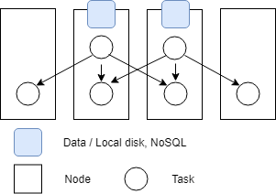
Requirements
Modeling dataflow graph
Preserving data locality
Streaming computation requirements
Complete graph is executing at any given time
Data locality
Tasks running in different nodes
Two tasks reads data and distributed them for processing
Communication Operations
Streaming - All the tasks of execution graph running

Slide 5
Dataflow Communications
Non-blocking
Dynamic data sizes
Streaming model
Batch case is modeled as a finite stream
The communications are between a set of tasks in an arbitrary task graph
Key based communications
Communications spilling to disks

Slide 6
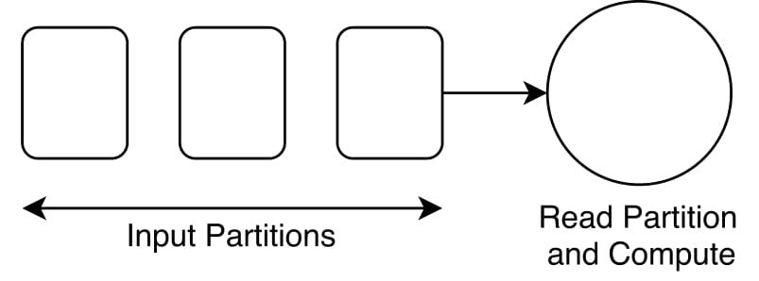
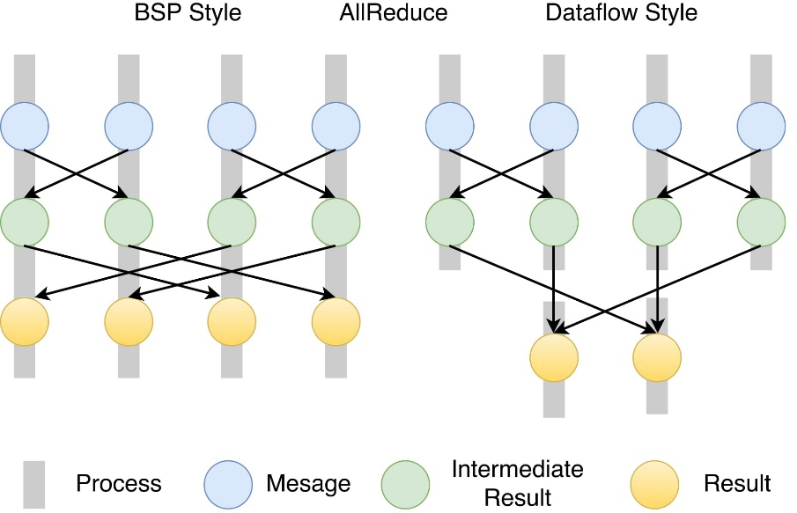
Twister:Net
Standalone Communication library capturing dataflow communications
Big data computation model
Communication can be invoked by multiple tasks in a process
AllReduce in an arbitrary task graph (right) compared to MPI (left)

Slide 7
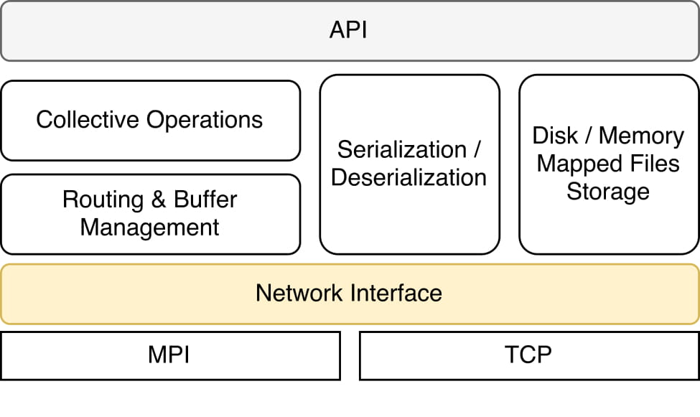
Twister:Net
Communication operators are state full
Buffer data, handle imbalanced communications, act as a combiner
Thread safe
Initialization
MPI
TCP / ZooKeeper
Buffer management
The messages are serialized by the library
Back-pressure
Uses flow control by the underlying channel
Architecture
Reduce | Gather | Partition | Broadcast
AllReduce | AllGather | Keyed-Partition
Keyed-Reduce | KeyedGather
Batch and Streaming versions
Optimized operation vs Serial

Slide 8
Twister:Net Model
Messages
Callback Receiver
Communication Operation

Slide 9
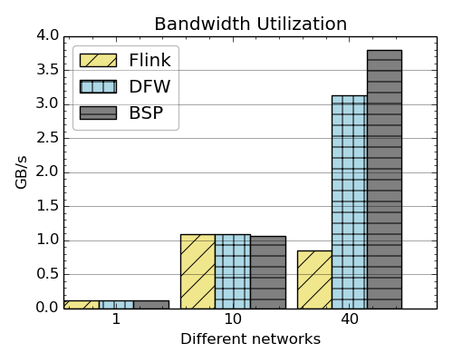
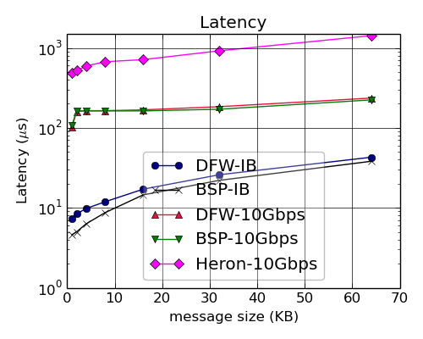
Bandwidth & Latency
Latency and bandwidth between two tasks running in two nodes
Bandwidth utilization of Flink, Twister2 and OpenMPI over 1Gbps, 10Gbps and IB with Flink on IPoIB
Latency of MPI and Twister:Net with different message sizes on a two-node setup

Slide 10
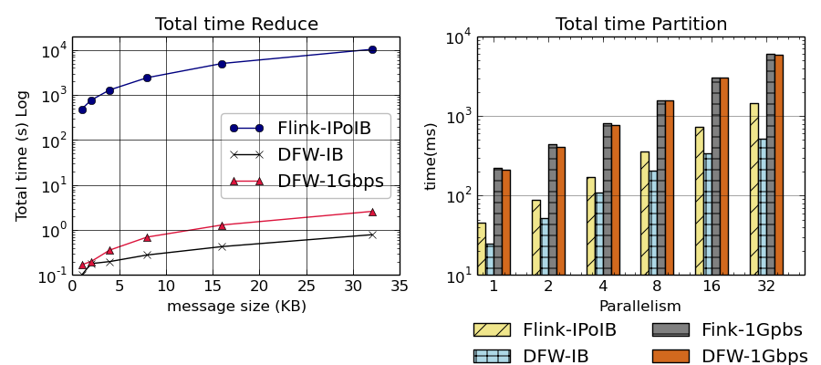
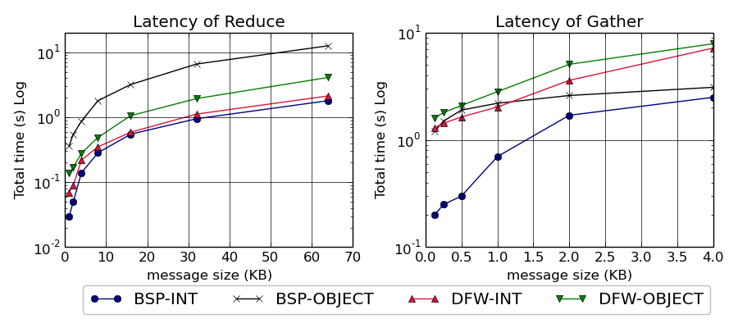
Flink, BSP and DFW Performance
Total time for Flink and Twister:Net for Reduce and Partition operations in 32 nodes with 640-way parallelism. The time is for 1 million messages in each parallel unit, with the given message size
Latency for Reduce and Gather operations in 32 nodes with 256-way parallelism. The time is for 1 million messages in each parallel unit, with the given message size. For BSP-Object case we do two MPI calls with MPIAllReduce / MPIAllGather first to get the lengths of the messages and the actual call. InfiniBand network is used.

Slide 11
Latency vs Heron
Speedup of about 100
Latency of Heron and Twister:Net DFW for Reduce, Broadcast and Partition operations in 16 nodes with 256-way parallelism

Slide 12
Direct Heron Communication Improvements
Stream Manager
Stream Manager
Sub Task
Sub Task
Sub Task
Sub Task
Sub Task
Sub Task
Sub Task
Sub Task
Sub Task
Sub Task
Sub Task
Sub Task
Sub Task
Sub Task
Sub Task
Sub Task
Container
Container
Container
Container
This architecture doesn’t work for parallel communications, Stream Manger is a bottleneck
Removed Stream Managers and allowed tasks to communicate

Slide 13
Heron direct implementation
Broadcast
Latency of broadcast with 16 nodes and 64, 128 and 256 parallel tasks. Message size varying from 1K to 32K
Reduce
Latency of reduce with 16 nodes and 64, 128 and 256 parallel tasks. Message size varying from 1K to 32K

Slide 14
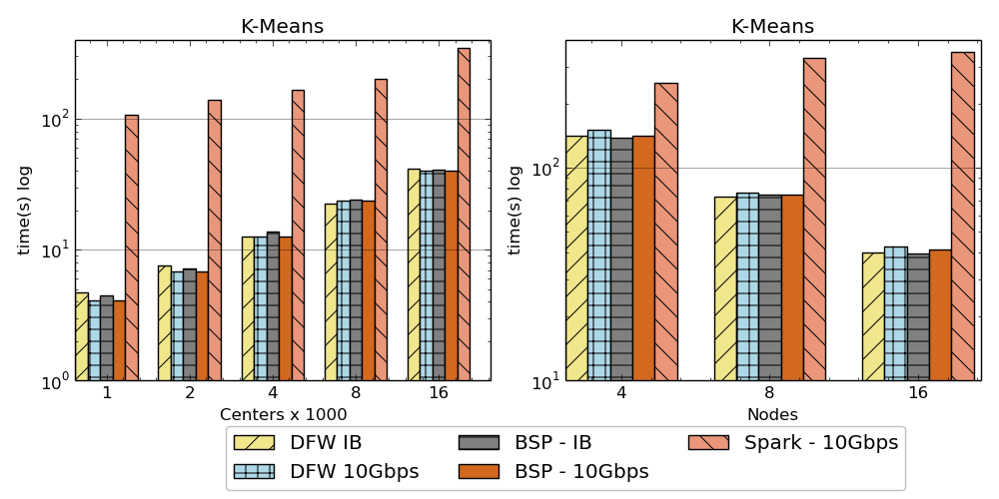
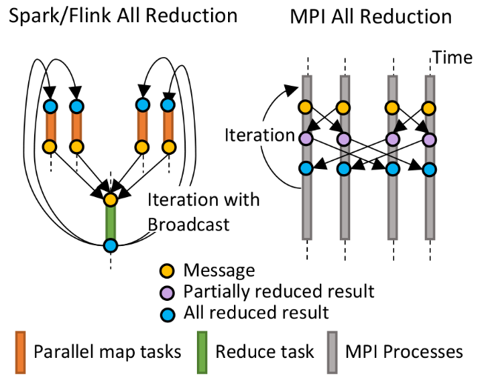
K-Means algorithm performance
AllReduce Communication
Left: K-means job execution time on 16 nodes with varying centers, 2 million points with 320-way parallelism. Right: K-Means wth 4,8 and 16 nodes where each node having 20 tasks. 2 million points with 16000 centers used.

Slide 15
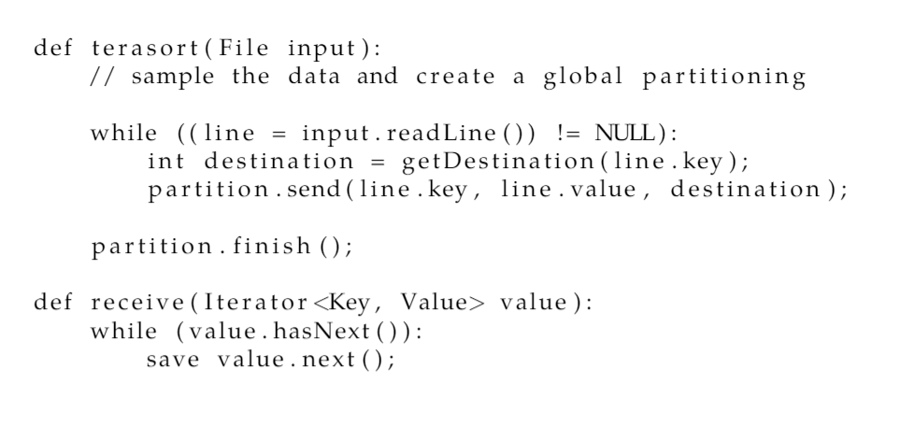
Sorting Records
Dataflow Partition operation

Slide 16
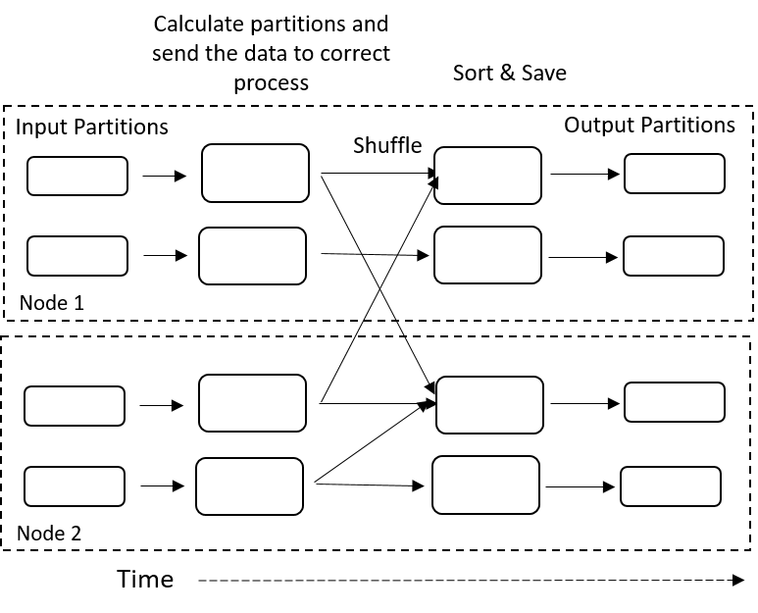
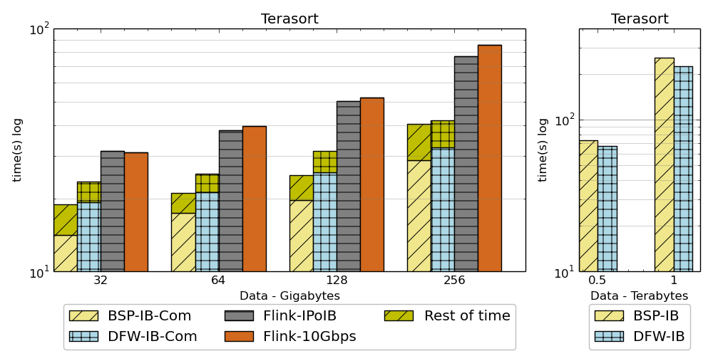
Sorting Records
For DFW case, a single node can get congested if many processes send message simultaneously.
Left: Terasort time on a 16 node cluster with 384 parallelism. BSP and DFW shows the communication time. Right: Terasort on 32 nodes with .5 TB and 1TB datasets. Parallelism of 320. Right 16 node cluster (Victor), Left 32 node cluster (Juliet) with InfiniBand.
Partition the data using a sample and regroup
BSP algorithm waits for others to send messages in a ring topology and can be in-efficient compared to DFW case where processes do not wait.

Slide 17
Conclusions
We have created a model for dataflow communications
We have implemented optimized versions of these communications for common patterns
The results show we can be much better in performance to big data systems

Slide 18
Questions

