Slide 1
Twister2: Design of a Big Data Toolkit
Supun Kamburugamuve, Kannan Govindarajan, Pulasthi Wickramasinghe,
Vibhatha Abeykon, Geoffrey Fox
Digital Science Center
Indiana University Bloomington
skamburu@indiana.edu,
ExaMPI 2017
`

Slide 2
Motivation
Use of public clouds increasing rapidly
  Edge computing adding another dimension
  Clouds becoming diverse with subsystems containing GPU’s, FPGA’s, high performance networks, storage, memory
Rich software stacks
  HPC (High Performance Computing) for Parallel Computing
  Apache for Big Data Software Stack ABDS – much more popular than HPC
Big data systems are characterized by
  Low-performance
  High-usability
Event driven computing model is becoming mainstream
  HPC – Asynchronous many task systems (AMT)
  All major big data frameworks
  Services in the form of Function as a Service (FaaS)

Slide 3
Big Data Landscape

Slide 4
Comparing Spark Flink and MPI
On Global Machine Learning GML.
Note Spark and Flink are successful on LML not GML and currently LML is more common than GML

Slide 5



Multidimensional Scaling - 3 Nested Parallel Sections
Flink
Spark
MPI
MPI Factor of 20-200 Faster than Spark/Flink
MDS execution time on 16 nodes with 20 processes in each node with varying number of points
MDS execution time with 32000 points on varying number of nodes. Each node runs 20 parallel tasks

Slide 6
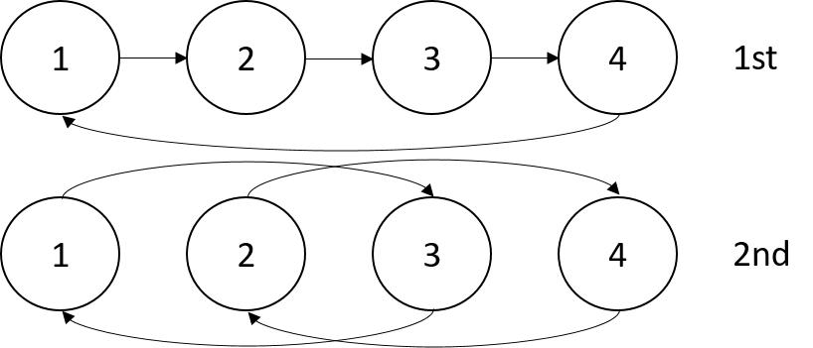


Terasort
Transfer data using MPI
Sorting 1TB of data records
Terasort execution time in 64 and 32 nodes. Only MPI shows the sorting time and communication time as other two frameworks doesn't provide a viable method to accurately measure them. Sorting time includes data save time. MPI-IB - MPI with Infiniband
Partition the data using a sample and regroup

Slide 7
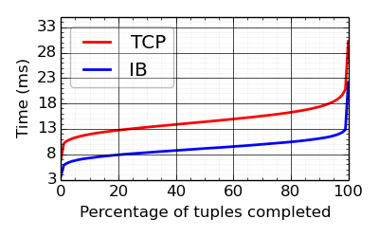
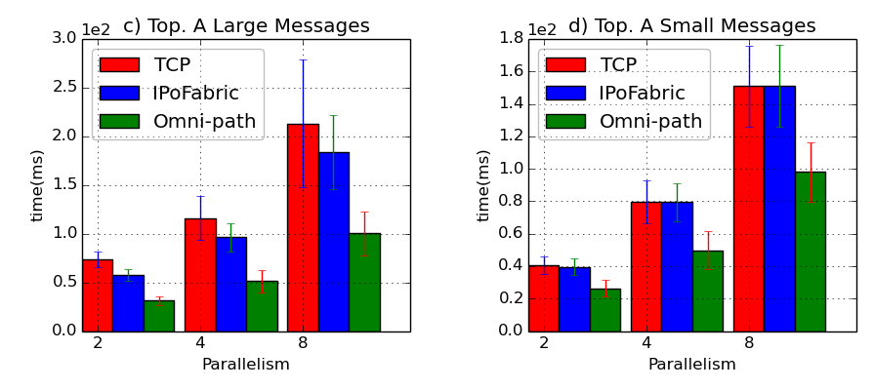
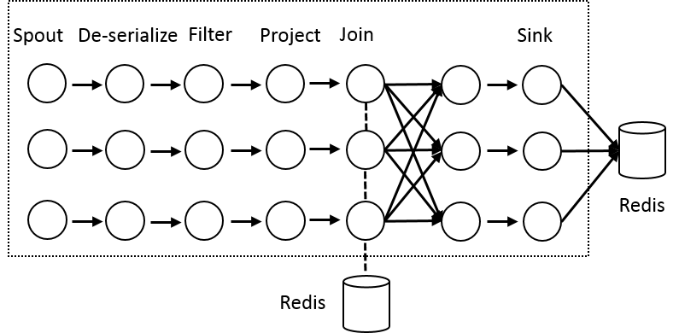
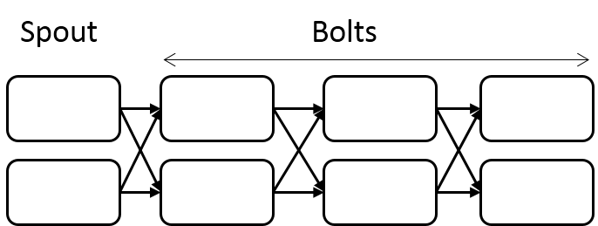
Heron High Performance Interconnects
Infiniband & Intel Omni-Path integrations
Using Libfabric as a library
Natively integrated to Heron through Stream Manager without needing to go through JNI
Latency of the Topology A with 1 spout and 7 bolt instances arranged in a chain with varying parallelism and message sizes. c) and d) are with 128k and 128bytes messages. The results are on KNL cluster.
Topology A. A long topology with 8 Stages
Yahoo Streaming Bench Topology on Haswell cluster

Slide 8
Layers of Parallel Applications
Data partitioning and placement
Manage distributed data
Data Management
Computation Graph
Execution (Threads/Processes), Scheduling of Executions
Task System
Internode and Intracore Communication
Network layer
Communication
What we need to write a parallel application
Three main abstractions

Slide 9
K-means Computation Graph
All Reduce
Internal
Execution Nodes
Data Set <Points>
Workflow Nodes
Graph for K-means
Data Set <Initial Centroids>
Map (nearest centroid calculation)
Reduce (update centroids)
Data Set <Updated Centroids>
Dataflow
Communication
Broadcast
K-Means compute
K-Means dataflow graph in Spark, MPI
Iterate
K-Means in MPI

Slide 10
Apache Big data Systems
Top down designs targeting one type of applications
  Users want to use them for every type of application
Monolithic designs with fixed choices
  Harder to change
Low performance
  Software engineering
  Not targeting advanced hardware
Only high level APIs/abstractions available
  Harder for an advanced user to optimize an application

Slide 11
Requirements
Large scale simulation requirements are well understood
We identify 4 types of applications
  Data pipelines
  Streaming
  Machine learning
  Function as a Service
Big Data requirements are not clear but there are a few key use types
  Pleasingly parallel processing (including local machine learning LML) as of different tweets from different users with perhaps MapReduce style of statistics and visualizations; possibly Streaming
  Database model with queries again supported by MapReduce for horizontal scaling
  Global Machine Learning GML with single job using multiple nodes as classic parallel computing
  Deep Learning certainly needs HPC

Slide 12
Twiste2 Approach
Clearly define functional layers
Develop base layers as independent components
Use interoperable common abstractions but multiple polymorphic implementations.
Allow users to pick and choose according to requirements
  Communication + Data Management
  Communication + Static graph
Use HPC features when possible

Slide 13
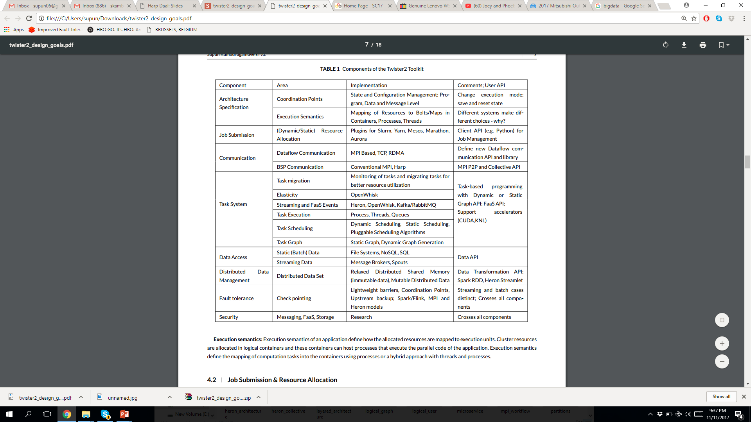
Twiste2 Components

Slide 14
Twiste2 Components

Slide 15
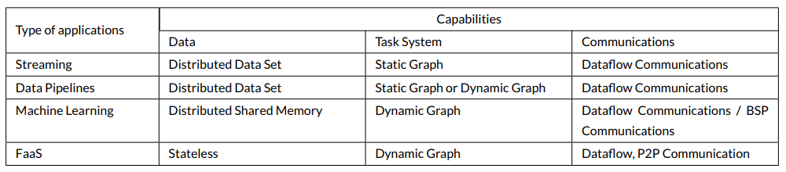
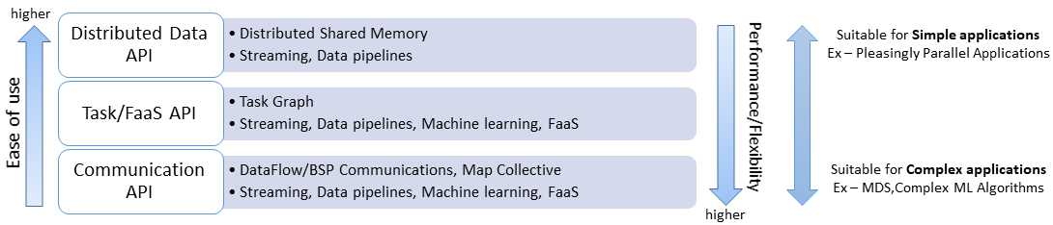
Different applications at different layers

Slide 16
Communication Models
MPI Characteristics: Tightly synchronized applications
  Efficient communications (ns latency) with use of advanced hardware
  In place communications and computations (Process scope for state)
Dataflow: Model a communication as part of a graph
  Nodes - computation Tasks, Edges - asynchronous communications
  A computation is activated when its input data dependencies are satisfied
  Streaming dataflow: Pub-Sub with data partitioned into streams
    Streams are unbounded, ordered data tuples
    Order of events important and group data into time windows
Machine Learning dataflow: Iterative computations and keep track of state
  There is both Model and Data, but only communicate the model
  Collective communication operations such as AllReduce, AllGather
  Can use in-place MPI style communication

Slide 17

HPC Runtime versus ABDS distributed Computing Model on Data Analytics
Hadoop writes to disk and is slowest; Spark and Flink spawn many processes and do not support AllReduce directly;
MPI does in-place combined reduce/broadcast and is fastest
Need Polymorphic Reduction capability choosing best implementation
Use HPC architecture with
  Mutable model
  Immutable data

Slide 18
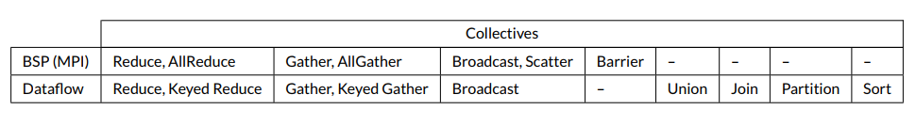
Communication Requirements
Need data driven higher level abstractions
Both BSP and Dataflow Style communications
  MPI / RDMA / TCP
MPI requirements
  Need MPI to work with Yarn/Mesos (Use MPI only as a communication library)
  Make MPI work with dynamic environments where processes are added / removed while an application is running
  We don’t need fault tolerance at MPI level

Slide 19
Harp Plugin for Hadoop: Important part of Twister2
Work of Judy Qiu

Slide 20
Task System
Generate computation graph dynamically
  Dynamic scheduling of tasks
  Allow fine grained control of the graph
Generate computation graph statically
  Dynamic or static scheduling
  Suitable for streaming and data query applications
  Hard to express complex computations, especially with loops
Hybrid approach
  Combine both static and dynamic graphs

Slide 21
Summary of Twister2: Next Generation HPC Cloud + Edge + Grid
We suggest an event driven computing model built around Cloud and HPC and spanning batch, streaming, and edge applications
  Highly parallel on cloud; possibly sequential at the edge
We have built a high performance data analysis library SPIDAL
We have integrated HPC into many Apache systems with HPC-ABDS
We have done a preliminary analysis of the different runtimes of Hadoop, Spark, Flink, Storm, Heron, Naiad, DARMA (HPC Asynchronous Many Task)
There are different technologies for different circumstances but can be unified by high level abstractions such as communication collectives
  Obviously MPI best for parallel computing (by definition)
Apache systems use dataflow communication which is natural for them
  No standard dataflow library (why?). Add Dataflow primitives in MPI-4?
MPI could adopt some of tools of Big Data as in Coordination Points (dataflow nodes), State management with RDD (datasets)

