Slide 1
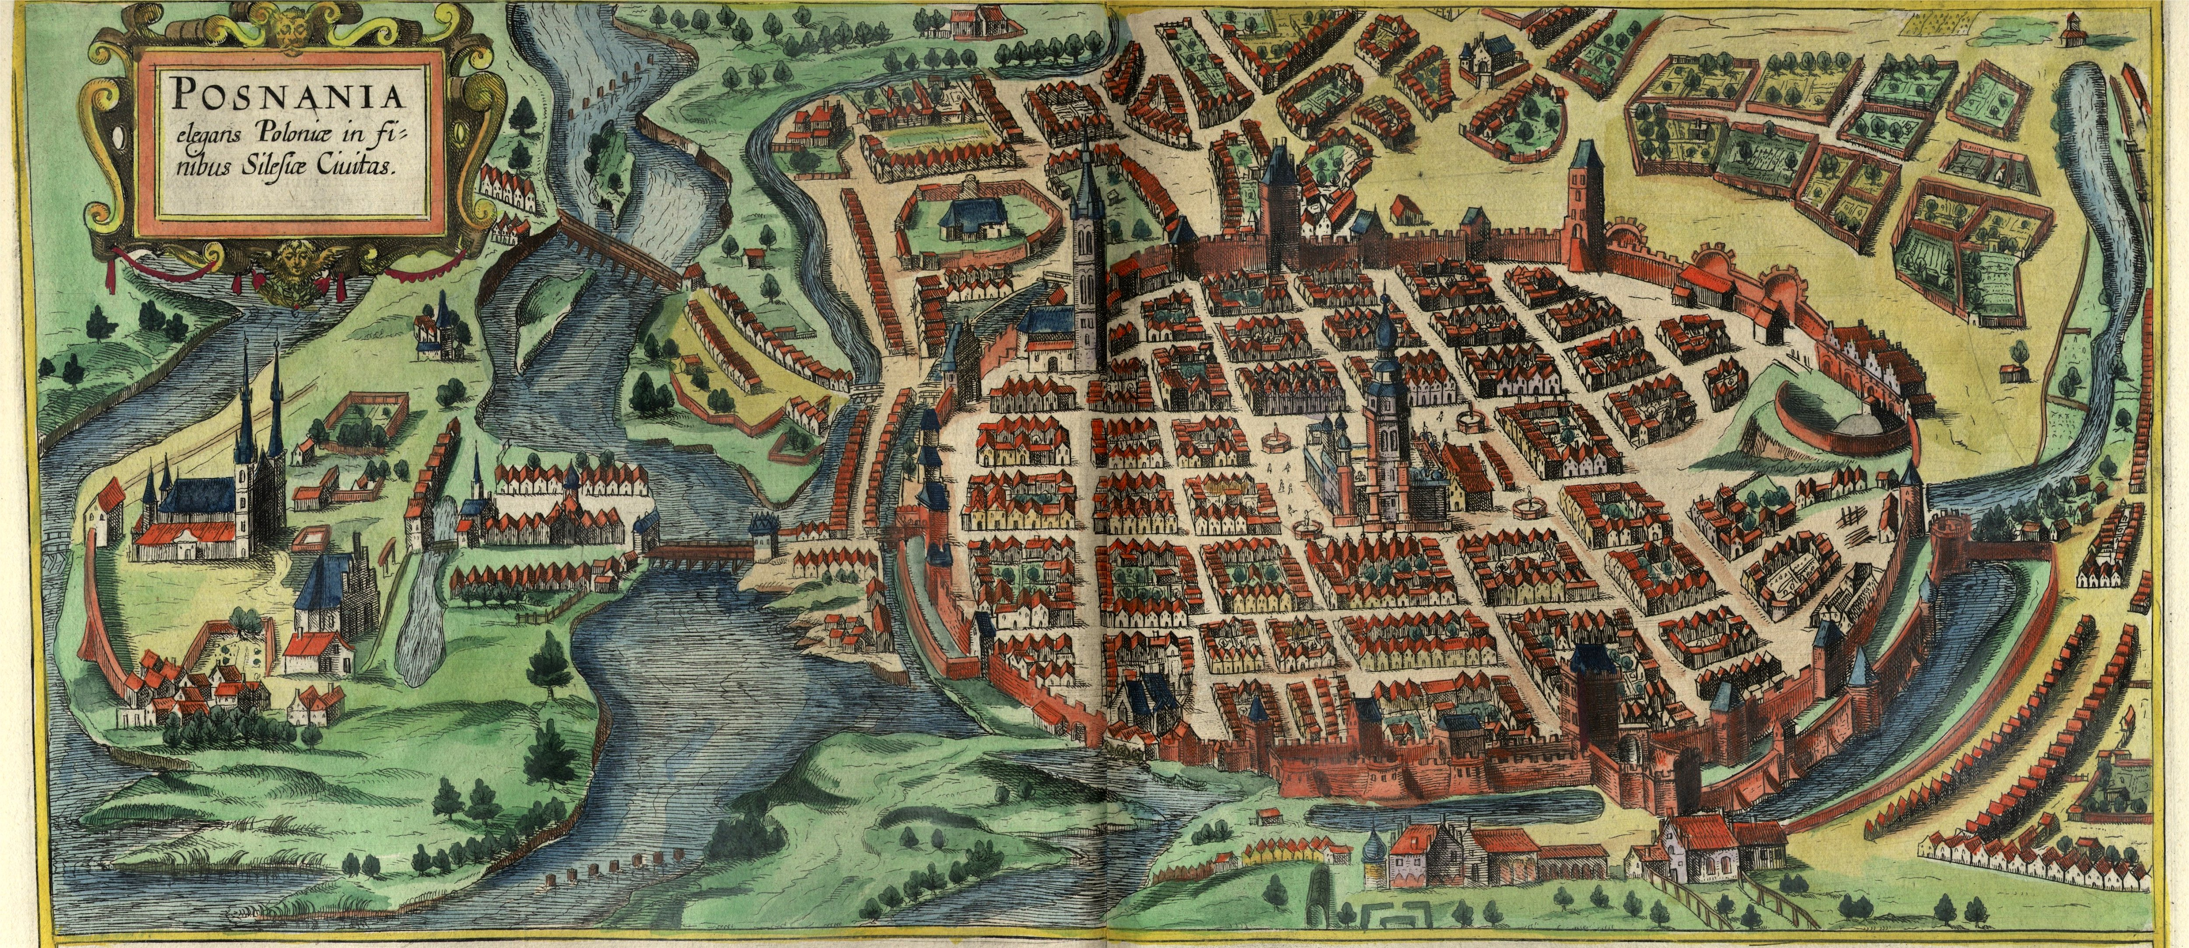
Twister2 for BDEC2 https://twister2.gitbook.io/twister2/
Poznan, Poland Geoffrey Fox, May 15, 2019 gcf@indiana.edu, http://www.dsc.soic.indiana.edu/, http://spidal.org/
Digital Science Center

Slide 2
Twister2 Highlights I
“Big Data Programming Environment” such as Hadoop, Spark, Flink, Storm, Heron but uses HPC wherever appropriate and outperforms Apache systems – often by large factors
Runs preferably under Kubernetes Mesos Nomad but Slurm supported
Highlight is high performance dataflow supporting iteration, fine-grain, coarse grain, dynamic, synchronized, asynchronous, batch and streaming
Three distinct communication environments
DFW Dataflow with distinct source and target tasks; data not message level; Data-level Communications spilling to disks as needed
BSP for parallel programming; MPI is default. Inappropriate for dataflow
Storm API for streaming events with pub-sub such as Kafka
Rich state model (API) for objects supporting in-place, distributed, cached, RDD (Spark) style persistence with Tsets (see Pcollections in Beam, Datasets in Flink, Streamlets in Storm, Heron)

Slide 3
Continually interacting in the Intelligent Aether with
Software model supported by Twister2

Slide 4
Twister2 Highlights II
Can be a pure batch engine
Not built on top of a streaming engine
Can be a pure streaming engine supporting Storm/Heron API
Not built on on top of a batch engine
Fault tolerance (June 2019) as in Spark or MPI today; dataflow nodes define natural synchronization points
Many API’s: Data, Communication, Task
High level hiding communication and decomposition (as in Spark) and low level (as in MPI)
DFW supports MPI and MapReduce primitives: (All)Reduce, Broadcast, (All)Gather, Partition, Join with and without keys
Component based architecture -- it is a toolkit
Defines the important layers of a distributed processing engine
Implements these layers cleanly aiming at high performance data analytics

Slide 5
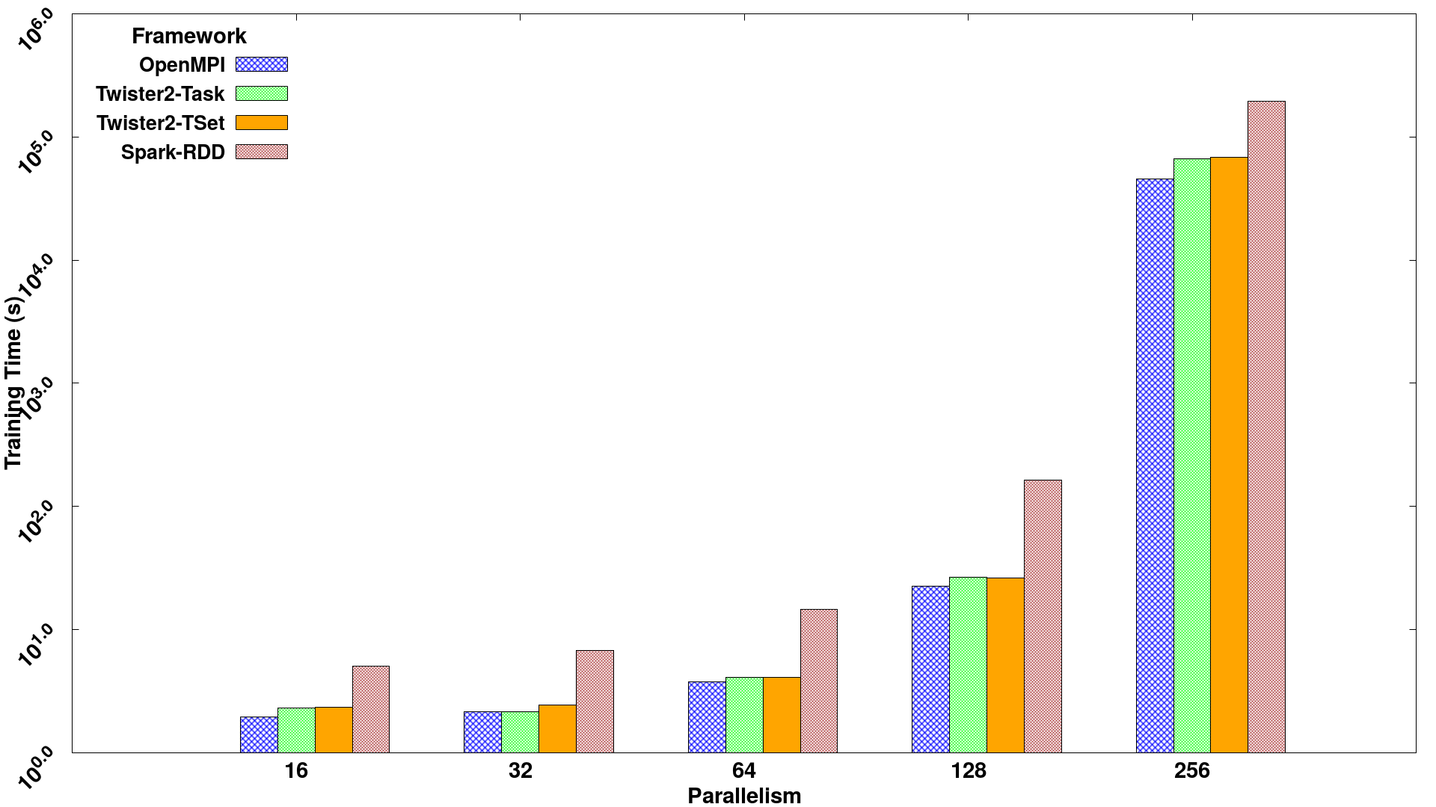
Parallel SVM using SGD execution time for 320K data points with 2000 features and 500 iterations, on 16 nodes with varying parallelism
Times
Spark RDD > Twister2 Tset > Twister2 Task > MPI

Slide 6
Twister2 Status
100,000 lines of new open source Code: mainly Java but significant Python
https://twister2.gitbook.io/twister2/tutorial
Operational with documentation and examples
End of June 2019: Fault tolerance, Apache BEAM Linkage, More applications
Fall2019: Python API, C++ Implementation (why Python hard)
Not scheduled: TensorFlow Integration, SQL API, Native MPI
Two IU application foci are integration of Machine Learning with nano and bio modelling MLforHPC and Streaming using Storm API

