Slide 1

Introduction to Twister2 for Tutorial
Geoffrey Fox, January 10-11, 2019
gcf@indiana.edu, http://www.dsc.soic.indiana.edu/, http://spidal.org/
5th International Winter School on Big Data BigDat 2019
Cambridge, United Kingdom - January 7-11, 2019
Digital Science Center
Indiana University

Slide 2

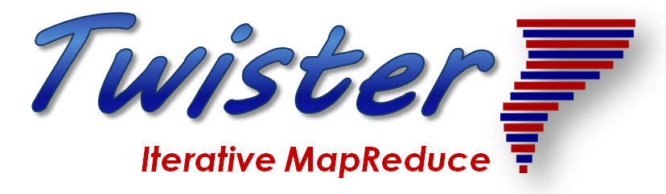
Overall Global AI and Modeling Supercomputer GAIMSC
2
http://www.iterativemapreduce.org/

Slide 3
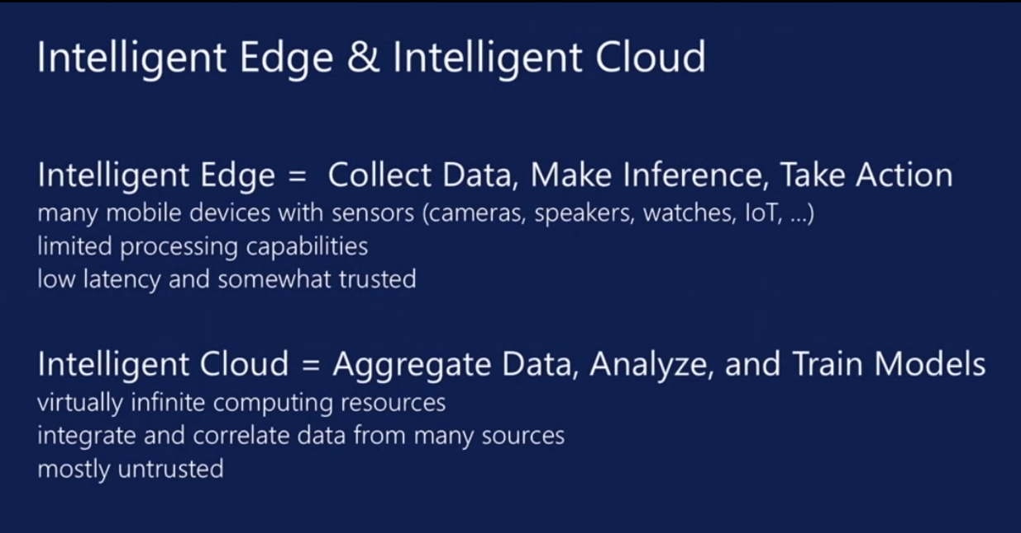
aa
From Microsoft
aa
https://www.microsoft.com/en-us/research/event/faculty-summit-2018/

Slide 4
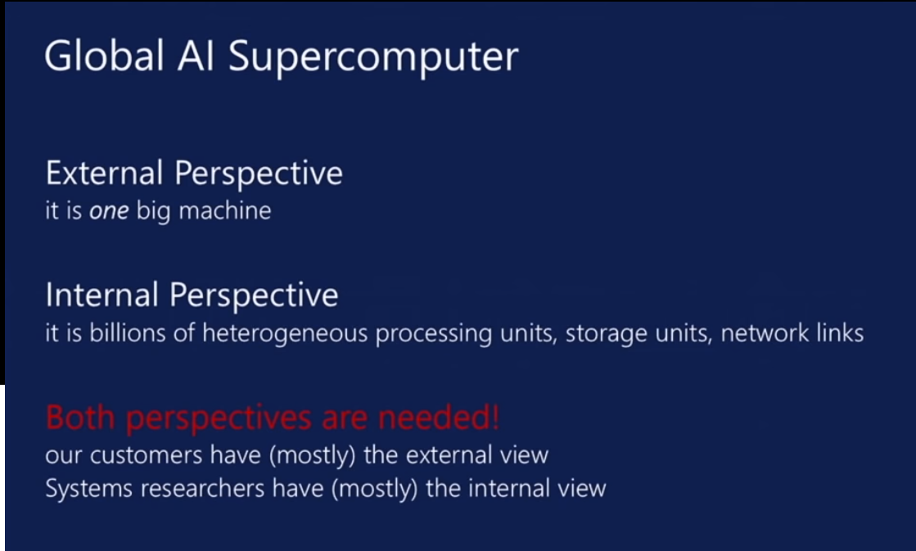
aa
aa

Slide 5
Overall Global AI and Modeling Supercomputer GAIMSC Architecture
There is only a cloud at the logical center but it’s physically distributed and owned by a few major players
There is a very distributed set of devices surrounded by local Fog computing; this forms the logically and physically distribute edge
The edge is structured and largely data
  These are two differences from the Grid of the past
  e.g. self driving car will have its own fog and will not share fog with truck that it is about to collide with
The cloud and edge will both be very heterogeneous with varying accelerators, memory size and disk structure.

Slide 6
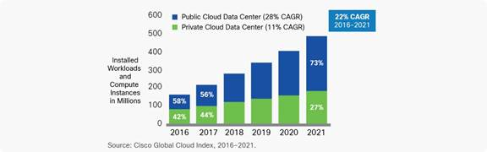
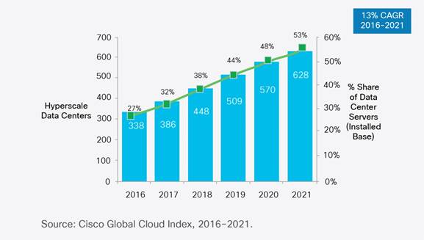
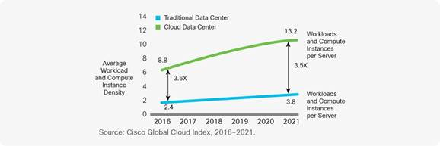
Remembering Grid Computing: IoT and Distributed Center I
Hyperscale data centers will grow from 338 in number at the end of 2016 to 628 by 2021. They will represent 53 percent of all installed data center servers by 2021.
  They form a distributed Compute (on data) grid with some 50 million servers
94 percent of workloads and compute instances will be processed by cloud data centers by 2021-- only six percent will be processed by traditional data centers.
Analysis from CISCO https://www.cisco.com/c/en/us/solutions/collateral/service-provider/global-cloud-index-gci/white-paper-c11-738085.html
Number of Public or Private Cloud Data Center Instances
Number of Cloud Data Centers
Number of instances per server

Slide 7
Remembering Grid Computing: IoT and Distributed Center II
By 2021, Cisco expects IoT connections to reach 13.7 billion, up from 5.8 billion in 2016, according to its Global Cloud Index.
Globally, the data stored in data centers will nearly quintuple by 2021 to reach 1.3ZB by 2021, up 4.6-fold (a CAGR of 36 percent) from 286 exabytes (EB) in 2016.
Big data will reach 403 EB by 2021, up almost eight-fold from 25EB in 2016. Big data will represent 30 percent of data stored in data centers by 2021, up from 18 percent in 2016.
The amount of data stored on devices will be 4.5-times higher than data stored in data centers, at 5.9ZB by 2021.
Driven largely by IoT, the total amount of data created (and not necessarily stored) by any device will reach 847ZB per year by 2021, up from 218ZB per year in 2016.
The Intelligent Edge or IoT is a distributed Data Grid

Slide 8
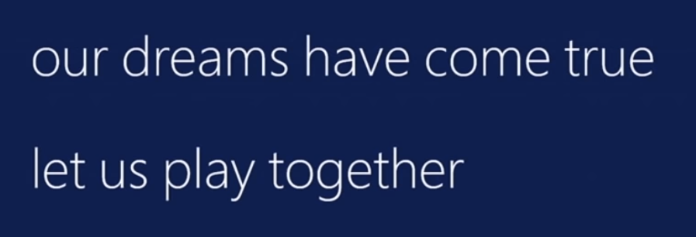
Collaborating on the
Global AI and Modeling Supercomputer GAIMSC
Microsoft says:
We can only “play together” and link functionalities from Google, Amazon, Facebook, Microsoft, Academia if we have open API’s and open code to customize
  We must collaborate
Open source Apache software
Academia needs to use and define their own Apache projects
We want to use AI and modeling supercomputer for AI-Driven science studying the early universe and the Higgs boson and not just producing annoying advertisements (goal of most elite CS researchers)

Slide 9
GAIMSC Global AI & Modeling Supercomputer Questions
What do gain from the concept? e.g. Ability to work with Big Data community
What do we lose from the concept? e.g. everything runs as slow as Spark
Is GAIMSC useful for BDEC2 initiative? For NSF? For DoE?
For Universities? For Industry? For users?
Does adding modeling to concept add value?
What are the research issues for GAIMSC? e.g. how to program?
What can we do with GAIMSC that we couldn’t do with classic Big Data technologies?
What can we do with GAIMSC that we couldn’t do with classic HPC technologies?
Are there deep or important issues associated with the “Global” in GAIMSC?
Is the concept of an auto-tuned Global AI and Modeling Supercomputer scary?

Slide 10
Systems Challenges for GAIMSC
Architecture of the Global AI and Modeling Supercomputer GAIMSC must reflect
  Global captures the need to mashup services from many different sources;
  AI captures the incredible progress in machine learning (ML);
  Modeling captures both traditional large-scale simulations and the models and digital twins needed for data interpretation;
  Supercomputer captures that everything is huge and needs to be done quickly and often in real time for streaming applications.
The GAIMSC includes an intelligent HPC cloud linked via an intelligent HPC Fog to an intelligent HPC edge. We consider this distributed environment as a set of computational and data-intensive nuggets swimming in an intelligent aether.
  We will use a dataflow graph to define a mesh in the aether
GAIMSC requires parallel computing to achieve high performance on large ML and simulation nuggets and distributed system technology to build the aether and support the distributed but connected nuggets.
In the latter respect, the intelligent aether mimics a grid but it is a data grid where there are computations but typically those associated with data (often from edge devices).
  So unlike the distributed simulation supercomputer that was often studied in previous grids, GAIMSC is a supercomputer aimed at very different data intensive AI-enriched problems.

Slide 11
Integration of Data and Model functions with ML wrappers in GAIMSC
There is a rapid increase in the integration of ML and simulations.
ML can analyze results, guide the execution and set up initial configurations (auto-tuning). This is equally true for AI itself -- the GAIMSC will use itself to optimize its execution for both analytics and simulations.
In principle every transfer of control (job or function invocation, a link from device to the fog/cloud) should pass through an AI wrapper that learns from each call and can decide both if call needs to be executed (maybe we have learned the answer already and need not compute it) and how to optimize the call if it really needs to be executed.
The digital continuum proposed by BDEC2 is an intelligent aether learning from and informing the interconnected computational actions that are embedded in the aether.
  Implementing the intelligent aether embracing and extending the edge, fog, and cloud is a major research challenge where bold new ideas are needed!
  We need to understand how to make it easy to automatically wrap every nugget with ML.

Slide 12
Implementing the GAIMSC
The new MIDAS middleware designed in SPIDAL has been engineered to support high-performance technologies and yet preserve the key features of the Apache Big Data Software.
  MIDAS seems well suited to build the prototype intelligent high-performance aether.
Note this will mix many relatively small nuggets with AI wrappers generating parallelism from the number of nuggets and not internally to the nugget and its wrapper.
However, there will be also large global jobs requiring internal parallelism for individual large-scale machine learning or simulation tasks.
Thus parallel computing and distributed systems (grids) must be linked in a deep fashion although the key parallel computing ideas needed for ML are closely related to those already developed for simulations.

Slide 13
Application Requirements
2
http://www.iterativemapreduce.org/

Slide 14
Requirements for Global AI (and Modeling) Supercomputer
Application Requirements: The structure of application clearly impacts needed hardware and software
  Pleasingly parallel
  Workflow
  Global Machine Learning
Data model: SQL, NoSQL; File Systems, Object store; Lustre, HDFS
Distributed data from distributed sensors and instruments (Internet of Things) requires Edge computing model
  Device – Fog – Cloud model and streaming data software and algorithms
Hardware: node (accelerators such as GPU or KNL for deep learning) and multi-node architecture configured as AI First HPC Cloud;
  Disks speed and location
Software requirements: Programming model for GAIMSC
Analytics
Data management
Streaming or Repository access or both

Slide 15
Distinctive Features of Applications
Ratio of data to model sizes: vertical axis on next slide
Importance of Synchronization – ratio of inter-node communication to node computing: horizontal axis on next slide
Sparsity of Data or Model; impacts value of GPU’s or vector computing
Irregularity of Data or Model
Geographic distribution of Data as in edge computing; use of streaming (dynamic data) versus batch paradigms
Dynamic model structure as in some iterative algorithms

Slide 16
Big Data and Simulation Difficulty in Parallelism
Size of Synchronization constraints
Loosely Coupled
Tightly Coupled
HPC Clouds: Accelerators
High Performance Interconnect
HPC Clouds/Supercomputers
Memory access also critical
Commodity Clouds
Size of Disk I/O
MapReduce as in scalable databases
Global Machine Learning
e.g. parallel clustering
Deep Learning
Graph Analytics e.g. subgraph mining
LDA
Pleasingly Parallel
Often independent events
Unstructured Adaptive Sparse
Current major Big Data category
Linear Algebra at core (often not sparse)
Structured Adaptive Sparse
Parameter sweep simulations
Largest scale simulations
Just two problem characteristics
There is also data/compute distribution seen in grid/edge computing
Exascale Supercomputers

Slide 17
Features of High Performance Big Data Processing Systems
Application Requirements: The structure of application clearly impacts needed hardware and software
  Pleasingly parallel
  Workflow
  Global Machine Learning
Data model: SQL, NoSQL; File Systems, Object store; Lustre, HDFS
Distributed data from distributed sensors and instruments (Internet of Things) requires Edge computing model
  Device – Fog – Cloud model and streaming data software and algorithms
Hardware: node (accelerators such as GPU or KNL for deep learning) and multi-node architecture configured as AI First HPC Cloud;
  Disks speed and location
This implies software requirements
Analytics
Data management
Streaming or Repository access or both

Slide 18
Comparing Spark, Flink and MPI
2
http://www.iterativemapreduce.org/

Slide 19
Machine Learning with MPI, Spark and Flink
Three algorithms implemented in three runtimes
  Multidimensional Scaling (MDS)
  Terasort
  K-Means (drop as no time and looked at later)
Implementation in Java
  MDS is the most complex algorithm - three nested parallel loops
  K-Means - one parallel loop
  Terasort - no iterations
With care, Java performance ~ C performance
Without care, Java performance << C performance (details omitted)

Slide 20



Multidimensional Scaling: 3 Nested Parallel Sections
Kmeans also bad
Flink
Spark
MPI
MPI Factor of 20-200 Faster than Spark/Flink
MDS execution time with 32000 points on varying number of nodes. Each node runs 20 parallel tasks
Spark, Flink No Speedup
MDS execution time on 16 nodes with 20 processes in each node with varying number of points

Slide 21


Terasort
Sorting 1TB of data records
Terasort execution time in 64 and 32 nodes. Only MPI shows the sorting time and communication time as other two frameworks doesn't provide a clear method to accurately measure them. Sorting time includes data save time.
MPI-IB - MPI with Infiniband
Partition the data using a sample and regroup

Slide 22
Programming Environment for Global AI and Modeling Supercomputer GAIMSC
2
http://www.iterativemapreduce.org/

Slide 23
Five Major Application Structures
Global Machine Learning
Always Classic Cloud Workload
Add High Performance Big Data Workload
Note Problem and System Architecture ae similar as efficient execution says they must match

Slide 24
Ways of adding High Performance to
Global AI (and Modeling) Supercomputer
Fix performance issues in Spark, Heron, Hadoop, Flink etc.
  Messy as some features of these big data systems intrinsically slow in some (not all) cases
  All these systems are “monolithic” and difficult to deal with individual components
Execute HPBDC from classic big data system with custom communication environment – approach of Harp for the relatively simple Hadoop environment
Provide a native Mesos/Yarn/Kubernetes/HDFS high performance execution environment with all capabilities of Spark, Hadoop and Heron – goal of Twister2
Execute with MPI in classic (Slurm, Lustre) HPC environment
Add modules to existing frameworks like Scikit-Learn or Tensorflow either as new capability or as a higher performance version of existing module.

Slide 25
GAIMSC Programming Environment Components I
Area | Component | Implementation | Comments: User API
Architecture Specification | Coordination Points | State and Configuration Management; Program, Data and Message Level | Change execution mode; save and reset state
 | Execution Semantics | Mapping of Resources to Bolts/Maps in Containers, Processes, Threads | Different systems make different choices - why?
 | Parallel Computing | Spark Flink Hadoop Pregel MPI modes | Owner Computes Rule
Job Submission | (Dynamic/Static) Resource Allocation | Plugins for Slurm, Yarn, Mesos, Marathon, Aurora | Client API (e.g. Python) for Job Management
Task System | Task migration | Monitoring of tasks and migrating tasks for better resource utilization | Task-based programming with Dynamic or Static Graph API; FaaS API; Support accelerators (CUDA,FPGA, KNL)
 | Elasticity | OpenWhisk
 | Streaming and FaaS Events | Heron, OpenWhisk, Kafka/RabbitMQ
 | Task Execution | Process, Threads, Queues
 | Task Scheduling | Dynamic Scheduling, Static Scheduling, Pluggable Scheduling Algorithms
 | Task Graph | Static Graph, Dynamic Graph Generation

Slide 26
GAIMSC Programming Environment Components II
Area | Component | Implementation | Comments
Communication API | Messages | Heron | This is user level and could map to multiple communication systems
 | Dataflow Communication | Fine-Grain Twister2 Dataflow communications: MPI,TCP and RMA Coarse grain Dataflow from NiFi, Kepler? | Streaming, ETL data pipelines; Define new Dataflow communication API and library
 | BSP Communication Map-Collective | Conventional MPI, Harp | MPI Point to Point and Collective API
Data Access | Static (Batch) Data | File Systems, NoSQL, SQL | Data API
 | Streaming Data | Message Brokers, Spouts
Data Management | Distributed Data Set | Relaxed Distributed Shared Memory(immutable data), Mutable Distributed Data | Data Transformation API; Spark RDD, Heron Streamlet
Fault Tolerance | Check Pointing | Upstream (streaming) backup; Lightweight; Coordination Points; Spark/Flink, MPI and Heron models | Streaming and batch cases distinct; Crosses all components
Security | Storage, Messaging, execution | Research needed | Crosses all Components

Slide 27
GAIMSC Programming Environment Components I
Component | Area | Implementations | Future Implementations
Distributed Data Management | Distributed Data Set | Tsets (Twister2 implementation of RDD and Streamlets) | Dataflow optimizations
Task System | Task migration | Not started | Streaming job task migrations
 | Streaming | Streaming execution of task graph | FaaS
 | Task Execution | Process, Threads | More executors
 | Task Scheduling | Dynamic Scheduling, Static Scheduling; Pluggable Scheduling Algorithms | More algorithms
 | Task Graph | Static Graph, Dynamic Graph Generation | Cyclic graphs for iteration as in Timely DataFlow
Communication | Dataflow Communication | MPI Based, TCP, Batch and Streaming Operations | Integrate to other big data systems, Integrate with RDMA
 | BSP Communication | Conventional MPI, Harp | Native MPI Integration
Job Submission | Job Submission (Dynamic Static) Resource Allocation | Plugins for Slurm,Mesos, Kubernetes, Aurora, Nomad | Yarn, Marathon
Data Access | Static (Batch) Data | File Systems | NoSQL, SQL
 | Streaming Data | Kafka Connector | RabbitMQ, ActiveMQ

Slide 28
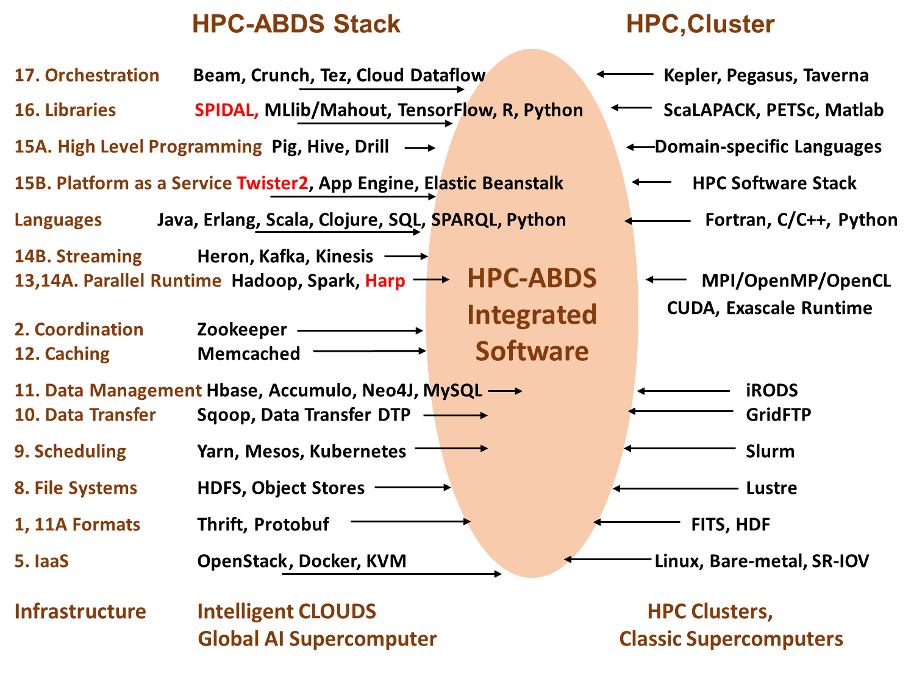
Different choices in software systems for Global AI and Modeling Supercomputer compared to that for conventional simulation supercomputers

Slide 29
Integrating HPC and Apache Programming Environments
Harp-DAAL with a kernel Machine Learning library exploiting the Intel node library DAAL and HPC communication collectives within the Hadoop ecosystem.
  Harp-DAAL supports all 5 classes of data-intensive AI first computation, from pleasingly parallel to machine learning and simulations.
Twister2 is a toolkit of components that can be packaged in different ways
  Integrated batch or streaming data capabilities familiar from Apache Hadoop, Spark, Heron and Flink but with high performance.
  Separate bulk synchronous and data flow communication;
  Task management as in Mesos, Yarn and Kubernetes
  Dataflow graph execution models
  Launching of the Harp-DAAL library with native Mesos/Kubernetes/HDFS environment
  Streaming and repository data access interfaces,
  In-memory databases and fault tolerance at dataflow nodes. (use RDD to do classic checkpoint-restart)

Slide 30
Qiu/Fox Core SPIDAL Parallel HPC Library with Collective Used
DA-MDS Rotate, AllReduce, Broadcast
Directed Force Dimension Reduction AllGather, Allreduce
Irregular DAVS Clustering Partial Rotate, AllReduce, Broadcast
DA Semimetric Clustering (Deterministic Annealing) Rotate, AllReduce, Broadcast
K-means AllReduce, Broadcast, AllGather DAAL
SVM AllReduce, AllGather
SubGraph Mining AllGather, AllReduce
Latent Dirichlet Allocation Rotate, AllReduce
Matrix Factorization (SGD) Rotate DAAL
Recommender System (ALS) Rotate DAAL
Singular Value Decomposition (SVD) AllGather DAAL
QR Decomposition (QR) Reduce, Broadcast DAAL
Neural Network AllReduce DAAL
Covariance AllReduce DAAL
Low Order Moments Reduce DAAL
Naive Bayes Reduce DAAL
Linear Regression Reduce DAAL
Ridge Regression Reduce DAAL
Multi-class Logistic Regression Regroup, Rotate, AllGather
Random Forest AllReduce
Principal Component Analysis (PCA) AllReduce DAAL
DAAL implies integrated on node with Intel DAAL Optimized Data Analytics Library (Runs on KNL!)

Slide 31
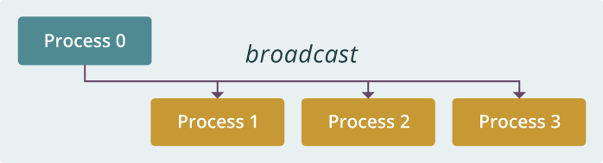
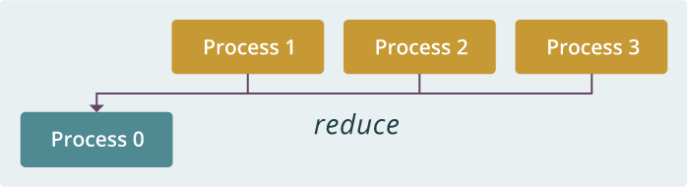
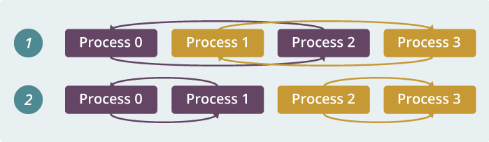
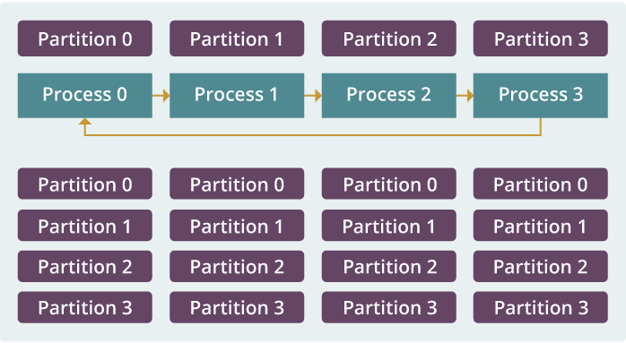
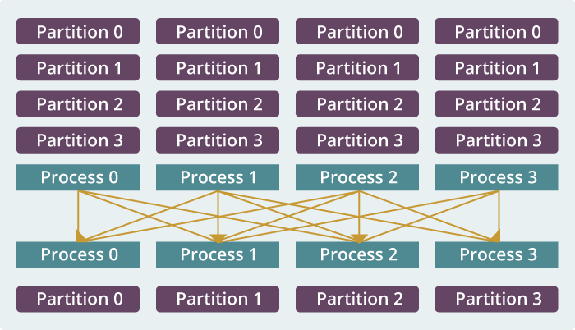
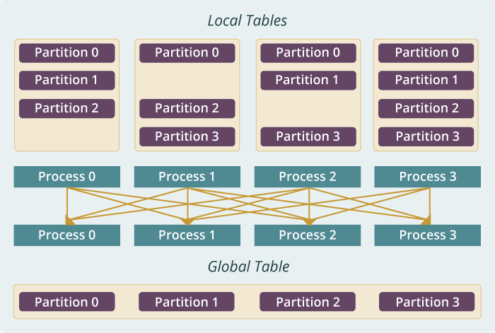
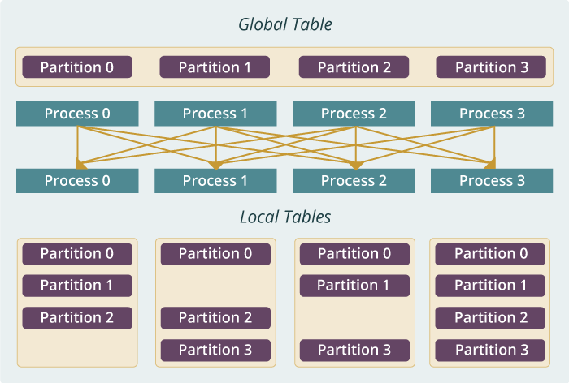
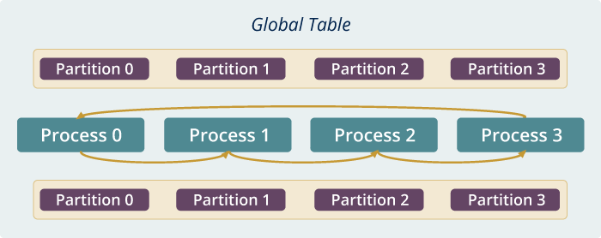
Run time software for Harp
broadcast
reduce
allreduce
allgather
regroup
push & pull
rotate
Map Collective Run time merges MapReduce and HPC

Slide 32
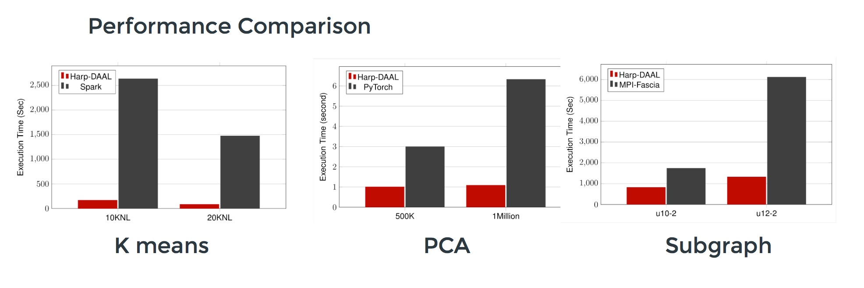
Harp v. Spark Harp v. Torch Harp v. MPI
Datasets: 5 million points, 10 thousand centroids, 10 feature dimensions
10 to 20 nodes of Intel KNL7250 processors
Harp-DAAL has 15x speedups over Spark MLlib
Datasets: 500K or 1 million data points of feature dimension 300
Running on single KNL 7250 (Harp-DAAL) vs. single K80 GPU (PyTorch)
Harp-DAAL achieves 3x to 6x speedups
Datasets: Twitter with 44 million vertices, 2 billion edges, subgraph templates of 10 to 12 vertices
25 nodes of Intel Xeon E5 2670
Harp-DAAL has 2x to 5x speedups over state-of-the-art MPI-Fascia solution

Slide 33
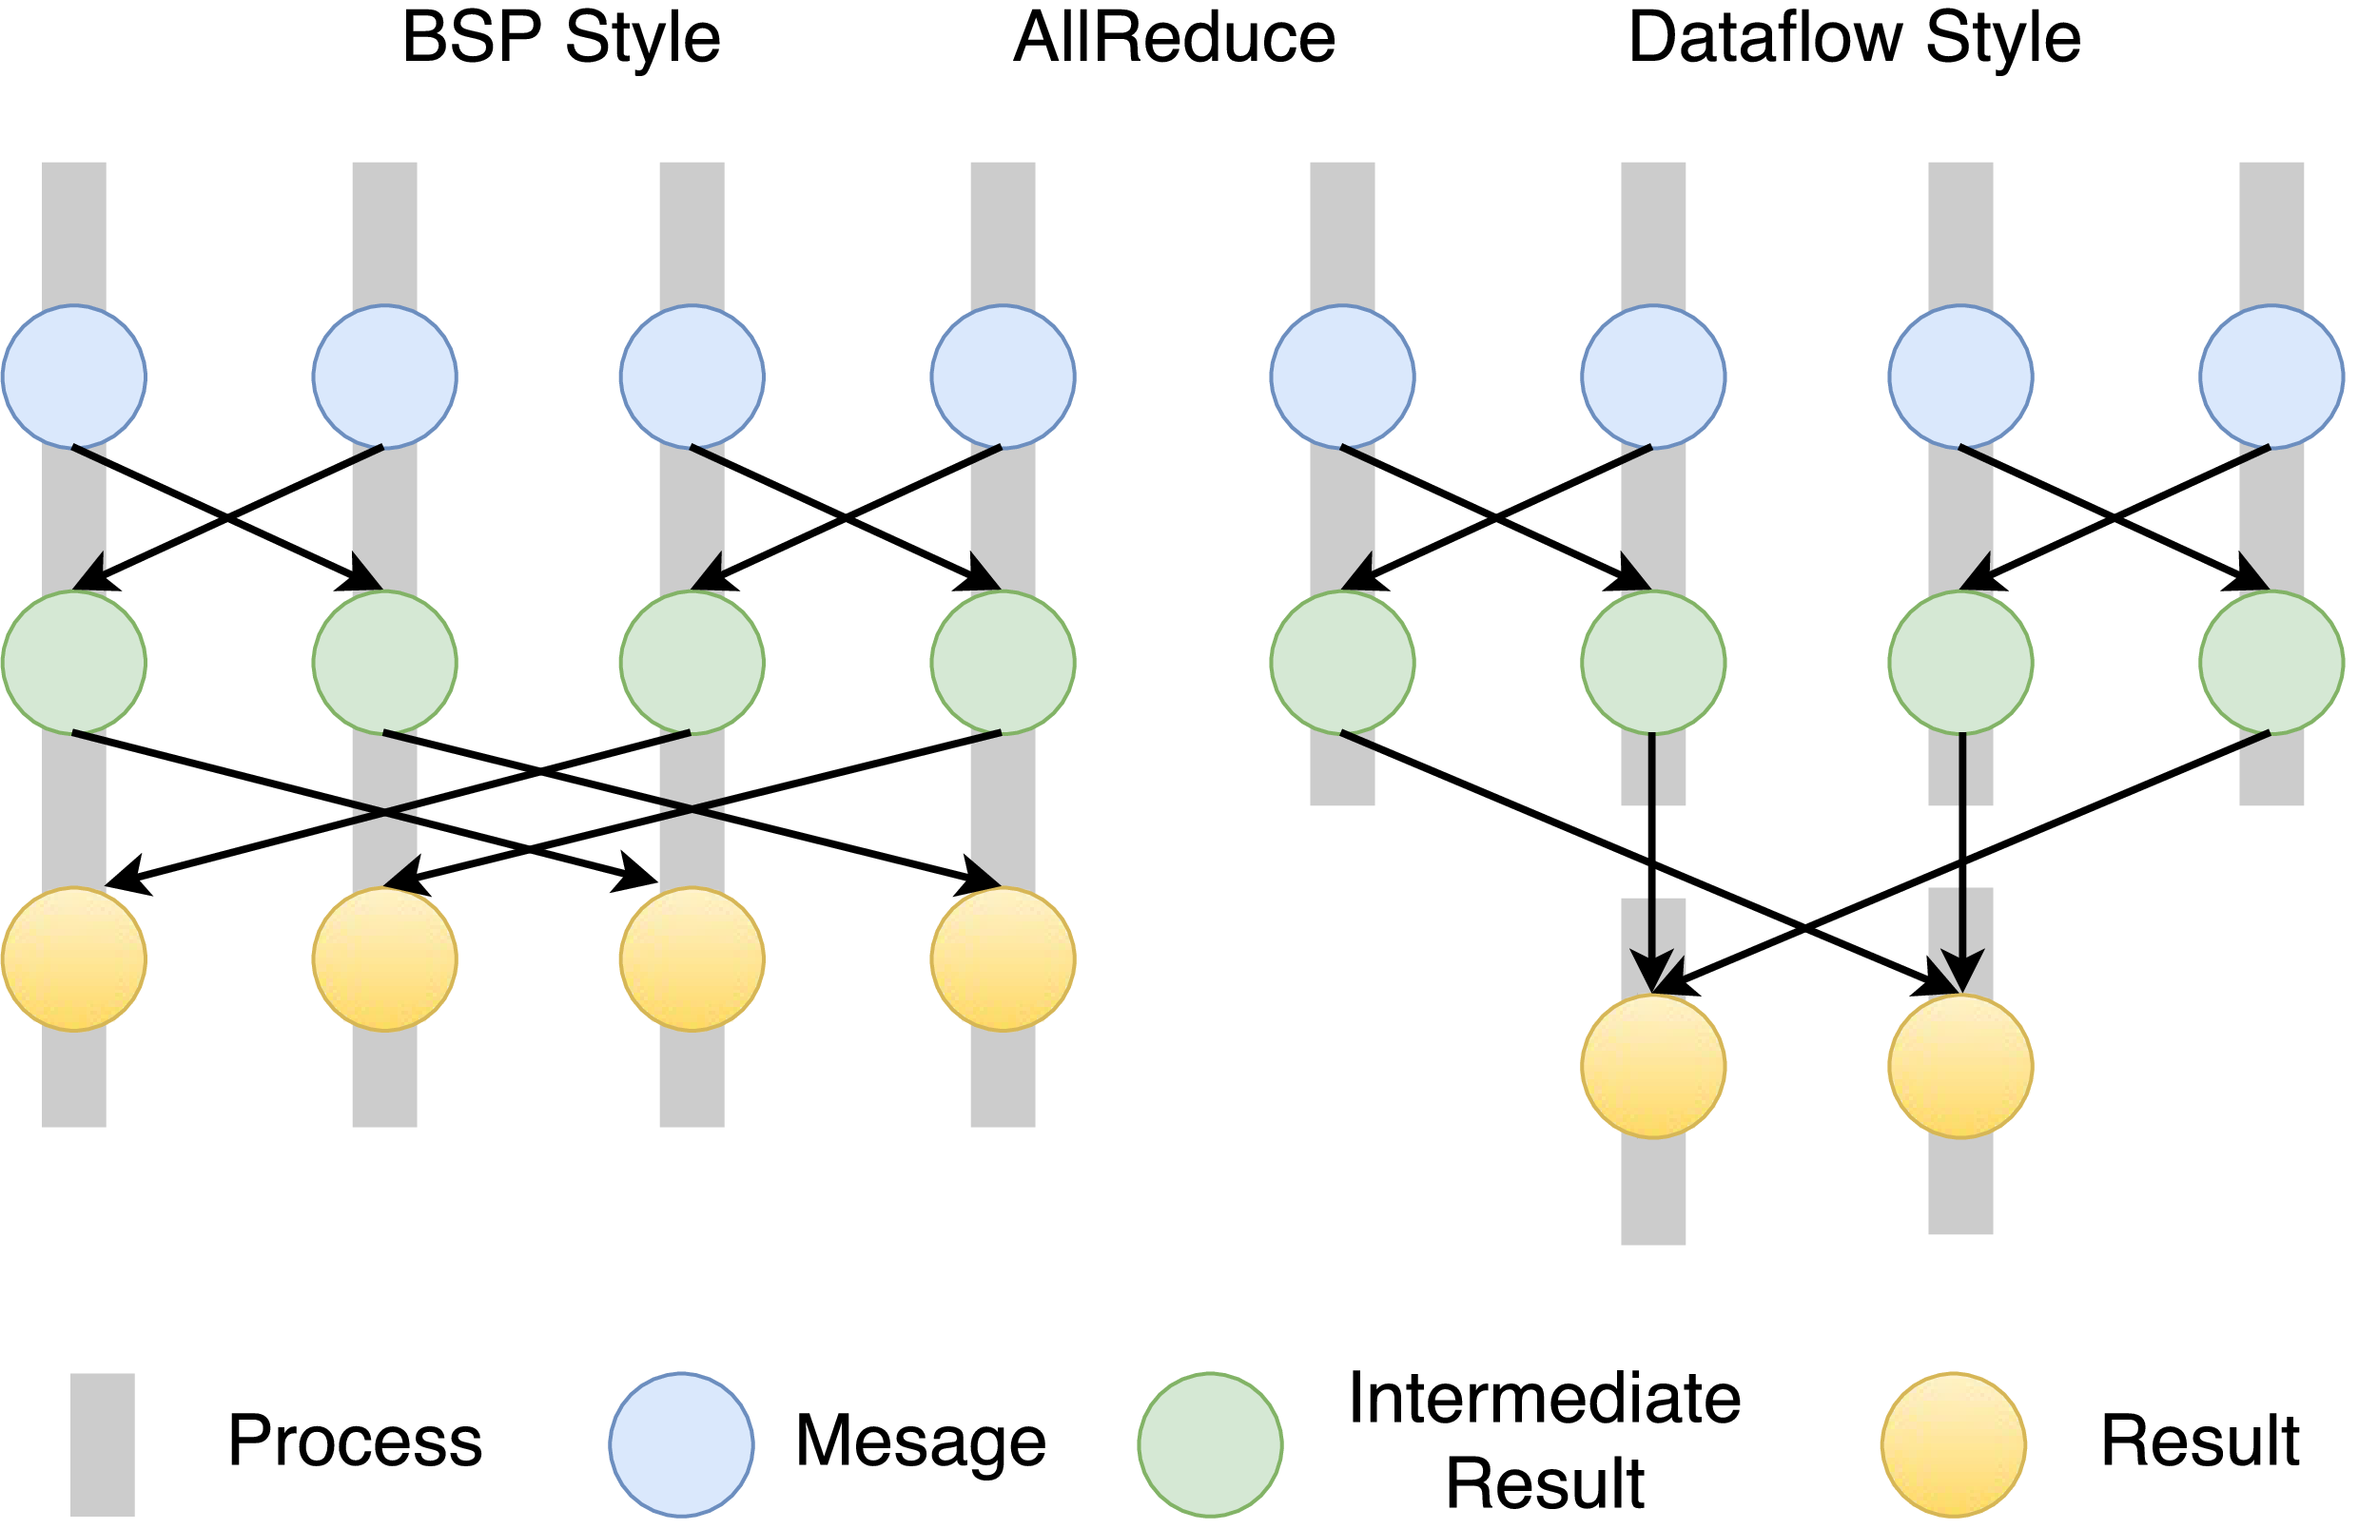
Twister2 Dataflow Communications
Twister:Net offers two communication models
BSP (Bulk Synchronous Processing) message-level communication using TCP or MPI separated from its task management plus extra Harp collectives
DFW a new Dataflow library built using MPI software but at data movement not message level
  Non-blocking
  Dynamic data sizes
  Streaming model
    Batch case is modeled as a finite stream
  The communications are between a set of
  tasks in an arbitrary task graph
  Key based communications
  Data-level Communications spilling to disks
  Target tasks can be different from source tasks

Slide 34
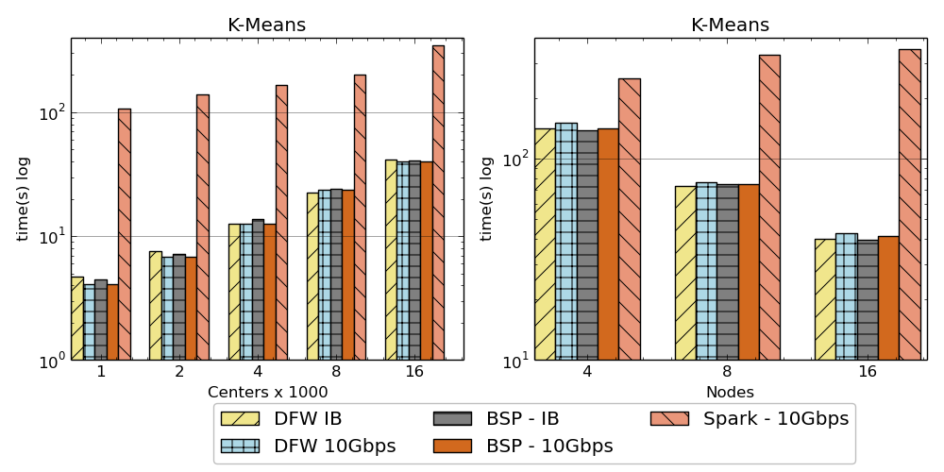
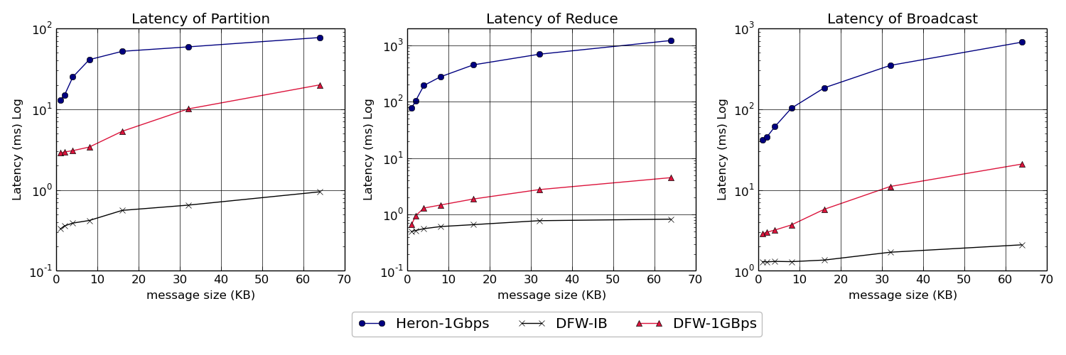
Twister:Net and Apache Heron and Spark
Left: K-means job execution time on 16 nodes with varying centers, 2 million points with 320-way parallelism. Right: K-Means wth 4,8 and 16 nodes where each node having 20 tasks. 2 million points with 16000 centers used.
Latency of Apache Heron and Twister:Net DFW (Dataflow) for Reduce, Broadcast and Partition operations in 16 nodes with 256-way parallelism

Slide 35
Intelligent Dataflow Graph
The dataflow graph specifies the distribution and interconnection of job components
  Hierarchical and Iterative
Allow ML wrapping of component at each dataflow node
Checkpoint after each node of the dataflow graph
  Natural synchronization point
  Let’s allows user to choose when to checkpoint (not every stage)
  Save state as user specifies; Spark just saves Model state which is insufficient for complex algorithms
Intelligent nodes support customization of checkpointing, ML, communication
Nodes can be coarse (large jobs) or fine grain requiring different actions

Slide 36

Dataflow at Different Grain sizes
Coarse Grain Dataflows links jobs in such a pipeline
Visualization
Dimension
Reduction
Data preparation
Clustering
But internally to each job you can also elegantly express algorithm as dataflow but with more stringent performance constraints
Corresponding to classic Spark K-means Dataflow
P = loadPoints()
C = loadInitCenters()
for (int i = 0; i < 10; i++) {
T = P.map().withBroadcast(C)
C = T.reduce() }
Internal Execution
Dataflow Nodes
Reduce
Iterate
HPC
Communication
Maps
Iterate

Slide 37
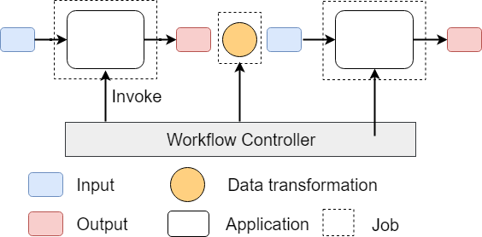
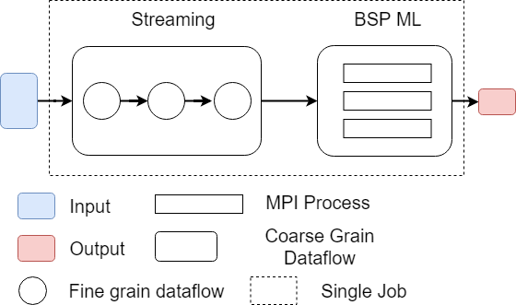
Workflow vs Dataflow: Different grain sizes and different performance trade-offs
The fine-grain dataflow can expand from Edge to Cloud
Coarse-grain Dataflow
Workflow Controlled by Workflow Engine or a Script
Fine-grain dataflow application running as a single job

Slide 38
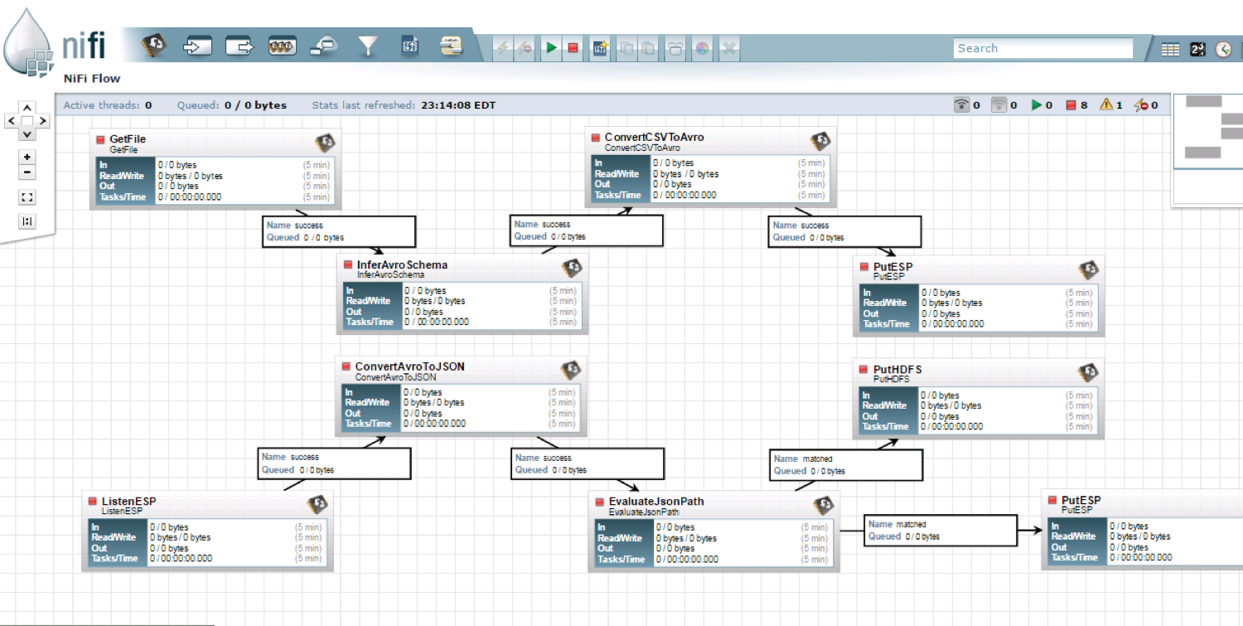
NiFi Coarse-grain Workflow

Slide 39
Futures
Implementing Twister2 for Global AI and Modeling Supercomputer
2
http://www.iterativemapreduce.org/

Slide 40
Twister2 Timeline:
Current Release (End of September 2018)
Twister:Net Dataflow Communication API
  Dataflow communications with MPI or TCP
Data access
  Local File Systems
  HDFS Integration
Task Graph
Streaming and Batch analytics – Iterative jobs
Data pipelines
Deployments on Docker, Kubernetes, Mesos (Aurora), Slurm
Harp for Machine Learning (Custom BSP Communications)
  Rich collectives
  Around 30 ML algorithms

Slide 41
Upcoming Releases (Major Features)
End of January 2019
  Connected DataFlow
  TSets
  Dashboard
  Heterogeneous Resources and Dynamic Scaling
End of June 2019
  Fault tolerance
  Python API
  Statistics gathering
  More applications
  Naiad Timely Dataflow
Not scheduled
  SQL API
  Native MPI

