Slide 1
Programming Environment for Global AI and Modeling Supercomputer GAIMSC
2
http://www.iterativemapreduce.org/

Slide 2
Ways of adding High Performance to Global AI (and Modeling) Supercomputer
Fix performance issues in Spark, Heron, Hadoop, Flink etc.
Messy as some features of these big data systems intrinsically slow in some (not all) cases
All these systems are “monolithic” and difficult to deal with individual components
Execute HPBDC from classic big data system with custom communication environment – approach of Harp for the relatively simple Hadoop environment
Provide a native Mesos/Yarn/Kubernetes/HDFS high performance execution environment with all capabilities of Spark, Hadoop and Heron – goal of Twister2
Execute with MPI in classic (Slurm, Lustre) HPC environment
Add modules to existing frameworks like Scikit-Learn or Tensorflow either as new capability or as a higher performance version of existing module.

Slide 3
GAIMSC Programming Environment Components I
Area | Component | Implementation | Comments: User API
Architecture Specification | Coordination Points | State and Configuration Management; Program, Data and Message Level | Change execution mode; save and reset state
 | Execution Semantics | Mapping of Resources to Bolts/Maps in Containers, Processes, Threads | Different systems make different choices - why?
 | Parallel Computing | Spark Flink Hadoop Pregel MPI modes | Owner Computes Rule
Job Submission | (Dynamic/Static) Resource Allocation | Plugins for Slurm, Yarn, Mesos, Marathon, Aurora | Client API (e.g. Python) for Job Management
Task System | Task migration | Monitoring of tasks and migrating tasks for better resource utilization | Task-based programming with Dynamic or Static Graph API; FaaS API; Support accelerators (CUDA,FPGA, KNL)
 | Elasticity | OpenWhisk
 | Streaming and FaaS Events | Heron, OpenWhisk, Kafka/RabbitMQ
 | Task Execution | Process, Threads, Queues
 | Task Scheduling | Dynamic Scheduling, Static Scheduling, Pluggable Scheduling Algorithms
 | Task Graph | Static Graph, Dynamic Graph Generation

Slide 4
GAIMSC Programming Environment Components II
Area | Component | Implementation | Comments
Communication API | Messages | Heron | This is user level and could map to multiple communication systems
 | Dataflow Communication | Fine-Grain Twister2 Dataflow communications: MPI,TCP and RMA Coarse grain Dataflow from NiFi, Kepler? | Streaming, ETL data pipelines; Define new Dataflow communication API and library
 | BSP Communication Map-Collective | Conventional MPI, Harp | MPI Point to Point and Collective API
Data Access | Static (Batch) Data | File Systems, NoSQL, SQL | Data API
 | Streaming Data | Message Brokers, Spouts
Data Management | Distributed Data Set | Relaxed Distributed Shared Memory(immutable data), Mutable Distributed Data | Data Transformation API; Spark RDD, Heron Streamlet
Fault Tolerance | Check Pointing | Upstream (streaming) backup; Lightweight; Coordination Points; Spark/Flink, MPI and Heron models | Streaming and batch cases distinct; Crosses all components
Security | Storage, Messaging, execution | Research needed | Crosses all Components

Slide 5
Integrating HPC and Apache Programming Environments
Harp-DAAL with a kernel Machine Learning library exploiting the Intel node library DAAL and HPC communication collectives within the Hadoop ecosystem.
Harp-DAAL supports all 5 classes of data-intensive AI first computation, from pleasingly parallel to machine learning and simulations.
Twister2 is a toolkit of components that can be packaged in different ways
Integrated batch or streaming data capabilities familiar from Apache Hadoop, Spark, Heron and Flink but with high performance.
Separate bulk synchronous and data flow communication;
Task management as in Mesos, Yarn and Kubernetes
Dataflow graph execution models
Launching of the Harp-DAAL library with native Mesos/Kubernetes/HDFS environment
Streaming and repository data access interfaces,
In-memory databases and fault tolerance at dataflow nodes. (use RDD to do classic checkpoint-restart)

Slide 6
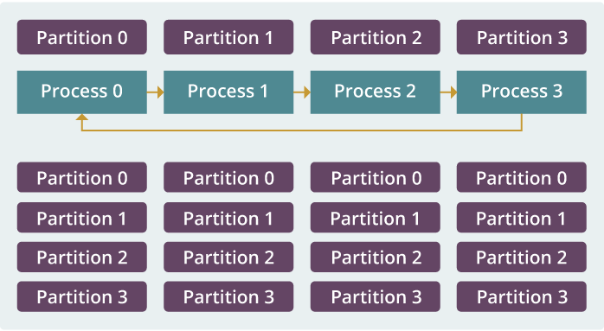
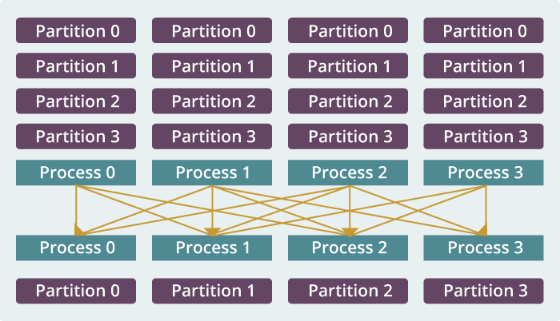
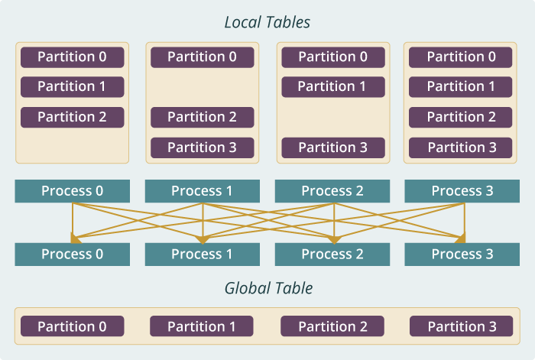
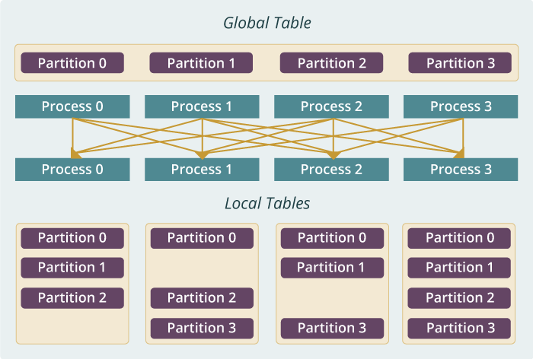
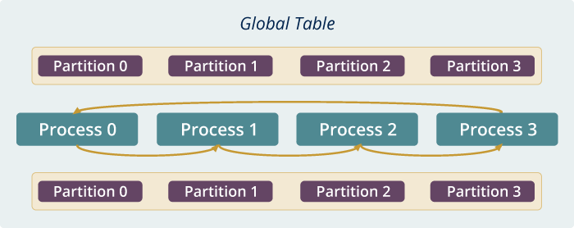
Run time software for Harp
broadcast
reduce
allreduce
allgather
regroup
push & pull
rotate
Map Collective Run time merges MapReduce and HPC

Slide 7
Harp v. Spark Harp v. Torch Harp v. MPI
Datasets: 5 million points, 10 thousand centroids, 10 feature dimensions
10 to 20 nodes of Intel KNL7250 processors
Harp-DAAL has 15x speedups over Spark MLlib
Datasets: 500K or 1 million data points of feature dimension 300
Running on single KNL 7250 (Harp-DAAL) vs. single K80 GPU (PyTorch)
Harp-DAAL achieves 3x to 6x speedups
Datasets: Twitter with 44 million vertices, 2 billion edges, subgraph templates of 10 to 12 vertices
25 nodes of Intel Xeon E5 2670
Harp-DAAL has 2x to 5x speedups over state-of-the-art MPI-Fascia solution

Slide 8
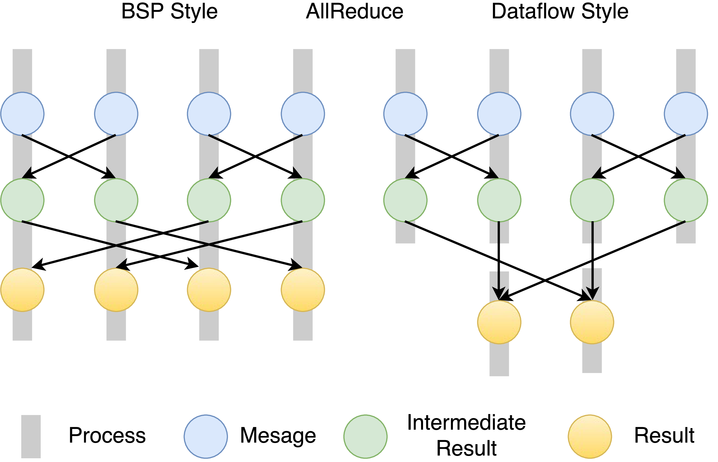
Twister2 Dataflow Communications
Twister:Net offers two communication models
BSP (Bulk Synchronous Processing) message-level communication using TCP or MPI separated from its task management plus extra Harp collectives
DFW a new Dataflow library built using MPI software but at data movement not message level
Non-blocking
Dynamic data sizes
Streaming model
Batch case is modeled as a finite stream
The communications are between a set of tasks in an arbitrary task graph
Key based communications
Data-level Communications spilling to disks
Target tasks can be different from source tasks

Slide 9
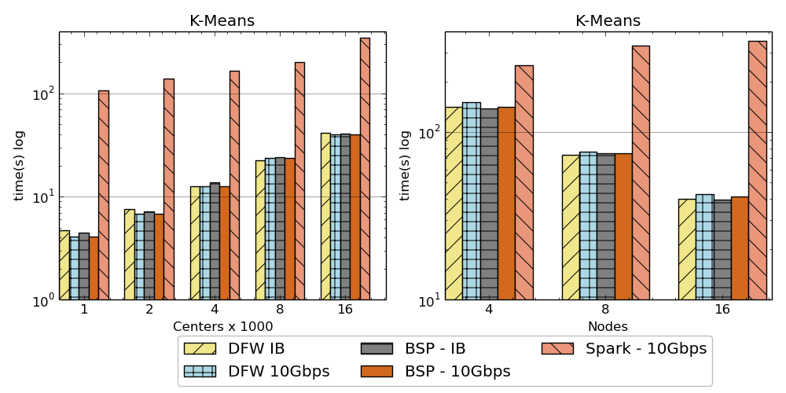
Twister:Net and Apache Heron and Spark
Left: K-means job execution time on 16 nodes with varying centers, 2 million points with 320-way parallelism. Right: K-Means wth 4,8 and 16 nodes where each node having 20 tasks. 2 million points with 16000 centers used.
Latency of Apache Heron and Twister:Net DFW (Dataflow) for Reduce, Broadcast and Partition operations in 16 nodes with 256-way parallelism

Slide 10
Intelligent Dataflow Graph
The dataflow graph specifies the distribution and interconnection of job components
Hierarchical and Iterative
Allow ML wrapping of component at each dataflow node
Checkpoint after each node of the dataflow graph
Natural synchronization point
Let’s allows user to choose when to checkpoint (not every stage)
Save state as user specifies; Spark just saves Model state which is insufficient for complex algorithms
Intelligent nodes support customization of checkpointing, ML, communication
Nodes can be coarse (large jobs) or fine grain requiring different actions

Slide 11
Dataflow at Different Grain sizes
Coarse Grain Dataflows links jobs in such a pipeline
Visualization
Dimension
Reduction
Data preparation
Clustering
But internally to each job you can also elegantly express algorithm as dataflow but with more stringent performance constraints
Corresponding to classic Spark K-means Dataflow
P = loadPoints()
C = loadInitCenters()
for (int i = 0; i < 10; i++) {
T = P.map().withBroadcast(C)
C = T.reduce() }
Internal Execution Dataflow Nodes
Reduce
Iterate
HPC Communication
Maps
Iterate

Slide 12
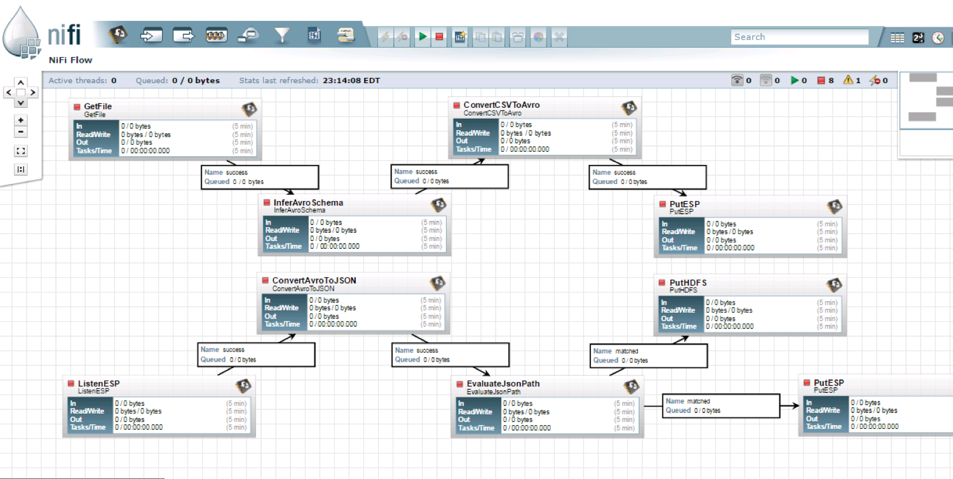
NiFi Coarse-grain Workflow

Slide 13
Futures Implementing Twister2 for Global AI and Modeling Supercomputer
2
http://www.iterativemapreduce.org/

Slide 14
Twister2 Timeline: Current Release (End of September 2018)
Twister:Net Dataflow Communication API
Dataflow communications with MPI or TCP
Data access
Local File Systems
HDFS Integration
Task Graph
Streaming and Batch analytics – Iterative jobs
Data pipelines
Deployments on Docker, Kubernetes, Mesos (Aurora), Slurm
Harp for Machine Learning (Custom BSP Communications)
Rich collectives
Around 30 ML algorithms

Slide 15
Twister2 Timeline: January 2018
DataSet API similar to Spark batch and Heron streaming with Tset realization
Can use Tsets for writing RDD/Streamlet style datasets
Fault tolerance as in Heron and Spark
Storm API for Streaming
Hierarchical Dynamic Heterogeneous Task Graph
Coarse grain and fine grain dataflow
Cyclic task graph execution
Dynamic scaling of resources and heterogeneous resources (at the resource layer) for streaming and heterogeneous workflow
Link to Pilot Jobs

Slide 16
Twister2 Timeline: July 1, 2019
Naiad model based Task system for Machine Learning
Native MPI integration to Mesos, Yarn
Dynamic task migrations
RDMA and other communication enhancements
Integrate parts of Twister2 components as big data systems enhancements (i.e. run current Big Data software invoking Twister2 components)
Heron (easiest), Spark, Flink, Hadoop (like Harp today)
Tsets become compatible with RDD (Spark) and Streamlet (Heron)
Support different APIs (i.e. run Twister2 looking like current Big Data Software),Hadoop, Spark (Flink), Storm
Refinements like Marathon with Mesos etc.
Function as a Service and Serverless
Support higher level abstractions
Twister:SQL (major Spark use case)
Graph API

