Slide 1


Twister2: Design and initial implementation of a Big Data Toolkit
4th International Winter School on Big Data
Timişoara, Romania, January 22-26, 2018
http://grammars.grlmc.com/BigDat2018/
January 25, 2018
Geoffrey Fox gcf@indiana.edu
http://www.dsc.soic.indiana.edu/, http://spidal.org/
http://hpc-abds.org/kaleidoscope/
Department of Intelligent Systems Engineering
School of Informatics and Computing,
Digital Science Center
Indiana University Bloomington

Slide 2
Where does Twister2 fit in HPC-ABDS I?
Hardware model: Distributed system; Commodity Cluster; HPC Cloud; Supercomputer
Execution model: Docker + Kubernetes (or equivalent) running on bare-metal (not OpenStack)
Usually we take existing Apache open source systems and enhance them – typically with HPC technology
  Harp enhances Hadoop with HPC communications, machine learning computation models, scientific data interfaces
  We added HPC to Apache Heron
  Others have enhanced Spark
When we analyzed source of poor performance, we found it came from making fixed choices for key components whereas the different application classes require distinct choices to perform at their best

Slide 3
Where does Twister2 fit in HPC-ABDS II?
So Twister2 is designed to flexibly allow choices in component technology
It is a toolkit that is a standalone entry in programming model space addressing same areas as Spark, Flink, Hadoop, MPI, Giraph
Being a toolkit, it also looks like an application development framework batch & streaming parallel programming and workflow.
This includes several HPC-ABDS levels:
  Inter process communication Collectives, point-to-point, publish-subscribe, Harp, MPI:
  A) Basic Programming model and runtime, SPMD, MapReduce:
  B) Streaming:
  B) Frameworks
  Workflow-Orchestration:
It invokes several other levels such as Docker, Mesos, Hbase, SPIDAL library at level 16.
High level frameworks like Tensorflow (Python notebooks) can invoke Twister2 runtime

Slide 4
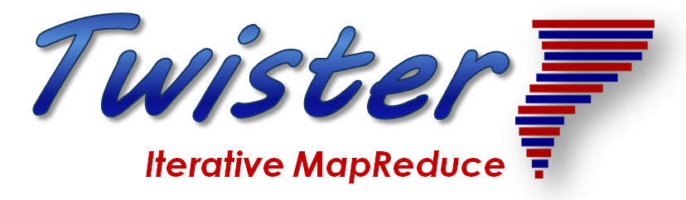
Comparing Spark Flink and MPI:
http://www.iterativemapreduce.org/
On Global Machine Learning.
Note Spark and Flink are successful on Local Machine Learning – not Global Machine Learning
Communication Model and its implementation matter!

Slide 5
Machine Learning with MPI, Spark and Flink
Three algorithms implemented in three runtimes
  Multidimensional Scaling (MDS)
  Terasort
  K-Means
Implementation in Java
  MDS is the most complex algorithm - three nested parallel loops
  K-Means - one parallel loop
  Terasort - no iterations

Slide 6
General Dataflow Reduction in Hadoop, Spark, Flink
Map Tasks
Separate Map and Reduce Tasks
MPI only has one sets of tasks for map and reduce
MPI gets efficiency by using shared memory intra-node (of all node cores)
MPI achieves AllReduce by interleaving multiple binary trees
Switching tasks is expensive! (see later)
Reduce Tasks
Follow by Broadcast for AllReduce which is what most iterative algorithms use
Output partitioned with Key

Slide 7

HPC Runtime versus ABDS distributed Computing Model on Data Analytics
Hadoop writes to disk and is slowest; Spark and Flink spawn many processes and do not support AllReduce directly;
MPI does in-place combined reduce/broadcast and is fastest
Need Polymorphic Reduction capability choosing best implementation
Use HPC architecture with
  Mutable model
  Immutable data

Slide 8



Multidimensional Scaling: 3 Nested Parallel Sections
MDS execution time on 16 nodes with 20 processes in each node with varying number of points
MDS execution time with 32000 points on varying number of nodes. Each node runs 20 parallel tasks

Slide 9

Flink MDS Dataflow Graph

Slide 10
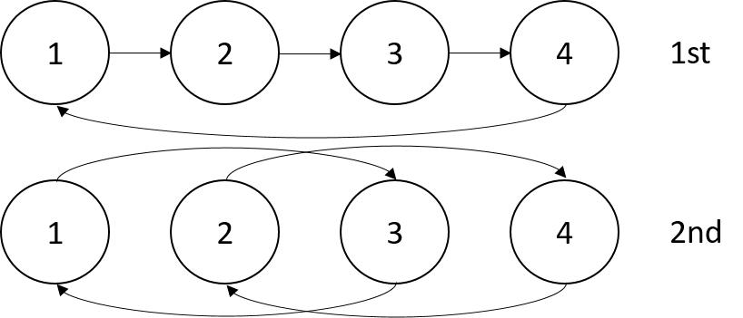


Terasort
Transfer data using MPI
Sorting 1TB of data records
Terasort execution time in 64 and 32 nodes. Only MPI shows the sorting time and communication time as other two frameworks doesn't provide a viable method to accurately measure them. Sorting time includes data save time. MPI-IB - MPI with Infiniband
Partition the data using a sample and regroup

Slide 11
K-Means Algorithm and Dataflow Specification
Point data set is partitioned and loaded to multiple map tasks
  Custom input format for loading the data as block of points
Full centroid data set is loaded at each map task
Iterate over the centroids
  Calculate the local point average at each map task
  Reduce (sum) the centroid averages to get a global centroids
  Broadcast the new centroids back to the map tasks
Data Set <Points>
Data Set <Initial Centroids>
Map (nearest centroid calculation)
Reduce (update centroids)
Data Set <Updated Centroids>
Broadcast

Slide 12
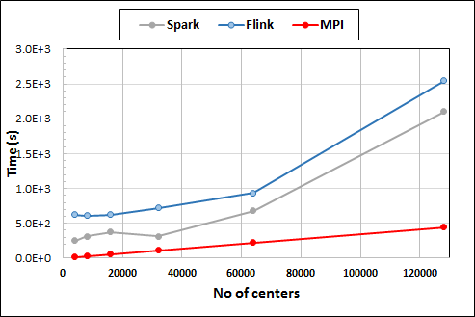
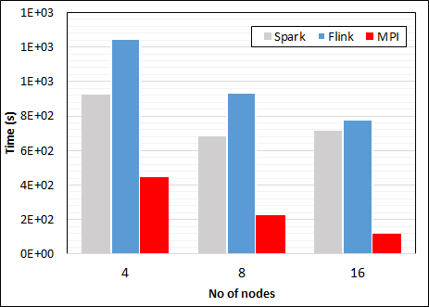
K-Means Clustering in Spark, Flink, MPI
K-Means execution time on 8 nodes with 20 processes in each node with 1 million points and varying number of centroids. Each point has 2 attributes.
K-Means execution time on varying number of nodes with 20 processes in each node with 1 million points and 64000 centroids. Each point has 2 attributes.
K-Means performed well on all three platforms when the computation time is high and communication time is low as illustrated in 10 million points. After lowering the computation and increasing the communication by setting the points to 1 million, the performance gap between MPI and the other two platforms increased.
Notes:
Note the differences in communication architectures
Note times are in log scale
Bars indicate compute only times, which is similar across these frameworks
Overhead is dominated by communications in Flink and Spark

Slide 13
Streaming Data and HPC
http://www.iterativemapreduce.org/
Apache Heron with Infiniband and Omnipath
Parallel performance increased by using HPC interconnects

Slide 14
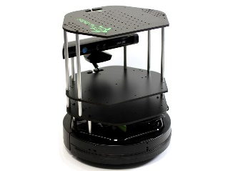
Data Pipeline from Edge to Cloud
Sending to
pub-sub
Sending to
Persisting
storage
Multiple
streaming
workflows
Streaming
workflow
A stream application with some tasks running in parallel
Gateway
Message Brokers
RabbitMQ, Kafka
Streaming Workflows
Apache Heron and Storm
End to end delays without any processing is less than 10ms
Storm/Heron do not support “real parallel processing” within bolts – add optimized inter-bolt communication and communication between stream managers
Hosted on HPC and OpenStack cloud

Slide 15
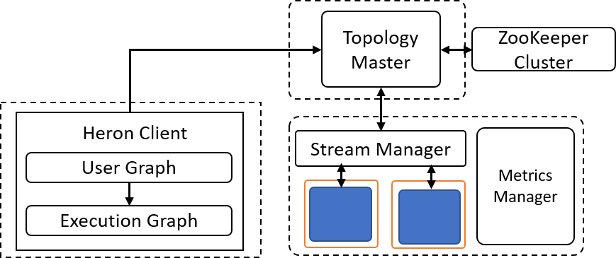
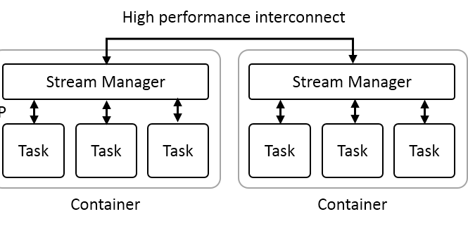
Heron and InfiniBand Integration
Heron Architecture
Heron Interconnect Integration
Libfabric for programming the interconnect
Heron Features
Completely replaced Storm 3 years ago in Twitter
3x reduction in cores and memory
Significantly reduced operational overhead
10x reduction in production incidents

Slide 16
InfiniBand Integration
Bootstrapping the communication
  Need to use out of band protocols to establish the communication
  TCP/IP to transfer the bootstrap information
Buffer management
  Fixed buffer pool for both sending and receiving
  Break messages manually if the buffer size is less than message size
Flow control
  Application level flow control using a standard credit based approach

Slide 17
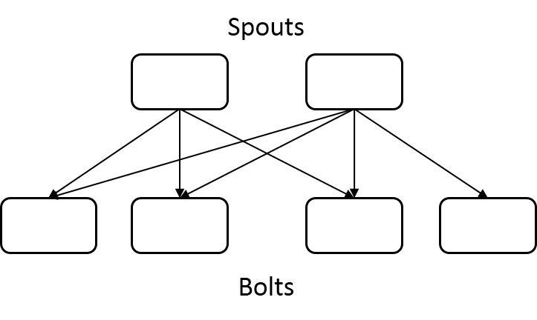
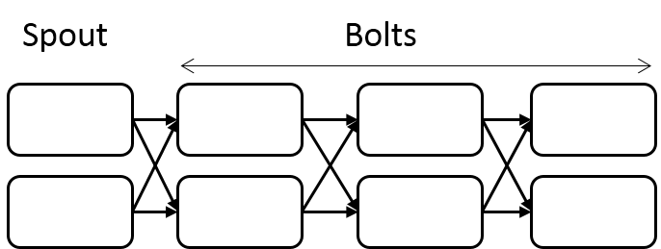
Experiment Topologies
Topology A. A long topology with 8 Stages
Topology B. A shallow topology with 2 Stages
Haswell Cluster:
Intel Xeon E5-2670 running at 2.30GHz.
24 cores (2 sockets x 12 cores each)
128GB of main memory
56Gbps Infiniband and 1Gbps dedicated Ethernet connection

Slide 18
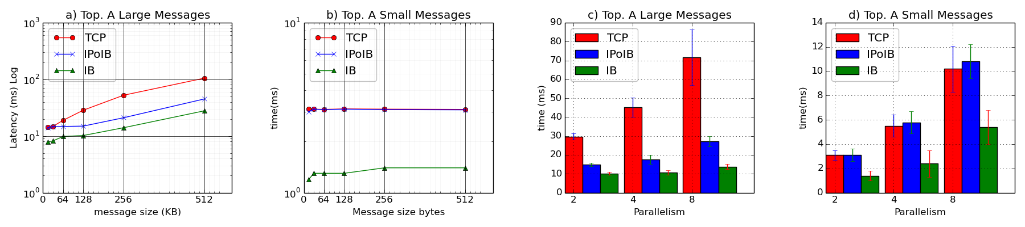
Latency I
Latency of the Topology B with 32 parallel bolt instances and varying number of spouts and message sizes. a) and b) are with 16 spouts and c) and d) are with 128k and 128bytes messages. The results are on Haswell cluster with IB.

Slide 19
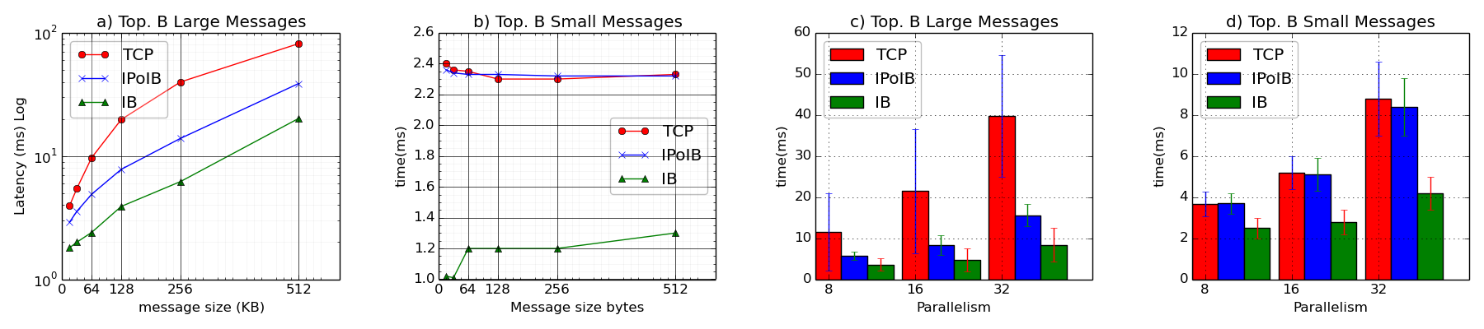
Latency II
Latency of the Topology A with 1 spout and 7 bolt instances arranged in a chain with varying parallelism and message sizes. a) and b) are with 2 parallelism and c) and d) are with 128k and 128bytes messages. The results are on Haswell cluster with IB.

Slide 20
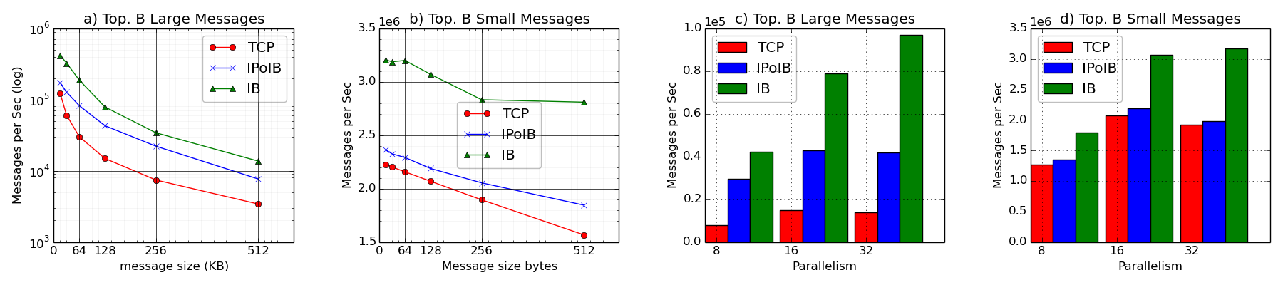
Throughput
Throughput of the Topology B with 32 bolt instances and varying message sizes and spout instances. The message size varies from 16K to 512K bytes. The spouts are changed from 8 to 32. The experiments are conducted on Haswell cluster.

Slide 21
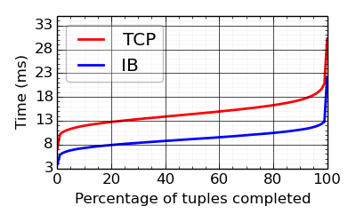
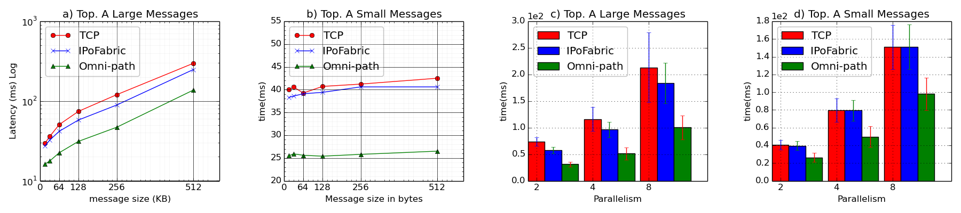
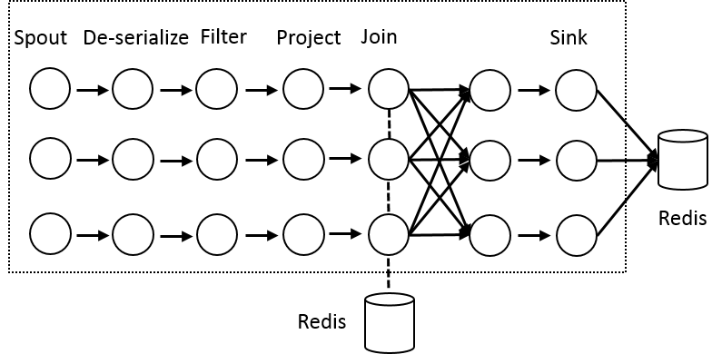
Heron High Performance Interconnects
Infiniband & Intel Omni-Path integrations
Using Libfabric as a library
Natively integrated to Heron through Stream Manager without needing to go through JNI
Latency of the Topology A with 1 spout and 7 bolt instances arranged in a chain with varying parallelism and message sizes. c) and d) are with 128k and 128bytes messages. The results are on KNL cluster.
Topology A. A long topology with 8 Stages
Yahoo Streaming Bench Topology on Haswell cluster

Slide 22
Intel Omni-Path Latency
Latency of the Topology A with 1 spout and 7 bolt instances arranged in a chain with varying parallelism and message sizes. a) and b) are with 2-way parallelism and c) and d) are with 128k and 128bytes messages. The results are on KNL cluster.

Slide 23
Dataflow Execution
http://www.iterativemapreduce.org/
Various Scales
Dataflow is great but performance/implementation depend on grain size

Slide 24
Flink MDS Dataflow Graph

Slide 25
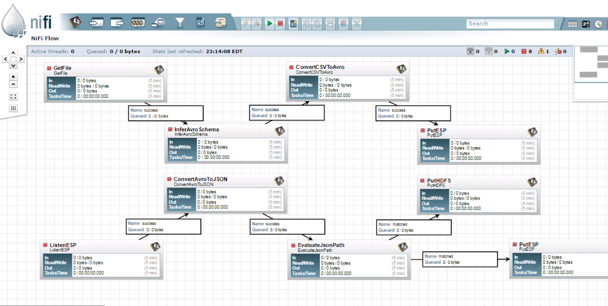
NiFi Workflow

Slide 26
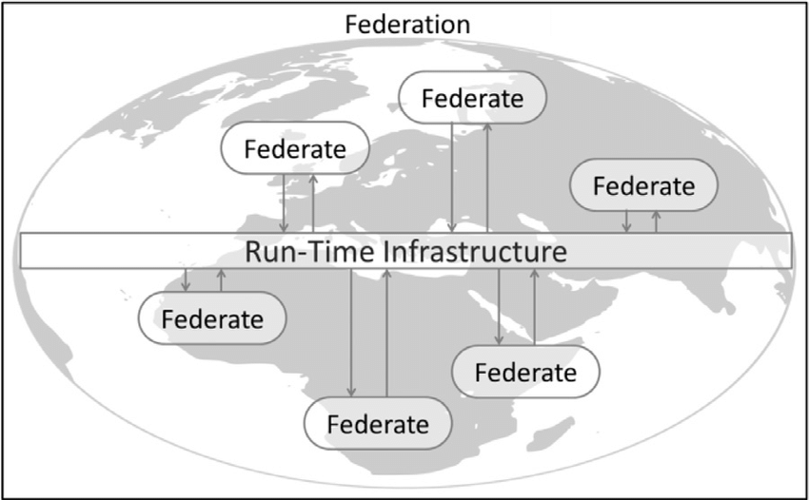
Naiad Timely Dataflow HLA Distributed Simulation

Slide 27
Dataflow for a linear algebra kernel
Typical target of HPC AMT System
Danalis 2016

Slide 28

Dataflow at Different Grain sizes
Coarse Grain Dataflows links jobs in such a pipeline
Visualization
Dimension
Reduction
Data preparation
Clustering
But internally to each job you can also elegantly express algorithm as dataflow but with more stringent performance constraints
Corresponding to classic Spark K-means Dataflow
P = loadPoints()
C = loadInitCenters()
for (int i = 0; i < 10; i++) {
T = P.map().withBroadcast(C)
C = T.reduce() }
Internal Execution
Dataflow Nodes
Reduce
Iterate
HPC
Communication
Maps
Iterate

Slide 29
Architecture of Twister2
http://www.iterativemapreduce.org/
This breaks rule from 2012-2017 of not “competing” with but rather “enhancing” Apache

Slide 30
Requirements I
On general principles parallel and distributed computing have different requirements even if sometimes similar functionalities
  Apache stack ABDS typically uses distributed computing concepts
  For example, Reduce operation is different in MPI (Harp) and Spark
Large scale simulation requirements are well understood
Big Data requirements are not agreed but there are a few key use types
  Pleasingly parallel processing (including local machine learning LML) as of different tweets from different users with perhaps MapReduce style of statistics and visualizations; possibly Streaming
  Database model with queries again supported by MapReduce for horizontal scaling
  Global Machine Learning GML with single job using multiple nodes as classic parallel computing
  Deep Learning certainly needs HPC – possibly only multiple small systems
Current workloads stress 1) and 2) and are suited to current clouds and to ABDS (with no HPC)
  This explains why Spark with poor Global Machine Learning performance is so successful and why it can ignore MPI even though MPI uses best technology for parallel computing

Slide 31
Requirements II
Need to Support several very different application structures
  Data pipelines and workflows
  Streaming
  Machine learning
  Function as a Service
Do as well as Spark (Flink, Hadoop) in those application classes where they do well and support wrappers to move existing Spark (Flink, Hadoop) applications over
  Allow Harp to run as an add-on to Spark or Flink
Support the 5 MapReduce categories
  Pleasingly Parallel
  Classic MapReduce
  Map-Collective
  Map-Point to Point
  Map-Streaming

Slide 32
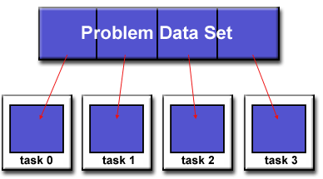
Parallel Computing: Big Data and Simulations
All the different programming models (Spark, Flink, Storm, Naiad, MPI/OpenMP) have the same high level approach
Break Problem Data and/or Model-parameters into parts assigned to separate nodes, processes, threads
In parallel, do computations typically leaving data untouched but changing model-parameters. Called Maps in MapReduce parlance
If Pleasingly parallel, that’s all it is
If Globally parallel, need to communicate computations between nodes during job
Communication mechanism (TCP, RDMA, Native Infiniband) can vary
Communication Style (Point to Point, Collective, Pub-Sub) can vary
Possible need for sophisticated dynamic changes in
partioning (load balancing)
Computation either on fixed tasks or flow between tasks
Choices: “Automatic Parallelism or Not”
Choices: “Complicated Parallel Algorithm or Not”
Fault-Tolerance model can vary
Output model can vary: RDD or Files or Pipes

Slide 33
Layers of Parallel Applications
Data partitioning and placement
Manage distributed data
Data Management
Computation Graph
Execution (Threads/Processes), Scheduling of Executions
Task System
Internode and Intracore Communication
Network layer
Communication
Three main
abstractions
What we need to write a parallel application

Slide 34
Twister2 Principles
Clearly define functional layers
Develop base layers as independent components
Use interoperable common abstractions but multiple polymorphic implementations.
Allow users to pick and choose according to requirements
  Communication + Data Management
  Communication + Static graph
Use HPC features when possible

Slide 35
Proposed Twister2 Approach
Unit of Processing is an Event driven Function (a microservice) replaces libraries
  Can have state that may need to be preserved in place (Iterative MapReduce)
  Functions can be single or 1 of 100,000 maps in large parallel code
Processing units run in HPC clouds, fogs or devices but these all have similar software architecture (see AWS Greengrass and Lambda)
  Universal Programming model so Fog (e.g. car) looks like a cloud to a device (radar sensor) while public cloud looks like a cloud to the fog (car)
Analyze the runtime of existing systems
  Hadoop, Spark, Flink, Pregel Big Data Processing
  Storm, Heron Streaming Dataflow
  Kepler, Pegasus, NiFi workflow systems
  Harp Map-Collective, MPI and HPC AMT runtime like DARMA
  And approaches such as GridFTP and CORBA/HLA (!) for wide area data links

Slide 36
Twister2 Components I
Area | Component | Implementation | Comments: User API
Architecture Specification | Coordination Points | State and Configuration Management; Program, Data and Message Level | Change execution mode; save and reset state
 | Execution Semantics | Mapping of Resources to Bolts/Maps in Containers, Processes, Threads, Queue | Different systems make different choices - why? Planning/API
 | Parallel Computing | Spark Flink Hadoop Pregel MPI modes | Owner Computes Rule
Job Submission | (Dynamic/Static) Resource Allocation | Plugins for Slurm, Yarn, Mesos, Marathon, Aurora | Client API (e.g. Python) for Job Management
Task System | Task migration | Monitoring of tasks and migrating tasks for better resource utilization | Task-based programming with Dynamic or Static Graph API; FaaS API; Support accelerators (CUDA,KNL)
 | Elasticity | OpenWhisk
 | Streaming and FaaS Events | Heron, OpenWhisk, Kafka/RabbitMQ
 | Task Execution | Execute as per Semantics
 | Task Scheduling | Dynamic Scheduling, Static Scheduling, Pluggable Scheduling Algorithms
 | Task Graph | Static Graph, Dynamic Graph Generation

Slide 37
Twister2 Components II
Area | Component | Implementation | Comments
Communication API | Messages | Heron | This is user level and could map to multiple communication systems
 | Dataflow Communication | Fine-Grain Twister2 Dataflow communications: MPI,TCP and RMA Coarse grain Dataflow from NiFi, Kepler? | Streaming, ETL data pipelines; Define new Dataflow communication API and library
 | BSP Communication Map-Collective | Conventional MPI, Harp | MPI Point to Point and Collective API
Data Access | Static (Batch) Data | File Systems, NoSQL, SQL | Data API
 | Streaming Data | Message Brokers, Spouts
Data Management | Distributed Data Set | Relaxed Distributed Shared Memory(immutable data), Mutable Distributed Data | Data Transformation API; Spark RDD, Heron Streamlet
Fault Tolerance | Check Pointing | Upstream (streaming) backup; Lightweight; Coordination Points; Spark/Flink, MPI and Heron models | Streaming and batch cases distinct; Crosses all components
Security | Storage, Messaging, execution | Research needed | Crosses all Components

Slide 38
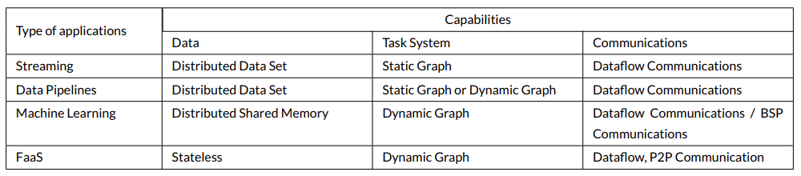
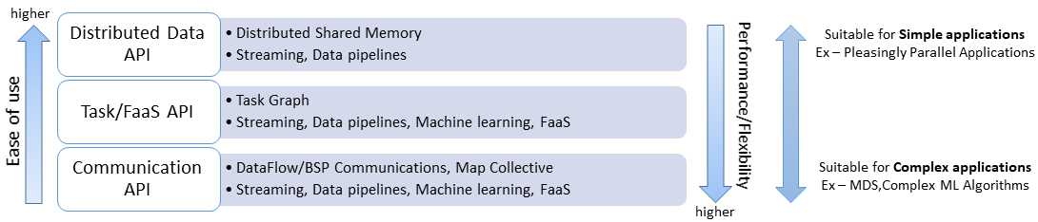
Different applications need different layers

Slide 39
Twister2 Architectural View
Data Transformation API
Distributed Data Sets
Task API
Task Graph
State Manager
Scheduler
Task Scheduler
Task Scheduler
Job Master
Execution Layer
Execution Layer
Communication (BSP Style, Dataflow)
Executor Process
Resource Abstraction
Resource Scheduler (Mesos, Yarn, Slurm, Reef, Aurora, Marathon, Kubernetis)
Tasks executed by threads
Data Access API
Container allocated by
resource scheduler
Data Sources (File Systems (HDFS, Local, Lustre), NoSQL, Streaming Sources)

Slide 40



Components of Twister2 in detail
Cloud
HPC
Cloud
HPC
Fog
Cloud
HPC
HPC Cloud can
be federated
Centralized HPC Cloud + IoT Devices
Centralized HPC Cloud + Edge = Fog + IoT Devices
Scheduling, Communication, Edge and Fog, Dataflow, State

Slide 41
Resource Scheduler Abstraction
Common abstraction for various resource schedulers
Resource schedulers are written as plugins
Current implementation
  Aurora and Mesos
  Slurm
Functionalities of Resource Scheduler
  Allocate compute resources using a specific resource scheduler such as Aurora
  Staging of job files in the cluster
  Starting the job processes and manage them
  Manage the life cycle of the job

Slide 42
Task System
Creating and managing the task graph
Generate computation task graph dynamically
  Dynamic scheduling of tasks
  Allow fine grained control of the graph
Generate computation graph statically
  Dynamic or static scheduling
  Suitable for streaming and data query applications
  Hard to express complex computations, especially with loops
Hybrid approach
  Combine both static and dynamic graphs

Slide 43
Task Scheduler
Schedule for various types of applications
  Streaming, Batch, FaaS
Static Scheduling and Dynamic Scheduling
Central Scheduler for static task graphs
Distributed scheduler for dynamic task graphs

Slide 44
Executor
Execute a task when its data dependencies are satisfied
Uses threads and queues
Performs task execution optimizations such as Pipelining tasks
Can be extended to support custom execution models

Slide 45
Communication Models
MPI Characteristics: Tightly synchronized applications
  Efficient communications (µs latency) with use of advanced hardware
  In place communications and computations (Process scope for state)
Basic dataflow: Model a computation as a graph
  Nodes do computations with Task as computations and
  edges are asynchronous communications
  A computation is activated when its input data dependencies
  are satisfied
Streaming dataflow: Pub-Sub with data partitioned into streams
  Streams are unbounded, ordered data tuples
  Order of events important and group data into time windows
Machine Learning dataflow: Iterative computations and keep track of state
  There is both Model and Data, but only communicate the model
  Collective communication operations such as AllReduce AllGather
  Can use in-place MPI style communication
W
S
W
G
S
Dataflow
W
Edge and Fog Computing

Slide 46
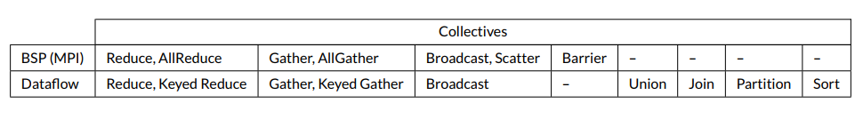
Communication Requirements
Need data driven higher level abstractions
Both BSP and Dataflow Style communications
  MPI / RDMA / TCP
  Automatically deal with large data sizes
MPI requirements
  Need MPI to work with Yarn/Mesos (Use MPI only as a communication library) – basic MPI insists on launching its tasks.
  Make MPI work with dynamic environments where processes are added / removed while an application is running
  We don’t need fault tolerance at MPI level

Slide 47
Twister2 and the Fog
What is the Fog?
In the spirit of yesterday’s Grid computing, the Fog is everything
  E.g. cars on a road see a fog as sum of all cars near them
  Smart Home can access all the devices and computing resources in their neighborhood
  This approach has obviously greatest potential performance and could for example allow road vehicles to self organize and avoid traffic jams
  It has the problem that bedeviled yesterday’s Grid; need to manage systems across administrative domains
The simpler scenario is that Fog is restricted to systems that are in same administrative domain as device and cloud
  The system can be designed without worrying about conflicting administration issues
  The Fog for devices in a car, is in SAME car
  The Smart home uses Fog in same home
  We address this simpler case
Twister2 is designed to address second simple view by supporting hierarchical clouds with fog looking like a cloud to the device

Slide 48
Data Access Layer
Provides a unified interface for accessing raw data
Supports multiple file systems such as NFS, HDFS, Lustre, etc.
Supports streaming data sources
Can be easily extended to support custom data sources
Manages data locality information

Slide 49
Fault Tolerance and State
State is a key issue and handled differently in systems
  CORBA, AMT, MPI and Storm/Heron have long running tasks that preserve state
  Spark and Flink preserve datasets across dataflow node using in-memory databases
  All systems agree on coarse grain dataflow; only keep state by exchanging data.
Similar form of check-pointing mechanism is used already in HPC and Big Data
  although HPC informal as doesn’t typically specify as a dataflow graph
  Flink and Spark do better than MPI due to use of database technologies; MPI is a bit harder due to richer state but there is an obvious integrated model using RDD type snapshots of MPI style jobs
Checkpoint after each stage of the dataflow graph
  Natural synchronization point
  Let’s allows user to choose when to checkpoint (not every stage)
  Save state as user specifies; Spark just saves Model state which is insufficient for complex algorithms

Slide 50
Twister2 Tutorial
This is a first hand experience on Twister2
Download and install Twister2
Run few examples (Working on the documentation)
  Streaming word count
  Batch word count
  Install - https://github.com/DSC-SPIDAL/twister2/blob/master/INSTALL.md
  Examples - https://github.com/DSC-SPIDAL/twister2/blob/master/docs/examples.md
Estimated time
  20 mins for installation
  20 mins for running examples
Join the Open Source Group working on Twister2!

Slide 51
Summary of Twister2: Next Generation HPC Cloud + Edge + Grid
We suggest an event driven computing model built around Cloud and HPC and spanning batch, streaming, and edge applications
  Highly parallel on cloud; possibly sequential at the edge
Integrate current technology of FaaS (Function as a Service) and server-hidden (serverless) computing with HPC and Apache batch/streaming systems
We have built a high performance data analysis library SPIDAL
We have integrated HPC into many Apache systems with HPC-ABDS
We have done a very preliminary analysis of the different runtimes of Hadoop, Spark, Flink, Storm, Heron, Naiad, DARMA (HPC Asynchronous Many Task)
There are different technologies for different circumstances but can be unified by high level abstractions such as communication collectives
  Obviously MPI best for parallel computing (by definition)
Apache systems use dataflow communication which is natural for distributed systems but inevitably slow for classic parallel computing
  No standard dataflow library (why?). Add Dataflow primitives in MPI-4?
MPI could adopt some of tools of Big Data as in Coordination Points (dataflow nodes), State management with RDD (datasets)

