Slide 1


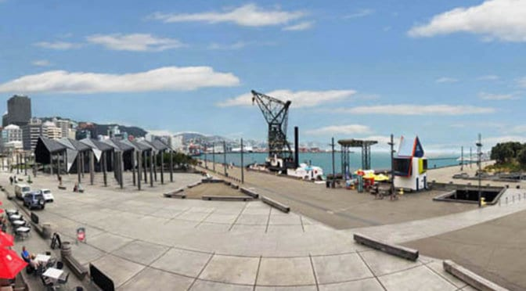
Big Data System Environments
Wellington, New Zealand
Geoffrey Fox, February 13, 2019
gcf@indiana.edu, http://www.dsc.soic.indiana.edu/, http://spidal.org/
Digital Science Center

Slide 2

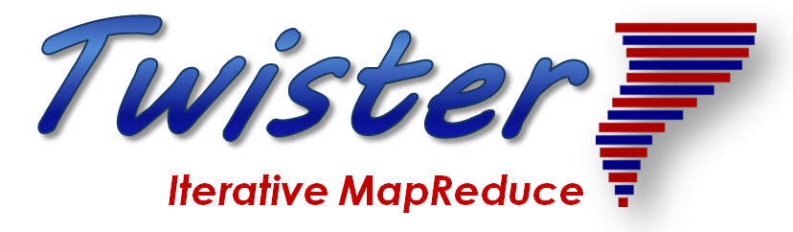
Overall Global AI and Modeling Supercomputer GAIMSC
2
http://www.iterativemapreduce.org/

Slide 3
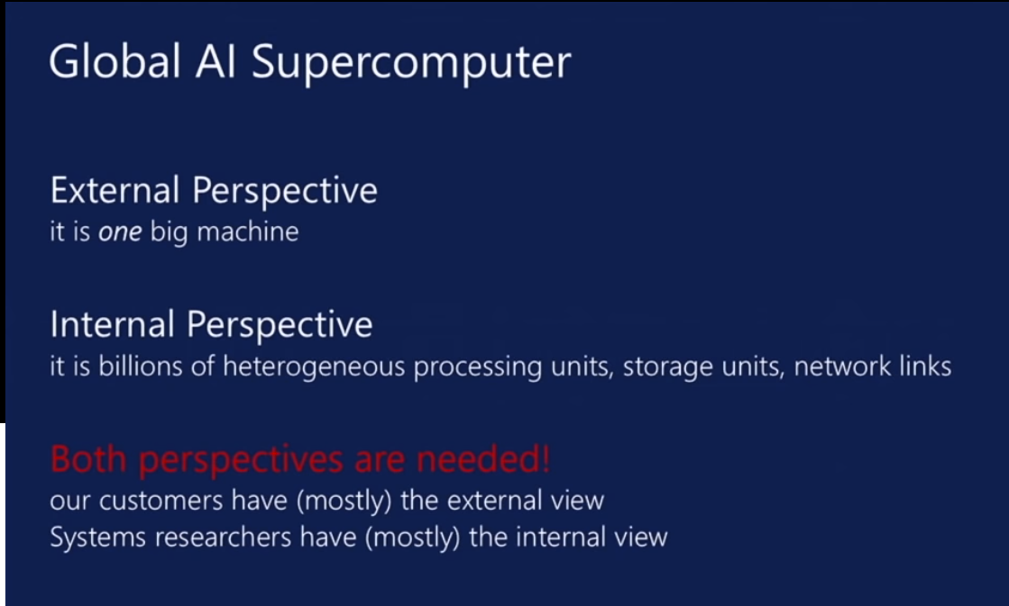
aa
From Microsoft
aa

Slide 4
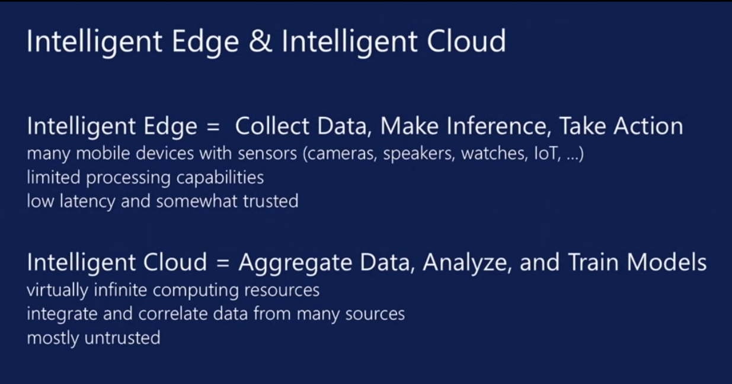
aa
From Microsoft
aa
https://www.microsoft.com/en-us/research/event/faculty-summit-2018/

Slide 5
Overall Global AI and Modeling Supercomputer GAIMSC Architecture
There is only a cloud at the logical center but it’s physically distributed and owned by a few major players
There is a very distributed set of devices surrounded by local Fog computing; this forms the logically and physically distribute edge
The edge is structured and largely data
  These are two differences from the Grid of the past
  e.g. self driving car will have its own fog and will not share fog with truck that it is about to collide with
The cloud and edge will both be very heterogeneous with varying accelerators, memory size and disk structure.
What is software model for GAIMSC?

Slide 6
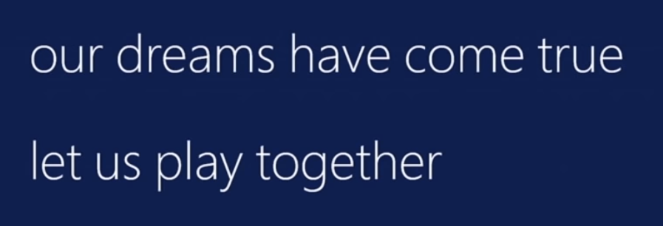
Collaborating on the
Global AI and Modeling Supercomputer GAIMSC
Microsoft says:
We can only “play together” and link functionalities from Google, Amazon, Facebook, Microsoft, Academia if we have open API’s and open code to customize
  We must collaborate
Open source Apache software
Academia needs to use and define their own Apache projects
We want to use AI and modeling supercomputer for AI-Driven engineering and science studying the early universe and the Higgs boson and not just producing annoying advertisements (goal of most elite CS researchers)

Slide 7
Systems Challenges for GAIMSC
Architecture of the Global AI and Modeling Supercomputer GAIMSC must reflect
  Global captures the need to mashup services from many different sources;
  AI captures the incredible progress in machine learning (ML);
  Modeling captures both traditional large-scale simulations and the models and digital twins needed for data interpretation;
  Supercomputer captures that everything is huge and needs to be done quickly and often in real time for streaming applications.
The GAIMSC includes an intelligent HPC cloud linked via an intelligent HPC Fog to an intelligent HPC edge. We consider this distributed environment as a set of computational and data-intensive nuggets swimming in an intelligent aether.
  We will use a dataflow graph to define a structure in the aether
GAIMSC requires parallel computing to achieve high performance on large ML and simulation nuggets and distributed system technology to build the aether and support the distributed but connected nuggets.
In the latter respect, the intelligent aether mimics a grid but it is a data grid where there are computations but typically those associated with data (often from edge devices).
  So unlike the distributed simulation supercomputer that was often studied in previous grids, GAIMSC is a supercomputer aimed at very different data intensive AI-enriched problems.

Slide 8
Integration of Data and Model functions with ML wrappers in GAIMSC
There is a increasing use in the integration of ML and simulations.
ML can analyze results, guide the execution and set up initial configurations (auto-tuning). This is equally true for AI itself -- the GAIMSC will use itself to optimize its execution for both analytics and simulations.
  See “The Case for Learned Index Structures” from MIT and Google
In principle every transfer of control (job or function invocation, a link from device to the fog/cloud) should pass through an AI wrapper that learns from each call and can decide both if call needs to be executed (maybe we have learned the answer already and need not compute it) and how to optimize the call if it really needs to be executed.
The digital continuum (proposed by BDEC2) is an intelligent aether learning from and informing the interconnected computational actions that are embedded in the aether.
  Implementing the intelligent aether embracing and extending the edge, fog, and cloud is a major research challenge where bold new ideas are needed!
  We need to understand how to make it easy to automatically wrap every nugget with ML.

Slide 9
Implementing the GAIMSC
My recent research aims to make good use of high-performance technologies and yet preserve the key features of the Apache Big Data Software.
  Originally aimed at using HPC to run Machine Learning but this is sort of understood and new focus is integration of ML, machine learning, clouds, edge
  We will describe Twister2 that seems well suited to build the prototype intelligent high-performance aether.
Note this will mix many relatively small nuggets with AI wrappers generating parallelism from the number of nuggets and not internally to the nugget and its wrapper.
However, there will be also large global jobs requiring internal parallelism for individual large-scale machine learning or simulation tasks.
Thus parallel computing and distributed systems (grids) must be linked in a clean fashion and the key parallel computing ideas needed for ML are closely related to those already developed for simulations.

Slide 10
Application Requirements
2
http://www.iterativemapreduce.org/

Slide 11
Distinctive Features of Applications
Ratio of data to model sizes: vertical axis on next slide
Importance of Synchronization – ratio of inter-node communication to node computing: horizontal axis on next slide
Sparsity of Data or Model; impacts value of GPU’s or vector computing
Irregularity of Data or Model
Geographic distribution of Data as in edge computing; use of streaming (dynamic data) versus batch paradigms
Dynamic model structure as in some iterative algorithms

Slide 12
Big Data and Simulation Difficulty in Parallelism
Size of Synchronization constraints
Loosely Coupled
Tightly Coupled
HPC Clouds: Accelerators
High Performance Interconnect
HPC Clouds/Supercomputers
Memory access also critical
Commodity Clouds
Size of Disk I/O
MapReduce as in scalable databases
Global Machine Learning
e.g. parallel clustering
Deep Learning
Graph Analytics e.g. subgraph mining
LDA
Pleasingly Parallel
Often independent events
Unstructured Adaptive Sparse
Current major Big Data category
Linear Algebra at core (often not sparse)
Structured Adaptive Sparse
Parameter sweep simulations
Largest scale simulations
Just two problem characteristics
There is also data/compute distribution seen in grid/edge computing
Exascale Supercomputers

Slide 13
Comparing Spark, Flink and MPI
2
http://www.iterativemapreduce.org/

Slide 14
Machine Learning with MPI, Spark and Flink
Three algorithms implemented in three runtimes
  Multidimensional Scaling (MDS)
  Terasort
  K-Means (drop as no time and looked at later)
Implementation in Java
  MDS is the most complex algorithm - three nested parallel loops
  K-Means - one parallel loop
  Terasort - no iterations (see later)
With care, Java performance ~ C performance
Without care, Java performance << C performance (details omitted)

Slide 15



Multidimensional Scaling: 3 Nested Parallel Sections
Flink
Spark
MPI
MPI Factor of 20-200 Faster than Spark/Flink
MDS execution time with 32000 points on varying number of nodes. Each node runs 20 parallel tasks
Spark, Flink No Speedup
MDS execution time on 16 nodes with 20 processes in each node with varying number of points
Flink especially loses touch with relationship of computing and data location
In open Wound Pragmas, Twister2 uses Parallel First Touch and Owner Computes
Current Big Data systems use forgotten touch, owner forgets and
Tragedy of the Commons Computes

Slide 16
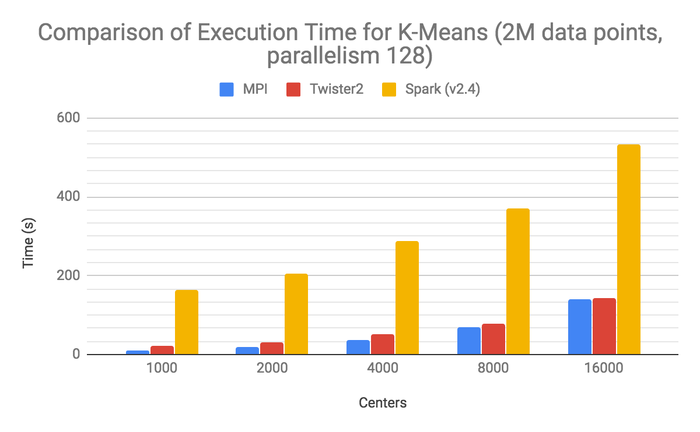

Slide 17
Linking Machine Learning and HPC
2
http://www.iterativemapreduce.org/

Slide 18
MLforHPC and HPCforML
We tried to distinguish between different interfaces for ML/DL and HPC.
HPCforML: Using HPC to execute and enhance ML performance, or using HPC simulations to train ML algorithms (theory guided machine learning), which are then used to understand experimental data or simulations.
MLforHPC: Using ML to enhance HPC applications and systems
A special case of Dean at NIPS 2017 – "Machine Learning for Systems and Systems for Machine Learning",

Slide 19
HPCforML in detail
HPCforML can be further subdivided
HPCrunsML: Using HPC to execute ML with high performance
SimulationTrainedML: Using HPC simulations to train ML algorithms, which are then used to understand experimental data or simulations.
Twister2 supports HPCrunsML by using high performance technology such as MPI

Slide 20
MLforHPC in detail
MLforHPC can be further subdivided into several categories:
  MLautotuning: Using ML to configure (autotune) ML or HPC simulations.
  MLafterHPC: ML analyzing results of HPC as in trajectory analysis and structure identification in biomolecular simulations
  MLaroundHPC: Using ML to learn from simulations and produce learned surrogates for the simulations. The same ML wrapper can also learn configurations as well as results
  MLControl: Using simulations (with HPC) in control of experiments and in objective driven computational campaigns. Here the simulation surrogates are very valuable to allow real-time predictions.
Twister2 supports MLforHPC by allowing nodes of dataflow representation to be wrapped with ML

Slide 21
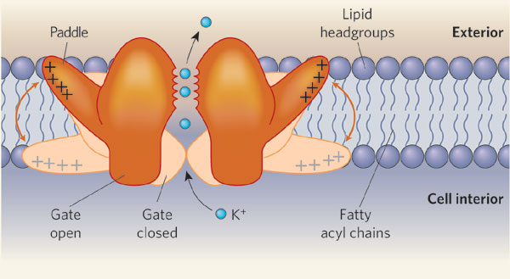
MLAutotuned HPC. Machine Learning for Parameter Auto-tuning in Molecular Dynamics Simulations: Efficient Dynamics of Ions near Polarizable Nanoparticles
Jcs Kadupitiya, Geoffrey Fox, Vikram Jadhao
Nature 444, 697 (2006)

Slide 22
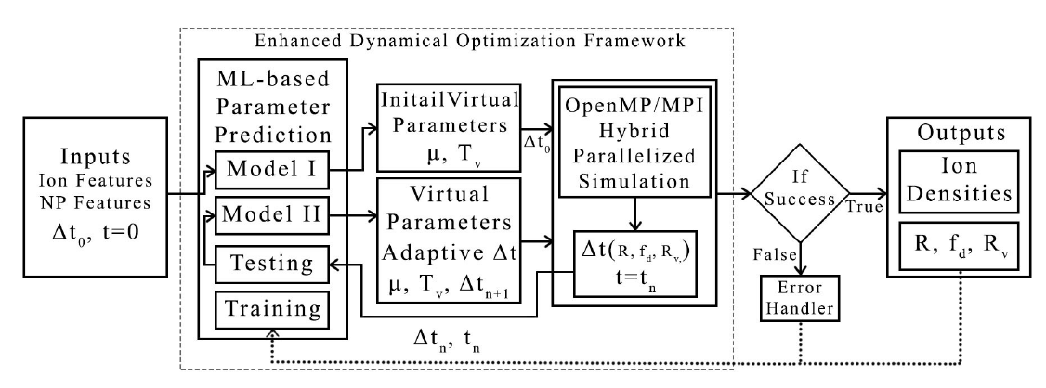
Electrostatics under
conventional approach
Electrostatics under Car-Parrinello
inspired variational framework
Integration of machine learning (ML) methods for parameter prediction in MD simulations by demonstrating how they were realized in MD simulations of ions near polarizable NPs.
Initial Charge Configuration
Initial Charge Configuration and optimized induced charge distribution
Reduction to Surface problem
Solve Poisson Equation
Compute
Force on charges
Force on additional degrees
Compute Forces on charges
Move charges and fake degrees
Move Charges using the Forces.
The electrostatic problem is solved on the fly in with energy conservation built-in the Lagrangian formalism.

Slide 23
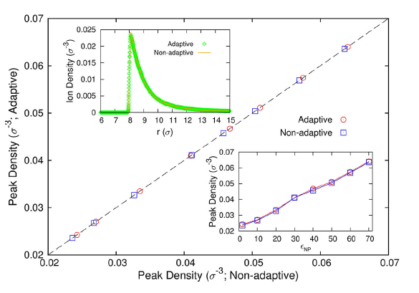
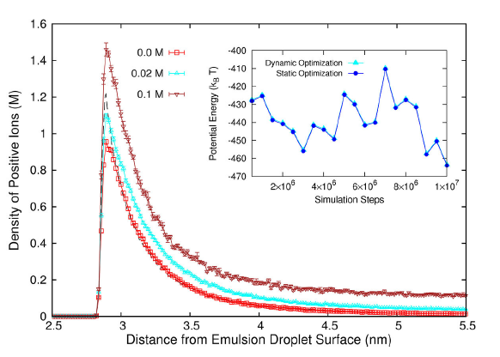
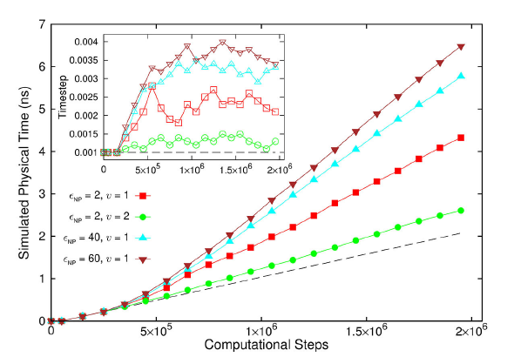
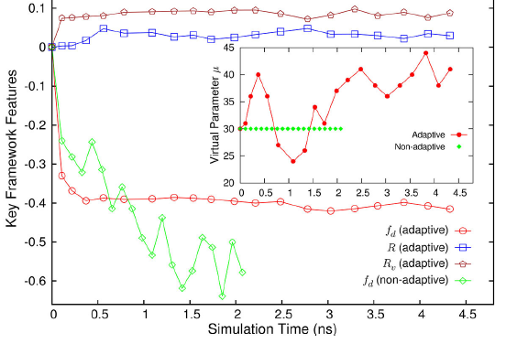
Results for MLAutotuning
Comparison of results for peak densities of counterions between adaptive (ML) and original non-adaptive cases (they look identical)
Ionic densities from MLAutotuned system. Inset compares ML system results with those of slower original system
Key characteristics of simulated system showing greater stability for ML enabled adaptive approach.
Quality of simulation measured by time simulated per step with increasing use of ML enhancements. (Larger is better).
Inset is timestep used
An ANN based regression model was integrated with MD simulation and predicted excellent simulation environment 94:3% of the time; human operation is more like 20(student)-50(faculty)% and runs simulation slower to be safe.
Auto-tuning of parameters generated accurate dynamics of ions for 10 million steps while improving the stability.
The integration of ML-enhanced framework with hybrid OpenMP/MPI parallelization techniques reduced the computational time of simulating systems with 1000 of ions and induced charges from 1000 of hours to 10 of hours, yielding a maximum speedup of 3 from ML-only and a maximum speedup of 600 from the combination of ML and parallel computing methods.
The approach can be generalized to select optimal parameters in other MD applications & energy minimization problems.

Slide 24
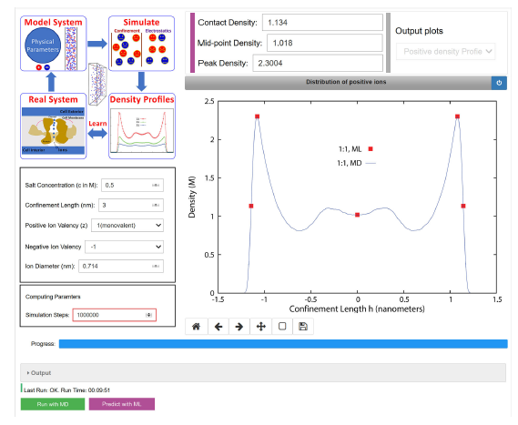
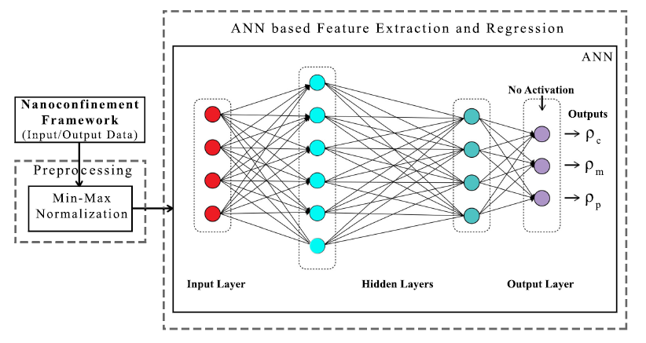
MLaroundHPC: Machine learning for performance enhancement with Surrogates of molecular dynamics simulations
Integration of machine learning (ML) with the high-performance computing enabled simulation frameworks to enhance their performance and improve their usability for both research and education.

Slide 25
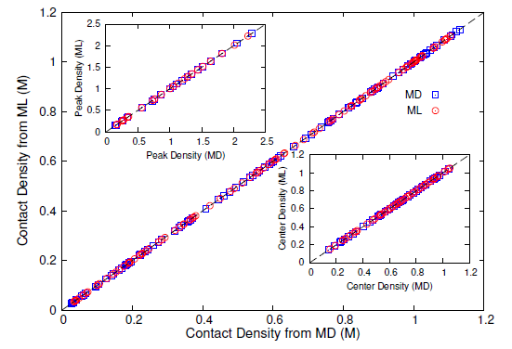
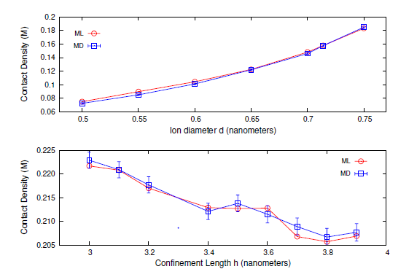
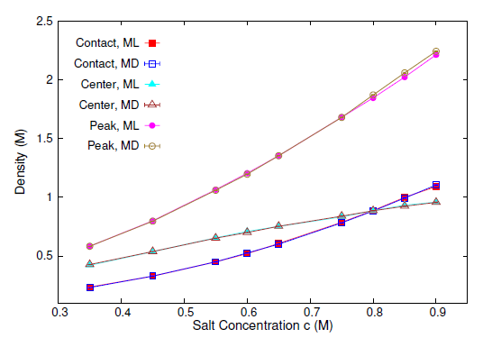
Correlation between Molecular Dynamics simulations and Learnt Machine Learning Predictions for contact density
Dependence of contact densities on ion diameter and confinement length compared between ML and MD
Contact, peak and center point densities versus salt concentration compared between MD and ML inference
We find that an artificial neural network based regression model successfully learns desired features associated with the output ionic density profiles (the contact, mid-point and peak densities) generating predictions for these quantities that are in excellent agreement with the results from explicit molecular dynamics simulations.
The integration of an ML layer enables real-time and anytime engagement with the simulation framework, thus enhancing the applicability for both research and educational use.

Slide 26
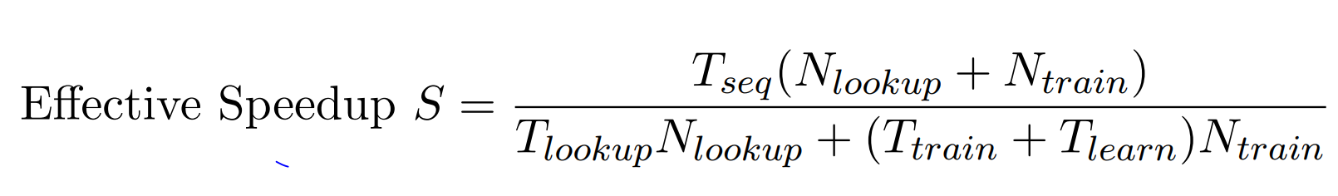
Speedup of MLaroundHPC
T_{seq} is sequential time
T_{train} time for a (parallel) simulation used in training ML
T_{learn} is time per point to run machine learning
T_{lookup} is time to run inference per instance
N_{train} number of training samples
N_{lookup} number of results looked up
Becomes T_{seq}/T_{train} if ML not used
Becomes T_{seq}/T_{lookup} (10⁵ faster in our case) if inference dominates (will overcome end of Moore’s law and win the race to zettascale)
This application deployed on nanoHub for high performance education use
N_{train} is 7K to 16K in our work

Slide 27
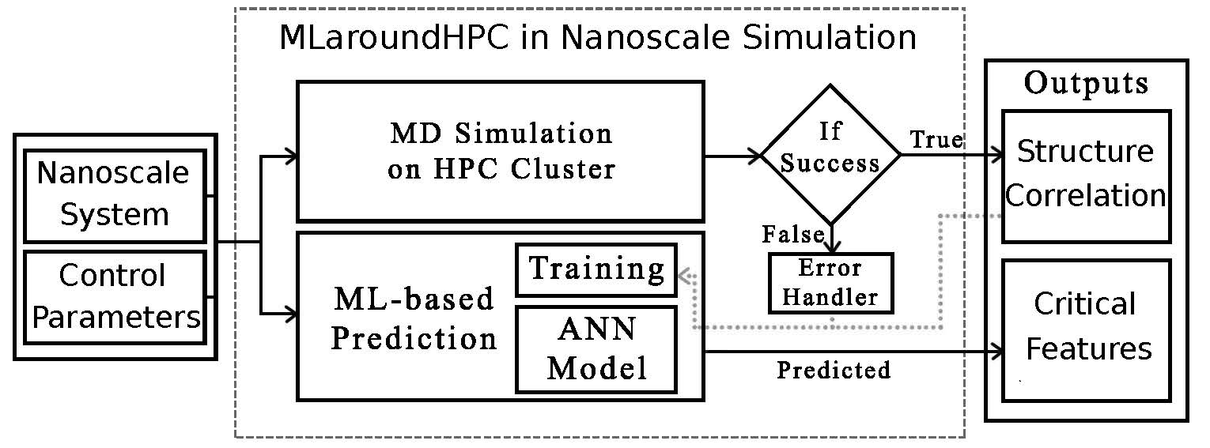
MLaroundHPC Architecture:
ML and MD intertwined
ML-Based Simulation Prediction
ANN Model
Training
Inference
Inference I

Slide 28
MLAutotuning: Integration Architecture
Integration of machine learning (ML) methods for parameter prediction in MD simulations by demonstrating how they were realized in MD simulations of ions near polarizable NPs.
ML is before and after MD
ML-Based Simulation Configuration
Inference I
Inference II
Testing
Training

Slide 29
Programming Environment for Global AI and Modeling Supercomputer GAIMSC
HPCforML and MLforHPC
2
http://www.iterativemapreduce.org/

Slide 30
Ways of adding High Performance to
Global AI (and Modeling) Supercomputer
Fix performance issues in Spark, Heron, Hadoop, Flink etc.
  Messy as some features of these big data systems intrinsically slow in some (not all) cases
  All these systems are “monolithic” and difficult to deal with individual components
Execute HPBDC from classic big data system with custom communication environment – approach of Harp for the relatively simple Hadoop environment
Provide a native Mesos/Yarn/Kubernetes/HDFS high performance execution environment with all capabilities of Spark, Hadoop and Heron – goal of Twister2
Execute with MPI in classic (Slurm, Lustre) HPC environment
Add modules to existing frameworks like Scikit-Learn or Tensorflow either as new capability or as a higher performance version of existing module.

Slide 31
Integrating HPC and Apache Programming Environments
Harp-DAAL with a kernel Machine Learning library exploiting the Intel node library DAAL and HPC communication collectives within the Hadoop ecosystem.
  Harp-DAAL supports all 5 classes of data-intensive AI first computation, from pleasingly parallel to machine learning and simulations.
Twister2 is a toolkit of components that can be packaged in different ways
  Integrated batch or streaming data capabilities familiar from Apache Hadoop, Spark, Heron and Flink but with high performance.
  Separate bulk synchronous and data flow communication;
  Task management as in Mesos, Yarn and Kubernetes
  Dataflow graph execution models
  Launching of the Harp-DAAL library with native Mesos/Kubernetes/HDFS environment
  Streaming and repository data access interfaces,
  In-memory databases and fault tolerance at dataflow nodes. (use RDD (Tsets) to do classic checkpoint-restart)

Slide 32
Twister2 Highlights I
“Big Data Programming Environment” such as Hadoop, Spark, Flink, Storm, Heron but with significant differences (improvements)
Uses HPC wherever appropriate
Links to “Apache Software” (Kafka, Hbase, Beam) wherever appropriate
Runs preferably under Kubernetes and Mesos but Slurm supported
Highlight is high performance dataflow supporting iteration, fine-grain, coarse grain, dynamic, synchronized, asynchronous, batch and streaming
Two distinct communication environments
  DFW Dataflow with distinct source and target tasks; data not message level
  BSP for parallel programming; MPI is default
Rich state model for objects supporting in-place, distributed, cached, RDD style persistence

Slide 33
Twister2 Highlights II
Can be a pure batch engine
  Not built on top of a streaming engine
Can be a pure streaming engine supporting Storm/Heron API
  Not built on on top of a batch engine
Fault tolerance as in Spark or MPI today; dataflow nodes define natural synchronization points
Many API’s: Data (at many levels), Communication, Task
  High level (as in Spark) and low level (as in MPI)
Component based architecture -- it is a toolkit
  Defines the important layers of a distributed processing engine
  Implements these layers cleanly aiming at data analytics and with high performance

Slide 34
Twister2 Highlights III
Key features of Twister2 are associated with its dataflow model
  Fast and functional inter-node linkage; distributed from edge to cloud or in-place between identical source and target tasks
  Streaming or Batch nodes (Storm persisent or Spark emphemeral model)
  Supports both Orchestration (as in Pegasus, Kepler, NiFi) or high performance streaming flow (as in Naiad) model
  Tset Twister2 datasets like RDD define a full object state model supported across links of dataflow

Slide 35
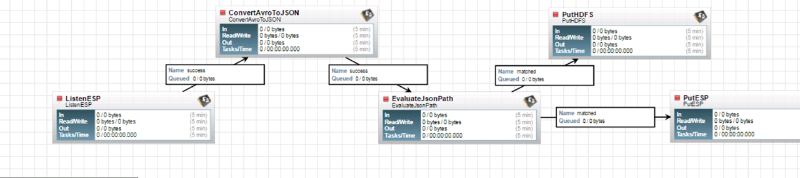
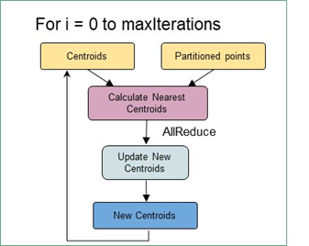
Some Choices in Dataflow Systems
NiFi
Classic coarse-grain workflow
Computations (maps) happen at nodes
Generalized Communication happens on links
  Direct, Keyed, Collective (broadcast, reduce), Join
In coarse-grain workflow, communication can be by disk
In fine-grain dataflow (as in K-means), communication needs to be fast
  Caching and/or use in-place tasks
In-place not natural for streaming as persistent nodes/tasks
K-means in Spark, Flink, Twister2

Slide 36
Twister2 Logistics
Open Source - Apache Licence Version 2.0
Github - https://github.com/DSC-SPIDAL/twister2
Documentation - https://twister2.gitbook.io/twister2 with tutorial
Developer Group - twister2@googlegroups.com – India(1) Sri Lanka(9) and Turkey(2)
Started in the 4th Quarter of 2017; reversing previous philosophy which was to modify Hadoop, Spark, Heron;
Bootstrapped using Heron code but that code now changed
About 80000 Lines of Code (plus 50,000 for SPIDAL+Harp HPCforML)
  Languages - Primarily Java with some Python

Slide 37


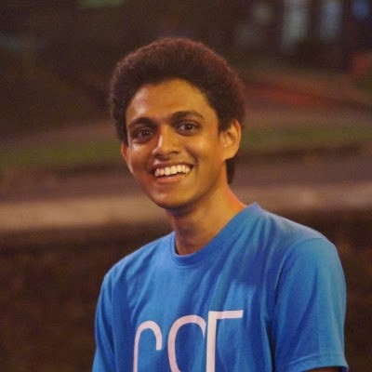
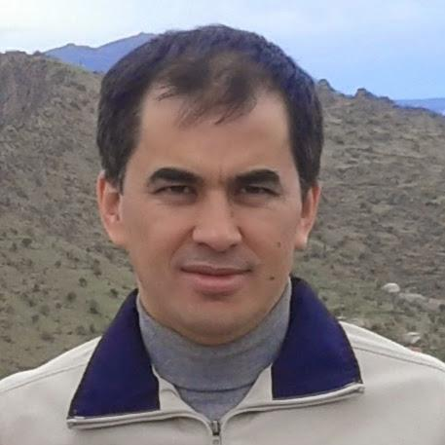
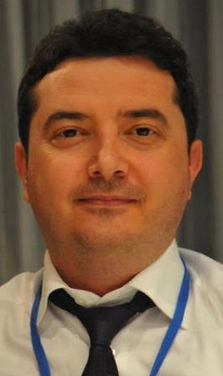
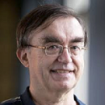






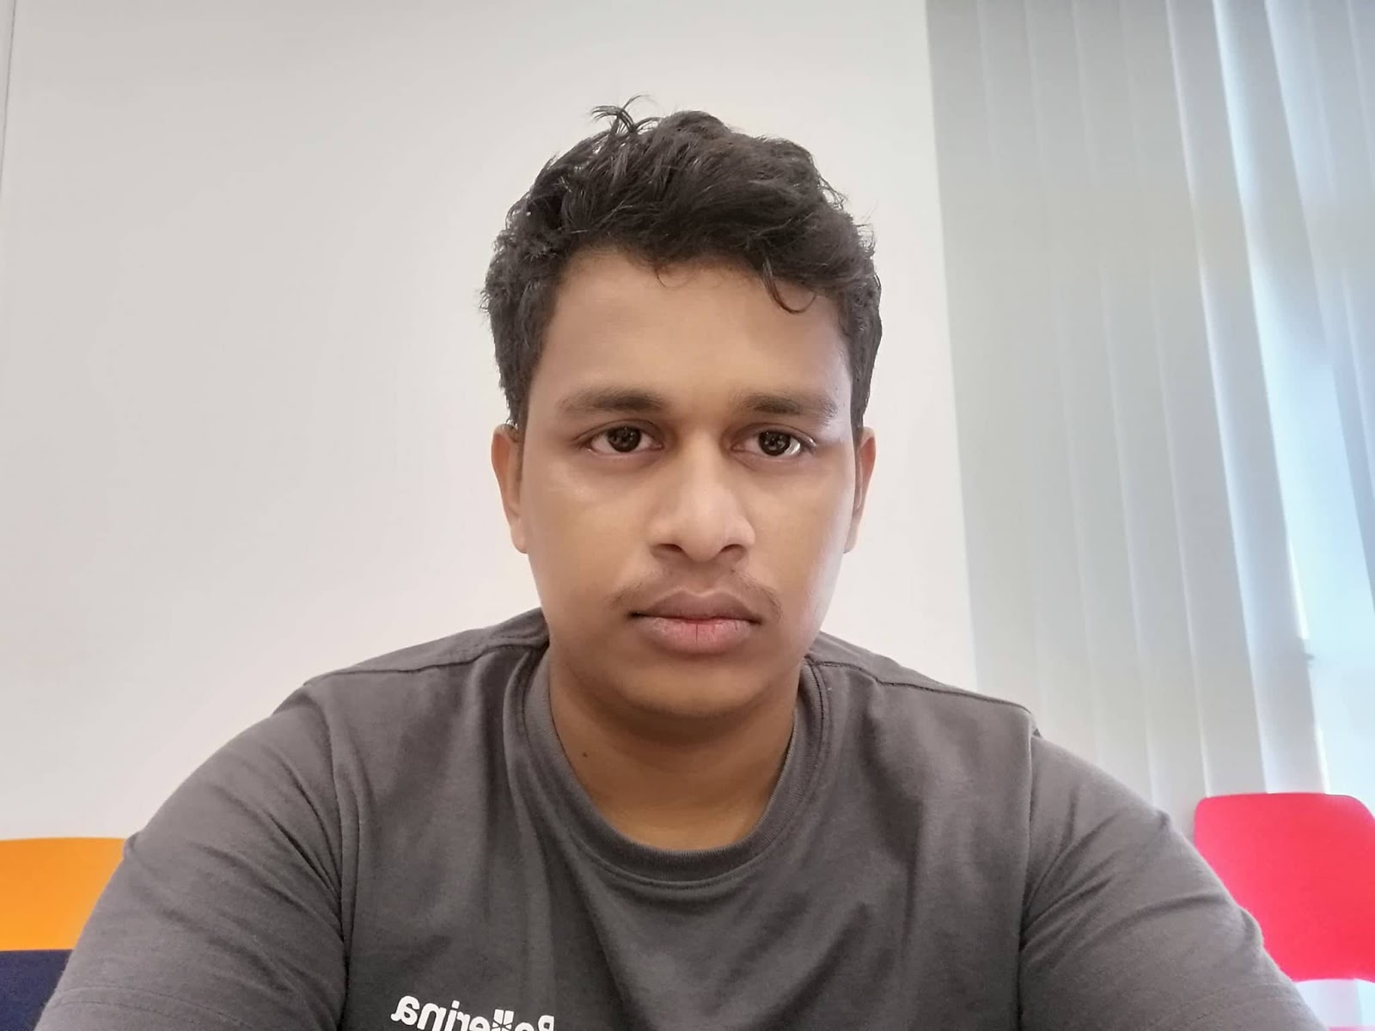
Twister2 Team

Slide 38
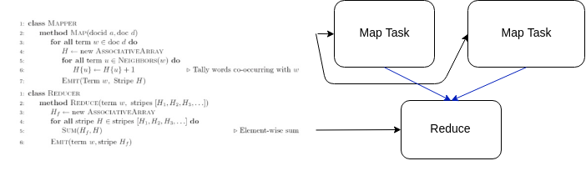
Big Data APIs
Started with Map-Reduce
Different Data APIs in community
Data transformation APIs
  Apache Crunch PCollections
  Apache Spark RDD
  Apache Flink DataSet
  Apache Beam PCollections
  Apache Storm Streamlets
Apache Storm Task Graph
SQL based APIs
Task Graph with computations on data in nodes
High-level Data API hides communication and decomposition from the user
Lower-level messaging and Task API’s offer harder to use more powerful capabilities

Slide 39
GAIMSC Programming Environment Components I
Area | Component | Implementation | Comments: User API
Architecture Specification | Coordination Points | State and Configuration Management; Program, Data and Message Level | Change execution mode; save and reset state
 | Execution Semantics | Mapping of Resources to Bolts/Maps in Containers, Processes, Threads | Different systems make different choices - why?
 | Parallel Computing | Spark Flink Hadoop Pregel MPI modes | Owner Computes Rule
Job Submission | (Dynamic/Static) Resource Allocation | Plugins for Slurm, Yarn, Mesos, Marathon, Aurora | Client API (e.g. Python) for Job Management
Task System | Task migration | Monitoring of tasks and migrating tasks for better resource utilization | Task-based programming with Dynamic or Static Graph API; FaaS API; Support accelerators (CUDA,FPGA, KNL)
 | Elasticity | OpenWhisk
 | Streaming and FaaS Events | Heron, OpenWhisk, Kafka/RabbitMQ
 | Task Execution | Process, Threads, Queues
 | Task Scheduling | Dynamic Scheduling, Static Scheduling, Pluggable Scheduling Algorithms
 | Task Graph | Static Graph, Dynamic Graph Generation

Slide 40
GAIMSC Programming Environment Components II
Area | Component | Implementation | Comments
Communication API | Messages | Heron | This is user level and could map to multiple communication systems
 | Dataflow Communication | Fine-Grain Twister2 Dataflow communications: MPI,TCP and RMA Coarse grain Dataflow from NiFi, Kepler? | Streaming, ETL data pipelines; Define new Dataflow communication API and library
 | BSP Communication Map-Collective | Conventional MPI, Harp | MPI Point to Point and Collective API
Data Access | Static (Batch) Data | File Systems, NoSQL, SQL | Data API
 | Streaming Data | Message Brokers, Spouts
Data Management | Distributed Data Set | Relaxed Distributed Shared Memory(immutable data), Mutable Distributed Data | Data Transformation API; Spark RDD, Heron Streamlet
Fault Tolerance | Check Pointing | Upstream (streaming) backup; Lightweight; Coordination Points; Spark/Flink, MPI and Heron models | Streaming and batch cases distinct; Crosses all components
Security | Storage, Messaging, execution | Research needed | Crosses all Components

Slide 41
Execution as a Graph for Data Analytics
The graph created by the user API can be executed using an event model
The events flow through the edges of the graph as messages
The compute units are executed upon arrival of events
  Supports Function as a Service
Execution state can be checkpointed automatically with natural synchronization at node boundaries
  Fault tolerance
T
T
Task Schedule
Events flow through edges
Graph
Execution Graph (Plan)
R

Slide 42
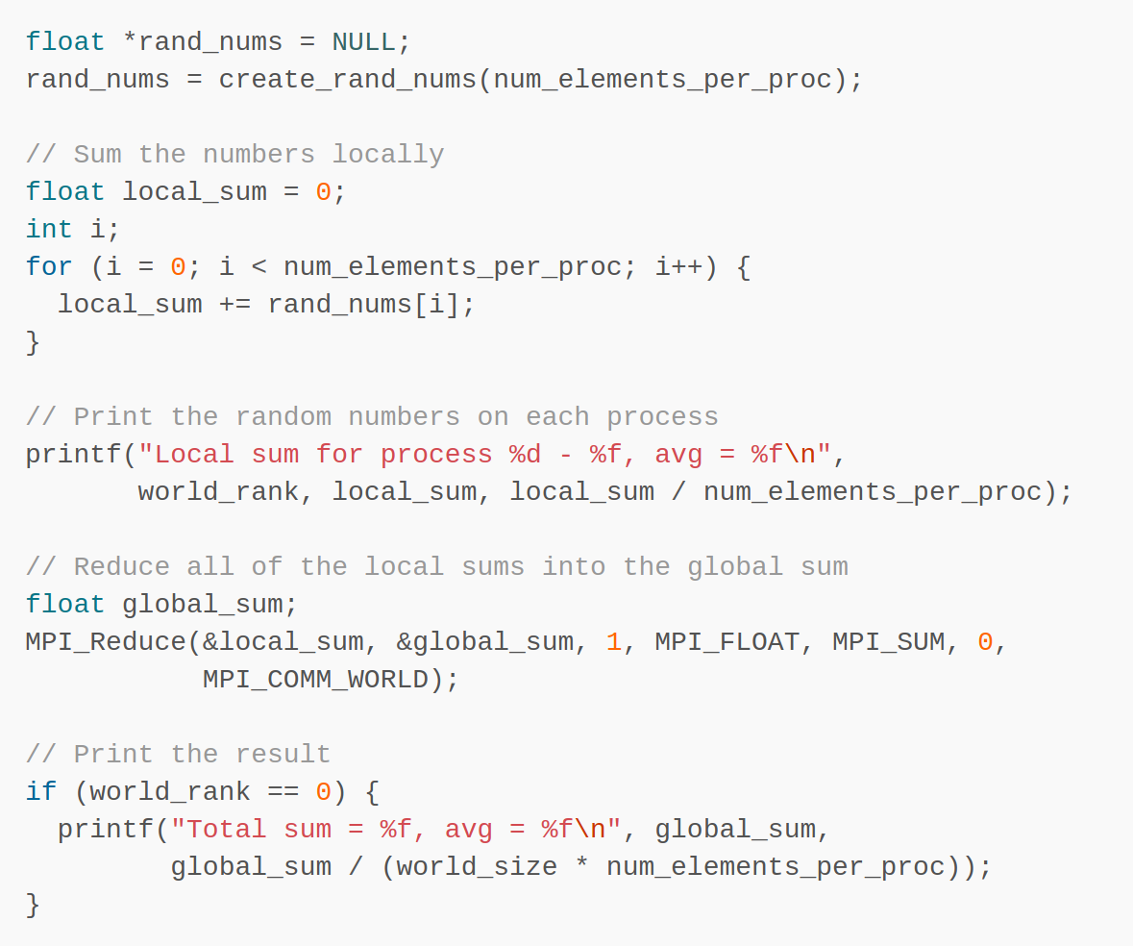
HPC APIs
Dominated by Message Passing Interface (MPI)
  Provides the most fundamental requirements in the most
  efficient ways possible
    Communication between parallel workers
    Managing of parallel processes
HPC has task systems and Data APIs
  They are all built on top of parallel communication libraries
  Legion from Stanford on top of CUDA and active messages (GASNet)
  Actually HPC usually defines “model parameter” API’s and Big Data “Data” API’s
  One needs both data and model parameters treated similarily in many cases
Simple MPI Program

Slide 43
Data and Model in Big Data and Simulations I
Need to discuss Data and Model as problems have both intermingled, but we can get insight by separating which allows better understanding of Big Data - Big Simulation “convergence” (or differences!)
The Model is a user construction and it has a “concept”, parameters and gives results determined by the computation. We use term “model” in a general fashion to cover all of these.
Big Data problems can be broken up into Data and Model
  For clustering, the model parameters are cluster centers while the data is set of points to be clustered
  For queries, the model is structure of database and results of this query while the data is whole database queried and SQL query
  For deep learning with ImageNet, the model is chosen network with model parameters as the network link weights. The data is set of images used for training or classification

Slide 44
Data and Model in Big Data and Simulations II
Simulations can also be considered as Data plus Model
  Model can be formulation with particle dynamics or partial differential equations defined by parameters such as particle positions and discretized velocity, pressure, density values
  Data could be small when just boundary conditions
  Data large with data assimilation (weather forecasting) or when data visualizations are produced by simulation
Big Data implies Data is large but Model varies in size
  e.g. LDA (Latent Dirichlet Allocation) with many topics or deep learning has a large model
  Clustering or Dimension reduction can be quite small in model size
Data often static between iterations (unless streaming); Model parameters vary between iterations
Data and Model Parameters are often confused in papers as term data used to describe the parameters of models.
Models in Big Data and Simulations have many similarities and allow convergence
Both data and model have non trivial parallel computing issues

Slide 45
Twister2 Features by Level of Effort
Feature | Current Lines of Code | Near-term Addons
Mesos+Kubernetes+Slurm Integration + Resource and Job Management (Job master) | 15000
Task system (scheduler + dataflow graph + executor) | 10000
DataFlow operators, Twister:Net | 20000
Fault tolerance | 2000 | 3000
Python API |  | 5000
Tset and Object State | 2500
Apache Storm Compatibility | 2000
Apache Beam Connection |  | 2000-5000
Connected (external) Dataflow | 5000 | 4000-8000
Data Access API | 5000 | 5000
Connectors ( RabbitMQ, MQTT, SQL, HBase etc.) | 1000 (Kafka) | 10000
Utilities and common code | 9000 (5000 + 4000)
Application Test code | 10000
Dashboard | 4000

Slide 46
Twister2 Implementation by Language
Language | Files | Blank Lines | Comment Lines | Line of Code
Java | 916 | 16247 | 26415 | 66045
Python | 54 | 2240 | 3178 | 6707
XML | 20 | 93 | 241 | 3714
Javascript | 35 | 220 | 217 | 2092
Bourne (Again) Shell | 25 | 242 | 344 | 338
YAML | 47 | 429 | 727 | 812
SASS | 12 | 93 | 53 | 423
Maven | 1 | 12 | 1 | 91
HTML | 1 | 3 | 20 | 22
SUM: | 1111 | 19579 | 31196 | 80801
Software Engineering will double amount of code with unit tests etc.

Slide 47
Runtime Components
Atomic Job Submission
Connected or External DataFlow
Orchestration API
Streaming, Batch and ML Applications
Python API
SQL API
Java APIs
Scala APIs
User APIs
Runtime
TSet
State
Task Graph System
BSP Operations
Internal (fine grain) DataFlow and State Definition Operations
Resource API
Mesos
Kubernetes
Standalone
Slurm
HDFS
NoSQL
Message Brokers
Local
Data Access APIs
Future Features: Python API critical

Slide 48
Twister2 APIs in Detail
Operator Level APIs
APIs built on top of Task Graph
Java API
Python API
Java API
Java API
Java API
TSet
SQL
DataFlow Operations
BSP Operations
Task Graph
Task Graph
Task Graph
Worker
Worker
DataFlow Operations
DataFlow Operations
DataFlow Operations
Worker
Worker
Worker
Low level APIs with the most flexibility. Harder to program
Higher Level APIs based on Task Graph
APIs are built combining different components of the System
Future

Slide 49
Twister2 API Levels
TSet API
Suitable for Simple Applications
Ex - Pleasingly Parallel
Easy to program functional API with type support
Ease of Use
Task API
Abstracts the threads, messages. Intermediate API
Performance/Flexibility
Operator API
User in full control, harder to program
Suitable for Complex Applications
Ex – Graph Analytics

Slide 50
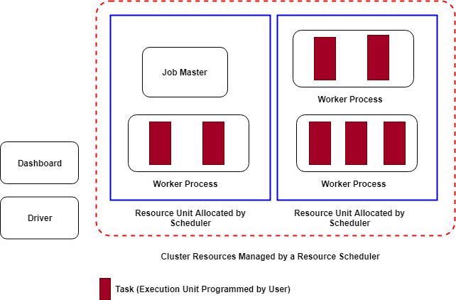
Runtime Process View
Driver
  User submits and controls the Job
Cluster Resources
  Resources managed by a resource scheduler
  such as Mesos or Kubernetes
Resource Unit
  A resource allocated by the scheduler: Core,
  Kubernetes Pod, Mesos Task, Compute Node
Worker Process
  A Twister2 process that executes the user tasks
Task
  Execution unit programmed by user
Every job runs in isolation (Dashboard is shared)

Slide 51
Features of Twister2:
HPCforML (Harp, SPIDAL)
DFW Communication Twister:Net
Dataflow in Twister2
2
http://www.iterativemapreduce.org/

Slide 52
Qiu/Fox Core SPIDAL Parallel HPC Library with Collective Used
DA-MDS Rotate, AllReduce, Broadcast
Directed Force Dimension Reduction AllGather, Allreduce
Irregular DAVS Clustering Partial Rotate, AllReduce, Broadcast
DA Semimetric Clustering (Deterministic Annealing) Rotate, AllReduce, Broadcast
K-means AllReduce, Broadcast, AllGather DAAL
SVM AllReduce, AllGather
SubGraph Mining AllGather, AllReduce
Latent Dirichlet Allocation Rotate, AllReduce
Matrix Factorization (SGD) Rotate DAAL
Recommender System (ALS) Rotate DAAL
Singular Value Decomp SVD AllGather DAAL
QR Decomposition (QR) Reduce, Broadcast DAAL
Neural Network AllReduce DAAL
Covariance AllReduce DAAL
Low Order Moments Reduce DAAL
Naive Bayes Reduce DAAL
Linear Regression Reduce DAAL
Ridge Regression Reduce DAAL
Multi-class Logistic Regression Regroup, Rotate, AllGather
Random Forest AllReduce
Principal Component Analysis (PCA) AllReduce DAAL
DAAL implies integrated on node with Intel DAAL Optimized Data Analytics Library

Slide 53
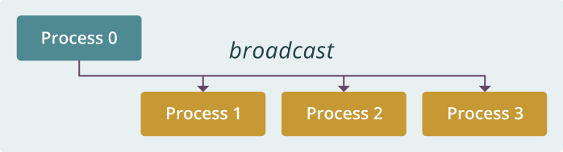
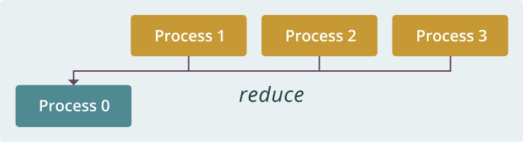
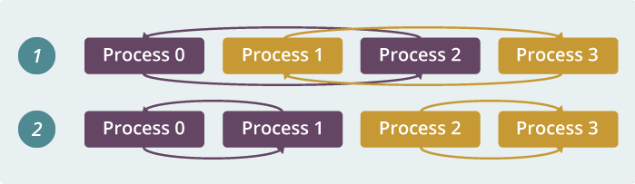
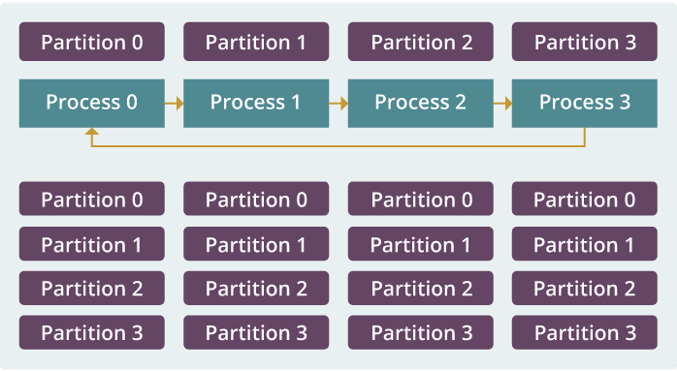
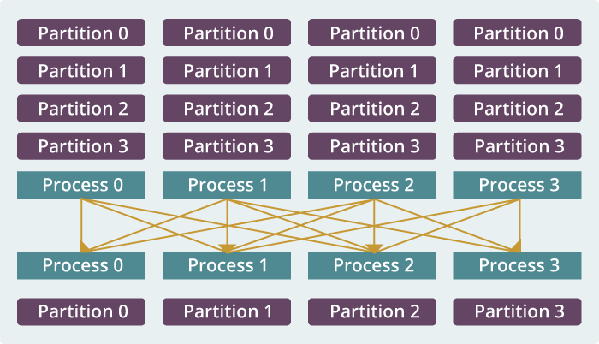
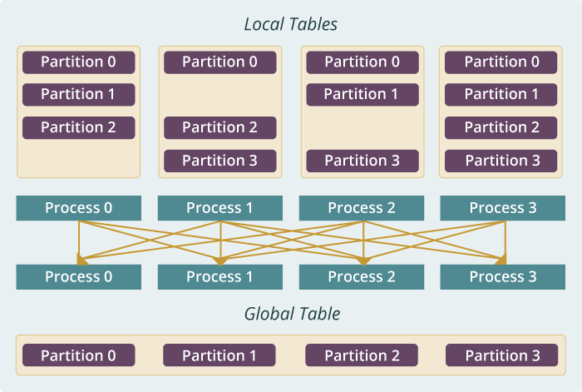
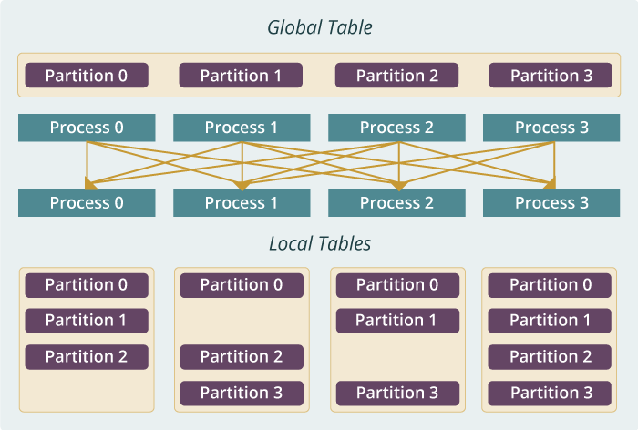
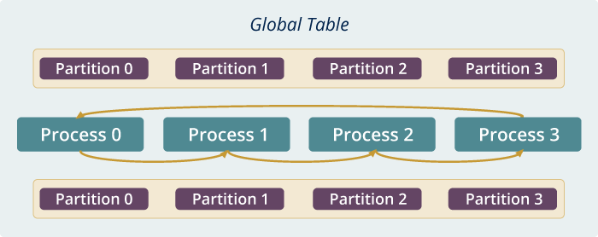
Run time software for Harp
broadcast
reduce
allreduce
allgather
regroup
push & pull
rotate
Map Collective Run time merges MapReduce and HPC

Slide 54
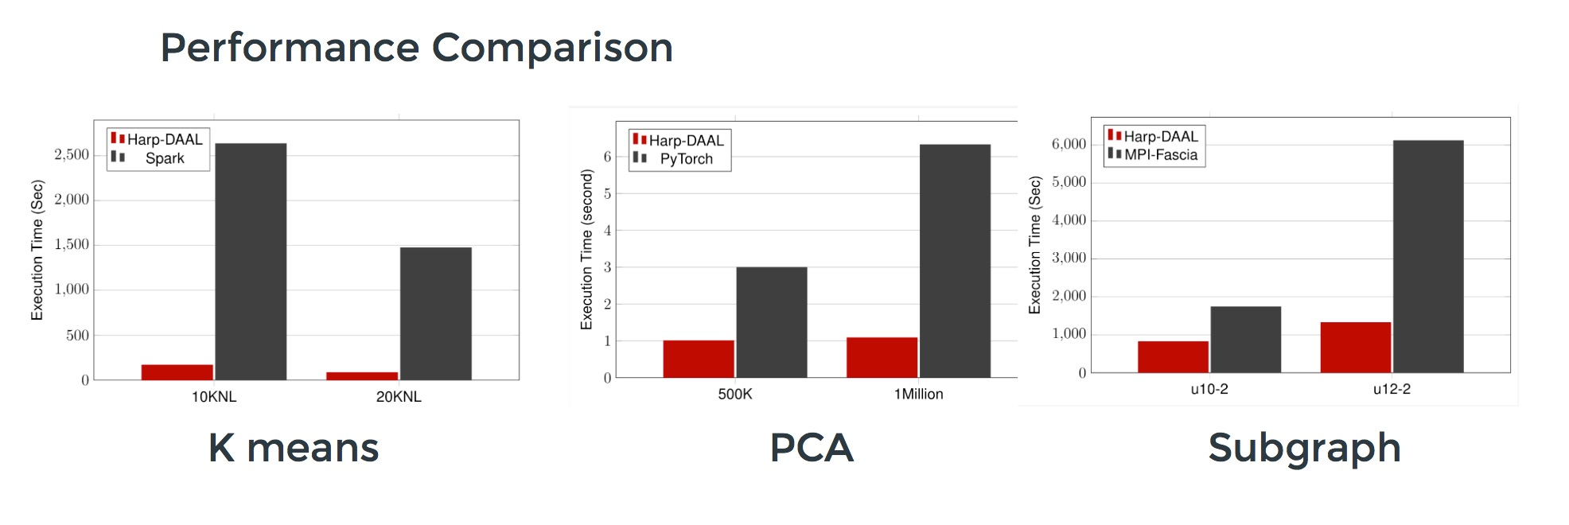
Harp v. Spark Harp v. Torch Harp v. MPI
Datasets: 5 million points, 10 thousand centroids, 10 feature dimensions
10 to 20 nodes of Intel KNL7250 processors
Harp-DAAL has 15x speedups over Spark MLlib
Datasets: 500K or 1 million data points of feature dimension 300
Running on single KNL 7250 (Harp-DAAL) vs. single K80 GPU (PyTorch)
Harp-DAAL achieves 3x to 6x speedups
Datasets: Twitter with 44 million vertices, 2 billion edges, subgraph templates of 10 to 12 vertices
25 nodes of Intel Xeon E5 2670
Harp-DAAL has 2x to 5x speedups over state-of-the-art MPI-Fascia solution

Slide 55
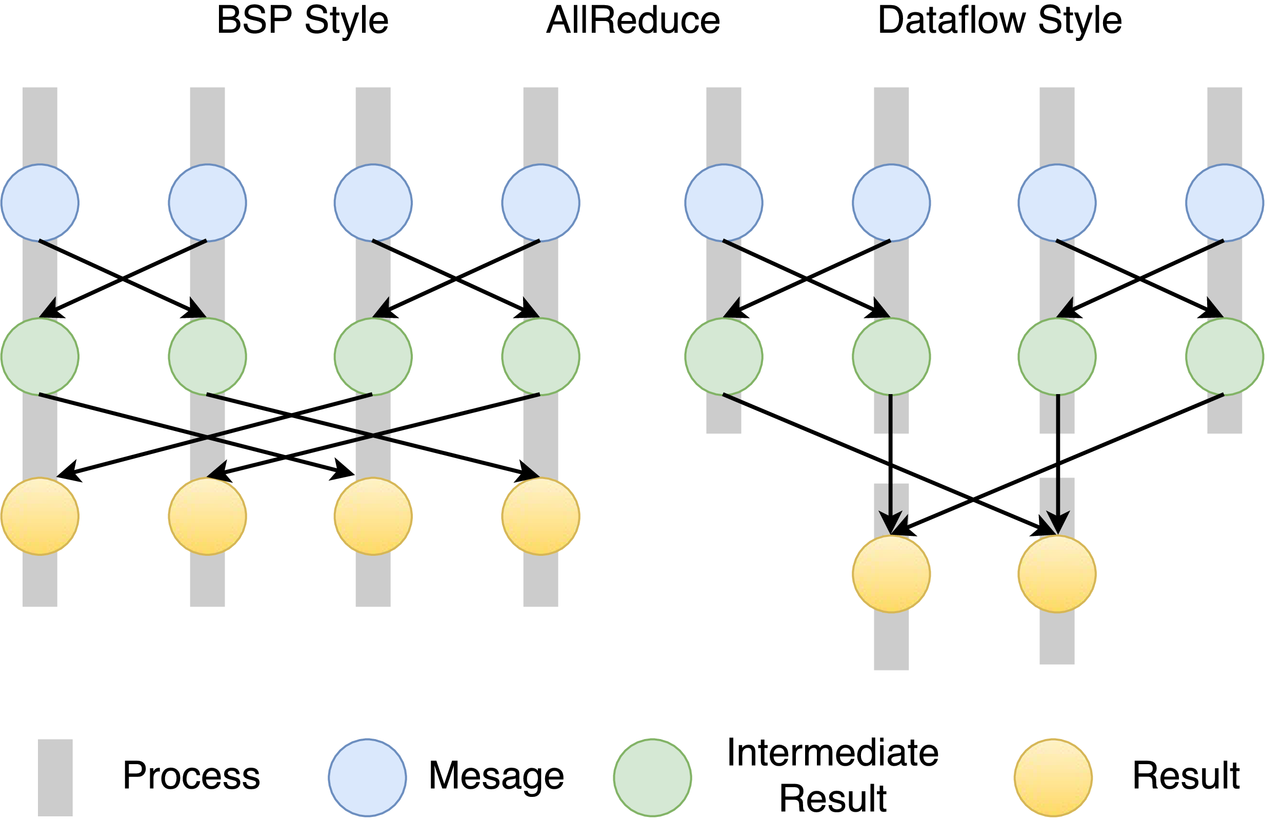
Twister2 Dataflow Communications
Twister:Net offers two communication models
BSP (Bulk Synchronous Processing) message-level communication using TCP or MPI separated from its task management plus extra Harp collectives
DFW a new Dataflow library built using MPI software but at data movement not message level
  Non-blocking
  Dynamic data sizes
  Streaming model
    Batch case is represented as a finite stream
  The communications are between a set of
  tasks in an arbitrary task graph
  Key based communications
  Data-level Communications spilling to disks
  Target tasks can be different from source tasks
BSP and DFW
for Reduce Operation

Slide 56
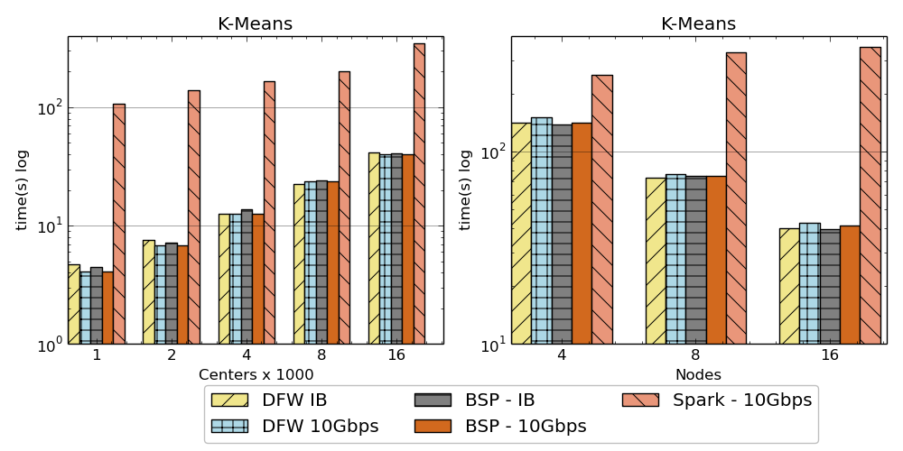
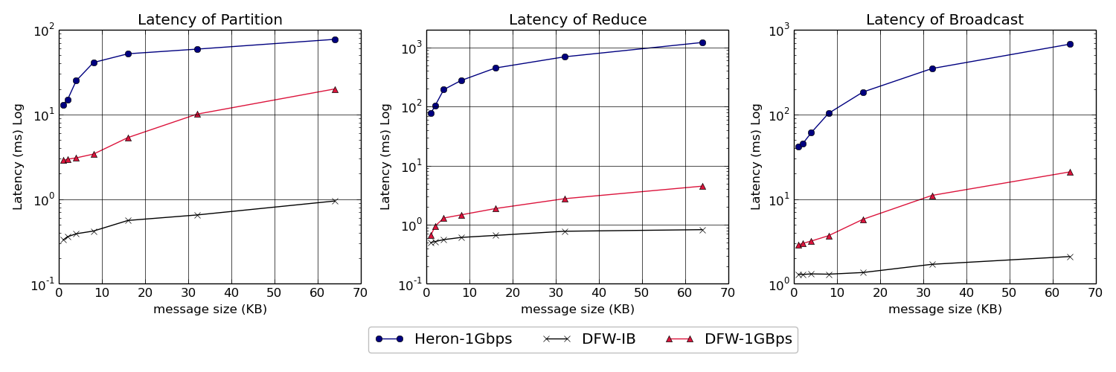
Twister:Net and Apache Heron and Spark
Left: K-means job execution time on 16 nodes with varying centers, 2 million points with 320-way parallelism. Right: K-Means wth 4,8 and 16 nodes where each node having 20 tasks. 2 million points with 16000 centers used.
Latency of Apache Heron and Twister:Net DFW (Dataflow) for Reduce, Broadcast and Partition operations in 16 nodes with 256-way parallelism

Slide 57
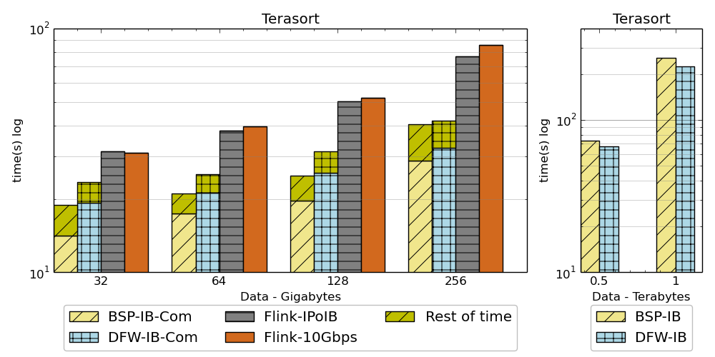
Results
Twister2 performance against Apache Flink and MPI for Terasort.
Notation :
DFW refers to Twister2
BSP refers to MPI (OpenMPI)

Slide 58
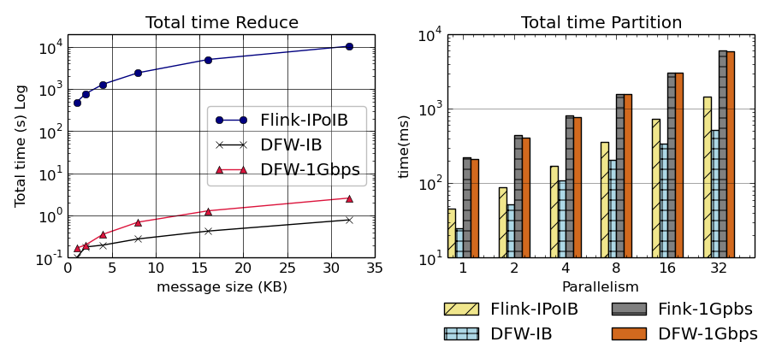
Results
Twister2 performance against Apache Flink for Reduce and partition operations in 32 nodes with 640-way parallelism.
Notation :
DFW refers to Twister2

Slide 59
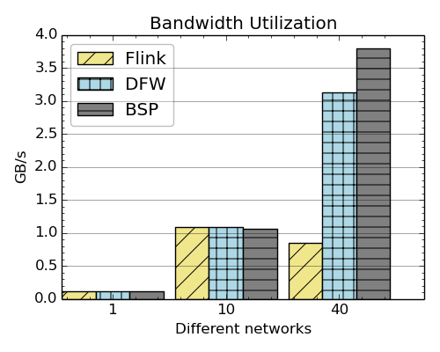
Results
Bandwidth utilization of Flink, Twister2 and OpenMPI over 1Gbps, 10Gbps and IB
Notation :
DFW refers to Twister2
BSP refers to MPI (OpenMPI)

Slide 60
Intelligent Dataflow Graph
The dataflow graph specifies the distribution and interconnection of job components
  Hierarchical and Iterative
Allow ML wrapping of component at each dataflow node
Checkpoint after each node of the dataflow graph
  Natural synchronization point
  Let’s allows user to choose when to checkpoint (not every stage)
  Save state as user specifies; Spark just saves Model state which is insufficient for complex algorithms
Intelligent nodes support customization of checkpointing, ML, communication
Nodes can be coarse (large jobs) or fine grain requiring different actions

Slide 61
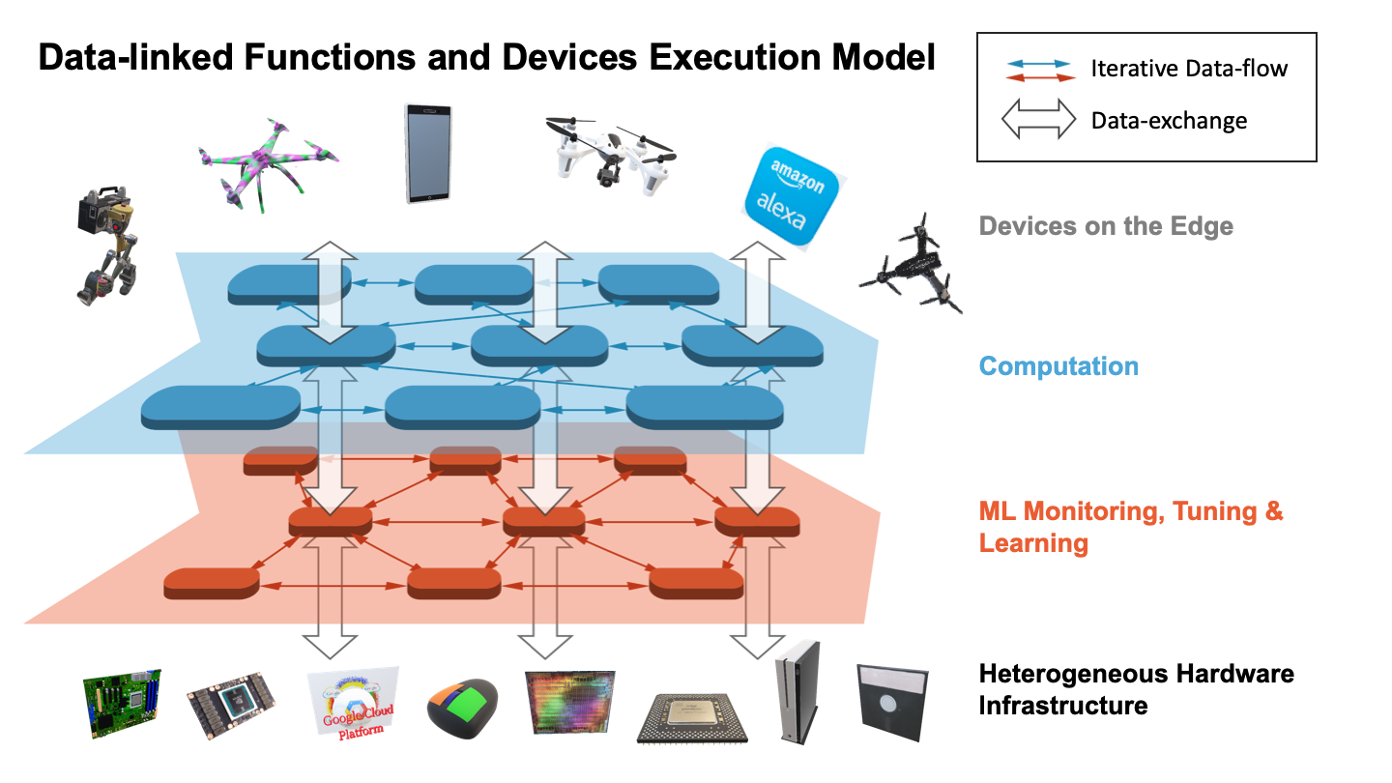
as a service
Continually interacting in the Intelligent Aether with
Software model supported by Twister2
(Omni)

Slide 62

Dataflow at Different Grain sizes
Coarse Grain Dataflows links jobs in a pipeline
Dimension
Reduction
Visualization
Data preparation
Clustering
But internally to each job you can also elegantly express algorithm as dataflow but with more stringent performance constraints
Corresponding to classic Spark K-means Dataflow
P = loadPoints()
C = loadInitCenters()
for (int i = 0; i < 10; i++) {
T = P.map().withBroadcast(C)
C = T.reduce() }
Internal Execution
Dataflow Nodes
Reduce
Iterate
HPC
Communication
Maps
Iterate

Slide 63
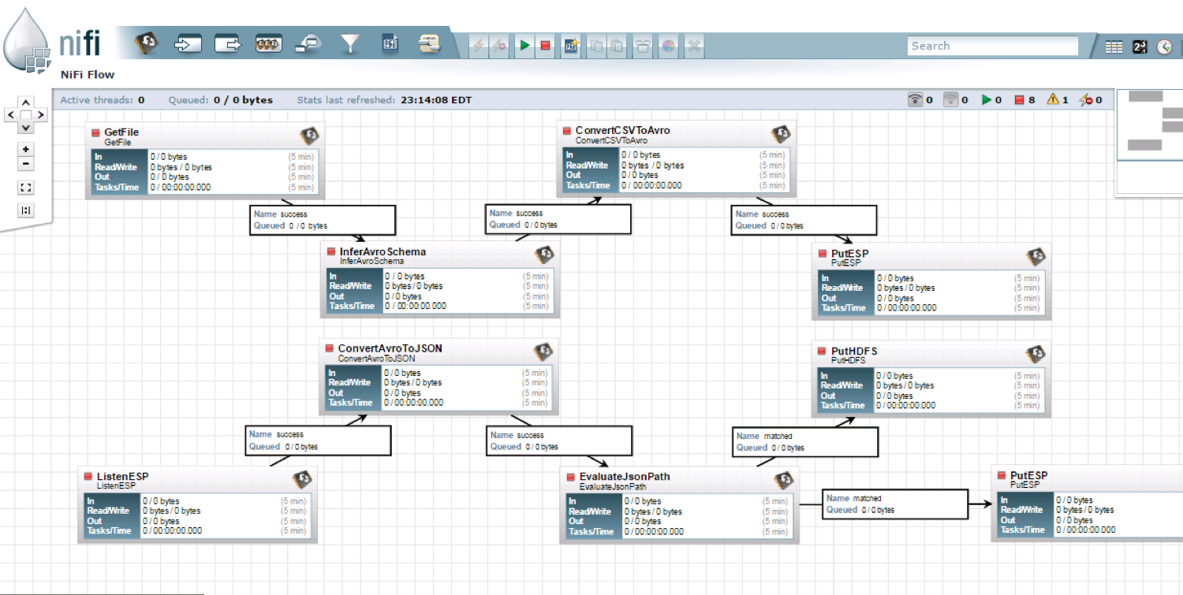
NiFi Coarse-grain Workflow

Slide 64
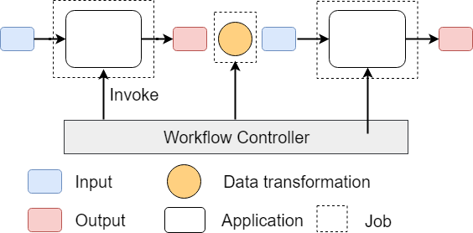
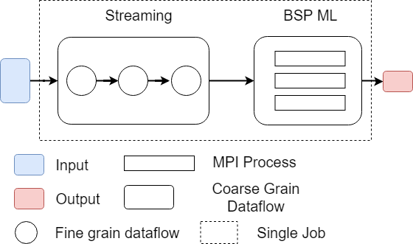
Workflow vs Dataflow: Different grain sizes and different performance trade-offs
The fine-grain dataflow can expand from Edge to Cloud
Coarse-grain Dataflow
Workflow Controlled by Workflow Engine or a Script
Fine-grain dataflow application running as a single job

