Slide 1
Cyberinfrastructure and Its Application
University of Arkansas Pine Bluff
Cyberinfrastructure Day
April 22 2011
Geoffrey Fox
gcf@indiana.edu
http://www.infomall.org http://www.futuregrid.org
Director, Digital Science Center, Pervasive Technology Institute
Associate Dean for Research and Graduate Studies, School of Informatics and Computing
Indiana University Bloomington
Notes:
SALSA is
Service Aggregated Linked Sequential Activities

Slide 2
Important Trends
Data Deluge in all fields of science
Multicore implies parallel computing important again
  Performance from extra cores – not extra clock speed
  GPU enhanced systems can give big power boost
Clouds – new commercially supported data center model replacing compute grids (and your general purpose computer center)
Light weight clients: Sensors, Smartphones and tablets accessing and supported by backend services in cloud
Commercial efforts moving much faster than academia in both innovation and deployment

Slide 3
Big Data in Many Domains
According to one estimate, we created 150 exabytes (billion gigabytes) of data in 2005. This year, we will create 1,200 exabytes
PC’s have ~100 Gigabytes disk and 4 Gigabytes of memory
Size of the web ~ 3 billion web pages: MapReduce at Google was on average processing 20PB per day in January 2008
During 2009, American drone aircraft flying over Iraq and Afghanistan sent back around 24 years’ worth of video footage
  http://www.economist.com/node/15579717
  New models being deployed this year will produce ten times as many data streams as their predecessors, and those in 2011 will produce 30 times as many
~108 million sequence records in GenBank in 2009, doubling in every 18 months
~20 million purchases at Wal-Mart a day
90 million Tweets a day
Astronomy, Particle Physics, Medical Records …
Most scientific task shows CPU:IO ratio of 10000:1 – Dr. Jim Gray
The Fourth Paradigm: Data-Intensive Scientific Discovery
Large Hadron Collider at CERN; 100 Petabytes to find Higgs Boson
Notes:
For each category, give examples, e.g. Astronomy solon 20 TB night,
http://www.datacenterknowledge.com/archives/2009/12/22/the-data-crunching-powerhouse-behind-avatar/

Slide 4
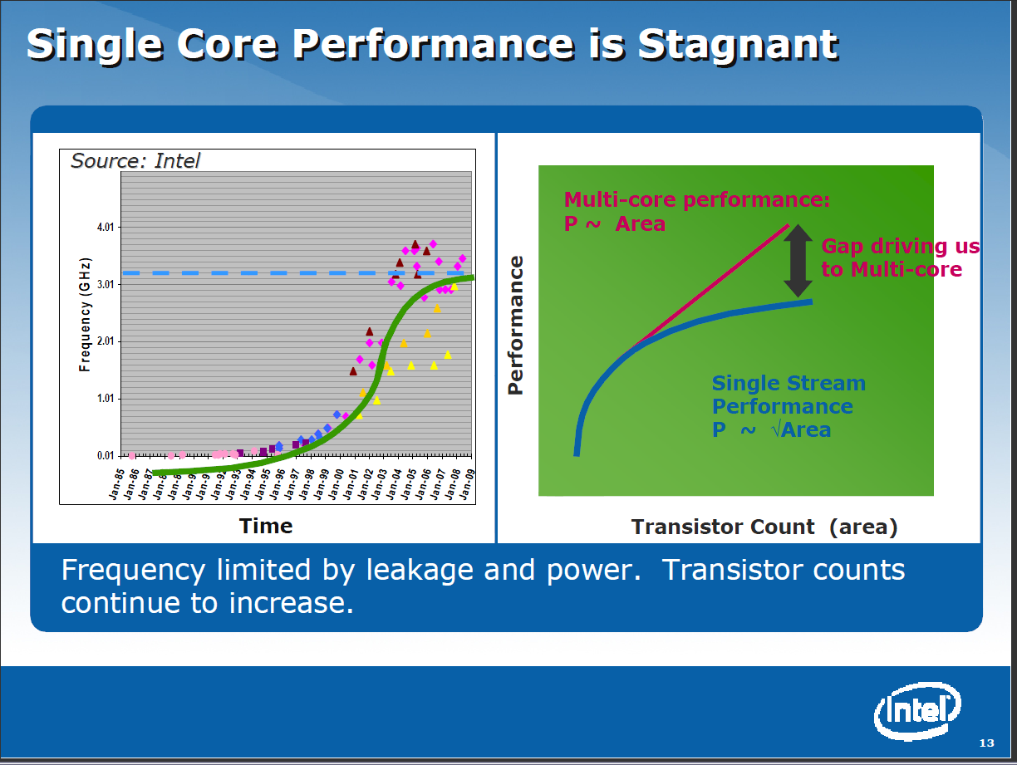

Slide 5
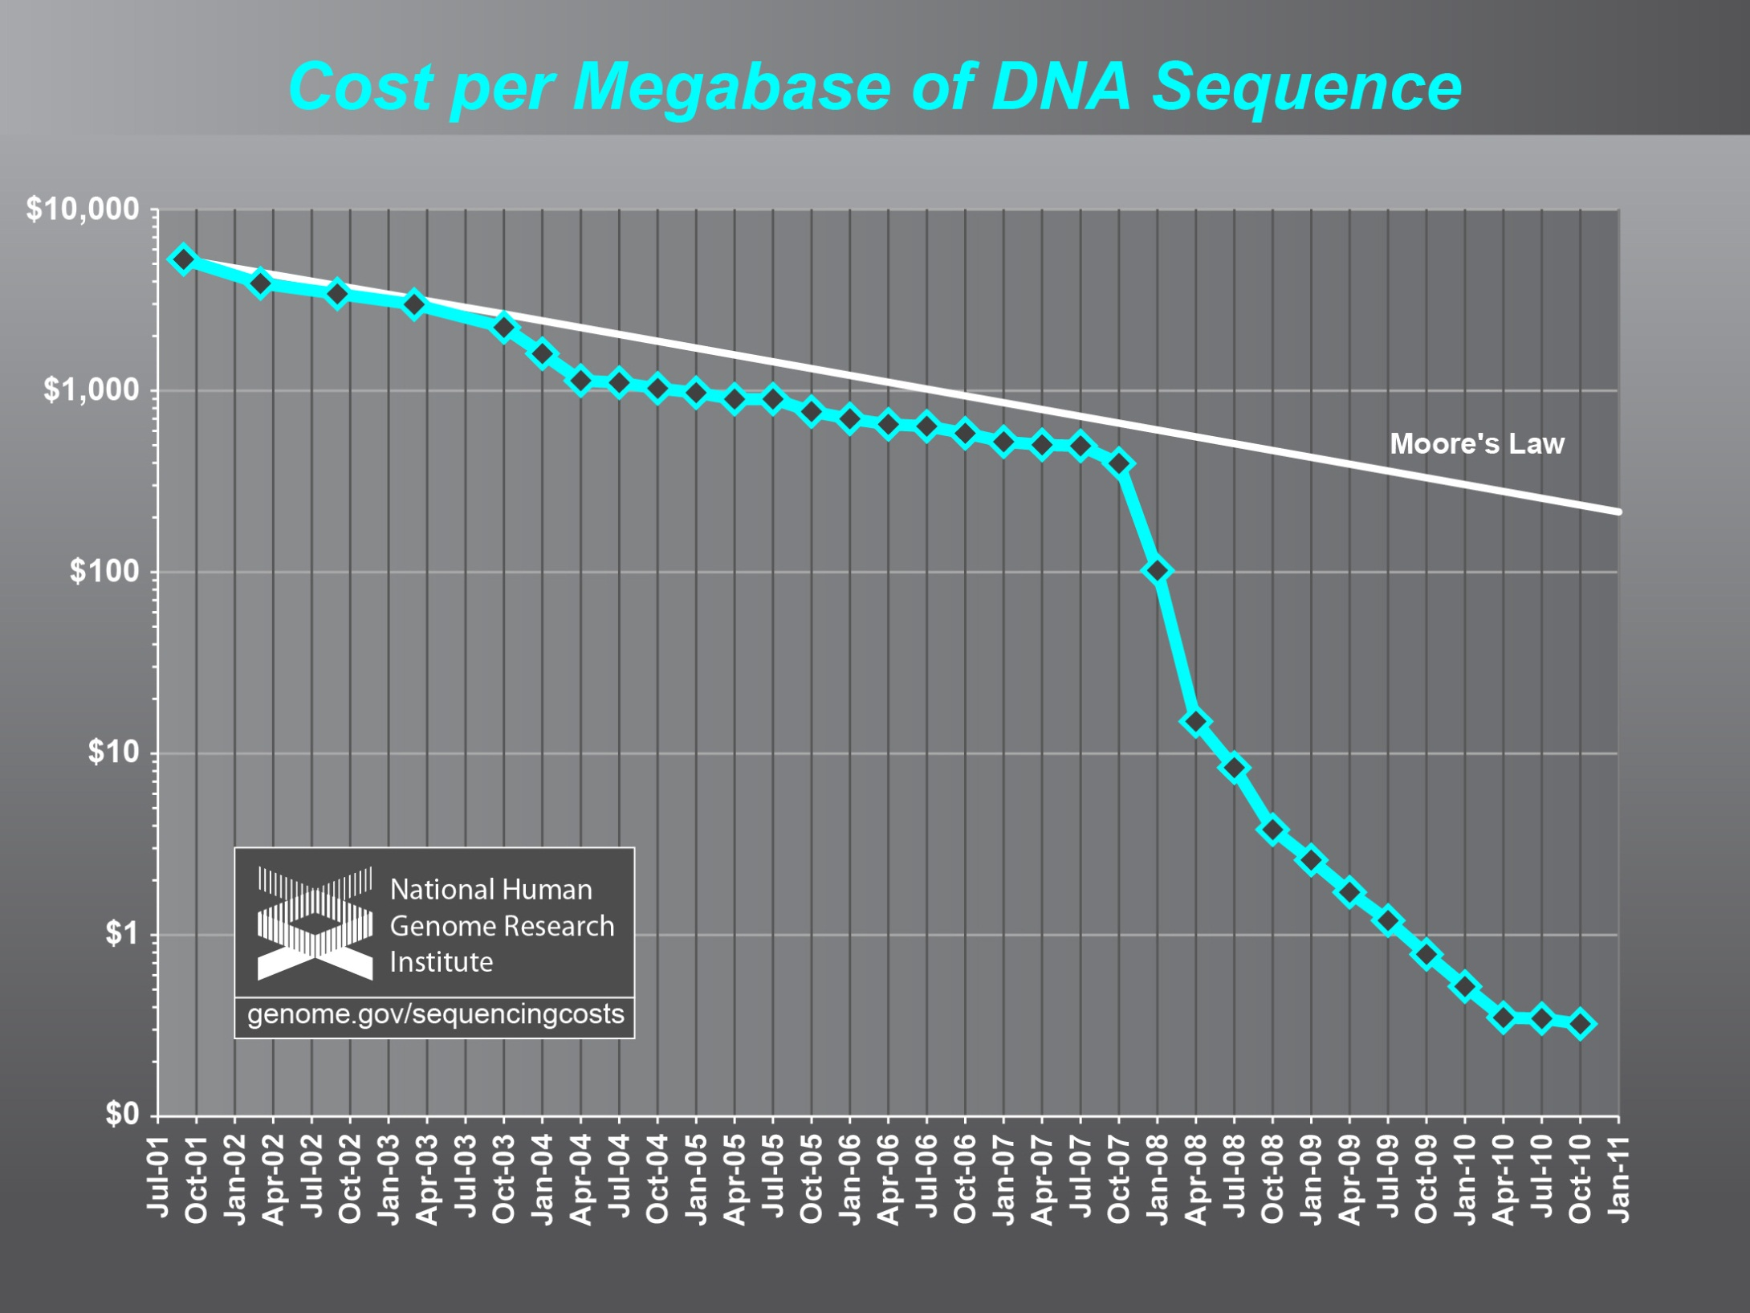

Slide 6
What is Cyberinfrastructure
Cyberinfrastructure is (from NSF) infrastructure that supports distributed research and learning (e-Science, e-Research, e-Education)
  Links data, people, computers
Exploits Internet technology (Web2.0 and Clouds) adding (via Grid technology) management, security, supercomputers etc.
It has two aspects: parallel – low latency (microseconds) between nodes and distributed – highish latency (milliseconds) between nodes
Parallel needed to get high performance on individual large simulations, data analysis etc.; must decompose problem
Distributed aspect integrates already distinct components – especially natural for data (as in biology databases etc.)
6
Notes:
6

Slide 7
e-moreorlessanything
‘e-Science is about global collaboration in key areas of science, and the next generation of infrastructure that will enable it.’ from inventor of term John Taylor Director General of Research Councils UK, Office of Science and Technology
e-Science is about developing tools and technologies that allow scientists to do ‘faster, better or different’ research
Similarly e-Business captures the emerging view of corporations as dynamic virtual organizations linking employees, customers and stakeholders across the world.
This generalizes to e-moreorlessanything including e-DigitalLibrary, e-FineArts, e-HavingFun and e-Education
A deluge of data of unprecedented and inevitable size must be managed and understood.
People (virtual organizations), computers, data (including sensors and instruments) must be linked via hardware and software networks
7
Notes:
7

Slide 8
The Span of Cyberinfrastructure
High definition videoconferencing linking people across the globe
Digital Library of music, curriculum, scientific papers
Flickr, Youtube, Amazon ….
Simulating a new battery design (exascale problem)
Sharing data from world’s telescopes
Using cloud to analyze your personal genome
Enabling all to be equal partners in creating knowledge and converting it to wisdom
Analyzing Tweets…documents to discover which stocks will crash; how disease is spreading; linguistic inference; ranking of institutions

Slide 9
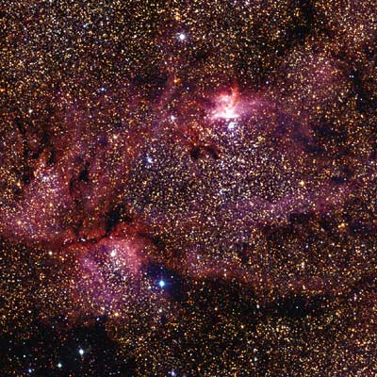
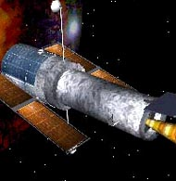
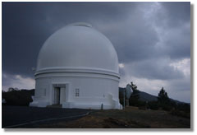
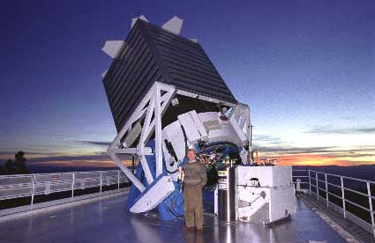
Tracking the Heavens
“The Universe is now being explored systematically, in a panchromatic way, over a range of spatial and temporal scales that lead to a more complete, and less biased understanding of its constituents, their evolution, their origins, and the physical processes governing them.”
Towards a National Virtual Observatory
Hubble Telescope
Palomar Telescope
Sloan Telescope

Slide 10
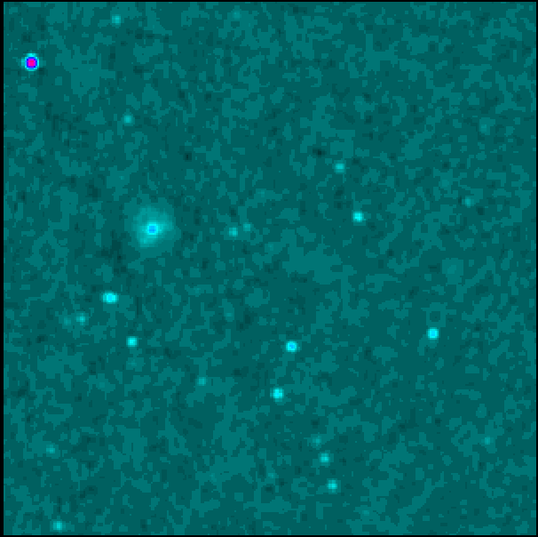
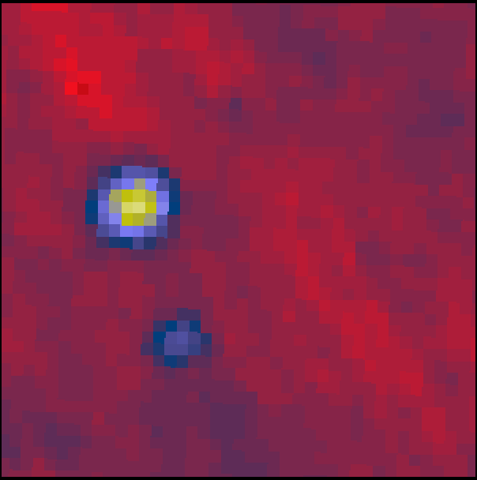
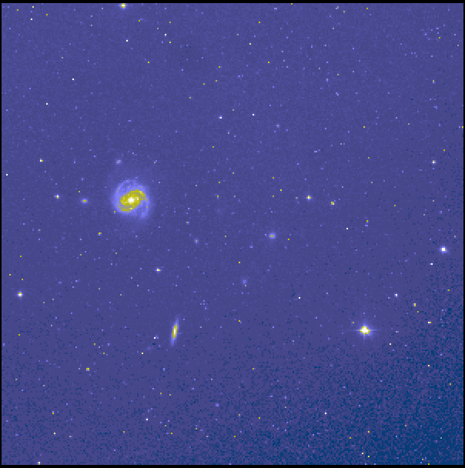
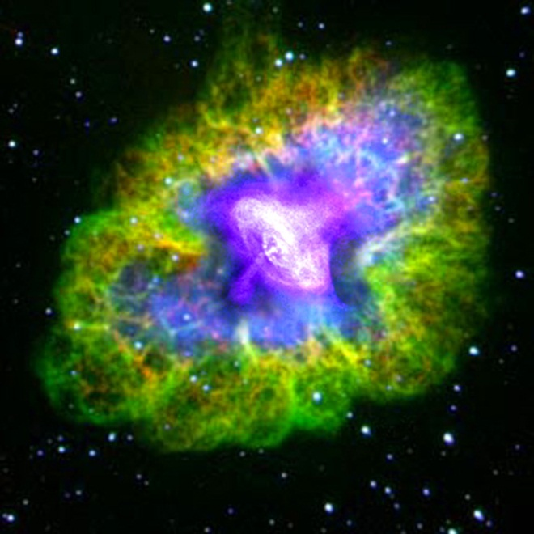
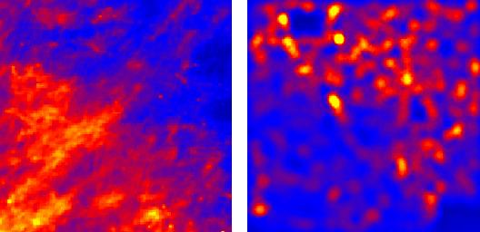
Virtual Observatory Astronomy Grid
Integrate Experiments
Radio
Far-Infrared
Visible
Dust Map
Visible + X-ray
Galaxy Density Map

Slide 11
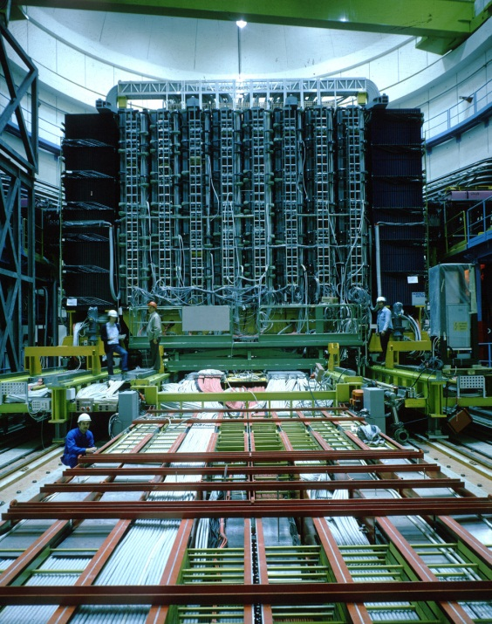
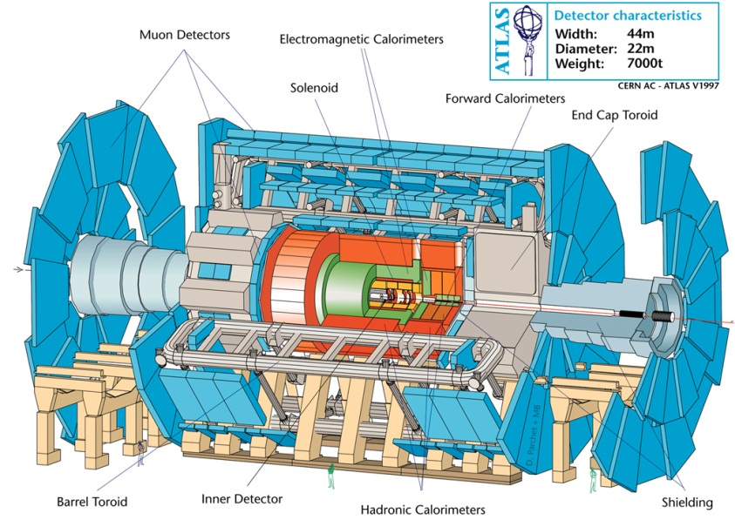
Particle Physics at the CERN LHC
ATLAS at LHC, 2006-2020
150*10⁶ sensors
UA1 at CERN 1981-1989
"hermetic detector"
LHC experimental collaborations (e.g. ATLAS) typically involve over 100 institutes and over 1000 physicists world wide

Slide 12
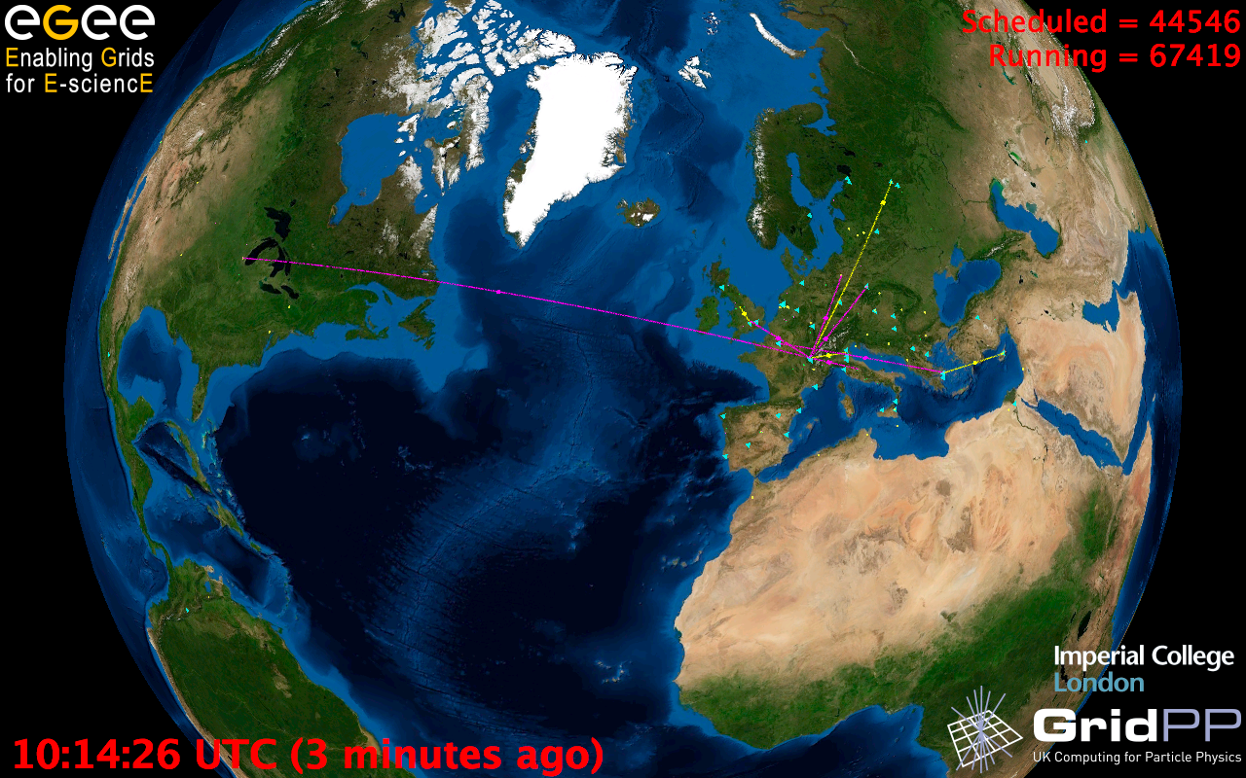
European Grid Infrastructure
Status April 2010 (yearly increase)
10000 users: +5%
243020 LCPUs (cores): +75%
40PB disk: +60%
61PB tape: +56%
15 million jobs/month: +10%
317 sites: +18%
52 countries: +8%
175 VOs: +8%
29 active VOs: +32%

Slide 13
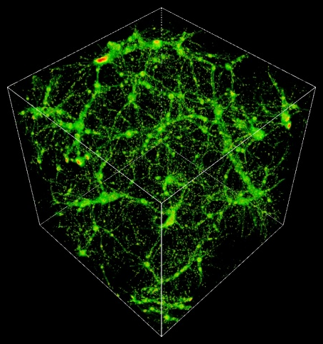
TeraGrid Example: Astrophysics
Science: MHD and star formation; cosmology at galactic scales (6-1500 Mpc) with various components: star formation, radiation diffusion, dark matter
Application: Enzo (loosely similar to: GASOLINE, etc.)
Science Users: Norman, Kritsuk (UCSD), Cen, Ostriker, Wise (Princeton), Abel (Stanford), Burns (Colorado), Bryan (Columbia), O’Shea (Michigan State), Kentucky, Germany, UK, Denmark, etc.
Notes:
The StarGate demo at SC09 combined steps 5 and 6, using 10 Gbps ESnet connection and 10 Gbps Dynamic Circuit Network (DCN) – 150 TB was moved from NICS to ANL for rendering on GPU cluster, results were streamed to OptiPortal at SC – our network tradeoffs include similar options.
The full simulation takes 3 months real time at NICS, moving data to ANL takes 3 nights – moving the data is practical, if it can be made simple and reliable.
http://www.lbl.gov/cs/Archive/news112009.html

Slide 14

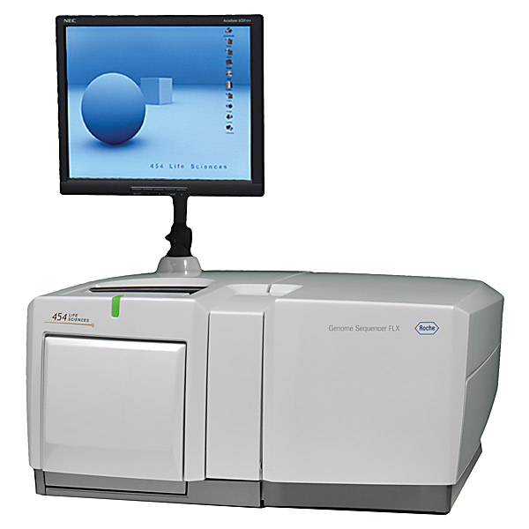
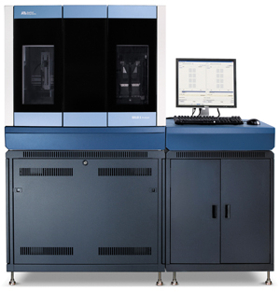
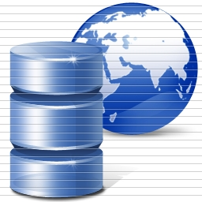
DNA Sequencing Pipeline
Illumina/Solexa Roche/454 Life Sciences Applied Biosystems/SOLiD
Internet
~300 million base pairs per day leading to
~3000 sequences per day per instrument
? 500 instruments at ~0.5M$ each
Read Alignment
Pairwise
clustering
Form block
Pairings
Sequence
alignment
Dissimilarity
Matrix
N(N-1)/2 values
Visualization
Plotviz
FASTA File
N Sequences
Blocking
MPI
MDS
MapReduce

Slide 15
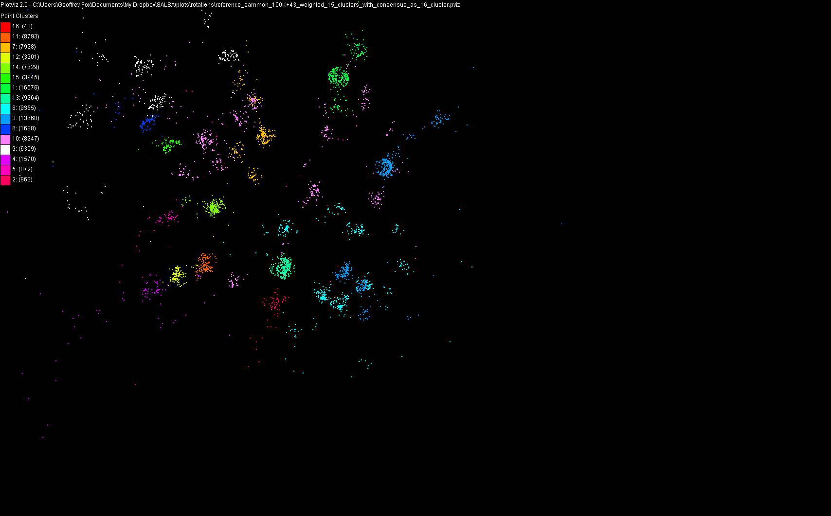
100,043 Metagenomics Sequences

Slide 16
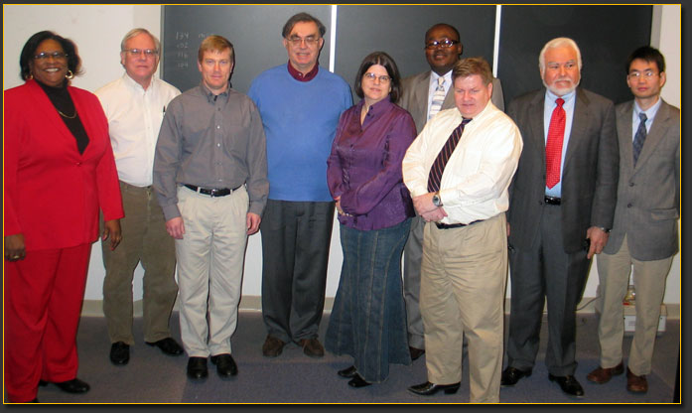
ECSU Cyberinfrastructure Day
Linda Hayden

Slide 17
Lightweight Cyberinfrastructure to support mobile Data gathering expeditions plus classic central resources (as a cloud)
See talk by Je’aime Powell ECSU

Slide 18
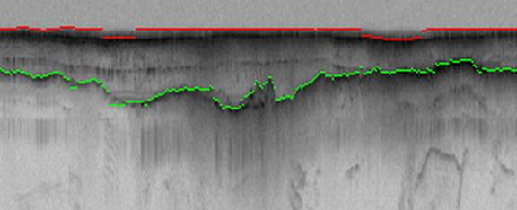
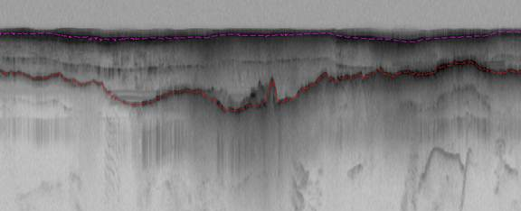
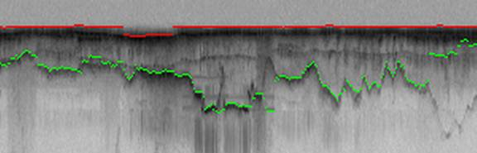
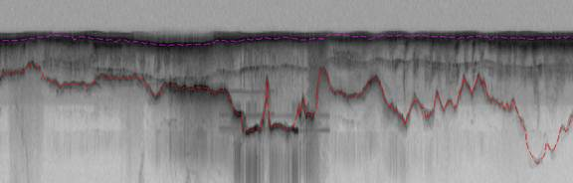
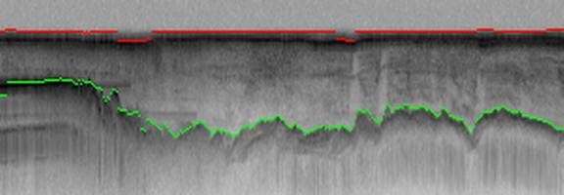
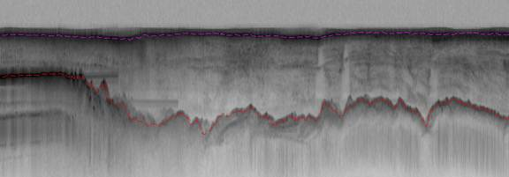
Hidden Markov Method based Layer Finding
P. Felzenszwalb, O. Veksler, Tiered Scene Labeling with Dynamic Programming, IEEE Conference on Computer Vision and Pattern Recognition (CVPR), 2010

Slide 19
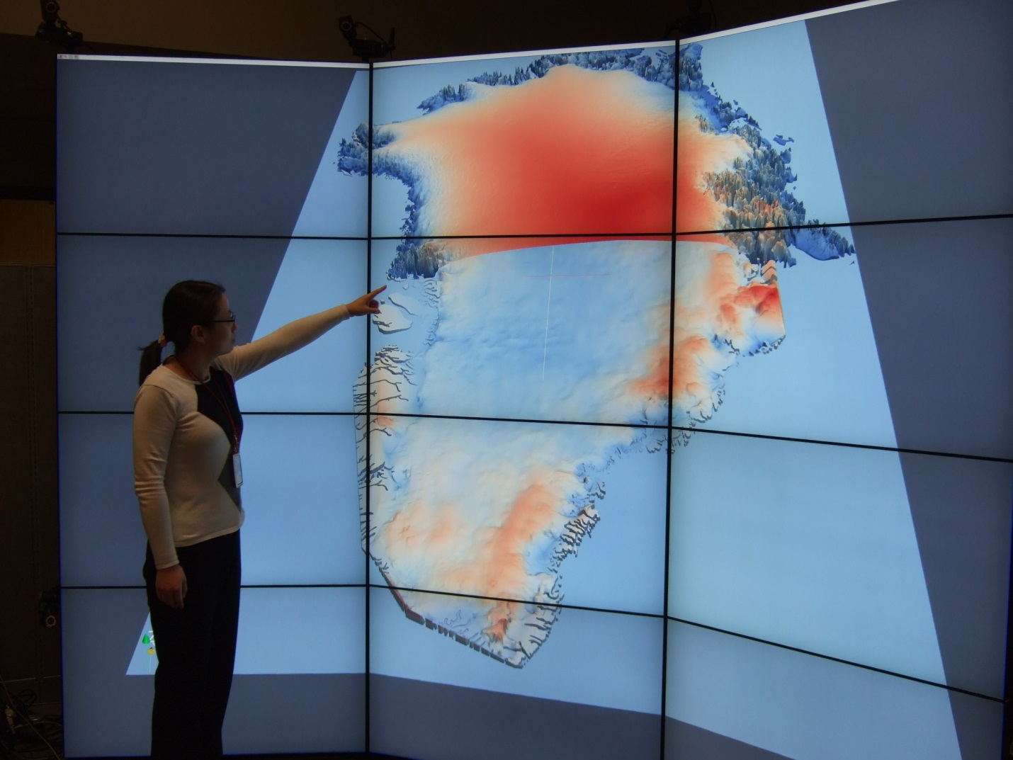
Use of Tiled Screens

Slide 20
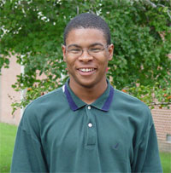
Jerome Mitchell: Undergraduate ECSU, Masters Kansas, PhD Indiana
ADMI Cloudy View on Computing
Workshop
Summer 2011

Slide 21



Data Centers Clouds &
Economies of Scale I
Range in size from “edge” facilities to megascale.
Economies of scale
  Approximate costs for a small size center (1K servers) and a larger, 50K server center.
2 Google warehouses of computers on the banks of the Columbia River, in The Dalles, Oregon
Such centers use 20MW-200MW
(Future) each with 150 watts per CPU
Save money from large size, positioning with cheap power and access with Internet
Technology | Cost in small-sized Data Center | Cost in Large Data Center | Ratio
Network | $95 per Mbps/ month | $13 per Mbps/ month | 7.1
Storage | $2.20 per GB/ month | $0.40 per GB/ month | 5.7
Administration | ~140 servers/ Administrator | >1000 Servers/ Administrator | 7.1
Each data center is
11.5 times
the size of a football field

Slide 22


Data Centers, Clouds
& Economies of Scale II
Builds giant data centers with 100,000’s of computers;
~ 200-1000 to a shipping container with Internet access
“Microsoft will cram between 150 and 220 shipping containers filled with data center gear into a new 500,000 square foot Chicago facility. This move marks the most significant, public use of the shipping container systems popularized by the likes of Sun Microsystems and Rackable Systems to date.”

Slide 23
















X as a Service
SaaS: Software as a Service imply software capabilities
(programs) have a service (messaging) interface
  Applying systematically reduces system complexity to being linear in number of components
  Access via messaging rather than by installing in /usr/bin
IaaS: Infrastructure as a Service or HaaS: Hardware as a Service – get your computer time with a credit card and with a Web interface
PaaS: Platform as a Service is IaaS plus core software capabilities on which you build SaaS
Cyberinfrastructure is “Research as a Service”
Other Services
Clients

Slide 24








Sensors as a Service
Cell phones are important sensor
Sensors as a Service
Sensor Processing as a Service (MapReduce)

Slide 25
Clouds and Jobs
Clouds are a major industry thrust with a growing fraction of IT expenditure that IDC estimates will grow to $44.2 billion direct investment in 2013 while 15% of IT investment in 2011 will be related to cloud systems with a 30% growth in public sector.
Gartner also rates cloud computing high on list of critical emerging technologies with for example “Cloud Computing” and “Cloud Web Platforms” rated as transformational (their highest rating for impact) in the next 2-5 years.
Correspondingly there is and will continue to be major opportunities for new jobs in cloud computing with a recent European study estimating there will be 2.4 million new cloud computing jobs in Europe alone by 2015.
Cloud computing is an attractive for projects focusing on workforce development. Note that the recently signed “America Competes Act” calls out the importance of economic development in broader impact of NSF projects

Slide 26
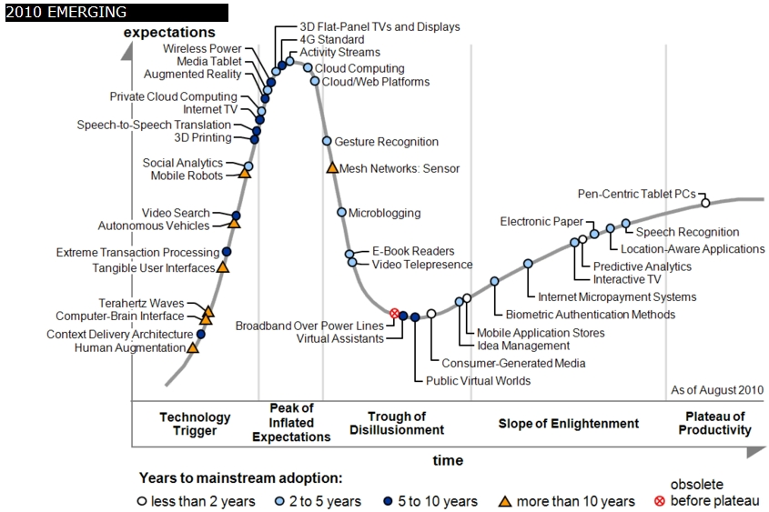
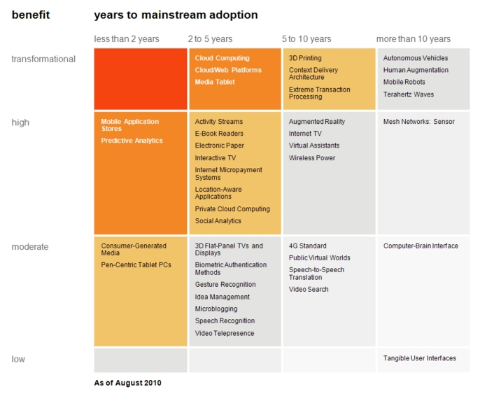

Transformational
High
Moderate
Low
Gartner 2009 Hype Curve
Clouds, Web2.0
Service Oriented Architectures
Cloud Computing
Cloud Web Platforms
Media Tablet

Slide 27
Workshop Details
Who:
  > 10-12 Association of Computer/Information Sciences and Engineering Departments at Minority Institutions (ADMI) faculty/students
Where:
  Elizabeth City State University (ECSU)
When:
  June 7 - July 5 2011
What:
  A Teach - One - Teach - Many approach to cloud computing
    Preliminary discussion on workshop at ADMI 2011 Conference (April 14-16, 2011)

Slide 28
Workshop Purpose
Introduce ADMI to the basics of the emerging Cloud Computing paradigm
  Learn how it came about
  Understand its enabling technologies
  Understand the computer systems constraints, tradeoffs, and techniques of setting up and using cloud
Teach ADMI how to implement algorithms in the Cloud
  Gain competence in cloud programming models for distributed processing of large datasets.
  Understand how different algorithms can be implemented and executed on cloud frameworks
  Evaluating the performance and identifying bottlenecks when mapping applications to the clouds

Slide 29
Exploit electronic infrastructure to enhance learning
Several quite old approaches are critical and dominant
  “Just a bunch of web pages” aka digital library
  Video conferencing
  Shared material as in Webex, Adobe Connect
Note asynchronous interaction via Twitter, Blackboard, Google docs etc. much easier (and successful) than synchronous (Polycom, access grid, Webex) approaches
Interactive web learning environments such as www.whyville.net
Virtual worlds such as Second Life have not taken off but some think this will change as performance of clients and networks are improving dramatically (VRML failed ~1999)
Must move to an environment consistent with world view of current students aka the “Twitter University”

Slide 30
Some Indiana Next Steps
Develop Appliances (Virtual machine based preconfigured computer systems) to support programming laboratories
Offer Cloud Computing course with
  Web portal support
  FutureGrid or Appliances locally
  Distance delivery
Deliver first to ECSU, then other ADMI Schools

Slide 31
US Cyberinfrastructure Context
There are a rich set of facilities
  Production TeraGrid facilities with distributed and shared memory
  Experimental “Track 2D” Awards
    FutureGrid: Distributed Systems experiments cf. Grid5000
    Keeneland: Powerful GPU Cluster
    Gordon: Large (distributed) Shared memory system with SSD aimed at data analysis/visualization
  Open Science Grid aimed at High Throughput computing and strong campus bridging
Talk by Jim Ferguson

Slide 32
FutureGrid key Concepts I
FutureGrid is a 4 year $15M project with 7 clusters at 5 sites across country with 8 funded partners
FutureGrid is a flexible testbed supporting Computer Science and Computational Science experiments in
  Innovation and scientific understanding of distributed computing (cloud, grid) and parallel computing paradigms
  The engineering science of middleware that enables these paradigms
  The use and drivers of these paradigms by important applications
  The education of a new generation of students and workforce on the use of these paradigms and their applications
  interoperability, functionality, performance or evaluation

Slide 33

FutureGrid key Concepts II
Rather than loading images onto VM’s, FutureGrid supports Cloud, Grid and Parallel computing environments by dynamically provisioning software as needed onto “bare-metal”
  Image library for MPI, OpenMP, Hadoop, Dryad, gLite, Unicore, Globus, Xen, ScaleMP (distributed Shared Memory), Nimbus, Eucalyptus, OpenNebula, KVM, Windows …..
Growth comes from users depositing novel images in library
Each use of FutureGrid is an experiment that is reproducible
Developing novel software to support these goals which build on Grid5000 in France
Image1
Image2
…
ImageN
Choose
Load
Run

Slide 34
FutureGrid Partners
Indiana University (Architecture, core software, Support)
Purdue University (HTC Hardware)
San Diego Supercomputer Center at University of California San Diego (INCA, Monitoring)
University of Chicago/Argonne National Labs (Nimbus)
University of Florida (ViNE, Education and Outreach)
University of Southern California Information Sciences (Pegasus to manage experiments)
University of Tennessee Knoxville (Benchmarking)
University of Texas at Austin/Texas Advanced Computing Center (Portal)
University of Virginia (OGF, Advisory Board and allocation)
Center for Information Services and GWT-TUD from Technische Universtität Dresden. (VAMPIR)
Red institutions have FutureGrid hardware

Slide 35

FutureGrid: a Grid/Cloud/HPC Testbed
NID: Network Impairment Device
Private
Public
FG Network

Slide 36
5 Use Types for FutureGrid
Training Education and Outreach
  Semester and short events; promising for outreach
Interoperability test-beds
  Grids and Clouds; OGF really needed this
Domain Science applications
  Life science highlighted
Computer science
  Largest current category
Computer Systems Evaluation
  TeraGrid (TIS, TAS, XSEDE), OSG, EGI

Slide 37
Education & Outreach on FutureGrid
Build up tutorials on supported software
Support development of curricula requiring privileges and systems destruction capabilities that are hard on conventional TeraGrid
Offer suite of appliances (customized VM based images) supporting online laboratories
Supporting several workshops including Virtual Summer School on “Big Data” July 26-30 2010; TeraGrid ‘10 “Cloud technologies, data-intensive science and the TG” August 2010; CloudCom conference tutorials Nov 30-Dec 3 2010
Experimental class use at Indiana, Florida and LSU
ADMI Summer 2011 School on Clouds and REU program for Minority Serving Institutions

