Slide 1
The High Performance Computing enhanced Apache Big Data Stack and Big Data Ogres
(Convergence Diamonds)
Workshop on Big Data and Data Science
Daresbury Laboratory (Hartree Centre)
May 4, 2017
gcf@indiana.edu
http://www.dsc.soic.indiana.edu/, http://spidal.org/ http://hpc-abds.org/kaleidoscope/
Department of Intelligent Systems Engineering
School of Informatics and Computing, Digital Science Center
Indiana University Bloomington

Slide 2
Abstract
The Ogres are a way of analyzing the ecosystem of two prominent paradigms for data-intensive applications – for both High Performance Computing and the Apache-Hadoop paradigm.
They provide a means of understanding and characterizing the most common application workloads found across the two paradigms.
HPC-ABDS, the High Performance Computing (HPC) enhanced Apache Big Data Stack (ABDS) uses the major open source Big Data software environment but develops the principles allowing use of HPC software and hardware to achieve good performance.

Slide 3
Underlying HPC Big Data Convergence Issues

Slide 4
Data and Model in Big Data and Simulations I
Need to discuss Data and Model as problems have both intermingled, but we can get insight by separating which allows better understanding of Big Data - Big Simulation “convergence” (or differences!)
The Model is a user construction and it has a “concept”, parameters and gives results determined by the computation. We use term “model” in a general fashion to cover all of these.
Big Data problems can be broken up into Data and Model
  For clustering, the model parameters are cluster centers while the data is set of points to be clustered
  For queries, the model is structure of database and results of this query while the data is whole database queried and SQL query
  For deep learning with ImageNet, the model is chosen network with model parameters as the network link weights. The data is set of images used for training or classification

Slide 5
Data and Model in Big Data and Simulations II
Simulations can also be considered as Data plus Model
  Model can be formulation with particle dynamics or partial differential equations defined by parameters such as particle positions and discretized velocity, pressure, density values
  Data could be small when just boundary conditions
  Data large with data assimilation (weather forecasting) or when data visualizations are produced by simulation
Big Data implies Data is large but Model varies in size
  e.g. LDA with many topics or deep learning has a large model
  Clustering or Dimension reduction can be quite small in model size
Data often static between iterations (unless streaming); Model parameters vary between iterations
Data and Model Parameters are often confused in papers as term data used to describe the parameters of models.

Slide 6
HPC and/or Cloud 1.0 2.0 3.0
Cloud 1.0: IaaS PaaS
Cloud 2.0: DevOps
Cloud 3.0: Amin Vahdat from Google; Insight (Solution) as a Service from IBM; serverless computing
HPC 1.0 and Cloud 1.0 separate ecosystems
HPCCloud or HPC-ABDS: Take performance of HPC and functionality of Cloud (Big Data) systems
HPCCloud 2.0 Use DevOps to invoke HPC or Cloud software on VM, Docker, HPC infrastructure
HPCCloud 3.0 Automate Solution as a Service using HPC-ABDS on “correct” infrastructure

Slide 7
Why Connect (“Converge”) Big Data and HPC
Two major trends in computing systems are
  Growth in high performance computing (HPC) with an international exascale initiative (China in the lead)
  Big data phenomenon with an accompanying cloud infrastructure of well publicized dramatic and increasing size and sophistication.
Note “Big Data” largely an industry initiative although software used is often open source
  So HPC labels overlaps with “research” e.g. HPC community largely responsible for Astronomy and Accelerator (LHC, Belle, BEPC ..) data analysis
Merge HPC and Big Data to get
  More efficient sharing of large scale resources running simulations and data analytics as HPCCloud 3.0
  Higher performance Big Data algorithms
  Richer software environment for research community building on many big data tools
  Easier sustainability model for HPC – HPC does not have resources to build and maintain a full software stack

Slide 8
Some Points to Make I
People ask me what is a cloud?
  Clouds are gradually having all possible capabilities (GPU, fast networks, KNL, FPGA)
  So all but largest supercomputing runs can be done on clouds
Interesting to distinguish 3 system deployments
  Pleasingly parallel: Master-worker: Big Data and Simulations
    Grid computing, long tail of science, was 20% in 1988- now much more
  Intermediate size (virtual) clusters of synchronized nodes run as pleasingly parallel parts of a large machine: Big Data and Simulations
    Capacity computing, Deep Learning
  Giant (exascale) cluster of synchronized nodes: Only simulations
Parallel Computing Technology like MPI aimed at synchronized nodes
“Define” MPI as fastest, lowest latency communication mechanism.
  Distinct from “MPI Programming model”
Grid computing technology and MapReduce aimed at pleasingly parallel or essentially unsynchronized computing

Slide 9
Some Points to Make II
Need to distinguish data intensive requirements
  Independent Event-based processing (present at start of most scientific data analysis)
    Pleasingly Parallel with often Local Machine Learning
  Database or data management functions
    MapReduce style
  Modest scale parallelism as in deep learning on modest cluster of GPU’s (64)
    Traditional small GPU Cluster <~ 16 nodes
  Large but not exascale scale parallelism with strong synchronization as in clustering of whole dataset (?10,000 cores)
    Traditional intermediate size HPC Cluster ~1024 nodes
    Global Machine Learning
There are issues like workflow in common across science, commercial, simulations, big data, clouds, HPC
Growing interest in use of public clouds in USA Universities
Must have Cloud or HPC Cloud interoperability with local resources (often an HPC or HTC Cluster)

Slide 10
Local and Global Machine Learning
Many applications use LML or Local machine Learning where machine learning (often from R or Python or Matlab) is run separately on every data item such as on every image
But others are GML Global Machine Learning where machine learning is a basic algorithm run over all data items (over all nodes in computer)
  maximum likelihood or χ² with a sum over the N data items – documents, sequences, items to be sold, images etc. and often links (point-pairs).
  GML includes Graph analytics, clustering/community detection, mixture models, topic determination, Multidimensional scaling, (Deep) Learning Networks
Note Facebook may need lots of small graphs (one per person and ~LML) rather than one giant graph of connected people (GML)

Slide 11
(IU) Contributions
Can classify applications from a uniform point of view and understand similarities and differences between simulation and data intensive applications
Can parallelize with high efficiency all data analytics remember “Parallel Computing Works” (on all large problems)
In spite of many arguments, Big data technology like Spark, Flink, Hadoop, Storm, Heron are not designed to support parallel computing well and tend to get poor performance on those jobs needing tight task synchronization and/or use high performance hardware
  They are nearer grid computing!
  Huge success of unmodified Apache software says not so much classic parallel computing in commercial workloads; confirmed by success of clouds that typically have major overheads on parallel jobs
One can add HPC and parallel computing to these Apache systems at some cost in fault tolerance and ease of use
  HPC-ABDS is HPC Apache Big Data Stack Integration
  Similarly can make Java run with performance similar to C.
Leads to HPC- Big Data Convergence

Slide 12
Convergence Points (Nexus) for
HPC-Cloud-Big Data-Simulation
Nexus 1: Applications – Divide use cases into Data and Model and compare characteristics separately in these two components with 64 Convergence Diamonds (features)
Nexus 2: Software – High Performance Computing (HPC) Enhanced Big Data Stack HPC-ABDS. 21 Layers adding high performance runtime to Apache systems (Hadoop is fast!). Establish principles to get good performance from Java or C programming languages
Nexus 3: Hardware – Use Infrastructure as a Service IaaS and DevOps (HPCCloud 2.0) to automate deployment of software defined systems on hardware designed for functionality and performance e.g. appropriate disks, interconnect, memory
Deliver Solutions (wisdom) as a Service HPCCloud 3.0

Slide 13





NSF 1443054: CIF21 DIBBs: Middleware and High Performance Analytics Libraries for Scalable Data Science
Software: MIDAS
HPC-ABDS
Big Data
Use Cases February 2017

Slide 14
Application Nexus of HPC, Big Data, Simulation Convergence
Use-case Data and Model
NIST Collection
Big Data Ogres
Convergence Diamonds
2nd NIST Big Data Workshop (more detail will be forthcoming) [June 1 and 2, 2017, Gaithersburg, Maryland] https://bigdatawg.nist.gov/

Slide 16

Original Use Case Template
26 fields completed for 51 areas
Government Operation: 4
Commercial: 8
Defense: 3
Healthcare and Life Sciences: 10
Deep Learning and Social Media: 6
The Ecosystem for Research: 4
Astronomy and Physics: 5
Earth, Environmental and Polar Science: 10
Energy: 1

Slide 17
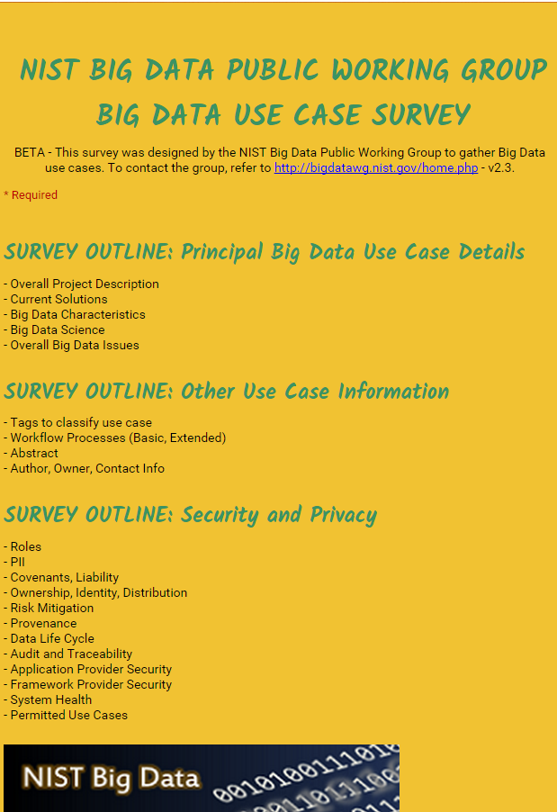
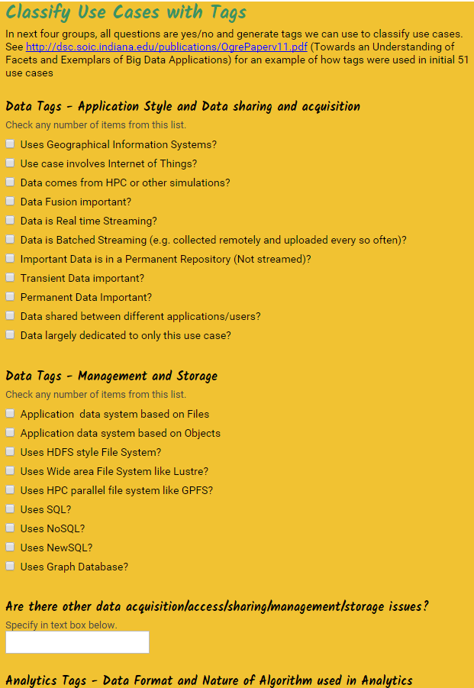
http://hpc-abds.org/kaleidoscope/survey/
Online Use Case Survey with Google Forms
Offline: PDF forms

Slide 18
51 Detailed Use Cases: Contributed July-September 2013
Covers goals, data features such as 3 V’s, software, hardware
Government Operation(4): National Archives and Records Administration, Census Bureau
Commercial(8): Finance in Cloud, Cloud Backup, Mendeley (Citations), Netflix, Web Search, Digital Materials, Cargo shipping (as in UPS)
Defense(3): Sensors, Image surveillance, Situation Assessment
Healthcare and Life Sciences(10): Medical records, Graph and Probabilistic analysis, Pathology, Bioimaging, Genomics, Epidemiology, People Activity models, Biodiversity
Deep Learning and Social Media(6): Driving Car, Geolocate images/cameras, Twitter, Crowd Sourcing, Network Science, NIST benchmark datasets
The Ecosystem for Research(4): Metadata, Collaboration, Language Translation, Light source experiments
Astronomy and Physics(5): Sky Surveys including comparison to simulation, Large Hadron Collider at CERN, Belle Accelerator II in Japan
Earth, Environmental and Polar Science(10): Radar Scattering in Atmosphere, Earthquake, Ocean, Earth Observation, Ice sheet Radar scattering, Earth radar mapping, Climate simulation datasets, Atmospheric turbulence identification, Subsurface Biogeochemistry (microbes to watersheds), AmeriFlux and FLUXNET gas sensors
Energy(1): Smart grid
Published by NIST as http://nvlpubs.nist.gov/nistpubs/SpecialPublications/NIST.SP.1500-3.pdf with common set of 26 features recorded for each use-case; “Version 2” being prepared
26 Features for each use case Biased to science

Slide 19

Part of Property Summary Table

Slide 20
51 Use Cases: What is Parallelism Over?
People: either the users (but see below) or subjects of application and often both
Decision makers like researchers or doctors (users of application)
Items such as Images, EMR, Sequences below; observations or contents of online store
  Images or “Electronic Information nuggets”
  EMR: Electronic Medical Records (often similar to people parallelism)
  Protein or Gene Sequences;
  Material properties, Manufactured Object specifications, etc., in custom dataset
  Modelled entities like vehicles and people
Sensors – Internet of Things
Events such as detected anomalies in telescope or credit card data or atmosphere
(Complex) Nodes in RDF Graph
Simple nodes as in a learning network
Tweets, Blogs, Documents, Web Pages, etc.
  And characters/words in them
Files or data to be backed up, moved or assigned metadata
Particles/cells/mesh points as in parallel simulations

Slide 21
Sample Features of 51 Use Cases I
PP (26) “All” Pleasingly Parallel or Map Only
MR (18) Classic MapReduce MR (add MRStat below for full count)
MRStat (7) Simple version of MR where key computations are simple reduction as found in statistical averages such as histograms and averages
MRIter (23) Iterative MapReduce or MPI (Flink, Spark, Twister)
Graph (9) Complex graph data structure needed in analysis
Fusion (11) Integrate diverse data to aid discovery/decision making; could involve sophisticated algorithms or could just be a portal
Streaming (41) Some data comes in incrementally and is processed this way
Classify (30) Classification: divide data into categories
S/Q (12) Index, Search and Query

Slide 22
Sample Features of 51 Use Cases II
CF (4) Collaborative Filtering for recommender engines
LML (36) Local Machine Learning (Independent for each parallel entity) – application could have GML as well
GML (23) Global Machine Learning: Deep Learning, Clustering, LDA, PLSI, MDS,
  Large Scale Optimizations as in Variational Bayes, MCMC, Lifted Belief Propagation, Stochastic Gradient Descent, L-BFGS, Levenberg-Marquardt . Can call EGO or Exascale Global Optimization with scalable parallel algorithm
Workflow (51) Universal
GIS (16) Geotagged data and often displayed in ESRI, Microsoft Virtual Earth, Google Earth, GeoServer etc.
HPC (5) Classic large-scale simulation of cosmos, materials, etc. generating (visualization) data
Agent (2) Simulations of models of data-defined macroscopic entities represented as agents

Slide 23
Typical Big Data Pattern 2. Perform real time analytics on data source streams and notify users when specified events occur
Specify filter
Filter Identifying Events
Fetch streamed Data
Post Selected Events
Streaming Data
Posted Data
Identified Events
Streaming Data
Streaming Data
Archive
Repository
Storm (Heron), Kafka, Hbase, Zookeeper

Slide 24
Typical Big Data Pattern 5A. Perform interactive analytics on observational scientific data
Science Analysis Code, Mahout, R, SPIDAL
Grid or Many Task Software, Hadoop, Spark, Giraph, Pig …
Data Storage: HDFS, Hbase, File Collection
Direct Transfer
Transport batch of data to primary analysis data system
Streaming Twitter data for Social Networking
Local Accumulate and initial computing
NIST examples include LHC, Remote Sensing, Astronomy and Bioinformatics
Record Scientific Data in “field”

Slide 25



6. Visualize data extracted from horizontally scalable Big Data store
Interactive Visualization
Specify Analytics
Orchestration Layer
Prepare Interactive Visualization
Mahout, R
Hadoop, Spark, Giraph, Pig …
Data Storage: HDFS, Hbase

Slide 26
Other Benchmark Sets

Slide 27
7 Computational Giants of
NRC Massive Data Analysis Report
http://www.nap.edu/catalog.php?record_id=18374 Big Data Models?
G1: Basic Statistics e.g. MRStat
G2: Generalized N-Body Problems
G3: Graph-Theoretic Computations
G4: Linear Algebraic Computations
G5: Optimizations e.g. Linear Programming
G6: Integration e.g. LDA and other GML
G7: Alignment Problems e.g. BLAST

Slide 28
HPC (Simulation) Benchmark Classics
Linpack or HPL: Parallel LU factorization
for solution of linear equations; HPCG
NPB version 1: Mainly classic HPC solver kernels
  MG: Multigrid
  CG: Conjugate Gradient
  FT: Fast Fourier Transform
  IS: Integer sort
  EP: Embarrassingly Parallel
  BT: Block Tridiagonal
  SP: Scalar Pentadiagonal
  LU: Lower-Upper symmetric Gauss Seidel
Simulation Models

Slide 29
13 Berkeley Dwarfs
Largely Models for Data or Simulation
Dense Linear Algebra
Sparse Linear Algebra
Spectral Methods
N-Body Methods
Structured Grids
Unstructured Grids
MapReduce
Combinational Logic
Graph Traversal
Dynamic Programming
Backtrack and
Branch-and-Bound
Graphical Models
Finite State Machines
First 6 of these correspond to Colella’s original. (Classic simulations)
Monte Carlo dropped.
N-body methods are a subset of Particle in Colella.
Note a little inconsistent in that MapReduce is a programming model and spectral method is a numerical method.
Need multiple facets to classify use cases!

Slide 30
Classifying Use cases

Slide 31
Classifying Use Cases
The Big Data Ogres built on a collection of 51 big data uses gathered by the NIST Public Working Group where 26 properties were gathered for each application.
This information was combined with other studies including the Berkeley dwarfs, the NAS parallel benchmarks and the Computational Giants of the NRC Massive Data Analysis Report.
The Ogre analysis led to a set of 50 features divided into four views that could be used to categorize and distinguish between applications.
The four views are Problem Architecture (Macro pattern); Execution Features (Micro patterns); Data Source and Style; and finally the Processing View or runtime features.
We generalized this approach to integrate Big Data and Simulation applications into a single classification looking separately at Data and Model with the total facets growing to 64 in number, called convergence diamonds, and split between the same 4 views.
A mapping of facets into work of the SPIDAL project has been given.

Slide 33
64 Features in 4 views for Unified Classification of Big Data and Simulation Applications
Both
Simulations
Analytics
(Model for Big Data)
(Nearly all Data)
(All Model)
(Mix of Data and Model)
(Nearly all Data+Model)

Slide 34
Convergence Diamonds and their 4 Views I
One view is the overall problem architecture or macropatterns which is naturally related to the machine architecture needed to support application.
  Unchanged from Ogres and describes properties of problem such as “Pleasing Parallel” or “Uses Collective Communication”
The execution (computational) features or micropatterns view, describes issues such as I/O versus compute rates, iterative nature and regularity of computation and the classic V’s of Big Data: defining problem size, rate of change, etc.
  Significant changes from ogres to separate Data and Model and add characteristics of Simulation models. e.g. both model and data have “V’s”; Data Volume, Model Size
  e.g. O(N²) Algorithm relevant to big data or big simulation model

Slide 35
Convergence Diamonds and their 4 Views II
The data source & style view includes facets specifying how the data is collected, stored and accessed. Has classic database characteristics
  Simulations can have facets here to describe input or output data
  Examples: Streaming, files versus objects, HDFS v. Lustre
Processing view has model (not data) facets which describe types of processing steps including nature of algorithms and kernels by model e.g. Linear Programming, Learning, Maximum Likelihood, Spectral methods, Mesh type,
  mix of Big Data Processing View and Big Simulation Processing View and includes some facets like “uses linear algebra” needed in both: has specifics of key simulation kernels and in particular includes facets seen in NAS Parallel Benchmarks and Berkeley Dwarfs
Instances of Diamonds are particular problems and a set of Diamond instances that cover enough of the facets could form a comprehensive benchmark/mini-app set
Diamonds and their instances can be atomic or composite

Slide 36
Problem Architecture View

Slide 37
Problem Architecture View (Meta or MacroPatterns)
Pleasingly Parallel – as in BLAST, Protein docking, some (bio-)imagery including Local Analytics or Machine Learning – ML or filtering pleasingly parallel, as in bio-imagery, radar images (pleasingly parallel but sophisticated local analytics)
Classic MapReduce: Search, Index and Query and Classification algorithms like collaborative filtering (G1 for MRStat in Features, G7)
Map-Collective: Iterative maps + communication dominated by “collective” operations as in reduction, broadcast, gather, scatter. Common datamining pattern
Map-Point to Point: Iterative maps + communication dominated by many small point to point messages as in graph algorithms
Map-Streaming: Describes streaming, steering and assimilation problems
Shared Memory: Some problems are asynchronous and are easier to parallelize on shared rather than distributed memory – see some graph algorithms
SPMD: Single Program Multiple Data, common parallel programming feature
BSP or Bulk Synchronous Processing: well-defined compute-communication phases
Fusion: Knowledge discovery often involves fusion of multiple methods.
Dataflow: Important application features often occurring in composite Ogres
Use Agents: as in epidemiology (swarm approaches) This is Model only
Workflow: All applications often involve orchestration (workflow) of multiple components
Most (11 of total 12) are properties of Data+Model
Notes:
Big dwarfs are Ogres
Implement Ogres in ABDS+

Slide 38
6 Forms of MapReduce
Describes Architecture of
- Problem (Model reflecting data)
- Machine
- Software
2 important variants (software) of Iterative MapReduce and Map-Streaming a) “In-place” HPC b) Flow for model and data

Slide 39
Examples in Problem Architecture View PA
The facets in the Problem architecture view include 5 very common ones describing synchronization structure of a parallel job:
  MapOnly or Pleasingly Parallel (PA1): the processing of a collection of independent events;
  MapReduce (PA2): independent calculations (maps) followed by a final consolidation via MapReduce;
  MapCollective (PA3): parallel machine learning dominated by scatter, gather, reduce and broadcast;
  MapPoint-to-Point (PA4): simulations or graph processing with many local linkages in points (nodes) of studied system.
  MapStreaming (PA5): The fifth important problem architecture is seen in recent approaches to processing real-time data.
  We do not focus on pure shared memory architectures PA6 but look at hybrid architectures with clusters of multicore nodes and find important performances issues dependent on the node programming model.
Most of our codes are SPMD (PA-7) and BSP (PA-8).

Slide 40
Relation of Problem and Machine Architecture
Problem is Model plus Data
In my old papers (especially book Parallel Computing Works!), I discussed computing as multiple complex systems mapped into each other
Problem → Numerical formulation → Software → Hardware
Each of these 4 systems has an architecture that can be described in similar language
One gets an easy programming model if architecture of problem matches that of Software
One gets good performance if architecture of hardware matches that of software and problem
So “MapReduce” can be used as architecture of software (programming model) or “Numerical formulation of problem”

Slide 41
Processing View

Slide 42
Diamond Facets in Processing (runtime) View I used in Big Data and Big Simulation
Pr-1M Micro-benchmarks ogres that exercise simple features of hardware such as communication, disk I/O, CPU, memory performance
Pr-2M Local Analytics executed on a single core or perhaps node
Pr-3M Global Analytics requiring iterative programming models (G5,G6) across multiple nodes of a parallel system
Pr-12M Uses Linear Algebra common in Big Data and simulations
  Subclasses like Full Matrix
  Conjugate Gradient, Krylov, Arnoldi iterative subspace methods
  Structured and unstructured sparse matrix methods
Pr-13M Graph Algorithms (G3) Clear important class of algorithms -- as opposed to vector, grid, bag of words etc. – often hard especially in parallel
Pr-14M Visualization is key application capability for big data and simulations
Pr-15M Core Libraries Functions of general value such as Sorting, Math functions, Hashing
Notes:
Big dwarfs are Ogres
Implement Ogres in ABDS+

Slide 43
Diamond Facets in Processing (runtime) View II used in Big Data
Pr-4M Basic Statistics (G1): MRStat in NIST problem features
Pr-5M Recommender Engine: core to many e-commerce, media businesses; collaborative filtering key technology
Pr-6M Search/Query/Index: Classic database which is well studied (Baru, Rabl tutorial)
Pr-7M Data Classification: assigning items to categories based on many methods
  MapReduce good in Alignment, Basic statistics, S/Q/I, Recommender, Classification
Pr-8M Learning of growing importance due to Deep Learning success in speech recognition etc..
Pr-9M Optimization Methodology: overlapping categories including
  Machine Learning, Nonlinear Optimization (G6), Maximum Likelihood or χ² least squares minimizations, Expectation Maximization (often Steepest descent), Combinatorial Optimization, Linear/Quadratic Programming (G5), Dynamic Programming
Pr-10M Streaming Data or online Algorithms. Related to DDDAS (Dynamic Data-Driven Application Systems)
Pr-11M Data Alignment (G7) as in BLAST compares samples with repository
Notes:
Big dwarfs are Ogres
Implement Ogres in ABDS+

Slide 44
Diamond Facets in Processing (runtime) View III used in Big Simulation
Pr-16M Iterative PDE Solvers: Jacobi, Gauss Seidel etc.
Pr-17M Multiscale Method? Multigrid and other variable resolution approaches
Pr-18M Spectral Methods as in Fast Fourier Transform
Pr-19M N-body Methods as in Fast multipole, Barnes-Hut
Pr-20M Both Particles and Fields as in Particle in Cell method
Pr-21M Evolution of Discrete Systems as in simulation of Electrical Grids, Chips, Biological Systems, Epidemiology. Needs Ordinary Differential Equation solvers
Pr-22M Nature of Mesh if used: Structured, Unstructured, Adaptive
Covers NAS Parallel Benchmarks and Berkeley Dwarfs
Notes:
Big dwarfs are Ogres
Implement Ogres in ABDS+

Slide 45
Execution View

Slide 46
Examples in Execution View EV
The Execution view is a mix of facets describing either data or model; PA was largely the overall Data+Model
EV-M14 is Complexity of model (O(N²) for N points) seen in the non-metric space models EV-M13 such as one gets with DNA sequences.
EV-M11 describes iterative structure distinguishing Spark, Flink, and Harp from the original Hadoop.
The facet EV-M8 describes the communication structure which is a focus of our research as much data analytics relies on collective communication which is in principle understood but we find that significant new work is needed compared to basic HPC releases which tend to address point to point communication.
The model size EV-M4 and data volume EV-D4 are important in describing the algorithm performance as just like in simulation problems, the grain size (the number of model parameters held in the unit – thread or process – of parallel computing) is a critical measure of performance.

Slide 47
View for Micropatterns or Execution Features
Performance Metrics; property found by benchmarking Diamond
Flops per byte; memory or I/O
Execution Environment; Core libraries needed: matrix-matrix/vector algebra, conjugate gradient, reduction, broadcast; Cloud, HPC etc.
Volume: property of a Diamond instance: a) Data Volume and b) Model Size
Velocity: qualitative property of Diamond with value associated with instance. Only Data
Variety: important property especially of composite Diamonds; Data and Model separately
Veracity: important property of applications but not kernels;
Model Communication Structure; Interconnect requirements; Is communication BSP, Asynchronous, Pub-Sub, Collective, Point to Point?
Is Data and/or Model (graph) static or dynamic?
Much Data and/or Models consist of a set of interconnected entities; is this regular as a set of pixels or is it a complicated irregular graph?
Are Models Iterative or not?
Data Abstraction: key-value, pixel, graph(G3), vector, bags of words or items; Model can have same or different abstractions e.g. mesh points, finite element, Convolutional Network
Are data points in metric or non-metric spaces? Data and Model separately?
Is Model algorithm O(N²) or O(N) (up to logs) for N points per iteration (G2)

Slide 48
Data Source and Style View

Slide 49
Examples in Data View DV
We can highlight DV-5 streaming where there is a lot of recent progress;
DV-9 categorizes our Biomolecular simulation application with data produced by an HPC simulation
DV-10 is Geospatial Information Systems covered by our spatial algorithms.
DV-7 provenance, is an example of an important feature that we are not covering.
The data storage and access DV-3 and D-4 is covered in our pilot data work.
The Internet of Things DV-8 is not a focus of our project although our recent streaming work relates to this and our addition of HPC to Apache Heron and Storm is an example of the value of HPC-ABDS to IoT.

Slide 50
Data Source and Style View I
SQL NewSQL or NoSQL: NoSQL includes Document,
Column, Key-value, Graph, Triple store; NewSQL is SQL redone to exploit NoSQL performance
Other Enterprise data systems: 10 examples from NIST integrate SQL/NoSQL
Set of Files or Objects: as managed in iRODS and extremely common in scientific research
File systems, Object, Blob and Data-parallel (HDFS) raw storage: Separated from computing or colocated? HDFS v Lustre v. Openstack Swift v. GPFS
Archive/Batched/Streaming: Streaming is incremental update of datasets with new algorithms to achieve real-time response (G7); Before data gets to compute system, there is often an initial data gathering phase which is characterized by a block size and timing. Block size varies from month (Remote Sensing, Seismic) to day (genomic) to seconds or lower (Real time control, streaming)
  Streaming divided into categories overleaf
Notes:
Big dwarfs are Ogres
Implement Ogres in ABDS+

Slide 51
Data Source and Style View II
Streaming divided into 5 categories depending on event size and synchronization and integration
  Set of independent events where precise time sequencing unimportant.
  Time series of connected small events where time ordering important.
  Set of independent large events where each event needs parallel processing with time sequencing not critical
  Set of connected large events where each event needs parallel processing with time sequencing critical.
  Stream of connected small or large events to be integrated in a complex way.
Shared/Dedicated/Transient/Permanent: qualitative property of data; Other characteristics are needed for permanent auxiliary/comparison datasets and these could be interdisciplinary, implying nontrivial data movement/replication
Metadata/Provenance: Clear qualitative property but not for kernels as important aspect of data collection process
Internet of Things: 24 to 50 Billion devices on Internet by 2020
HPC simulations: generate major (visualization) output that often needs to be mined
Using GIS: Geographical Information Systems provide attractive access to geospatial data
Notes:
Big dwarfs are Ogres
Implement Ogres in ABDS+

Slide 52
Examples of HPC Analytics

Slide 53
Clustering and Visualization
The SPIDAL Library includes several clustering algorithms with sophisticated features
  Deterministic Annealing
  Radius cutoff in cluster membership
  Elkans algorithm using triangle inequality
They also cover two important cases
  Points are vectors – algorithm O(N) for N points
  Points not vectors – all we know is distance δ(i, j) between each pair of points i and j. algorithm O(N²) for N points
We find visualization important to judge quality of clustering
As data typically not 2D or 3D, we use dimension reduction to project data so we can then view it
Have a browser viewer WebPlotViz that replaces an older Windows system
Clustering and Dimension Reduction are modest HPC applications
Calculating distance δ(i, j) is similar compute load but pleasingly parallel
All examples require HPC but largest size used ~600 cores

Slide 54
Fungal Sequences
Input data
  ~7 million gene sequences in FASTA format.
Pre-processing
  Input data filtered to locate unique sequences that appear multiple occasions in the input data, resulting in 170K gene sequences.
  Smith–Waterman algorithm is applied to generate distance matrix for 170K gene sequences.
Clustering data with DAPWC
  Run DAPWC iteratively to produce clean clustering for the data. Initial step of DAPWC is done with 8 clusters. Resulting clusters are visualized and further clustered using DAPWC with appropriate number of clusters that are determined through visualizing in WebPlotViz.
  Resulting clusters are gathered and merged to produce the final clustering result.

Slide 55
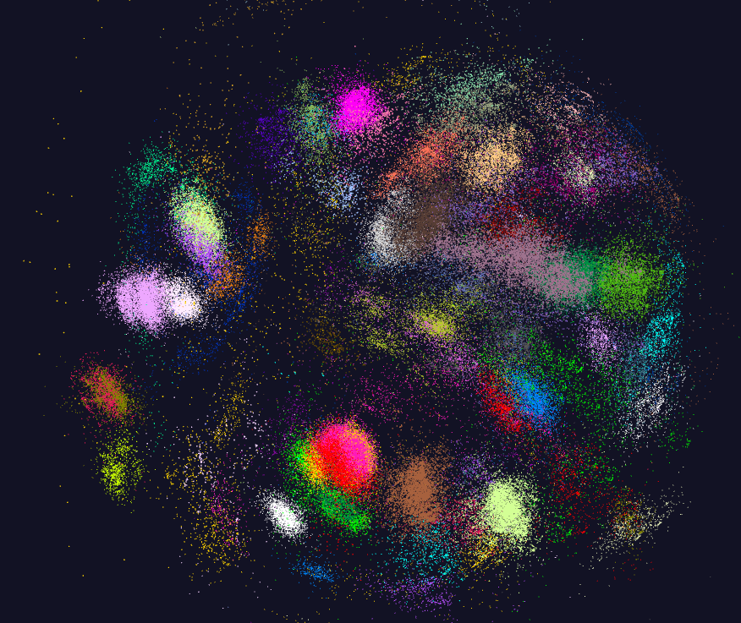
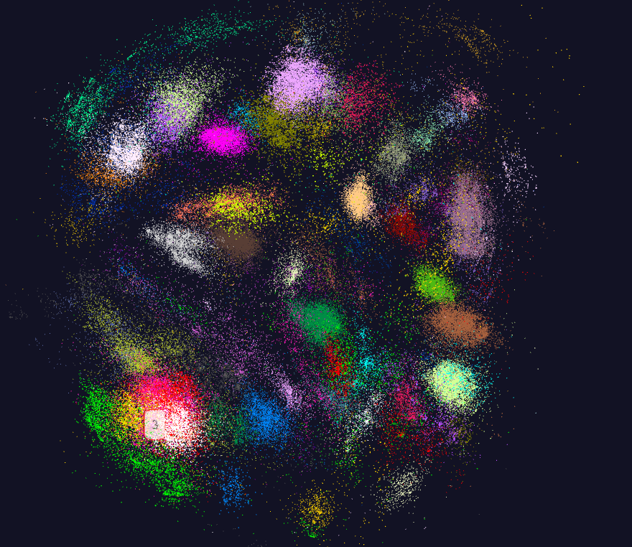
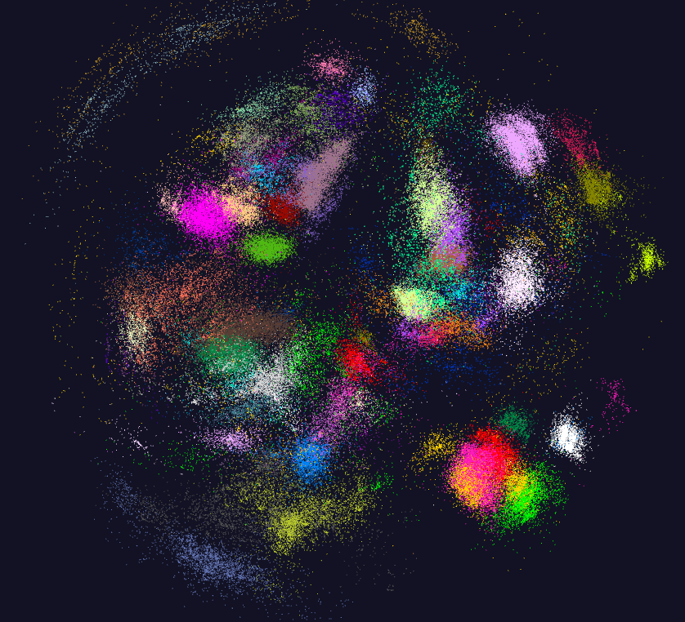
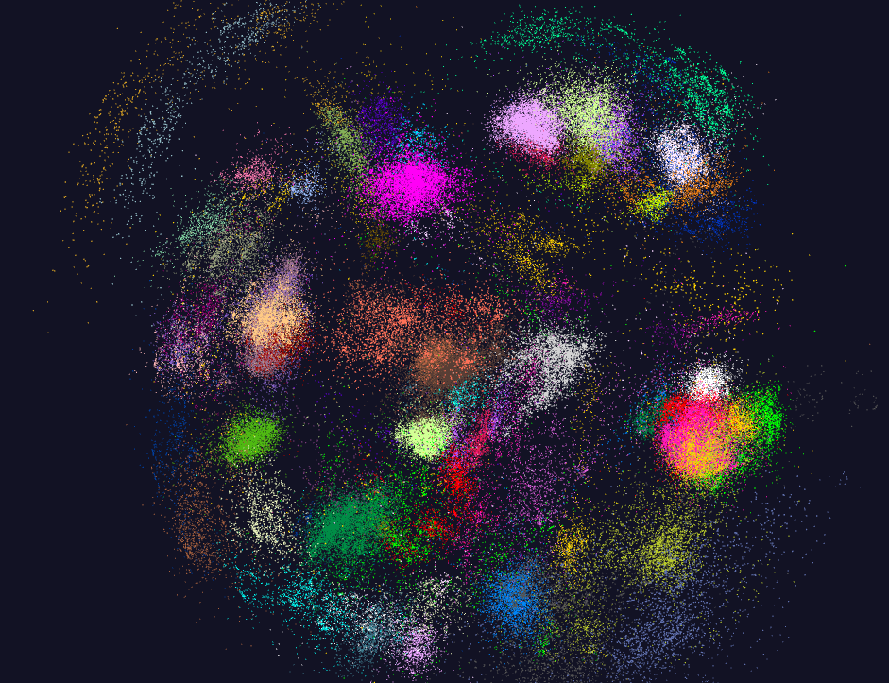
170K Fungi sequences

Slide 56
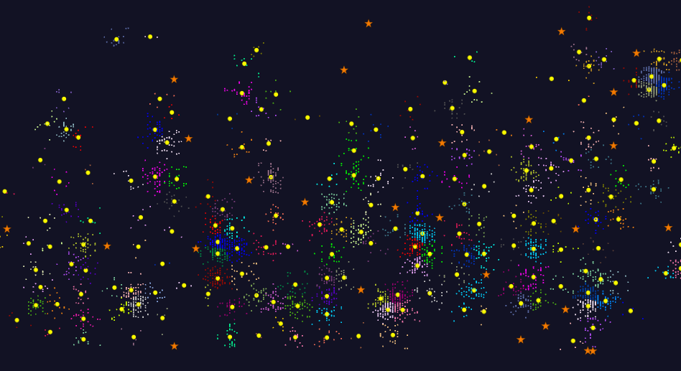
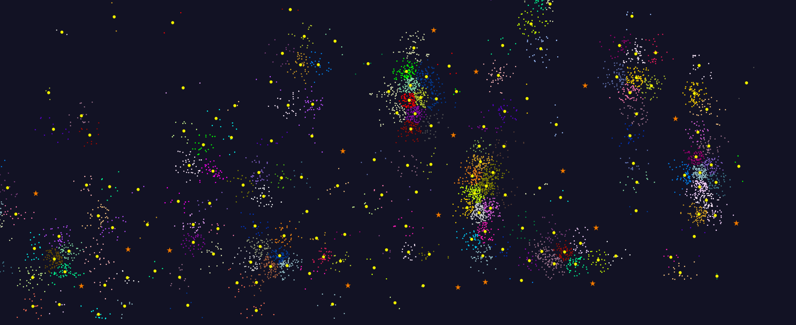
2D Vector Clustering with cutoff at 3 σ
Orange Star – outside all clusters; yellow circle cluster centers
LCMS Mass Spectrometer Peak Clustering. Charge 2 Sample with 10.9 million points and 420,000 clusters visualized in WebPlotViz

Slide 57
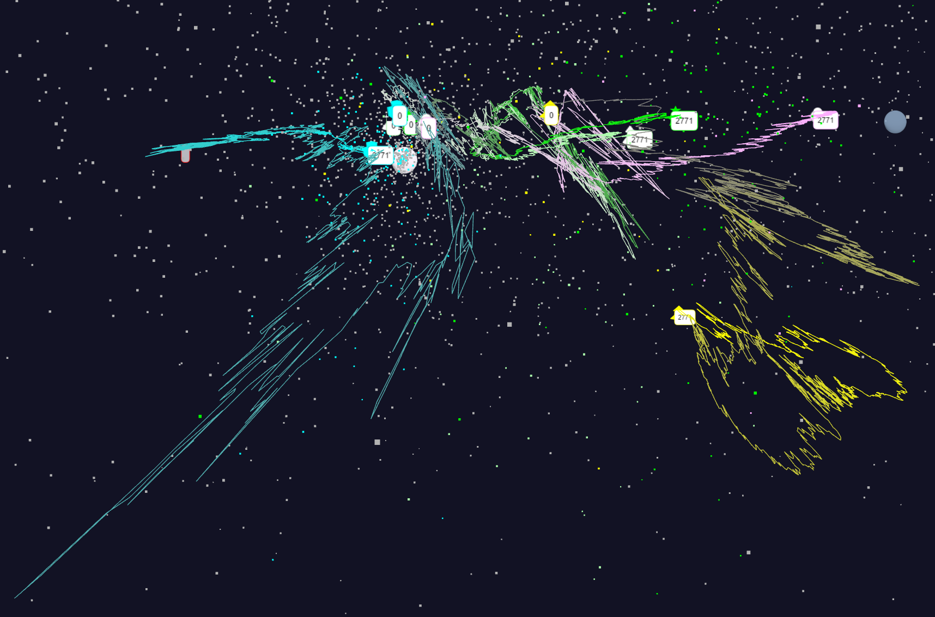
Relative Changes in Stock Values using one day values
S&P
Mid Cap
S&P
Mid Cap
Dow Jones
Dow Jones
+10%
Finance
Finance
Origin
0% change
Energy
Energy
1/20/2018
57

Slide 58
NSF 1443054: CIF21 DIBBs: Middleware and High Performance Analytics Libraries for Scalable Data Science
INSERT
Software: MIDAS
HPC-ABDS
WebPlotViz: February 2017

Slide 59
Tutorials on using SPIDAL
DAMDS, Clustering, WebPlotviz https://dsc-spidal.github.io/tutorials/
Active WebPlotViz for clustering plus DAMDS on fungi
  https://spidal-gw.dsc.soic.indiana.edu/public/resultsets/1273112137
  https://spidal-gw.dsc.soic.indiana.edu/public/groupdashboard/Anna_GeneSeq
Active WebPlotViz for 2D Proteomics https://spidal-gw.dsc.soic.indiana.edu/public/resultsets/1657429765
Active WebPlotViz for Pathology Images https://spidal-gw.dsc.soic.indiana.edu/public/resultsets/1678860580
Harp https://github.com/DSC-SPIDAL/Harp

Slide 60
NSF 1443054: CIF21 DIBBs: Middleware and High Performance Analytics Libraries for Scalable Data Science
Software: MIDAS
HPC-ABDS
HPC Cloud
Convergence
February 2017 I

Slide 61
NSF 1443054: CIF21 DIBBs: Middleware and High Performance Analytics Libraries for Scalable Data Science
Software: MIDAS
HPC-ABDS
General
HPC-ABDS
February 2017

Slide 62
Software Nexus
Application Layer On
Big Data Software Components for Programming and Data Processing On
HPC for runtime On
IaaS and DevOps Hardware and Systems

Slide 63
Big Data ABDS HPCCloud 3.0 HPC, Cluster
17. Orchestration Beam, Crunch, Tez, Cloud Dataflow Kepler, Pegasus, Taverna
16. Libraries MLlib/Mahout, TensorFlow, CNTK, R, Python ScaLAPACK, PETSc, Matlab
15A. High Level Programming Pig, Hive, Drill Domain-specific Languages
15B. Platform as a Service App Engine, BlueMix, Elastic Beanstalk XSEDE Software Stack
Languages Java, Erlang, Scala, Clojure, SQL, SPARQL, Python Fortran, C/C++, Python
14B. Streaming Storm, Kafka, Kinesis
13,14A. Parallel Runtime Hadoop, MapReduce MPI/OpenMP/OpenCL
2. Coordination Zookeeper
12. Caching Memcached
11. Data Management Hbase, Accumulo, Neo4J, MySQL iRODS
10. Data Transfer Sqoop GridFTP
9. Scheduling Yarn, Mesos Slurm
8. File Systems HDFS, Object Stores Lustre
1, 11A Formats Thrift, Protobuf FITS, HDF
5. IaaS OpenStack , Docker Linux, Bare-metal, SR-IOV
Infrastructure CLOUDS Clouds and/or HPC SUPERCOMPUTERS
HPC-ABDS Integrated
Software
CUDA, Exascale Runtime

Slide 64
HPC-ABDS

Slide 65
Functionality of 21 HPC-ABDS Layers
Message Protocols:
Distributed Coordination:
Security & Privacy:
Monitoring:
IaaS Management from HPC to hypervisors:
DevOps:
Interoperability:
File systems:
Cluster Resource Management:
Data Transport:
A) File management
B) NoSQL
C) SQL
In-memory databases & caches / Object-relational mapping / Extraction Tools
Inter process communication Collectives, point-to-point, publish-subscribe, MPI:
A) Basic Programming model and runtime, SPMD, MapReduce:
B) Streaming:
A) High level Programming:
B) Frameworks
Application and Analytics:
Workflow-Orchestration:
Lesson of large number (350). This is a rich software environment that HPC cannot “compete” with. Need to use and not regenerate
Note level 13 Inter process communication added

Slide 66
Using “Apache” (Commercial Big Data) Data Systems for Science/Simulation
Pro: Use rich functionality and usability of ABDS (Apache Big Data Stack)
Pro: Sustainability model of community open source
Con (Pro for many commercial users): Optimized for fault-tolerance and usability and not performance
Feature: Naturally run on clouds and not HPC platforms
Feature: Cloud is logically centralized, physically distributed but science data typically distributed.
Question: how do science data analysis requirements differ from those commercially e.g. recommender systems heavily used commercially
Approach: HPC-ABDS using HPC runtime and tools to enhance commercial data systems (ABDS on top of HPC)
  Upper level software: ABDS
  Lower level runtime: HPC
  HPCCloud Hardware: HPC or classic cloud dependent on application requirements

Slide 67
HPC-ABDS SPIDAL Project Activities
Green is MIDAS
Black is SPIDAL
Level 17: Orchestration: Apache Beam (Google Cloud Dataflow) integrated with Heron/Flink and Cloudmesh on HPC cluster
Level 16: Applications: Datamining for molecular dynamics, Image processing for remote sensing and pathology, graphs, streaming, bioinformatics, social media, financial informatics, text mining
Level 16: Algorithms: Generic and custom for applications SPIDAL
Level 14: Programming: Storm, Heron (Twitter replaces Storm), Hadoop, Spark, Flink. Improve Inter- and Intra-node performance; science data structures
Level 13: Runtime Communication: Enhanced Storm and Hadoop (Spark, Flink, Giraph) using HPC runtime technologies, Harp
Level 12: In-memory Database: Redis + Spark used in Pilot-Data Memory
Level 11: Data management: Hbase and MongoDB integrated via use of Beam and other Apache tools; enhance Hbase
Level 9: Cluster Management: Integrate Pilot Jobs with Yarn, Mesos, Spark, Hadoop; integrate Storm and Heron with Slurm
Level 6: DevOps: Python Cloudmesh virtual Cluster Interoperability

Slide 68
Exemplar Software for a Big Data Initiative
Functionality of ABDS and Performance of HPC
Workflow: Apache Beam, Crunch, Python or Kepler
Data Analytics: Mahout, R, ImageJ, Scalapack
High level Programming: Hive, Pig
Batch Parallel Programming model: Hadoop, Spark, Giraph, Harp, MPI;
Streaming Programming model: Storm, Kafka or RabbitMQ
In-memory: Memcached
Data Management: Hbase, MongoDB, MySQL
Distributed Coordination: Zookeeper
Cluster Management: Yarn, Slurm
File Systems: HDFS, Object store (Swift), Lustre
DevOps: Cloudmesh, Chef, Puppet, Docker, Cobbler
IaaS: Amazon, Azure, OpenStack, Docker, SR-IOV
Monitoring: Inca, Ganglia, Nagios

Slide 69
NSF 1443054: CIF21 DIBBs: Middleware and High Performance Analytics Libraries for Scalable Data Science
Software: MIDAS
HPC-ABDS
SPIDAL Java
Optimized
February 2017

Slide 70
Performance Factors
Threads
  Can threads “magically” speedup your application?
Affinity
  How to place threads/processes across cores?
  Why should we care?
Communication
  Why Inter-Process Communication (IPC) is expensive?
  How to improve?
Other factors
  Garbage collection
  Serialization/Deserialization
  Memory references and cache
  Data read/write

Slide 71
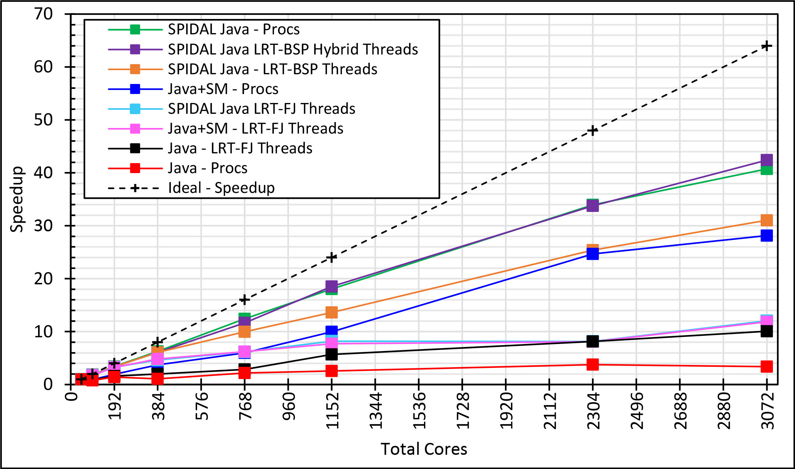
Java MPI performs better than FJ Threads
128 24 core Haswell nodes on SPIDAL 200K DA-MDS Code
Speedup compared to 1 process per node on 48 nodes
Best MPI; inter and intra node
BSP Threads are better than FJ and at best match Java MPI
MPI; inter/intra node; Java not optimized
Best FJ Threads intra node; MPI inter node

Slide 72
Investigating Process and Thread Models
Fork Join (FJ) Threads lower performance than Bulk Synchronous Parallel (BSP)
LRT is Long Running Threads
Results
  Large effects for Java
  Best affinity is process and thread binding to cores - CE
  At best LRT mimics performance of “all processes”
6 Thread/Process Affinity Models
LRT-FJ
LRT-BSP
Serial work
Non-trivial parallel work
Busy thread synchronization
Threads Affinity | Processes Affinity
 | Cores | Socket | None (All)
Inherit | CI | SI | NI
Explicit per core | CE | SE | NE

Slide 73
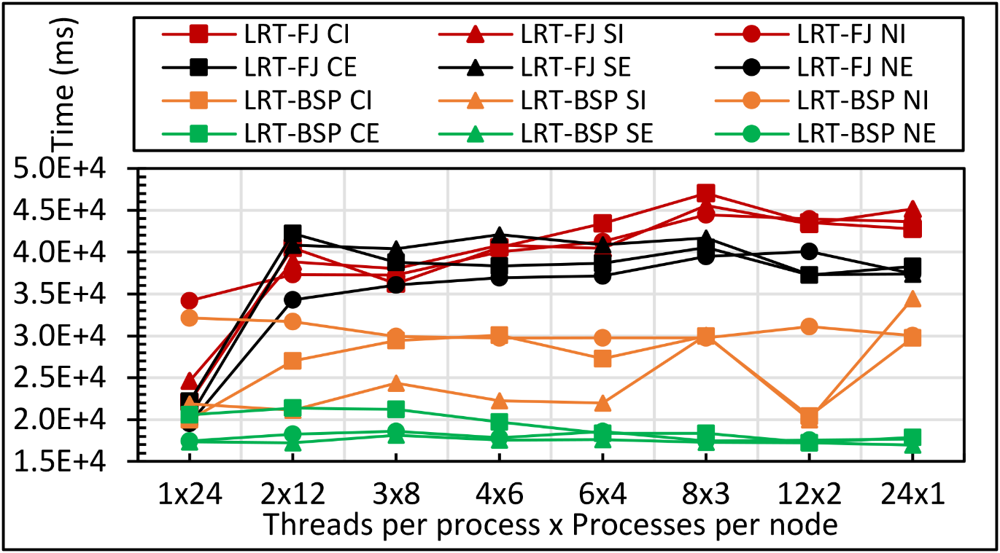
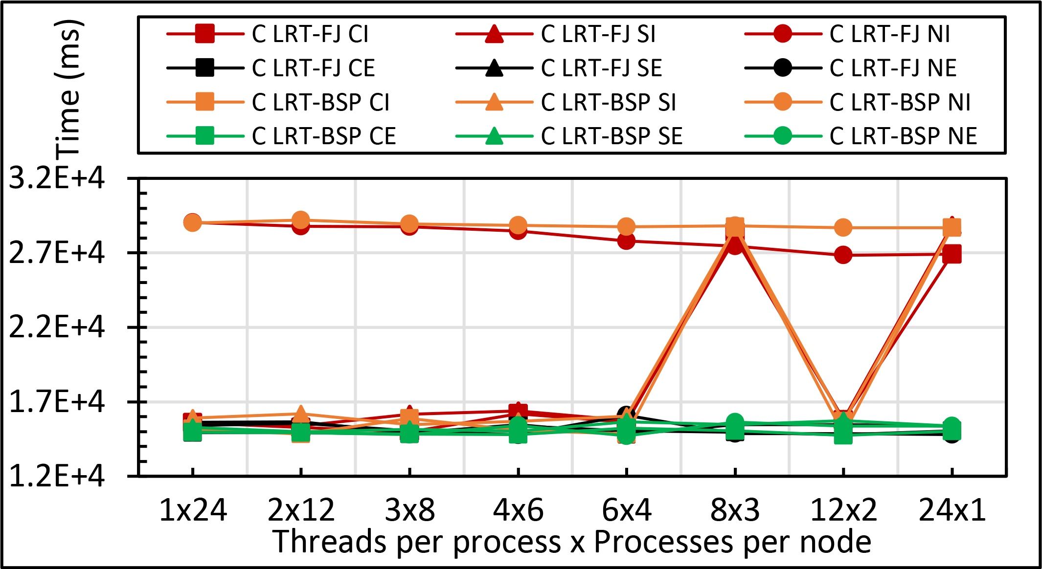
Performance
Sensitivity
Kmeans: 1 million points and 1000 centers performance on 16 24 core nodes for LRT-FJ and LRT-BSP with varying affinity patterns (6 choices) over varying threads and processes
C less sensitive than Java
All processes less sensitive than all threads
Java
C

Slide 74
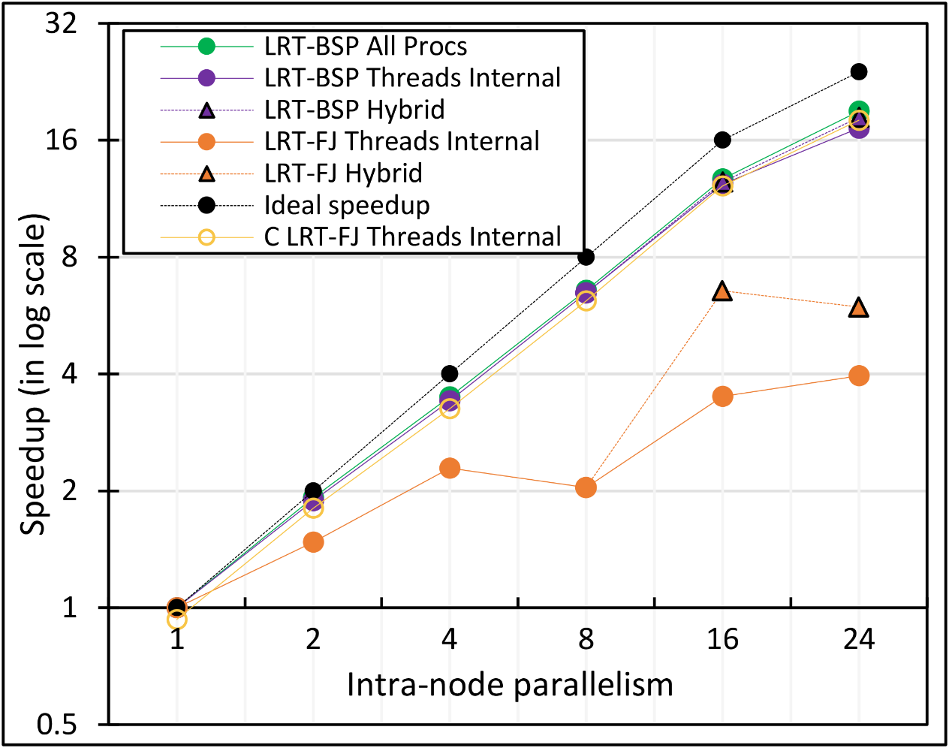
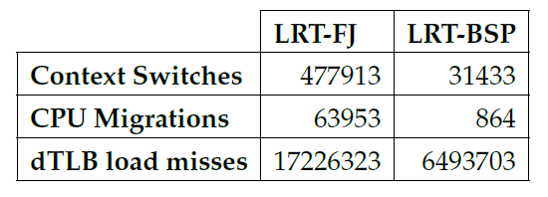
Performance Dependence on Number of Cores inside 24-core node (16 nodes total)
All MPI internode
  All Processes
LRT BSP Java
  All Threads internal to node
  Hybrid – Use one process per chip
LRT Fork Join Java
  All Threads
  Hybrid – Use one process per chip
Fork Join C
All Threads
15x
74x
2.6x

Slide 75
Java versus C Performance
C and Java Comparable with Java doing better on larger problem sizes
All data from one million point dataset with varying number of centers on 16 nodes 24 core Haswell

Slide 76
HPC-ABDS
Introduction
DataFlow and In-place Runtime

Slide 77
HPC-ABDS Parallel Computing
Both simulations and data analytics use similar parallel computing ideas
Both do decomposition of both model and data
Both tend use SPMD and often use BSP Bulk Synchronous Processing
One has computing (called maps in big data terminology) and communication/reduction (more generally collective) phases
Big data thinks of problems as multiple linked queries even when queries are small and uses dataflow model
Simulation uses dataflow for multiple linked applications but small steps such as iterations are done in place
Reduction in HPC (MPIReduce) done as optimized tree or pipelined communication between same processes that did computing
Reduction in Hadoop or Flink done as separate map and reduce processes using dataflow
  This leads to 2 forms (In-Place and Flow) of Map-X mentioned in use-case (Ogres) section
Interesting Fault Tolerance issues highlighted by Hadoop-MPI comparisons – not discussed here!

Slide 78
General Reduction in Hadoop, Spark, Flink
Map Tasks
Separate Map and Reduce Tasks
MPI only has one sets of tasks for map and reduce
MPI gets efficiency by using shared memory intra-node (of 24 cores)
MPI achieves AllReduce by interleaving multiple binary trees
Switching tasks is expensive! (see later)
Reduce Tasks
Follow by Broadcast for AllReduce which is what most iterative algorithms use
Output partitioned with Key

Slide 79

HPC Runtime versus ABDS distributed Computing Model on Data Analytics
Hadoop writes to disk and is slowest; Spark and Flink spawn many processes and do not support allreduce directly; MPI does in-place combined reduce/broadcast

Slide 80
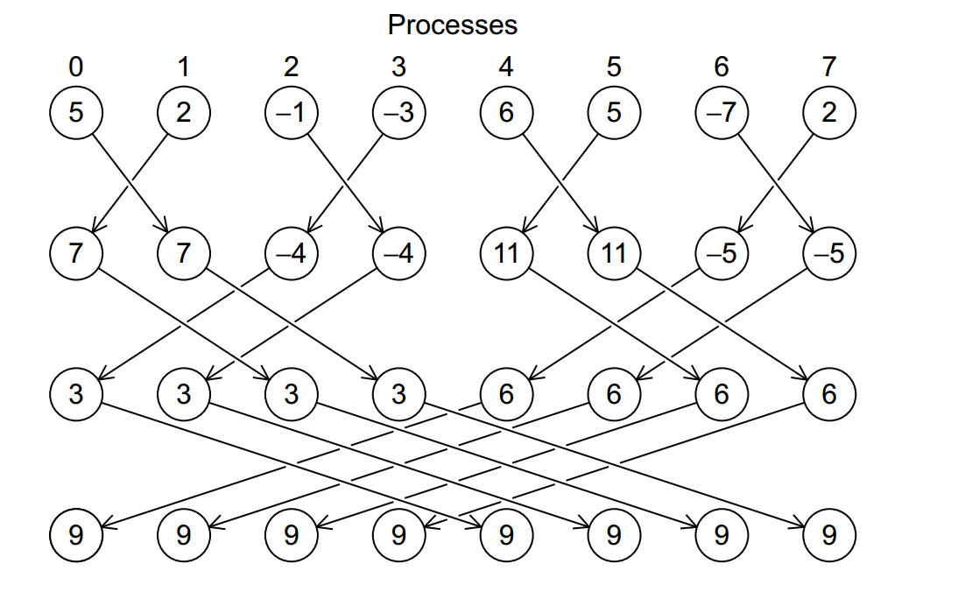
Illustration of In-Place AllReduce in MPI

Slide 81
HPC-ABDS
Spark Flink MPI Comparison

Slide 82

Flink MDS Dataflow Graph

Slide 83


MDS Results with Flink, Spark and MPI
MDS execution time on 16 nodes with 20 processes in each node with varying number of points
MDS execution time with 32000 points on varying number of nodes. Each node runs 20 parallel tasks
MDS performed poorly on Flink due to its lack of support for nested iterations. In Flink and Spark the algorithm doesn’t scale with the number of nodes.

Slide 84
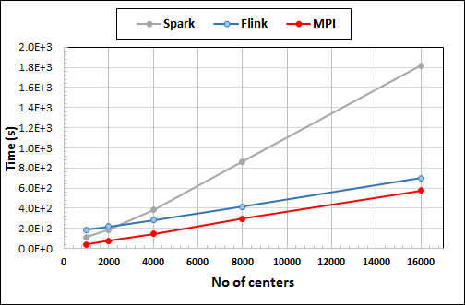
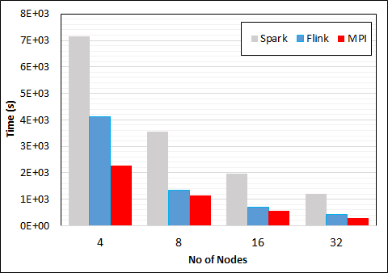
K-Means Clustering in Spark, Flink, MPI
Data Set <Points>
Dataflow for K-means
Data Set <Initial Centroids>
Map (nearest centroid calculation)
Reduce (update centroids)
Data Set <Updated Centroids>
Broadcast
K-Means execution time on 16 nodes with 20 parallel tasks in each node with 10 million points and varying number of centroids. Each point has 100 attributes.
K-Means execution time on varying number of nodes with 20 processes in each node with 10 million points and 16000 centroids. Each point has 100 attributes.
Notes:
Note the differences in communication architectures
Note times are in log scale
Bars indicate compute only times, which is similar across these frameworks
Overhead is dominated by communications in Flink and Spark

Slide 85
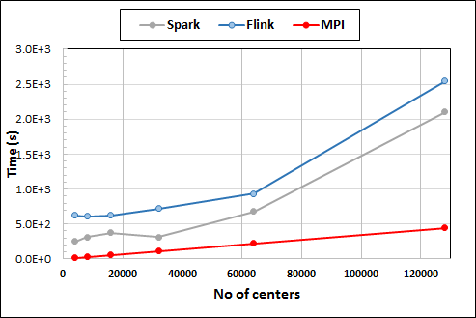
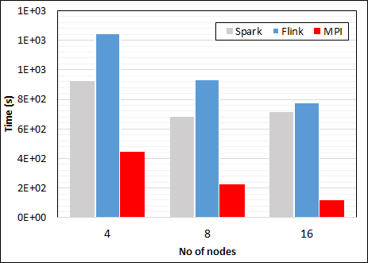
K-Means Clustering in Spark, Flink, MPI
K-Means execution time on 8 nodes with 20 processes in each node with 1 million points and varying number of centroids. Each point has 2 attributes.
K-Means execution time on varying number of nodes with 20 processes in each node with 1 million points and 64000 centroids. Each point has 2 attributes.
K-Means performed well on all three platforms when the computation time is high and communication time is low as illustrated in 10 million points and 10 iterations case. After lowering the computation and increasing the communication by setting the points to1 million and iterations to 100, the performance gap between MPI and the other two platforms increased.
Notes:
Note the differences in communication architectures
Note times are in log scale
Bars indicate compute only times, which is similar across these frameworks
Overhead is dominated by communications in Flink and Spark

Slide 86

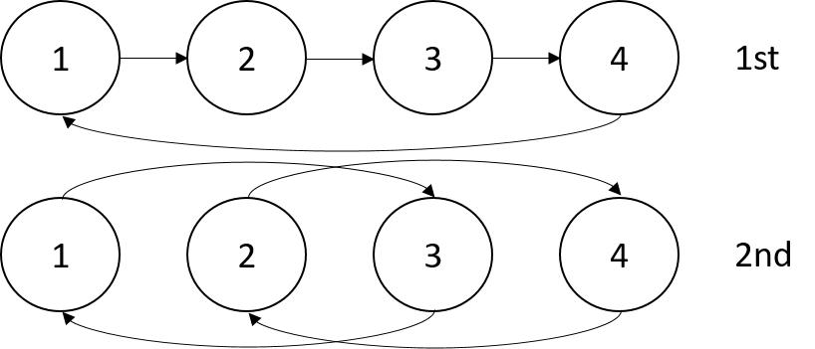

Sorting 1Tb of records
MPI Shuffling using a ring communication
Terasort flow
All three platforms worked relatively well because of the bulk nature of the data transfer.
Terasort execution time in 64 and 32 nodes. Only MPI shows the sorting time and communication time as other two frameworks doesn't provide a viable method to accurately measure them. Sorting time includes data save time. MPI-IB - MPI with Infiniband
Notes:
Note the differences in communication architectures
Note times are in log scale
Bars indicate compute only times, which is similar across these frameworks
Overhead is dominated by communications in Flink and Spark

Slide 87
HPC-ABDS
General Summary
DataFlow and In-place Runtime

Slide 88
HPC-ABDS Parallel Computing
MPI designed for fine grain case and typical of parallel computing used in large scale simulations
  Only change in model parameters are transmitted
  In-place implementation
  Synchronization important as parallel computing
Dataflow typical of distributed or Grid computing workflow paradigms
  Data sometimes and model parameters certainly transmitted
  If used in workflow, large amount of computing (>> communication) and no performance constraints from synchronization
  Caching in iterative MapReduce avoids data communication and in fact systems like TensorFlow, Spark or Flink are called dataflow but usually implement “model-parameter” flow
HPC-ABDS Plan: Add in-place implementations to ABDS when best performance keeping ABDS Interface as in next slide

Slide 89
Programming Model I
Programs are broken up into parts
  Functionally (coarse grain)
  Data/model parameter decomposition (fine grain)
Fine grain needs low latency or minimal data copying
Coarse grain has lower communication /
compute cost
MPI
Dataflow
Possible Iteration

Slide 90
Programming Model II
MPI designed for fine grain case and typical of parallel computing used in large scale simulations
  Only change in model parameters are transmitted
Dataflow typical of distributed or Grid computing paradigms
  Data sometimes and model parameters certainly transmitted
  Caching in iterative MapReduce avoids data communication and in fact systems like TensorFlow, Spark or Flink are called dataflow but usually implement “model-parameter” flow
Different Communication/Compute ratios seen in different cases with ratio (measuring overhead) larger when grain size smaller. Compare
  Intra-job reduction such as Kmeans clustering accumulation of center changes at end of each iteration and
  Inter-Job Reduction as at end of a query or word count operation

Slide 91
Programming Model Summary
Need to distinguish
  Grain size and Communication/Compute ratio (characteristic of problem or component (iteration) of problem)
  DataFlow versus “Model-parameter” Flow (characteristic of algorithm)
  In-Place versus Flow Software implementations
Inefficient to use same mechanism independent of characteristics
Classic Dataflow is approach of Spark and Flink so need to add parallel in-place computing as done by Harp for Hadoop
  TensorFlow uses In-Place technology
Note parallel machine learning (GML not LML) can benefit from HPC style interconnects and architectures as seen in GPU-based deep learning
  So commodity clouds not necessarily best

Slide 92
Streaming Applications and Technology

Slide 93
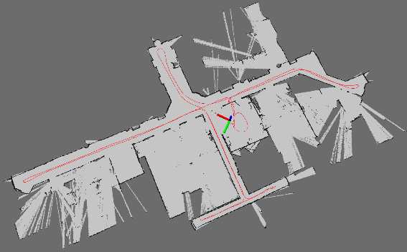
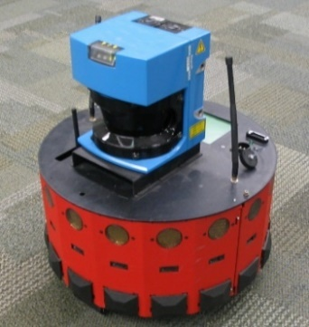
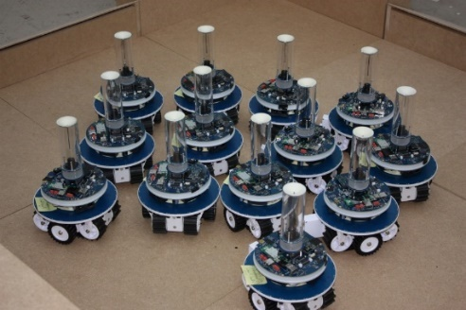
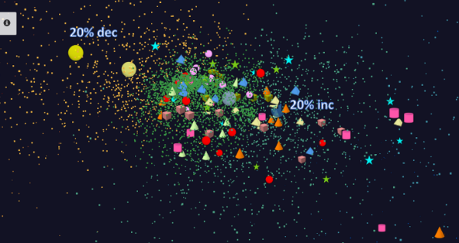
Adding HPC to Storm & Heron for Streaming
Robotics Applications
Time series data visualization in real time
Simultaneous Localization and Mapping
N-Body Collision
Avoidance
Map Built from
Robot data
Robot with a Laser Range Finder
Robots need to avoid collisions when they move
Map High dimensional data to 3D visualizer
Apply to Stock market data tracking 6000 stocks

Slide 94
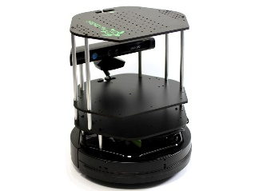
Data Pipeline
Sending to
pub-sub
Sending to
Persisting
storage
Multiple
streaming
workflows
Streaming
workflow
A stream application with some tasks running in parallel
Gateway
Message Brokers
RabbitMQ, Kafka
Streaming Workflows
Apache Heron and Storm
End to end delays without any processing is less than 10ms
Storm does not support “real parallel processing” within bolts – add optimized inter-bolt communication
Hosted on HPC and OpenStack cloud

Slide 95
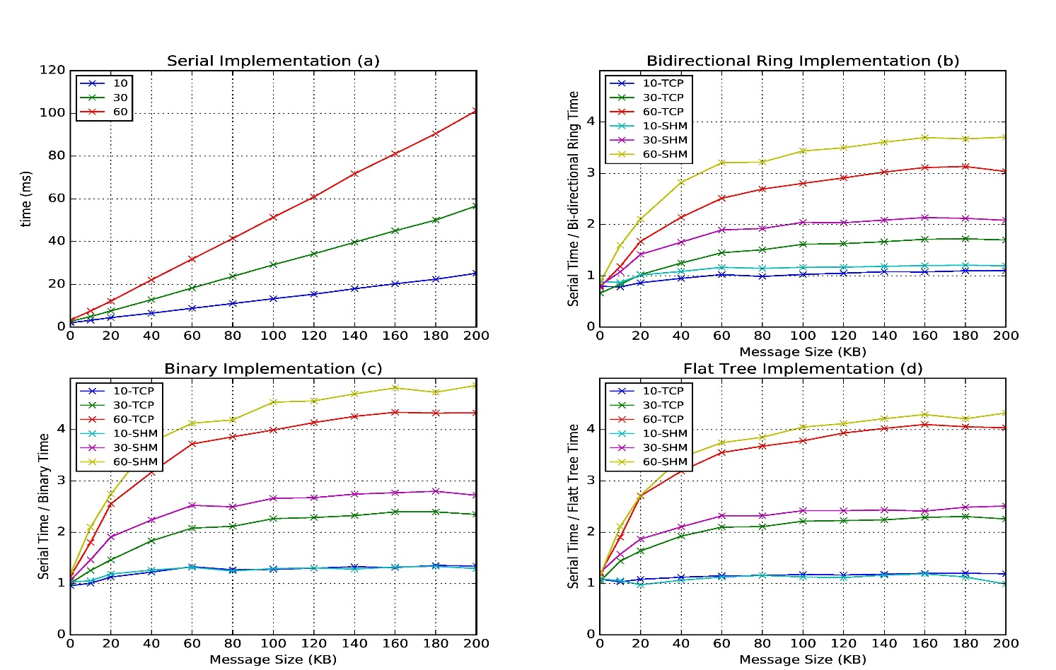
Improvement of Storm (Heron) using HPC communication algorithms
Latency of binary tree, flat tree and bi-directional ring implementations compared to serial implementation. Different lines show varying # of parallel tasks with either TCP communications and shared memory communications(SHM).
Original Time
Speedup Ring
Speedup Binary
Speedup Tree

Slide 96
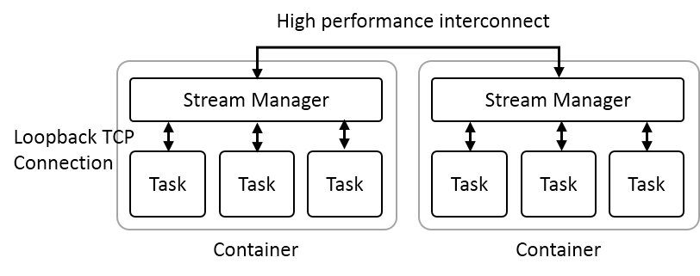
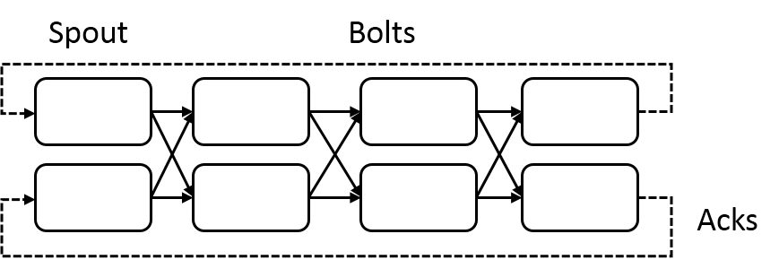
Heron Streaming Architecture
Add HPC
Infiniband
Omnipath
Inter node
Intranode
Typical Processing Topology
Parallelism 2; 4 stages

Slide 97
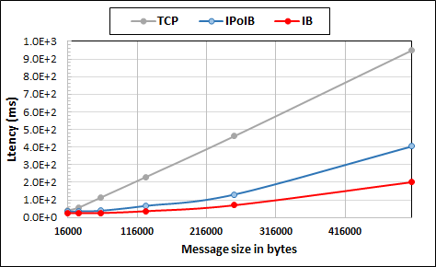
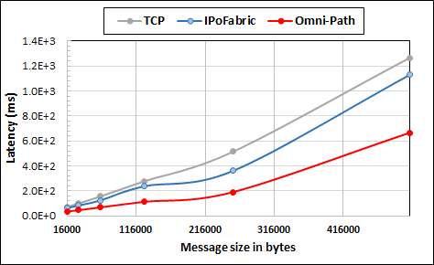
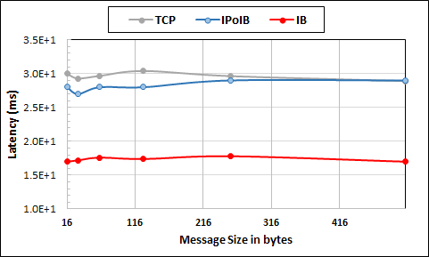
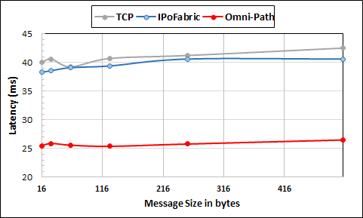
Intel Haswell Cluster with 2.4GHz Processors and 56Gbps Infiniband and 1Gbps Ethernet
Intel KNL Cluster with 1.4GHz Processors and 100Gbps Omni-Path and 1Gbps Ethernet
Large messages
Small messages
Parallelism of 2 and using 8 Nodes
Parallelism of 2 and using 4 Nodes
This is HPC Hardware and not parallel computing

Slide 98
NSF 1443054: CIF21 DIBBs: Middleware and High Performance Analytics Libraries for Scalable Data Science
Software: MIDAS
HPC-ABDS
Harp HPC for Big Data
February 2017

Slide 99
Harp (Hadoop Plugin) brings HPC to ABDS
Judy Qiu: Iterative HPC communication; scientific data abstractions
Careful support of distributed data AND distributed model
Avoids parameter server approach but distributes model over worker nodes and supports collective communication to bring global model to each node
Integrated with Intel DaaL high performance node library
Applied first to Latent Dirichlet Allocation LDA with large model and data
Have also added HPC to Apache Storm and Heron
MapReduce Model
MapCollective Model
MapReduce Applications
MapCollective Applications
M
M
M
M
M
M
M
M
MapReduce V2
Harp
Shuffle
Collective Communication
R
R
YARN

Slide 100
MapCollective Model
Collective Communication Operations
Collective Communication Operations | Description
broadcast | The master worker broadcasts the partitions to the tables on other workers.
reduce | The partitions from all the workers are reduced to the table on the master worker.
allreduce | The partitions from all the workers are reduced in tables of all the workers.
allgather | Partitions from all the workers are gathered in the tables of all the workers.
regroup | Regroup partitions on all the workers based on the partition ID.
push & pull | Partitions are pushed from local tables to the global table or pulled from the global table to local tables.
rotate | Build a virtual ring topology, and rotate partitions from a worker to a neighbor worker.
Notes:
Explanation of collective communication operations

Slide 101
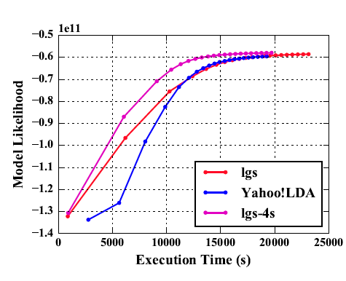
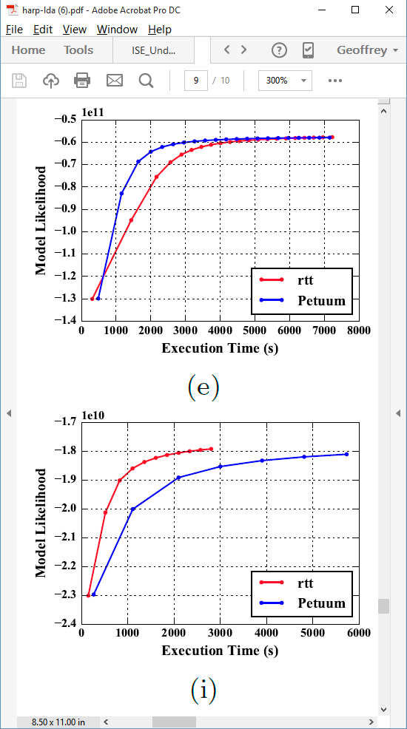
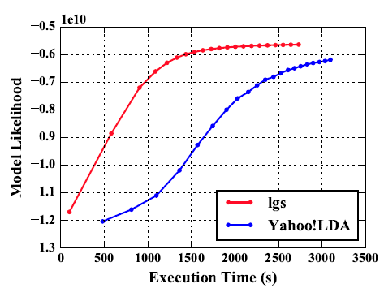
Latent Dirichlet Allocation on 100 Haswell nodes: red is Harp (lgs and rtt)
Clueweb
Clueweb
enwiki
Bi-gram

Slide 102
Collapsed Gibbs Sampling for Latent Dirichlet Allocation
45% faster
18% faster
Notes:
The execution time comparison between Harp and Petuum when the model is converged

Slide 103
Stochastic Gradient Descent for Matrix Factorization
58% faster
93% faster
Notes:
The execution time comparison between Harp and NOMAD when the model is converged

Slide 104
Hadoop + Harp + Intel DAAL High Performance node kernels
Harp offers HPC internode performance
Integration with Hadoop
Science Big Data interfaces
Integration with Intel HPC node libraries
Asynchronous update models

Slide 105
Knights Landing KNL Data Analytics: Harp, Spark, NOMAD
Single Node and Cluster performance: 1.4GHz 68 core nodes
Kmeans SGD ALS
Strong Scaling Multi Node Parallelism Scaling - Omnipath Interconnect
Strong Scaling Single Node Core Parallelism Scaling

Slide 106
NSF 1443054: CIF21 DIBBs: Middleware and High Performance Analytics Libraries for Scalable Data Science
Software: MIDAS
HPC-ABDS
Software Defined Systems
February 2017

Slide 107
Infrastructure Nexus
Software Defined Systems enable interoperability and reproducible computing
DevOps
Cloudmesh HPCCloud 2.0

Slide 108
HPCCloud 2.0 Software Defined Systems
Significant advantages in specifying job software with scripts such as Chef, Puppet, Ansible – “Software Defined Systems” (SDS)
  Choose Ansible as Python based
Less voluminous than machine images; easier to ensure latest version; easy to recreate image on demand after crashes
In work with NIST, we looked at 87 applications from two of our “big data on cloud” classes and from NIST itself (6)
The 6 NIST use cases need 27 Ansible roles (distinct software subsystems) and full set of 87 needed 62 separate roles (average 4.75 roles per use case)
https://docs.google.com/spreadsheets/d/1e8-pzWn-7lz47-gIAra0VzCX6IkAypa8Cu5YG5MES_4
With NIST Public Big Data group, looking at mapping SDS to system architecture
Preparing Ansible specifications of many subsystems and use cases
Note many public Ansible roles (Ansible Galaxy collection) do NOT expose full functionality of software and/or have errors
Microservices, HPCCloud 3.0 and serverless computing build on SDS https://youtu.be/iNN9KAsQ3G8?t=8m Amin Vahdat (Google)
  Amazon Lambda, Google Cloud Functions, Microsoft Azure Functions,
  IBM OpenWhisk; WOSC2017 workshop June 2017

Slide 109
27 Ansible Roles and Re-use in 6 NIST use cases
ID | 6 NIST Use Cass | Hadoop | Mesos | Spark | Storm | Pig | Hive | Drill | HDFS | HBase | Mysql | MongoDB | RethinkDB | Mahout | D3, Tableau | nltk | MLlib | Lucene/Solr | OpenCV | Python | Java | maven | Ganglia | Nagios | spark supervisord | zookeeper | AlchemyAPI | R
1 | NIST Fingerprint Matching | x |  | x |  |  | x | x |  | x | x |  |  |  |  |  |  |  |  |  | x | x | x | x | x | x
2 | Human and Face Detection |  | x | x |  |  |  |  |  |  |  |  |  |  |  |  |  |  | x | x |  |  |  |  |  | x
3 | Twitter Analysis |  |  |  | x |  |  |  |  | x |  | x |  |  | x | x |  |  |  | x | x |  |  |  |  | x | x | x
4 | Analytics for Healthcare Data/Health Informatics | x |  | x |  |  |  |  |  | x |  |  |  | x | x |  | x | x |  |  | x |  |  |  |  | x
5 | Spatial Big Data/Spatial Statistics/Geographic Information Systems | x |  | x |  |  |  |  |  |  |  |  |  | x | x |  | x |  |  |  | x | x
6 | Data Warehousing and Data Mining | x |  | x |  | x | x |  |  | x |  | x |  | x | x |  | x | x |  |  | x |  |  |  |  | x
count |  | 4 | 1 | 5 | 1 | 1 | 2 | 1 | 0 | 4 | 1 | 2 | 0 | 3 | 4 | 1 | 3 | 2 | 1 | 2 | 5 | 2 | 3 | 1 | 1 | 5 | 1 | 1

Slide 110
Cloudmesh HPCCloud 2.0 DevOps Tool
Model: Define software configuration with tools like Ansible (Chef, Puppet); instantiate on a virtual cluster
Save scripts not virtual machines and let script build applications
Cloudmesh is an easy-to-use command line program/shell and portal to interface with heterogeneous infrastructures taking script as input
  It first defines virtual cluster and then instantiates script on it
  It has several common Ansible defined software built in
Supports OpenStack, AWS, Azure, SDSC Comet, virtualbox, libcloud supported clouds as well as classic HPC and Docker infrastructures
  Has an abstraction layer that makes it possible to integrate other IaaS frameworks
Managing VMs across different IaaS providers is easier
Demonstrated interaction with various cloud providers:
  FutureSystems, Chameleon Cloud, Jetstream, CloudLab, Cybera, AWS, Azure, virtualbox
Status: AWS, and Azure, VirtualBox, Docker need improvements; we focus currently on SDSC Comet and NSF resources that use OpenStack
Interoperability Layer to build HPCCloud 2.0

Slide 111
Cloudmesh Architecture
Software Engineering Process
We define a basic virtual cluster which is a set of instances with a common security context
We then add basic tools including languages Python Java etc.
Then add management tools such as Yarn, Mesos, Storm, Slurm etc …..
Then add roles for different HPC-ABDS PaaS subsystems such as Hbase, Spark
  There will be dependencies e.g. Storm role uses Zookeeper
Any one project picks some of HPC-ABDS PaaS Ansible roles and adds >=1 SaaS that are specific to their project and for example read project data and perform project analytics
E.g. there will be an OpenCV role used in Image processing applications

Slide 112
NSF 1443054: CIF21 DIBBs: Middleware and High Performance Analytics Libraries for Scalable Data Science
Software: MIDAS
HPC-ABDS
HPC Cloud
Convergence
February 2017 II

Slide 113
Clouds, HPC Clouds
Simulations, Big Data

Slide 114
Considerations on Big Data v. Clouds/HPC
“High Performance” seems natural for Big Data as this needs a lot of processing and HPC could do it faster?
Cons: But much big data processing involves I/O of distributed data and this dominates over computing accelerated by HPC
  Other problems (such as LHC data processing) are compute dominated but this is pleasingly parallel and so parallel computing and nifty HPC algorithms irrelevant
  Other problems (like basic databases) are essentially MapReduce and also do not have tight synchronization constraints addressed by HPC
Pros: Andrew Ng notes that a leading machine learning group must have both deep learning and HPC excellence.
  Some machine learning like topic modelling (LDA), clustering, deep learning, dimension reduction, graph algorithms involve Map-Collective or Map-Point to Point iterative structure and benefit from HPC
  HPC (MPI) often large factors (10-100) faster than Hadoop, Spark, Flink, Storm

Slide 115
Why HPC Cloud architectures?
Exascale simulations needed as have differential equation based models that need small space and time steps and this leads to numerical formulations that need the memory and compute power of an exascale machine to solve individual problems (capability computing)
Big data problems do not have differential operators and it is not obvious that you need a full exascale system to address a single Big Data problem
Rather you will be running lots of jobs that are sometimes pleasingly parallel/MapReduce (Cloud) and sometimes small to medium size HPC jobs which in aggregate are exascale (HPC Cloud) (capacity computing)
  Deep learning doesn’t exhibit massive parallelism due to stochastic gradient descent using small mini-batches of training data
  But deep learning does use small accelerator enhanced HPC clusters.
Note modest size clusters need all the software, hardware and algorithm expertise of HPC.
Systems designed for exascale HPC simulations, should be well suited for HPC cloud if I/O handled correctly (as it is in traditional clouds)
HPCCloud 2.0 uses DevOps to automate deployment on cloud or HPC
HPCCloud 3.0 uses SaaS to deliver Wisdom/Insight as a Service

Slide 116
Comparison of Data Analytics with Simulation

Slide 117
Structure of Applications
Real-time (streaming) data is increasingly common in scientific and engineering research, and it is ubiquitous in commercial Big Data (e.g., social network analysis, recommender systems and consumer behavior classification)
  So far little use of commercial and Apache technology in analysis of scientific streaming data
Pleasingly parallel applications important in science (long tail) and data communities
Commercial-Science application differences: Search and recommender engines have different structure to deep learning, clustering, topic models, graph analyses such as subgraph mining
  Latter very sensitive to communication and can be hard to parallelize
  Search typically not as important in Science as in commercial use as search volume scales by number of users
Should discuss data and model separately
  Term data often used rather sloppily and often refers to model

Slide 118
Comparison of Data Analytics with Simulation I
Simulations (models) produce big data as visualization of results – they are data source
  Or consume often smallish data to define a simulation problem
  HPC simulation in (weather) data assimilation is data + model
Pleasingly parallel often important in both
Both are often SPMD and BSP
  Non-iterative MapReduce is major big data paradigm
  not a common simulation paradigm except where “Reduce” summarizes pleasingly parallel execution as in some Monte Carlos
Big Data often has large collective communication
  Classic simulation has a lot of smallish point-to-point messages
  Motivates MapCollective model
Simulations characterized often by difference or differential operators leading to nearest neighbor sparsity
Some important data analytics can be sparse as in PageRank and “Bag of words” algorithms but many involve full matrix algorithm

Slide 119


“Force Diagrams” for macromolecules and Facebook

Slide 120
Comparison of Data Analytics with Simulation II
There are similarities between some graph problems and particle simulations with a particular cutoff force.
  Both are MapPoint-to-Point problem architecture
Note many big data problems are “long range force” (as in gravitational simulations) as all points are linked.
  Easiest to parallelize. Often full matrix algorithms
  e.g. in DNA sequence studies, distance δ(i, j) defined by BLAST, Smith-Waterman, etc., between all sequences i, j.
  Opportunity for “fast multipole” ideas in big data. See NRC report
Current Ogres/Diamonds do not have facets to designate underlying hardware: GPU v. Many-core (Xeon Phi) v. Multi-core as these define how maps processed; they keep map-X structure fixed; maybe should change as ability to exploit vector or SIMD parallelism could be a model facet.

Slide 121
Comparison of Data Analytics with Simulation III
In image-based deep learning, neural network weights are block sparse (corresponding to links to pixel blocks) but can be formulated as full matrix operations on GPUs and MPI in blocks.
In HPC benchmarking, Linpack being challenged by a new sparse conjugate gradient benchmark HPCG, while I am diligently using non- sparse conjugate gradient solvers in clustering and Multi-dimensional scaling.
Simulations tend to need high precision and very accurate results – partly because of differential operators
Big Data problems often don’t need high accuracy as seen in trend to low precision (16 or 32 bit) deep learning networks
  There are no derivatives and the data has inevitable errors
Note parallel machine learning (GML not LML) can benefit from HPC style interconnects and architectures as seen in GPU-based deep learning
  So commodity clouds not necessarily best but modern clouds fine

Slide 122
Implications of Big Data Requirements
“Atomic” Job Size: Very large jobs are critical aspects of leading edge simulation, whereas much data analysis is pleasing parallel and involves many quite small jobs. The latter follows from event structure of much observational science.
  Accelerators produce a stream of particle collisions; telescopes, light sources or remote sensing a stream of images. The many events produced by modern instruments implies data analysis is a computationally intense problem but can be broken up into many quite small jobs.
  Similarly the long tail of science produces streams of events from a multitude of small instruments
Why use HPC machines to analyze data and how large are they? Some scientific data has been analyzed on HPC machines because the responsible organizations had such machines often purchased to satisfy simulation requirements. Whereas high end simulation requires HPC style machines, that is typically not true for data analysis; that is done on HPC machines because they are available

Slide 123
Who uses What Software
HPC/Science use of Big Data Technology now: Some aspects of the Big Data stack are being adopted by the HPC community: Docker and Deep Learning are two examples.
Big Data use of HPC: The Big Data community has used (small) HPC clusters for deep learning, and it uses GPUs and FPGAs for training deep learning systems
Docker v. OpenStack(hypervisor): Docker (or equivalent) is quite likely to be the virtualization approach of choice (compared to say OpenStack) for both data and simulation applications. OpenStack is more complex than Docker and only clearly needed if you share at core level whereas large scale simulations and data analysis seem to just need node level sharing.
  Parallel computing almost implies sharing at node not core level
Science use of Big Data: Some fraction of the scientific community uses Big Data style analysis tools (Hadoop, Spark, Cassandra, Hbase ….)

Slide 124
Choosing Languages
Language choice C++, Fortran, Java, Scala, Python, R, Matlab needs thought. This is a mixture of technical and social issues.
Java Grande was a 1997-2000 activity to make Java run fast and web site still there! http://www.javagrande.org/
Basic Java now much better but object structure, dynamic memory allocation and Garbage collection have their overheads
Java virtual machine JVM dominant Big Data environment?
One can mix languages quite efficiently
  Java MPI as binding to C++ version excellent
Scripting languages Python, R, Matlab address different requirements than Java, C++ ….

Slide 125
HPCCloud and Summary of Big Data - Big Simulation Convergence
HPC-Clouds convergence? (easier than converging higher levels in stack)
Can HPC continue to do it alone?
Convergence Ogres/Diamonds
HPC-ABDS Software on differently optimized hardware infrastructure

Slide 126
HPCCloud Convergence Architecture
Running same HPC-ABDS software across all platforms but data management machine has different balance in I/O, Network and Compute from “model” machine
  Note data storage approach: HDFS v. Object Store v. Lustre style file systems is still rather unclear
The Model behaves similarly whether from Big Data or Big Simulation.
Data Management Model for Big Data
and Big Simulation
HPCCloud Capacity-style Operational Model matches hardware features with application requirements

Slide 127
Summary of Big Data HPC Convergence I
Applications, Benchmarks and Libraries
  51 NIST Big Data Use Cases, 7 Computational Giants of the NRC Massive Data Analysis, 13 Berkeley dwarfs, 7 NAS parallel benchmarks
  Unified discussion by separately discussing data & model for each application;
  64 facets– Convergence Diamonds -- characterize applications
  Characterization identifies hardware and software features for each application across big data, simulation; “complete” set of benchmarks (NIST)
Exemplar Ogre and Convergence Diamond Features
  Overall application structure e.g. pleasingly parallel
  Data Features e.g. from IoT, stored in HDFS ….
  Processing Features e.g. uses neural nets or conjugate gradient
  Execution Structure e.g. data or model volume
Need to distinguish data management from data analytics
Management and Search I/O intensive and suitable for classic clouds
  Science data has fewer users than commercial but requirements poorly understood
Analytics has many features in common with large scale simulations
  Data analytics often SPMD, BSP and benefits from high performance networking and communication libraries.
  Decompose Model (as in simulation) and Data (bit different and confusing) across nodes of cluster

Slide 128
Summary of Big Data HPC Convergence II
Software Architecture and its implementation
  HPC-ABDS: Cloud-HPC interoperable software: performance of HPC (High Performance Computing) and the rich functionality of the Apache Big Data Stack.
  Added HPC to Hadoop, Storm, Heron, Spark; could add to Beam and Flink
  Could work in Apache model contributing code in different ways
  One approach is an HPC project in Apache Foundation
HPCCloud runs same HPC-ABDS software across all platforms but “data management” nodes have different balance in I/O, Network and Compute from “model” nodes
  Optimize to data and model functions as specified by convergence diamonds rather than optimizing for simulation and big data
Convergence Language: Make C++, Java, Scala, Python (R) … perform well
Training: Students prefer to learn machine learning and clouds and need to be taught importance of HPC to Big Data
Sustainability: research/HPC communities cannot afford to develop everything (hardware and software) from scratch
HPCCloud 2.0 uses DevOps to deploy HPC-ABDS on clouds or HPC
HPCCloud 3.0 delivers Solutions as a Service

Slide 129
Some Points to Make I
People ask me what is a cloud?
  Clouds are gradually having all possible capabilities (GPU, fast networks, KNL, FPGA)
  So all but largest supercomputing runs can be done on clouds
Interesting to distinguish 3 system deployments
  Pleasingly parallel: Master-worker: Big Data and Simulations
    Grid computing, long tail of science, was 20% in 1988- now much more
  Intermediate size (virtual) clusters of synchronized nodes run as pleasingly parallel components of a large machine: Big Data and Simulations
    Capacity computing, Deep Learning
  Giant (exascale) cluster of synchronized nodes: Only simulations
Parallel Computing Technology like MPI aimed at synchronized nodes
Grid computing technology and MapReduce aimed at pleasingly parallel or essentially unsynchronized computing

Slide 130
Some Points to Make II
Need to distinguish data intensive requirements
  Independent Event-based processing (present at start of most scientific data analysis)
    Pleasingly Parallel with often Local Machine Learning
  Database or data management functions
    MapReduce style
  Modest scale parallelism as in deep learning on modest cluster of GPU’s (64)
    Traditional small GPU Cluster <~ 16 nodes
  Large but not exascale scale parallelism with strong synchronization as in clustering of whole dataset (?10,000 cores)
    Traditional intermediate size HPC Cluster ~1024 nodes
    Global Machine Learning
There are issues like workflow in common across science, commercial, simulations, big data, clouds, HPC
Growing interest in use of public clouds in USA Universities
Must have Cloud or HPC Cloud interoperability with local resources (often an HPC or HTC Cluster)

Slide 131
(IU) Contributions
Can classify applications from a uniform point of view and understand similarities and differences between simulation and data intensive applications
Can parallelize with high efficiency all data analytics remember “Parallel Computing Works” (on all large problems)
In spite of many arguments, Big data technology like Spark, Flink, Hadoop, Storm, Heron are not designed to support parallel computing well and tend to get poor performance on those jobs needing tight task synchronization and/or use high performance hardware
  They are nearer grid computing!
  Huge success of unmodified Apache software says not so much classic parallel computing in commercial workloads; confirmed by success of clouds that typically have major overheads on parallel jobs
One can add HPC and parallel computing to these Apache systems at some cost in fault tolerance and ease of use
  HPC-ABDS is HPC Apache Big Data Stack Integration
  Similarly can make Java run with performance similar to C.
Leads to HPC- Big Data Convergence

