Slide 1
Structure of Problems and its Relation to Software and Hardware
Scientific Computing Department
Rutherford Appleton Laboratory May 3, 2017
gcf@indiana.edu
http://www.dsc.soic.indiana.edu/, http://spidal.org/ http://hpc-abds.org/kaleidoscope/
Department of Intelligent Systems Engineering
School of Informatics and Computing, Digital Science Center
Indiana University Bloomington

Slide 2





NSF 1443054: CIF21 DIBBs: Middleware and High Performance Analytics Libraries for Scalable Data Science
Software: MIDAS
HPC-ABDS
RAL Talk May 3 2017

Slide 3
Abstract
We review classes of Big Data and simulation problems and the differences between Big Data and Simulation Fields.
We show how standard software like MPI Spark and Hadoop work badly or well on some important problem classes.
We use this to explain how one can merge software and ideas from HPC and the Apache Big Data stack to provide broadly high performance and high functionality systems.

Slide 4
Points to Make
Need to distinguish 3 system deployments
  Pleasingly parallel: Master-worker
  Intermediate (virtual) clusters of synchronized nodes run as pleasingly parallel components of a large machine
  Giant (exascale) cluster of synchronized nodes
Need to distinguish data intensive requirements
  Database or data management functions
  Event-based pleasingly parallel processing (present at start of most scientific data analysis)
  Modest scale parallelism as in deep learning on modest cluster of GPU’s
  Large scale parallelism as in clustering of whole dataset
There are issues like workflow in common across science, commercial, simulations, big data, clouds, HPC

Slide 5
(IU) Contributions
Can classify applications from a uniform point of view and understand similarities and differences between simulation and data intensive applications
Can parallelize with high efficiency all data analytics remember “Parallel Computing Works” (on all large problems)
In spite of many arguments, Big data technology like Spark, Flink, Hadoop, Storm, Heron are not designed to support parallel computing well and tend to get poor performance on those jobs needing tight task synchronization and/or use high performance hardware
  They are nearer grid computing!
  Huge success of unmodified Apache software says not so much classic parallel computing in commercial workloads; confirmed by success of clouds that typically have major overheads on parallel jobs
One can add HPC and parallel computing to these Apache systems at some cost in fault tolerance and ease of use
  HPC-ABDS is HPC Apache Big Data Stack Integration
  Similarly can make Java run with performance similar to C.
Leads to HPC- Big Data Convergence

Slide 6
Some Cosmic Issues in HPC – Big Data areas and their linkage

Slide 7
Some Confusing Issues; Missing Requirements; Missing Consensus I
Different Problem Types
  Data Management v. Data Analytics
  Every problem has Data & Model; which is Big/Important?
  Streaming v Batch; Interactive v Batch
  Science Requirements v. Commercial Requirements; are they similar?; what are important problems ; how big are they and are they global or locally parallel?
Broad Execution Issues
  Pleasingly Parallel (Local Machine Learning) v. Global Machine Learning
  Fine grain v. Coarse Grain parallelism; workflow (dataflow with directed graph) v. parallel computing (tight synchronization and ~BSP))
  Threads v Processes
  Objects v files; HDFS v Lustre

Slide 8
Some confusing issues; Missing Requirements; Missing Consensus II
Qualitative Aspects of Approach
  Need for Interdisciplinary Collaboration
  Trade-off between Performance and Productivity
  What about software sustainability? Should we do all with Apache?
  Academic v. Industry; who is leading?
  Why is Industry thriving ignoring HPC (except for deep learning)
Many choices in all parts of System
  Virtualization: HPC v Docker v OpenStack (OpenNebula)
  Apache Beam v. Kepler for orchestration and lots of other HPC v “Apache” or “Apache v Apache” choices e.g. Beam v. Crunch v. NiFi
  What Language should be used: Python/R/Matlab, C++, Java …
  350 Software systems in HPC-ABDS collection with lots of choice
  HPC simulation stack well defined and highly optimized; user makes few choices

Slide 9
Some confusing issues; Missing Requirements; Missing Consensus III
What is the appropriate hardware?
  Depends on answers to “what are requirements” and software choices
  What is flexible cost effective hardware; at universities? In public clouds?
  HPC v. HTC (high throughput) v. Cloud
  Value of GPU’s and other innovative node hardware
Miscellaneous Issues
  Big Data Performance analysis often rudimentary (compared to HPC)
  What is the Big Data Stack?
  Trade-off between “integrated systems” versus using a collection of independent components
  What are parallelization challenges? Library of “hand optimized” code versus automatic parallelization and domain specific libraries
  Can DevOps be used more systematically to promote interoperability
  Orchestration v. Management; TOSCA v. BPEL (Heat v. Beam)

Slide 10
Some confusing issues; Missing Requirements; Missing Consensus IV
Status of field: facts
  Increasing use of public clouds suggests University Cluster – Cloud convergence; satisfied by HPC-Cloud convergence
  Long Tail science pleasingly parallel
  Precision Medicine currently pleasingly parallel?
  Streaming data analysis largely pleasingly parallel?
Status of field: questions
  What problems need to be solved?
  What is pretty universally agreed?
  What is understood (by some) but not broadly agreed?
  What is not understood and needs substantial more work?
  Is there an interesting Big Data Exascale Convergence?
  Role of Data Science? Curriculum of Data Science?
  Role of Benchmarks

Slide 11
Software Nexus
Application Layer On
Big Data Software Components for Programming and Data Processing On
HPC for runtime On
IaaS and DevOps Hardware and Systems

Slide 12
Big Data ABDS HPCCloud 3.0 HPC, Cluster
17. Orchestration Beam, Crunch, Tez, Cloud Dataflow Kepler, Pegasus, Taverna
16. Libraries MLlib/Mahout, TensorFlow, CNTK, R, Python ScaLAPACK, PETSc, Matlab
15A. High Level Programming Pig, Hive, Drill Domain-specific Languages
15B. Platform as a Service App Engine, BlueMix, Elastic Beanstalk XSEDE Software Stack
Languages Java, Erlang, Scala, Clojure, SQL, SPARQL, Python Fortran, C/C++, Python
14B. Streaming Storm, Kafka, Kinesis
13,14A. Parallel Runtime Hadoop, MapReduce MPI/OpenMP/OpenCL
2. Coordination Zookeeper
12. Caching Memcached
11. Data Management Hbase, Accumulo, Neo4J, MySQL iRODS
10. Data Transfer Sqoop GridFTP
9. Scheduling Yarn, Mesos Slurm
8. File Systems HDFS, Object Stores Lustre
1, 11A Formats Thrift, Protobuf FITS, HDF
5. IaaS OpenStack , Docker Linux, Bare-metal, SR-IOV
Infrastructure CLOUDS Clouds and/or HPC SUPERCOMPUTERS
HPC-ABDS IntegratedSoftware
CUDA, Exascale Runtime

Slide 13
HPC-ABDS

Slide 14
Functionality of 21 HPC-ABDS Layers
Message Protocols:
Distributed Coordination:
Security & Privacy:
Monitoring:
IaaS Management from HPC to hypervisors:
DevOps:
Interoperability:
File systems:
Cluster Resource Management:
Data Transport:
A) File management
B) NoSQL
C) SQL
In-memory databases & caches / Object-relational mapping / Extraction Tools
Inter process communication Collectives, point-to-point, publish-subscribe, MPI:
A) Basic Programming model and runtime, SPMD, MapReduce:
B) Streaming:
A) High level Programming:
B) Frameworks
Application and Analytics:
Workflow-Orchestration:
Lesson of large number (350). This is a rich software environment that HPC cannot “compete” with. Need to use and not regenerate
Note level 13 Inter process communication added

Slide 15
Using “Apache” (Commercial Big Data) Data Systems for Science/Simulation
Pro: Use rich functionality and usability of ABDS (Apache Big Data Stack)
Pro: Sustainability model of community open source
Con (Pro for many commercial users): Optimized for fault-tolerance and usability and not performance
Feature: Naturally run on clouds and not HPC platforms
Feature: Cloud is logically centralized, physically distributed but science data typically distributed.
Question: how do science data analysis requirements differ from those commercially e.g. recommender systems heavily used commercially
Approach: HPC-ABDS using HPC runtime and tools to enhance commercial data systems (ABDS on top of HPC)
  Upper level software: ABDS
  Lower level runtime: HPC
  HPCCloud Hardware: HPC or classic cloud dependent on application requirements

Slide 16
HPC-ABDS SPIDAL Project Activities
Green is MIDAS
Black is SPIDAL
Level 17: Orchestration: Apache Beam (Google Cloud Dataflow) integrated with Heron/Flink and Cloudmesh on HPC cluster
Level 16: Applications: Datamining for molecular dynamics, Image processing for remote sensing and pathology, graphs, streaming, bioinformatics, social media, financial informatics, text mining
Level 16: Algorithms: Generic and custom for applications SPIDAL
Level 14: Programming: Storm, Heron (Twitter replaces Storm), Hadoop, Spark, Flink. Improve Inter- and Intra-node performance; science data structures
Level 13: Runtime Communication: Enhanced Storm and Hadoop (Spark, Flink, Giraph) using HPC runtime technologies, Harp
Level 12: In-memory Database: Redis + Spark used in Pilot-Data Memory
Level 11: Data management: Hbase and MongoDB integrated via use of Beam and other Apache tools; enhance Hbase
Level 9: Cluster Management: Integrate Pilot Jobs with Yarn, Mesos, Spark, Hadoop; integrate Storm and Heron with Slurm
Level 6: DevOps: Python Cloudmesh virtual Cluster Interoperability

Slide 17
Exemplar Software for a Big Data Initiative
Functionality of ABDS and Performance of HPC
Workflow: Apache Beam, Crunch, Python or Kepler
Data Analytics: Mahout, R, ImageJ, Scalapack
High level Programming: Hive, Pig
Batch Parallel Programming model: Hadoop, Spark, Giraph, Harp, MPI;
Streaming Programming model: Storm, Kafka or RabbitMQ
In-memory: Memcached
Data Management: Hbase, MongoDB, MySQL
Distributed Coordination: Zookeeper
Cluster Management: Yarn, Slurm
File Systems: HDFS, Object store (Swift),Lustre
DevOps: Cloudmesh, Chef, Puppet, Docker, Cobbler
IaaS: Amazon, Azure, OpenStack, Docker, SR-IOV
Monitoring: Inca, Ganglia, Nagios

Slide 18
Application Nexus of HPC, Big Data, Simulation Convergence
Use-case Data and Model
NIST Collection
Big Data Ogres
Convergence Diamonds

Slide 20
Data and Model in Big Data and Simulations I
Need to discuss Data and Model as problems have both intermingled, but we can get insight by separating which allows better understanding of Big Data - Big Simulation “convergence” (or differences!)
The Model is a user construction and it has a “concept”, parameters and gives results determined by the computation. We use term “model” in a general fashion to cover all of these.
Big Data problems can be broken up into Data and Model
  For clustering, the model parameters are cluster centers while the data is set of points to be clustered
  For queries, the model is structure of database and results of this query while the data is whole database queried and SQL query
  For deep learning with ImageNet, the model is chosen network with model parameters as the network link weights. The data is set of images used for training or classification

Slide 21
Data and Model in Big Data and Simulations II
Simulations can also be considered as Data plus Model
  Model can be formulation with particle dynamics or partial differential equations defined by parameters such as particle positions and discretized velocity, pressure, density values
  Data could be small when just boundary conditions
  Data large with data assimilation (weather forecasting) or when data visualizations are produced by simulation
Big Data implies Data is large but Model varies in size
  e.g. LDA with many topics or deep learning has a large model
  Clustering or Dimension reduction can be quite small in model size
Data often static between iterations (unless streaming); Model parameters vary between iterations
Data and Model Parameters are often confused in papers as term data used to describe the parameters of models.

Slide 22

Use Case Template
26 fields completed for 51 areas
Government Operation: 4
Commercial: 8
Defense: 3
Healthcare and Life Sciences: 10
Deep Learning and Social Media: 6
The Ecosystem for Research: 4
Astronomy and Physics: 5
Earth, Environmental and Polar Science: 10
Energy: 1

Slide 23
Sample Features of 51 Use Cases I
PP (26) “All” Pleasingly Parallel or Map Only
MR (18) Classic MapReduce MR (add MRStat below for full count)
MRStat (7) Simple version of MR where key computations are simple reduction as found in statistical averages such as histograms and averages
MRIter (23) Iterative MapReduce or MPI (Flink, Spark, Twister)
Graph (9) Complex graph data structure needed in analysis
Fusion (11) Integrate diverse data to aid discovery/decision making; could involve sophisticated algorithms or could just be a portal
Streaming (41) Some data comes in incrementally and is processed this way
Classify (30) Classification: divide data into categories
S/Q (12) Index, Search and Query

Slide 24
Sample Features of 51 Use Cases II
CF (4) Collaborative Filtering for recommender engines
LML (36) Local Machine Learning (Independent for each parallel entity) – application could have GML as well
GML (23) Global Machine Learning: Deep Learning, Clustering, LDA, PLSI, MDS,
  Large Scale Optimizations as in Variational Bayes, MCMC, Lifted Belief Propagation, Stochastic Gradient Descent, L-BFGS, Levenberg-Marquardt . Can call EGO or Exascale Global Optimization with scalable parallel algorithm
Workflow (51) Universal
GIS (16) Geotagged data and often displayed in ESRI, Microsoft Virtual Earth, Google Earth, GeoServer etc.
HPC (5) Classic large-scale simulation of cosmos, materials, etc. generating (visualization) data
Agent (2) Simulations of models of data-defined macroscopic entities represented as agents

Slide 25
Classifying Use cases

Slide 26
Classifying Use Cases
The Big Data Ogres built on a collection of 51 big data uses gathered by the NIST Public Working Group where 26 properties were gathered for each application.
This information was combined with other studies including the Berkeley dwarfs, the NAS parallel benchmarks and the Computational Giants of the NRC Massive Data Analysis Report.
The Ogre analysis led to a set of 50 features divided into four views that could be used to categorize and distinguish between applications.
The four views are Problem Architecture (Macro pattern); Execution Features (Micro patterns); Data Source and Style; and finally the Processing View or runtime features.
We generalized this approach to integrate Big Data and Simulation applications into a single classification looking separately at Data and Model with the total facets growing to 64 in number, called convergence diamonds, and split between the same 4 views.
A mapping of facets into work of the SPIDAL project has been given.

Slide 28
64 Features in 4 views for Unified Classification of Big Data and Simulation Applications
Both
Simulations
Analytics
(Model for Big Data)
(Nearly all Data)
(All Model)
(Mix of Data and Model)
(Nearly all Data+Model)

Slide 29
Convergence Diamonds and their 4 Views I
One view is the overall problem architecture or macropatterns which is naturally related to the machine architecture needed to support application.
  Unchanged from Ogres and describes properties of problem such as “Pleasing Parallel” or “Uses Collective Communication”
The execution (computational) features or micropatterns view, describes issues such as I/O versus compute rates, iterative nature and regularity of computation and the classic V’s of Big Data: defining problem size, rate of change, etc.
  Significant changes from ogres to separate Data and Model and add characteristics of Simulation models. e.g. both model and data have “V’s”; Data Volume, Model Size
  e.g. O(N²) Algorithm relevant to big data or big simulation model

Slide 30
Convergence Diamonds and their 4 Views II
The data source & style view includes facets specifying how the data is collected, stored and accessed. Has classic database characteristics
  Simulations can have facets here to describe input or output data
  Examples: Streaming, files versus objects, HDFS v. Lustre
Processing view has model (not data) facets which describe types of processing steps including nature of algorithms and kernels by model e.g. Linear Programming, Learning, Maximum Likelihood, Spectral methods, Mesh type,
  mix of Big Data Processing View and Big Simulation Processing View and includes some facets like “uses linear algebra” needed in both: has specifics of key simulation kernels and in particular includes facets seen in NAS Parallel Benchmarks and Berkeley Dwarfs
Instances of Diamonds are particular problems and a set of Diamond instances that cover enough of the facets could form a comprehensive benchmark/mini-app set
Diamonds and their instances can be atomic or composite

Slide 31
Problem Architecture View

Slide 32
Local and Global Machine Learning
Many applications use LML or Local machine Learning where machine learning (often from R or Python or Matlab) is run separately on every data item such as on every image
But others are GML Global Machine Learning where machine learning is a basic algorithm run over all data items (over all nodes in computer)
  maximum likelihood or χ² with a sum over the N data items – documents, sequences, items to be sold, images etc. and often links (point-pairs).
  GML includes Graph analytics, clustering/community detection, mixture models, topic determination, Multidimensional scaling, (Deep) Learning Networks
Note Facebook may need lots of small graphs (one per person and ~LML) rather than one giant graph of connected people (GML)
Need Pleasingly Parallel or Map-Reduce (gather together results of lots of pleasingly parallel maps) for LML
Need Map-Collective for parallel data analytics
Need Map-Streaming for much data collection

Slide 33
6 Forms of MapReduce
Describes Architecture of
- Problem (Model reflecting data)
- Machine
- Software
2 important variants (software) of Iterative MapReduce and Map-Streaming a) “In-place” HPC b) Flow for model and data

Slide 34
HPC-ABDS
Introduction
DataFlow and In-place Runtime

Slide 35
HPC-ABDS Parallel Computing
Both simulations and data analytics use similar parallel computing ideas
Both do decomposition of both model and data
Both tend use SPMD and often use BSP Bulk Synchronous Processing
One has computing (called maps in big data terminology) and communication/reduction (more generally collective) phases
Big data thinks of problems as multiple linked queries even when queries are small and uses dataflow model
Simulation uses dataflow for multiple linked applications but small steps such as iterations are done in place
Reduction in HPC (MPIReduce) done as optimized tree or pipelined communication between same processes that did computing
Reduction in Hadoop or Flink done as separate map and reduce processes using dataflow
  This leads to 2 forms (In-Place and Flow) of Map-X mentioned in use-case (Ogres) section
Interesting Fault Tolerance issues highlighted by Hadoop-MPI comparisons – not discussed here!

Slide 36
General Reduction in Hadoop, Spark, Flink
Map Tasks
Separate Map and Reduce Tasks
MPI only has one sets of tasks for map and reduce
MPI gets efficiency by using shared memory intra-node (of 24 cores)
MPI achieves AllReduce by interleaving multiple binary trees
Switching tasks is expensive! (see later)
Reduce Tasks
Follow by Broadcast for AllReduce which is what most iterative algorithms use
Output partitioned with Key

Slide 37

HPC Runtime versus ABDS distributed Computing Model on Data Analytics
Hadoop writes to disk and is slowest; Spark and Flink spawn many processes and do not support allreduce directly; MPI does in-place combined reduce/broadcast

Slide 38
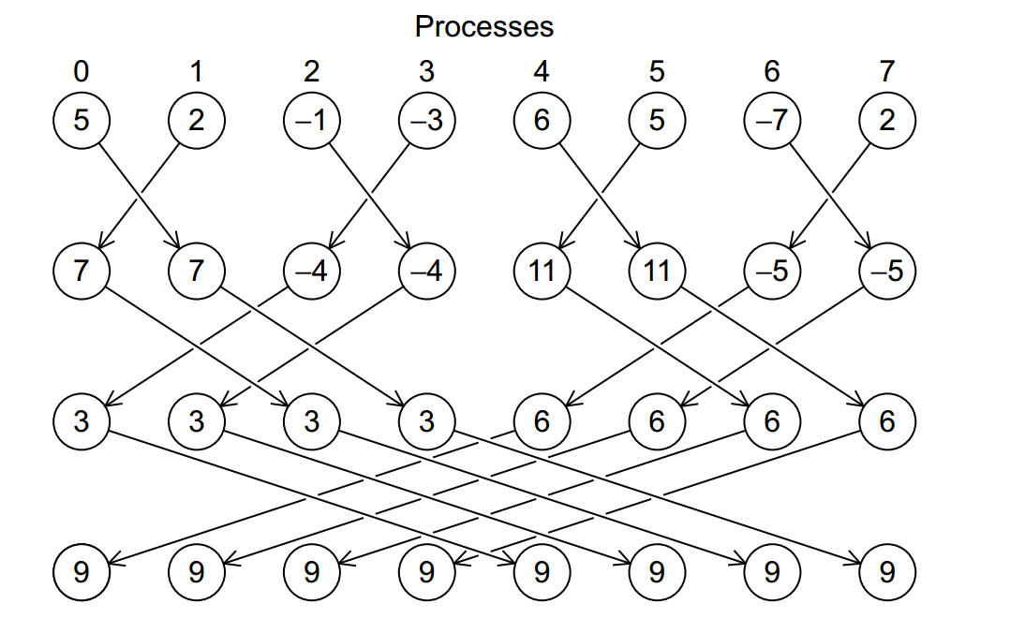
Illustration of In-Place AllReduce in MPI

Slide 39
HPC-ABDS
Spark Flink MPI Comparison

Slide 40

Flink MDS Dataflow Graph

Slide 41


MDS Results with Flink, Spark and MPI
MDS execution time on 16 nodes with 20 processes in each node with varying number of points
MDS execution time with 32000 points on varying number of nodes. Each node runs 20 parallel tasks
MDS performed poorly on Flink due to its lack of support for nested iterations. In Flink and Spark the algorithm doesn’t scale with the number of nodes.

Slide 42
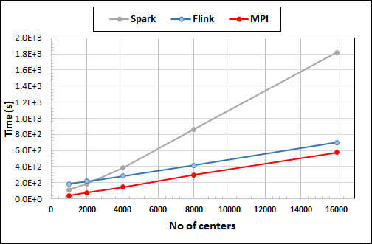
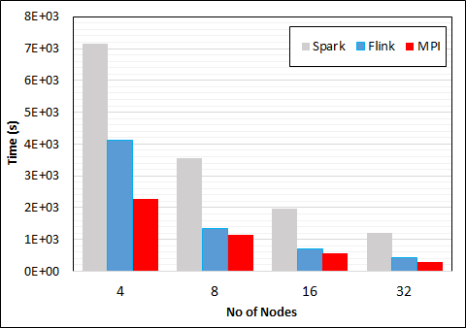
K-Means Clustering in Spark, Flink, MPI
Data Set <Points>
Dataflow for K-means
Data Set <Initial Centroids>
Map (nearest centroid calculation)
Reduce (update centroids)
Data Set <Updated Centroids>
Broadcast
K-Means execution time on 16 nodes with 20 parallel tasks in each node with 10 million points and varying number of centroids. Each point has 100 attributes.
K-Means execution time on varying number of nodes with 20 processes in each node with 10 million points and 16000 centroids. Each point has 100 attributes.
Notes:
Note the differences in communication architectures
Note times are in log scale
Bars indicate compute only times, which is similar across these frameworks
Overhead is dominated by communications in Flink and Spark

Slide 43
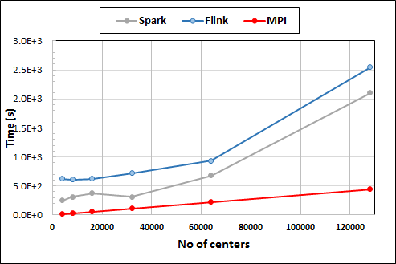
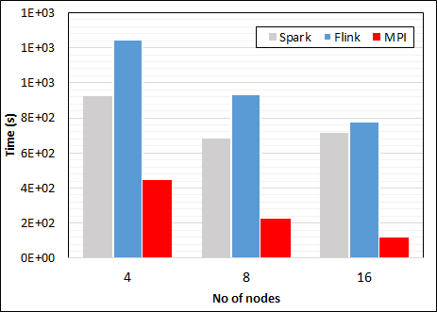
K-Means Clustering in Spark, Flink, MPI
K-Means execution time on 8 nodes with 20 processes in each node with 1 million points and varying number of centroids. Each point has 2 attributes.
K-Means execution time on varying number of nodes with 20 processes in each node with 1 million points and 64000 centroids. Each point has 2 attributes.
K-Means performed well on all three platforms when the computation time is high and communication time is low as illustrated in 10 million points and 10 iterations case. After lowering the computation and increasing the communication by setting the points to1 million and iterations to 100, the performance gap between MPI and the other two platforms increased.
Notes:
Note the differences in communication architectures
Note times are in log scale
Bars indicate compute only times, which is similar across these frameworks
Overhead is dominated by communications in Flink and Spark

Slide 44

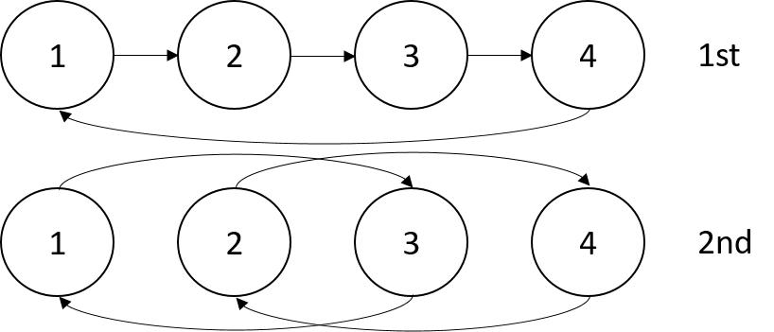

Sorting 1Tb of records
MPI Shuffling using a ring communication
Terasort flow
All three platforms worked relatively well because of the bulk nature of the data transfer.
Terasort execution time in 64 and 32 nodes. Only MPI shows the sorting time and communication time as other two frameworks doesn't provide a viable method to accurately measure them. Sorting time includes data save time. MPI-IB - MPI with Infiniband
Notes:
Note the differences in communication architectures
Note times are in log scale
Bars indicate compute only times, which is similar across these frameworks
Overhead is dominated by communications in Flink and Spark

Slide 45
HPC-ABDS
General Summary
DataFlow and In-place Runtime

Slide 46
HPC-ABDS Parallel Computing
MPI designed for fine grain case and typical of parallel computing used in large scale simulations
  Only change in model parameters are transmitted
  In-place implementation
  Synchronization important as parallel computing
Dataflow typical of distributed or Grid computing workflow paradigms
  Data sometimes and model parameters certainly transmitted
  If used in workflow, large amount of computing (>> communication) and no performance constraints from synchronization
  Caching in iterative MapReduce avoids data communication and in fact systems like TensorFlow, Spark or Flink are called dataflow but usually implement “model-parameter” flow
HPC-ABDS Plan: Add in-place implementations to ABDS when best performance keeping ABDS Interface as in next slide

Slide 47
Programming Model I
Programs are broken up into parts
  Functionally (coarse grain)
  Data/model parameter decomposition (fine grain)
Fine grain needs low latency or minimal data copying
Coarse grain has lower communication /
compute cost
MPI
Dataflow
Possible Iteration

Slide 48
Programming Model II
MPI designed for fine grain case and typical of parallel computing used in large scale simulations
  Only change in model parameters are transmitted
Dataflow typical of distributed or Grid computing paradigms
  Data sometimes and model parameters certainly transmitted
  Caching in iterative MapReduce avoids data communication and in fact systems like TensorFlow, Spark or Flink are called dataflow but usually implement “model-parameter” flow
Different Communication/Compute ratios seen in different cases with ratio (measuring overhead) larger when grain size smaller. Compare
  Intra-job reduction such as Kmeans clustering accumulation of center changes at end of each iteration and
  Inter-Job Reduction as at end of a query or word count operation

Slide 49
Programming Model Summary
Need to distinguish
  Grain size and Communication/Compute ratio (characteristic of problem or component (iteration) of problem)
  DataFlow versus “Model-parameter” Flow (characteristic of algorithm)
  In-Place versus Flow Software implementations
Inefficient to use same mechanism independent of characteristics
Classic Dataflow is approach of Spark and Flink so need to add parallel in-place computing as done by Harp for Hadoop
  TensorFlow uses In-Place technology
Note parallel machine learning (GML not LML) can benefit from HPC style interconnects and architectures as seen in GPU-based deep learning
  So commodity clouds not necessarily best

Slide 50
Streaming Applications and Technology

Slide 51
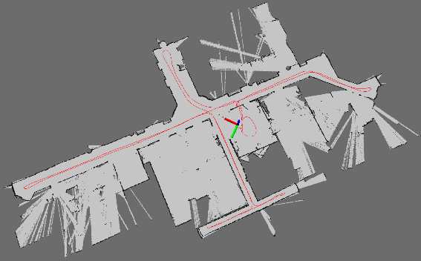
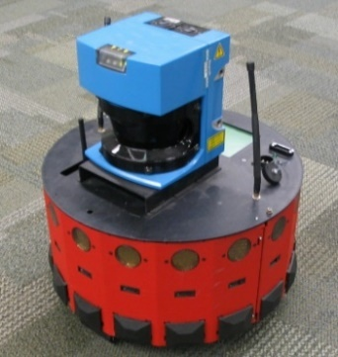
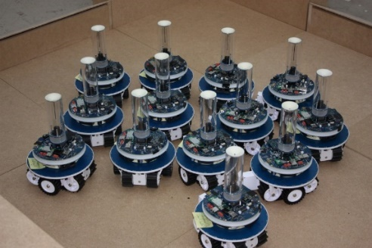
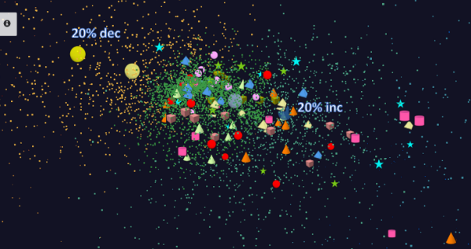
Adding HPC to Storm & Heron for Streaming
Robotics Applications
Time series data visualization in real time
Simultaneous Localization and Mapping
N-Body Collision
Avoidance
Map Built from
Robot data
Robot with a Laser Range Finder
Robots need to avoid collisions when they move
Map High dimensional data to 3D visualizer
Apply to Stock market data tracking 6000 stocks

Slide 52
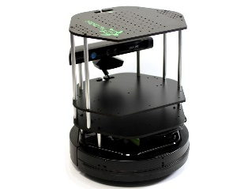
Data Pipeline
Sending to
pub-sub
Sending to
Persisting
storage
Multiple
streaming
workflows
Streaming
workflow
A stream application with some tasks running in parallel
Gateway
Message Brokers
RabbitMQ, Kafka
Streaming Workflows
Apache Heron and Storm
End to end delays without any processing is less than 10ms
Storm does not support “real parallel processing” within bolts – add optimized inter-bolt communication
Hosted on HPC and OpenStack cloud

Slide 53
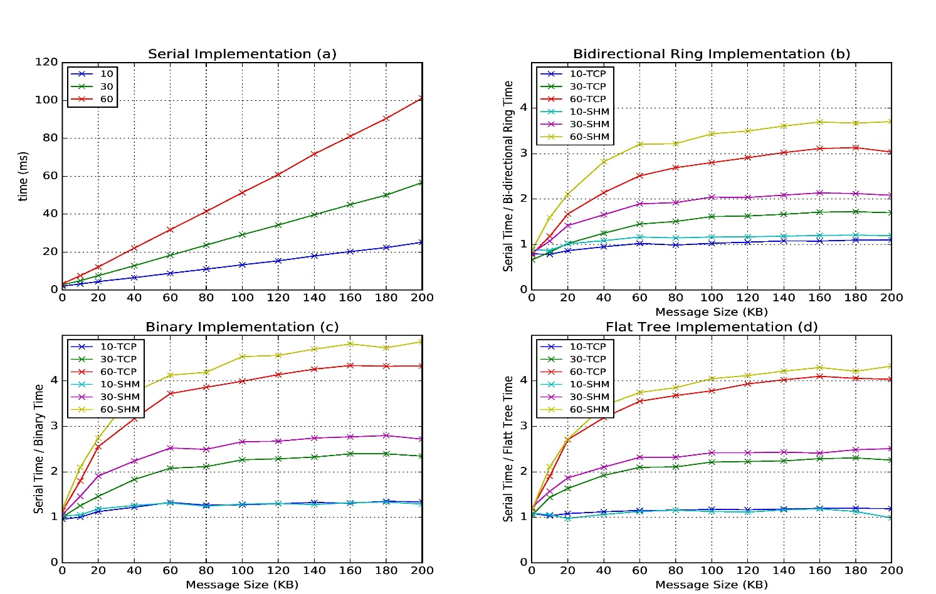
Improvement of Storm (Heron) using HPC communication algorithms
Latency of binary tree, flat tree and bi-directional ring implementations compared to serial implementation. Different lines show varying # of parallel tasks with either TCP communications and shared memory communications(SHM).
Original Time
Speedup Ring
Speedup Binary
Speedup Tree

Slide 54
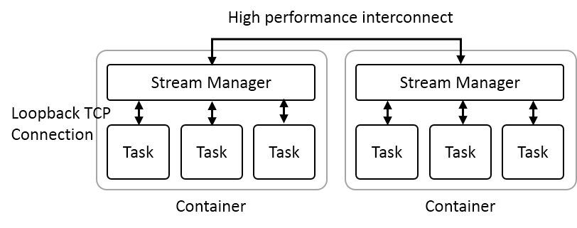
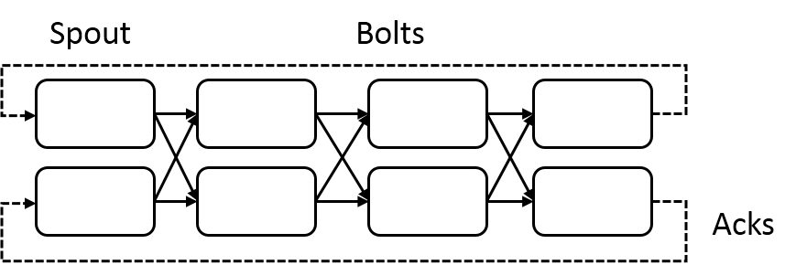
Heron Streaming Architecture
Add HPC
Infiniband
Omnipath
Inter node
Intranode
Typical Processing Topology
Parallelism 2; 4 stages

Slide 55
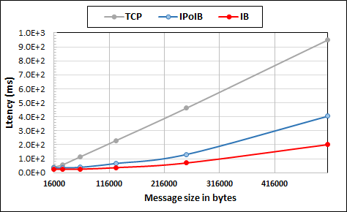
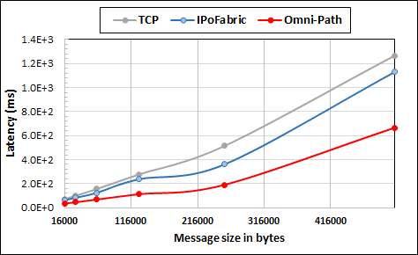
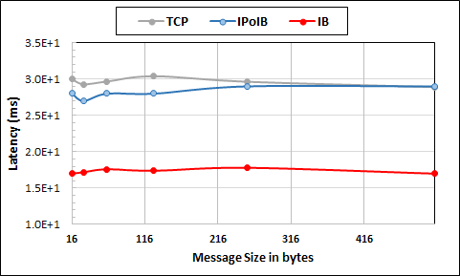
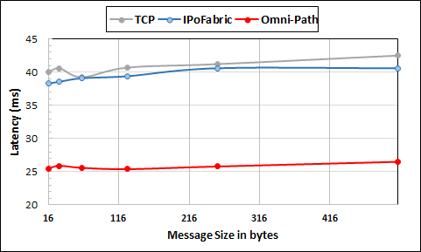
Intel Haswell Cluster with 2.4GHz Processors and 56Gbps Infiniband and 1Gbps Ethernet
Intel KNL Cluster with 1.4GHz Processors and 100Gbps Omni-Path and 1Gbps Ethernet
Large messages
Small messages
Parallelism of 2 and using 8 Nodes
Parallelism of 2 and using 4 Nodes
This is HPC Hardware and not parallel computing

Slide 56
Harp (Hadoop Plugin) brings HPC to ABDS
Judy Qiu: Iterative HPC communication; scientific data abstractions
Careful support of distributed data AND distributed model
Avoids parameter server approach but distributes model over worker nodes and supports collective communication to bring global model to each node
Integrated with Intel DaaL high performance node library
Applied first to Latent Dirichlet Allocation LDA with large model and data
Have also added HPC to Apache Storm and Heron
MapReduce Model
MapCollective Model
MapReduce Applications
MapCollective Applications
M
M
M
M
M
M
M
M
MapReduce V2
Harp
Shuffle
Collective Communication
R
R
YARN

Slide 57
MapCollective Model
Collective Communication Operations
Collective Communication Operations | Description
broadcast | The master worker broadcasts the partitions to the tables on other workers.
reduce | The partitions from all the workers are reduced to the table on the master worker.
allreduce | The partitions from all the workers are reduced in tables of all the workers.
allgather | Partitions from all the workers are gathered in the tables of all the workers.
regroup | Regroup partitions on all the workers based on the partition ID.
push & pull | Partitions are pushed from local tables to the global table or pulled from the global table to local tables.
rotate | Build a virtual ring topology, and rotate partitions from a worker to a neighbor worker.
Notes:
Explanation of collective communication operations

Slide 58
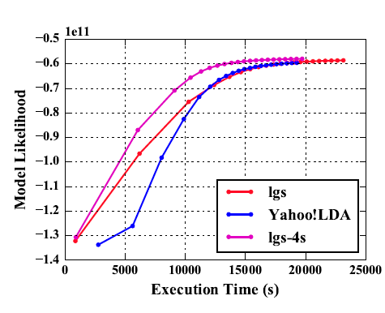
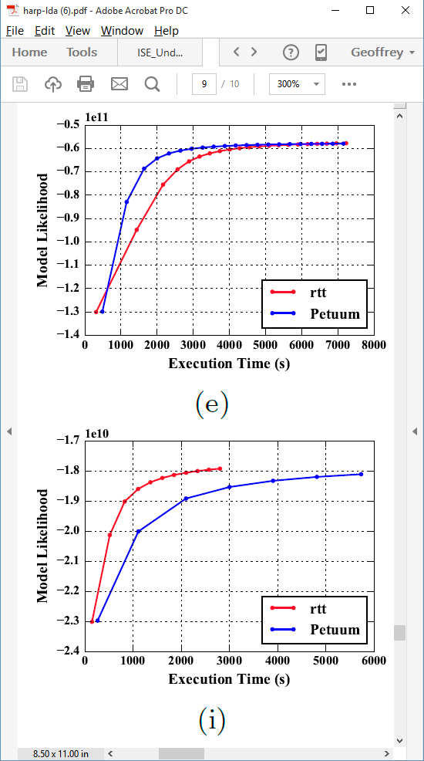
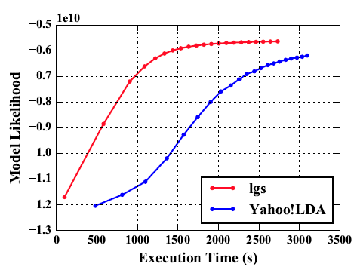
Latent Dirichlet Allocation on 100 Haswell nodes: red is Harp (lgs and rtt)
Clueweb
Clueweb
enwiki
Bi-gram

Slide 59
Collapsed Gibbs Sampling for Latent Dirichlet Allocation
45% faster
18% faster
Notes:
The execution time comparison between Harp and Petuum when the model is converged

Slide 60
Stochastic Gradient Descent for Matrix Factorization
58% faster
93% faster
Notes:
The execution time comparison between Harp and NOMAD when the model is converged

Slide 61
Hadoop + Harp + Intel DAAL High Performance node kernels
Harp offers HPC internode performance
Integration with Hadoop
Science Big Data interfaces
Integration with Intel HPC node libraries
Asynchronous update models

Slide 62
Knights Landing KNL Data Analytics: Harp, Spark, NOMAD
Single Node and Cluster performance: 1.4GHz 68 core nodes
Kmeans SGD ALS
Strong Scaling Multi Node Parallelism Scaling - Omnipath Interconnect
Strong Scaling Single Node Core Parallelism Scaling

Slide 63
HPCCloud and Summary of Big Data - Big Simulation Convergence
HPC-Clouds convergence? (easier than converging higher levels in stack)
Can HPC continue to do it alone?
Convergence Ogres/Diamonds
HPC-ABDS Software on differently optimized hardware infrastructure

Slide 64
HPCCloud Convergence Architecture
Running same HPC-ABDS software across all platforms but data management machine has different balance in I/O, Network and Compute from “model” machine
  Note data storage approach: HDFS v. Object Store v. Lustre style file systems is still rather unclear
The Model behaves similarly whether from Big Data or Big Simulation.
Data Management Model for Big Data
and Big Simulation
HPCCloud Capacity-style Operational Model matches hardware features with application requirements

Slide 65
Summary of Big Data HPC Convergence I
Applications, Benchmarks and Libraries
  51 NIST Big Data Use Cases, 7 Computational Giants of the NRC Massive Data Analysis, 13 Berkeley dwarfs, 7 NAS parallel benchmarks
  Unified discussion by separately discussing data & model for each application;
  64 facets– Convergence Diamonds -- characterize applications
  Characterization identifies hardware and software features for each application across big data, simulation; “complete” set of benchmarks (NIST)
Exemplar Ogre and Convergence Diamond Features
  Overall application structure e.g. pleasingly parallel
  Data Features e.g. from IoT, stored in HDFS ….
  Processing Features e.g. uses neural nets or conjugate gradient
  Execution Structure e.g. data or model volume
Need to distinguish data management from data analytics
Management and Search I/O intensive and suitable for classic clouds
  Science data has fewer users than commercial but requirements poorly understood
Analytics has many features in common with large scale simulations
  Data analytics often SPMD, BSP and benefits from high performance networking and communication libraries.
  Decompose Model (as in simulation) and Data (bit different and confusing) across nodes of cluster

Slide 66
Summary of Big Data HPC Convergence II
Software Architecture and its implementation
  HPC-ABDS: Cloud-HPC interoperable software: performance of HPC (High Performance Computing) and the rich functionality of the Apache Big Data Stack.
  Added HPC to Hadoop, Storm, Heron, Spark; could add to Beam and Flink
  Could work in Apache model contributing code in different ways
  One approach is an HPC project in Apache Foundation
HPCCloud runs same HPC-ABDS software across all platforms but “data management” nodes have different balance in I/O, Network and Compute from “model” nodes
  Optimize to data and model functions as specified by convergence diamonds rather than optimizing for simulation and big data
Convergence Language: Make C++, Java, Scala, Python (R) … perform well
Training: Students prefer to learn machine learning and clouds and need to be taught importance of HPC to Big Data
Sustainability: research/HPC communities cannot afford to develop everything (hardware and software) from scratch
HPCCloud 2.0 uses DevOps to deploy HPC-ABDS on clouds or HPC
HPCCloud 3.0 delivers Solutions as a Service

