Slide 1
Advances in Clouds and their application to Data Intensive problems
Electrical Engineering
University of Southern California
February 24 2012
Geoffrey Fox
gcf@indiana.edu
http://www.infomall.org http://www.salsahpc.org
Director, Digital Science Center, Pervasive Technology Institute
Associate Dean for Research and Graduate Studies, School of Informatics and Computing
Indiana University Bloomington
Work with Judy Qiu and several students

Slide 2
Topics Covered
Broad Overview: Data Deluge to Clouds
Internet of Things: Sensor Grids supported as pleasingly parallel applications on clouds
MapReduce and Iterative MapReduce for non trivial parallel “analytics” on Clouds
MapReduce and Twister on Azure
Clouds Grids and Supercomputers: Infrastructure and Applications
FutureGrid
Abstract Image management on FutureGrid

Slide 3
Broad Overview:
Data Deluge to Clouds

Slide 4

Some Trends
  The Data Deluge is clear trend from Commercial (Amazon, e-commerce) , Community (Facebook, Search) and Scientific applications
  Light weight clients from smartphones, tablets to sensors
  Multicore reawakening parallel computing
  Exascale initiatives will continue drive to high end with a simulation orientation
  Clouds with cheaper, greener, easier to use IT for (some) applications
  New jobs associated with new curricula
    Clouds as a distributed system (classic CS courses)
    Data Analytics (Important theme at SC11)
    Network/Web Science

Slide 5
Some Data sizes
  ~40 10⁹ Web pages at ~300 kilobytes each = 10 Petabytes
  Youtube 48 hours video uploaded per minute;
    in 2 months in 2010, uploaded more than total NBC ABC CBS
    ~2.5 petabytes per year uploaded?
  LHC 15 petabytes per year
  Radiology 69 petabytes per year
  Square Kilometer Array Telescope will be 100 terabits/second
  Earth Observation becoming ~4 petabytes per year
  Earthquake Science – few terabytes total today
  PolarGrid – 100’s terabytes/year
  Exascale simulation data dumps – terabytes/second

Slide 6
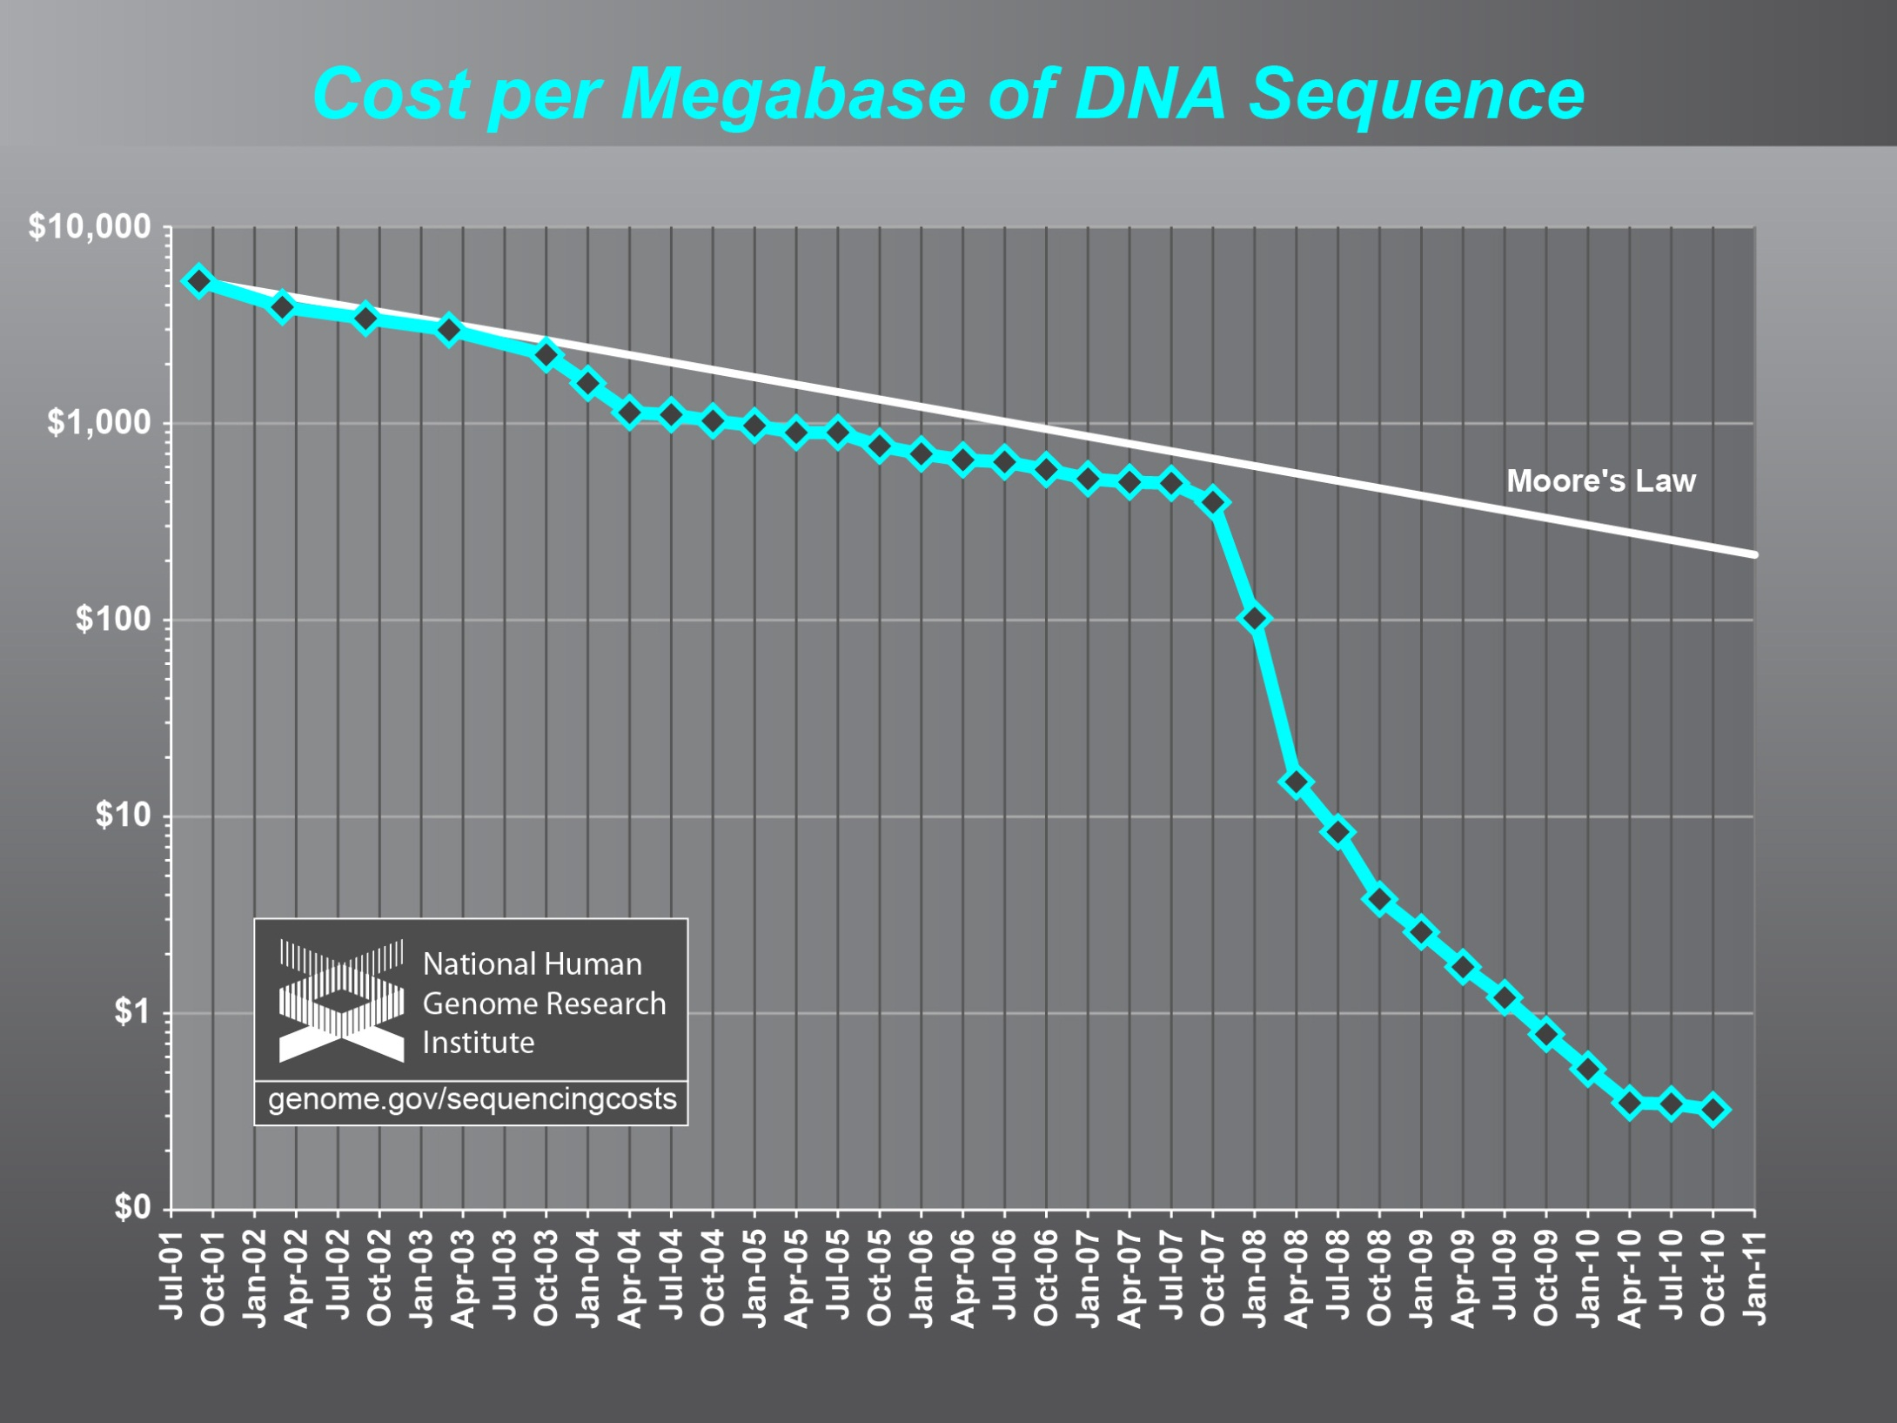
Why need cost effective
Computing!
Full Personal Genomics: 3 petabytes per day

Slide 7
Clouds Offer From different points of view
Features from NIST:
  On-demand service (elastic);
  Broad network access;
  Resource pooling;
  Flexible resource allocation;
  Measured service
Economies of scale in performance and electrical power (Green IT)
Powerful new software models
  Platform as a Service is not an alternative to Infrastructure as a Service – it is instead an incredible valued added
  Amazon is as much PaaS as Azure

Slide 8
The Google gmail example
http://www.google.com/green/pdfs/google-green-computing.pdf
Clouds win by efficient resource use and efficient data centers
Business Type | Number of users | # servers | IT Power per user | PUE (Power Usage effectiveness) | Total Power per user | Annual Energy per user
Small | 50 | 2 | 8W | 2.5 | 20W | 175 kWh
Medium | 500 | 2 | 1.8W | 1.8 | 3.2W | 28.4 kWh
Large | 10000 | 12 | 0.54W | 1.6 | 0.9W | 7.6 kWh
Gmail (Cloud) | ∞ | ∞ | < 0.22W | 1.16 | < 0.25W | < 2.2 kWh

Slide 9

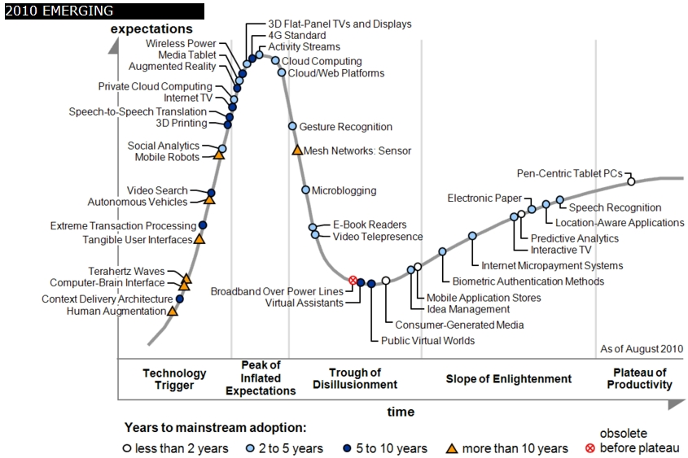
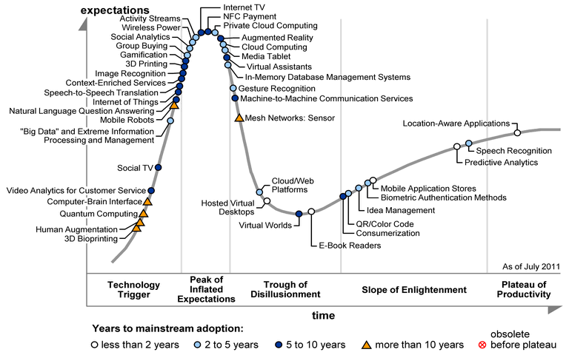
Gartner 2009 Hype Curve
Clouds, Web2.0, Green IT
Service Oriented Architectures

Slide 10


Slide 11

Jobs v. Countries

Slide 12
2 Aspects of Cloud Computing:
Infrastructure and Runtimes
Cloud infrastructure: outsourcing of servers, computing, data, file space, utility computing, etc..
Cloud runtimes or Platform: tools to do data-parallel (and other) computations. Valid on Clouds and traditional clusters
  Apache Hadoop, Google MapReduce, Microsoft Dryad, Bigtable, Chubby and others
  MapReduce designed for information retrieval but is excellent for a wide range of science data analysis applications
  Can also do much traditional parallel computing for data-mining if extended to support iterative operations
  Data Parallel File system as in HDFS and Bigtable

Slide 13
Internet of Things: Sensor Grids supported as pleasingly parallel applications on clouds

Slide 14
  Internet of Things: Sensor Grids
  A pleasingly parallel example on Clouds
  A sensor (“Thing”) is any source or sink of time series
    In the thin client era, smart phones, Kindles, tablets, Kinects, web-cams are sensors
    Robots, distributed instruments such as environmental measures are sensors
    Web pages, Googledocs, Office 365, WebEx are sensors
    Ubiquitous Cities/Homes are full of sensors
    They have IP address on Internet
  Sensors – being intrinsically distributed are Grids
  However natural implementation uses clouds to consolidate and control and collaborate with sensors
  Sensors are typically “small” and have pleasingly parallel cloud implementations

Slide 15








Sensors as a Service
Output Sensor
Sensors as a Service
A larger sensor ………
Sensor Processing as a Service (MapReduce)

Slide 16
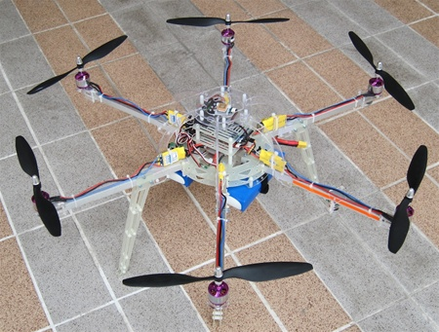
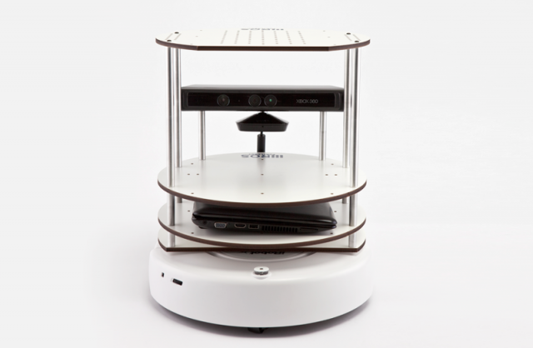
More on Sensors
Hardware sensors
1. GPS device
2. RFID reader and tags’ signal strength
3. Lego NXT Robots with:
a. Light b. Sound
c. Touch d. Ultrasonic
e. Compass f. Gyro
g. Accelerometer h. Temperature
4. Wii Remote Controller
5. Android Phones and Tablets
6. IP Cameras/microphones (RTSP, RTMP,HTTP)
7. Web Cameras/microphones
Computational services (software sensors)
1. Video Edge Detection
2. Video Face Detection
3. Twitter Sensor
4. Collaborative Sensors
a. Chat (with language translation)
b. File Transfer
Future Work
HexaCopter from jDrones
TurtleBot from Willow Garage

Slide 17
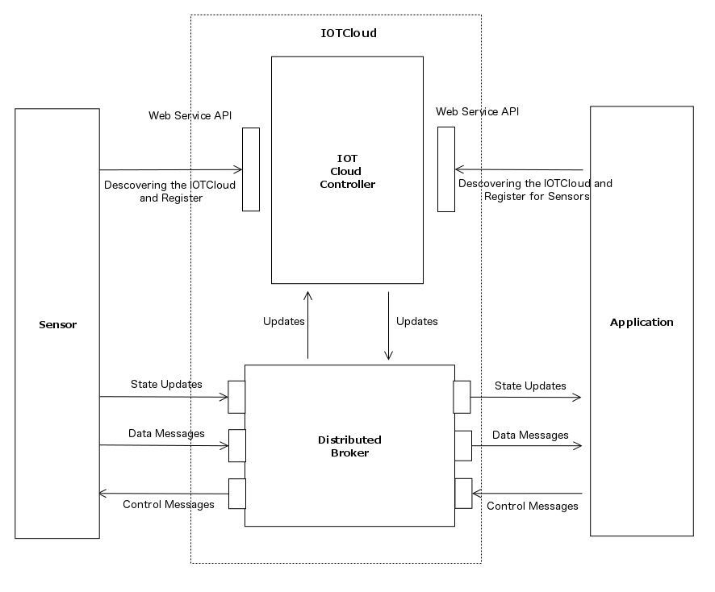
IoT Architecture

Slide 18
Performance of Pub-Sub Cloud Brokers
High end sensors equivalent to Kinect or MPEG4 TRENDnet TV-IP422WN camera at about 1.8Mbps per sensor instance
OpenStack hosted sensors and middleware

Slide 19
MapReduce and Iterative MapReduce for non trivial parallel applications on Clouds

Slide 20






MapReduce “File/Data Repository” Parallelism
Map = (data parallel) computation reading and writing data
Reduce = Collective/Consolidation phase e.g. forming multiple global sums as in histogram
Instruments
MPI or Iterative MapReduce
Map Reduce Map Reduce Map
Communication
Reduce
Portals
/Users
Disks
Map₁
Map₂
Map₃

Slide 21
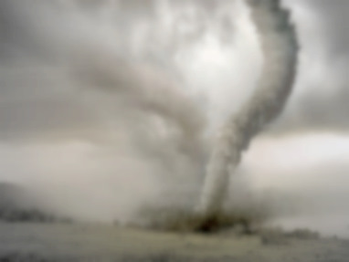
Twister v0.9
March 15, 2011
  New Interfaces for Iterative MapReduce Programming
  http://www.iterativemapreduce.org/
SALSA Group
Bingjing Zhang, Yang Ruan, Tak-Lon Wu, Judy Qiu, Adam Hughes, Geoffrey Fox, Applying Twister to Scientific Applications, Proceedings of IEEE CloudCom 2010 Conference, Indianapolis, November 30-December 3, 2010
Twister4Azure released May 2011
http://salsahpc.indiana.edu/twister4azure/
MapReduceRoles4Azure available for some time at
http://salsahpc.indiana.edu/mapreduceroles4azure/
Microsoft Daytona project July 2011 is Azure version

Slide 22

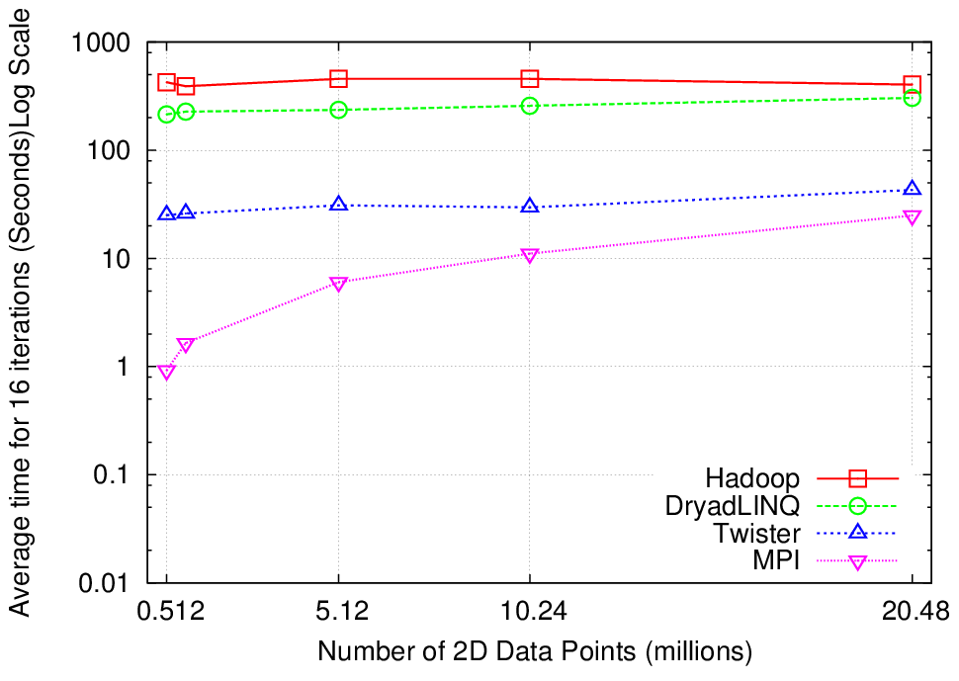
K-Means Clustering
Compute the distance to each data point from each cluster center and assign points to cluster centers
map
map
Time for 20 iterations
reduce
Compute new cluster
centers
User program
Compute new cluster centers
Iteratively refining operation
Typical MapReduce runtimes incur extremely high overheads
  New maps/reducers/vertices in every iteration
  File system based communication
Long running tasks and faster communication in Twister enables it to perform close to MPI

Slide 23


Twister
Pub/Sub Broker Network
Map Worker
M
Worker Nodes
R
Reduce Worker
Streaming based communication
Intermediate results are directly transferred from the map tasks to the reduce tasks – eliminates local files
Cacheable map/reduce tasks
  Static data remains in memory
Combine phase to combine reductions
User Program is the composer of MapReduce computations
Extends the MapReduce model to iterative computations
D
D
MR
Driver
User
Program
M
M
M
M
D
MRDeamon
R
R
R
R
Data Read/Write
Communication
Data Split
File System
Iterate
Static
data
Configure()
User Program
Map(Key, Value)
δ flow
Reduce (Key, List<Value>)
Combine (Key, List<Value>)
Different synchronization and intercommunication mechanisms used by the parallel runtimes
Close()

Slide 24
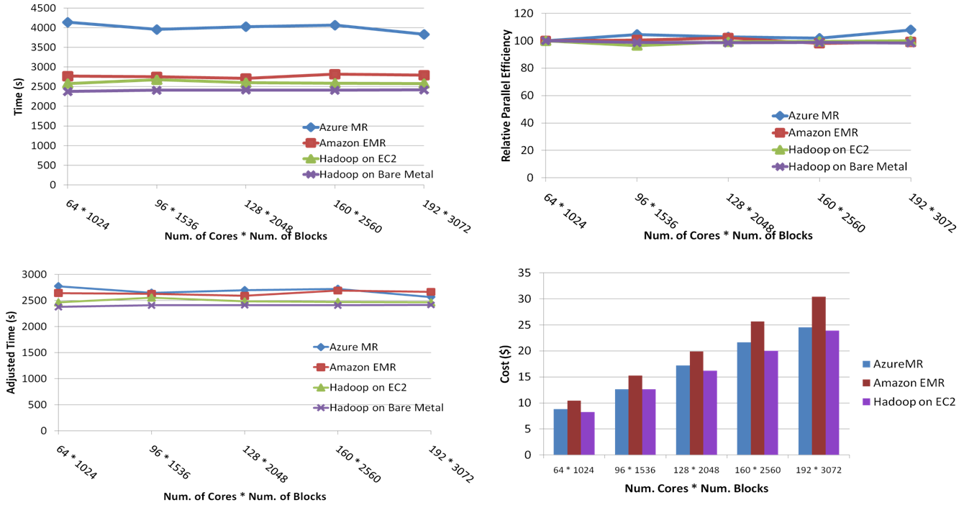
SWG Sequence Alignment Performance
Smith-Waterman-GOTOH to calculate all-pairs dissimilarity
Notes:
~123 million sequence alignments, for under 30$ with zero up front hardware cost,

Slide 25

Performance of Pagerank using
ClueWeb Data (Time for 20 iterations)
using 32 nodes (256 CPU cores) of Crevasse

Slide 26
Map Collective Model (Judy Qiu)
Combine MPI and MapReduce ideas
Implement collectives optimally on Infiniband, Azure, Amazon ……
Iterate
Input
map
Most Parallel Programs consist of loosely synchronized succession of compute-communicate stages.
MPI Collectives supported this
MapReduce shows how high-level collective patterns can improve the MPI model – this broad idea actually well used in classic parallel computing
Compute
Communicate
Compute
Communicate
Initial Collective Step
Network of Brokers
Generalized Reduce
Final Collective Step
Network of Brokers

Slide 27
Execution Time Improvements
Applying well known polyalgorithm approach to MPI to (Iterative) MapReduce
Looking at best Infiniband approaches

Slide 28
Twister on Azure

Slide 29
High Level Flow Twister4Azure
Map
Combine
Job Start
Map
Reduce
Combine
Merge
Add Iteration?
Job Finish
Reduce
No
Map
Combine
Yes
Data Cache
Merge Step
In-Memory Caching of static data
Cache aware scheduling
Azure Queues for scheduling, Tables to store meta-data and monitoring data, Blobs for input/output/intermediate data storage.
Notes:
In our current work, we extend MR4Azure to support iterative mapreduce computations. We added an additional merge step to the programming model, where the computations decides whether to go for a new iteration or not. We also support in-memory caching of static data between iterations and we developed a hybrid scheduling strategy to perform cache aware scheduling.

Slide 30
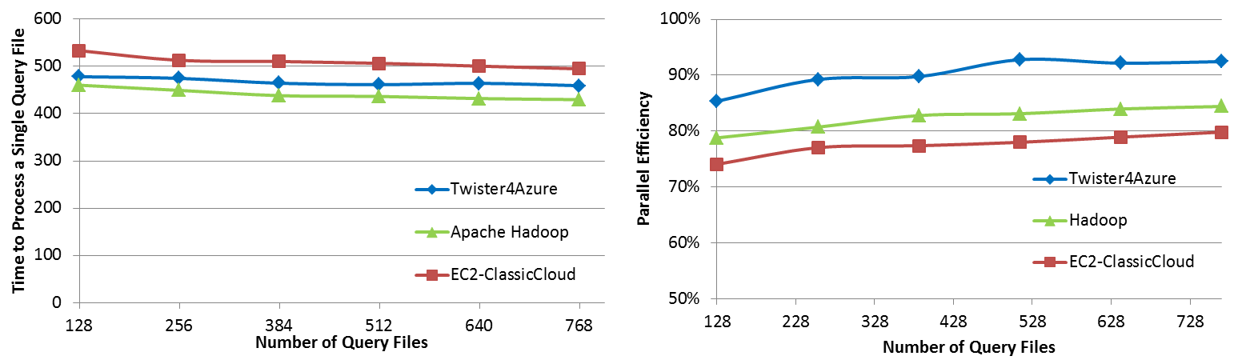

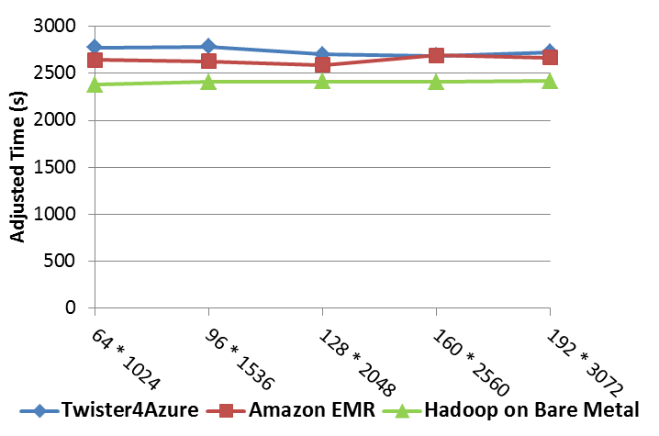
Simple Performance Comparisons
BLAST Sequence Search
Smith Waterman Sequence Alignment
Cap3 Sequence Assembly

Slide 31
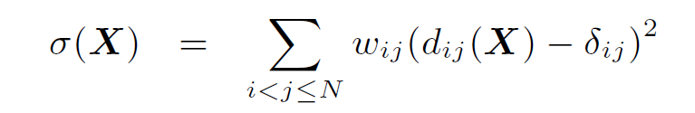
Look at one problem in detail
Visualizing Metagenomics where sequences are ~1000 dimensions
Map sequences to 3D so you can visualize
Minimize Stress
Improve with deterministic annealing (gives lower stress with less variation between random starts)
Need to iterate Expectation Maximization
N² dissimilarities (Smith Waterman, Needleman-Wunsch, Blast) δ_{i j}
Communicate N positions X between steps

Slide 32
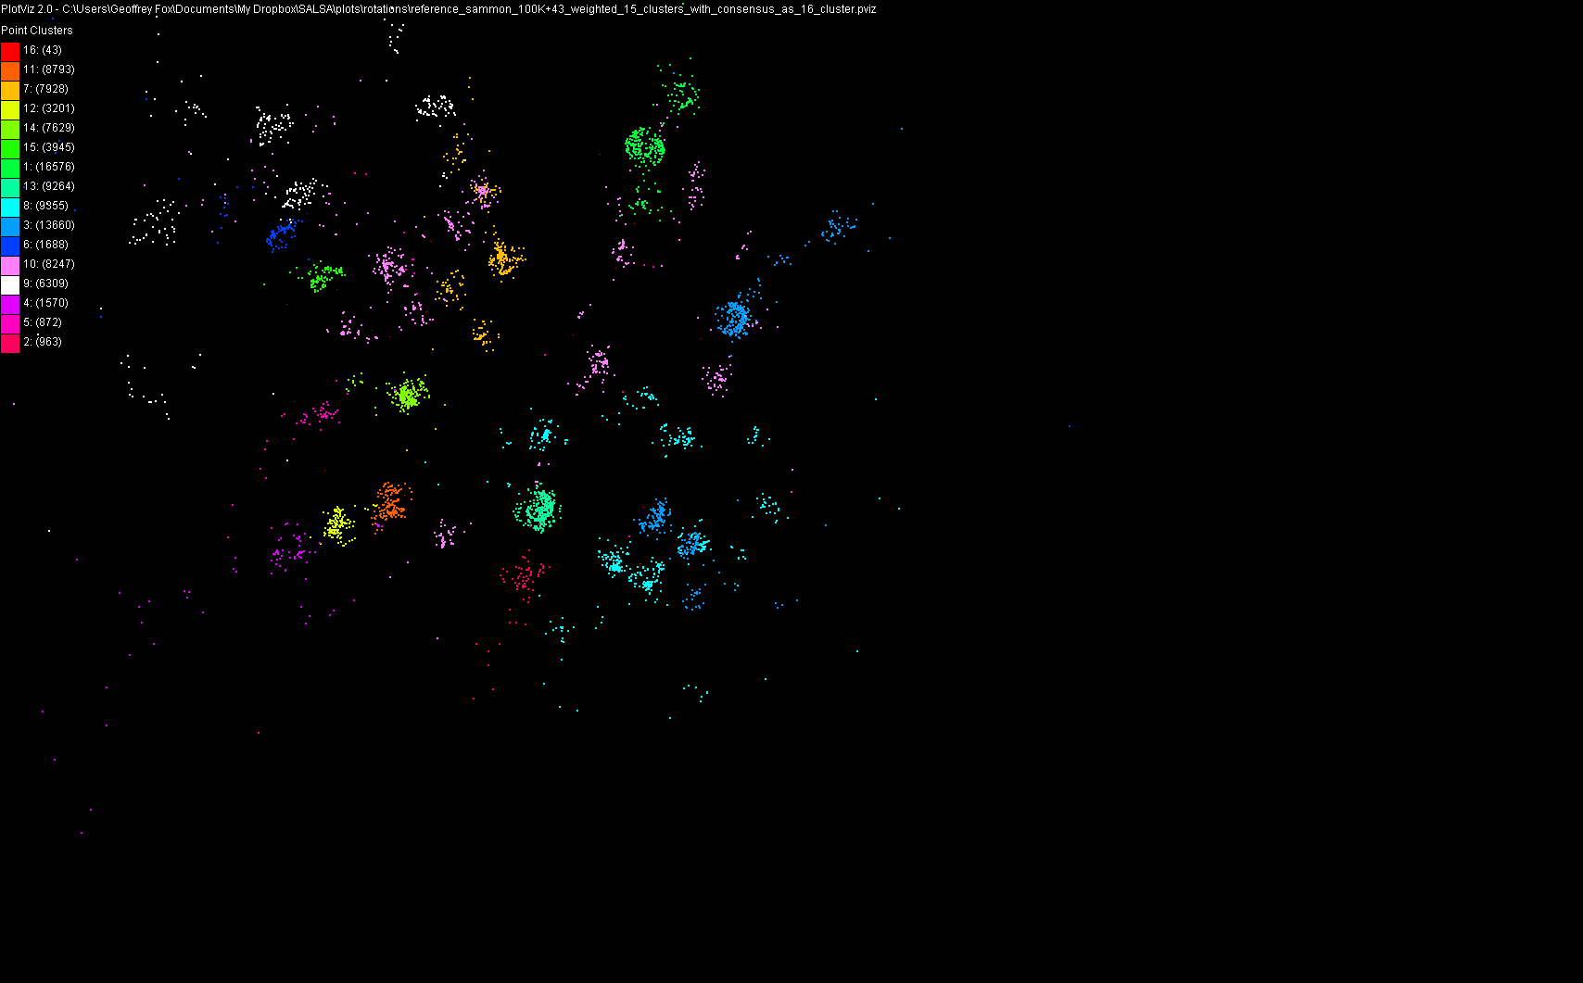
100,043 Metagenomics Sequences mapped to 3D

Slide 33
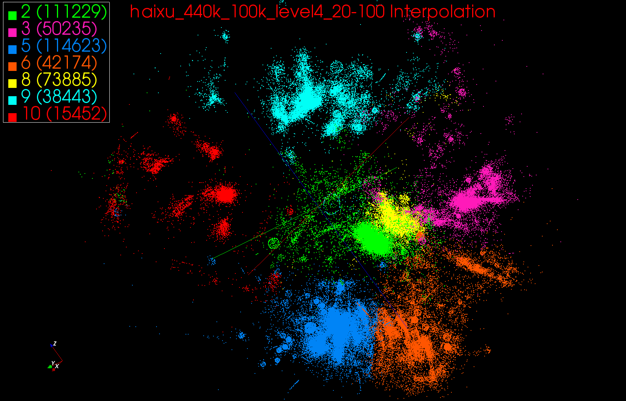
440K Interpolated

Slide 34
Multi-Dimensional-Scaling
Many iterations
Memory & Data intensive
3 Map Reduce jobs per iteration
X_{k} = invV * B(X_{(k-1)}) * X_{(k-1)}
2 matrix vector multiplications termed BC and X
BC: Calculate BX
X: Calculate invV (BX)
Calculate Stress
Map
Reduce
Merge
Map
Reduce
Merge
Map
Reduce
Merge
New Iteration

Slide 35
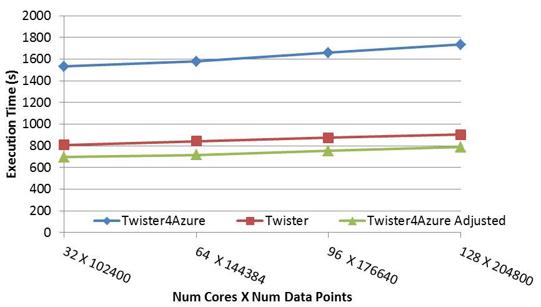
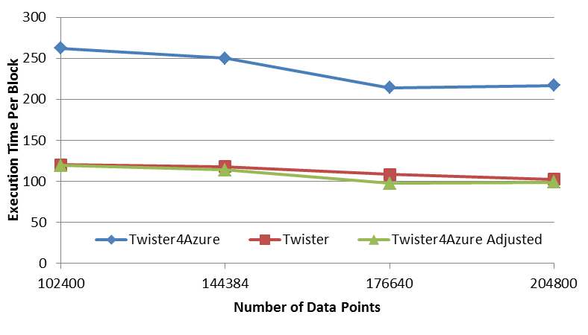




Performance – Multi Dimensional Scaling
Performance adjusted for sequential performance difference
Weak Scaling
Data Size Scaling
Performance with/without
data caching
Speedup gained using data cache
Scaling speedup
Increasing number of iterations
Notes:
The Java HPC Twister experiment was performed in a dedicated large-memory cluster of Intel(R) Xeon(R) CPU E5620 (2.4GHz) x 8 cores with 192GB memory per compute node and with Gigabit Ethernet on Linux. Java HPC Twister results do not include the initial data distribution time.
Azure large instances with 4 workers per instances is used. Memory mapped based caching and AllGather primitive are used.
Left: Weak scaling where workload per core is ~constant. Ideal is a straight horizontal line. X axis is
Right: Data size scaling with 128 Azure small instances/cores, 20 iterations.
The Twister4Azure adjusted (t_{a}) depicts the performance of Twister4Azure normalized according to the sequential MDS BC calculation and Stress calculation performance ratio between the Azure(t_{sa}) and Cluster(t_{sc}) environments used for Java HPC Twister. It is calculated using t_{a} x (t_{sc}/t_{sa}). This estimation however does not account for the overheads that remain constant irrespective of the computation time. Hence Twister4Azure seems to perform better, but in reality when the task execution times become smaller, twister4Azure overheads will become relatively larger and the performance would not be as good as shown in the adjusted curve.

Slide 36

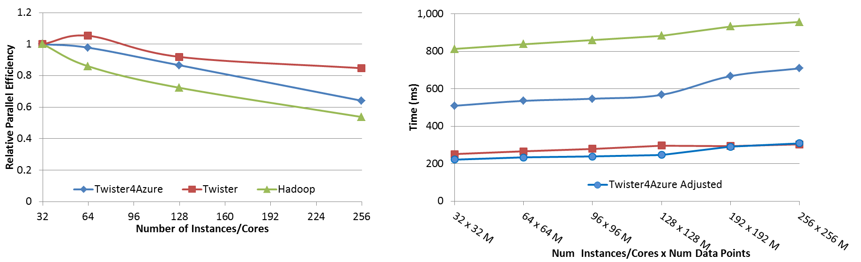
Performance – Kmeans Clustering
Overhead between iterations
First iteration performs the initial data fetch
Task Execution Time Histogram
Number of Executing Map Task Histogram
Scales better than Hadoop on bare metal
Strong Scaling with 128M Data Points
Weak Scaling
Performance with/without
data caching
Speedup gained using data cache
Scaling speedup
Increasing number of iterations
Notes:
Right(c): Twister4Azure executing Map Task histogram for 128 million data points in 128 Azure small instances
Figure 5. KMeansClustering Scalability. Left(a): Relative parallel efficiency of strong scaling using 128 million data points.
Center(b): Weak scaling. Workload per core is kept constant (ideal is a straight horizontal line).

Slide 37
Data Caching
In-memory and disk caching
  Loop-invariant data
  Any other shared data (eg: broadcast data)
  Loop-invariant and other shared data (eg: broadcast data)
    Disk Caching – up to 50% speedups over non-cached
    In-Memory – up to 22% speedups over disk caching
  Least Recently Used (LRU) cache invalidation

Slide 38
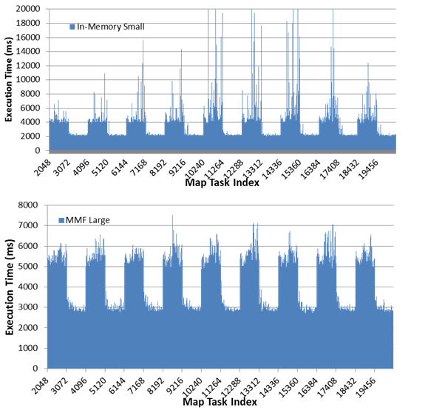
Memory Caching performance anomaly
In-Memory caching
  Inconsistencies with high memory applications
Disk caching
  performance inconsistencies with disk I/O
.Net Memory Mapped file based caching
  Stable performance
  Works better on larger instances
Mechanism | Instance Type | Total Execution Time (s) | Task Time (BCCalc) |  |  | Map F^{n} Time (BCCalc)
 |  |  | Average (ms) | STDEV (ms) | # of slow tasks | Average (ms) | STDEV (ms) | # of slow tasks
Disk Cache only | small * 1 | 2676 | 6,390 | 750 | 40 | 3,662 | 131 | 0
In-Memory Cache | small * 1 | 2072 | 4,052 | 895 | 140 | 3,924 | 877 | 143
Memory Mapped File (MMF) Cache | large * 4 | 1876 | 5,052 | 371 | 6 | 4,928 | 357 | 4
Notes:
With in-memory caching, ocasional non-deterministic fluctuations of the Map function execution times.
Duplicate executions do not work here, as duplicate data download is much more costly
Local disk-only caching is better in terms of Map function execution time, but the total execution time fluctuates. (total time includes reading data from disk and disk I/O seems to fluctuate)
A memory-mapped file contains the contents of a file mapped to the virtual memory and can be read or modified directly through memory.
.NET framework version 4 introduces first class support for memory-mapped files to .NET world.
.NET memory mapped files facilitate the creation of a memory-mapped file directly in the memory, with no associated physical file
We use this feature to implement the Twister4Azure in-memory data cache.
In this implementation, Twister4Azure fetch the data directly to the memory-mapped file and the memory mapped file will be reused across the iterations.
With in-memory caching, the performance on larger Azure instances (with number of workers equal to the number of cores) was very unstable. On the contrary, when using memory-mapped caching, the execution times were more stable on the larger instances than in smaller instances.
Usage of larger instances improves the data sharing across workers, facilitate better load balancing within the instances, provide better deployment stability, reduce the data broadcasting load and simplify the cluster monitoring.
The memory-mapped file based caching requires the data to be parsed (decoded) each time the data is used adding an overhead to the task execution times. In order to avoid duplicate loading of data products to memory, we use real time data parsing in the case of memory-mapped files. Hence, the parsing overhead becomes part of the Map function execution time. However, we find that the execution time stability advantage outweighs the added cost.

Slide 39
Iterative MapReduce Collective Communication Operations
Supports common higher-level communication patterns
  Substitutes certain steps of the computation
Framework can optimize these operations transparently to users
Ease of use
  Don’t have to implement the steps substituted by these operations
SumReduce
  Addition of single value numerical outputs of Map Tasks
AllGather
  Already 8% improvement in execution time

Slide 40
Clouds Grids and Supercomputers: Infrastructure and Applications

Slide 41
What Applications work in Clouds
Workflow and Services
Pleasingly parallel applications of all sorts analyzing roughly independent data or spawning independent simulations including
  Long tail of science
  Integration of distributed sensor data
Science Gateways and portals
Commercial and Science Data analytics that can use MapReduce (some of such apps) or its iterative variants (most analytic apps)
Note Data Analysis requirements not well articulated in many fields – See http://www.delsall.org for life sciences

Slide 42
Clouds and Grids/HPC
Synchronization/communication Performance
Grids > Clouds > HPC Systems
Clouds appear to execute effectively Grid workloads but are not easily used for closely coupled HPC applications
Service Oriented Architectures and workflow appear to work similarly in both grids and clouds
Assume for immediate future, science supported by a mixture of
  Clouds – data analysis (and pleasingly parallel)
  Grids/High Throughput Systems (moving to clouds as convenient)
  Supercomputers (“MPI Engines”) going to exascale

Slide 43
Application Classification
(a) Map Only
(b) Classic MapReduce
(c) Iterative MapReduce
(d) Loosely Synchronous
Input
Input
Iterations
Input
map
map
map
P_{ij}
reduce
reduce
Output
BLAST Analysis
Smith-Waterman Distances
Parametric sweeps
PolarGrid Matlab data analysis
High Energy Physics (HEP) Histograms
Distributed search
Distributed sorting
Information retrieval
Expectation maximization clustering e.g. Kmeans
Linear Algebra
Multimensional Scaling
Page Rank
Many MPI scientific applications such as solving differential equations and particle dynamics
Domain of MapReduce and Iterative Extensions
MPI

Slide 44
FutureGrid in a Nutshell

Slide 45
FutureGrid key Concepts I
FutureGrid is an international testbed modeled on Grid5000
Supporting international Computer Science and Computational Science research in cloud, grid and parallel computing (HPC)
  Industry and Academia
  Note much of current use Education, Computer Science Systems and Biology/Bioinformatics
The FutureGrid testbed provides to its users:
  A flexible development and testing platform for middleware and application users looking at interoperability, functionality, performance or evaluation
  Each use of FutureGrid is an experiment that is reproducible
  A rich education and teaching platform for advanced cyberinfrastructure (computer science) classes

Slide 46

FutureGrid key Concepts II
Rather than loading images onto VM’s, FutureGrid supports Cloud, Grid and Parallel computing environments by dynamically provisioning software as needed onto “bare-metal” using Moab/xCAT
  Image library for MPI, OpenMP, Hadoop, Dryad, gLite, Unicore, Globus, Xen, ScaleMP (distributed Shared Memory), Nimbus, Eucalyptus, OpenStack, KVM, Windows …..
Growth comes from users depositing novel images in library
FutureGrid has ~4000 (will grow to ~5000) distributed cores with a dedicated network and a Spirent XGEM network fault and delay generator
Image1
Image2
…
ImageN
Choose
Load
Run

Slide 47

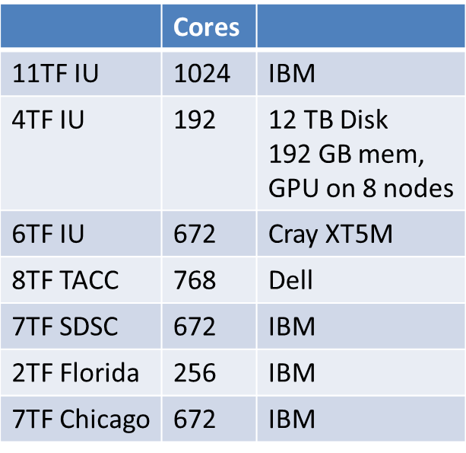
FutureGrid: a Grid/Cloud/HPC Testbed
 | Cores
11TF IU | 1024 | IBM
4TF IU | 192 | 12 TB Disk 192 GB mem, GPU on 8 nodes
6TF IU | 672 | Cray XT5M
8TF TACC | 768 | Dell
7TF SDSC | 672 | IBM
2TF Florida | 256 | IBM
7TF Chicago | 672 | IBM
NID: Network Impairment Device
Private
Public
FG Network
Upgrades include
Larger memory 192GB/node
12 TB disk per node
GPU ScaleMP

Slide 48
FutureGrid Partners
Indiana University (Architecture, core software, Support)
Purdue University (HTC Hardware)
San Diego Supercomputer Center at University of California San Diego (INCA, Monitoring)
University of Chicago/Argonne National Labs (Nimbus)
University of Florida (ViNE, Education and Outreach)
University of Southern California Information Sciences (Pegasus to manage experiments)
University of Tennessee Knoxville (Benchmarking)
University of Texas at Austin/Texas Advanced Computing Center (Portal)
University of Virginia (OGF, Advisory Board and allocation)
Center for Information Services and GWT-TUD from Technische Universtität Dresden. (VAMPIR)
Red institutions have FutureGrid hardware

Slide 49
5 Use Types for FutureGrid
~122 approved projects over last 12 months
Training Education and Outreach (11%)
  Semester and short events; promising for non research intensive universities
Interoperability test-beds (3%)
  Grids and Clouds; Standards; Open Grid Forum OGF really needs
Domain Science applications (34%)
  Life sciences highlighted (17%)
  Computer science (41%)
  Largest current category
Computer Systems Evaluation (29%)
  TeraGrid (TIS, TAS, XSEDE), OSG, EGI, Campuses
Clouds are meant to need less support than other models; FutureGrid needs more user support …….

Slide 50
Software Components
Portals including “Support” “use FutureGrid” “Outreach”
Monitoring – INCA, Power (GreenIT)
Experiment Manager: specify/workflow
Image Generation and Repository
Intercloud Networking ViNE
Virtual Clusters built with virtual networks
Performance library
Rain or Runtime Adaptable InsertioN Service for images
Security Authentication, Authorization,
“Research”
Above and below
Nimbus OpenStack Eucalyptus

Slide 51
RAIN related Terminology
Image Management provides the low level software (create, customize, store, share and deploy images) needed to achieve Dynamic Provisioning and Rain
Abstract Image Management stores templates to create images suitable for different environments
Dynamic Provisioning is in charge of providing machines with the requested OS. The requested OS must have been previously deployed in the infrastructure
RAIN is our highest level component that uses Dynamic Provisioning and Image Management to provide custom environments that may or may not exits. Therefore, a Rain request may involve the creation, deployment and provision of one or more images in a set of machines

Slide 52
Architecture
Notes:
IM provides a unified environment to create and maintain VM and bare-metal images
Integrate images through a repository to instantiate services on demand with RAIN
Essentially enables the rapid development and deployment of Platform services on FutureGrid infrastructure

Slide 53
Image Generation
  Creates and customizes images according to user:
  OS type
  OS version
  Architecture
  Software Packages
Image is stored in the Image Repository or returned to the users
Images are not aimed to any specific infrastructure

Slide 54
Image Deployment
Customizes images for specific infrastructures and deploys them
  Decides if an image is secure enough to be deployed or if it needs additional security tests
Two main infrastructures types
  HPC deployment: Create network bootable images that can run in bare metal machines
  Cloud deployment: Convert the images in VMs
Notes:
Customizes images (network IP, DNS, file system table, kernel modules, etc) for specific infrastructures and and deploys them

Slide 55
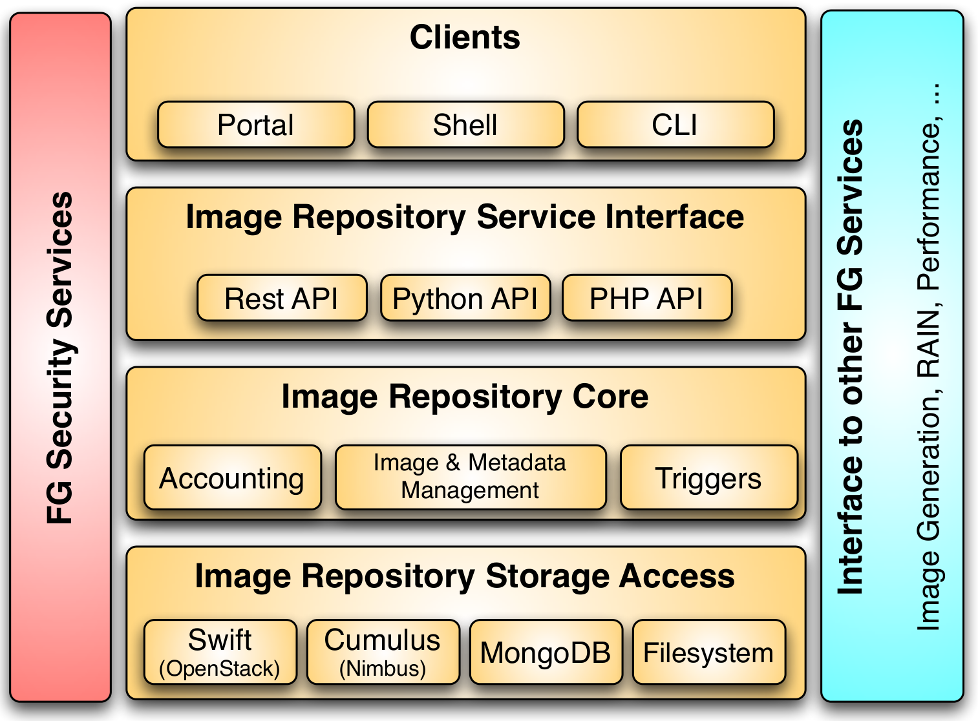
Image Repository Architecture

Slide 56
Image Generation
  Creates and customizes images according to user requirements
  Images are not aimed to any specific infrastructure

Slide 57
Image Deployment
Customizes and deploys images for specific infrastructures
Two main infrastructures types:
HPC Deployment
Cloud Deployment
https://portal.futuregrid.org

Slide 58
Dynamic Provisioning Scalability Test
HPC including reboot

Slide 60
FutureGrid in a nutshell
The FutureGrid project mission is to enable experimental work that advances:
  Innovation and scientific understanding of distributed computing and parallel computing paradigms,
  The engineering science of middleware that enables these paradigms,
  The use and drivers of these paradigms by important applications, and,
  The education of a new generation of students and workforce on the use of these paradigms and their applications.
The implementation of mission includes
  Distributed flexible hardware with supported use
  Identified IaaS and PaaS “core” software with supported use
    Growing list of software from FG partners and users
  Outreach

Slide 61
EXTRAS

Slide 62
Genomics in Personal Health
  Suppose you measured everybody’s genome every 2 years
    30 petabits of new gene data per day
    factor of 100 more for raw reads with coverage
  Data surely distributed
  1.5*10⁸ to 1.5*10¹⁰ continuously running present day cores to perform a simple Blast analysis on this data
    Amount depends on clever hashing and maybe Blast not good enough as field gets more sophisticated

Slide 63
Clouds and Jobs
Clouds are a major industry thrust with a growing fraction of IT expenditure that IDC estimates will grow to $44.2 billion direct investment in 2013 while 15% of IT investment in 2011 will be related to cloud systems with a 30% growth in public sector.
Gartner also rates cloud computing high on list of critical emerging technologies with for example “Cloud Computing” and “Cloud Web Platforms” rated as transformational (their highest rating for impact) in the next 2-5 years.
Correspondingly there is and will continue to be major opportunities for new jobs in cloud computing with a recent European study estimating there will be 2.4 million new cloud computing jobs in Europe alone by 2015.
Cloud computing spans research and economy and so attractive component of curriculum for students that mix “going on to PhD” or “graduating and working in industry” (as at Indiana University where most CS Masters students go to industry)

Slide 64
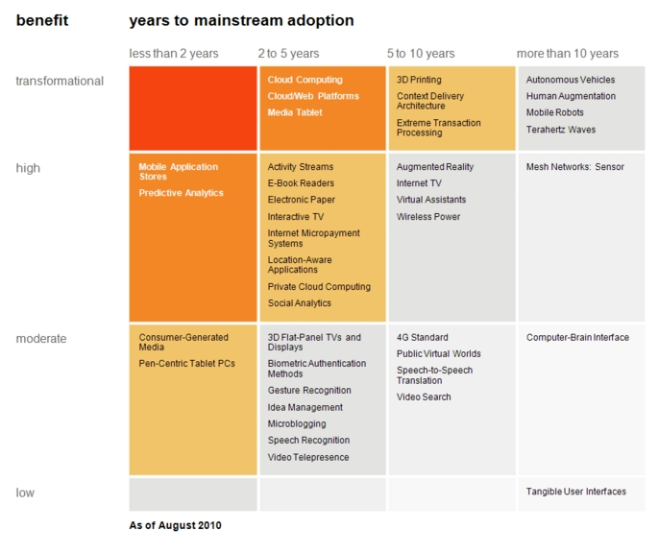
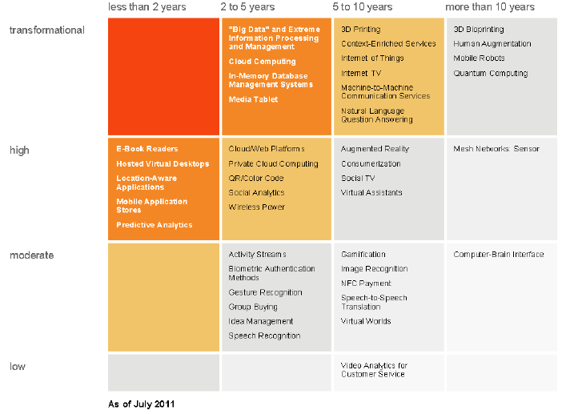
“Big Data” and Extreme
Information Processing and Management
Cloud Computing
In-memory Database Management Systems
Media Tablet
Transformational
High
Moderate
Low
Cloud Computing
Cloud Web Platforms
Media Tablet
Cloud/Web Platforms
Private Cloud Computing
QR/Color Bar Code
Social Analytics
Wireless Power

Slide 65
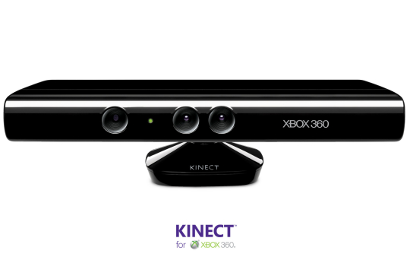




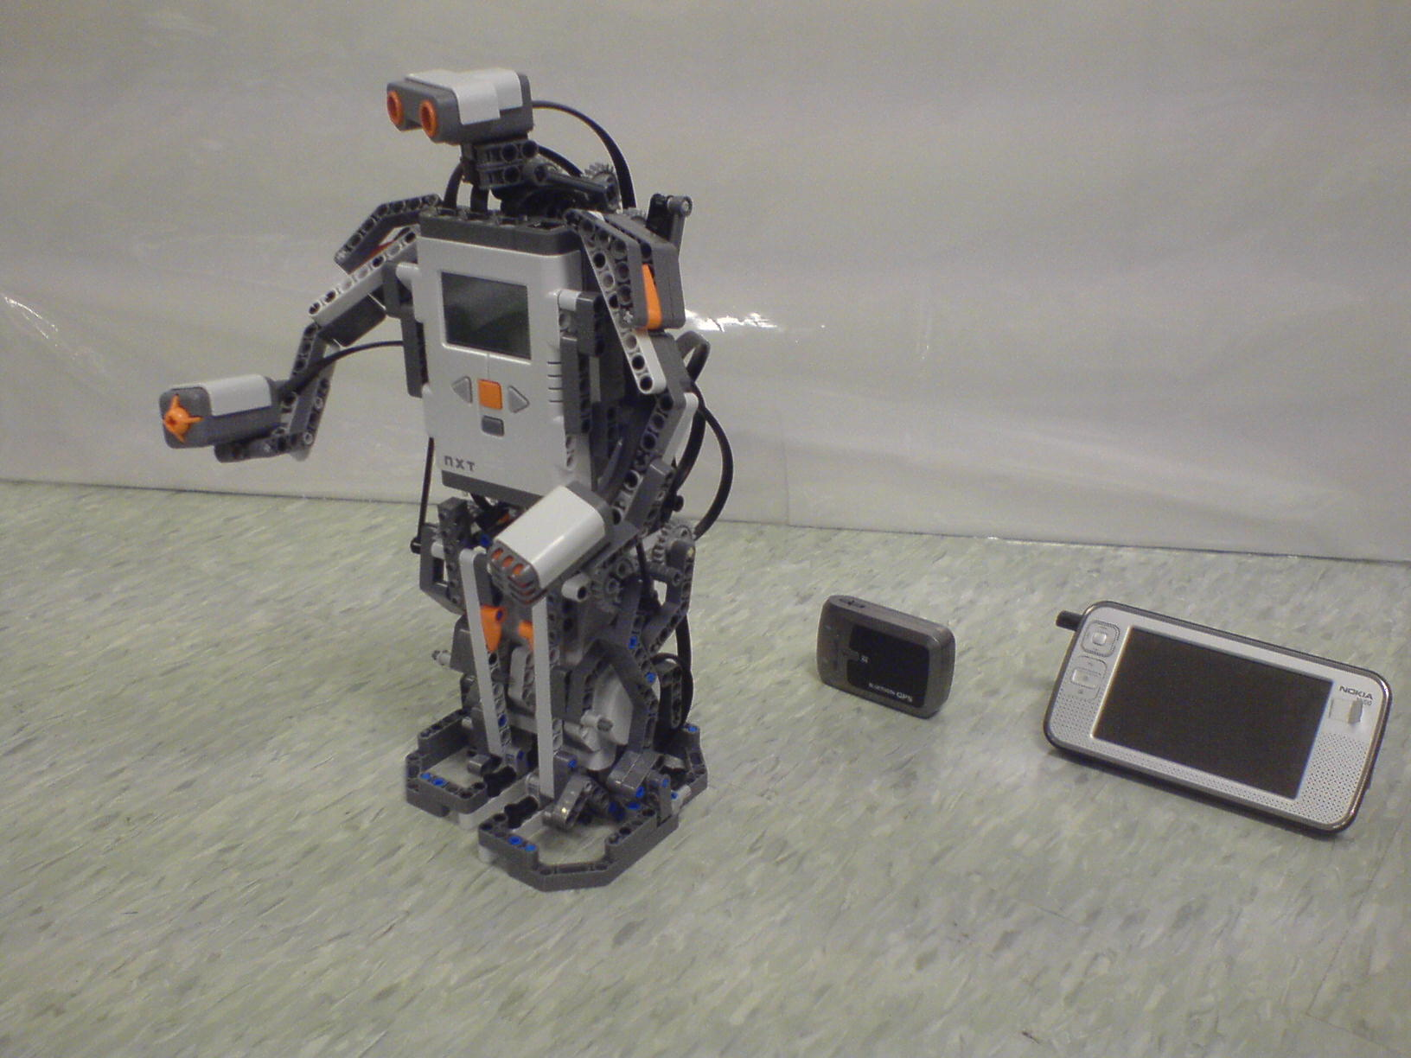
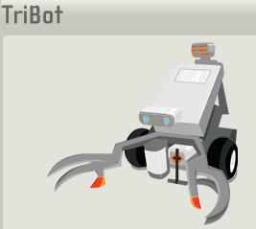
Some Sensors
Cellphones
Laptop for PowerPoint
Surveillance Camera
RFID Reader
RFID Tag
Lego Robot GPS Nokia N800

Slide 66
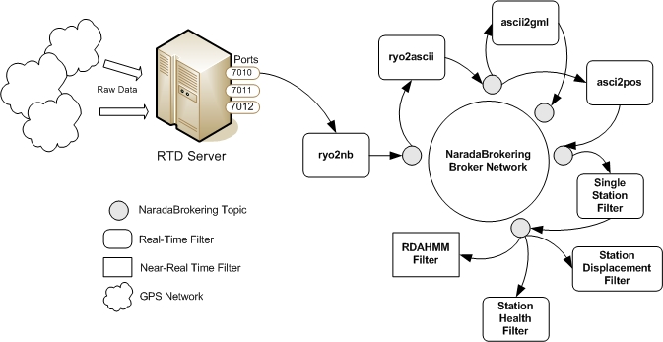
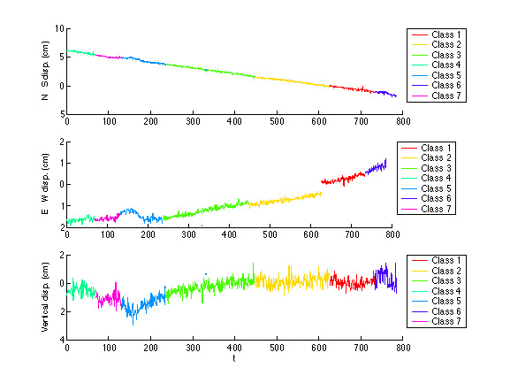
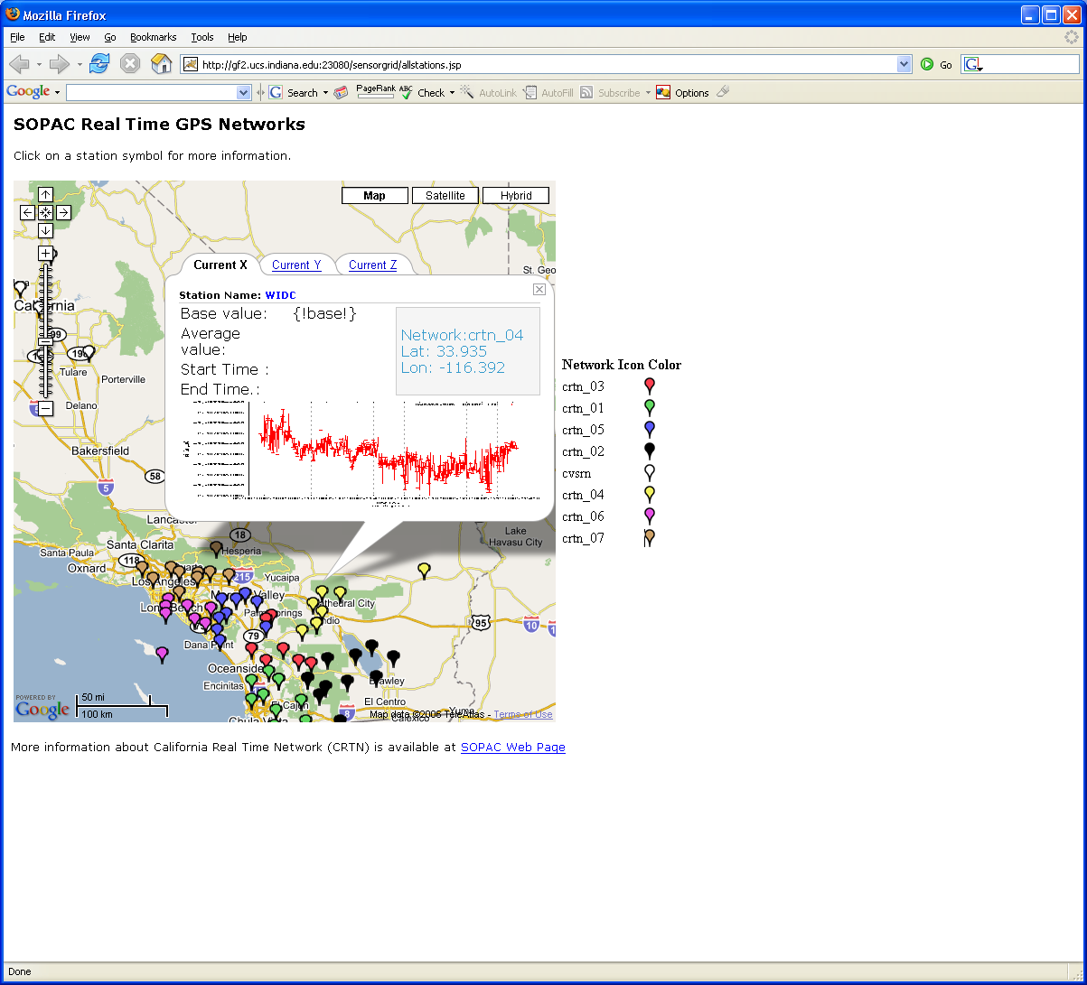
Real-Time GPS Sensor Data-Mining
Services process real time data from ~70 GPS Sensors in Southern California
Brokers and Services on Clouds – no major performance issues
CRTN GPS
Earthquake
Streaming Data
Support
Transformations
Data Checking
Archival
Hidden Markov
Datamining (JPL)
Display (GIS)
Real Time
66
Notes:
66

Slide 67
MapReduce and Twister on Azure

Slide 68
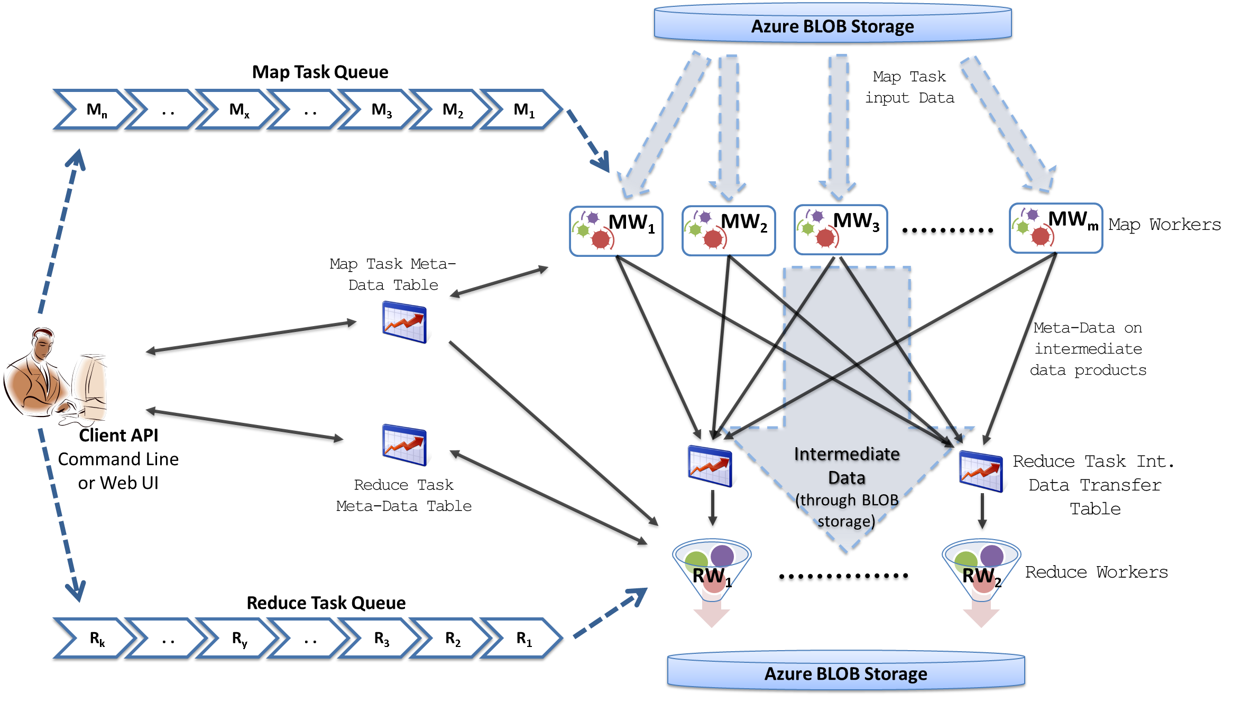
MapReduceRoles4Azure Architecture
Azure Queues for scheduling, Tables to store meta-data and monitoring data, Blobs for input/output/intermediate data storage.
Notes:
We use Azure Queues for scheduling, Tables to store meta-data and monitoring data, Blobs for input/output/intermediate data storage.

Slide 69
MapReduceRoles4Azure
Use distributed, highly scalable and highly available cloud services as the building blocks.
  Azure Queues for task scheduling.
  Azure Blob storage for input, output and intermediate data storage.
  Azure Tables for meta-data storage and monitoring
Utilize eventually-consistent , high-latency cloud services effectively to deliver performance comparable to traditional MapReduce runtimes.
Minimal management and maintenance overhead
Supports dynamically scaling up and down of the compute resources.
MapReduce fault tolerance
http://salsahpc.indiana.edu/mapreduceroles4azure/

Slide 70
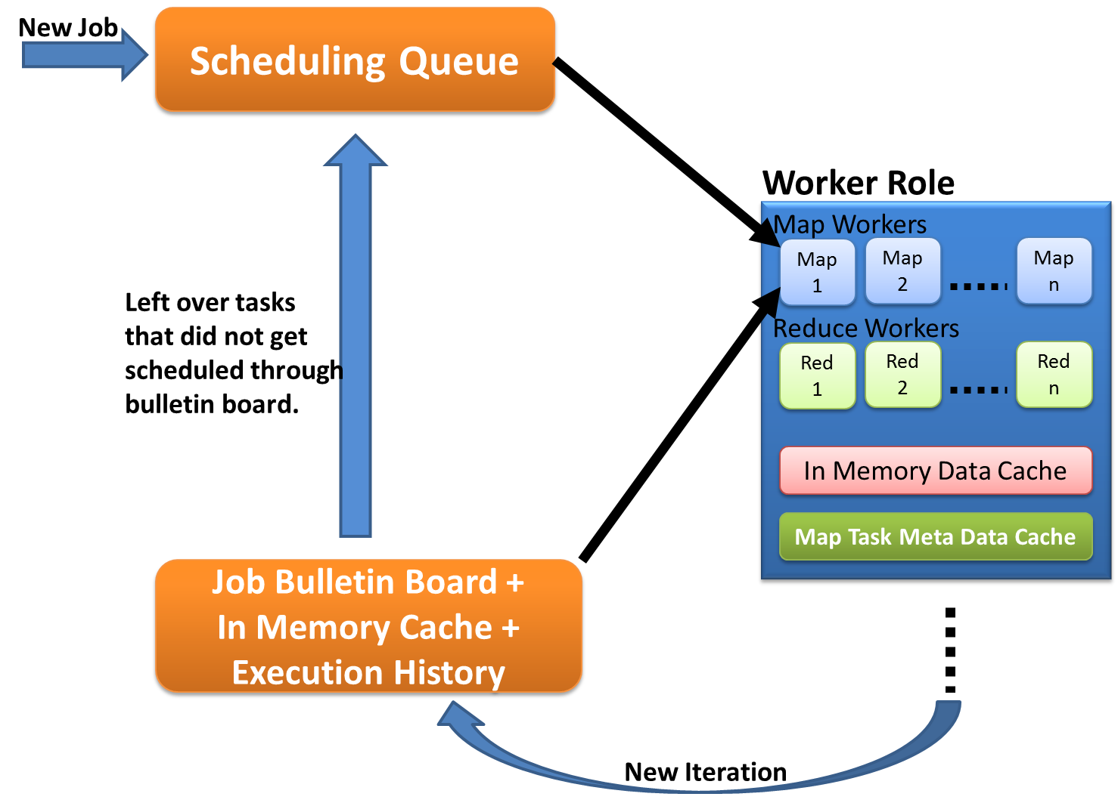
Cache aware scheduling
New Job (1st iteration)
  Through queues
New iteration
  Publish entry to Job Bulletin Board
  Workers pick tasks based on in-memory data cache and execution history (MapTask Meta-Data cache)
  Any tasks that do not get scheduled through the bulletin board will be added to the queue.

Slide 71
Performance – Kmeans Clustering
Task Execution Time Histogram
Number of Executing Map Task Histogram
Strong Scaling with 128M Data Points
Weak Scaling
Notes:
Right(c): Twister4Azure executing Map Task histogram for 128 million data points in 128 Azure small instances
Figure 5. KMeansClustering Scalability. Left(a): Relative parallel efficiency of strong scaling using 128 million data points.
Center(b): Weak scaling. Workload per core is kept constant (ideal is a straight horizontal line).

Slide 72
Kmeans Speedup from 32 cores

Slide 73
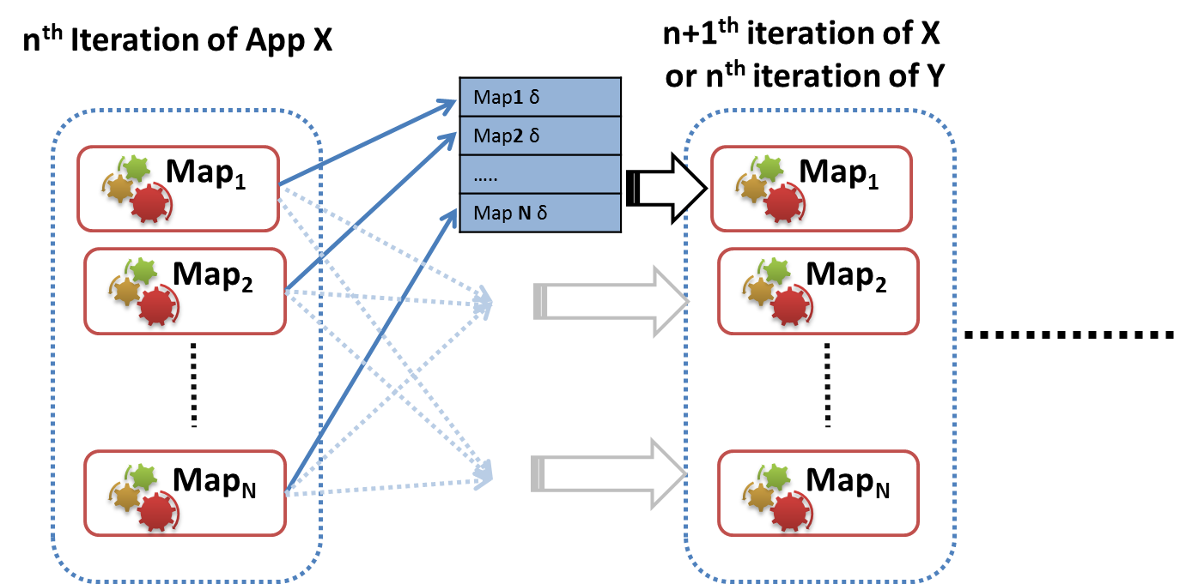
AllGather
Broadcasts the Map outputs to all other nodes
Assembles them together in the recipient nodes
Schedules the next iteration of the application
Eliminates the shuffle, reduce, merge overhead
Currently implemented using Azure inter-role TCP based all-to-all broadcast
We have noticed up to 8% speedup
  much larger improvement in terms of reduction of overhead
Notes:
8% speedup is for MDS with 128 cores (32 Azure large instances). The speedup will be much more when the computation becomes more fine grained (eg: if we use a smaller MDS data matrix).

Slide 74
Twister4Azure Conclusions
Twister4Azure enables users to easily and efficiently perform large scale iterative data analysis and scientific computations on Azure cloud.
  Supports classic and iterative MapReduce
  Non pleasingly parallel use of Azure
Utilizes a hybrid scheduling mechanism to provide the caching of static data across iterations.
Should integrate with workflow systems
Plenty of testing and improvements needed!
Open source: Please use http://salsahpc.indiana.edu/twister4azure

Slide 75
Summary of
Applications Suitable for Clouds

Slide 76
Application Classification
(a) Map Only
(b) Classic MapReduce
(c) Iterative MapReduce
(d) Loosely Synchronous
Input
Input
Iterations
Input
map
map
map
P_{ij}
reduce
reduce
Output
BLAST Analysis
Smith-Waterman Distances
Parametric sweeps
PolarGrid Matlab data analysis
High Energy Physics (HEP) Histograms
Distributed search
Distributed sorting
Information retrieval
Expectation maximization clustering e.g. Kmeans
Linear Algebra
Multimensional Scaling
Page Rank
Many MPI scientific applications such as solving differential equations and particle dynamics
Domain of MapReduce and Iterative Extensions
MPI

Slide 77
Expectation Maximization and Iterative MapReduce
Clustering and Multidimensional Scaling are both EM (expectation maximization) using deterministic annealing for improved performance
EM tends to be good for clouds and Iterative MapReduce
  Quite complicated computations (so compute largish compared to communicate)
  Communication is Reduction operations (global sums in our case)
  See also Latent Dirichlet Allocation and related Information Retrieval algorithms similar structure

Slide 78
DA-PWC EM Steps (E is red, M Black) k runs over clusters; i,j, α points
A(k) = - 0.5 ∑_{i=1}^{N} ∑_{j=1}^{N} δ(i, j) <M_{i}(k)> <M_{j}(k)> / <C(k)>²
B_{α}(k) = ∑_{i=1}^{N} δ(i, α) <M_{i}(k)> / <C(k)>
ε_{α}(k) = (B_{α}(k) + A(k))
<M_{i}(k)> = p(k) exp( -ε_{i}(k)/T )/
∑_{k’=1}^{K} p(k’) exp(-ε_{i}(k’)/T)
C(k) = ∑_{i=1}^{N} <M_{i}(k)>
p(k) = C(k) / N
Loop to converge variables; decrease T from ∞; split centers by halving p(k)
Steps 1 global sum (reduction)
Step 1, 2, 5 local sum if <M_{i}(k)> broadcast

Slide 79
What can we learn?
There are many pleasingly parallel data analysis algorithms which are super for clouds
  Remember SWG computation longer than other parts of analysis
There are interesting data mining algorithms needing iterative parallel run times
There are linear algebra algorithms with flaky compute/communication ratios
Expectation Maximization good for Iterative MapReduce

Slide 80
Research Issues for (Iterative) MapReduce
Quantify and Extend that Data analysis for Science seems to work well on Iterative MapReduce and clouds so far.
  Iterative MapReduce (Map Collective) spans all architectures as unifying idea
Performance and Fault Tolerance Trade-offs;
  Writing to disk each iteration (as in Hadoop) naturally lowers performance but increases fault-tolerance
  Integration of GPU’s
Security and Privacy technology and policy essential for use in many biomedical applications
Storage: multi-user data parallel file systems have scheduling and management
  NOSQL and SciDB on virtualized and HPC systems
Data parallel Data analysis languages: Sawzall and Pig Latin more successful than HPF?
Scheduling: How does research here fit into scheduling built into clouds and Iterative MapReduce (Hadoop)
  important load balancing issues for MapReduce for heterogeneous workloads

Slide 81
Architecture of Data-Intensive Clouds

Slide 82
Authentication and Authorization: Provide single sign in to All system architectures
Workflow: Support workflows that link job components between Grids and Clouds.
Provenance: Continues to be critical to record all processing and data sources
Data Transport: Transport data between job components on Grids and Commercial Clouds respecting custom storage patterns like Lustre v HDFS
Program Library: Store Images and other Program material
Blob: Basic storage concept similar to Azure Blob or Amazon S3
DPFS Data Parallel File System: Support of file systems like Google (MapReduce), HDFS (Hadoop) or Cosmos (dryad) with compute-data affinity optimized for data processing
Table: Support of Table Data structures modeled on Apache Hbase/CouchDB or Amazon SimpleDB/Azure Table. There is “Big” and “Little” tables – generally NOSQL
SQL: Relational Database
Queues: Publish Subscribe based queuing system
Worker Role: This concept is implicitly used in both Amazon and TeraGrid but was (first) introduced as a high level construct by Azure. Naturally support Elastic Utility Computing
MapReduce: Support MapReduce Programming model including Hadoop on Linux, Dryad on Windows HPCS and Twister on Windows and Linux. Need Iteration for Datamining
Software as a Service: This concept is shared between Clouds and Grids
Web Role: This is used in Azure to describe user interface and can be supported by portals in Grid or HPC systems
Components of a Scientific Computing Platform

Slide 83
Architecture of Data Repositories?
Traditionally governments set up repositories for data associated with particular missions
  For example EOSDIS, GenBank, NSIDC, IPAC for Earth Observation , Gene, Polar Science and Infrared astronomy
  LHC/OSG computing grids for particle physics
This is complicated by volume of data deluge, distributed instruments as in gene sequencers (maybe centralize?) and need for complicated intense computing

Slide 84
Clouds as Support for Data Repositories?
The data deluge needs cost effective computing
  Clouds are by definition cheapest
Shared resources essential (to be cost effective and large)
  Can’t have every scientists downloading petabytes to personal cluster
Need to reconcile distributed (initial source of ) data with shared computing
  Can move data to (disciple specific) clouds
  How do you deal with multi-disciplinary studies

Slide 85
Traditional File System?
S
Data
C
C
C
C
S
C
C
C
C
Archive
Data
S
C
C
C
C
Data
C
C
C
C
S
Data
Compute Cluster
Storage Nodes
Typically a shared file system (Lustre, NFS …) used to support high performance computing
Big advantages in flexible computing on shared data but doesn’t “bring computing to data”
Object stores similar to this?

Slide 86
Data Parallel File System?
Block1
Replicate each block
File1
Block2
……
Breakup
BlockN
C
C
C
C
Data
Data
Data
Data
C
C
C
C
Data
Data
Data
Data
C
C
C
C
Data
Data
Data
Data
C
C
C
C
Data
Data
Data
Data
Block1
File1
Block2
……
Breakup
Replicate each block
BlockN
No archival storage and computing brought to data

Slide 87
Summary of
Data-Intensive Applications on Clouds

Slide 88
Summarizing Guiding Principles
Clouds may not be suitable for everything but they are suitable for majority of data intensive applications
  Solving partial differential equations on 100,000 cores probably needs classic MPI engines
Cost effectiveness, elasticity and quality programming model will drive use of clouds in many areas such as genomics
Need to solve issues of
  Security-privacy-trust for sensitive data
  How to store data – “data parallel file systems” (HDFS), Object Stores, or classic HPC approach with shared file systems with Lustre etc.
Programming model which is likely to be MapReduce based
  Look at high level languages
  Compare with databases (SciDB?)
  Must support iteration to do “real parallel computing”
  Need Cloud-HPC Cluster Interoperability

Slide 89
FutureGrid in a Nutshell

Slide 90
What is FutureGrid?
The FutureGrid project mission is to enable experimental work that advances:
  Innovation and scientific understanding of distributed computing and parallel computing paradigms,
  The engineering science of middleware that enables these paradigms,
  The use and drivers of these paradigms by important applications, and,
  The education of a new generation of students and workforce on the use of these paradigms and their applications.
The implementation of mission includes
  Distributed flexible hardware with supported use
  Identified IaaS and PaaS “core” software with supported use
    Expect growing list of software from FG partners and users
  Outreach

Slide 91
Motivation for RAIN
Provide users with the ability to easily create their own computational environments (OS, packages, software)
Users can deploy and run their environments in both bare-metal and virtualized infrastructures like Amazon, OpenStack, Eucalyptus, Nimbus or OpenNebula

Slide 92
Scalability of Image Generation
Concurrent CentOS image creation requests
Increasing number of OpenNebula compute nodes to scale
Notes:
OpenNebula is used to provide scalability and independence from the OS. Each time that we receive an image creation request, we boot a VM with the appropriate OS and create the image in that VM.

Slide 93
HPC Deployment

