Slide 1

Cyberinfrastructure and its Applications
University of Texas Pan American
Cyberinfrastructure Day
March 27 2009
Geoffrey Fox
Co-founder MSI-CIEC
Computer Science, Informatics, Physics
Chair Informatics Department
Director Community Grids Laboratory and Digital Science Center
Indiana University Bloomington IN 47404
gcf@indiana.edu
http://www.infomall.org

Slide 2
e-moreorlessanything
‘e-Science is about global collaboration in key areas of science, and the next generation of infrastructure that will enable it.’ from inventor of term John Taylor Director General of Research Councils UK, Office of Science and Technology
e-Science is about developing tools and technologies that allow scientists to do ‘faster, better or different’ research
Similarly e-Business captures the emerging view of corporations as dynamic virtual organizations linking employees, customers and stakeholders across the world.
This generalizes to e-moreorlessanything including e-DigitalLibrary, e-SocialScience, e-HavingFun and e-Education
A deluge of data of unprecedented and inevitable size must be managed and understood.
People (virtual organizations), computers, data (including sensors and instruments) must be linked via hardware and software networks
2
Notes:
2

Slide 3
What is Cyberinfrastructure
Cyberinfrastructure is (from NSF) infrastructure that supports distributed research and learning (e-Science, e-Research, e-Education)
  Links data, people, computers
Exploits Internet technology (Web2.0 and Clouds) adding (via Grid technology) management, security, supercomputers etc.
It has two aspects: parallel – low latency (microseconds) between nodes and distributed – highish latency (milliseconds) between nodes
Parallel needed to get high performance on individual large simulations, data analysis etc.; must decompose problem
Distributed aspect integrates already distinct components – especially natural for data (as in biology databases etc.)
3
Notes:
3

Slide 4
Gartner 2008 Technology Hype Curve
Clouds, Microblogs and Green IT appear
Basic Web Services, Wikis and SOA
becoming mainstream

Slide 5
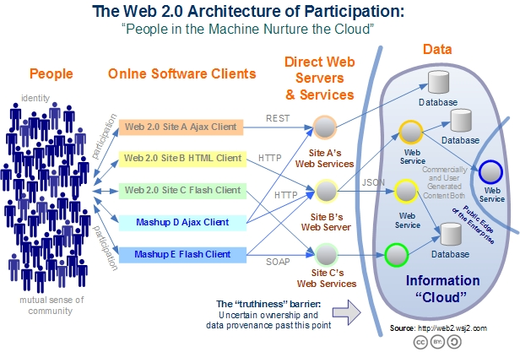
Web 2.0 Systems illustrate Cyberinfrastructure
Captures the incredible development of interactive Web sites enabling people to create and collaborate

Slide 6
Relevance of Web 2.0
Web 2.0 can help e-Research in many ways
Its tools (web sites) can enhance scientific collaboration, i.e. effectively support virtual organizations, in different ways from grids
The popularity of Web 2.0 can provide high quality technologies and software that (due to large commercial investment) can be very useful in e-Research and preferable to complex Grid or Web Service solutions
The usability and participatory nature of Web 2.0 can bring science and its informatics to a broader audience
Cyberinfrastructure is research analogue of major commercial initiatives e.g. to important job opportunities for students!
Web 2.0 is major commercial use of computers and “Google/Amazon” farms spurred cloud computing
  Same computer answering your Google query can do bioinformatics
  Can be accessed from a web page with a credit card i.e. as a Service

Slide 7
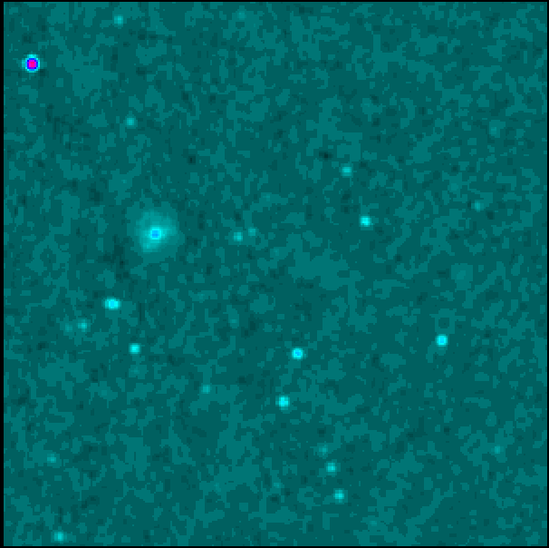
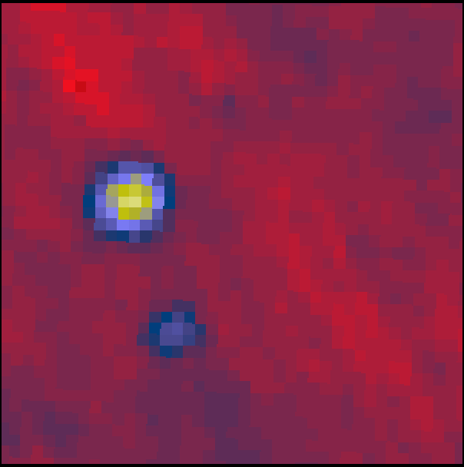
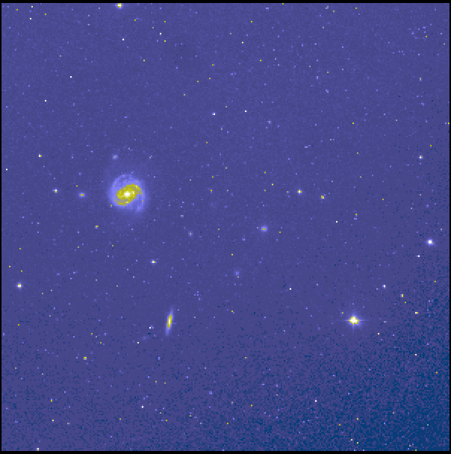
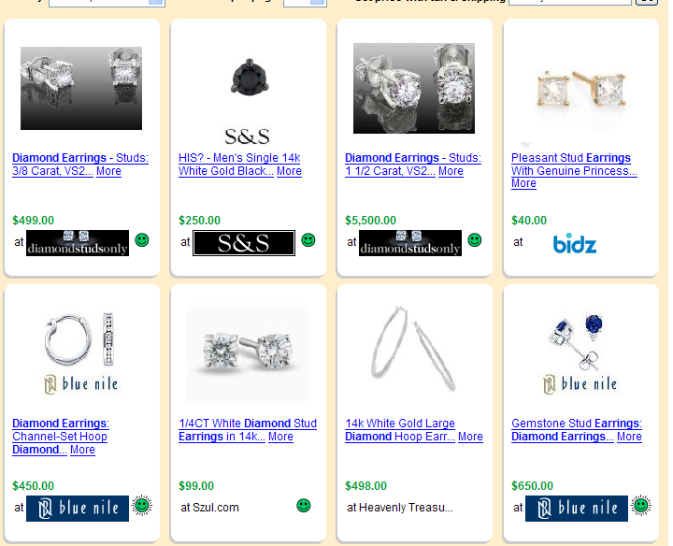
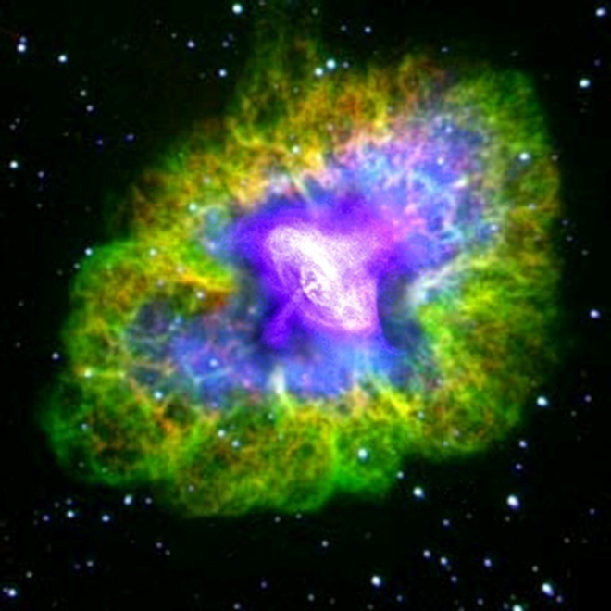
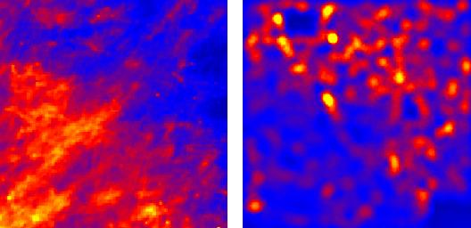
Virtual Observatory in Astronomy uses
Cyberinfrastructure to Integrate Experiments
Radio
Far-Infrared
Visible
Comparison Shopping is Internet analogy to Integrated Astronomy using similar technology
Dust Map
Visible + X-ray
Galaxy Density Map

Slide 8
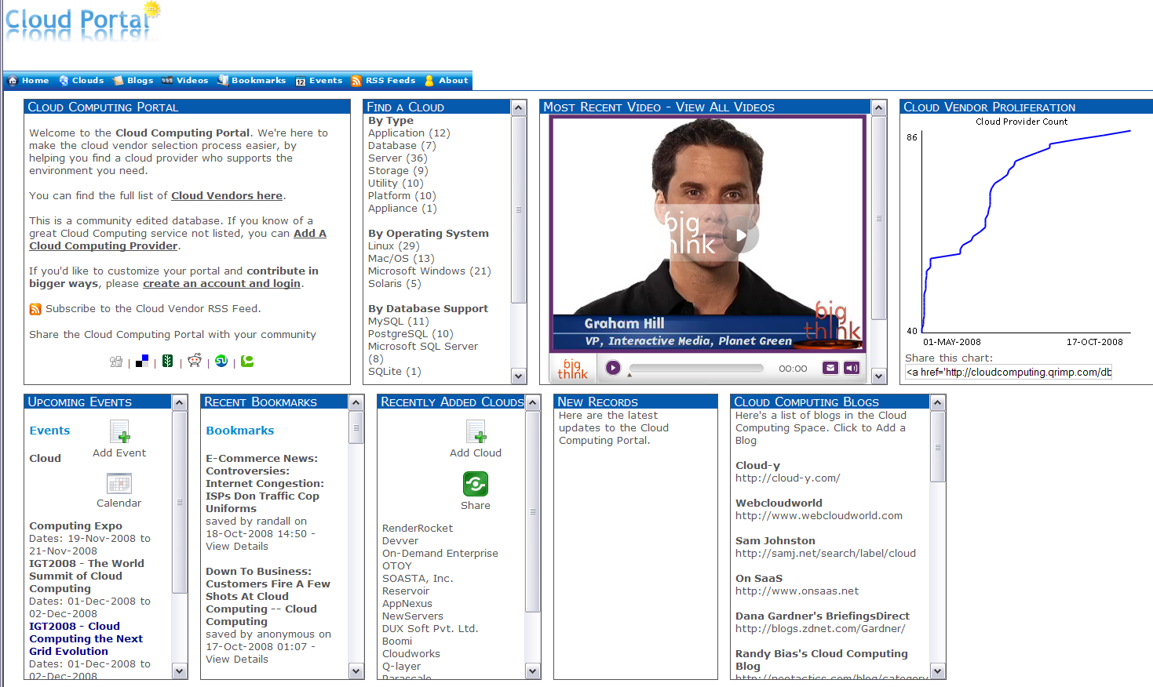
Cloud Computing Resources from Amazon, IBM, Google, Microsoft ……
Computing as a Service from a web page with a credit card

Slide 9
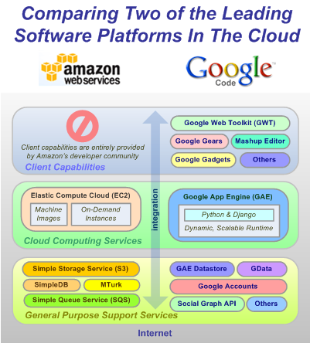
The Big Players are in Clouds!
Amazon and Google
IBM, Dell, Microsoft, Sun ….
Also key players
> 90 providers

Slide 10
Virtualization important both Inter-CPUs (Clouds) and intra-CPU (VMWare)
Science Gateway

Slide 11


Clouds as Cost Effective Data Centers
Exploit the Internet by allowing one to build giant data centers with 100,000’s of computers; ~ 200-1000 to a shipping container
“Microsoft will cram between 150 and 220 shipping containers filled with data center gear into a new 500,000 square foot Chicago facility. This move marks the most significant, public use of the shipping container systems popularized by the likes of Sun Microsystems and Rackable Systems to date.”

Slide 12

Clouds hide Complexity
Build portals around all computing capability
SaaS: Software as a Service
IaaS: Infrastructure as a Service or HaaS: Hardware as a Service
PaaS: Platform as a Service delivers SaaS on IaaS
Cyberinfrastructure is “Research as a Service”
2 Google warehouses of computers on the banks of the Columbia River, in The Dalles, Oregon
Such centers use 20MW-200MW
(Future) each
150 watts per core
Save money from large size, positioning with cheap power and access with Internet

Slide 13
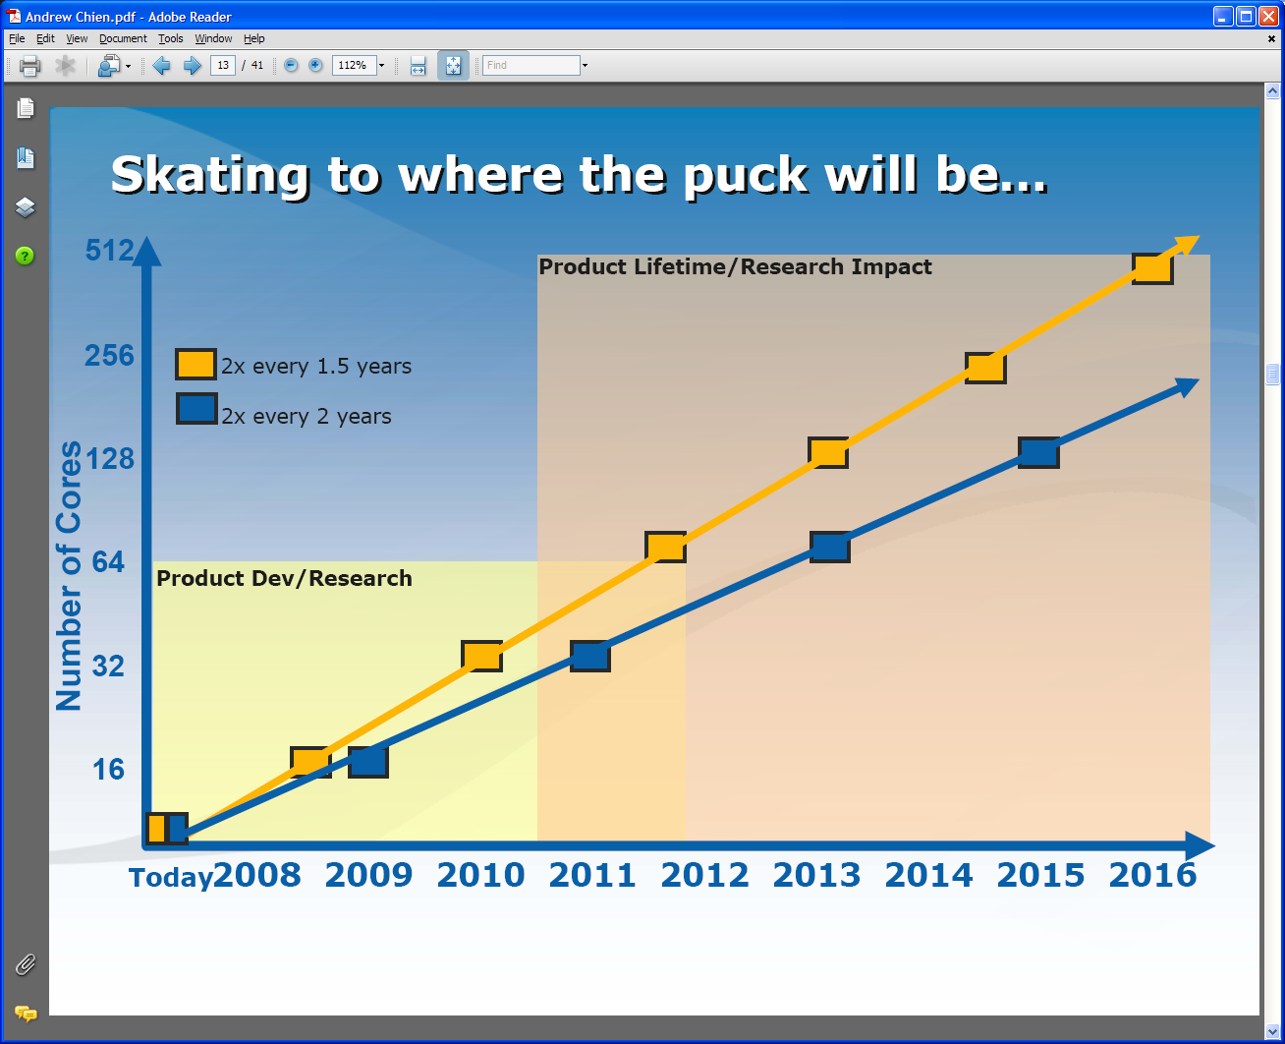
Intel’s Projection
Technology might support:
2010: 16—64 cores 200GF—1 TF
2013: 64—256 cores 500GF– 4 TF
2016: 256--1024 cores 2 TF– 20 TF

Slide 14
Intel’s Application Stack

Slide 15

What is the TeraGrid?
An instrument (cyberinfrastructure) that delivers high-end IT resources - storage, computation, visualization, and data/service hosting - almost all of which are UNIX-based under the covers; some hidden by Web interfaces
  A data storage and management facility: over 20 Petabytes of storage (disk and tape), over 100 scientific data collections
  A computational facility - over 750 TFLOPS in parallel computing systems and growing
  (Sometimes) an intuitive way to do very complex tasks, via Science Gateways, or get data via data services
A service: help desk and consulting, Advanced Support for TeraGrid Applications (ASTA), education and training events and resources
The largest individual cyberinfrastructure facility funded by the NSF, which supports the national science and engineering research community
Something you can use without financial cost - allocated via peer review (and without double jeopardy)
©Trustees of Indiana University. May be reused so long as IU and TeraGrid logos remain, and any modifications to original are noted. Courtesy Craig A. Stewart, IU

Slide 16
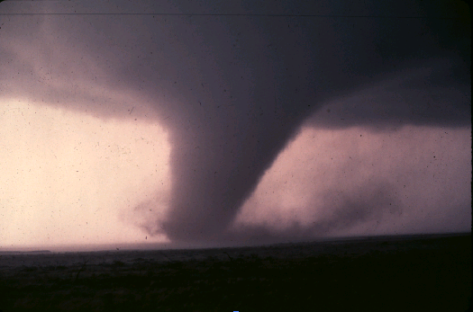
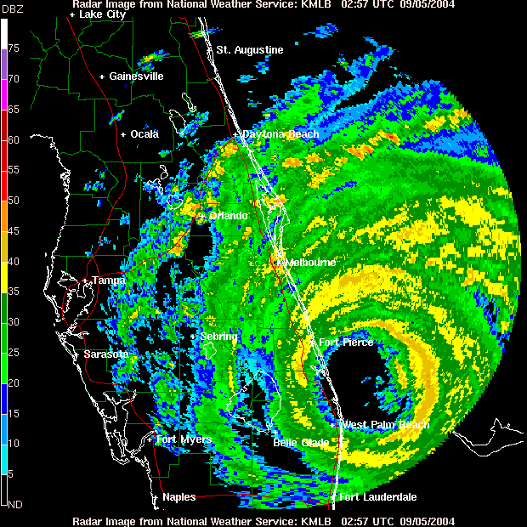
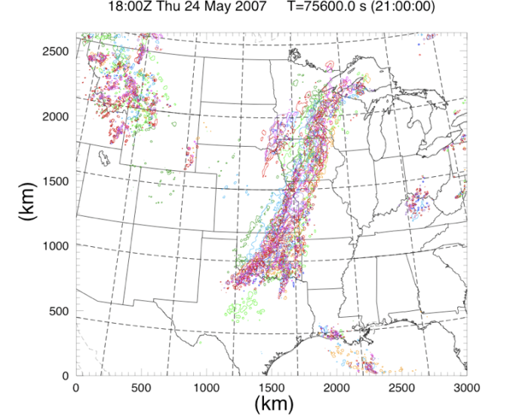
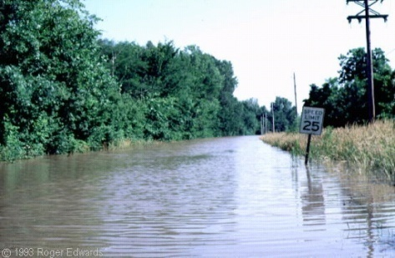
Predicting storms
Hurricanes and tornadoes cause massive loss of life and damage to property
TeraGrid supported spring 2007 NOAA and University of Oklahoma Hazardous Weather Testbed
  Major Goal: assess how well ensemble forecasting predicts thunderstorms, including the supercells → tornadoes
  Nightly reservation at PSC
  Delivers “better than real time” prediction
  Used 675,000 CPU hours for the season
  Used 312 TB on HPSS storage at PSC
Slide courtesy of Dennis Gannon, IU, and LEAD Collaboration
Notes:
2007 NOAA and University of Oklahoma Hazardous Weather Testbed (HWT) Spring Experiment
Major goal: assess how well ensemble forecasting works to predict thunderstorms, including the supercells that spawn tornados.

Slide 17
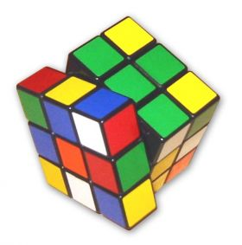
Solve any Rubik’s Cube in 26 moves?
Rubik's Cube is perhaps the most famous combinatorial puzzle of its time
> 43 quintillion states (4.3x10^19)
Gene Cooperman and Dan Kunkle of Northeastern Univ. proved any state can be solved in 26 moves
7TB of distributed storage on TeraGrid allowed them to develop the proof
Source: http://www.physorg.com/news99843195.html
Notes:
Itﾕs a toy that most kids have played with at one time or another, but the findings of Northeastern University Computer Science professor Gene Cooperman and graduate student Dan Kunkle are not childﾕs play. The two have proven that 26 moves suffice to solve any configuration of a Rubik's cube ﾐ a new record. Historically the best that had been proved was 27 moves.
Why the fascination with the popular puzzle? ﾒThe Rubik's cube is a testing ground for problems of search and enumeration,ﾓ says Cooperman. ﾒSearch and enumeration is a large research area encompassing many researchers working in different disciplines ﾐ from artificial intelligence to operations. The Rubik's cube allows researchers from different disciplines to compare their methods on a single, well-known problem.ﾓ Cooperman and Kunkle were able to accomplish this new record through two primary techniques: They used 7 terabytes of distributed disk as an extension to RAM, in order to hold some large tables and developed a new, ﾒfaster fasterﾓ way of computing moves, and even whole groups of moves, by using mathematical group theory.
Rubik's Cube, invented in the late 1970s by Erno Rubik of Hungary, is perhaps the most famous combinatorial puzzle of its time. Its packaging boasts billions of combinations, which is actually an understatement. In fact, there are more than 43 quintillion (4.3252 x 10**19) different states that can be reached from any given configuration.

Slide 18
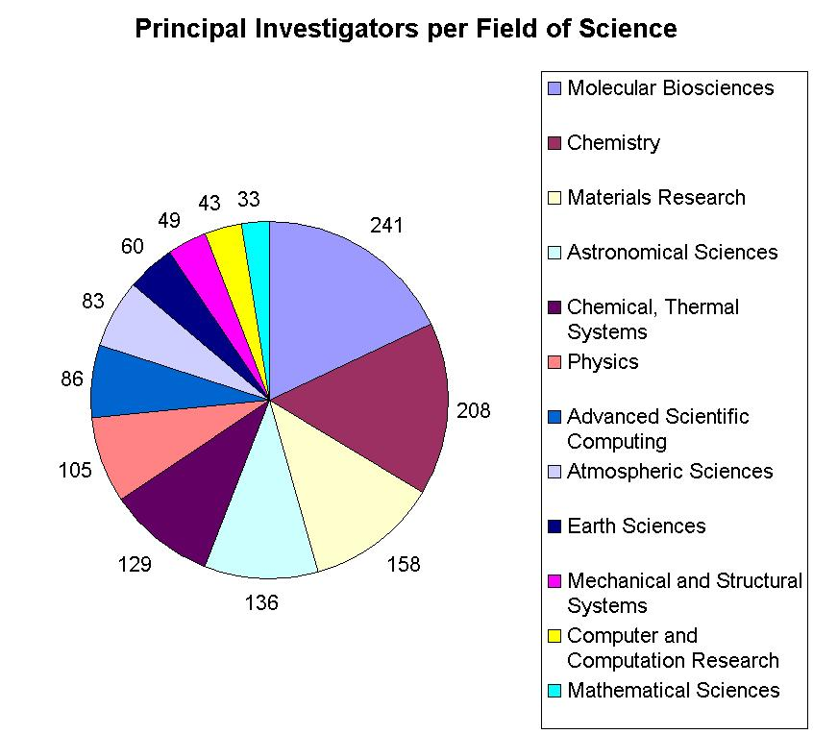
Resources for many disciplines!
> 40,000 processors in aggregate
Resource availability will grow during 2008 at unprecedented rates

Slide 19
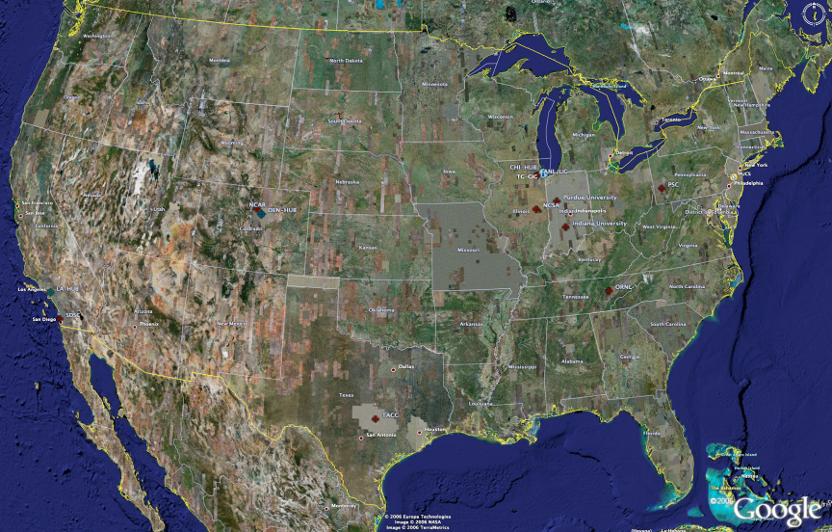
TeraGrid High Performance Computing Systems 2007-8
UC/ANL
PSC
PU
NCAR
NCSA
IU
2008
(~1PF)
ORNL
Tennessee
SDSC
(504TF)
LONI/LSU
TACC
Computational Resources
(size approximate - not to scale)
Slide Courtesy Tommy Minyard, TACC

Slide 20
Resources for many disciplines!
> 40,000 processors in aggregate
Resource availability will grow during 2008 at unprecedented rates

Slide 21

Large Hadron Collider CERN, Geneva: 2008 Start
pp √s =14 TeV L=10³⁴ cm⁻² s⁻¹
27 km Tunnel in Switzerland & France
CMS
TOTEM
pp, general
purpose; HI
5000+ Physicists
250+ Institutes
60+ Countries
Atlas
ALICE : HI
LHCb: B-physics
Higgs, SUSY, Extra Dimensions, CP Violation, QG Plasma, … the Unexpected
Challenges: Analyze petabytes of complex data cooperatively
Harness global computing, data & network resources

Slide 22
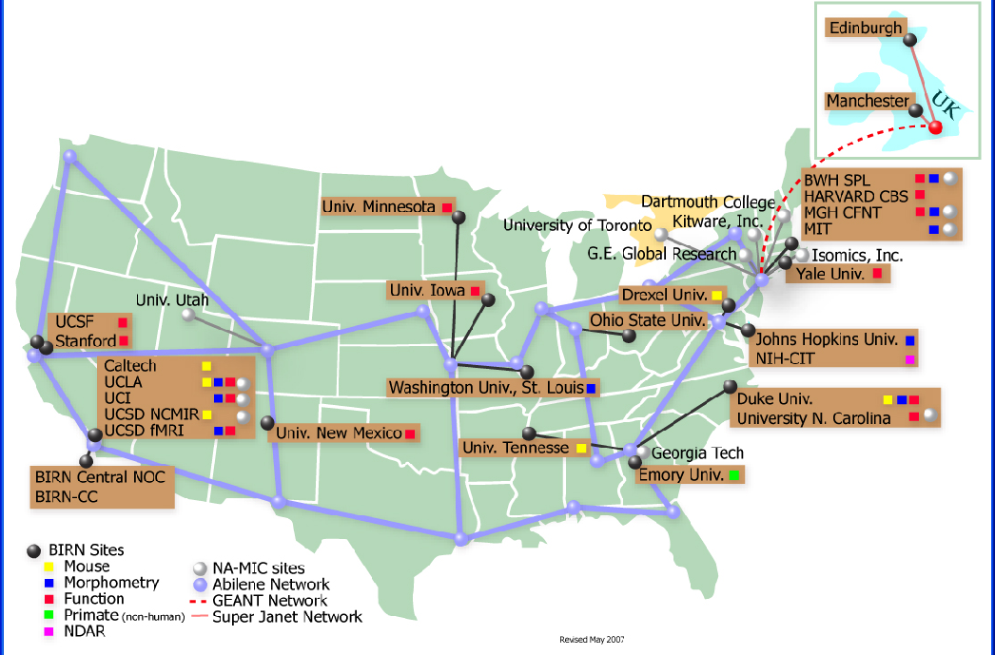
BIRN Bioinformatics Research Network

Slide 23
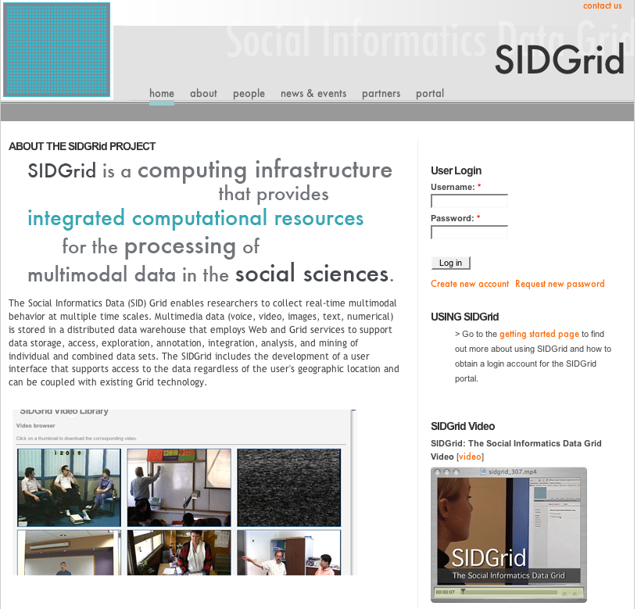
U. Chicago SIDGrid (sidgrid.ci.uchicago.edu)

Slide 24
Data Intensive Research?
Research is advanced by observation i.e. analyzing data from
      Gene Sequencers
      Accelerators
      Telescopes
      Environmental Sensors
      Web Crawlers
      Ethnographic Interviews
This data is “filtered”, “analyzed” (term used in science), “data-mined” (term used in Computer Science) to produce conclusions
The analysis is guided by hypotheses
One can also make models to test hypotheses
These models can be constrained by data from observations – termed data assimilation
  Weather forecasting and Climate prediction are of this type

Slide 25
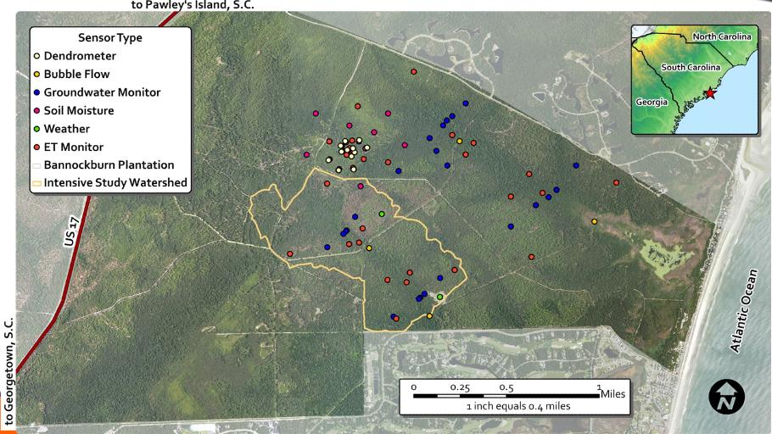
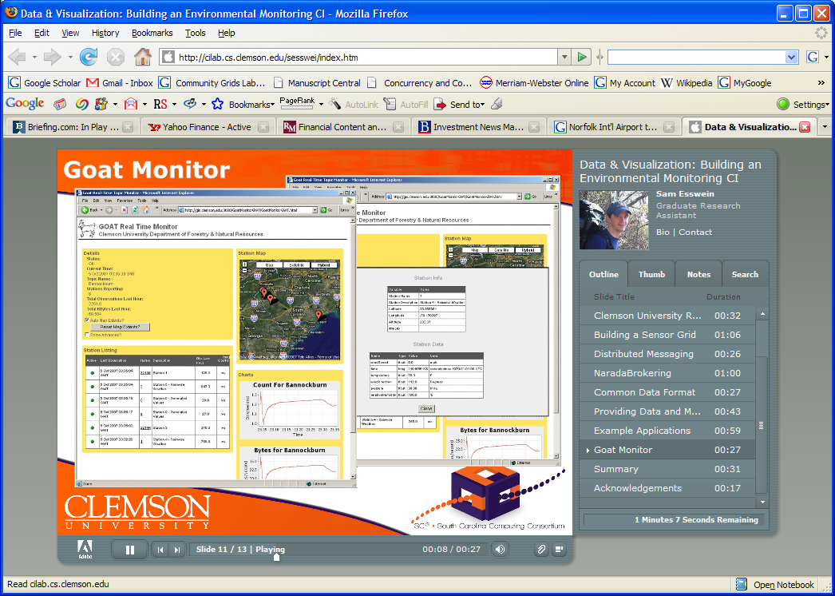
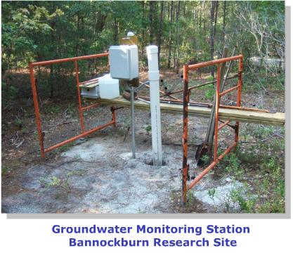
Environmental Monitoring Cyberinfrastructure at Clemson

Slide 26
Sensor Grids Can be Fun
Note sensors are any time dependent source of information and a fixed source of information is just a broken sensor
  SAR Satellites
  Environmental Monitors
  Nokia N800 pocket computers
  RFID tags and readers
  GPS Sensors
  Lego Robots
  RSS Feeds
  Audio/video: web-cams
  Presentation of teacher in distance education
  Text chats of students
  Cell phones

Slide 27

The Sensors on the Fun Grid
Laptop for PowerPoint
2 Robots used
Lego Robot GPS Nokia N800 RFID Tag RFID Reader

Slide 29
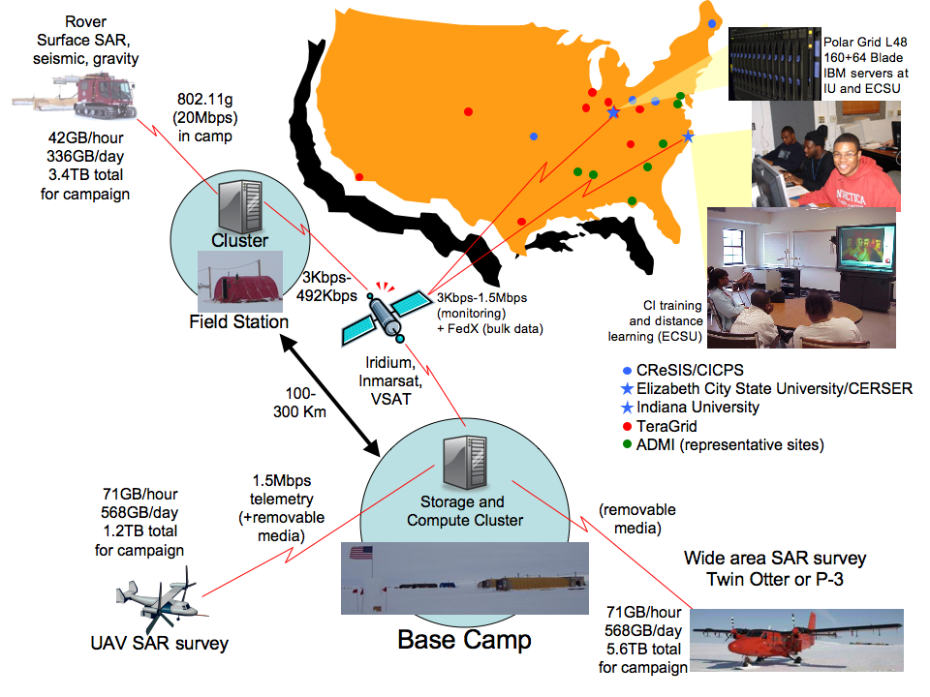

Slide 30
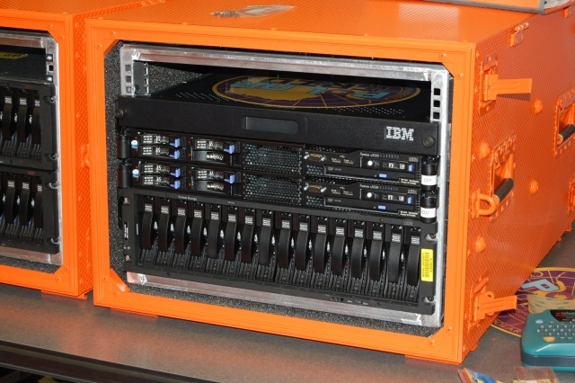
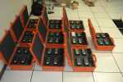
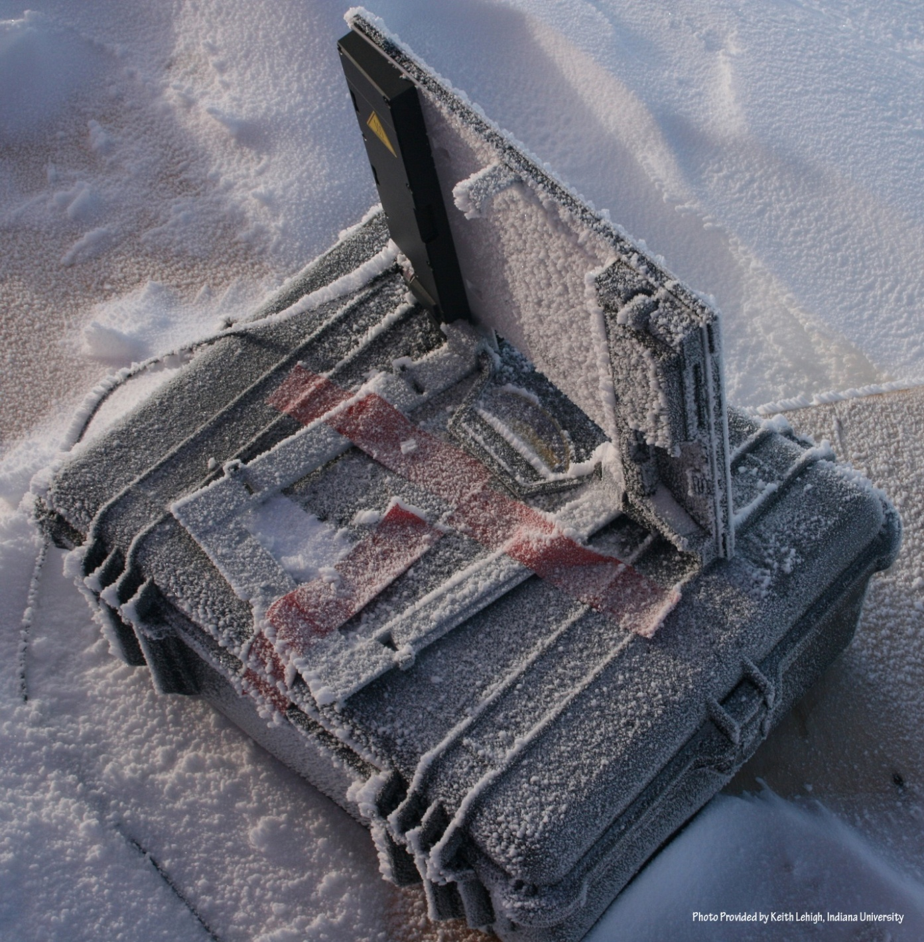
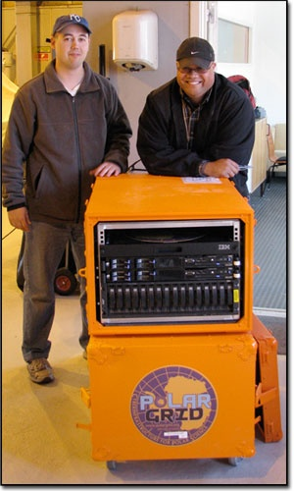
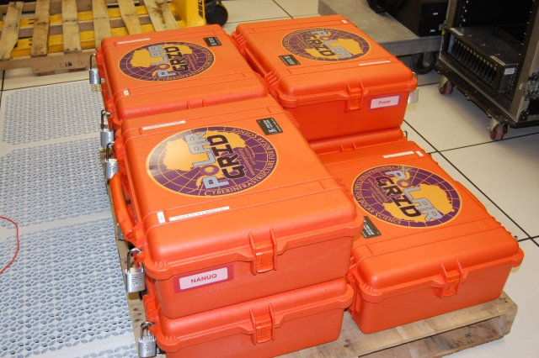
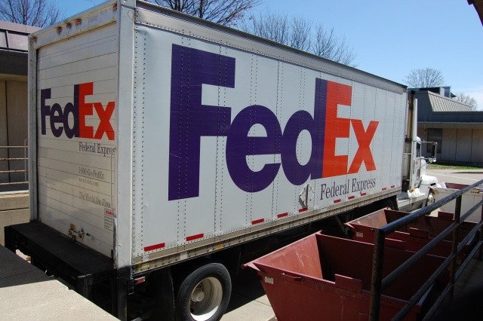
Polar Grid goes to Greenland

Slide 31
The People in Cyberinfrastructure
Web 2.0 can enhance scientific collaboration, i.e. effectively support virtual organizations, in different ways from grids
I expect more resources like MyExperiment from UK, SciVee from SDSC and Connotea from Nature that offer Flickr, YouTube, Facebook, Second Life type capabilities optimized for science
The usability and participatory nature of Web 2.0 can bring science and its informatics to a broader audience
In particular distance collaborative aspects of such Cyberinfrastructure can level playing field; you do not have to be at Harvard etc. to succeed
  e.g. ECSU in CReSIS NSF Science and Technology Center
  Navajo Tech can access TeraGrid Science Gateways

Slide 32
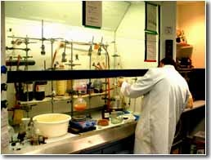
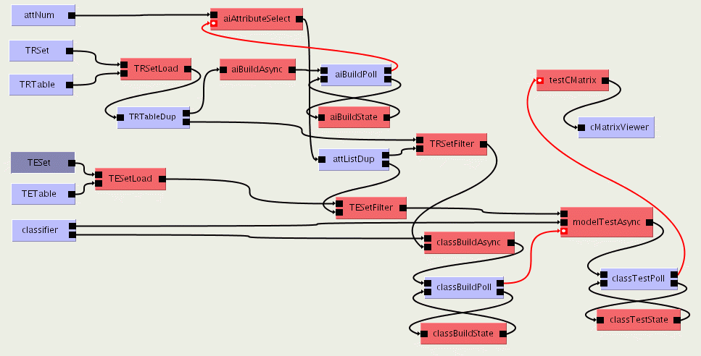

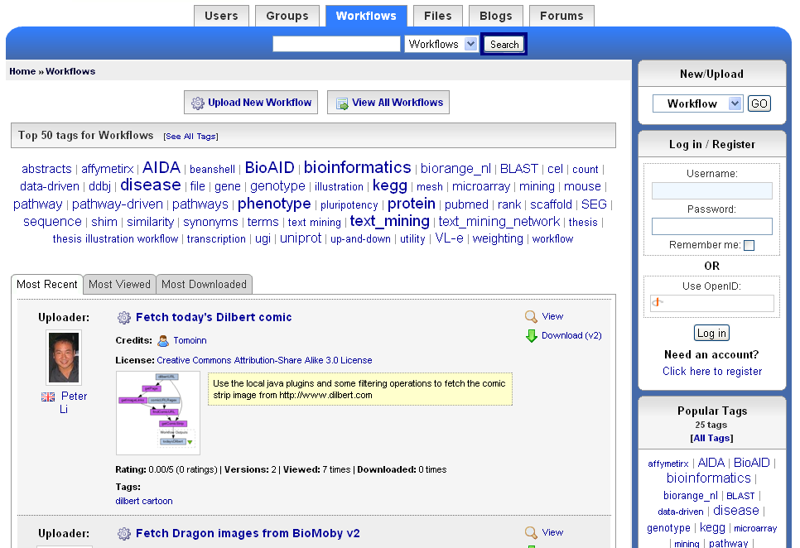
The social process of science 2.0
Virtual Learning Environment
Role of Libraries
and Publishers?
Undergraduate Students
Digital Libraries
scientists
Graduate Students
Reprints
Peer-Reviewed Journal & Conference Papers
experimentation
Technical Reports
Preprints & Metadata
Local
Web
Repositories
Certified Experimental Results & Analyses
Data, Metadata Provenance Workflows
Ontologies

Slide 33
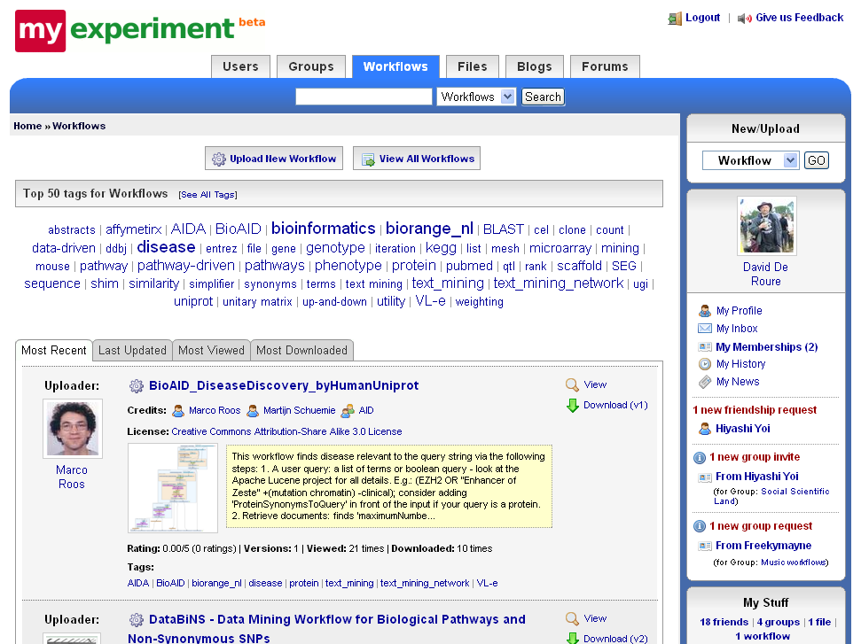

Slide 34
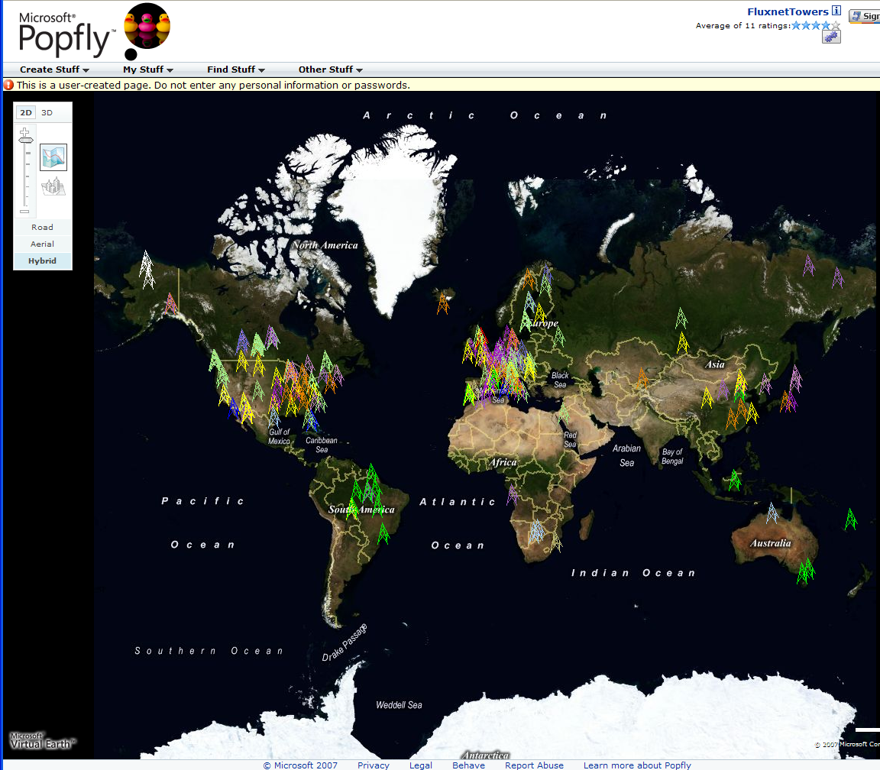
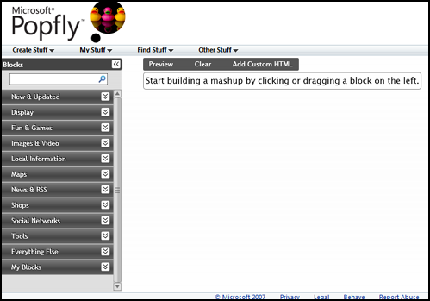
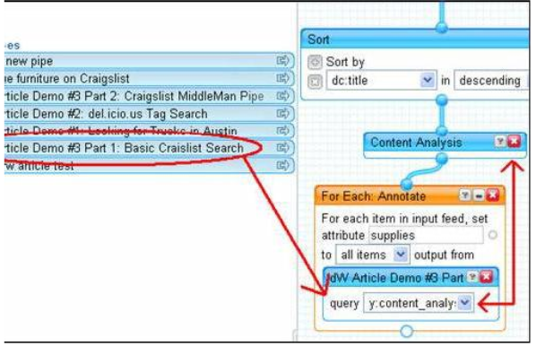
Major Companies entering mashup area
Web 2.0 Mashups (same as workflow in Grids) are likely to drive composition (programming) tools for Grids, Clouds and web
Recently we see Mashup tools like Yahoo Pipes and Microsoft Popfly which have familiar graphical interfaces
Currently only simple examples but tools could become powerful
Yahoo Pipes

