Slide 1
UltraScan Gateway Advanced Support
GIG Team:
Suresh Marru, Raminder Singh, Marlon Pierce
Pervasive Technology Institute
Indiana University
Gateway Personal:
Borries Demeler, Emre Brookes
UT Health Science Center

Slide 2
Outline
UltraScan Gateway
  Target Community
  Usage Statistics
  Current Architecture
Advanced Support Request
  Requested Support
  Current Status
Gateway Enhancement Plan
  Overview of OGCE
  Customizing/Extending/Integrating OGCE tools with UltraScan

Slide 3
Slide Courtesy
This Talk is derived from Advanced Support Request submitted by Dr. Borries Demeler

Slide 4
UltraScan Science Gateway
A biophysics gateway for investigating properties and structure-function relationships of biological macromolecules, nanoparticles, polymers and colloids that are implicated in many diseases, including cancer.
High-resolution analysis and modeling of hydrodynamic data from an analytical ultracentrifuge device (AUC).

Slide 5
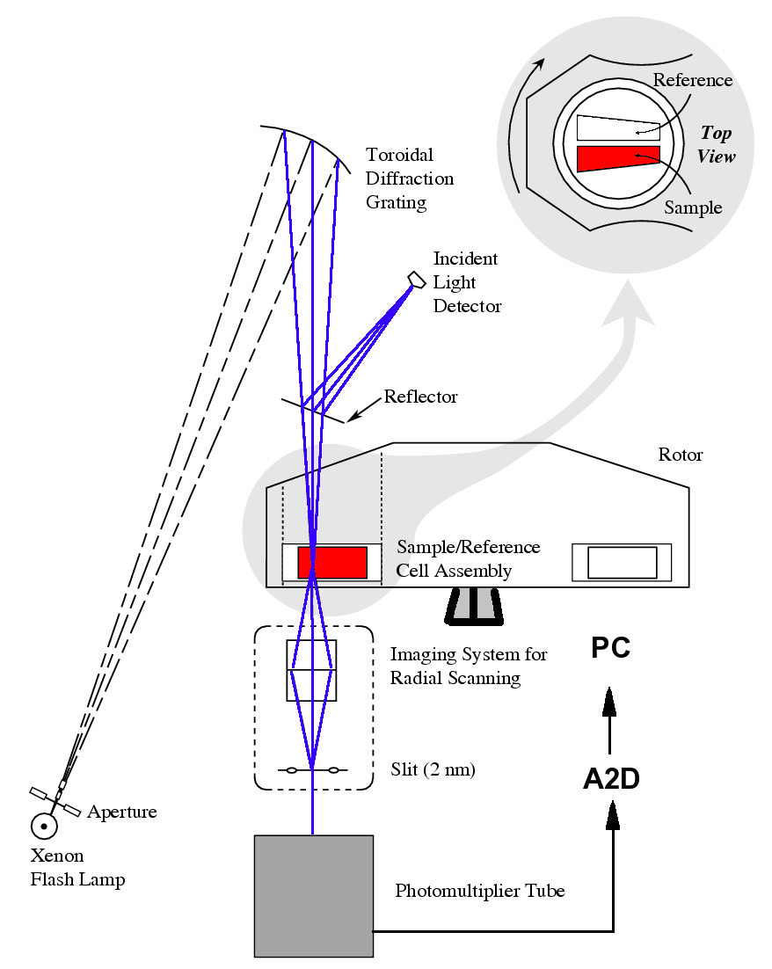
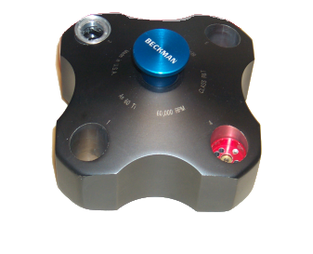
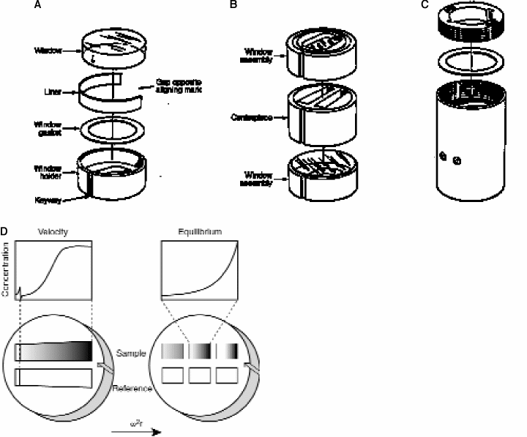
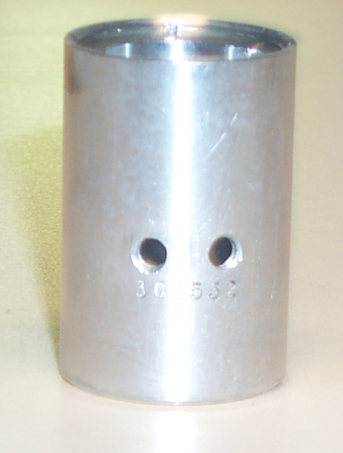
Analytical Ultra Centrifuge
AUC
Experimental
Setup

Slide 6
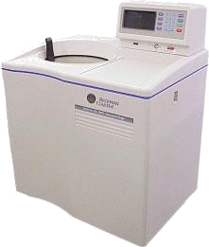
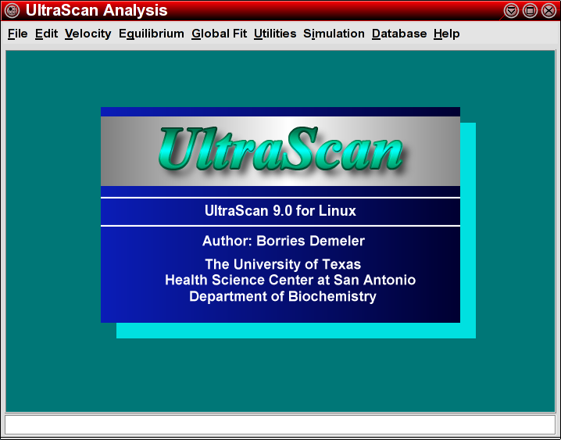
High Level Overview
User
Web Server
MySQL DB
US LIMS
GridControl
TeraGrid
UTHSCSA Jacinto
Terascale storage
TIGRE/Globus Network
High Performance Computing Clusters
Notes:
The user interacts with the XLA, the UltraScan GUI program, which is written in platform independent C++, and the web server running on Jacinto. The user collects the data on the XLA/I/F and transfers it to UltraScan, which is used to store it in the MySQL database. The user can then go to a website and log into the USLIMS program, a PHP suite of modules that control access to the data through a series of web applications that control data sharing, data display, and analysis submission. Analysis jobs are submitted to the TIGRE/Globus grid of supercomputers. Such computers can be anywhere in the world and can be configured to share jobs for higher performance analysis.

Slide 7
Application & Gateway Software
Application Software: UltraScan – provides the highest resolution analysis possible for AUC experiments.
  solves the inverse problem of extracting molecular parameters from experimental data on parallel computing infrastructure.
Gateway Software:US-LIMS – Ultrascan Laboratory Information System
  Provides access to HPC resources to broader research community
  Experiment Management Interfaces

Slide 8
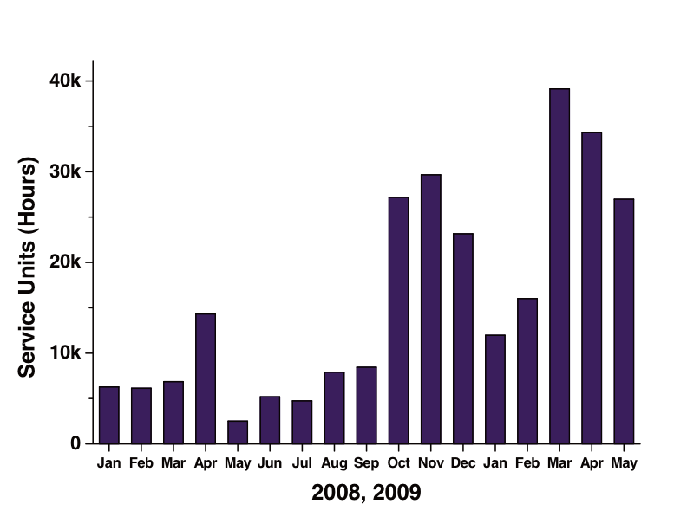
Ultrascan Usage by month

Slide 9
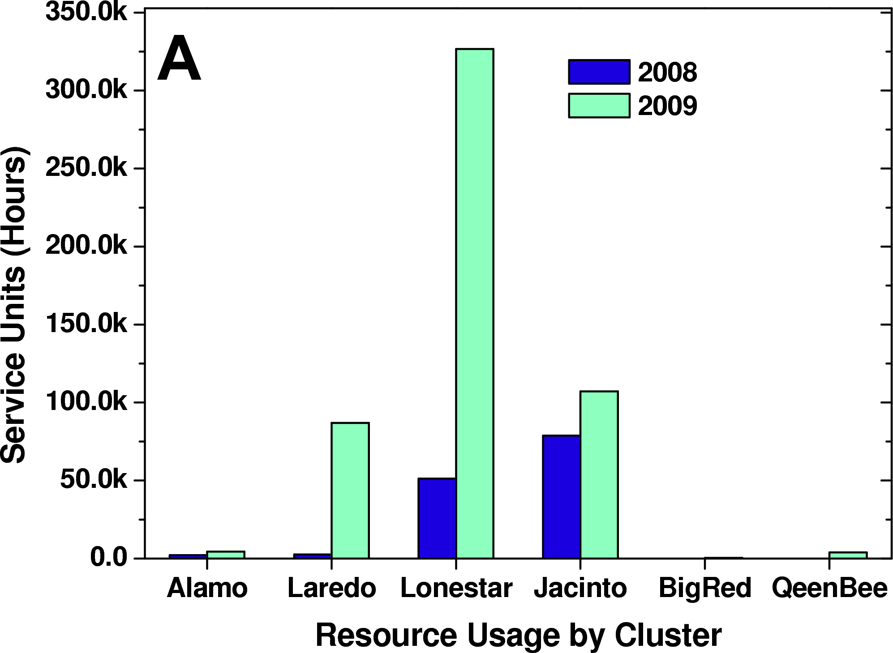
TG Usage in 2008 and 2009

Slide 10
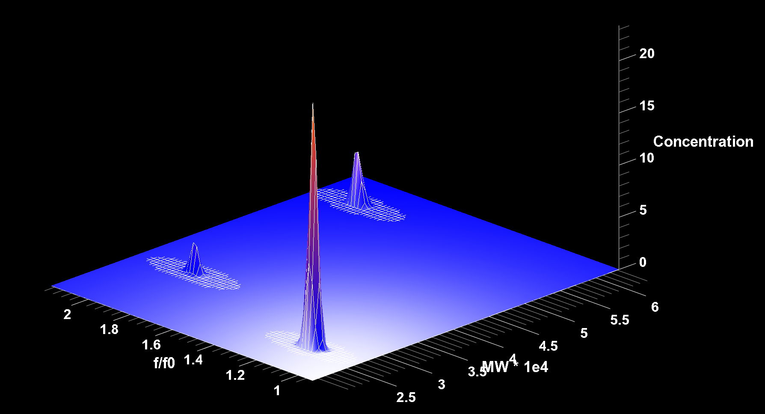
Example Data Analysis
Example: CuZn hSOD mutant freshly isolated
Data courtesy of John Hart, UTHSCSA

Slide 11
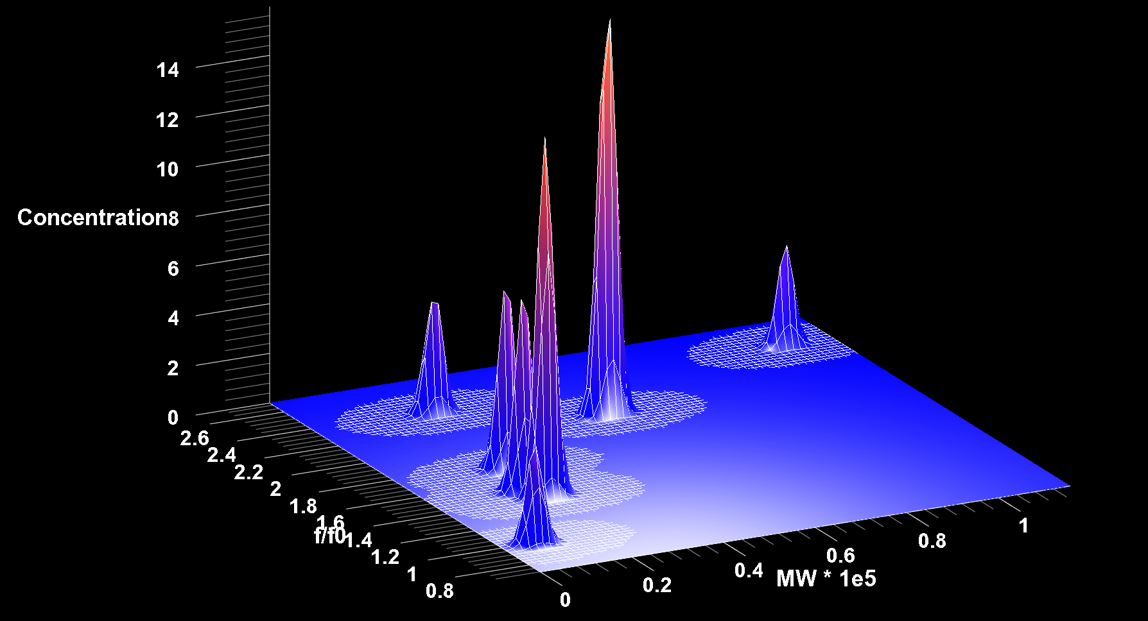
Applying Monte Carlo Simulations
Example: CuZn hSOD mutant after 7 days at 4C
Data courtesy of John Hart, UTHSCSA

Slide 12
ASTA Request
Porting to new architectures and parallel performance enhancements
Porting to and incorporation of TeraGrid storage and server environments
New workflow implementations, new grid computing and grid middleware support
Additional parallelization's to improve scaling for Monte Carlo analyses
Hardening of code performance through check-pointing and processor failure detection

Slide 13
OGCE Gateway Tool Adaption & Reuse
LEAD
LEAD
GFac, XBaya, XRegistry, FTR
Eventing System
Experiment Builder, XRegistry Interface
GridChem
XBaya
GridChem
Ultrascan
Resource Discovery Service
OGCE
Re-engineer, Generalize, Build, Test and Release
Gfac, Eventing System
OVP/
RST/
MIG
BioVLab
TeraGrid
User Portal
XBaya, GFac
GPIR, File Browser
ODI
Workflow Suite
OGCE Team
Bio Drug Screen
Gadget Container, GTLab, Javascript Cog, XRegistry Interface, Experiment Builder, Axis2 Gfac, Axis2 Eventing System, Resource Prediction Service
Workflow Suite
EST Pipeline
Workflow Suite
Future Grid
???
13
13
Notes:
13
13

Slide 14
OGCE Workflow Suite
Generic Service Toolkit
  Tool to wrap command-line applications as web services
  Handles file staging & job submission and monitoring
  Extensible runtime for security, resource brokering & urgent computing
  Generic Factory service for on-demand creation of application services
XRegistry
  Information repository for the OGCE workflow suite
  Register, search, retrieve & share XML documents
  User & hierarchical group based authorization
XBaya
  GUI based tool to compose & monitor workflows
  Extensible support for compiler plug-ins like BPEL, Jython, SCUFL
  Dynamic Workflow Execution support to start, pause, resume, rewind of workflow executions
Apache ODE Scientific Workflow Extensions
  XBaya GUI integration for BPEL Generation
  Asynchronous support for long running workflows
  Instrumented with fine grained monitoring
Eventing System
  Supports both WS-Eventing and WS-Notification Standards
  Very scalable
  Persistent Message Box for clients behind firewalls and with intermittent network glitches.

Slide 15
GridChem Science Gateway
A chemistry/material Science Gateway for running computational chemistry codes, workflows, and parameter sweeps.
Integrates molecular science applications and tools for community use.
400+ users heavily using TeraGrid. One of the consistent top5 TeraGrid Gateway users.
Supports all popular Chemistry applications including Gaussian, GAMESS, NWChem, QMCPack, Amber and MolPro, CHARMM

Slide 16
GridChem Advanced Support
GridChem supports single application executions
Advanced support request for supporting workflows
Improved Fault Tolerance

Slide 17
GridChem OGCE Integration
OGCE workflow tools wrapped Gaussian & Charmm chemistry applications
Coupled Butane workflow using Gaussian & Charmm Integration
100 member gaussian parametric sweeps
Integration with Pegasus workflow tools

Slide 18
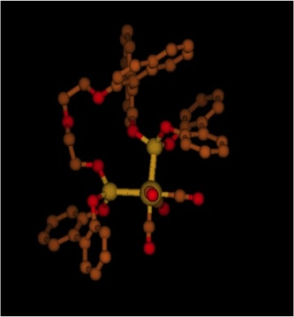
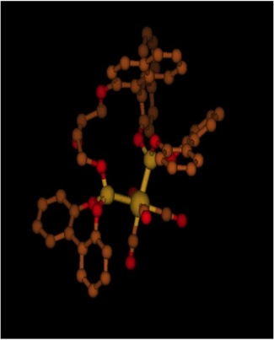
GridChem Using OGCE Tools
Initial Structure
Optimized Structure
GridChem using OGCE Workflow Tools to construct and execute CHARMM and Gaussian Molecular chemistry Models

Slide 19
UltraScan Gateway Architecture
Gateway Middleware
User
Apache
Web Interface
UltraScan
LIMS DB
Analysis
Control Unit
Cluster 1
S1
S1
S1
Cluster 1
Cluster 1
Cluster 2
Cluster 1
Cluster 1
Cluster 1
Cluster n
Cluster 1
Job
Scheduler
Job
Scheduler
Job
Scheduler
Job
Scheduler
Job
Scheduler
Job
Scheduler
S2
S2
S2
...
...
...
Distributor
Module
Distributor
Module
Distributor
Module
Sn
Sn
Sn
Notes:
All results are sent back to the Analysis Control unit, where the results are combined and prepared for reporting by the Apache web interface.

Slide 20
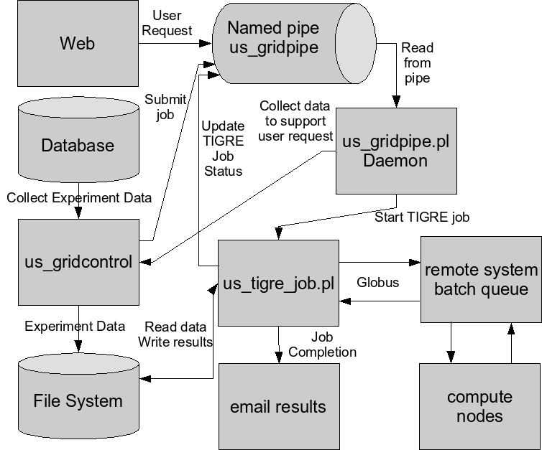
Gateway Advanced Support
Coordinate with HPC ASTA Support in Porting to new architectures and parallel performance enhancements.
New workflow implementations, new grid computing and grid middleware support:
  Reliability problems with WSGram
  Missing job status
  Only supports Gram4, needs porting to other middleware
  Issues with data movement.
  Need Fault tolerance at all levels.
  Users decide resources manually, need automated scheduling.
Current Architecture

Slide 21
Derived ASTA Requirements
Enhance the perl job submission daemon with OGCE Gfac service.
Enhance socket and email based job monitoring with OGCE Eventing System
Implement and iteratively enhance fault tolerance.
Port to Community account usage with gridshib auditing support.
Support Unicore to run jobs on European and Australian resources.

Slide 22
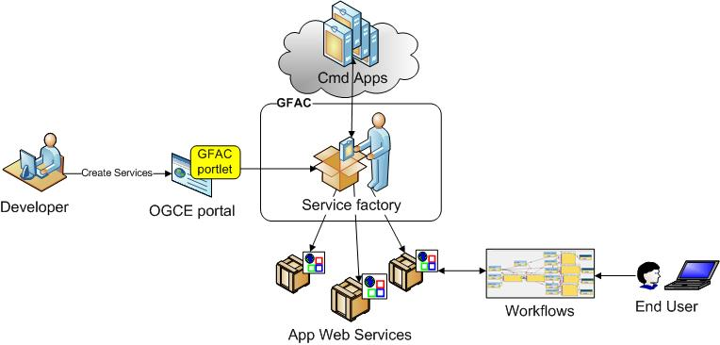
GFac Science Application Wrapper Tool

Slide 23
GFac Existing & Requested Features
Apache Axis2
Globus
Input Handlers
Registry Interface
Scheduling Interface
Monitoring Interface
Campus Resources
Output Handlers
Fault Tolerance
Data Management Abstraction
Amazon Eucalyptus
Auditing
Checkpoint Support
Job Management
Abstraction
Unicore
Gram5
Color Coding
Existing Features
UltraScan Requested Features

Slide 24
Target Compute Resource
UT Health Science Center Clusters
Texas State Grid: HiPCaT– TIGRE software stack
TeraGrid Resources – Ranger, Lonestar, Abe/Queenbee, Bigred
Clusters in Germany and Australia

Slide 25

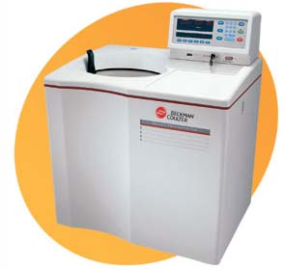

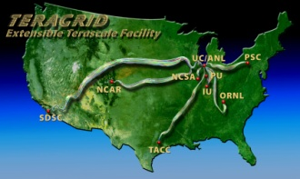



OGCE based UltraScan development Architecture
Manual Process
Quarry Gateway Hosting Machine
UltraScan Middleware
GFac, Eventing System, Fault Tolerance
Europe & Australian Grids

Slide 26
Current Status
Deployed Ultrascan software on IU Gateway Hosting Service
Replicated the production system to facilitate Gateway & HPC ASTA Testing
Deployed UltraScan application on Queenbee & Ranger
Working with GRAM 5 Integration on Ranger

Slide 27
Future Work
Add support to Unicore Job Management
Build Fault Tolerance
Reiterate ASTA Requirements

