Slide 1
FutureGrid: Supporting Next Generation Cyberinfrastructure
VTDC10 - The 4th International Workshop on Virtualization Technologies in Distributed Computing at HPDC Chicago Illinois June 20-25 2010
http://www.grid-appliance.org/wiki/index.php/VTDC10
June 22 2010
Geoffrey Fox
gcf@indiana.edu
http://www.infomall.org http://www.futuregrid.org
Director, Digital Science Center, Pervasive Technology Institute
Associate Dean for Research and Graduate Studies, School of Informatics and Computing
Indiana University Bloomington

Slide 2
FutureGrid Concepts
Support development of new applications and new middleware using Cloud, Grid and Parallel computing (Nimbus, Eucalyptus, Hadoop, Globus, Unicore, MPI, OpenMP. Linux, Windows …) looking at functionality, interoperability, performance
Put the “science” back in the computer science of grid computing by enabling replicable experiments
Open source software built around Moab/xCAT to support dynamic provisioning from Cloud to HPC environment, Linux to Windows ….. with monitoring, benchmarks and support of important existing middleware
June 2010 Initial users; September 2010 All hardware (except IU shared memory system) accepted and significant use starts; October 2011 FutureGrid allocatable via TeraGrid process

Slide 3
FutureGrid Hardware
Secondary
Default local
System type
# CPUs
# Cores
TFLOPS
RAM (GB)
s
torage (TB)
file system
Site
Dynamically configurable systems
IBM iDataPlex
256
1024
11
3072
335*
Lustre
IU
Dell PowerEdge
192
1152
12
1152
15
NFS
TACC
IBM iDataPlex
168
672
7
2016
120
GPFS
UC
IBM iDataPlex
168
672
7
2688
72
Lustre/PVFS
UC
SD
Subtotal
784
3520
37
8928
542
Systems not dynamically configurable
Cray XT5m
168
672
6
1344
335*
Lustre
IU
Shared memory system TBD
40**
480**
4**
640**
335*
Lustre
IU
GPU Cluster TBD
Cell BE Cluster
4
IBM iDataPlex
64
256
2
768
5
NFS
UF
High
Throughput Cluster
192
384
4
192
PU
Subtotal
552
2080
21
3328
10
Total
1336
5600
58
10560
552
FutureGrid has dedicated network (except to TACC) and a network fault and delay generator
Can isolate experiments on request; IU runs Network for NLR/Internet2
(Many) additional partner machines will run FutureGrid software and be supported (but allocated in specialized ways)
(*) IU machines share same storage; (**) Shared memory and GPU Cluster in year 2

Slide 4
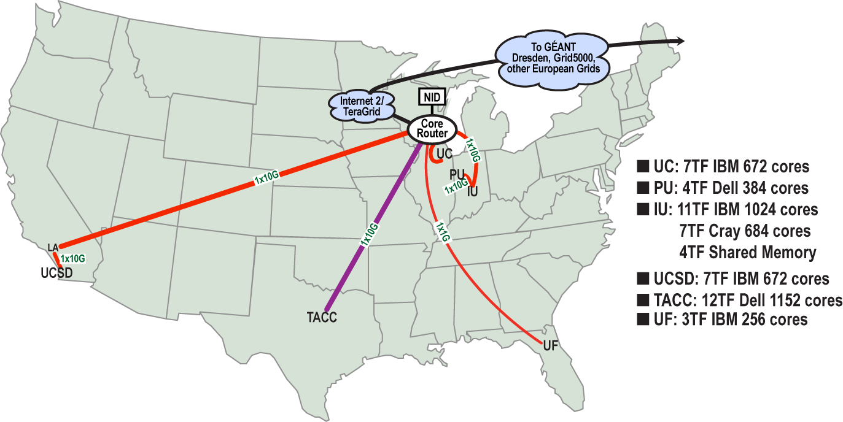
FutureGrid: a Grid/Cloud Testbed
IU Cray operational, IU IBM (iDataPlex) completed stability test May 6
UCSD IBM operational, UF IBM stability test completed June 12
Network, NID and PU HTC system operational
UC IBM stability test completed June 7; TACC Dell awaiting completion of installation
NID: Network Impairment Device
Private Public
FG Network

Slide 5
Storage and Interconnect Hardware
System Type | Capacity (TB) | File System | Site | Status
DDN 9550 (Data Capacitor) | 339 | Lustre | IU | Existing System
DDN 6620 | 120 | GPFS | UC | New System
SunFire x4170 | 72 | Lustre/PVFS | SDSC | New System
Dell MD3000 | 30 | NFS | TACC | New System
Machine | Name | Internal Network
IU Cray | xray | Cray 2D Torus SeaStar
IU iDataPlex | india | DDR IB, QLogic switch with Mellanox ConnectX adapters Blade Network Technologies & Force10 Ethernet switches
SDSC iDataPlex | sierra | DDR IB, Cisco switch with Mellanox ConnectX adapters Juniper Ethernet switches
UC iDataPlex | hotel | DDR IB, QLogic switch with Mellanox ConnectX adapters Blade Network Technologies & Juniper switches
UF iDataPlex | foxtrot | Gigabit Ethernet only (Blade Network Technologies; Force10 switches)
TACC Dell | tango | QDR IB, Mellanox switches and adapters Dell Ethernet switches
Names from International Civil Aviation Organization (ICAO) alphabet

Slide 6
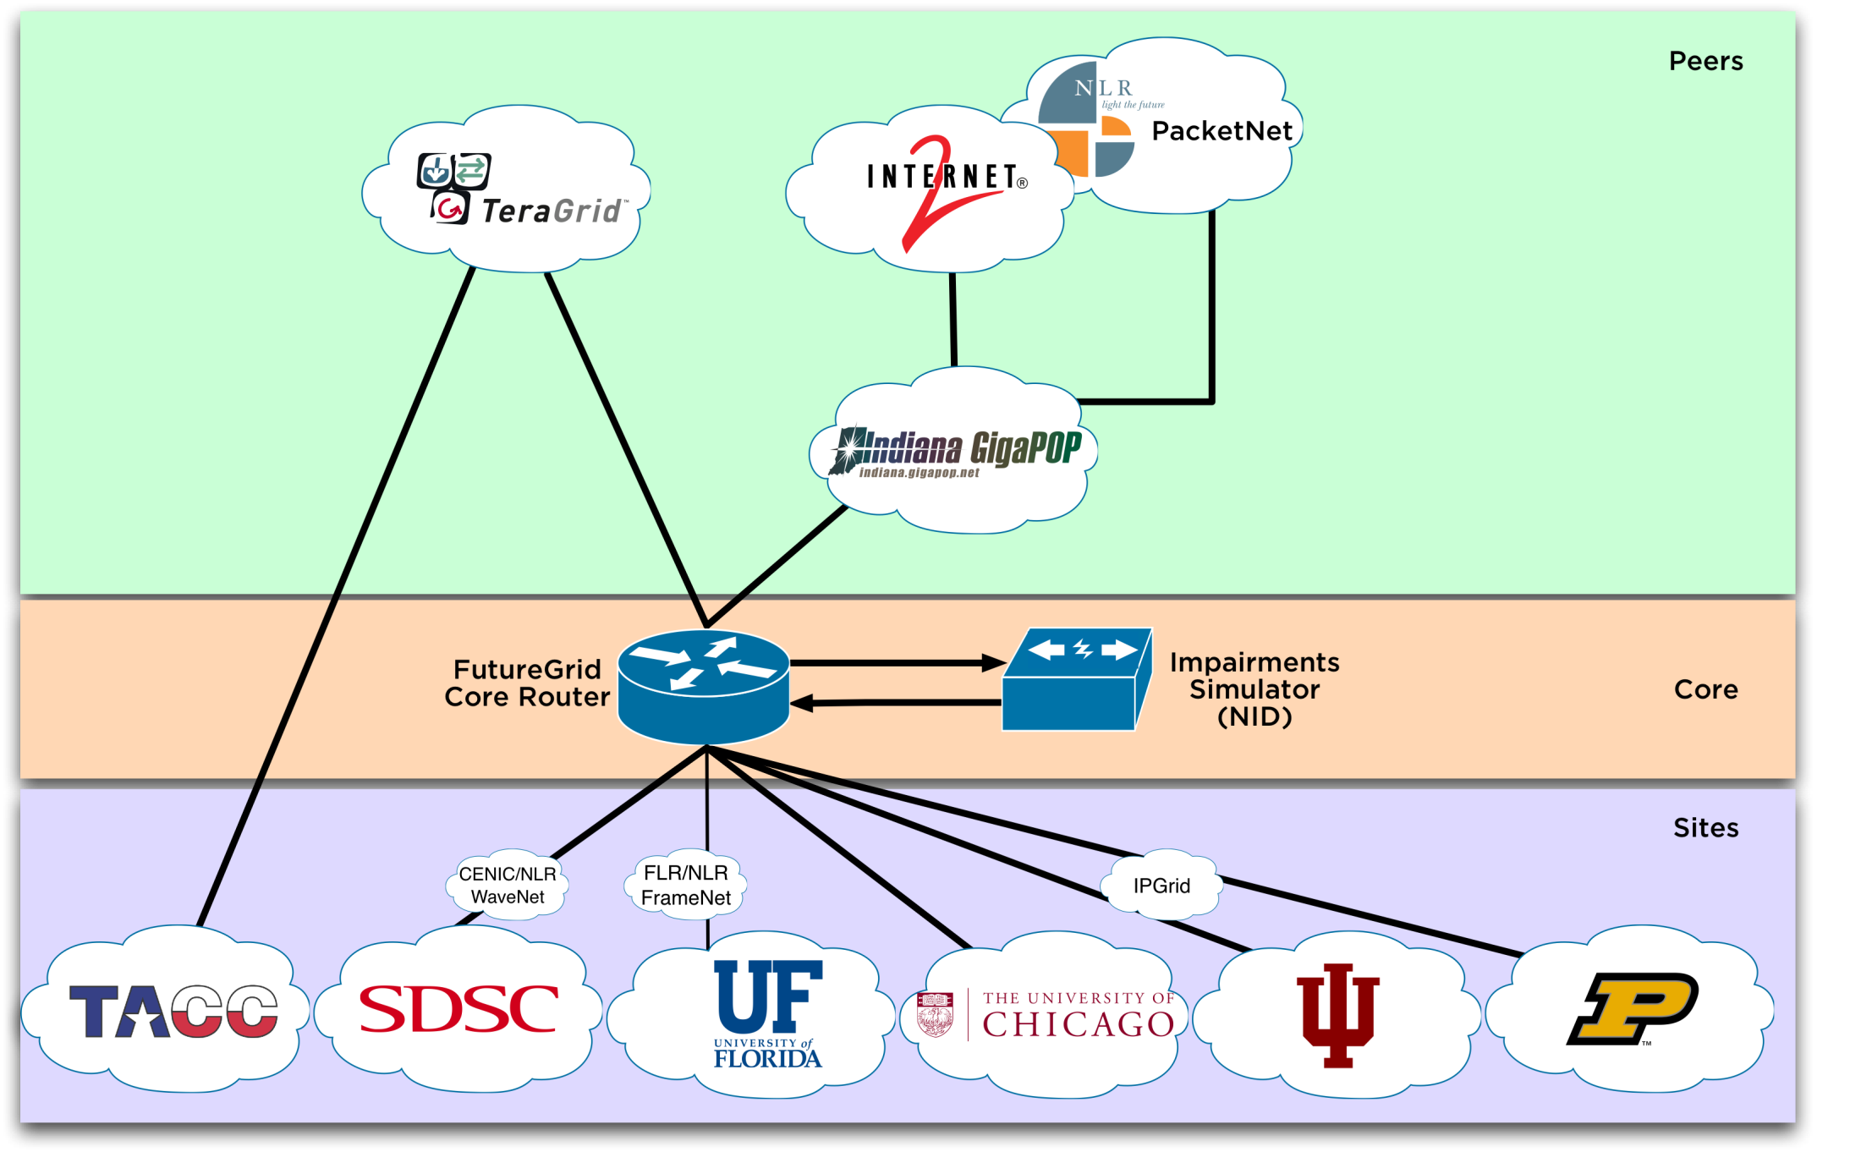
Logical Diagram

Slide 7
Network Impairment Device
Spirent XGEM Network Impairments Simulator for jitter, errors, delay, etc
Full Bidirectional 10G w/64 byte packets
up to 15 seconds introduced delay (in 16ns increments)
0-100% introduced packet loss in .0001% increments
Packet manipulation in first 2000 bytes
up to 16k frame size
TCL for scripting, HTML for manual configuration
Need exciting proposals to use!!

Slide 8
Network Milestones
December 2009
Setup and configuration of core equipment at IU
Juniper EX 8208
Spirent XGEM
January 2010
Core equipment relocated to Chicago
IP addressing & AS #
February 2010
Coordination with local networks
First Circuits to Chicago Active
March 2010
Peering with TeraGrid & Internet2
April 2010
NLR Circuit to UFL (via FLR) Active
May 2010
NLR Circuit to SDSC (via CENIC) Active

Slide 9
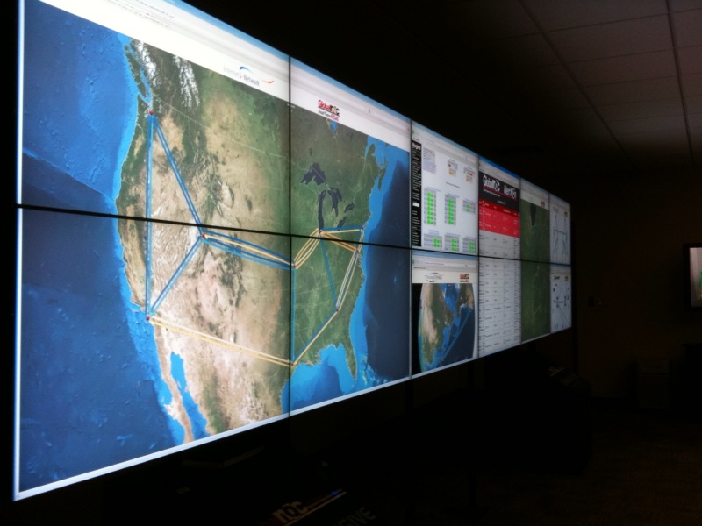
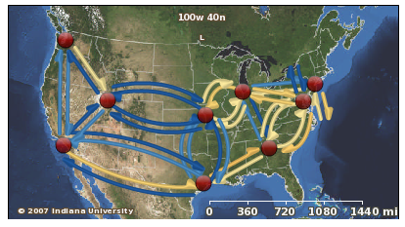
Global NOC Background
~65 total staff
Service Desk: proactive & reactive monitoring 24x7x365, coordination of support
Engineering: All operational troubleshooting
Planning/Senior Engineering: Senior Network engineers dedicated to single projects
Tool Developers: Developers of GlobalNOC tool suite

Slide 10
FutureGrid Partners
Indiana University (Architecture, core software, Support)
Collaboration between research and infrastructure groups
Purdue University (HTC Hardware)
San Diego Supercomputer Center at University of California San Diego (INCA, Monitoring)
University of Chicago/Argonne National Labs (Nimbus)
University of Florida (ViNE, Education and Outreach)
University of Southern California Information Sciences (Pegasus to manage experiments)
University of Tennessee Knoxville (Benchmarking)
University of Texas at Austin/Texas Advanced Computing Center (Portal)
University of Virginia (OGF, Advisory Board and allocation)
Center for Information Services and GWT-TUD from Technische Universtität Dresden. (VAMPIR)
Red institutions have FutureGrid hardware

Slide 11
Other Important Collaborators
Early users from an application and computer science perspective and from both research and education
Grid5000 and D-Grid in Europe
Commercial partners such as
Eucalyptus ….
Microsoft (Dryad + Azure)
Application partners
NSF
TeraGrid – Tutorial at TG10
Open Grid Forum
Possibly Open Nebula, Open Cirrus Testbed, Open Cloud Consortium, Cloud Computing Interoperability Forum. IBM-Google-NSF Cloud, Magellan and other DoE/NSF/NASA … clouds
You!!

Slide 12
FutureGrid Usage Model
The goal of FutureGrid is to support the research on the future of distributed, grid, and cloud computing.
FutureGrid will build a robustly managed simulation environment and test-bed to support the development and early use in science of new technologies at all levels of the software stack: from networking to middleware to scientific applications.
The environment will mimic TeraGrid and/or general parallel and distributed systems – FutureGrid is part of TeraGrid and one of two experimental TeraGrid systems (other is GPU)
It will also mimic commercial clouds (initially IaaS not PaaS)
FutureGrid is a (small ~5000 core) Science/Computer Science Cloud but it is more accurately a virtual machine or bare-metal based simulation environment
This test-bed will succeed if it enables major advances in science and engineering through collaborative development of science applications and related software.

Slide 13
Education on FutureGrid
Build up tutorials on supported software
Support development of curricula requiring privileges and systems destruction capabilities that are hard to grant on conventional TeraGrid
Offer suite of appliances supporting online laboratories
The training, education, and outreach mission of FutureGrid leverages extensively the use of virtual machines and self-configuring virtual networks to allow convenient encapsulation and seamless instantiation of virtualized clustered environments in a variety of resources: FutureGrid machines, cloud providers, and desktops or clusters within an institution. The Grid Appliance provides a framework for building virtual educational environments used in FutureGrid.

Slide 14
Lead: Gregor von Laszewski
FutureGrid Software

Slide 15
FutureGrid Software Architecture
Flexible Architecture allows one to configure resources based on images
Managed images allows to create similar experiment environments
Experiment management allows reproducible activities
Through our modular design we allow different clouds and images to be “rained” upon hardware.
Note will eventually be supported 24x7 at “TeraGrid Production Quality”
Will support deployment of “important” middleware including TeraGrid stack, Condor, BOINC, gLite, Unicore, Genesis II, MapReduce, Bigtable …..
Love more supported software!
Will support links to external clouds, GPU clusters etc.
Grid5000 initial highlight with OGF29 Hadoop deployment over Grid5000 and FutureGrid
Love more external system collaborators!

Slide 16
Software Components
Portals including “Support” “use FutureGrid” “Outreach”
Monitoring – INCA, Power (GreenIT)
Experiment Manager: specify/workflow
Image Generation and Repository
Intercloud Networking ViNE
Performance library
Rain or Runtime Adaptable InsertioN Service: Schedule and Deploy images
Security (including use of isolated network), Authentication, Authorization,

Slide 17
RAIN: Dynamic Provisioning
Change underlying system to support current user demands at different levels
Linux, Windows, Xen, KVM, Nimbus, Eucalyptus, Hadoop, Dryad
Switching between Linux and Windows possible!
Stateless (means no “controversial” state) images: Defined as any node that that does not store permanent state, or configuration changes, software updates, etc.
Shorter boot times
Pre-certified; easier to maintain
Statefull installs: Defined as any node that has a mechanism to preserve its state, typically by means of a non-volatile disk drive.
Windows
Linux with custom features
Encourage use of services: e.g. MyCustomSQL as a service and not MyCustomSQL as part of installed image?
Runs OUTSIDE virtualization so cloud neutral
Use Moab to trigger changes and xCAT to manage installs

Slide 18
xCAT and Moab in detail
xCAT
Uses Preboot eXecution Environment (PXE) to perform remote network installation from RAM or disk file systems
Creates stateless Linux images (today)
Changes the boot configuration of the nodes
We are intending in future to use remote power control and console to switch on or of the servers (IPMI)
Moab
Meta-schedules over resource managers
Such as TORQUE(today) and Windows HPCS
control nodes through xCAT
Changing the OS
Remote power control in future

Slide 19
Dynamic provisioning Examples
Give me a virtual cluster with 30 nodes based on Xen
Give me 15 KVM nodes each in Chicago and Texas linked to Azure and Grid5000
Give me a Eucalyptus environment with 10 nodes
Give me a Hadoop environment with 160 nodes
Give me a 1000 BLAST instances linked to Grid5000
Run my application on Hadoop, Dryad, Amazon and Azure … and compare the performance

Slide 20
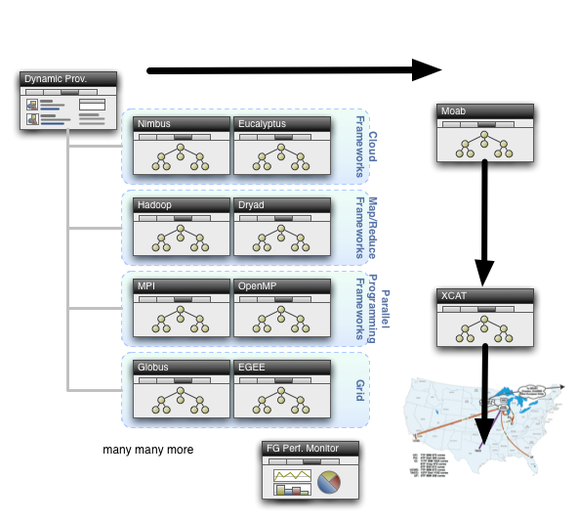
Dynamic Provisioning

Slide 21
Command line RAIN Interface
fg-deploy-image
host name
image name
start time
end time
label name
fg-add
label name
framework hadoop
version 1.0
Deploys an image on a host
Adds a feature to a deployed image

Slide 22
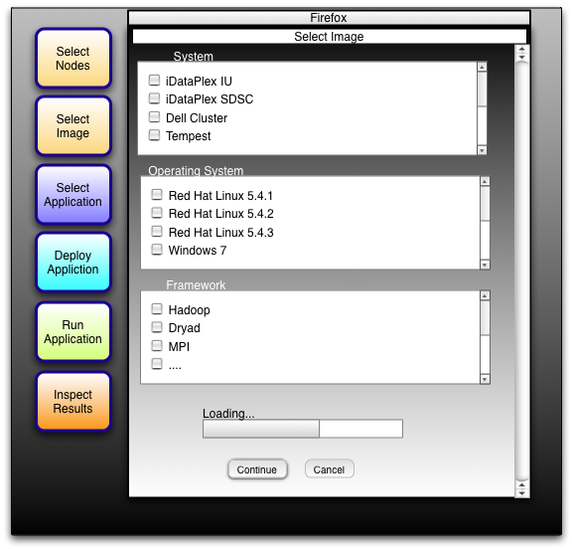
Draft GUI for FutureGrid Dynamic Provisioning
Google Gadget for FutureGrid Support
We are building a FutureGrid Portal!

Slide 23
Experiment Manager FutureGrid Software Component
Objective
Manage the provisioning for reproducible experiments
Coordinate workflow of experiments
Share workflow and experiment images
Minimize space through reuse
Risk
Images are large
Users have different requirements and need different images

Slide 24
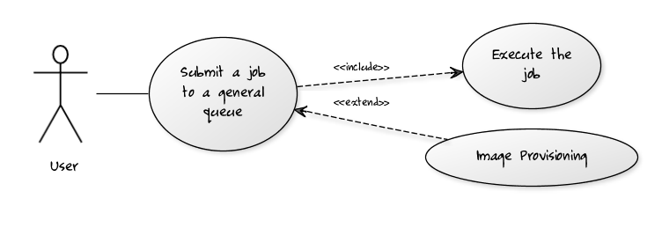
Per Job Reprovisioning
The user submits a job to a general queue. This job specifies a custom Image type attached to it.
The Image gets reprovisioned on the resources
The job gets executed within that image
After job is done the Image is no longer needed.
Use case: Many different users with many different images

Slide 25
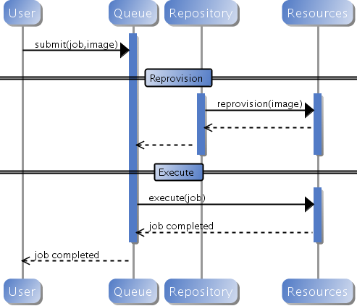
Custom Reprovisioning
Normal approach to job submission

Slide 26
Reprovisioning based on prior state
The user submits a job to a general queue. This job specifies an OS (re-used stateless image) type attached to it.
The queue evaluates the OS requirement.
If an available node has OS already running, run the job there.
If there are no OS types available, reprovision an available node and submit the job to the new node.
Repeat the provisioning steps if the job requires multiple processors (such as a large MPI job).
Use case: reusing the same stateless image between usages

Slide 27
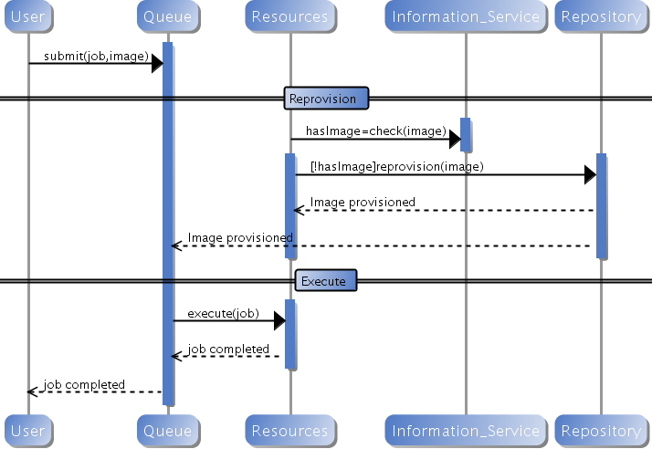
Generic Reprovisioning

Slide 28
Manage your own VO queue
This use case illustrates how a group of users or a Virtual Organization (VO) can handle their own queue to specifically tune their application environment to their specification.
A VO sets up a new queue, and provides an Operating System image that is associated to this image.
Can aid in image creation through the use of advanced scripts and a configuration management tool.
A user within the VO submits a job to the VO queue.
The queue is evaluated, and determines if there are free resource nodes available.
If there is an available node and the VO OS is running on it, then the Job is scheduled there.
If an un-provisioned node is available, the VO OS is provisioned and the job is then submitted to that node.
If there are other idle nodes without jobs running, a node can be re-provisioned to the VO OS and the job is then submitted to that node.
Repeat the provisioning steps if multiple processors are required (such as an MPI job).
Use case: Provide a service to the users of a VO. For example: submit a job that uses particular software. For example provide a queue called Genesis or Hadoop for the associated user community. Provisioning is hidden from the users.

Slide 29
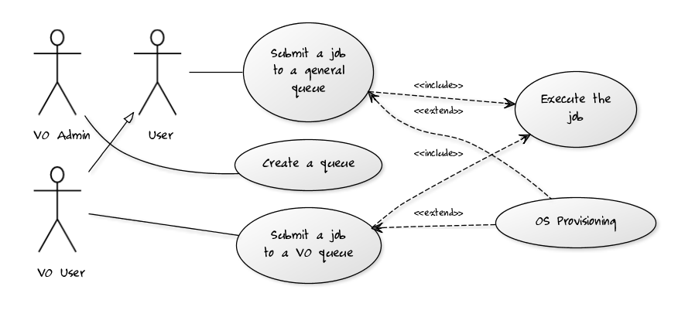
VO Queue

Slide 30
Current Status of Dynamic Provisioning @ FutureGrid
FutureGrid now supports the Dynamic Provisioning feature through MOAB.
Submit a job with ‘os1’ requested, if there is a node running ‘os1’ and in idle status, the job will be scheduled.
If there is no node running ‘os1’, a provisioning job will be started automatically and change an idle node’s OS to the requested one. And when it's done, the submitted job will be scheduled there.
In our experiment we used 2 rhel5 OS and dynamically switched between, one stateless and one statefull.
In our experiment the reprovisioning costs were
Approximately 4-5 minutes for Statefull and Stateless
Used sierra.futuregrid.org iDataPlex at SDSC

Slide 31
Difficult Issues
Performance of VM’s poor with Infiniband: FutureGrid does not have resources to address such core VM issues – we can identify issues and report
What about root access? Typically administrators involved in preparation of images requiring root access. This is part of certification process. We will offer certified tools to prepare images
What about attacks on Infiniband switch? We need to study this
How does one certify statefull images? All statefull images must have a certain default software included that auto-update the image which is tested against a security service prior to staging. In case an image is identified as having a security risk it is no longer allowed to be booted.

Slide 32
FutureGrid and Commercial Clouds

Slide 33
FutureGrid Interaction with Commercial Clouds
We support experiments that link Commercial Clouds and FutureGrid experiments with one or more workflow environments and portal technology installed to link components across these platforms
We support environments on FutureGrid that are similar to Commercial Clouds and natural for performance and functionality comparisons.
These can both be used to prepare for using Commercial Clouds and as the most likely starting point for porting to them (item c below).
One example would be support of MapReduce-like environments on FutureGrid including Hadoop on Linux and Dryad on Windows HPCS which are already part of FutureGrid portfolio of supported software.
We develop expertise and support porting to Commercial Clouds from other Windows or Linux environments
We support comparisons between and integration of multiple commercial Cloud environments -- especially Amazon and Azure in the immediate future
We develop tutorials and expertise to help users move to Commercial Clouds from other environments.

Slide 34
Philosophy of Clouds and Grids
Clouds are (by definition) commercially supported approach to large scale computing
So we should expect Clouds to replace all but high end Compute Grids
Current Grid technology involves “non-commercial” software solutions which are hard to evolve/sustain
Maybe Clouds ~4% IT expenditure 2008 growing to 14% in 2012 (IDC Estimate)
Public Clouds are broadly accessible resources like Amazon and Microsoft Azure – powerful but not easy to customize and perhaps data trust/privacy issues
Private Clouds run similar software and mechanisms but on “your own computers” (not clear if still elastic)
Platform features such as Queues, Tables, Databases limited
FutureGrid can help to develop Private Clouds
Services still are correct architecture with either REST (Web 2.0) or Web Services
Clusters still critical concept

Slide 35
Cloud Computing: Infrastructure and Runtimes
Cloud infrastructure: outsourcing of servers, computing, data, file space, utility computing, etc.
Handled through Web services that control virtual machine lifecycles.
Cloud runtimes or Platform: tools (for using clouds) to do data-parallel (and other) computations.
Apache Hadoop, Google MapReduce, Microsoft Dryad, Bigtable, Chubby and others
MapReduce designed for information retrieval but is excellent for a wide range of science data analysis applications
Can also do much traditional parallel computing for data-mining if extended to support iterative operations
MapReduce not usually on Virtual Machines

Slide 36
FutureGrid Platform Features I?
An opportunity to design a scientific computing platform?
Authentication and Authorization: Provide single sign in to both FutureGrid and Commercial Clouds linked by workflow
Workflow: Support workflows that link job components between FutureGrid and Commercial Clouds. Trident from Microsoft Research is initial candidate
Data Transport: Transport data between job components on FutureGrid and Commercial Clouds respecting custom storage patterns
Program Library: Store Images and other Program material (basic FutureGrid facility)
Worker Role: This concept is implicitly used in both Amazon and TeraGrid but was first introduced as a high level construct by Azure
Software as a Service: This concept is shared between Clouds and Grids and can be supported without special attention. However making “everything” a service (from SQL to Notification to BLAST) is significant
Web Role: This is used in Azure to describe important link to user and can be supported in FutureGrid with a Portal framework

Slide 37
FutureGrid Platform Features II?
Need partners to support features?
Blob: Basic storage concept similar to Azure Blob or Amazon S3; Disks as a service as opposed to disks as a Drive/Elastic Block Store
DPFS Data Parallel File System: Support of file systems like Google (MapReduce), HDFS (Hadoop) or Cosmos (dryad) with compute-data affinity optimized for data processing
Table: Support of Table Data structures modeled on Apache Hbase or Amazon SimpleDB/Azure Table. Bigtable (Hbase) v Littletable (Document store such as CouchDB)
SQL: Relational Database
Queues: Publish Subscribe based queuing system
MapReduce: Support MapReduce Programming model including Hadoop on Linux, Dryad on Windows HPCS and Twister on Windows and Linux

Slide 38
An Example of FutureGrid Performance Study

Slide 39
Hadoop/Dryad Comparison Inhomogeneous Data I
Inhomogeneity of data does not have a significant effect when the sequence lengths are randomly distributed
Dryad with Windows HPCS compared to Hadoop with Linux RHEL on Idataplex (32 nodes)

Slide 40
Hadoop/Dryad Comparison Inhomogeneous Data II
This shows the natural load balancing of Hadoop MR dynamic task assignment using a global pipe line in contrast to the DryadLinq static assignment
Dryad with Windows HPCS compared to Hadoop with Linux RHEL on Idataplex (32 nodes)

Slide 41
Hadoop VM Performance Degradation
Perf. Degradation = (T_{vm} – T_{baremetal})/T_{baremetal}
15.3% Degradation at largest data set size

Slide 42
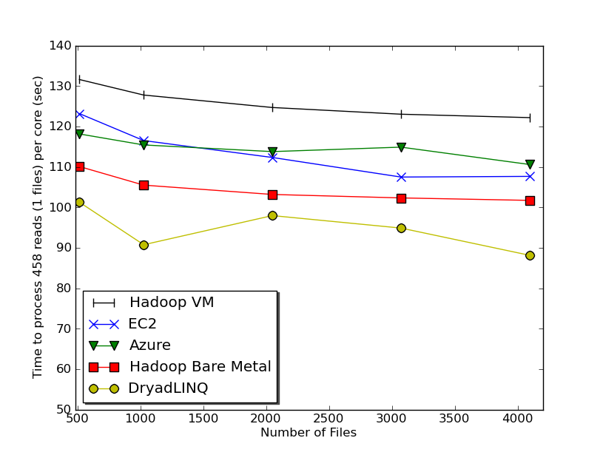
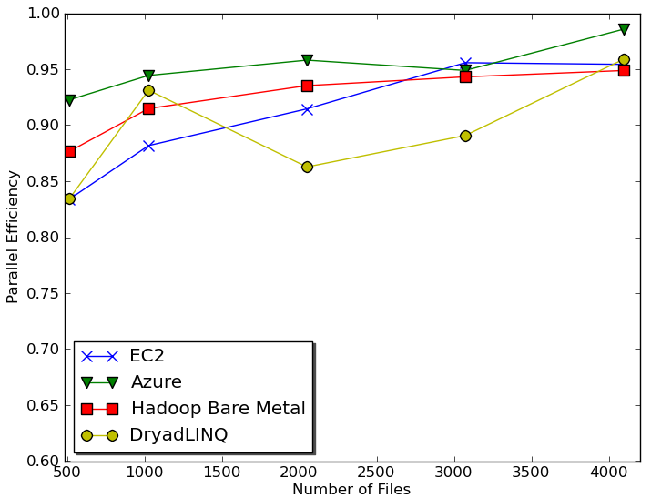
Sequence Assembly in the Clouds
Cap3 parallel efficiency
Cap3 – Per core per file (458 reads in each file) time to process sequences

Slide 43
Cost to assemble to process 4096 FASTA files
~ 1 GB / 1875968 reads (458 readsX4096)
Amazon AWS total :11.19 $
Compute 1 hour X 16 HCXL (0.68$ * 16) = 10.88 $
10000 SQS messages = 0.01 $
Storage per 1GB per month = 0.15 $
Data transfer out per 1 GB = 0.15 $
Azure total : 15.77 $
Compute 1 hour X 128 small (0.12 $ * 128) = 15.36 $
10000 Queue messages = 0.01 $
Storage per 1GB per month = 0.15 $
Data transfer in/out per 1 GB = 0.10 $ + 0.15 $
Tempest (amortized) : 9.43 $
24 core X 32 nodes, 48 GB per node
Assumptions : 70% utilization, write off over 3 years, include support

Slide 44
 | AWS/ Azure | Hadoop | DryadLINQ
Programming patterns | Independent job execution | MapReduce | DAG execution, MapReduce + Other patterns
Fault Tolerance | Task re-execution based on a time out | Re-execution of failed and slow tasks. | Re-execution of failed and slow tasks.
Data Storage | S3/Azure Storage. | HDFS parallel file system. | Local files
Environments | EC2/Azure, local compute resources | Linux cluster, Amazon Elastic MapReduce | Windows HPCS cluster
Ease of Programming | EC2 : ** Azure: *** | **** | ****
Ease of use | EC2 : *** Azure: ** | *** | ****
Scheduling & Load Balancing | Dynamic scheduling through a global queue, Good natural load balancing | Data locality, rack aware dynamic task scheduling through a global queue, Good natural load balancing | Data locality, network topology aware scheduling. Static task partitions at the node level, suboptimal load balancing

Slide 45
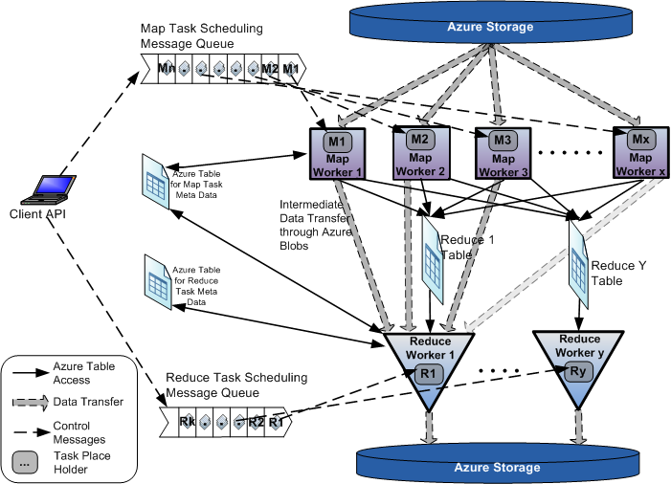
AzureMapReduce

Slide 46
Early Results with AzureMapreduce
Compare
Hadoop - 4.44 ms Hadoop VM - 5.59 ms DryadLINQ - 5.45 ms Windows MPI - 5.55 ms

Slide 47
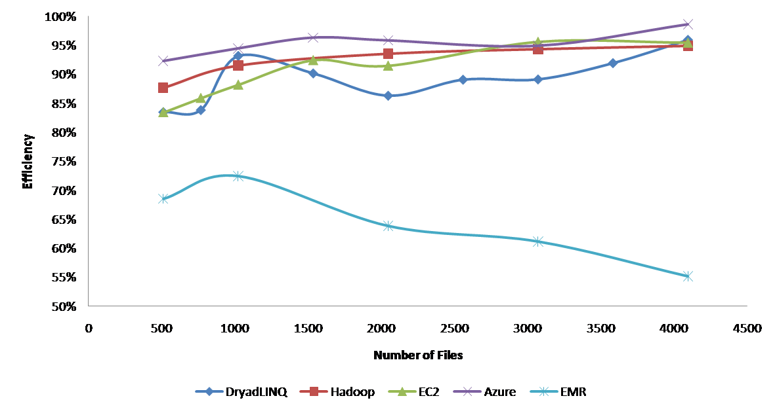
Currently we cant make Amazon Elastic MapReduce run well
Hadoop runs well on Xen FutureGrid Virtual Machines

Slide 48
Some Issues with AzureTwister and AzureMapReduce
Transporting data to Azure: Blobs (HTTP), Drives (GridFTP etc.), Fedex disks
Intermediate data Transfer: Blobs (current choice) versus Drives (should be faster but don’t seem to be)
Azure Table v Azure SQL: Handle all metadata
Messaging Queues: Use real publish-subscribe system in place of Azure Queues
Azure Affinity Groups: Could allow better data-compute and compute-compute affinity

Slide 49
 | Google MapReduce | Apache Hadoop | Microsoft Dryad | Twister | Azure Twister
Programming Model | 98 | MapReduce | DAG execution, Extensible to MapReduce and other patterns | Iterative MapReduce | MapReduce-- will extend to Iterative MapReduce
Data Handling | GFS (Google File System) | HDFS (Hadoop Distributed File System) | Shared Directories & local disks | Local disks and data management tools | Azure Blob Storage
Scheduling | Data Locality | Data Locality; Rack aware, Dynamic task scheduling through global queue | Data locality; Network topology based run time graph optimizations; Static task partitions | Data Locality; Static task partitions | Dynamic task scheduling through global queue
Failure Handling | Re-execution of failed tasks; Duplicate execution of slow tasks | Re-execution of failed tasks; Duplicate execution of slow tasks | Re-execution of failed tasks; Duplicate execution of slow tasks | Re-execution of Iterations | Re-execution of failed tasks; Duplicate execution of slow tasks
High Level Language Support | Sawzall | Pig Latin | DryadLINQ | Pregel has related features | N/A
Environment | Linux Cluster. | Linux Clusters, Amazon Elastic Map Reduce on EC2 | Windows HPCS cluster | Linux Cluster EC2 | Window Azure Compute, Windows Azure Local Development Fabric
Intermediate data transfer | File | File, Http | File, TCP pipes, shared-memory FIFOs | Publish/Subscribe messaging | Files, TCP

Slide 50
FutureGrid CloudBench
Maintain a set of comparative benchmarks for comparable operations on FutureGrid, Azure, Amazon
e.g. http://azurescope.cloudapp.net/ with Amazon and FutureGrid analogues
Need MapReduce as well

Slide 51
The term SALSA or Service Aggregated Linked Sequential Activities, is derived from Hoare’s Concurrent Sequential Processes (CSP)
SALSA Group
http://salsahpc.indiana.edu
Group Leader: Judy Qiu
Staff : Adam Hughes
CS PhD: Jaliya Ekanayake, Thilina Gunarathne, Jong Youl Choi, Seung-Hee Bae,
Yang Ruan, Hui Li, Bingjing Zhang, Saliya Ekanayake,
CS Masters: Stephen Wu
Undergraduates: Zachary Adda, Jeremy Kasting, William Bowman
http://salsahpc.indiana.edu/content/cloud-materials Cloud Tutorial Material

Slide 52
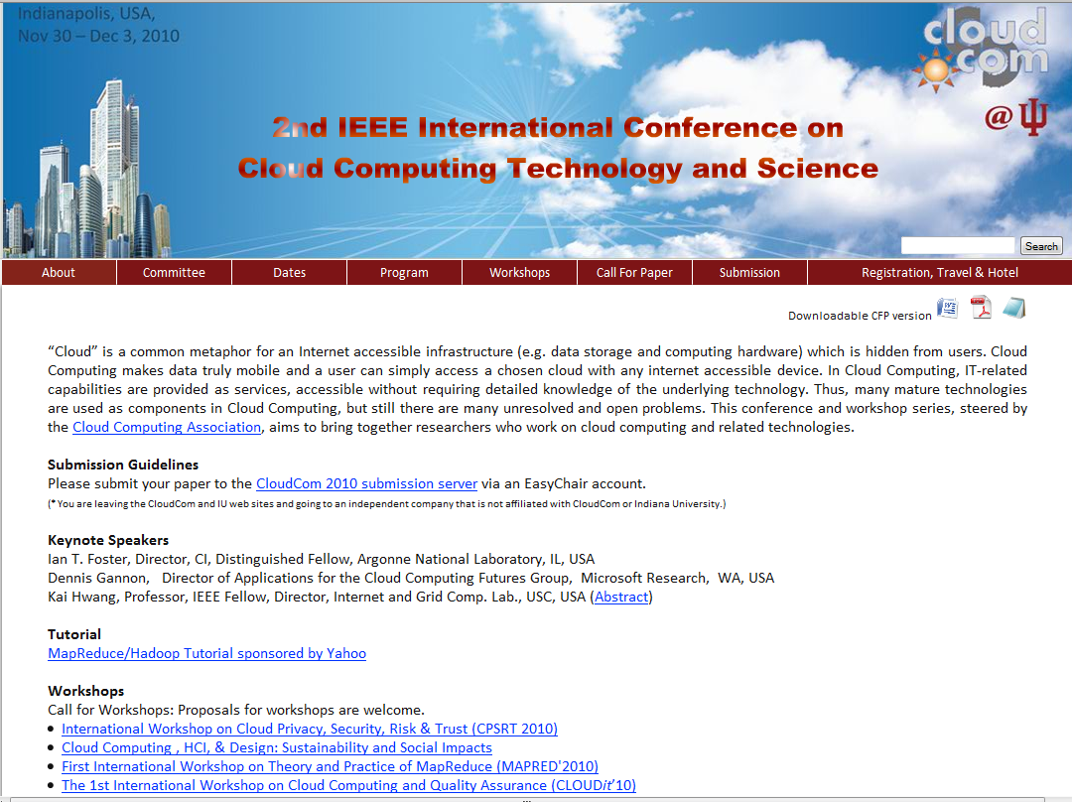
Microsoft Azure Tutorial

