Slide 1

Scalable Data Analytics: Parallel Computing Reborn
Vrije Universiteit
Amsterdam
September 24 2014
Geoffrey Fox
gcf@indiana.edu
http://www.infomall.org
School of Informatics and Computing
Digital Science Center
Indiana University Bloomington

Slide 2
Data Science Masters Features
Fully approved by University; expected to be approved by State October 2014
Blended online and residential
Department of Information and Library Science, Division of Informatics and Division of Computer Science in the Department of Informatics and Computer Science, School of Informatics and Computing and the Department of Statistics, College of Arts and Science, IUB
30 credits (10 conventional courses)
Basic (general) Masters degree plus tracks
  Currently only track is “Computational and Analytic Data Science ” but will label courses “decision-maker” or “technical”
  Other tracks can be proposed and approved by campus, data science faculty, data science curriculum committee
A purely online 4-course Certificate in Data Science has been approved and started January 2014 (75 students), and a Ph.D. Minor in Data Science will be proposed.

Slide 3
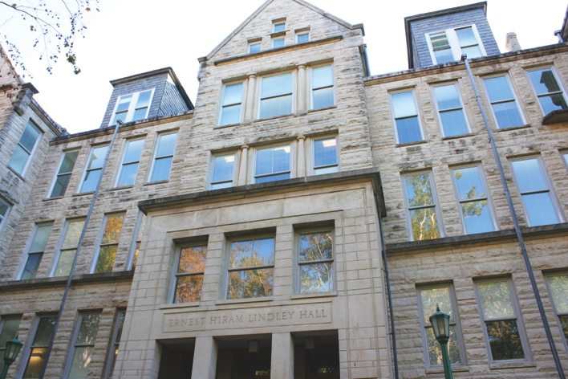
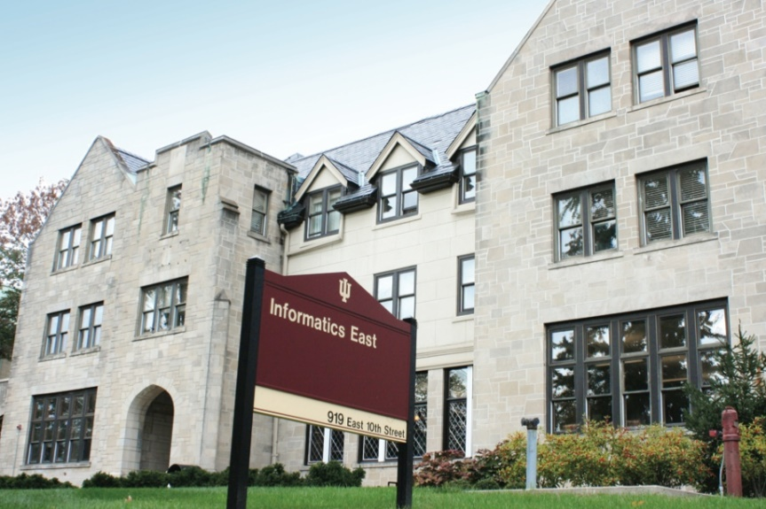
Background of the School
The School of Informatics was established in 2000 as first of
its kind in the United States.
Computer Science was established in 1971 and became part
of the school in 2005.
Library and Information Science
was established in 1951 and
became part of the school
in 2013.
Now named the School of
Informatics and Computing.
97 faculty, 1191 undergraduates,
644 masters, 263 PhD

Slide 4

McKinsey Institute on Big Data Jobs
Decision maker and Technical paths
There will be a shortage of talent necessary for organizations to take advantage of big data. By 2018, the United States alone could face a shortage of 140,000 to 190,000 people with deep analytical skills as well as 1.5 million managers and analysts with the know-how to use the analysis of big data to make effective decisions.
At SOIC, Informatics/ILS aimed at 1.5 million jobs. Computer Science covers the 140,000 to 190,000
http://www.mckinsey.com/mgi/publications/big_data/index.asp.

Slide 5
Abstract
We review Big Data applications and the emerging source software model -- often associated with Apache projects like Hadoop.
We propose a software model HPC-ABDS (High Performance Computing -- Apache Big Data Stack) with some 150 software projects divided into 17 layers including one devoted to communication.
The goal is the sustainability and pervasive advantages of Apache and the performance of HPC. R and Mahout are popular cloud analytics libraries but they miss many good algorithms and are typically slow.
We describe an activity SPIDAL (Scalable Parallel Interoperable Data Analytics Library) that aims to produce a high performance data analytics library with its deployment as "Data Analytics as a Service" on top of HPC-ABDS.
We describe progress and challenges in areas such as algorithms, parallelism, performance models and Java runtime.

Slide 6
Thank you NSF
3 yr. XPS: FULL: DSD: Collaborative Research: Rapid Prototyping HPC Environment for Deep Learning IU, Tennessee (Dongarra), Stanford (Ng)
“Rapid Python Deep Learning Infrastructure” (RaPyDLI) Builds optimized Multicore/GPU/Xeon Phi kernels (best exascale dataflow) with Python front end for general deep learning problems with ImageNet exemplar. Leverage Caffe from UCB.
5 yr. Datanet: CIF21 DIBBs: Middleware and High Performance Analytics Libraries for Scalable Data Science IU, Rutgers (Jha), Virginia Tech (Marathe), Kansas (CReSIS), Emory (Wang), Arizona State(Beckstein), Utah(Cheatham)
HPC-ABDS: Cloud-HPC interoperable software performance of HPC (High Performance Computing) and the rich functionality of the commodity Apache Big Data Stack.
SPIDAL (Scalable Parallel Interoperable Data Analytics Library): Scalable Analytics for Biomolecular Simulations, Network and Computational Social Science, Epidemiology, Computer Vision, Spatial Geographical Information Systems, Remote Sensing for Polar Science and Pathology Informatics.

Slide 7
Analytics and the DIKW Pipeline
Data goes through a pipeline
Raw data → Data → Information → Knowledge → Wisdom → Decisions
Each link enabled by a filter which is “business logic” or “analytics”
We are interested in filters that involve “sophisticated analytics” which require non trivial parallel algorithms
  Improve state of art in both algorithm quality and (parallel) performance
Design and Build SPIDAL (Scalable Parallel Interoperable Data Analytics Library)
Data
Information
Analytics
Information
Knowledge
More Analytics

Slide 8

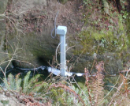
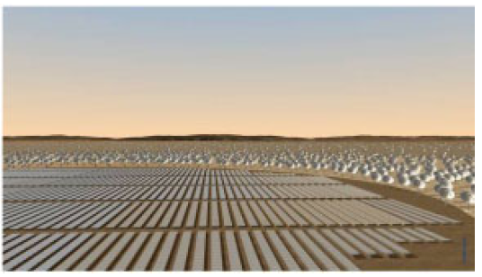
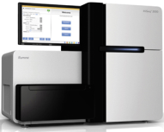
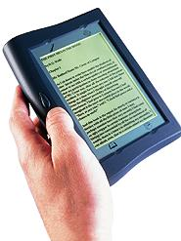





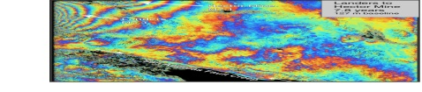
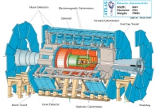
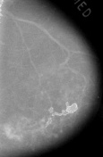



Raw Data → Data → Information → Knowledge → Wisdom → Decisions
Another
Grid
SS
SS
SS
SS
SS
SS
SS
Filter
Cloud
Discovery
Cloud
Portal
Filter
Cloud
Fusion for Discovery/Decisions
SS
Filter
Cloud
Another
Service
SS
Filter
Cloud
Filter
Cloud
Filter
Cloud
Discovery
Cloud
SS
SS: Sensor or Data
Interchange
Service
Workflow through multiple filter/discovery clouds or Services
SS
Filter
Cloud
Filter
Cloud
Filter
Cloud
Filter
Cloud
SS
Another
Cloud
SS
SS
SS
SS
SS
SS
SS
SS
SS
SS
SS
SS
SS
Compute
Cloud
Storage
Cloud
Distributed
Grid
Hadoop Cluster
Database

Slide 9
Strategy to Build SPIDAL
Analyze Big Data applications to identify analytics needed and generate benchmark applications
Analyze existing analytics libraries (in practice limit to some application domains) – catalog library members available and performance
  Mahout low performance, R largely sequential and missing key algorithms, MLlib just starting
Identify big data computer architectures
Identify software model to allow interoperability and performance
Design or identify new or existing algorithm including parallel implementation
Collaborate with application scientists, computer systems and statistics/algorithms communities

Slide 10
NIST Big Data Use Cases

Slide 11

Use Case Template
26 fields completed for 51 areas
Government Operation: 4
Commercial: 8
Defense: 3
Healthcare and Life Sciences: 10
Deep Learning and Social Media: 6
The Ecosystem for Research: 4
Astronomy and Physics: 5
Earth, Environmental and Polar Science: 10
Energy: 1

Slide 12
51 Detailed Use Cases: Contributed July-September 2013
Covers goals, data features such as 3 V’s, software, hardware
26 Features for each use case
Biased to science
http://bigdatawg.nist.gov/usecases.php
https://bigdatacoursespring2014.appspot.com/course (Section 5)
Government Operation(4): National Archives and Records Administration, Census Bureau
Commercial(8): Finance in Cloud, Cloud Backup, Mendeley (Citations), Netflix, Web Search, Digital Materials, Cargo shipping (as in UPS)
Defense(3): Sensors, Image surveillance, Situation Assessment
Healthcare and Life Sciences(10): Medical records, Graph and Probabilistic analysis, Pathology, Bioimaging, Genomics, Epidemiology, People Activity models, Biodiversity
Deep Learning and Social Media(6): Driving Car, Geolocate images/cameras, Twitter, Crowd Sourcing, Network Science, NIST benchmark datasets
The Ecosystem for Research(4): Metadata, Collaboration, Language Translation, Light source experiments
Astronomy and Physics(5): Sky Surveys including comparison to simulation, Large Hadron Collider at CERN, Belle Accelerator II in Japan
Earth, Environmental and Polar Science(10): Radar Scattering in Atmosphere, Earthquake, Ocean, Earth Observation, Ice sheet Radar scattering, Earth radar mapping, Climate simulation datasets, Atmospheric turbulence identification, Subsurface Biogeochemistry (microbes to watersheds), AmeriFlux and FLUXNET gas sensors
Energy(1): Smart grid

Slide 13

Table 4: Characteristics of 6 Distributed Applications
Application Example | Execution Unit | Communication | Coordination | Execution Environment
Montage | Multiple sequential and parallel executable | Files | Dataflow (DAG) | Dynamic process creation, execution
NEKTAR | Multiple concurrent parallel executables | Stream based | Dataflow | Co-scheduling, data streaming, async. I/O
Replica-Exchange | Multiple seq. and parallel executables | Pub/sub | Dataflow and events | Decoupled coordination and messaging
Climate Prediction (generation) | Multiple seq. & parallel executables | Files and messages | Master-Worker, events | @Home (BOINC)
Climate Prediction (analysis) | Multiple seq. & parallel executables | Files and messages | Dataflow | Dynamics process creation, workflow execution
SCOOP | Multiple Executable | Files and messages | Dataflow | Preemptive scheduling, reservations
Coupled Fusion | Multiple executable | Stream-based | Dataflow | Co-scheduling, data streaming, async I/O
Part of Property Summary Table

Slide 14
Big Data Features leads to Ogres characterizing them

Slide 15
Would like to capture “essence of these use cases”
“small” kernels, mini-apps
Or Classify applications into patterns
Do it from HPC background not database viewpoint
e.g. focus on cases with detailed analytics
Section 5 of my class https://bigdatacoursespring2014.appspot.com/preview classifies 51 use cases with ogre facets

Slide 16
HPC Benchmark Classics
Linpack or HPL: Parallel LU factorization for solution of linear equations
NPB version 1: Mainly classic HPC solver kernels
  MG: Multigrid
  CG: Conjugate Gradient
  FT: Fast Fourier Transform
  IS: Integer sort
  EP: Embarrassingly Parallel
  BT: Block Tridiagonal
  SP: Scalar Pentadiagonal
  LU: Lower-Upper symmetric Gauss Seidel

Slide 17
13 Berkeley Dwarfs
Dense Linear Algebra
Sparse Linear Algebra
Spectral Methods
N-Body Methods
Structured Grids
Unstructured Grids
MapReduce
Combinational Logic
Graph Traversal
Dynamic Programming
Backtrack and Branch-and-Bound
Graphical Models
Finite State Machines
First 6 of these correspond to Colella’s original.
Monte Carlo dropped.
N-body methods are a subset of Particle in Colella.
Note a little inconsistent in that MapReduce is a programming model and spectral method is a numerical method.
Need multiple facets!

Slide 18
51 Use Cases: What is Parallelism Over?
People: either the users (but see below) or subjects of application and often both
Decision makers like researchers or doctors (users of application)
Items such as Images, EMR, Sequences below; observations or contents of online store
  Images or “Electronic Information nuggets”
  EMR: Electronic Medical Records (often similar to people parallelism)
  Protein or Gene Sequences;
  Material properties, Manufactured Object specifications, etc., in custom dataset
  Modelled entities like vehicles and people
Sensors – Internet of Things
Events such as detected anomalies in telescope or credit card data or atmosphere
(Complex) Nodes in RDF Graph
Simple nodes as in a learning network
Tweets, Blogs, Documents, Web Pages, etc.
  And characters/words in them
Files or data to be backed up, moved or assigned metadata
Particles/cells/mesh points as in parallel simulations

Slide 19
Features of 51 Use Cases I
PP (26) Pleasingly Parallel or Map Only
MR (18) Classic MapReduce MR (add MRStat below for full count)
MRStat (7) Simple version of MR where key computations are simple reduction as found in statistical averages such as histograms and averages
MRIter (23) Iterative MapReduce or MPI (Spark, Twister)
Graph (9) Complex graph data structure needed in analysis
Fusion (11) Integrate diverse data to aid discovery/decision making; could involve sophisticated algorithms or could just be a portal
Streaming (41) Some data comes in incrementally and is processed this way
Classify (30) Classification: divide data into categories
S/Q (12) Index, Search and Query

Slide 20
Features of 51 Use Cases II
CF (4) Collaborative Filtering for recommender engines
LML (36) Local Machine Learning (Independent for each parallel entity)
GML (23) Global Machine Learning: Deep Learning, Clustering, LDA, PLSI, MDS,
  Large Scale Optimizations as in Variational Bayes, MCMC, Lifted Belief Propagation, Stochastic Gradient Descent, L-BFGS, Levenberg-Marquardt . Can call EGO or Exascale Global Optimization with scalable parallel algorithm
Workflow (51) Universal
GIS (16) Geotagged data and often displayed in ESRI, Microsoft Virtual Earth, Google Earth, GeoServer etc.
HPC (5) Classic large-scale simulation of cosmos, materials, etc. generating (visualization) data
Agent (2) Simulations of models of data-defined macroscopic entities represented as agents

Slide 21
Global Machine Learning aka EGO – Exascale Global Optimization
Typically maximum likelihood or χ² with a sum over the N data items – documents, sequences, items to be sold, images etc. and often links (point-pairs). Usually it’s a sum of positive numbers as in least squares
Covering clustering/community detection, mixture models, topic determination, Multidimensional scaling, (Deep) Learning Networks
PageRank is “just” parallel linear algebra
Note many Mahout algorithms are sequential – partly as MapReduce limited; partly because parallelism unclear
  MLLib (Spark based) better
SVM and Hidden Markov Models do not use large scale parallelization in practice?
Detailed papers on particular parallel graph algorithms
Name invented at Argonne-Chicago workshop

Slide 22
Big Data Ogres
Facets I: These features (PP, MR, MRStat, MRIter, Graph, Fusion, Streaming, Classify, S/Q, CF, LML, GML, Workflow, GIS, HPC, Agents) plus some broad features familiar from past like BSP (Bulk Synchronous Processing), SPMD, iterative?, irregular?, dynamic?, communication/compute, I-O/compute, Data abstraction (array, key-value…)
Facets II: Data source and access (see later)
Kernels (generalized analytics): see later

Slide 23
System Architecture

Slide 24
4 Forms of MapReduce
(1) Map Only
(2) Classic MapReduce
(3) Iterative Map Reduce or Map-Collective
(4) Point to Point or Map-Communication
Input
Input
Iterations
Input
map
map
map
Local
reduce
reduce
Output
Graph
PP | MR MRStat | MRIter | Graph, HPC
BLAST Analysis Local Machine Learning Pleasingly Parallel | High Energy Physics (HEP) Histograms Distributed search Recommender Engines | Expectation maximization Clustering e.g. K-means Linear Algebra, PageRank | Classic MPI PDE Solvers and Particle Dynamics Graph Problems
MapReduce and Iterative Extensions (Spark, Twister) |  |  | MPI, Giraph
Integrated Systems such as Hadoop + Harp with Compute and Communication model separated
Correspond to first 4 of Identified Architectures

Slide 25
Useful Set of Analytics Architectures
Pleasingly Parallel: including local machine learning as in parallel over images and apply image processing to each image
- Hadoop could be used but many other HTC, Many task tools
Classic MapReduce including search, collaborative filtering and motif finding implemented using Hadoop etc.
Map-Collective or Iterative MapReduce using Collective Communication (clustering) – Hadoop with Harp, Spark …..
Map-Communication or Iterative Giraph: (MapReduce) with point-to-point communication (most graph algorithms such as maximum clique, connected component, finding diameter, community detection)
  Vary in difficulty of finding partitioning (classic parallel load balancing)
Large and Shared memory: thread-based (event driven) graph algorithms (shortest path, Betweenness centrality) and Large memory applications
Ideas like workflow are “orthogonal” to this

Slide 26
HPC-ABDS
Integrating High Performance Computing with Apache Big Data Stack
Shantenu Jha, Judy Qiu, Andre Luckow

Slide 27
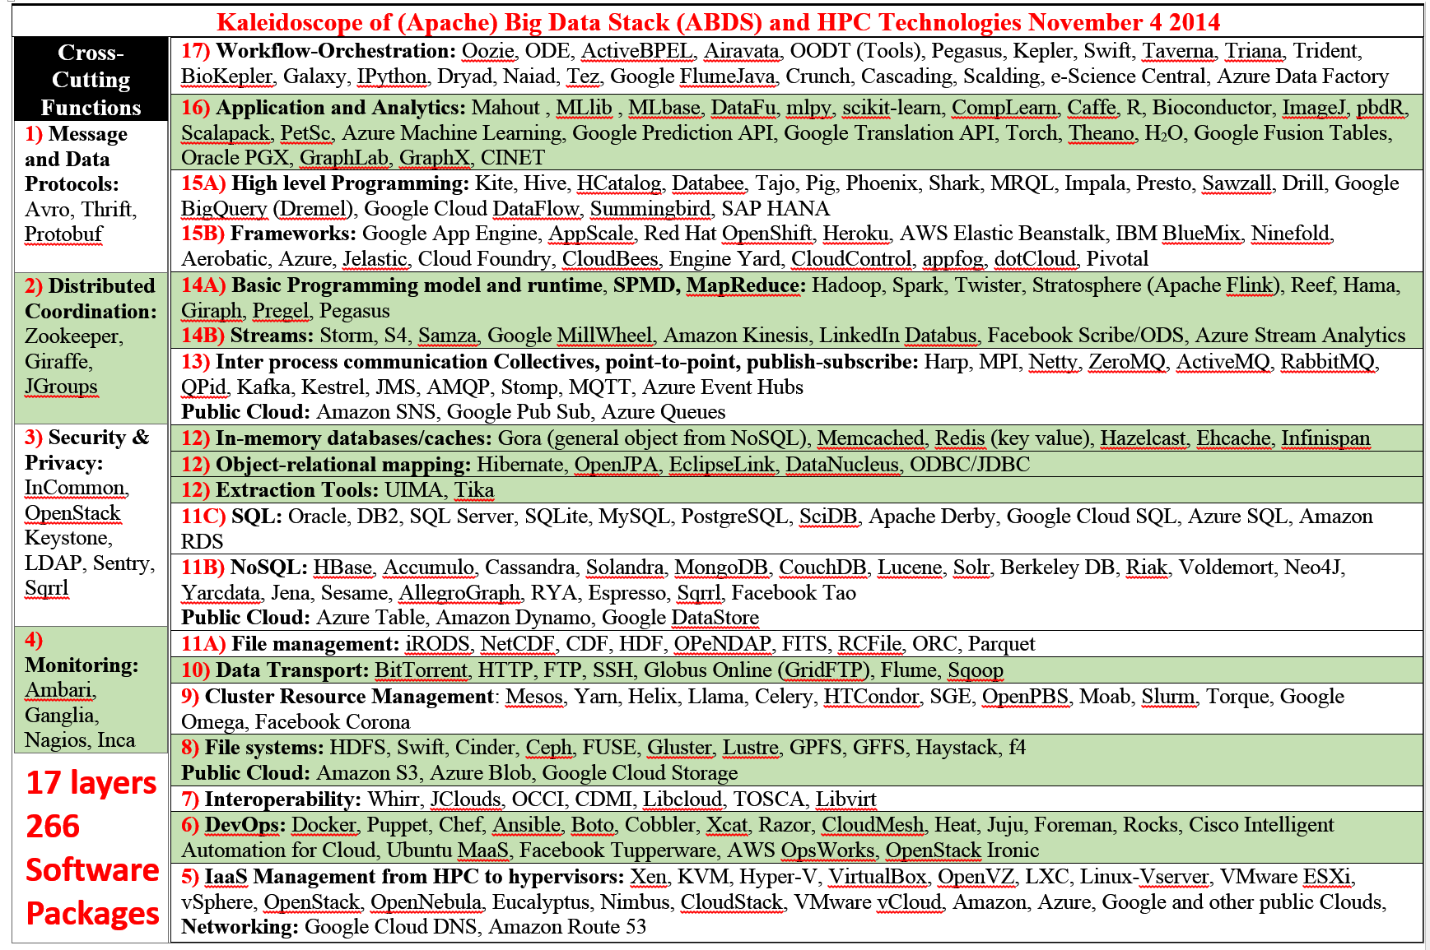

Slide 28







HPC ABDS SYSTEM (Middleware)
150 Software Projects
System Abstraction/Standards
Data Format and Storage
HPC ABDS
Hourglass
HPC Yarn for Resource management
Horizontally scalable parallel programming model
Collective and Point to Point Communication
Support for iteration (in memory processing)
Application Abstractions/Standards
Graphs, Networks, Images, Geospatial ..
Scalable Parallel Interoperable Data Analytics Library (SPIDAL)
High performance Mahout, R, Matlab …..
High Performance Applications

Slide 29
Maybe a Big Data Initiative would include
We don’t need 266 software packages so can choose e.g.
Workflow: IPython, Pegasus or Kepler (replaced by tools like Tez?)
Data Analytics: Mahout, R, ImageJ, Scalapack
High level Programming: Hive, Pig
Parallel Programming model: Hadoop, Spark, Giraph (Twister4Azure, Harp), MPI; Storm, Kapfka or RabbitMQ (Sensors)
In-memory: Memcached
Data Management: Hbase, MongoDB, MySQL or Derby
Distributed Coordination: Zookeeper
Cluster Management: Yarn, Slurm
File Systems: HDFS, Lustre
DevOps: Cloudmesh, Chef, Puppet, Docker, Cobbler
IaaS: Amazon, Azure, OpenStack, Libcloud
Monitoring: Inca, Ganglia, Nagios

Slide 30
Applications SPIDAL MIDAS ABDS
Govt. Operations | Commercial Defense |  | Healthcare, Life Science |  |  | Deep Learning, Social Media |  | Research Ecosystems | Astronomy, Physics |  | Earth, Env., Polar Science |  | Energy
(Inter)disciplinary Workflow
Analytics Libraries
Native ABDS SQL-engines, Storm, Impala, Hive, Shark |  | Native HPC MPI |  | HPC-ABDS MapReduce
 |  |  |  | Map Only, PP Many Task |  |  | Classic MapReduce |  |  | Map Collective |  | Map – Point to Point, Graph
MIddleware for Data-Intensive Analytics and Science (MIDAS) API
Communication (MPI, RDMA, Hadoop Shuffle/Reduce, HARP Collectives, Giraph point-to-point) |  |  |  |  |  |  | Data Systems and Abstractions (In-Memory; HBase, Object Stores, other NoSQL stores, Spatial, SQL, Files)
Higher-Level Workload Management (Tez, Llama) |  |  |  |  | Workload Management (Pilots, Condor) |  |  |  |  | Framework specific Scheduling (e.g. YARN)
External Data Access (Virtual Filesystem, GridFTP, SRM, SSH) |  |  |  |  |  |  | Cluster Resource Manager (YARN, Mesos, SLURM, Torque, SGE)
Compute, Storage and Data Resources (Nodes, Cores, Lustre, HDFS)
Community & Examples
SPIDAL
Programming & Runtime Models
MIDAS
Resource Fabric

Slide 31
Software-Defined Distributed
System (SDDS) as a Service includes
FutureGrid uses
SDDS-aaS Tools
Provisioning
Image Management
IaaS Interoperability
NaaS, IaaS tools
Expt management
Dynamic IaaS NaaS
DevOps
CS Research Use e.g. test new compiler or storage model
Class Usages e.g. run GPU & multicore
Applications
Software
(Application
Or Usage) SaaS
CloudMesh is a SDDSaaS tool that uses Dynamic Provisioning and Image Management to provide custom environments for general target systems
Involves (1) creating,
(2) deploying, and
(3) provisioning
of one or more images in a set of machines on demand http://cloudmesh.futuregrid.org/
Cloud e.g. MapReduce
HPC e.g. PETSc, SAGA
Computer Science e.g. Compiler tools, Sensor nets, Monitors
Platform
PaaS
Infra
structure
IaaS
Software Defined Computing (virtual Clusters)
Hypervisor, Bare Metal
Operating System
Network
NaaS
Software Defined Networks
OpenFlow GENI

Slide 32
Cloudmesh Functionality
Notes:
Due to its integrated services Cloudmesh provides the ability to be an onramp for other clouds.
It provides information services to various system level sensors to give access to sensor and utilization data. Internally, it can be used to optimize the system usage.
The provisioning experience from FutureGrid has taught us that we need to provide
the creation of new clouds (rain)
the repartitioning of resources between services (cloud shifting)
and the integration of external cloud resources in case of over provisioning (cloud bursting)
As we deal with many IaaS frameworks, we need an abstraction layer on top of the IaaS framework.
Experiment management is conducted with workflows controlled in shells, Python/iPython, as well as systems such as OpenStack's Heat.
Accounting is supported through additional services such as user management and charge rate management.
Not all features are yet implemented. Figure shows the main functionality that we target at this time to implement.

Slide 33
Iterative MapReduce
Implementing HPC-ABDS
Judy Qiu, Bingjing Zhang, Dennis Gannon, Thilina Gunarathne

Slide 34
Harp Design
Parallelism Model
Architecture
MapReduce Model
Map-Collective or Map-Communication Model
M
M
M
M
MapReduce Applications
Map-Collective
or Map-Communication Applications
M
M
M
M
Application
Shuffle
Harp
Optimal Communication
MapReduce V2
R
R
Framework
Resource Manager
YARN

Slide 35
Features of Harp Hadoop Plugin
Hadoop Plugin (on Hadoop 1.2.1 and Hadoop 2.2.0)
Hierarchical data abstraction on arrays, key-values and graphs for easy programming expressiveness.
Collective communication model to support various communication operations on the data abstractions (will extend to Point to Point)
Caching with buffer management for memory allocation required from computation and communication
BSP style parallelism
Fault tolerance with checkpointing

Slide 36
WDA SMACOF MDS (Multidimensional Scaling) using Harp on IU Big Red 2
Parallel Efficiency: on 100-300K sequences
Best available MDS (much better than that in R)
Java
Harp (Hadoop plugin)
Cores =32 #nodes
Conjugate Gradient (dominant time) and Matrix Multiplication

Slide 37
Increasing Communication
Identical Computation
Mahout and Hadoop MR – Slow due to MapReduce
Python slow as Scripting; MPI fastest
Spark Iterative MapReduce, non optimal communication
Harp Hadoop plug in with ~MPI collectives

Slide 38
Data Gathering, Storage, Use

Slide 39
Data Source and Style Facet of Ogres I
(i) SQL or NoSQL: NoSQL includes Document, Column, Key-value, Graph, Triple store
(ii) Other Enterprise data systems: 10 examples from NIST integrate SQL/NoSQL
(iii) Set of Files: as managed in iRODS and extremely common in scientific research
(iv) File, Object, Block and Data-parallel (HDFS) raw storage: Separated from computing?
(v) Internet of Things: 24 to 50 Billion devices on Internet by 2020
(vi) Streaming: Incremental update of datasets with new algorithms to achieve real-time response (G7)
(vii) HPC simulations: generate major (visualization) output that often needs to be mined
(viii) Involve GIS: Geographical Information Systems provide attractive access to geospatial data
Notes:
Big dwarfs are Ogres
Implement Ogres in ABDS+

Slide 40
Data Source and Style Facet of Ogres II
Before data gets to compute system, there is often an initial data gathering phase which is characterized by a block size and timing. Block size varies from month (Remote Sensing, Seismic) to day (genomic) to seconds or lower (Real time control, streaming)
There are storage/compute system styles: Shared, Dedicated, Permanent, Transient
Other characteristics are needed for permanent auxiliary/comparison datasets and these could be interdisciplinary, implying nontrivial data movement/replication
10 Data Access/Use Styles from Bob Marcus at NIST
Notes:
Big dwarfs are Ogres
Implement Ogres in ABDS+

Slide 41
10 Generic Data Processing Styles
Multiple users performing interactive queries and updates on a database with basic availability and eventual consistency (BASE = (Basically Available, Soft state, Eventual consistency) as opposed to ACID = (Atomicity, Consistency, Isolation, Durability) )
Perform real time analytics on data source streams and notify users when specified events occur
Move data from external data sources into a highly horizontally scalable data store, transform it using highly horizontally scalable processing (e.g. Map-Reduce), and return it to the horizontally scalable data store (ELT Extract Load Transform)
Perform batch analytics on the data in a highly horizontally scalable data store using highly horizontally scalable processing (e.g MapReduce) with a user-friendly interface (e.g. SQL like)
Perform interactive analytics on data in analytics-optimized database
Visualize data extracted from horizontally scalable Big Data store
Move data from a highly horizontally scalable data store into a traditional Enterprise Data Warehouse (EDW)
Extract, process, and move data from data stores to archives
Combine data from Cloud databases and on premise data stores for analytics, data mining, and/or machine learning
Orchestrate multiple sequential and parallel data transformations and/or analytic processing using a workflow manager

Slide 42
2. Perform real time analytics on data source streams and notify users when specified events occur
Specify filter
Filter Identifying Events
Fetch streamed Data
Post Selected Events
Streaming Data
Posted Data
Identified Events
Streaming Data
Streaming Data
Archive
Repository
Storm, Kafka, Hbase, Zookeeper

Slide 43



5. Perform interactive analytics on data in analytics-optimized data system
Mahout, R
Hadoop, Spark, Giraph, Pig …
Data Storage: HDFS, Hbase
Data, Streaming, Batch …..

Slide 44
5A. Perform interactive analytics on observational scientific data
Science Analysis Code, Mahout, R
Grid or Many Task Software, Hadoop, Spark, Giraph, Pig …
Data Storage: HDFS, Hbase, File Collection (Lustre)
Direct Transfer
Transport batch of data to primary analysis data system
Streaming Twitter data for Social Networking
Local Accumulate and initial computing
NIST Examples include LHC, Remote Sensing (see later), Astronomy and Bioinformatics
Record Scientific Data in “field”

Slide 45
Analytics Facet (kernels) of the Ogres

Slide 46
Machine Learning in Network Science, Imaging in Computer Vision, Pathology, Polar Science, Biomolecular Simulations
Algorithm | Applications | Features | Status | Parallelism
Graph Analytics
Community detection | Social networks, webgraph | Graph . | P-DM | GML-GrC
Subgraph/motif finding | Webgraph, biological/social networks |  | P-DM | GML-GrB
Finding diameter | Social networks, webgraph |  | P-DM | GML-GrB
Clustering coefficient | Social networks |  | P-DM | GML-GrC
Page rank | Webgraph |  | P-DM | GML-GrC
Maximal cliques | Social networks, webgraph |  | P-DM | GML-GrB
Connected component | Social networks, webgraph |  | P-DM | GML-GrB
Betweenness centrality | Social networks | Graph, Non-metric, static | P-Shm | GML-GRA
Shortest path | Social networks, webgraph |  | P-Shm
Spatial Queries and Analytics
Spatial relationship based queries | GIS/social networks/pathology informatics | Geometric | P-DM | PP
Distance based queries |  |  | P-DM | PP
Spatial clustering |  |  | Seq | GML
Spatial modeling |  |  | Seq | PP
GML Global (parallel) ML
GrA Static GrB Runtime partitioning

Slide 47
Some specialized data analytics in SPIDAL
Algorithm | Applications | Features | Status | Parallelism
Core Image Processing
Image preprocessing | Computer vision/pathology informatics | Metric Space Point Sets, Neighborhood sets & Image features | P-DM | PP
Object detection & segmentation |  |  | P-DM | PP
Image/object feature computation |  |  | P-DM | PP
3D image registration |  |  | Seq | PP
Object matching |  | Geometric | Todo | PP
3D feature extraction |  |  | Todo | PP
Deep Learning
Learning Network, Stochastic Gradient Descent | Image Understanding, Language Translation, Voice Recognition, Car driving | Connections in artificial neural net | P-DM | GML
aa
PP Pleasingly Parallel (Local ML)
Seq Sequential Available
GRA Good distributed algorithm needed
Todo No prototype Available
P-DM Distributed memory Available
P-Shm Shared memory Available

Slide 48
Some Core Machine Learning Building Blocks
Algorithm | Applications | Features | Status | //ism
DA Vector Clustering | Accurate Clusters | Vectors | P-DM | GML
DA Non metric Clustering | Accurate Clusters, Biology, Web | Non metric, O(N²) | P-DM | GML
Kmeans; Basic, Fuzzy and Elkan | Fast Clustering | Vectors | P-DM | GML
Levenberg-Marquardt Optimization | Non-linear Gauss-Newton, use in MDS | Least Squares | P-DM | GML
SMACOF Dimension Reduction | DA- MDS with general weights | Least Squares, O(N²) | P-DM | GML
Vector Dimension Reduction | DA-GTM and Others | Vectors | P-DM | GML
TFIDF Search | Find nearest neighbors in document corpus | Bag of “words” (image features) | P-DM | PP
All-pairs similarity search | Find pairs of documents with TFIDF distance below a threshold
 |  |  | Todo | GML
Support Vector Machine SVM | Learn and Classify | Vectors | Seq | GML
Random Forest | Learn and Classify | Vectors | P-DM | PP
Gibbs sampling (MCMC) | Solve global inference problems | Graph | Todo | GML
Latent Dirichlet Allocation LDA with Gibbs sampling or Var. Bayes | Topic models (Latent factors) | Bag of “words” | P-DM | GML
Singular Value Decomposition SVD | Dimension Reduction and PCA | Vectors | Seq | GML
Hidden Markov Models (HMM) | Global inference on sequence models | Vectors | Seq | PP & GML

Slide 49
Remarks on GML Parallelism
All use parallelism over data points
  Entities to cluster or search or map to Euclidean space
Except deep learning which has parallelism over pixel plane in neurons not over items in training set
  as need to look at small numbers of data items at a time in Stochastic Gradient Descent
Maximum Likelihood or χ² both lead to structure like
Minimize sum ∑_{items=1}^{N} (Positive nonlinear function of unknown parameters for item i)
All solved iteratively with (clever) first or second order approximation to shift in objective function
  Sometimes steepest descent direction; sometimes Newton
  Have classic Expectation Maximization structure

Slide 50
Structure of Parameters
Note learning networks have huge number of parameters (11 billion in Stanford work) so that inconceivable to look at second derivative
Clustering and MDS have lots of parameters but can be practical to look at second derivative and use Newton’s method to minimize
Parameters are determined in distributed fashion but are typically needed globally
  MPI use broadcast and “AllCollectives”
  AI community: use parameter server and access as needed

Slide 51
Robustness from Deterministic Annealing
Deterministic annealing smears objective function and avoids local minima and being much faster than simulated annealing
Clustering
  Vectors: Rose (Gurewitz and Fox) 1990
  Clusters with fixed sizes and no tails (Proteomics team at Broad)
  No Vectors: Hofmann and Buhmann (Just use pairwise distances)
Dimension Reduction for visualization and analysis
  Vectors: GTM Generative Topographic Mapping
  No vectors SMACOF: Multidimensional Scaling) MDS (Just use pairwise distances)
Can apply to HMM & general mixture models (less study)
  Gaussian Mixture Models
  Probabilistic Latent Semantic Analysis with Deterministic Annealing DA-PLSA as alternative to Latent Dirichlet Allocation for finding “hidden factors”

Slide 52
Some Important Cases
Need to cover non vector semimetric and vector spaces for clustering and dimension reduction (N points in space)
Vector spaces have Euclidean distance and scalar products
  Algorithms can be O(N) and these are best for clustering but for MDS O(N) methods may not be best as obvious objective function O(N²)
MDS Minimizes Stress
σ(X) = Σ_{i<j=1}^{N} weight(i,j) (δ(i, j) - d(X_{i} , X_{j}))²
Semimetric spaces just have pairwise distances defined between points in space δ(i, j)
Note matrix solvers all use conjugate gradient – converges in 5-200 iterations – a big gain for matrix with a million rows. This removes factor of N in time complexity
Ratio of #clusters to #points important; new ideas if ratio >~ 0.1

Slide 53
More Efficient Parallelism
The canonical model is correct at start but each point does not really contribute to each cluster as damped exponentially by exp( - (X_{i}- Y(k))² /T )
For Proteomics problem, on average only 6.45 clusters needed per point if require (X_{i}- Y(k))² /T ≤ ~40 (as exp(-40) small)
So only need to keep nearby clusters for each point
As average number of Clusters ~ 20,000, this gives a factor of ~3000 improvement
Further communication is no longer all global; it has nearest neighbor components and calculated by parallelism over clusters
Claim that ~all O(N²) machine learning algorithms can be done in O(N)logN using ideas as in fast multipole (Barnes Hut) for particle dynamics
  ~0 use in practice

Slide 54
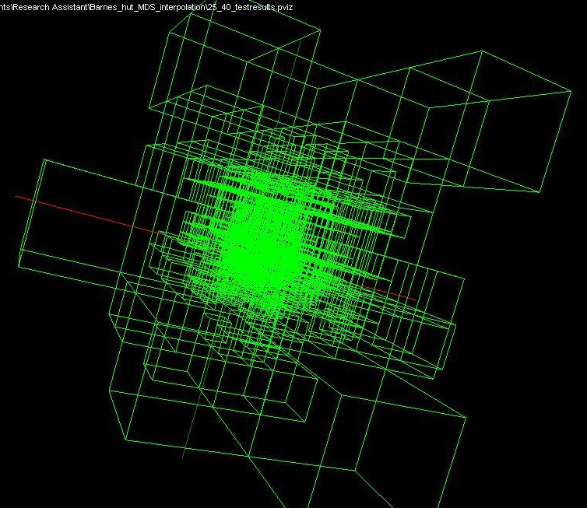
Use Barnes Hut OctTree, originally developed to make O(N²) astrophysics O(NlogN), to give similar speedups in machine learning

Slide 55
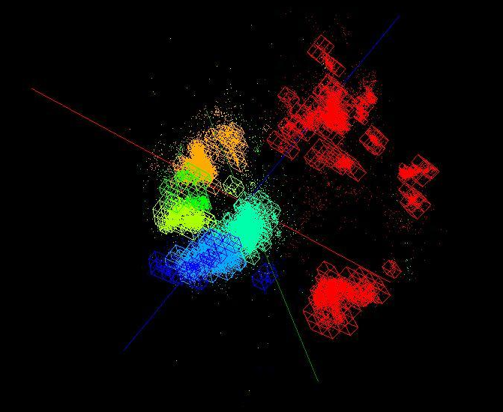
OctTree for 100K sample of Fungi
We use OctTree for logarithmic interpolation (streaming data)

Slide 56
Some Futures
Always run MDS. Gives insight into data
  Leads to a data browser as GIS gives for spatial data
Claim is algorithm change gave as much performance increase as hardware change in simulations. Will this happen in analytics?
  Today is like parallel computing 30 years ago with regular meshs. We will learn how to adapt methods automatically to give “multigrid” and “fast multipole” like algorithms
Need to start developing the libraries that support Big Data
  Understand architectures issues
  Have coupled batch and streaming versions
  Develop much better algorithms
Please join SPIDAL (Scalable Parallel Interoperable Data Analytics Library) community

Slide 57
SPIDAL Examples

Slide 58
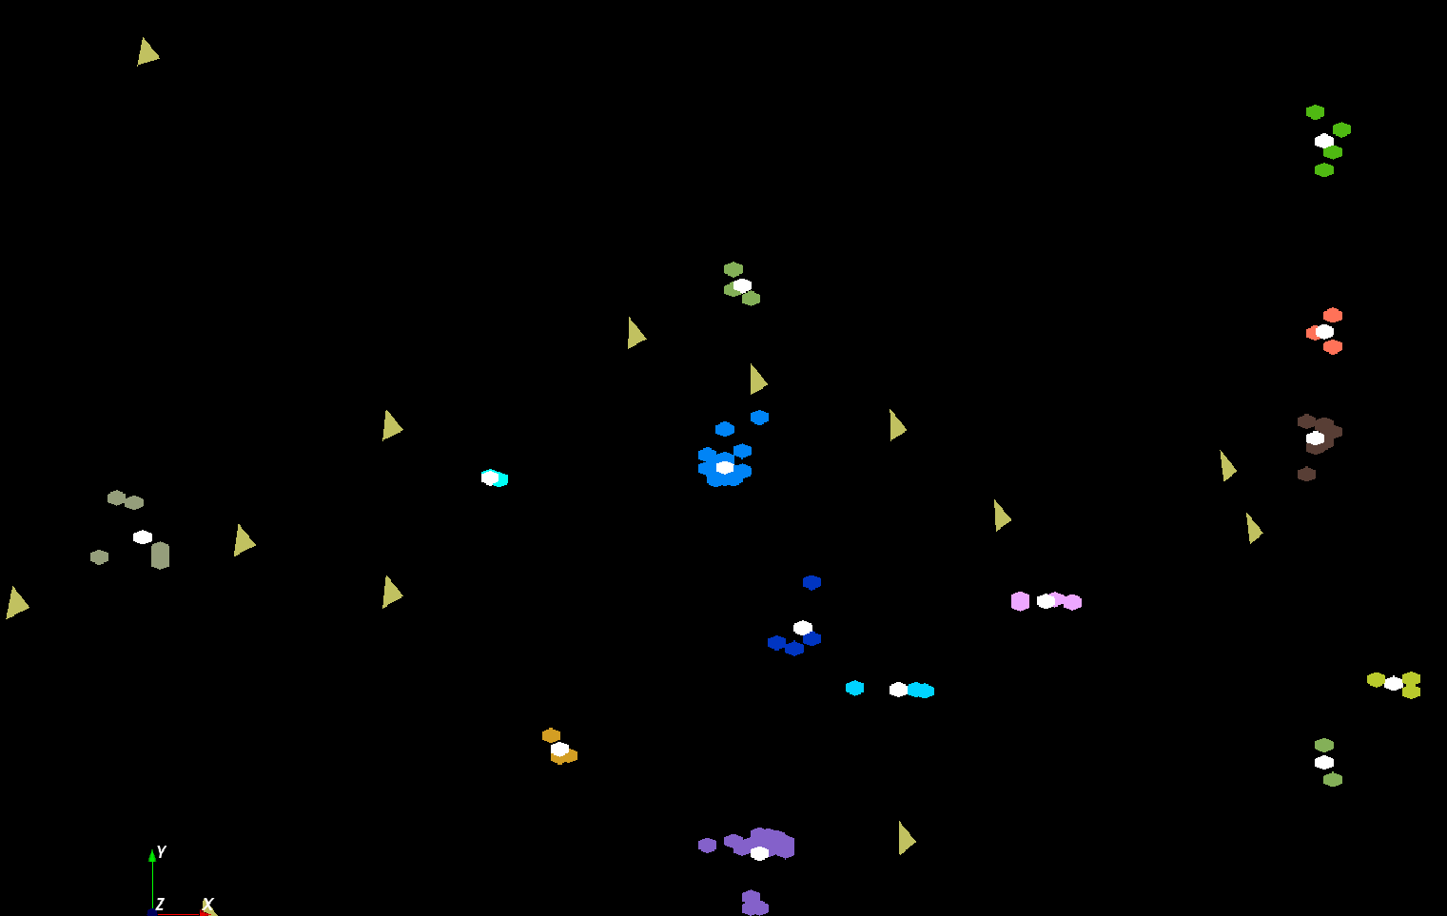
The brownish triangles are stray peaks outside any cluster.
The colored hexagons are peaks inside clusters with the white hexagons being determined cluster center
Fragment of 30,000 Clusters
241605 Points

Slide 59
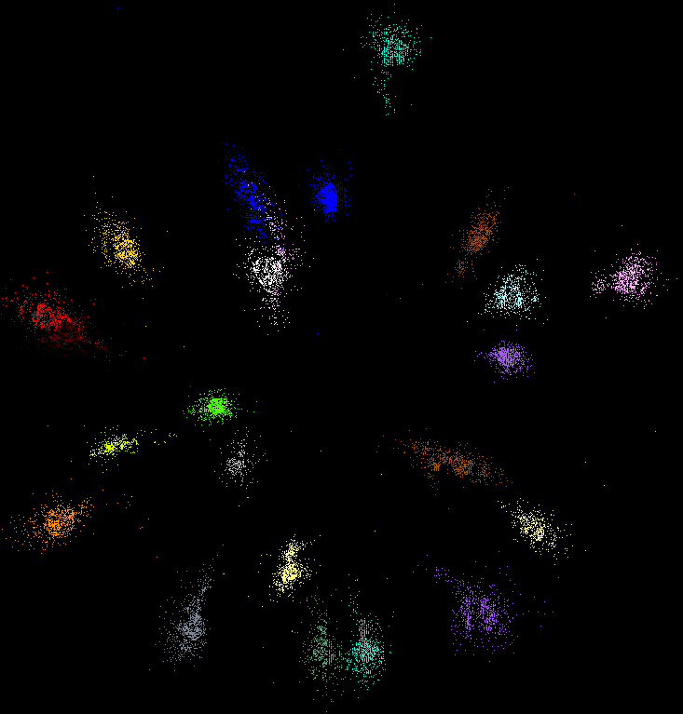
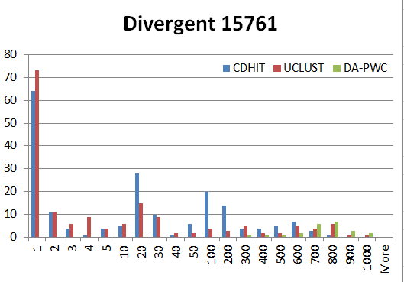
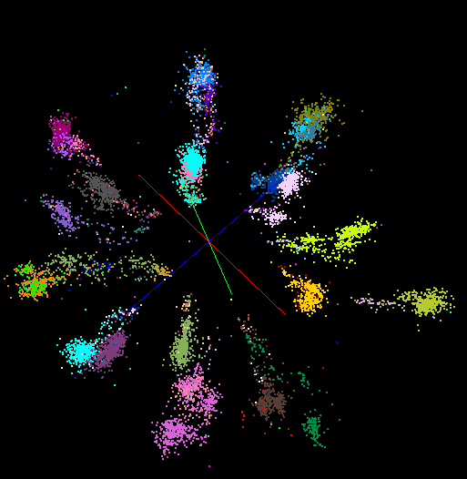
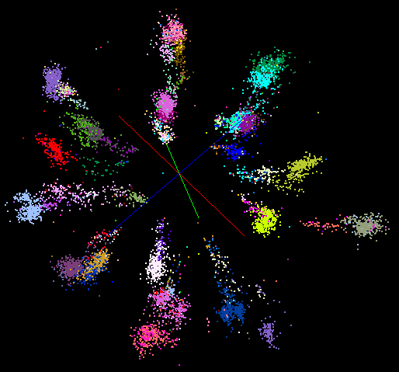
“Divergent” Data Sample
23 True Sequences
DA-PWC
UClust
CDhit
Divergent Data Set UClust (Cuts 0.65 to 0.95)
DAPWC 0.65 0.75 0.85 0.95
Total # of clusters 23 4 10 36 91
Total # of clusters uniquely identified 23 0 0 13 16
(i.e. one original cluster goes to 1 uclust cluster )
Total # of shared clusters with significant sharing 0 4 10 5 0
(one uclust cluster goes to > 1 real cluster)
Total # of uclust clusters that are just part of a real cluster 0 4 10 17(11) 72(62)
(numbers in brackets only have one member)
Total # of real clusters that are 1 uclust cluster 0 14 9 5 0
but uclust cluster is spread over multiple real clusters
Total # of real clusters that have 0 9 14 5 7
significant contribution from > 1 uclust cluster

Slide 60

Protein Universe Browser for COG Sequences with a few illustrative biologically identified clusters

Slide 61
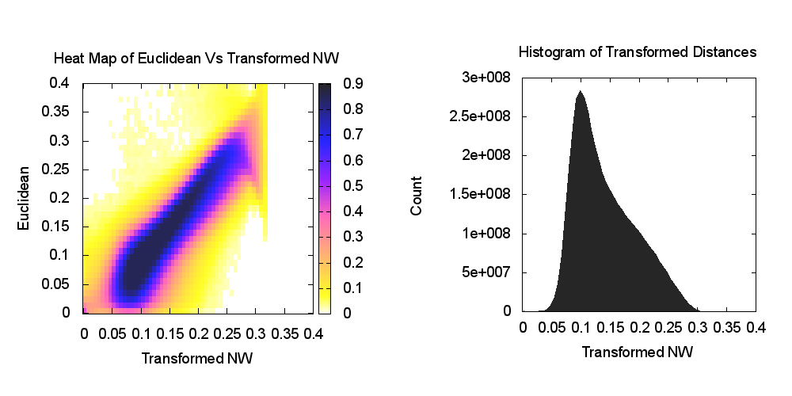
Heatmap of biology distance (Needleman-Wunsch) vs 3D Euclidean Distances
If d a distance, so is f(d) for any monotonic f. Optimize choice of f

Slide 62
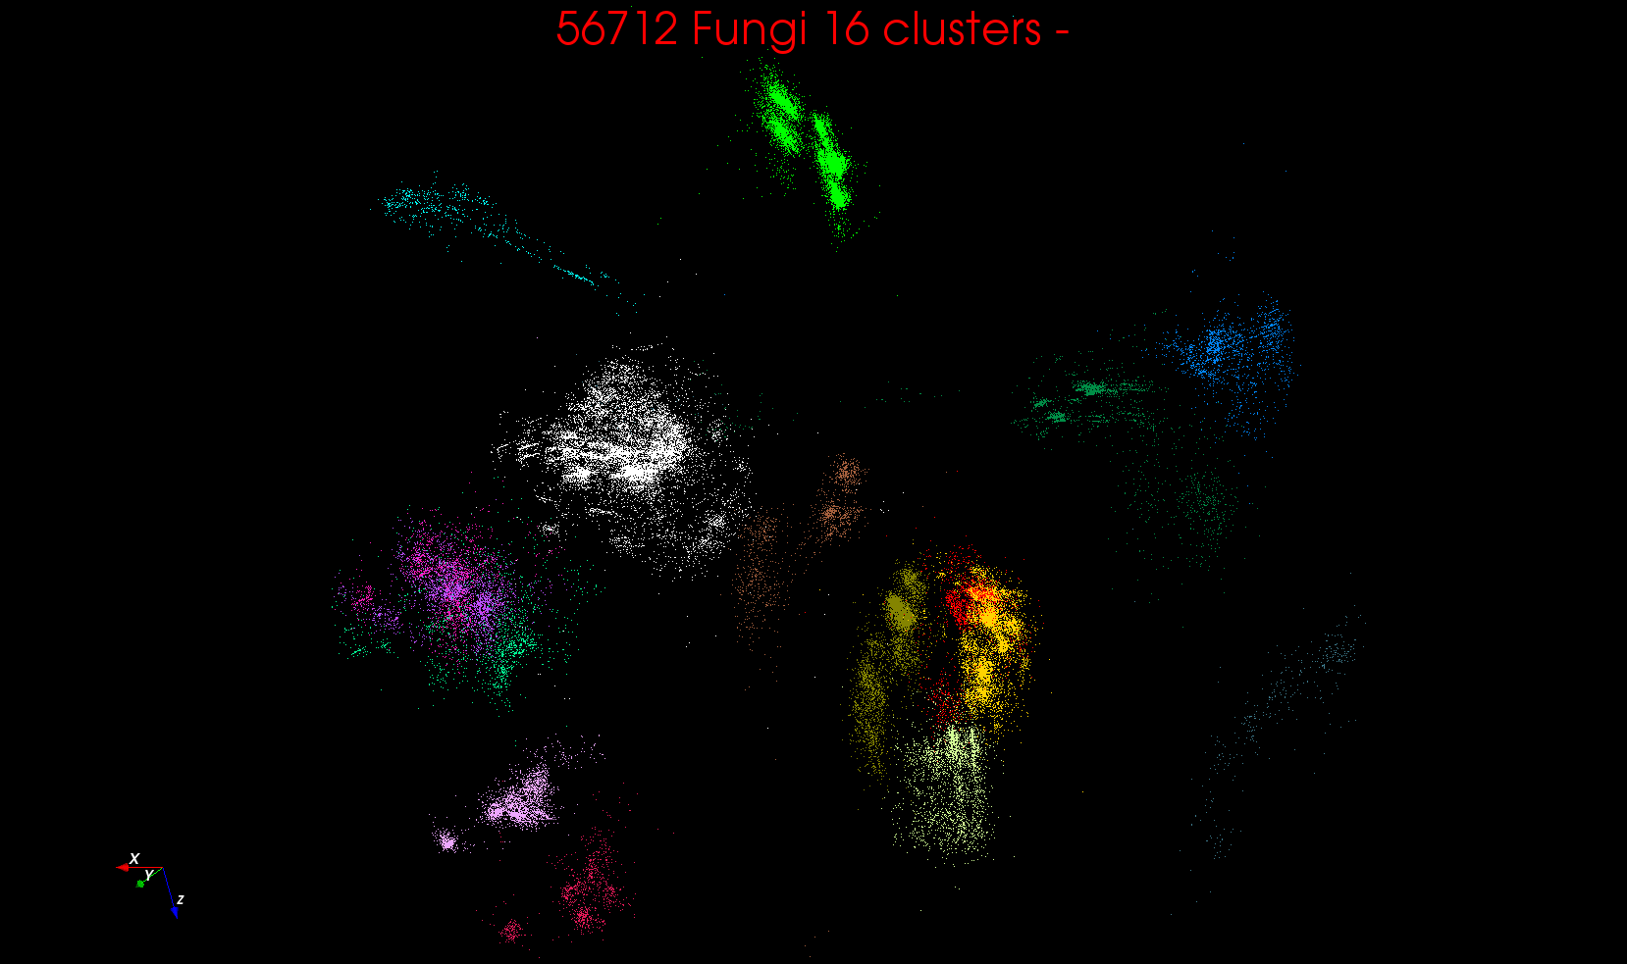
Example of Multidimensional Scaling

Slide 63
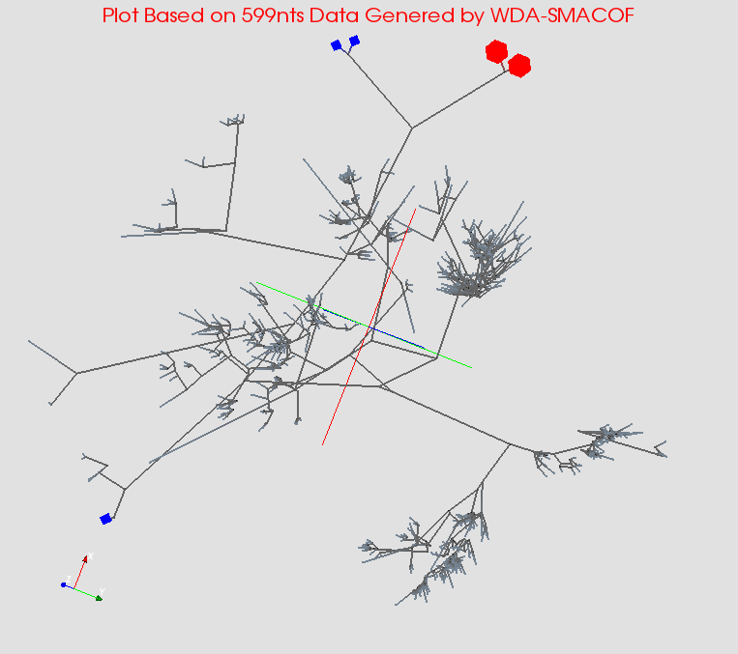
MDS gives classifying cluster centers and existing sequences for Fungi nice 3D Phylogenetic trees

Slide 64
Java Grande

Slide 65
Java Grande
We once tried to encourage use of Java in HPC with Java Grande Forum but Fortran, C and C++ remain central HPC languages.
  Not helped by .com and Sun collapse in 2000-2005
The pure Java CartaBlanca, a 2005 R&D100 award-winning project, was an early successful example of HPC use of Java in a simulation tool for non-linear physics on unstructured grids.
Of course Java is a major language in ABDS and as data analysis and simulation are naturally linked, should consider broader use of Java
Using Habanero Java (from Rice University) for Threads and mpiJava or FastMPJ for MPI, gathering collection of high performance parallel Java analytics
  Converted from C# and sequential Java faster than sequential C#
So will have either Hadoop+Harp or classic Threads/MPI versions in Java Grande version of Mahout

Slide 66
Performance of MPI Kernel Operations
Pure Java as in FastMPJ slower than Java interfacing to C version of MPI

Slide 67
Lessons / Insights
Proposed classification of Big Data applications with features and kernels for analytics
Integrate (don’t compete) HPC with “Commodity Big data” (Google to Amazon to Enterprise Data Analytics)
  i.e. improve Mahout; don’t compete with it
  Use Hadoop plug-ins rather than replacing Hadoop
Enhanced Apache Big Data Stack HPC-ABDS has ~140 members with HPC opportunities at Resource management, Data/File, Streaming, Programming, monitoring, workflow layers.
Data intensive algorithms do not have the well developed high performance libraries familiar from HPC
Global Machine Learning or (Exascale Global Optimization) particularly challenging
Develop SPIDAL (Scalable Parallel Interoperable Data Analytics Library)
  New algorithms and new high performance parallel implementations

