Slide 1
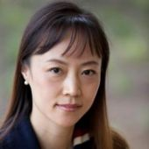
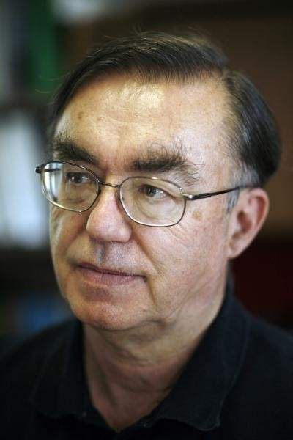
Research at Indiana University in DSC Digital Science Center
Judy Qiu Associate Professor in ISE (Intelligent Systems Engineering) and director of data science graduate program at Indiana University
Parallel graph algorithms on CPU, vector and GPU hardware
Anomaly detection
Real time streaming machine learning
xqiu@indiana.edu
Geoffrey Fox Professor in ISE and a Fellow of APS (Physics) and ACM (Computing) and works on the interdisciplinary interface between computing and applications.
High performance computing and interface to Big Data and Deep Learning
gcf@indiana.edu
http://www.dsc.soic.indiana.edu/

Slide 2
Summary of DSC Activities and Capabilities
Intersection Big Data, High Performance Computing and Deep Learning
Systems for streaming real-time ML
Data Engineering (HPC Spark and Hadoop) as in support of
SICE Social Media Observatory (last 6 years)
Deep Learning Surrogates for large scale simulations
Large time steps for particle dynamics with recurrent neural networks
Taxonomy of Opportunities
Future application to agent-based computational biology (IU, Glazier)
Deep Learning for (Geospatial) Timeseries
Indy 500 race data analysis
Earthquakes with UC Davis and JPL
COVID-19 case data versus demographics with Pittsburgh Public Health
Performance
MLPerf Consortium (over 80 members) on ML for Science Data
ML on Vector (with NEC) GPU and CPU
Edge devices

