Slide 1
Volume 3, Use Cases and General Requirements Document Scope
Version 1 collected 51 big data use cases with a 26 feature template and used this to extract requirements to feed into NIST Big Data Reference Architecture
The version 2 template merges version 1 General and Security & Privacy use case analysis
The discussion of this at first NIST Big Data meeting identified need for patterns which were proposed during version 2 work; version 2 template incorporates new questions to help identify patterns.

Slide 2
Volume 3, Use Cases and General Requirements Version 1 Overview
Gathered and evaluated 51 use cases from nine application domains.
Gathered input regarding Big Data requirements
Analyzed and prioritized a list of challenging use case specific requirements that may delay or prevent adoption of Big Data deployment
Developed a comprehensive list of generalized Big Data requirements
Developed a set of features that characterized applications
Used to compare different Big Data problems
Collaborated with the NBD-PWG Reference Architecture Subgroup to provide input for the NBDRA

Slide 3
51 Detailed Use Cases: Version 1 Contributed July-September 2013
http://bigdatawg.nist.gov/usecases.php, 26 Features for each use case
Government Operation(4): National Archives and Records Administration, Census Bureau
Commercial(8): Finance in Cloud, Cloud Backup, Mendeley (Citations), Netflix, Web Search, Digital Materials, Cargo shipping (as in UPS)
Defense(3): Sensors, Image surveillance, Situation Assessment
Healthcare and Life Sciences(10): Medical records, Graph and Probabilistic analysis, Pathology, Bioimaging, Genomics, Epidemiology, People Activity models, Biodiversity
Deep Learning and Social Media(6): Driving Car, Geolocate images/cameras, Twitter, Crowd Sourcing, Network Science, NIST benchmark datasets
The Ecosystem for Research(4): Metadata, Collaboration, Translation, Light source data
Astronomy and Physics(5): Sky Surveys including comparison to simulation, Large Hadron Collider at CERN, Belle II Accelerator in Japan
Earth, Environmental and Polar Science(10): Radar Scattering in Atmosphere, Earthquake, Ocean, Earth Observation, Ice sheet Radar scattering, Earth radar mapping, Climate simulation datasets, Atmospheric turbulence identification, Subsurface Biogeochemistry (microbes to watersheds), AmeriFlux and FLUXNET gas sensors
Energy(1): Smart grid

Slide 4
Version 1 Use Case Template
Note agreed in this form August 11 2013
Some clarification on Veracity v. Data Quality added
Request for picture and summary done by hand for version 1 but included in version 2 template.
Early version 1 use cases did a detailed breakup of workflow into multiple stages which we want to restore but do not have agreed format yet

Slide 5
Volume 3, Use Cases and General Requirements Version 2 Accomplishments I
Developed the Use Case Template version 2 to describe additional use cases with more specific information
Extra information developed from looking at 51 version 1 use cases and seeing where was missing or vague
Made available as a PDF or Google Form – Version 1 a Word document
Version 1 use case combined with Security and Privacy (S&P) analysis to generate very detailed information on this
Can also be used to generate only S&P information or only general information such as analysis environment and data characteristics
Continued study of characteristics of version 1 use cases
compare Big Data with High Performance Computing workloads
Will evaluate additional use cases as they are submitted

Slide 6
Volume 3, Use Cases and General Requirements Version 2 Accomplishments II
Socialized Version 1 use cases with the developing ISO Big Data community, which reportedly found them representative and useful
The new template was developed to:
Better understand processing stages and workflow
Gather additional use case detail
Collect use cases with sensitive privacy & other security concerns (sidebar)
Two versions of the new template were deployed
Collecting detail-rich use cases is challenging
Added key use cases from US Census and health care (consent flow and “Break Glass”)
- Roles - PII - Covenants, Liability - Ownership, Identity, Distribution - Risk Mitigation - Provenance - Data Life Cycle - Audit and Traceability - Application Provider Security - Framework Provider Security - System Health - Permitted Use Cases

Slide 7
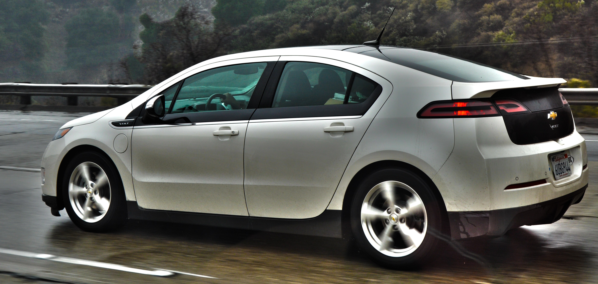
Volume 3, Use Cases and General Requirements Version 2 Opportunities for Contribution
More use cases. (Roll up sleeves; budget an hour.)
Soliciting greater application domain diversity:
Smart cars (Smart X)
Large scale utility IoT
Geolocation applications involving people
Energy from discovery to generation
Scientific studies involving human subjects at large scale
Highly distributed use cases bridging multiple enterprises
Choose a domain and collect/analyze a set of related use-cases
Develop technology requirements for applications in domain
Feed lessons into version 3 of template

Slide 8
Volume 3, Use Cases and General Requirements Possible Version 3 Topics
Identify gaps in use cases
Develop plausible, semi-fictionalized use cases from industry reports, white papers, academic project reports
Identify important parameters for estimating systems
Microservice use cases
Use cases mapped to work in Vol 8
Container-oriented use cases
Forensic and provenance-centric use cases
Review fitness of the BDRA to use cases

