Slide 1
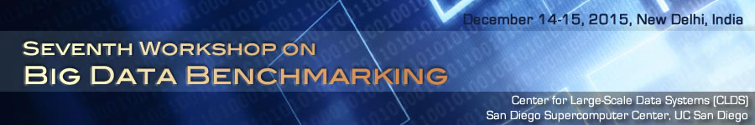
Classifying Simulation and Data Intensive Applications and the HPC-Big Data Convergence
WBDB 2015 Seventh Workshop on Big Data Benchmarking
Geoffrey Fox, Shantenu Jha, Judy Qiu December 14, 2015
gcf@indiana.edu
http://www.dsc.soic.indiana.edu/, http://spidal.org/ http://hpc-abds.org/kaleidoscope/
Department of Intelligent Systems Engineering
School of Informatics and Computing, Digital Science Center
Indiana University Bloomington

Slide 2
NIST Big Data Initiative
Led by Chaitin Baru, Bob Marcus, Wo Chang
And
Big Data Application Analysis

Slide 3
NBD-PWG (NIST Big Data Public Working Group) Subgroups & Co-Chairs
There were 5 Subgroups
  Note mainly industry
Requirements and Use Cases Sub Group
  Geoffrey Fox, Indiana U.; Joe Paiva, VA; Tsegereda Beyene, Cisco
Definitions and Taxonomies SG
  Nancy Grady, SAIC; Natasha Balac, SDSC; Eugene Luster, R2AD
Reference Architecture Sub Group
  Orit Levin, Microsoft; James Ketner, AT&T; Don Krapohl, Augmented Intelligence
Security and Privacy Sub Group
  Arnab Roy, CSA/Fujitsu Nancy Landreville, U. MD Akhil Manchanda, GE
Technology Roadmap Sub Group
  Carl Buffington, Vistronix; Dan McClary, Oracle; David Boyd, Data Tactics
See http://bigdatawg.nist.gov/usecases.php
and http://bigdatawg.nist.gov/V1_output_docs.php FINAL VERSION

Slide 4

Use Case Template
26 fields completed for 51 apps
Government Operation: 4
Commercial: 8
Defense: 3
Healthcare and Life Sciences: 10
Deep Learning and Social Media: 6
The Ecosystem for Research: 4
Astronomy and Physics: 5
Earth, Environmental and Polar Science: 10
Energy: 1
Now an online form

Slide 5
51 Detailed Use Cases: Contributed July-September 2013
Covers goals, data features such as 3 V’s, software, hardware
26 Features for each use case
Biased to science
http://bigdatawg.nist.gov/usecases.php
https://bigdatacoursespring2014.appspot.com/course (Section 5)
Government Operation(4): National Archives and Records Administration, Census Bureau
Commercial(8): Finance in Cloud, Cloud Backup, Mendeley (Citations), Netflix, Web Search, Digital Materials, Cargo shipping (as in UPS)
Defense(3): Sensors, Image surveillance, Situation Assessment
Healthcare and Life Sciences(10): Medical records, Graph and Probabilistic analysis, Pathology, Bioimaging, Genomics, Epidemiology, People Activity models, Biodiversity
Deep Learning and Social Media(6): Driving Car, Geolocate images/cameras, Twitter, Crowd Sourcing, Network Science, NIST benchmark datasets
The Ecosystem for Research(4): Metadata, Collaboration, Language Translation, Light source experiments
Astronomy and Physics(5): Sky Surveys including comparison to simulation, Large Hadron Collider at CERN, Belle Accelerator II in Japan
Earth, Environmental and Polar Science(10): Radar Scattering in Atmosphere, Earthquake, Ocean, Earth Observation, Ice sheet Radar scattering, Earth radar mapping, Climate simulation datasets, Atmospheric turbulence identification, Subsurface Biogeochemistry (microbes to watersheds), AmeriFlux and FLUXNET gas sensors
Energy(1): Smart grid

Slide 6
Features and Examples

Slide 7
51 Use Cases: What is Parallelism Over?
People: either the users (but see below) or subjects of application and often both
Decision makers like researchers or doctors (users of application)
Items such as Images, EMR, Sequences below; observations or contents of online store
  Images or “Electronic Information nuggets”
  EMR: Electronic Medical Records (often similar to people parallelism)
  Protein or Gene Sequences;
  Material properties, Manufactured Object specifications, etc., in custom dataset
  Modelled entities like vehicles and people
Sensors – Internet of Things
Events such as detected anomalies in telescope or credit card data or atmosphere
(Complex) Nodes in RDF Graph
Simple nodes as in a learning network
Tweets, Blogs, Documents, Web Pages, etc.
  And characters/words in them
Files or data to be backed up, moved or assigned metadata
Particles/cells/mesh points as in parallel simulations

Slide 8
Features of 51 Use Cases I
PP (26) “All” Pleasingly Parallel or Map Only
MR (18) Classic MapReduce MR (add MRStat below for full count)
MRStat (7) Simple version of MR where key computations are simple reduction as found in statistical averages such as histograms and averages
MRIter (23) Iterative MapReduce or MPI (Spark, Twister)
Graph (9) Complex graph data structure needed in analysis
Fusion (11) Integrate diverse data to aid discovery/decision making; could involve sophisticated algorithms or could just be a portal
Streaming (41) Some data comes in incrementally and is processed this way
Classify (30) Classification: divide data into categories
S/Q (12) Index, Search and Query

Slide 9
Features of 51 Use Cases II
CF (4) Collaborative Filtering for recommender engines
LML (36) Local Machine Learning (Independent for each parallel entity) – application could have GML as well
GML (23) Global Machine Learning: Deep Learning, Clustering, LDA, PLSI, MDS,
  Large Scale Optimizations as in Variational Bayes, MCMC, Lifted Belief Propagation, Stochastic Gradient Descent, L-BFGS, Levenberg-Marquardt . Can call EGO or Exascale Global Optimization with scalable parallel algorithm
Workflow (51) Universal
GIS (16) Geotagged data and often displayed in ESRI, Microsoft Virtual Earth, Google Earth, GeoServer etc.
HPC (5) Classic large-scale simulation of cosmos, materials, etc. generating (visualization) data
Agent (2) Simulations of models of data-defined macroscopic entities represented as agents

Slide 10
Big Data - Big Simulation (Exascale) Convergence
Lets distinguish Data and Model (e.g. machine learning analytics) in Big Data problems
Then in Big Data, typically Data is large but Model varies
  E.g. LDA with many topics or deep learning has large model
  Clustering or Dimension reduction can be quite small
Simulations can also be considered as Data and Model
  Model is solving particle dynamics or partial differential equations
  Data could be small when just boundary conditions or
  Data large with data assimilation (weather forecasting) or when data visualizations produced by simulation
In each case, Data often static between iterations (unless streaming), model varies between iterations

Slide 11
Big Data Patterns – the Ogres
Classification

Slide 12
Classifying Big Data Applications
“Benchmarks” “kernels” “algorithm” “mini-apps” can serve multiple purposes
Motivate hardware and software features
  e.g. collaborative filtering algorithm parallelizes well with MapReduce and suggests using Hadoop on a cloud
  e.g. deep learning on images dominated by matrix operations; needs CUDA&MPI and suggests HPC cluster
Benchmark sets designed cover key features of systems in terms of features and sizes of “important” applications
Take 51 uses cases → derive specific features; each use case has multiple features
Generalize and systematize as Ogres with features termed “facets”
50 Facets divided into 4 sets or views where each view has “similar” facets
  Allow one to study coverage of benchmark sets
Discuss Data and Model together as built around problems which combine them but we can get insight by separating and this allows better understanding of Big Data - Big Simulation “convergence”

Slide 13
7 Computational Giants of
NRC Massive Data Analysis Report
http://www.nap.edu/catalog.php?record_id=18374
Big Data Models?
G1: Basic Statistics e.g. MRStat
G2: Generalized N-Body Problems
G3: Graph-Theoretic Computations
G4: Linear Algebraic Computations
G5: Optimizations e.g. Linear Programming
G6: Integration e.g. LDA and other GML
G7: Alignment Problems e.g. BLAST

Slide 14
HPC Benchmark Classics
Linpack or HPL: Parallel LU factorization
for solution of linear equations
NPB version 1: Mainly classic HPC solver kernels
  MG: Multigrid
  CG: Conjugate Gradient
  FT: Fast Fourier Transform
  IS: Integer sort
  EP: Embarrassingly Parallel
  BT: Block Tridiagonal
  SP: Scalar Pentadiagonal
  LU: Lower-Upper symmetric Gauss Seidel
Simulation Models

Slide 15
13 Berkeley Dwarfs
Dense Linear Algebra
Sparse Linear Algebra
Spectral Methods
N-Body Methods
Structured Grids
Unstructured Grids
MapReduce
Combinational Logic
Graph Traversal
Dynamic Programming
Backtrack and
Branch-and-Bound
Graphical Models
Finite State Machines
Largely Models for Data or Simulation
First 6 of these correspond to Colella’s original. (Classic simulations)
Monte Carlo dropped.
N-body methods are a subset of Particle in Colella.
Note a little inconsistent in that MapReduce is a programming model and spectral method is a numerical method.
Need multiple facets!

Slide 16

Geospatial Information System
Shared / Dedicated / Transient / Permanent
HPC Simulations
Data Source and Style View
Internet of Things
Metadata/Provenance
Archived/Batched/Streaming
Processing View
10
9
8
HDFS/Lustre/GPFS
7
6
Enterprise Data Model
5
Files/Objects
SQL/NoSQL/NewSQL
4
Search / Query / Index
Local Analytics
Graph Algorithms
Micro-benchmarks
Alignment
Optimization Methodology
Learning
Classification
Streaming
Global Analytics
Linear Algebra Kernels
Recommendations
Visualization
Base Statistics
3
2
1
4 Ogre Views and 50 Facets
Pleasingly Parallel
1
2
3
4
5
6
7
8
9
10
11
12
13
14
14
13
12
11
10
9
8
7
6
Classic MapReduce
Map-Collective
5
4
3
2
1
Map Point-to-Point
Single Program Multiple Data
Map Streaming
1
Shared Memory
Bulk Synchronous Parallel
2
3
Problem
Architecture
View
Performance Metrics
4
Volume
Dynamic = D / Static = S
$O\left(N^{2}\right)$ = NN / $O(N)$ = N
Velocity
Variety
Veracity
Communication Structure
Regular = R / Irregular = I
Data Abstraction
Iterative / Simple
5
Metric = M / Non-Metric = N
Flops per Byte; Memory I/O
Execution Environment; Core libraries
6
7
Fusion
Dataflow
8
9
Agents
10
Workflow
Execution View
11
12

Slide 17
Dwarfs and Ogres give
Convergence Diamonds
Macropatterns or Problem Architecture View: Unchanged
Execution View: Significant changes to separate Data and Model and add characteristics of Simulation models
Data Source and Style View: Unchanged – present but less important for Simulations compared to big data
Processing View: becomes Big Data Processing View
Add Big Simulation Processing View: includes specifics of key simulation kernels – includes NAS Parallel Benchmarks and Berkeley Dwarfs

Slide 18
Facets of the Ogres
Problem Architecture
Meta or Macro Aspects of Ogres
Valid for Big Data or Big Simulations as describes Problem which is Model-Data combination

Slide 19
Problem Architecture View of Ogres (Meta or MacroPatterns)
Pleasingly Parallel – as in BLAST, Protein docking, some (bio-)imagery including Local Analytics or Machine Learning – ML or filtering pleasingly parallel, as in bio-imagery, radar images (pleasingly parallel but sophisticated local analytics)
Classic MapReduce: Search, Index and Query and Classification algorithms like collaborative filtering (G1 for MRStat in Features, G7)
Map-Collective: Iterative maps + communication dominated by “collective” operations as in reduction, broadcast, gather, scatter. Common datamining pattern
Map-Point to Point: Iterative maps + communication dominated by many small point to point messages as in graph algorithms
Map-Streaming: Describes streaming, steering and assimilation problems
Shared Memory: Some problems are asynchronous and are easier to parallelize on shared rather than distributed memory – see some graph algorithms
SPMD: Single Program Multiple Data, common parallel programming feature
BSP or Bulk Synchronous Processing: well-defined compute-communication phases
Fusion: Knowledge discovery often involves fusion of multiple methods.
Dataflow: Important application features often occurring in composite Ogres
Use Agents: as in epidemiology (swarm approaches) This is Model
Workflow: All applications often involve orchestration (workflow) of multiple components
Notes:
Big dwarfs are Ogres
Implement Ogres in ABDS+

Slide 20
Relation of Problem and Machine Architecture
Problem is Model plus Data
In my old papers (especially book Parallel Computing Works!), I discussed computing as multiple complex systems mapped into each other
Problem → Numerical formulation → Software → Hardware
Each of these 4 systems has an architecture that can be described in similar language
One gets an easy programming model if architecture of problem matches that of Software
One gets good performance if architecture of hardware matches that of software and problem
So “MapReduce” can be used as architecture of software (programming model) or “Numerical formulation of problem”

Slide 21
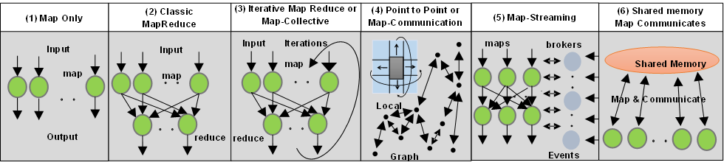
6 Forms of MapReduce cover “all” circumstances
Describes
- Problem (Model reflecting data)
- Machine
- Software
Architecture

Slide 22
Ogre Facets
Execution Features View
Many similar Features for Big Data and Simulations
Needs split into1) Model 2) Data 3) Problem (the combination) add a) difference/differential operator in model and b) multi-scale/hierarchical model

Slide 23
One View of Ogres has Facets that are micropatterns or Execution Features
Performance Metrics; property found by benchmarking Ogre
Flops per byte; memory or I/O
Execution Environment; Core libraries needed: matrix-matrix/vector algebra, conjugate gradient, reduction, broadcast; Cloud, HPC etc.
Volume: property of an Ogre instance: a) Data Volume and b) Model Size
Velocity: qualitative property of Ogre with value associated with instance. Mainly Data
Variety: important property especially of composite Ogres; Data and Model separately
Veracity: important property of “mini-appls” but not kernels; Data and Model separately
Model Communication Structure; Interconnect requirements; Is communication BSP, Asynchronous, Pub-Sub, Collective, Point to Point?
Is Data and/or Model (graph) static or dynamic?
Much Data and/or Models consist of a set of interconnected entities; is this regular as a set of pixels or is it a complicated irregular graph?
Are Models Iterative or not?
Data Abstraction: key-value, pixel, graph(G3), vector, bags of words or items; Model can have same or different abstractions e.g. mesh points, finite element, Convolutional Network
Are data points in metric or non-metric spaces? Data drives Model?
Is Model algorithm O(N²) or O(N) (up to logs) for N points per iteration (G2)

Slide 24
Comparison of Data Analytics with Simulation I
Simulations produce big data as visualization of results – they are data source
  Or consume often smallish data to define a simulation problem
  HPC simulation in weather data assimilation is data + model
Pleasingly parallel often important in both
Both are often SPMD and BSP
  Non-iterative MapReduce is major big data paradigm
  not a common simulation paradigm except where “Reduce” summarizes pleasingly parallel execution as in Some Monte Carlos
Big Data often has large collective communication
  Classic simulation has a lot of smallish point-to-point messages
Simulations characterized often by difference or differential operators
Simulation dominantly sparse (nearest neighbor) data structures
  Some important data analytics involves full matrix algorithm but
  “Bag of words (users, rankings, images..)” algorithms are sparse, as is PageRank

Slide 25


“Force Diagrams” for macromolecules and Facebook

Slide 26
Comparison of Data Analytics with Simulation II
There are similarities between some graph problems and particle simulations with a strange cutoff force.
  Both Map-Communication
Note many big data problems are “long range force” (as in gravitational simulations) as all points are linked.
  Easiest to parallelize. Often full matrix algorithms
  e.g. in DNA sequence studies, distance δ(i, j) defined by BLAST, Smith-Waterman, etc., between all sequences i, j.
  Opportunity for “fast multipole” ideas in big data. See NRC report
In image-based deep learning, neural network weights are block sparse (corresponding to links to pixel blocks) but can be formulated as full matrix operations on GPUs and MPI in blocks.
In HPC benchmarking, Linpack being challenged by a new sparse conjugate gradient benchmark HPCG, while I am diligently using non- sparse conjugate gradient solvers in clustering and Multi-dimensional scaling.

Slide 27
Facets of the Ogres
Big Data Processing View
Largely Model Properties
Could produce a separate set of facets for Simulation Processing View

Slide 28
Facets in Processing (runtime) View of Ogres I
Micro-benchmarks ogres that exercise simple features of hardware such as communication, disk I/O, CPU, memory performance
Local Analytics executed on a single core or perhaps node
Global Analytics requiring iterative programming models (G5,G6) across multiple nodes of a parallel system
Optimization Methodology: overlapping categories
  Nonlinear Optimization (G6)
  Machine Learning
  Maximum Likelihood or χ² minimizations
  Expectation Maximization (often Steepest descent)
  Combinatorial Optimization
  Linear/Quadratic Programming (G5)
  Dynamic Programming
Visualization is key application capability with algorithms like MDS useful but it itself part of “mini-app” or composite Ogre
Alignment (G7) as in BLAST compares samples with repository
Notes:
Big dwarfs are Ogres
Implement Ogres in ABDS+

Slide 29
Facets in Processing (run time) View of Ogres II
Streaming divided into 5 categories depending on event size and synchronization and integration
  Set of independent events where precise time sequencing unimportant.
  Time series of connected small events where time ordering important.
  Set of independent large events where each event needs parallel processing with time sequencing not critical
  Set of connected large events where each event needs parallel processing with time sequencing critical.
  Stream of connected small or large events to be integrated in a complex way.
Basic Statistics (G1): MRStat in NIST problem features
Search/Query/Index: Classic database which is well studied (Baru, Rabl tutorial)
Recommender Engine: core to many e-commerce, media businesses; collaborative filtering key technology
Classification: assigning items to categories based on many methods
  MapReduce good in Alignment, Basic statistics, S/Q/I, Recommender, Calssification
Deep Learning of growing importance due to success in speech recognition etc.
Problem set up as a graph (G3) as opposed to vector, grid, bag of words etc.
Using Linear Algebra Kernels: much machine learning uses linear algebra kernels
Notes:
Big dwarfs are Ogres
Implement Ogres in ABDS+

Slide 30
Facets of the Ogres
Data Source and Style Aspects add streaming from Processing view here
Present but often less important for Simulations (that use and produce data)

Slide 31
Data Source and Style View of Ogres I
SQL NewSQL or NoSQL: NoSQL includes Document,
Column, Key-value, Graph, Triple store; NewSQL is SQL redone to exploit NoSQL performance
Other Enterprise data systems: 10 examples from NIST integrate SQL/NoSQL
Set of Files or Objects: as managed in iRODS and extremely common in scientific research
File systems, Object, Blob and Data-parallel (HDFS) raw storage: Separated from computing or colocated? HDFS v Lustre v. Openstack Swift v. GPFS
Archive/Batched/Streaming: Streaming is incremental update of datasets with new algorithms to achieve real-time response (G7); Before data gets to compute system, there is often an initial data gathering phase which is characterized by a block size and timing. Block size varies from month (Remote Sensing, Seismic) to day (genomic) to seconds or lower (Real time control, streaming)
Notes:
Big dwarfs are Ogres
Implement Ogres in ABDS+

Slide 32
Data Source and Style View of Ogres II
Shared/Dedicated/Transient/Permanent: qualitative property of data; Other characteristics are needed for permanent auxiliary/comparison datasets and these could be interdisciplinary, implying nontrivial data movement/replication
Metadata/Provenance: Clear qualitative property but not for kernels as important aspect of data collection process
Internet of Things: 24 to 50 Billion devices on Internet by 2020
HPC simulations: generate major (visualization) output that often needs to be mined
Using GIS: Geographical Information Systems provide attractive access to geospatial data
Note 10 Bob Marcus (led NIST effort) Use cases
Notes:
Big dwarfs are Ogres
Implement Ogres in ABDS+

Slide 33
Summary
Classification of Big Data Applications and Big Data Exascale convergence

Slide 34
Big Data and (Exascale) Simulation Convergence I
Our approach to Convergence is built around two ideas that avoid addressing the hardware directly as with modern DevOps technology it isn’t hard to retarget applications between different hardware systems.
Rather we approach Convergence through applications and software. This talk has described the Convergence Diamonds Convergence that unify Big Simulation and Big Data applications and so allow one to more easily identify good approaches to implement Big Data and Exascale applications in a uniform fashion. This is summarized on Slides III and IV
The software approach builds on the HPC-ABDS High Performance Computing enhanced Apache Big Data Software Stack concept described in Slide II (http://dsc.soic.indiana.edu/publications/HPC-ABDSDescribed_final.pdf, http://hpc-abds.org/kaleidoscope/ )
This arranges key HPC and ABDS software together in 21 layers showing where HPC and ABDS overlap. It for example, introduces a communication layer to allow ABDS runtime like Hadoop Storm Spark and Flink to use the richest high performance capabilities shared with MPI Generally it proposes how to use HPC and ABDS software together.
  Layered Architecture offers some protection to rapid ABDS technology change (for ABDS independent of HPC)

Slide 35
Big Data and (Exascale) Simulation Convergence II
Green implies HPC
Integration

Slide 36
Things to do for Big Data and (Exascale) Simulation Convergence III
Converge Applications: Separate data and model to classify Applications and Benchmarks across Big Data and Big Simulations to give Convergence Diamonds with many facets
  Indicated how to extend Big Data Ogres to Big Simulations by looking separately at model and data in Ogres
  Diamonds will have five views or collections of facets: Problem Architecture; Execution; Data Source and Style; Big Data Processing; Big Simulation Processing
  Facets cover data, model or their combination – the problem or application
  Note Simulation Processing View has similarities to old parallel computing benchmarks

Slide 37
Things to do for Big Data and (Exascale) Simulation Convergence IV
Convergence Benchmarks: we will use benchmarks that cover the facets of the convergence diamonds i.e. cover big data and simulations;
  As we separate data and model, compute intensive simulation benchmarks (e.g. solve partial differential equation) will be linked with data analytics (the model in big data)
  IU focus SPIDAL (Scalable Parallel Interoperable Data Analytics Library) with high performance clustering, dimension reduction, graphs, image processing as well as MLlib will be linked to core PDE solvers to explore the communication layer of parallel middleware
  Maybe integrating data and simulation is an interesting idea in benchmark sets
Convergence Programming Model
  Note parameter servers used in machine learning will be mimicked by collective operators invoked on distributed parameter (model) storage
  E.g. Harp as Hadoop HPC Plug-in
  There should be interest in using Big Data software systems to support exascale simulations
  Streaming solutions from IoT to analysis of astronomy and LHC data will drive high performance versions of Apache streaming systems

Slide 38
Things to do for Big Data and (Exascale) Simulation Convergence V
Converge Language: Make Java run as fast as C++ (Java Grande) for computing and communication – see following slides
  Surprising that so much Big Data work in industry but basic high performance Java methodology and tools missing
  Needs some work as no agreed OpenMP for Java parallel threads
  OpenMPI supports Java but needs enhancements to get best performance on needed collectives (For C++ and Java)
  Convergence Language Grande should support Python, Java (Scala), C/C++ (Fortran)

Slide 39
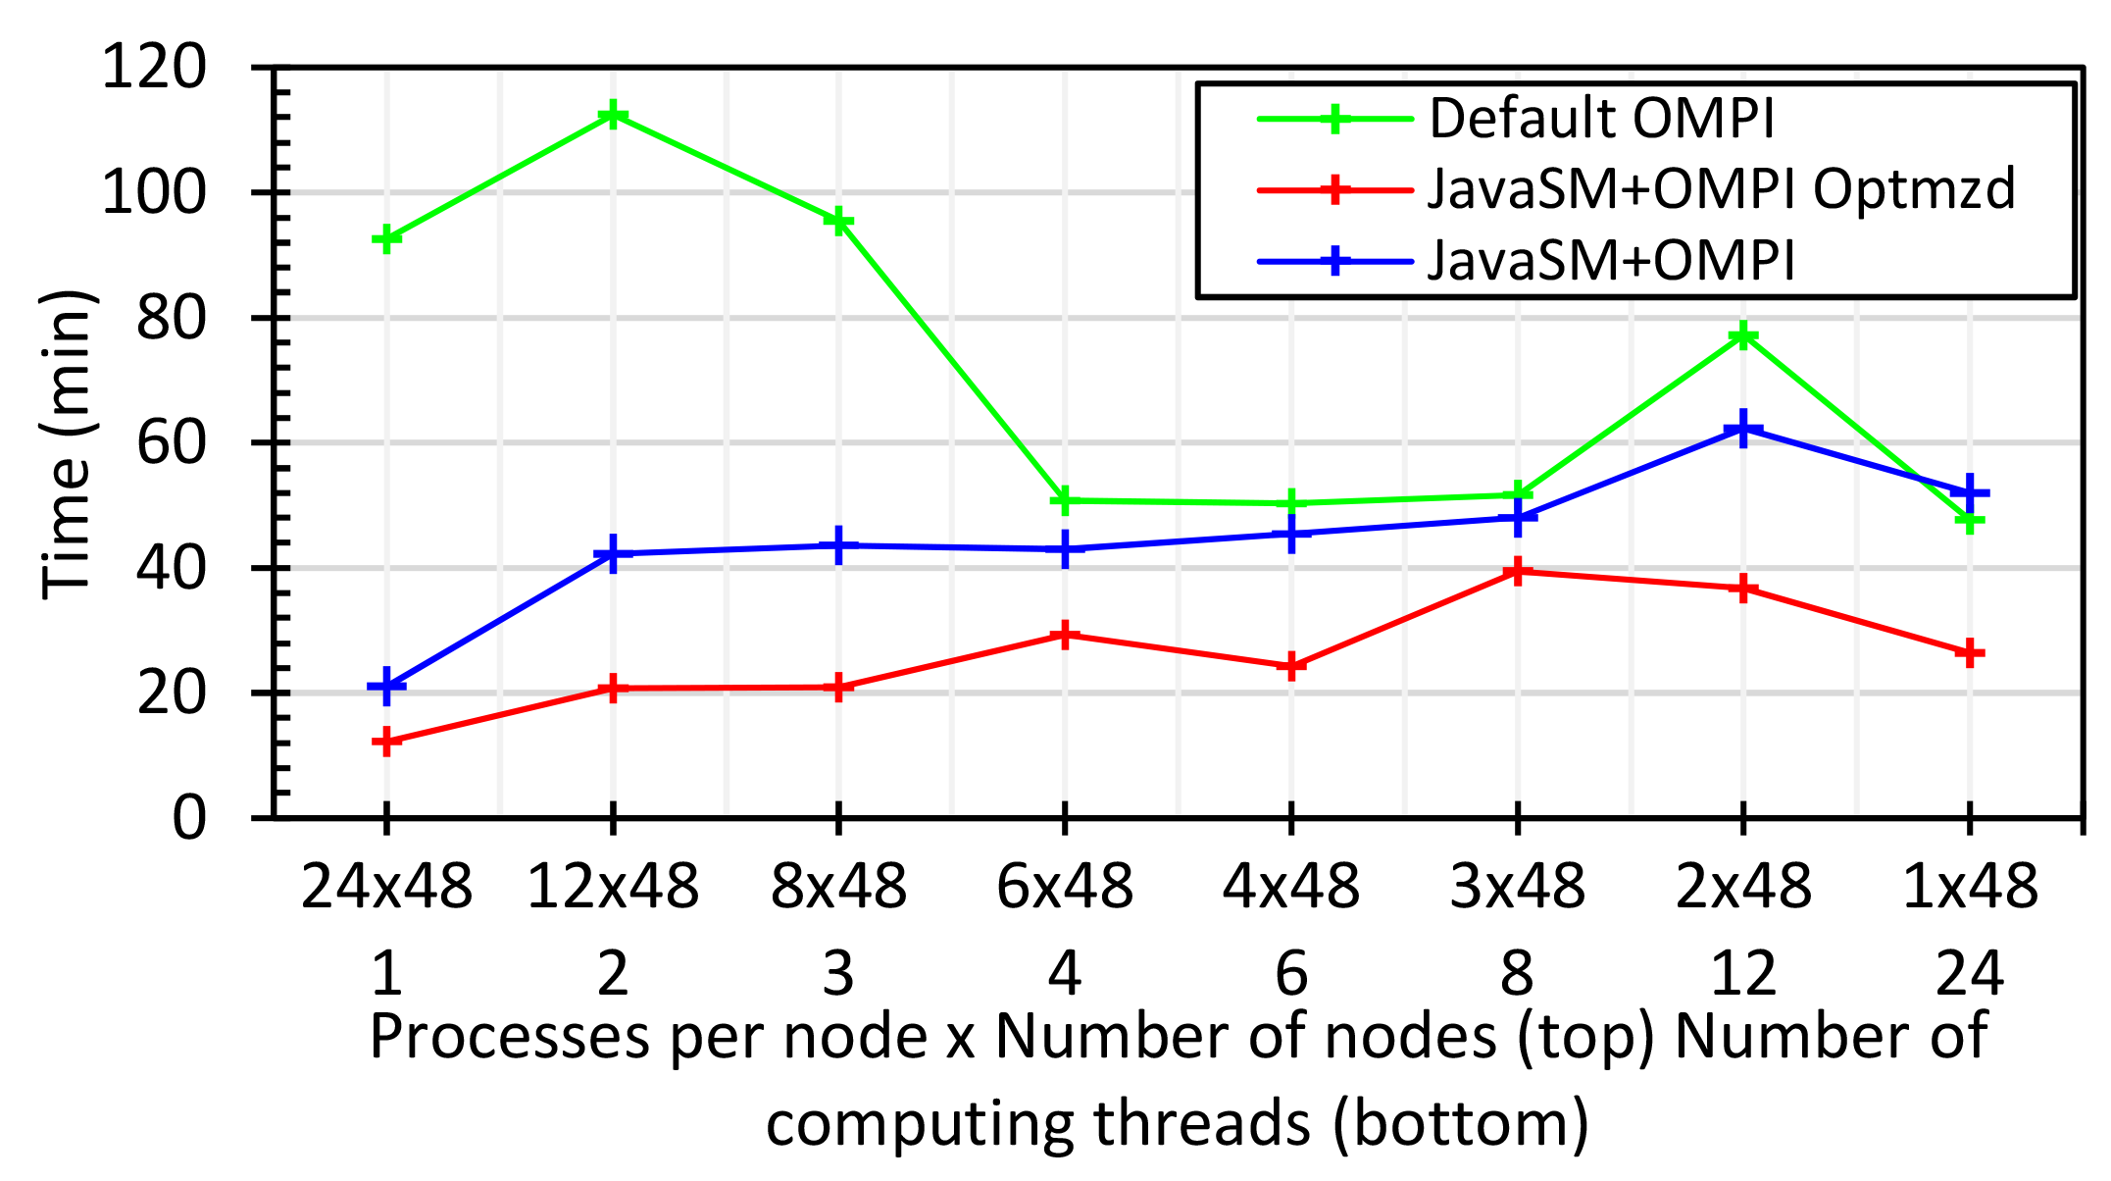
Java MPI performs better than Threads I
128 24 core Haswell nodes – parallel machine learning
Default MPI much worse than threads
Optimized OMPI (OpenMPI) using shared memory node-based messaging is much better than threads

Slide 40
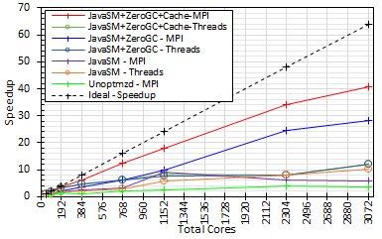
Java MPI performs better than Threads II
128 24 core Haswell nodes
200K Dataset Speedup

